Slide 1
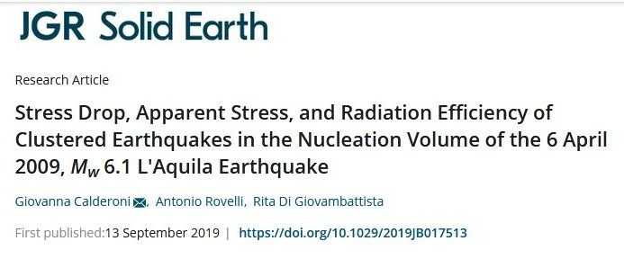
Spatio-temporal variations of source parameters in the nucleation zone of the 6 April 2009, M_{w} 6.1 L'Aquila Earthquake
G. Calderoni, A. Rovelli, and R. Di Giovambattista
Istituto Nazionale di Geofisica e Vulcanologia
EGU General Assemby 4-8 May 2020

Slide 2
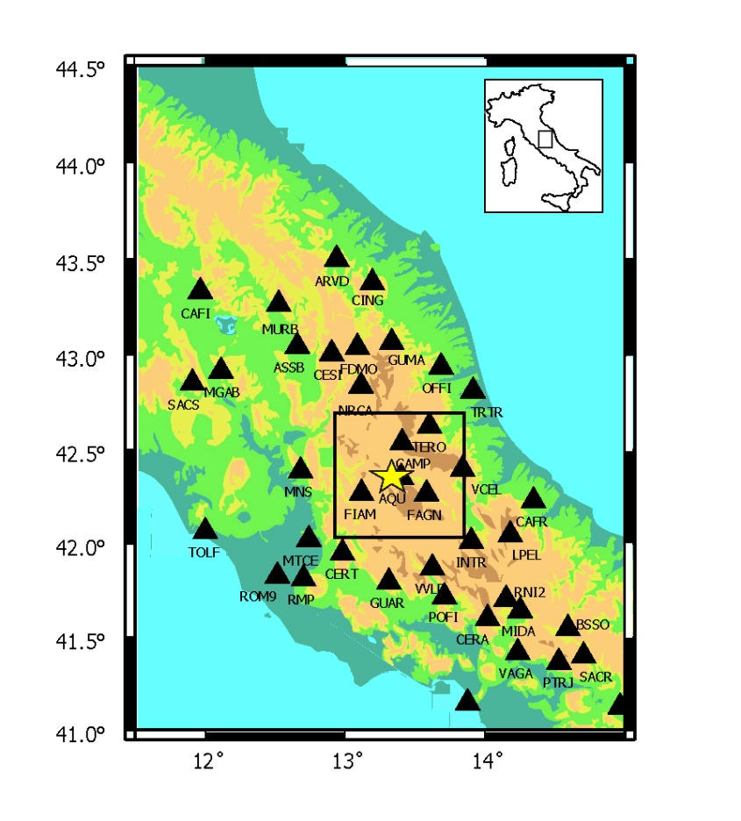
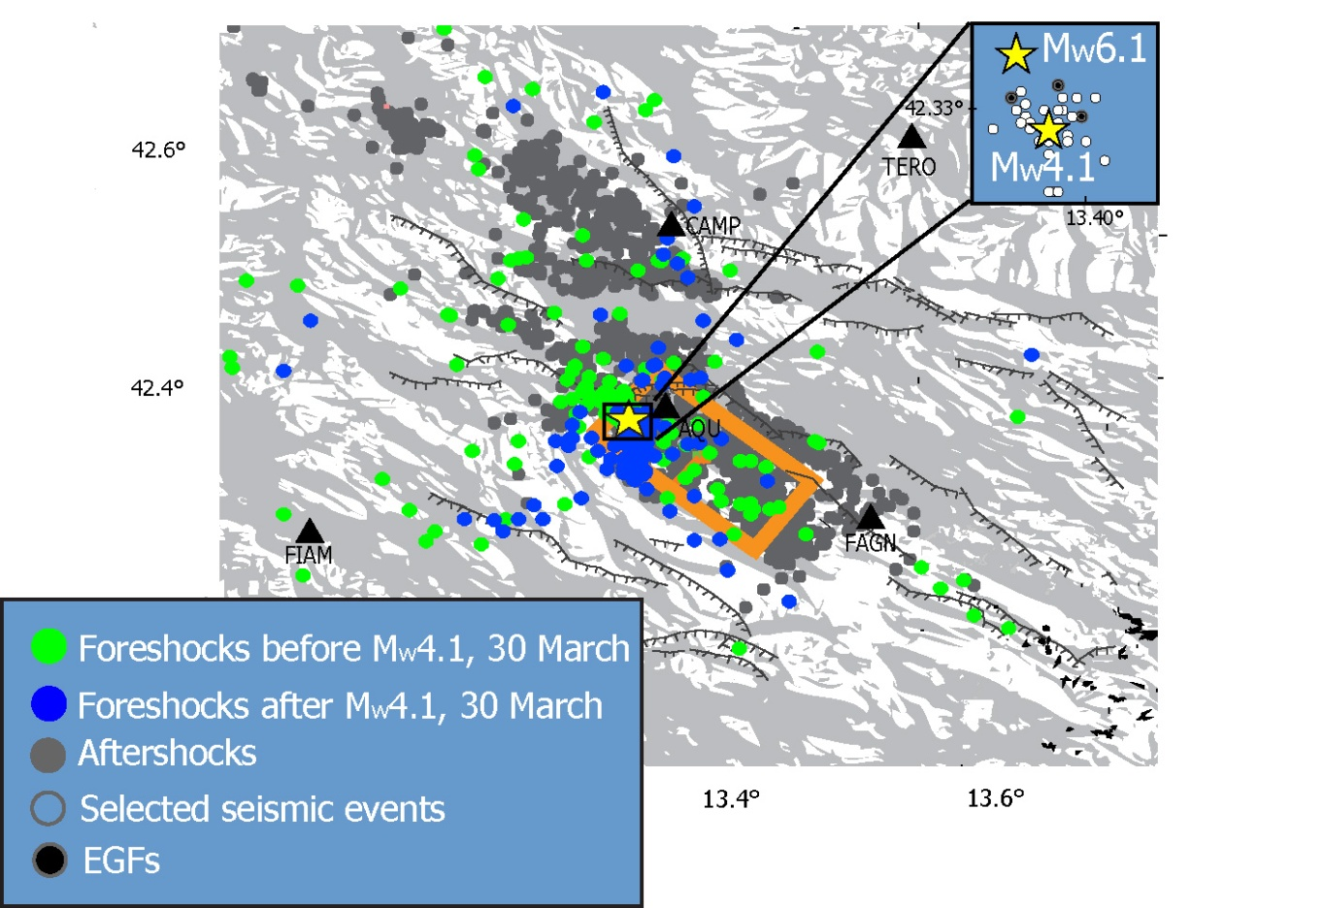
Stations and Study Area
Cluster of earthquakes
in the nucleation zone
Foreshocks before Mw4.1 30 March
Foreshocks after Mw4.1 30 March
Aftershocks
Selected seismic events
EGFs

Slide 3
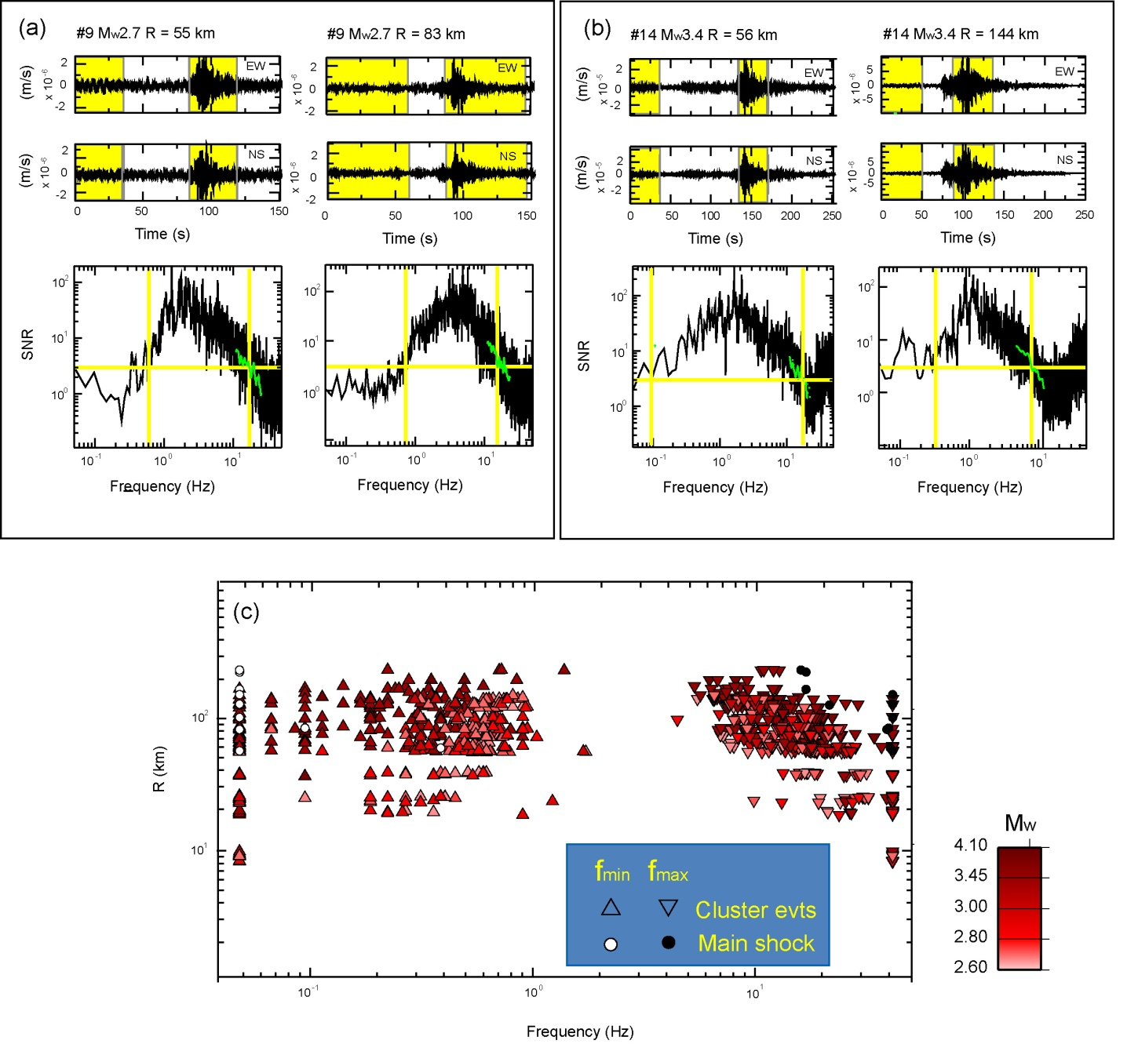
Signal to Noise Ratio (SNR)
Noise
Signal
For each of the selected events,
the SNR was computed at the available stations.
S/N = 3
fmin
fmax
fmin and fmax are the lower and upper bound of the frequency range where the SNR > 3
fmin fmax
Cluster event
Main schock

Slide 4
Method of Analysis
The amplitude spectrum of ground motion (S(f.R)) at distance R from the source is the convolution of the source (Ω₀(f,R)), crustal wave propagation (A(f,R)), and site contributions (H(f)):
The source‐radiated displacement spectrum
is expressed as:
Following Eshelby [1957] and Keilis-Borok [1959],
the radius r and uniform stress drop (∆σ) of a circular crack in an
infinite Poisson solid are linked to M₀ and f₀ through the equations:
Brune stress drops estimated in a conventional Empirical Green’s Function (EGF) approach in the
frequency domain is:
Apparent stress (τa) estimated following the standard method of Wyss and Brune [1968],and the Savage-Wood radiation efficiency (ηsw) are obtained through following equations:

Slide 5
The Brune stress drop of the target event (Δσ) is estimated through a grid search procedure. For each station and each EGF, the quality of the fit is checked through the range in which the variance of the fit is within 5% of the minimum value. According to Abercrombie [2015], the width of the 5% range is used as estimate error of the fit. The final stress drop of each event is computed as the average over stations and over EGFs applying an inverse-error weighting.
(a) Behavior of individual-station misfit variance for a specific event using the available stations and three EGFs.
(b) Comparison between the estimates of the
individual-event stress drop for the different EGFs.

Slide 6
The values of ∆σ resulting from the analysis vary from 0.1 to 2 MPa for the smaller events whereas ∆σ attains 8.7 MPa for the main shock. These estimates are consistent with those by other authors [Malagnini et al., 2011; Calderoni et al., 2013, Pacor et al., 2016]. There is an increase of ∆σ inter-event variability in the cluster toward the smallest magnitudes. This effect was already observed by Calderoni et al. [2013] during the L’Aquila seismic sequence. Rovelli and Calderoni [2016] confirmed the same behavior in other normal faulting earthquakes of the Apennines, in the Umbria-Marche region.
∆σ and τa result in a substantial correlation, their ratio ranging mostly from 0.1 to 0.15.
Significant differences in stress drop at similar magnitudes are confirmed by the different behavior of displacement spectra for low and high stress drop events.
Main shock
ηsw=0.5 high efficiency
ηsw=0.23 theoretical efficiency of the Ω² model
ηsw=0.1 high efficiency
At low frequency:
spectra converge.
Similar M0
At high frequency:
spectra diverge.
±1 sd around
the mean spectrum
of individual events
are neatly separated.

Slide 7
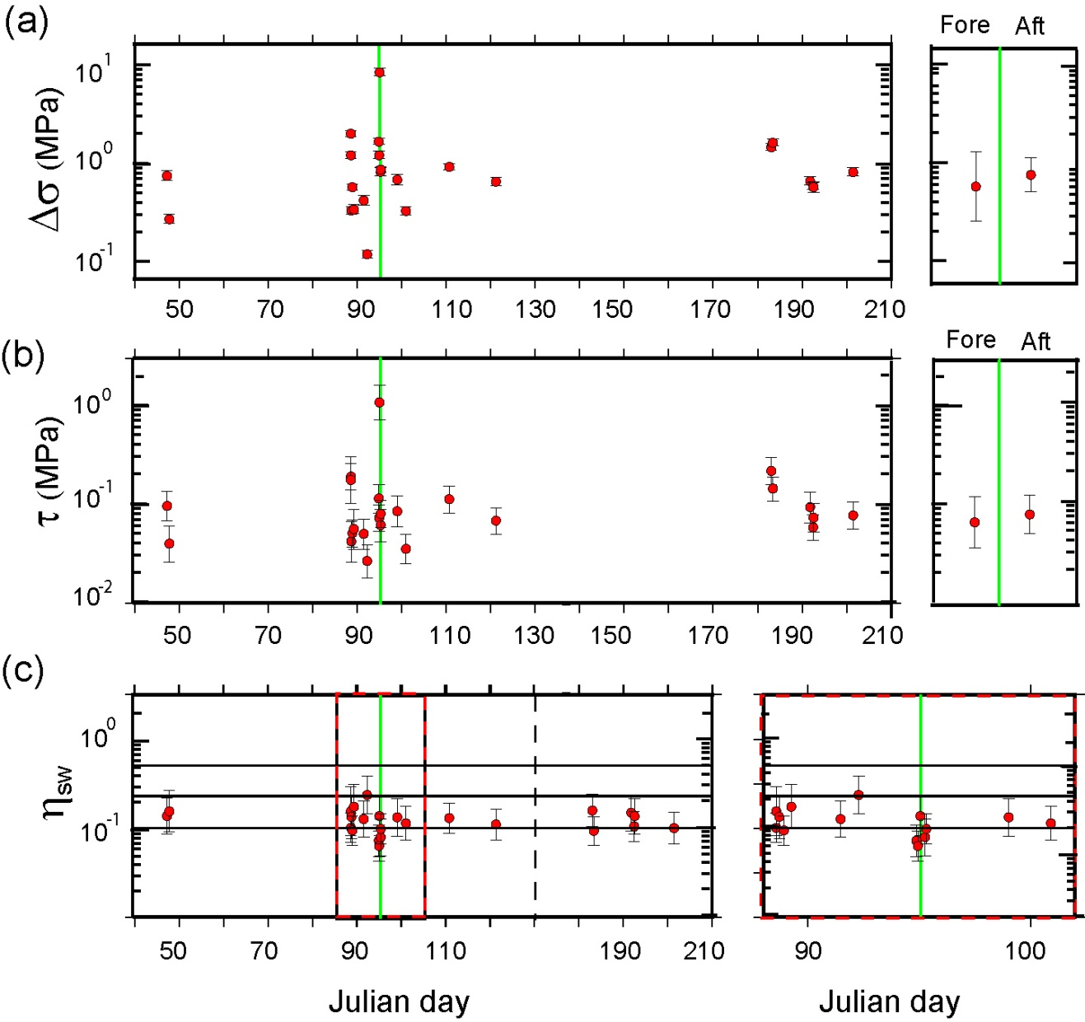
Temporal variation of source parameters
The two stress parameters (∆σ, τa) depict a similarly scattered trend, with the highest value corresponding to the main shock (the vertical green straight line remarks the main-shock time). Seismic efficiency (η_{sw}) is substantially stable versus time, however we can see that the events with the smallest values of η_{sw} are mostly concentrated in the days immediately before and after the main shock.
∆σ, τa of foreshocks and
aftershocks do no differ
statistically.
The zoomed view of ηsw is relative
to a two-week time window, one
week before and one after the mainshock. Many of the smallest
(less than 0.1) values of ηsw are concentrated around the main-shock time

Slide 8
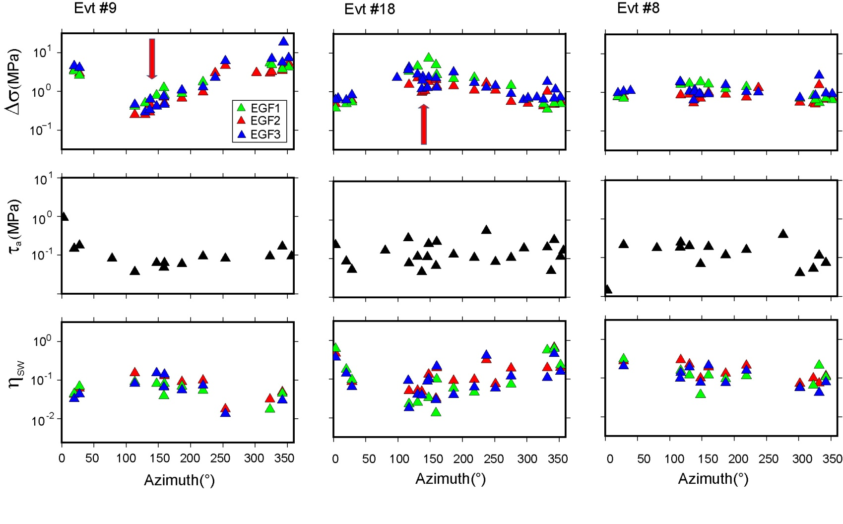
Spatial variation of source parameters
The implications of the Brune model are evaluated looking at the pattern of individual-station values of source parameters (∆σ, τa, and η_{sw}) at different azimuths. A neat difference emerges in the behavior of three different examples shown in the following figure. The red arrows indicate the L'Aquila fault strike as estimated by the DISS Working Group (2010).
Unilateral directivity
Small (or no) directivity

Slide 9
Spatial variation of source parameters to a scale of few kilometers
Exists an inverse relationship between Brune stress drop and b-value (e.g. Smith and Priestley [2000], Ruhl et al. [2017]). The spatial distribution of the cluster events shows that the high stress drop events spread around the largest M_{w} 4.1 foreshock, south to southeast of the main shock, whereas the lower stress drop events tend to be concentrated to the south at a larger distance from the main shock. The occurrence of a spatial variation in the main shock nucleation zone was also proposed by Sugan et al. [2014] that found significantly lower b-values in a patch of about 4 km² adjacent to the main shock nucleation.
Main shock
Mw 4.1

Slide 10
Conclusions
Source directivity can be very important for individual-station estimates even at small magnitudes, but the average over many stations reduces the bias within random estimate fluctuations.
The analysis of clustered earthquakes leads to a finer spatial resolution than previous studies on the source parameters of the 2009 seismic sequence.
No difference is found in the stress parameters between foreshocks and aftershocks in the cluster.
The stress drop variations are originated by an asperity patch, and a good correlation is found at the scale of a few kilometers between the smallest and largest ∆σ with the largest and smallest b-values, respectively, found by other authors.
In the days immediately before and after the main shock, radiation efficiency decreases below 0.1, down to values as low as 0.06, consistently with ruptures that propagate into the focal volume with the highest dynamic strength.

