Slide 1
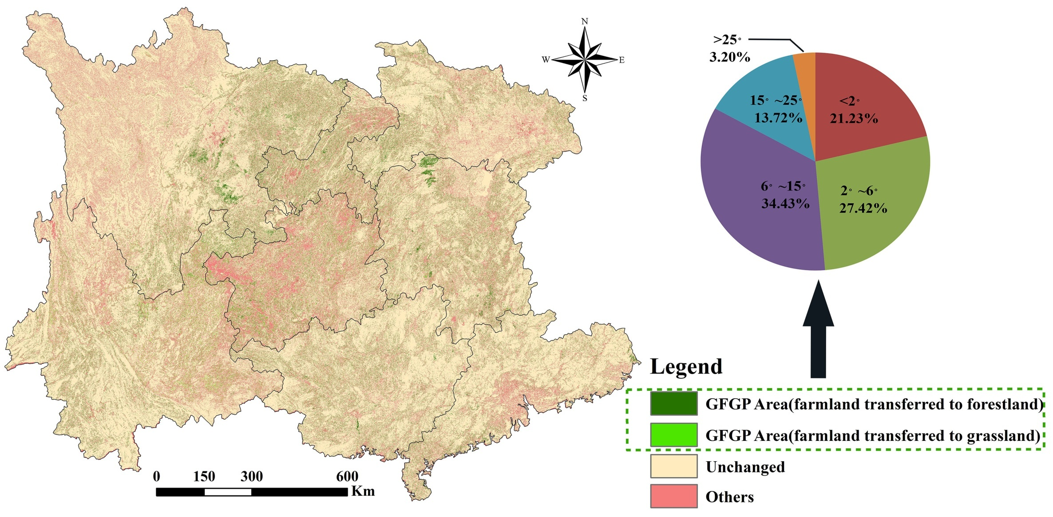
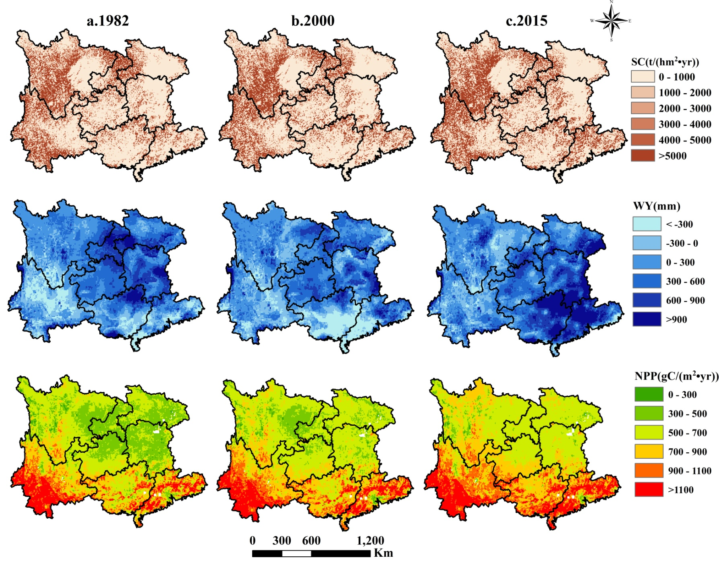
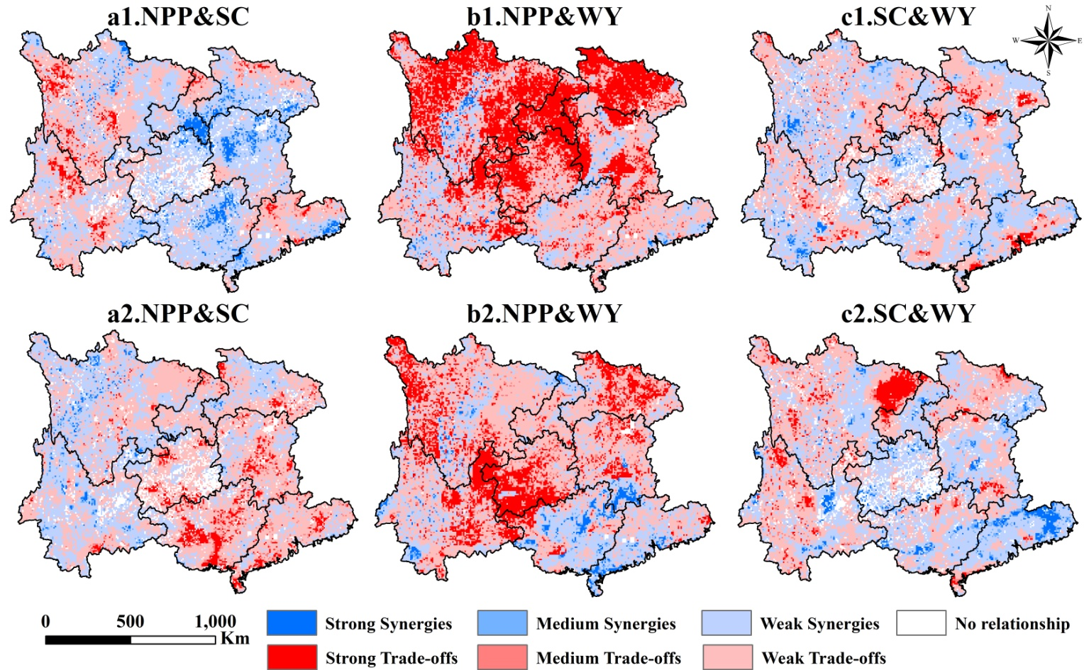
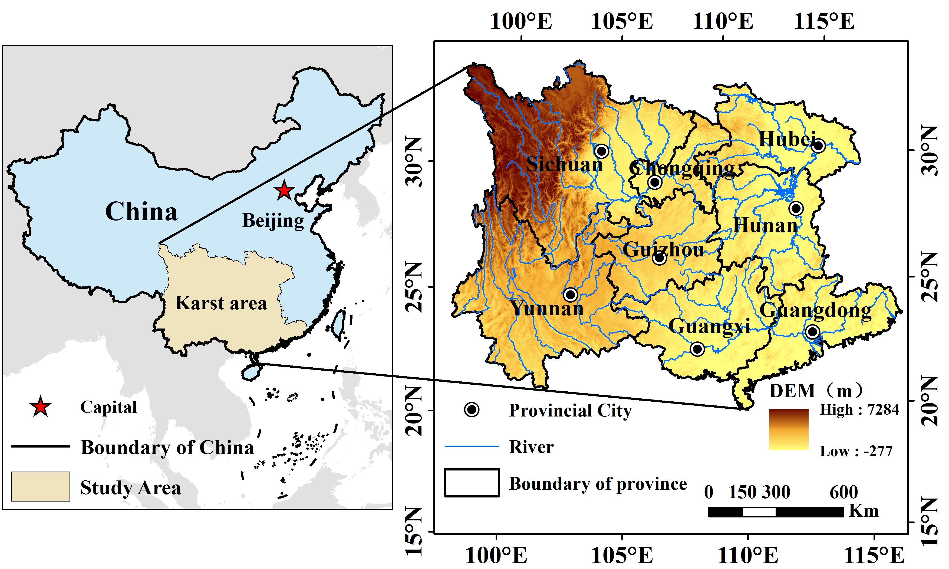
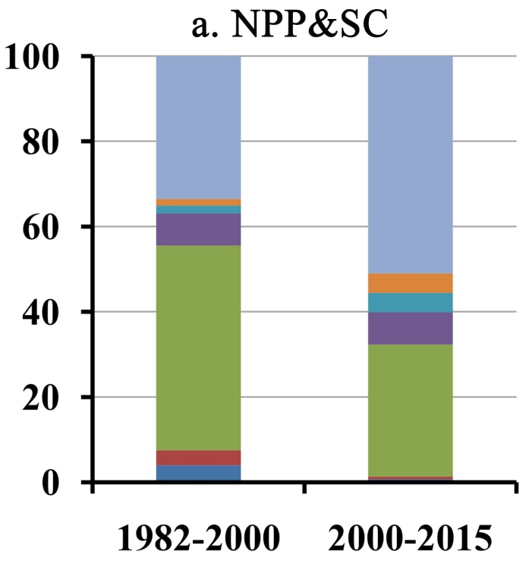
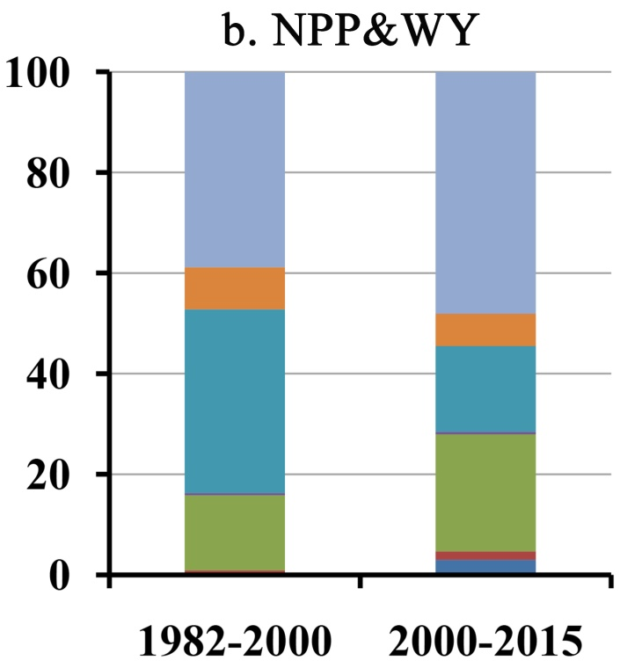
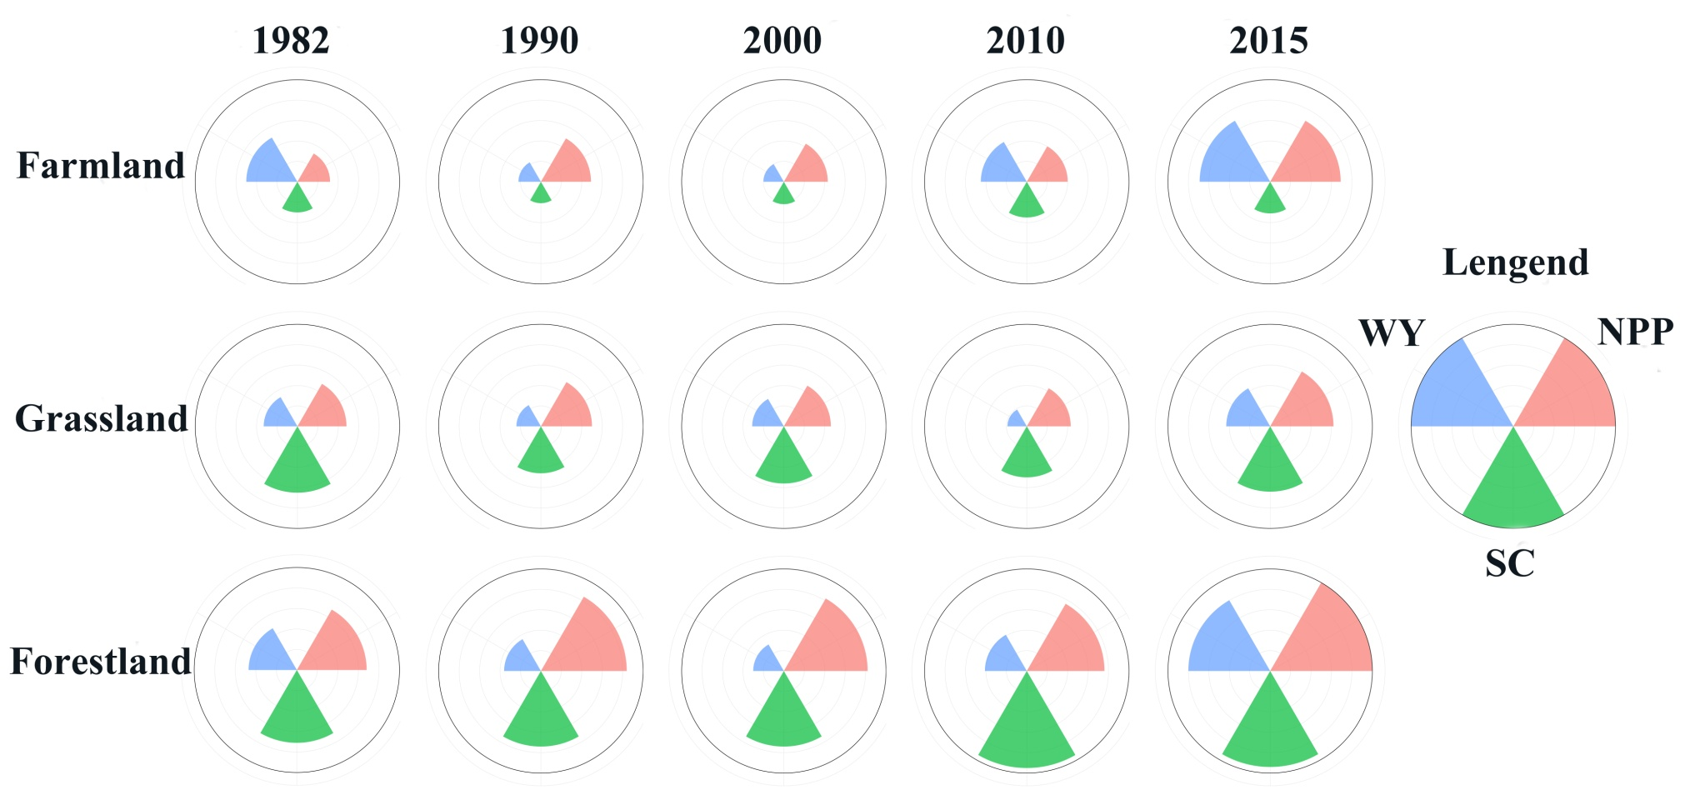
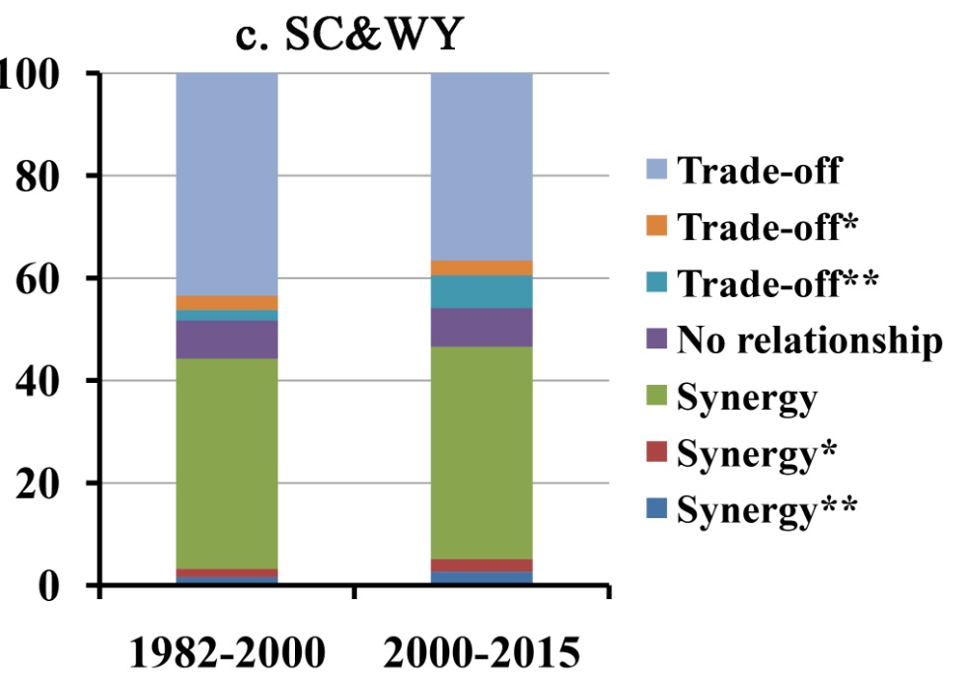
Trade-offs and Synergies of Ecosystem Services in Karst Area of China Driven by Grain-for-Green Program
Xiaofeng Wang^{1,2}, Xinrong Zhang¹, Xiaoming Feng³, Shirong Liu⁴
¹ School of Earth Sciences and Resources , Chang’an University, Xi’an, Shaanxi 710054, China;
² Shaanxi Key Laboratory of Land Consolidation, Xi’an , Shaanxi 710054, China;
³ State Key Laboratory of Urban and Regional Ecology, Research Center for Eco-Environmental Sciences, Chinese Academy of Sciences, Beijing 10085, China;
⁴ Institute of Forest Ecology, Environment and Protection, Chinese Academy of Forestry, Beijing 100091, China
Introduction
Results
Ecosystem services (ESs) are the resource and environmental basis for the survival and sustainable development of human society. Complex trade-off and synergy relationships exist between multiple ESs. Under the background of global climate change, human’s unconscionable exploitation and utilization have led to global environmental destruction and ecological degradation. Vegetation restoration program aims to initiate or promote the restoration process of degraded ecosystems through human intervention, which is an important means to cope with ecological degradation problems and to improve Ess, the Chinese government has launched large-scale ecological restoration program such as the Grain-for-Green Program (GFGP) .
Fig2. Land use changes of Karst area during 2000-2015 and slope distribution of GFGP area
Objectives
Calculating three key types of ESs including water yield (WY), soil conservation (SC), and net primary productivity (NPP) .
Exploring the trade-offs relationship of ESs in different land use types.
Discussing the spatial-temporal changes of ESs trade-offs in GFGP area driven by the ecological program
Fig3. The temporal changes of SC, NPP and WY in Karst area from 1982 to 2015
a. Study area
Materials and methods
Fig5. The spatial patterns of pairwise ecosystem services interactions in Karst area from 1982 to 2000 and from 2000 to 2015
Fig4. Spatial distribution of ecosystem services in Karst area of China in 1982, 2000, and 2015
Fig1.Study area
Fig6. Rose map of ecosystem services in Karst area by land-use type from 1982 to 2015
Fig7. The area proportion of pairwise ecosystem services interactions in the GFGP area from 1982 to 2015
b. Quantifying ecosystem service
The NPP is estimated utilizing the information of APAR and the light use efficiency. SC is calculated as soil loss supposedly ignoring vegetation cover and soil erosion control practices (Ap) minus the current LUCC patterns and soil erosion control practices (Ar). Based on the water balance method, WY is calculated as the difference between precipitation (P) and actual evapotranspiration (AET).
Discussion
The regional climate condition of the Karst area has exhibited a warming and wetting trend.
Trade-offs exist between ESs under the scenario of ecological restoration.
the trade-offs relationship among ESs has spatial and temporal differences and uncertainties.
c. Quantifying trade-offs and synergies of ecosystem services
Conclusions
We consider that the annual precipitation as an important climatic factor has a significant impact on WY, SC, and NPP. So we controlled annual precipitation and respectively calculated the partial correlation coefficients between WY and NPP, WY and SC, NPP and SC.
Forestland, wetland, and built-up land increased, whereas farmland and grassland decreased. The GFGP mainly concentrated on slope degree ranging from 2º to 15º.
Temporally, SC and NPP exhibited an increasing trend, while WY exhibited a decreasing trend. Spatially, SC basically decreased from west to east; NPP basically increased from north to south; WY basically increased from west to east.
Among ESs in different land-use types, NPP and WY in the forestland changed in the opposite way, whereas SC keep increasing.
NPP and SC, SC and WY developed in the direction of trade-offs driven by the GFGP, while NPP and WY developed in the direction of synergies.

