Slide 1
GLImER: A MATLAB-based tool to image global lithospheric structure
Stéphane Rondenay
Lucas Sawade
Peter Makus
Universitetet i Bergen
See presenter notes
for accompanying text!
EGU General Assembly, Online, 7 May 2020
Notes:
ABSTRACT
Project GLImER (Global Lithospheric Imagining using Earthquake Recordings) aims to conduct a global survey of lithospheric interfaces using converted teleseismic body waves. Data from permanent and temporary seismic networks worldwide are processed automatically to produce global maps of key interfaces (crust-mantle boundary, intra-lithospheric interfaces, lithosphere-asthenosphere boundary). In this presentation, we reflect on the challenges associated with automating the analysis of converted waves and the potential of the resulting data products to be used in novel imaging approaches. A large part of the analysis and the visualization are carried out via MATLAB-based applications. The main steps of the workflow include signal processing for quality control of the input data and earthquake source normalization, mapping of the data to depth for image generation, and interactive 2-D/3-D plotting for visualization. We discuss how these various tools, especially the visualization ones, can be used for both research and education purposes.

Slide 2
Imaging with converted teleseismic waves
physical model:
, ∆ρ
seismic data:
rotated data:
Receiver Function (RF):
Surface
Discontinuity
data:
t (s)
depth
(km)
Rondenay, Surv Geophys, 2010
Notes:
Physical model
Consider waves from distant earthquakes (teleseismic waves) that are converted at discontinuities in elastic properties in the subsurface (green line) beneath seismic stations (inverted black triangles)
Discontinuities in elastic properties reflect changes in composition, phase, mineral/structural fabric, etc.
Imaging the position and strength of these discontinuities provide solid earth scientist with information about the physical anc chemical processes operating in the earth
Data
The incident and converted wavefields (seismic data) are isolated and rotated
We deconvolve the incident wavefield from the converted wavefield to obtain an estimate of the ground’s impulse response (Receiver Function, or RF for short)
Receiver Function
The Receiver Function is mapped to depth by computing incident versus converted wave travel times in an assumed seismic velocity model
The resulting Receiver Functions can be used directly to image the subsurface and can also form building blocks for a number of more sophisticated 2-D/3-D imaging methods

Slide 3
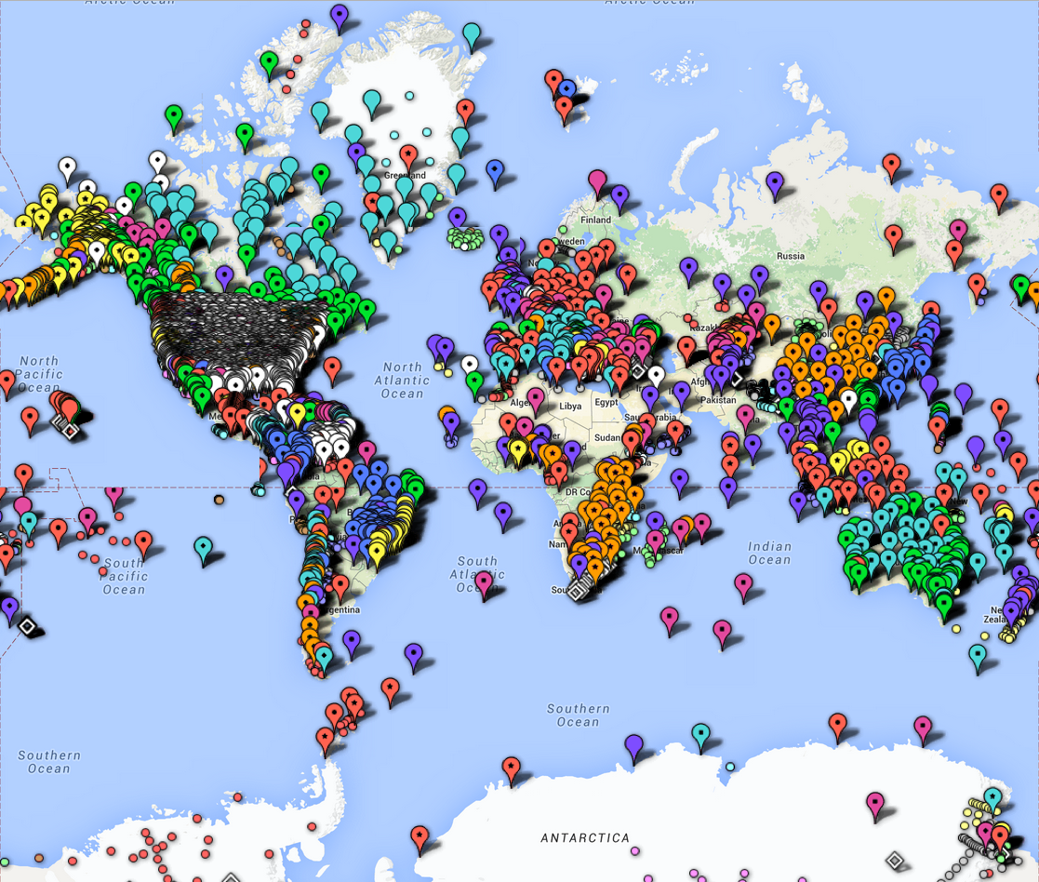
Notes:
Most scientists carry out Receiver Function analysis at individual seismic stations or using regional networks of seismic stations
This map shows the global distribution of seismic stations available for RF analysis; data from these stations are publicly available through national/international archives (generally via web services)
In GLImER, we have developed a set of programs that allows us to download the data and calculate RFs automatically at all stations
It is a flexible scheme in which the selection criteria can be refined and the RFs can be quickly regenerated using a variety of deconvolution approaches
The workflow involves a series of signal processing steps, with main challenges associated with the automatic selection/identification of key elements, such as (1) high-quality data amenable for analysis (i.e., quality control via multiple signal-to-noise ratio criteria), (2) optimal filtering parameters, and (3) stable Receiver Function outputs
MATLAB was chosen to carry out most of this work because it allowed us to build, test, and validate the automated workflow in an efficient and highly interactive way

Slide 4
GLImER in numbers
Number of seismic stations: 8,288
Number of seismic even: 9,752
Number of Ps receiver functions: 2,603,848

Slide 5
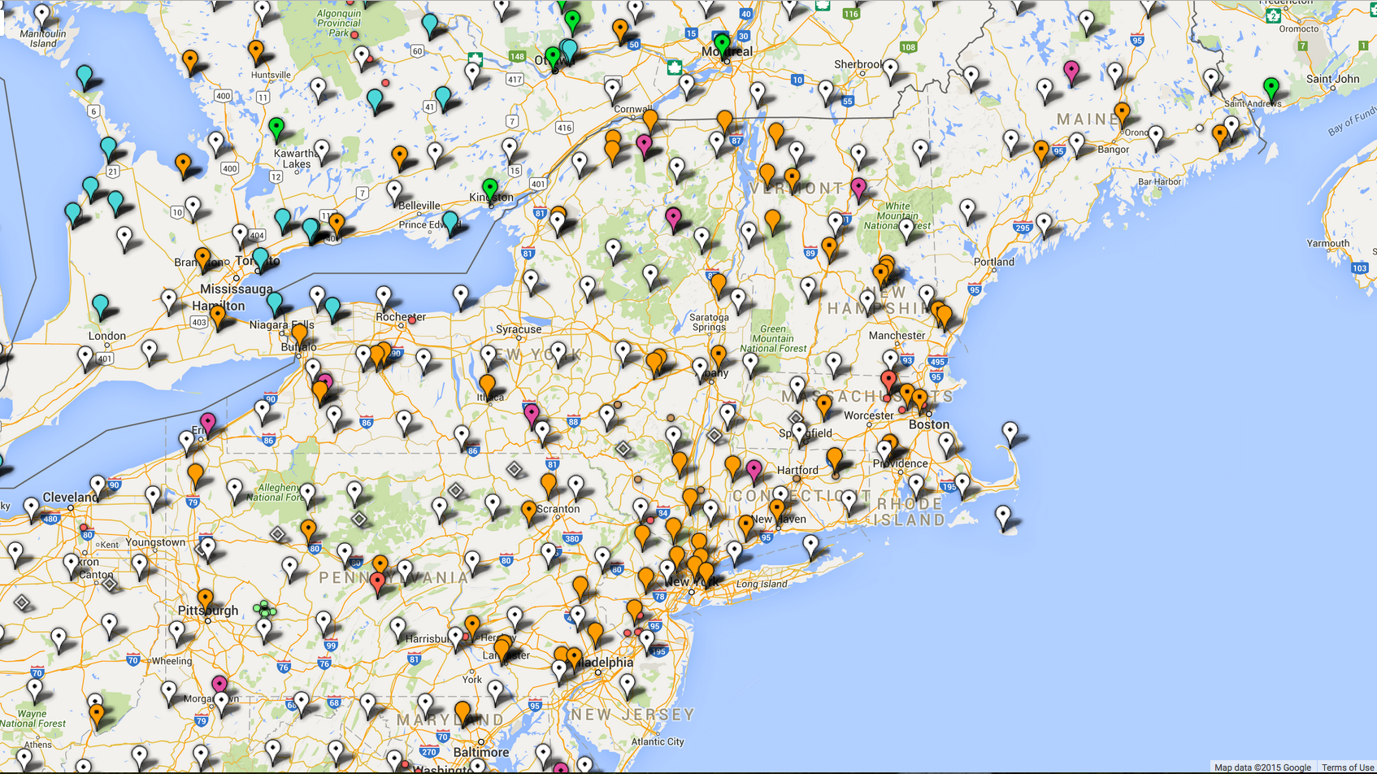
Notes:
Receiver Functions at individual stations
Receiver Functions computed at each station are mapped to depth and stacked
Results are viewable via a Google map interface, by clicking on individual stations
The example here shows the stacked RF for station HRV, in Harvard, Massachusetts
Link: http://www.stephanerondenay.com/glimermap

Slide 6
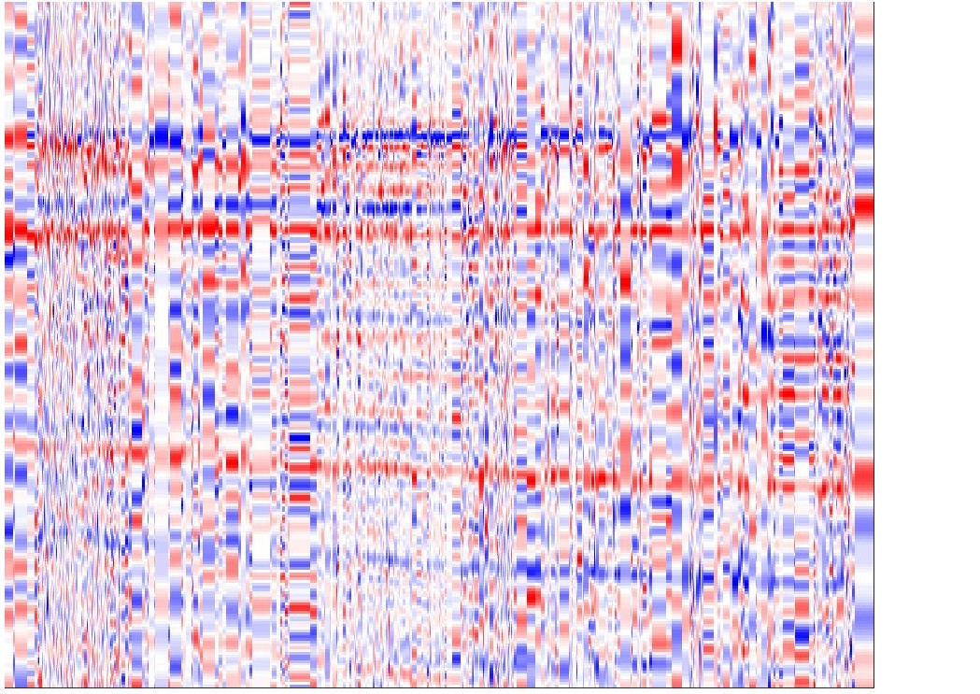
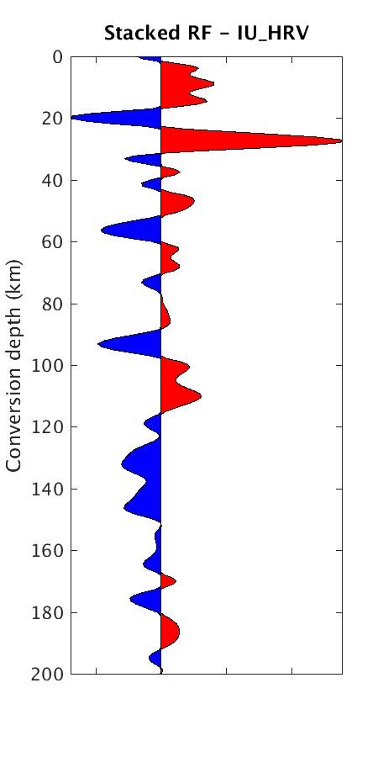
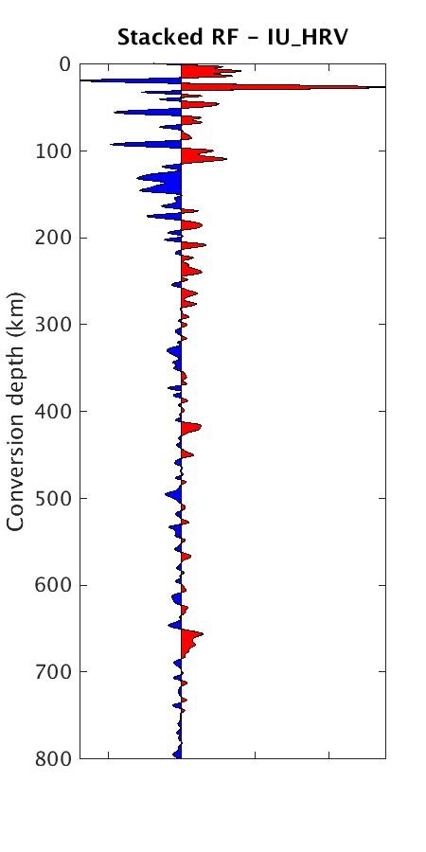
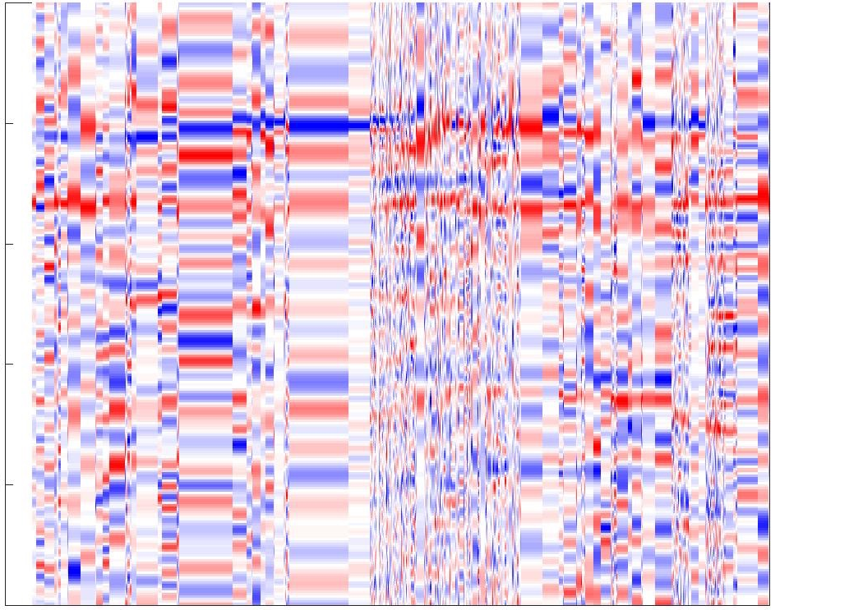
Station IU-HRV
Individual RFs vs ray parameter
Stacked RF 0 - 200 km
Stacked RF 0 - 800 km
0
Time (s)
Moho
5
10
MLD
15
LAB
0.08
0.07
0.06
0.05
0.04
20
Ray parameter (s/km)
410
Individual RFs vs back-azimuth
0
660
Time (s)
5
10
15
0
50
100
150
200
250
300
350
20
Backazimuth (deg)
Notes:
Receiver Functions at individual stations
Clicking on the links in the station tab leads users to a page containing RF stacks mapped to depths of 0-200 km and 0-800 km depth, which show the depth of the crust-mantle boundary (Moho), Mid-Lithospheric Discontinuity (MLD), Lithosphere-Asthenosphere Boundary (LAB), and discontinuities of the mantle transition zone at 410 and 660 km depth
One can also view cross-sections of individual RFs as a function of either earthquake distance (expressed as the ray parameter) or backazimuth (the azimuth from the station to the earthquake)

Slide 7
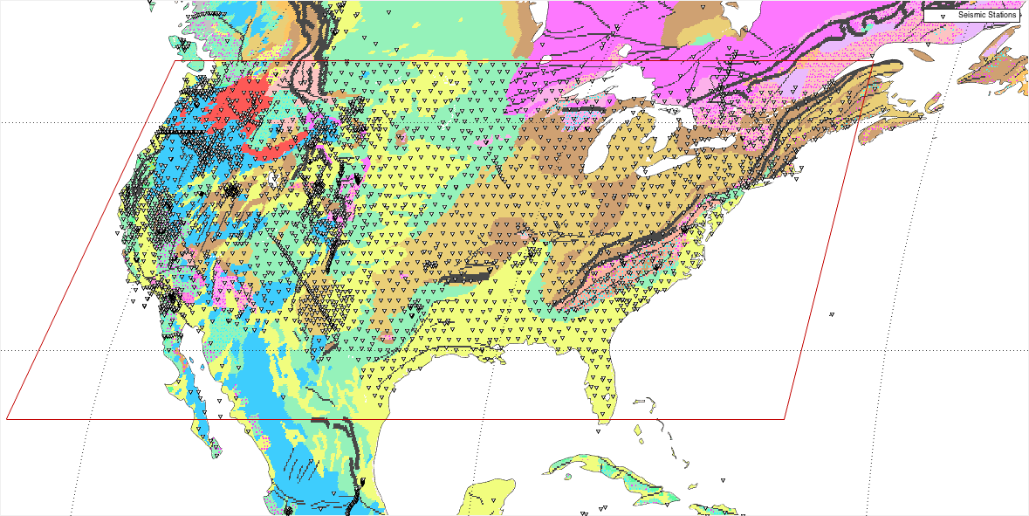
Mantle transition zone across North America
Notes:
Receiver Functions at multiple stations
RFs recorded at multiple stations can be combined at imaging points at depth, through binning and stacking of RF signals at Common Conversion Points (CCPs), giving us the ability to image subsurface structure in 2-D/3-D
As part of GLImER, we created a global grid of CCPs and computed stacked RFs for all CCP grid points illuminated by converted seismic waveforms
We have also built some tools to visualize our CCPs in 2-D (cross sections) and in 3-D (volumes)
Here we are going to use the 3-D visualization tool to look at the mantle transition zone beneath North America
In the MATLAB program, the user first selects a window

Slide 8
Mantle transition zone across North America
Notes:
Receiver Functions at multiple stations
Then the user can navigate and explore the 3-D volume of stacked Receiver Function through this interface
CLICK ON IMAGE TO START MOVIE! You will see features such as:
sliders to change the contrast to highlight the discontinuities of interest
option to rotate volume to see the profiles from all angles
another set of sliders to move the sections across the 3D CCP volume - here we move the EW cross-section to the north
You will see the 410 and 660 km discontinuities of the mantle transition zone remaining at a rather constant depth across the study area
There is also an intermittent discontinuity at 520 km depth which is more or less visible as a function of latitude
The data for global CCP image volumes and the 3-D visualization tools will be made publicly available
For this, we used MATLAB because it affords efficient data distribution means (mat or netcdf files) and a powerful visualization platform

