Slide 1
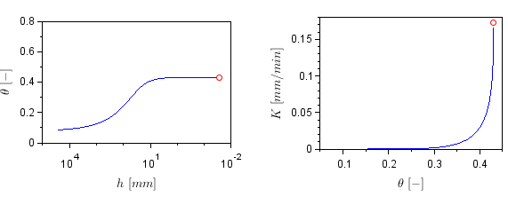
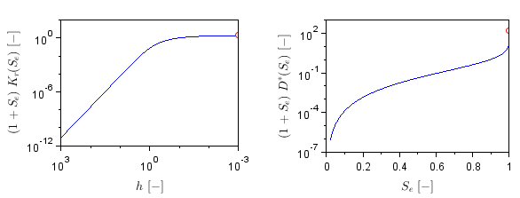
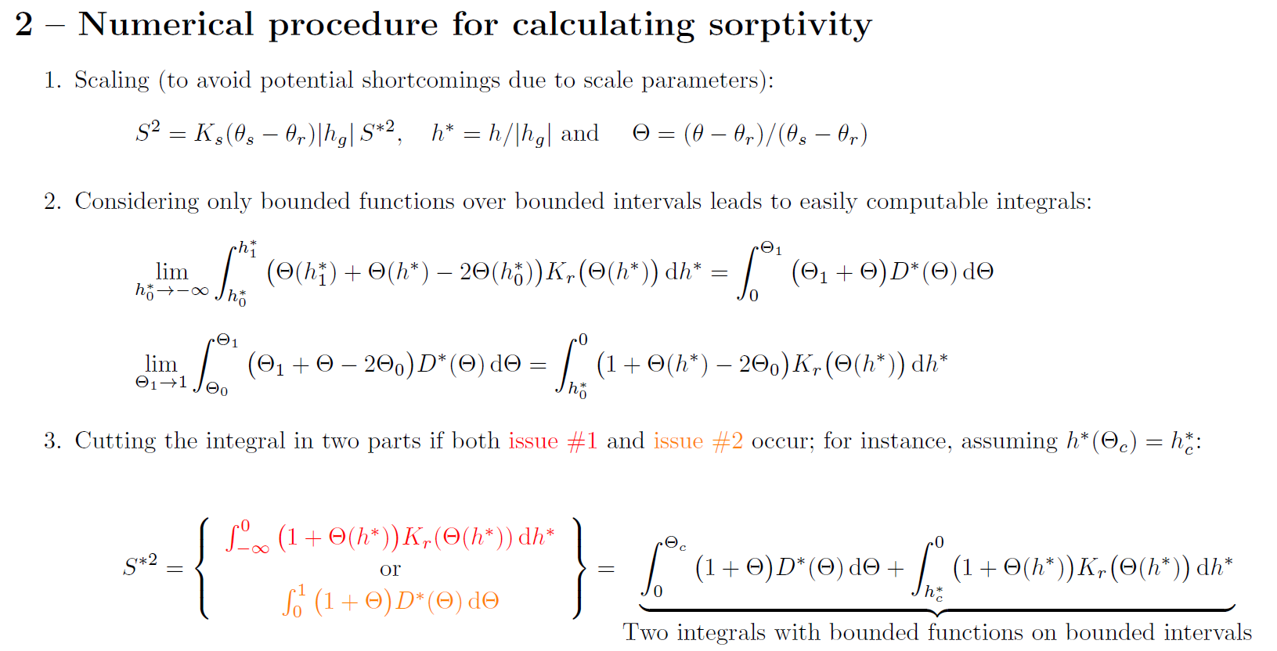
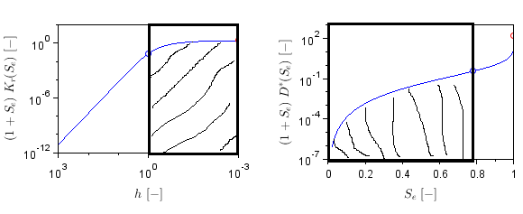
Finite formulation for the computation of sorptivity
Pierre-Emmanuel Peyneau¹, Laurent Lassabatere², Joseph Pollacco³, Jesús Fernández-Gálvez⁴, Borja Latorre⁵, David Moret-Fernández⁵, Simone Di Prima⁶, Rafael Angulo-Jaramillo¹
EGU2020-22664
o Hydraulic functions for loamy soil (Carsel and Parrish, 1988)
o Sorptivity integrands
2
+∞
o Determination of entire sorptivity
A1
A2
$S^{∗2}\left(0,1\right)$ = A1 + A2 = 0.478
$S^{2}\left(θ_{r},θ_{s}\right)$ = 0.810
*Corresponding author : pierre-emmanuel.peyneau@ifsttar.fr, (1) GERS-LEE, Univ Gustave Eiffel, IFSTTAR, F-44344 Bouguenais, France, (2) Univ Lyon, Université Claude Bernard Lyon 1, CNRS, ENTPE, UMR5023 LEHNA, F-69518, Vaulx-en-Velin, France, (3) Manaaki Whenua – Landcare Research, Lincoln 7640, New Zealand, (4) Department of Regional Geographic Analysis and Physical Geography, University of Granada, Granada 18071, Spain, (5) Departamento de Suelo y Agua, Estación Experimental de Aula Dei, Consejo Superior de Investigaciones Científicas (CSIC), PO Box 13034, 50080 Zaragoza, Spain, (6) Agricultural Department, University of Sassari, Viale Italia, 39, 07100 Sassari, Italy

