Slide 1

The Icy Giants & Triton’s Inonosphere
– lessons learned from Cassini observations within Saturn’s and Titan’s Inonospheres
Jan-Erik Wahlund, Michiko W. Morooka, David Andrews, Mats André, Jan Bergman, Niklas Edberg, Anders I. Eriksson, Lina Hadid^{(*}, Yuri Khotyaintsev, Andris Vaivads^{(**}, and Erik Vigren
Swedish Institute of Space Physics (IRF), Uppsala, Sweden
^{(* Moved to LPP, Paris}
^{(** Moved to KTH, Stockholm}
Jan-Erik Wahlund
Swedish Institute of Space Physics (IRF)
EGU2020-22682

Slide 2
Abstract
We discuss the importance to determine the structure and composition of the upper atmospheres and ionospheres of the Icy Giants (Uranus & Neptune) as well as Triton’s ionosphere in the light of numerous recently obtained Cassini results.
The ionizing radiation and charging environment within the upper atmospheres of Saturn and Titan creates a very complex organic chemistry leading to charged sub-nm-sized to 100 nm-sized aerosols. The charged dust has a profound effect on the ionospheric structure and related chemistry, enhancing the ion number density well above photochemical equilibrium levels, while the electrons tend to become attached to the dust population.
The organic chemistry leads to compounds reaching above 50,000 amu diffusing downward and possibly creating a pre-biotic chemistry. This process, involving nitrogen, methane and water may very well be a more general process, also applicable for the cases of Uranus, Neptune and Triton, were all have these starting species abundant in their upper atmospheres.
We therefore propose that a future mission to the Ice Giants and the moon Triton has Langmuir probe, electron spectrometer, dust, ion- and neutral mass spectrometers onboard to make detailed in-situ measurements on both the orbiter and atmospheric probe in order to investigate this fundamental chemistry and aerosol formation.

Slide 3
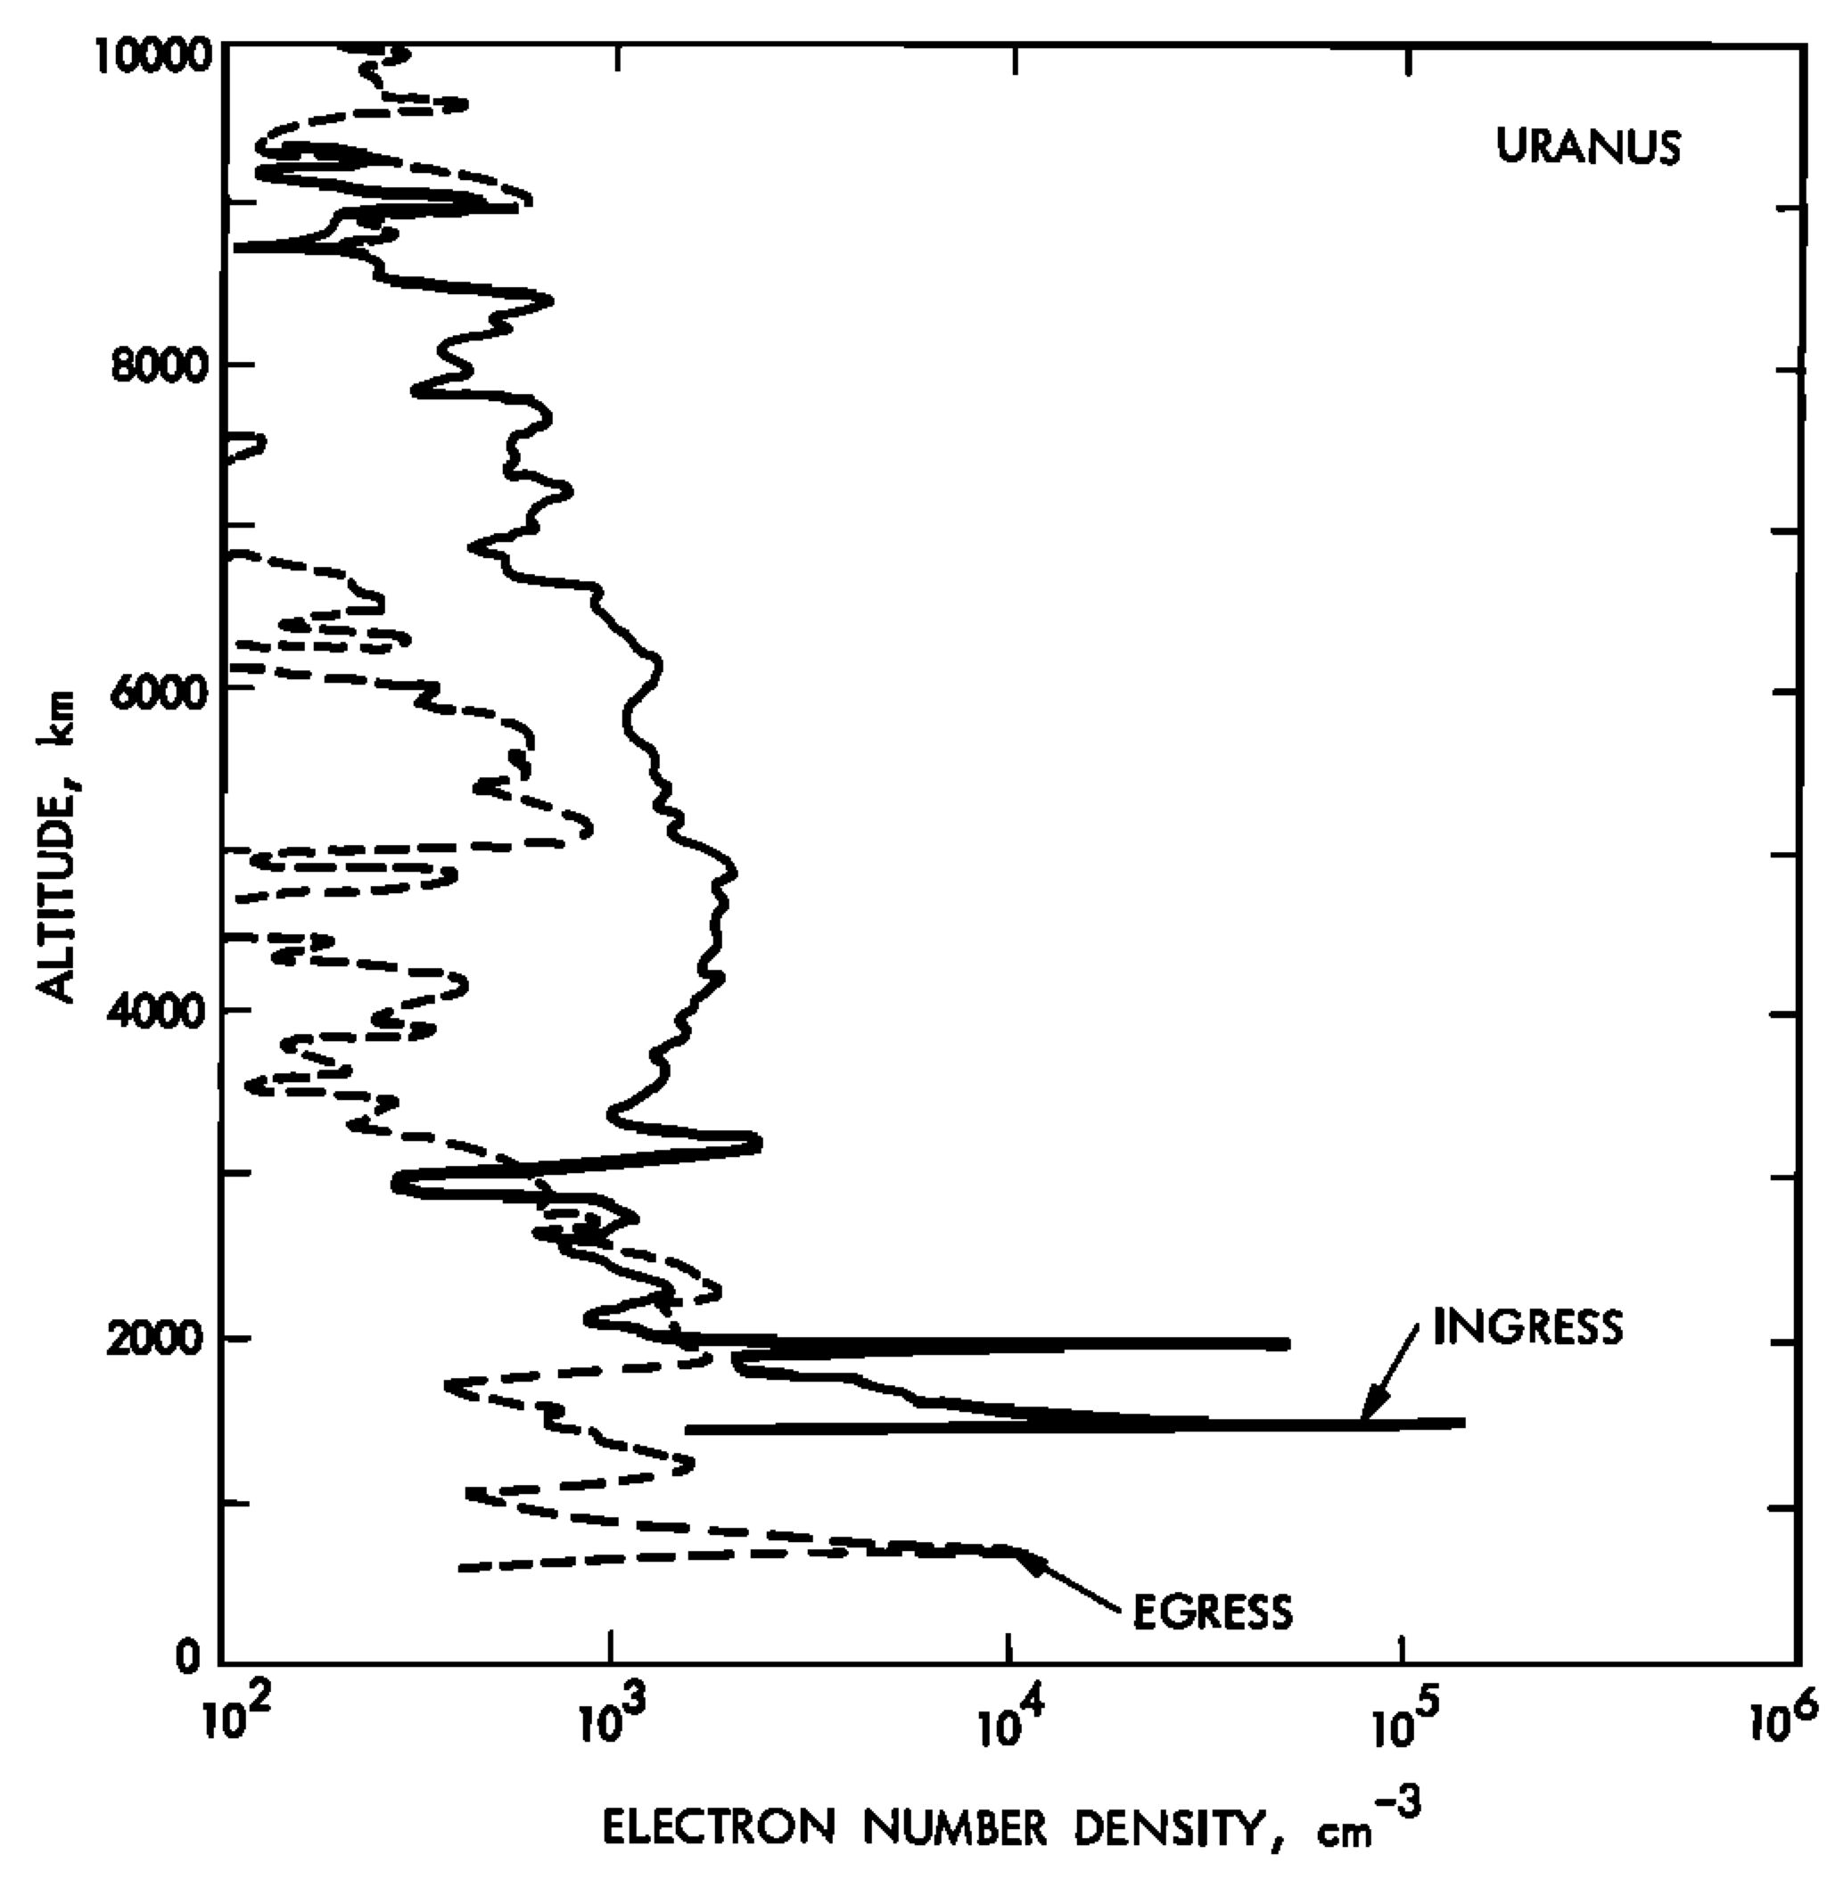
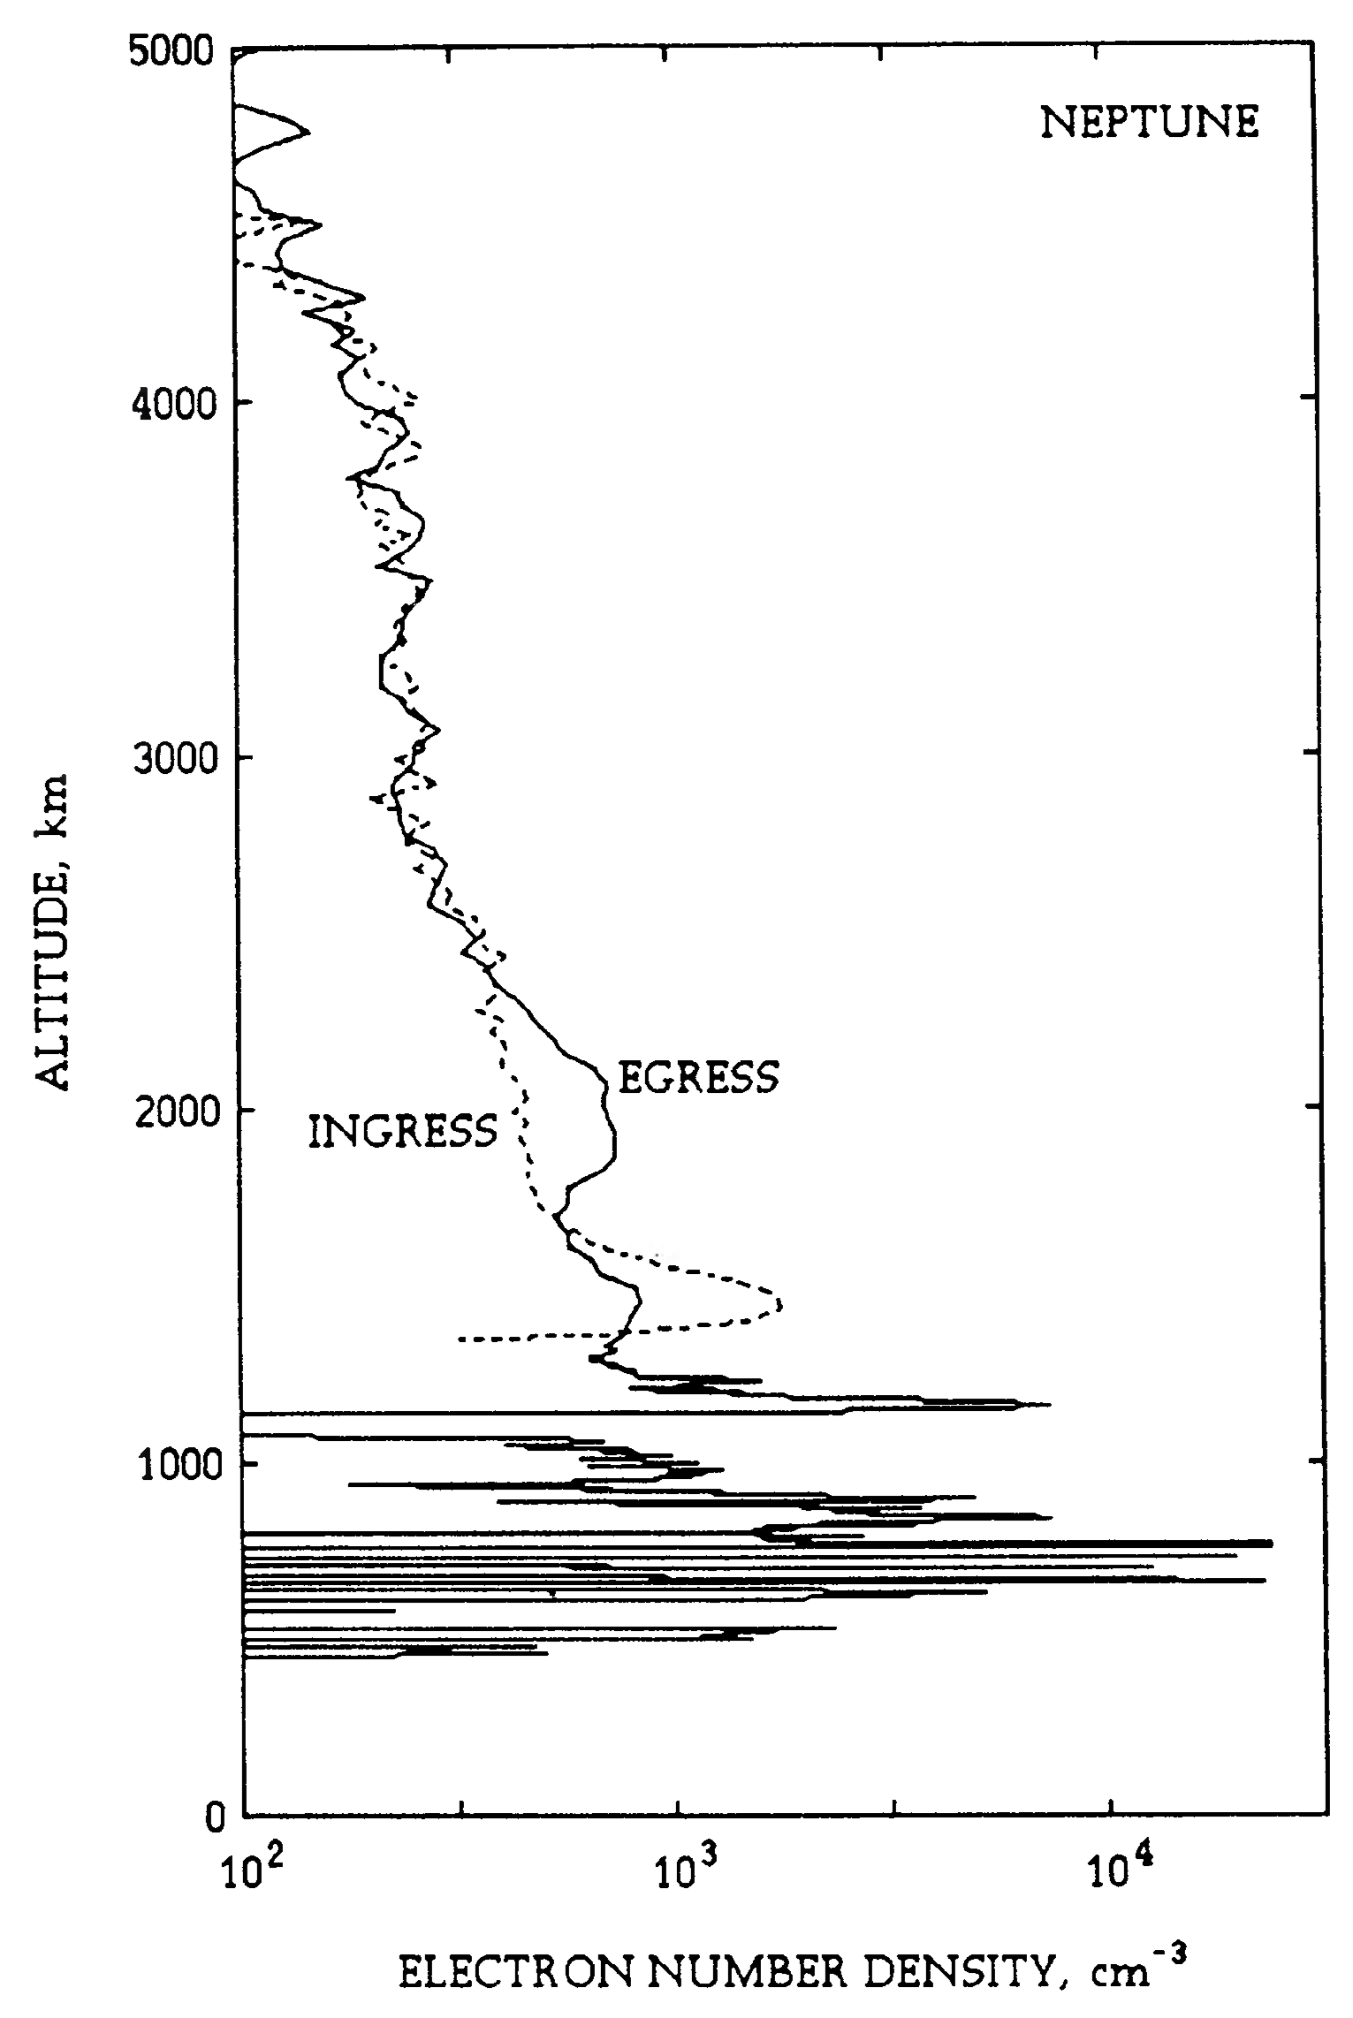
Ice Giant Ionospheres
Uranus Ionosphere
Neptune Ionosphere
One couple (ingress & egress) of radio occultation measurements were made each at Uranus and Neptune by the Voyager-2 spacecraft, giving electron density (n_{e}) altitude profiles [Lindal et al., 1987; Lindal, 1992].
Spiky (sharp) n_{e} layers were detected below about 2000 km (above 1 bar level), and the measured n_{e} was significantly lower than expected from theoretical photochemical equilibrium predictions [e.g., Atreya & Donahue, 1975; Shinagawa & Waite, 1989]. Similar features have also been observed at Saturn and Jupiter. This lead to speculations of the existence of heavy ions of meteoritic, ring or moon origin [e.g., Lyons, 1995; Nagy et al., 2006].

Slide 4
Cassini in-situ observations of
Saturn’s Ionosphere
The Cassini in-situ measurements during the proximal orbits monitored the ring material, Saturn’s ionosphere and thermosphere. The Radio and Plasma Wave Science (RPWS), the Magnetosphere Imaging Instrument (MIMI), the Cosmic Dust Analyzer (CDA) and the Ion and Neutral Mass Spectrometer (INMS) together reveled [e.g. Mitchell et al., 2018; Hsu et al., 2018; Waite et al., 2018; Wahlund et al., 2017, 2020; Hadid et al., 2018; Persoon et al., 2018; Morooka et al., 2019]:
The topside ionosphere, closest to the D-ring, contained large amounts of <50 nm-sized dust near the equatorial plane. The nm-sized grains were predominantly negatively charged.
An influx of ring material is continuously deposited into the atmosphere, and when the dust impacts deeper atmospheric layers at large speeds (~30 km/s), they partly break apart, sublimate, and deposit energy and mass at 1500-1900 km altitude above the 1-bar level.
A very complex neutral and ion chemistry results in Saturn’s ionosphere near the density peak with a dusty/aerosol plasma state that consists of negatively and positively charged heavy cluster ions and grains. The large ion densities (10⁴-10⁵ cm⁻³) were clearly not in agreement with normal photochemical equilibrium models.

Slide 5
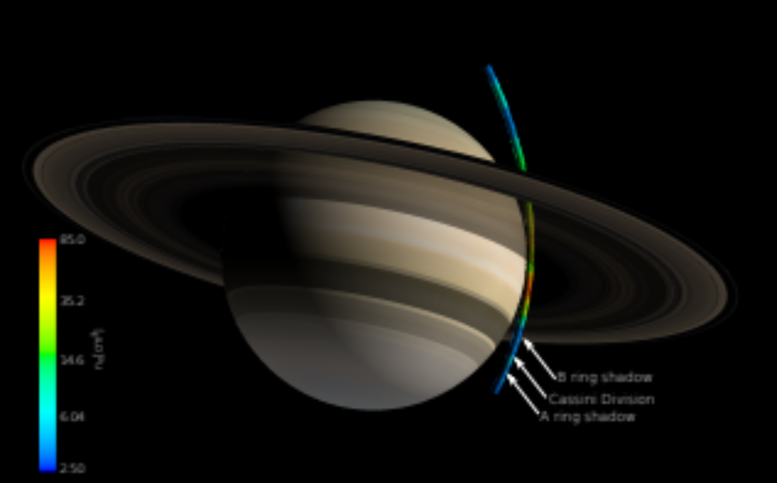
Complex Organic Chemistry & Aerosol production at Saturn
22 proximal orbits
1 plunge
Inside & into Saturn’s atmosphere/ionosphere
Initial results indicate a more complex organic chemistry than on Titan!
Wahlund et al., 2017; Waite et al., 2018; Mitchell et al., 2018; Dougherty et al., 2018; Hsu et al., 2018

Slide 6
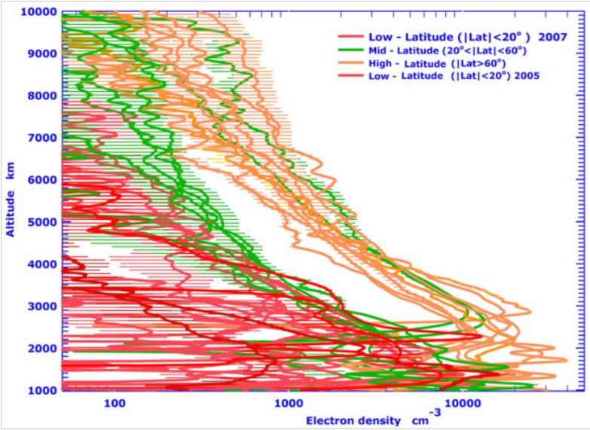
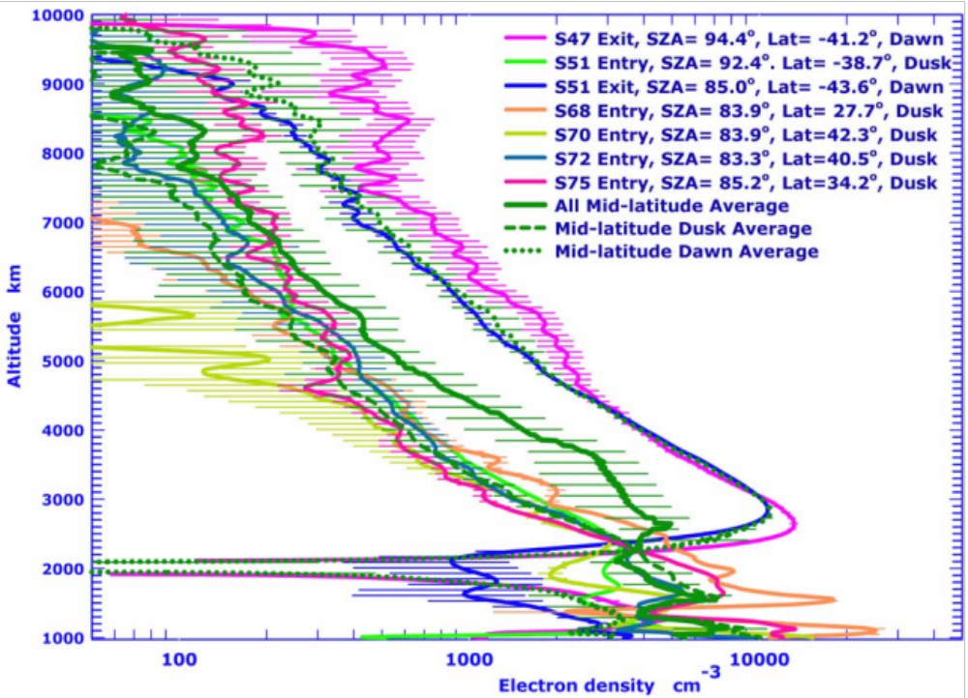
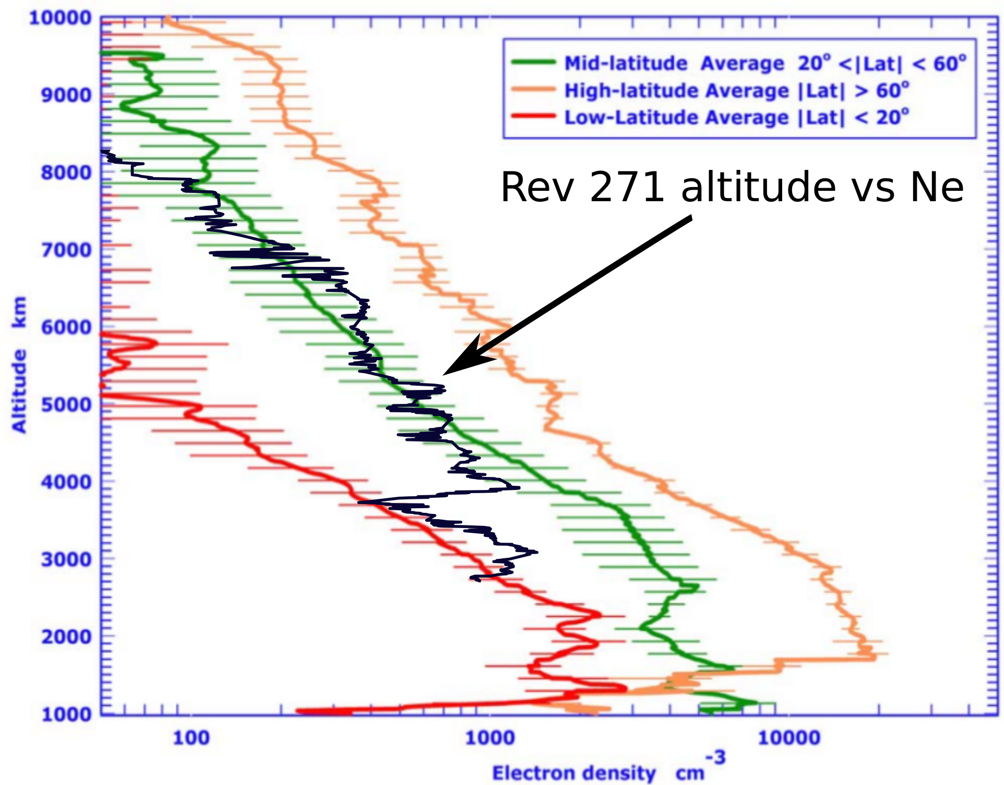
Previous Radio Occultation measurements
Kliore et al., 2009
(limb measurements, only N_{e})
(RPWS/LP
Wahlund et a., 2017)
Cassini deepest
“Mess” < 2300 km!?

Slide 7
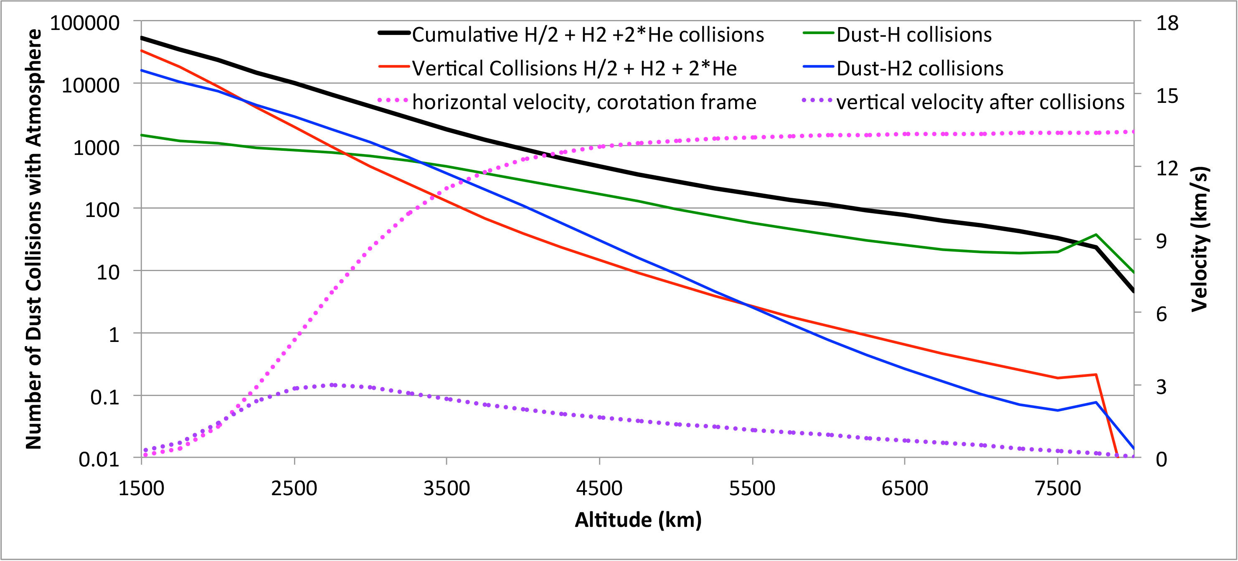
Infall of nm-sized grains
Mitchel et al., Science, 2018

Slide 8
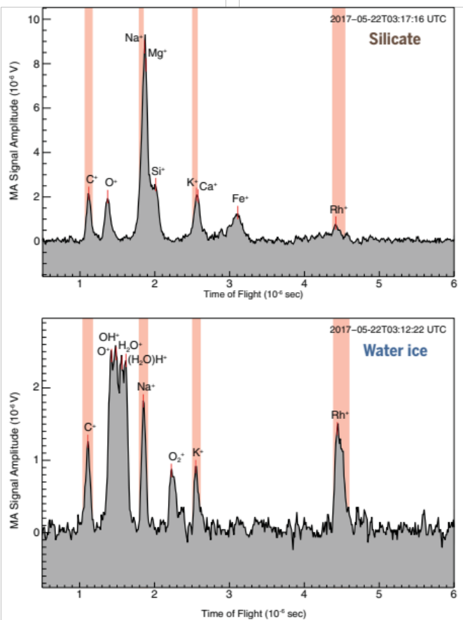
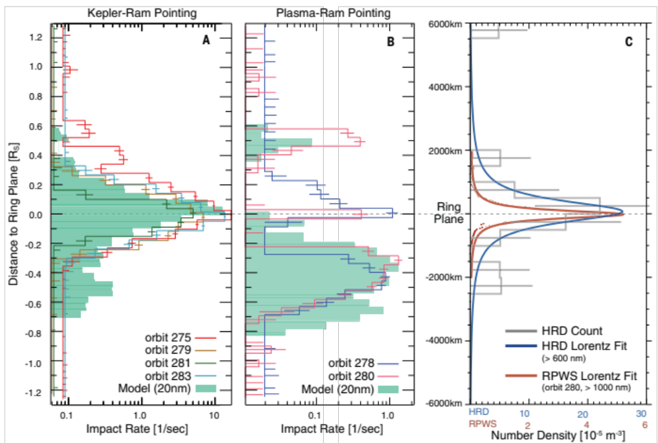
CDA measurements
Water & Silicate nano-grains fall into ionosphere (100-400 kg/s, few % of what INMS reports)
Hsu et al., 2018

Slide 9
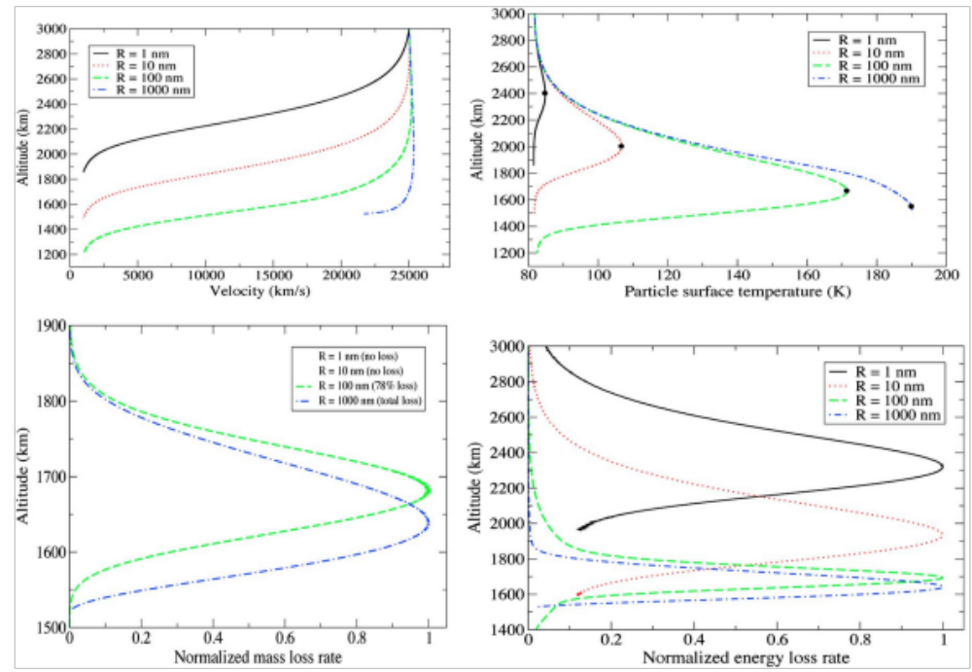
Fate of grains from D-ring
Hamil et al., 2018

Slide 10
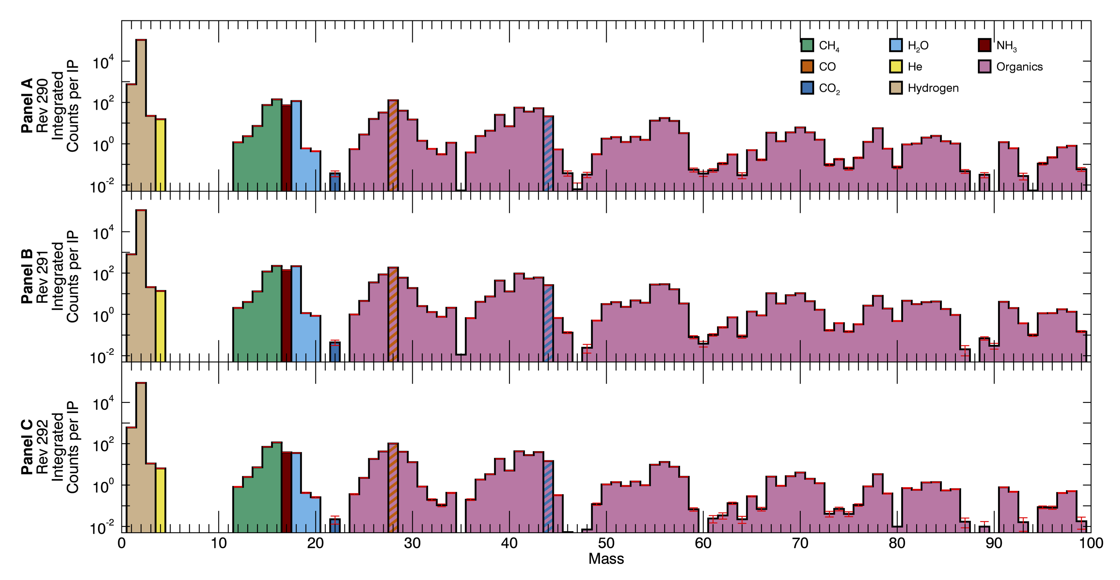
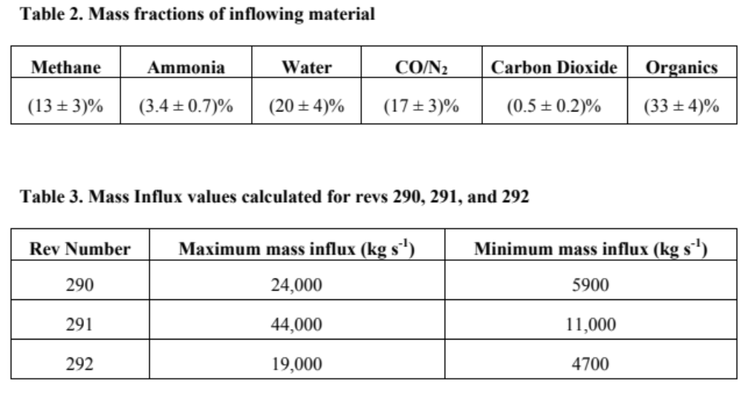
INMS Observations of complex organic chemistry at ionosphere altitudes
Waite et al., 2018

Slide 11
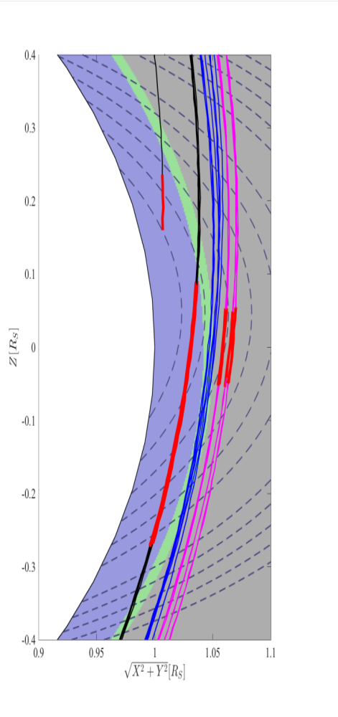
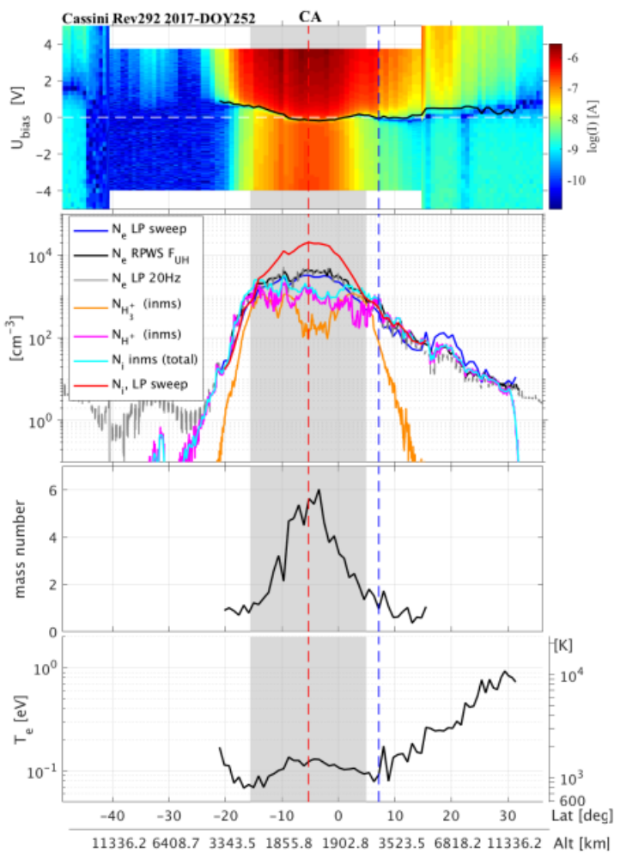
Complex organics/aerosol & Ring dust
RPWS/Langmuir probe measurements
Ring
dust
H⁺ topside ionosphere
H⁺ and H₃⁺
Heavy ion / charged aerosol layer
(chemically processed material)
D-ring dust partly charged
Heavy positively-charged ions & Charged aerosol/dust dominate ionosphere below ~2300 km altitude
Morooka et al., 2018

Slide 12
The Dust-Ionosphere Model (1)
Use this dust prescribed altitude distribution
Choose a dust-size
Use measured solar EUV ionization rate
Use simple ion-molecule chemistry
  Photo-ionization
  Recombination
Dust charging/de-charging model
No diffusive transport

Slide 13
Dusty ionosphere Model (2)
Grain charging according to Draine & Sutin, 1987; Meyer-Vernet, 2013; Vigren et al., 2015
$$\frac{∂N_{i}}{∂t}=q−α_{ei} N_{e}N_{i}−k_{ig}N_{dg}N_{i}−\sum_{j=1}^{10}{k_{ij}N_{dj}N_{i}}$$
$$\frac{∂N_{dg}}{∂t}={k_{ep}N_{e}N_{dp}+k_{i1}N_{i}N_{d1}+β_{EUV}N_{d1}−β}_{iEUV}N_{dg}−k_{eg}N_{e}N_{dg}−k_{ig}N_{i}N_{dg}$$
$$\frac{∂N_{d1}}{∂t}={k_{eg}N_{e}N_{dg}+k_{i2}N_{i}N_{d2}+β_{eEUV}N_{d2}−β}_{EUV}N_{d1}−k_{e1}N_{e}N_{d1}−k_{i1}N_{i}N_{d1}$$
$$\sum_{j=2}^{9}{\left\{\frac{∂N_{dj}}{∂t}={k_{ej−1}N_{e}N_{dj−1}+k_{ij+1}N_{i}N_{dj+1}+β_{eEUV}N_{dj+1}−β}_{eEUV}N_{dj}−k_{ej}N_{e}N_{dj}−k_{ij}N_{i}N_{dj}\right\}}$$
$$\frac{∂N_{d10}}{∂t}={k_{e9}N_{e}N_{d9}−β}_{eEUV}N_{d10}−k_{i10}N_{i}N_{d10}$$
$$\frac{∂N_{dp}}{∂t}=β_{EUV}N_{dg}+k_{ig}N_{i}N_{dg}−k_{ep}N_{e}N_{dp}$$
The electron number density (N_{e}) is constrained from quasi-neutrality: $N_{e}=N_{dp}+N_{i}−\sum_{j=1}^{10}{{jN}_{dj}}$, and the total amount of grains (N_{d,tot} = N_{dg} + N_{dp} + $\sum_{j=1}^{10}{N_{dj}}$) are held constant with a pre-defined altitude profile.

Slide 14
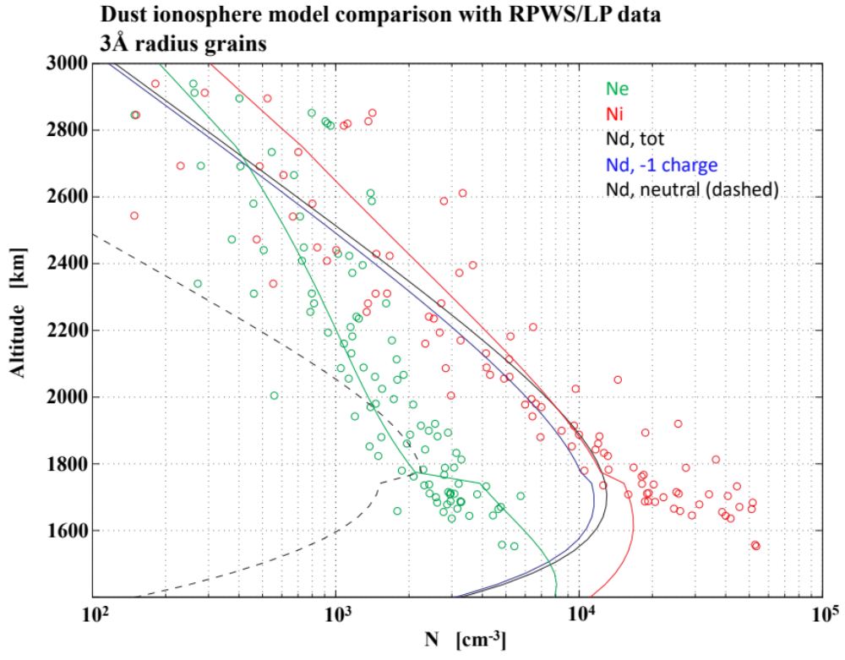
Greasy Ionosphere Works!
Aerosol acts as charge reservoir, and quasineutrality require that positive ion densities increase
Leads to deficiency of H⁺ and H₃⁺ due to attachment to grains
Wahlund et al., submitted
(Dust-Ionosphere model)

Slide 15
Conclusions: Saturn’s ionosphere
A dusty ionosphere with sub nm-sized grains is compliant with the measurements
  Dust grain number density is 10,000-15,000 cm⁻³
  It heats (with unkown process) the electrons up to 6,000 K (Morooka et al., 2018)
Electrons will become partly attached to the grains and the relatively stable negatively-charged grain population causes the ion number density to increase, resulting in an N_{e}/N_{i}-ratio to approach 10-20% in the deeper observed parts of Saturn’s ionosphere (1500-2000 km altitude above 1-bar level).

Slide 16
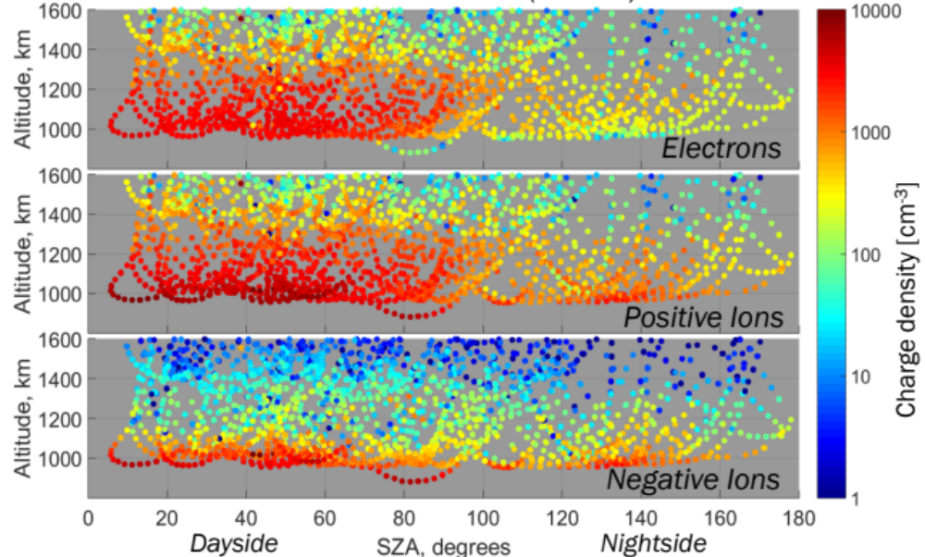
Similar situation in Titan’s ionosphere
Over 120 flybys of Titan has mapped Titan’s ionosphere in detail. The RPWS Langmuir Probe, the INMS and electron spectrometer (ELS) confirmed the existence of a substantial ionosphere at Titan [e.g. Wahlund et al., 2005; Waite et al., 2007; Coates et al., 2007; 2010; Ågren et al., 2009; Shebanist et al., 2013].
One of the more intriguing discoveries was the formation of complex negative organic ions and aerosol pre-cursors in the deep ionosphere of Titan, which may have implications for how pre-biotic chemistry occurred on the early Earth. The production of the global orange-brown haze on Titan starts by the energetic bombardment of the upper atmosphere of Titan.
Shebanits et al., 2013

Slide 17
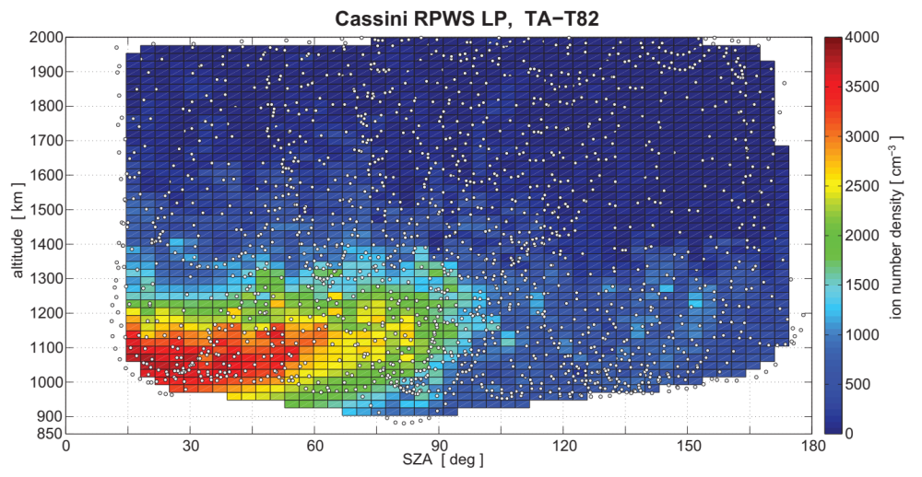
Titan Ionosphere (N_{i})
Dayside
Solar EUV
2500 - 3500 cm⁻³
Nightside
Energetic particles from magnetosphere of Saturn
400 - 1000 cm⁻³
Ågren et al., 2009
Shebanits et al., 2013
Reviews, Cambridge Univ. Press, 2013
  Galand et al., Wahlund et al.

Slide 18
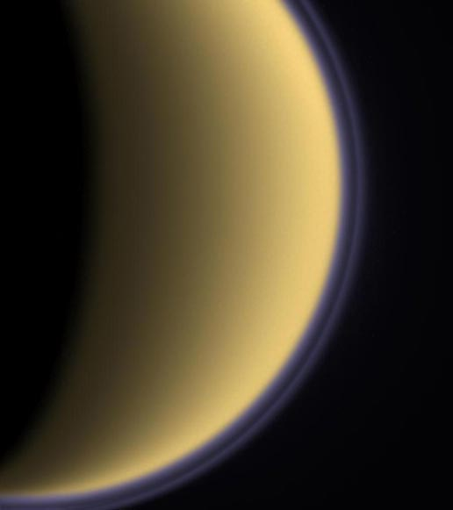
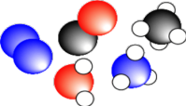
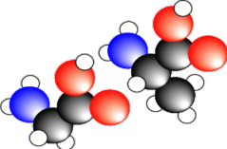

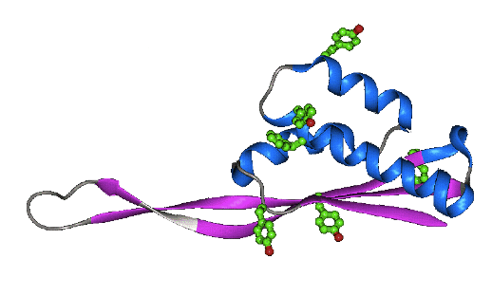
Complex Organic Chemistry & Aerosol production at Titan
Ionizing radiation
  EUV/X, energetic particles
“Catalyses” chemical processes
  In N₂-CH₄ rich atmospheres (thermospheres)
  Produce complex organic molecules
    Via N₂⁺, N⁺, dissociation
  Produce organic rich aerosol (haze)
?

Slide 19
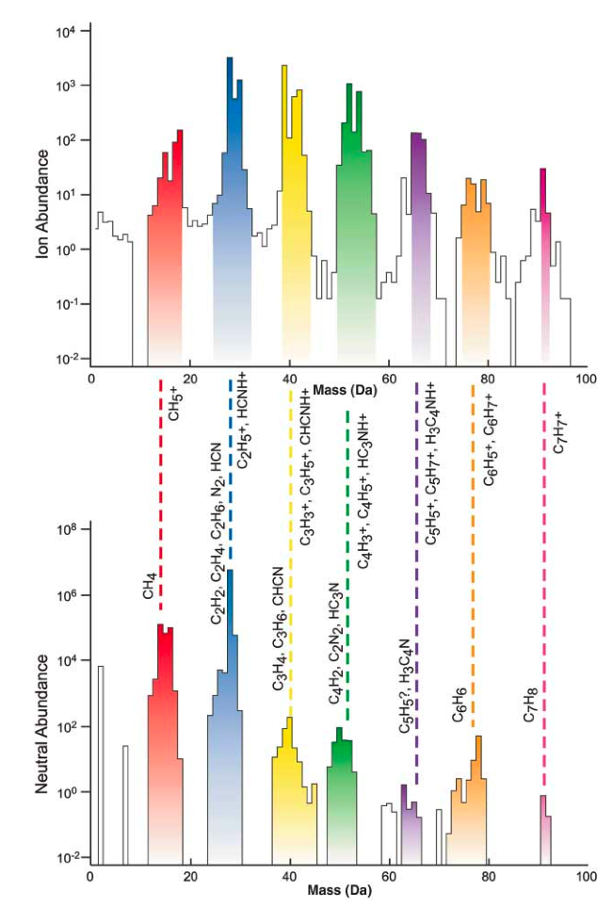
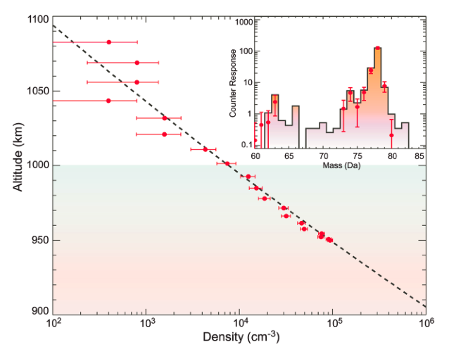
Detection of Complex Chemistry
Ions
Benzen, T16
Waite et al., 2007 – Tholin formation?
Vuitton et al., 2007, 2008 – Comparison with lab measurements
Neutrals

Slide 20
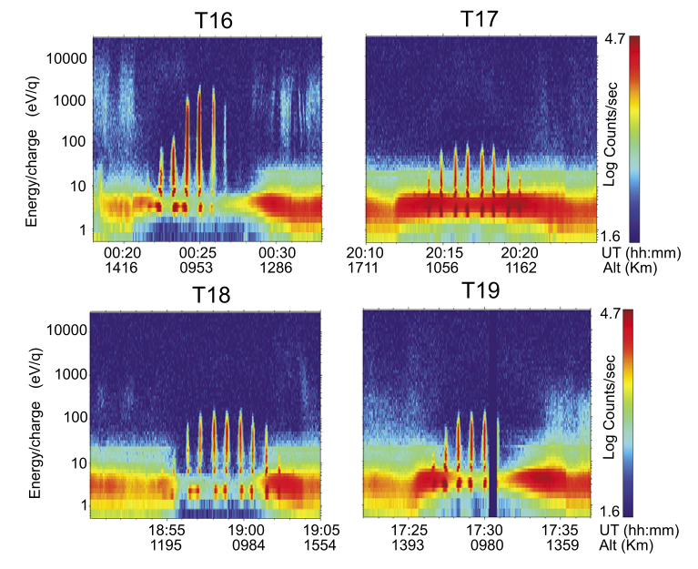
Detection of large Negative Ions
Initial stages for aerosol (tholin) formation?
  < 10000 amu/q
Catalytic polymerization (suggested)
  CN⁻, NH₂⁻, (O⁻)
  NCN⁻, HNCN⁻, C₃H⁻
  C₅H₅⁻, C₆H⁻, C₆H₅⁻
  Polyenes (R=CH₂)
  Nitriles (triple bonds to N)
  PAH
  Cyano-aromatics (CN-ring)
Coates et al., 2007; 2010

Slide 21
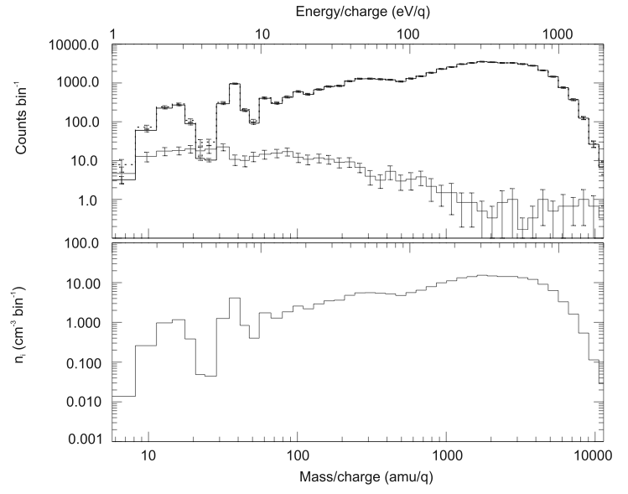
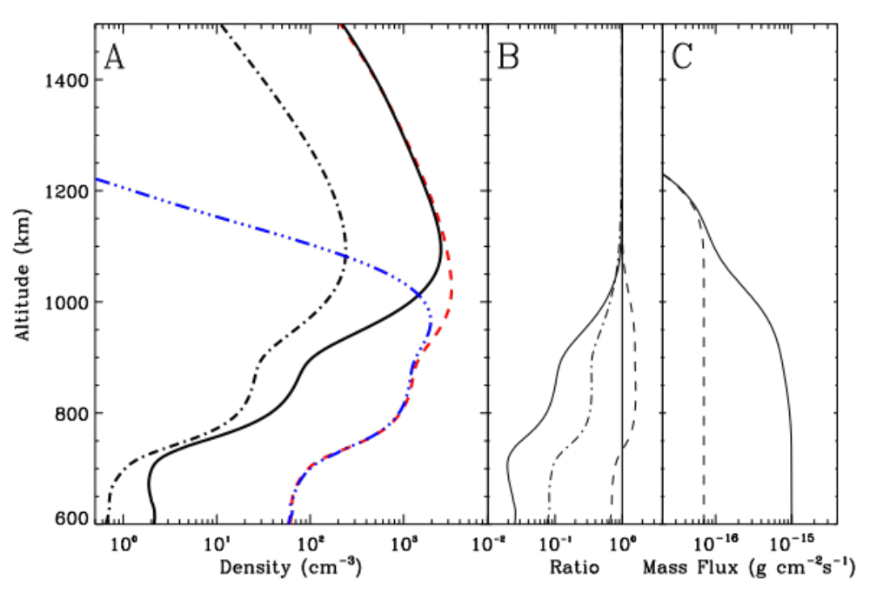
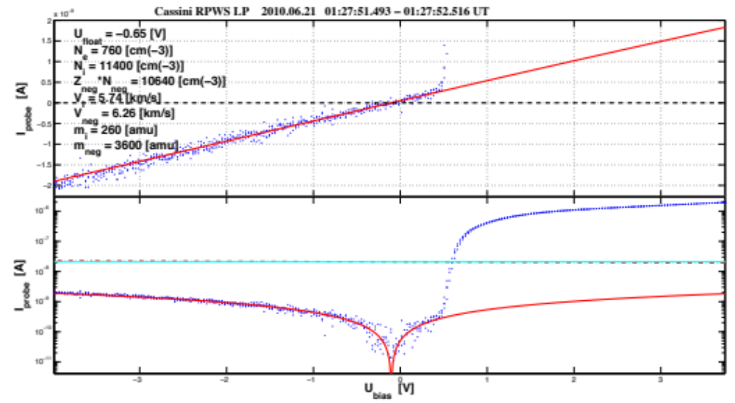
Aerosol Production
- ions
- dust
Coates et al., 2007
Aerosol precursor
RPWS/LP
950 km altitude
Lavvas et al., 2012
0.1-1 Mton/yr
Ågren et al., 2012

Slide 22
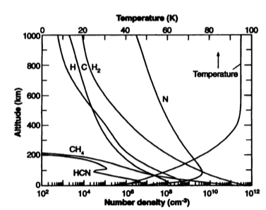
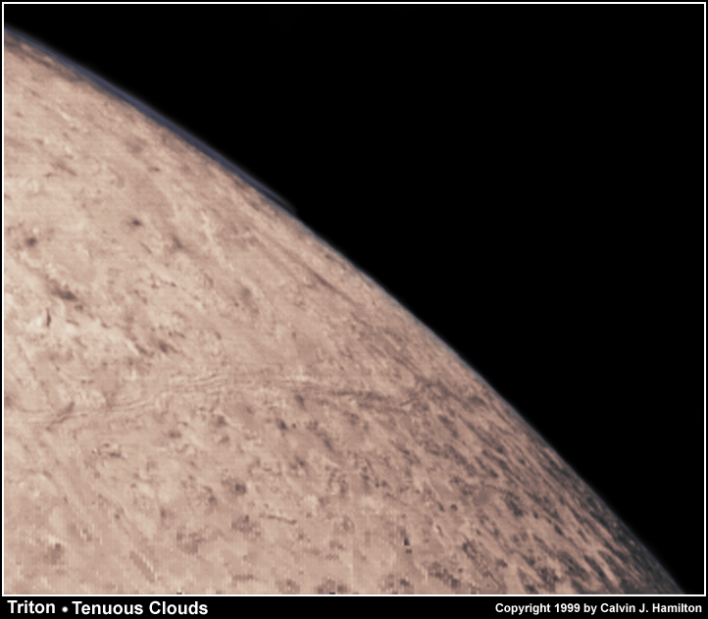
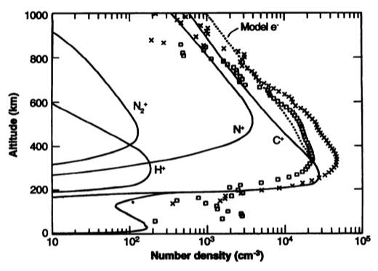
Triton’s atmosphere & ionosphere
Atmosphere
  N, CH₄, HCN, H₂
  Less organics than Titan
    Fast outflows + slower electron recombination
Ionosphere
  Dense, 20000-40000 cm⁻³
  What chemistry?
  C⁺, N⁺
Should have aerosol formation <200 km
Magnetic field?

Slide 23
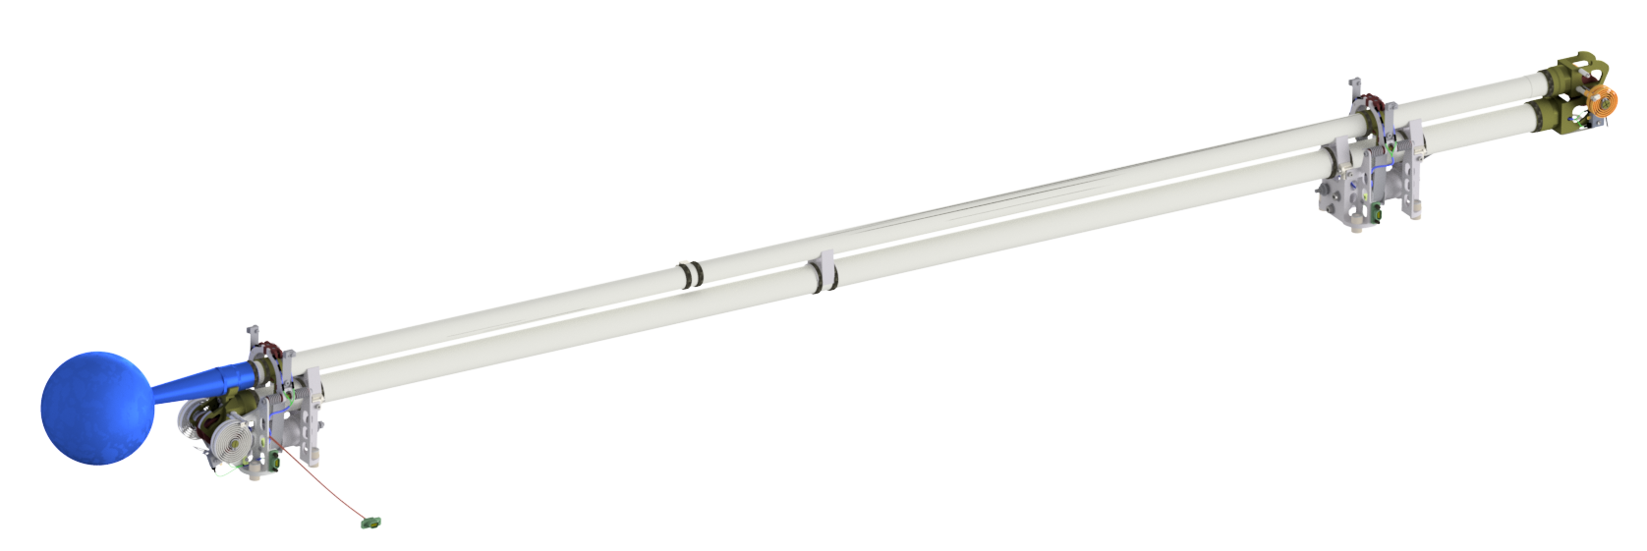
Measured parameters of Ionospheres in a planetary context
Needs:
  It is not enough to measure just the electron density (N_{e}) !
    And several independent methods should be used
  Many ionospheres in the solar system are “dusty”, which carry negative charge and enhance the positively charged ion density (N_{i}), and therefore requires a measurement of also the negative cluster ion/aerosol density (N_{d})
  To understand the ion-molecule chemistry (ion and neutral mass spectrum, species) it is important to know the electron temperature (T_{e}) and the size and charge distribution and composition of the aerosol (dust)
  In order to infer the ionospheric currents & heating/drift/acceleration and coupling to the magnetosphere, one also need the magnetic (B, δB(f)) and electric fields (E, δE(f)) from DC to the electron plasma frequency (at least covering the Alfvén wave frequencies)
JUICE/RPWI Langmuir probe

Slide 24
Conclusions
The Cassini results from Saturn’s and Titan’s ionosphere reveal a complex organic chemistry leading to a charged aerosol
Profound effect on the atmospheric chemistry with possible astrobiology implications
May affect atmospheric isotopic ratios for certain elements
A (double) Langmuir Probe (LP) experiment together with electron & ion spectrometers is useful for identifying complex organic chemistry & charged aerosol/dust in Neptune’s & Uranus’ ionospheres and to give definite quantitative estimates on
The number densities of charged particles
The electron temperature, a crucial parameter for ion-molecule reaction rates
Triton, a possible ocean (KBO?) world with a substantial ionosphere, may harbour a complex organic chemistry, aerosol production and active plumes
An LP would monitor readily this ionosphere and charged aerosol during flybys there
An LP can be made to fit both an atmospheric probe, an orbiter or a Triton lander.

