Slide 1
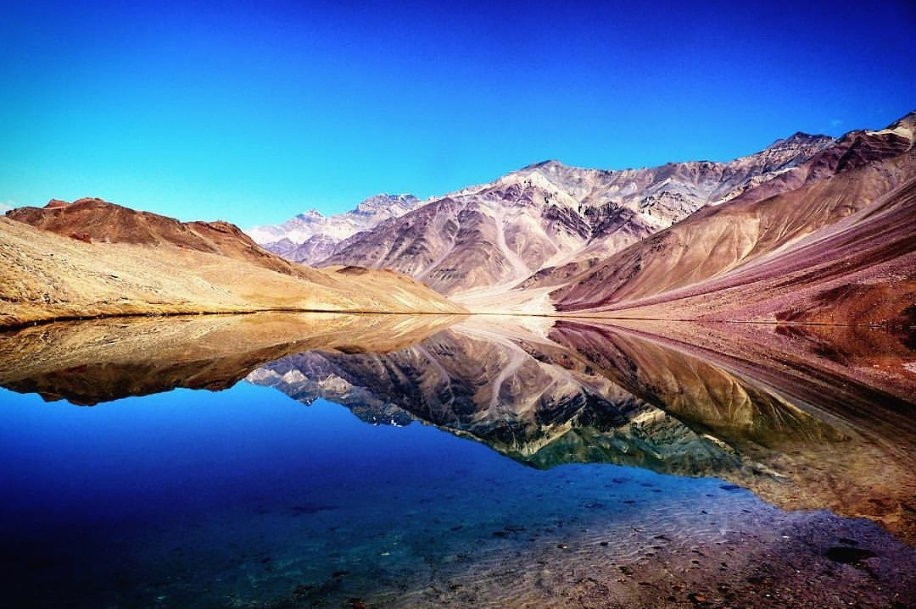
Geodiversity and Geomorphosites based Seasonal Economy in Cold Desert of Indian Trans-Himalaya
Dr. Krishnanand
Assistant Professor, Department of Geography,
Shaheed Bhagat Singh College, University of Delhi
Email :krishna.geography@gmail.com

Slide 2
Introduction
The Himalaya, is ascribed to be the most populous and most fragile of the world's mountains and is credited to be the most significant geological and geomorphological (crustal) feature of Asia covering approximately an area of 3.4 million km² according to the State of the world's mountain report, 1994. It comprises of about 16 per cent of the country’s geographical area.
“Geodiversity”, it may be defined simply as the natural range (diversity) of geological (rocks, minerals, fossils), geomorphological (land form, physical processes) and soil features. It includes their assemblages, relationships, properties, interpretations and systems (Gray, 2004).
The interface of geodiversity and human response refers to the interaction zone between the abiotic components of geodiversity and the corresponding human response to the diversity of these factors.

Slide 3
STUDY AREA

Slide 4
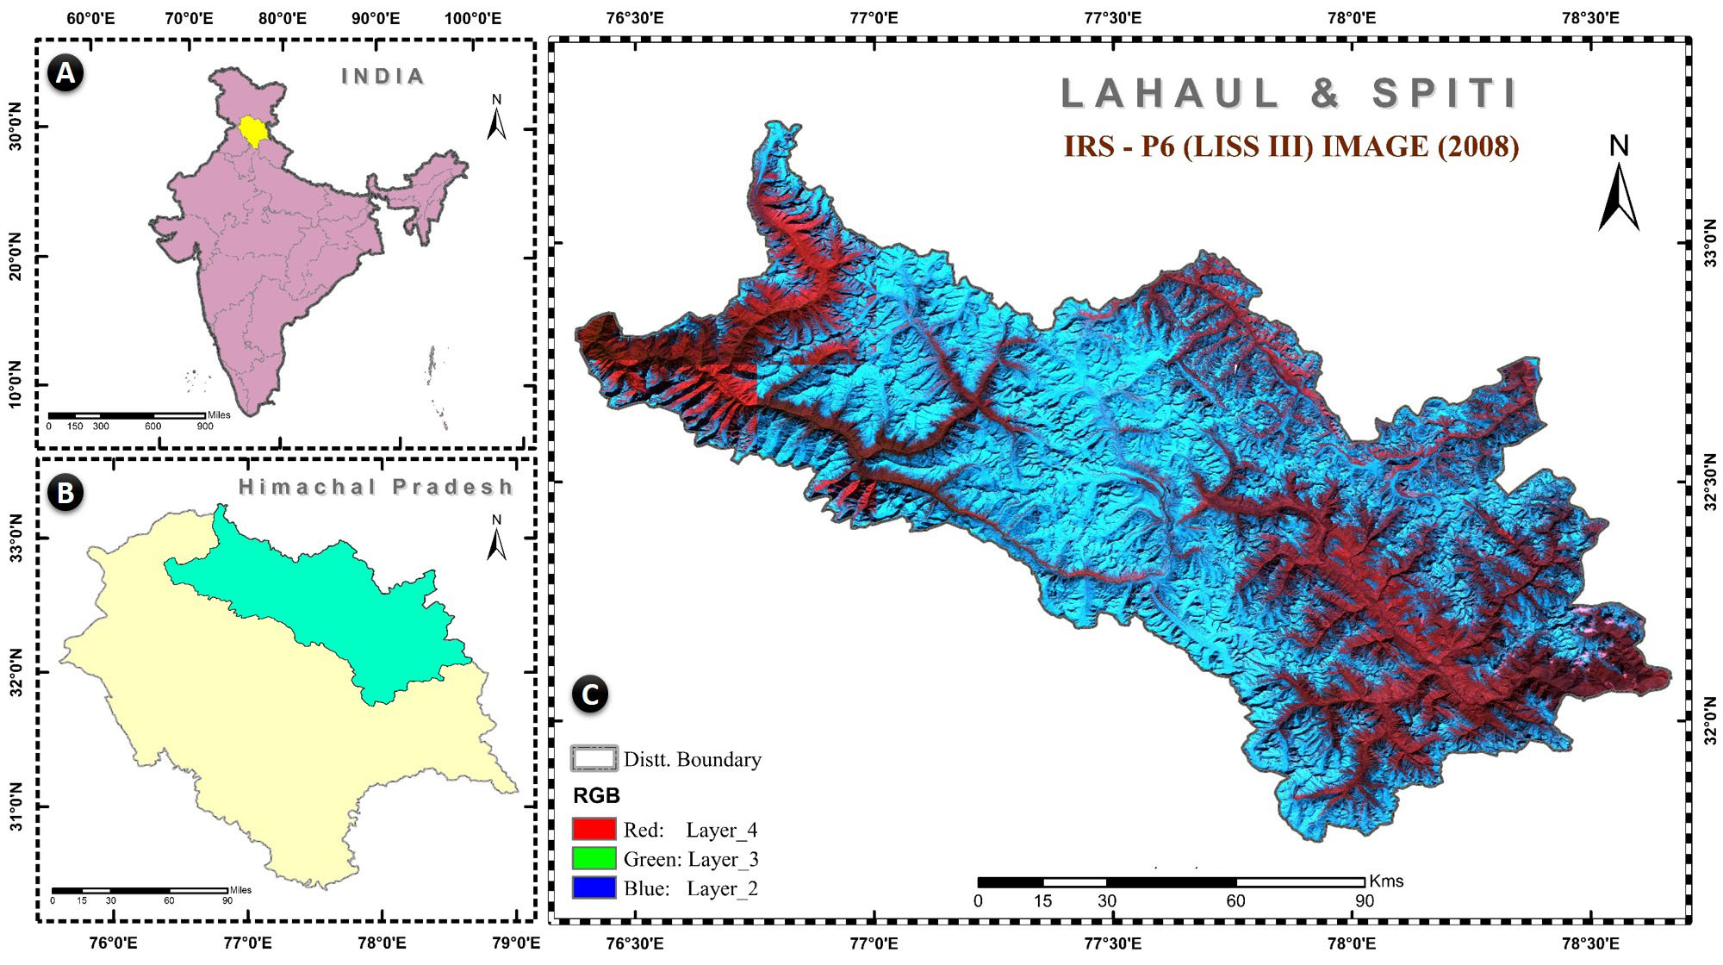
Source: Survey of India and IRS LISS III Imageries from BHUVAN
A. Position of Himachal Pradesh in India. B. Position of Lahaul and Spiti in Himachal Pradesh. C. Lahaul and Spiti (LISS III extract view)

Slide 5
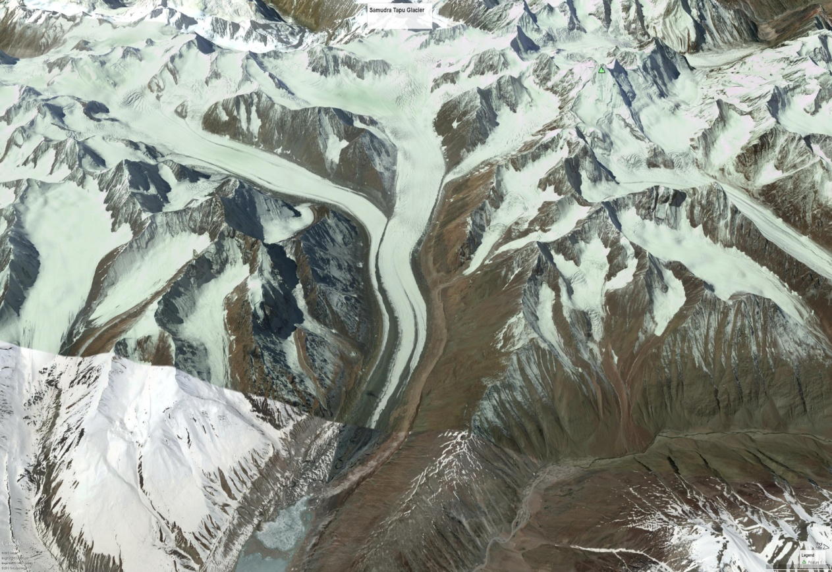
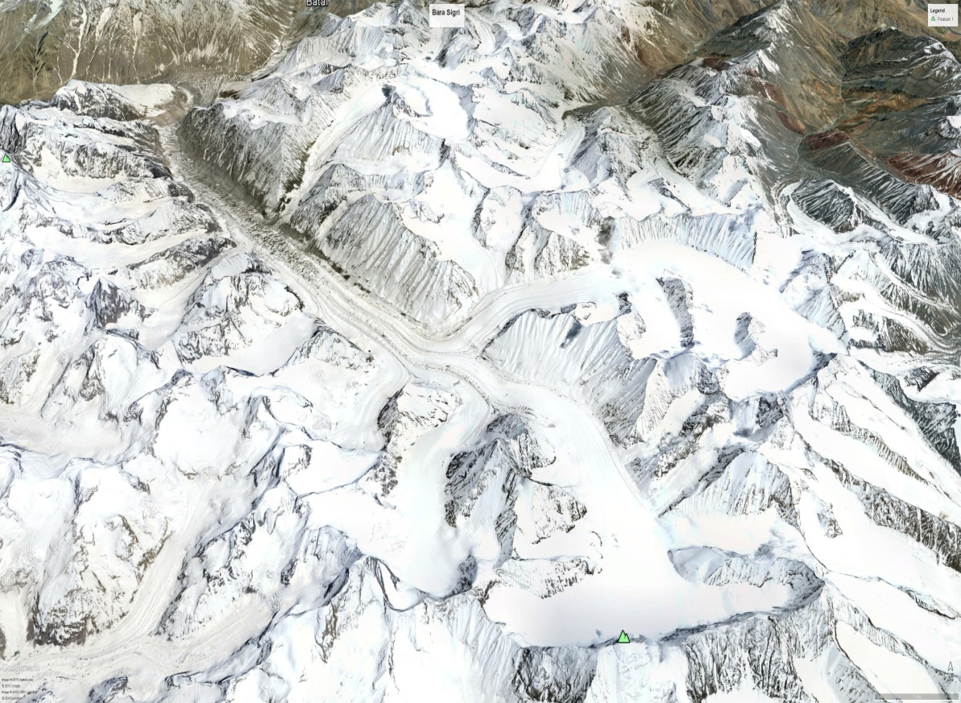
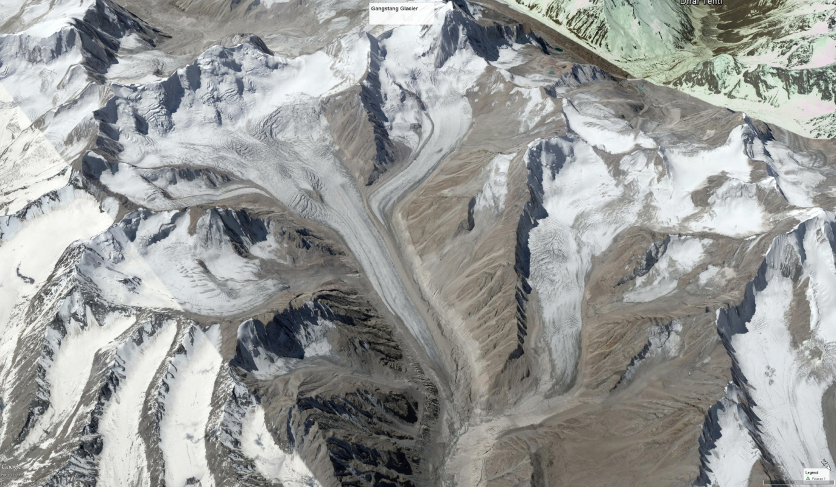
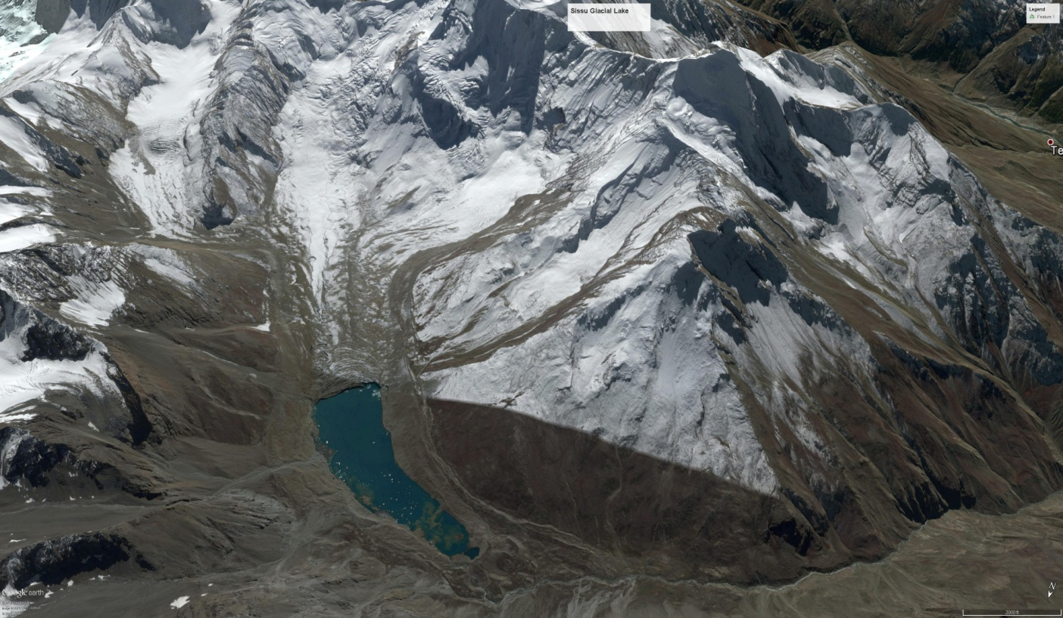
1
2
3
4

Slide 6
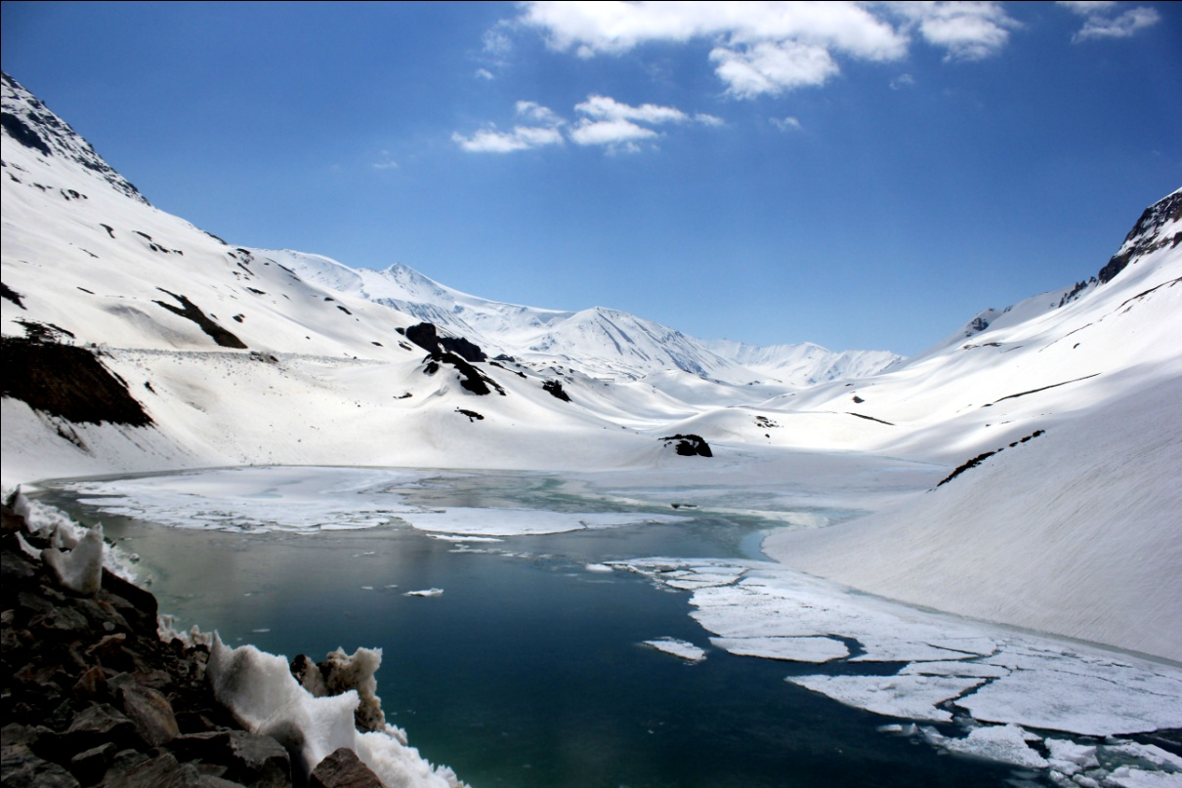
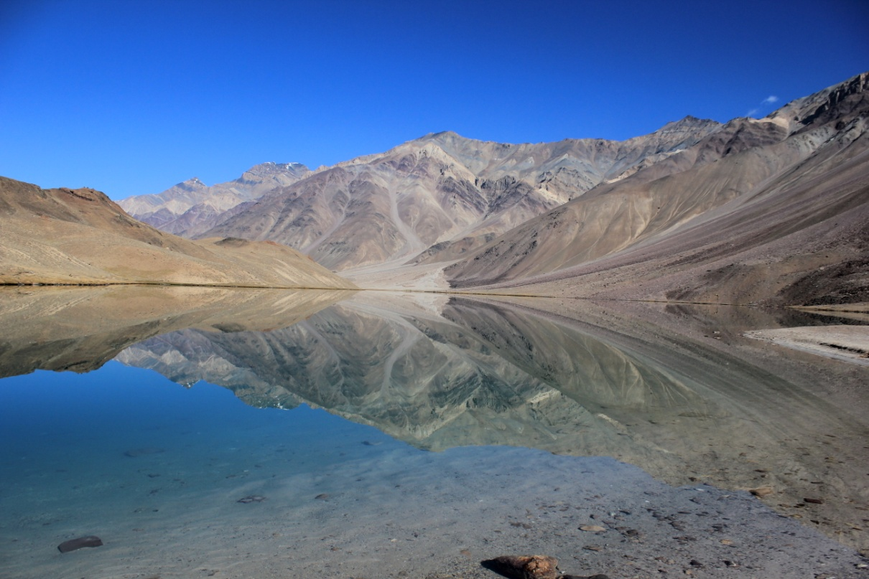
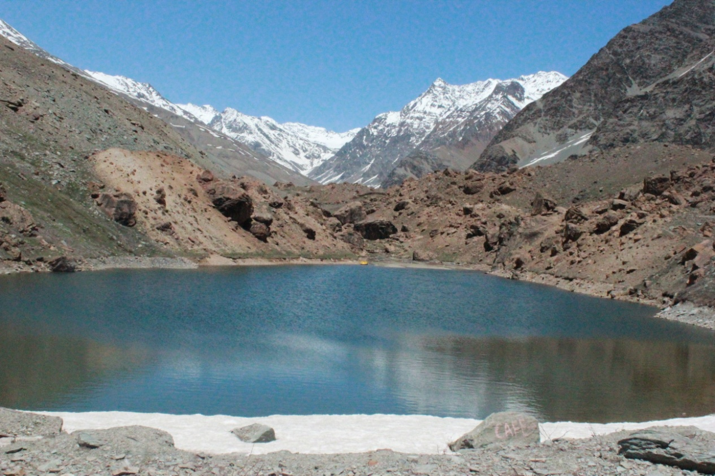
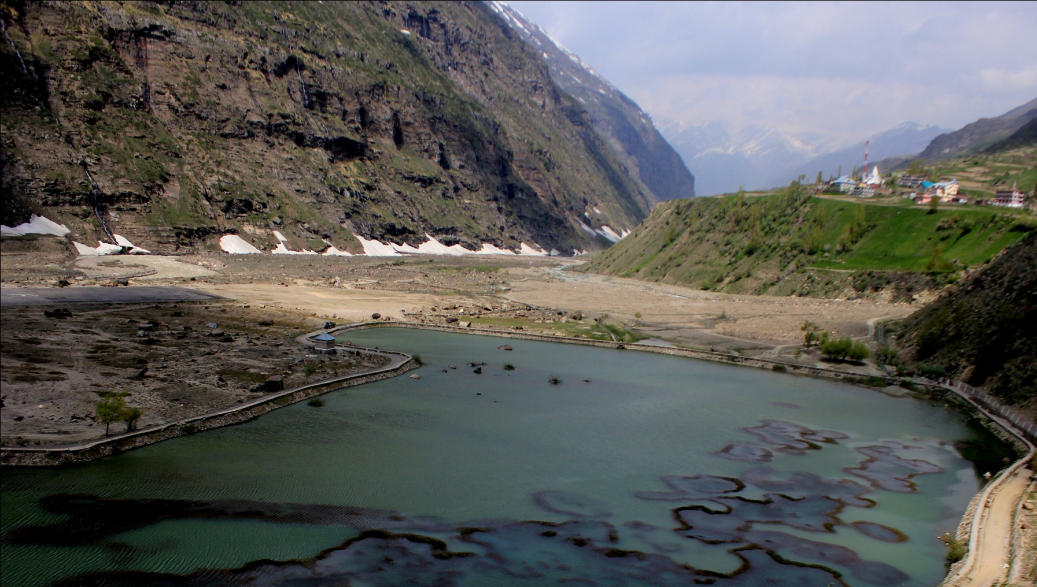
1
2
3
4

Slide 7
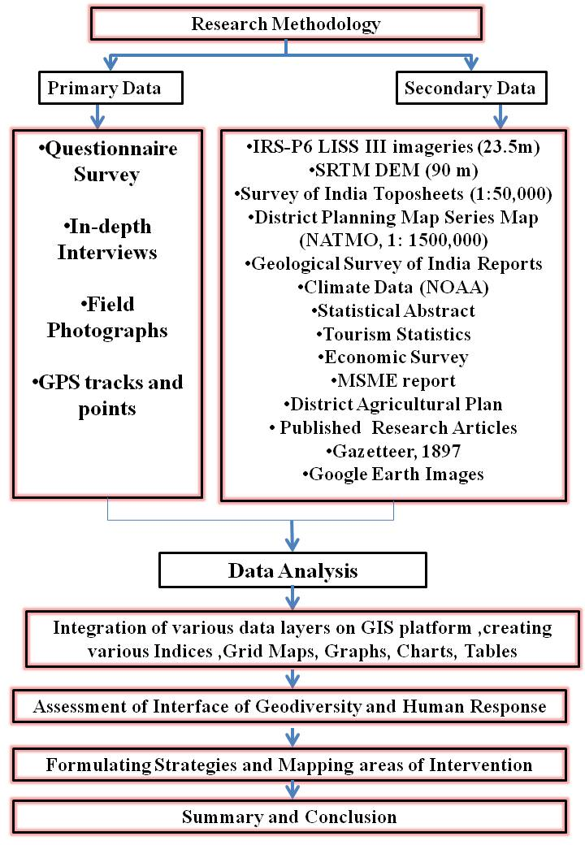

Slide 8
Mapping Geodiversity
According to this innovative method, the partial numerical indices calculated over different physical maps representing the highest number of geodiversity elements on them.
The Geodiversity Index is obtained from the sum of these partial indices, with the latter resulting from the sum of units and occurrences in areas defined by a grid. It has been further modified by giving weightage to the various components of these physical maps on the basis of rarity and uniqueness.
The weightage has been allocated to these components based on numerous literature reviews and according to the standards of USDA, USGS, GSI and NATMO. Thus the modified Grid Index has been prepared to showcase the geodiversity in the study area.
For this kind of study two most important factors that needs to be taken into account are following:
Scale: The selection of scale is of paramount significance since it reflects the range of detail and level of the available data.
Grid: The overlay of a grid onto a map is considered a basic tool for the geodiversity assessment of any territory. The grid provides squares in which units and occurrences can be counted and prevent the discrimination of results achieved.

Slide 9
At first, the external boundary of the Lahaul and Spiti district was digitized from the base maps obtained from National Atlas Thematic Mapping Organization (NATMO) i.e. District Planning Map and Survey of India Toposheet in the GIS environment using Arc Map 10.
In order to prepare these Grid (Units) maps, various components of each map was first prepared using digitization technique from the base maps using Arc Map 10 software and following procedure was followed to convert them to Grid (Units) Maps.
Creation of Fishnet: To create grid sizes of 16 * 16 kms using "Fishnet tool" (Figure 3.1) available in the "Feature Class" of "Data Management Tools" same software was used. After deciding the best fit number of rows and columns, fishnet has been generated and labeled.
Grid Extraction: The next step is to extract the study area from the Grids generated in order to carry out further exercises. In this process, "Analyst tool" was used in which "Extract" and "Clip" options come into play in order to extract the actual study area.
Each individual map with various component layers was overlayed with the extracted grid, that was clipped and saved as a Grid (Units) Map separately. Hence, six individual Grid layers were made.

Slide 10
Step wise GIS Operations for Geodiversity Assessment
Steps | Description
Input all the Physical Layers in the software. | Geological, Hydrological, Hydrogeological, geomorphological, Pedological and Climatological Units Maps.
Join all the features per Grid/Unit | Using "Union" option, all the features per grid have been joined together.
Assigning Subjective Weightage | This is based on Rarity, Uniqueness and Extremity of the different components of various physical features.
Joining the table of all Physical Layers | In the attribute table, all the weightage are joined together.
Calculations | 1. Number of features per grid 2. Total weight of each grid 3. Average Total weight of each grid
Generation of Maps | 1. Geodiversity Index (GI) 2. Total Weighted Geodiversity Index (TWGI) 3. Average Total weighted Geodiversity Index (ATWGI)
Classification | The entire range has been classified into five categories i.e. very high, high, moderate, low, very low found statistically significant.
Source: Self Prepared

Slide 12
Various Physical Layers for Geodiversity Mapping Include:
Hydrological Units Map: It includes Main river, its tributaries, Glaciers and Glacial lakes.
Hydrogeological Units Map: It includes Groundwater Potential and Groundwater Hydrology i.e. aquifers and Natural Springs.
Geological Units Map: It includes various rock types, mineral occurrences and Faults.
Geomorphological Units Map: It includes the Land Slope and Elevation features of the study area.
Pedological Units Map: It includes various soil types available in the study area based on USDA classification (United States department of agriculture).
Climatological Units Map: It includes average annual temperature and average annual rainfall for 36 years.

Slide 13
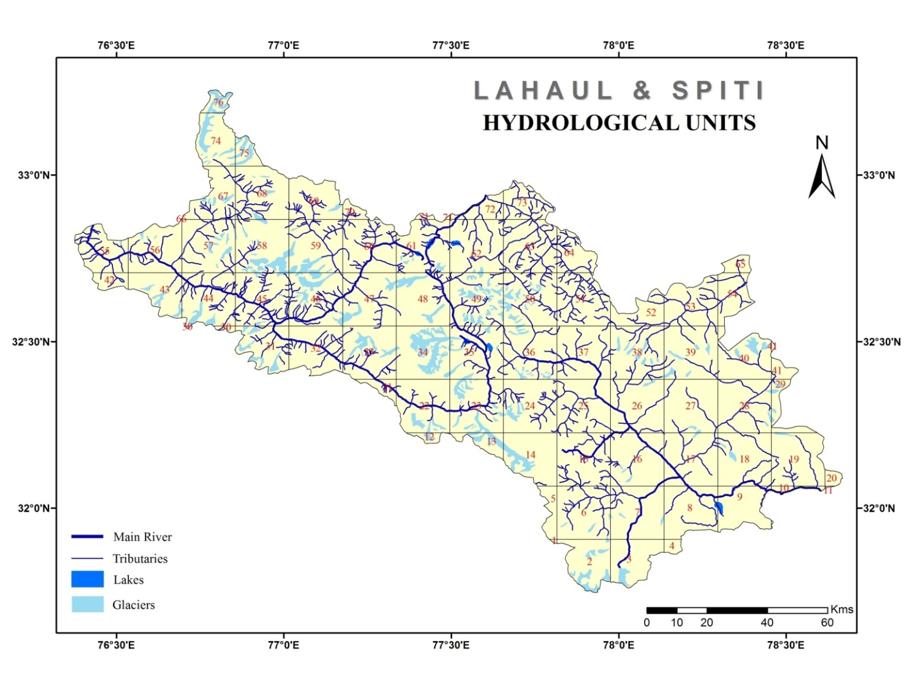

Slide 21
Map Units | Classes | Sub classes | Weightage
Hydrological Units | Rivers | Major and Tributaries | 5
 | Lakes | Glacial and Glacier Fed | 5
 | Glaciers | Major and Tributaries | 5
Hydrogeological Units | Ground Water potential | 1< litres/sec. | 2
 |  | 1-5 litres/sec | 5
 | Ground Water Hydrology | Natural Spring | 5
Geological Units | Rock types | Granite, Grano-diorite, Pegmatite | 3
 |  | Limestone, Sandstone and Clay Shale | 3
 |  | Quartzite | 1
 |  | Quartzite, Slate, Phyllite, Limestone, Shale,Shists and Conglomerate | 5
 |  | Sandstone, Shale and Limestone | 3
 |  | Shale, Slate, Sandstone, Quartzite, Limestone and Conglomerate | 5
 |  | Slate, Greywacke and Quartzite | 3
 | Faults | Normal Fault | 5
 |  | Thrust Fault | 5
 |  | Active Normal fault | 5
 |  | Seismites | 5
 |  | Listric faults | 5
 |  | Normal faults within Lake sediments | 5
 | Minerals | Asbestos | 5
 |  | Copper | 3
 |  | Gypsum | 4
 |  | Iron ore | 3
 |  | Lead, Zinc and Silver | 4
Geomorphological Units | Elevation | Below 3000 mts. | 3
 |  | 3000- 4500 mts. | 4
 |  | Above 4500 mts. | 5
 | Land Slope | Less than 300 mts. per km | 3
 |  | 300- 600 mts. per km | 4
 |  | More than 600 mts. per km | 5
Pedological Units | Alfisols | Sub-Montane | 2
 | Entisols | Skeletal | 5
 | Histosols | Snow field | 4
 | Mollisols | Mountain meadows | 3
Climatological Units | Average Annual Rainfall | High | 5
 |  | Medium | 4
 |  | Low | 3
 | Average Annual Temperature | High | 5
 |  | Medium | 4
 |  | Low | 3
Assigned Weightage to Various Map Units

Slide 24
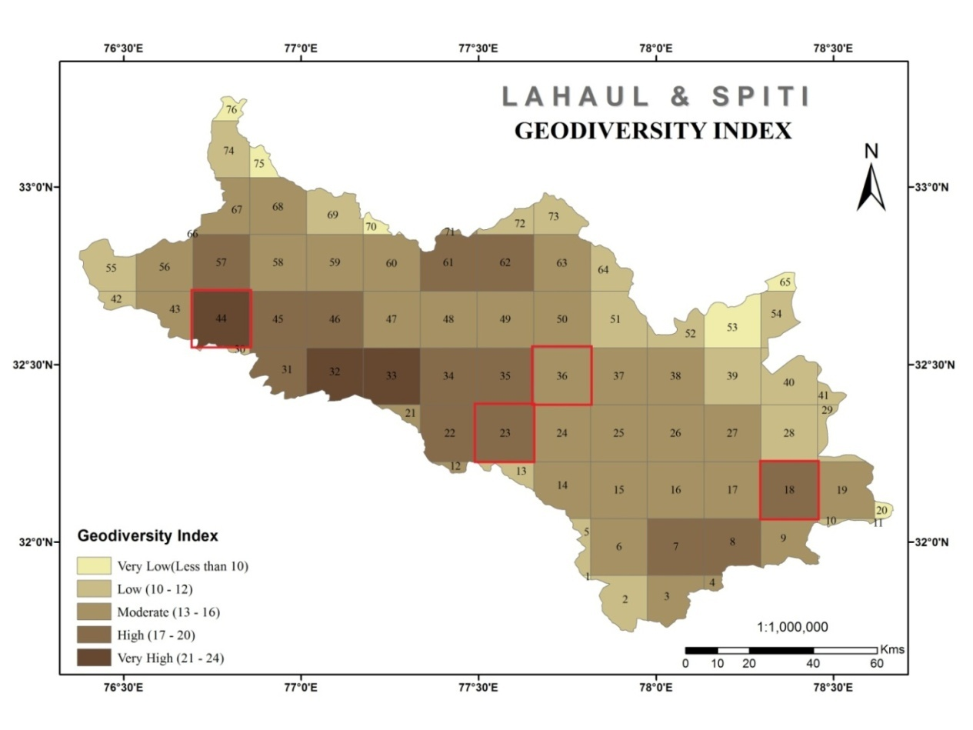
Selected Sample Grids for Case Study
Source: Geodiversity Index
Selected Sample Grids

Slide 25
Source: Survey of India Toposheet

Slide 26
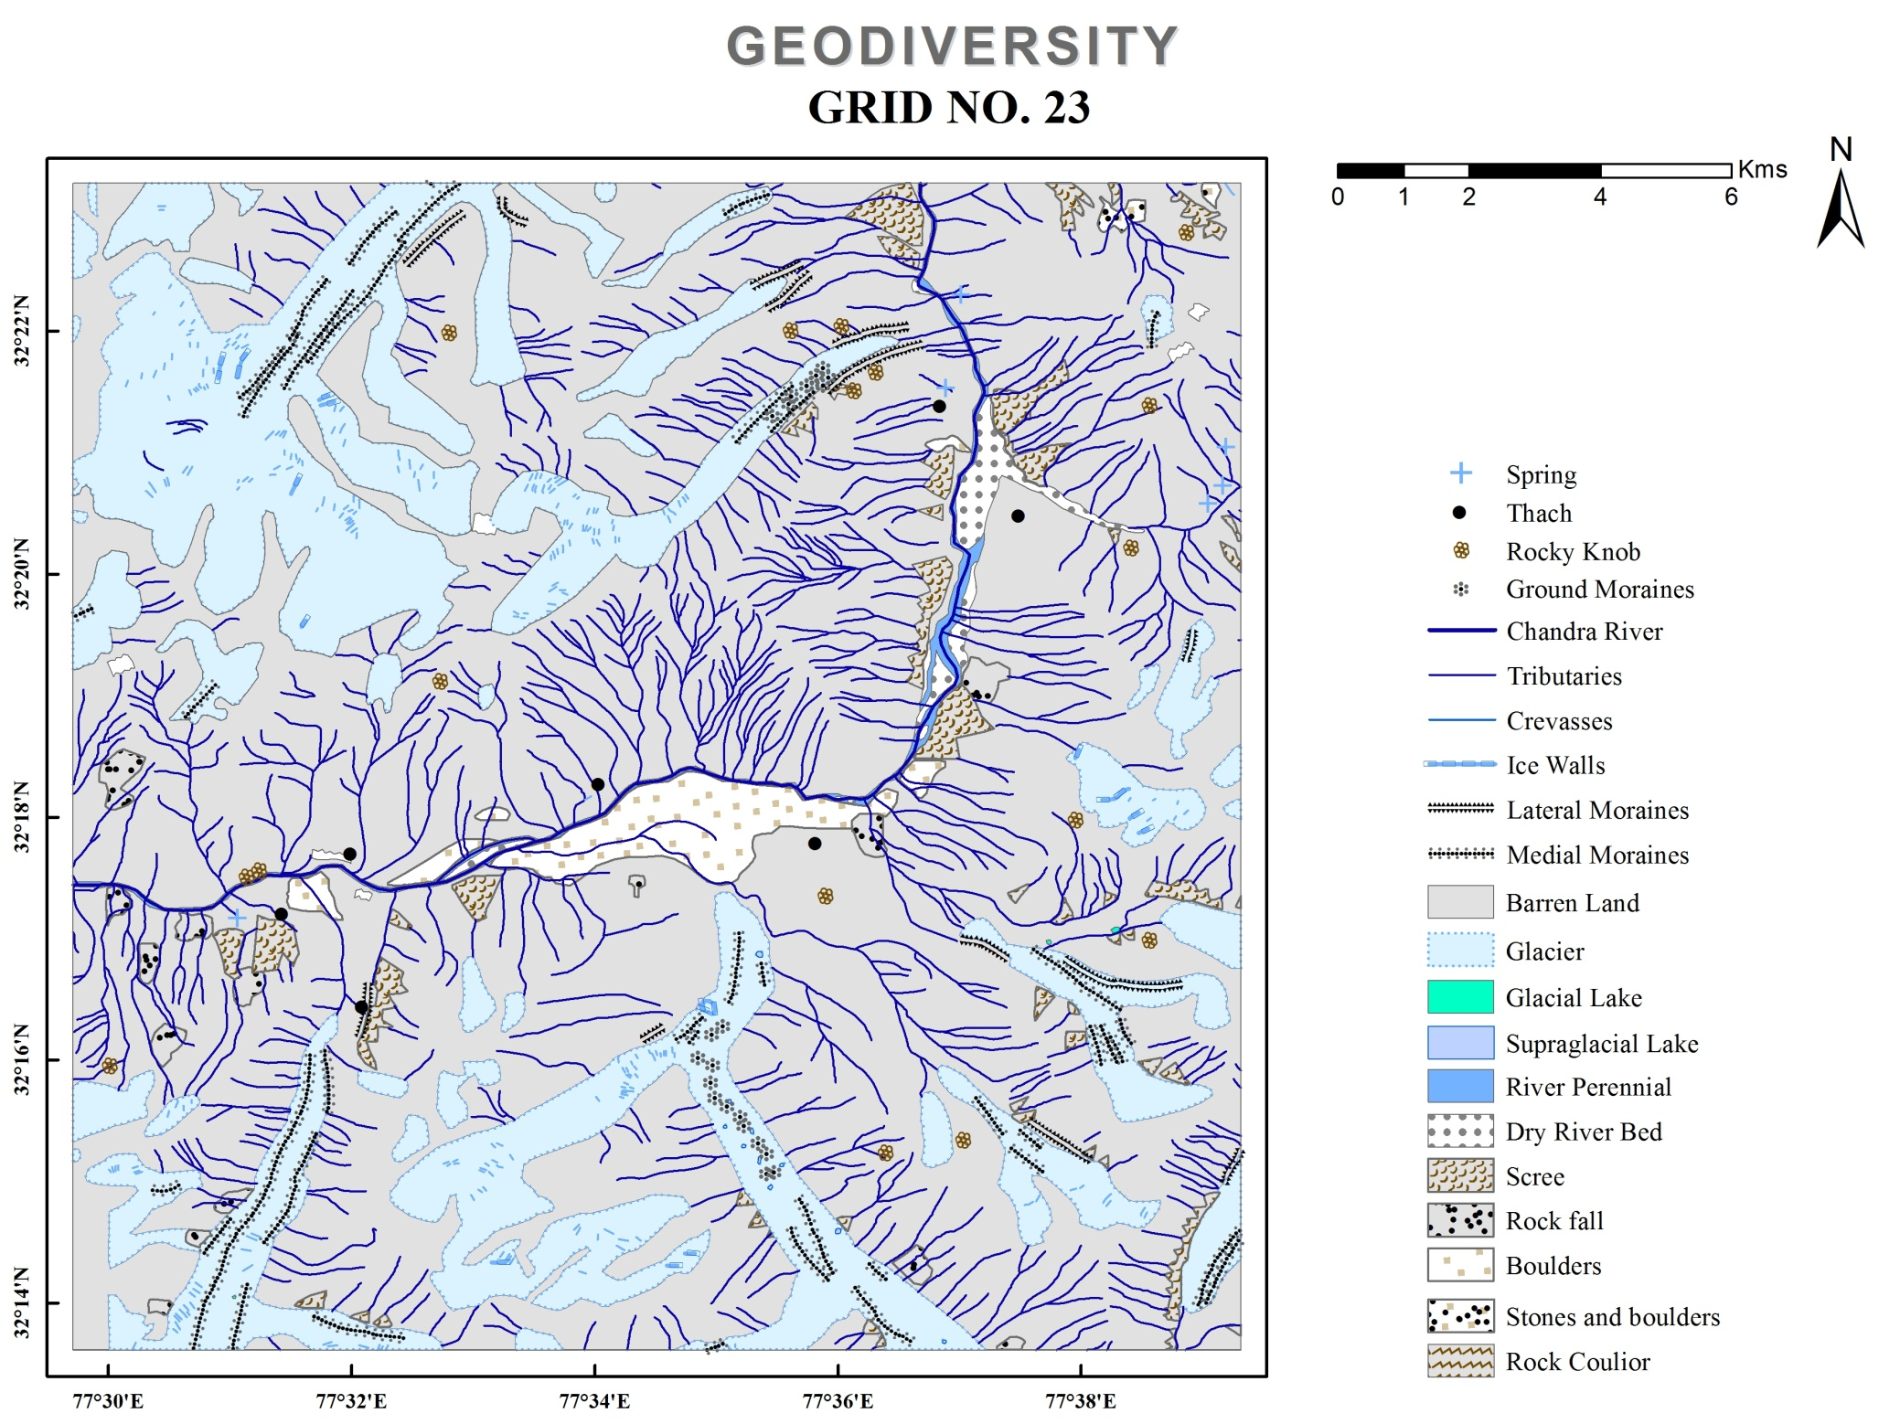
Source: Survey of India Toposheet

Slide 27
Source: Survey of India Toposheet

Slide 28
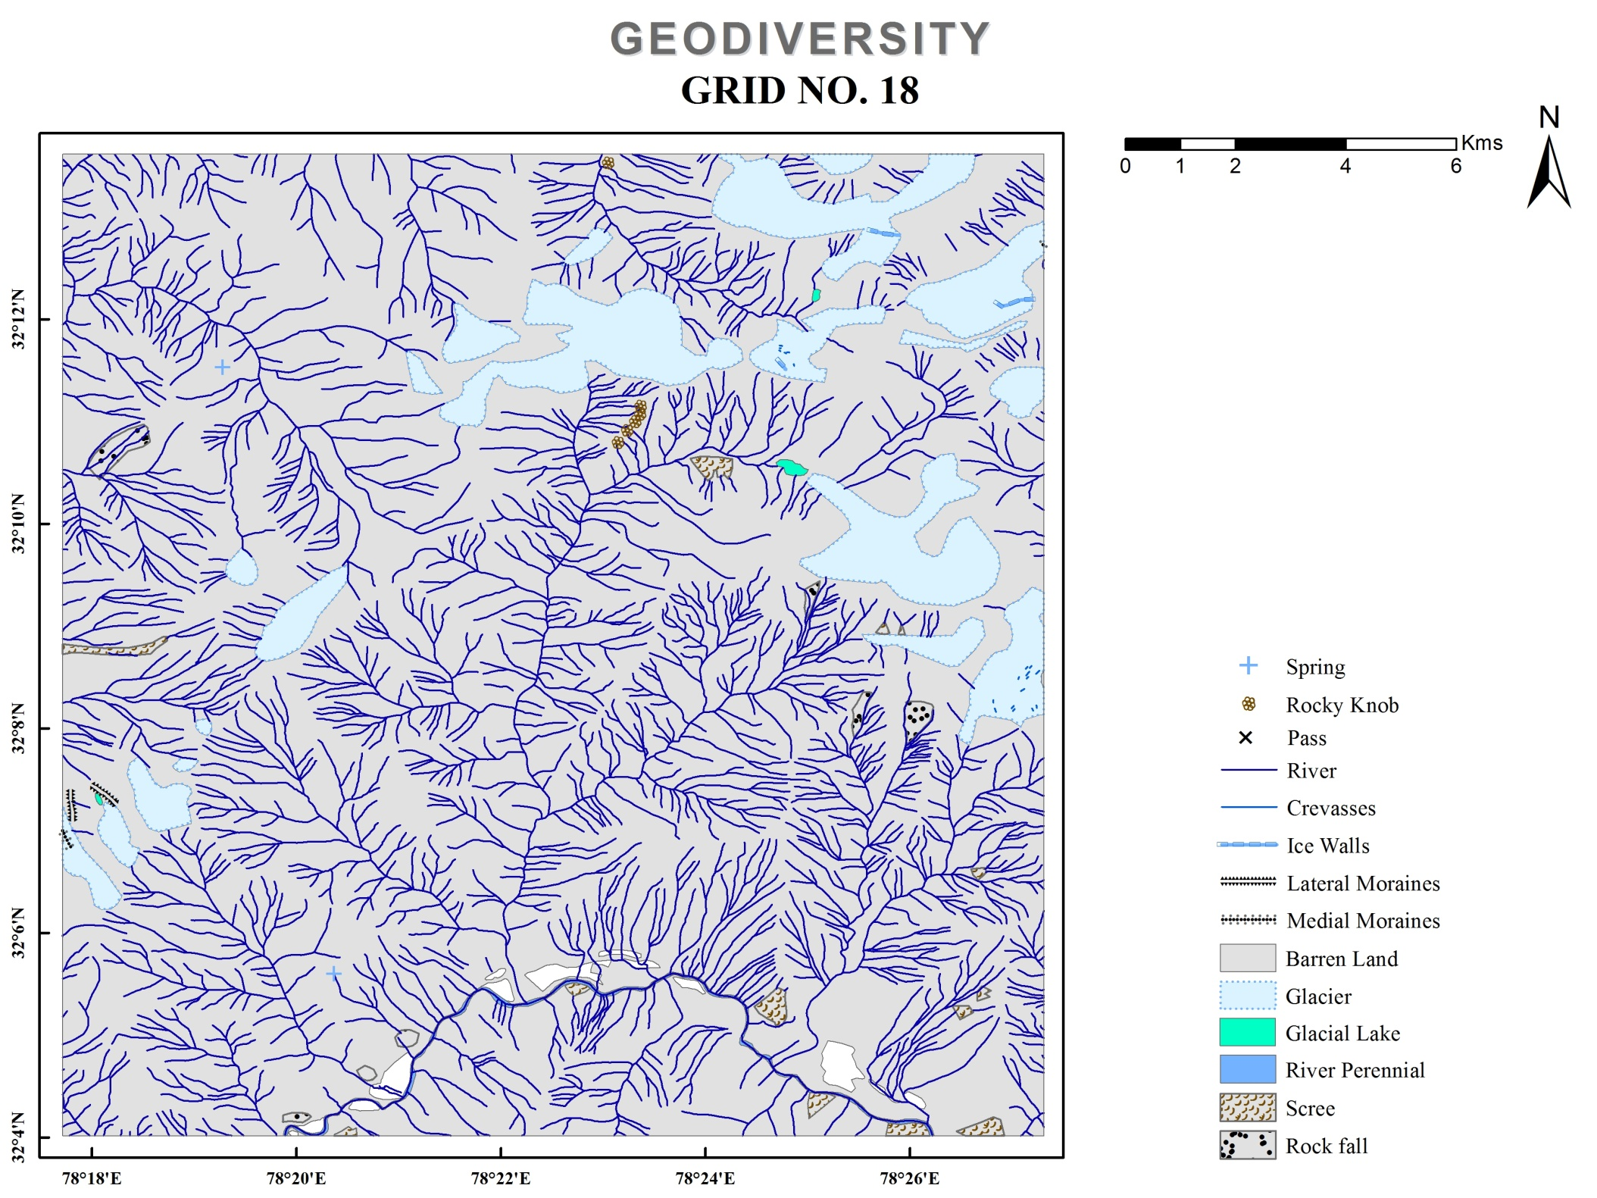
Source: Survey of India Toposheet

Slide 29
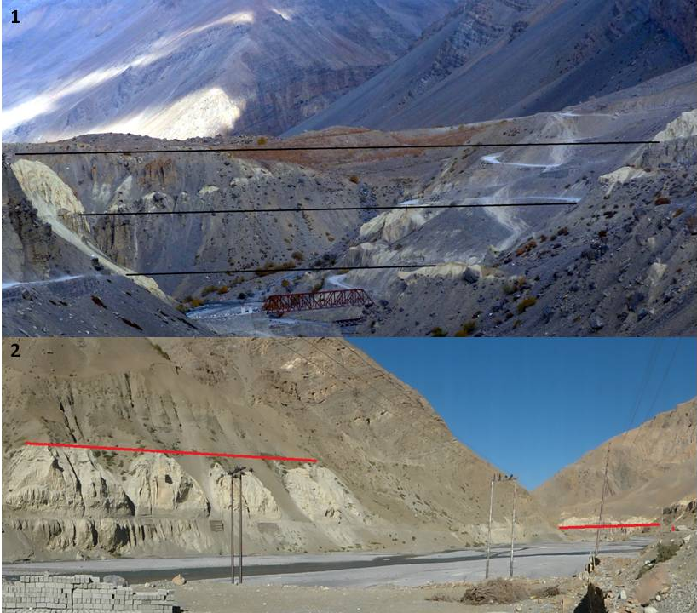
Lacustrine Tethyan Sediment Deposits in Spiti Valley
Source: Field Survey, October, 2014 Coordinates
1. Hanse - Kioto Bridge N32 27.059, E77 51.630
2. Attargu- Lingti Village N32 07.019, E78 10.567

Slide 30
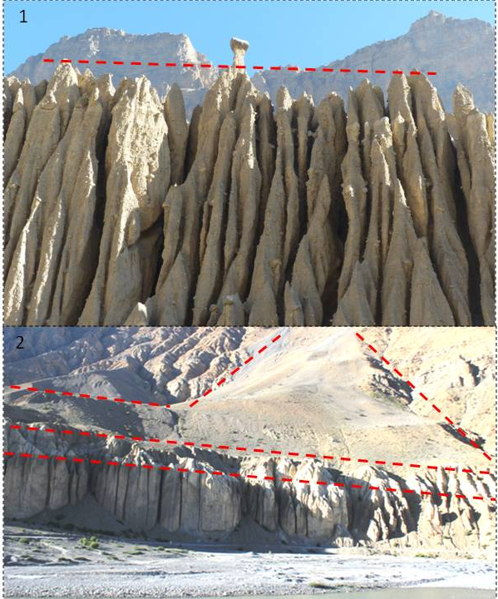
Glacio-fluviatile Deposits in Spiti Valley
Source: Field Survey, October, 2014 Coordinates
1. Near Kaza N32 13.681, E78 04.293
2. Near Attargu N32 07.495, E78 09.733

Slide 31
Interface of Geodiversity and Human Response
Interface may be understood as the interactive zone where different biophysical events take place. In the context of the study, the interface has been defined as the interactive zone between geodiversity and human response in trans or Tibetan Himalayan region of Himachal Pradesh which is distinct in its geo-climate.
An analogy to the "stimuli-response" mechanism has been put to use in the context of the study area, where the various geodiversity components act as the stimulus for the human beings and accordingly the response varies.
The response to the stimulus of geodiversity components depends upon the adaptability and vulnerability of the local population in terms of the traditional and modern technological usage for living.
In the present study, human response has been assessed in terms of agriculture (including horticulture and pastoralism), habitat construction and the seasonality in tourism and their management for living in this high altitude trans Himalayan district giving a distinct shape to this unique interface by overlaying the various layers of human response aspects on the geodiversity index map in the GIS environment using software ArcMap10.

Slide 32
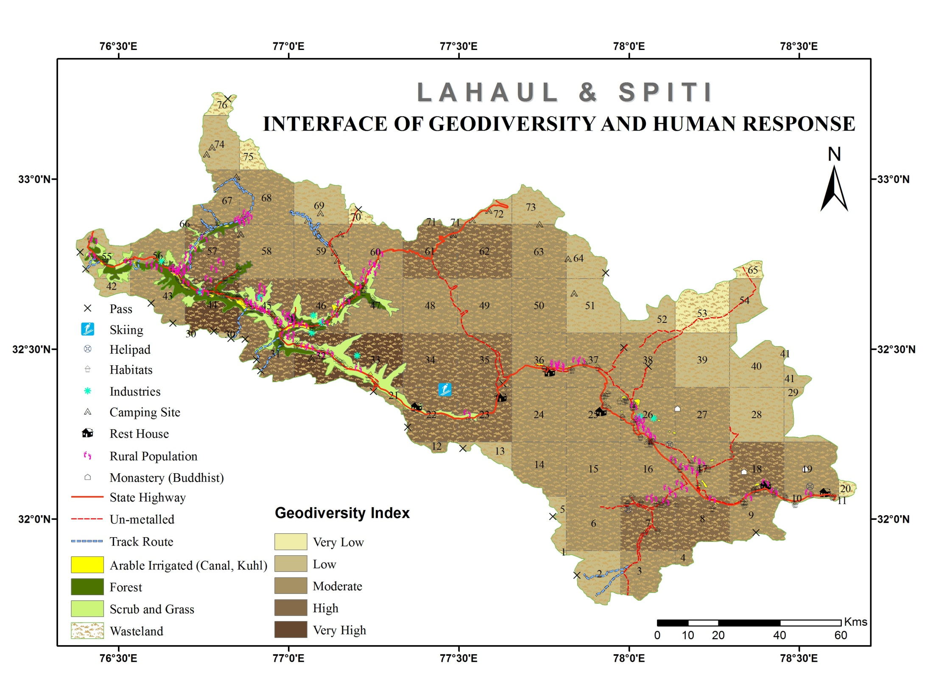
Source: NATMO

Slide 33
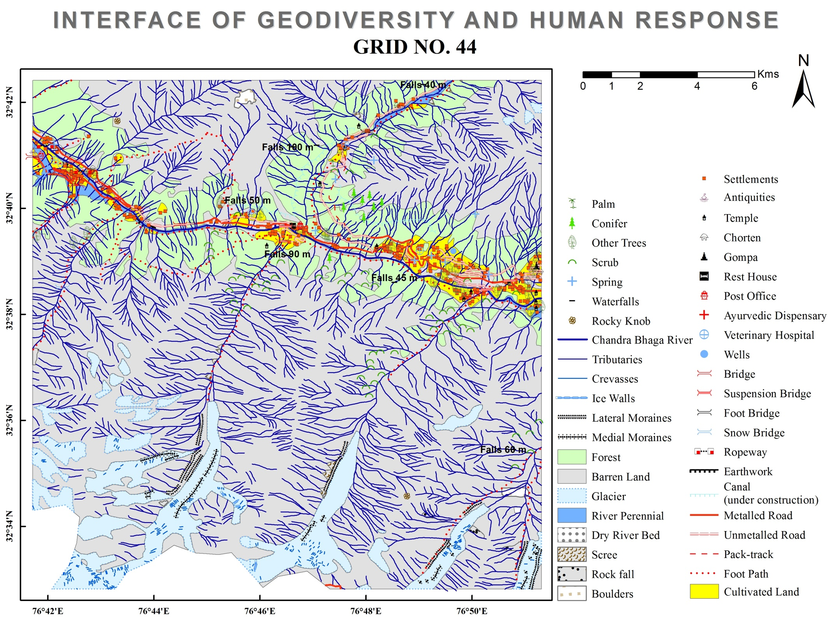
Source: Survey of India Toposheet

Slide 34
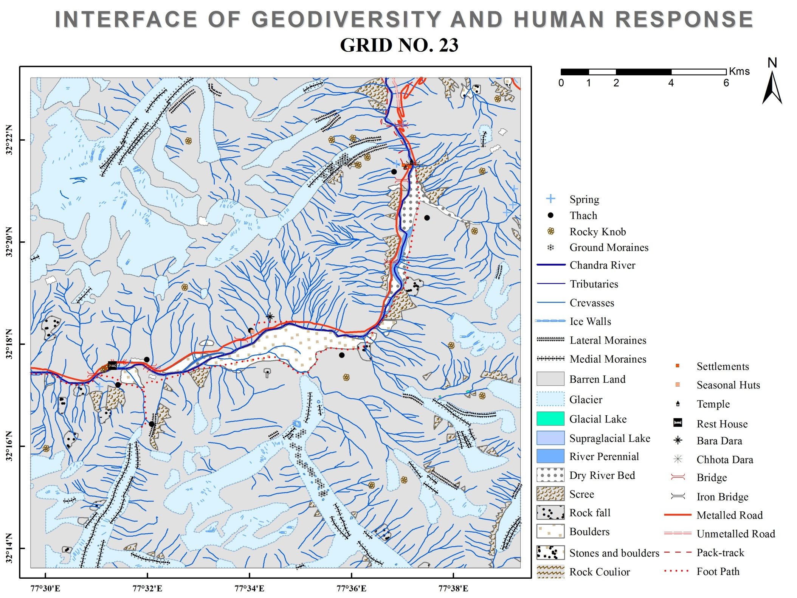
Source: Survey of India Toposheet

Slide 35
Source: Survey of India Toposheet

Slide 36
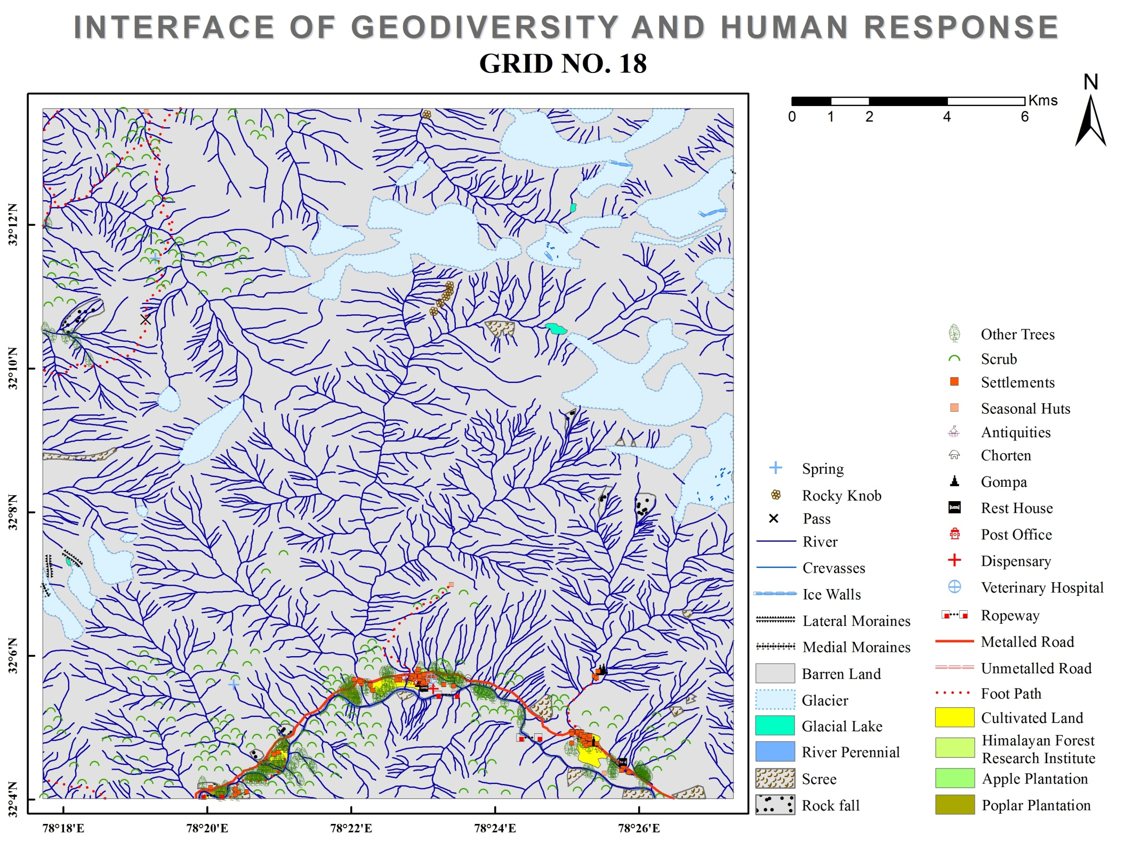
Source: Survey of India Toposheet

Slide 37
Field Survey Sites in Lahaul and Spiti
S.No. | Locations | Grid No. | Geodiversity Zone | Altitude (msl) | Population (2011)
1 | Udaipur | 56 | Moderate | 2661 m | 1237
2 | Triloknath | 44 | Very High | 2922 m | 824
3 | Thirot | 44 | Very High | 2734 m | 167
4 | Goshal | 45 | High | 3091 m | 395
5 | Keylong | 46 | High | 3113 m | 1977
6 | Jispa | 47 | Moderate | 3275 m | 332
7 | Sissu | 32 | Very High | 3032 m | 398
8 | Losar | 36 | Moderate | 4114 m | 227
9 | Hanse | 37 | Moderate | 3988 m | 214
10 | Rangrik | 26 | Moderate | 3717 m | 738
11 | Kaza | 16 | Moderate | 3693 m | 1367
12 | Kibber | 26 | Moderate | 4130 m | 295
13 | Komic | 26 | Moderate | 4536 m | 114
14 | Dhankar | 17 | Moderate | 3863 m | 319
15 | Tabo | 18 | High | 3297 m | 635
16 | Sagnam | 7 | High | 3668 m | 456
Source: Primary Survey 2018-19
*The total number of respondents are 130 from these 16 locations.

Slide 38
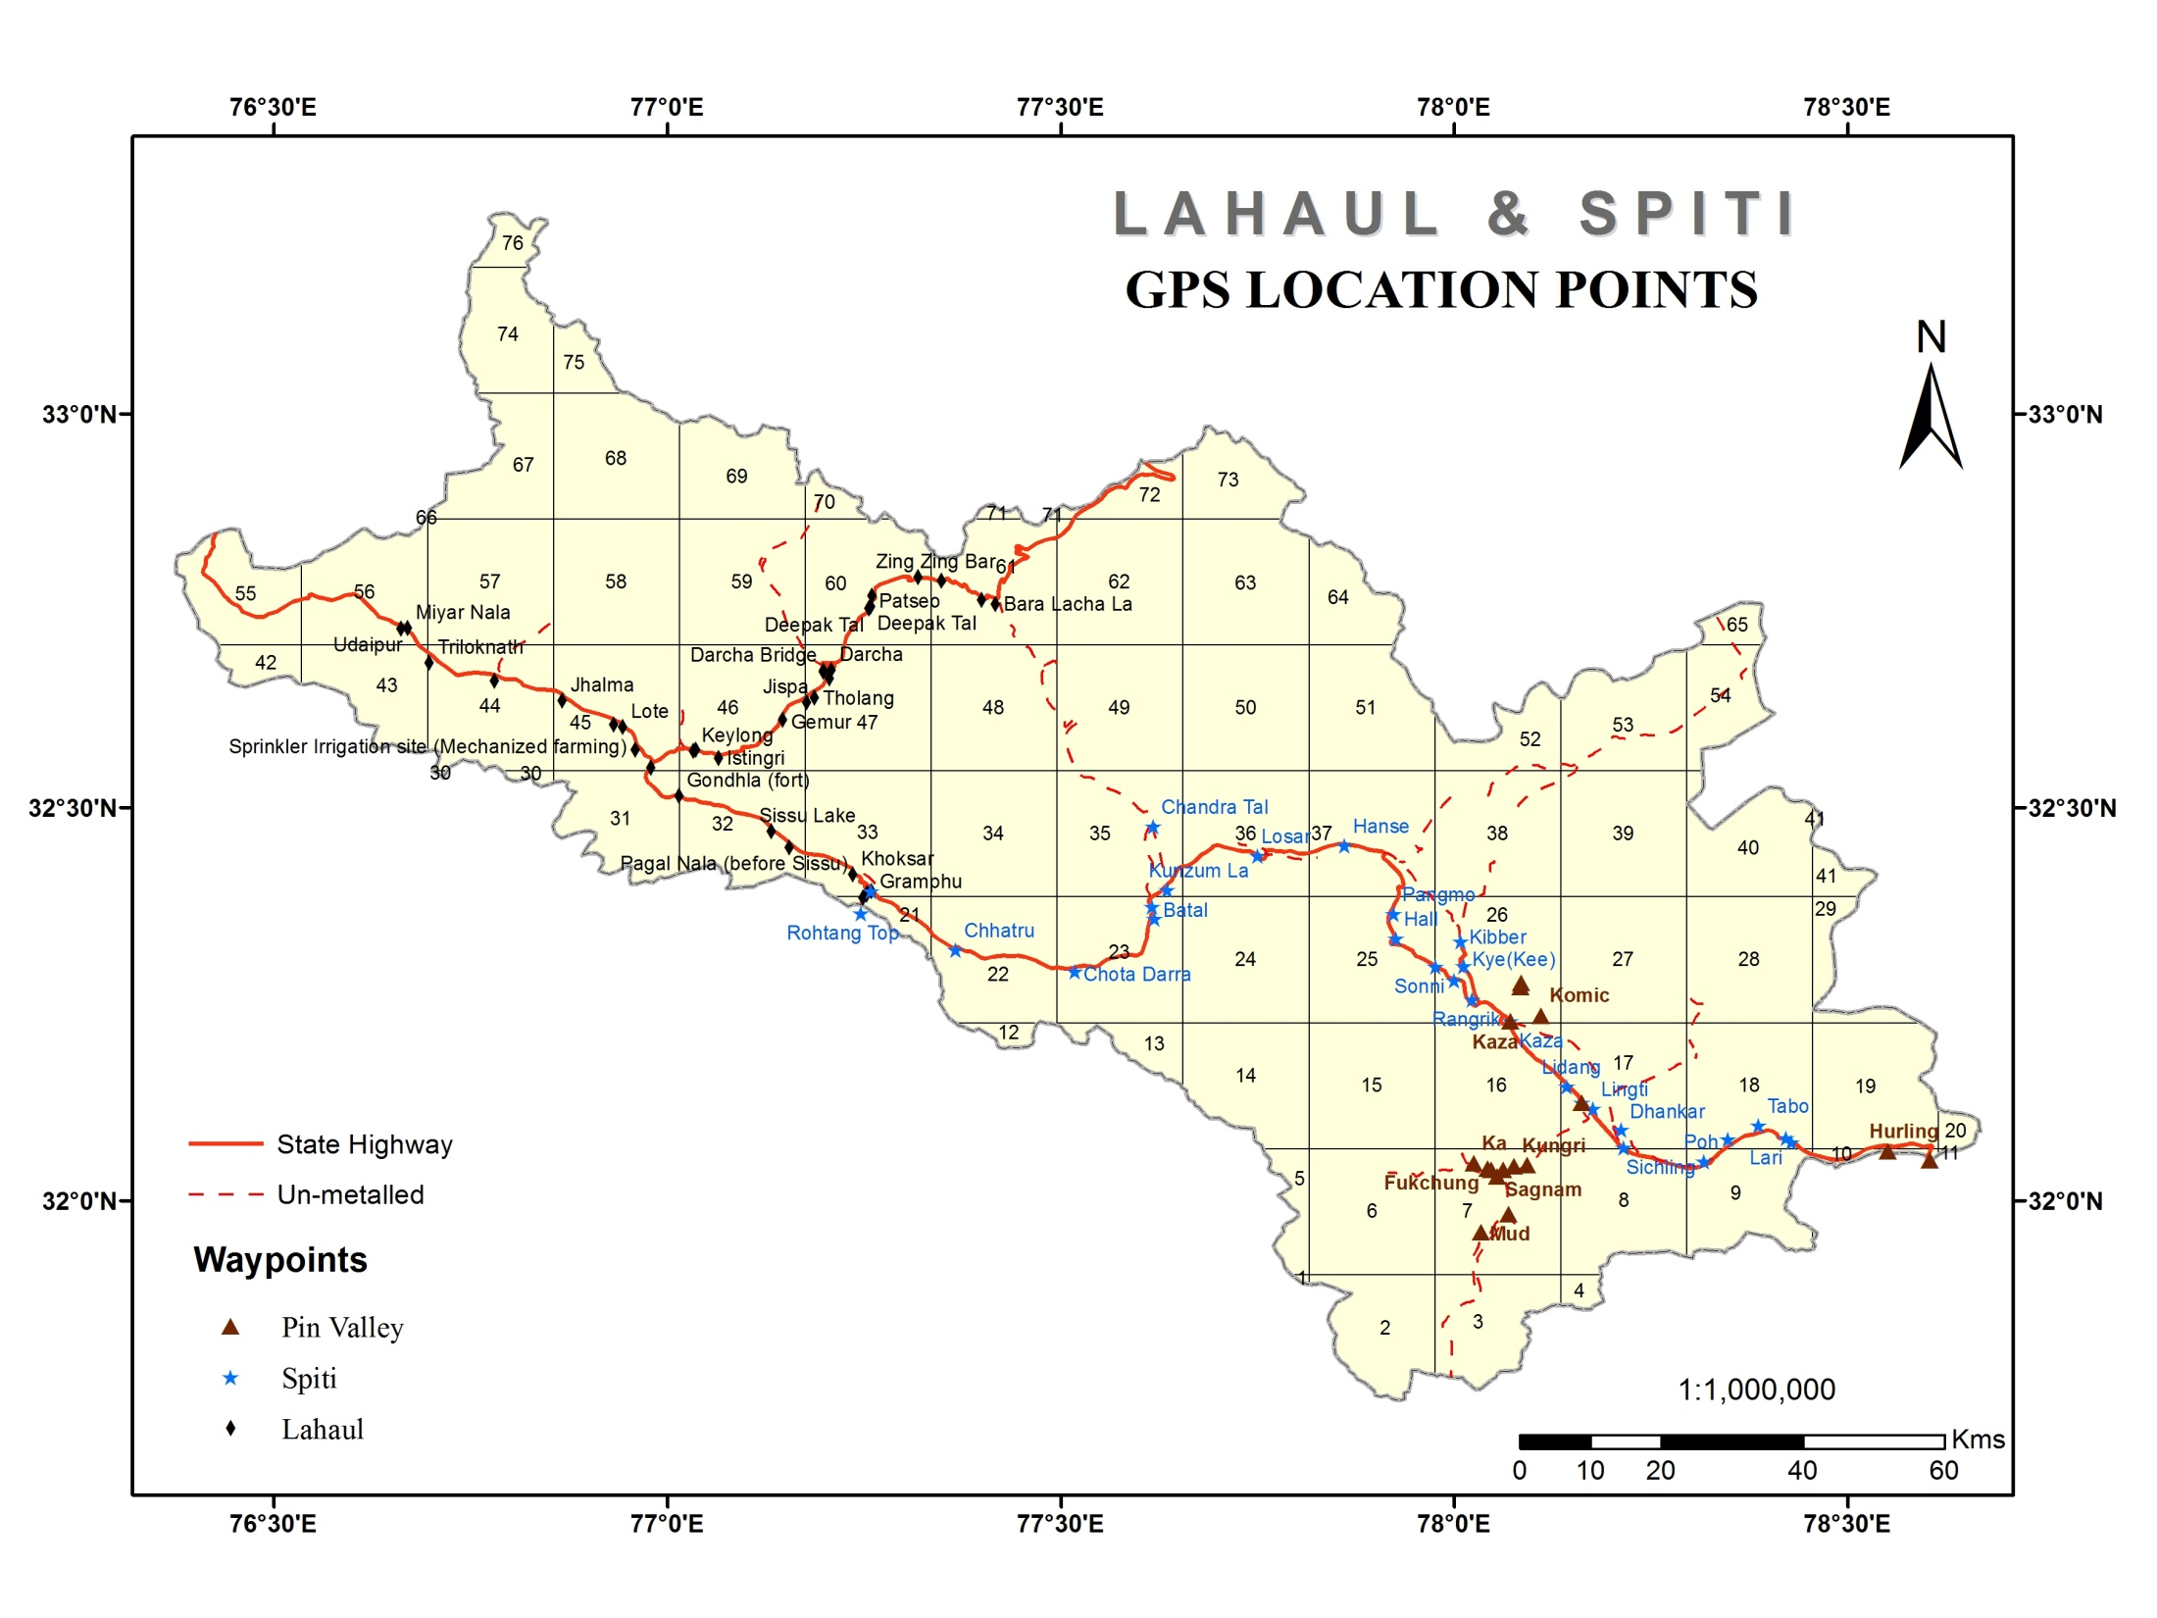

Slide 39
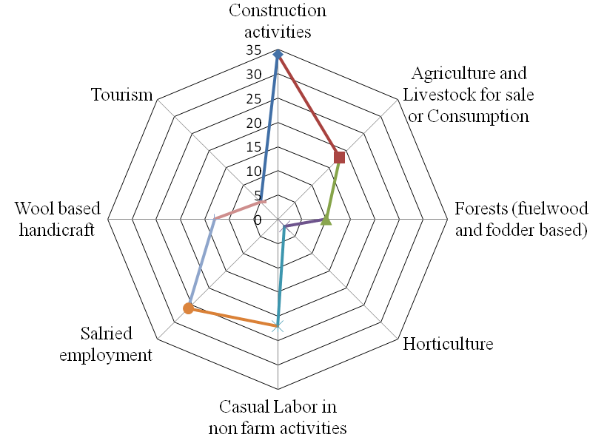
Livelihood Sources
Source: Primary Survey 2018-19

Slide 40
Materials for Construction of Habitat and their Sources
Material for Construction | Source | Locations of Use
Rocks | Local | Spiti
Mud/clay | Local | Spiti
Wood | Local | Spiti
Metal | Outside | Lahaul-Udaipur
Cement | Outside | Lahaul-Udaipur
Bricks | Outside | Lahaul-Udaipur
Tin | Outside | Lahaul-Spiti-Udaipur
Paint | Outside | Lahaul-Spiti-Udaipur
Source: Primary Survey 2018-19

Slide 41
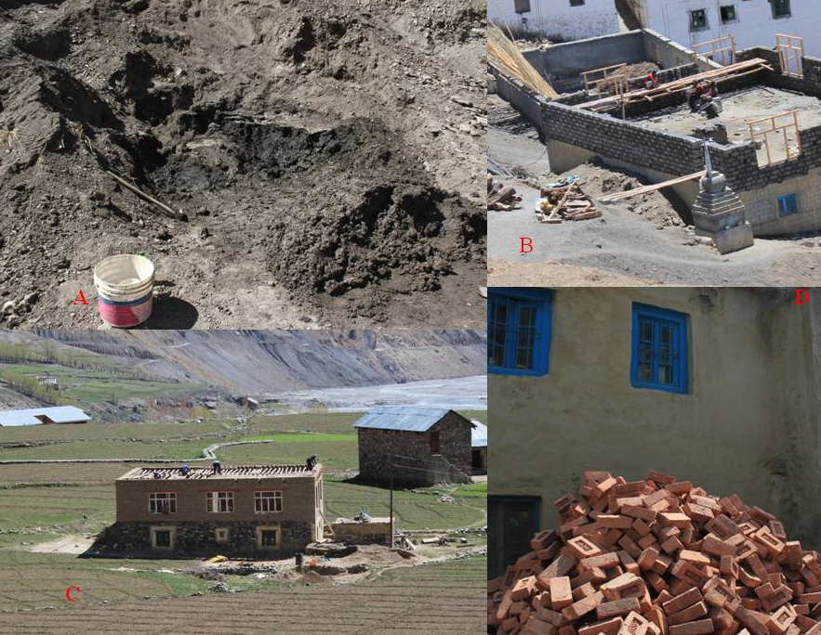
Construction of Houses
Source: Primary Survey, 2013-14 Coordinates
A. Earthen material (mud) at Kibber village N32 19.778, E78 00.482
B. House under construction at Langza village N32 16.620, E78 05.103
C. House under construction at Sagnam N32 01.875, E78 03.260
D. Bricks coming from Kullu at Udaipur N32 43.623, E76 39.677

Slide 42
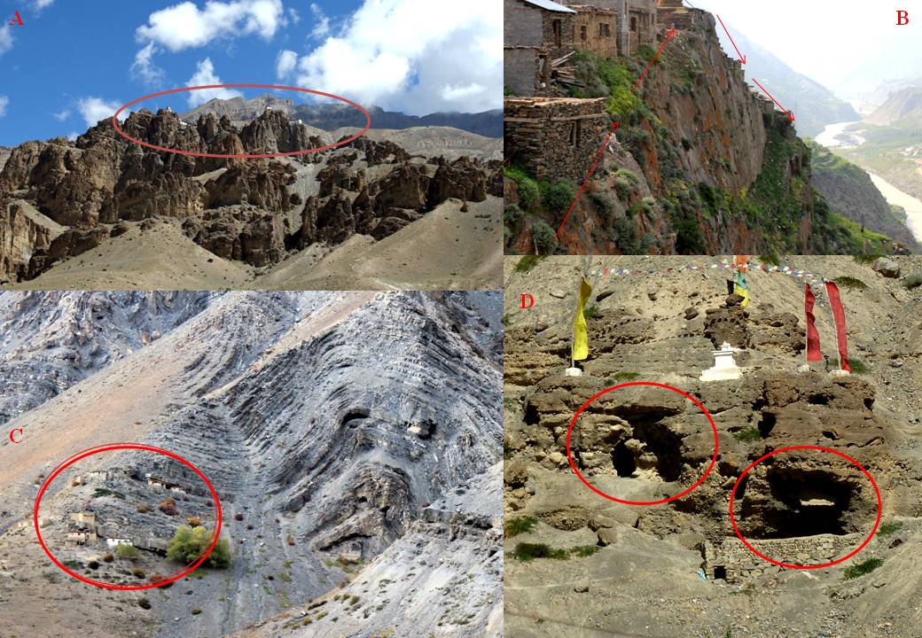
Lithology and Structural Control in the Settlements
Source: Primary Survey, 2013-14 Coordinates
A. Dhankar village N32 05.412, E78 12.752
B. Triloknath village N32 41.001, E76 41.831
C. Fukchung village N32 02.437, E78 02.554
D. Tabo caves N32 05.736, E78 23.205

Slide 43
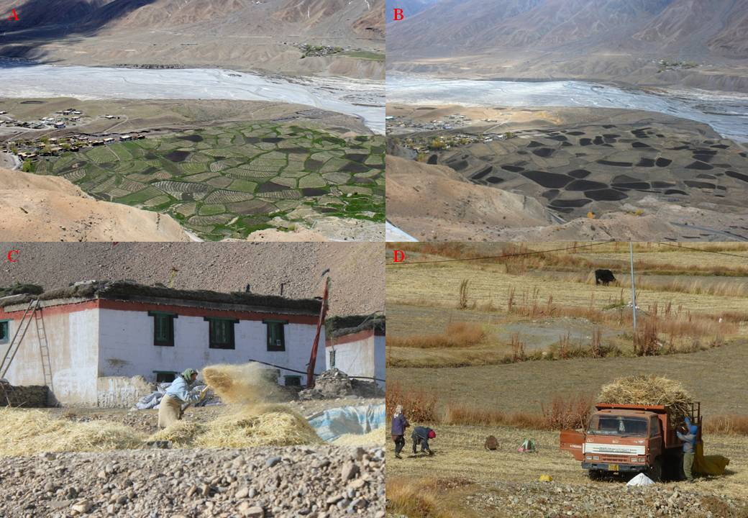
Seasonality in Agriculture
Source: Primary Survey, 2013-14 Coordinates
A. Key village (June) N32 17.899, E78 00.725
B. Key village (October) N32 17.899, E78 00.725
C. Hanse village N32 26.279, E77 45.000
D. Losar village N32 05.736, E78 23.205

Slide 44
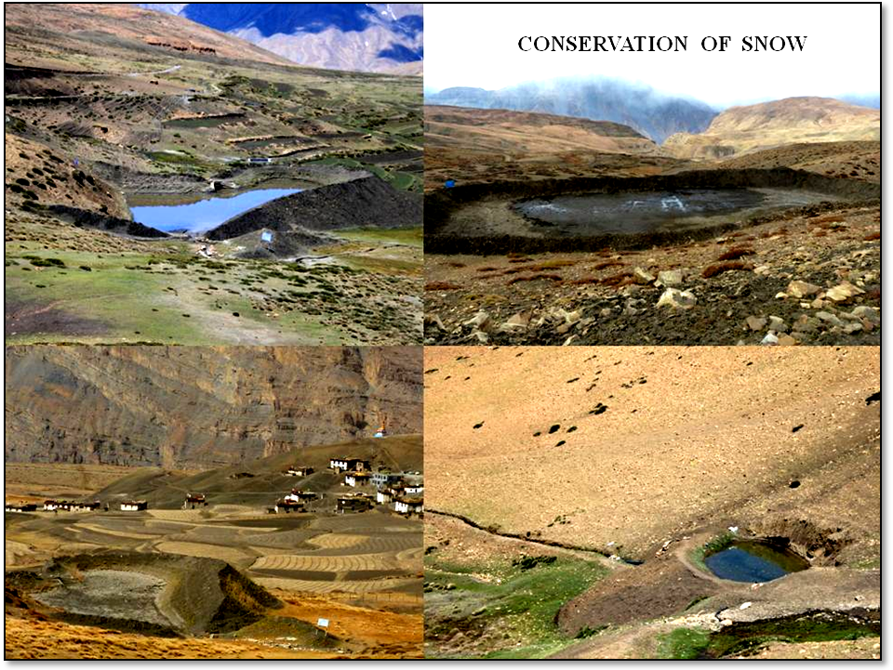
A
B
C
D
Source: Primary Survey, 2013-14 Coordinates
A. Langza N32 16.620 E78 05.103
B. Komic N32 14.104 E78 06.630
C. Kungri N32 02.648 E78 04.533
D. Mud N31 57.612 E78 02.058

Slide 45
Role of Geodiversity in Traditional Amchi System of Medicine
One of those prominent systems of indigenous therapy originated and developed in this isolated area known by the name of Tibetan Medical System, that evolved and thrived based on the available bio-resources, geodiversity (rocks and minerals) and indigenous beliefs.
The practitioners of this ethno-medical system are known as Amchis. Various aspects of geodiversity are utilized by the amchis in order to cure the ailments of trans-Himalayan communities.
Specific usage of few minerals and metals by amchis include the following:
Shilajeet : Longevity, rejuvenation
Gold : Promotes longevity
Silver : Dries up pus
Copper : Cures fever, dries up pus
Iron : Cures liver poisoning, eye diseases, anaemia
Pearls : Food Poisoning
Stones : Useful in physiotherapy
Other minerals used in treatments for various ailments such as leprosy, rheumatism, blisters, itching, skin eruption, stomach disorders etc. are Borax, Sodium Sulphate, Antimoni Sulphate, Sodium Bicarbonate, Yellow Arsenic, Serpentine, Quartz, Metals and Bhasmas.

Slide 46
Geotourism in Lahaul and Spiti
Geotourism can be understood as tourism based on the non-living (abiotic) components of the natural and built environment. It includes the geological and geomorphologically focussed tourism that emphasizes the preservation of geographical sense of a place (Gray, 2004). The concept of geotourism is based on the assimilation of geodiversity sites and their respective features .
Geoheritage, Geodiversity and Associated Tourism
Features | Location | Awareness of Local People | Level of Tourism Associated (high/medium/low) | Benefits to Local People (yes/no) | Measures taken by Local/Government for Conservation (if any)
Chandra Tal | Lahaul | High | High | Yes | Yes, (Ramsar Convention Site)
Suraj Tal | Lahaul | High | Medium | No | No
Deepak Tal | Lahaul | Low | Low | No | No
Sissu Tal | Lahaul | Low | Low | No | No
Neelkanth Tal | Lahaul | Medium | Low | Yes | No
Dhankar lake | Spiti | High | Medium | Yes | Yes, World Monument Fund
Baralacha la | Lahaul | High | Low | No | No
Kunzum la | Spiti | High | High | No | No
Bara Sigri | Lahaul | Medium | Low | No | No
Lady of Keylong | Lahaul | Low | Low | No | No
Source: Primary Survey, 2013-2014

Slide 47
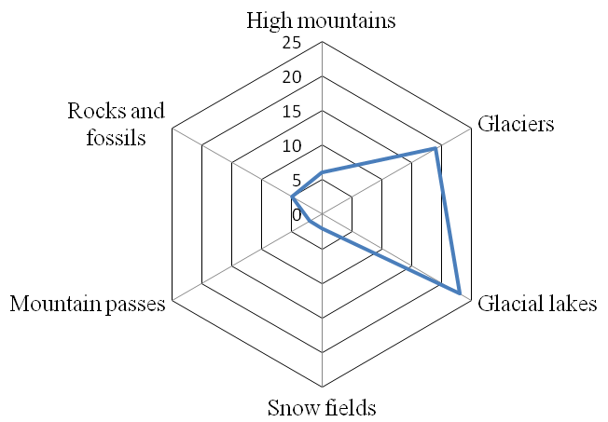
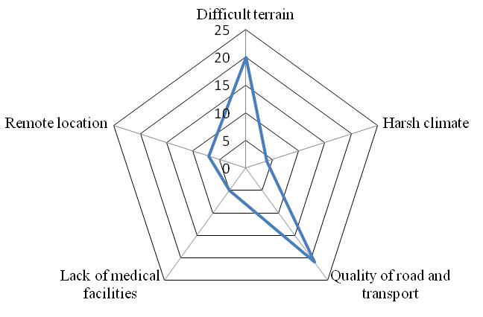
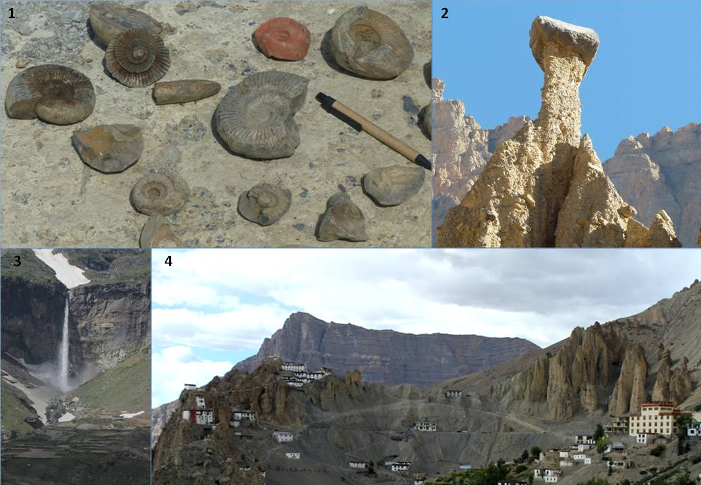
Some Important Features of Geotourism in Lahaul and Spiti
Source: Primary Survey, 2013-14
Coordinates
Fossils at Langza village N32 16.620, E78 05.103
2. Glacio-fluvial structures (mud) near Kaza N32 08.691, E78 08.555
3. Sissu village N32 28.147, E77 07.916
4. Dhankar village N32 05.412, E78 12.752

Slide 48
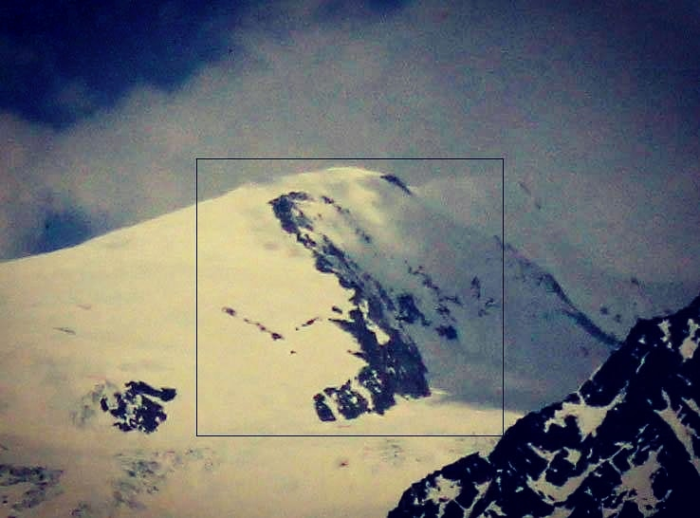
Lady of Keylong

Slide 50
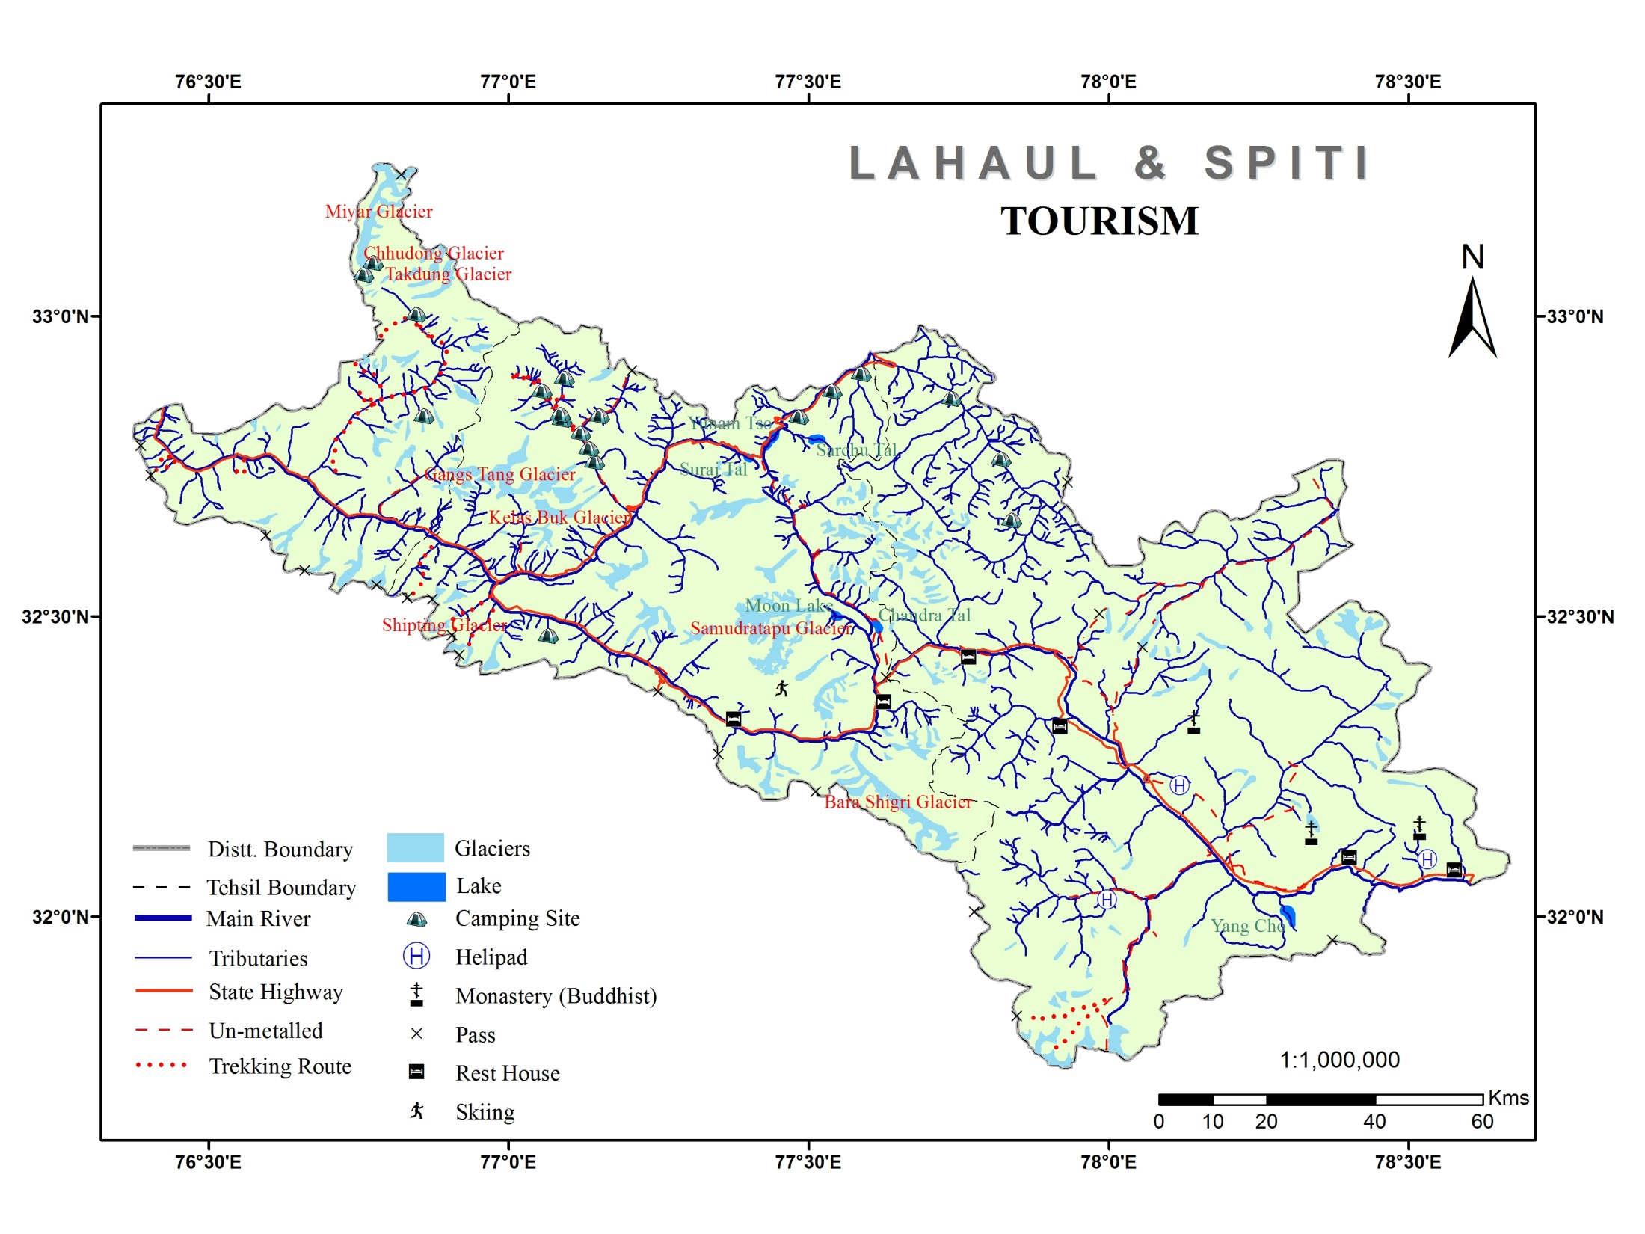
GEOTOURISM
Source: National Atlas Thematic Mapping Organization, Kolkata

Slide 51
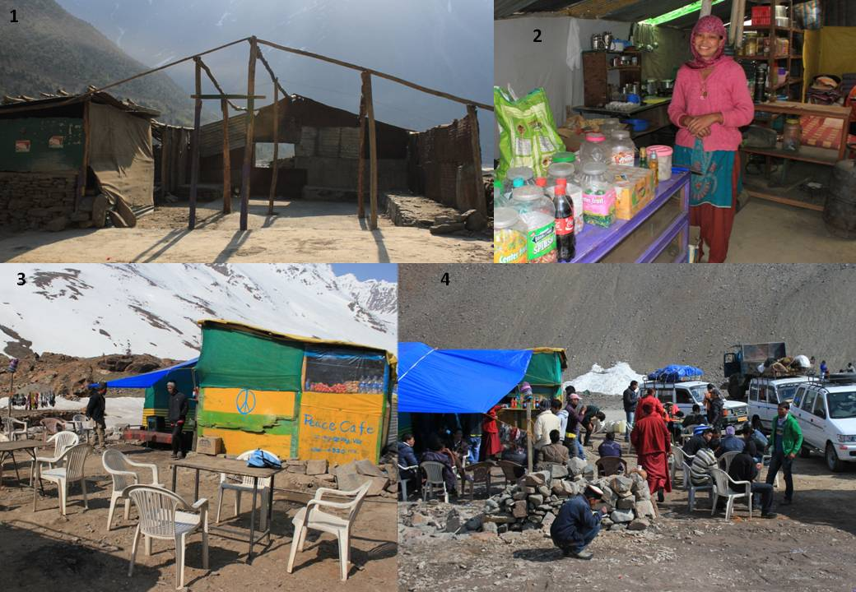
Seasonal Dhaba Economy in Lahaul and Spiti
Source: Primary Survey, 2013-14 Coordinates
1. Dhaba under construction at Darcha village N32 40.323, E77 11.8
2. Sonam in her Dhaba at Jispa N32 37.985, E77 10.585
3. Peace caffe at Zing Zing Bar N32 47.246,E77 20.901
4. Tourists at Batal Dhaba N32 21.493 E77 37.148

Slide 53
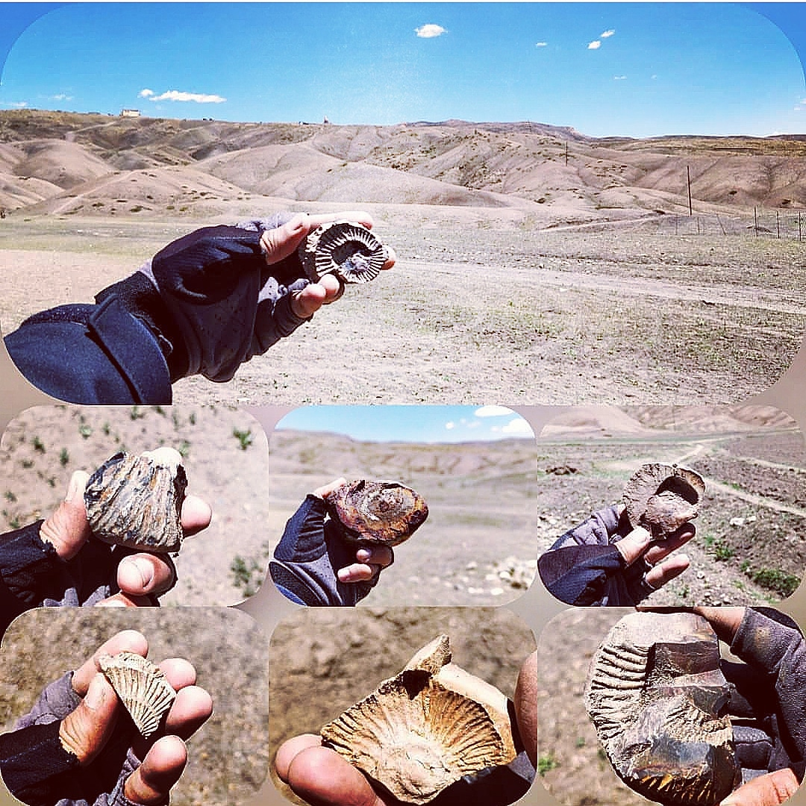

Slide 54
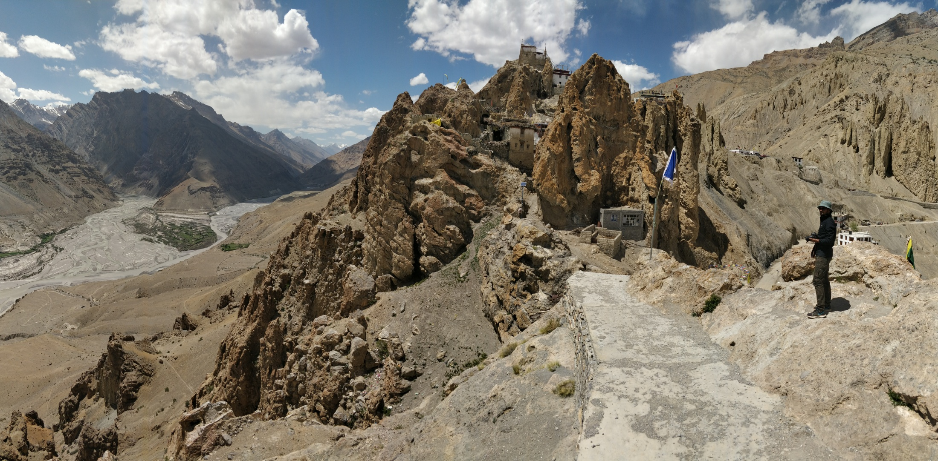

Slide 55
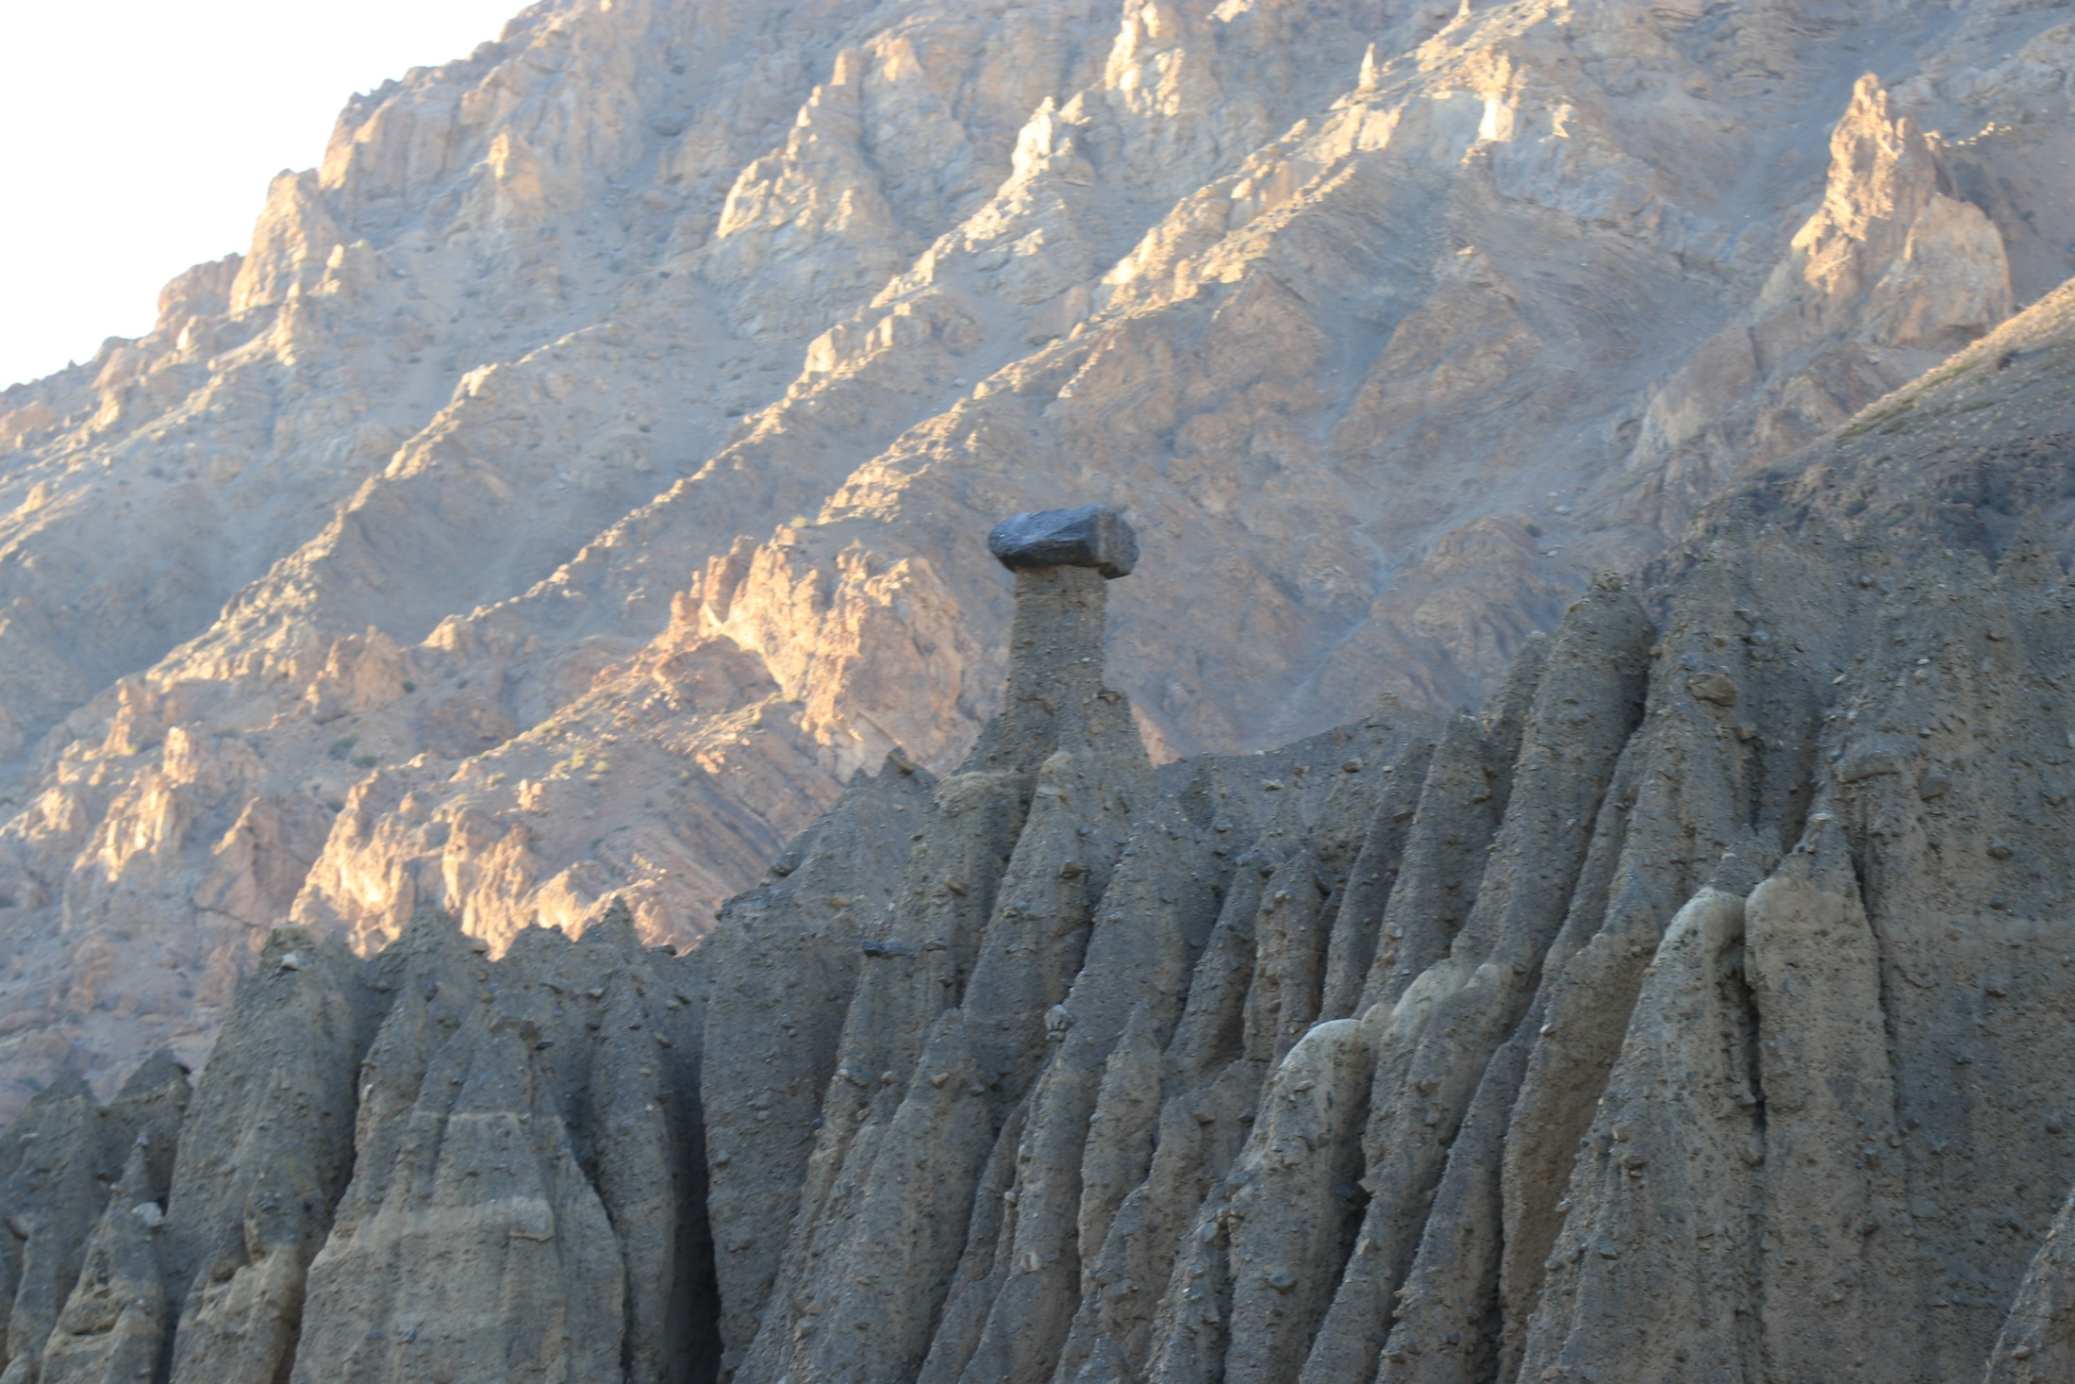

Slide 56
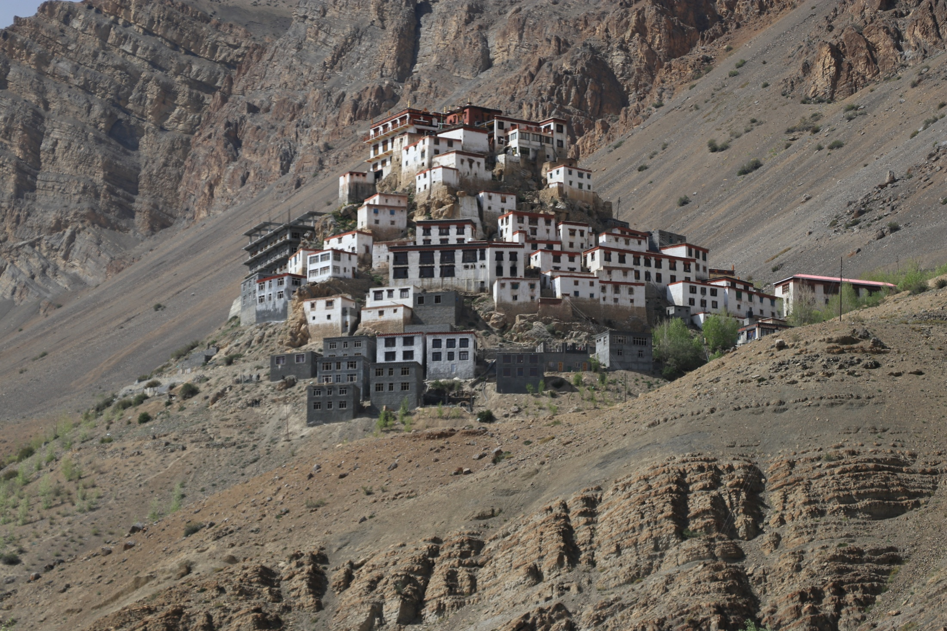

Slide 57
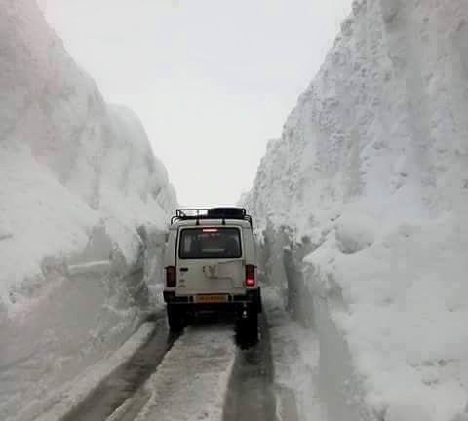
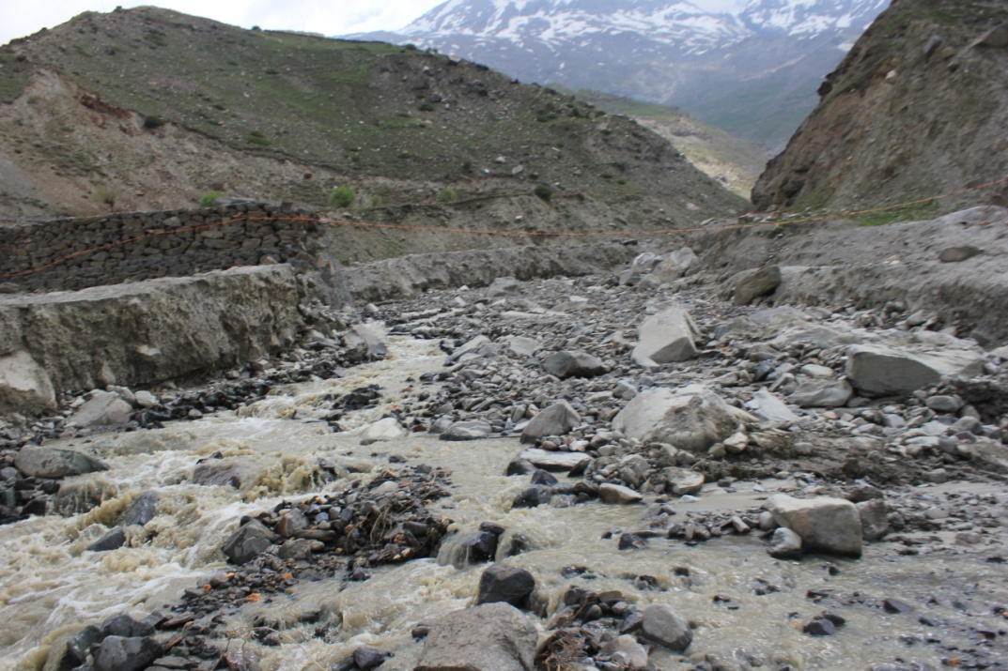
1
2
3
4

Slide 58
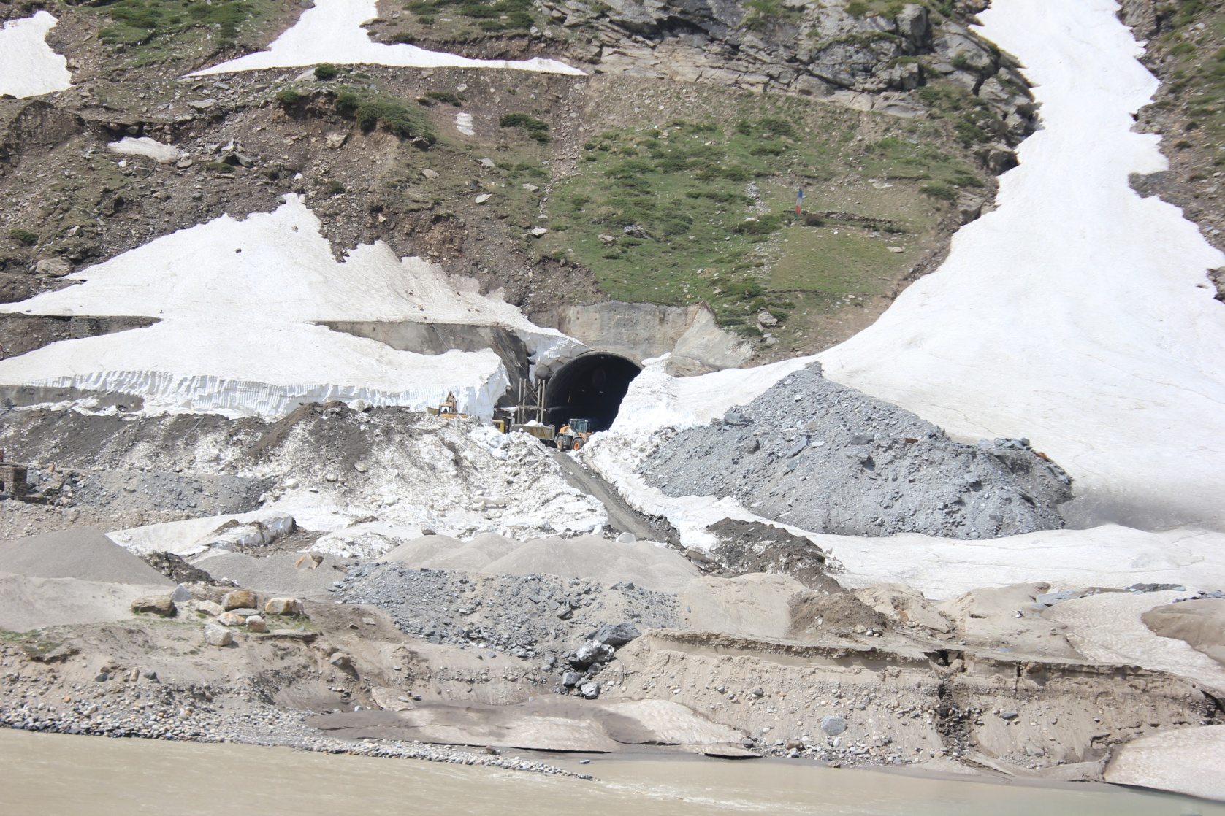
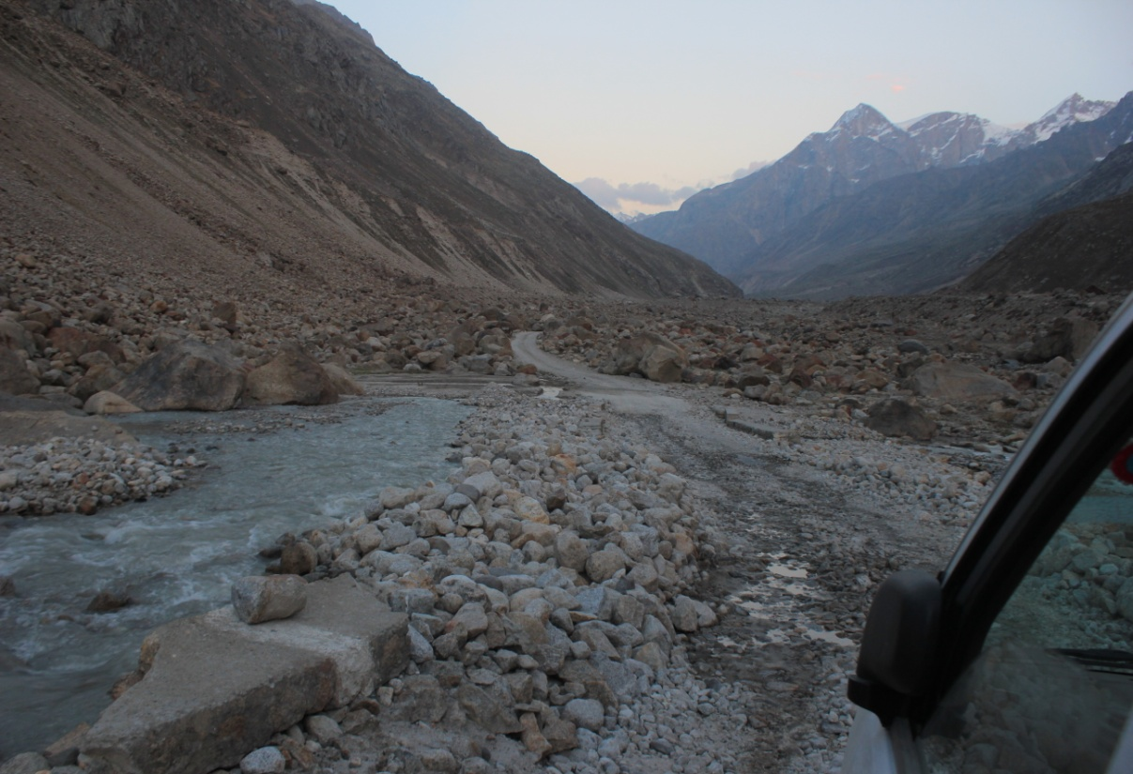
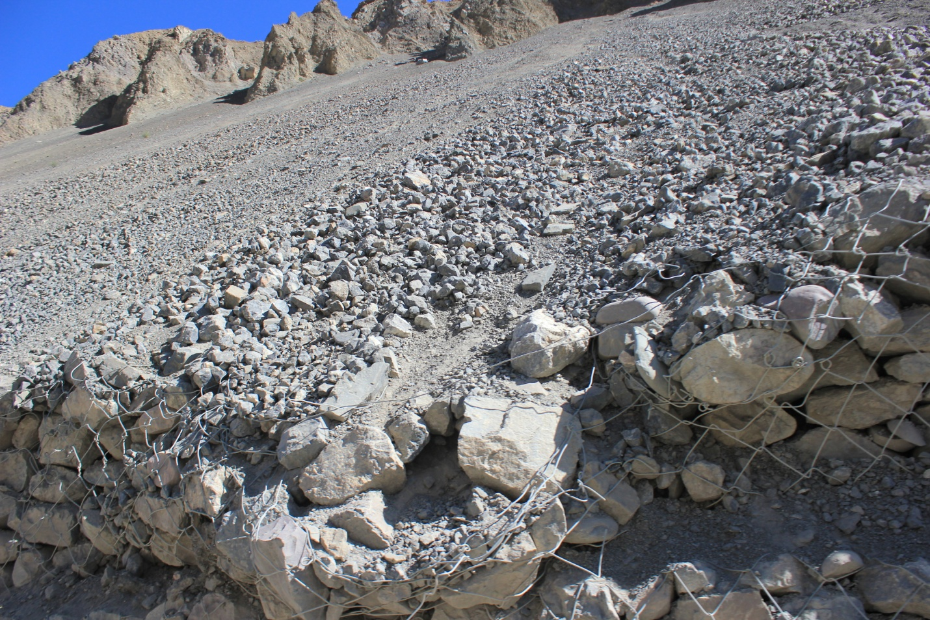
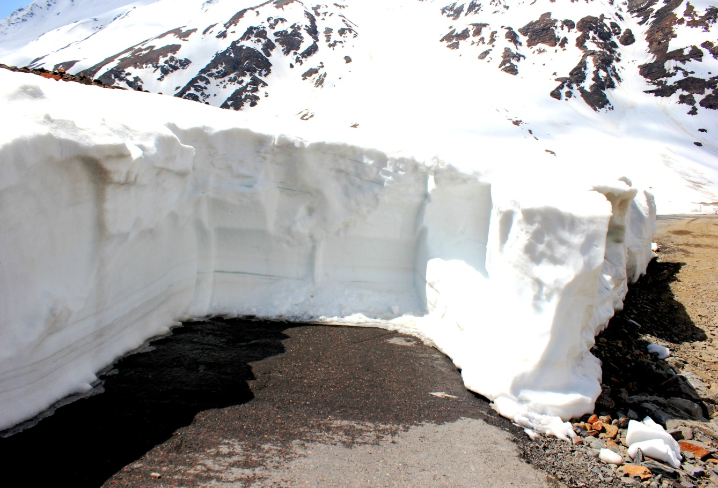
2
1
3
4

Slide 59
Areas of Intervention
Mountain Pass
Troubled Connectivity

Slide 60
Dynamic Human Response
Collection of fuel and fodder
Modern Technological Input
Agricultural activities
Business
Tourism
Festivals
Geoanthropic Sites
Open Mountain passes
(May- October)
No snowfall/avalanche/landslide
+ve
Communication Lines
Stimuli (Geo-climate)
Human Response (activities)
-ve
Static Human Response
Consumption of fuel and fodder
Indigenous Technological Input
No agriculture
No business
No tourism
Survival acts
Closed Mountain passes
(November-April)
Heavy snowfall/avalanche/landslide
STIMULI - RESPONSE THEORY OF LANDSCAPE
(Unpublished)

Slide 61
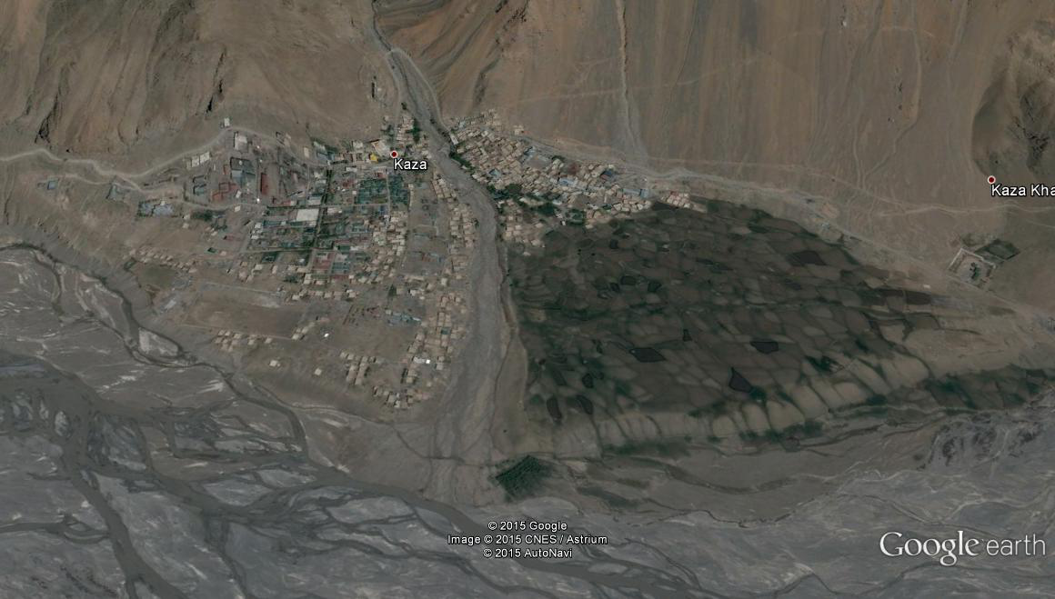
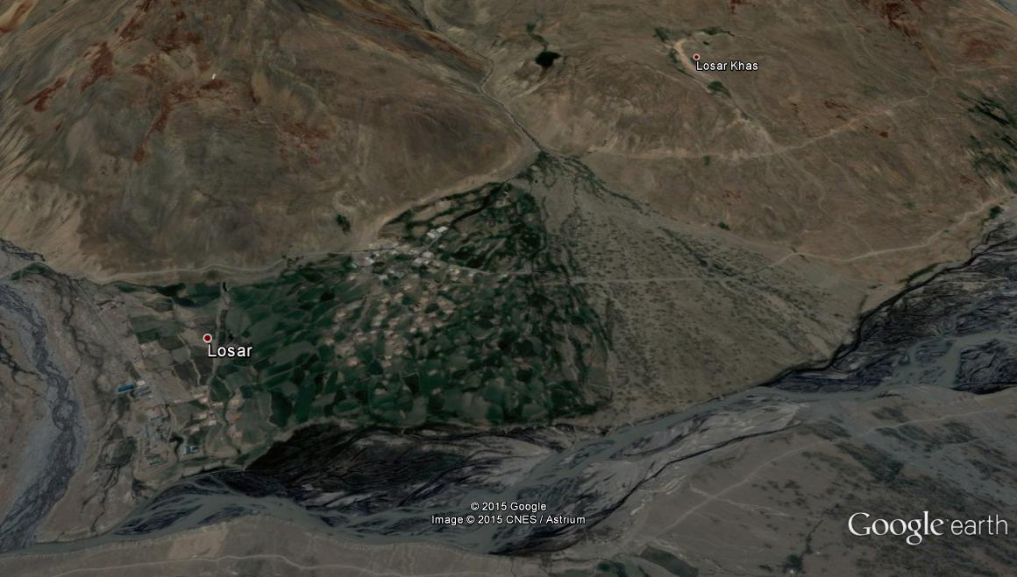
Fan Morphology at Kaza
Fan Morphology at Losar
Source: Google Earth, 2015

Slide 62
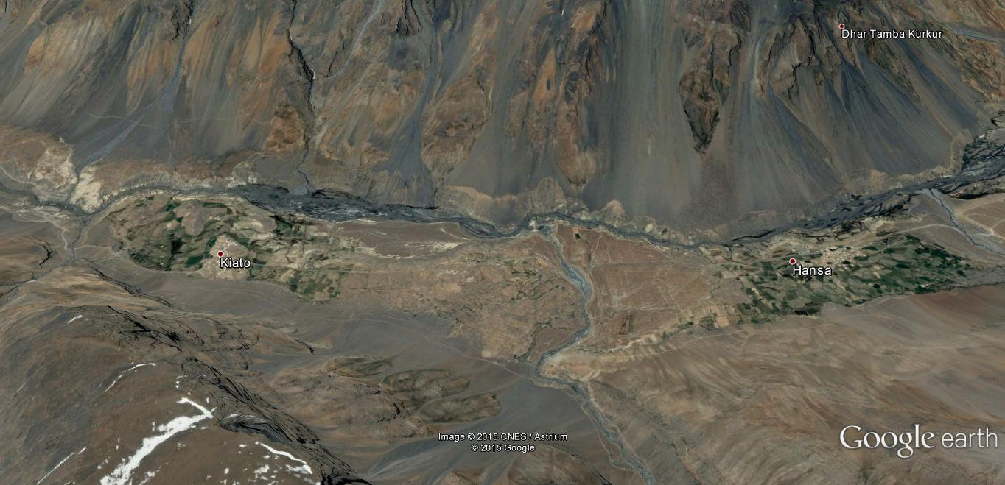
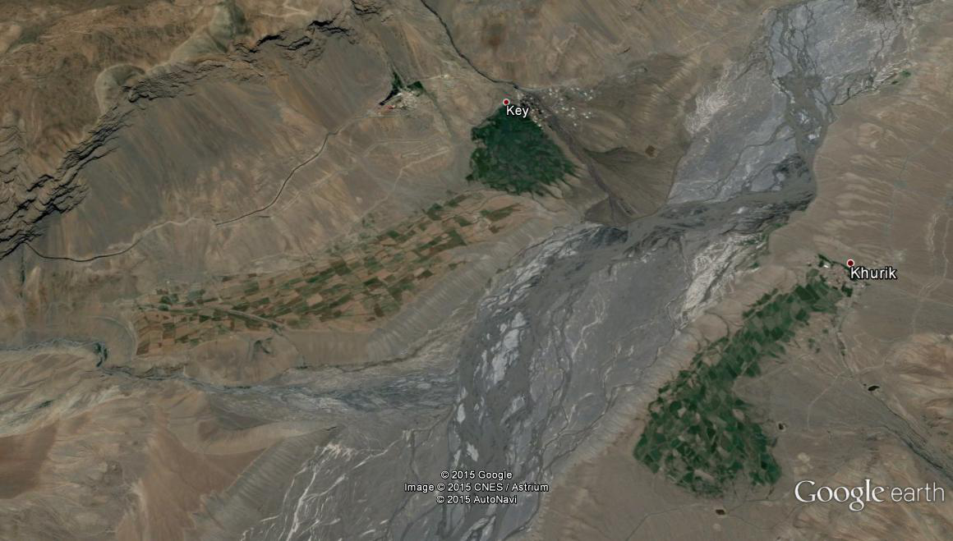
Lacustrine Deposition Site, Hanse-Kioto Village
River Terrace Agricultural Interface in Spiti Valley
Spiti River
Source: Google Earth, 2015

Slide 63
Summary and Conclusion
Significant academic research has been undertaken to establish the relationships between geodiversity and human response at different scales.
The methodology for assessing geodiversity has been adopted and modified considering the fulfillment of the objective to quantify and incorporate the maximum possible number of geodiversity elements at different both macro and micro level.
The methodology is based on geographic data comprising geology, geomorphology, hydrology, geohydrology, pedology and climate of the area.
In this methodology, the selection of scale, legend level, grid size and weightage for each geodiversity element are most important aspects.
The geographic scales, legend levels and grid size chosen for the assessment of the geodiversity of Lahaul and Spiti, is considered to be appropriate as it provides a better distinction of geodiversity values for the various indices at macro and micro levels.
After the analysis of various facets of human response to the geodiversity and geoclimate in Lahaul and Spiti, it is evident that the response manifested by the various human attributes to the stimuli of geo-climate has a dynamic relationship.

Slide 64
The mountain passes, seasonality, availability of rocks and boulders, mud together with the hydrological resources provide ample opportunity for the hard working population who use the georesources in the best possible manner to shape their milieu.
The role of locally available materials for construction is mostly preferred over the outside. It has indispensable role in habitat construction and management. The advent of new technologies in agriculture together with improved communication lines have made the life of tribal communities easier
The role of geotourism is gradually becoming very significant in the district. The glacial lakes, glaciers, snow mountain peaks, hot waster springs and the waterfalls are few of many physical features in the landscape that has maximum potential for geotourism in the region. The ancient reserves of Tethyan sediments and lacustrine deposits in the area makes it a paradise for geoscientists.
The traditional medicine system of Amchis that use significant components of the abiotic nature makes it more clear that the geodiversity in the area has through ages been a significant part of human sustenance in trans Himalaya.
The role of seasonal dhabas can't be undermined in the economic development of the area as they are lifelines for the travellers, explorers, tourists and geoscientists.
Overall, the major issue is inaccessibility which needs to be well addressed and taken care with better management efforts.

Slide 65
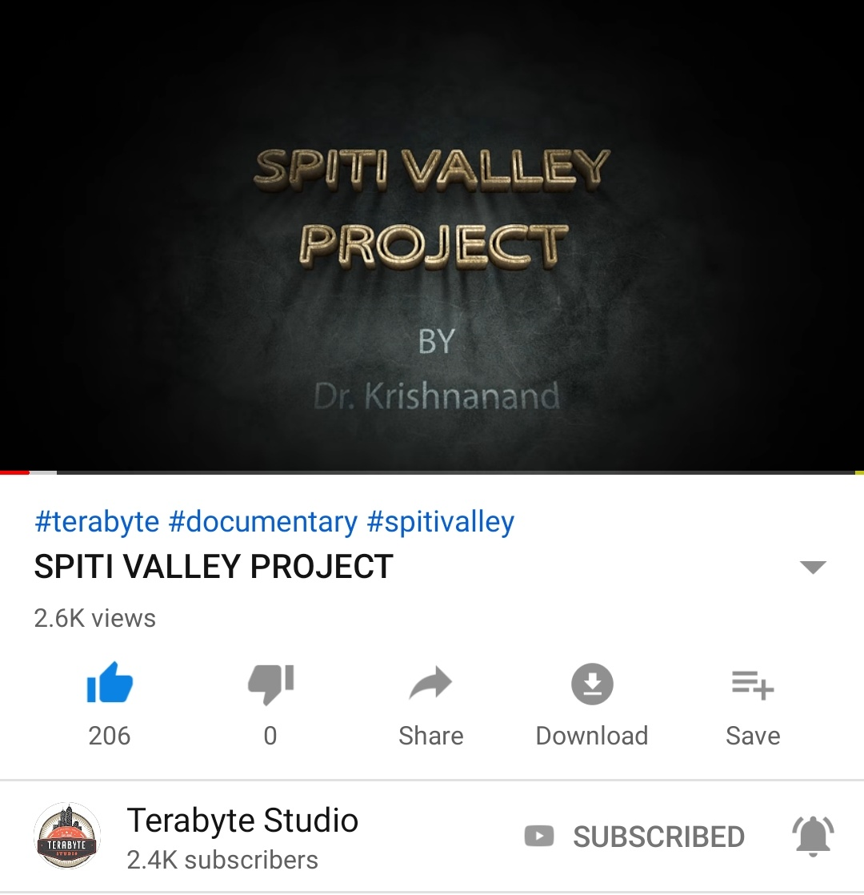

Slide 67
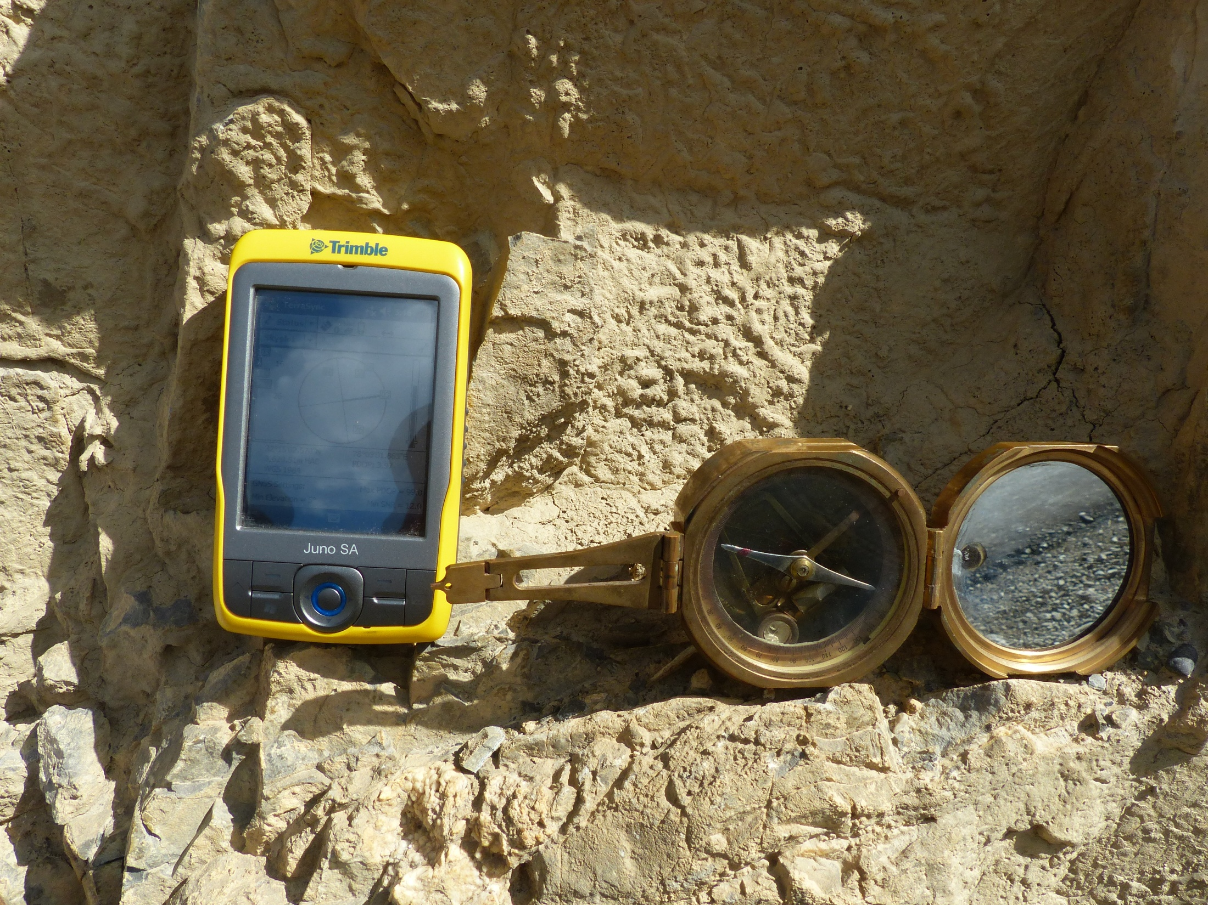
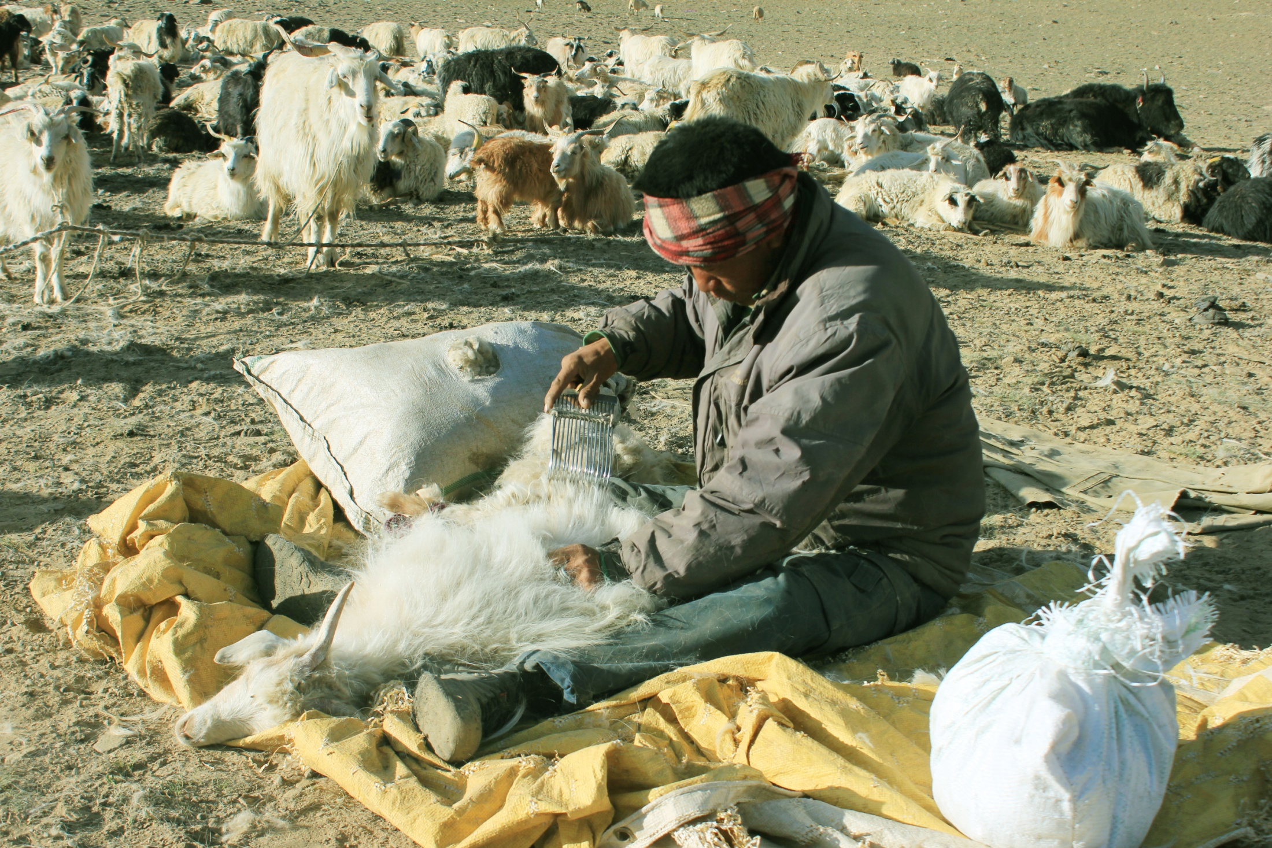
THANK YOU FOR PATIENT HEARING :)

