Slide 1
Transient Pleistocene simulations with a new coupled climate-ice-sheet model
Dipayan Choudhury,
Axel Timmermann, Fabian Schloesser and David Pollard
https://www.clim-past-discuss.net/cp-2020-46/

Slide 2
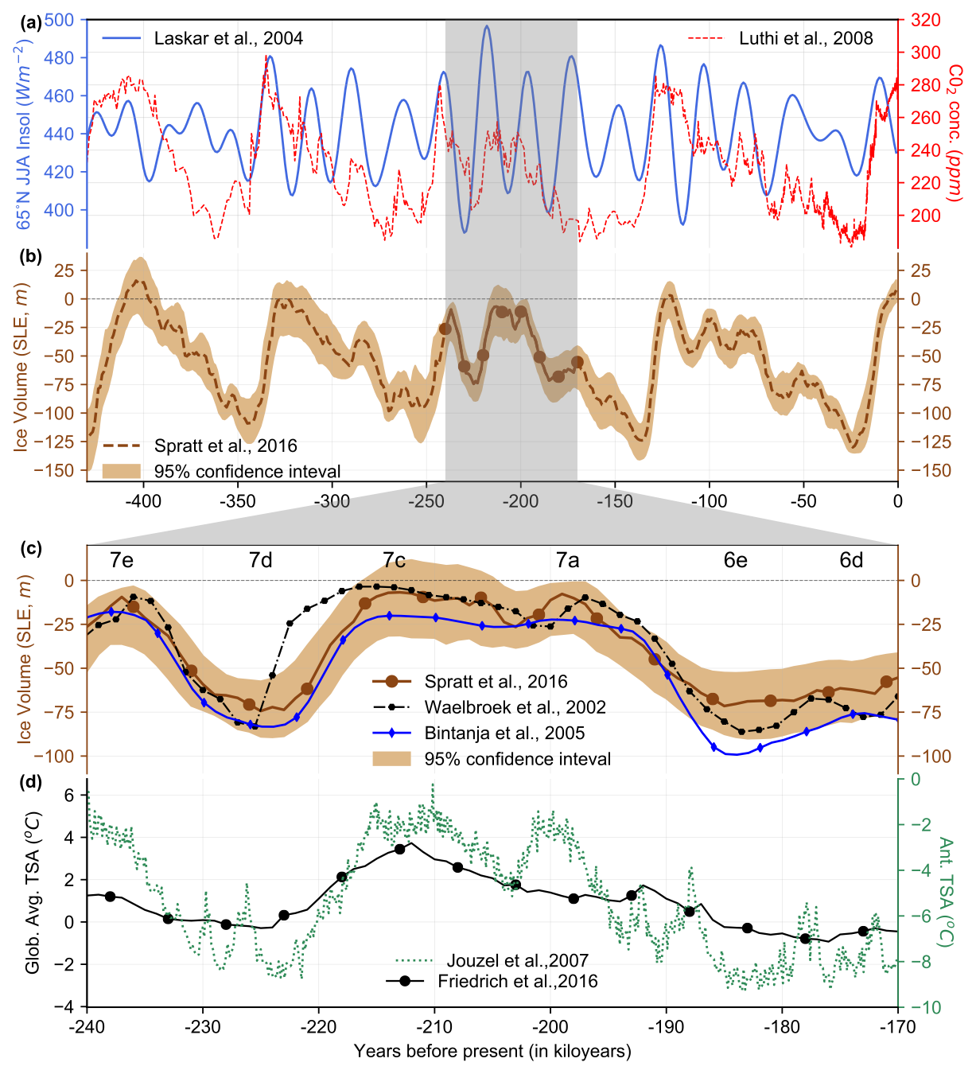
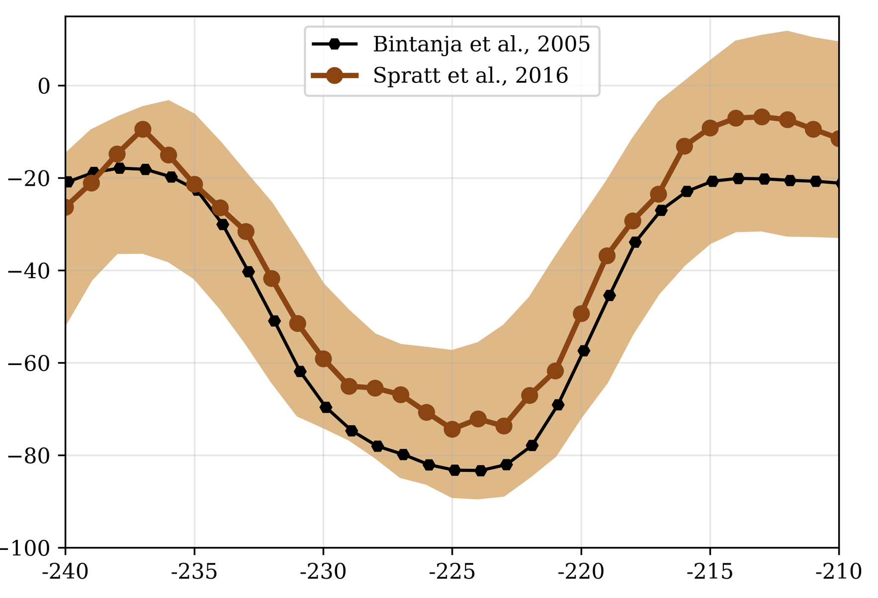
What drives glacial cycles?
Is Milankovitch forcing enough to drive glacial cycles?
What is the role of internal ice sheet dynamics/feedback on glacial cycle?
Is additional CO2 forcing needed (which is also driven by Milankovitch)?
Milankovitch forcing
Climate
Carbon Cycle
Ice Sheets
Testbed
Between the high stands of MIS 7e-7c: ≈60m in 20ky
References
Berger, A., 1978: Long-term variations of daily insolation and quaternary climate changes. J. Atmos. Sci., 35, 2362–2367.
Lüthi, D., M. Le Floch et al. 2008. High-resolution carbon dioxide concentration record 650,000-800,000 years before present. Nature, Vol. 453, pp. 379-382, 15 May 2008.
Spratt, R. M., & Lisiecki, L. E. (2016). A late pleistocene sea level stack. Climate of the Past, 12(4), 1079–1092.

Slide 3
Coupled climate-ice sheet model
Atmosphere-ECBILT-(T21)
Ocean-CLIO- (3˚x3˚-20 levels) + Thermodynamic Sea Ice Model
LOVECLIM (EMIC)
Vegetation-VECODE
LOVECLIM
t=’n+1’
SAT, Solar Radiation, Precipitation, Tocean
Orography, Runoff, Landmask, Calving
SAT, Solar Radiation, Precipitation, Tocean
NH - 1˚x 0.5˚
Rectilinear
t=’n’
t=’n+1’
SH-40km x 40km
Stereographic
Ice sheet Model - PSUIM
PSUIM
References
H. Goosse et al. (2010), Description of the Earth system model of intermediate complexity LOVECLIM version 1.2. Geosci. Model Dev. 3, 603–633.
Pollard, D., DeConto, R.M. (2012), Description of a hybrid ice sheet-shelf model, and application to Antarctica. Geosci. Model Dev. 5, 1273–1295.

Slide 4
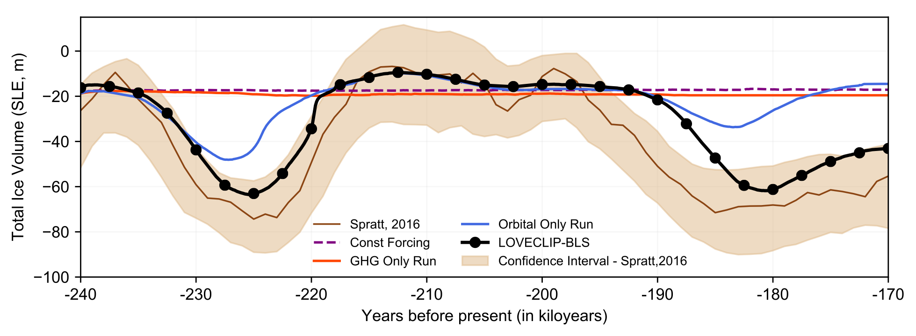
Effects of Independent Forcings
GHG forcing alone does not lead the system to glaciation.
Orbital forcing alone can push the system to glaciate, but simulates half the amplitude.

Slide 5
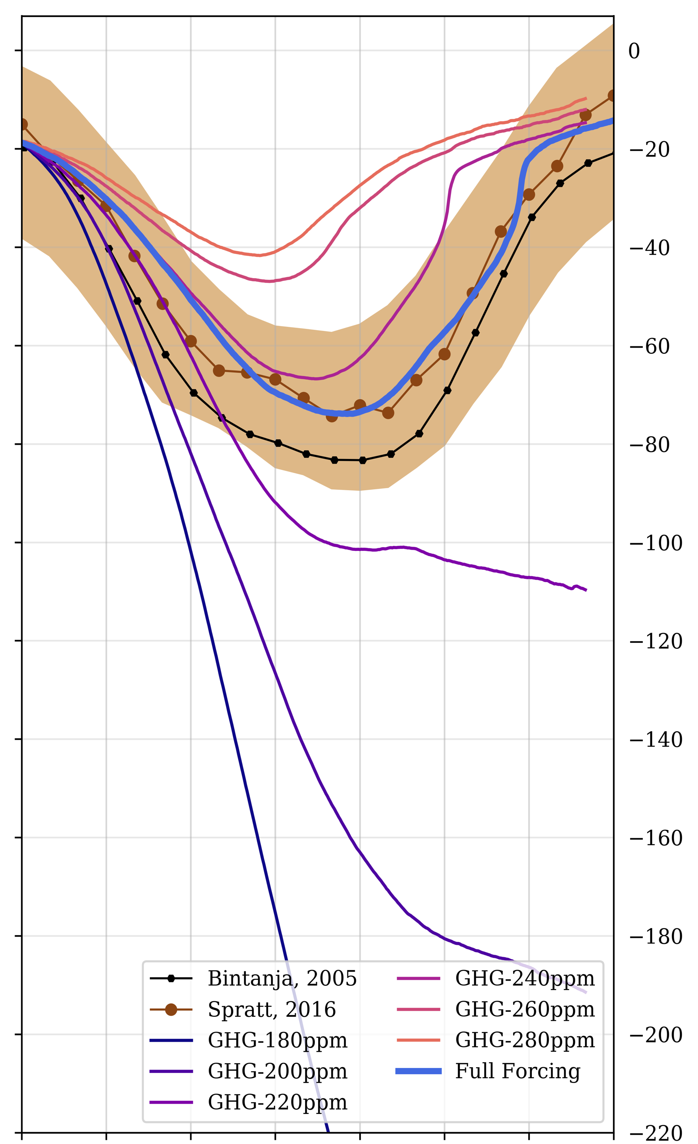
Effects of background CO2 on response to Orbital Forcing
Glacial inception: Orbital forcing alone can cause a system to start glaciating, even with a constant 280ppm CO2.
Glacial termination: Orbital forcing alone cannot lead to deglaciation if CO2≤220ppm. This threshold, however, could be model dependent and different for different glacial periods.
280
180

Slide 6
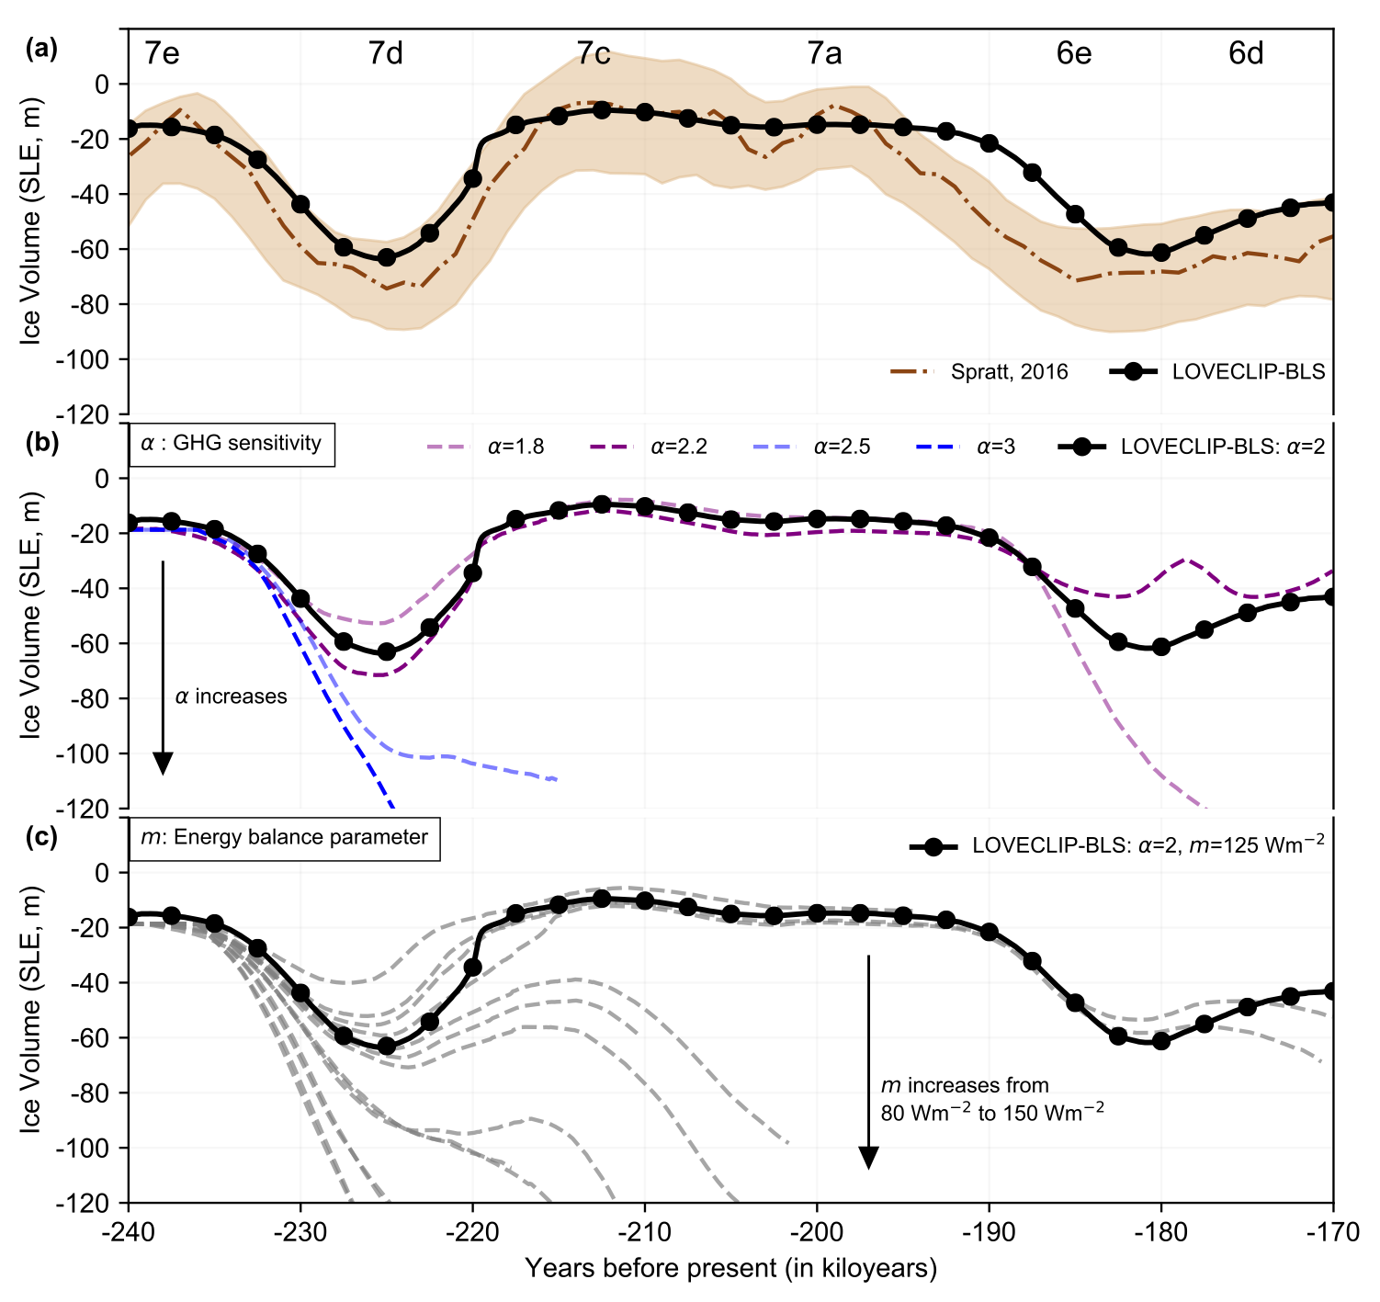
Multi ensemble transient simulation
⍺=Scaling factor for effect of CO₂ variations on the LW radiation flux
m=Linear energy balance parameter
-represents net upwards infrared radiation from a solid surface at temperature 𝑇 to the atmosphere, plus a constant correction for other simplifications
𝑏 = 10 𝑊𝑚⁻²𝐾⁻¹, 𝑇 is the surface air temperature, 𝑇 the freezing point, 𝑎 the albedo, 𝑄 the surface incoming shortwave radiation, and parameter 𝑚 a constant (see Sect.2.3). The albedo is linearly interpolated between values for no snow (𝑎_{ns} = 0.5), wet snow (𝑎_{ws} = 0.6), and dry snow (𝑎_{ds} = 0.8), 𝑟_{s} is the snow-covered area fraction and 𝑟_{l} the ratio between liquid water contained in the snow mass and the maximum embedded liquid capacity.

Slide 7
Pre – Post inception over 2 10ky periods

Slide 8
Pre – Post inception over 2 10ky periods

Slide 9
Ice Sheet Dynamics

Slide 10
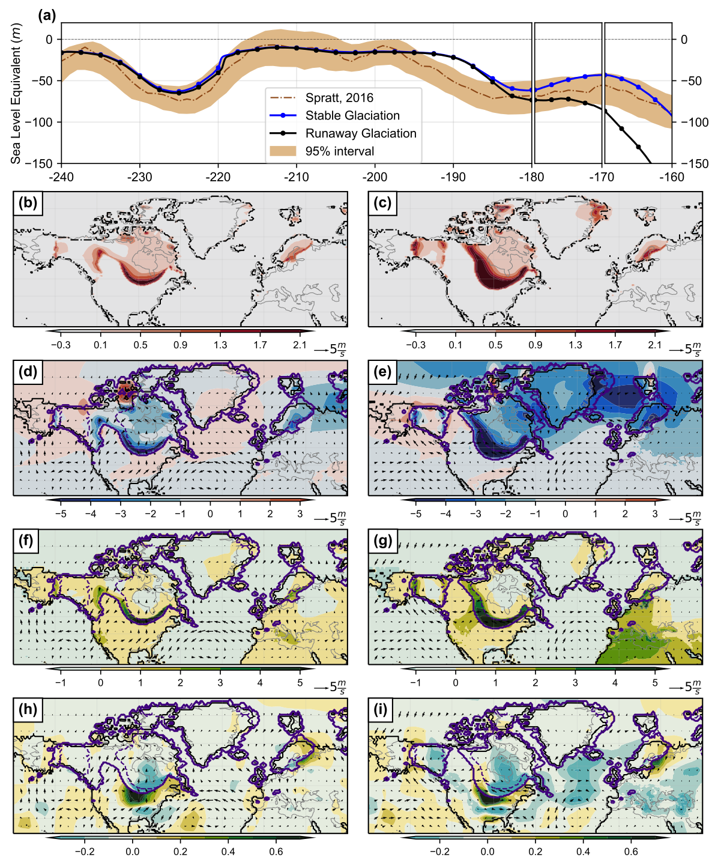
Small differences feedback into very different states
180ka
170ka

Slide 11
Conclusions
Glacial inceptions can be initiated independently by Orbital forcings, but not by GHG forcings.
Glacial terminations, however, cannot be independently simulated by individual forcings, and need both orbital and GHG forcings to work in tandem.
Small changes in Laurentide’s ice distribution can cause a saddle-node bifurcation, which determines whether the coupled trajectory will follow a deglaciation or a runaway glaciation pathway.
This runaway glaciation can be explained in terms of a positive stationary-wave-ice sheet feedback in which ice topography-driven moisture transport from westerly storm tracks and the Gulf of Mexico leads to enhanced rainfall accumulation over the southern tip of the Laurentide, making it grow further southwestward.
Simulations are realistic over a narrow range of parameters, since small differences can integrate for thousands of years to create completely difference trajectories.
Further details in:
https://www.clim-past-discuss.net/cp-2020-46/
Email: dipayanc@pusan.ac.kr/dipayanc@live.in

