Slide 1
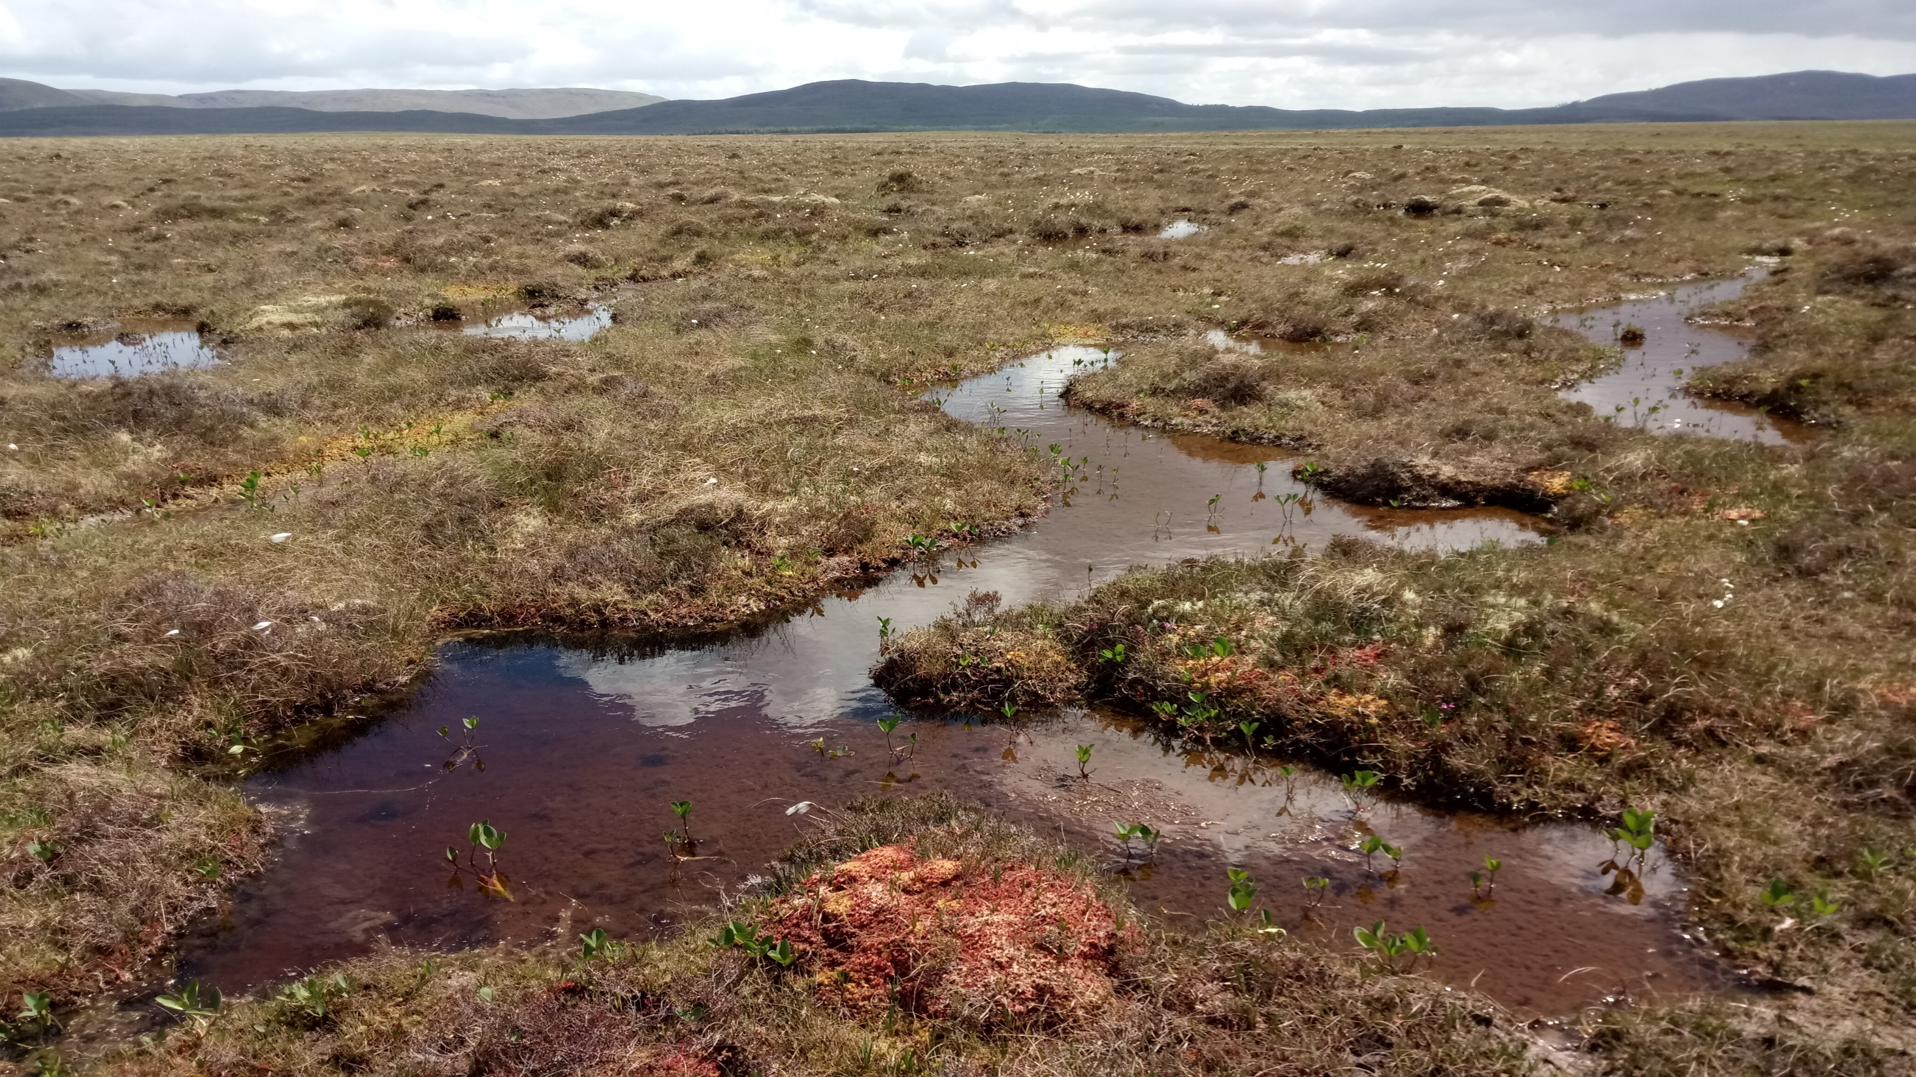
Beneath the Blanket Towards a better understanding of stream ecology in blanket peat covered catchments
Raymond Flynn, Claire McVeigh, Francis Mackin, Sorcha Cahill, & Florence Renou-Wilson
Queen’s University Belfast,
University College Dublin.

Slide 2
Conventional View of Blanket Bog Hydrology
Covered in varying layer of low permeability partially decomposed organic matter (catotelm).
May have thin covering of much more permeable material (acrotelm), depending on hydrology.
The role of the substrate is rarely considered

Slide 3
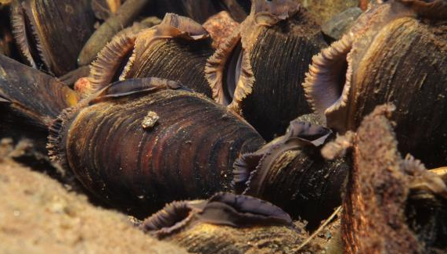
Blanket Bog Hydrochemistry
Bog water typically
Low pH (<5.5)
Low specific electrical conductance, typically 30µS/cm-80µS/cm
Rich in dissolved organic carbon.
Major inorganic ions dominated by Na and Cl.
Highly under saturated wrt Calcium carbonate.
…yet streams draining these catchments can contain organisms with calcium carbonate shells.
How can this happen?
Is it related to human interference?
Photo: Scottish Natural Heritage.

Slide 4
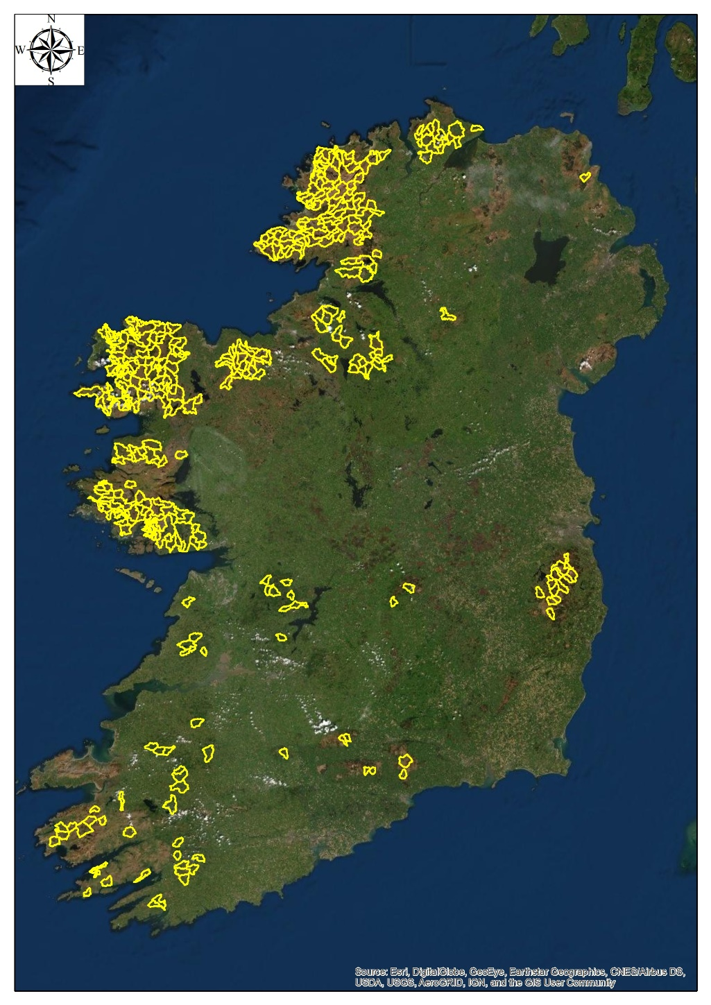
Research Gaps/Objectives
G
Looked at flow and water quality regime in catchments (each > 1km²) covered by relatively intact blanket peat.
This was compared to more degraded conditions nearby.
Three sites ,falling along climatic gradient, selected. (Wetter, in west)
Contrasting bedrock geology, but significant areas of active blanket bog.
Sites were characterised for aquatic ecology, water quality and flow.
C
L
Above: Location of 341 blanket bog-covered catchments (>1km²) displaying least amount of disturbance from human activity.

Slide 5
Results: Aquatic Invertebrates
Q scoring is a national classification system employed by Irish Environmental Protection Agency (EPA) to reflect the WFD status of water bodies.
Q-scores based on biological and physico chemical metrics.
Values for both extend from
1 (Bad status) through 3-4 (moderate) to 5 (High status - reference conditions).
Conditions at study points highly variable, despite no obvious external pressures.

Slide 6
Water Quality I
Very large differences in baseflow and quickflow water quality at all three sites.
Baseflow water significantly different from bog groundwater.
Have evolution of water quality toward more conductive, lower DOC, Calcium bicarbonate waters with flow recession.

Slide 7
Water Quality-Differences
G
All three sites underlain by variable thickness of glacial till resting on different bedrock types.
L-Carbonate-free crystalline-rich glacial till over limestone.
C- Locally derived glacial till over sandstone
G-Locally derived glacial till over basalt.
Base flow water quality signatures differ strongly between catchments and reflect discharge from both subsoil and bedrock with different geochemistries.
C
L
Basemap: Geological Survey of Ireland

Slide 8
Revised Conceptual Model of Blanket Bog hydrology
Water quality (and hydraulic head) data indicate water flows through the peat to the underlying substrate.
The water discharging from the peat reacts with substrate materials to give more mineralised water that supports baseflow.
The level of mineralisation in baseflow can partially explain contrasts in stream biota.
Flow balance data indicate that vertical losses from the peat make up less than 5% of total inputs.
This flow is essential for supporting stream flow and water quality during prolonged dry periods.

Slide 9
Questions / Comments?
Photograph: Francis Mackin

