Slide 1

Future changes in high impact events in pan-European convection permitting projections
Dr. Lizzie Kendon
Segolene Berthou, Steven Chan, Abdullah Kahraman, Colin Manning and Nigel Roberts

Slide 2
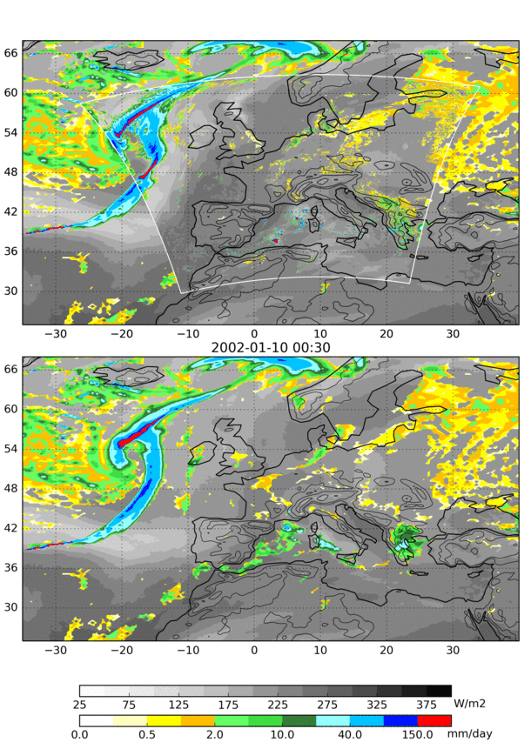
Convection-permitting climate simulations over Europe
2.2km (1536 x 1536 x 70)
convection-permitting model
N512 global 25x39km (768 x 1024 x 85)
convection-parameterised model
10+ year simulations:
ERA-interim driven (1999-2015)
present-day (1997-2006) GCM driven
future (~2097-2106), RCP8.5
Notes:
The Eur2.2km simulations provide a much more realistic representation of rainfall compared to the coarser 25km resolution driving model.
From animation see …
Improved diurnal cycle – no longer strong midday peak
Increased intensity of heavy rainfall
More realistic rainfall structures with less light rainfall
For the first time CPMs provide credible projections of future changes in hourly rainfall.

Slide 3

Germany JJA
Enhanced future intensification of precipitation extremes at convection permitting scale across Europe
Southern France SON
Eastern Spain SON
Chan et al, 2020, Clim. Dyn.
Notes:
Future changes of exceedance rates under present-climate thresholds for (a) JJA Germany, (b) SON Eastern Spain, and (c) SON Southern France at 25km scale for the 2.2km and N512 GCM simulations.

Slide 4
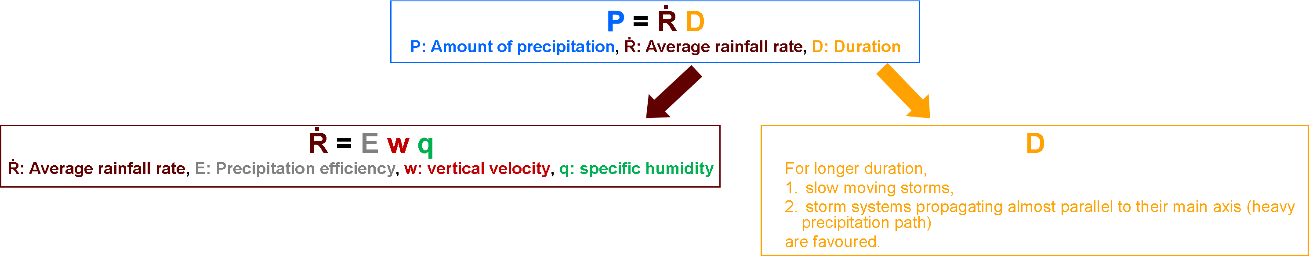
More slow moving intense rainstorms with climate change
Following the ‘ingredients-based methodology’ from short-range forecasting for heavy precipitation producing storms;
We define two metrics in the climate model output:
  Extreme Precipitation Potential (EPP)
  => 850 hPa specific humidity ≥ 10 gkg⁻¹ AND 700 hPa vertical velocity ≥ 2 ms⁻¹
  Slow-moving Extreme Precipitation Potential (SEPP)
  => EPP with storm system motion ≤ 3 ms⁻¹ (using Corfidi Vector approach)
Courtesy Abdullah Kahraman
Notes:
Corfidi vector is defined as 2 x (average wind speed between 850 and 300hPa) – wind speed at 850hPa
This is a measure of the storm system speed, using the theory of MCS propagation and storm retriggering.
When the low level wind is low, Corfidi vector is strongly related to upper level wind speed.
EPP – extreme precipitation rates
SEPP – extreme precipitation accumulations and hence of key importance for flooding

Slide 5
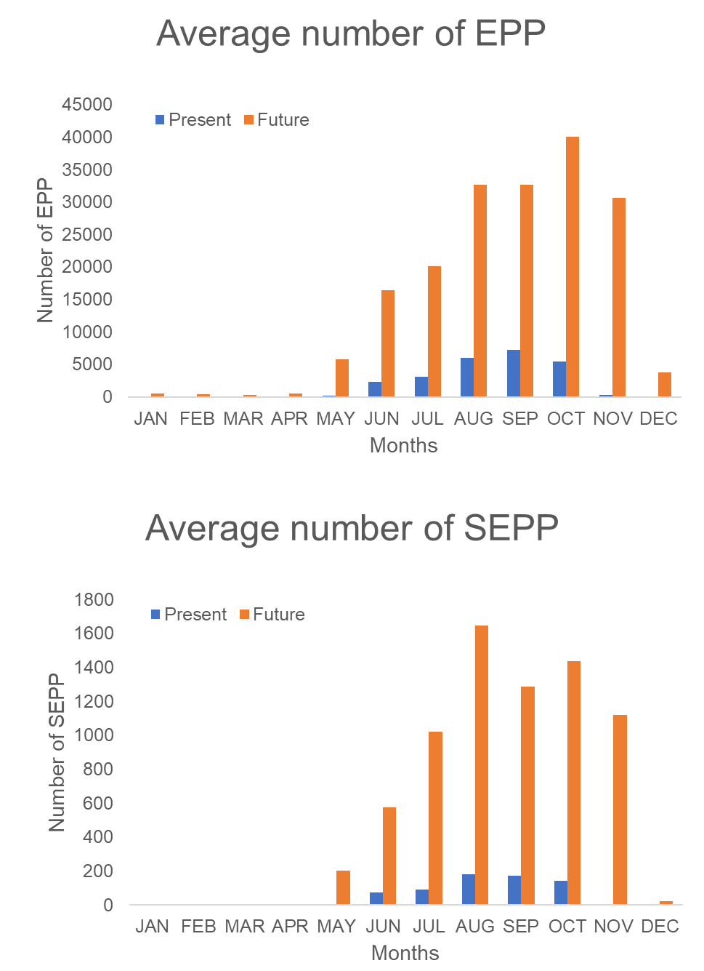
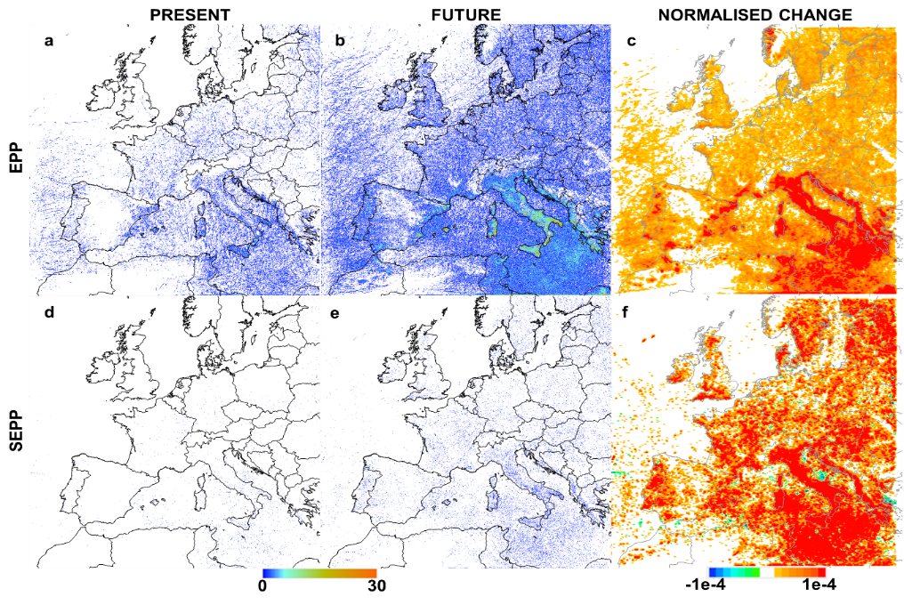
More slow moving intense rainstorms with climate change
11 years simulations of present and future climate (RCP8.5), 2.2km grid spacing
Future EPP freq. = ~7.5 x Current EPP freq.
Future SEPP freq. = ~10.9 x Current SEPP freq.
Courtesy Abdullah Kahraman
Notes:
Normalised change = future change divided by domain-average present value

Slide 6
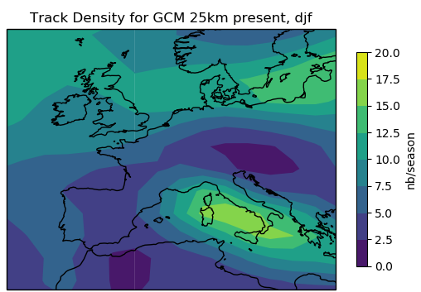
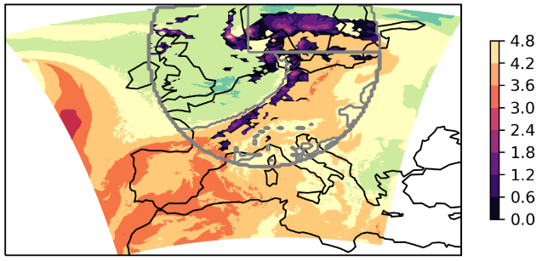
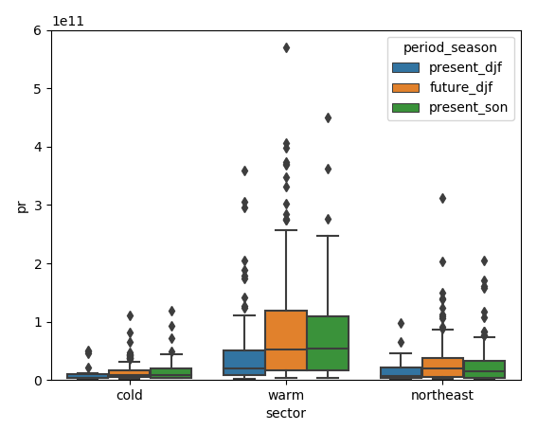
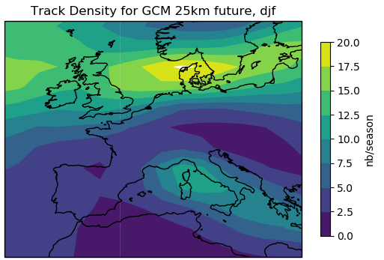

Convection in future winter storms over northern Europe
Courtesy: Segolene Berthou
Present nb of storms
Northeast sector
Cold sector
(dry intrusion)
Warm sector
Total intense (>5mm/h) precipitation per storm sector
Precipitation (mm/h)
Future nb of storms
Wet-bulb potential temperature at 850hPa
2) For each storm, at time of minimum sea level pressure, we define 3 sectors based on a wet-bulb potential temperature threshold (which has the maximum density of fronts)
3) Future winter storms have similar rainfall characteristics as present-day autumn storm.
1) Number of storms is given by the GCM: 25% increase in northern Europe
Notes:
Point people to Segolene’s poster in EUCP session on Tuesday

Slide 7
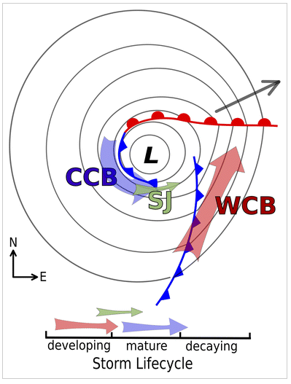
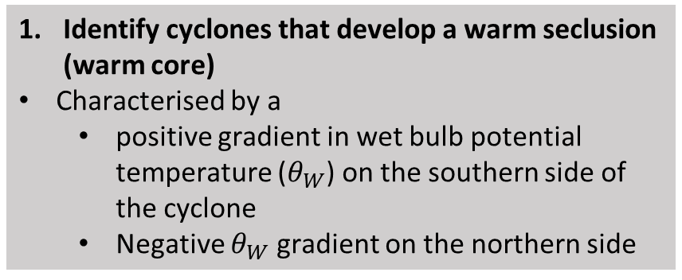
Diagnosing sting jets in DJF storms
Identify cyclones that develop a warm seclusion (warm core)
Characterised by a
  positive gradient in wet bulb potential temperature ($θ_{W}$) on the southern side of the cyclone
  Negative $θ_{W}$ gradient on the northern side
SJ: Sting-Jet CCB: Cold Conveyor Belt WCB: Warm Conveyor Belt
Hart et al. (2017)
Courtesy Colin Manning
Notes:
Colin has developed a method for automated identification of sting jet events.

Slide 8
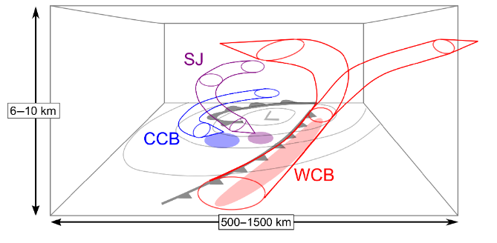
Diagnosing sting jets in DJF storms
Identify cyclones that develop a warm seclusion (warm core)
Characterised by a
  positive gradient in wet bulb potential temperature ($θ_{W}$) on the southern side of the cyclone
  Negative $θ_{W}$ gradient on the northern side
2. Identify slanted core of maximum wind speeds of sting-jet
Clark and Gray (2018)
SJ: Sting-Jet CCB: Cold Conveyor Belt WCB: Warm Conveyor Belt
Courtesy Colin Manning
Notes:
Colin has developed a method for automated identification of sting jet events.

Slide 9
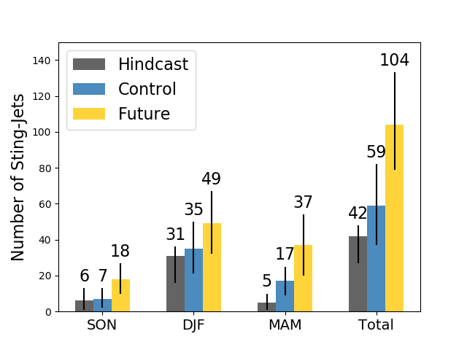
Future changes in frequency of sting jet storms
Future increases in frequency of sting-jet storms across Europe found in all seasons
Black bars represent 95% uncertainty interval obtained via bootstrapping
Courtesy Colin Manning
Notes:
Point people to Colin’s poster in CPM session on Friday

Slide 10
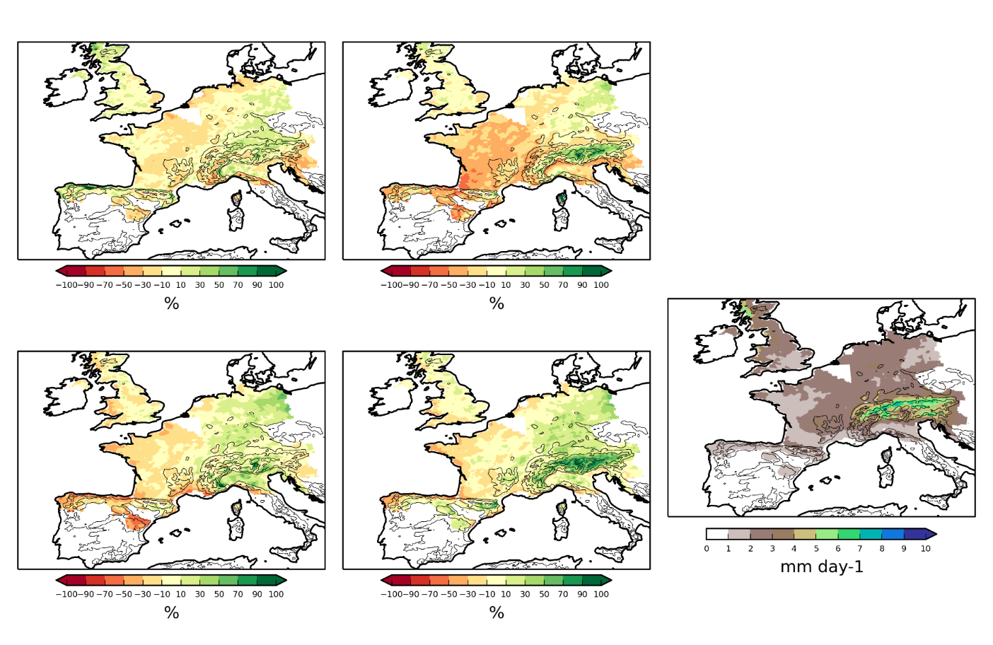
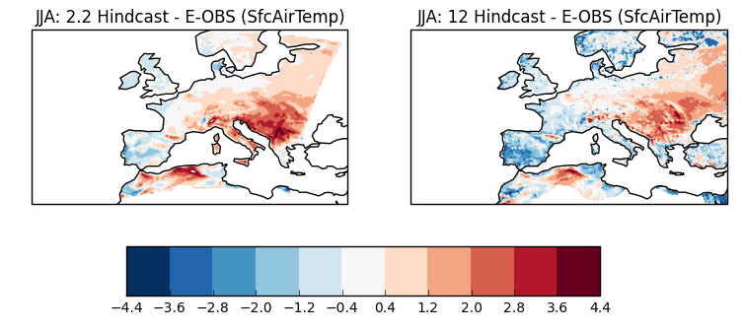
Issue of land-surface atmosphere coupling in CPMs
2.2km bias
12km bias
30-50% precipitation bias in 2.2km
Dry bias in Europe 2.2km model in summer, resulting in significant warm bias over C/E Europe
Precipitation JJA
2.2km is warmer by ~1K.
Temperature in JJA
Berthou et al. (2018) Clim. Dyn.
(K)

Slide 11
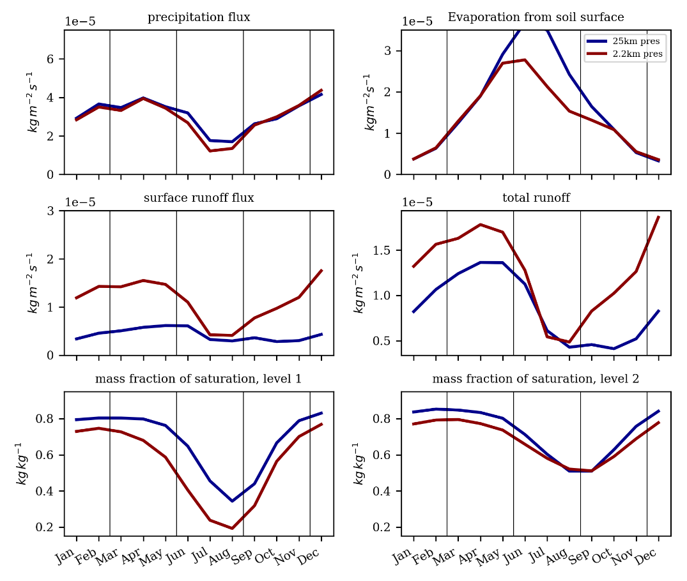
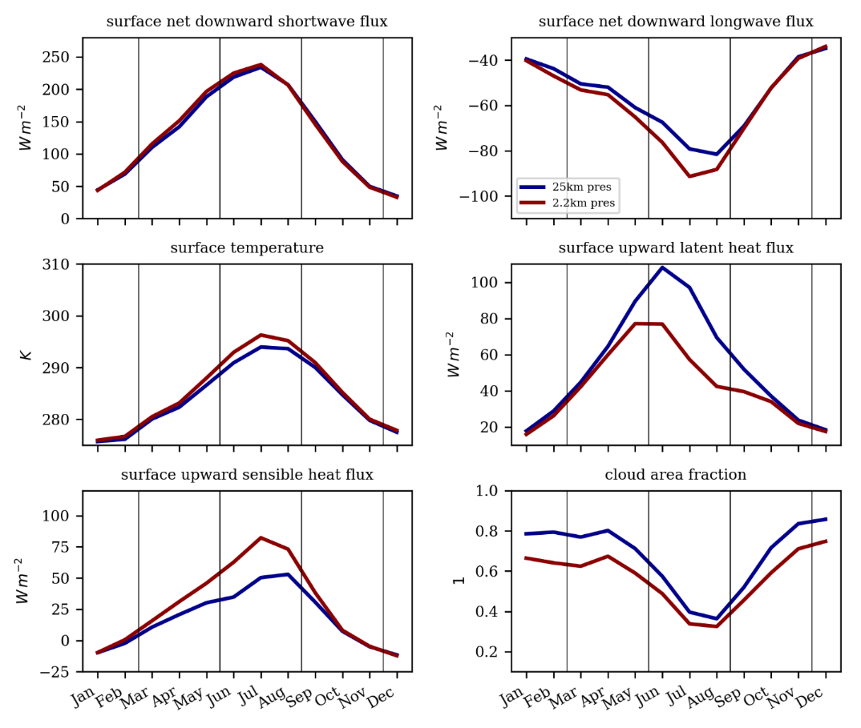
Dry bias in Europe 2.2km model in summer
=
www.metoffice.gov.uk © Crown Copyright 2018, Met Office
Enhanced spring run off, due to intense/intermittent nature of rain.

Slide 12
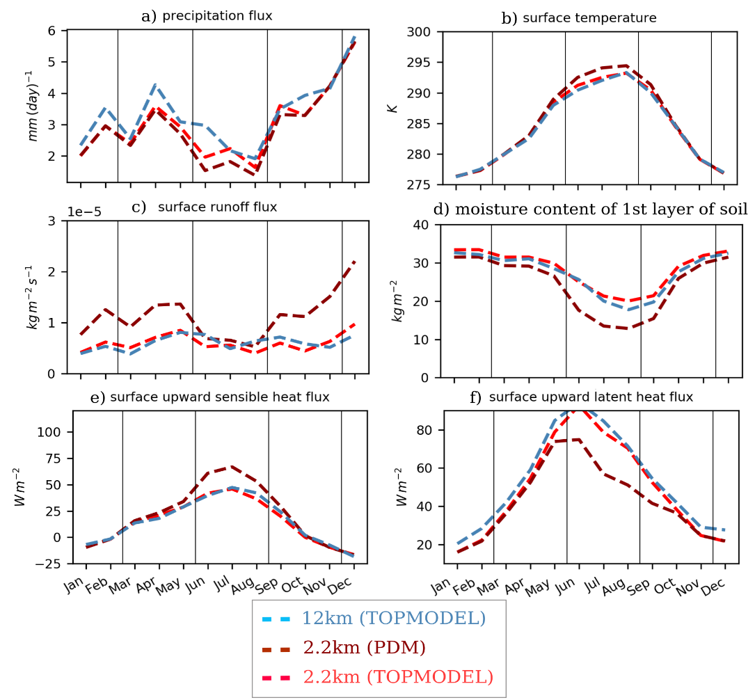
Significant improvement on using TOPMODEL
Impact of TOPMODEL on annual cycles over France
TOPMODEL is a more complex scheme that represents soil moisture heterogeneity throughout the soil column, including a water table.
TOPMODEL leads to significant improvements in soil moisture, with less rainfall running off at the surface. This reduces the warm, dry biases over central Europe (1-2K cooler and 30% more rainfall in summer).
www.metoffice.gov.uk © Crown Copyright 2017, Met Office
Notes:
Mean annual cycle over France for a 12km simulation with TOPMODEL, a 2.2km simulation with PDM and a 2.2km simulation with TOPMODEL. Note: this graph only uses 2 years of simulation, as the sensitivity test is still running.
And some further description:
The default 2.2km + PDM simulation shows a large precipitation deficit in summer (a) compared to the 12km + PDM simulation (and to observations, not shown). Switching from PDM to TOPMODEL reduces surface runoff (c), increases soil moiture in the 3 top layers of soil in summer (d - only 1st layer shown here), which increases latent heat fluxes (e), decreases sensible heat fluxes (d) and leads to 1-2K cooler temperature (b) and 30% more rainfall in summer (a). Overall, this shows that the UM precipitation flux at 2.2km resolution is very sensitive to soil moisture in summer in Central Europe.

Slide 13
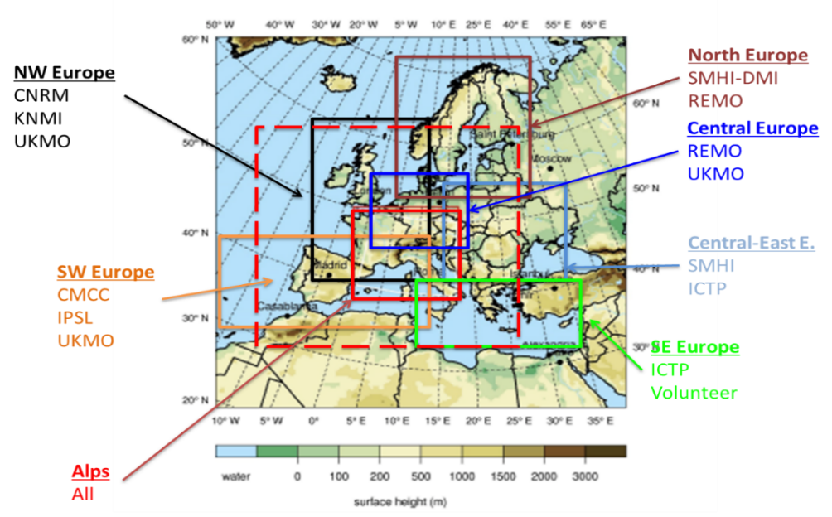
Summary and outlook
Improved realism of rainfall in CPMs -> CPMs provide credible projections of future changes in hourly rainfall and extremes, unlike coarser resolution climate models.
      Greater future increase in hourly precipitation extremes in CPM compared to driving model
      Increases in precipitation rates due to increasing moisture, but also evidence of more slower moving storms leading to high precipitation accumulations
CPMs are able to capture sting jets, allowing first look at future changes.
      CPM shows increasing frequency of sting jets in future
Remaining science issues:
      Heavy rainfall tends to be too intense, due to convection under-resolved. Scale-aware convection schemes may help alleviate this.
      Too much runoff at the surface, due to intense/intermittent nature of rain. Improved with new land-surface schemes that model complex surface moisture fluxes.
      Limited sampling of uncertainty
Multi-model experiments at km-scale are underway as part of the CORDEX-FPS and EUCP projects. These will provide a first indication of the extent to which results are robust across different CPMs, complementing results from the 12-member CPM ensemble run over the UK as part of UKCP18.
Notes:
Mention talk I’m giving on Friday on the UKCP 2.2km ensemble projections.

Slide 14

My personal pledges to reduce carbon
stop buying red meat
cycle or walk to work every day
never take domestic flights
rarely fly on holiday and carbon offset any flights
minimise flights for work and participate in meetings remotely wherever possible

Slide 15
Spare slides

Slide 16
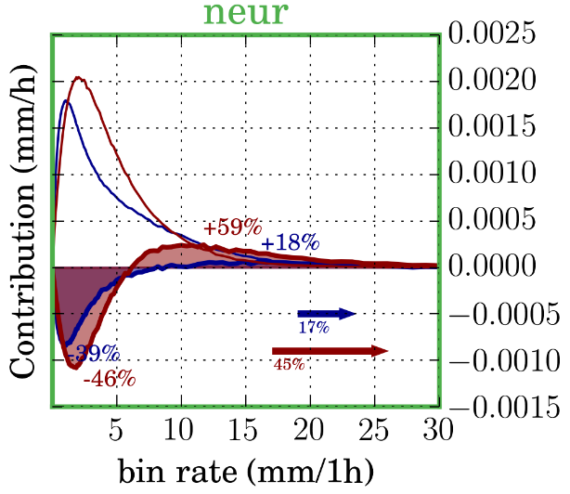
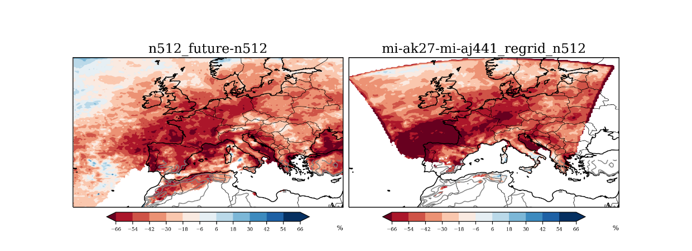
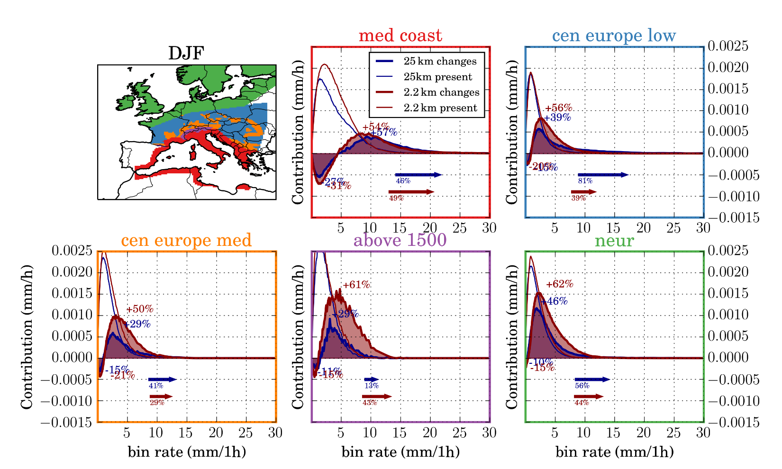
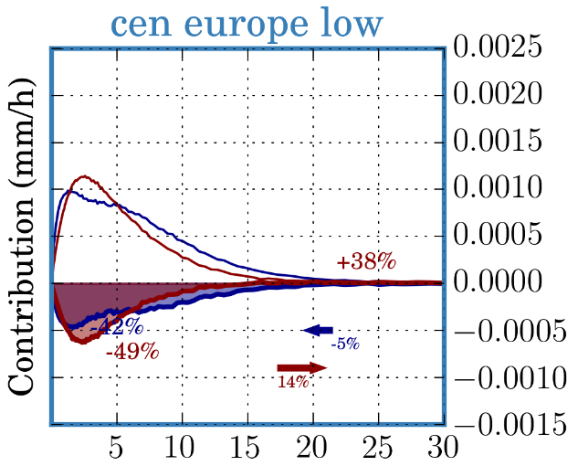
Future changes in precipitation in Europe 2.2km
JJA future mean precipitation changes
2.2km
GCM (25km)
CPM (2.2km)
25km
Larger mean drying in summer in 2.2km.
Due to larger decrease in moderate/light events in 2.2km.
In northern Europe, strongest events increase in frequency, more so in 2.2km.
2.2km
25km
Courtesy: Segolene Berthou

Slide 17
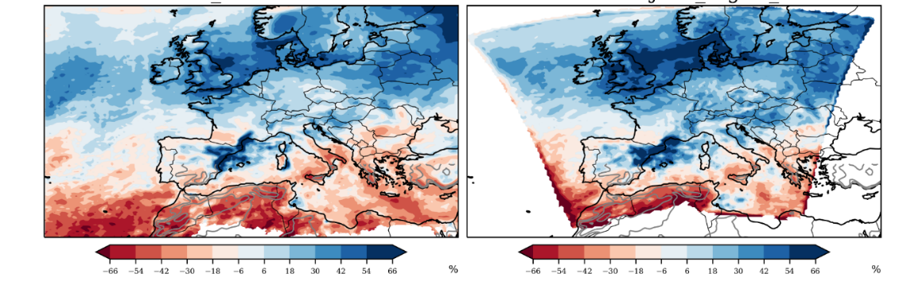
Future changes in precipitation in Europe 2.2km
DJF future mean precipitation changes
CPM (2.2km)
2.2km
GCM (25km)
25km
Present-day precipitation distributions similar between models in winter.
Tendency for greater future mean increase in 2.2km.
Precipitation rates above 1.5mm/h increase more in 2.2km.
2.2km
25km
Courtesy: Segolene Berthou

Slide 18
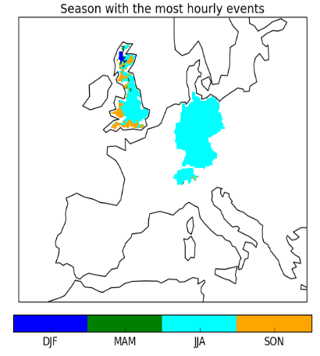
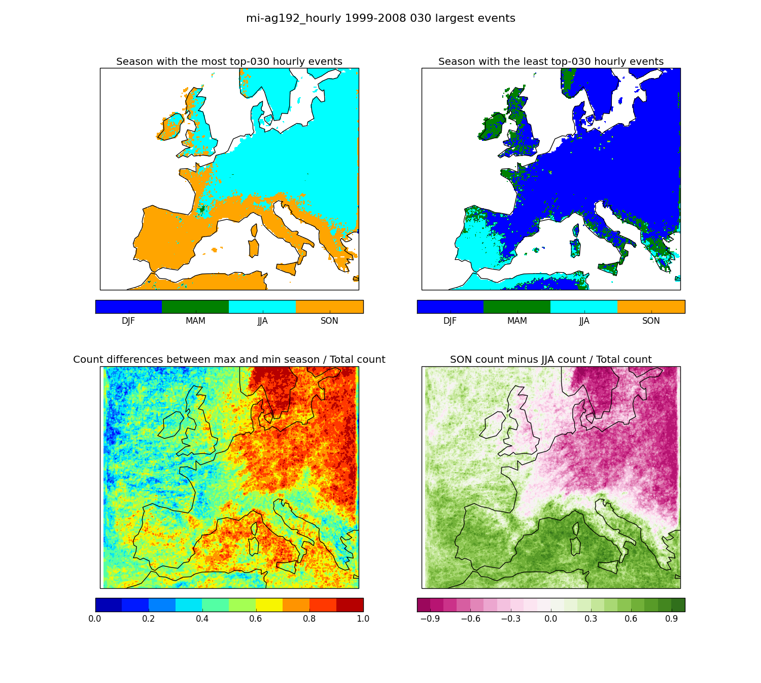
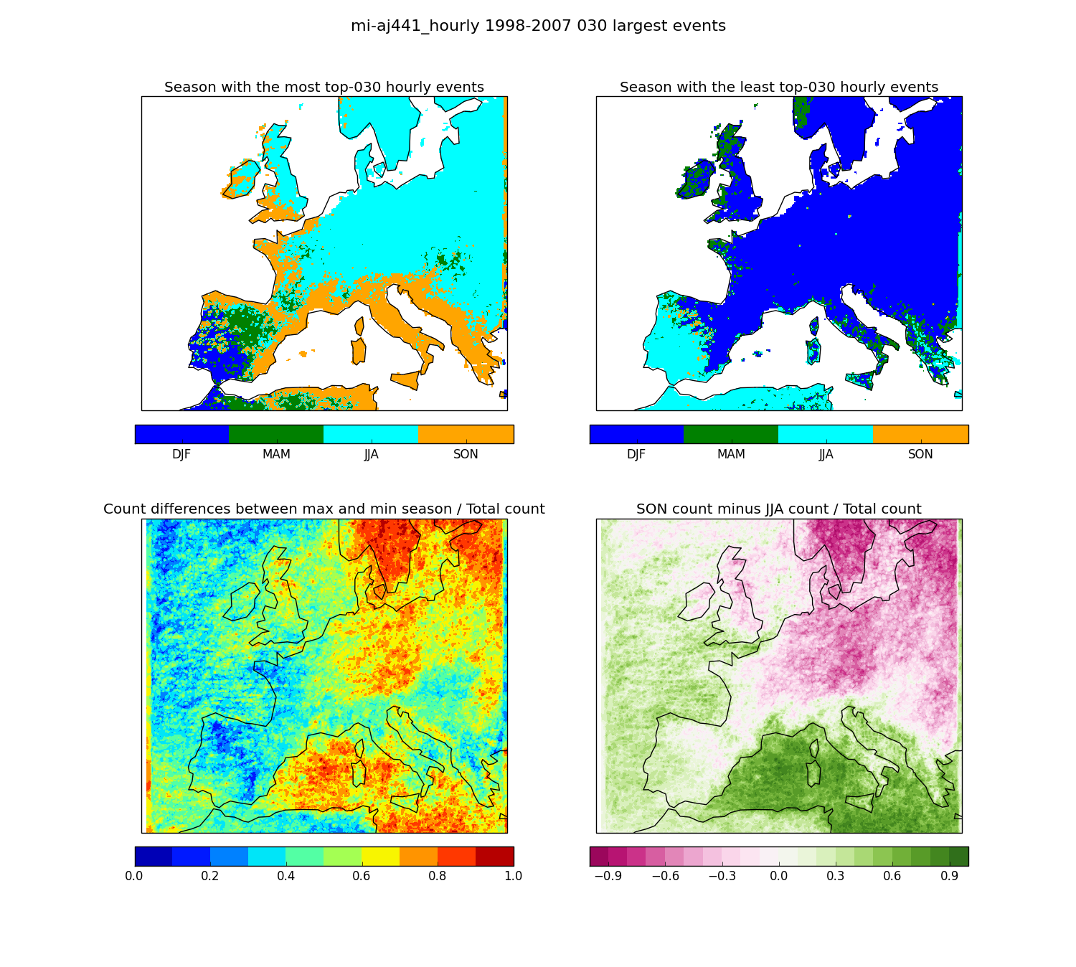
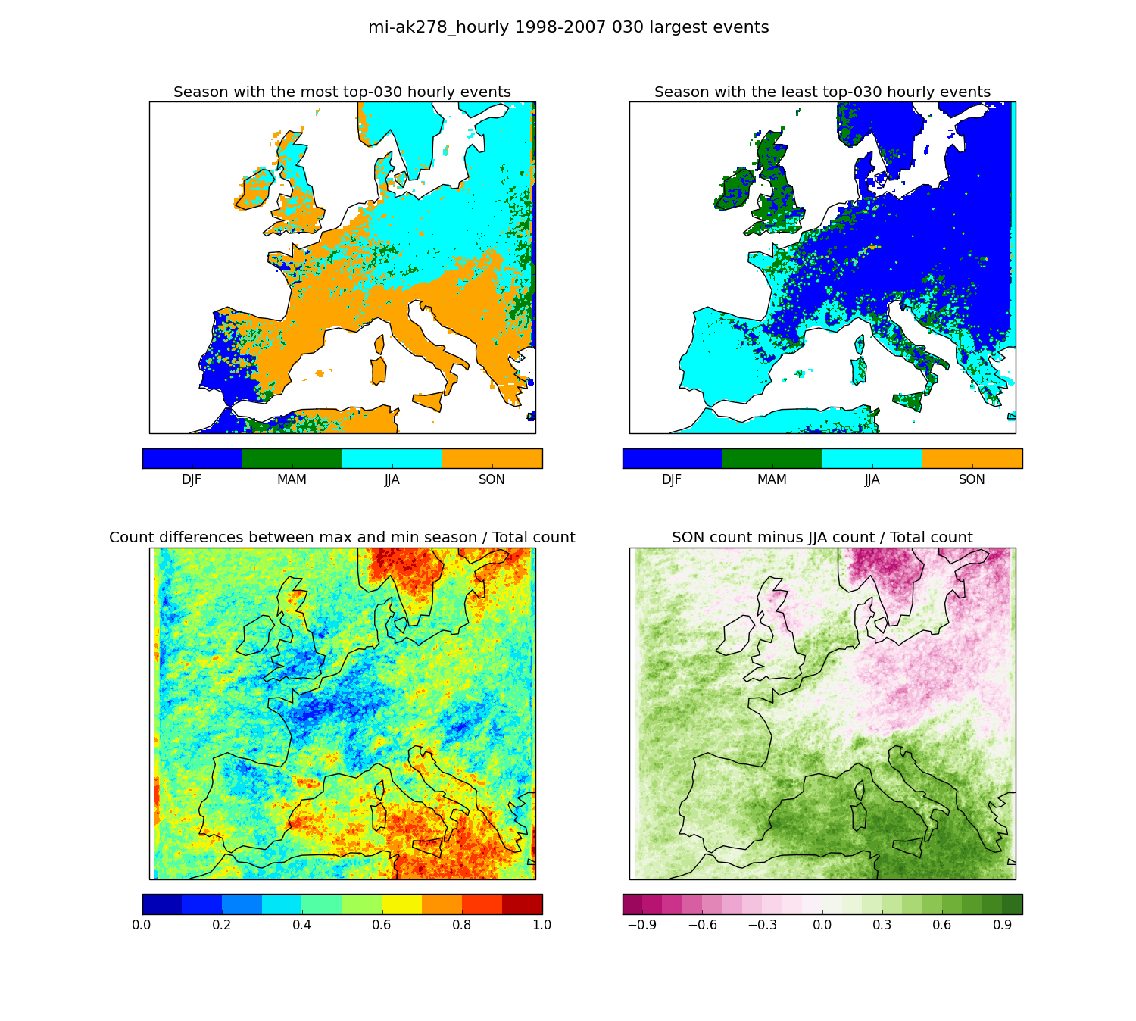
Future changes in extreme precipitation in Europe 2.2km
Season with the most hourly events
Future/present exceedance of extreme hourly events
Winter Summer
OBS
ERAI 2.2
Control 2.2
Future 2.2
Greatest changes occur in seasons that not historically associated with hourly extremes
Chan et al, 2020, Clim. Dyn.
Notes:
Left: 6 events per year (~98th percentile, annually) threshold.
Seasonally, most of the increases occur in SON and DJF, i.e. not in the seasons that historically associate with occurrence of hourly extremes
Right: 3 events per year (~99th percentile) threshold.
Shows change in seasonal timing of hourly extremes from JJA to SON.

Slide 19
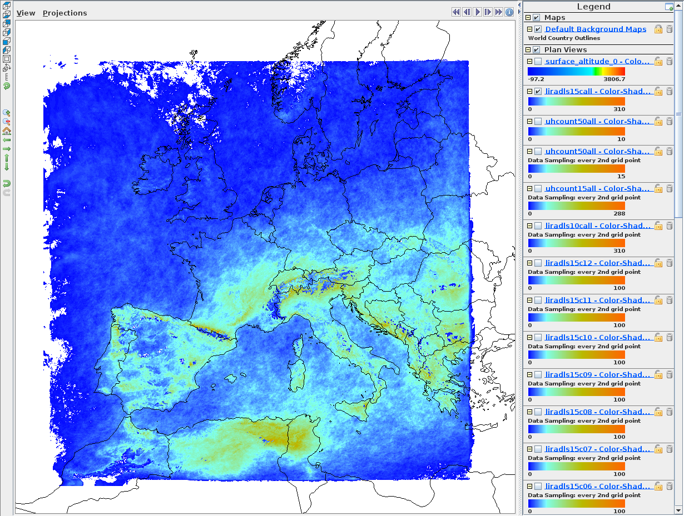
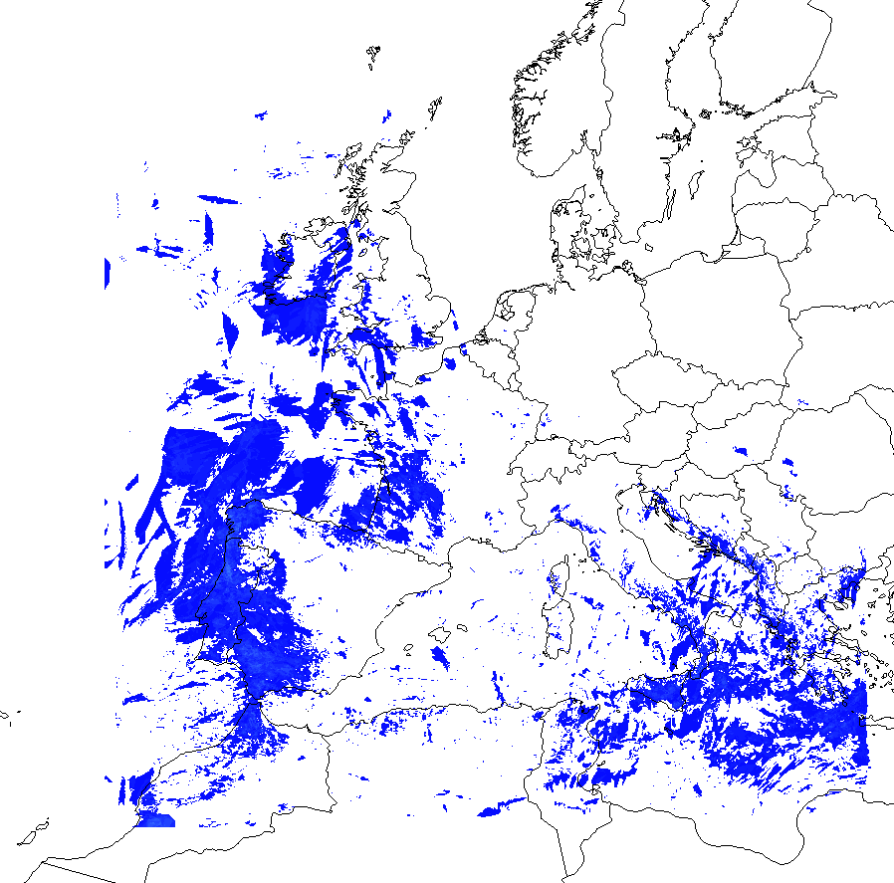
Severe storm environments (1999-2014)
Number of occasions with
Lifted Index LI ≤ -2K
AND
Precipitation ≥ 0.1 mm
AND
Deep Layer Shear ≥ 15ms⁻¹
Data: 15 years, 3 hourly intervals
www.metoffice.gov.uk © Crown Copyright 2018, Met Office
Courtesy: Abdullah Kahraman
Notes:
Currently doing quite a lot of work looking at storms in these Europe 2.2km simulations as part of the FUTURE-STORMS project. Here is just one example …
Left plot shows occurrence of severe storm environments across Europe in present-day – with highest values over Mediterranean.
Animation is seasonal cycle.
Understanding changes in severe storm environments is important for understanding future changes in hail and lightning.

Slide 20
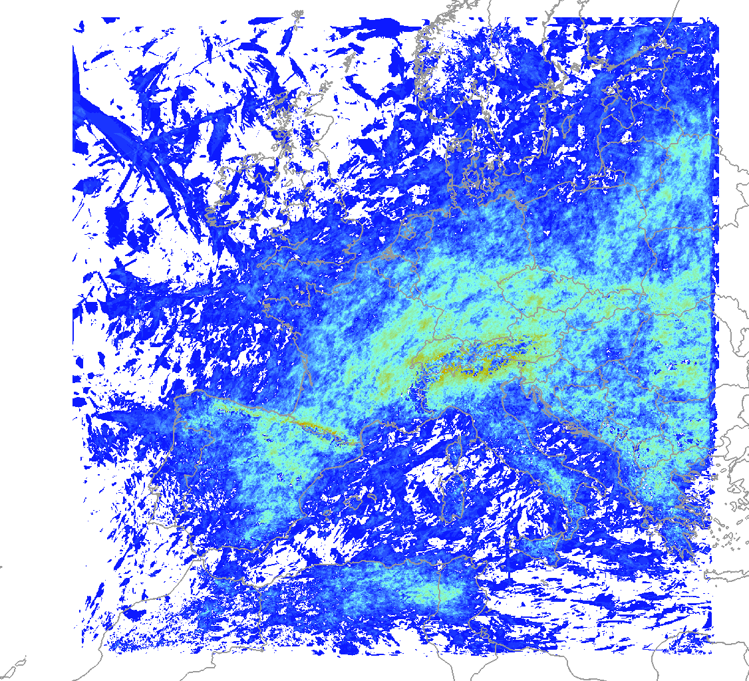
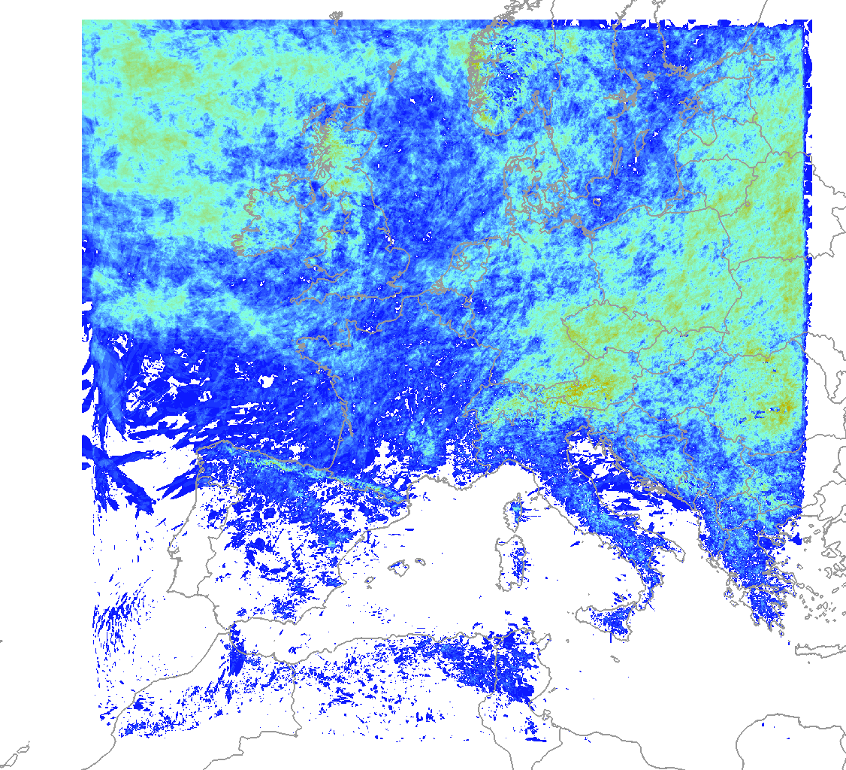
Future change in severe storm environments
JUNE: control vs future
www.metoffice.gov.uk © Crown Copyright 2018, Met Office
Courtesy: Abdullah Kahraman
Notes:
Here looking at future changes in the number of occurrences of severe storm environments for June.
June is the peak month for severe storm occurrences across the continent.
Here using 3 hourly data from 10 years in present and 10 years in future.
See big increase over British Isles and over eastern Europe.

Slide 21
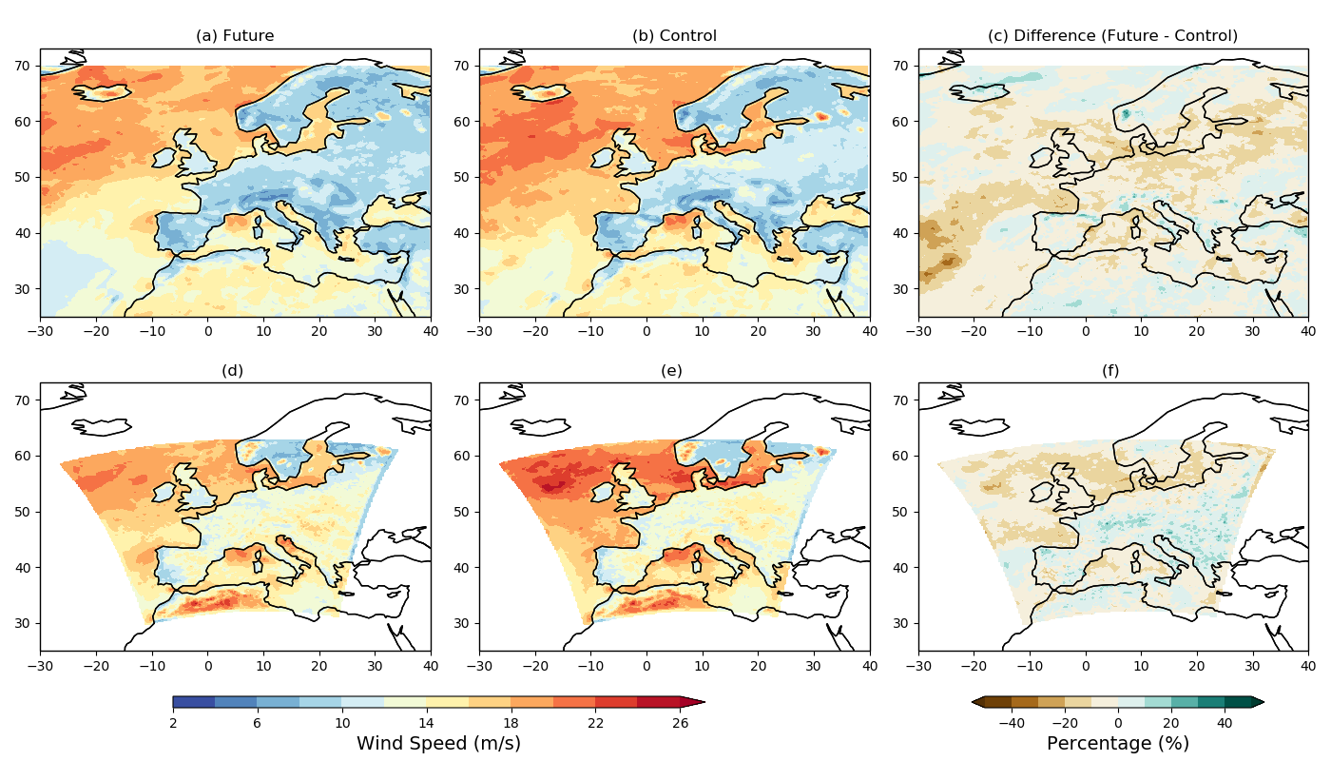
Future changes in wind extremes in Europe 2.2km - JJA
25km GCM
Extreme winds in summer larger in CPM than GCM
Smaller future decreases across Europe in CPM
CPM
99.5th percentile of daily max wind speed in summer
Courtesy Colin Manning
Notes:
Extreme winds in summer considerably larger in CPM than driving GCM especially over land, with smaller future decreases across Europe.
99.5th percentile of daily maximum wind speed at the surface

Slide 22
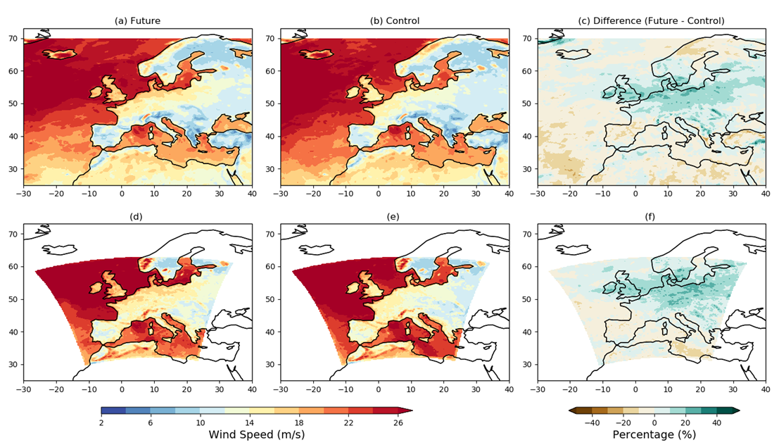
Future changes in wind extremes in Europe 2.2km - DJF
25km GCM
Extreme winds in winter larger in CPM than GCM
Both models show future increases across much of Europe
CPM
99.5th percentile of daily max wind speed in winter
Courtesy Colin Manning
Notes:
Extreme winds in winter larger in CPM than driving GCM, with both showing increases across much of Europe in future.
99.5th percentile of daily maximum wind speed at the surface

Slide 23
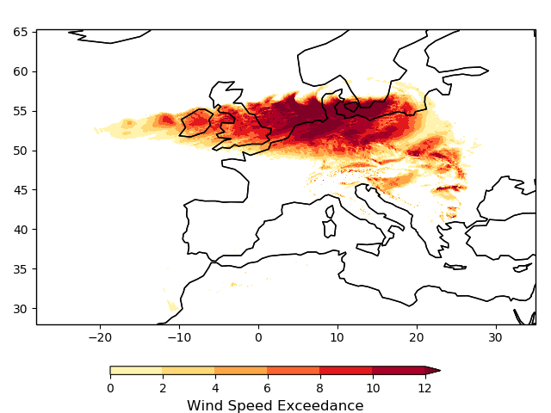
Diagnosing sting jets in DJF storms
Storm Footprint (max. 98th perc. Excedance at 850hPa)
Case study: Storm Anatol
3rd December 1999
Known sting-jet event
Caused US $2.6 bn in insured damages
Courtesy Colin Manning
Notes:
The storm footprint was created using 3-hourly wind speeds at 850hPa. The figure shows the maximum 98th percentile exceedance that occurred during the storm.

Slide 24
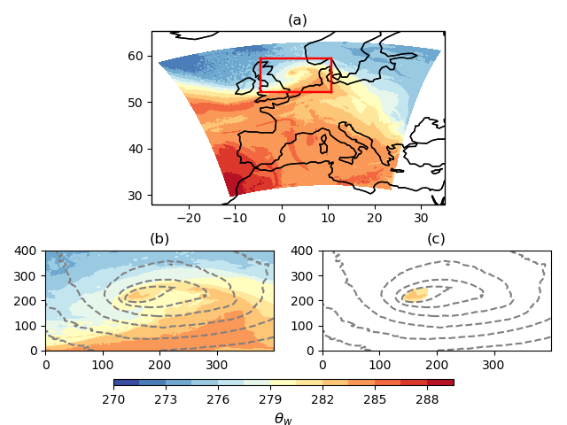
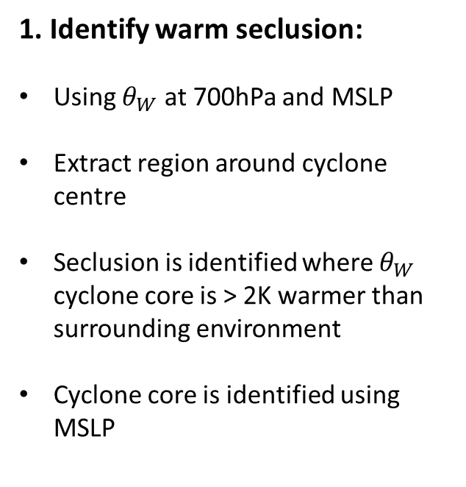
Diagnosing sting jets in DJF storms
1. Identify warm seclusion:
Using $θ_{W}$ at 700hPa and MSLP
Extract region around cyclone centre
Seclusion is identified where $θ_{W}$ cyclone core is > 2K warmer than surrounding environment
Cyclone core is identified using MSLP
Courtesy Colin Manning
Notes:
Method:
Seclusion is identified using theta_w at 700hPa (850hPa can also be used but 700hPa seemed to be better in this case).
Identify seclusion as a peak in latitudinal and longitudinal cross-sections. Seclusion is identified where theta_w is >2K warmer than the surrounding area. This criterion must be met in the north-south direction and the west->east direction.
Identified grid points must also occur within the cyclone’s core defined using MSLP.

Slide 25
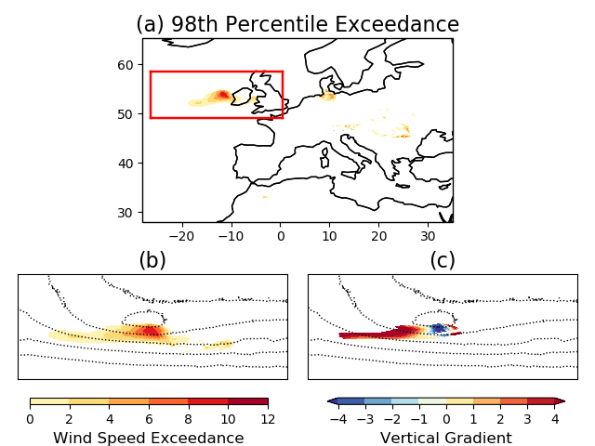
Diagnosing sting jets in DJF storms
2. Identify slantwise core of max windspeeds:
Difference between winds at 700hPa and 850hpa
RED: 700hPa > 850hPa
Blue: 700hPa < 850hPa
Looking only at areas where
wind exceeds its 98th percentile
Courtesy Colin Manning
Notes:
Method:
All values below the 98th percentile are masked.
Calculate vertical wind speed gradient between 750hPa and 850hPa (+ve gradient: wind_750 > wind_850, -ve grad: wind_750 < wind_850).
A sting jet is identified when we see a reversal in the vertical wind gradient. This is identified along the winds trajectory at 850hPa. The negative part of the reversal must also occur within a region of strong wind speed gradients to the north, south, east and west (i.e. blue region in panel (c) should occur with red region of panel (b).

