Slide 1

Using a convection-permitting model ensemble for projecting future change in high-impact events
Dr. Lizzie Kendon
Giorgia Fosser, Steven Chan, Robin Clark, Glen Harris, Gill Martin, James Murphy, Nigel Roberts, Simon Tucker.

Slide 2
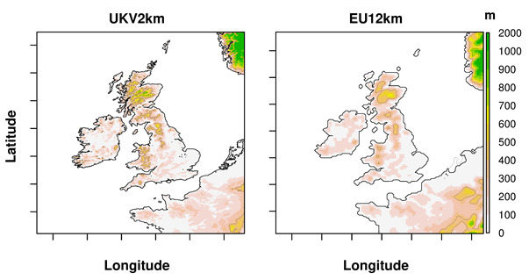
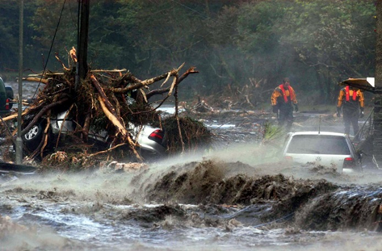
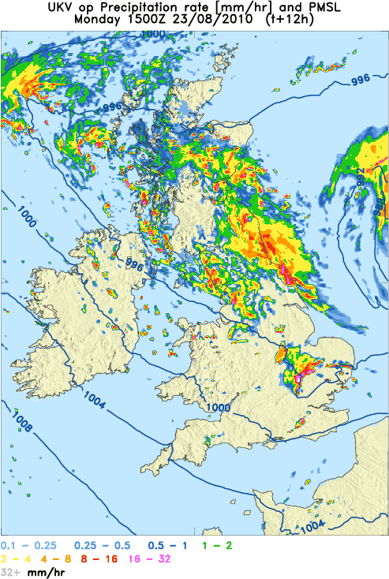
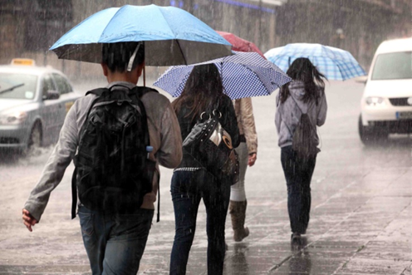
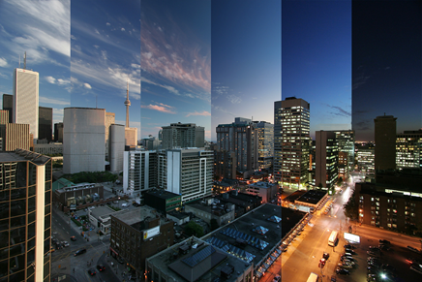
First national climate scenarios at convection-permitting scale
UKCP Local (2.2km) projections
New set of 12 climate projections using a model as detailed as that typically used for weather forecasts.
Hydrological impacts modelling e.g. flash floods
New estimates of changes in daily and hourly extremes
Storms
Summer downpours
Severe wind gusts
UKCP18 2.2km ensemble
2.2km resolution for UK
12 members
Driven by 12km RCM
Data for 1981-2000, 2021-40, 2061-80
High emissions scenario RCP8.5
Climate change for cities e.g. urban extremes
Supports UK risk assessments
© Crown Copyright 2018, Met Office
Notes:
Here we are providing a new set of 12 projections at 2.2km resolution. This is the first time anywhere, that national climate scenarios are being provided at a resolution on par with current operational weather forecast models. It is a major step forward in national climate capability, allowing us to look at future changes in hourly rainfall and also on small spatial scales such as cities.

Slide 3
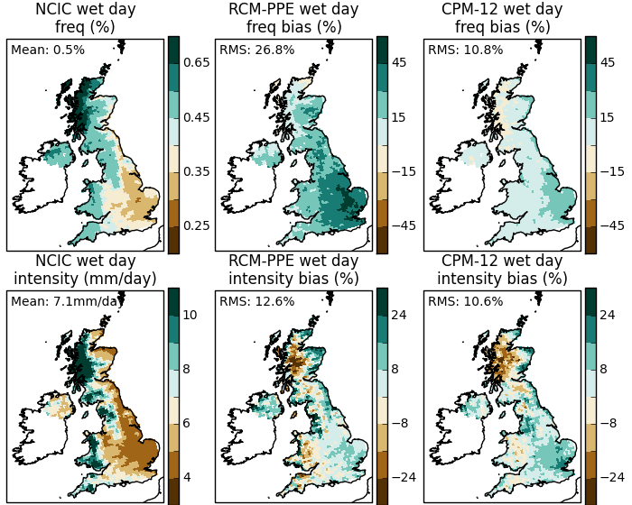
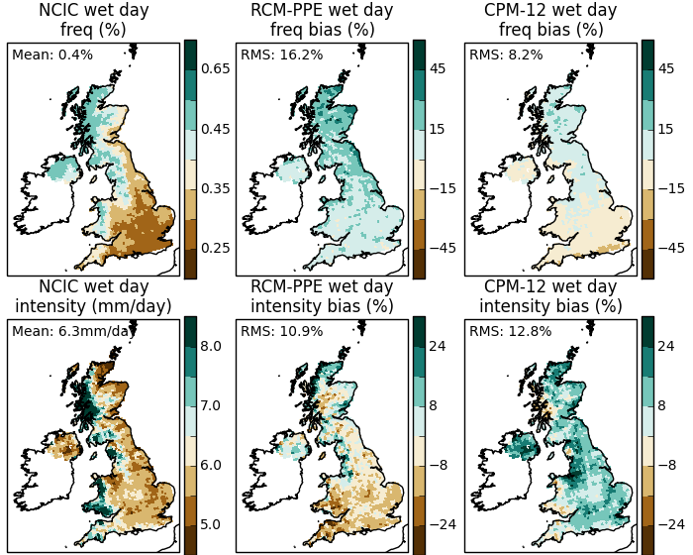
Local (2.2km) better simulates daily precipitation variability
Winter Summer
Observed and simulated daily precipitation in (left) winter and (right) summer
Frequency
Intensity
Regional (12km) has too many wet days, which is improved in Local (2.2km)
Local (2.2km) overestimates rainfall intensity away from orography
Lower Local model bias
Regional model bias
Local (2.2km) gives improvements in how rainfall varies day-to-day.
© Crown Copyright 2018, Met Office

Slide 4
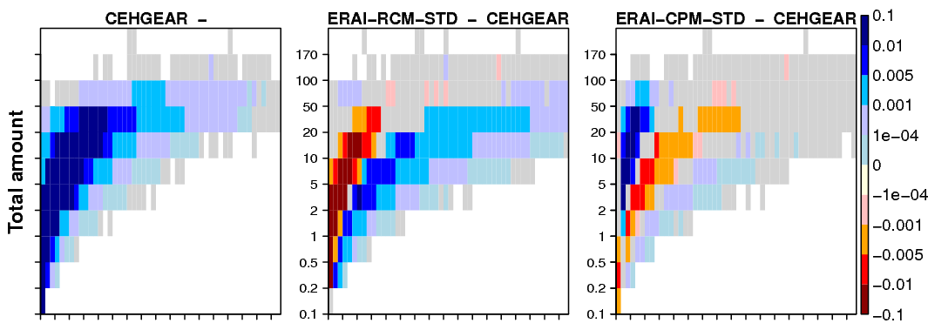
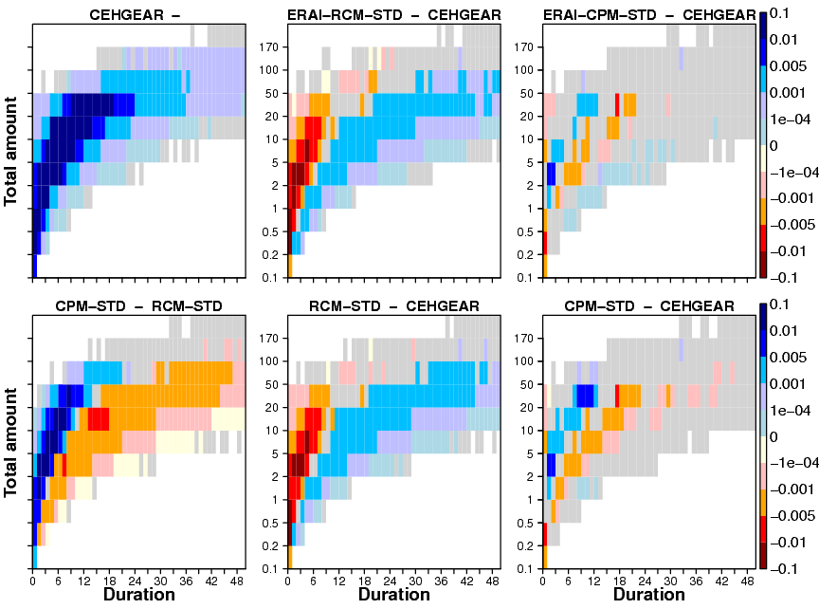
Local (2.2km) gives improvements in how rainfall varies hour-to-hour.
Observations
Regional model bias
Local (2.2km) better simulates hourly rainfall, including intensity and duration.
For the first time, it provides credible information for changes on hourly scales.
Summer
Winter
Lower Local (2.2km) model bias
© Crown Copyright 2018, Met Office
Notes:
There are still biases in the Local (2.2km) model – in particular there is a tendency for heavy rainfall to be too intense.
However, overall the Local model represents a major improvement in the realism of rainfall so that for the first time, it provides credible information on hourly scales.

Slide 5
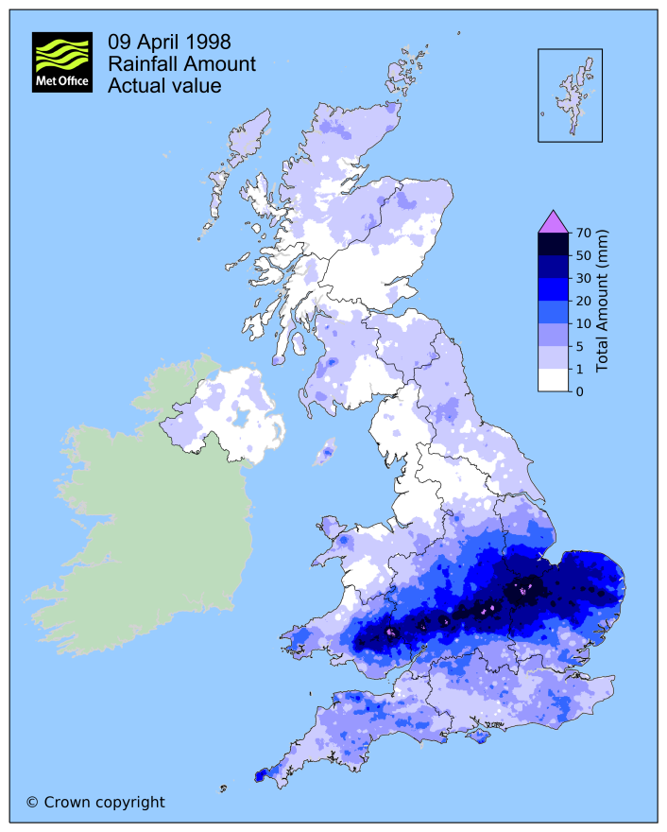
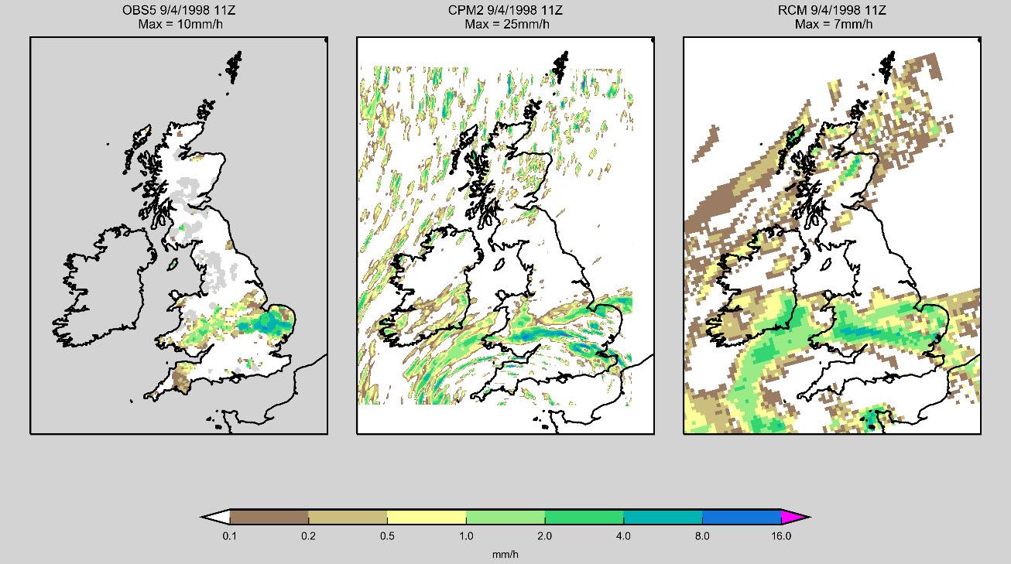
Easter floods 1998
Observations Local (2.2km) Regional (12km)
Observed rainfall for 24 hours from 09Z 9th April 1998. 61.6mm fell in 12 hours near Worcester, with peak rainfall rate of 10mm/h at 11am.
Hourly rainfall snapshot at 11am on 9th April 1998 in 5km observations, 2.2km and 12km models on native model grid
Local (2.2km) provides more realistic representation of showers and embedded convection.
© Crown Copyright 2018, Met Office
Notes:
Here we are looking at the example of an actual event, that nicely demonstrates the improved realism of rainfall in the Local (2.2km) model …
Can see that the 12km and 2.2km models agree well on the position of the front, but the 2.2km model provides more detail including embedded convective elements. It also gives a much more realistic representation of showery activity over the north of the UK.

Slide 6

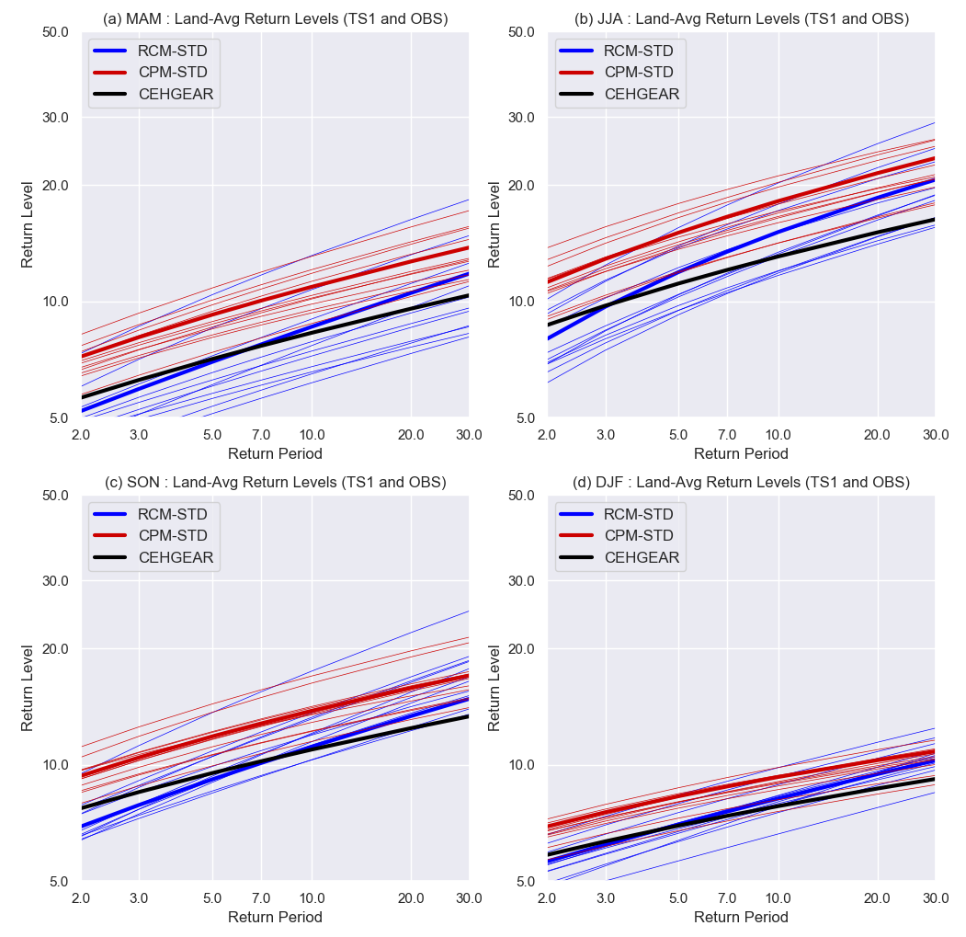
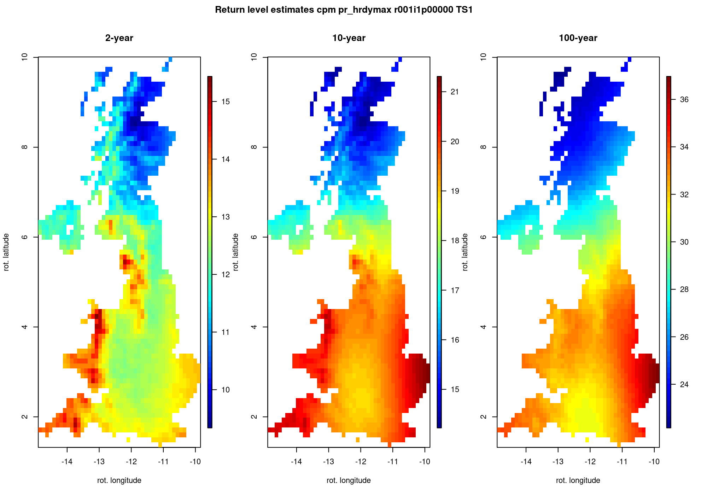
Present-day hourly precipitation extremes
Local 2.2km overestimates hourly extremes, but better represents rate extremes increase with increasing return period
Regional 12km has unphysical grid point storms leading to high values >100mm/h in the far extreme tail
Extreme hourly precipitation over south UK
MAM
JJA
Return levels mm/h in 2.2km (using spatial covariate)
2yr 10yr 100yr
15
14
13
12
11
10
21
20
19
18
17
16
15
36
34
32
30
28
26
24
SON
DJF
Courtesy: Steven Chan
Notes:
Local 2.2km correctly represents the growth curve (i.e. rate extremes increase with return period), suggesting it captures the processes by which extremes increase as conditions become more favourable. This has important implications for our confidence in future projections of extreme rainfall change.
Steven Chan is currently developing a method to fit all the extremes in a region (or UK as a whole) at once using a spatial covariate – this allows more robust return level estimates. Bottom left plot shows preliminary result showing return levels of daily max hourly precip in CPM using mean precipitation climatology as covariate. Large influence of orography is seen in 2yr return level, but this is no longer the case for more extreme events.

Slide 7
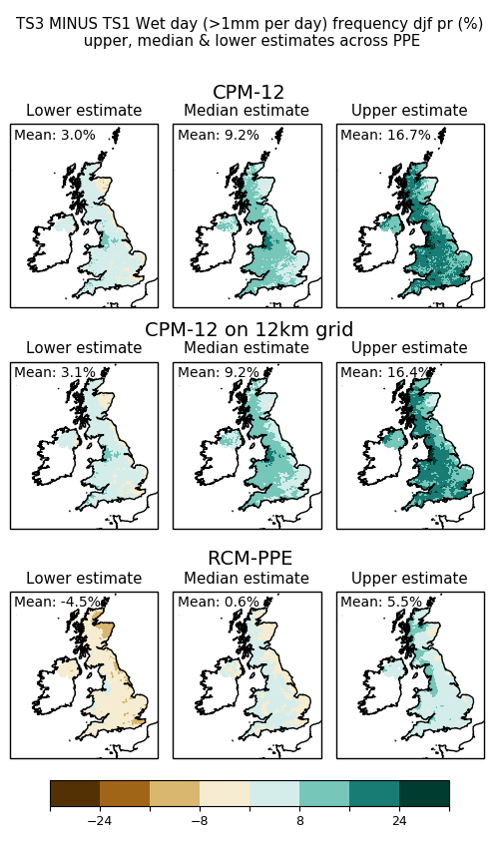
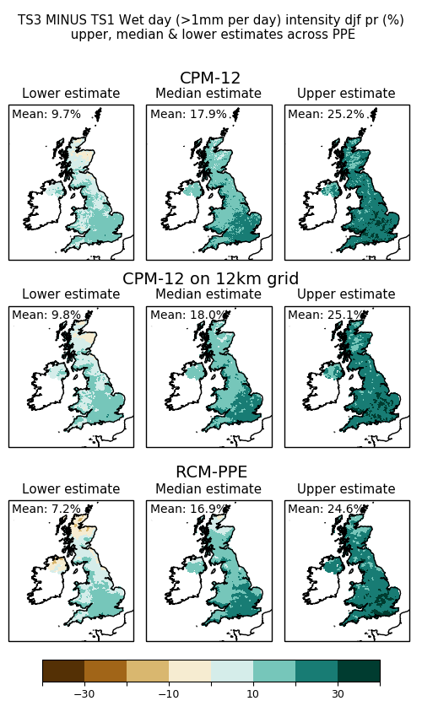
Local (2.2km) shows larger increases in wet day frequency than Regional (12km)
Future climate projections
Winter precipitation increases in both frequency of wet days and intensity on wet days
Wet day frequency change %
Wet day intensity change %
Projected changes to 2061-2080 for RCP8.5 as %
© Crown Copyright 2018, Met Office
Notes:
Wet day frequency increase 9.2% in 2.2km versus 0.6% in 12km – i.e. Much larger in 2.2km
Wet day intensity increase 17.9% in 2.2km versus 16.9% in 12km

Slide 8
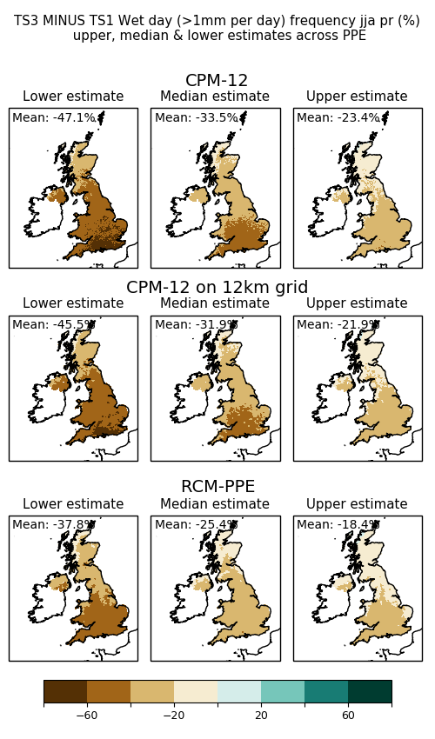
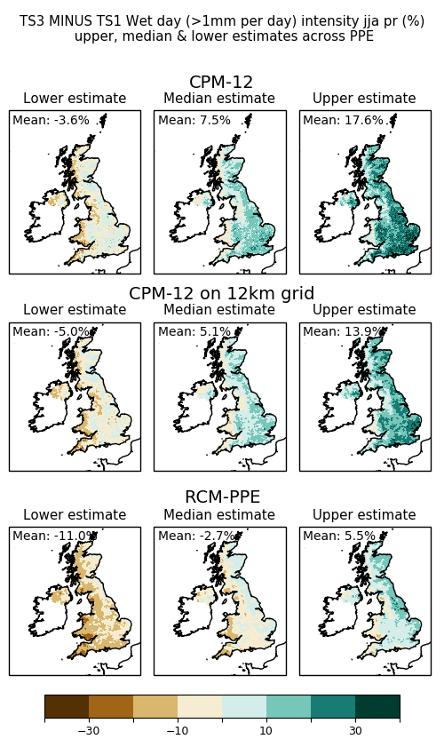
Local (2.2km) shows greater increases in summer rainfall intensity than Regional (12km).
Future climate projections
Despite overall summer drying, Local (2.2km) suggests future increases in the intensity of summer rainfall.
Wet day frequency change %
Wet day intensity change %
Projected changes to 2061-2080 for RCP8.5 as %
© Crown Copyright 2018, Met Office
Notes:
For wet day intensity changes, central estimate is 7.5% increase in Local but 2.7 decrease in Regional

Slide 9
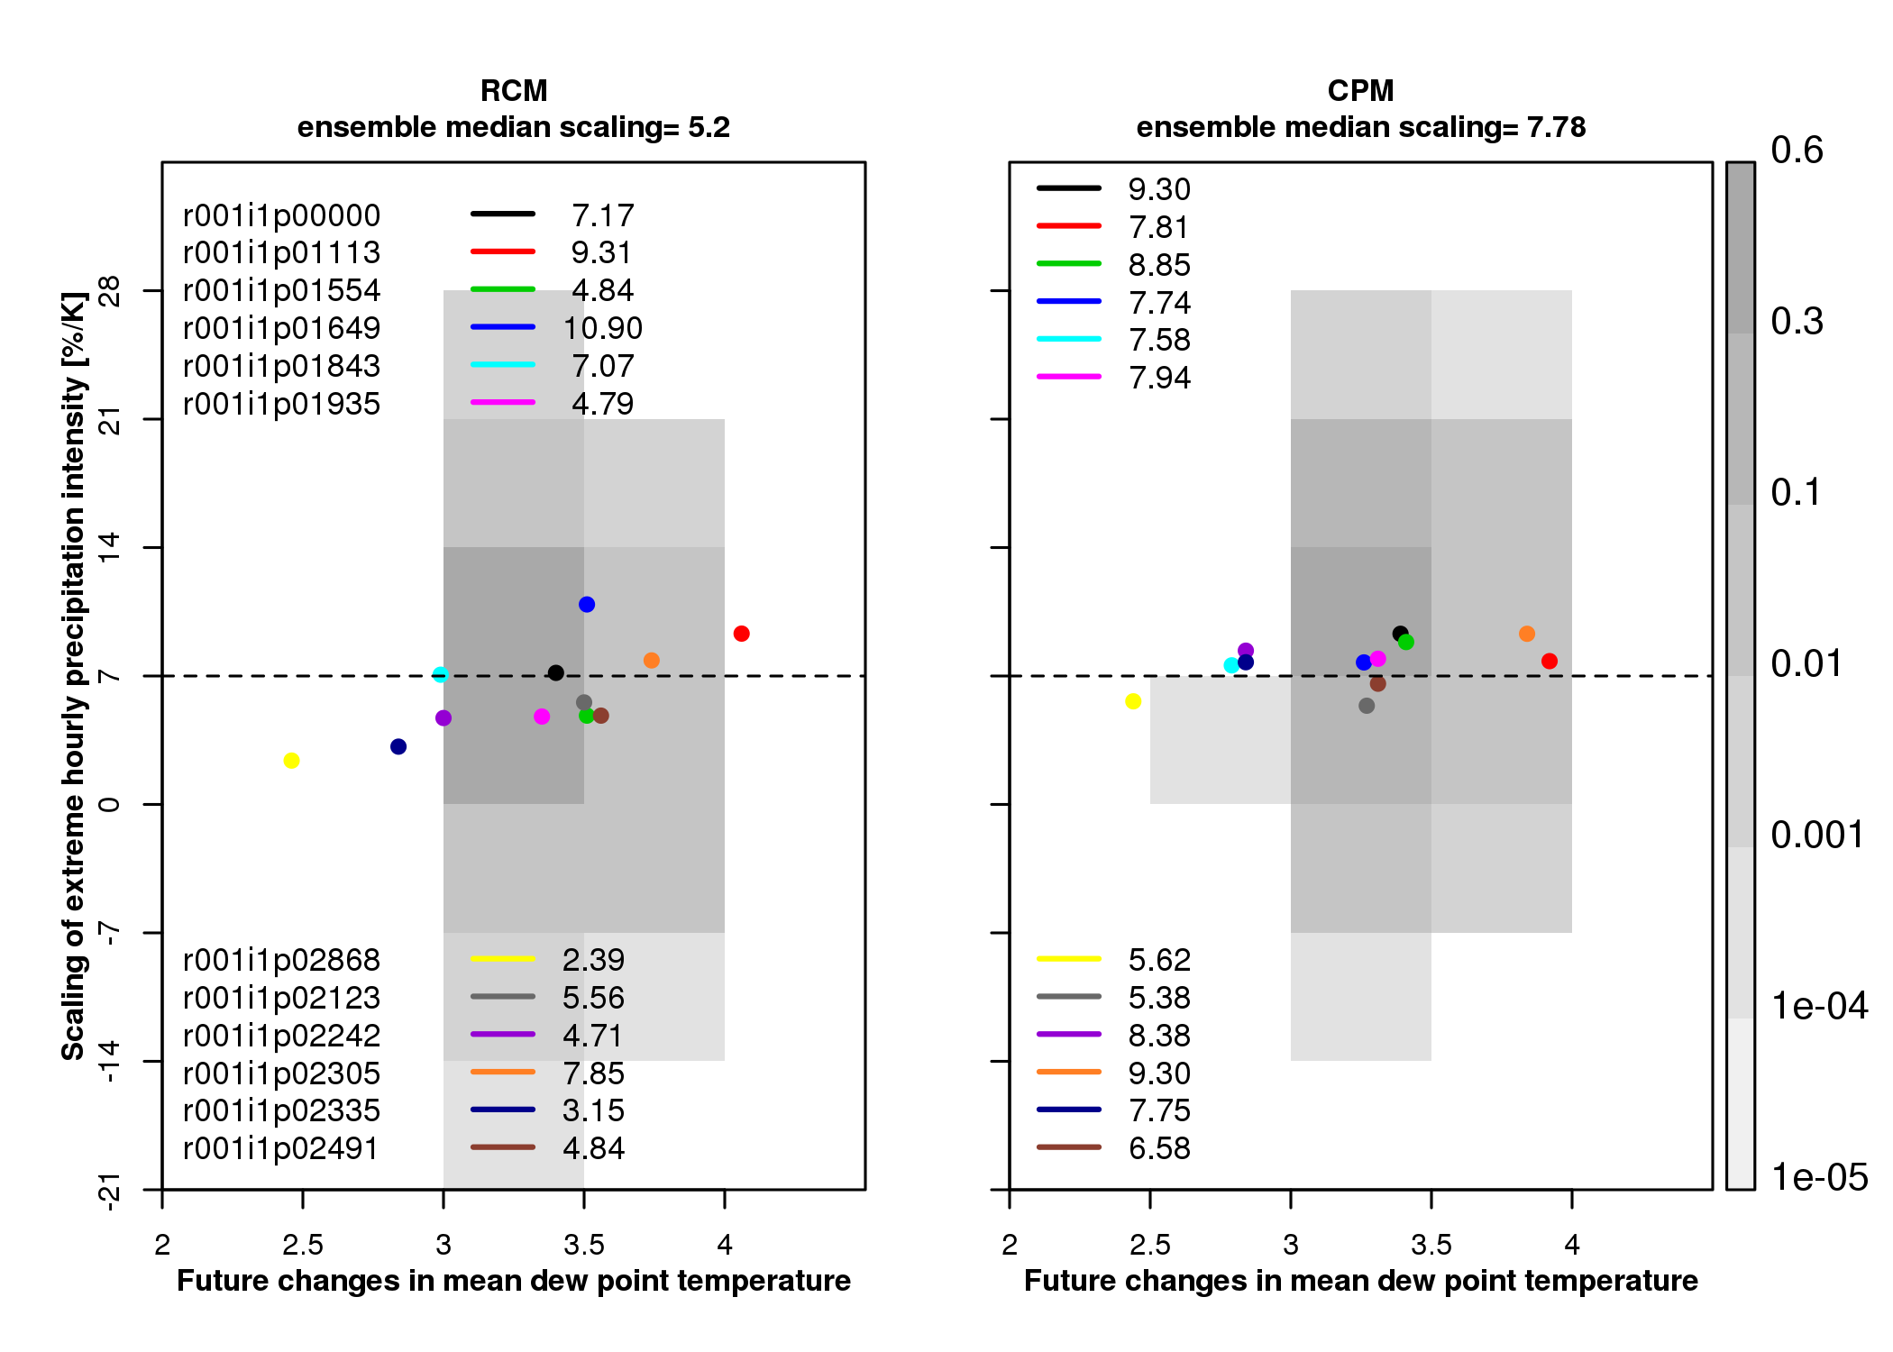
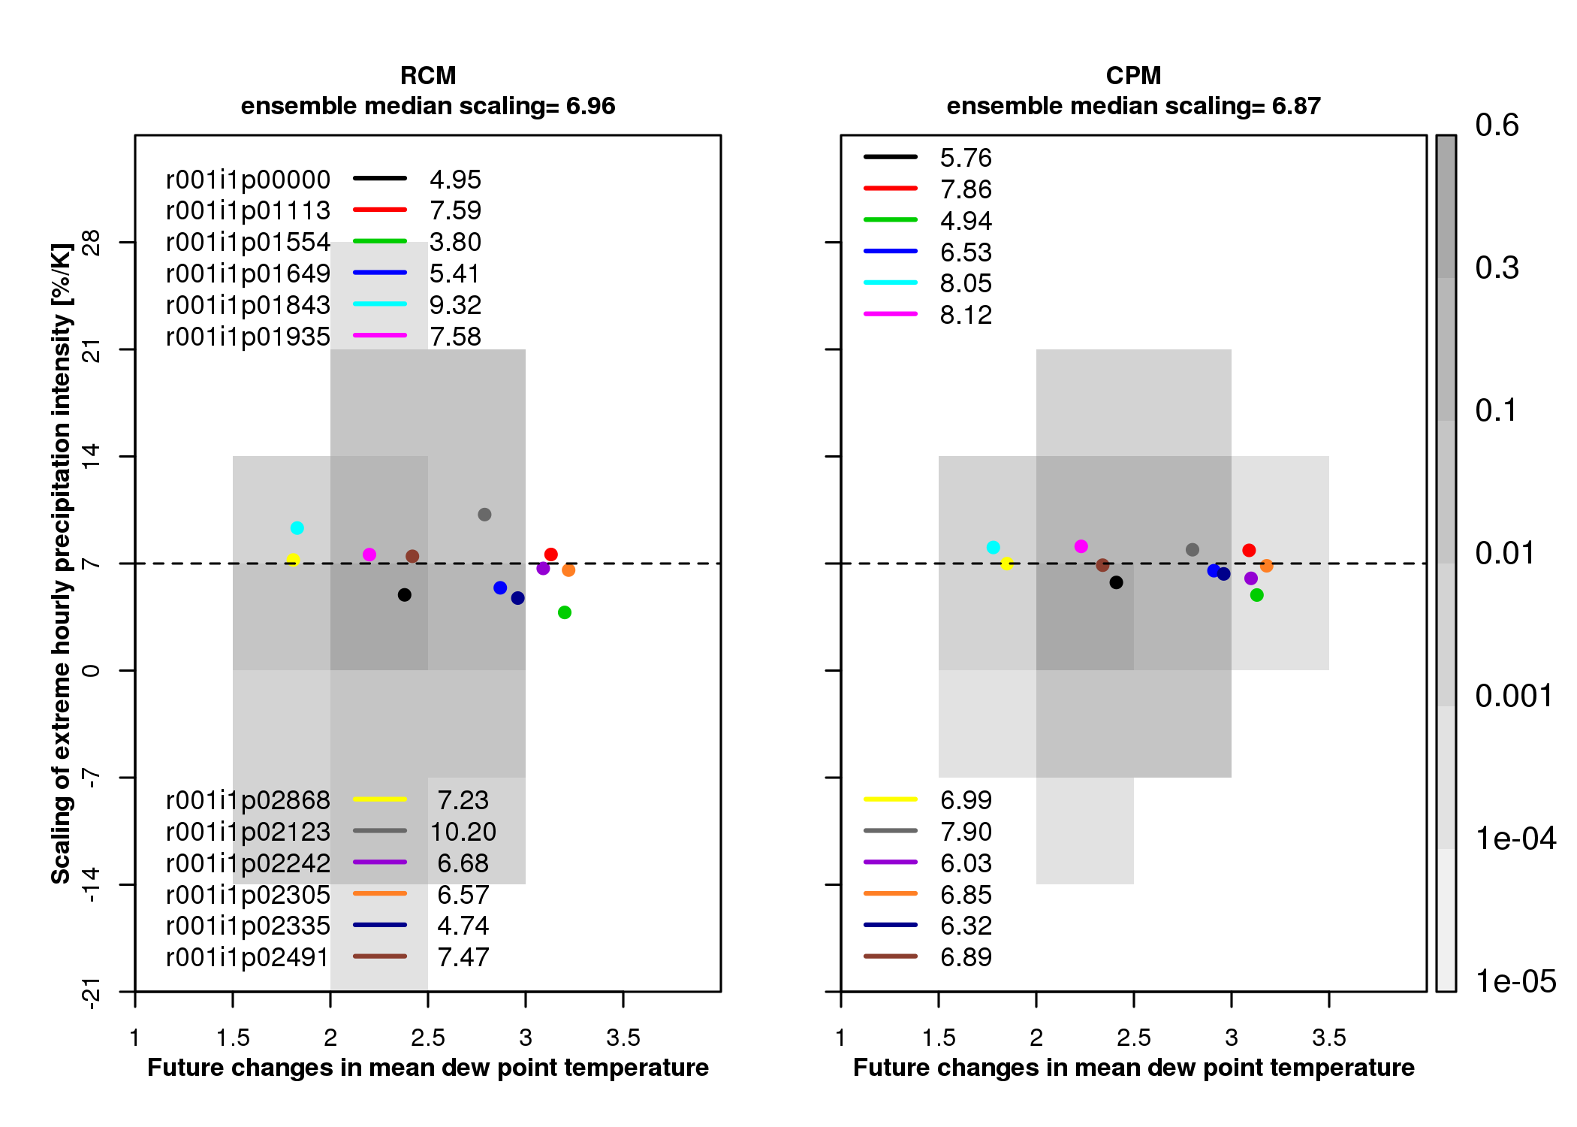
2.2km shows increases in summer extreme hourly intensities beyond CC-scaling.
Summer Winter
2.2km = 7.8 (5.4-9.3) %/K 2.2km = 6.9 (4.9-8.1) %/K
12km = 5.2 (2.4-10.9) %/K 12km = 7.0 (3.8-10.2) %/K
© Crown Copyright 2018, Met Office
Notes:
Increases in extreme hourly precipitation intensities are beyond expectations simply from increasing atmospheric moisture with warming.
In summer, increases in extreme hourly precipitation intensity are on average higher than CC scaling in the CPM (ensemble mean UK-average scaling of 7.8 %/K) but lower than CC-scaling in the RCM (5.2%/K). These CPM-RCM differences in scaling are significant compared to natural variability. There is a large range of UK-average scaling values across the CPM ensemble in summer (of 5.4-9.3 %/K), but these differences in scaling rates between individual members are not significant and are largely explained by natural variability.
In winter, increases in hourly precipitation intensity approximately follow CC scaling, with similar scaling rates in the CPM and RCM.

Slide 10
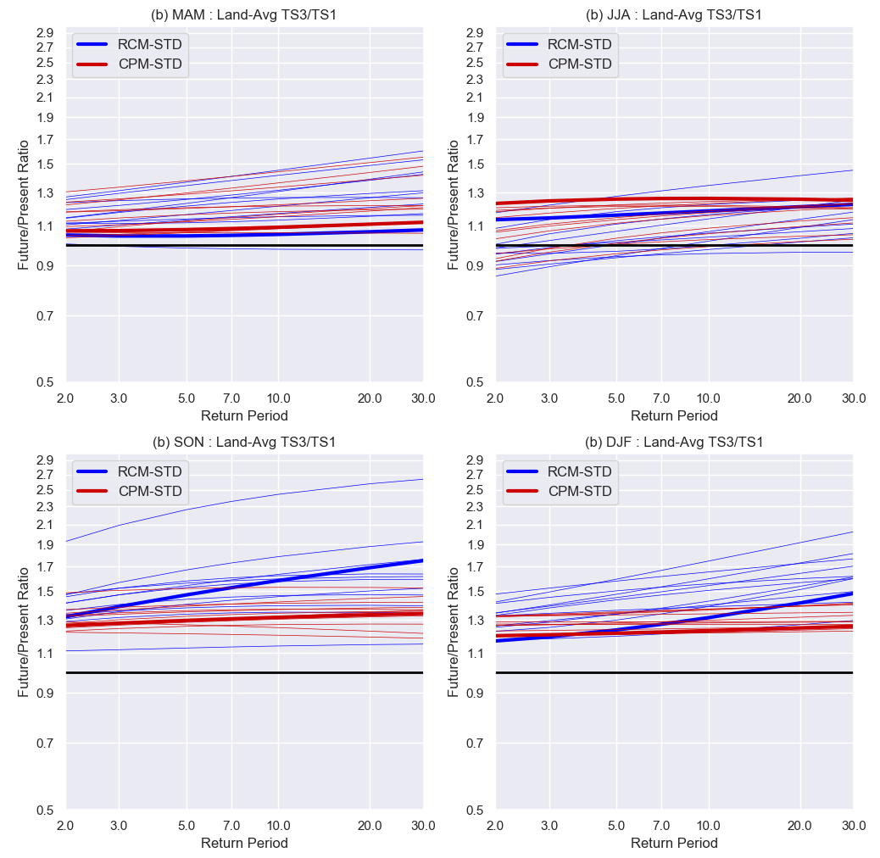
Local (2.2km) provides credible projections of future changes in hourly rainfall extremes
Future change in hourly extremes over south UK
Local (2.2km) suggests significant increases
in hourly precipitation extremes.
2yr return level precipitation increases by 25%, by 2070s, with Local 2.2km giving similar projected change to Regional 12km
Regional 12km shows greater increases in return level with increasing return period – but low confidence in 12km results for rare extremes
High values in excess of 100mm/h, at the 12km scale, in Regional 12km are implausible.
MAM
JJA
SON
DJF
© Crown Copyright 2018, Met Office
Notes:
Max value in future in autumn (summer) is 150 mm/h (128 mm/h) in 12km compared to 74 mm/h (87 mm/h) in 2.2km.

Slide 11
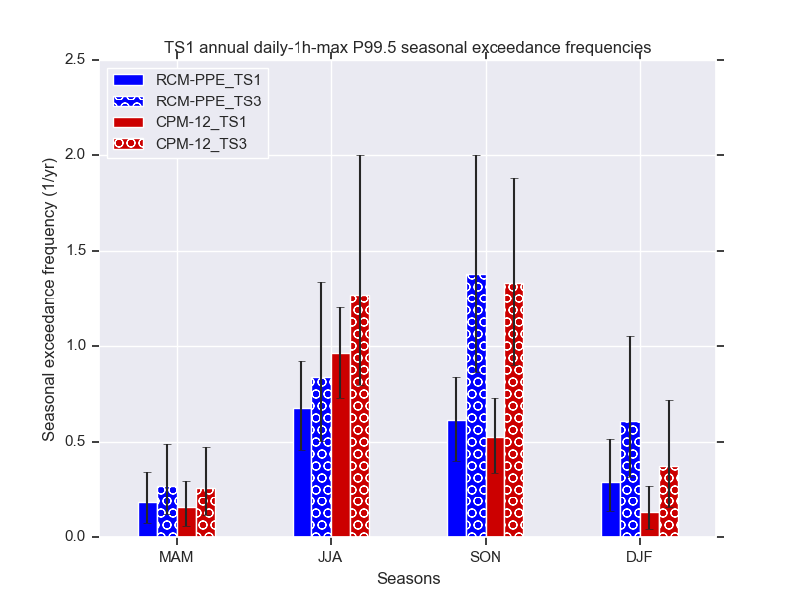
Local (2.2km) shows change in seasonality of hourly precipitation extremes
Future climate change is projected to bring about a change in the seasonality of extremes.
Local (2.2km) projects an extension of the convective season into autumn, with significant increases in hourly rainfall extremes in autumn.
Seasonal occurrence of extreme threshold exceedances. Threshold is 99.5th percentile of daily maximum hourly precipitation at each grid box.
© Crown Copyright 2018, Met Office
Notes:
Plotted is central estimate, with black lines giving 2nd lowest to 2nd highest estimate.

Slide 12
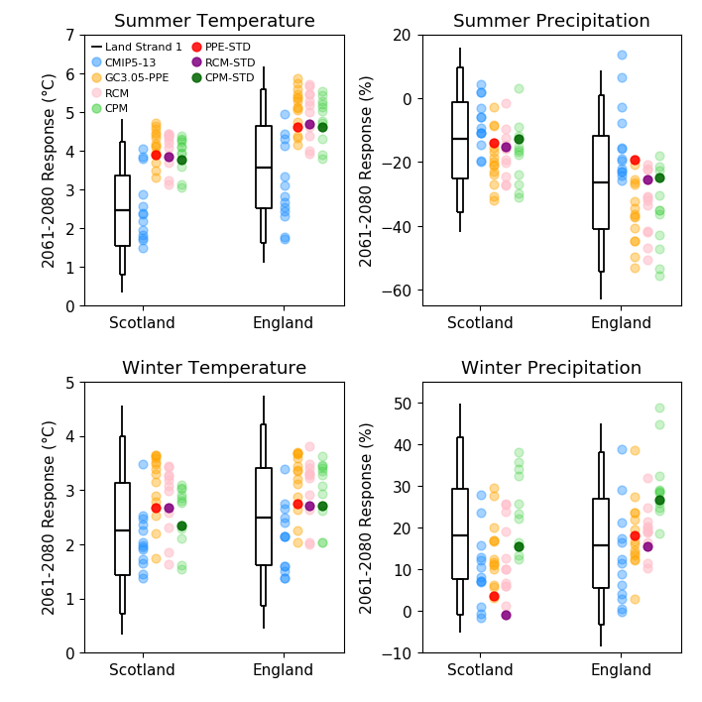
Local (2.2km) and Regional (12km) are driven by a subset of the Global (60km) projections, in particular those that simulate relatively high levels of global warming.
Strands 1 and 2 reveal wider range of potential outcomes for changes in summer, sampling smaller increases in temperature and smaller reductions in rainfall.
Projected changes to 2061-2080 for RCP8.5
Local 2.2km/Regional 12km projections span narrower uncertainty range than Global 60km
© Crown Copyright 2018, Met Office
Notes:
Local and Regional projections are driven by a subset of the Global projections. Blue are the CMIP5 models and the yellow the Hadley Centre models used in Strand 2. The Regional (pink) and Local (green) are only driven by the Hadley Centre models (yellow).
Black box and whiskers denote the 5, 10, 25, 50, 75, 90 and 95% probability levels of the Strand 1 probabilistic projections.
This shows that it is important to consider the Local projections in the context of the wider sampling of uncertainty from the Global and probabilistic projections.

Slide 13
Local (2.2km) shows greater increase in winter precipitation compared to Regional (12km). For one member, increase is outside 5-95% range from probabilistic projections.
Very large winter precipitation increases may be more likely than the probabilistic projections suggest.
Projected changes to 2061-2080 for RCP8.5
Local 2.2km/Regional 12km projections span narrower uncertainty range than Global 60km
© Crown Copyright 2018, Met Office

Slide 14
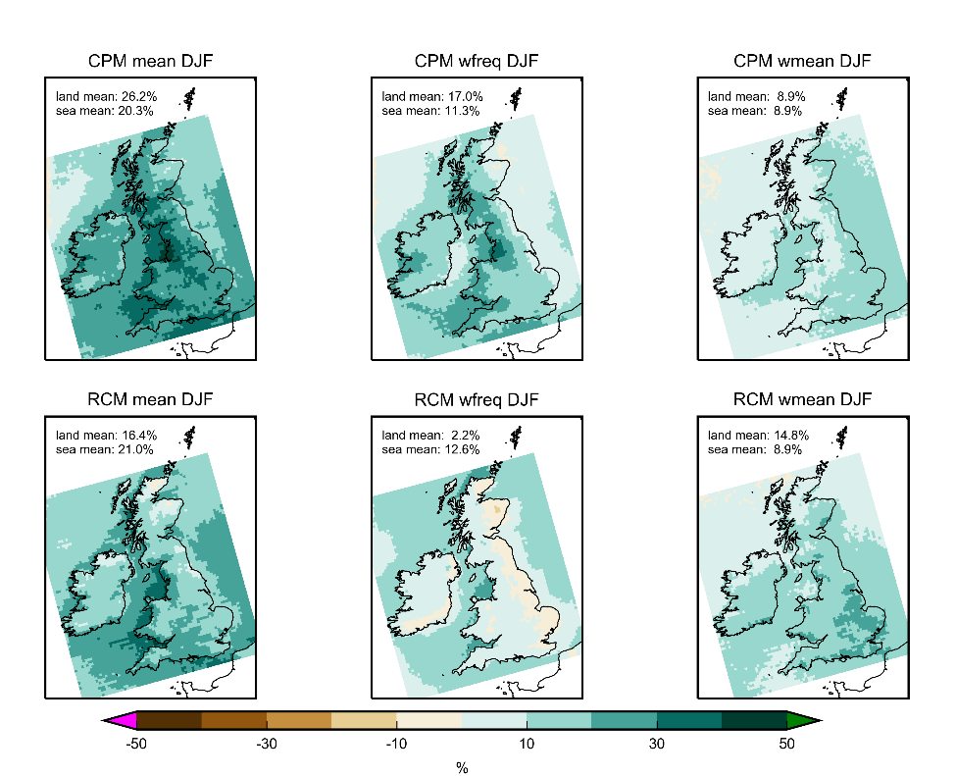
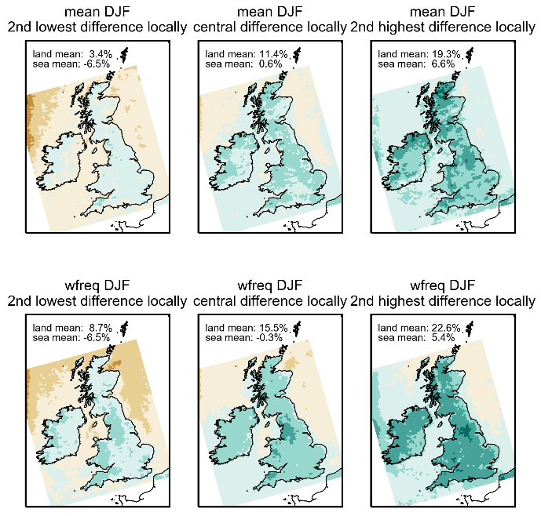
Different winter precipitation response in Local (2.2km) compared to Regional (12km)
Mean
Frequency
Intensity
17%
Low, central and high estimates of Local (2.2km) - Regional (12km) member differences
2.2km
2%
Differences in future response robust across ensemble
12km
Over land, much larger increase in precipitation occurrence in Local 2.2km compared to Regional 12km. Good agreement over sea.
Kendon et al, J Climate, under review.
Notes:
Central estimate of future changes in winter hourly precipitation (mean, occurrence and intensity) for (top) Local (2.2km) and (bottom) Regional (12km). Changes over sea are in good agreement between CPM and RCM. However over UK land see 10% larger increase in winter mean precip in CPM compared to RCM-PPE. This difference comes from much larger increase in occurrence of rainfall over land in CPM (17% compared to 2% increase). In the RCM, the increase in rainfall occurrence over the sea, does not extend over land.
Looking across the ensemble we find that this difference between the CPM and RCM responses is seen for all members i.e. is a robust result.

Slide 15
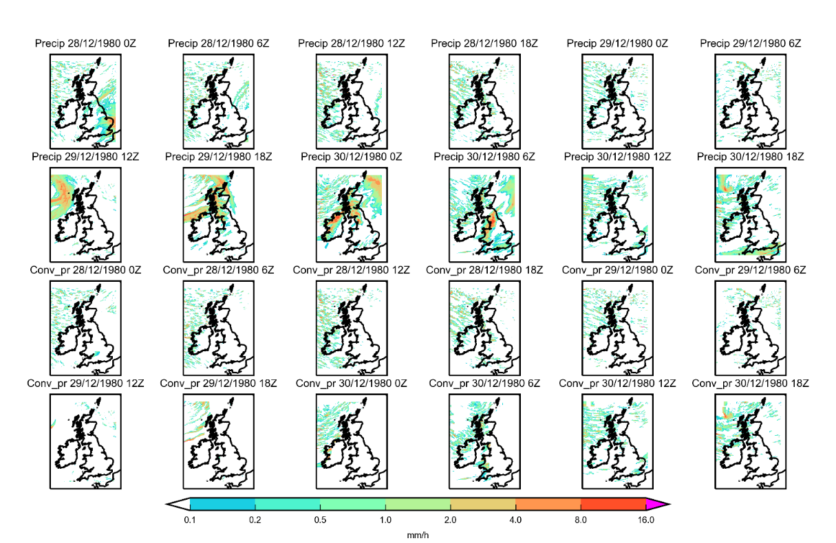
Changes in convective showers significantly contribute to winter precipitation response in 2.2km
Diagnosis of convective showers in 2.2km
(top) Total precipitation
(bottom) Diagnosed convective component
Using vertical gradient in wet bulb potential temperature to diagnose convection in winter.
Changes in convective showers account for large part (60%) of precipitation occurrence change in 2.2km over land.
Showers likely triggered over the warmer ocean and then advected in land, with potentially further development.
In 12km, increases in convective showers over the sea do not extend over land. Convection scheme acts locally without direct memory, so cannot advect showers. It may also act to stabilise atmosphere more over the sea than 2.2km.
Kendon et al, J Climate, under review.
© Crown Copyright 2018, Met Office
Notes:
To explore this further, we have developed a method to diagnose convection in a CPM using vertical gradient in wet bulb potential temperature. Plot on left shows that this method is very successful.
We find that changes in convective showers account for 60% of precipitation occurrence change in CPM over land.
The importance of accurately representing convection extends beyond short duration extremes in summer, to mean precipitation in winter.

Slide 16
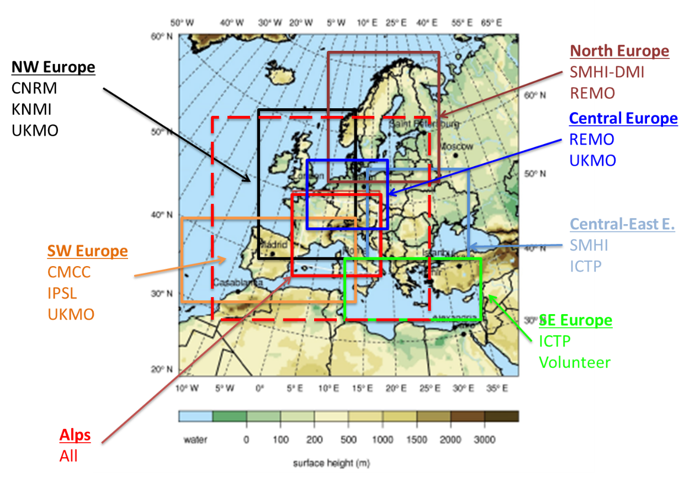
Multi-model CPM projections for Europe
Multi-model experiments at convection-permitting scale are underway as part of the CORDEX-FPS and EUCP projects.
UKMO 2.2km pan-Europe experiments are contributing to these.
These projects will provide a first indication of CPM structural uncertainties, and will complement the UKCP Local (2.2km) ensemble that is based solely on the Met Office model.
EUCP CPM domains and contributing groups
EUCP multi-model experiments will complement UKCP Local (2.2km) ensemble
© Crown Copyright 2018, Met Office
Notes:
These Europe 2.2km simulations are part of the EUCP project, which is carrying out coordinated MME CPM experiments across Europe.
EUCP = European Climate Prediction system
Structural uncertainties = uncertainties due to different parameterisation schemes or model architectures

Slide 17
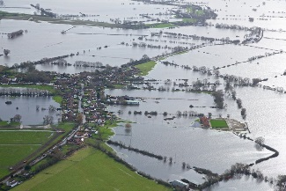

Summary and outlook
For the UK the first national climate scenarios at a resolution on par with weather forecast models were launched in Sept 2019.
Improved realism of rainfall in 2.2km convection-permitting model (CPM), such that provides credible projections of future changes in hourly rainfall and extremes, unlike coarser resolution climate models.
Largest benefits of CPMs for precipitation at hourly timescales, and for regions/seasons where convection dominates. But over UK, also see differences in mean winter rainfall and its future change, related to better representation of wintertime convective showers.
Over UK in 2.2km CPM, see significant increases in hourly precipitation extremes, greater increases in summer rainfall intensity (beyond CC scaling) and greater increases in winter rainfall occurrence compared to 12km climate model.
UKCP Local (2.2km) projections allow us for the first time to estimate uncertainties in changes at hourly and kilometre scales. They provide enhanced spatial detail to explore, for example, urban climate change or climate change over mountainous regions.
Remaining issues:
Heavy rainfall tends to be too intense
Issue with representation of graupel and its inclusion in snow pack
Limited sampling of uncertainty (in UKCP only downscaling Hadley Centre models)
Future plans for CPM climate modelling: downscaling CMIP5 models over UK, multi-model CPM downscaling (e.g. EUCP), scale-aware convection, large-domain simulations and inclusion of earth-system processes

Slide 18

My personal pledges to reduce carbon
stop buying red meat
cycle or walk to work every day
never take domestic flights
rarely fly on holiday and carbon offset any flights
minimise flights for work and participate in meetings remotely wherever possible

Slide 19
Spare slides

Slide 20
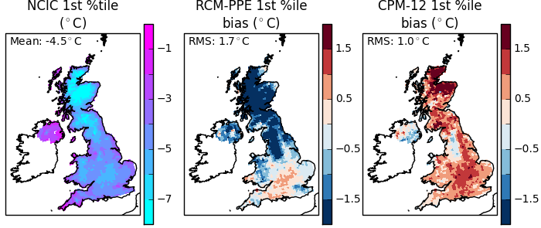
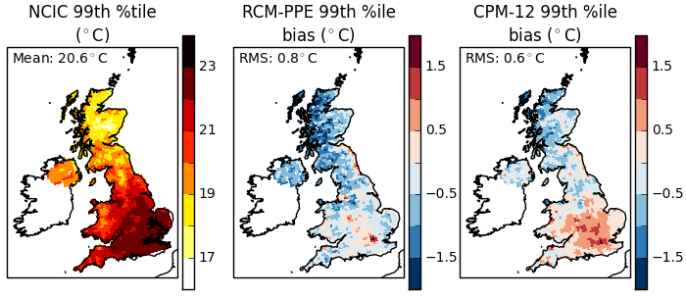
Model differences likely due representation of snow, cloud, and drier soils in Local 2.2km
Local (2.2km) better represents cold winter days and the number
of intense cold spells in the north UK in the present-day.
In summer, local (2.2km) is warmer than the regional model, giving better agreement with observations in the north but not in the south
Winter and summer temperature extremes
Observations
Lower Local model bias
Regional model bias
© Crown Copyright 2018, Met Office
Notes:
Cold winter days are too cold in the RCM especially in the north, with biases improved in CPM. Differences related to snow scheme, with more lying snow in RCM.
Hot summer days are too cold in RCM in north, and too hot in CPM in south. Drier soils in CPM may be contributing factor.

Slide 21
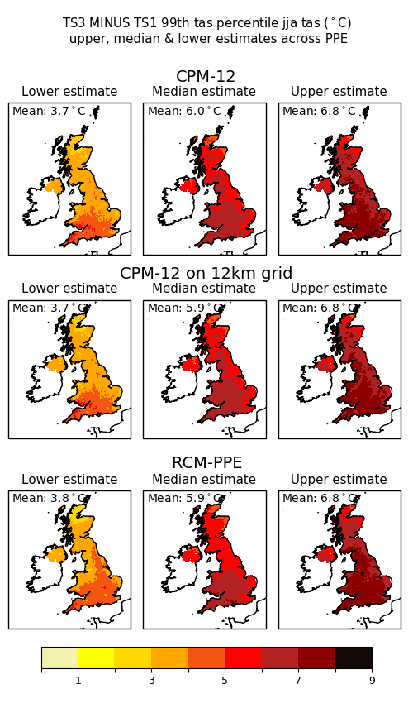
In general the Local (2.2km) model reinforces the results from the Regional (12km) model
How much might hot summer days warm?
The Local (2.2km) ensemble suggests:
Hot summer days will warm more than the summer average
Range is 3.7 to 6.8ºC
Hot summer days warm more than cold winter days
Projected changes to 2061-2080 for RCP8.5 (ºC)
© Crown Copyright 2018, Met Office
Notes:
Hot summer days are the 99th percentile of daily mean temperature.
For cold winter days range is 2.7 to 4.7 degC increase

Slide 22
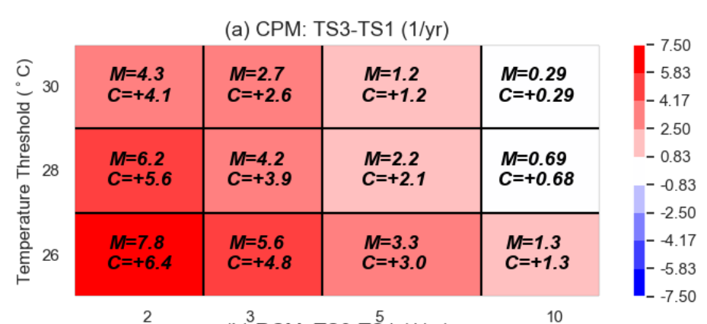
Hot spells become more frequent.
Exceeding 30ºC for >2 days rises from typically once every 4 years now, to about four times every year by 2070s.
Minimum length of warm spell in days
Projected changes to 2061-2080 for RCP8.5 M=model future value and C=change from present
In general the Local (2.2km) model reinforces the results from the Regional (12km) model
© Crown Copyright 2018, Met Office
Notes:
Hot spells here are defined as daily max exceeding 30C for 2 or more consecutive days, and this is the threshold used to trigger public health warnings.
Here we a seeing a 16-fold increase!

Slide 23
Local (2.2km) suggests doubling of frequency of exceeding flash flood warning threshold
Local threshold exceedances in 2.2km projections.
Frequency of exceeding 30mm/h locally
Location | Present day (1/y) | Future (1/y) | Frequency change
Greater London | 0.095 | 0.139 | X1.5
Edinburgh | 0.054 | 0.099 | X1.8
Belfast | 0.136 | 0.233 | X1.7
Cardiff | 0.092 | 0.191 | X2.1
Exeter | 0.109 | 0.225 | X2.1
The frequency of days with hourly rainfall >30mm/h almost doubles, by 2070s – increasing from UK-average of once every 10 years now to almost once every 5 years
© Crown Copyright 2018, Met Office
Notes:
If instead examine changes in hourly extremes by looking at frequency of exceedance of specific threshold
e.g. 30 mm/h is official threshold used to issue a warning regarding flash flooding
Then see significant increases in frequency.
For Greater London
Frequency of days with >30mm/h 0.095 -> 0.139 x1.5
Frequency of days with > 100 mm/d 0.007 -> 0.018 ` x2.6
For 30 mm/h:
Edinburgh: 0.054 1/yr -> 0.099 1/yr
Belfast: 0.136 1/yr -> 0.233 1/yr
Cardiff: 0.092 1/yr -> 0.191 1/yr
Exeter: 0.109 1/yr -> 0.225 1/yr
For 100 mm/d:
Edinburgh: 0.001 1/yr -> 0.022 1/yr
Belfast: 0.012 1/yr -> 0.043 1/yr
Cardiff: 0.011 1/yr -> 0.036 1/yr
Exeter: 0.005 1/yr -> 0.019 1/yr

Slide 24
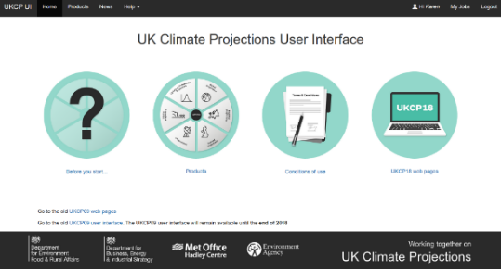


Accessing Local (2.2km) Data
Regridded data on Ordnance Survey’s British National Grid (5km)
https://ukclimateprojections-ui.metofffice.gov.uk
Original climate model data on rotated pole (2.2km)
Table 4 of UKCP Factsheet: Local (2.2km) Projections
https://ukclimateprojections.metoffice.gov.uk
https://catalogue.ceda.ac.uk
© Crown Copyright 2018, Met Office

