Slide 1
Numerical simulations to study the geodynamic origin of Los Humeros Volcanic Field in Mexico
Authors: Andrés David Bayona
Vlad Constantin Manea
Motivation:
The origin of the volcanic caldera Los Humeros in Mexico has not been studied using numerical modeling.
Key question:
What specific mantle conditions are necessary for the formation of Los Humeros?

Slide 2
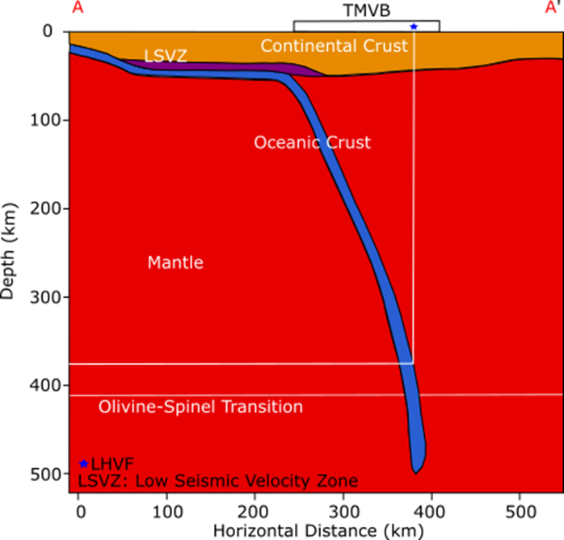
Los Humeros Volcanic Field (LHVF) is a large caldera about 21 by 15 km wide, located in the eastern part of the Trans-Mexican Volcanic Belt (TMVB), roughly 440 km away from the Middle American Trench and 380 km above the slab of the Cocos plate.
Fig. 1. Tectonic map and the location of Los Humeros Volcanic Field
LHVF is the third largest geothermal field in Mexico in terms of energy output. This added to its geographical location is still a great unknown to understand the conditions (at upper mantle levels) under which it was formed. For these reasons, numerical models are employed to study the formation of LHVF based on the diameter and temperature of several asthenospheric thermal anomalies. In addition, the role of regional tectonic stresses are also studied.
Fig. 2. Subduction of Cocos Plate beneath North American Plate.

Slide 3
Fig. 3. LHVF is located to the northwest of a chain of volcanoes, which are above a slab tear. Modified from Clayton & Perez (2018).

Slide 4
Video 1: Rock distribution evolution for a numerical model with a series of thermal intrusions. Excess temperature of the initial thermal anamolay (shown in red) is 100 K. Total regional tectonic extension full rate: 5 mm/yr. Initial radius of the thermal anomaly: 7500 m. Radius of the second and third thermal anomalies: 8000 m. The 2nd and 3rd thermal anomalies are inserted into the modeling at 1000 and 1500 numerical steps (corresponding to 0,46 Myr and 0,57 Myr after the model start).

Slide 5
Conclusions
The minimum temperature excess of astenospheric anomalies ​​under which the magma achieved to rise to the surface is 100 K. This corresponds to mantle temperature at slab depth beneath LHVF.
It is necessary to include tectonic horizontal extensional stresses in the models to form zones of weakness (shear bands) to facilitate the rise of the magma. This is in agreement with cenozoic extension recorded in the area associated with the perpendicular extension to the Middle American Trench by the isostatic compensation of the TMVB, probably induced by the rollback of the slab of the Cocos Plate.
Our modeling simulations show that several thermal anomalies are necessary for the formation of a volcanic body of dimensions similar to LHVF. Three or more successive thermal pulses are required in order for the thermal anomaly to penetrate the cold continental crust and reach the surface.

