Slide 1






Resolving the differences in the simulated and reconstructed temperature response to volcanism over the Last Millennium Reanalysis
Feng Zhu¹, Julien Emile-Geay¹, Gregory J. Hakim², Jonathan King³, Kevin Anchukaitis³
EGU CL1.18: Studying the climate of the last two millennia
May 8, 2020
Zhu F, Emile‐Geay J, Hakim GJ, et al (2020) Resolving the Differences in the Simulated and Reconstructed Temperature Response to Volcanism. Geophysical Research Letters 47:e2019GL086908. https://doi.org/10.1029/2019GL086908

Slide 2
The community has been trying to use paleo-records to constrain model physics...

Slide 3

Among many approaches, the response to volcanic eruptions over the past millennium has become a critical benchmark of model performance.
picture from learnodo-newtonic.com

Slide 4
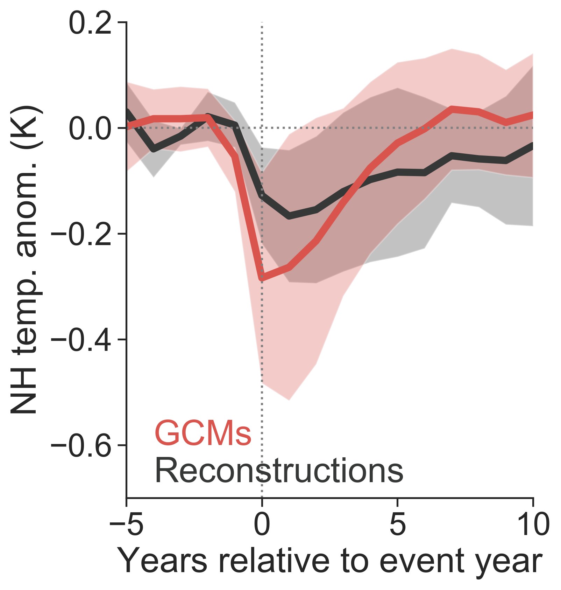
Motivation
2. recovery length
1. peak cooling amplitude
3. peak cooling year
(reproduced from IPCC AR5, Fig. 5.8b)

Slide 5
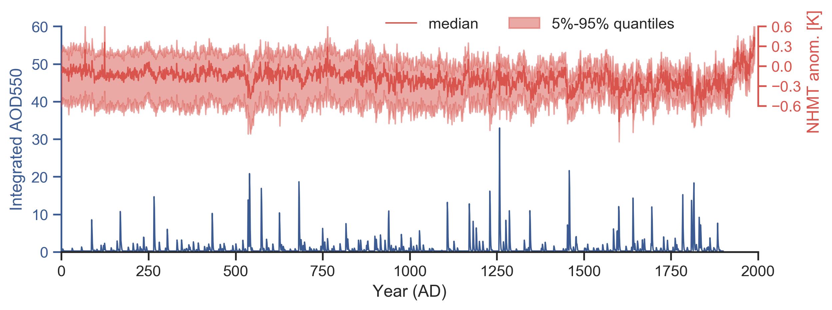
Compositing eruptions
LMR v2.1 from Tardif et al. (2019)
eVolv2k_v3 from Toohey and Sigl (2017)

Slide 6
Superposed Epoch Analysis (SEA)
models
or
reconstructions
or
both
(reproduced from IPCC AR5 Fig. 5.8b)

Slide 7

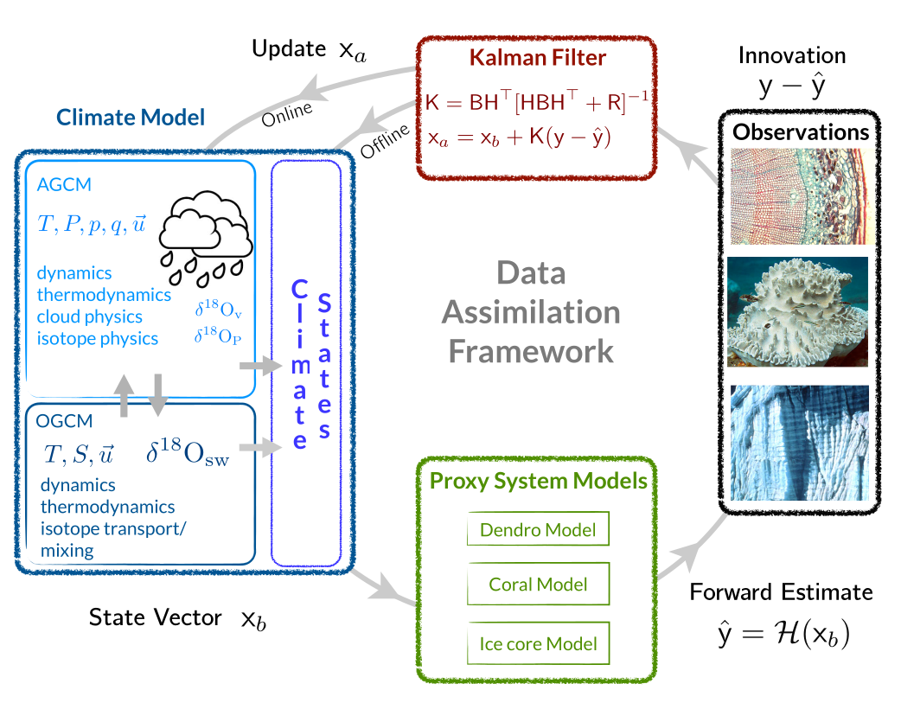
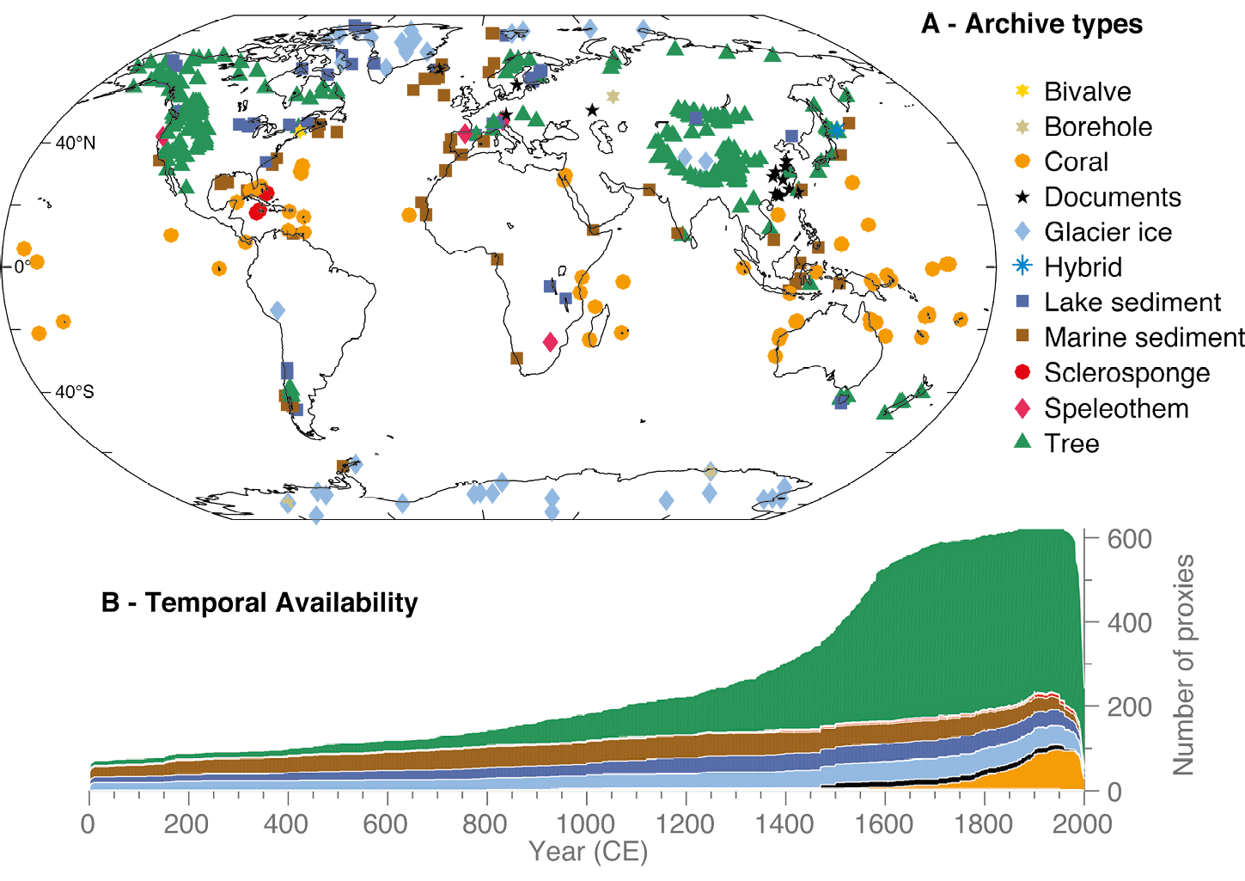
Last millennium reanalysis (LMR) paleo-DA framework [Hakim et al., 2016; Tardif et al., 2019]
isotope-enabled CESM (iCESM) [Brady et al., 2019; Stevenson et al., 2019]
PAGES2k version 2 proxy database [PAGES 2k Consortium, 2017]

Slide 8
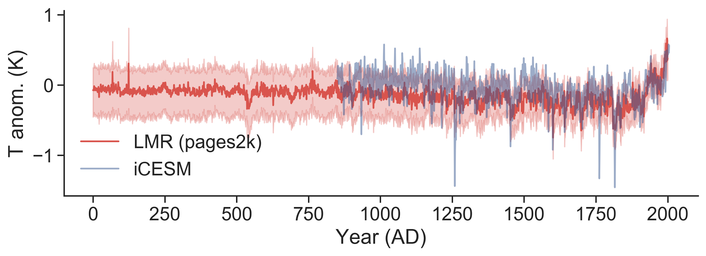
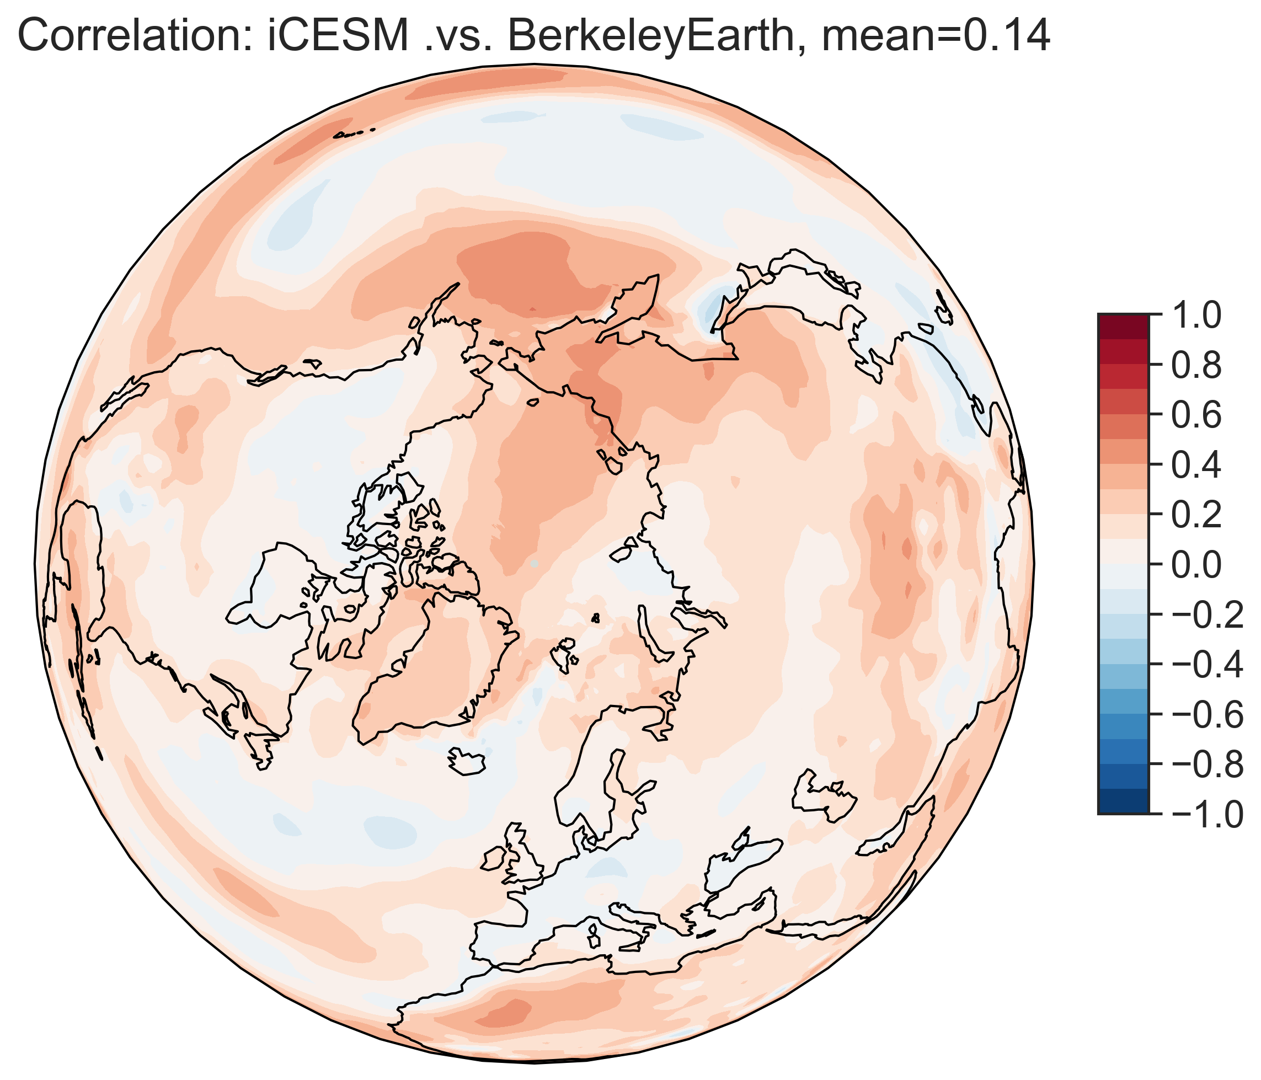
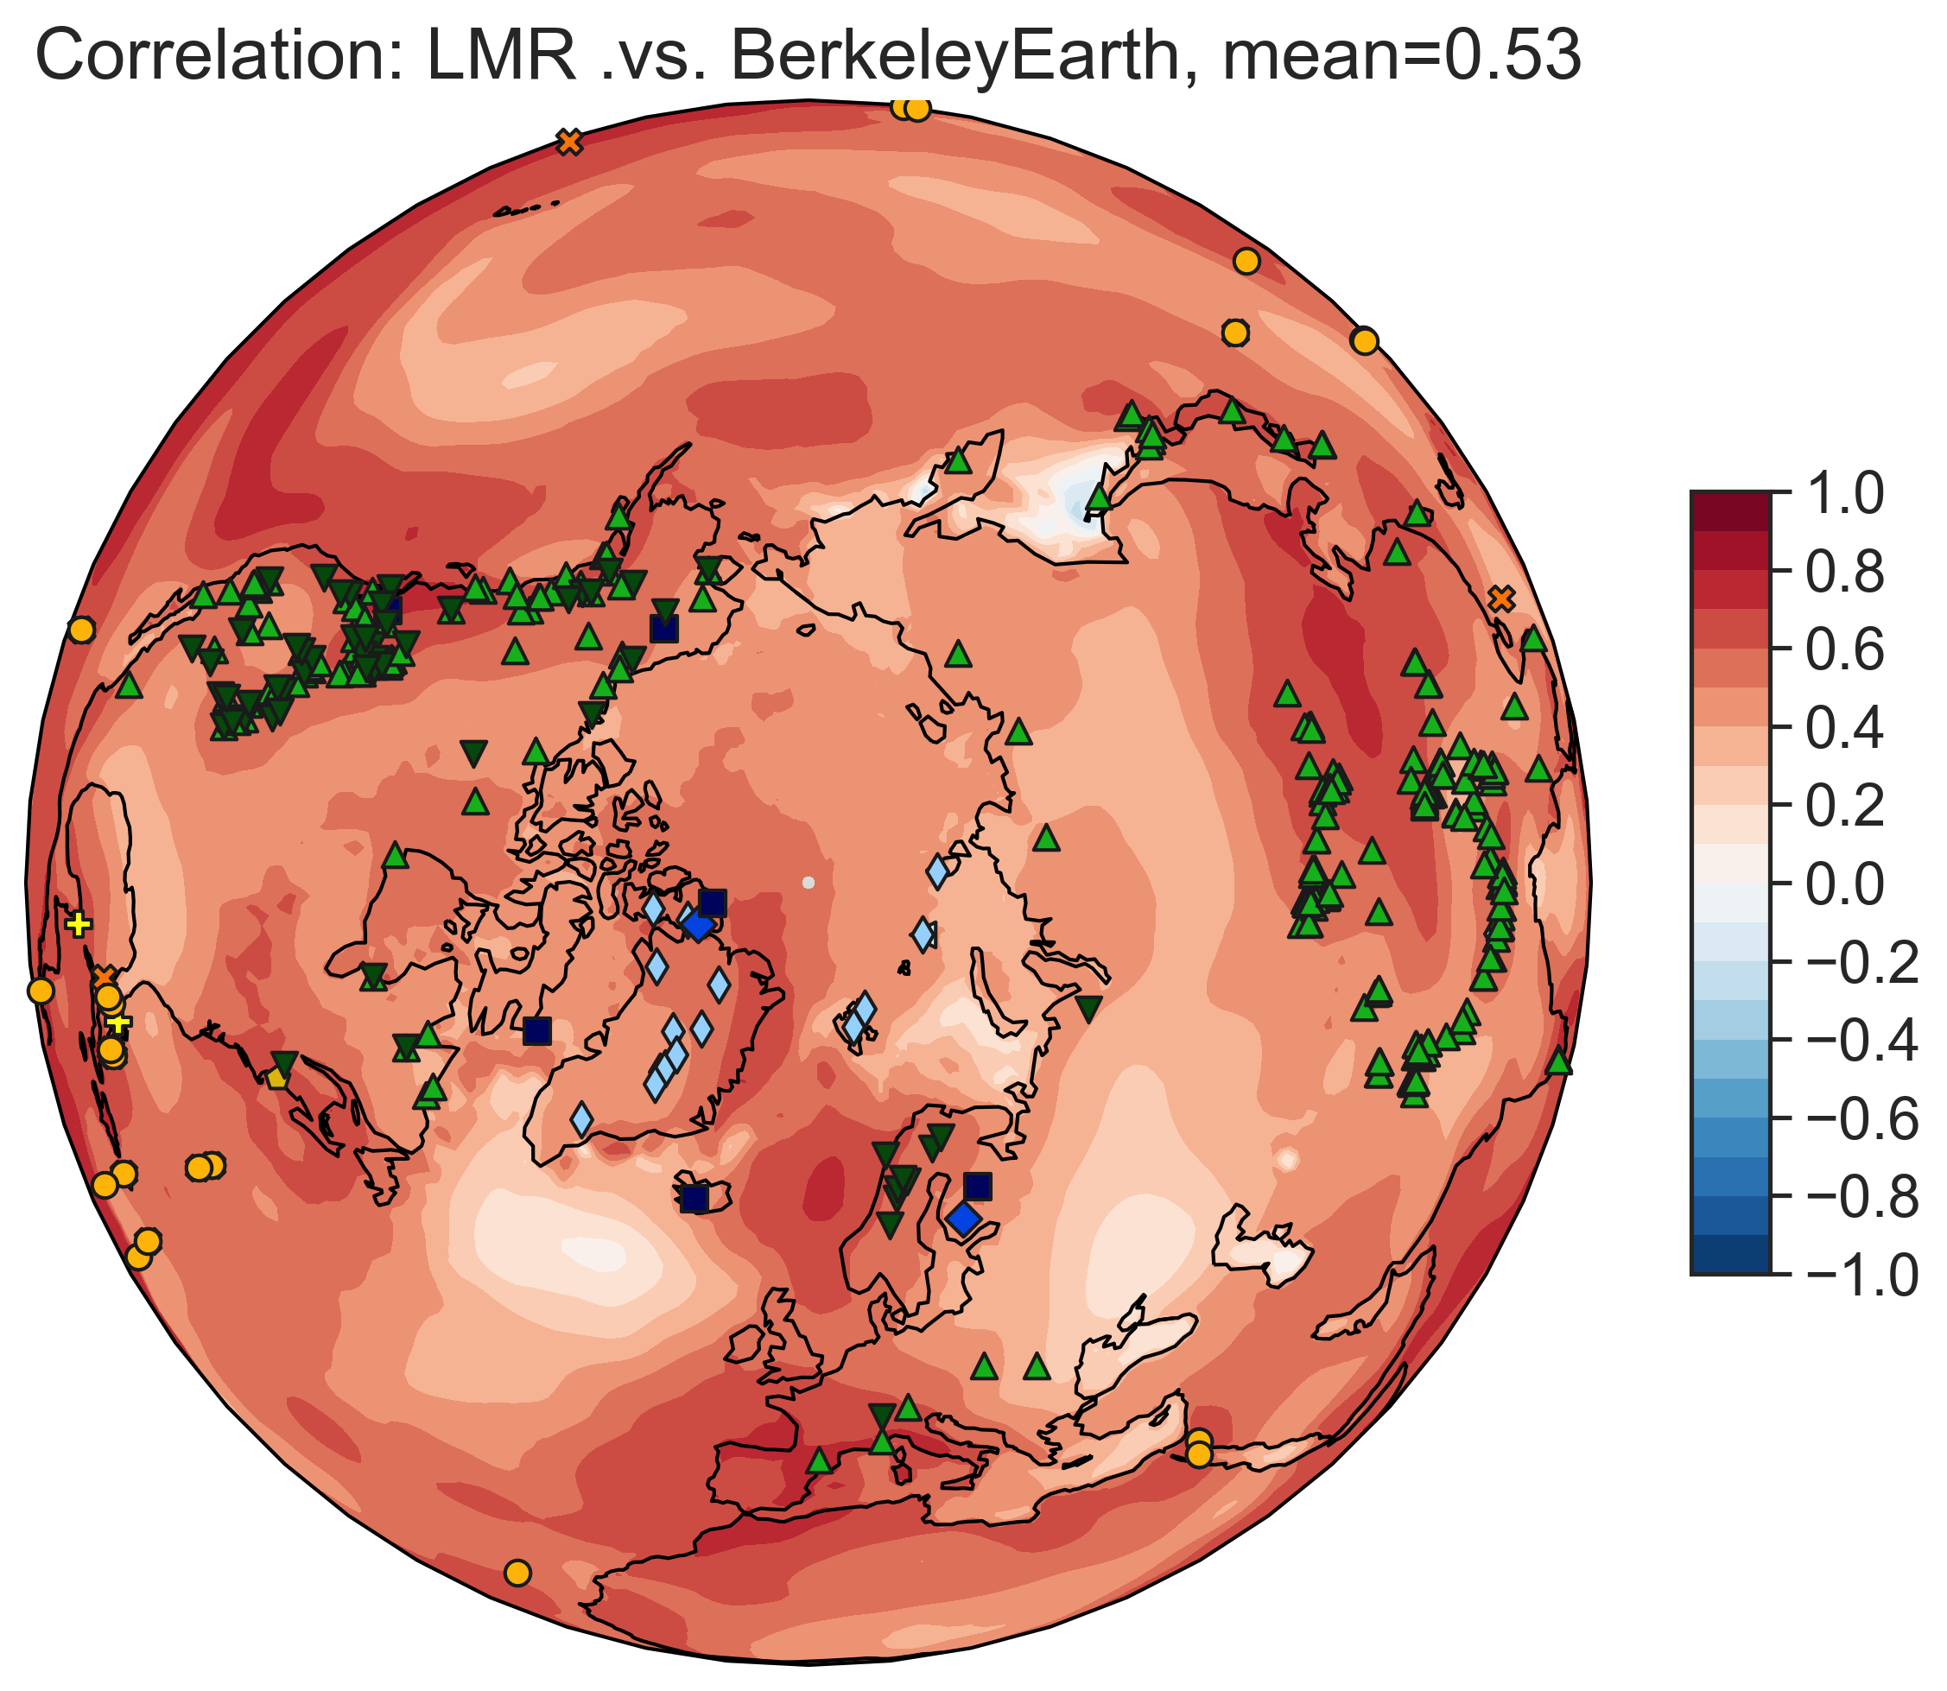
NHMT
corr(iCESM, obs)
corr(LMR, obs)
Verification over [1880, 2000]
Berkeley Earth instrumental temperature analysis (Rohde et al., 2013)

Slide 9
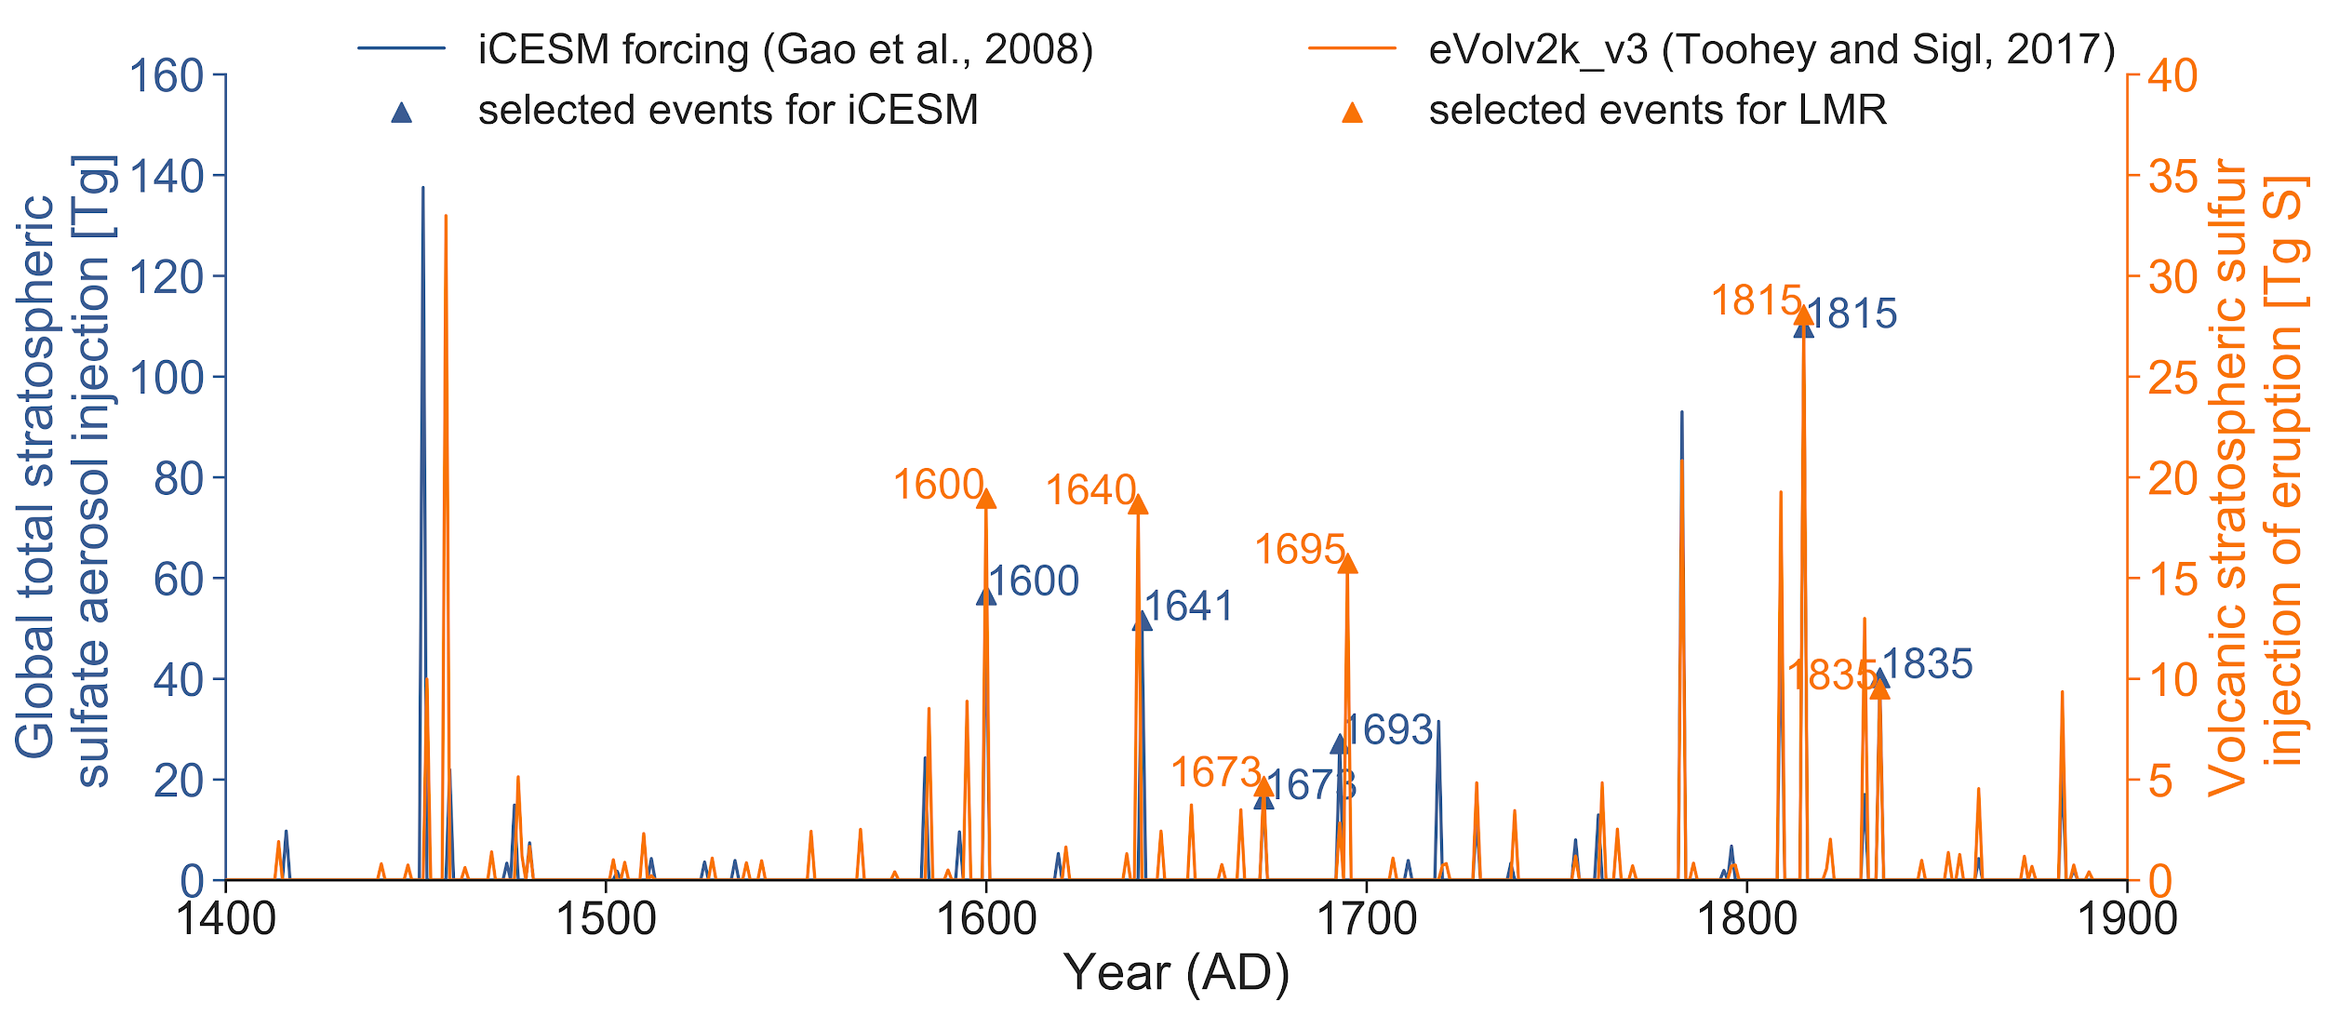
Eruption events

Slide 10
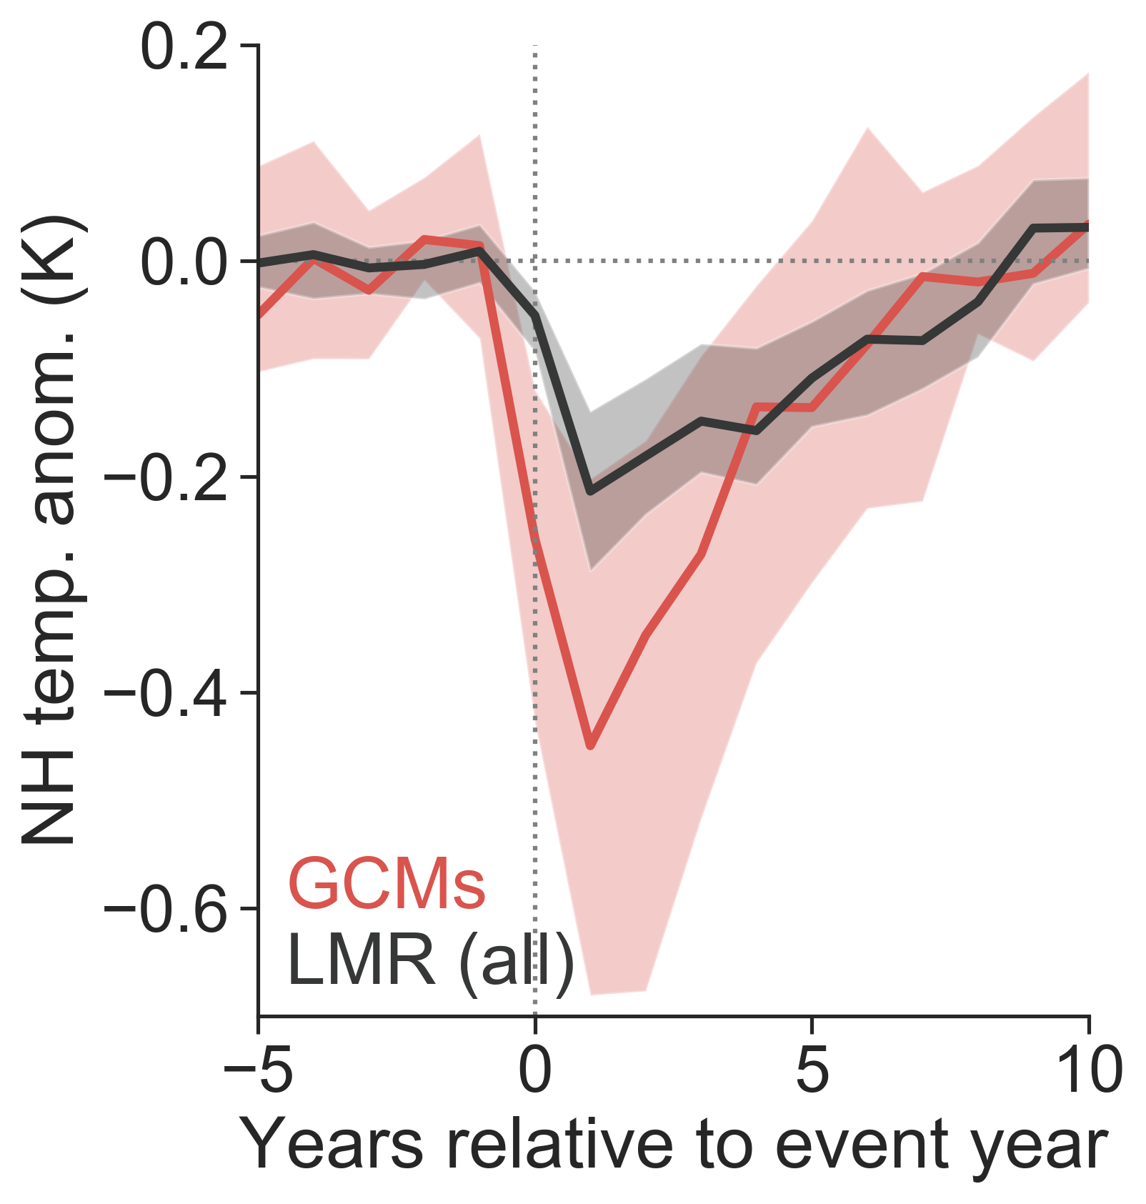
{ }
GCMs
iCESM, BCC, GISS, HadCM3, IPSL, MIROC, MPI-ESM-P, CSIRO, CCSM4, CESM-LME
real proxies
(reproduced from IPCC AR5 Fig. 5.8b)

Slide 11
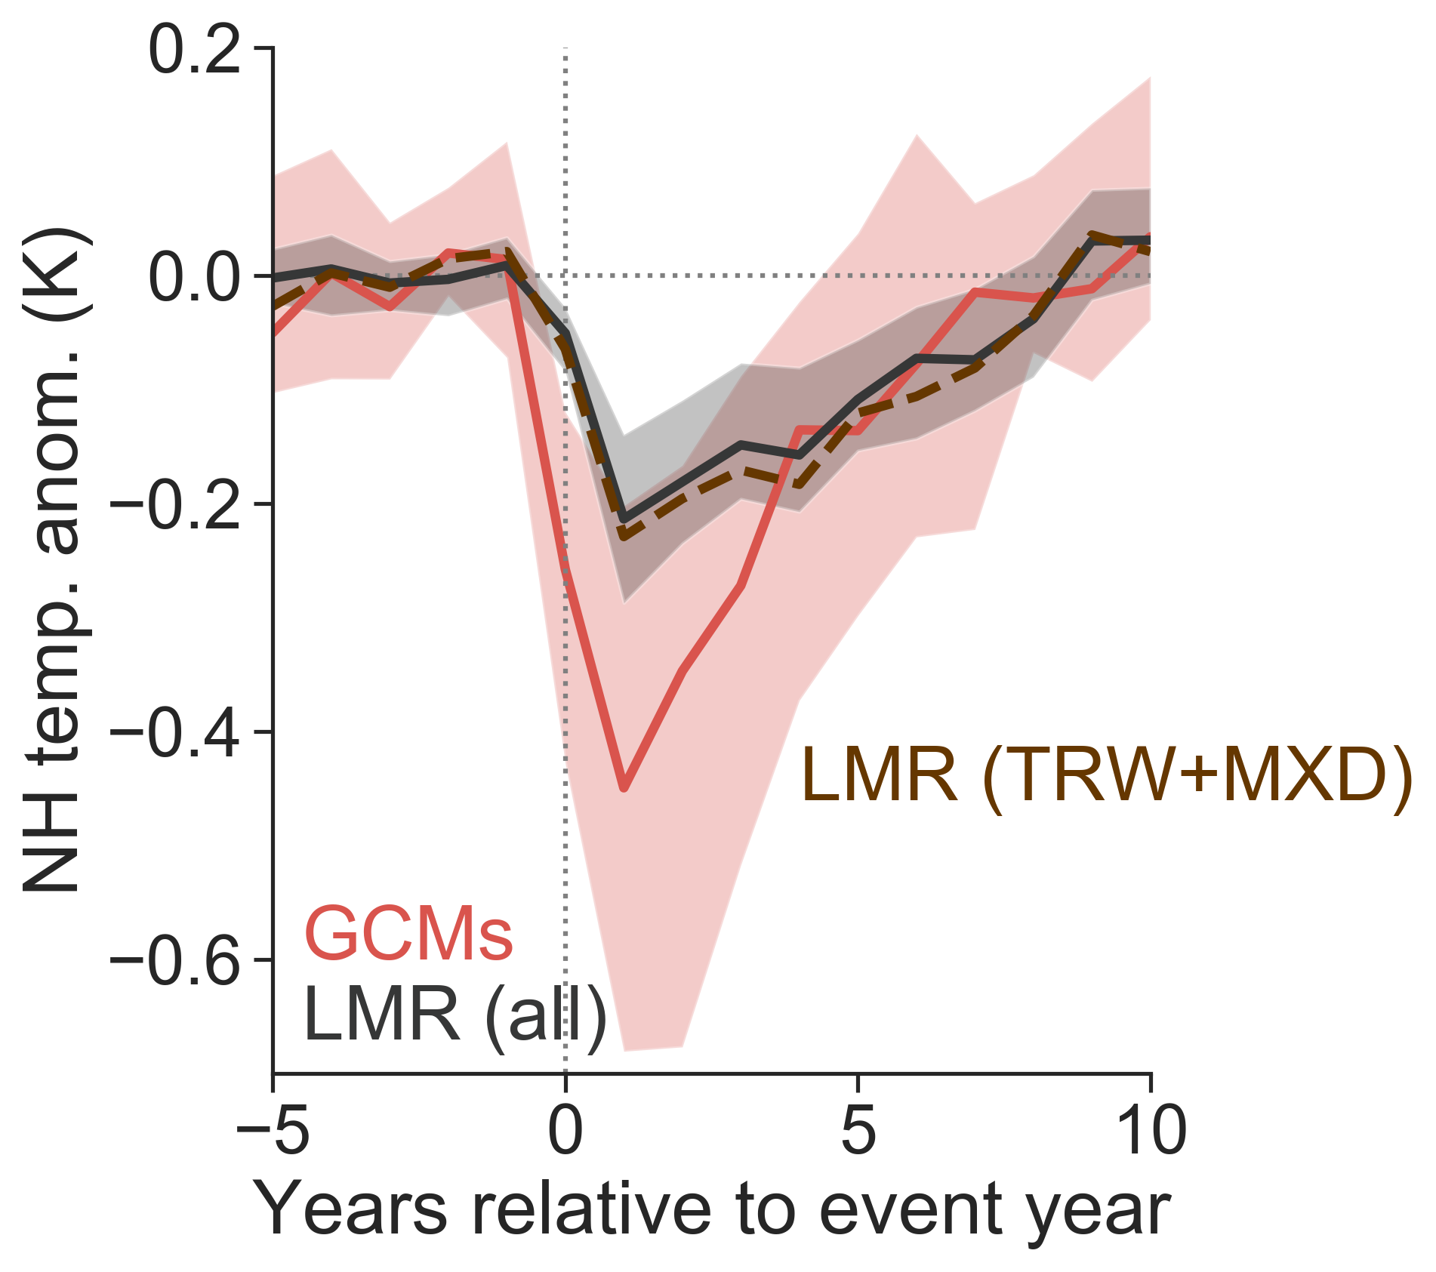
{ }
TRW: tree-ring width
MXD: max. latewood density
What accounts for the discrepancy?
real proxies
spatial coverage
seasonality
biological memory
noise

Slide 12
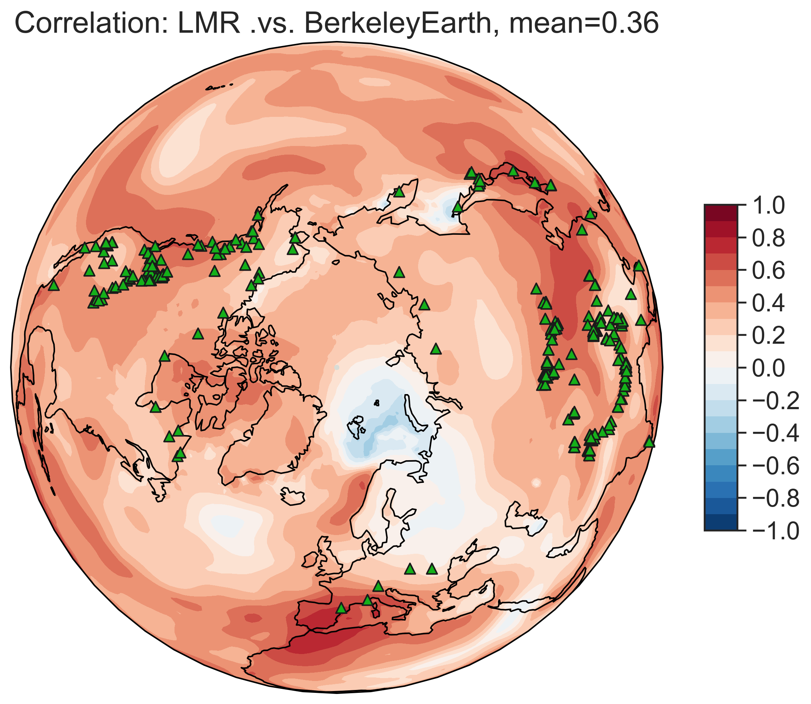
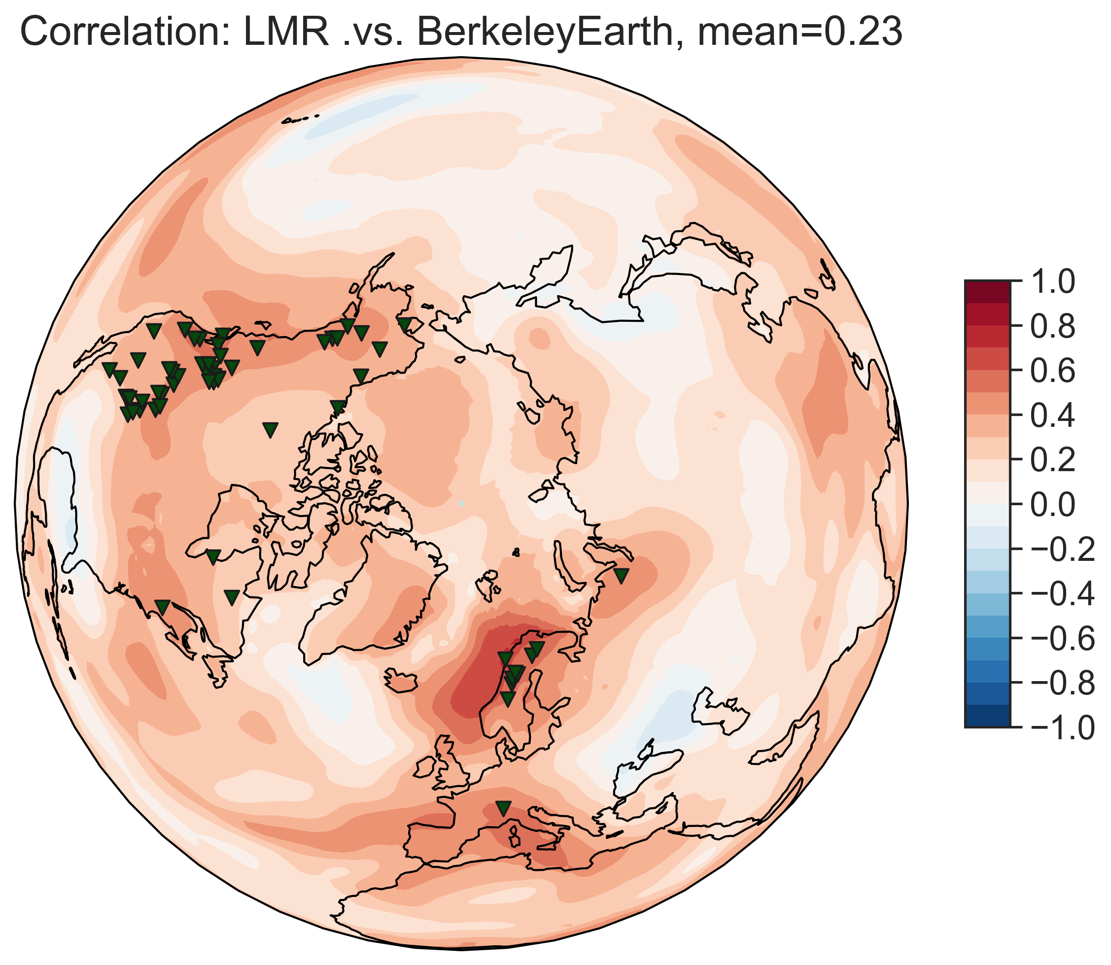
1. Spatial coverage
Assimilating TRW only (n=336)
Assimilating MXD only (n=59)
Verification over [1880, 2000]

Slide 13
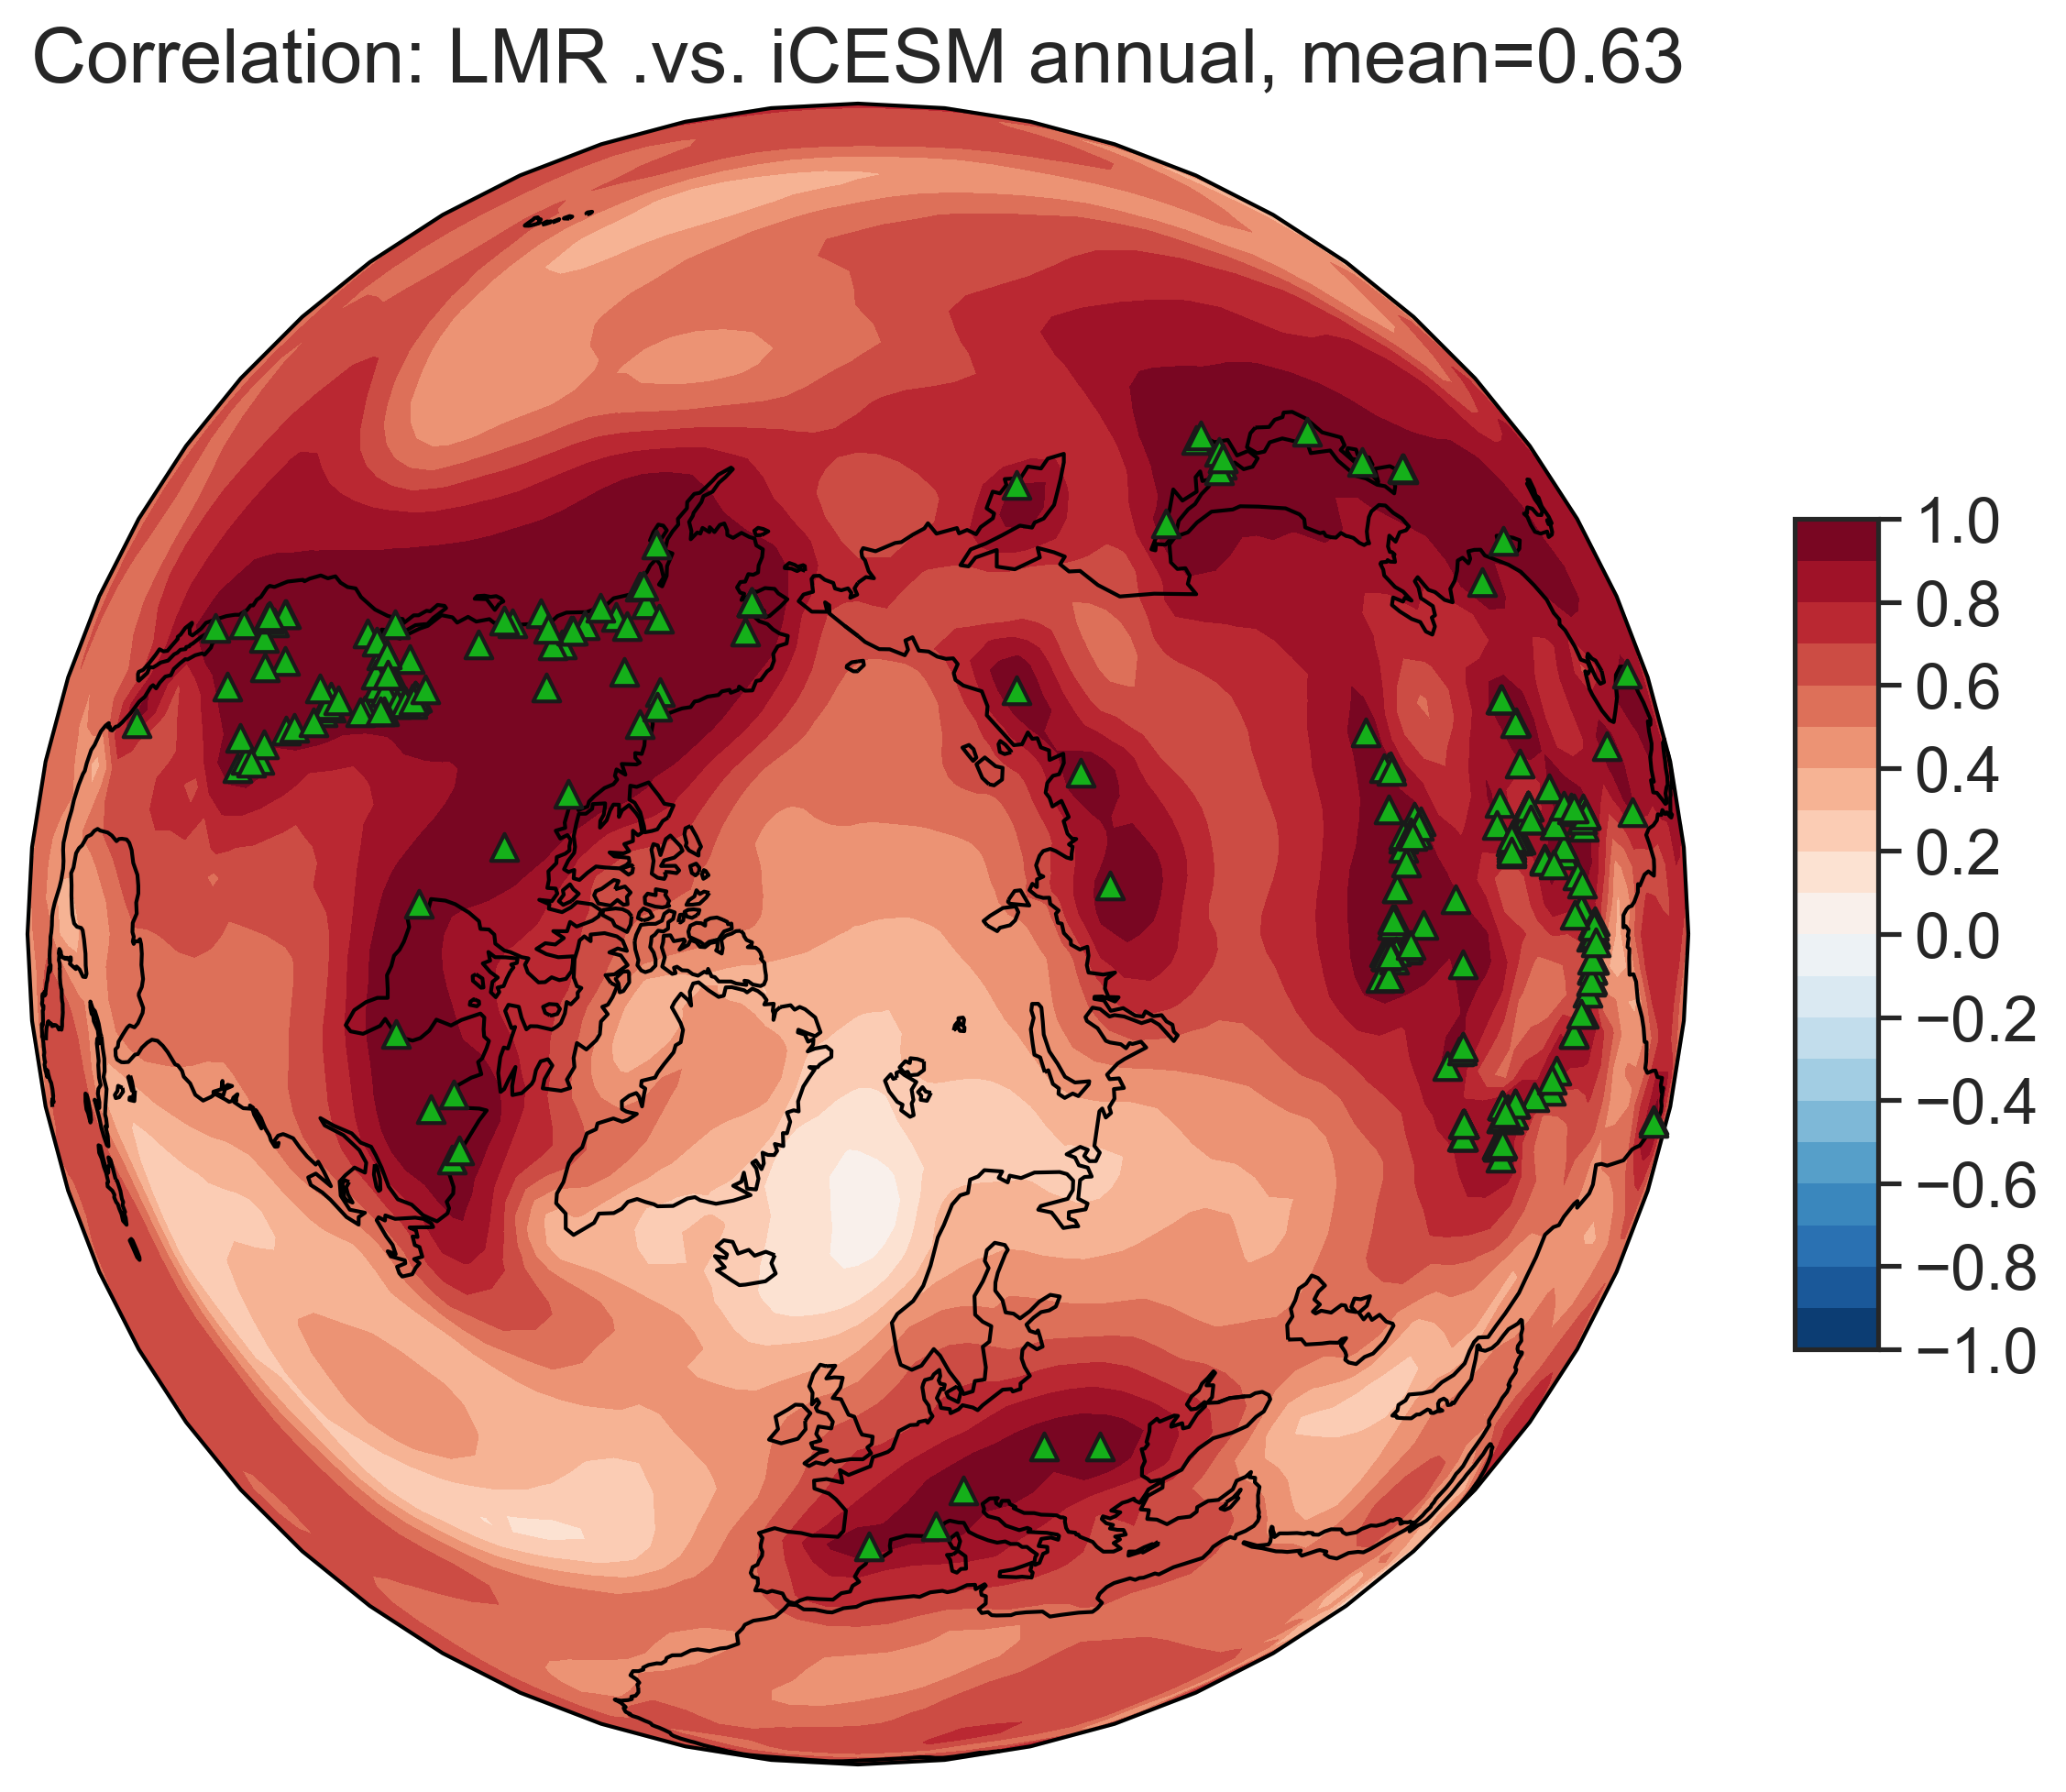
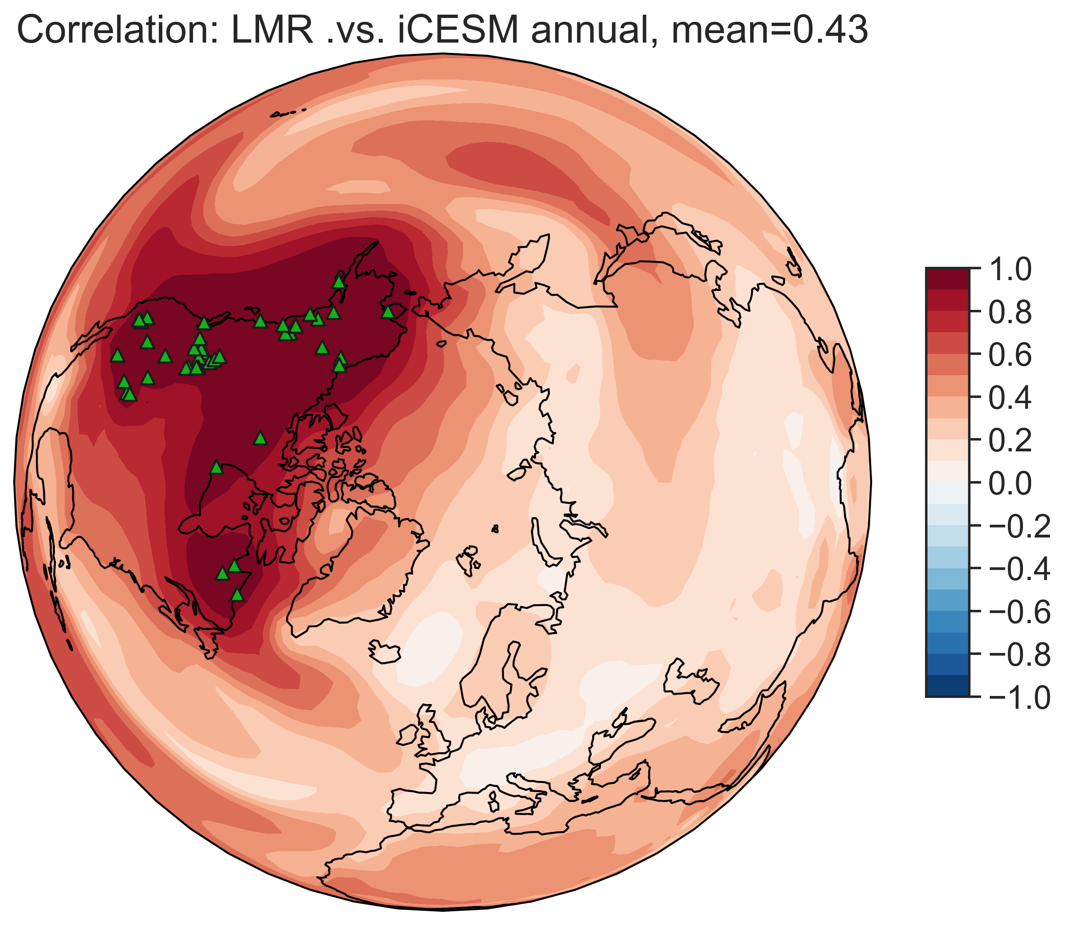
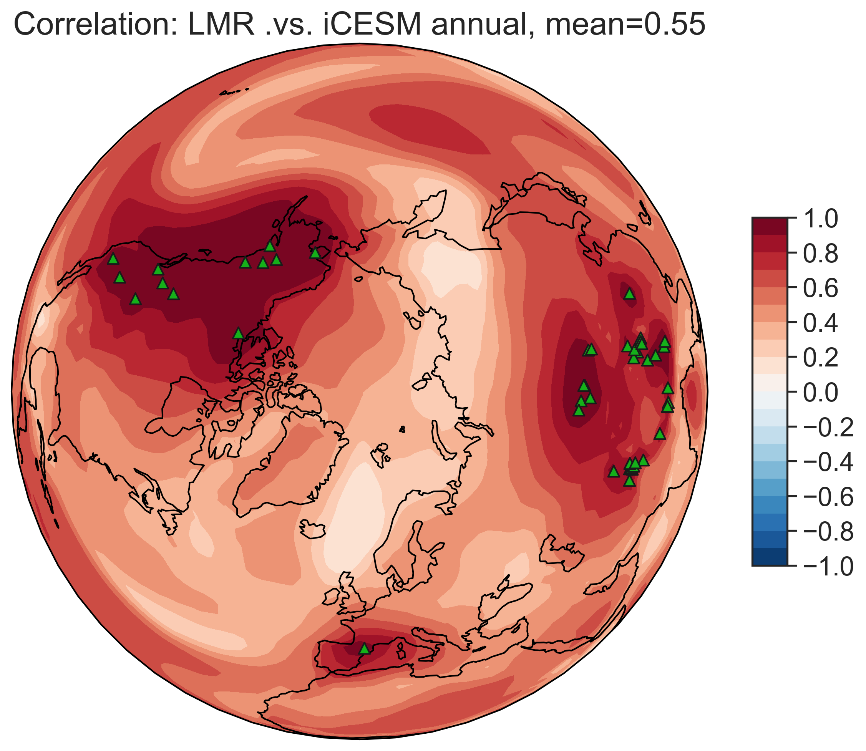
Pseudoproxy experiment design
prior: iCESM annual temp
pseudoproxy: iCESM annual temp (perfect temperature recorder)
NH TRW (n=336)
NA TRW (n=50)
NH TRW (n=50)
Verification over [850, 1850]

Slide 14
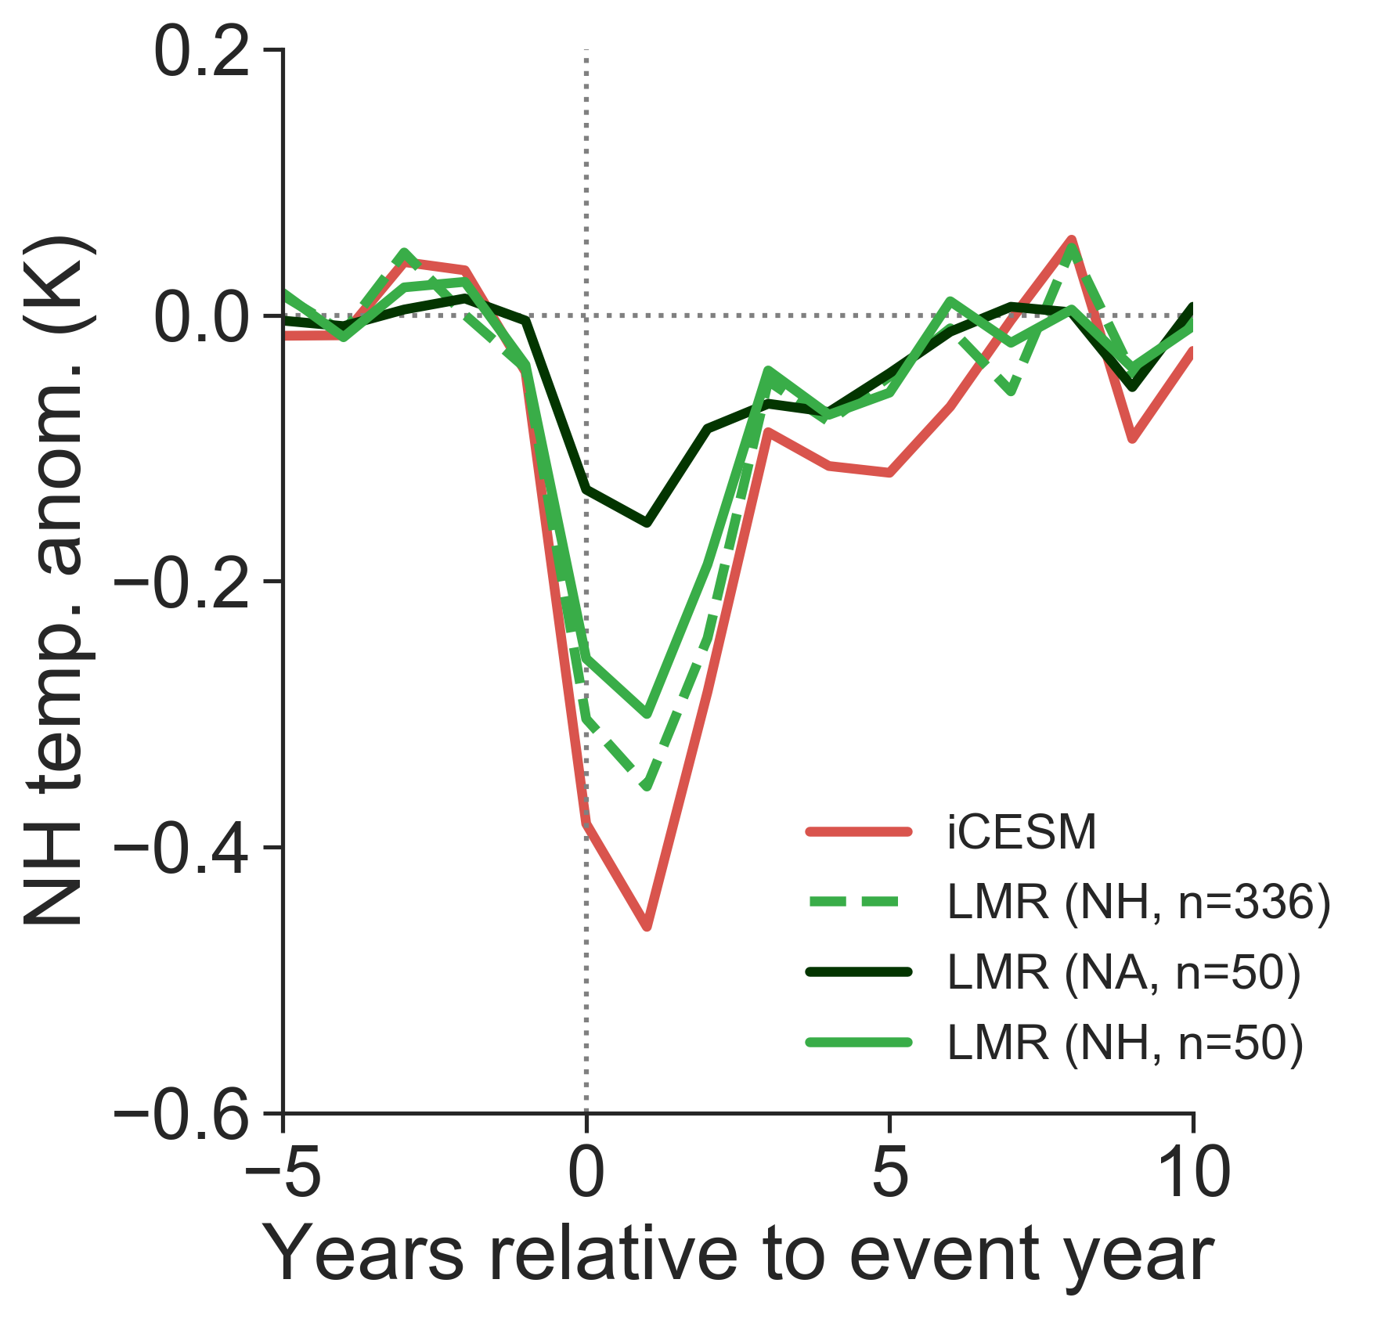
spatial coverage
>
sheer number of records
pseudoproxies

Slide 15
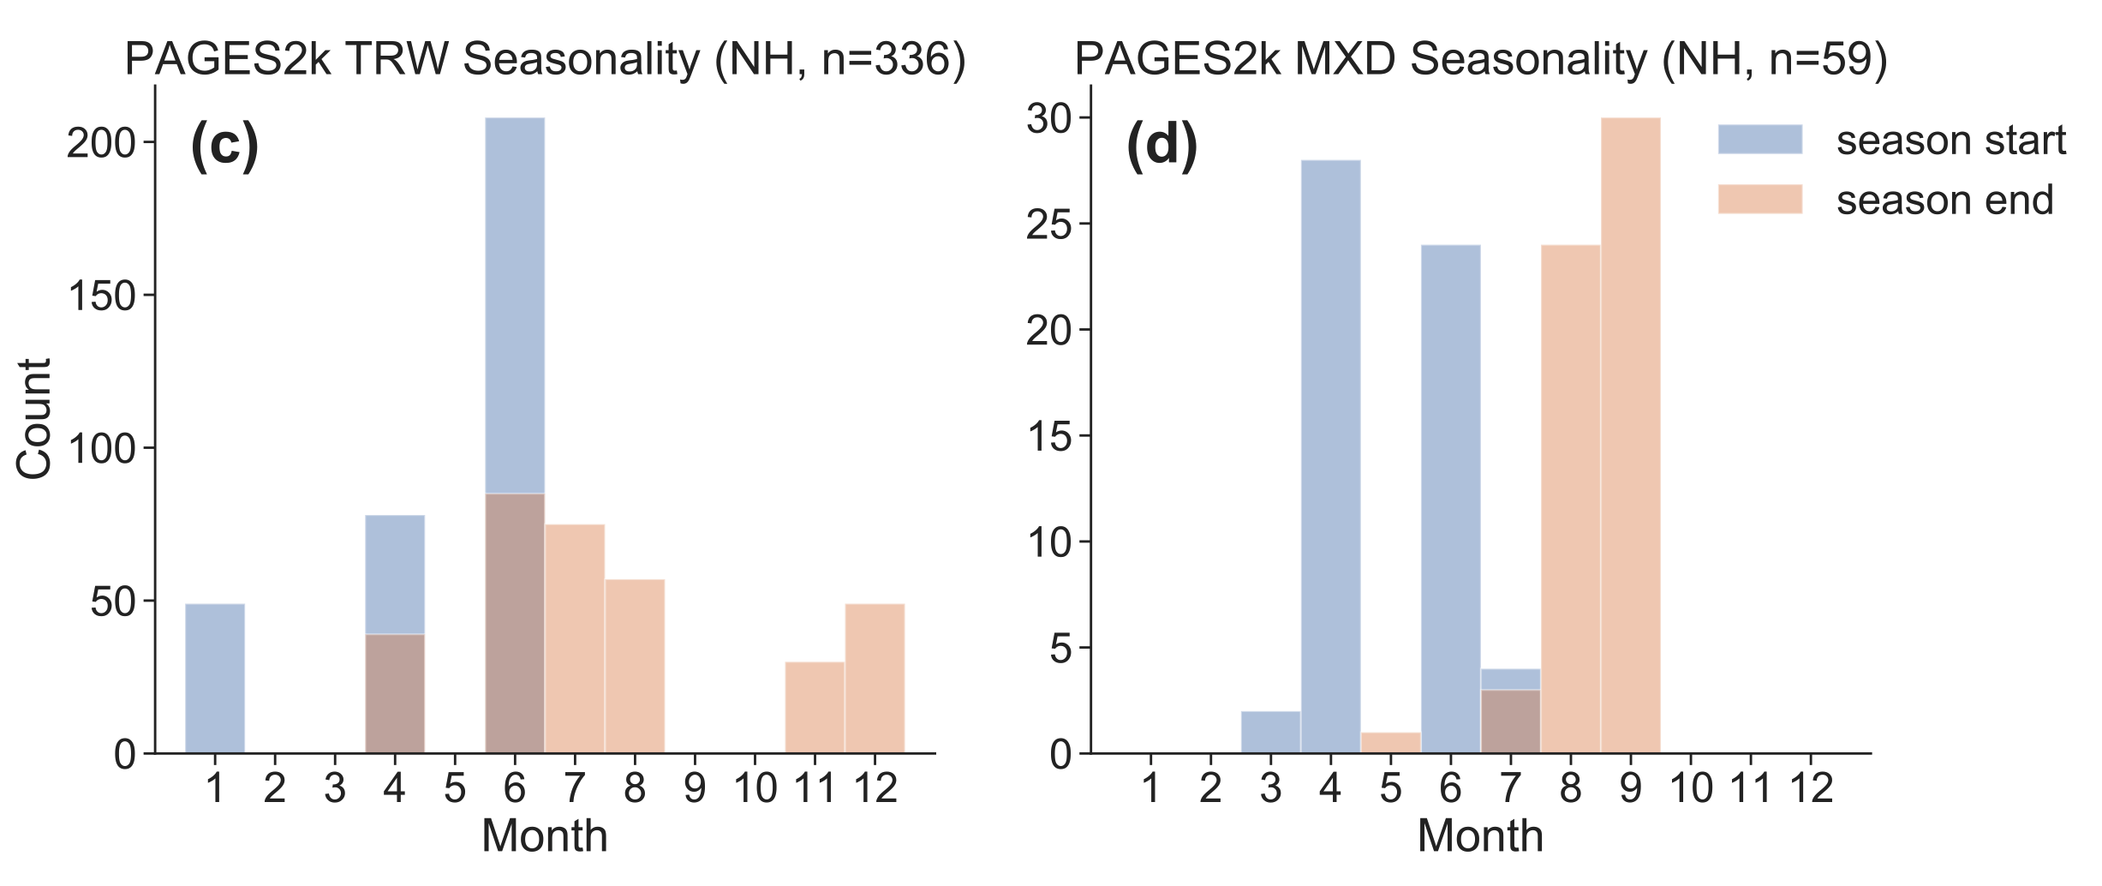
2. Seasonality
Trees register climate only during their growing season (which varies from place to place)

Slide 16
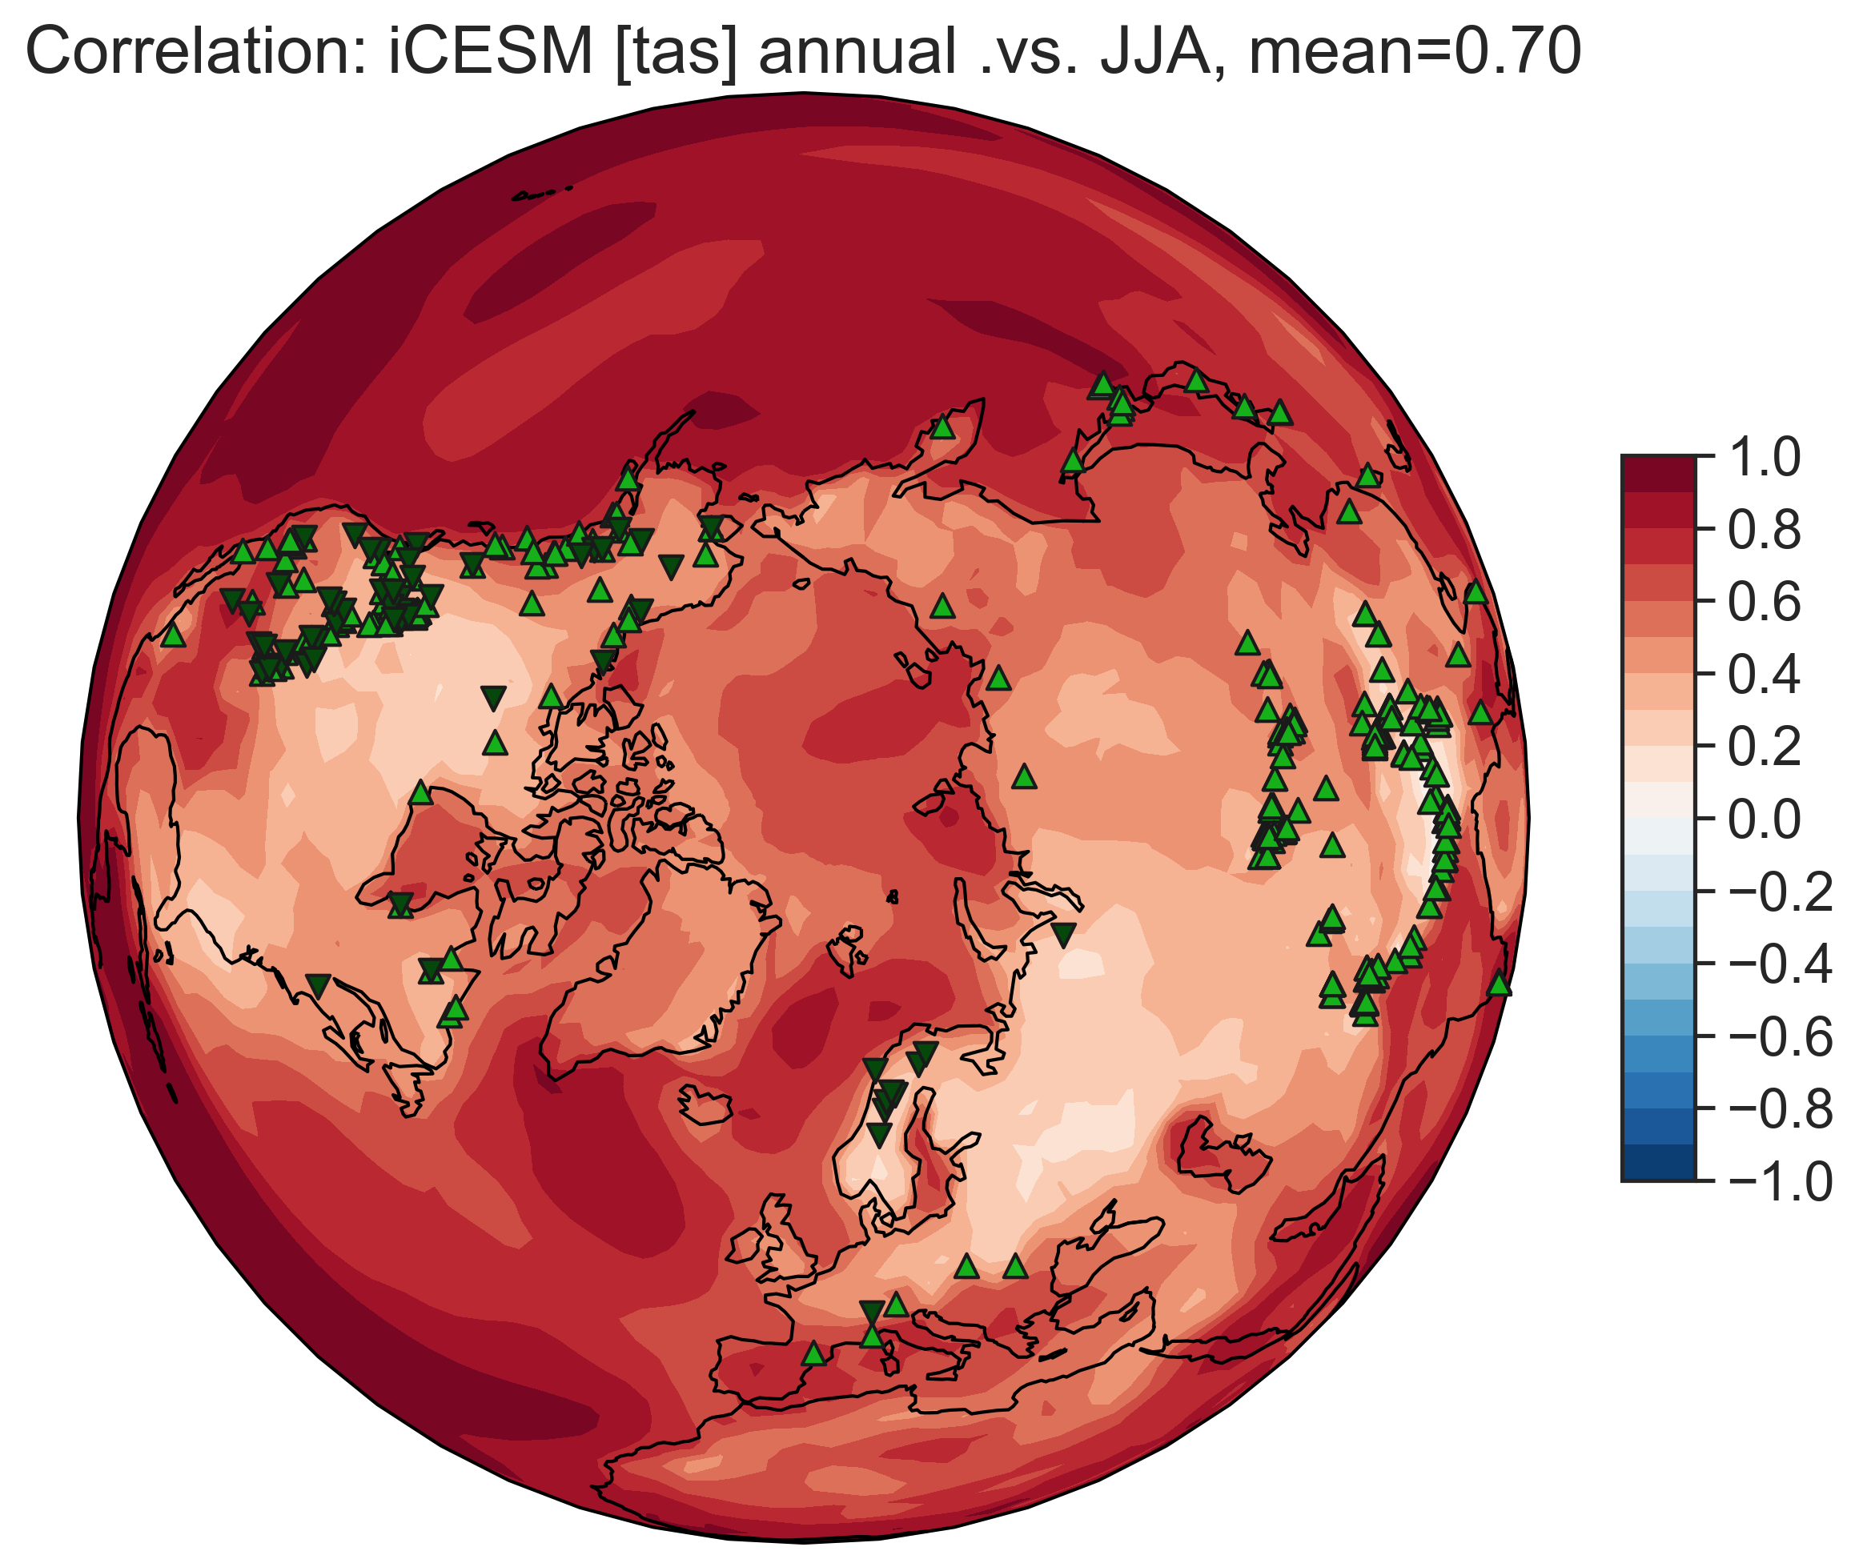
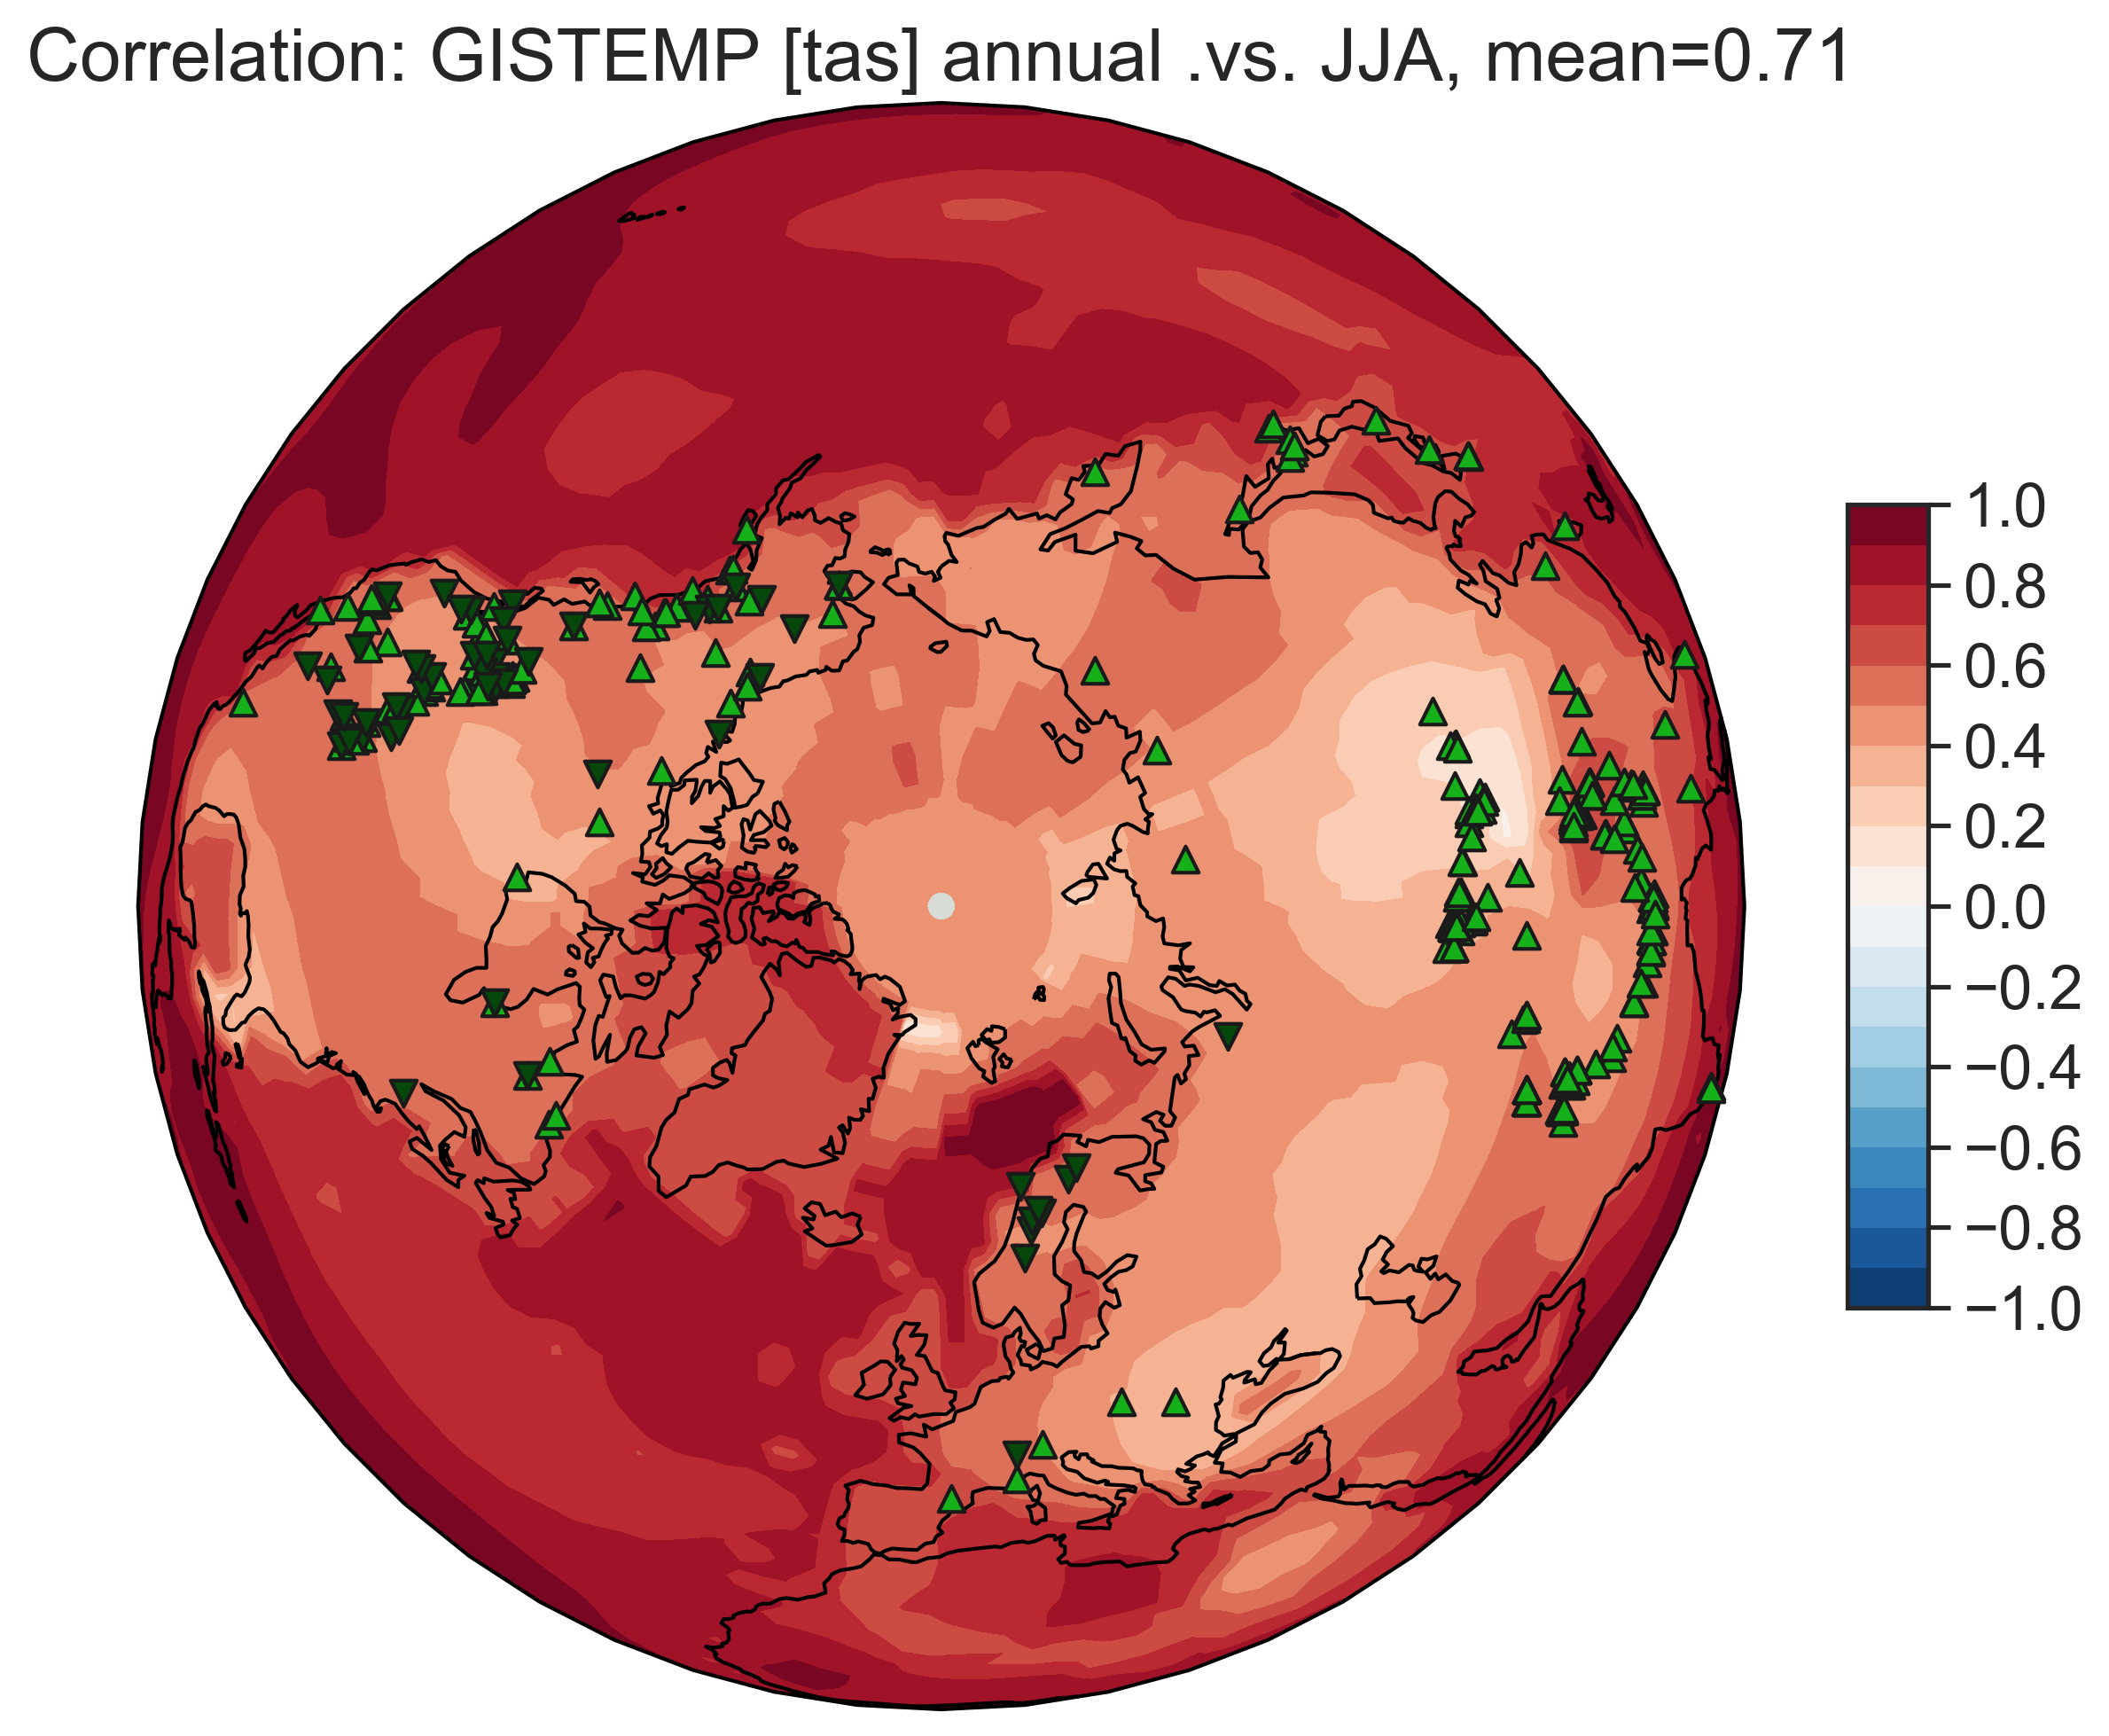
Correlation between annual & summer temp
Goddard Institute for Space Studies (GISS) Surface Temperature Analysis (GISTEMP) [Hansen et al., 2010]

Slide 17
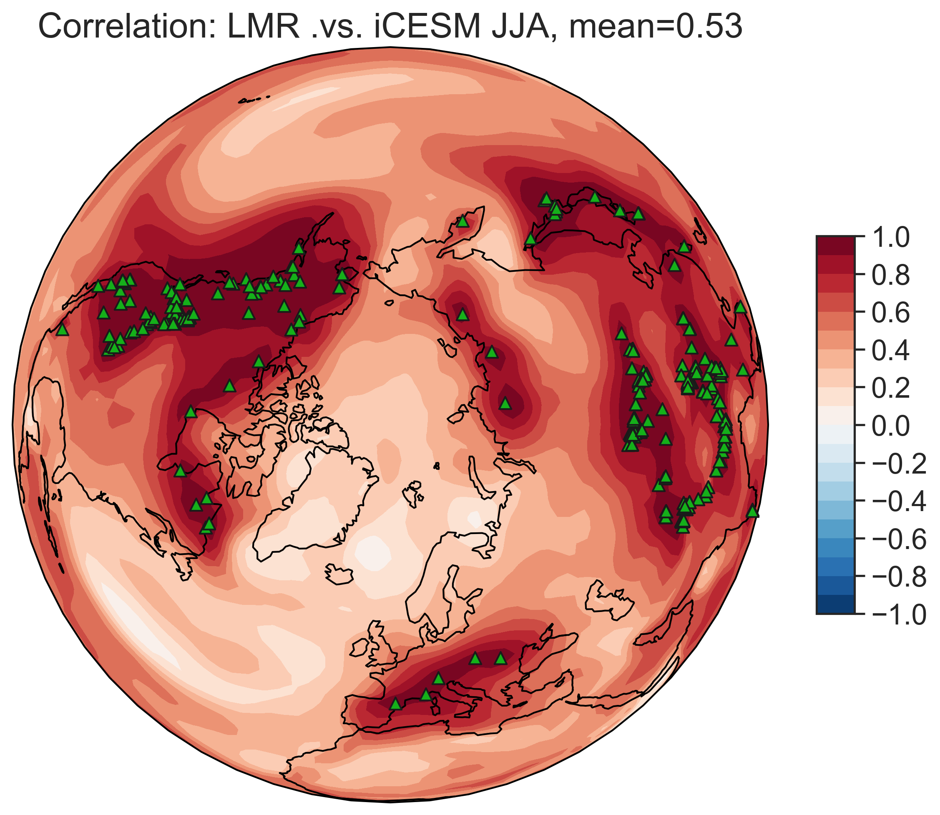
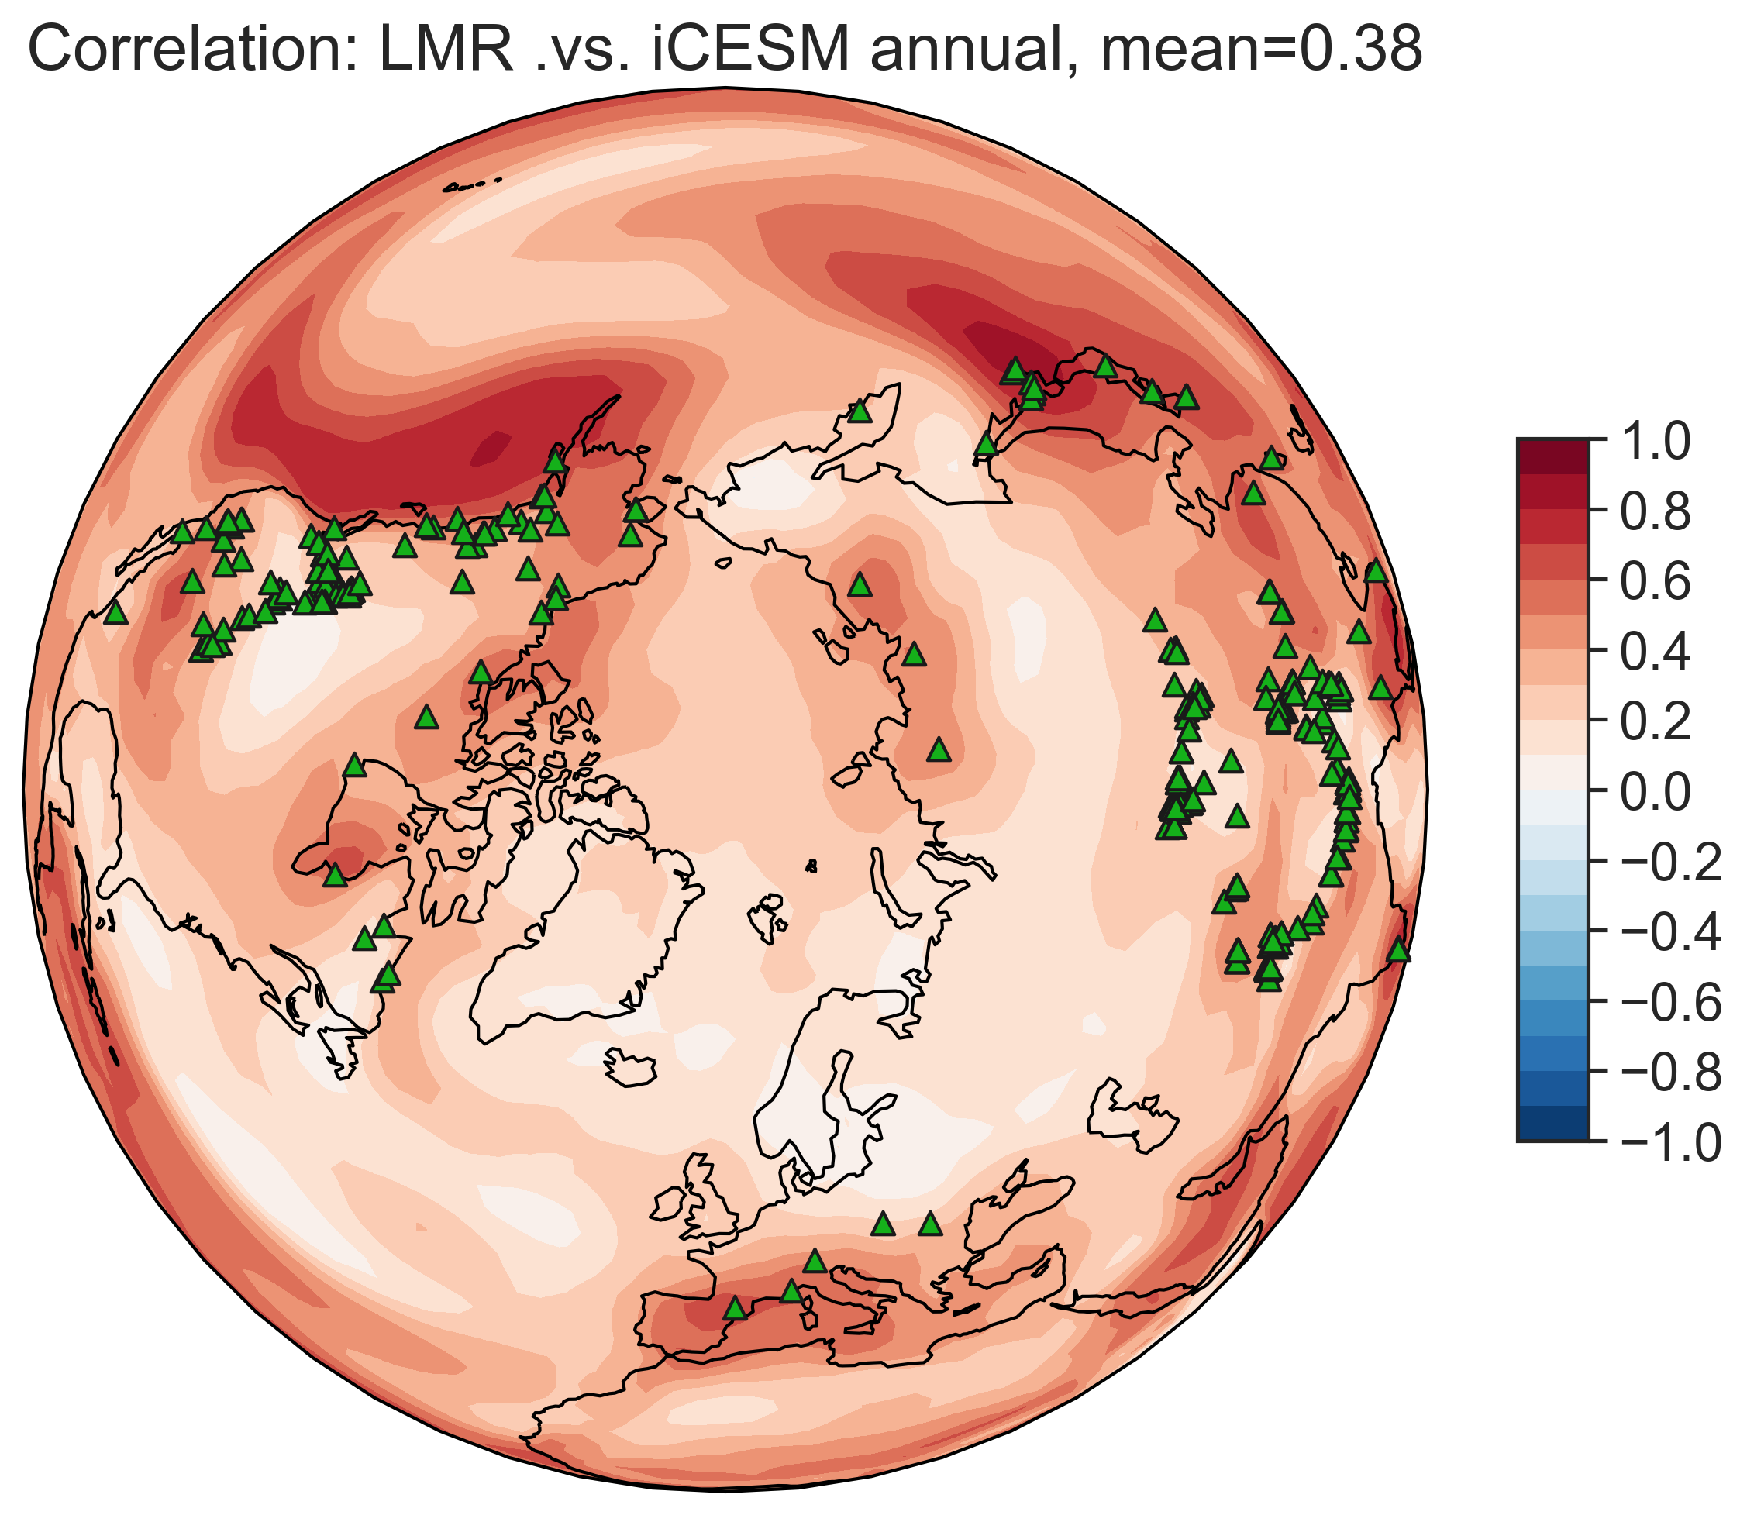
Pseudoproxy experiments (PPE) settings
prior: iCESM annual/JJA tas
pseudoproxy: iCESM JJA tas (perfect summer temperature recorder)
Summer-sensitive trees can only reconstruct annual temperature to the extent that it resembles summer temperature!
recon. summer temp
recon. annual temp
Verification over [850, 1850]

Slide 18
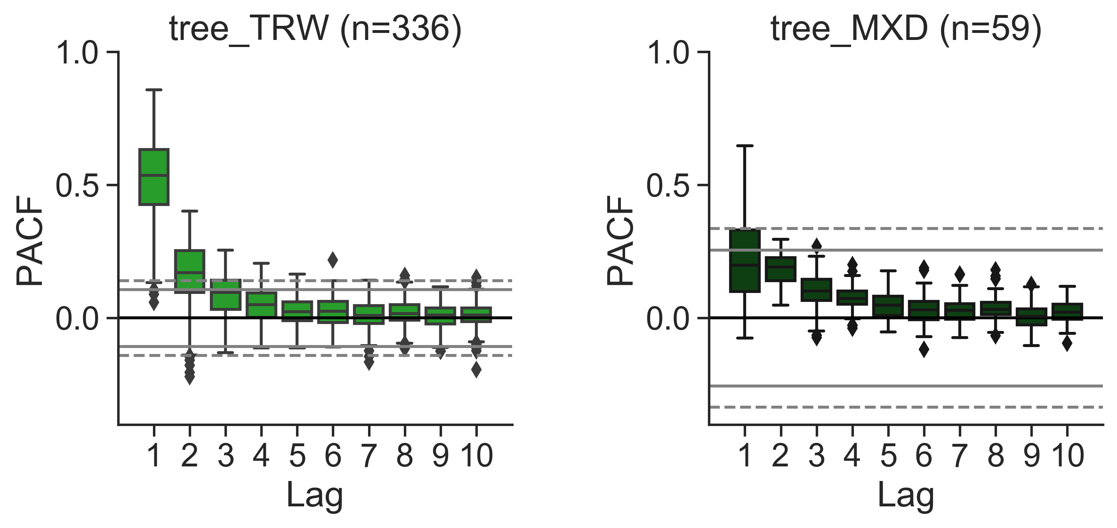
3. Biological memory
real proxies
References: D’Arrigo et al. (2008), Frank et al. (2013), Esper et al. (2015), Zhang et al. (2015a, b), Lücke et al. (2019)

Slide 19
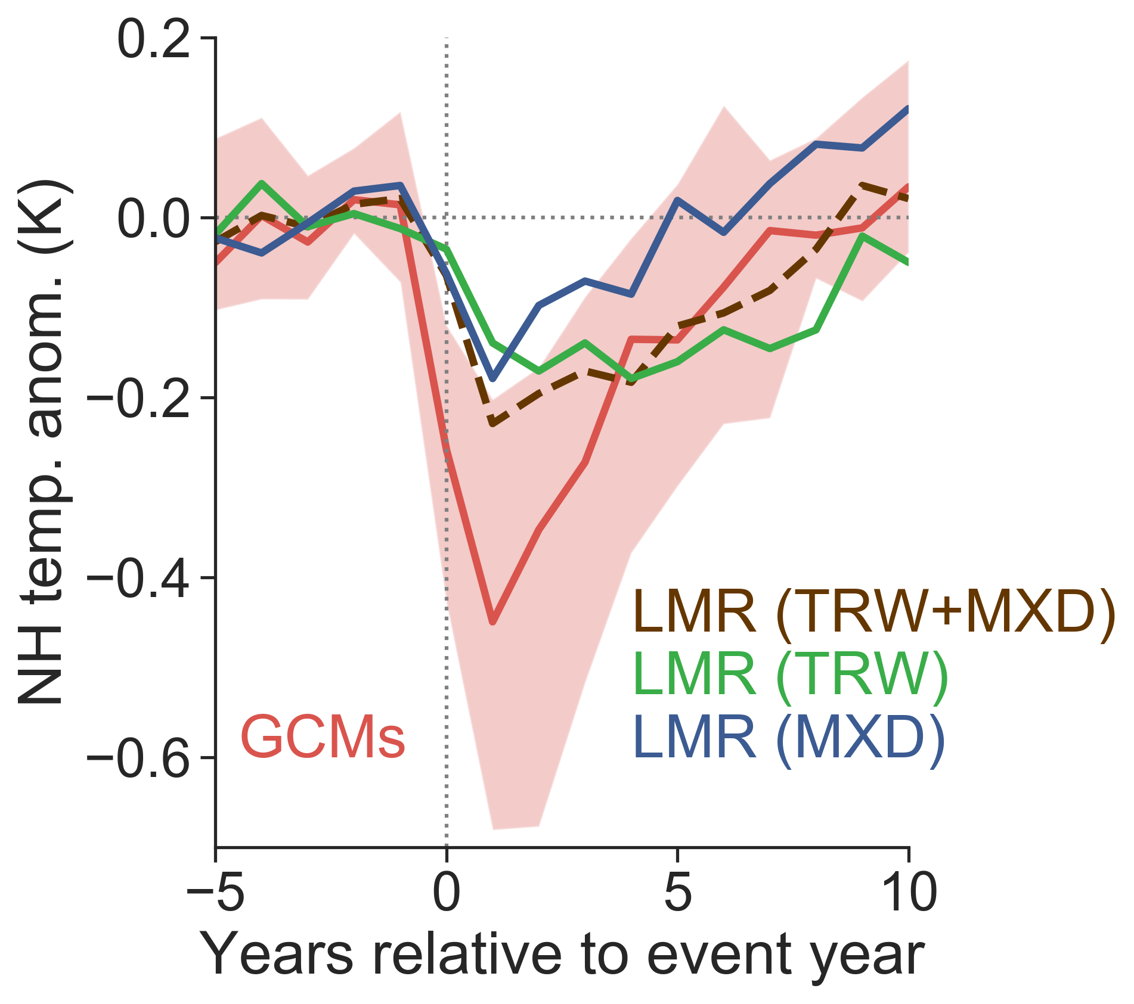
the lag is due to ring-width records
real proxies

Slide 20
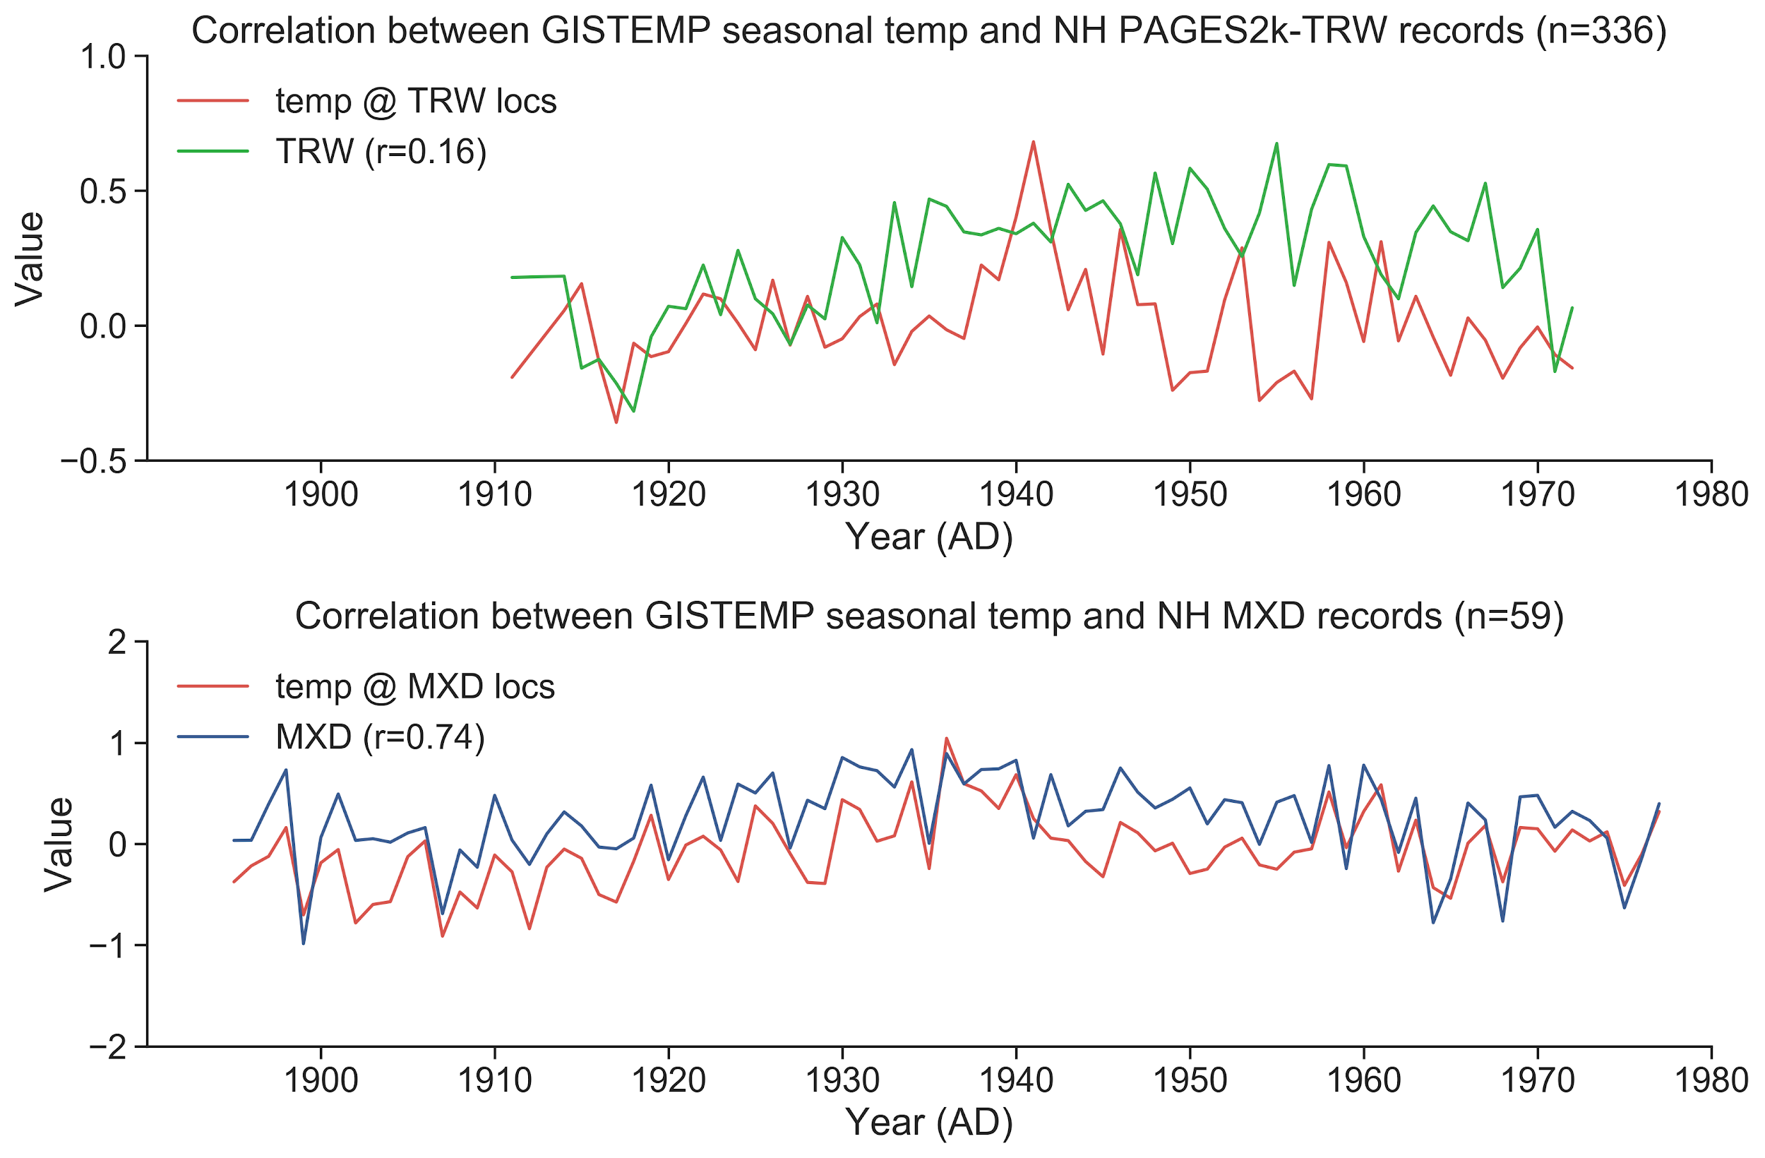
Lagged cooling in TRW composites
Krakauer and Randerson 2003, Frank et al. 2007, Breitenmoser et al. 2012
real proxies

Slide 21
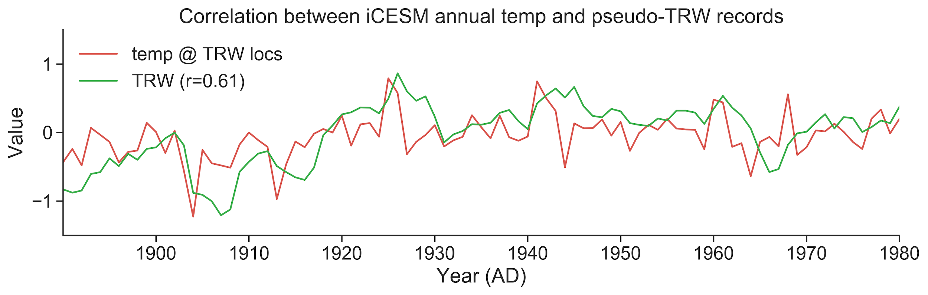
Pseudoproxy experiments
prior: iCESM annual tas
pseudoproxy: 5-yr moving average of iCESM annual temp (temperature smoother)
pseudoproxies

Slide 22
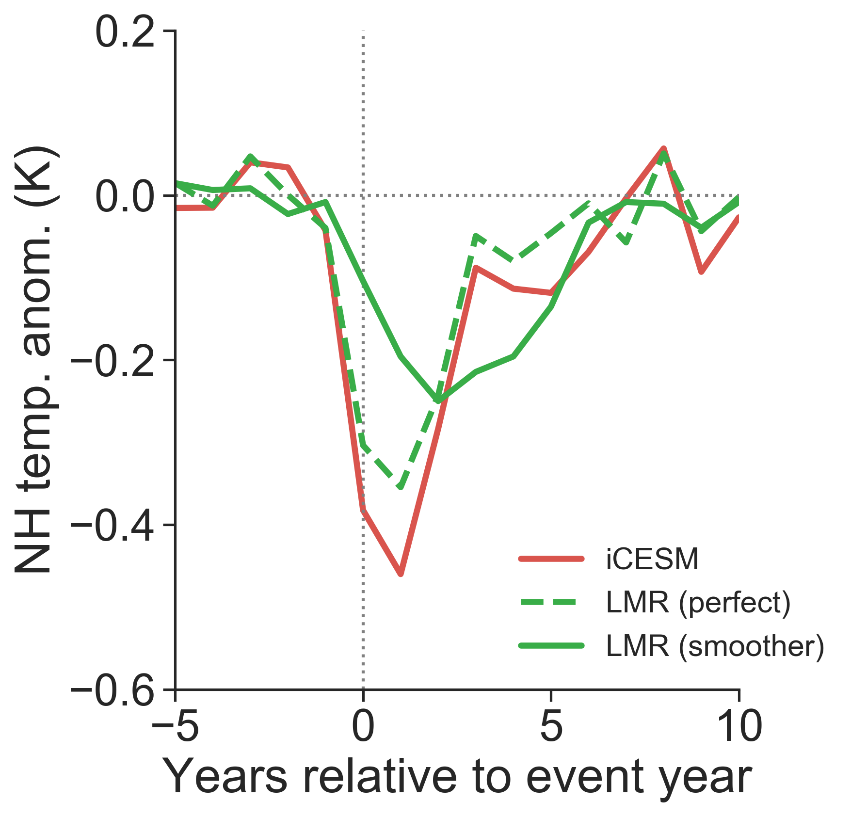
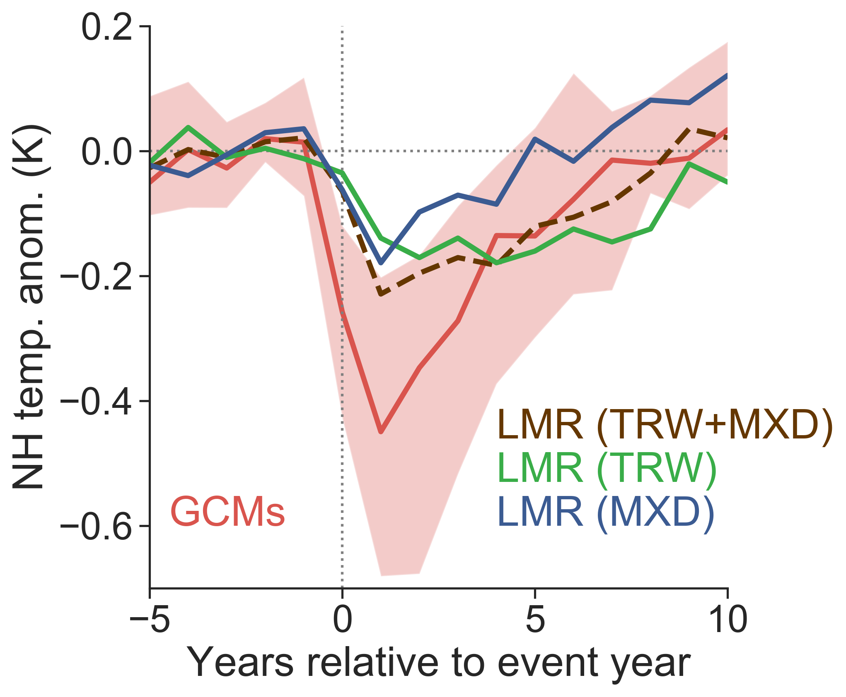
pseudoproxies
1. prolonged recovery
2. lagged peaking cooling year
3. damped peak cooling amplitude
[in agreement with Lücke et al. (2019)]
real proxies

Slide 23
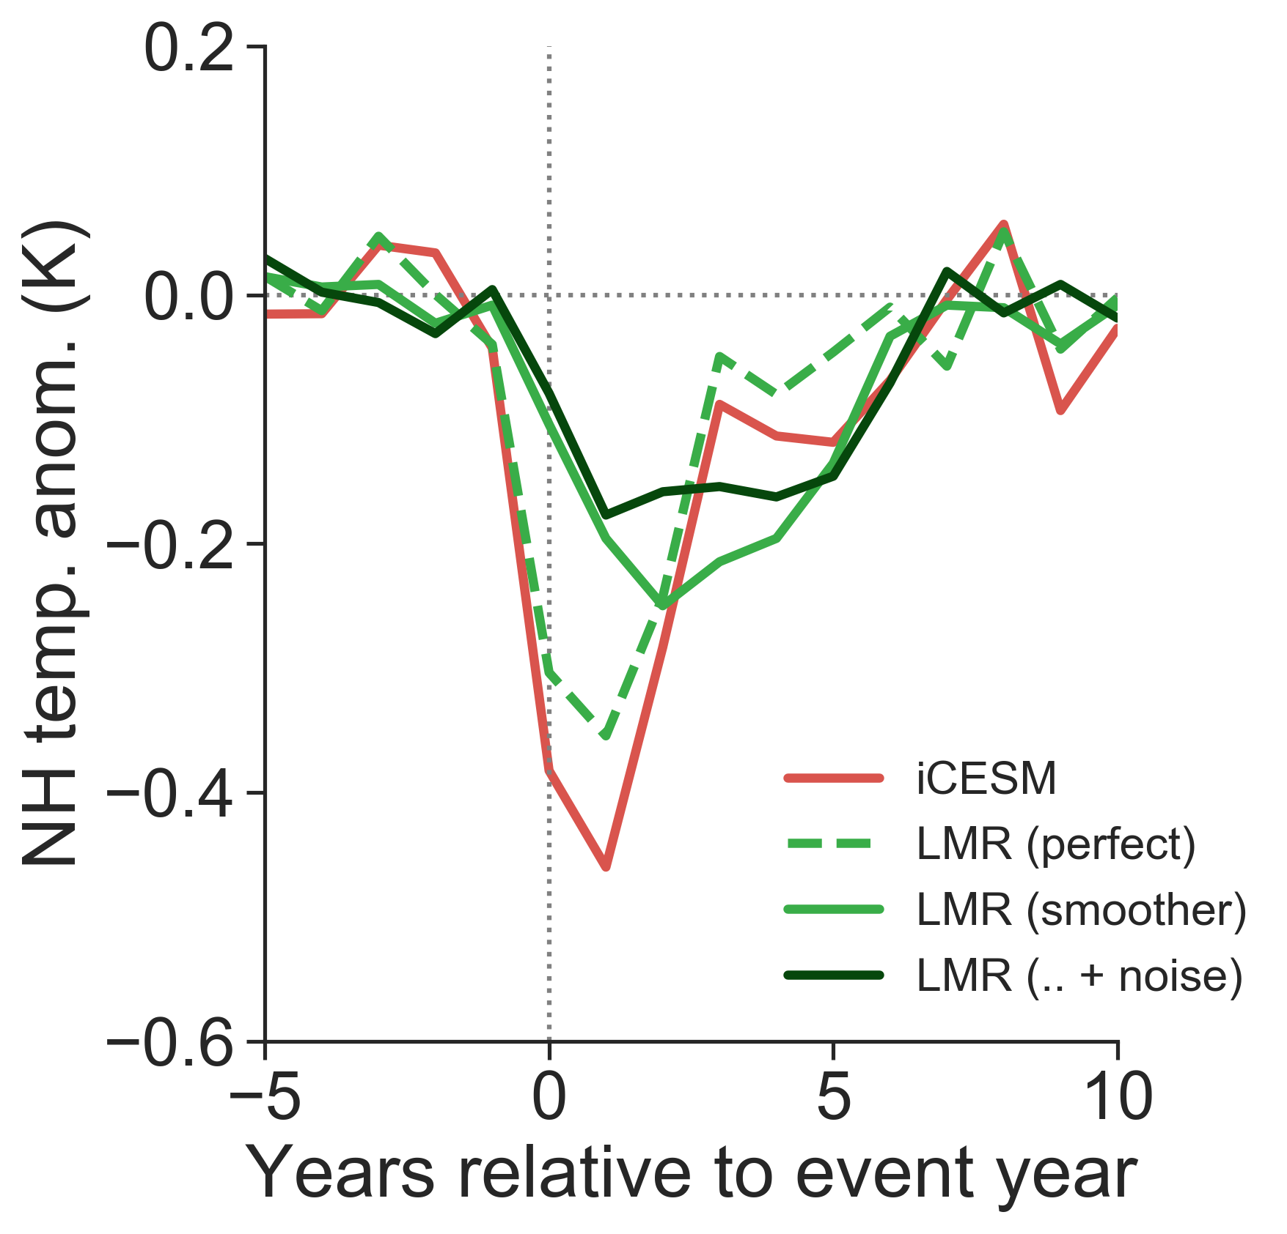
4. Proxy noise
pseudoproxy: 5-yr moving average of iCESM annual tas (temperature smoother) + Gaussian noise w/ SNR=0.3
pseudoproxies
real proxies

Slide 24
Four factors influence the comparison
spatial coverage
seasonality
biological memory
noise
What can we do about them?

Slide 25
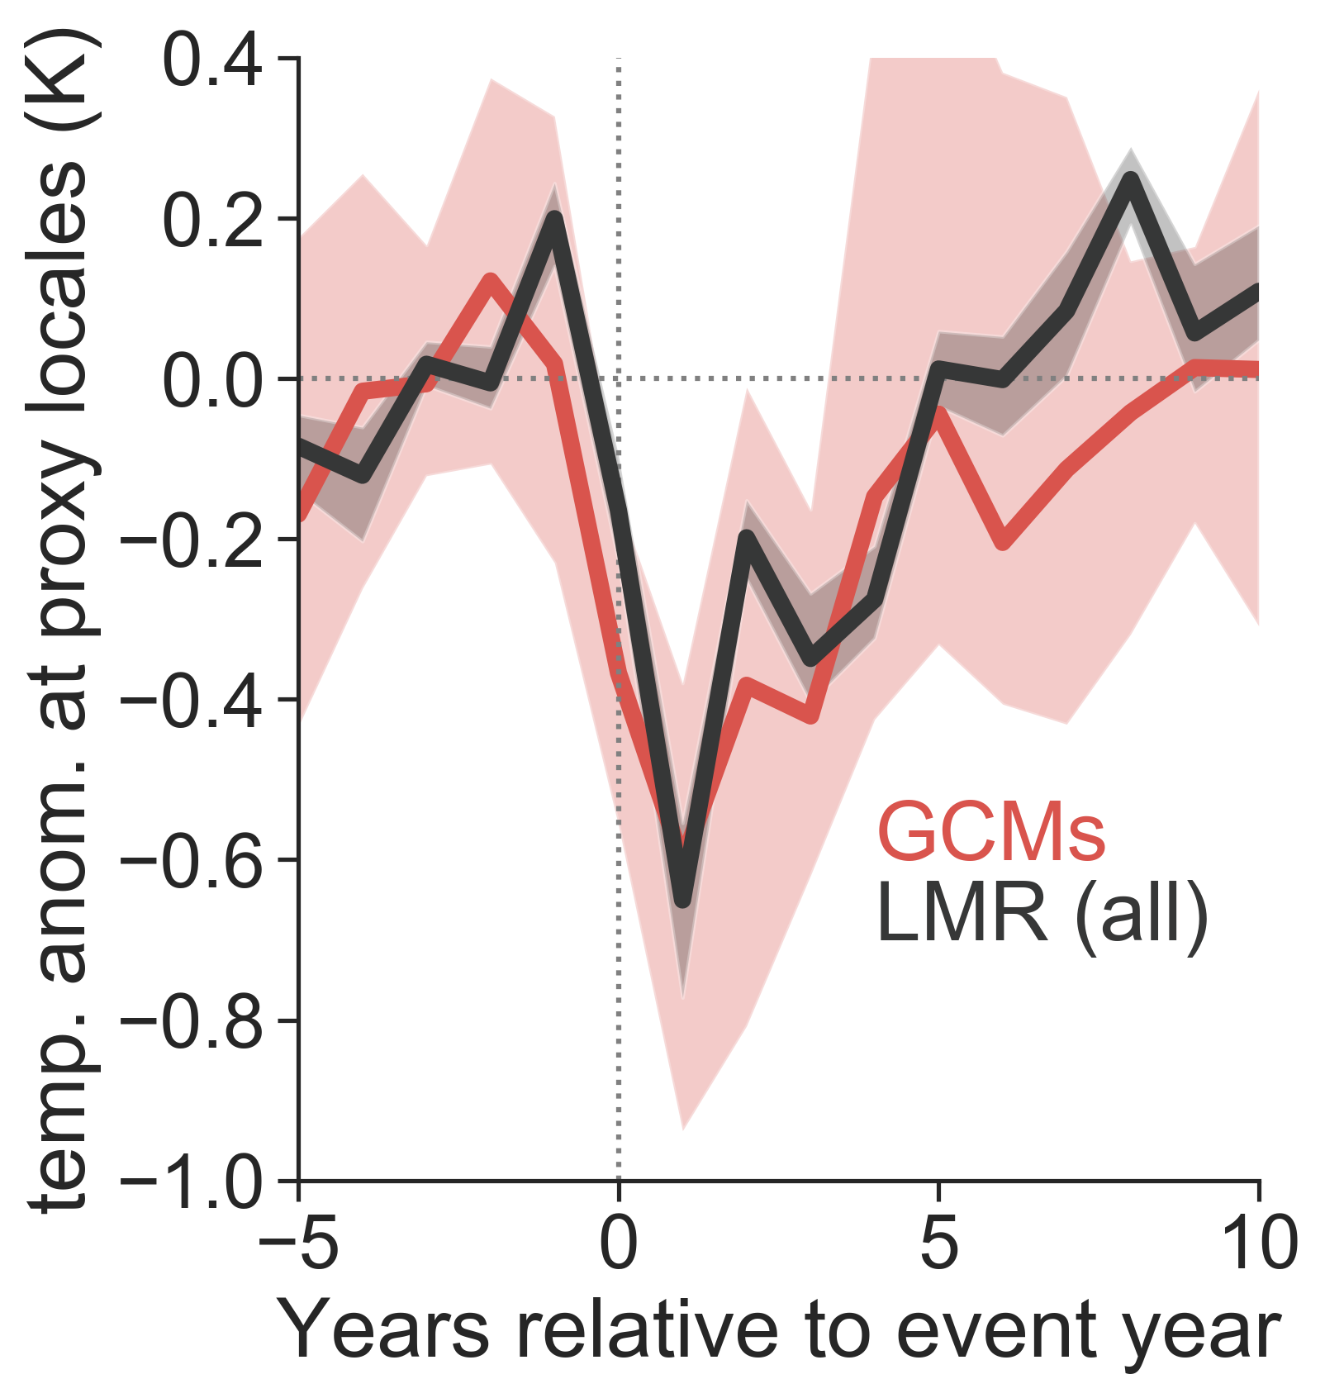
Bridging the gap
We can
assimilate MXD only to alleviate the biological memory issue
reconstruct NH summer temperature to suppress seasonal bias
perform SEA at proxy locations to account for limited spatial coverage
real proxies
real proxies

Slide 26
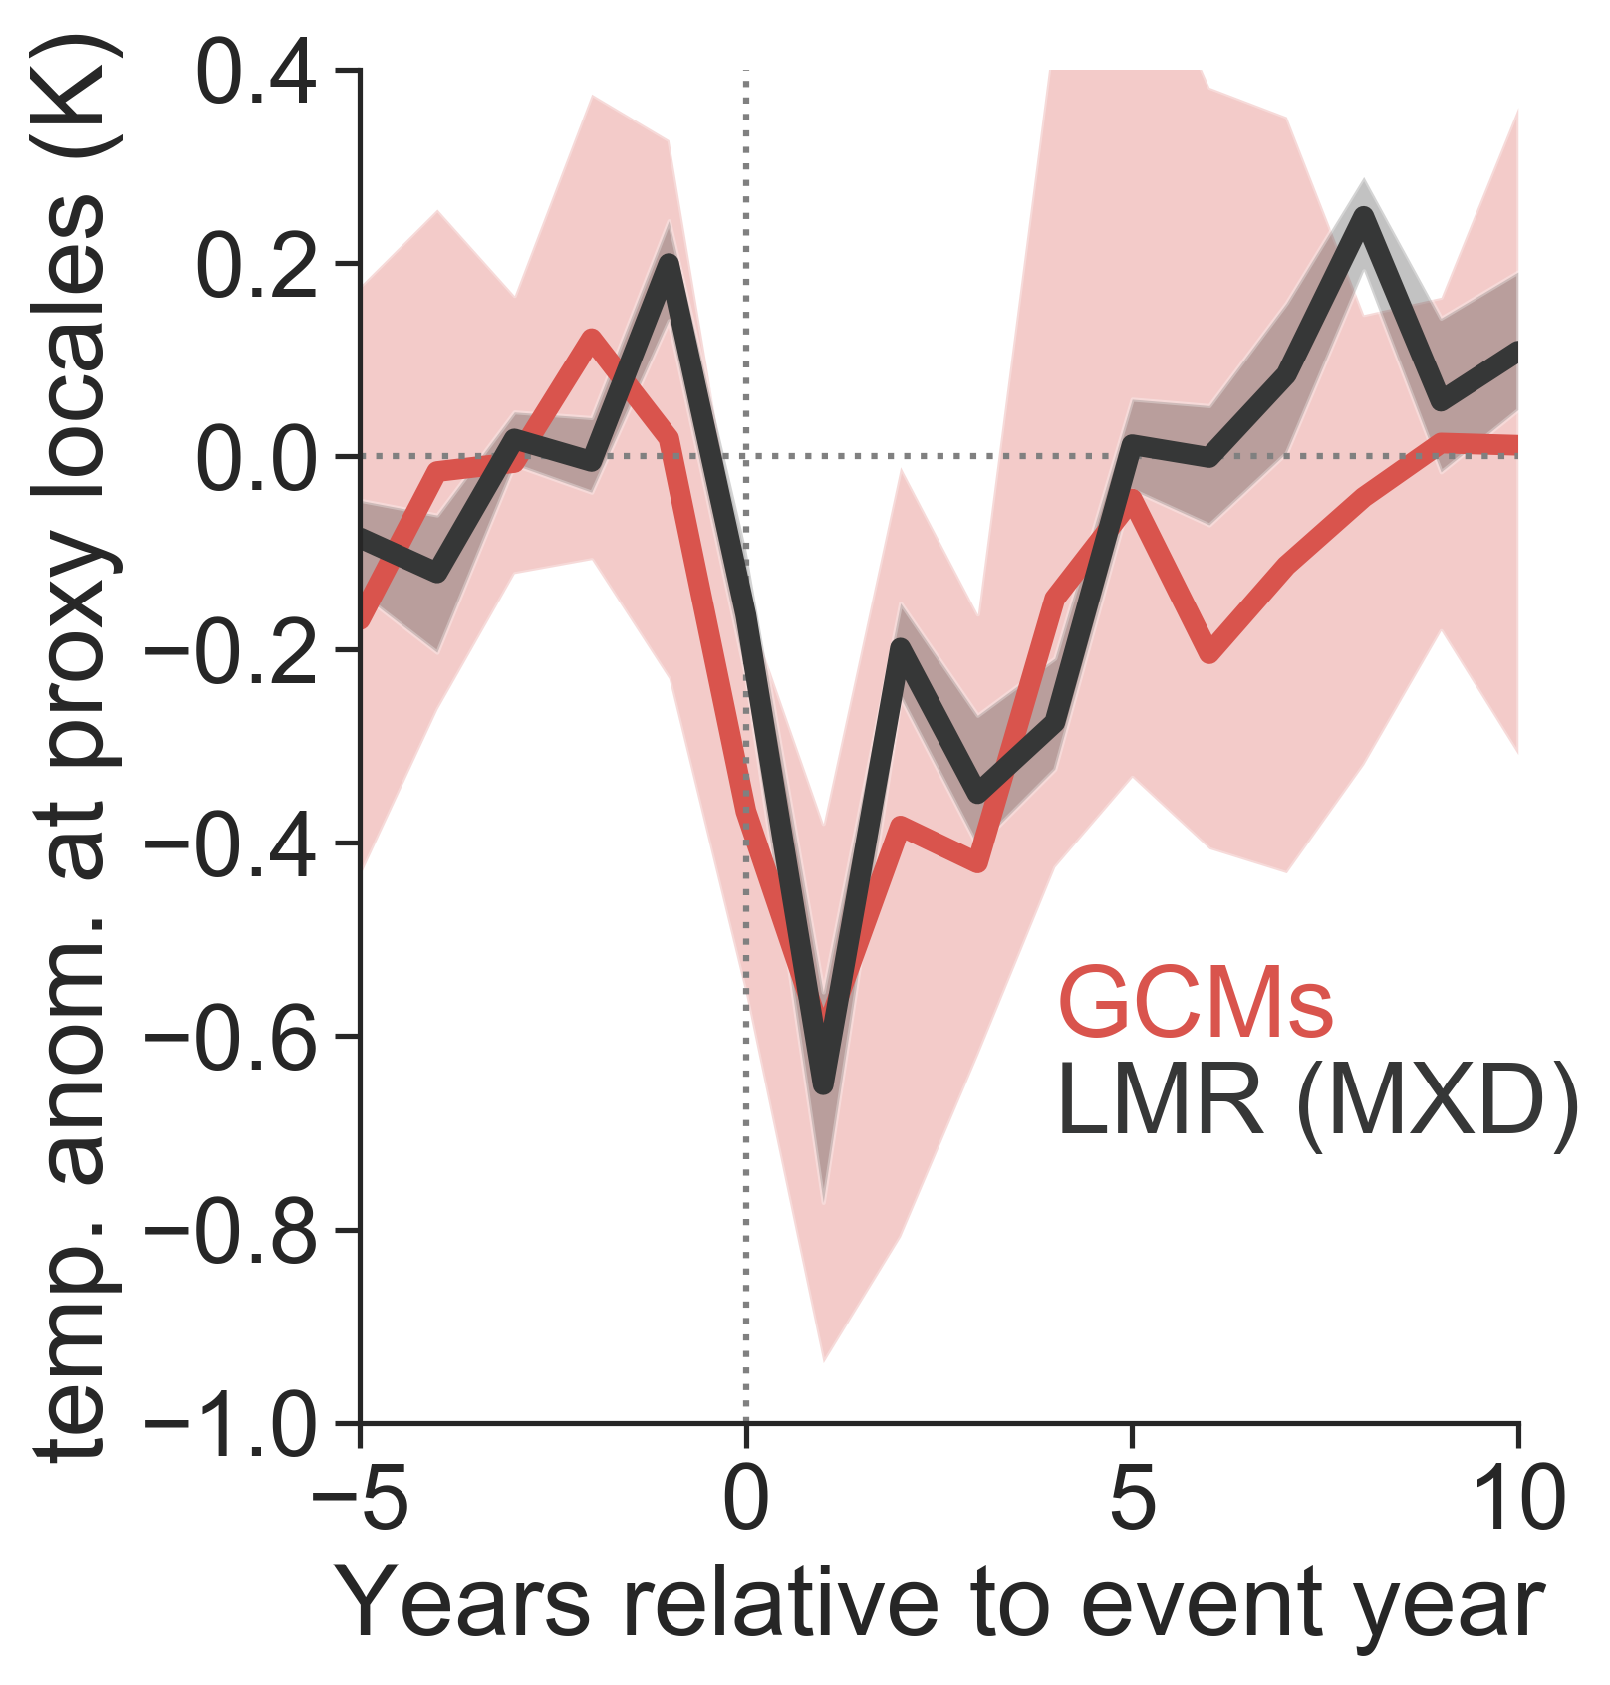
Conclusion
Problem solved!
(reproduced from IPCC AR5 Fig. 5.8b)
(Yet, more MXD records would be nice!)

Slide 27


Thank you!

