Slide 1
Particle acceleration by transient structures around Earth’s bow shock
Terry Liu^{1,2}, Vassilis Angelopoulos³, Heli Hietala^{4,5,3}, San Lu³, and Drew Turner⁶
1. University Corporation for Atmospheric Research 2. University of Alaska, Fairbanks 3. University of California, Los Angeles 4. Imperial College London 5. University of Turku 6. Johns Hopkins University Applied Physics Laboratory

Slide 2
Part I. Foreshock transients

Slide 3
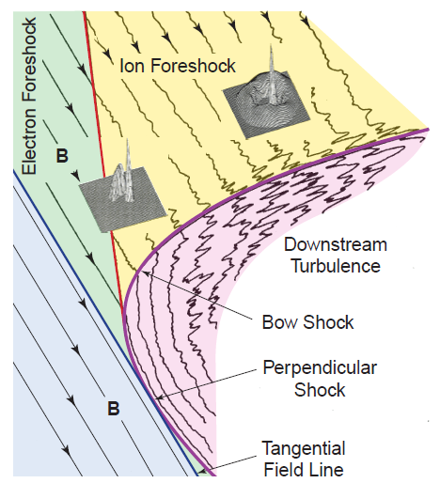
Introduction: foreshock
Eastwood et al. [2005]
Omidi [2007]

Slide 4
Introduction: HFAs and FBs
Turner et al. [2013]

Slide 5
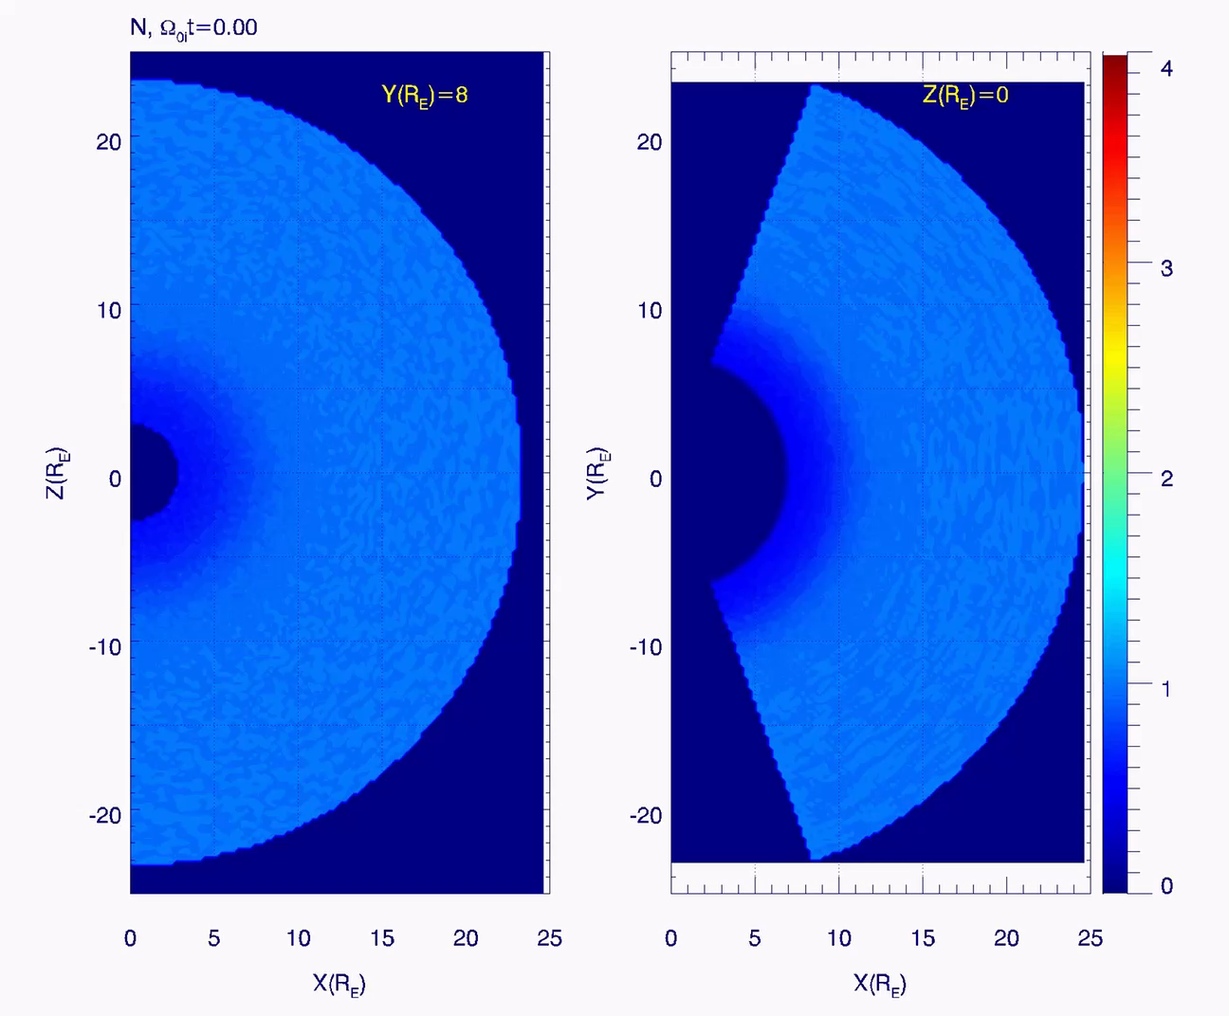
3D global hybrid simulation of an FB
RD
Density
XZ
XY
IMF
In XY plane
By San Lu, UCLA

Slide 6
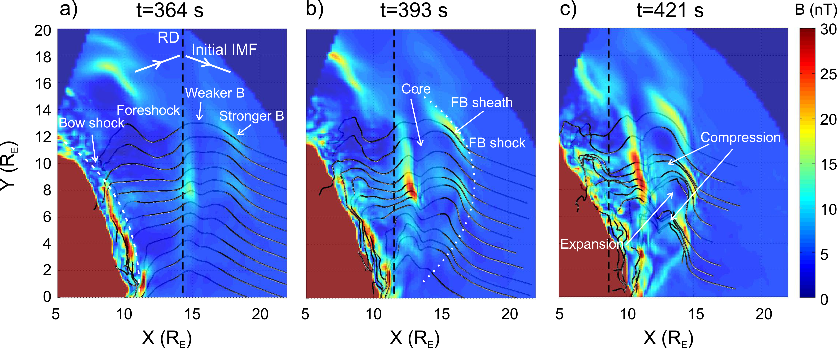
Possible acceleration mechanisms
Fermi acceleration
Betatron
RX
Shock drift
acceleration
Field line evolution in the hybrid simulation

Slide 7
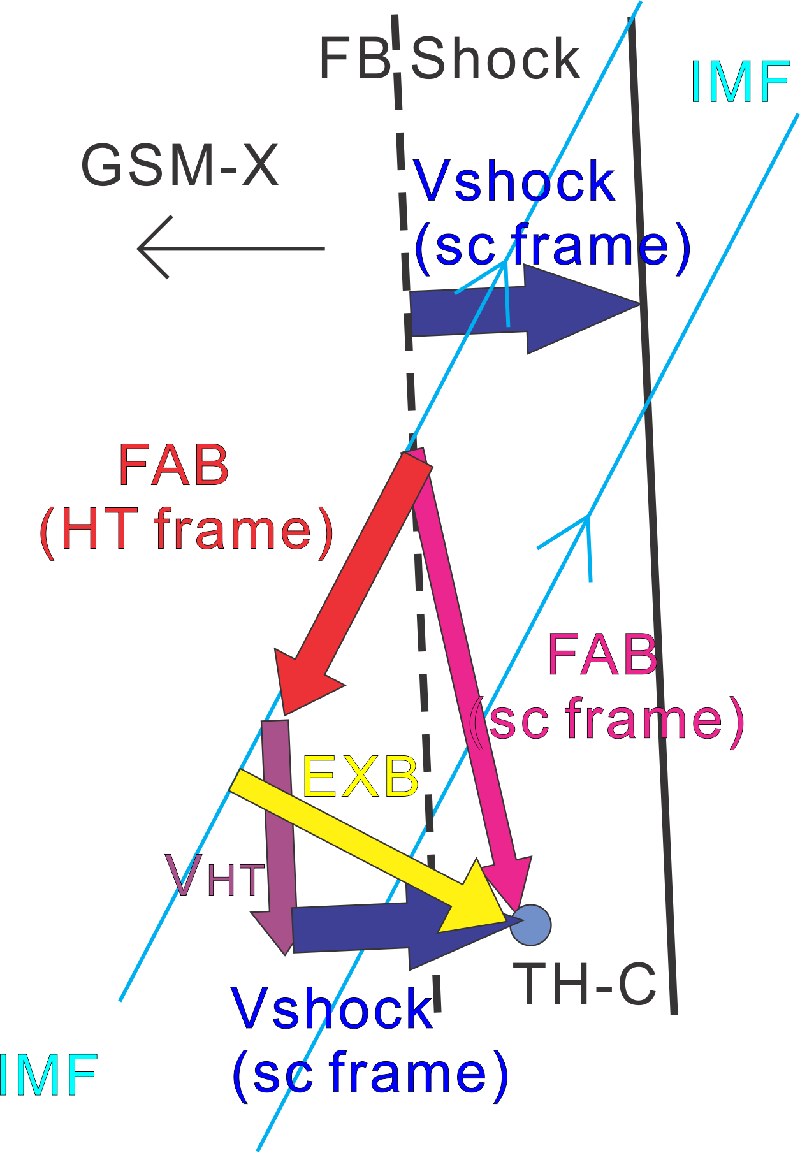
FB foreshock: shock drift acceleration at FB shock
EXB
Along B
Solar wind particles can be reflected and shock drift accelerated at the FB shock
The reflected field-aligned beam is moving slightly earthward, as FB shock is moving earthward in the sc frame
Liu et al. [2016]
Notes:
https://agupubs.onlinelibrary.wiley.com/doi/full/10.1002/2016GL068984

Slide 8
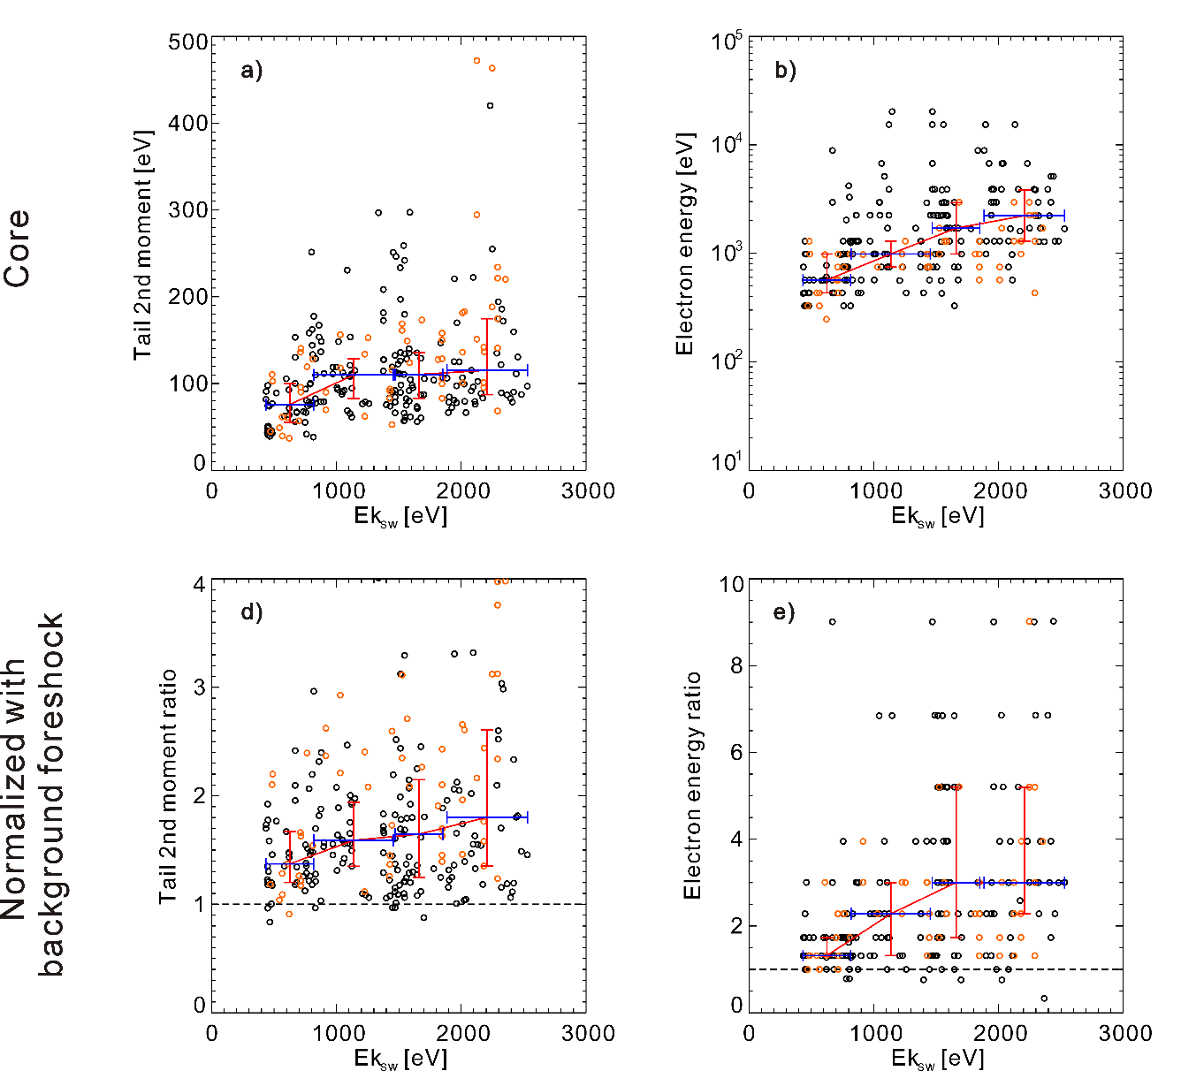
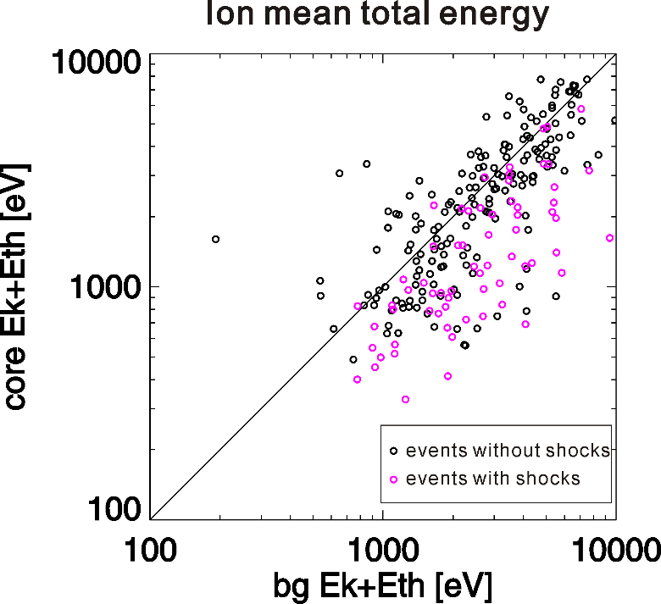
Statistical study: particle energy in the core
Almost all events have electron energy in the core enhanced
Only some events have higher ion energy (foreshock ions lose energy to support the formation)
Suprathermal electron energy vs solar wind energy
Liu et al. [2017a]
Notes:
https://agupubs.onlinelibrary.wiley.com/doi/full/10.1002/2017JA024043

Slide 9
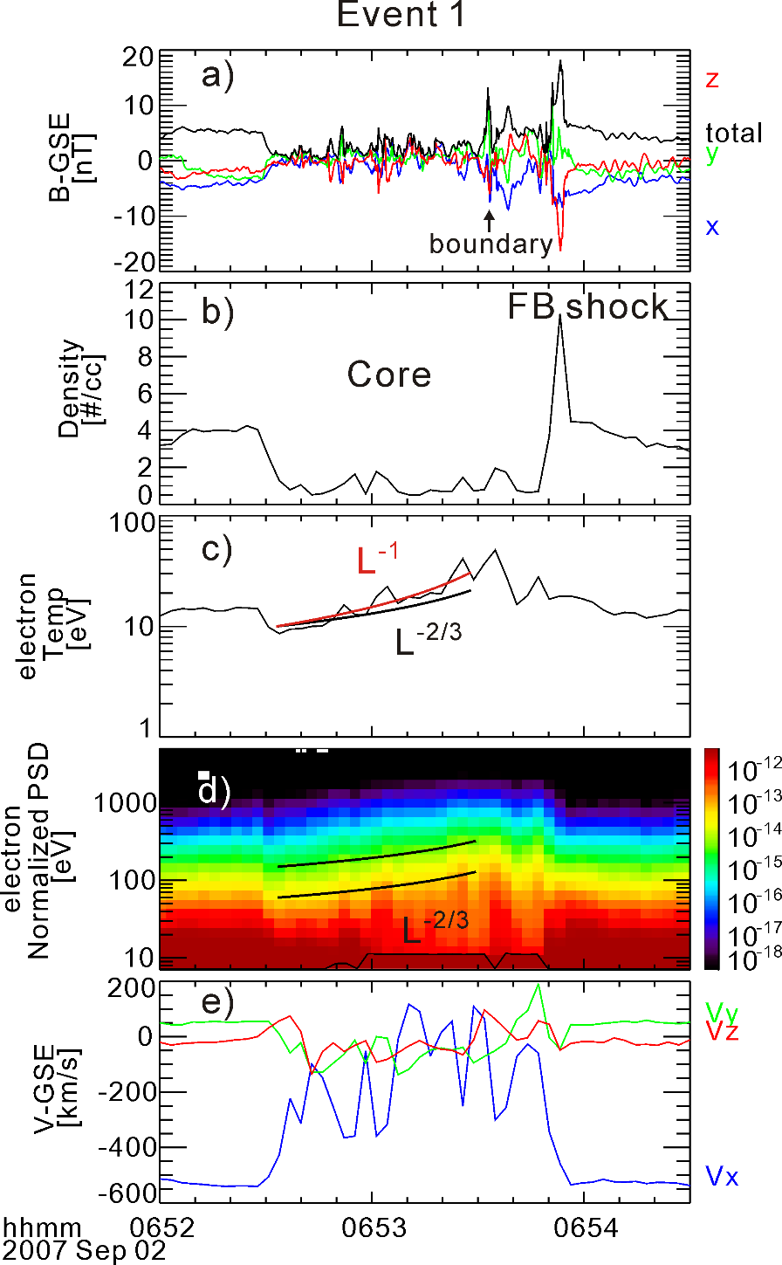
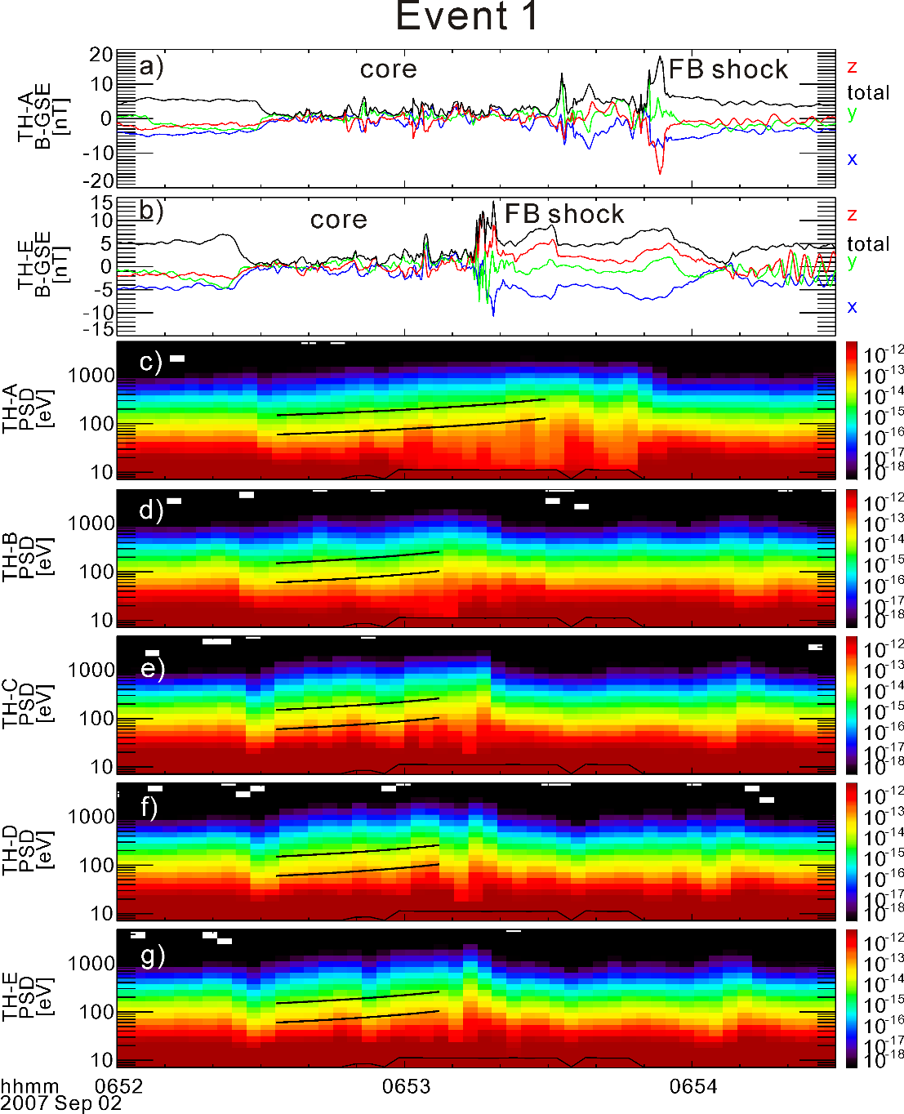
Electron Fermi
In the core, background B field ~0
Fluctuations dominates
Leakage could be ignored
Te represents the energy increase of low energy electrons
Electron PSD is conserved
The PSD contour follows the theoretical prediction (black lines E~L^{-2/3})
The energy increase ratio is not a function of energy
Energy increase rate is not a function of space
Liu et al. [2017b]
Notes:
https://agupubs.onlinelibrary.wiley.com/doi/full/10.1002/2017JA024480

Slide 10
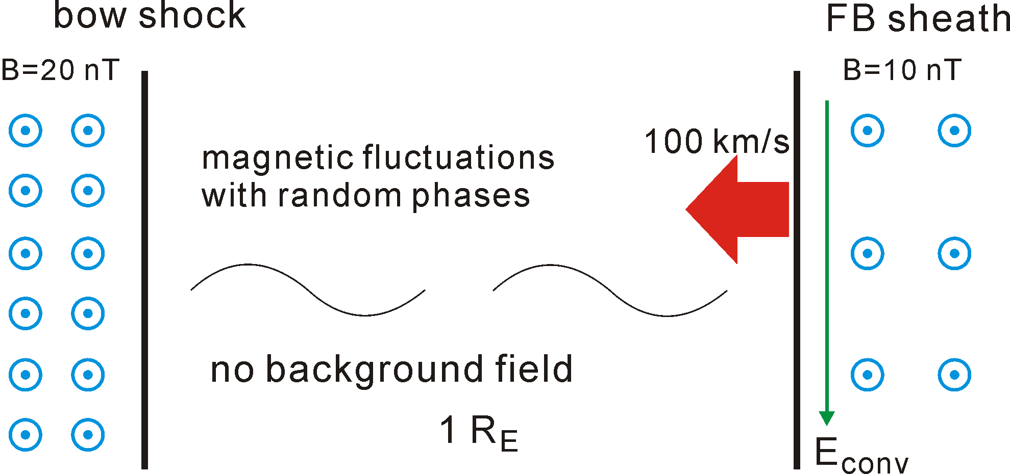
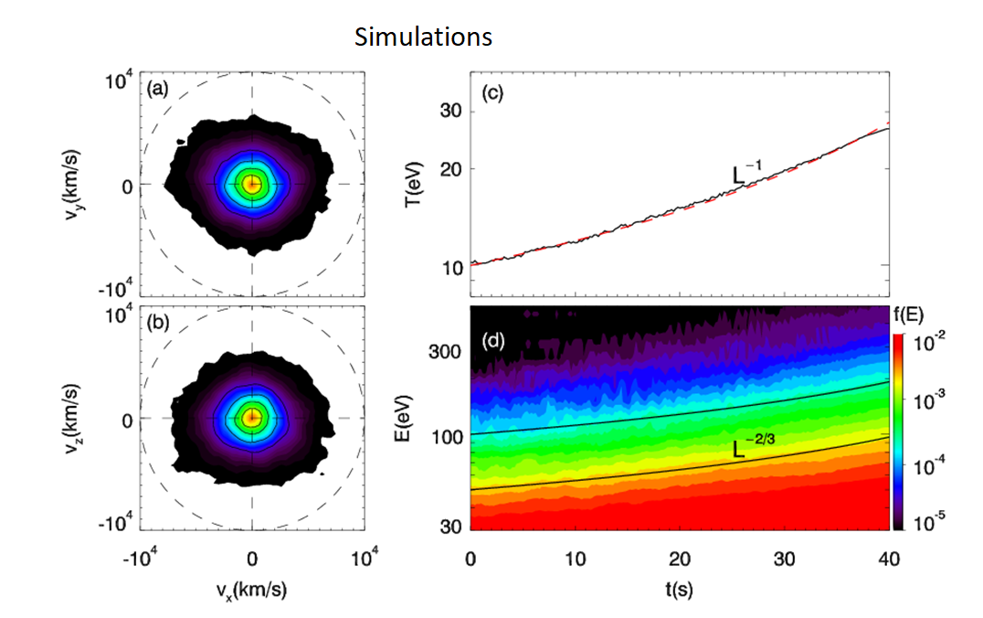
Observation vs
Simulation
Observation
Simulation setup
Liu et al. [2017b]

Slide 11
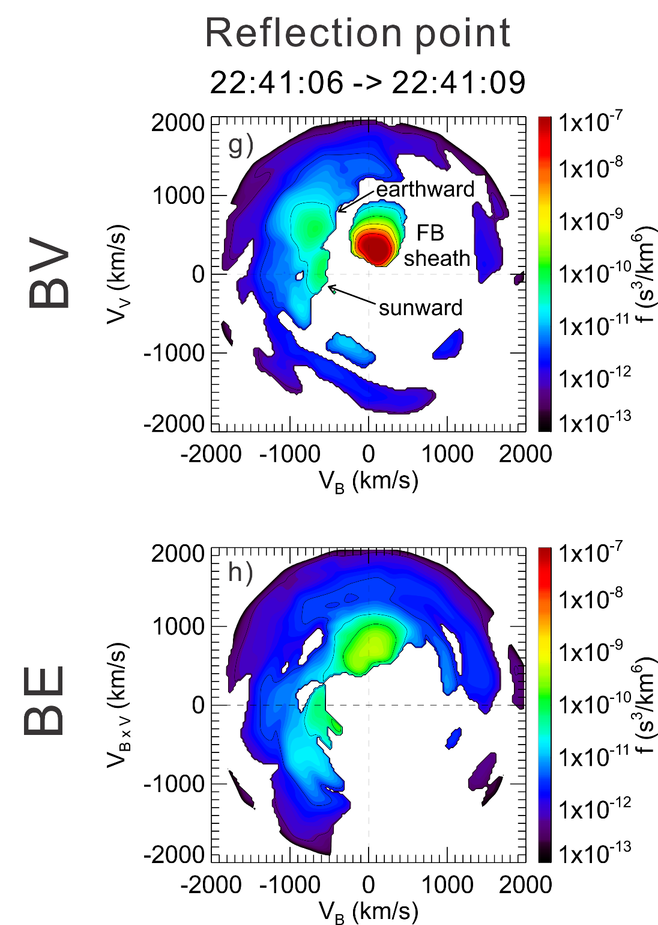
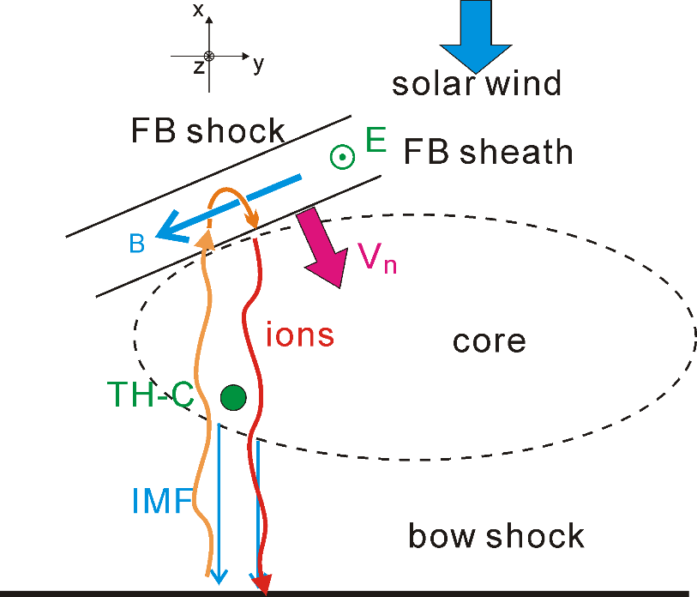
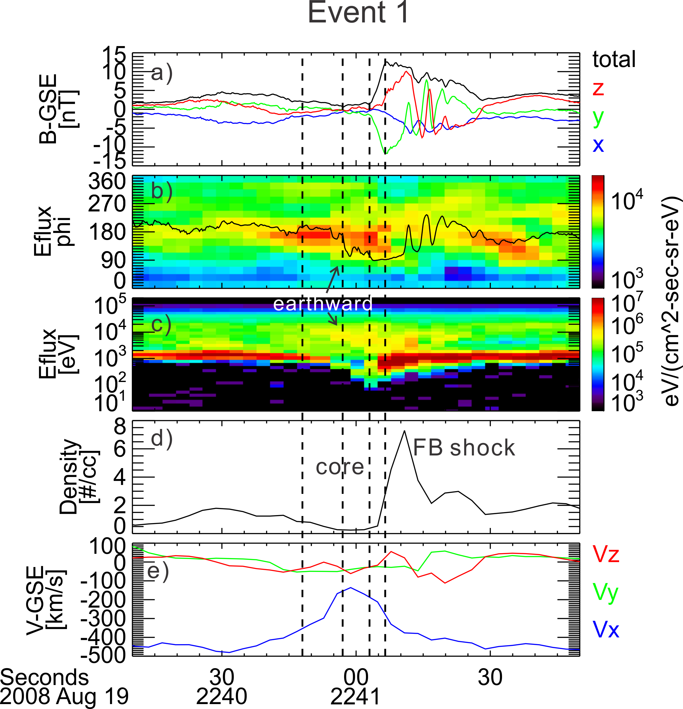
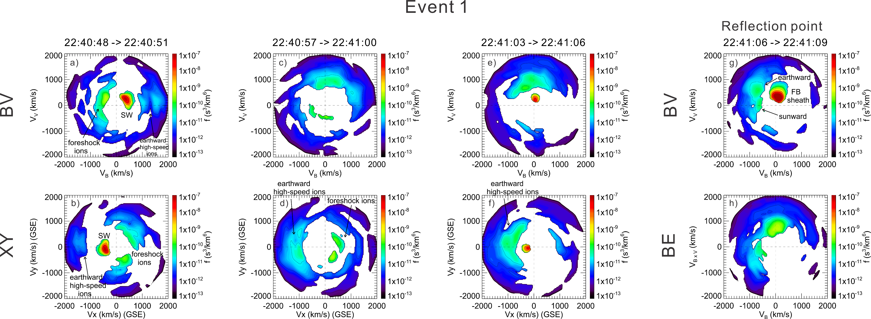
Ion acceleration in the core
1 2 3
3
Sunward foreshock ions can be reflected by the compressional boundary and gain energy in the sc frame (lose energy in the sw rest frame) through partial gyration along (against) the electric field
1
2
Liu et al. [2018]
Notes:
https://agupubs.onlinelibrary.wiley.com/doi/full/10.1002/2017JA024838

Slide 12
Virtual spacecraft observation in 3D hybrid
Trajectory of two traced ions
Liu et al. [2018]

Slide 13
Multi-bounces: ion Fermi
Turner et al. [2018, Nature]

Slide 14
Multi-bounces
The observed spectra is consistent with theoretical model
Turner et al. [2018, Nature]
Notes:
https://www.nature.com/articles/s41586-018-0472-9

Slide 15
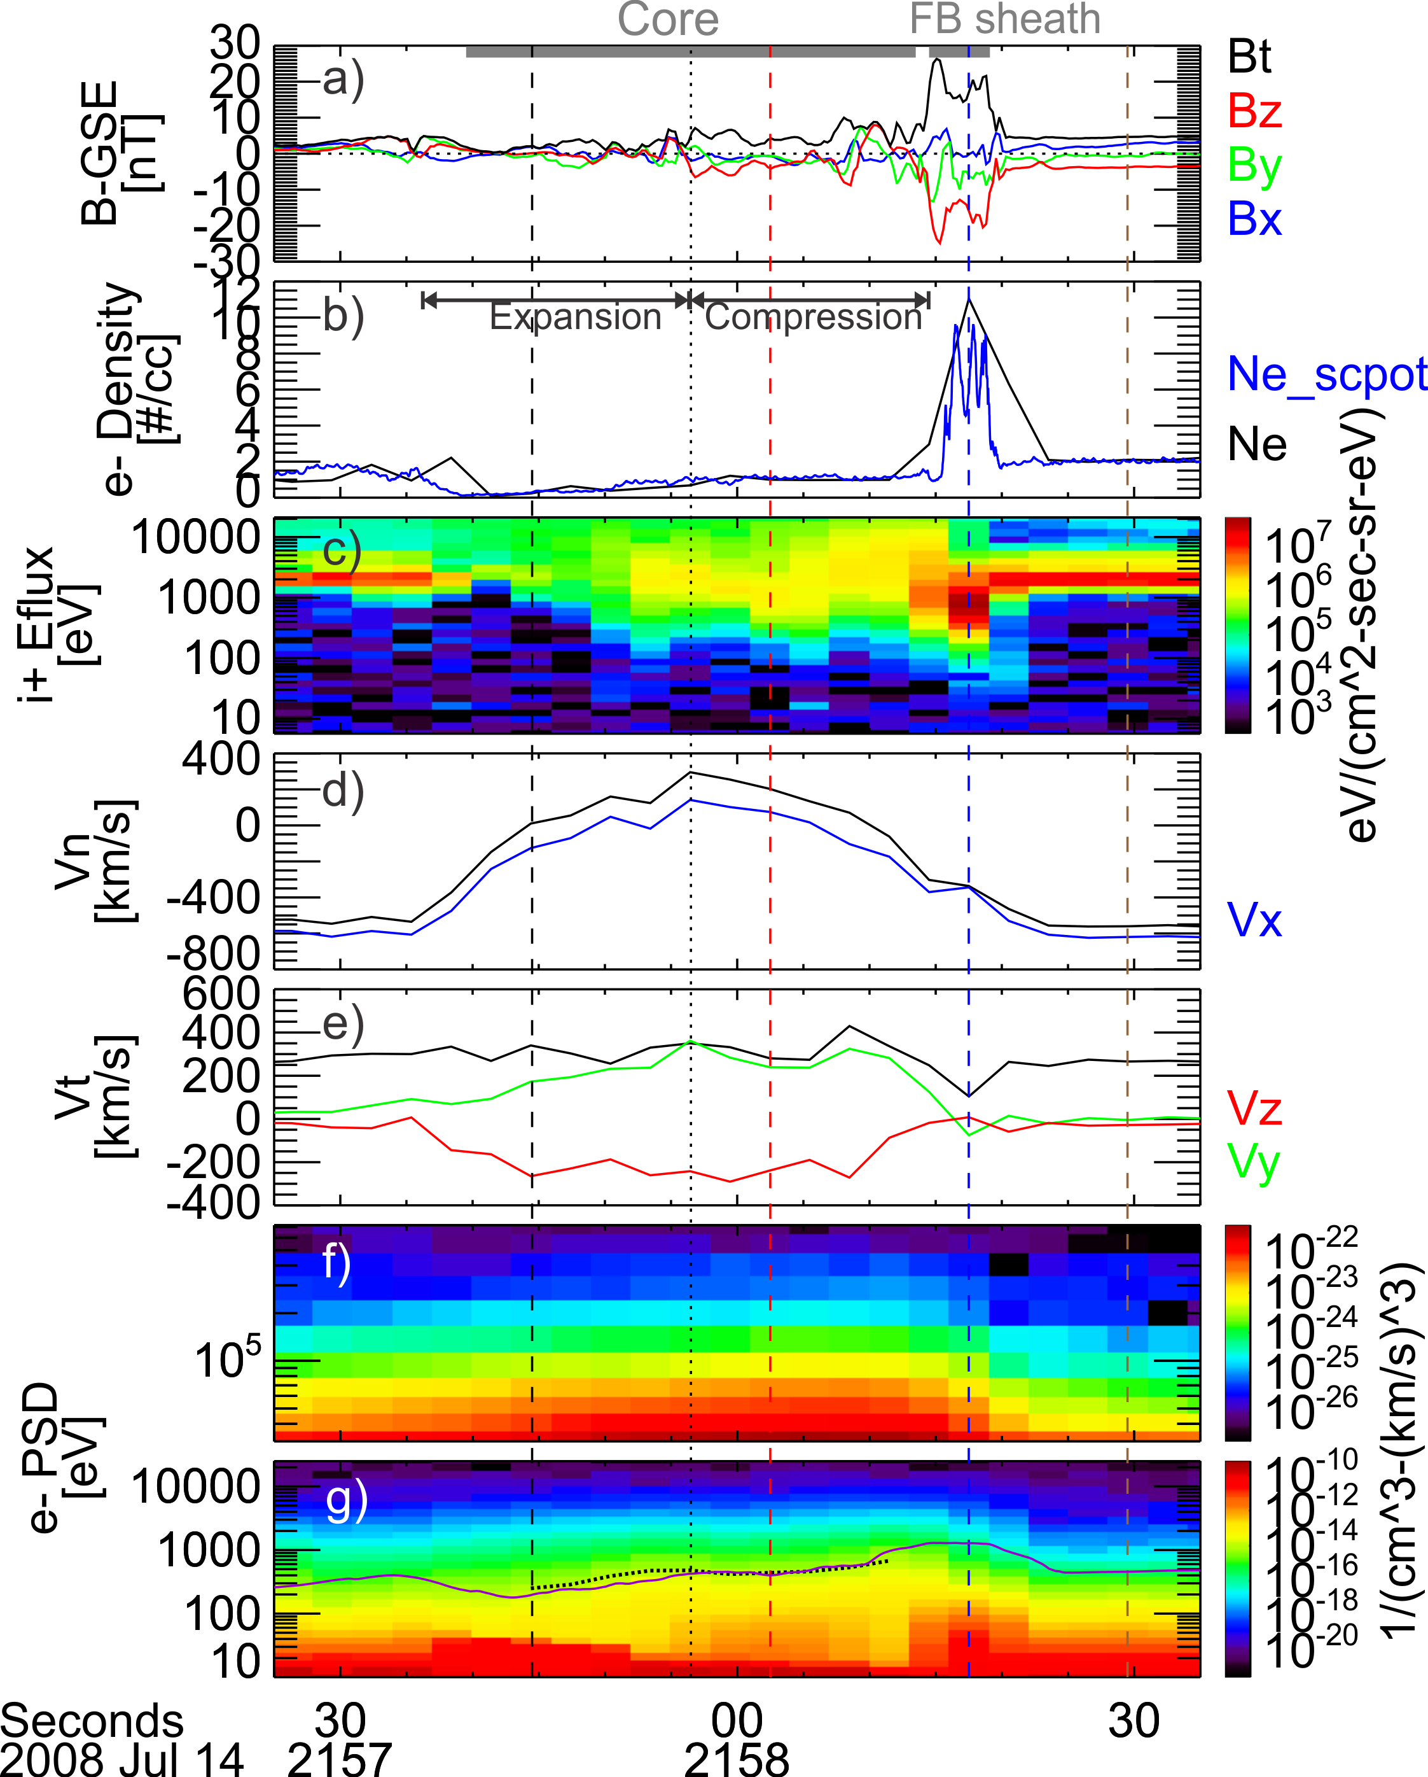
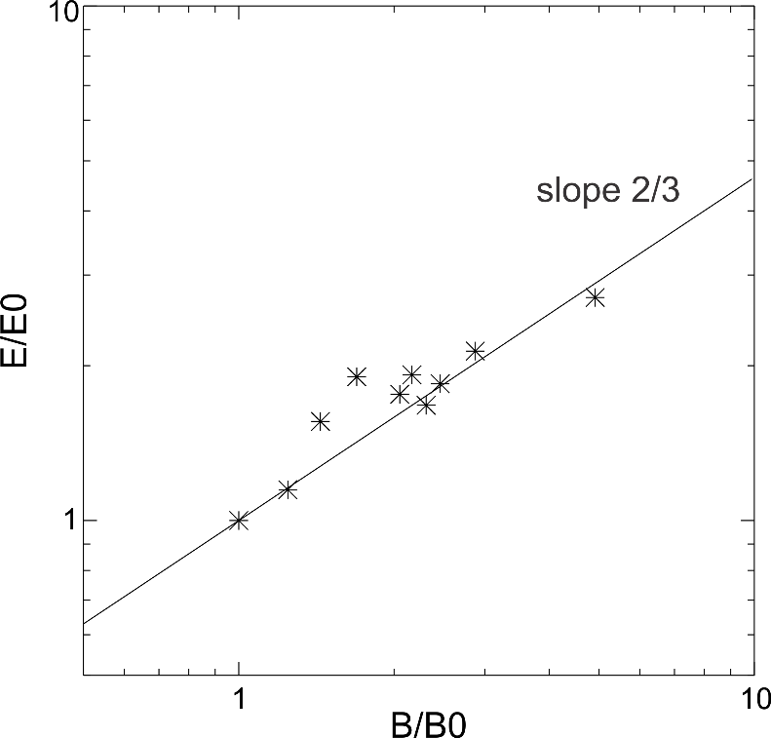
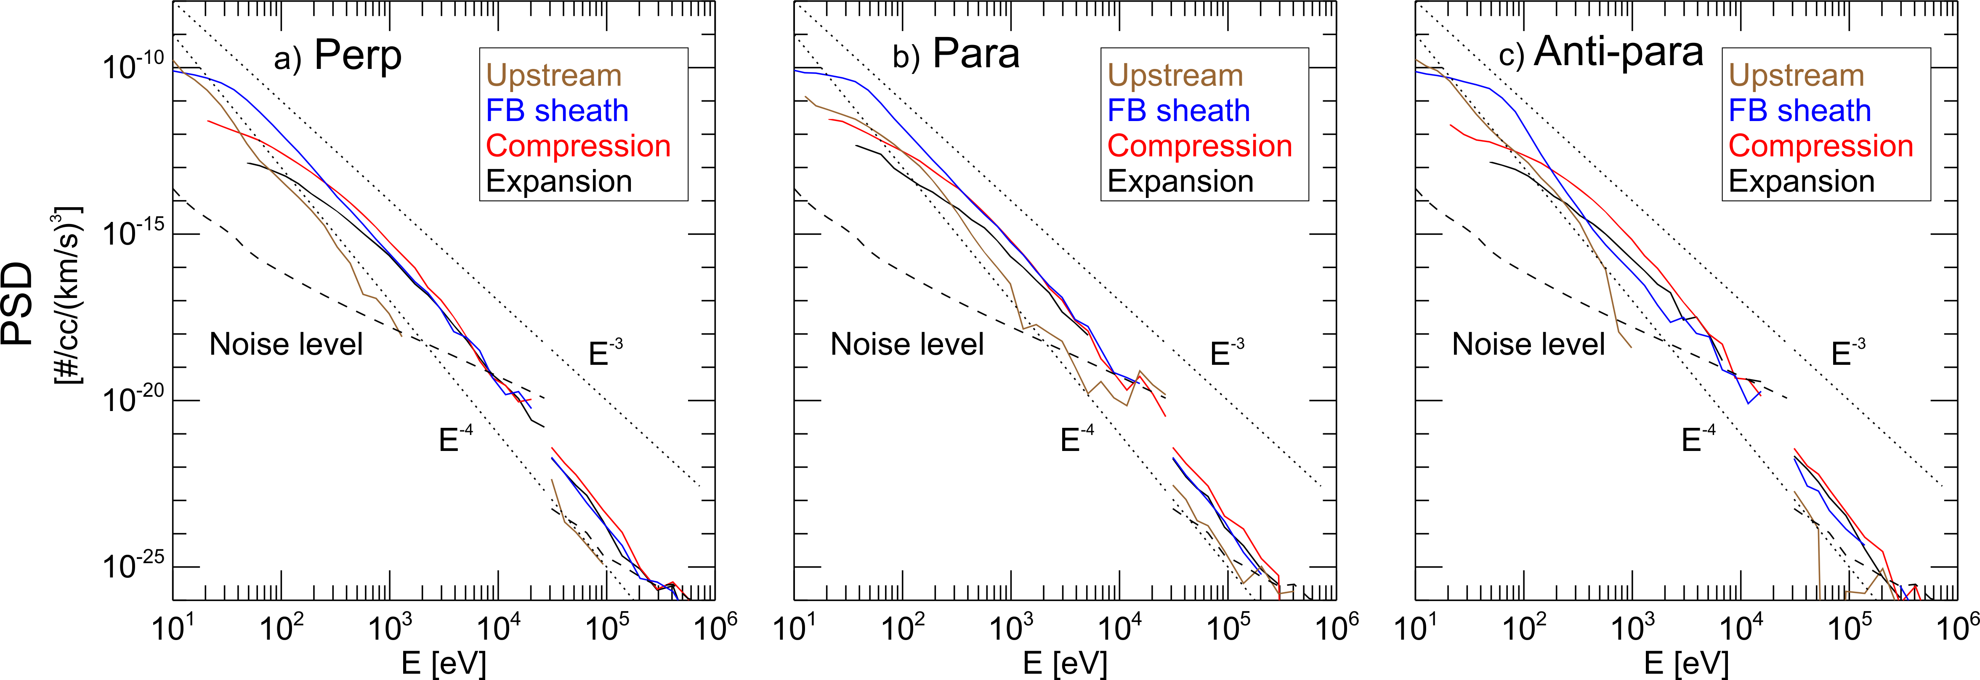
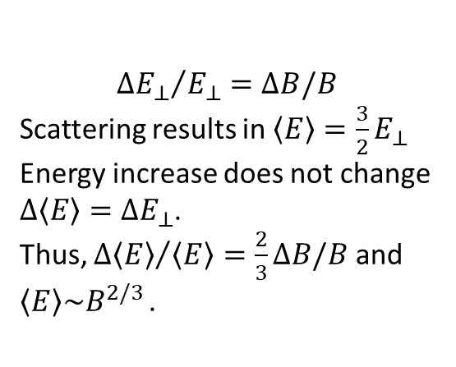
Betatron acceleration due to outward magnetic flux transportation
$${∆E_{⊥}}/{E_{⊥}}=∆B/B$$
Scattering results in $〈E〉=\frac{3}{2}E_{⊥}$
Energy increase does not change $∆〈E〉=∆E_{⊥}$.
Thus, ${∆〈E〉}/{〈E〉}=\frac{2}{3}∆B/B$ and $〈E〉\sim B^{2/3 }$.
Electron energy can be further enhanced from 10s of keV in the background foreshock to 100s of keV
Liu et al. [2019a, Science Advances]
Notes:
https://advances.sciencemag.org/content/5/7/eaaw1368

Slide 16
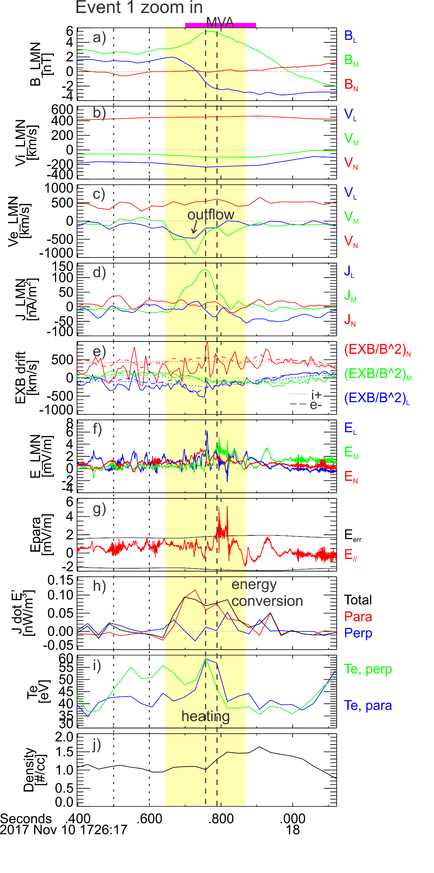
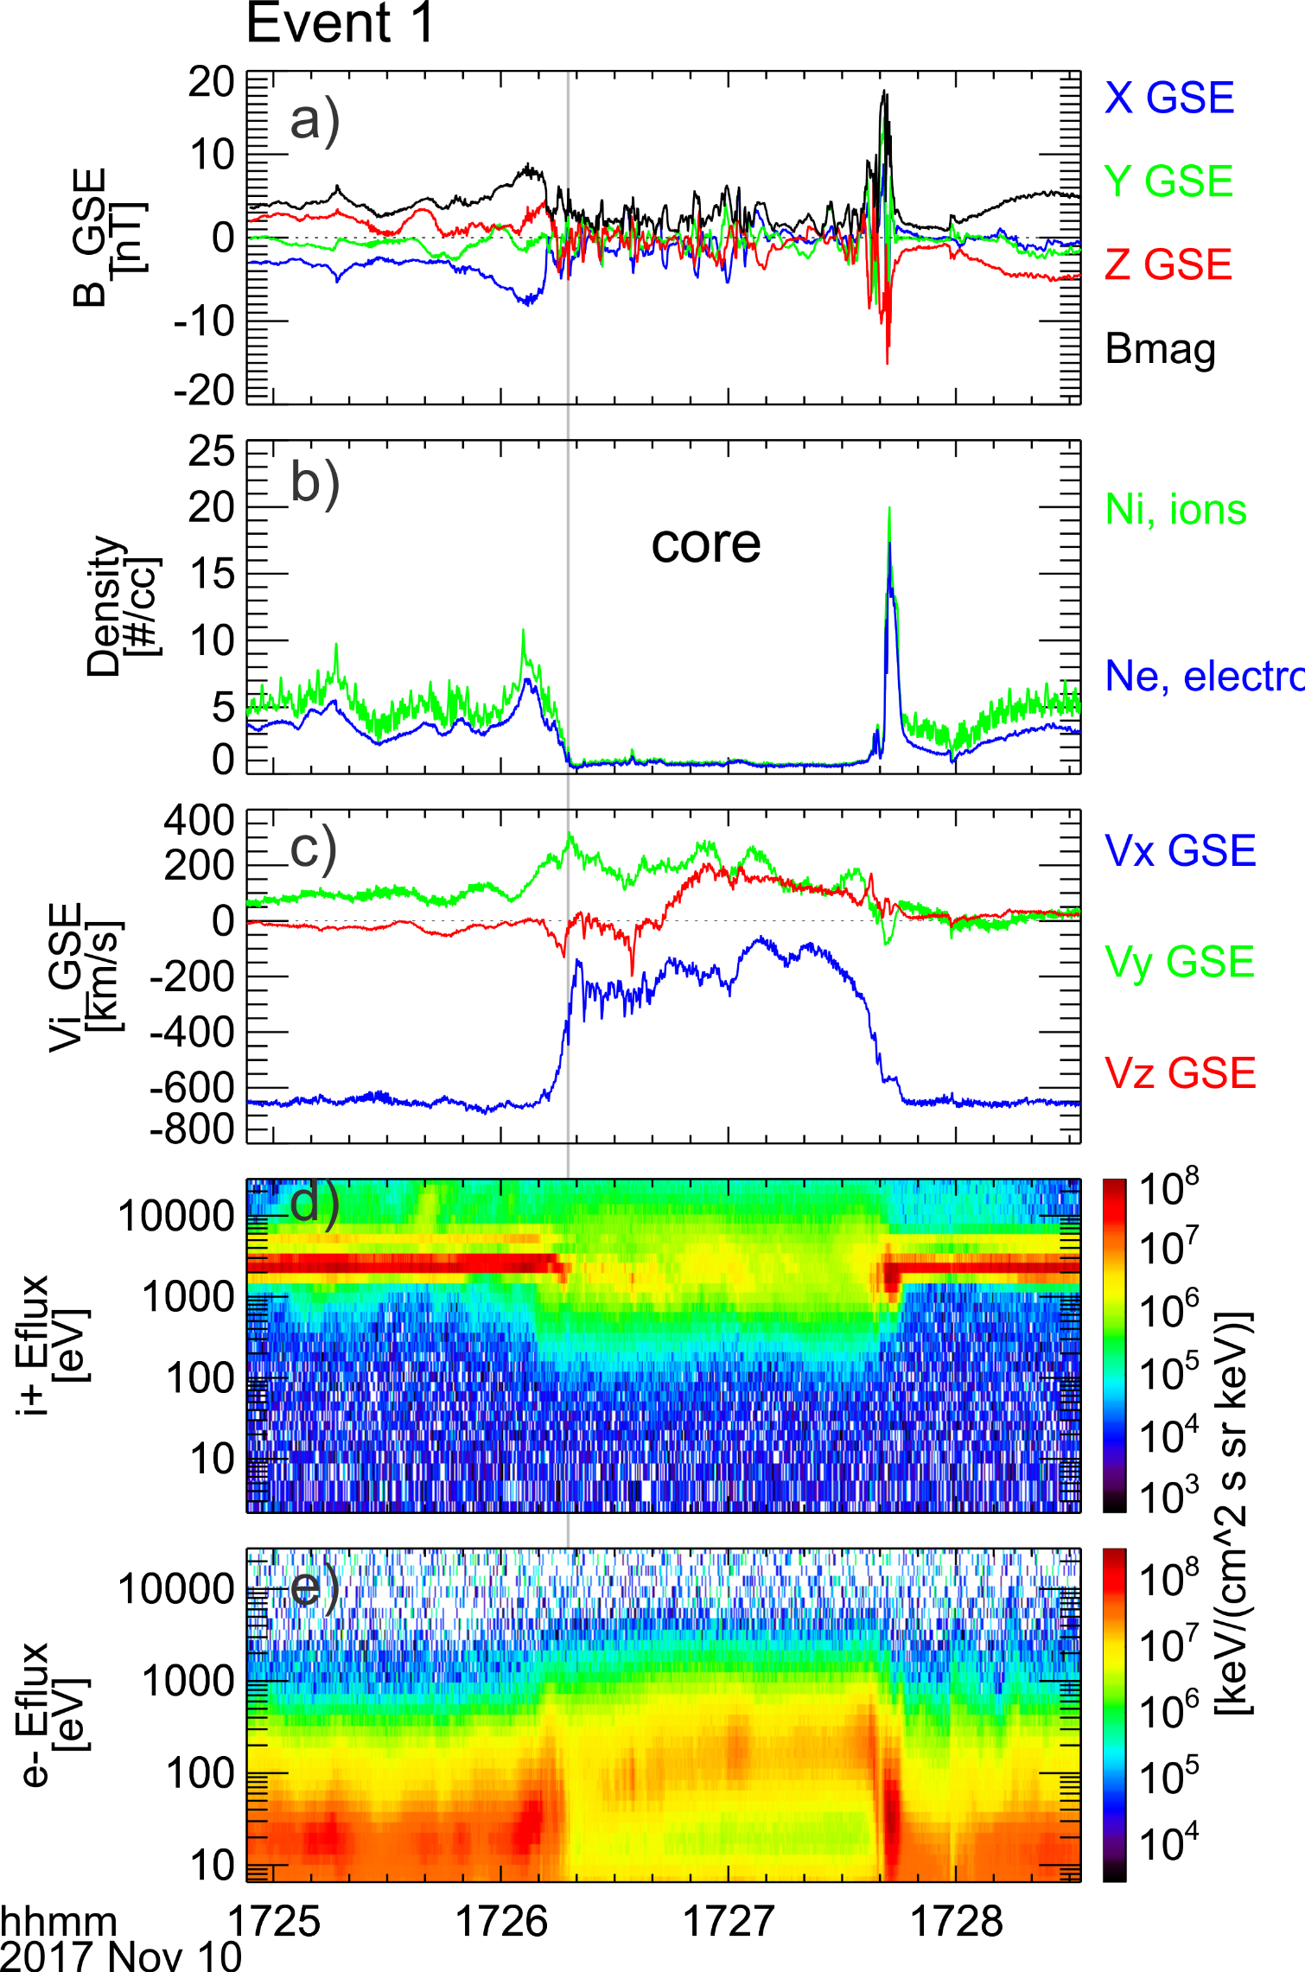
Magnetic reconnection in the core
A super‐ion‐Alfvénic electron jet was observed within a current sheet with thickness less than or comparable to 1 di.
Energy was converted from the magnetic field to electrons, manifested as an increase in electron temperature (mainly by Epara).
Weak or no ion coupling was observed
Liu et al. 2020a
Notes:
https://agupubs.onlinelibrary.wiley.com/doi/full/10.1029/2020JA027822

Slide 17
Part II. Magnetosheath jets

Slide 18
Introduction: magnetosheath jets
A localized fast jet with enhanced dynamic pressure
Earth
Jet
Bow shock
Hietala et al. [2009]
Hietala et al. [2013]
Karimabadi et al. [2014]

Slide 19
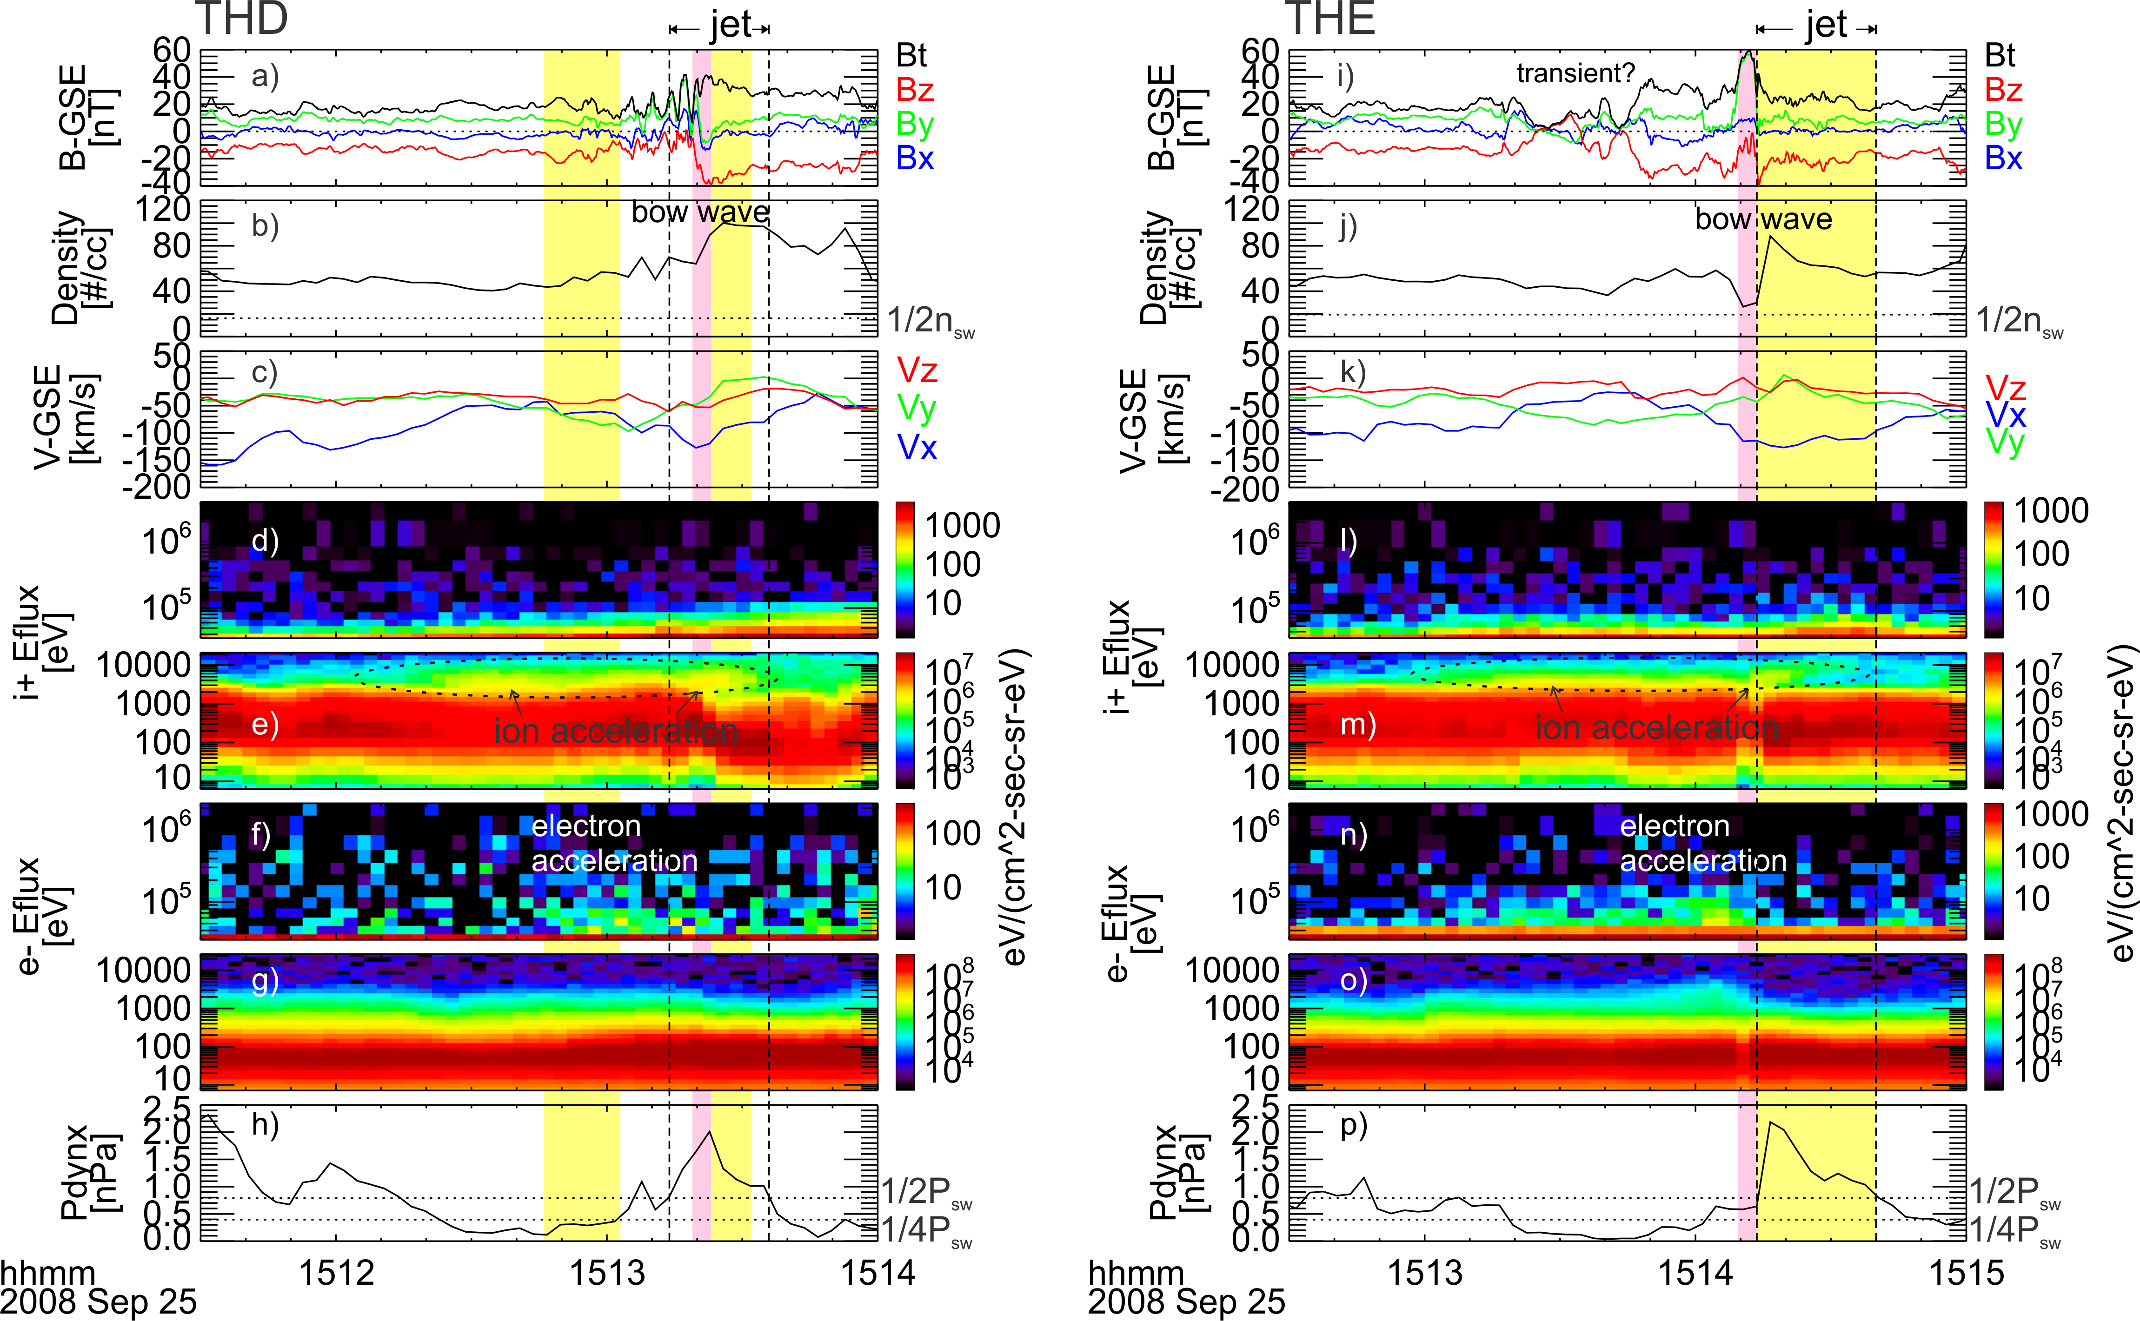
Ion shock drift acceleration at the bow wave driven by a supermagnetosonic jet
Liu et al. [2019b]
Notes:
https://agupubs.onlinelibrary.wiley.com/doi/full/10.1029/2019GL082614

Slide 20
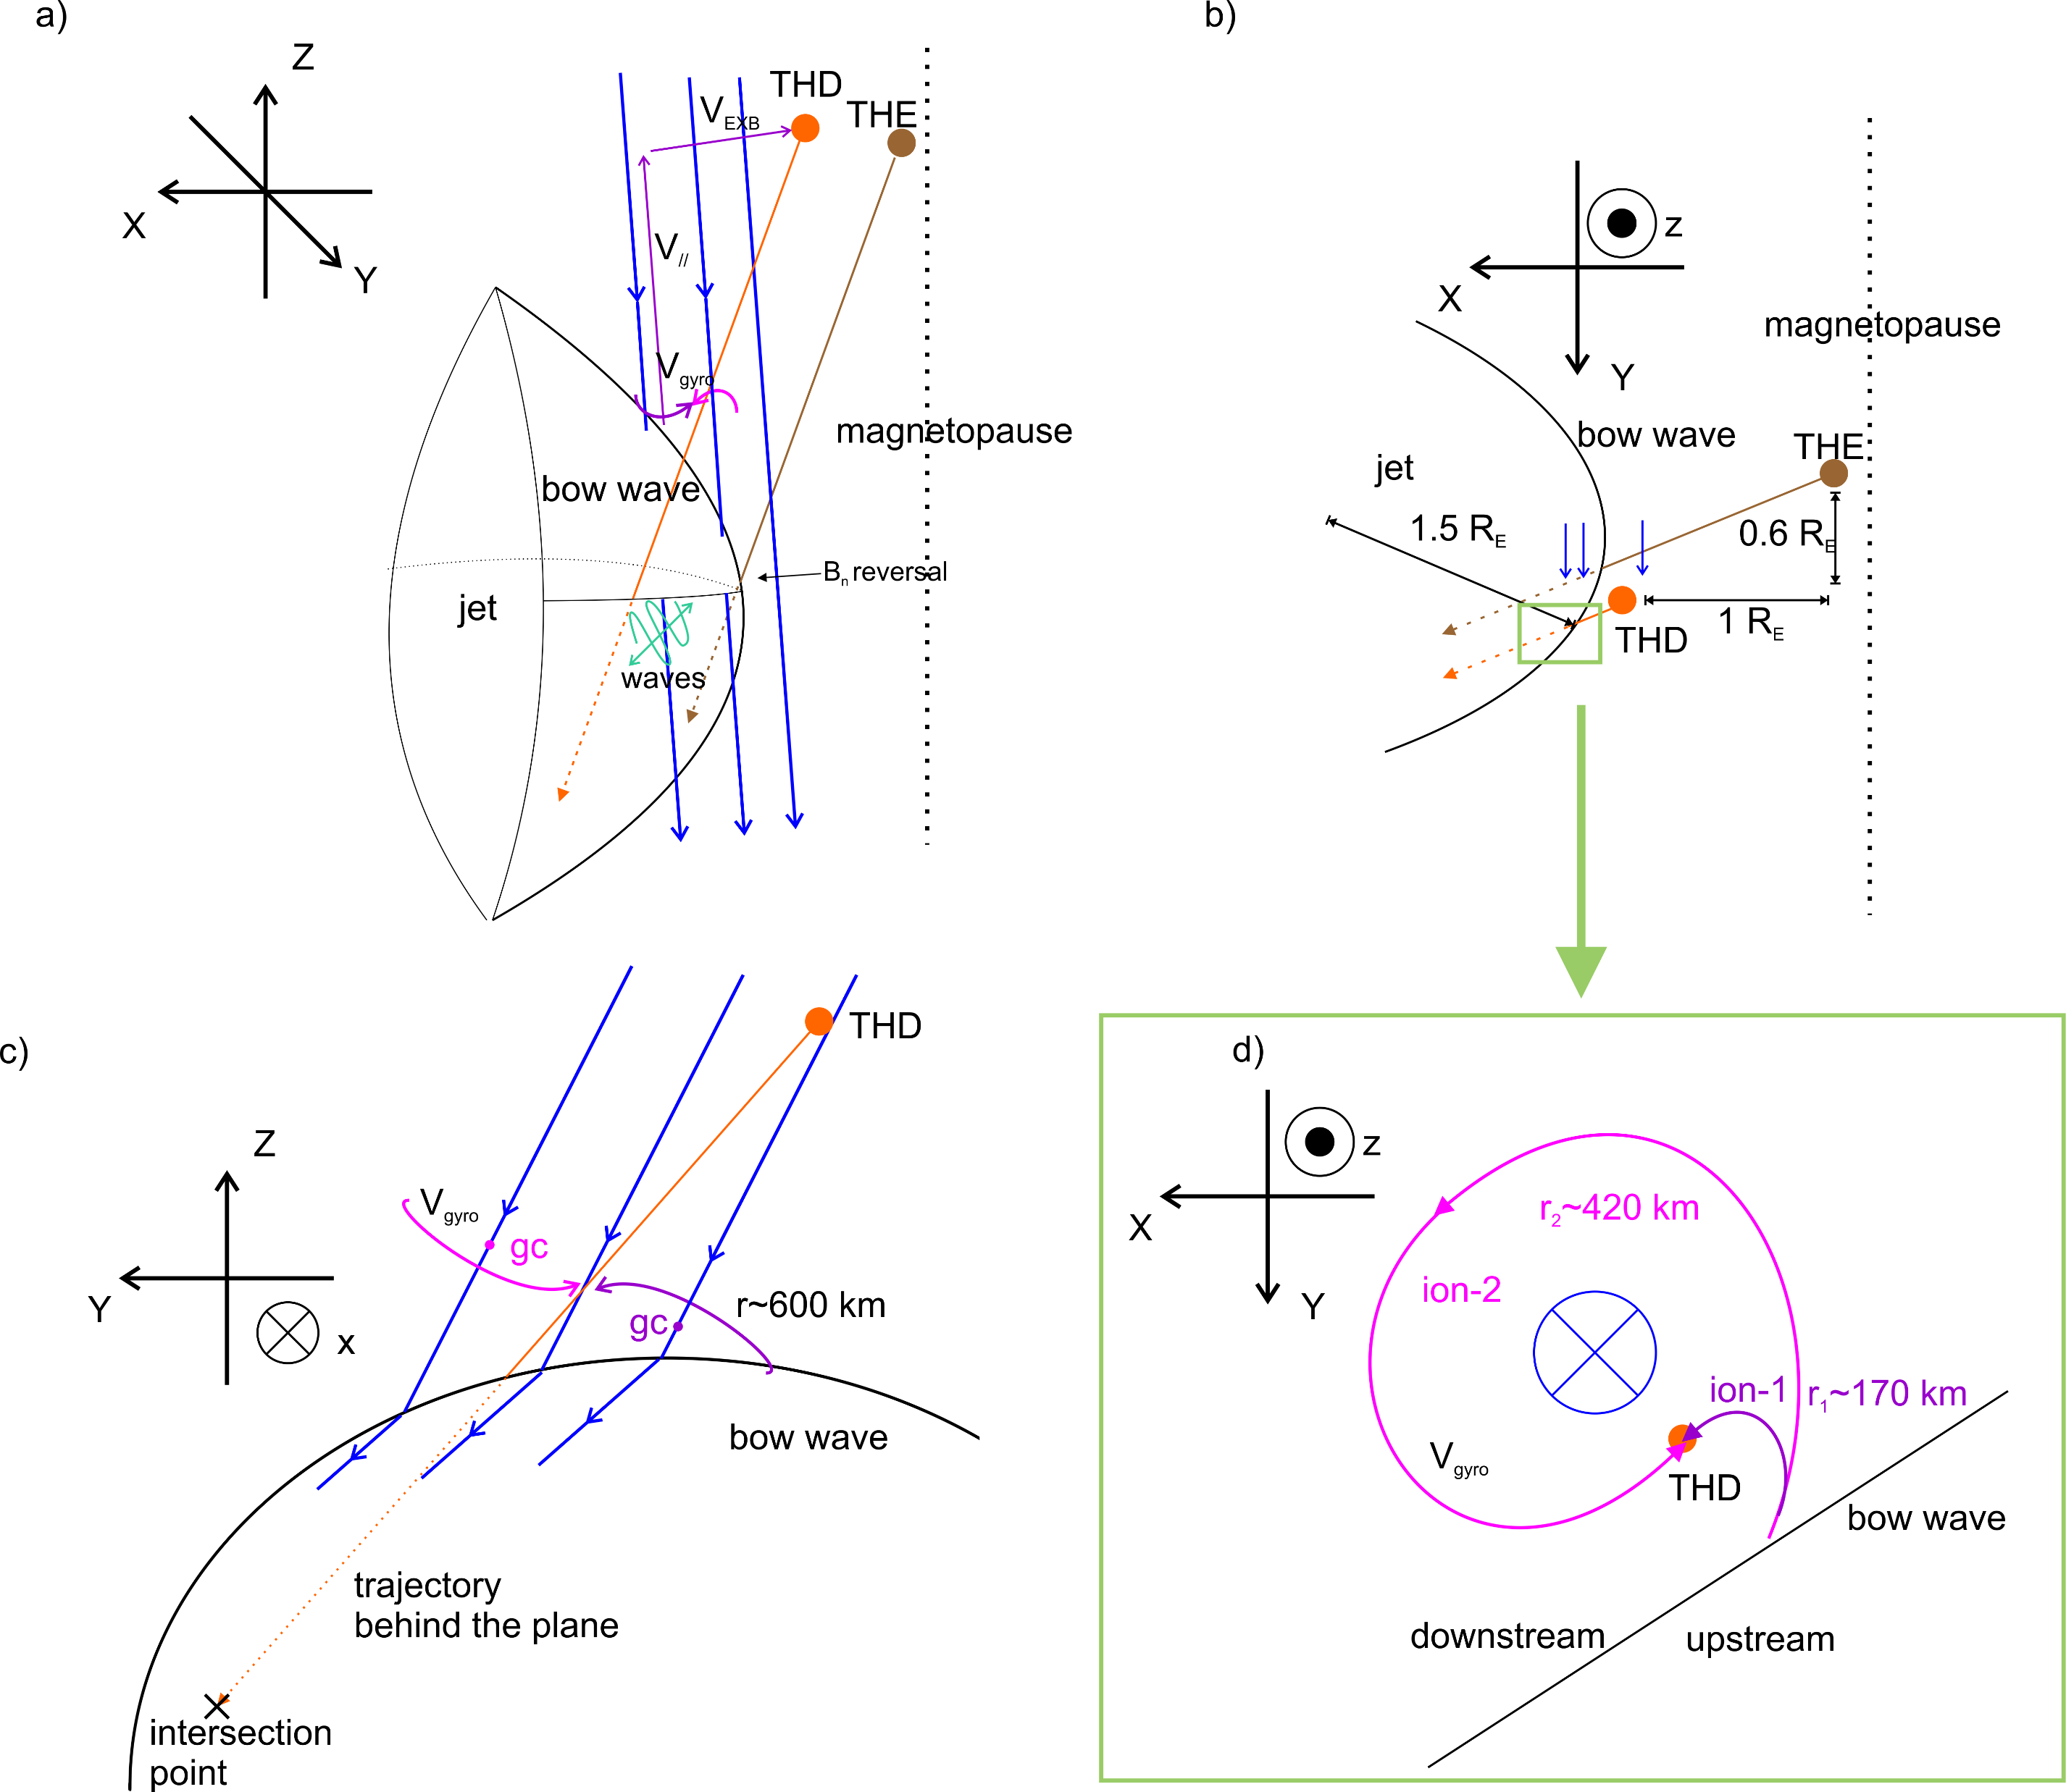
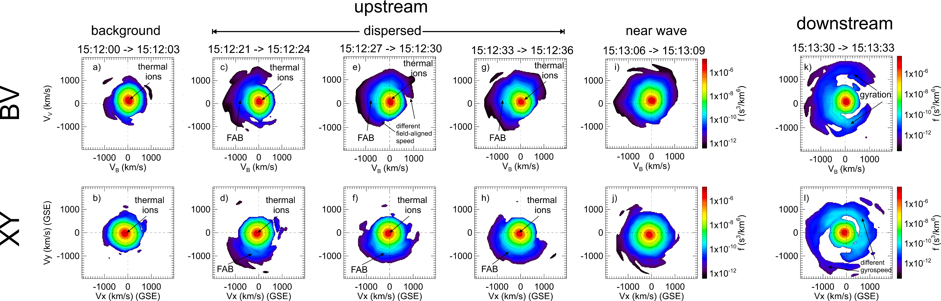

$${V_{∥}/V}_{EXB}=d_{∥}/d_{EXB}$$
EXB
B

Slide 21
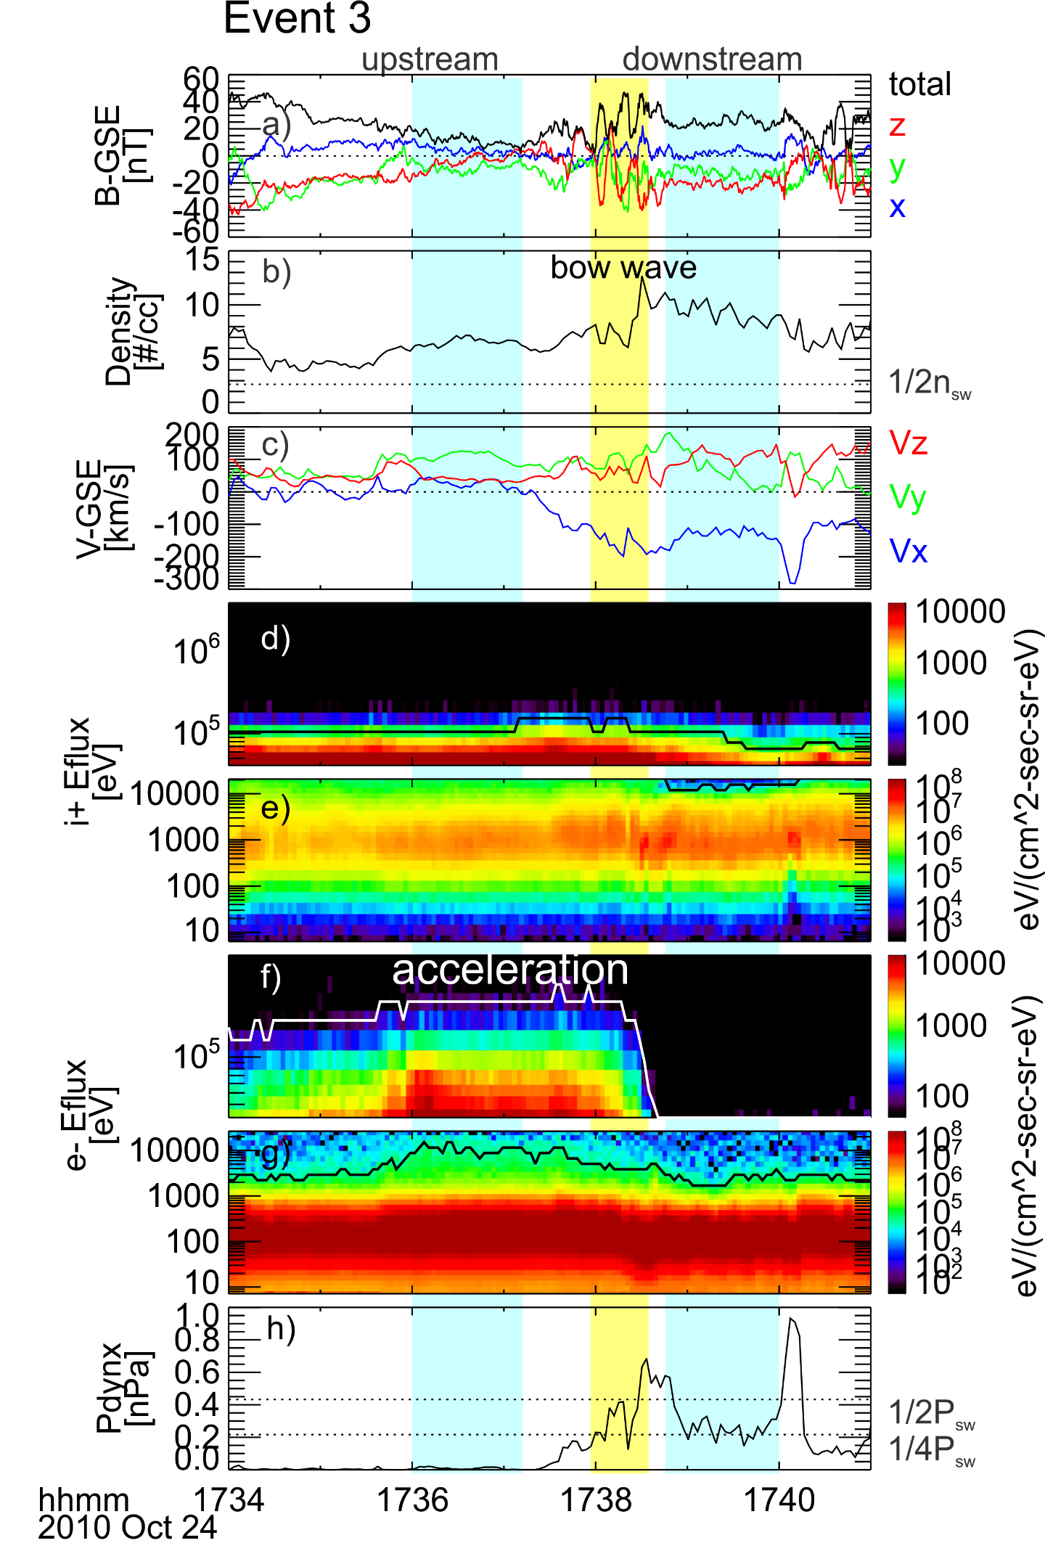
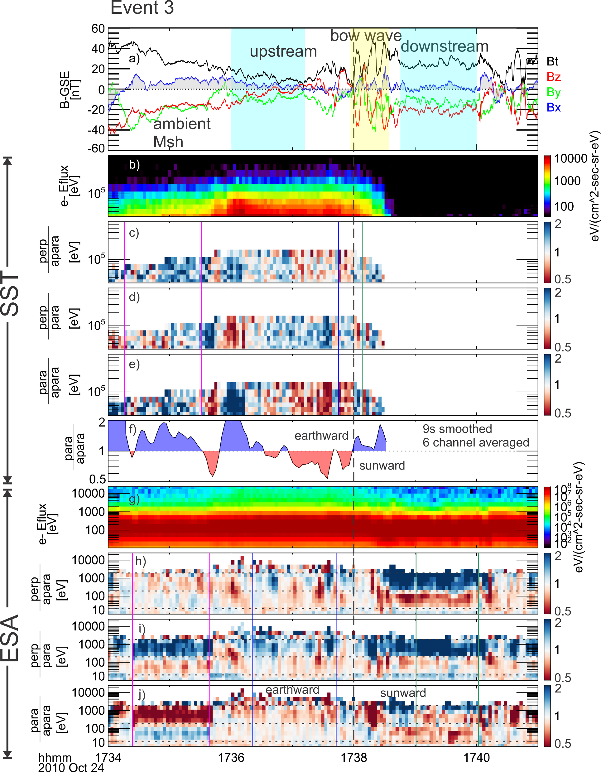
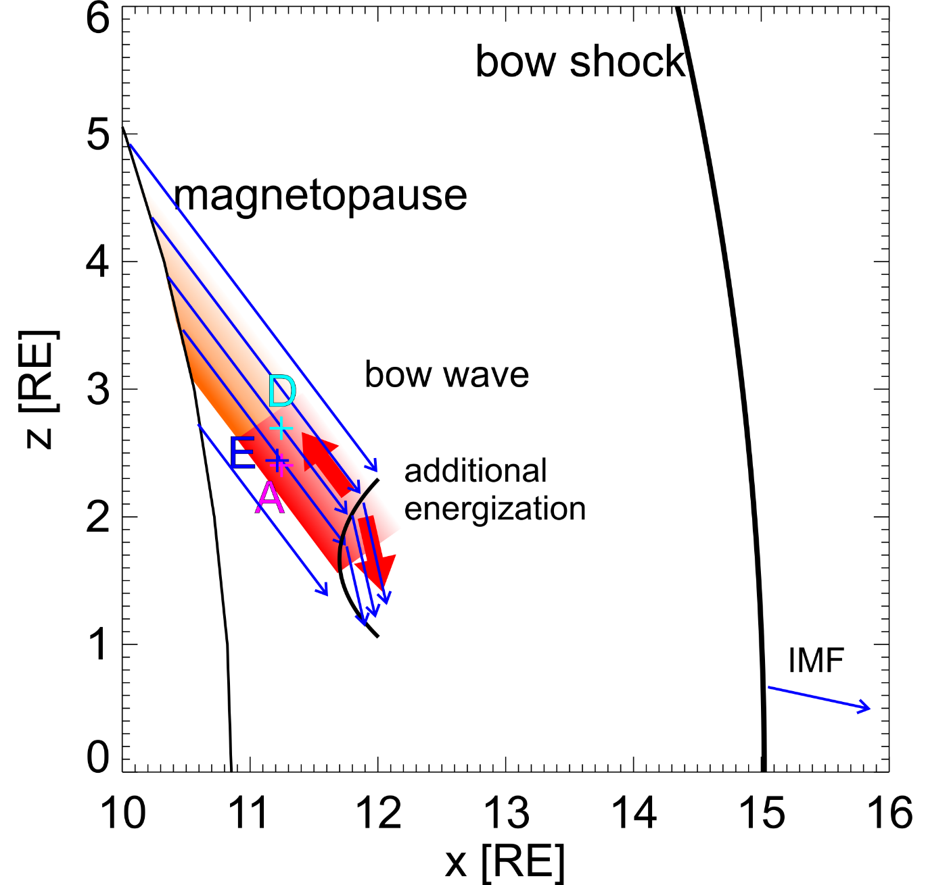
Electron fast Fermi
Jet-driven bow waves can further enhance electron energy resulting in bi-directional energy flux
Liu et al. 2020b under review

Slide 22
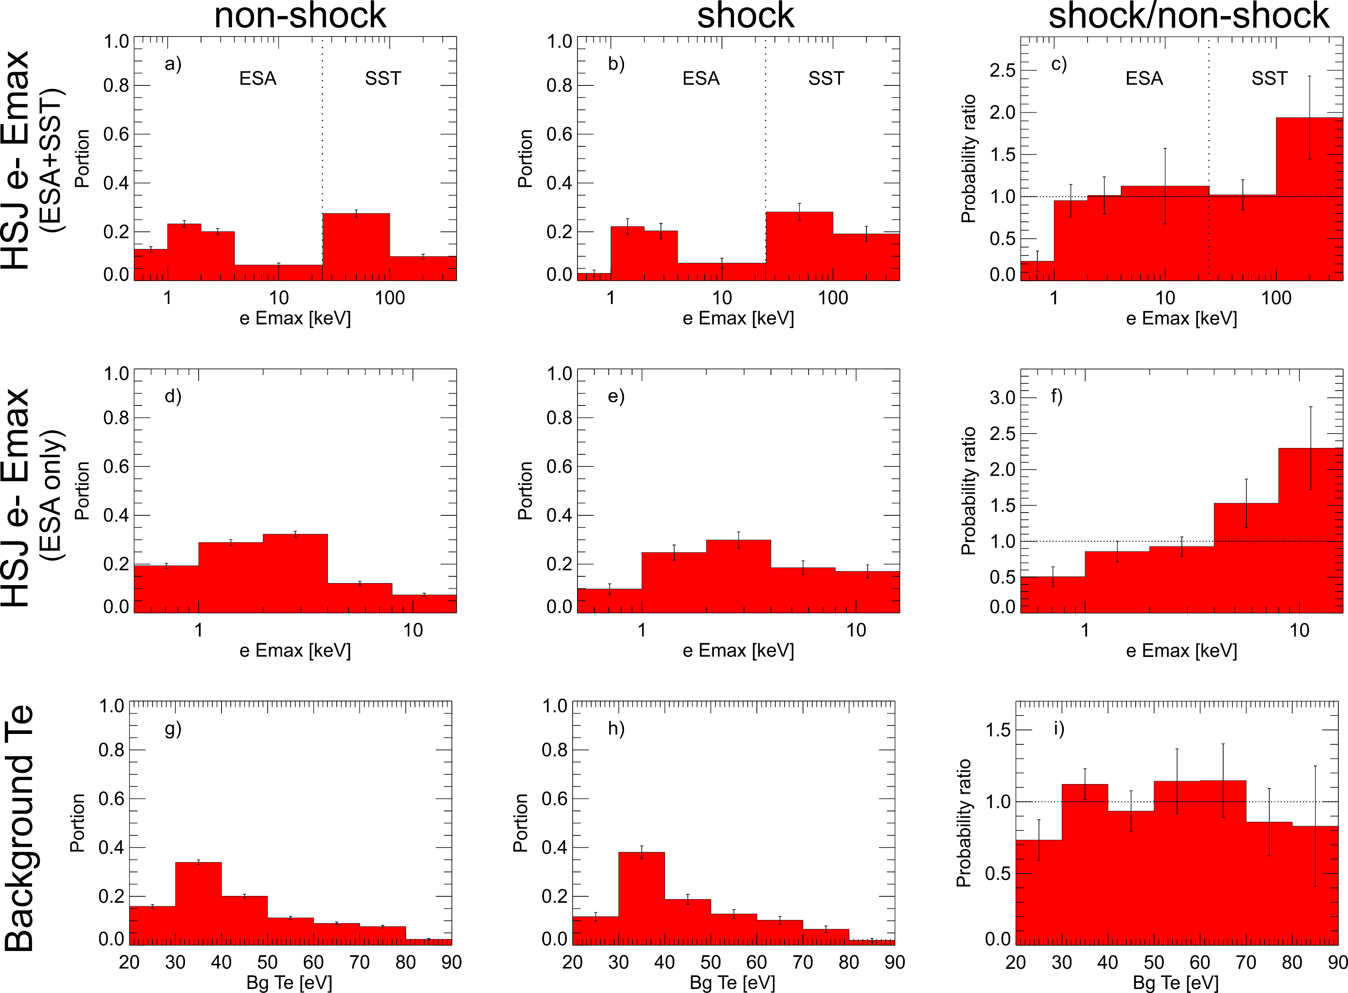
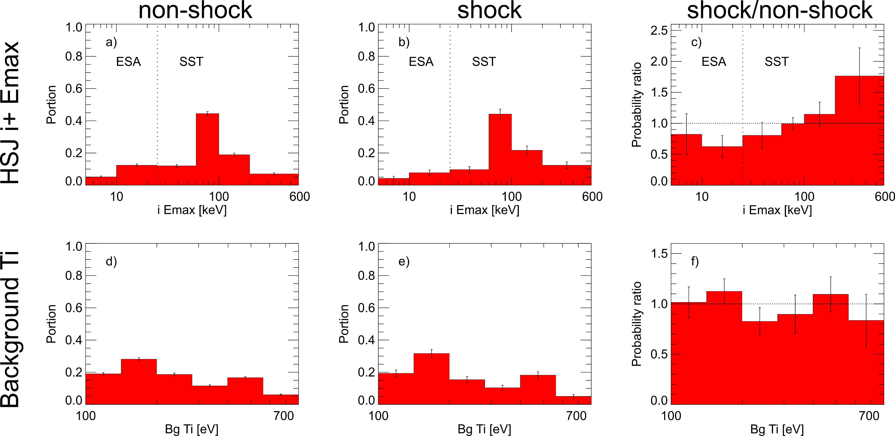
Statistical study-maximum particle energy
2513 events
346 events
Without preference in background thermal energy, jets with bow wave/shock have higher maximum particle energy
Liu et al. 2020c JGR accepted

Slide 23
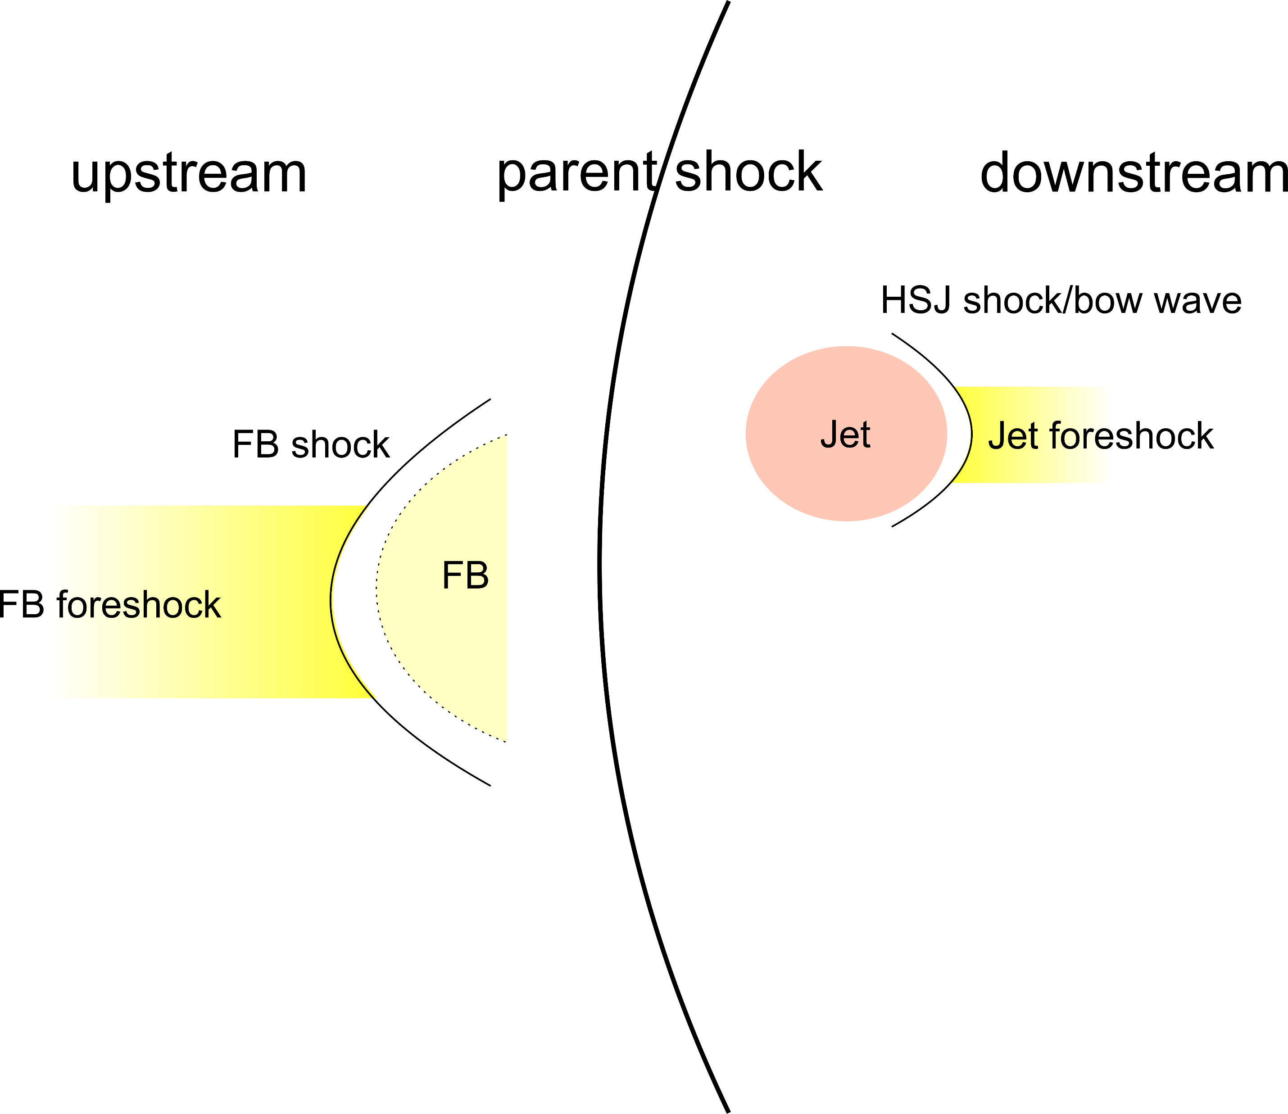
Nonlinear structures both upstream and downstream of shocks can accelerate particles, especially for high Mach number shocks.
These nonlinear structures should be included in shock models.

