Slide 1
Detection of SST fronts from high-resolution model hindcast results and its preliminary evaluation in the South China Sea
Shihe Renª, Xueming Zhuª, and Drevillon Marie^{b}
a National Marine Environmental Forcasting Center, Beijing, China
b Mercator Océan, Ramonville Saint Agne, France
EGU, 8 May 2020

Slide 2
Outline
Background
Data
Front detection algorithm
Results and discussion
Conclusion

Slide 3
front detection methods
gradient-based approach with Canny operator (Canny, 1986; Kostianoy et al., 2004; Breaker et al., 2005; Belkin and Oreilly 2009; Oram et al. 2008; Kirches et al. 2016; ......)
histogram-based approach: single edge detection algorithm (SIED) (Cayula and Cornillon 1992; Miller, 2004&2009; Ullman and Cornillon, 1999; Hickox et al., 2000;Nieto and Demarcq,2006; ......)
other methods
  statistical approach (Ping et al. 2015; Hopkins et al. 2010; ..... )
  entropic approach (Shimada et al., 2005;.....)
  Convolutional Neural Network (Lima et al. 2017;....)
  .......
Notes:
There are a lot of front detection methods. Two widely used approaches are: gradient method and the histogram method. The gradient method is usaually used with Canny edge operators which is first used in computer vision field. Another widely used method is single edge detection method. And there are also other detection methods, such as statistical approach, entropic method and recently convolutional neural network methods.

Slide 4
Automated front detection tools for HR-model results
Detection for HR-model data is different with satellite data.
Specific pre-processing and post-processing procedure are needed to ensure balance of frontal continuity and positioning accuracy.
We need highlight the quasi-stationary frontal position and primary/strong fronts
Frontal parameters and products are needed.
The aim is to build mesoscale frontal forecasting system with detection, forecasting and validation.
Notes:
Most of algorithms mentioned before was designed for detecting satellite images, mainly focus on the problem of satellite date limitations, such as missing data, cloud mask ... Although for model data, we do not have this problem. But from the aspect of forecasting, detection for HR-model data is also different with satellite data. There are many tiny and complex front structures from the high-resolution model results. We need to design Specific pre-processing and post-processing procedure are needed to ensure balance of frontal continuity and positioning accuracy. Also We need highlight the quasi-stationary frontal position and primary/strong fronts. Our goal is to build mesoscale frontal forecasting system with detection, forecasting and validation.

Slide 5
Outline
Background
Data
Front detection algorithm
Results
Conclusion

Slide 6
long-term daily SST(2008-2017)
  regional ROMS daily average hindcast in the South China Sea (1/30º)
OSTIA daily SST (5km)
  Mercator (1/12º) global reanalysis (PSY4V3)
Notes:
We use 3 type of SST data for our detection. All of them are long-term daily SST data.
1. regional ROMS developed by our center, daily average hindcast in the South China Sea
2. OSTIA daily SST data, which is a merge L4 product with 5km resolution.
3. For comparison, we also used reanalysis data from Mercator France. the resolution is 1/12 degree.

Slide 7
Outline
Background
Data
Front detection algorithm
Results
Conclusion

Slide 8
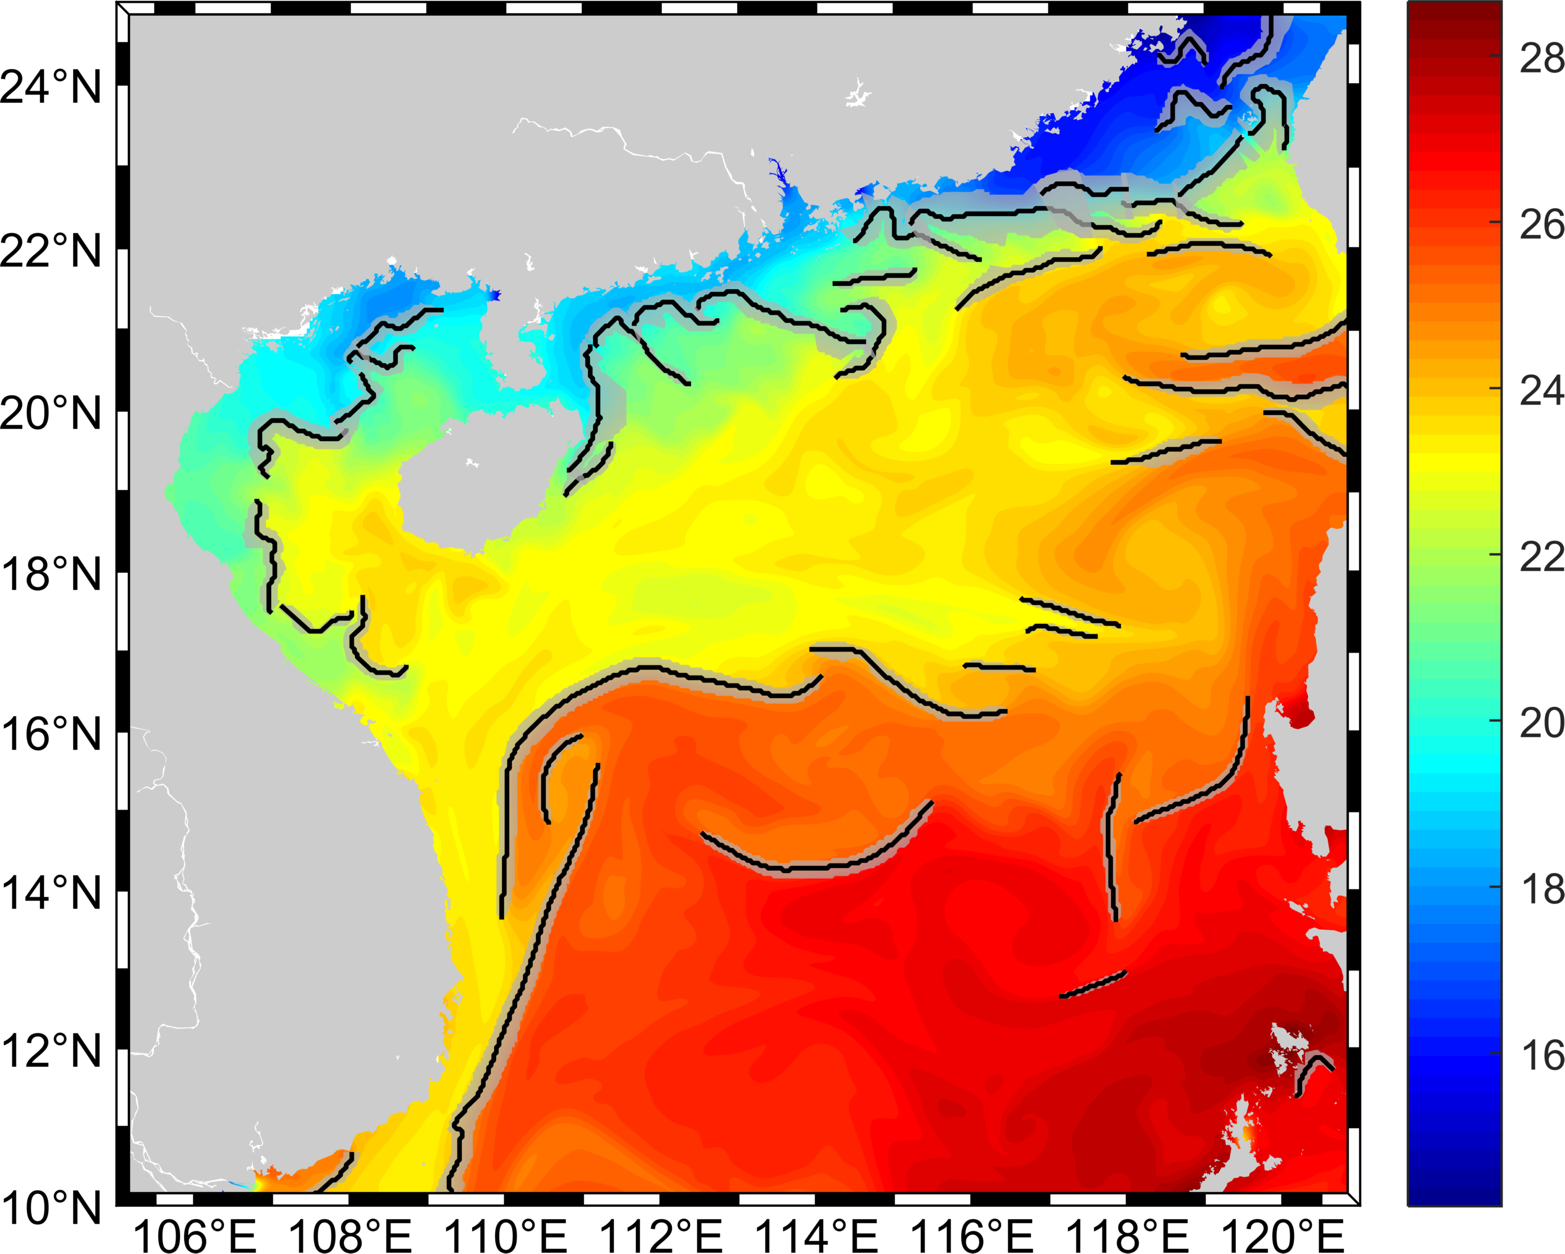
front detection algorithm
Frontal line
Frontal Zone
detected result snapshot (frontal length greater than 100km)
Notes:
frontal detection algorithm
flowchart

Slide 9
frontal line detection
front edge localization with Canny method
front edge following to deal with branch pixels
front edge merging to link nearby segments
Notes:
too many slides here, delete some
or make them into 1-2 slides

Slide 10

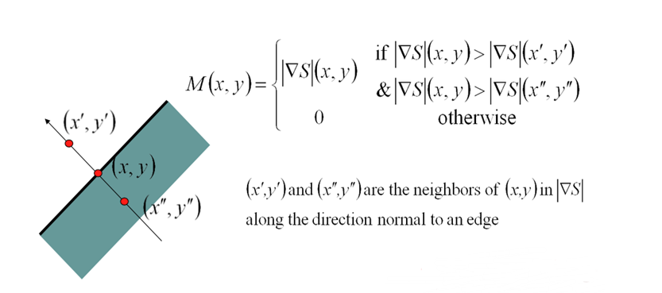
Canny edge detection steps
Calculate front gradient and direction
Non-maximum suppression
  determine local maxima along gradient direction
  change non-maximum pixels value to zero
Hysteresis thresholding
  Large threshold: less edge points, more gaps
  Small threshold: more edge points, more false edges
Edge linking
edges
Weak edges
Strong edge
Weak edge removed
Canny, 1986, A computational approach to edge detection, IEEE Transactions on Pattern Analysis and Machine Intelligence 8(6) , pp. 679–698
Notes:
Steps of canny detection include:
1. calculate front gradient and front direction
2. non-maxima suppression, in this process, we determine if the gradient magnitude is a local maxima along the gradient direction, then change non-maximum pixels to zero.
3. Canny algorithm use double thresholds k_{high} and k_{low} instead of same threshold to detect edges.
4. Use k_{high} to find strong edges, Use k_{low} to find weak edges,We declare it an edge pixel if it is strong.
We also declare it an edge pixel if it is weak but is connected to an edge.

Slide 11
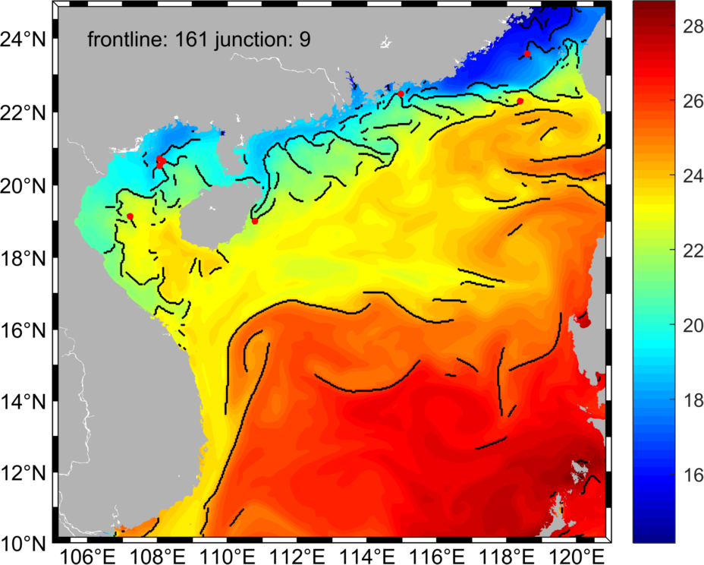
front edge following
branch pixels still exist after edge localization (9 junctions occur in test data)
necessary to extract and find which edge should be followed based on front direction and magnitude
separate branches to examine the statistics of each individual front line
frontal line extracted after edge localization
Notes:
edge following
why? branch exists
explain edge follow algorithm

Slide 12
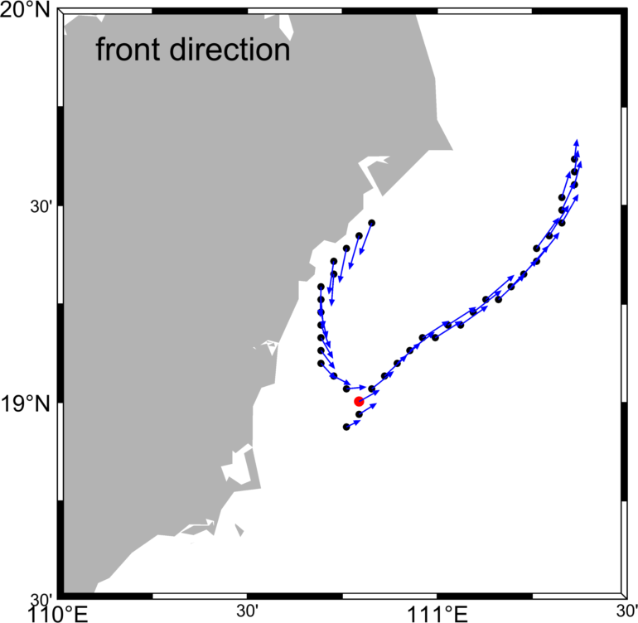

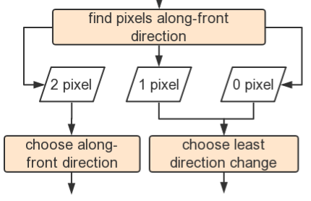
front edge following
1 pixels
start pixel
center pixel
non-front pixel
along-front pixel
2 pixels
0 pixels
Notes:
core part is how to deal with junction and branch pixels. we first find from 3 ore more neighbored pixels. find how many front pixels along front directions. Three options ,2 1 or 0. then we split to 5 conditions and try to depart these branch structure.

Slide 13



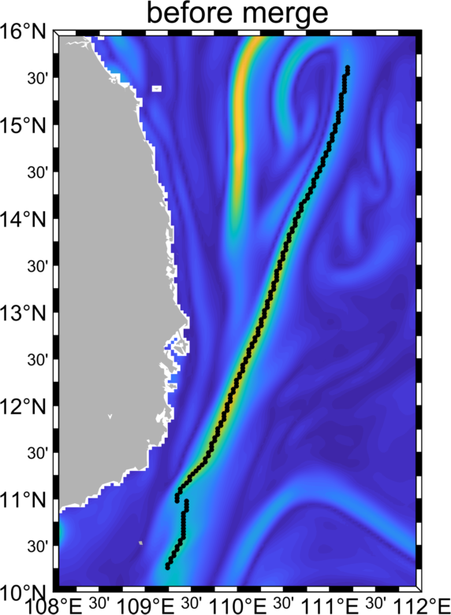
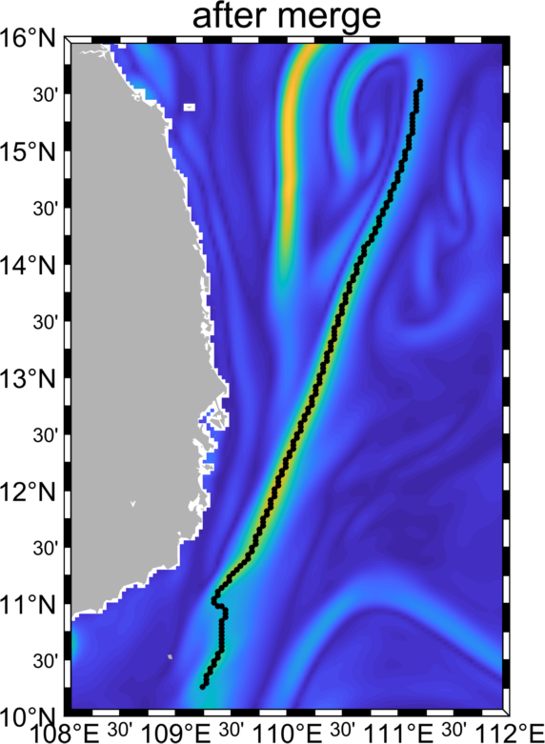
front edge merging
(a)
(b)
before merge
after merge
(c)
(d)
after merging, frontline number from 166 to 117

Slide 14
Outline
Background
Data
Front detection algorithm
Results
Conclusion

Slide 15
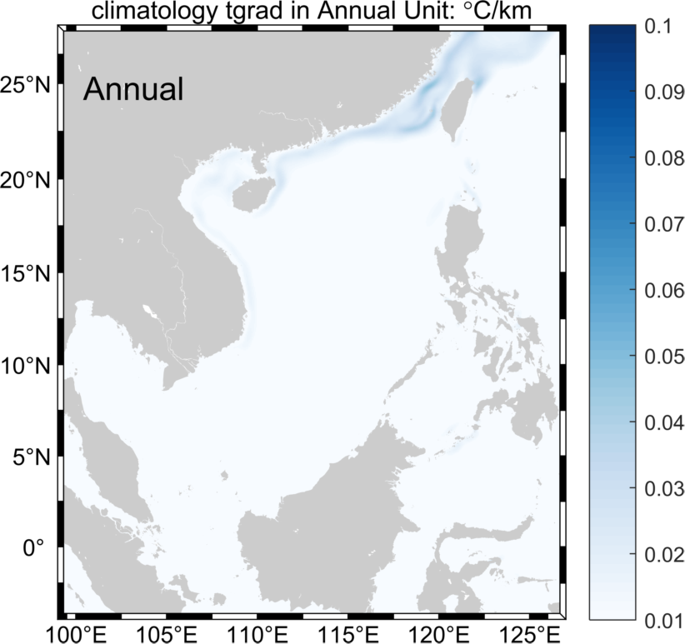
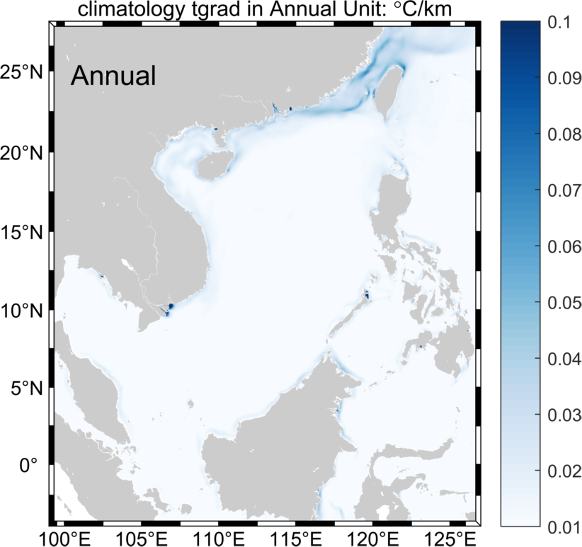
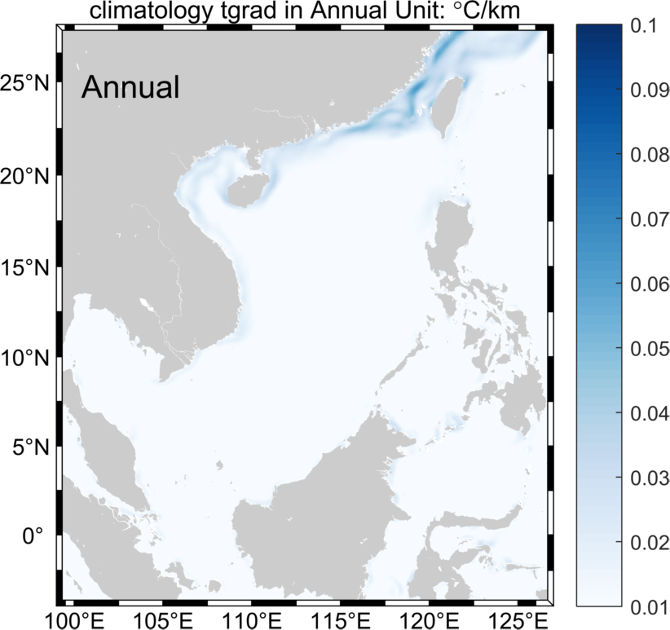
Climatology: SST gradient
OSTIA
ROMS
Mercator

Slide 16
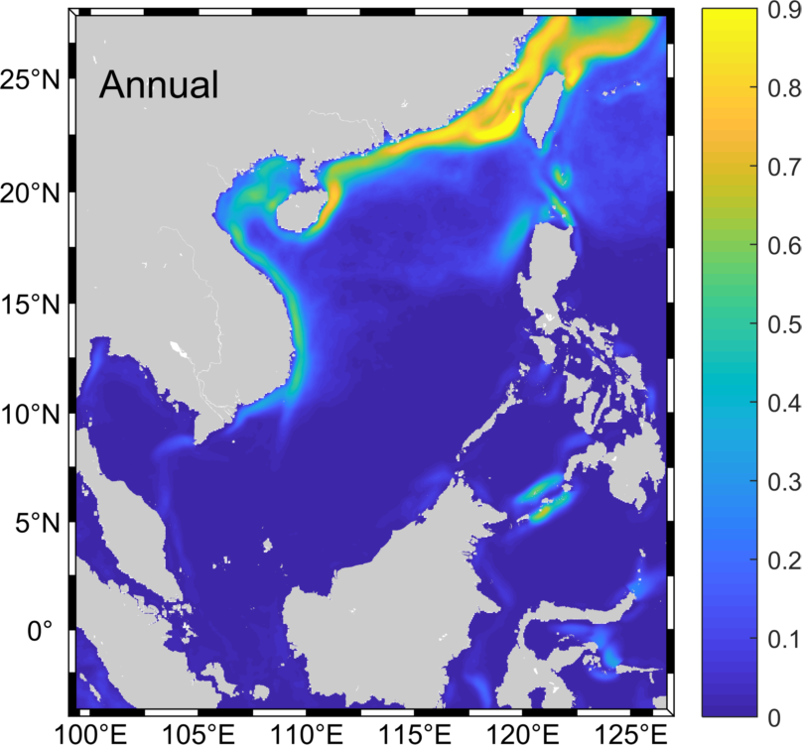
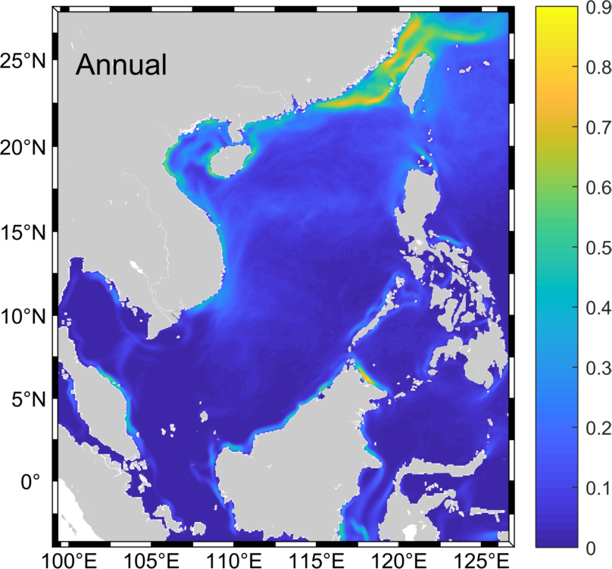
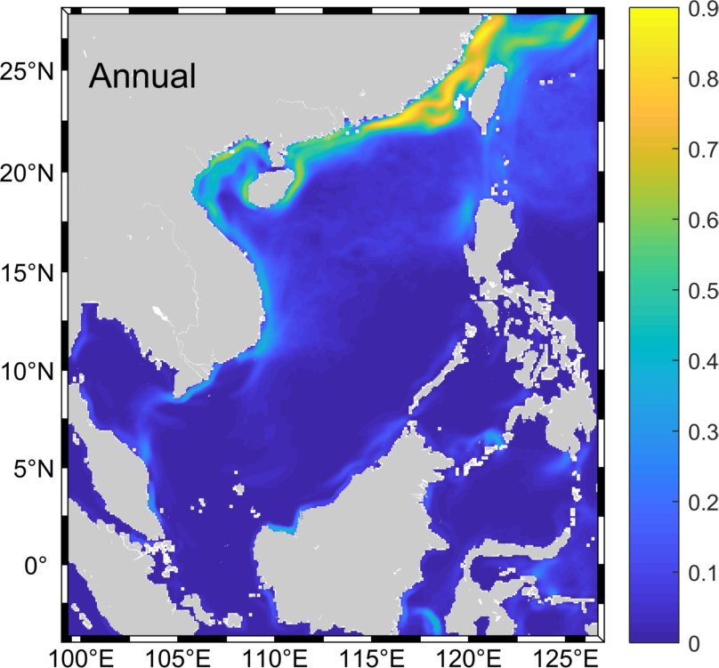
climatology: front area occurence frequency
OSTIA
ROMS
Mercator

Slide 17
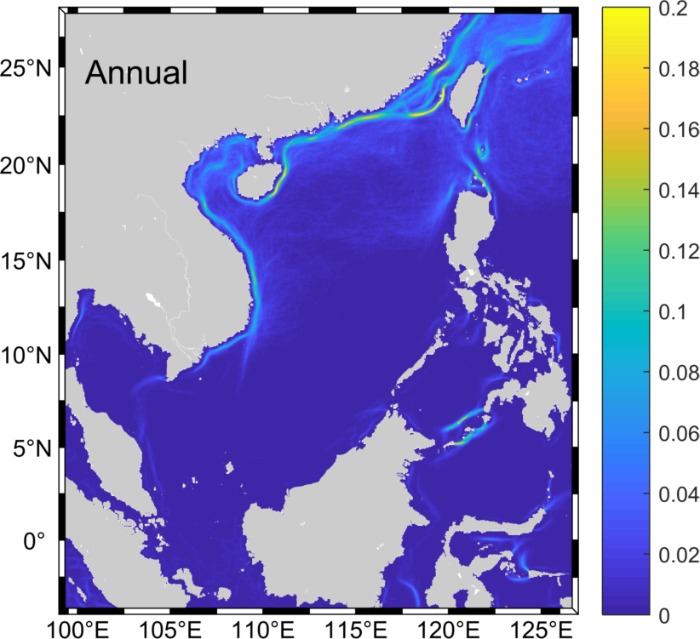
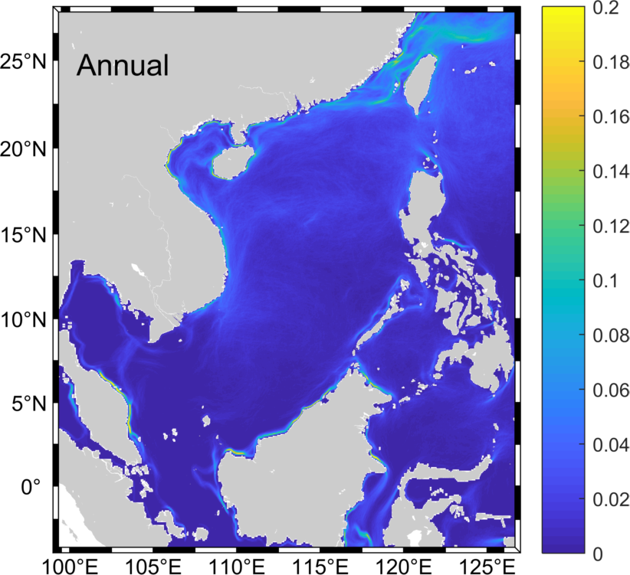
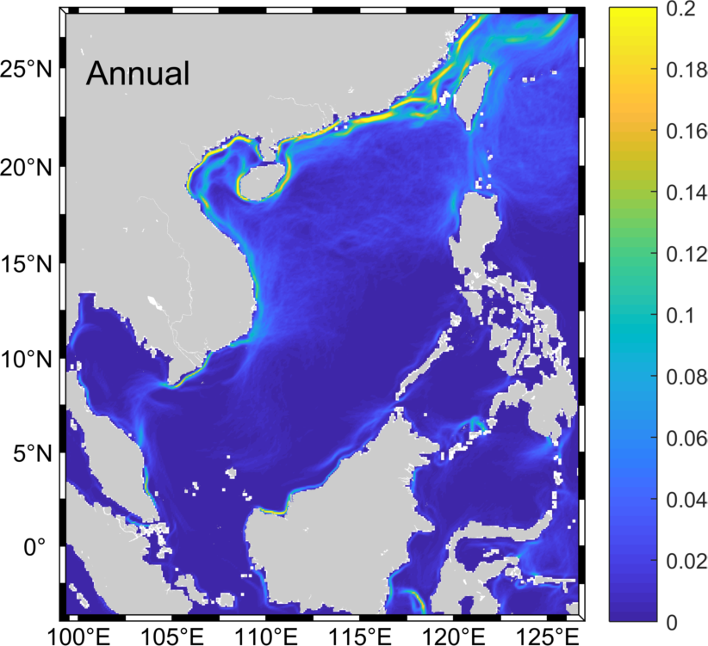
climatology: front line occurence frequency
OSTIA
ROMS
Mercator

Slide 18
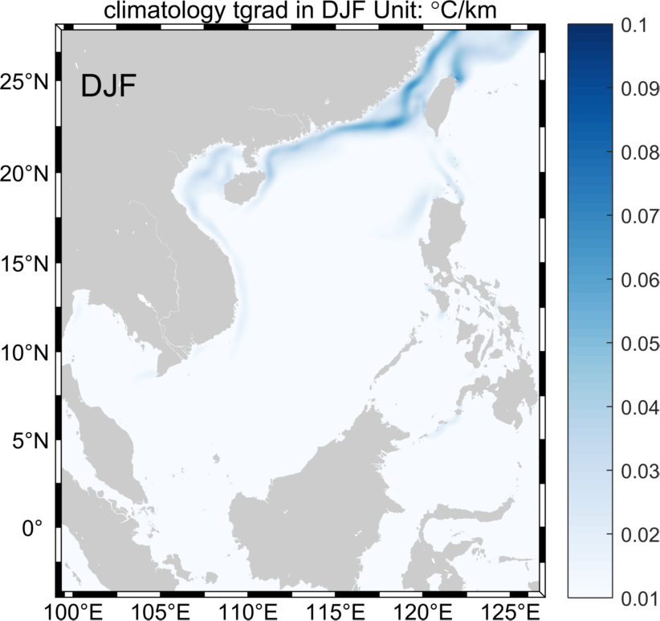
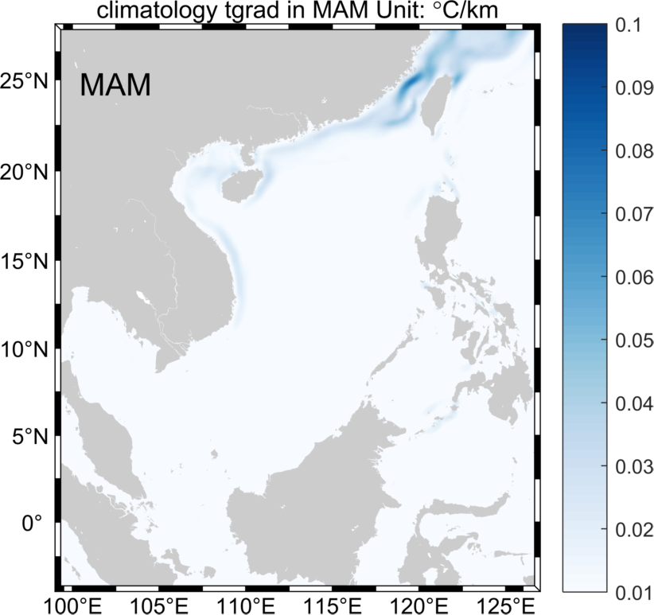
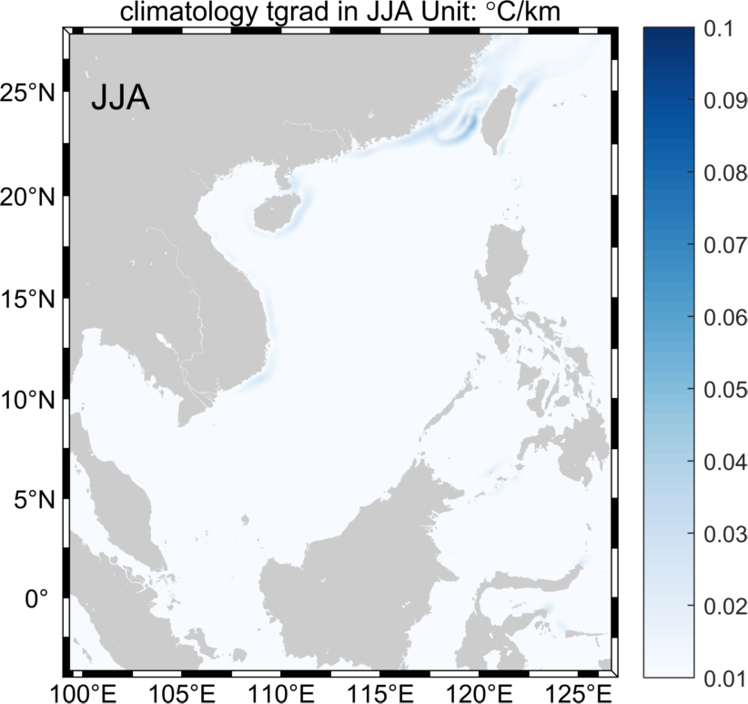
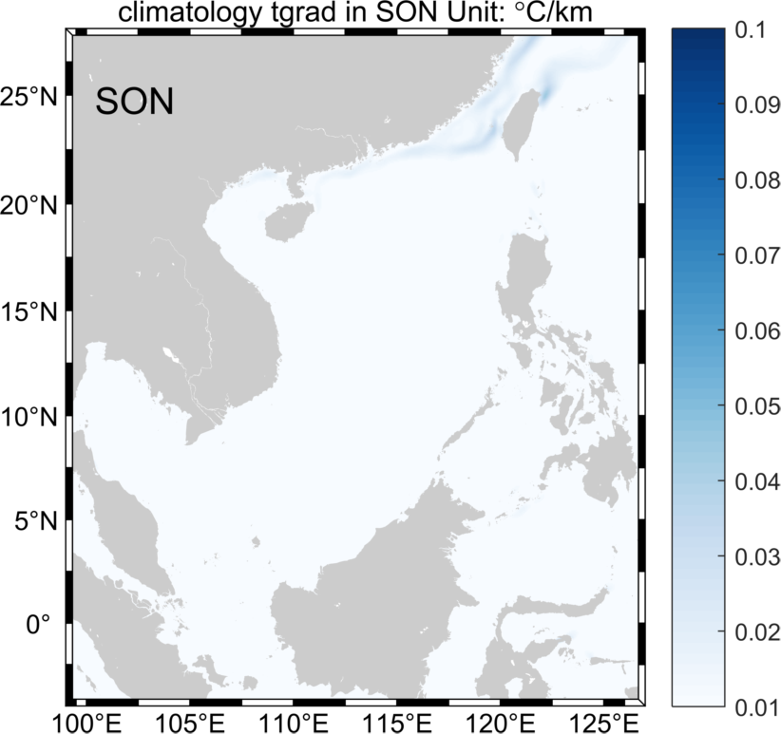
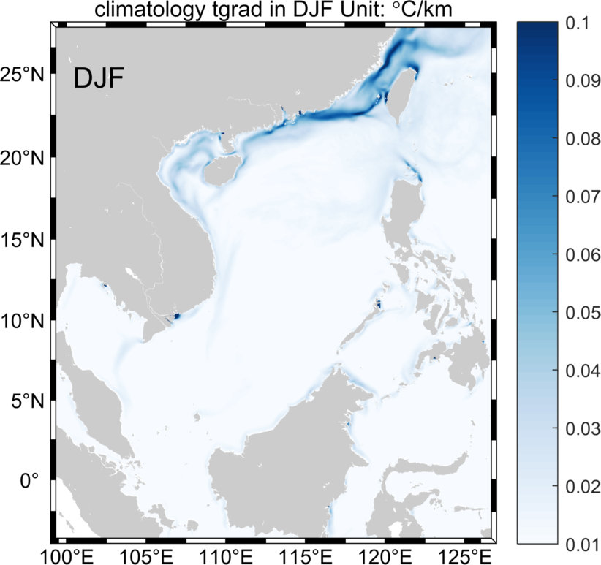

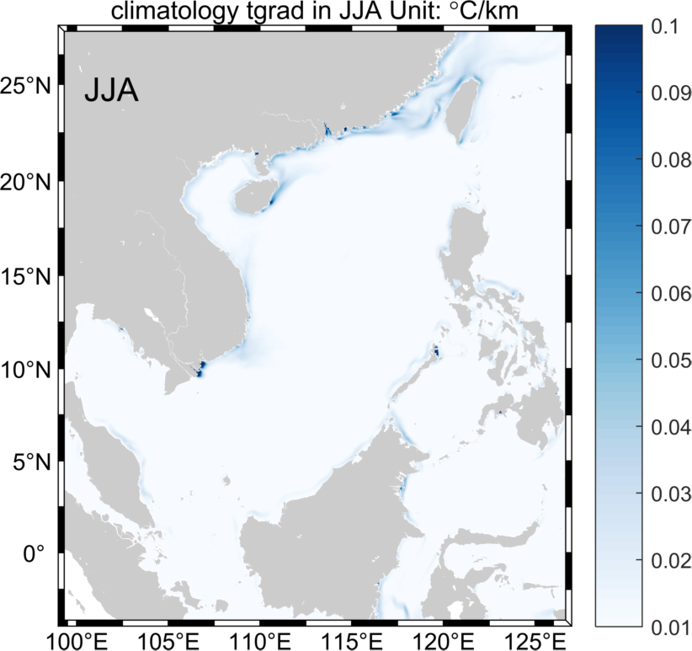

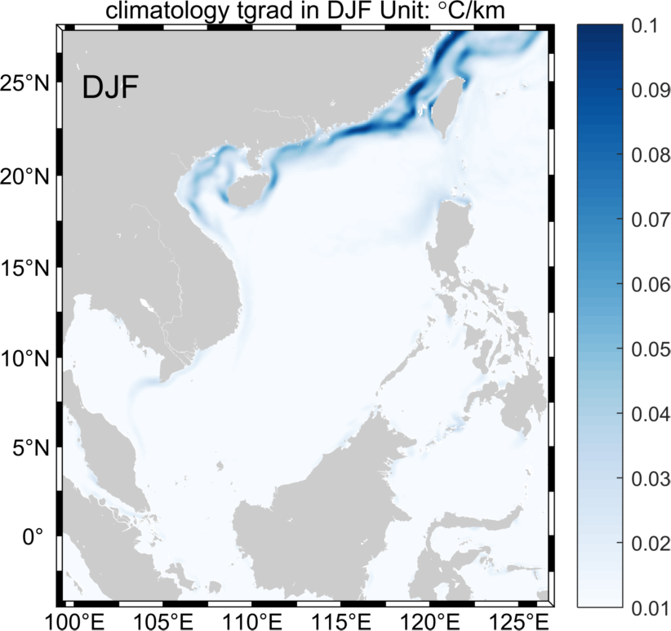
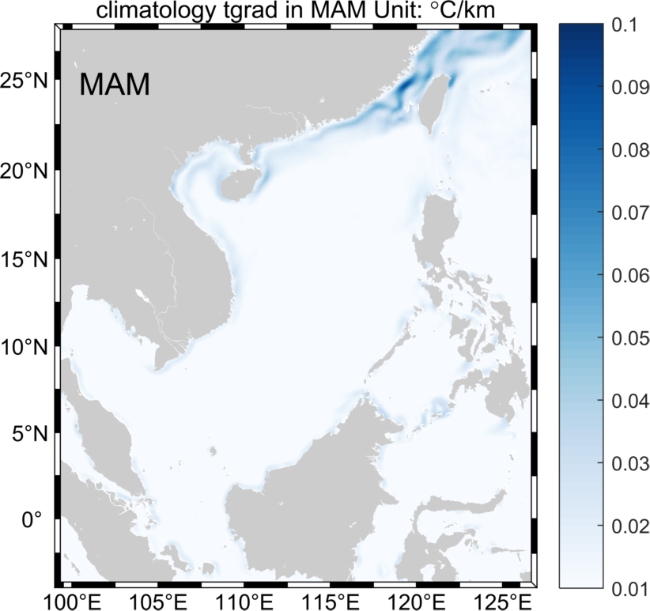
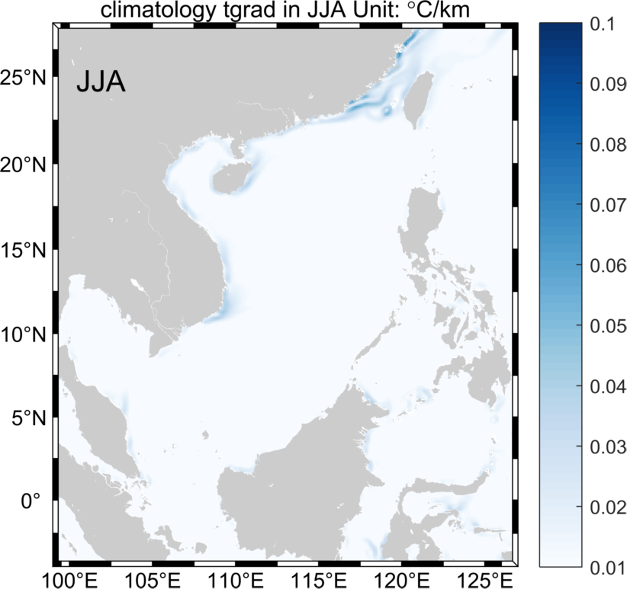

OSTIA
ROMS
Mercator

Slide 19
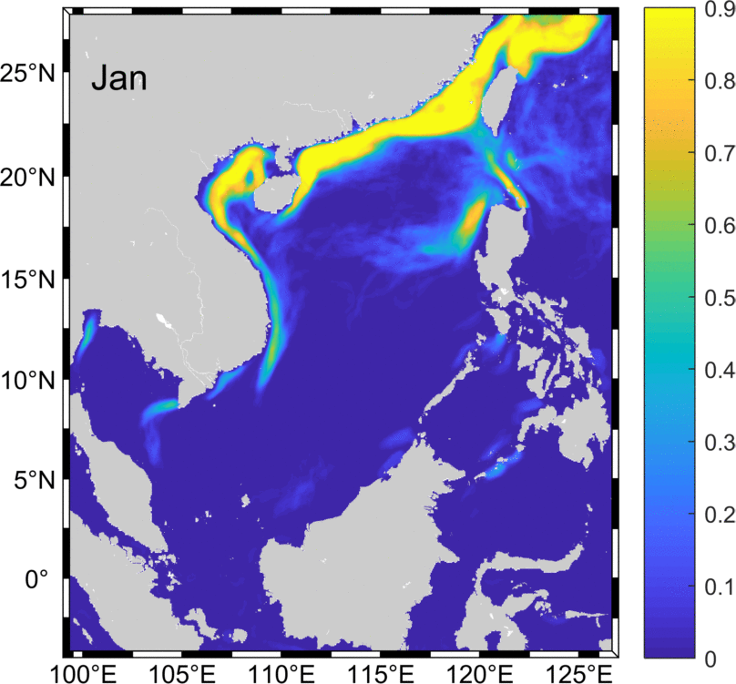
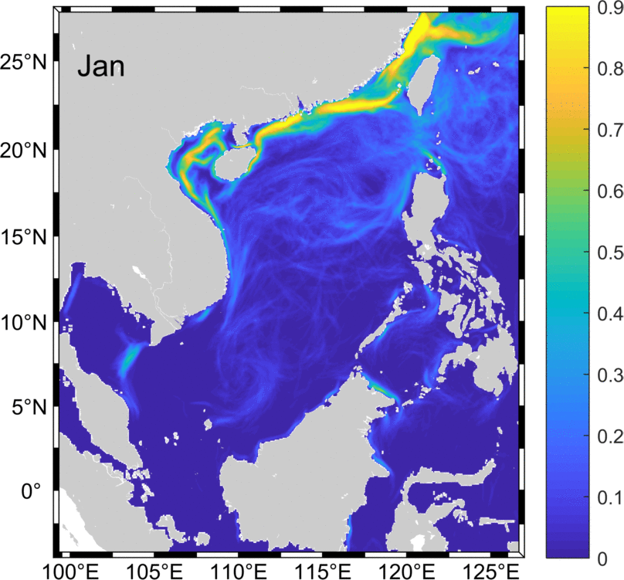
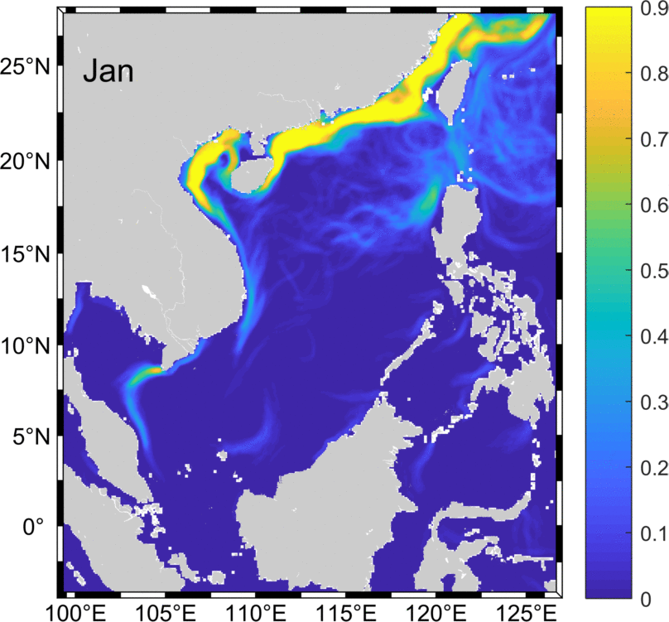
front area occurence frequency
OSTIA
ROMS
Mercator

Slide 20
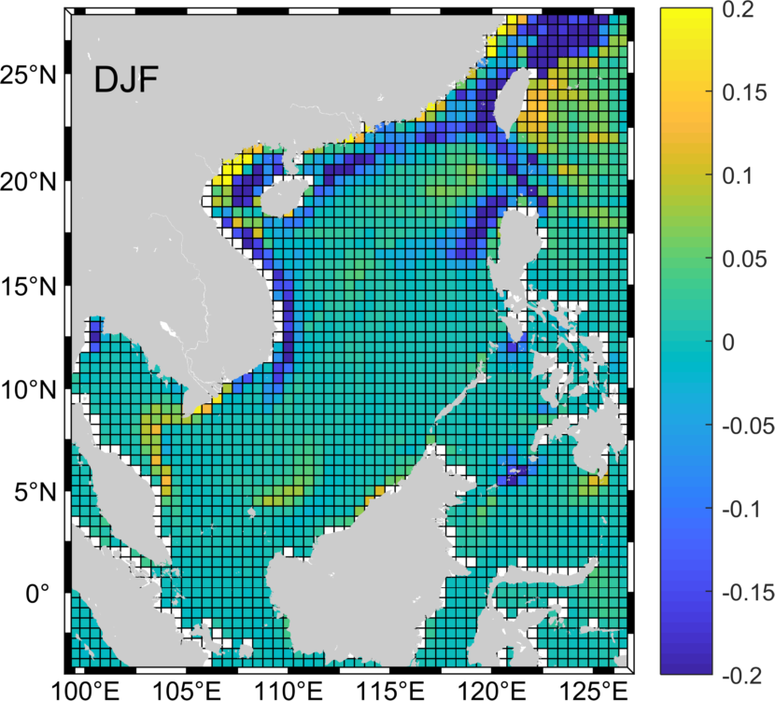

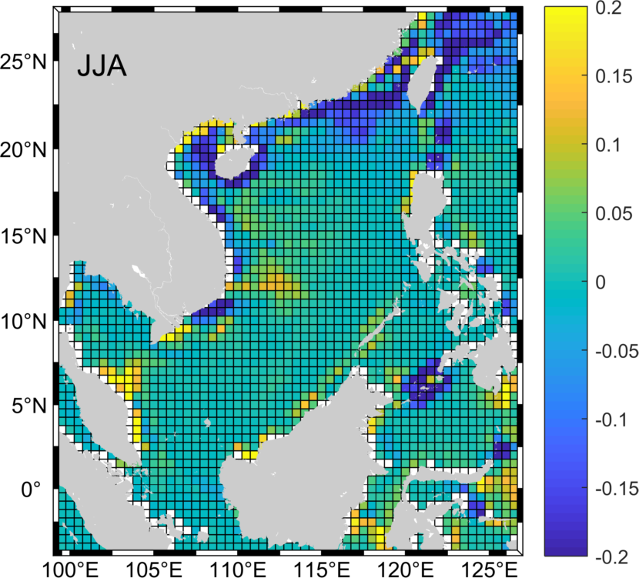
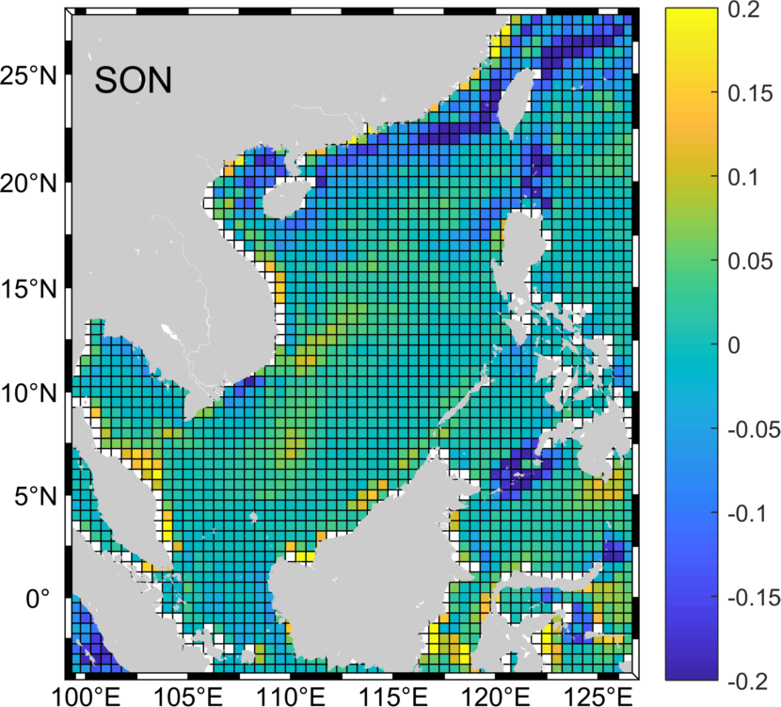
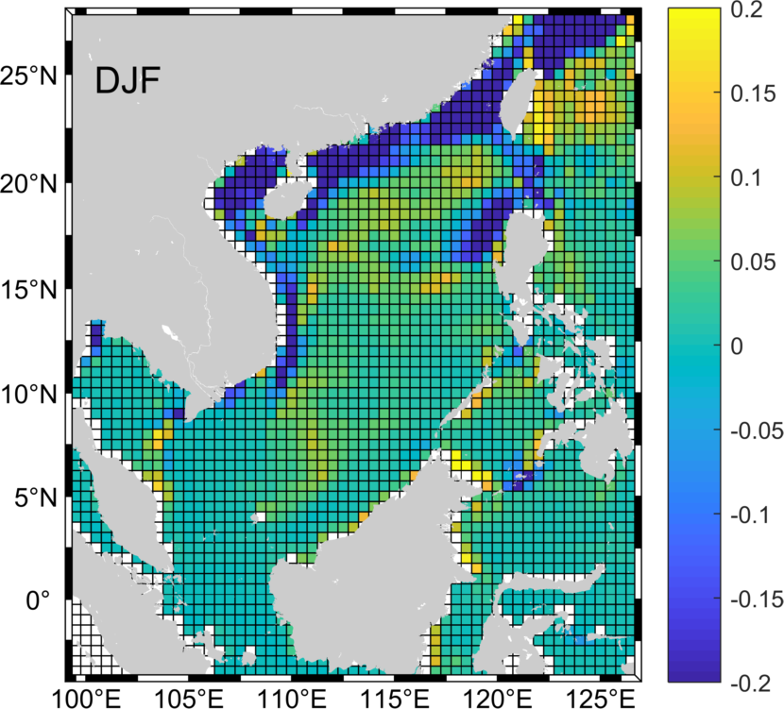
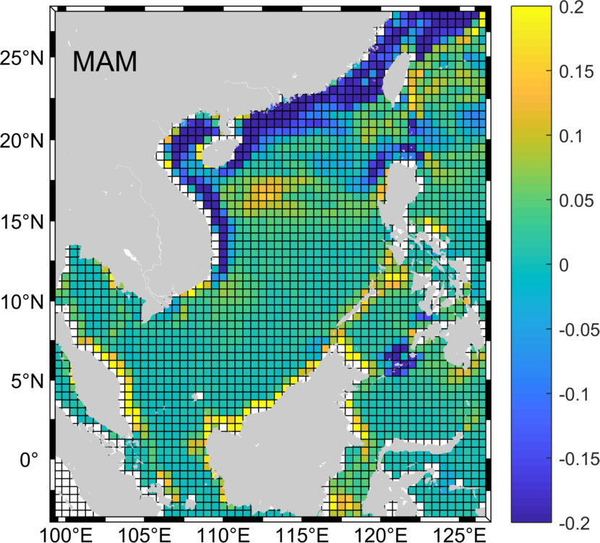
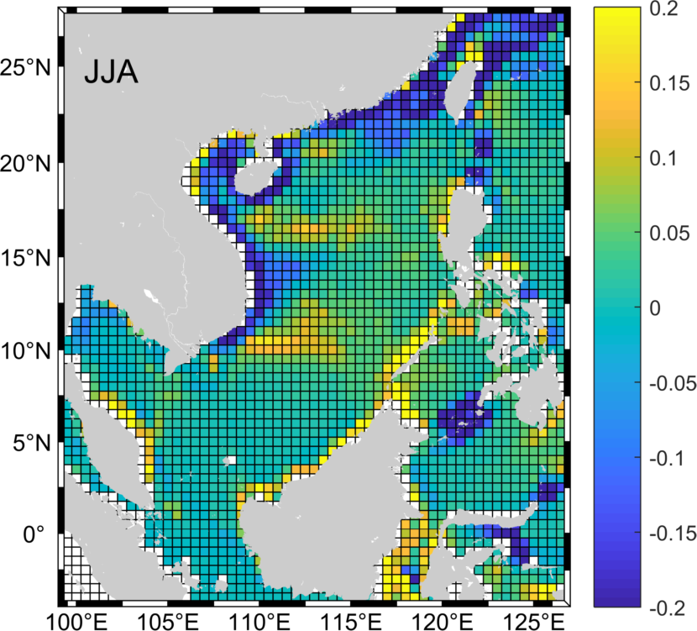
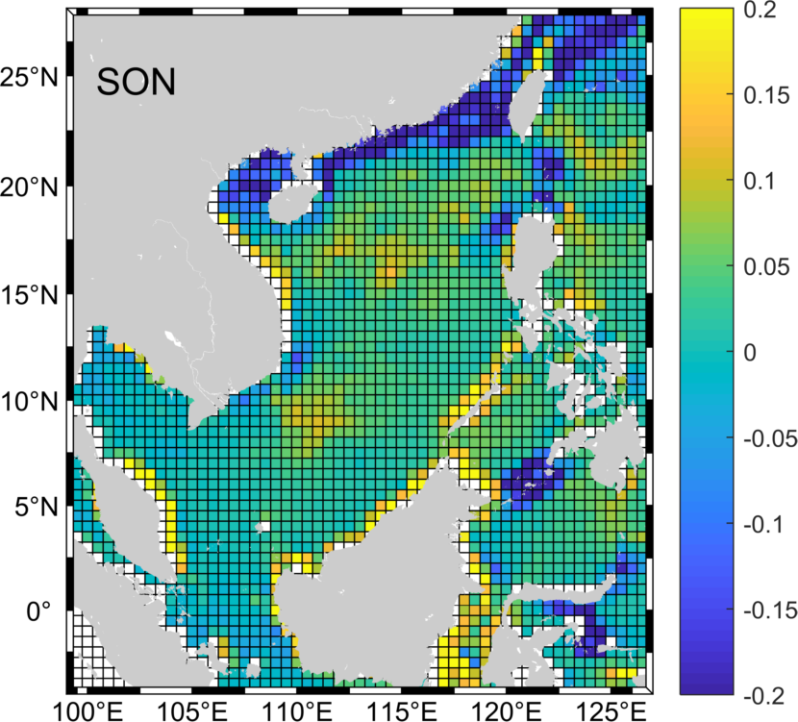
front area occurence frequency(bias)
Mercator - OSTIA
ROMS - OSTIA

Slide 21
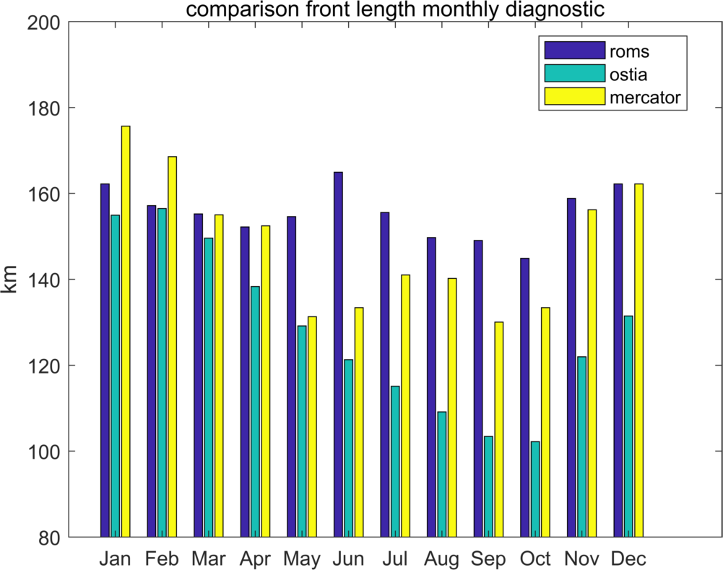
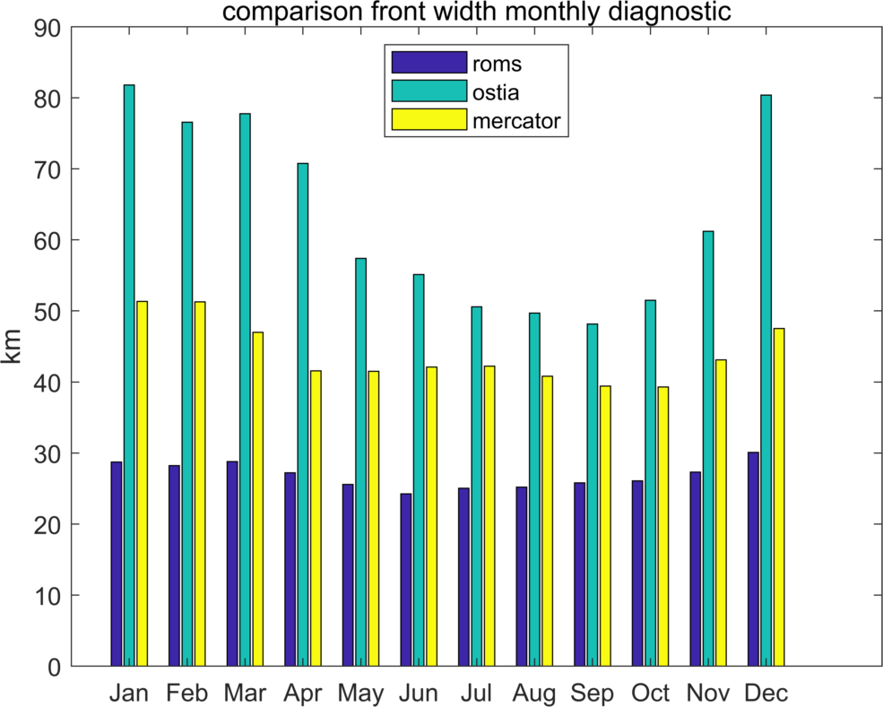
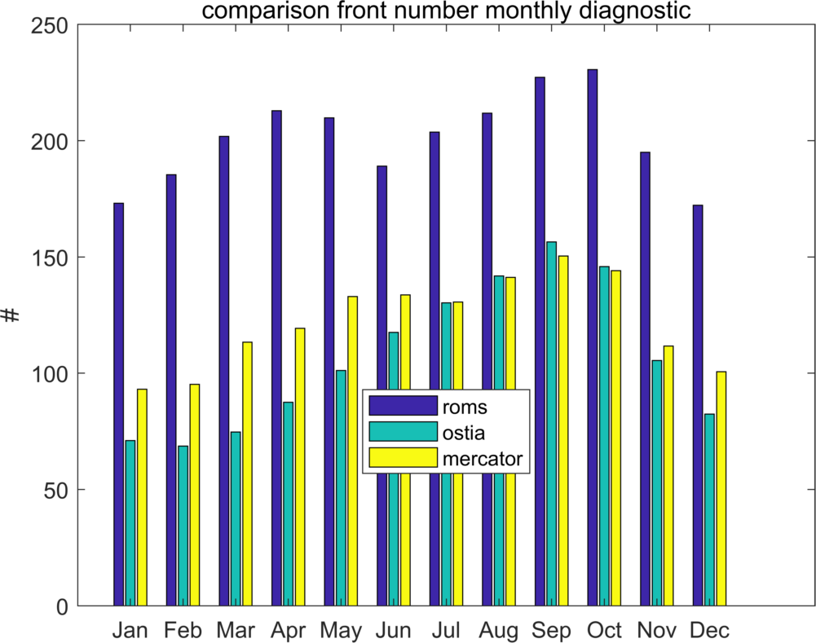
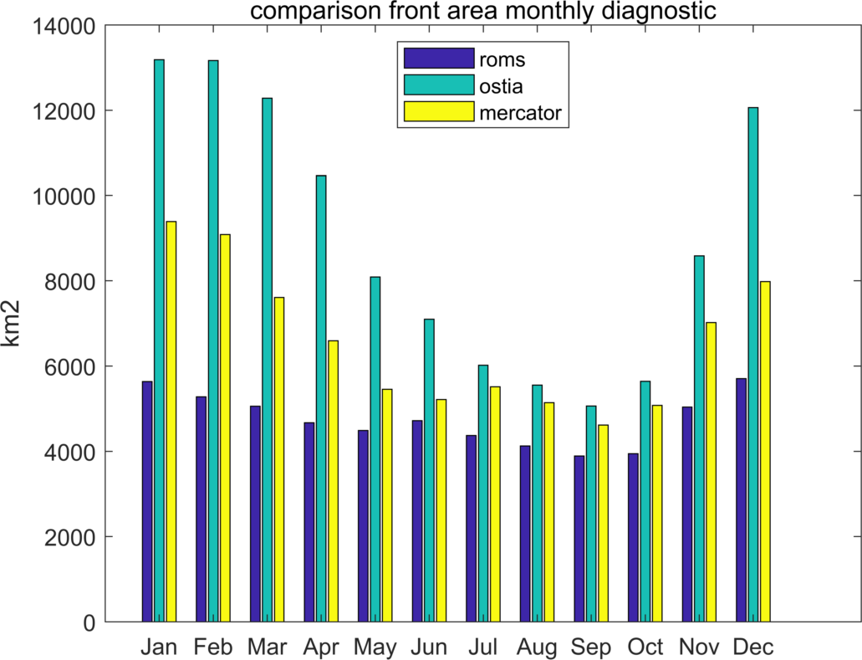
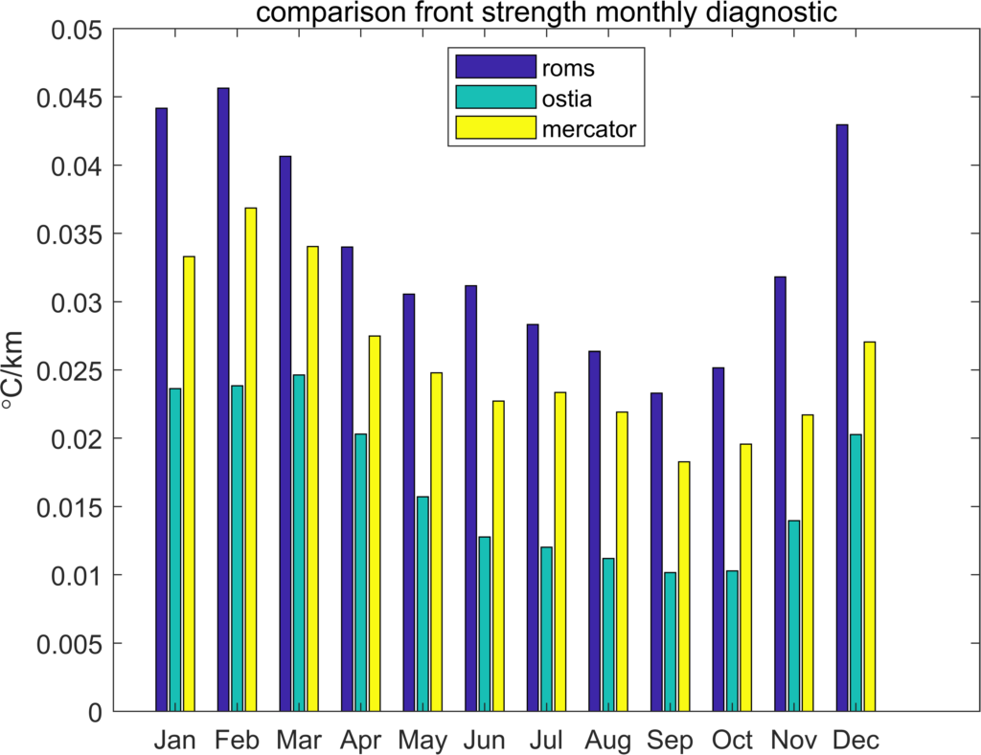
climatology of front parameter
length
number
width
seasonal varibility
area
strength
Notes:
bar map and explain why
use daily data explain

Slide 22
summary
developing frontal detecting tools
  finish a stable frontal detection tools
  performing frontal statistical with different SST datasets
  daily, monthly, seasonal ....
  frontal parameter, occurence frequency

Slide 23
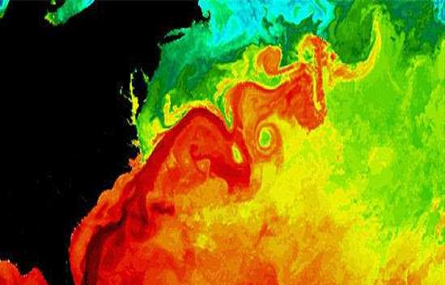
Thank you for attention

