Slide 1
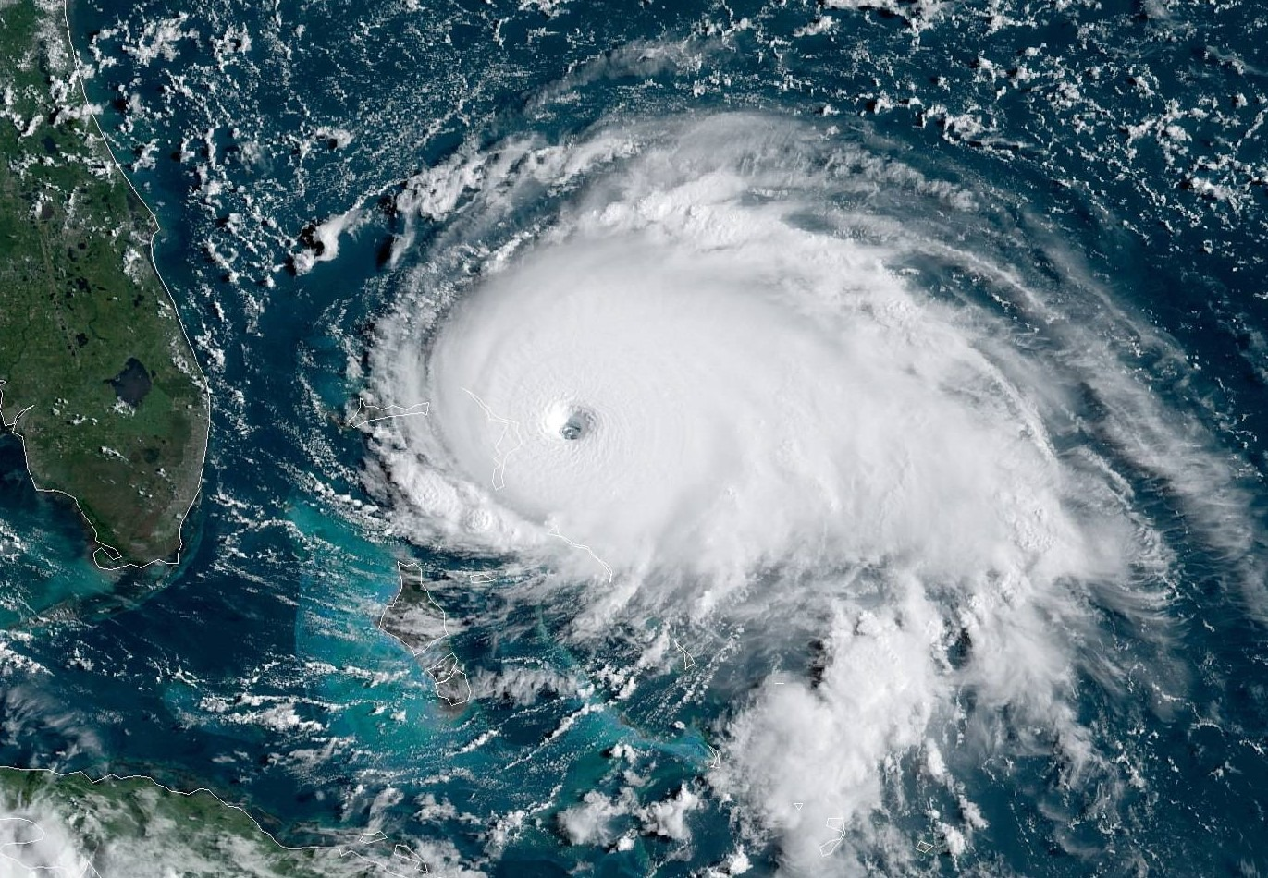
Estimation of Global Tropical Cyclone Wind Probabilities using the STORM dataset
Name Author
Nadia Bloemendaal (nadia.bloemendaal@vu.nl), H. de Moel, S. Muis, I.D. Haigh, J.C.J.H. Aerts

Slide 2
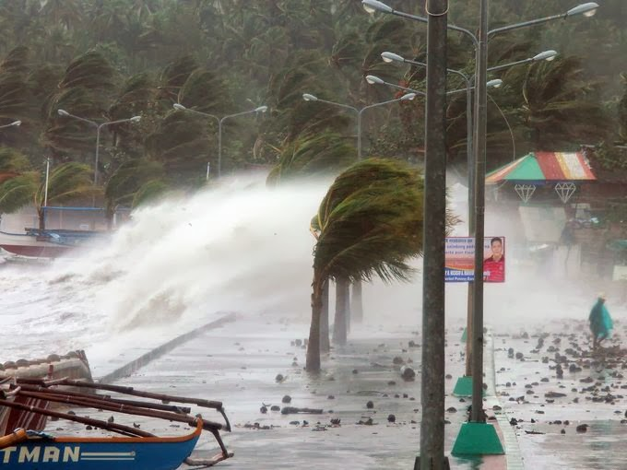
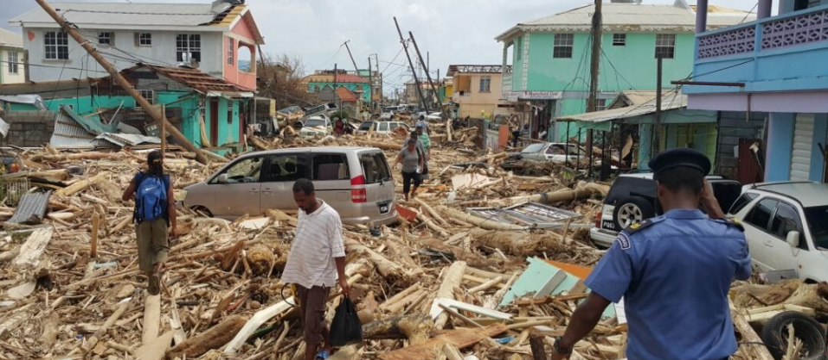
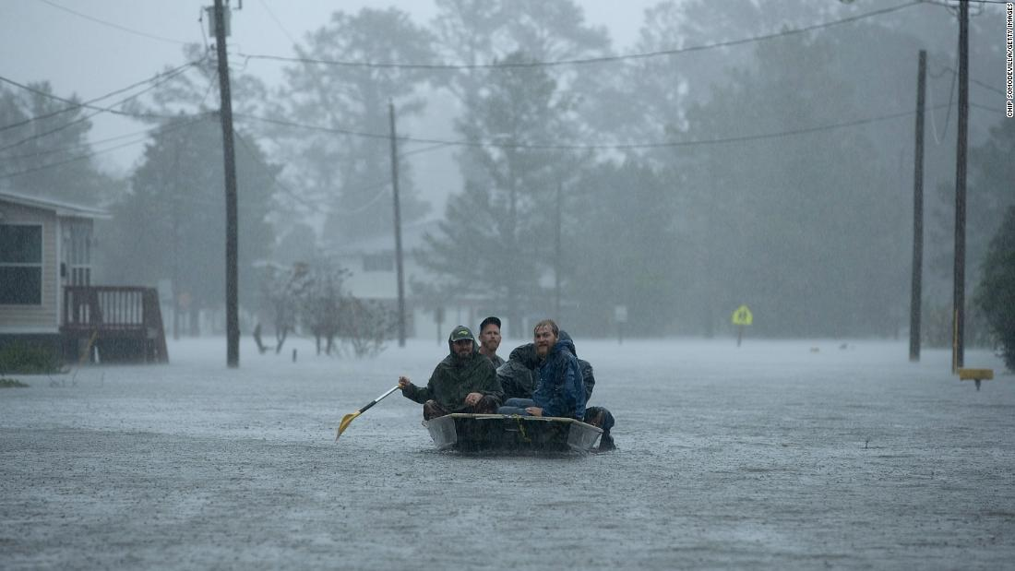
Tropical cyclones
Tropical cyclones (TCs) are one of the deadliest natural hazards, affecting coastal areas all around the globe when they make landfall.
To minimize future loss of life and damage to property, it is essential to perform accurate TC risk assessments in coastal regions. This answers questions like:
What are the strongest TCs we can expect in a region?
What are the 1-in-100-year wind speeds that my house should be able to withstand?
Are there ‘undiscovered’ regions at risk?
How is this risk going to change under climate change?

Slide 3
Problem statement
Answering these questions, however, is difficult using solely historical data. This is because:
There are around 90 (± 10) formations per year globally
Only a fraction of these make landfall – around 16 per year
At landfall, TCs only affect a relatively small stretch of coastline (< 500 km)
Reliable global TC records only date back till 1980 +
= Too few events to perform risk analysis

Slide 4
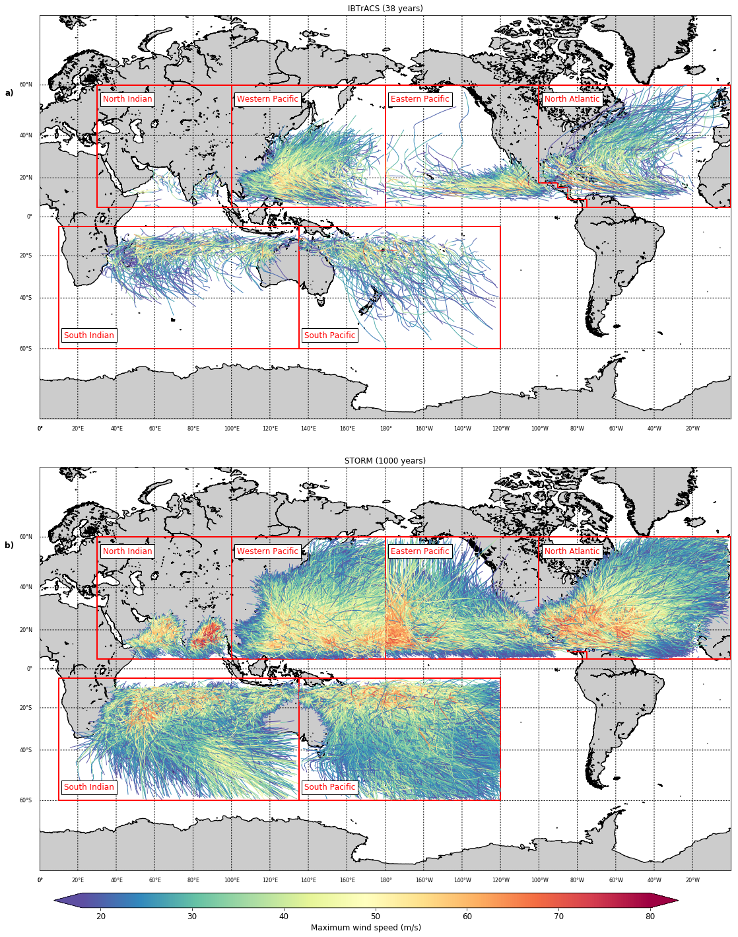
The STORM model
We can overcome the aforementioned problems using the methodology of synthetic track modelling. Using this methodology, a historical or climatological dataset can be statistically extended to longer time scales, whilst preserving the climatological characteristics as found in the original dataset.
Here, we present the recently developed state-of-the-art Synthetic Tropical cyclOne geneRation Model (STORM). STORM is a fully statistical model simulating TC track, intensity, and size (radius to maximum winds) at the global scale. Using IBTrACS as input dataset, we used STORM to create 10,000 years of synthetic TC tracks under present-climate conditions.
Figure 38 years of IBTrACS data (top) vs 1,000 years of STORM data (bottom)

Slide 5
Wind speed return periods
The STORM dataset (presented in the previous slide) now contains enough TCs per location to perform an adequate TC risk assessment. The final step then is to calculate the wind speed return periods from the synthetic data. As the dataset now spans 10,000 years of data, we do not need to fit extreme value distributions to the data – there is enough data available to empirically calculate the high (greater than 1-in-100-years) return periods! Hence, these return periods are derived empirically from the synthetic data using Weibull’s plotting formula:
$$P_{exc}\left(\vec{v}\right)=\frac{i}{n+1}∙\frac{n}{m}$$
$$T\left(\vec{v}\right)=1/P_{exc}(\vec{v})$$
$P_{exc}(\vec{v})$ is the exceedance probability for a given maximum wind speed $\vec{v}$ at rank $i$. $n$ is the total number of events in the set, and m the total length of the dataset (in years; here, $m=10,000$). The return period $T(\vec{v})$ is given as the inverse of $P_{exc}$.
To demonstrate the calculation of wind speed return periods, we derive the return periods for TC events within a 100 km radius of 18 selected coastal cities (see next slide).

Slide 6
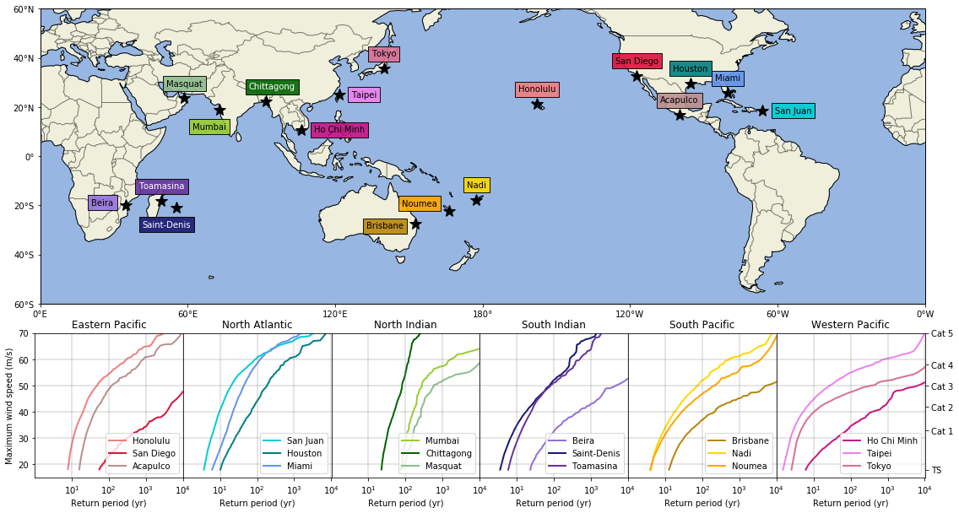
Wind speed return periods for coastal cities
Figure Wind speed return periods within a radius of 100 km for a selection of coastal cities.

Slide 7
Wind speed return periods for coastal cities
Honolulu:
48 years
Miami:
44 years
Mumbai:
275 years
Saint-Denis:
75 years
Nadi:
74 years
Taipei:
27 years
Figure Wind speed return periods within a radius of 100 km for a selection of coastal cities. Values in text boxes represent the return period for a Category-3 event.

Slide 8
Wind speed return periods at 10 km resolution
Aside from calculating wind speed return periods in the vicinity of pre-selected locations, the STORM dataset can also be used to calculate return periods at high resolution. Here, we construct 2D-parametric wind fields from the STORM dataset using the parametric approach of Holland, further refined by Lin and Chavas.
We compute the 2D-wind field using a mesh with 10 km resolution, and store the maximum wind speed at each grid cell whenever this wind speed exceeds 18 m/s (Tropical Storm-classification on the Saffir-Simpson scale).

Slide 9
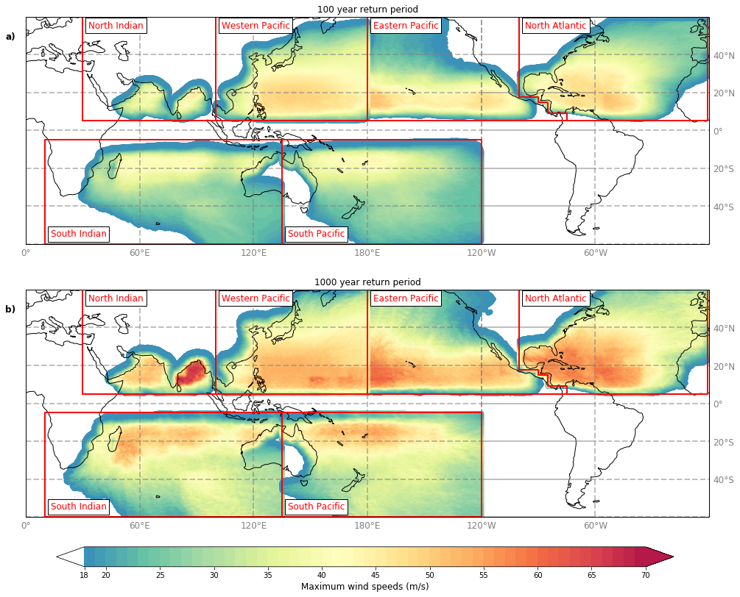
Wind speed return periods at 10 km resolution
Next, using Weibull’s empirical formula, we can calculate the wind speeds corresponding to a fixed set of return periods. Such information gives policymakers insights in, for example, how high the 1-in-100-year wind speed is in their city or area. This data is a valuable contribution to e.g. the design of construction regulations anywhere in TC-prone areas, including small island nations and regions not frequently hit by TCs.
Figure maximum wind speed at the 1-in-100-year (top) and 1-in-1000-year return period, at 10 km resolution

Slide 10
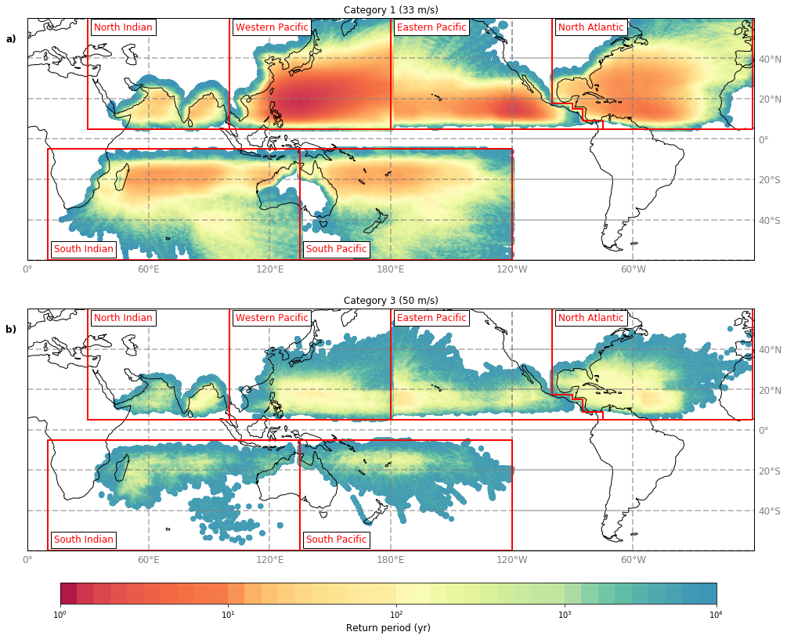
Wind speed return periods at 10 km resolution
The aforementioned methodology of calculating wind speed return periods can also be reversed to calculate the return period at fixed wind speeds. This way, we can give estimations on the return periods of certain wind speeds anywhere in TC-prone areas.
Figure Return period for a Category 1 (33 m/s) (top) and Category 3 (50 m/s) TC, at 10 km resolution

Slide 11
Summary
The STORM model is a fully statistical model that generates 10,000 years of synthetic tropical cyclones from an input dataset, preserving the climatological statistics as found in the original dataset.
The STORM dataset can be used for a variety of TC-related (risk) studies. As the STORM dataset spans 10,000 years, we do not need to fit extreme value distributions to the data to derive the return periods of extreme (greater than 1-in-100-years) events. Instead, we can use an empirical approach, such as Weibull’s plotting formula. This formula was applied to calculate wind speed return periods within a radius of 100 km for a selection of 18 coastal cities.
By coupling the synthetic TC tracks with a 2D-parametrization wind model, we can calculate high-resolution wind speed return periods anywhere in TC-prone areas. We coupled this model setup with a 10 km mesh and Weibull’s plotting formula to estimate wind speeds for fixed return periods, and return periods for fixed wind speeds.
The work presented here contributes to the understanding of spatial variation of TC risk around the globe. The resulting data can be used to calculate TC risk in all coastal areas, including small island nations and regions not frequently hit by TCs.

Slide 12
Further reading, datasets & contact info
STORM model: Bloemendaal, N., Haigh, I.D., de Moel, H. et al. Generation of a global synthetic tropical cyclone hazard dataset using STORM. Sci Data 7, 40 (2020). https://doi.org/10.1038/s41597-020-0381-2
STORM datasets: are publicly accessible and can be found at
https://data.4tu.nl/repository/uuid:82c1dc0d-5485-43d8-901a-ce7f26cda35d
Wind speed return periods using STORM: Bloemendaal, N., de Moel, H., Muis, S. et al. Estimation of global tropical cyclone wind probabilities using the STORM dataset. In preparation; to be submitted to Scientific Data.
Return period datasets: will be made publicly available through the 4TU.Repository when the accompanying paper is published.
For more information, please contact me via nadia.bloemendaal@vu.nl

