Slide 1


Spatio-Temporal Dynamics of East Asia Atmospheric Rivers and their Atmospheric Steering and Climatic Regulation
EGU2020-257 AS4.6
Mengxin Pan¹ , Mengqian Lu¹ , Upmanu Lall² , and Qizhen Dong¹
¹Department of Civil and Environmental Engineering, the Hong Kong University of Science and Technology, Hong Kong SAR, China (mpanab@connect.ust.hk)
²Department of Earth and Environmental Engineering, Columbia Water Center, Columbia University, New York, NY, USA

Slide 2
Outlines
AR identification algorithm (PanLu 2.0)
East Asia AR catalog
Eight-stage East Asia AR annual cycle and Atmospheric Steering
Precipitation Predictability

Slide 3
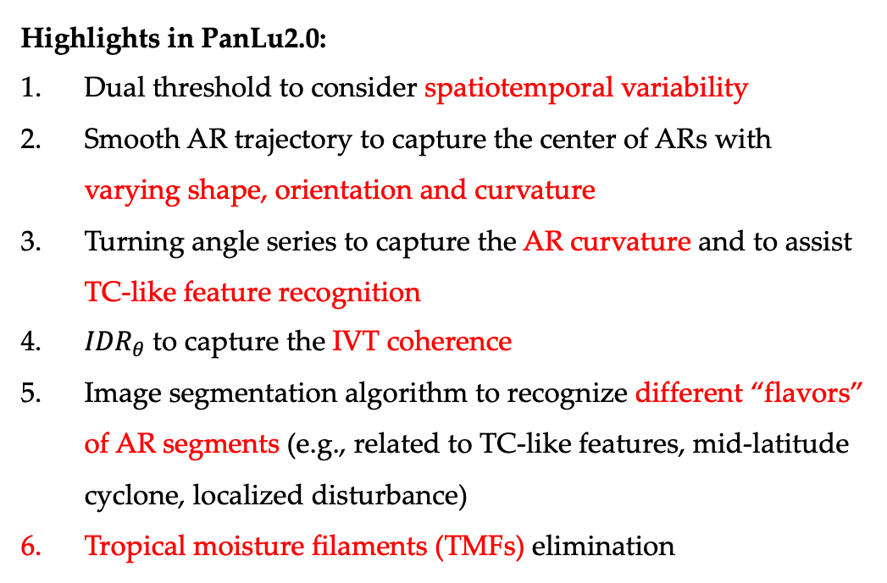
AR identification algorithm (PanLu2.0)
Highlights in PanLu2.0:
Dual threshold to consider spatiotemporal variability
Smooth AR trajectory to capture the center of ARs with varying shape, orientation and curvature
Turning angle series to capture the AR curvature and to assist TC-like feature recognition
${IDR}_{θ}$ to capture the IVT coherence
Image segmentation algorithm to recognize different “flavors” of AR segments (e.g., related to TC-like features, mid-latitude cyclone, localized disturbance)
Tropical moisture filaments (TMFs) elimination
More details are provided in (Pan & Lu, 2019) and (Pan & Lu, 2020; under review), and parallel live chat on AS4.6 A novel global AR identification algorithm by Mengqian Lu and Mengxin Pan
(Pan & Lu, 2019)

Slide 4
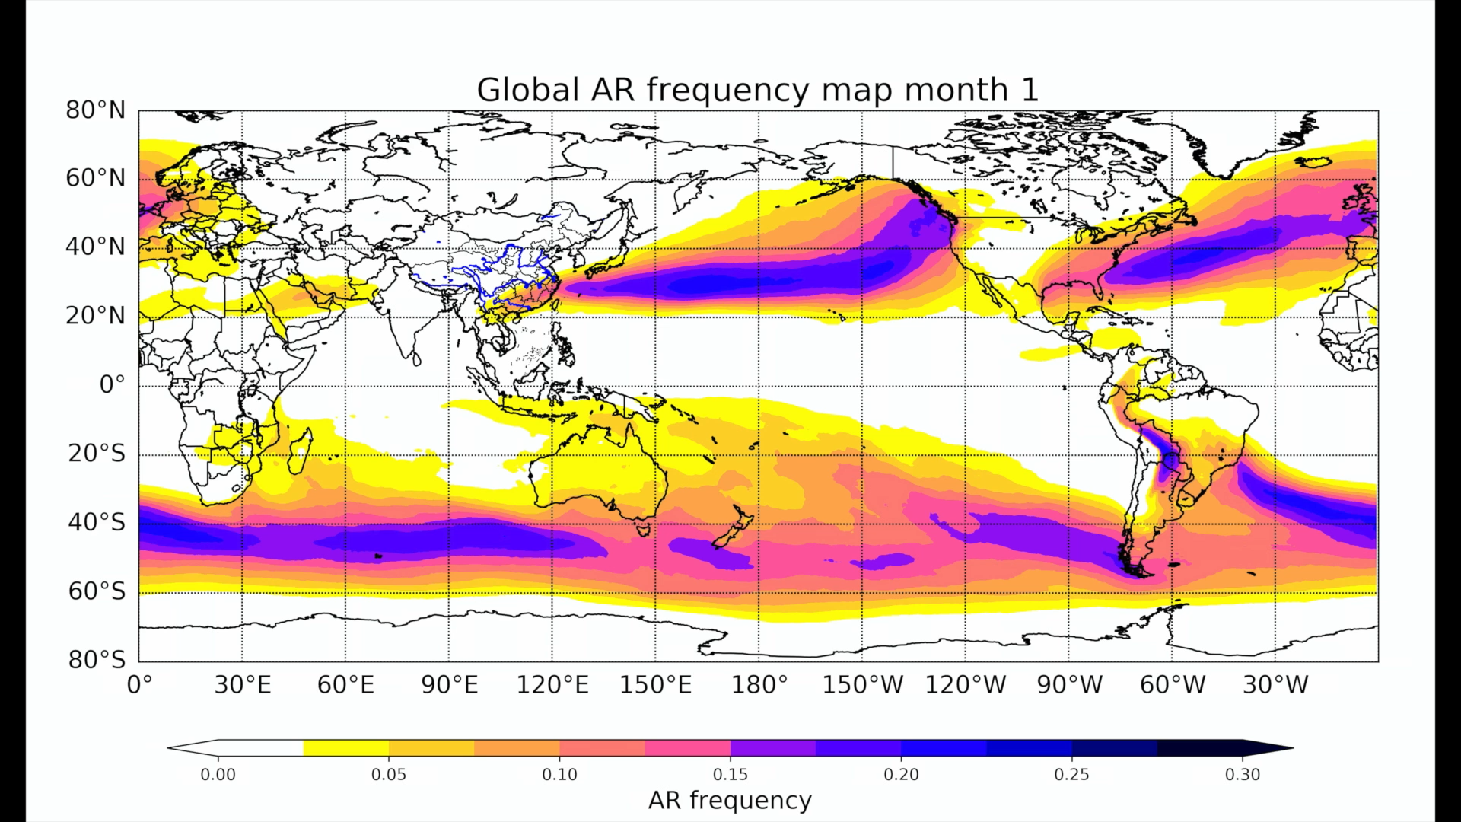
In September 2019, PanLu2.0 joined the ARTMIP project and contributed the AR global catalog (available at http://www.cgd.ucar.edu/projects/artmip/).
MERRA2

Slide 5
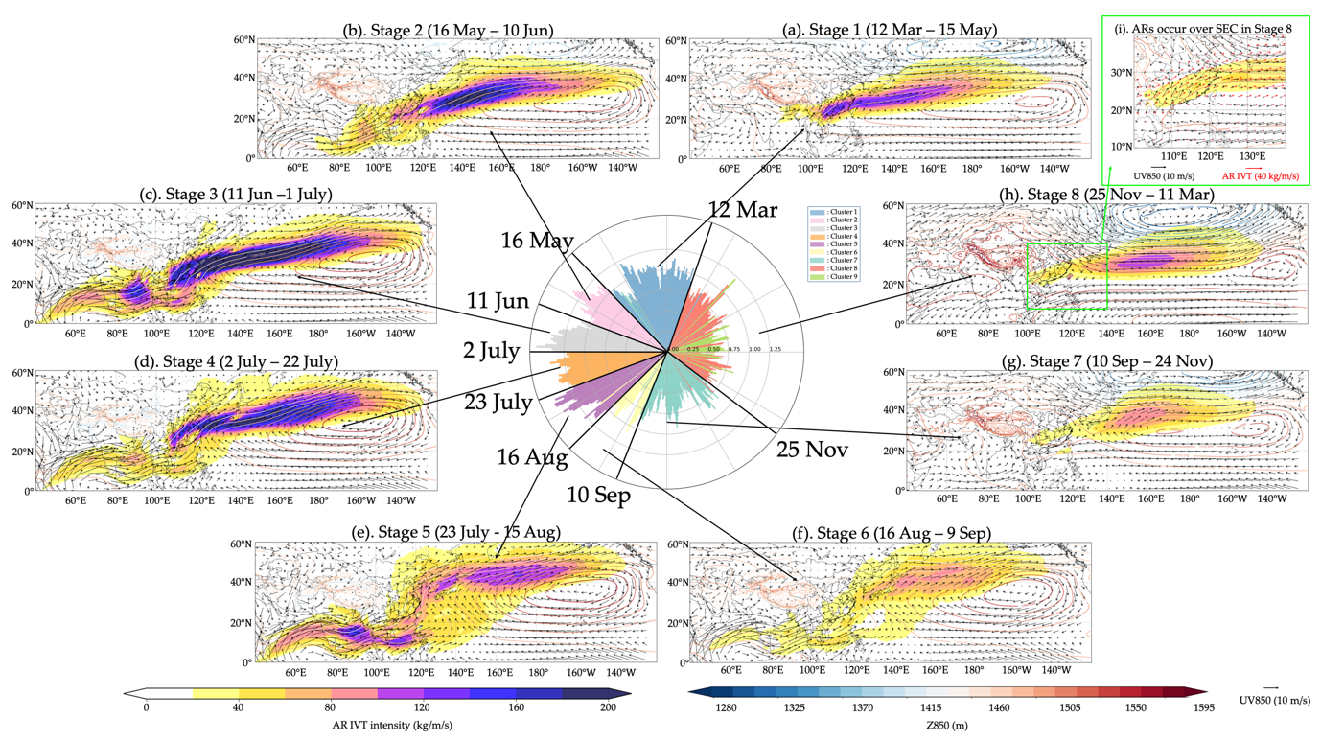
Eight-stage annual cycle of EA AR
Based on PanLu2.0, the East Asia (EA) AR catalog is constructed.
The eight-stage annual cycle is recognized by applying the Self-organizing map on the calendar day climatology of AR-IVT field.
Eight stages well capture the season-to-subseasonal (S2S) evolution of EA AR, especially for the Asian summer monsoon season.

Slide 6
Spring stage
ARs prevail over southeast China (SEC) and western North Pacific (WNP).
Springtime east-west thermal contrast over the Indochina Peninsula (IP) and the western North Pacific (WNP) to the east of the Philippines results in deep extension of the Western North Pacific Subtropical High (WNPSH) to south China sea (SCS) (Li, Zhou, & Chen, 2018; Tian & Yasunari, 1998).
The resulting intensive southwesterly over the northwestern flank of WNPSH is likely the key to the intensification of springtime ARs over the SEC and spring precipitation.

Slide 7
Early Asian summer monsoon stages
In stage 2:
ARs emerge in the SCS, IP and bay of Bengal (BOB) and further intensify over northwest flank of WNPSH.
In line with eastward retreat and northwestward intensification of WNPSH; onset of east Asia summer monsoon (EASM) prevailing wind over SCS and pre-summer rainfall over south China (Ding & Chan, 2005; Ho & Wang, 2002).
In stage 3:
The AR-IVT intensifies significantly almost over the entire AR main route.
In line with further northward shifting and intensification of WNPSH; the grand intensification of monsoon flow over the ASM region; and the commencement of Meiyu/Baiu rainy season and Indian rainy season (Ding & Chan, 2005).

Slide 8
Late Asian summer monsoon stages
In stage 4:
The AR main route shift northward and weaken suddenly over south China.
Second northward jump of WNPSH; Changma rainy season over the Korean Peninsula (KP); end of the pre-summer rainy season over south China (Wang, 2006).
In stage 5:
The AR is further weakened and advanced further north.
Further northward progression of EASM flow, rain belt to northeast China and the break of Meiyu/Baiu rainy season (Wang, 2006).

Slide 9
Late-summer to early-winter stages
In stage 6:
The AR is weakened extensively.
Withdraw of ASM and disappear of major monsoon rain belt.
In stage 7:
The AR enters the weakest stage in a year.

Slide 10
Late-winter to early-spring stage
The ARs intensify over North Pacific, embedding in the strong East Asia winter monsoon (EAWM) flow.
The ARs over SEC bring warm and moisture-laden air from the southwest. The winter precipitation is very likely to be triggered when ARs come across dry and cold air over SEC.

Slide 11
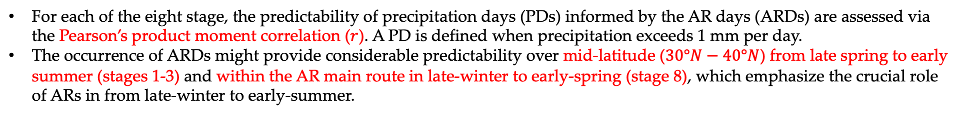
Precipitation day (PD) predictability
Correlation map between PDs and ARDs
For each of the eight stage, the predictability of precipitation days (PDs) informed by the AR days (ARDs) are assessed via the Pearson’s product moment correlation ($r$). A PD is defined when precipitation exceeds 1 mm per day.
The occurrence of ARDs might provide considerable predictability over mid-latitude ($30°N−40°N$) from late spring to early summer (stages 1-3) and within the AR main route in late-winter to early-spring (stage 8), which emphasize the crucial role of ARs in from late-winter to early-summer.

Slide 12
Heavy precipitation day (HPD) predictability
Correlation map between HPDs and ARDs
The predictablity of heavy precipitation days (HPDs) are also assessed. HPD is defined when precipitation exceeds 80th quantile of the precipitation days (Q80).

Slide 13
Difference between PDs and HPDs
Correlation of HPDs minis correlation of PDs
By comparing the difference of correlation between PDs and HPDs (HPDs minus PDs), we found that the correlation is decrease beneath the AR main route and increase outside the AR main route.
We reckon that over the AR main route, the climatological humidity is already at a substantial level, the occurrence of HPDs may be more attributable to the meso to synoptic-scale disturbances along the monsoon front (Wang, 2006) than the AR-related intensive moisture transport.

Slide 14
Consider the AR near the PD grids
Correlation based on AR frequency over the 3-degree neighborhood minis gird-by-grid correlation of PDs
In order to consider the influence of ARs in the vicinity of the rainfall grid, the correlation analysis is extended to relate the AR frequency over the neighborhood to the PD/HPD grid.
The correlation peaks at when we consider the neighborhood within 3 degree, then decreases as neighborhood expends (result not shown).

Slide 15
Consider the AR near the HPD grids
Correlation based on AR frequency over the 1-degree neighborhood minis gird-by-grid correlation of HPDs
As for HPDs, the correlation within the AR main route increase sharply for neighborhood within 1 degree, then decreases slowly (result not shown).
So, the influence of AR near PD/HPD is suggested to be considered for AR-related rainfall prediction in the future.

Slide 16
Conclusion & discussion
In this study, we take a climatological scan of the EA AR. Whereas, numerous research topics emerge, such as the interannual, interdecadal and S2S variability of ARs and associated environmental condition, which may provide more insight of the onset and oscillation of ASM and associated rainfall prediction.
The promising potential predictability of (heavy) precipitation over the mid-latitude from the late-spring to early-summer, and over SEC and south Japan from late-winter to early-spring emphasize the crucial role of AR in spring and winter precipitation prediction.
During the peak ASM season, the only moderate predictability of precipitation informed by ARs. The underlying reason is that in the peak ASM season when the climatological humidity is maintained in a considerate level, the occurrence of rainfall is more likely related to disturbances along the monsoon front than the abundant moisture supply brought be ARs.

Slide 17
References
Pan, M., & Lu, M. East Asia Atmospheric River Catalog: Annual Cycle, Transition Mechanism and Precipitation Predictability. Geophysical Research Letters (under review).
Pan, M., & Lu, M. (2019). A Novel Atmospheric River Identification Algorithm. Water Resources Research, 55(7), 6069–6087. https://doi.org/10.1029/2018WR024407
Ding, Y., & Chan, J. C. L. (2005). The East Asian summer monsoon: an overview. Meteorology and Atmospheric Physics, 89(1–4), 117–142. https://doi.org/10.1007/s00703-005-0125-z
Wang, B. (2006). The Asian Monsoon. In Springer (Vol. 53).
Tian, S., & Yasunari, T. (1998). Climatological aspects and mechanism of spring persistent rains over central china. Journal of the Meteorological Society of Japan, 76(1), 57–71. https://doi.org/10.2151/jmsj1965.76.1_57
Ho, L., & Wang, B. (2002). The time-space structure of the Asian-Pacific summer monsoon: A fast annual cycle view. Journal of Climate, 15(15), 2001–2019. https://doi.org/10.1175/1520-0442(2002)015<2001:TTSSOT>2.0.CO;2
Li, P., Zhou, T., & Chen, X. (2018). Water vapor transport for spring persistent rains over southeastern China based on five reanalysis datasets. Climate Dynamics, 51(11–12), 4243–4257. https://doi.org/10.1007/s00382-017-3680-3

