Slide 1
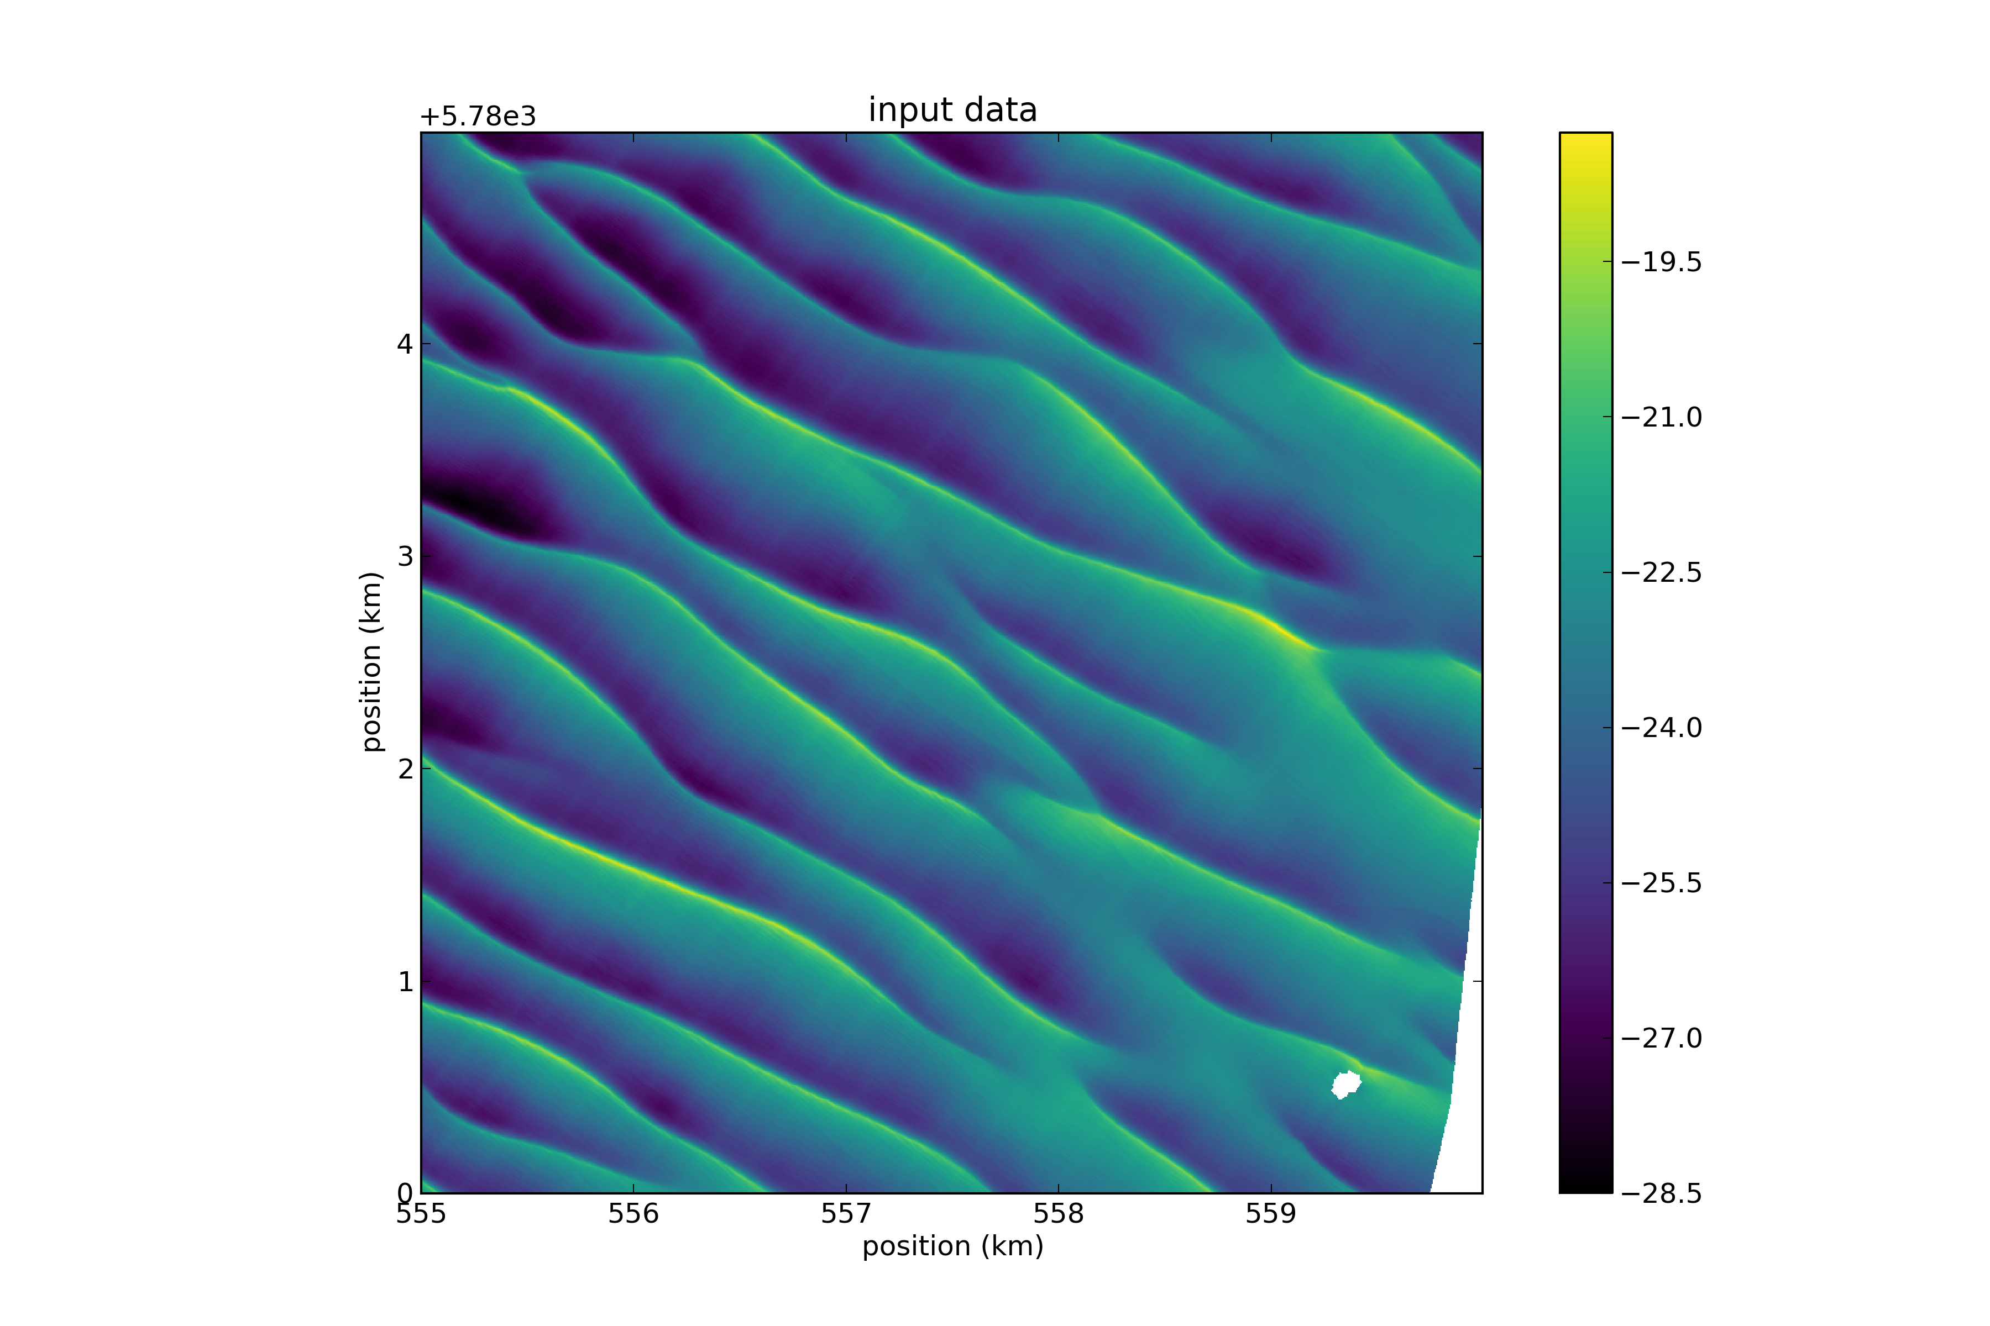












Validation of process-based sand wave models: applying a linear and nonlinear sand wave model to the Netherlands Continental Shelf
NOTE: This .ppt file includes a recording, which guides you through this presentation.
G.H.P. (Geert) Campmans*, P.C. Roos, T.A.G.P. van Dijk, S.J.M.H. Hulscher
*g.h.p.campmans@utwente.nl

Slide 2
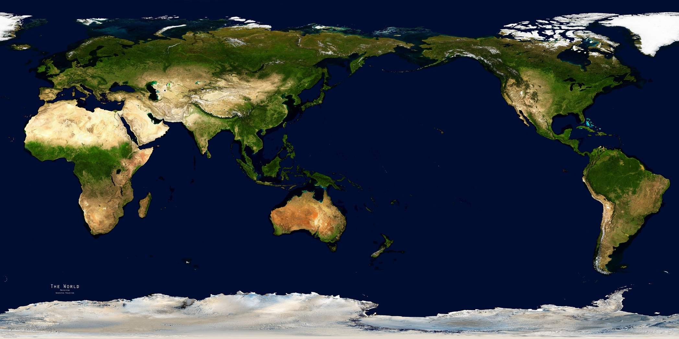
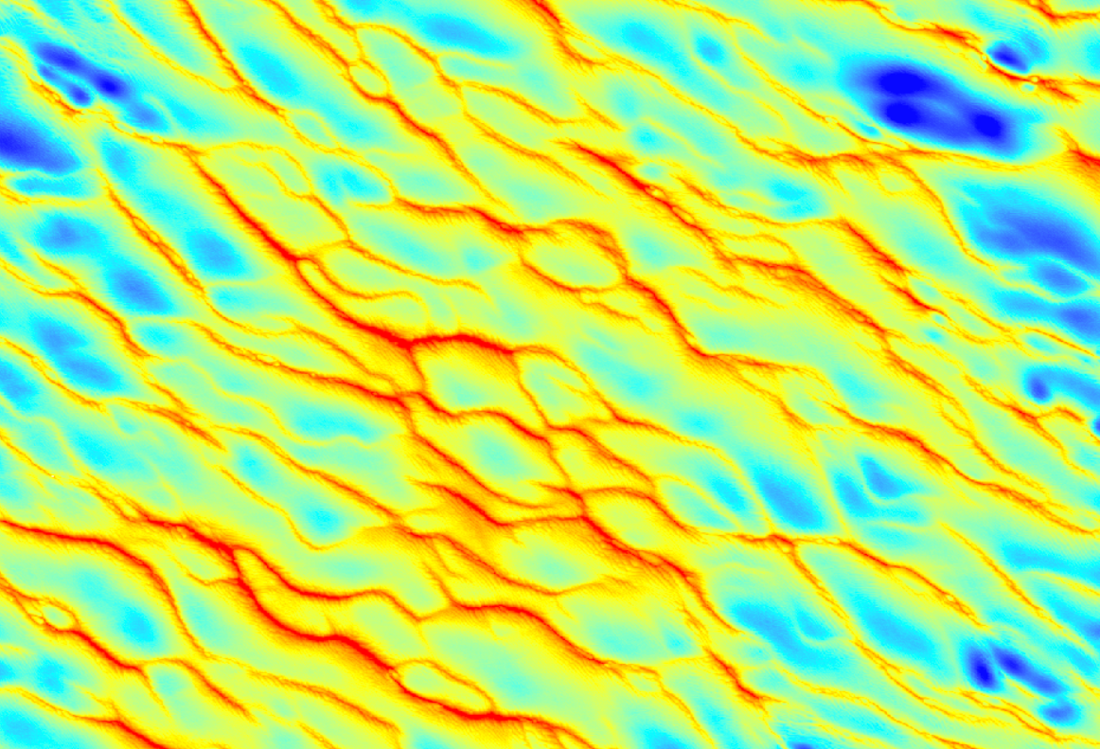
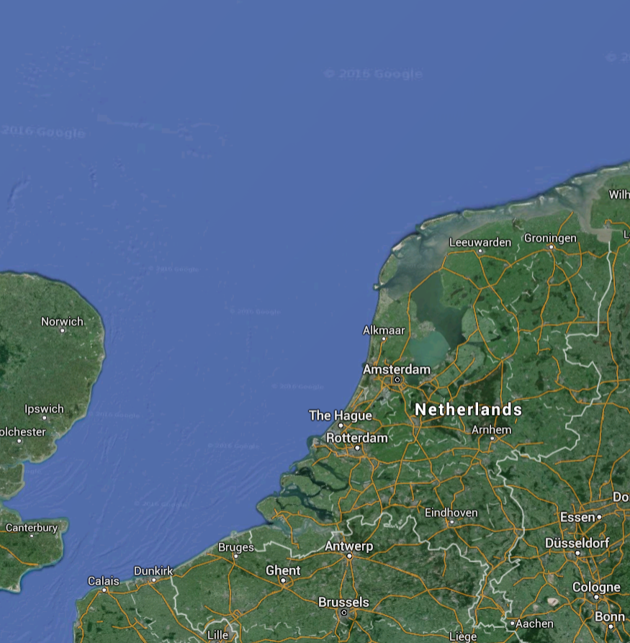
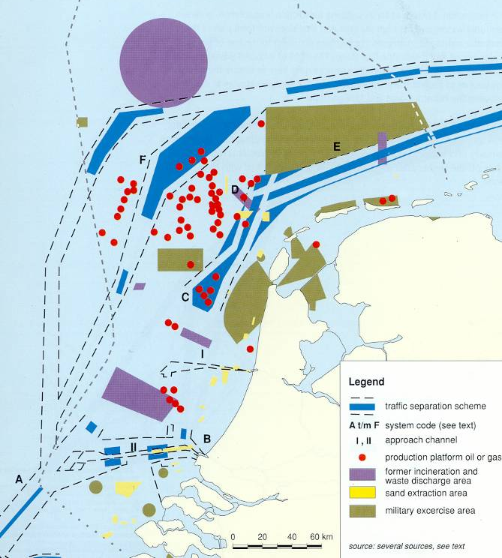
Tidal Sand Waves
Tidal Sand Waves
Can we predict sand save characteristics using process-based models?
300 m
So far sand wave models are mainly used qualitatively to explain processes
Notes:
Bahia Blanca Estuary, Argentina - A SAND WAVE FIELD IN THE ENTRANCE TO BAHIA BLANCA ESTUARY, ARGENTINA - SALVADOR ALIOTTA and GERARDO M.E. PERILLO (1987)
Adolphus channel, northeastern Australia - Harris, P. T. (1989). Sandwave movement under tidal and wind-driven currents in a shallow marine environment: Adolphus channel, northeastern australia. Continental Shelf Research, 9(11):981{1002.
Eastern Long Island Sound, USA - Fenster, M. S., Fitzgerald, D. M., Bohlen, W. F., Lewis, R. S., and Baldwin, C. T. (1990). Stability of giant sand waves in eastern long island sound, usa. Marine Geology, 91(3):207{225.
North Sea, Europe - Terwindt, J. H. J. (1971). Sand waves in the southern bight of the north sea. Marine Geology, 10(1):51{67.
San Francisco Bay, USA - Barnard, P. L., Hanes, D. M., Rubin, D. M., and Kvitek, R. G. (2006). Giant sand waves at the mouth of san francisco bay. Eos, Transactions American Geophysical Union, 87(29):285{289.
Bisanseto Sea, Japan - Katoh, K., Kume, H., Kuroki, K., and Hasegawa, J. (1998). The development of sand waves and the maintenance of navigation channels in the bisanseto sea. Coastal Engineering Proceedings, 1(26).
South China Sea - Numerical research on evolvement of submarine sand waves in the Northern South China Sea, Zhou, Q., Hu, G., Sun, Y. et al. Front. Earth Sci. (2017) 11: 35. https://doi.org/10.1007/s11707-016-0571-6
Note: this is not a complete list, but just some examples.

Slide 3
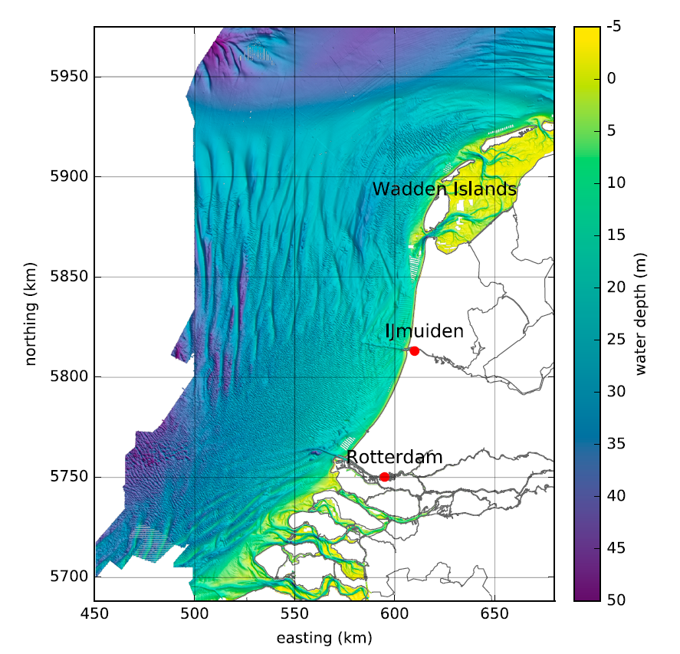
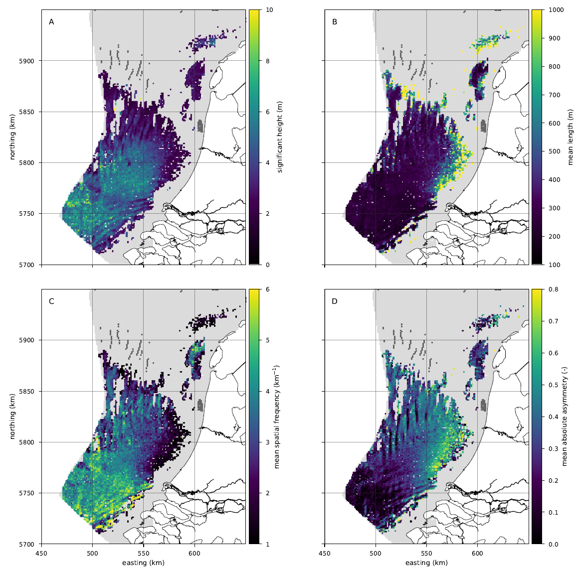
Sand waves in Netherlands continental Shelf
Sands wave Height
Wavelength
Damen et al., (2018) determined sand wave characteristics based on bathymetric data of the Netherlands Continental Shelf
Netherlands Continental Shelf
Figures from Damen et al., (2018) https://doi.org/10.1002/2017JF004322

Slide 4
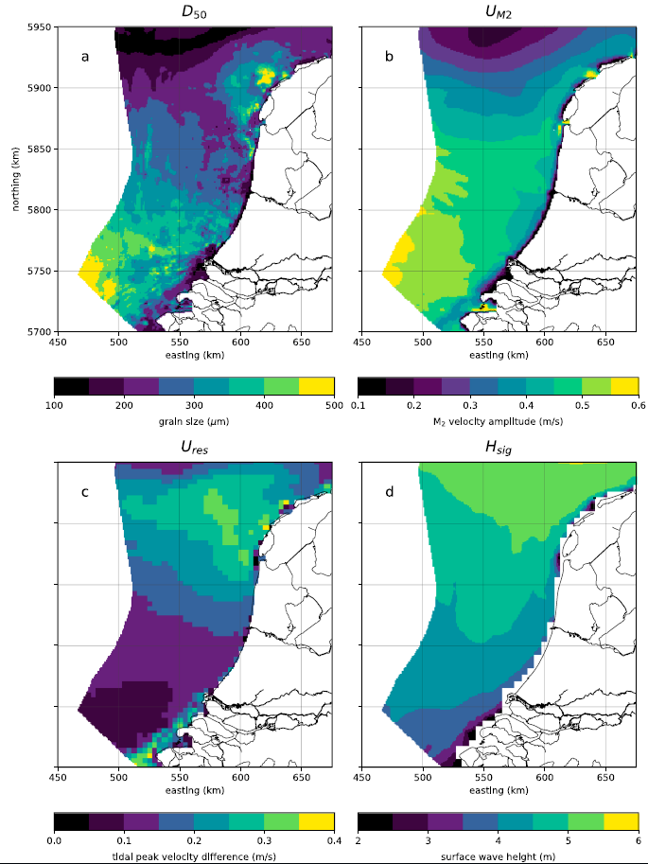
Environmental conditions
Damen et al., (2018) determined correlations between environmental conditions and sand wave characteristics
Sediment
grain size
Tidal velocity
In this presentation we use these environmental conditions as model input and compare observed and modeled sand waves
Residual tidal
velocity
Wave height
Figure from Damen et al., (2018)
https://doi.org/10.1002/2017JF004322

Slide 5
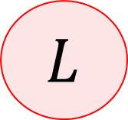
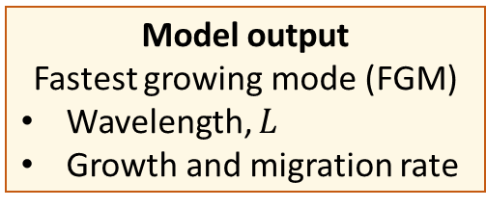
Sand wave models: linear and nonlinear
Model input
Water depth, Tidal components, Waves
Linear stability analysis
Initial morphodynamic response to a infinitesimal perturbation in the bed
Campmans et al., (2017)
https://doi.org/10.1016/j.csr.2017.02.002
Nonlinear model
Nonlinear morphodynamic evolution towards equilibrium state
Campmans et al., (2018)
https://doi.org/10.1029/2018JF004616
$$L$$
Model output
Fastest growing mode (FGM)
Wavelength, $L$
Growth and migration rate
Model output
Morphodynamic evolution
Equilibrium Height, Migration rate and Shape

Slide 6
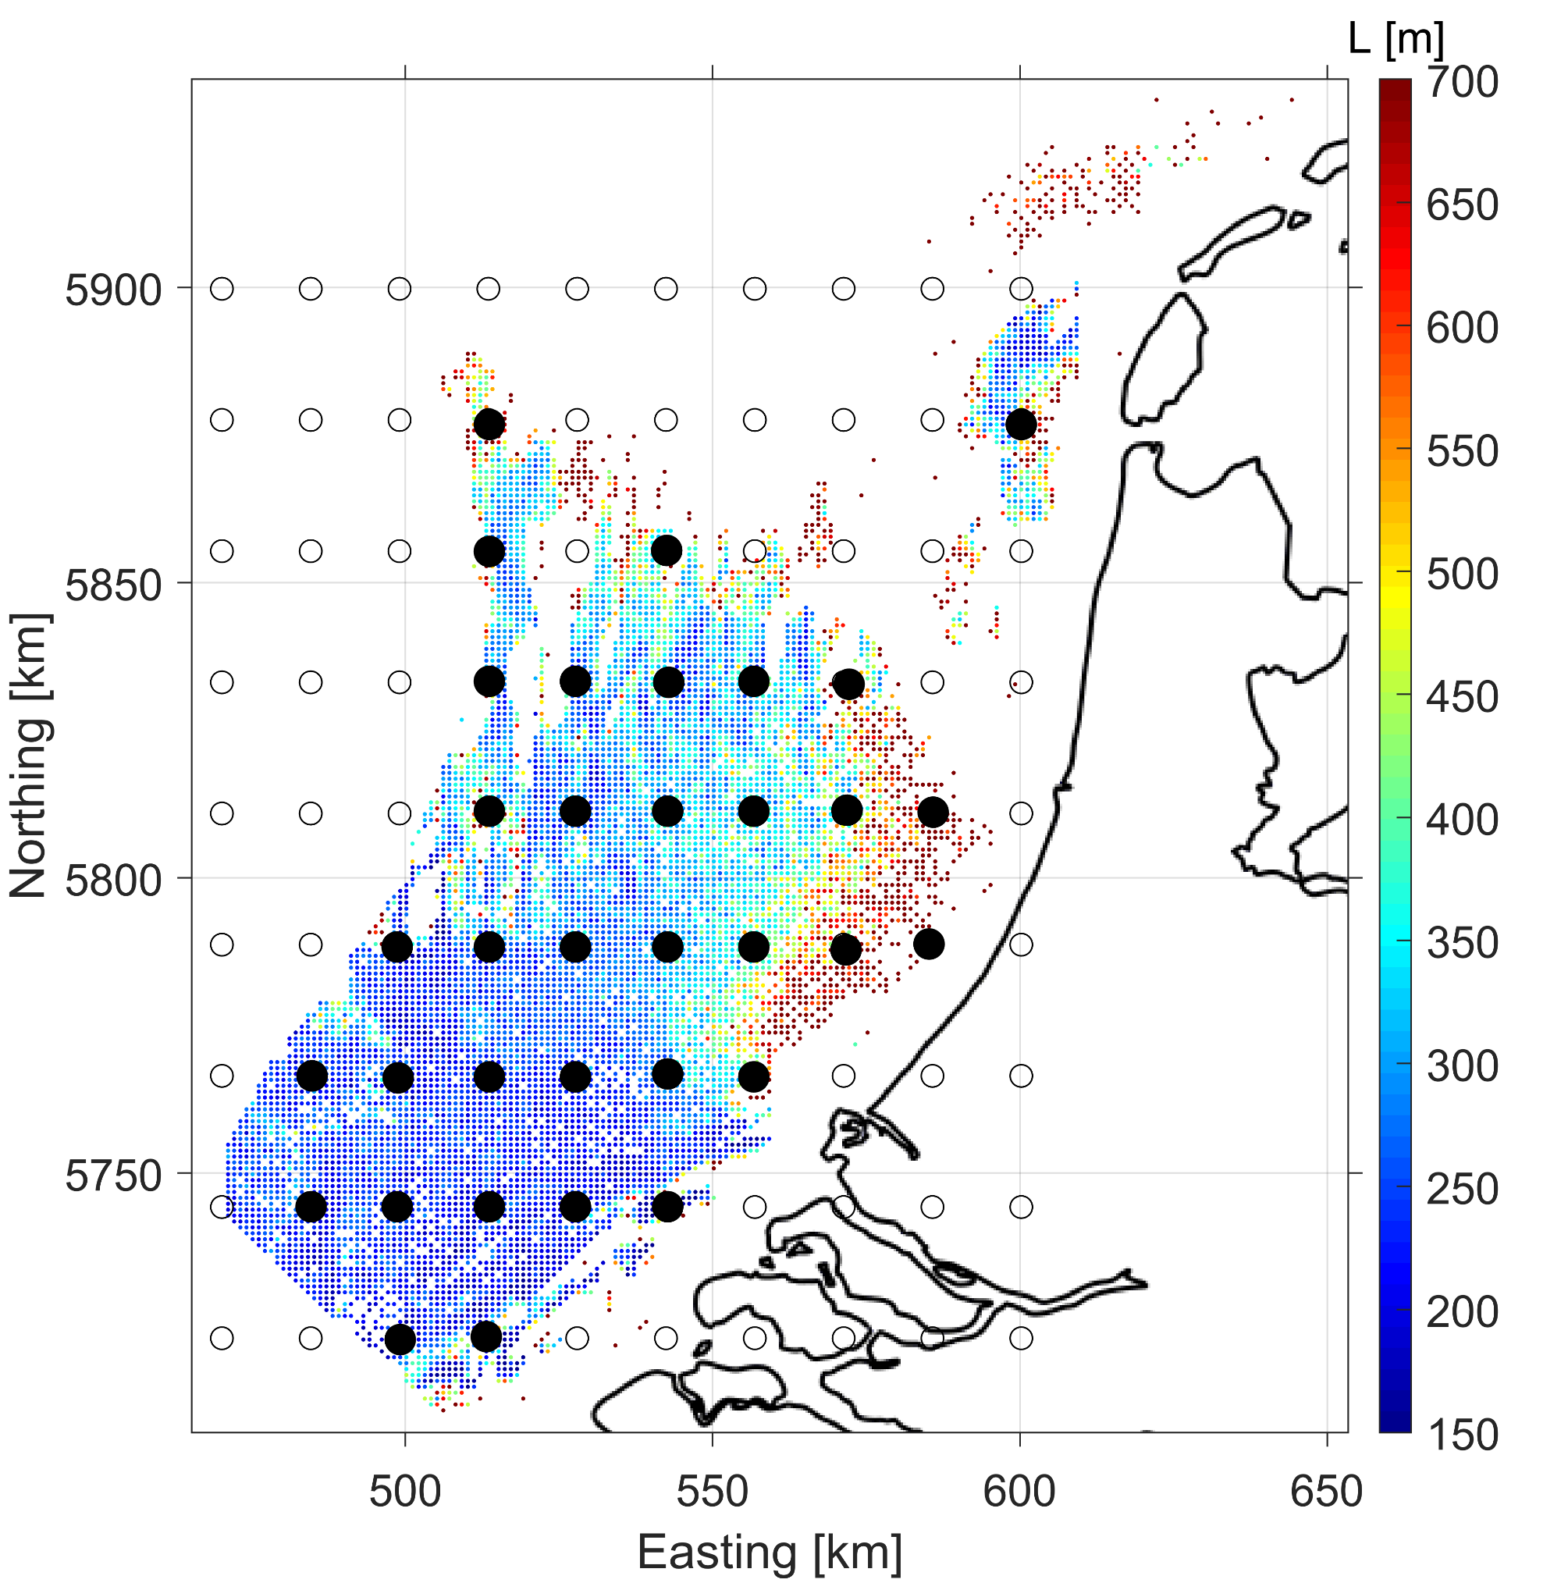
Comparison locations

Slide 7
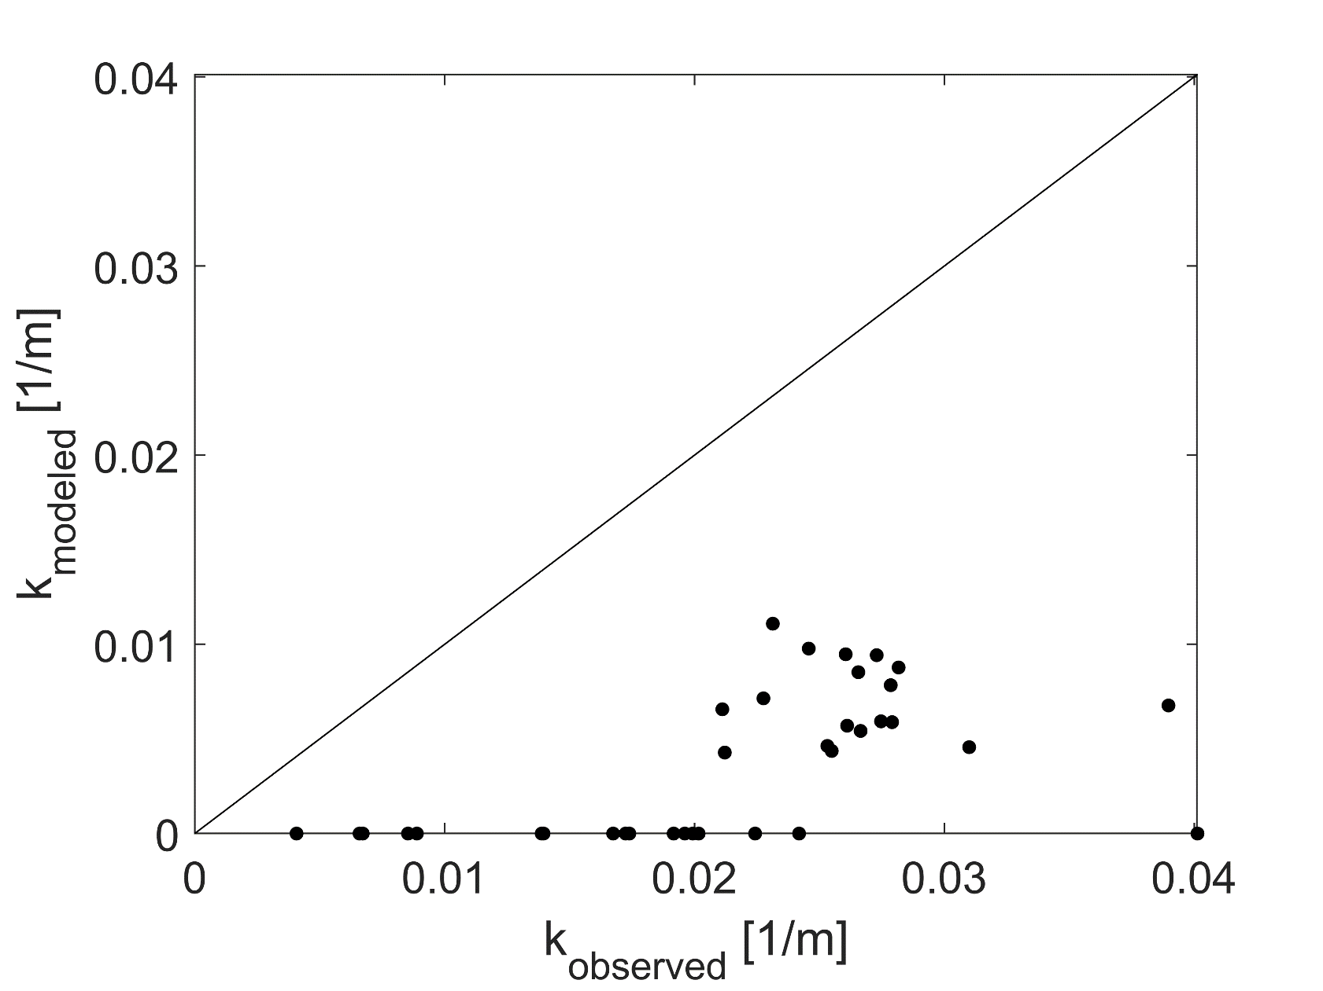

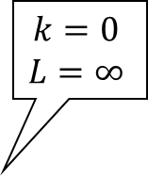
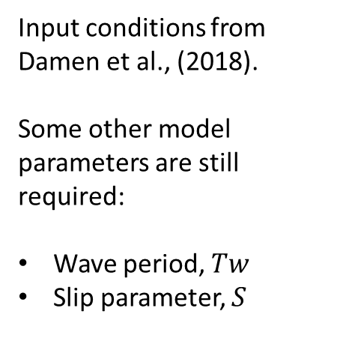
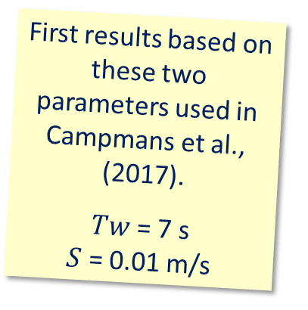
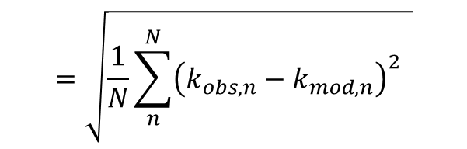
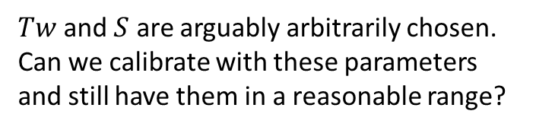
Linear stability model
Input conditions from Damen et al., (2018).
Some other model parameters are still required:
Wave period, $Tw$
Slip parameter, $S$
$$k=0$$
$$L=∞$$
First results based on these two parameters used in Campmans et al., (2017).
$Tw$ = 7 s
$S$ = 0.01 m/s
$$=\sqrt{\frac{1}{N}\sum_{n}^{N}{{\left(k_{obs,n}−k_{mod,n}\right)}^{2}} }$$
Error
$Tw$ and $S$ are arguably arbitrarily chosen.
Can we calibrate with these parameters and still have them in a reasonable range?

Slide 8
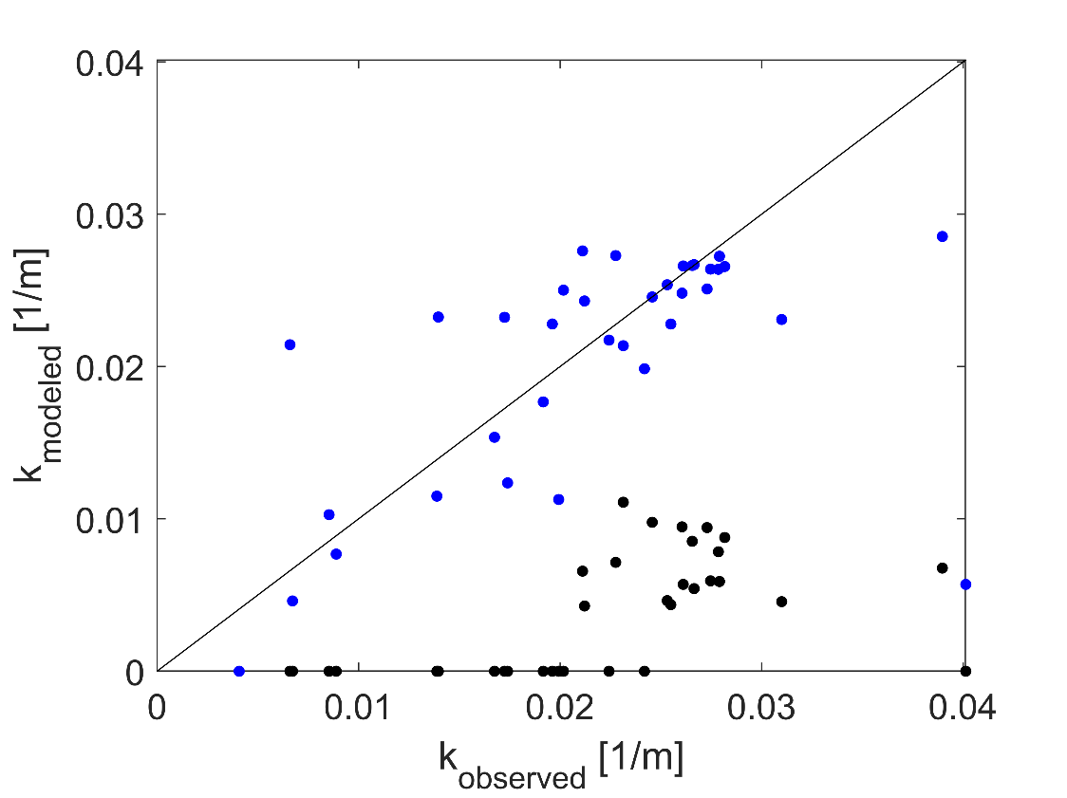
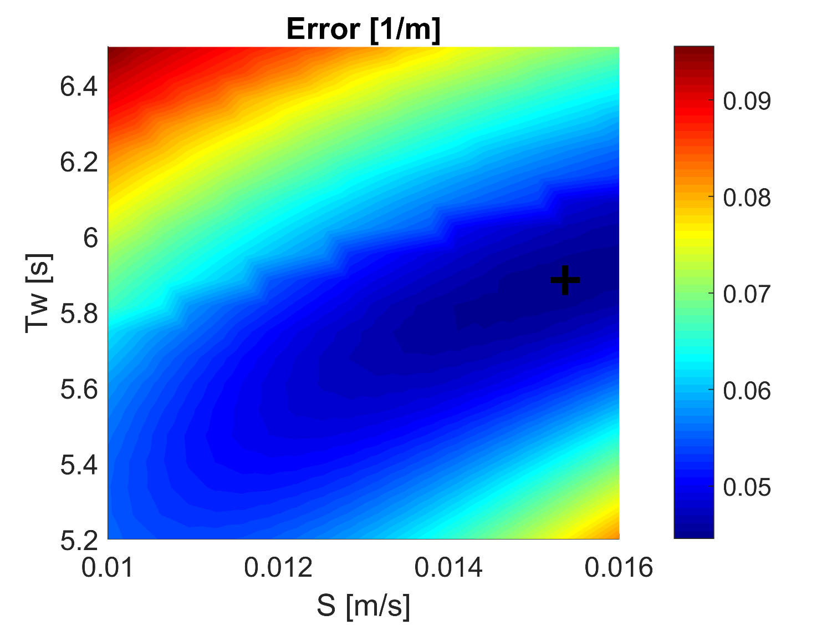

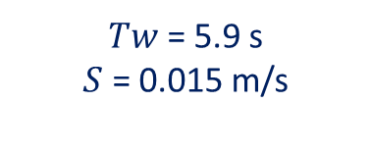
Calibrate for Tw and S
$Tw$ = 5.9 s
$S$ = 0.015 m/s
A local minimum in the error is obtained for
$Tw$ = 5.9 s
$S$ = 0.015 m/s

Slide 9
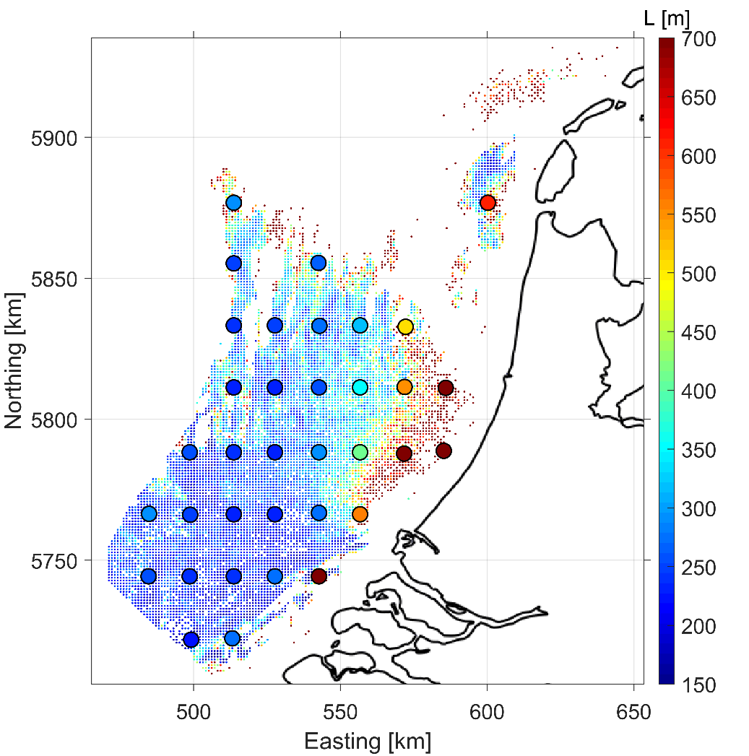
Calibrate for Tw and S
$Tw$ = 5.9 s
$S$ = 0.015 m/s
Calibration locations
Validation locations

Slide 10
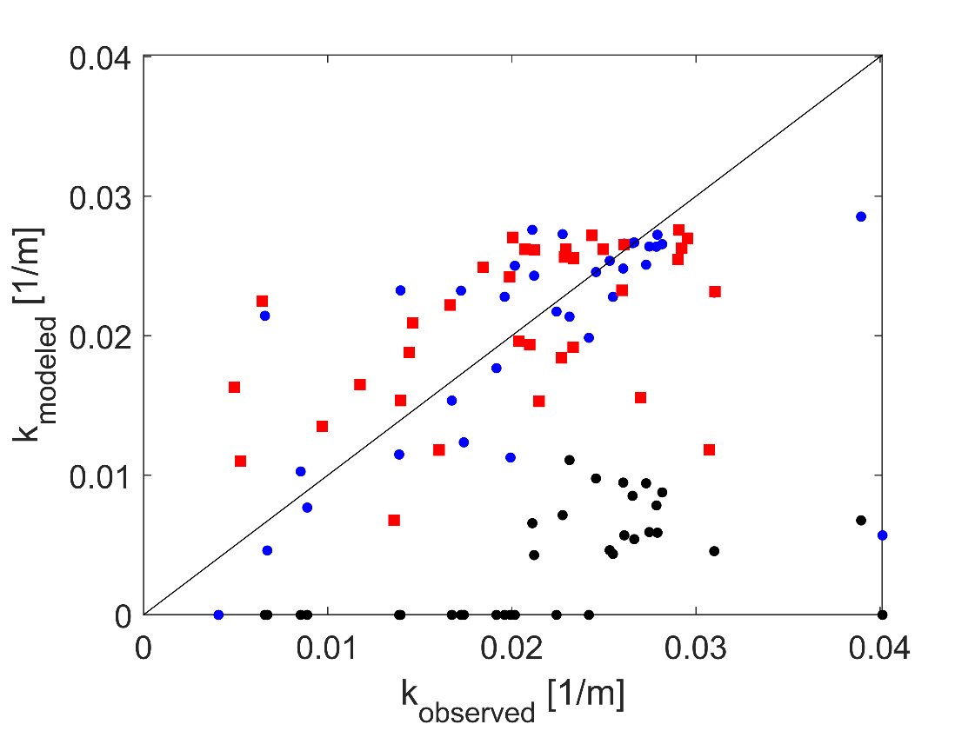
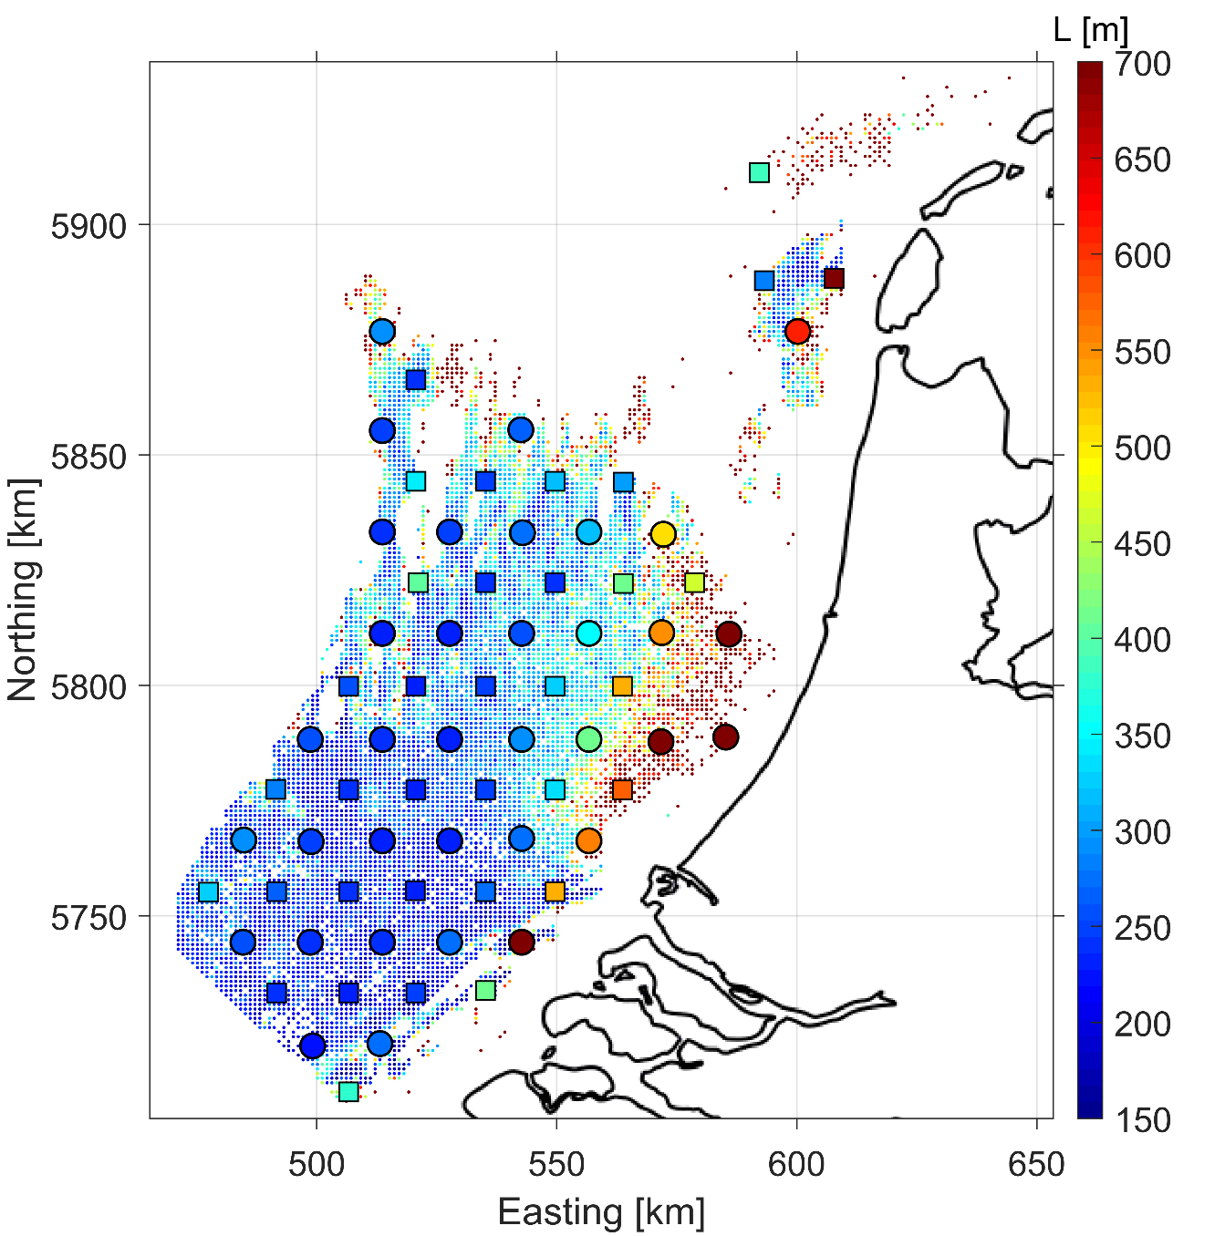
Calibrate and validate for Tw and S
$Tw$ = 5.9 s
$S$ = 0.015 m/s
Calibration locations
Validation locations

Slide 11
Nonlinear model
$Tw$ = 5.9 s
$S$ = 0.015 m/s
The linear stability model was used to calibrate and then validate the wavelength of modeled sand waves.
The nonlinear model is too slow to do such optimization for sand wave height in reasonable time.
But it is fast enough to compare observed and modeled sand wave heights for the obtained parameters, Tw and S.
Calibration locations
Validation locations

Slide 12
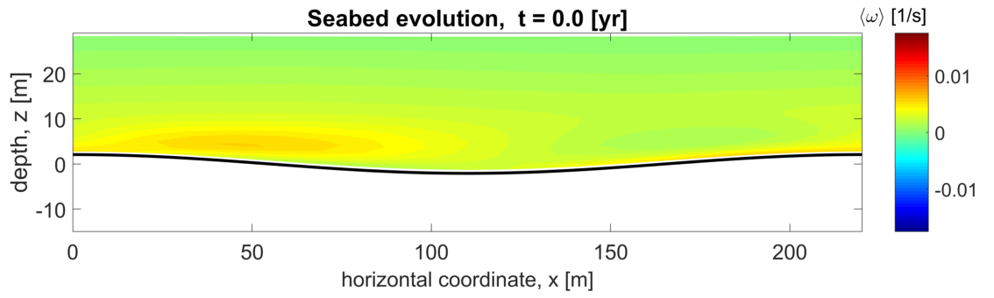
Nonlinear model

Slide 13
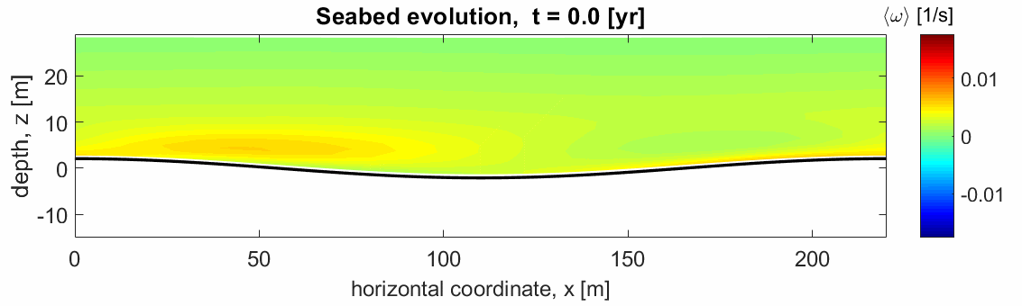
Nonlinear model

Slide 14
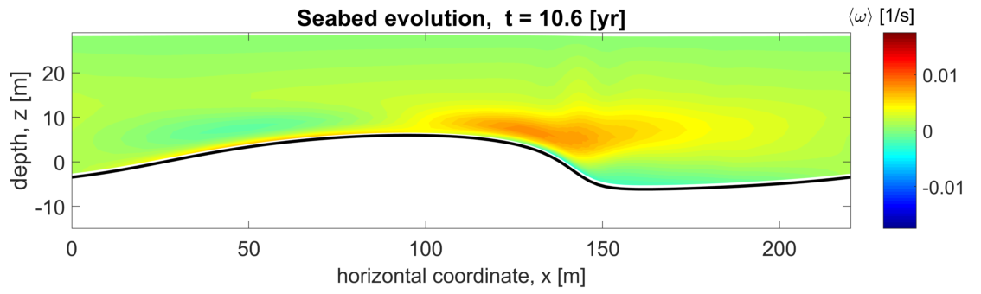
Nonlinear model

Slide 15
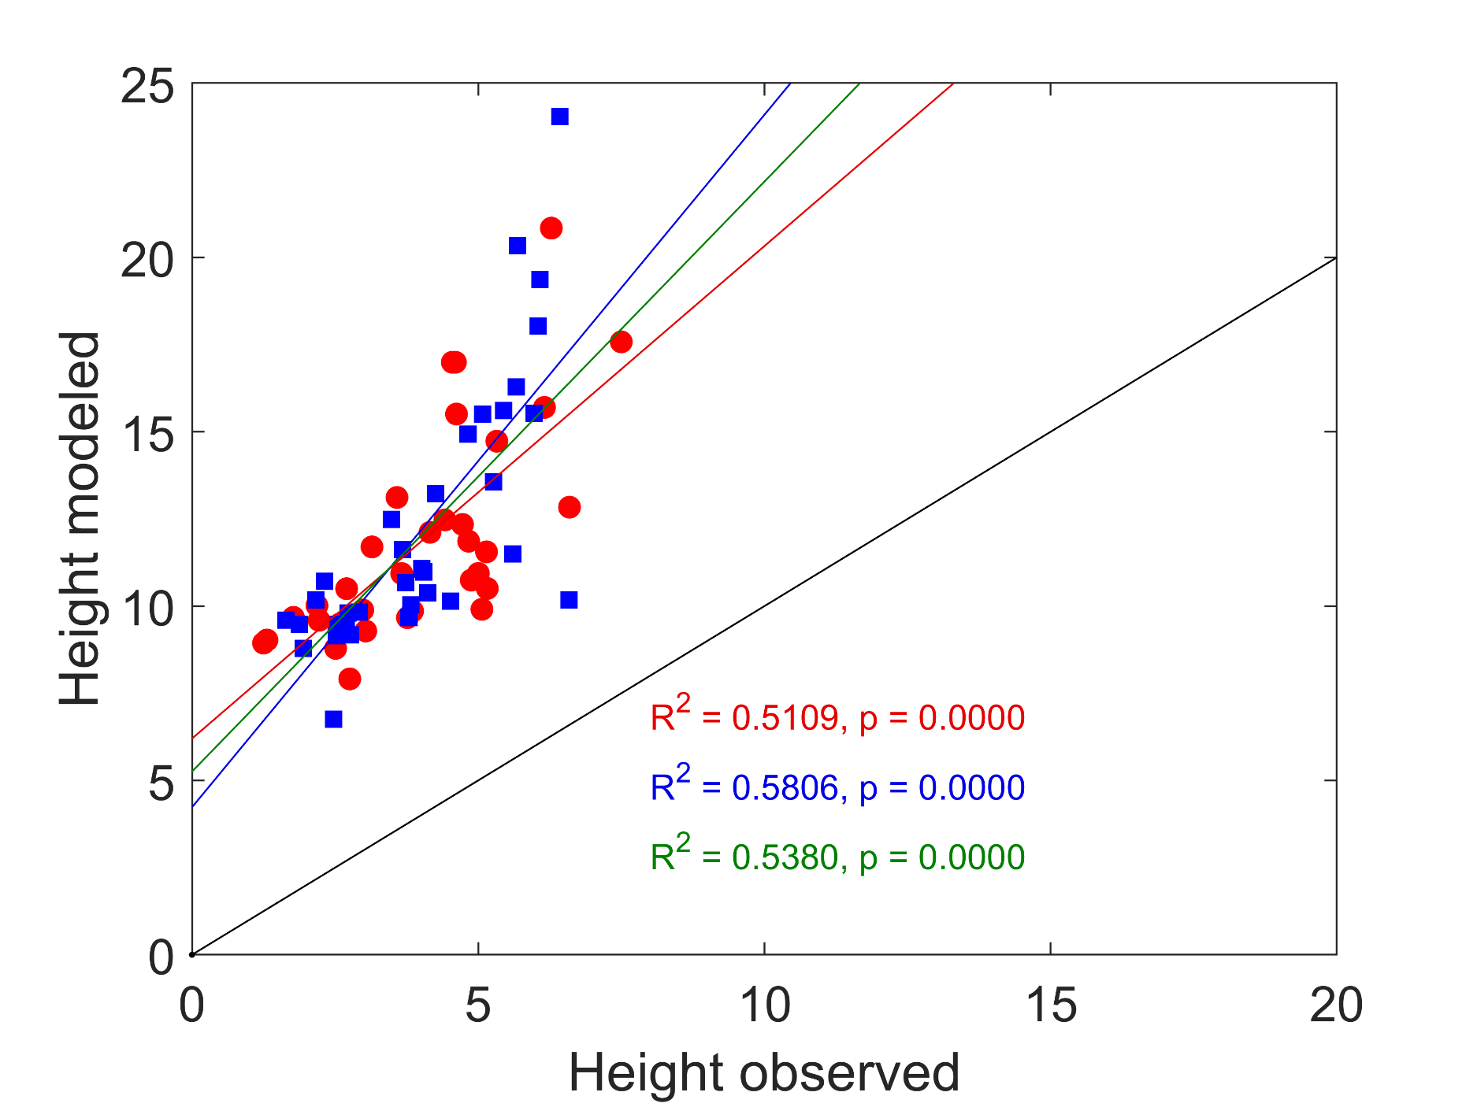
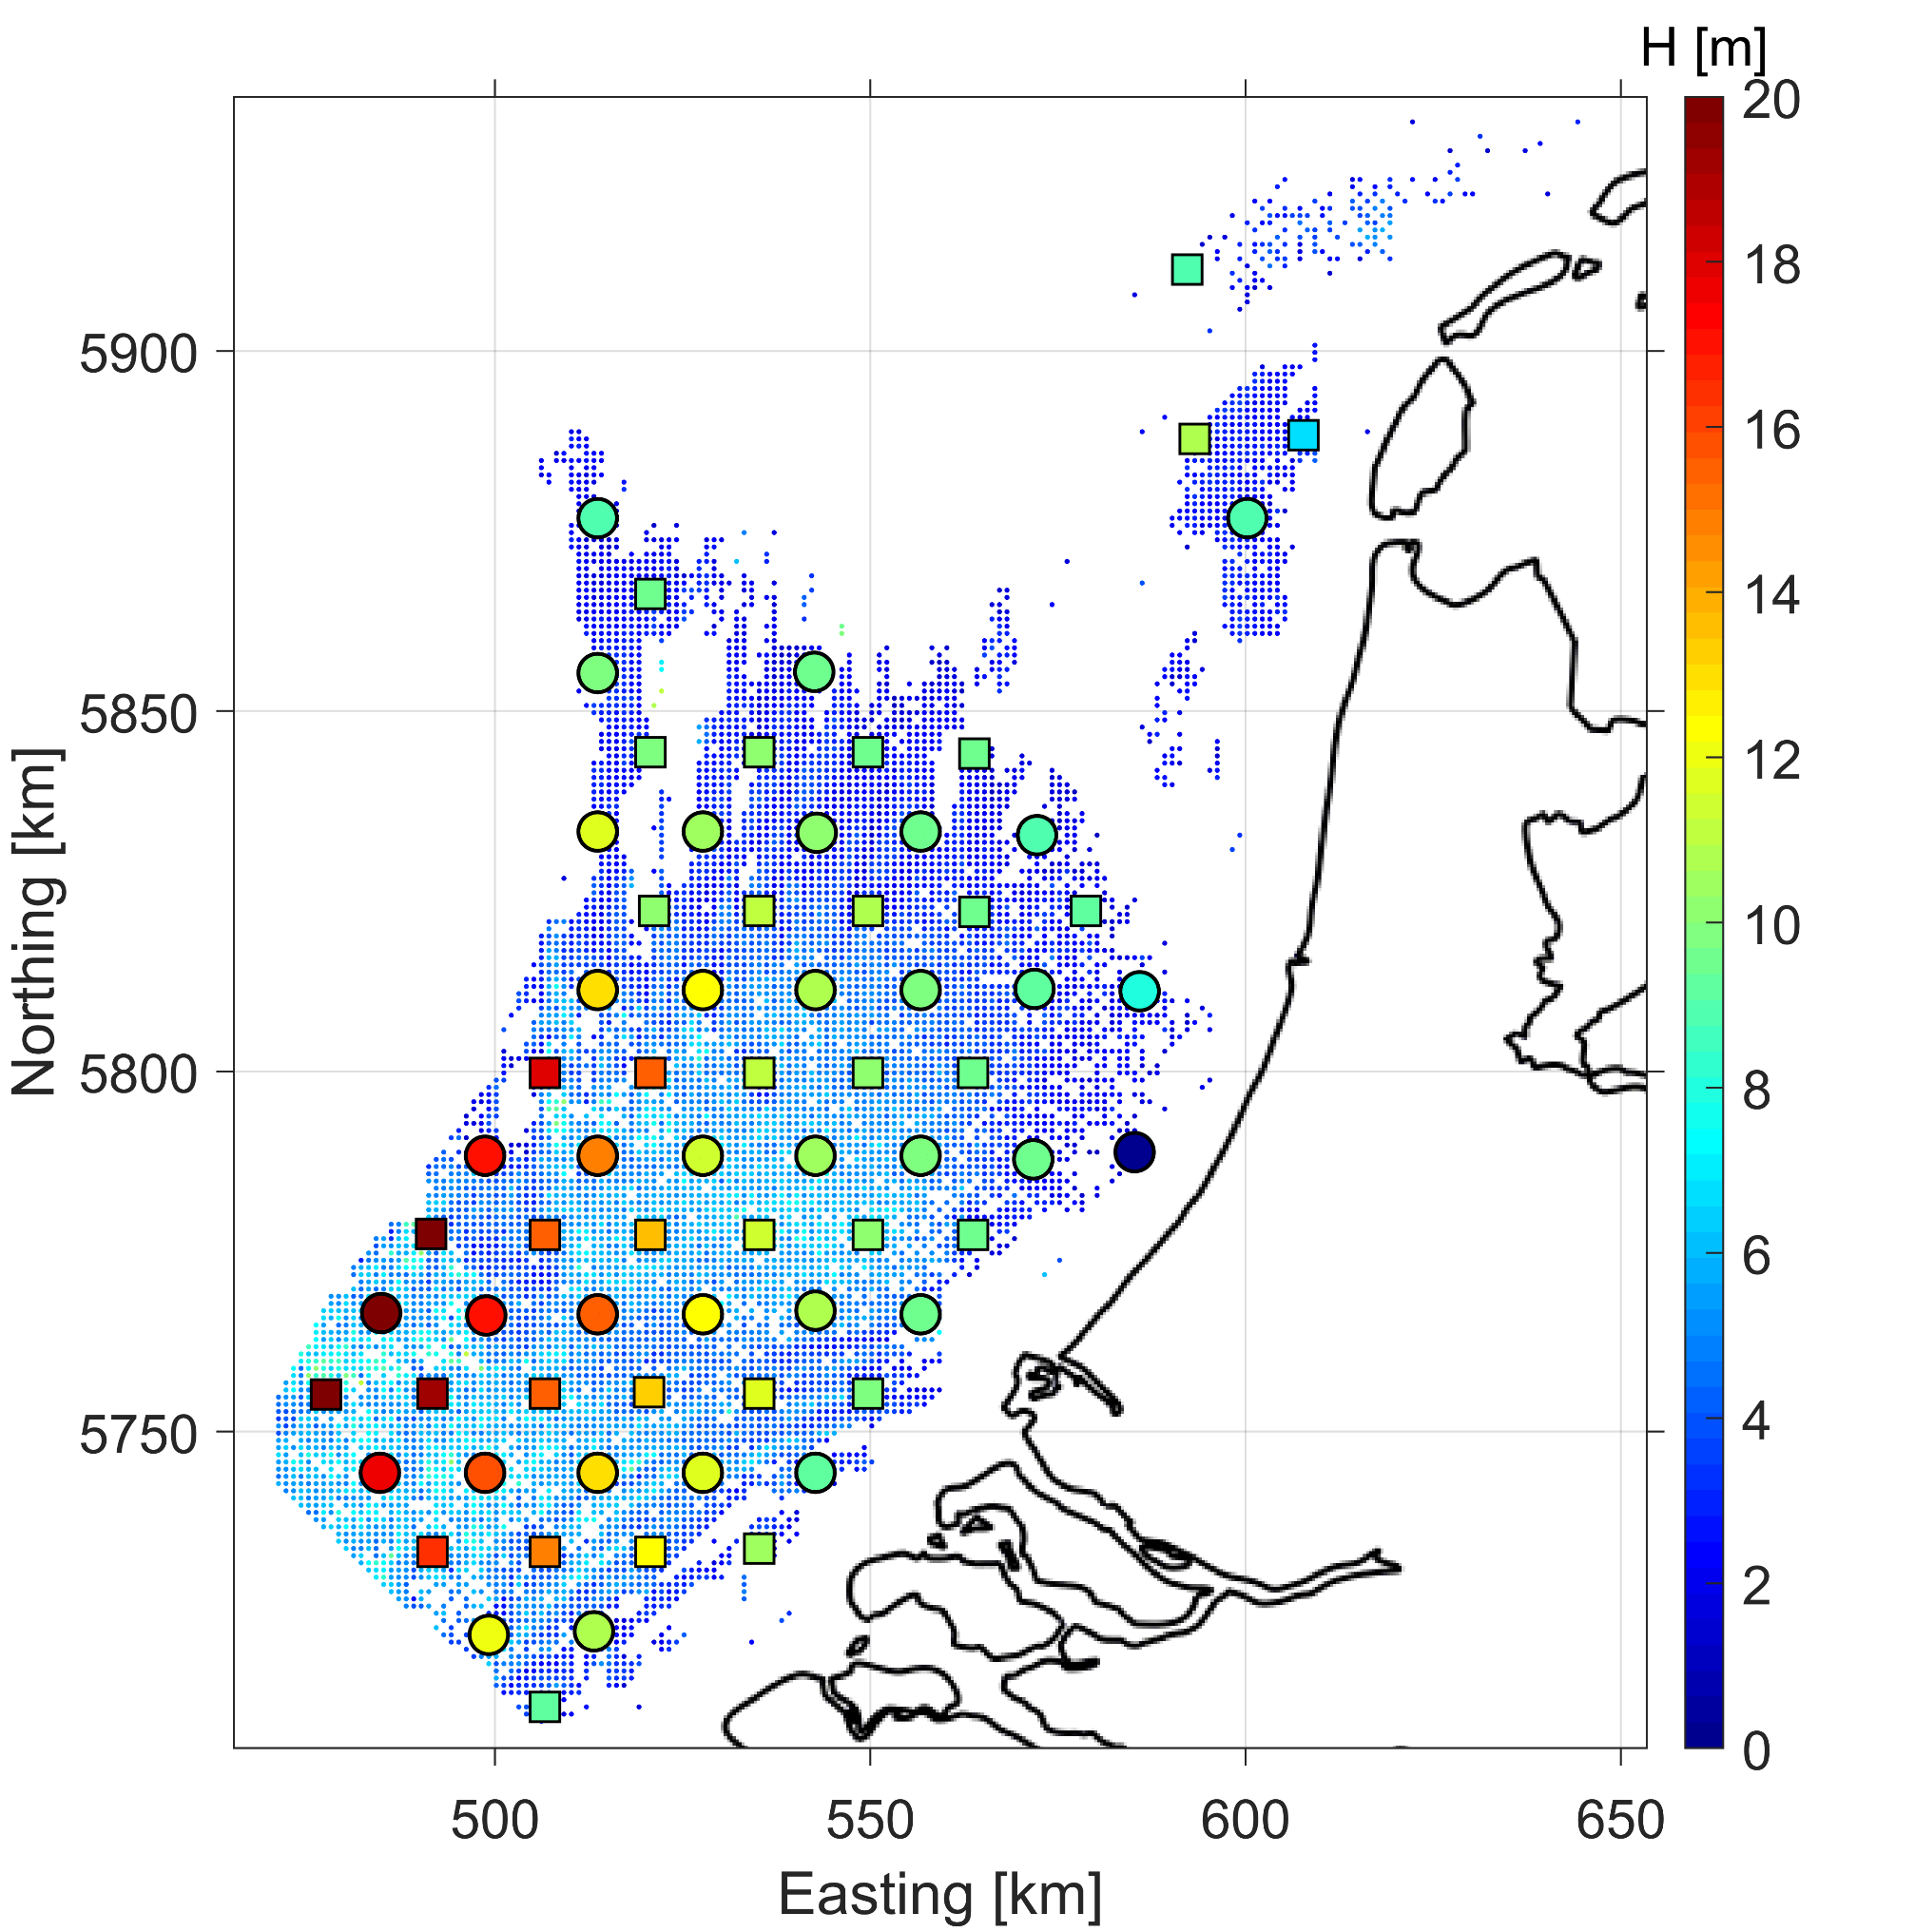
Nonlinear model
$Tw$ = 5.9 s
$S$ = 0.015 m/s
Can we correct model predictions using the correlation of the calibration set only?
Qualitatively okay
Quanitatively poor
Calibration locations
Validation locations

Slide 16
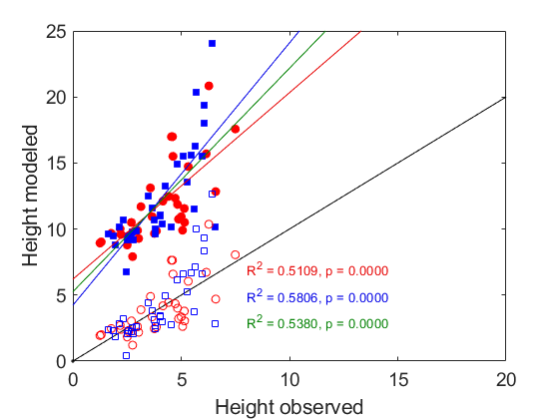
Nonlinear model
$Tw$ = 5.9 s
$S$ = 0.015 m/s
Can we correct model predictions using the correlation of the calibration set only?
Qualitatively okay
Quanitatively poor
Calibration locations
Validation locations

Slide 17
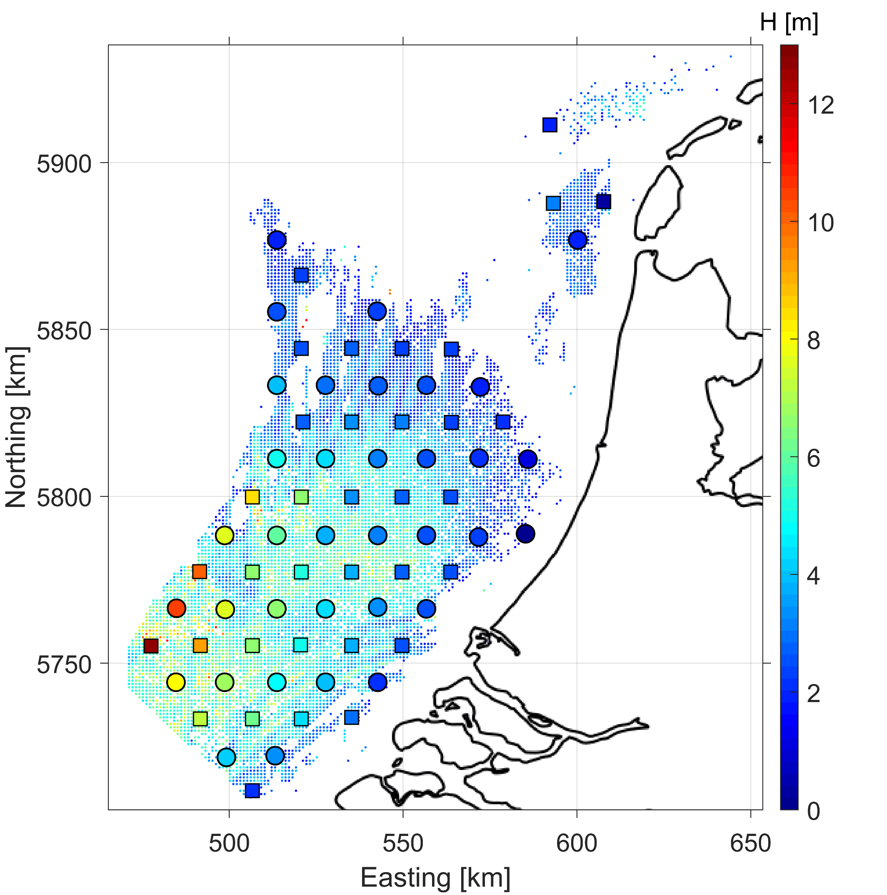
Nonlinear model
$Tw$ = 5.9 s
$S$ = 0.015 m/s
Corrected Height predictions
Can we correct model predictions using the correlation of the calibration locations only?
Qualitatively okay
Quanitatively poor
Calibration locations
Validation locations

Slide 18

Conclusions
Direct comparison between process-based models and observation are not straightforward.
Sand wave length and height are qualitatively modeled correctly.
Calibration and correction steps can be used to obtain reasonable quantitative estimates.
g.h.p.campmans@utwente.nl

