Slide 1
Lagged ensemble vs burst sampling strategies for sub-seasonal prediction
Frederic Vitart
ECMWF

Slide 2
S2S Database models
2 different strategies for S2S initialization:
Some S2S models are run infrequently (once or twice a week) but with a large ensemble size (e.g. ECMWF, BoM). All the ensemble members are produced from the same start dates: this is referred to as Burst sampling
Other S2s models (e.g. UKMO, CMA) are run more frequently (at least once a day) but with a small ensemble size (e.g. 4 members). Since the ensemble size is low, ensemble forecasts are produced by combining the latest forecast with forecasts produced over several past days: this is referred to as a lagged ensemble.
 | Time-range | Resol. | Ens. Size | Freq. | Hcsts | Hcst length | Hcst Freq | Hcst Size
ECMWF | D 0-46 | Tco639/319L91 | 51 | 2/week | On the fly | Past 20y | 2/weekly | 11
UKMO | D 0-60 | N216L85 | 4 | daily | On the fly | 1993-2015 | 4/month | 7
NCEP | D 0-44 | N126L64 | 4 | 4/daily | Fix | 1999-2010 | 4/daily | 1
ECCC | D 0-32 | 0.6x0.6L40 | 21 | weekly | On the fly | 1995-2014 | weekly | 4
BoM | D 0-60 | T47L17 | 33 | weekly | Fix | 1981-2013 | 6/month | 33
JMA | D 0-33 | Tl479/Tl319L100 | 50 | weekly | Fix | 1981-2010 | 3/month | 5
KMA | D 0-60 | N216L85 | 4 | daily | On the fly | 1996-2009 | 4/month | 3
CMA | D 0-45 | T106L40 | 4 | daily | Fix | 1886-2014 | daily | 4
CNRM | D 0-32 | T255L91 | 51 | Weekly | Fix | 1993-2014 | 2/monthly | 15
CNR-ISAC | D 0-32 | 0.75x0.56 L54 | 40 | weekly | Fix | 1981-2010 | 6/month | 5
HMCR | D 0-63 | 1.1x1.4 L28 | 20 | weekly | On the fly | 1981-2010 | weekly | 10
Notes:
Slide 34: Main characteristics of the S2S database models

Slide 3
Advantages of burst sampling:
For the same ensemble size (after lagging when applied), it should be more accurate and skilful than a lagged ensemble on the burst start dates (e.g. Mondays or Thursdays for ECMWF) since the burst ensemble start dates are more recent than in a lagged ensemble.
The forecast calibration and product generation is much simpler with burst sampling since all the ensemble members have the same lead-time.
Advantages of lagged ensemble sampling:
A lagged ensemble is likely to provide more skilful forecasts the other days of the week (more frequent update).
The day to day evolution of the forecast products is also likely to be smoother, with less chance of flip-flop behaviour.
Lagged ensemble vs Burst sampling

Slide 4
The ECMWF extended-range forecasts
A 51-member ensemble is integrated for 46 days twice a week (Mondays and Thursdays at 00Z)
Atmospheric component: IFS with the latest operational cycle and with a TCo639L91 resolution up to day 15 and TCo319L91 after day 15.
Ocean-atmosphere coupling from day 0 to NEMO (about 1/4 degree) every hour.
Initial conditions:
Atmosphere: Operational 4-D var analysis + SVs+ EDA perturbations
Ocean: 3D-Var analysis (NEMOVAR) + wind stress perturbations
Notes:
Slide 8: Description of the ensemble forecasting system. Twice a week, the coupled model is integrated forward to make a 46 day forecast with 51 different initial conditions, in order to create a 51-member ensemble.

Slide 5
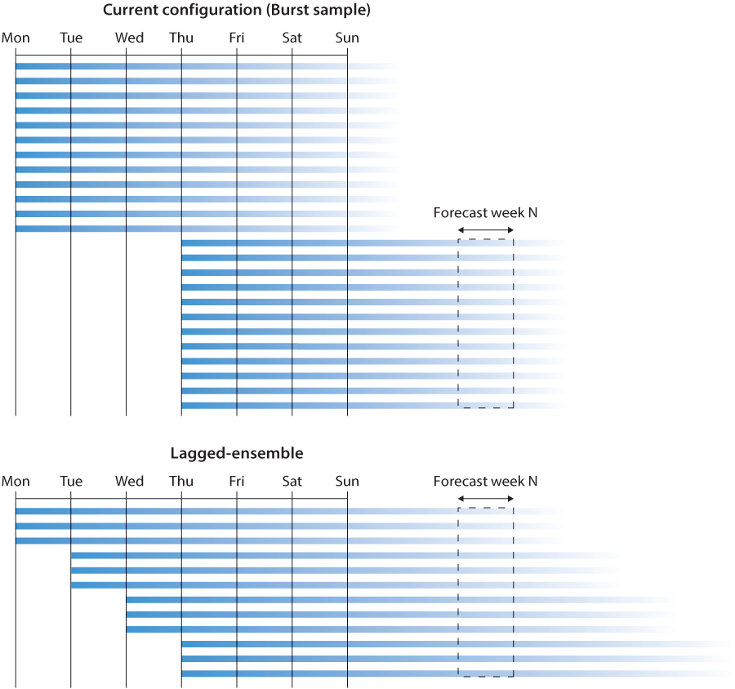
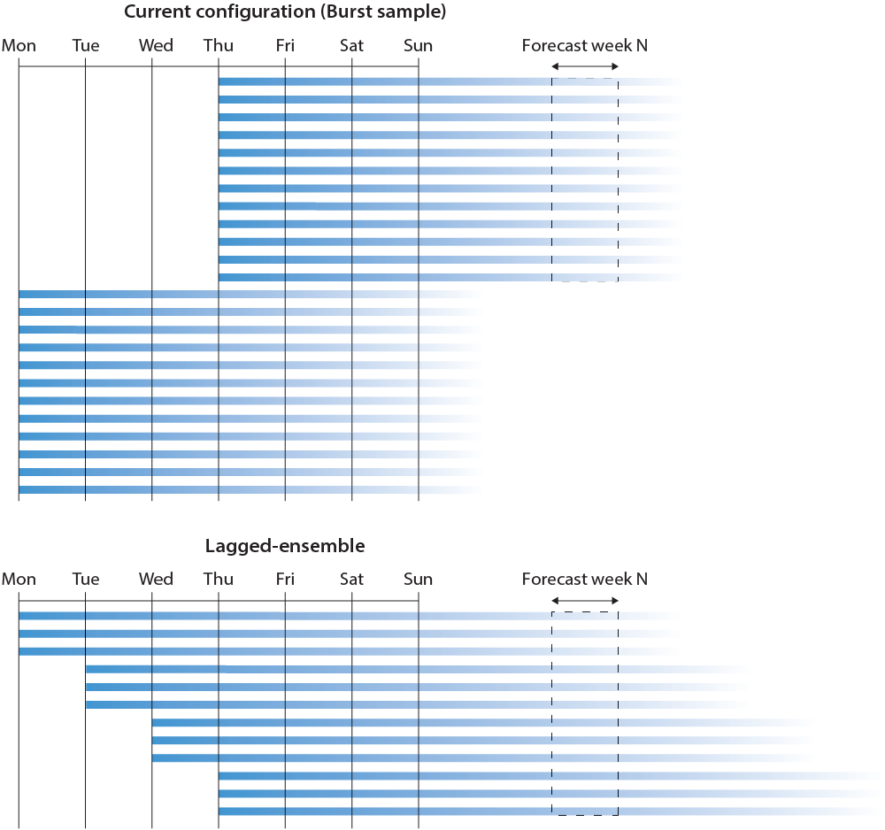
ECMWF Extended-Range Forecasts
A lagged ensemble has 2 attributes:
Ensemble size per day: Ne
Number of forecast days combined: Nd
Increasing Nd increases the ensemble size (positive impact on probabilistic skill scores) but includes additional “old” forecasts (negative impact on probabilistic skill scores). So for a given value of Ne, there should be an optimal value of Nd.
51m
Main question to be addressed:
What is the minimum value of Ne so that there is a lagged ensemble forecast (Nd forecast dates combined) which is at least as skilful as the current system on Mondays and Thursdays?
Ne
Nd

Slide 6
Experimentation
Burst sample:
15-member ensemble of 32-day runs starting on 1st Feb/1st May/1st August/1st Nov 1989-2016
Resolution: Tco319 (about 36km) with 91 vertical levels
Model version: Cycle 45R1 (operational in 2017/2018)
Lagged ensemble:
Additional runs starting 1, 2, 3, 4 days before
1st Feb 1989
D 5-11
Burst
Lag 2
31 Jan 1989
D 6-12
Lag 3
30 Jan 1989
D 7-13
Lag 4
29 Jan 1989
D 8-14
Lag 5
28 Jan 1989
D 9-15

Slide 7
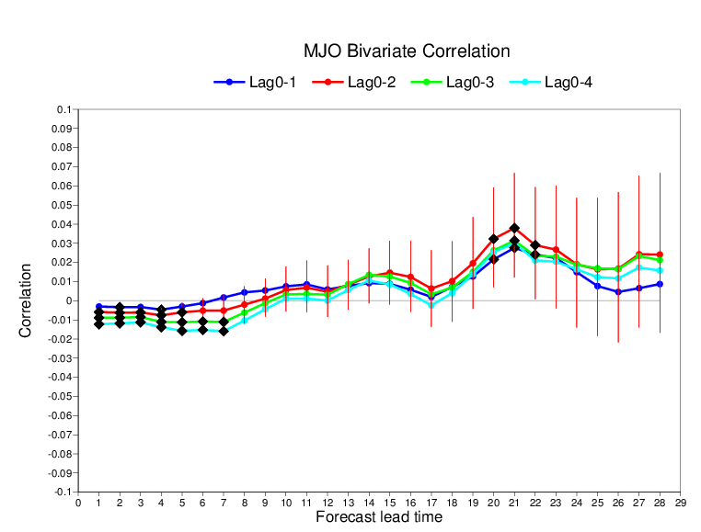
Lag (15xd) – Burst (15 m)
Madden Julian Oscillation
This plot shows the difference of MJO bivariate correlation between different lagged ensemble configurations (from 2 to 5-days window) and the 15-member burst sample as a function of the forecast lead time (up to 29 days). Negative (positive) values indicate that the burst sample outperforms (underperforms) the lagged ensembles. Vertical bars indicate the 95% confidence level. Black diamonds indicate statistically significant differences.
This plot indicates that the burst sample is generally more skilful than the lagged ensembles up to about day 10, even if its ensemble size (15) is much lower than the ensemble size of the lagged ensembles (up to 75 members). After day 10, the lagged ensembles produce more skilful MJO forecasts with a 3-day lagged ensemble being the optimal configuration.
Lagged (15m each day ) – Burst (15 m)
30m
45m
60m
75m

Slide 8
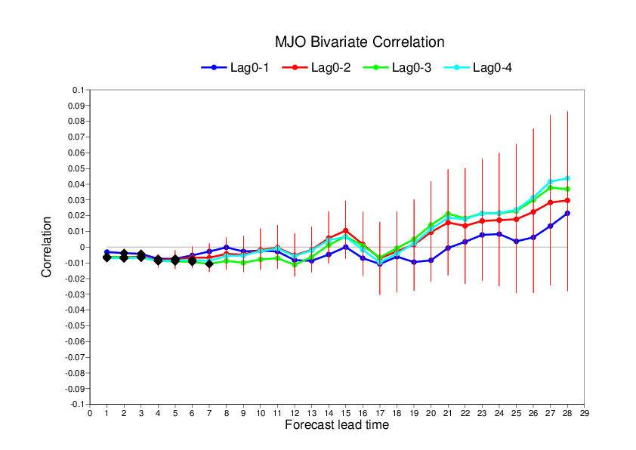
Lag (5m each day ) – Burst (15 m)
Madden Julian Oscillation
Lagged (5m each day ) – Burst (15 m)
Same plot as in the previous slide, but this time the lagged ensemble is produced using 5-members per day instead of 15 members so that we are comparing two configurations with comparable cost (is it better to run 5 members every day or 15 members twice a week?)
This plot indicates that up to about day 15, the burst sample is generally more skilful than the lagged ensembles, After day 20, the lagged ensembles produce more skilful MJO forecasts, although the difference is not statistically significant. The benefit of the lagged ensemble after day 20 could come from a larger ensemble spread than in the burst sample which is strongly under-dispersive.
10m
15m
20m
25m

Slide 9
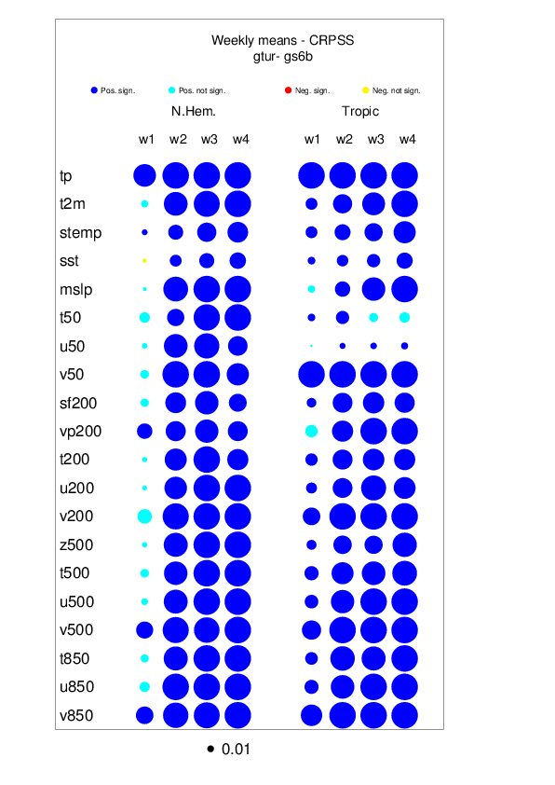
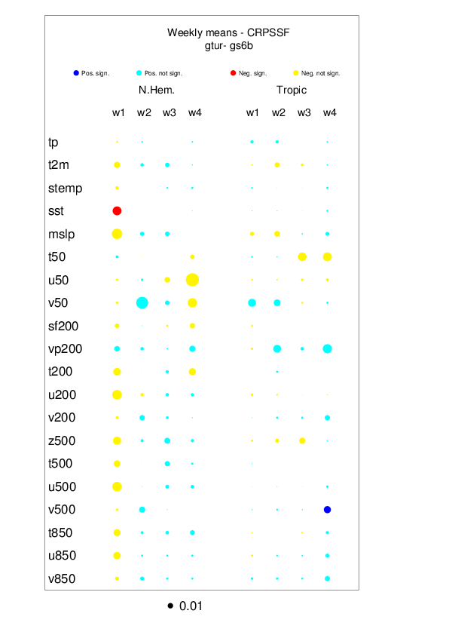
Scorecards
Difference of CRPSS scores between a 3-day lagged ensemble and the burst sample for forecast weeks 1 to 4 over the northern Extratropics (left side of each panel) and tropics (right side of each panel) for 20 variables (e.g. tp=total precipitation). The size of each circle is proportional to the difference. Blue (red) color indicates that the lagged ensemble outperforms (underperforms) the burst sample.
The left panel suggests that a lagged ensemble which is 3 times more expensive than the 15m burst sample is significantly more skilful than the burst sample, except for week 1 in the Northern Extratropics.
The right panel suggests that at same cost (15m burst vs 5m every day 3-day lagged ensemble), the forecast skill scores are not statistically different, except for a slight degradation in week1 over the northern Extratropics.
These results indicate that a lagged ensemble combining 5 members per day can be as skilful as a 15-member burst sample.
3d 15m lag (45m) vs 15m burst
3d 5m lag (15m) vs 15m burst

Slide 10
ECMWF operational forecasts (51m)
The conclusion of the previous slide (for the same computing cost a lagged ensemble can be as skilful as a burst sample for extended-range forecasts) may not apply to the current ECMWF operational configuration (51 members burst sample instead of 15 members in the experiments). This is because the impact of a lagged ensemble is:
Increase of forecast skill scores due to increased ensemble size
Decrease of forecast skill score due the deterioration of the initial conditions
2) Is independent of the burst ensemble size, but 1) is dependent on the burst sample size. The benefit of increased ensemble size is asymptotic, so doubling the size of a 15 member ensemble has a larger impact on the probabilistic skill scores than doubling a 51 member ensemble. Therefore outperforming a 51-member burst sample is likely to be much harder for a lagged ensemble than outperforming a 15 -member ensemble. There are 2 options:
Redo the experiment with 51 members
Use a formula to extrapolate the CRPSS of an ensemble of size m knowing the CRPSS obtained with 15 members.
In this study we use option 2, option 1 being too costly.2

Slide 11
Lagged ensemble vs 51m Burst sample
CPRS dependency on ensemble size
A formula to extrapolate CRPS of ensemble of size M from CRPS of ensemble of size m is:
Ferro et al., 2008
Lag ensemble defined with 2 attributes:
Ne: Ensemble size per day (Ne=1 to 51)
Nd: Number of lag days (Nd=2 to 5)
For each weekly mean, we can use the formula above to compute the 2-dimensional table:
T(Ne,Nd)=$\frac{1}{20}(\sum_{v=1}^{20}{CRPSS\left(Lag\left(Ne,Nd\right)\right)−\sum_{v=1}^{20}{CRPSS\left(Burst(51)\right)) }}$
Where v (1 to 20) represent 20 different variables (the same as in the scorecard): each column of the scorecard has been collapsed into a single number by averaging the values of the 20 different parameters.
A positive (negative) value of T (Ne,Nd) indicates that the lagged ensemble defined by Ne and nd outperforms (underperforms) the burst sample.

Slide 12
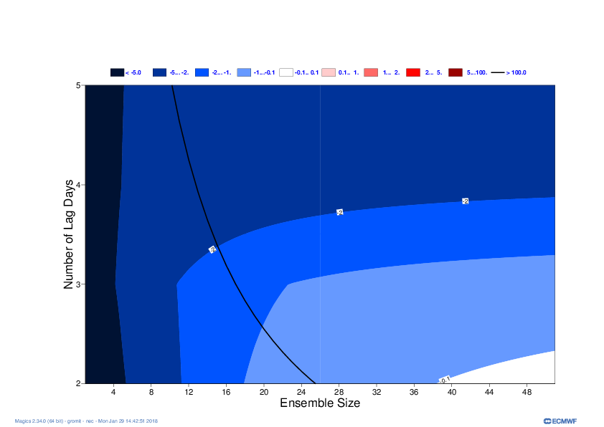
Impact of lag ensemble on CRPSS Northern Extratropics
Diff Lag ensemble – Burst (51m)
WEEK 1 (Day 5-11)
Cheaper
More expensive
At this time range (day 5-11) lagged ensembles with a window larger than 24h do not beat the 51 member burst sample, even if the lagged ensemble has an ensemble size 5 times larger than the burst sample.
However, at ECMWF, forecasts at this time range are already produced twice daily with 51 members. However, the forecasts beyond day 15 are produced only twice a week.
Ensemble size per day
Lagged size < Burst size
Lagged size > Burst size

Slide 13
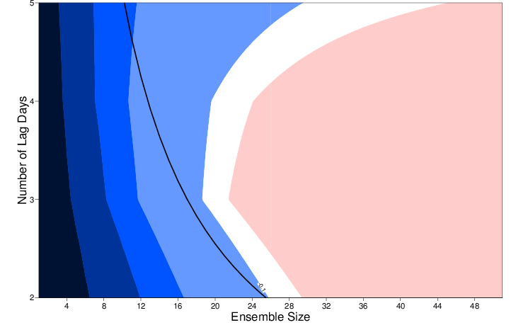
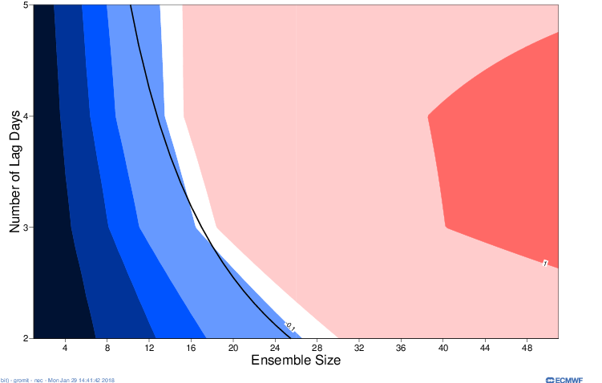
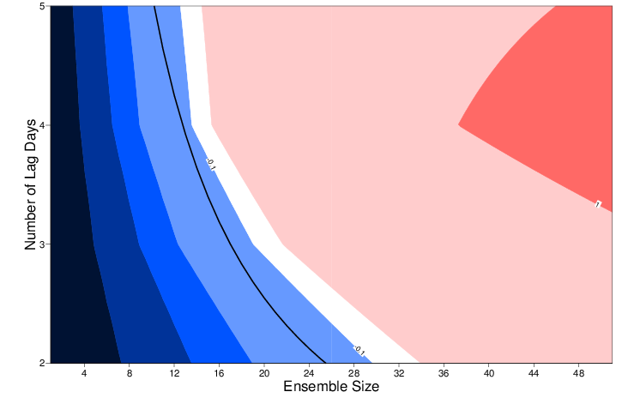
Impact of lagged ensemble on CRPSS (averaged over 20 variables) N. Extratropics
Lag ensemble defined by 2 attributes:
Ne: Ensemble size per day (Ne=1 to 51)
Nd: Number of combined dates (Nd=2 to 5)
Diff Lag ensemble (Ne,Nd) – Burst (51m)
Running ECMWF extended-range forecasts (day15-46) daily could be an option if daily ensemble size > 20
(+8% cost increase)
Using lagged ensembles can help improve skill of weeks 2, 3 and 4
Lagged ensemble size should be larger than burst ensemble size
Optimal number of lag days increases with lead time
Day 5-11
40m, 2d
Day 12-18
20m, 3d
Nd
Nd
Ne
Ne
Day 19-25
14m, 4d
Day 26-32
13m, 5d
Nd
Nd
Ne
Ne

Slide 14
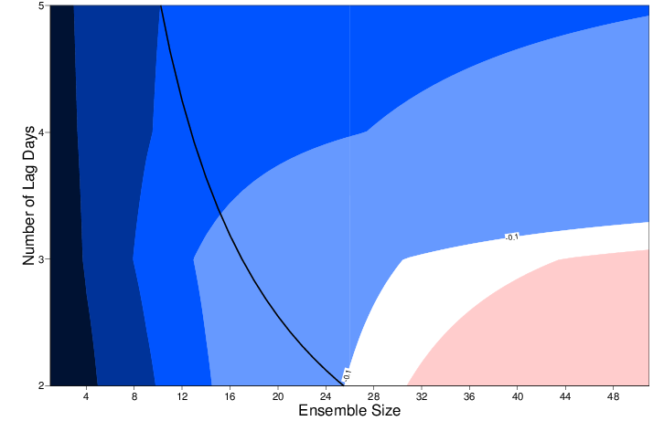
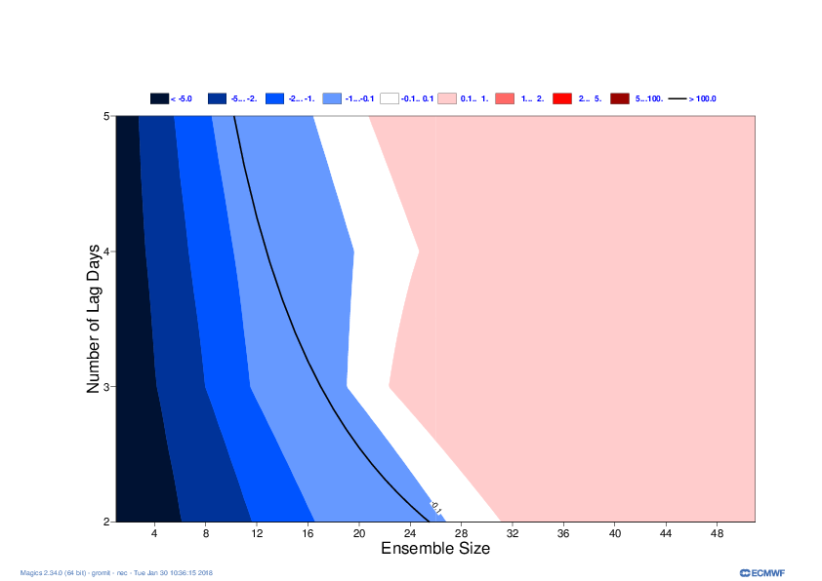
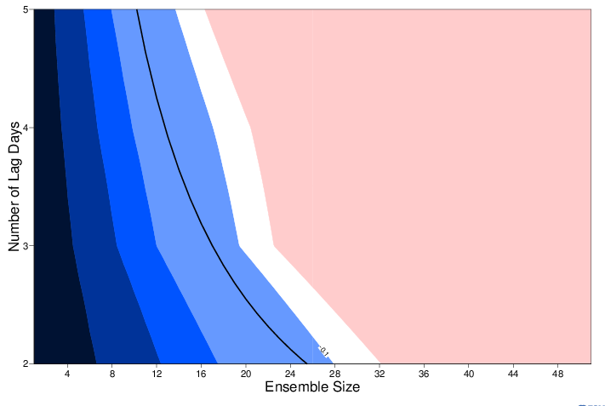
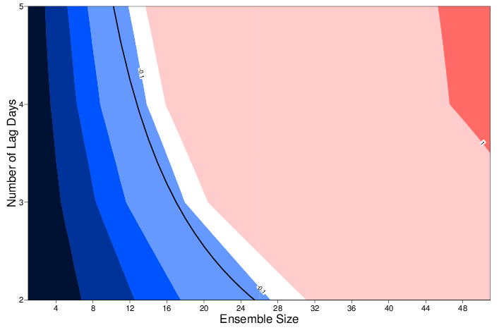
Impact of lag ensemble on CRPSS Tropics
Diff Lag ensemble – Burst (51m)
Day 5-11
Day 12-18
Over the Tropics, the lagged ensemble approach seems to be more beneficial than in the northern Extratropics.
Lagged ensembles with 24 hour window can improve day 5-11 forecasts if Ne > 32.
The optimal number of lagged days tends to be larger in the Tropics.
Day 19-25
Day 26-32

Slide 15
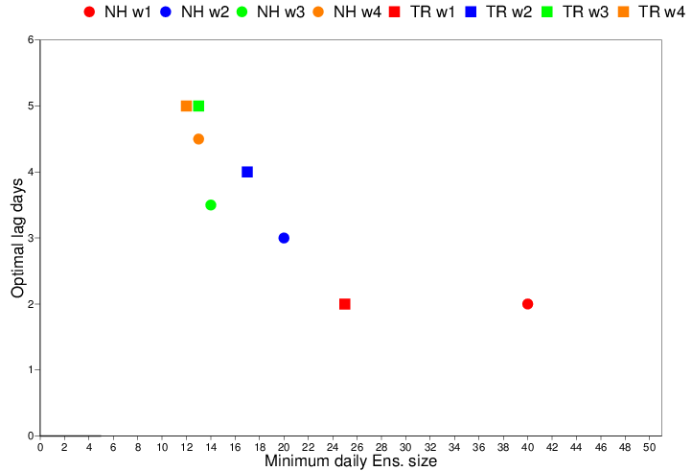
Minimum daily ensemble size and optimal number of lag days
Minimum daily ensemble size (x-axis) and optimal number of lagged days for the northern Extratropics (circles) and Tropics (squares) for different time ranges (weeks 1 to 4). This plot shows that:
The minimum daily ensemble size decreases with lead time
The optimal number of lagged days increases with lead time
Lagged ensemble seems to be more beneficial in the Tropics than in the northern Extratropics.

Slide 16
Conclusions
Running ECMWF extended-range forecasts (day 15-46) daily instead of twice weekly with smaller ensemble size could be an option as long as daily ensemble size > 20.
Using lagged ensembles can help improve skill of weeks 2, 3 and 4
Lagged ensemble size should be larger than burst ensemble size
Optimal number of lagged days increases with lead time and in the Tropics

