Slide 1
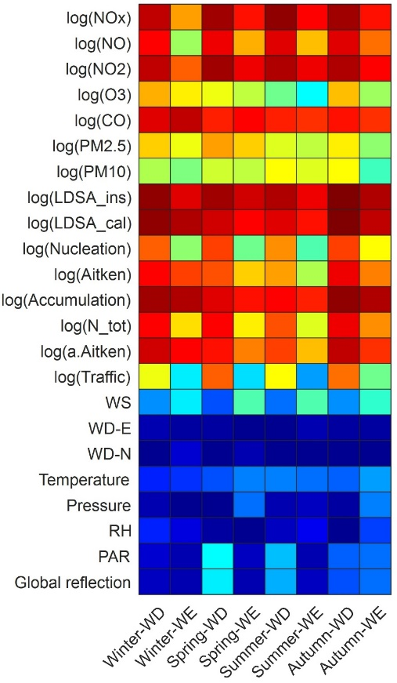
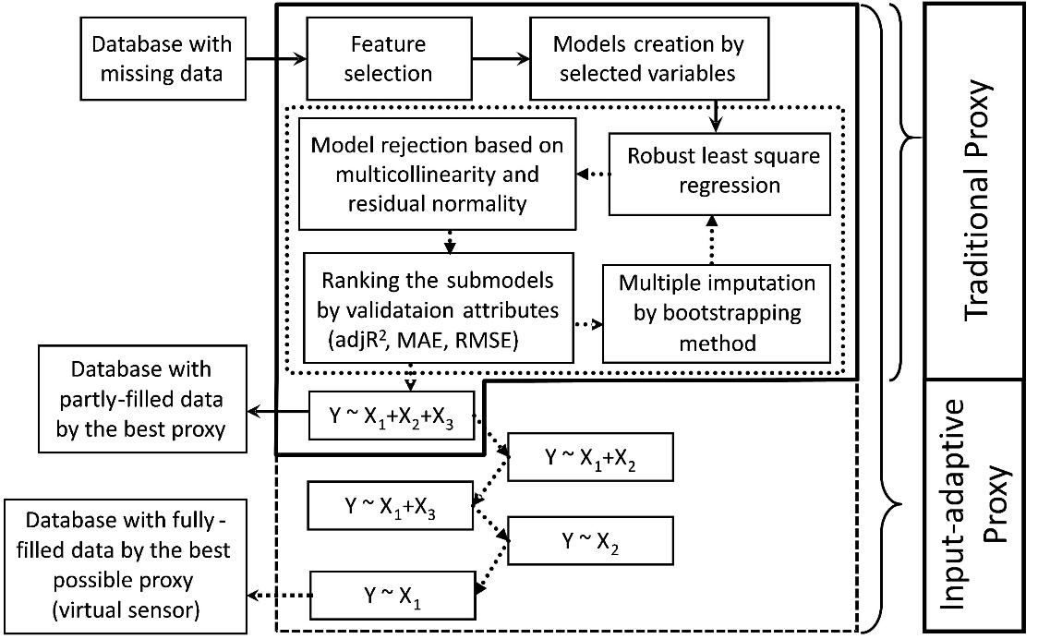
Input-adaptive proxy of air quality parameters: A case study for black carbon in Helsinki, Finland
Pak L Fung, Martha A Zaidan, Salla Sillanpää, Anu Kousa, Jarkko V Niemi, Hilkka Timonen, Joel Kuula, Erkka Saukko, Krista Luoma, Tuukka Petäjä, Sasu Tarkoma, Markku Kulmala, and Tareq Hussein
Figure 2: Heatmap showing the correlation of BC and other variables in different seasons.
R² = 0.87, MAE = 0.199, RMSE = 0.310
Figure 1: Schematic diagram of input-adaptive proxy (IAP).
Figure 3: Scatter plot showing the proxy performance (bright color indicates the higher frequency of the data points).
Figure 4: Time-series of the measured BC, BC by IAP and simple linear regression in street canyon and urban background sites.
(Fung, et al., Sensors, 2020)

