Slide 1

Atmospheric Acidity over North America: GEM-MACH Simulations for AQMEII-4
paul.makar@canada.ca for more information and discussion!
P.A. Makar¹, A. Akingunola¹, J. Zhang¹, B. Pabla¹, Q. Zheng¹, M. D. Moran¹, P. Cheung¹, A. Lupu¹, A. Robichaud¹, J. Aherne², O. Clifton³, D. Schwede⁴, R. Bianconi⁵, R. Bellasio⁵, C. Hogrefe⁴, S. Galmarini⁶
Environment and Climate Change Canada
Trent University
University Corporation for Atmospheric Research
US Environmental Protection Agency
Enviroware
Joint Research Centre
EGU 2020 on-line session AS2.14: Atmospheric Acidity, Air-sea Chemical Fluxes and their Impacts. May 8, 2020

Slide 2
Air Quality Model Evaluation International Initiative, Phase 4
Motivation:
  Deposition remains a crucial process in the species budget of any AQ model yet has not been systematically evaluated across multiple AQ modeling systems
    Past studies typically focused on specific modeling systems and deposition totals
    No systematic analysis exists of the individual and combined impacts of different representations of resistances, deposition media, land use, and meteorological conditions, on simulated total deposition
Goals of AQMEII Phase 4:
  Assess in detail the deposition processes in regional scale models, through a diagnostic evaluation, and investigate the reasons for differences
  Assess the impact of the diversity of different land types and land type databases, on model-estimated deposition
  Determine the boundaries of variability of deposition estimates produced by the community relative to common, aggregated, land use types
  Assess the different methodologies to describe deposition pathways into and onto vegetation
  Assess the range of variability for estimated critical loads and critical load exceedances

Slide 3
AQMEII-4, Activity 1: regional modelling ensemble
Two full years of simulations are required from all participants, on at least one of two domains:
  Continental Europe: 2009 and 2010
  Continental North America: 2010 and 2016
Models use a common set of input emissions data and chemical lateral boundary conditions.
Meteorological fields will be simulated by each group
Model output submitted to a common database
  Extracted at observation station locations
  Regridded to a common latitude/longitude grid, 0.125º spacing.
Additional “non-standard” diagnostic outputs are required.

Slide 4
AQMEII-4, Diagnostics
Provided by land-use fraction, and remapped from model land-use types to a common set of generic land use types.
  Aerodynamic Resistance
  Surface Resistance
  Stomatal Resistance
  Cuticle Resistance
  Stomatal Effective Conductance^{1,2}
  Cuticle Effective Conductance^{1,2}
  Soil Effective Conductance^{1,2}
  Lower Canopy Effective Conductance^{1,2}
  Quasi-Laminar Sublayer Resistance, for stomatal, cuticle, soil and lower canopy pathways.
Paulot et al, 2018: https://doi.org/10.5194/acp-18-17963-2018
Clifton et al, 2020: https://agupubs.onlinelibrary.wiley.com/doi/full/10.1029/2020JD032398

Slide 5
GEM-MACH and AQMEII-4
AQMEII-4 simulations are currently underway by up to 19 modelling teams in Europe and North America.
The remainder of this presentation will focus on some example simulations and results from one of these models:
Environment and Climate Change Canada’s Global Environmental Multiscale – Modelling Air-quality and CHemistry (GEM-MACH)
These are preliminary results only!
SO₂ only (bonus slides have NO₂ and O₃)
  We present a detailed analysis of this acidic component of the atmosphere, using AQMEII-4’s statistics.

Slide 6

GEM-MACH configurations
On-line model, 42 gas species, 14 particle species (sectional approach, 12 bins).
3 Configurations used here, for 3 separate 2016 simulations:
“Base Case”:
    Fully coupled (direct + indirect effect),
    Forest canopy and vehicle-induced turbulence effects,
    Revised plume rise,
    Revised particle deposition algorithm
    Monthly averaged satellite-derived leaf area index values,
    Gas-phase deposition by Alain Robichaud³.
Ops: ‘closer to Operational’:
    Same particle speciation,
    One-way coupling,
    Original particle deposition algorithm
    No additional turbulence parameterizations,
    LAI from older databases
    But still using Robichaud gas-phase deposition.
Zhang:
    Same as base case, but
    Leiming Zhang’s⁴ gas-phase deposition algorithm instead of Robichaud
Comparing these two shows the effects of the new parameterizations on deposition fluxes. Same gas deposition algorithm, but feedbacks can alter meteorology.
Comparing these two shows the effects of using a different deposition algorithm within a fully coupled model.
3. Makar et al., 2018 (see Supplementary Information): https://www.atmos-chem-phys.net/18/9897/2018/
4. Zhang et al., 2003: https://www.atmos-chem-phys.net/3/2067/2003/
The examples which follow are for SO₂, for June/July/August of 2016.

Slide 7
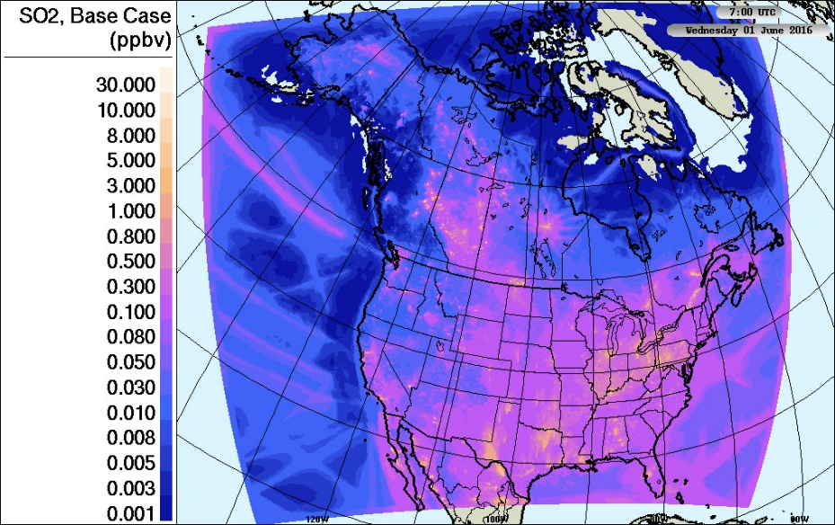
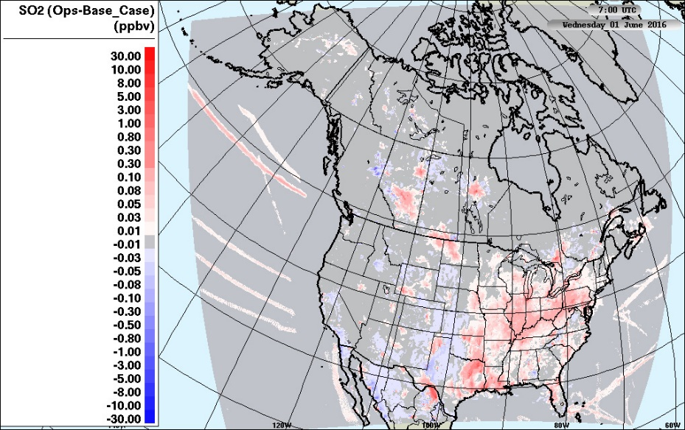
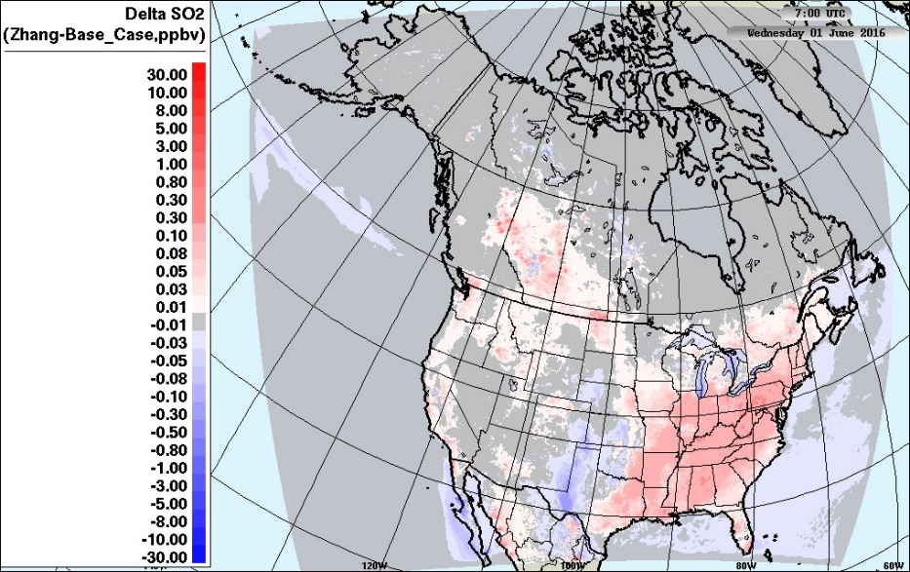
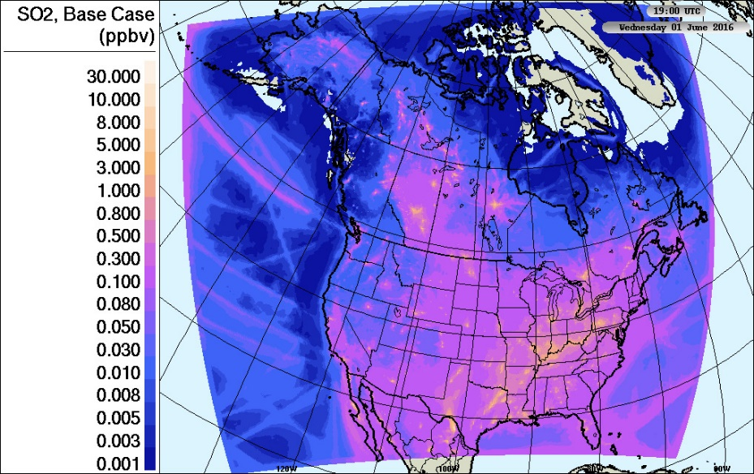
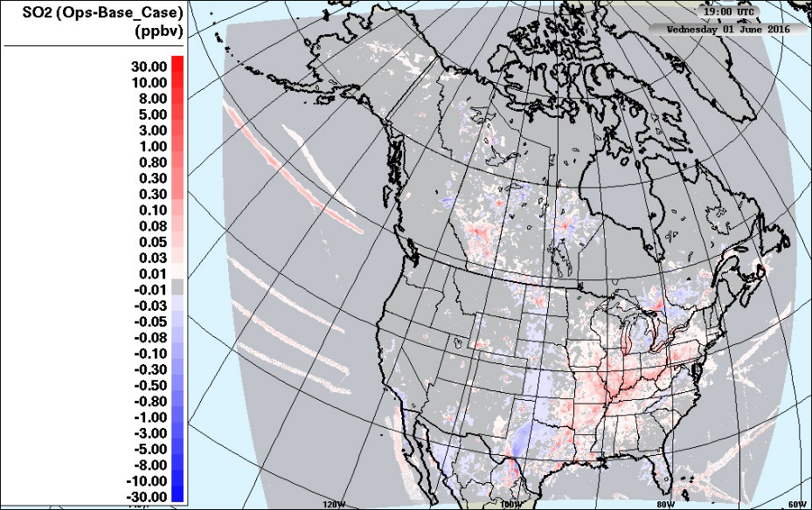
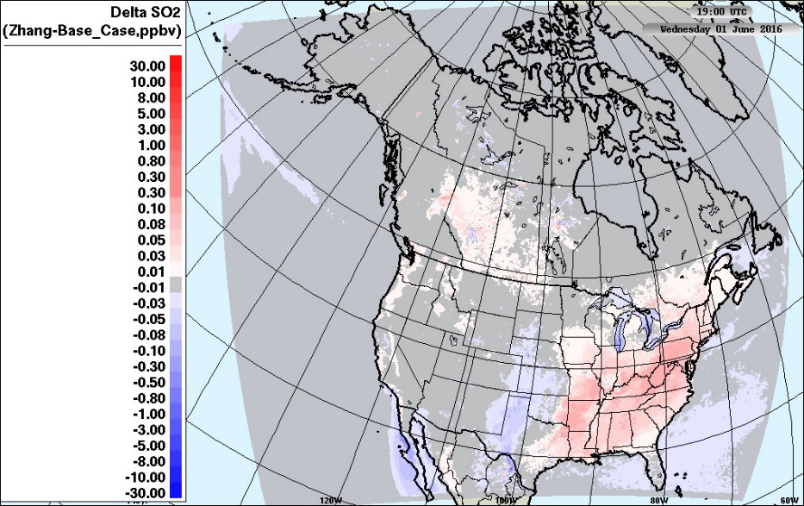
June-July-August (JJA) average SO₂ concentration
Base Case
Ops - Base Case
Zhang - Base Case
And note that the colour bar scales are base 10 logarithmic!
Usually, 3 orders of magnitude variation are shown.
Base Case
Fully Coupled, new plume rise, forest canopy shading and turbulence, vehicle-induced turbulence, satellite-derived Leaf Area Index used throughout, Alain Robichaud’s gas-phase deposition algorithm.
Impact of other model changes on deposition.
None of the model updates at left, but same gas-phase deposition algorithm
Impact of deposition algorithm changes.
Fully Coupled, etc., as at left, only difference is the gas-phase deposition code: here we use the algorithm of Leiming Zhang
7 UT (local nighttime)
7 UT
(local
night)
19 UT (local daytime)
19 UT
(local
day)
Effect of a suite of model parameterization changes (including feedbacks): if you turn them all off, SO₂ increases close near sources, decreases downwind.
SO₂ concentration increases with Zhang gas-phase deposition.

Slide 8
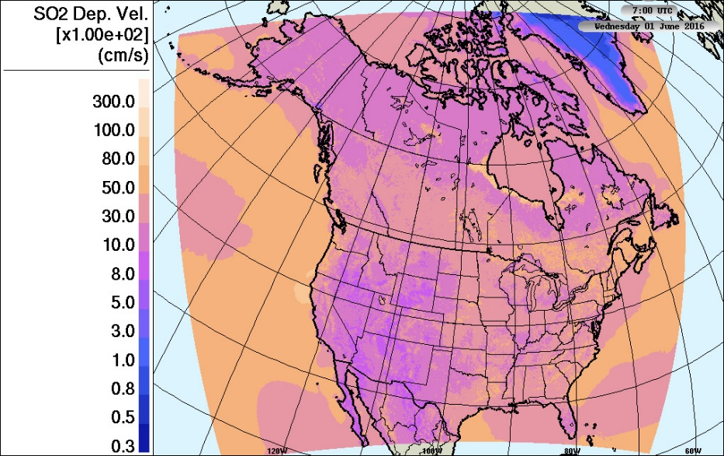
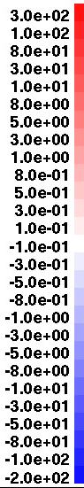
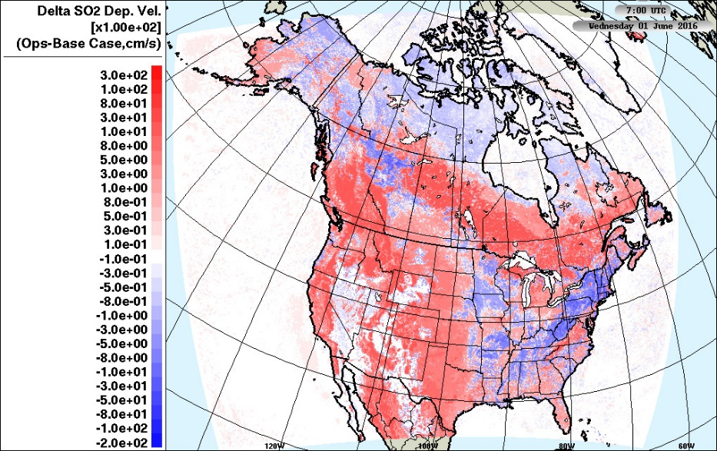

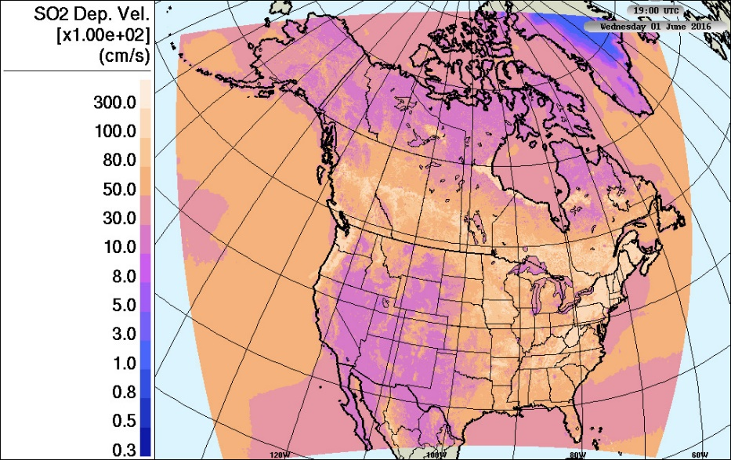
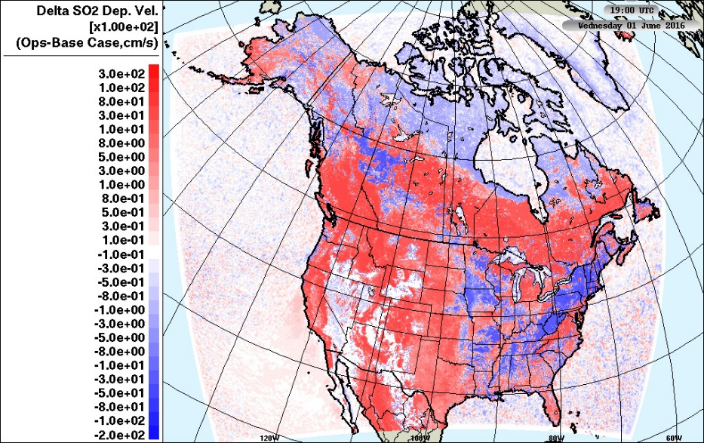
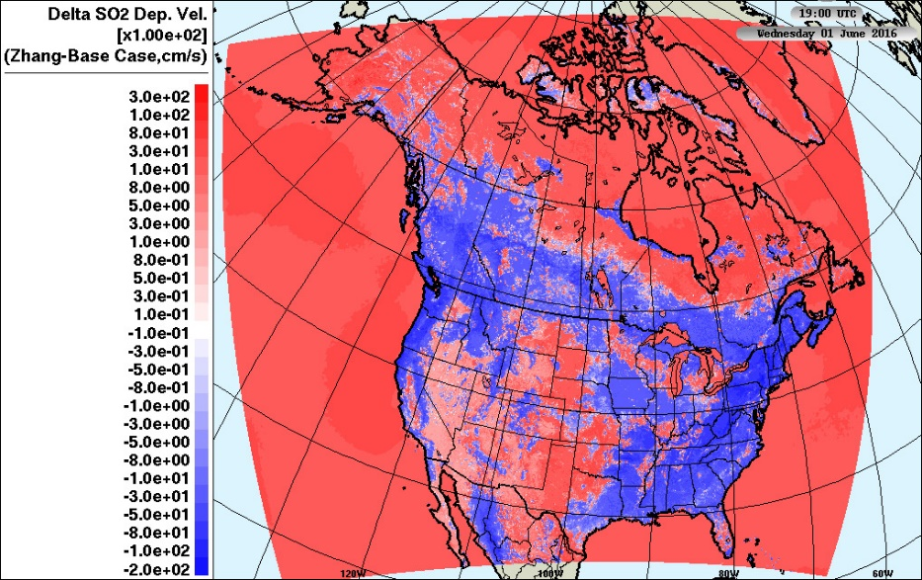
JJA average SO₂ Deposition Velocity
Base Case
Ops - Base Case
Zhang - Base Case
7 UT
(local
night)
19 UT
(local
day)
Ops and Base Case have the same deposition algorithm: feedbacks between aerosols and meteorology are changing the meteorology, which changes the
The SO₂ concentration increases correspond to V_{SO2} decreases
deposition velocity! Removing them decreases
deposition velocity near source regions. So feedbacks are increasing dep velocity near sources

Slide 9
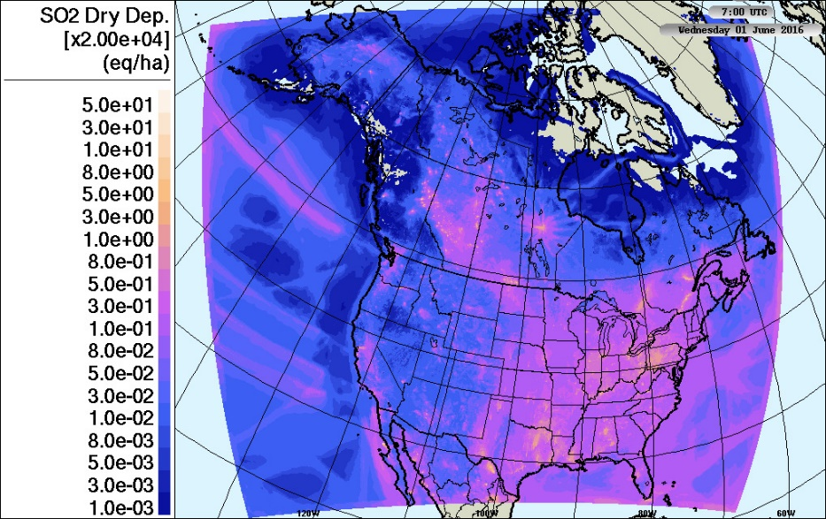
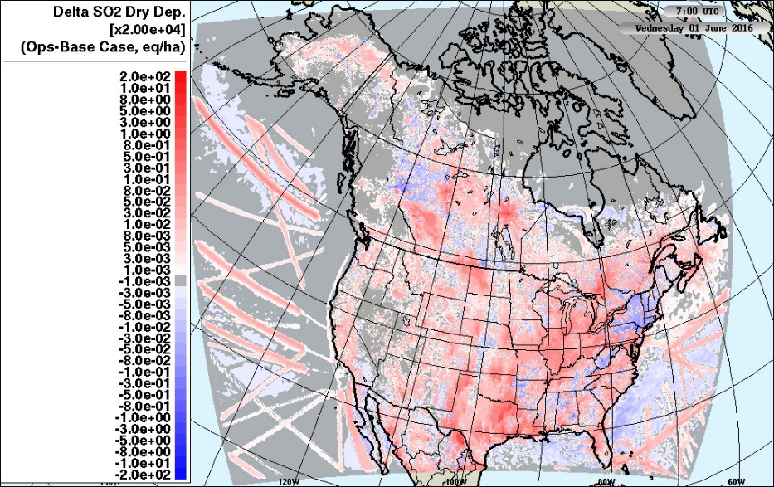
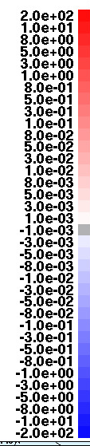

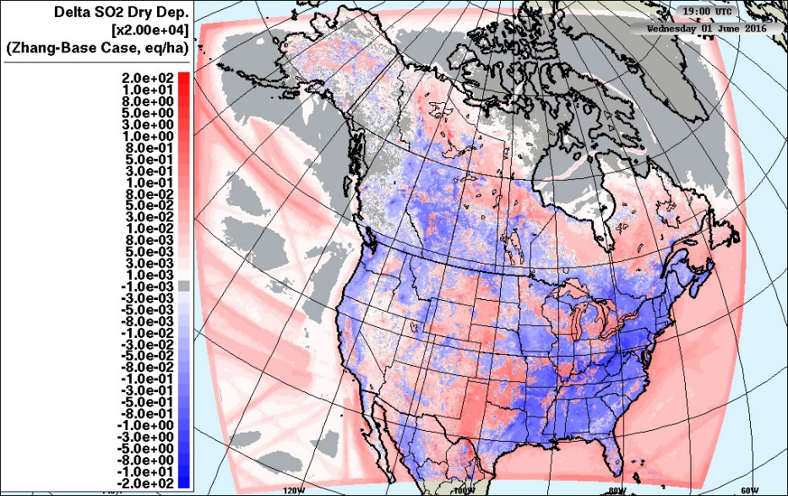
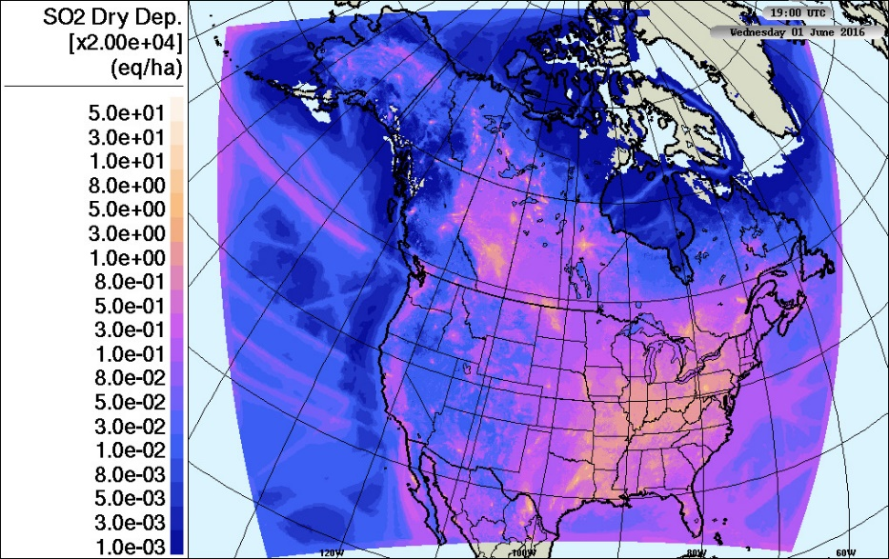
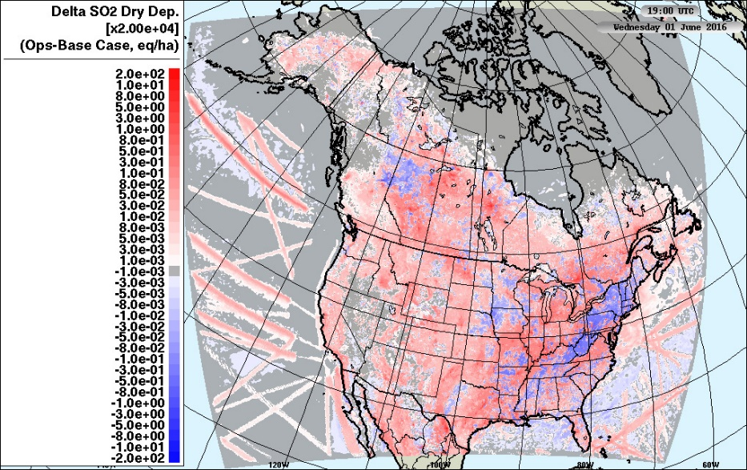
JJA total SO₂ Deposition Flux
Base Case
Ops - Base Case
Zhang - Base Case
7 UT
(local
night)
19 UT
(local
day)
Removing the suite of model changes, including feedbacks, increases the SO₂ dry deposition flux close to sources. Conversely, adding them in decreases the dry deposition flux.
The reduced SO₂ deposition velocity results in reduced deposition flux, and increased concentrations.

Slide 10
From the above comparisons
In a fully coupled model, with additional changes to surface turbulence, plume rise, etc., compared to the operational configuration (base case – ops):
  SO₂ decreases near the sources and increases downwind.
  Deposition velocity increases near the sources, decreases further downwind
  However, dry deposition flux decreases near the sources, increases further downwind.
Changing the deposition algorithm in a fully coupled model from Robichaud to Zhang:
  Decreases deposition velocities near sources
  Decreases deposition fluxes near sources
  Increases SO₂ concentrations near sources.
Ok, can we delve a bit deeper into the deposition flux changes, using AQMEII4 diagnostics?

Slide 11
For AQMEII-4, we want to know more than just stating the differences. What is causing them?
Conductance analysis using AQMEII4 gas-phase deposition diagnostics: how much does each resistance pathway contribute to the net deposition velocity?
  Lower Canopy / Buoyancy
  Soil
  Stomatal (+Mesophyll)
  Cuticle
How do these contributions change, when
  Parameterizations aside from deposition change (same deposition code)?
  The deposition code changes (and the rest of the model stays the same)?
A caveat: this analysis tells us the factors controlling deposition velocity, but not necessarily the factors controlling deposition flux.
  Other model changes may affect SO₂ concentration, in turn modifying the fluxes
Let’s look at August 1, 2016, at 7 UT (local nighttime) and 19 UT (local daytime), and one vegetation type (evergreen needleleaf trees) as an example..

Slide 12
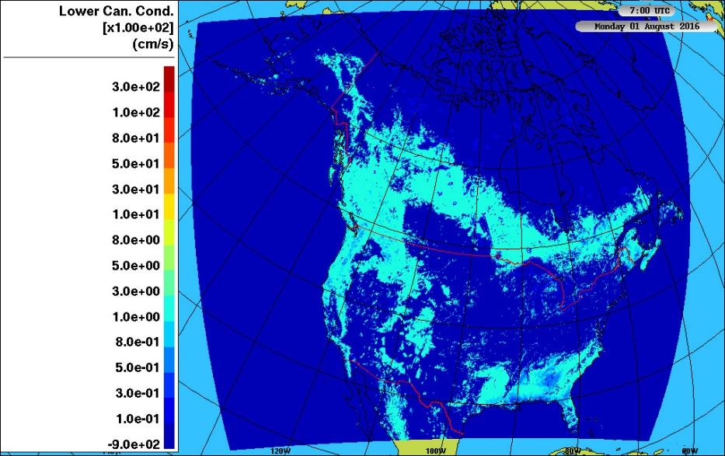

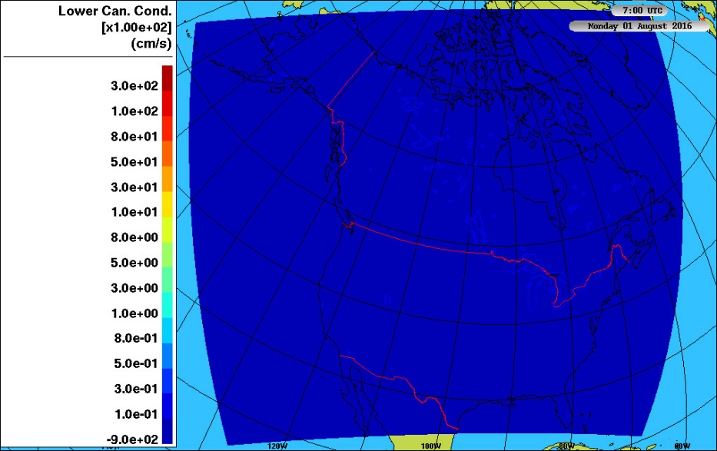
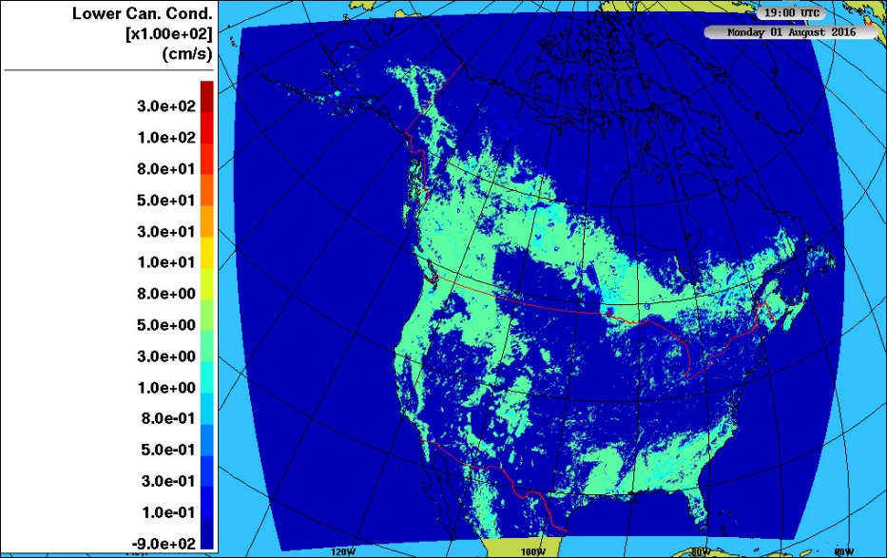

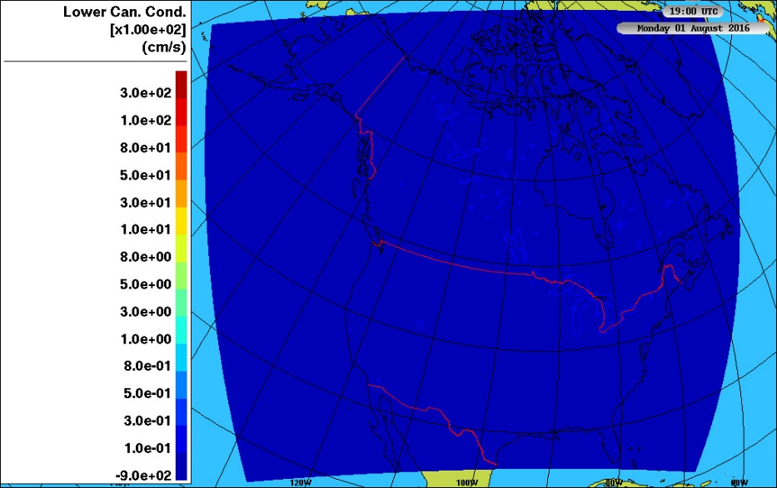
August 1, 2016: SO₂ Lower canopy Conductance
Base Case
Ops
Zhang
Differences are due to changes in meteorological conditions associated with use feedbacks. Same deposition algorithm (Alain Robichaud)
Uses Zhang et al gas-phase deposition algorithm. Differences are due to the change in deposition algorithm
Units are in hundredths of a cm/s
7 UT
(local
night)
Units are in hundredths of a cm/s
19 UT
(local
day)
The Zhang et al deposition code (right hand column) does not include a lower canopy buoyancy term. This is one source of the reduced deposition fluxes when this algorithm is used.

Slide 13
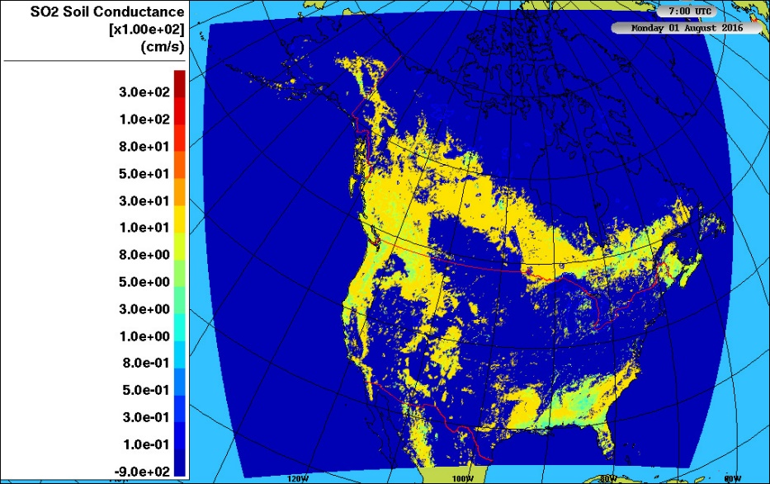

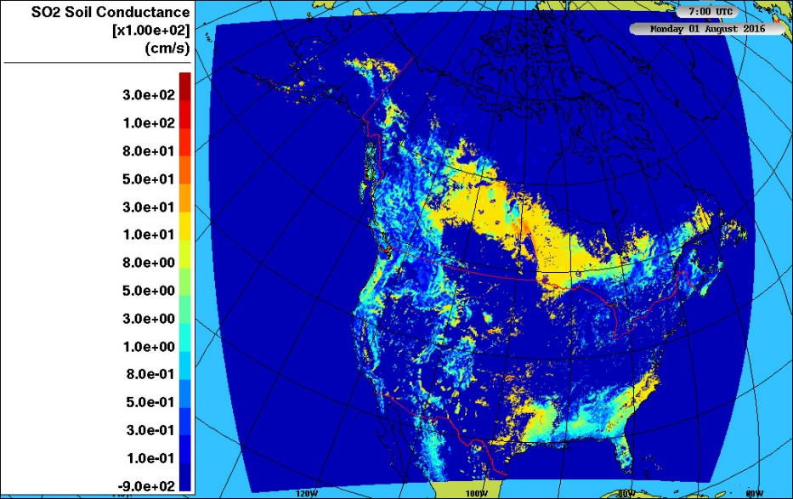



August 1, 2016: SO₂ Soil Conductance
Base Case
Ops
Zhang
Units are in hundredths of a cm/s
7 UT
(local
night)
Units are in hundredths of a cm/s
19 UT
(local
day)
Note that feedbacks are changing soil conductance in some areas (colour scales are logarithmic), particularly at night.
Another reason for smaller SO₂ deposition fluxes with the Zhang et al deposition algorithm: smaller soil conductance, particularly at night.

Slide 14
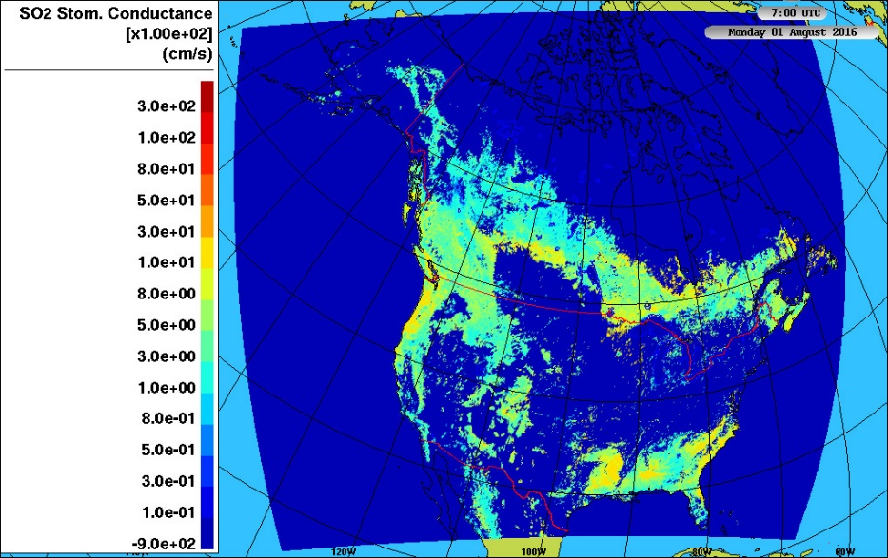
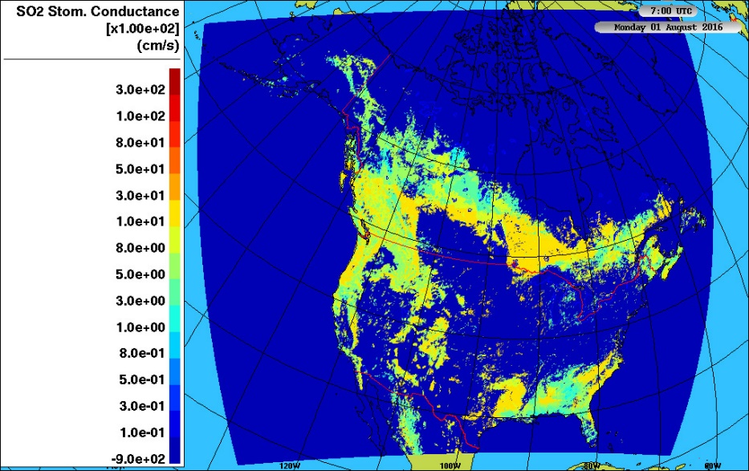

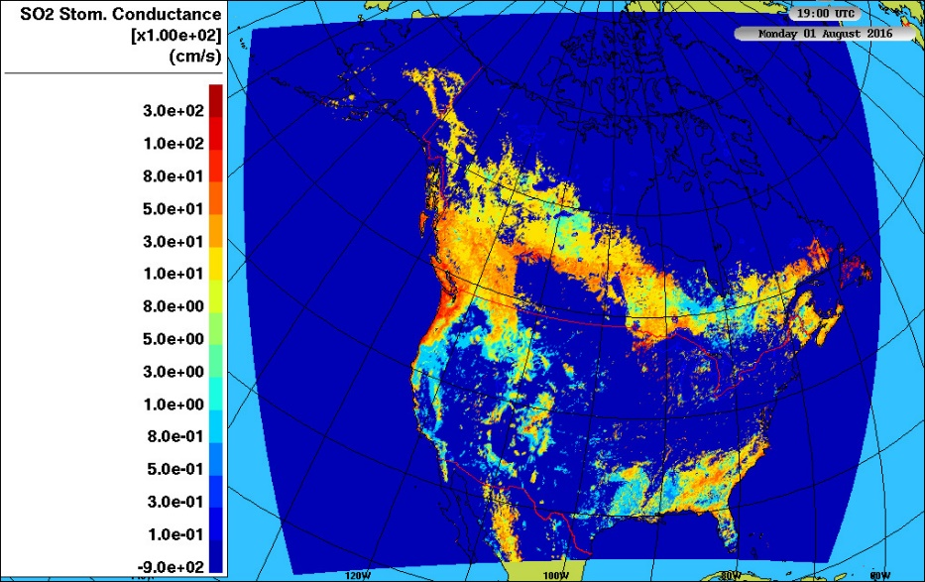
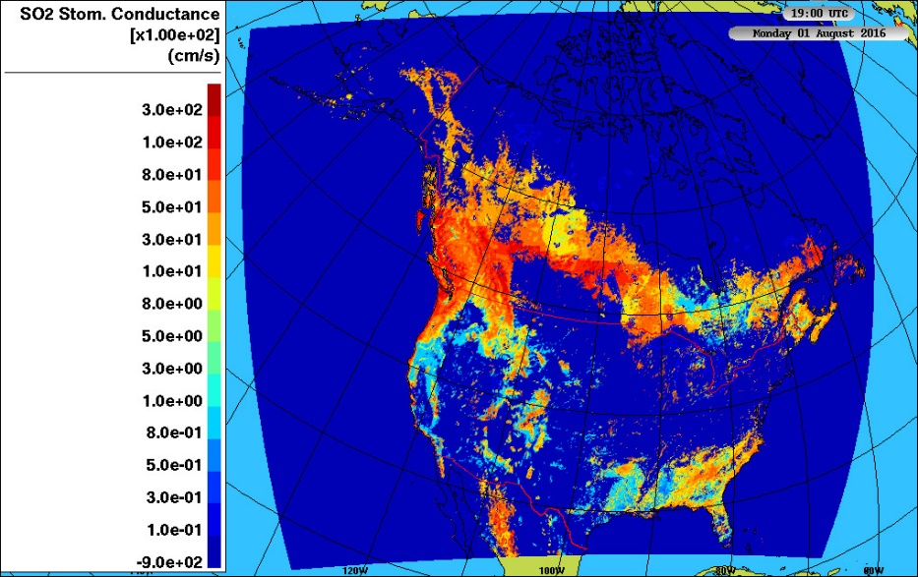
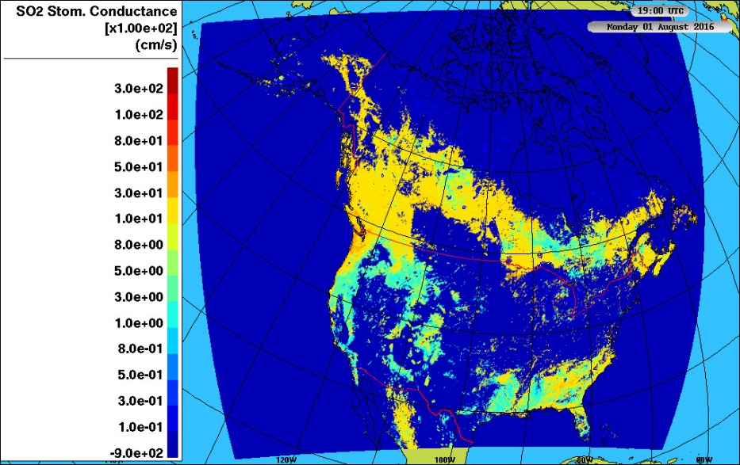
August 1, 2016: SO₂ Stomatal Conductance
Base Case
Ops
Zhang
Units are in hundredths of a cm/s
7 UT
(local
night)
Units are in hundredths of a cm/s
19 UT
(local
day)
Stomatal conductance is largest of the four pathways, drops by 1 to 2 orders of magnitude going from day to night, but does not shut off completely. Removing feedbacks increases stomatal conductance; adding feedbacks decreases it.
Zhang et al stomatal conductance shuts off at night – significant reduction in deposition. Daytime changes are also smaller than the Robichaud approach.

Slide 15
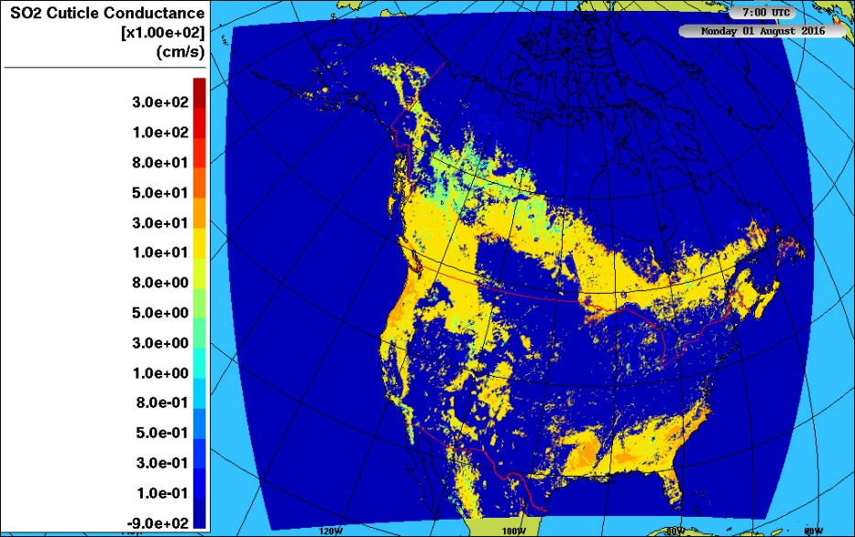
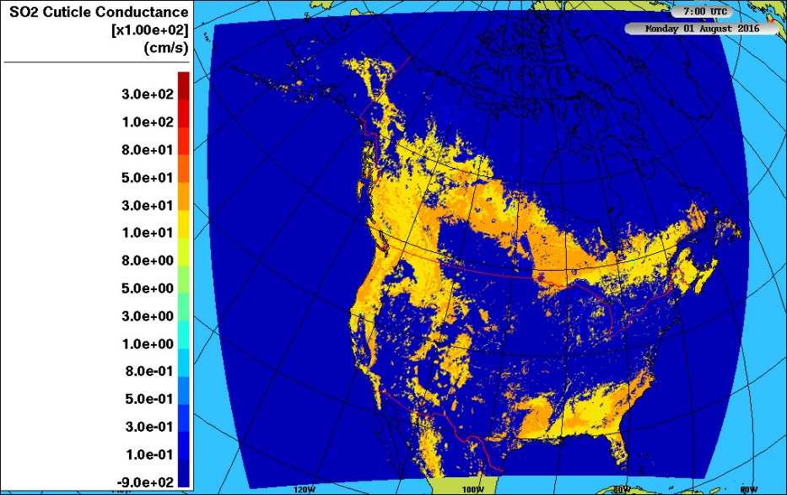
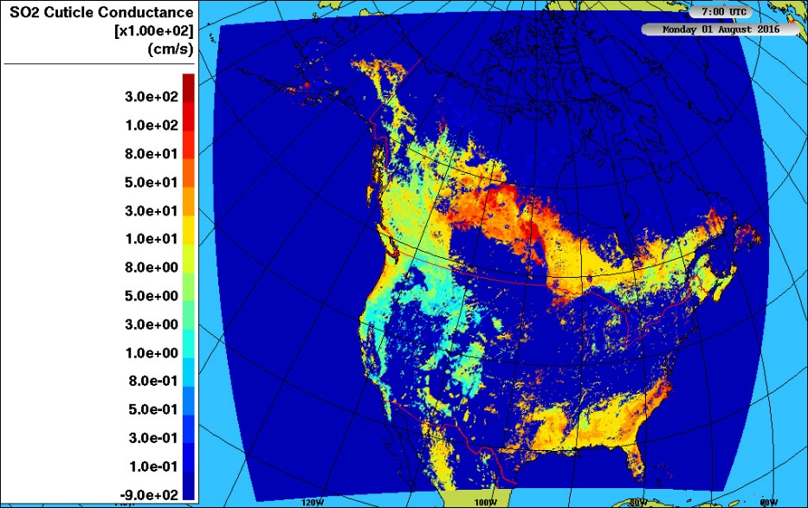
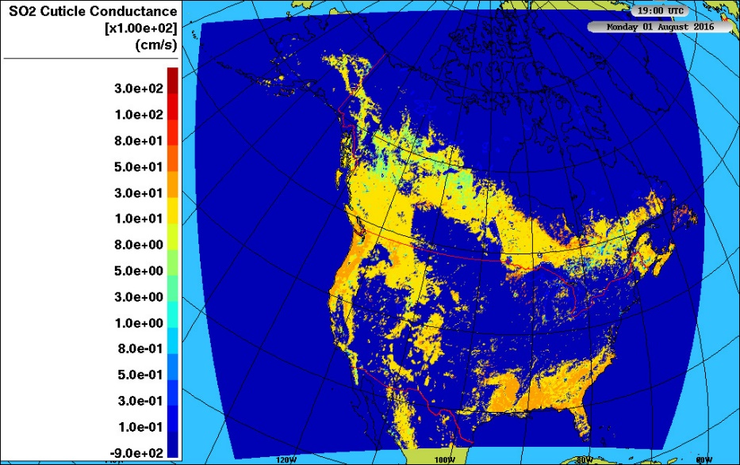

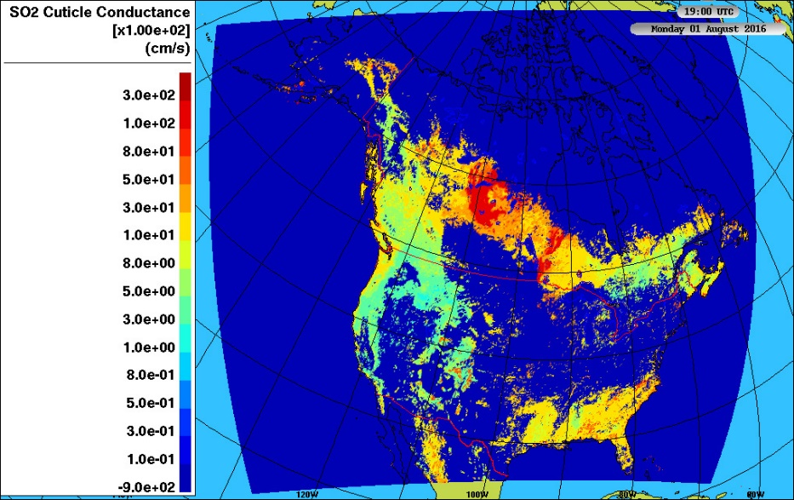
August 1, 2016: SO₂ Cuticle Conductance
Base Case
Ops
Zhang
Units are in hundredths of a cm/s
7 UT
(local
night)
Units are in hundredths of a cm/s
19 UT
(local
day)
Operational model cuticle conductance is greater than base case: feedback changes in weather are affecting this pathway.
Zhang et al cuticle conductance has more spatial variation than the Robichaud approach. Both lower and higher values, depending on location.

Slide 16
The AQMEII-4 diagnostics have told us (for evergreen needleleaf forests):
The meteorological changes associated with feedbacks have:
  Increased soil conductance slightly in some areas
  Decreased stomatal conductance a lot.
  Decreased cuticle conductance a lot.
  ➔ The latter two result in decreased dry deposition fluxes near the sources, within this kind of vegetation.
Changing the deposition algorithm from Robichaud to Zhang:
  Removes the lower canopy buoyancy conductance
  Decreases the nighttime soil conductance
  Removes the nighttime stomatal conductance and reduces the daytime stomatal conductance
  Increases the spatial variability of the cuticle conductance.
  ➔ These cause a decrease in the net SO₂ deposition flux, going from the Robichaud to the Zhang deposition algorithm.

Slide 17
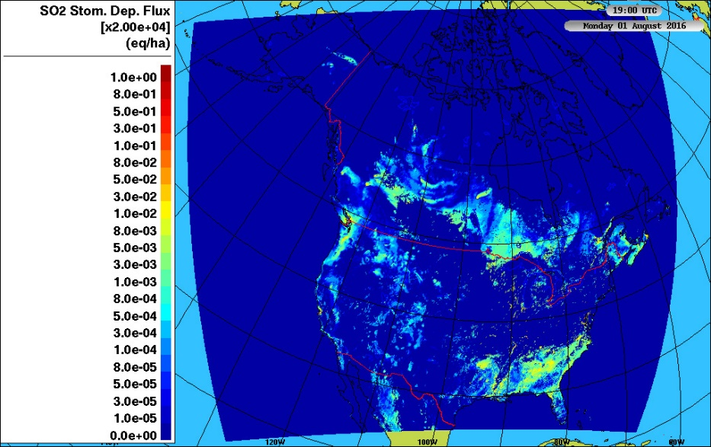
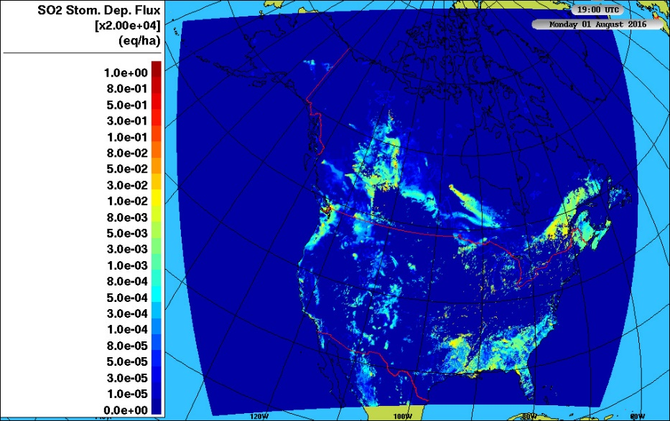
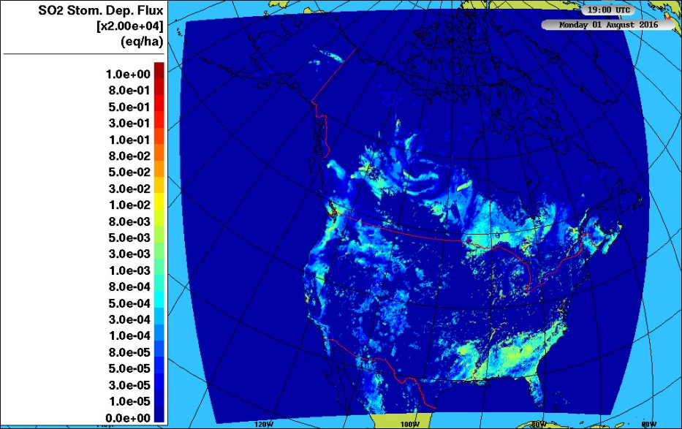
A caveat:
Sensitivities in deposition velocity don’t necessarily correspond to sensitivities in deposition flux
The SO₂ flux depends on both deposition velocity and concentration
The effect of the other model components can have a strong impact on SO₂ concentrations.
Below: Stomatal component of SO₂ deposition flux to evergreen needleleaf trees, afternoon of August 1, 2016.
The two simulations in which feedbacks are changing the meteorology have more similar fluxes on this hour …
Than the simulation which has one-way coupling only.
19 UT
(local
day)
Base Case
Ops
Zhang

Slide 18
Conclusions (all very tentative)
Using GEM-MACH’s SO2 output for three 2016 simulations as an example:
In fully coupled models, changes in weather due to the particle indirect and direct effects can change the deposition velocity. (shown here)
Deposition can also influence the weather through, e.g.,
  Removing gas-phase SO₂
  Which changes the amount of SO₂ available for particle sulphate formation
  Which changes the weather through the direct and indirect effects.
Changing the gas-phase deposition velocity algorithm changes the deposition flux, in this case by:
  Removing pathways that might be considered minor - lower canopy pathway
  Switching some pathways off at night – stomatal pathway
  Having a stronger diurnal variation – soil conductance pathway

Slide 19
Next Steps (with the rest of the AQMEII-4 team)
Completion of GEM-MACH simulations
Multimodel analysis of the details of deposition
Evaluation of the models and ensemble against observations via ENSEMBLE database.
Calculation of ensemble deposition and ensemble member deposition impacts on critical loads, critical load exceedances
Papers! ☺
Questions or comments: paul.makar@canada.ca

Slide 20
Disclaimer: The views expressed in this presentation are those of the authors and do not necessarily reflect the views or policies of the U.S. Environmental Protection Agency.

Slide 21
Bonus Material
Preliminary evaluation of SO₂ at four monitoring networks, for each of these simulations.
Differences in NO₂ concentration, deposition velocities, and deposition fluxes between these three simulations.
Differences in O₃ concentration, deposition velocities, and deposition fluxes between these three simulations.

Slide 22
July 2016 SO₂ performance for the simulations shown here. Simulation with the better or tied score highlighted in red. Base case generally has the best performance, particularly for normalized mean bias (NMB).
NMB: Normalized Mean Bias, RMSE: Root Mean Square Error, FAC2: Number of model values within a factor of two of observations, R: Pearson Correlation Coefficient
Monitoring Network | Statistic | Simulation
 |  | Base Case | Ops | Zhang
AQS (USA) | No. observations | 303273
 | NMB | 0.48 | 0.87 | 0.58
 | RMSE | 2.98 | 3.42 | 3.02
 | FAC2 | 0.26 | 0.25 | 0.26
 | R | 0.16 | 0.14 | 0.16
NAPS (Canadian, mostly urban) | No. observations | 90776
 | NMB | 0.88 | 1.42 | 0.99
 | RMSE | 5.09 | 5.78 | 5.26
 | FAC2 | 0.08 | 0.08 | 0.09
 | R | 0.16 | 0.16 | 0.15
CAPMoN (Canadian, mostly remote) | No. observations | 575
 | NMB | 1.61 | 1.68 | 1.90
 | RMSE | 0.61 | 0.64 | 0.66
 | FAC2 | 0.20 | 0.21 | 0.18
 | R | 0.61 | 0.60 | 0.61
CASTNET (USA, mostly rural to remote) | No. observations | 362
 | NMB | 0.51 | 0.63 | 0.88
 | RMSE | 0.72 | 0.83 | 1.06
 | FAC2 | 0.56 | 0.52 | 0.44
 | R | 0.64 | 0.62 | 0.63

Slide 23
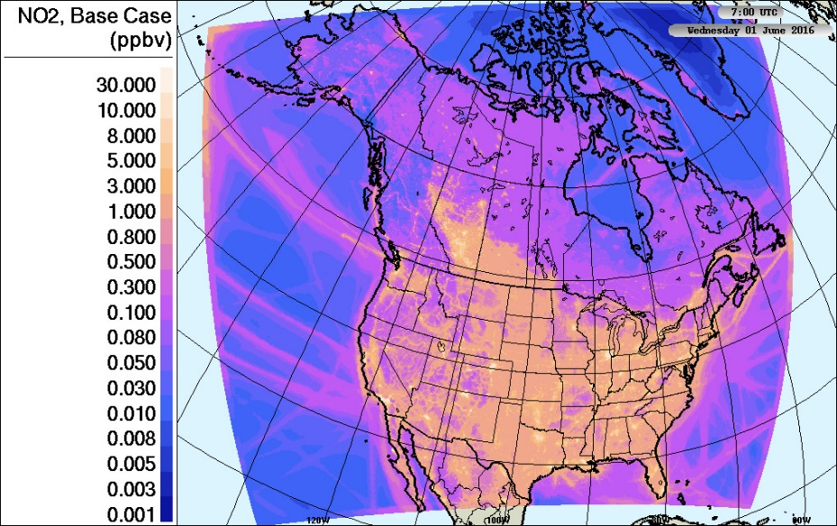
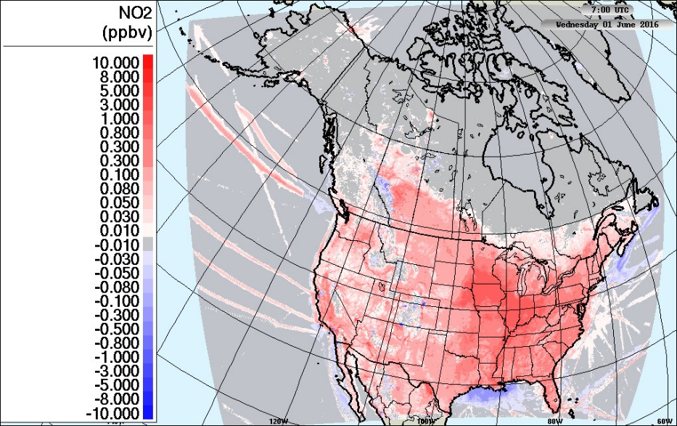
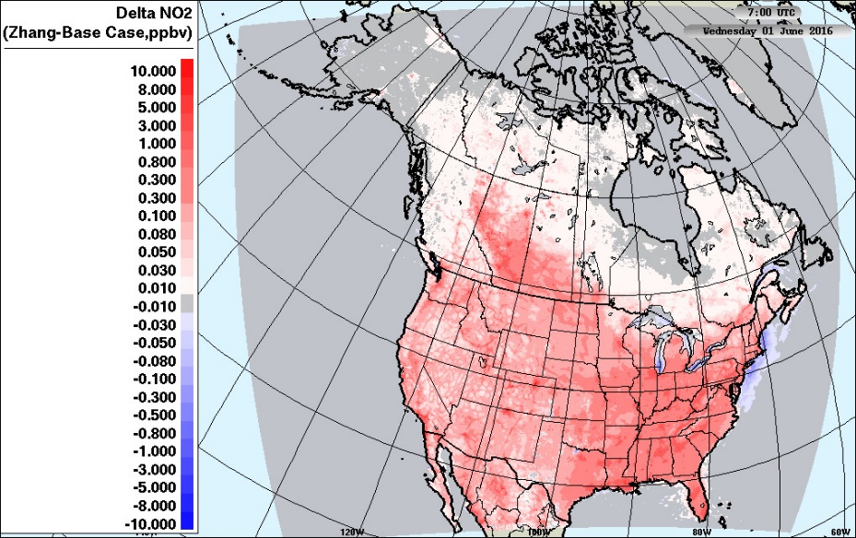
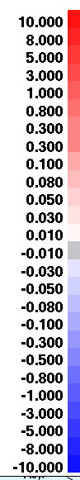
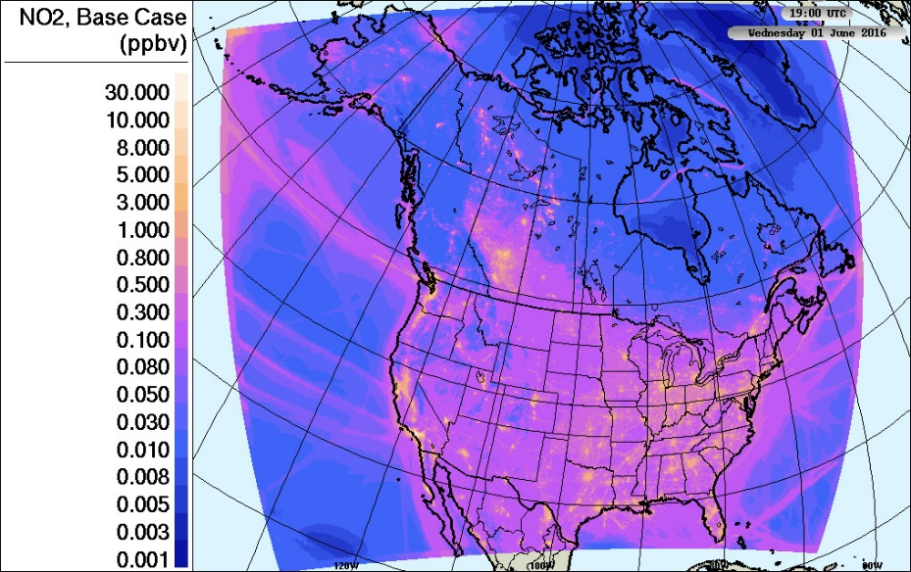
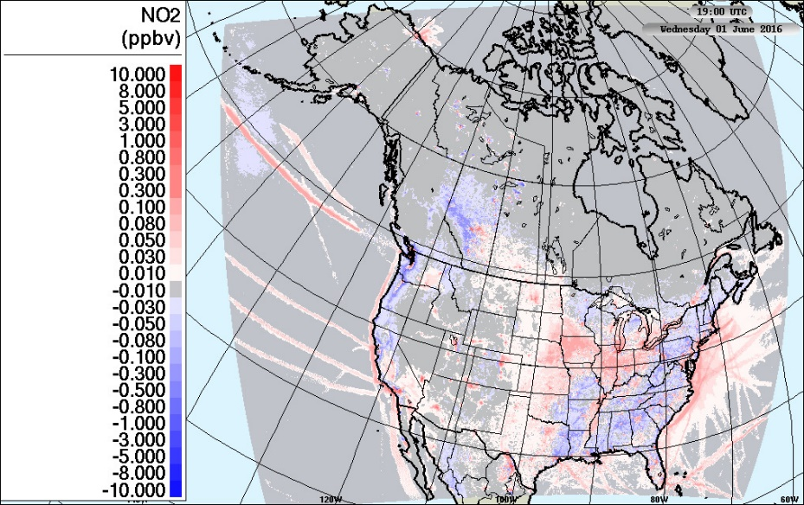
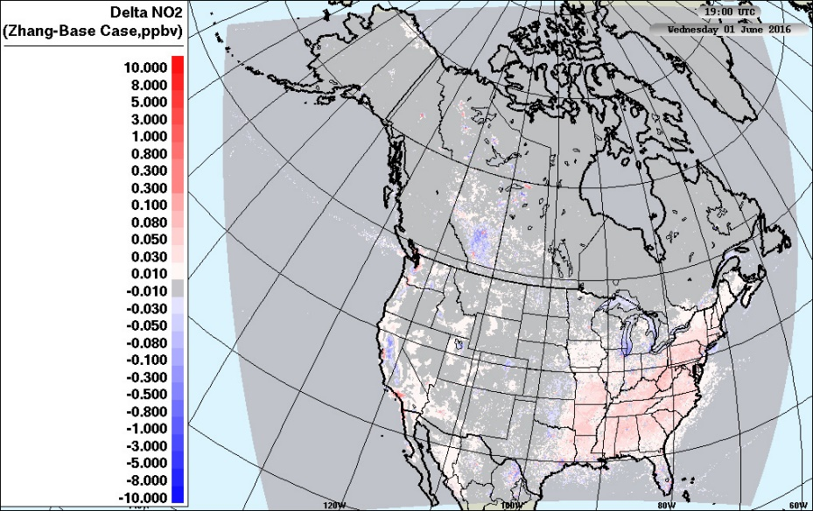
JJA Average NO₂ concentration
Base Case
Ops - Base Case
Zhang - Base Case
7 UT
(local
night)
19 UT
(local
day)

Slide 24
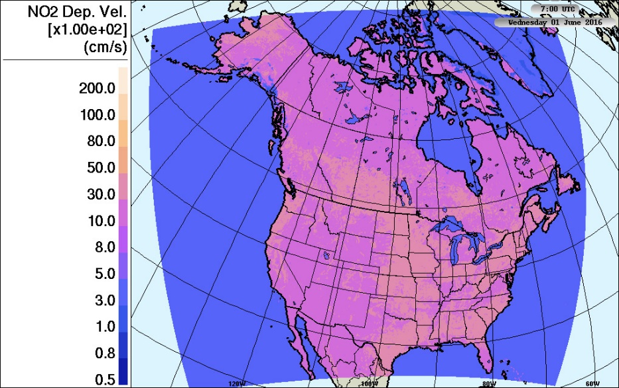
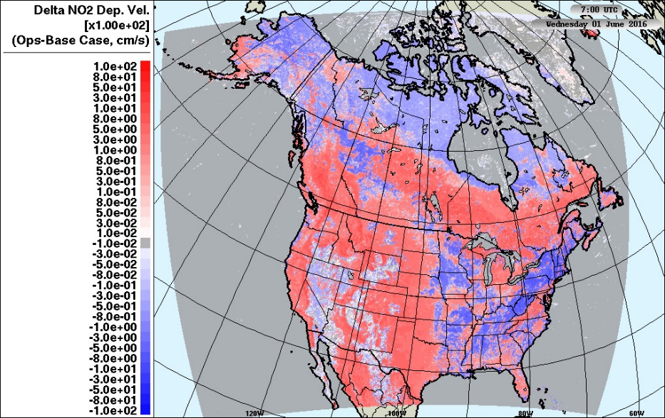
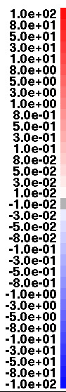

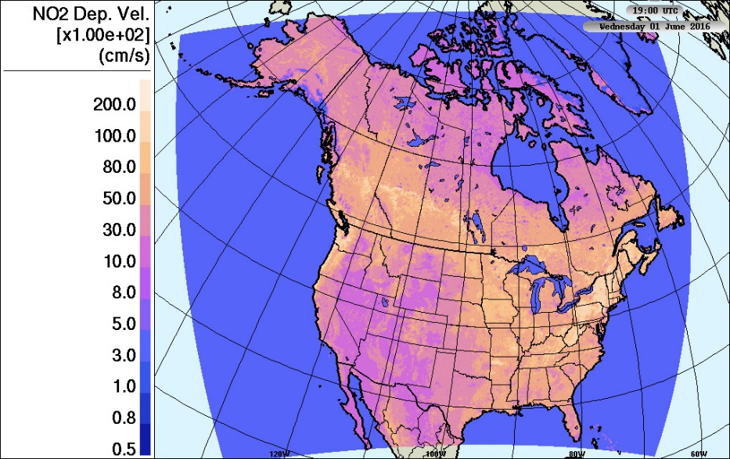
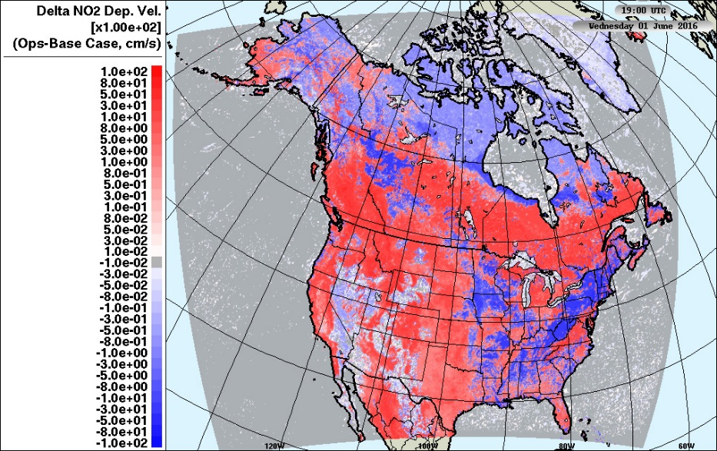
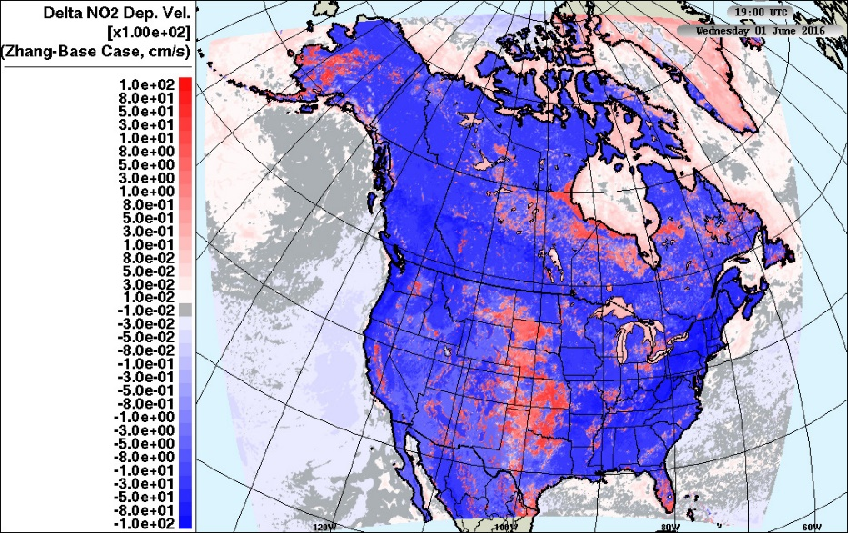
JJA Average NO₂ Deposition Velocity
Base Case
Ops - Base Case
Zhang - Base Case
Units are in hundredths of a cm/s
7 UT
(local
night)
Units are in hundredths of a cm/s
19 UT
(local
day)

Slide 25





JJA Net NO₂ Deposition Flux
Base Case
Ops - Base Case
Zhang - Base Case
7 UT
(local
night)
19 UT
(local
day)

Slide 26







JJA Average O₃ concentration
Base Case
Ops - Base Case
Zhang - Base Case
7 UT
(local
night)
19 UT
(local
day)

Slide 27







JJA Average O₃ Deposition Velocity
Base Case
Ops - Base Case
Zhang - Base Case
Units are in hundredths of a cm/s
7 UT
(local
night)
Units are in hundredths of a cm/s
19 UT
(local
day)

Slide 28







JJA Net O₃ Deposition Flux
Base Case
Ops - Base Case
Zhang - Base Case
7 UT
(local
night)
19 UT
(local
day)

