Slide 1
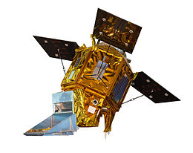
Spatiotemporal Characteristics of Tropospheric and Surface NO2 from Sentinel-5 Precursor (S5P) and in-situ Observations in Taiwan
Presenter Yi Jhen Cai
Dr. Chian-Yi Liu
Dr. Charles C. K. Chou
Advisor
Academia Sinica 中央研究院
Research Center for Environmental Changes 環境變遷研究中心
National Central University, TAIWAN 國立中央大學
Department of Atmospheric Sciences 大氣科學系
Geophysical Radiation and Atmospheric Composition Exploration Laboratory

Slide 2
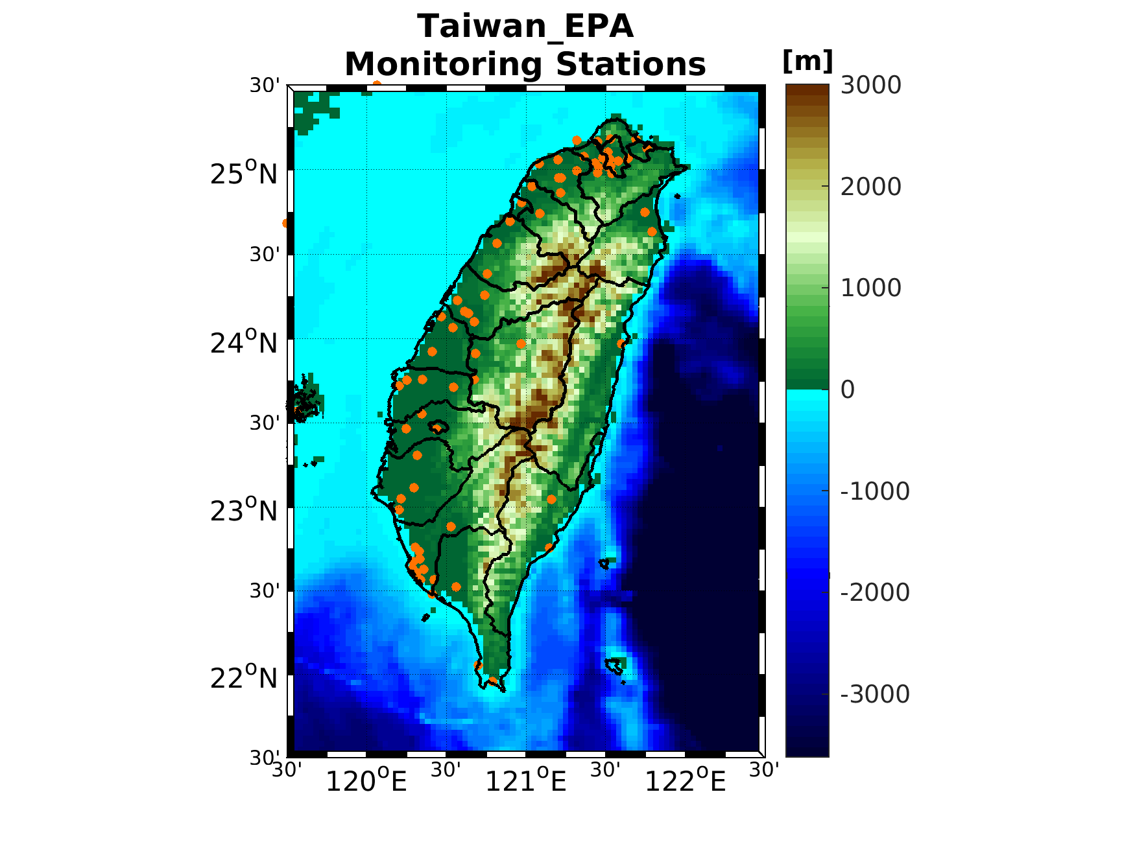
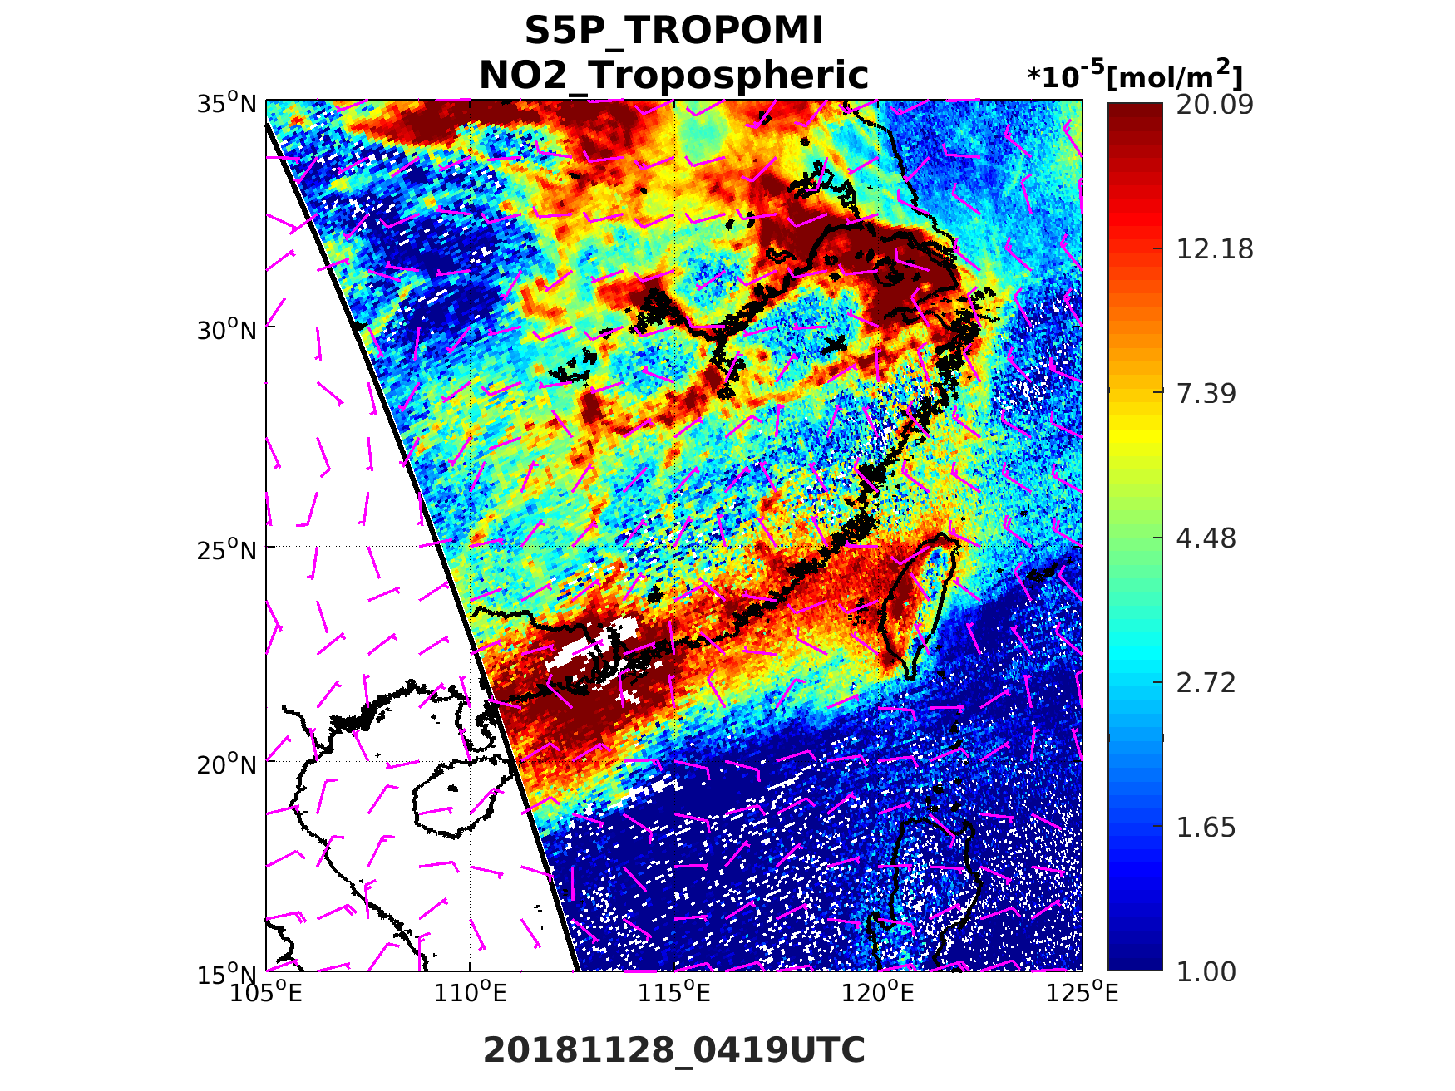
Introduction
Nitrogen oxide (NOx) which is not only mainly air pollutant in urban area but also the precursors of secondary aerosol and ozone.
Sentinel-5 Precursor (S5P) is a new generation environmental satellite, and provides trace gases concentrations information for global coverage.
→ Launch time October 2017 → Instrument: TROPOMI
→ Global daily coverage at 13:30 LST → Spatial resolution: 7×3.5 km ²
Evaluate whether spaceborne TROPOMI on S5P could be conducting related research in Taiwan.
Research Time:June 2018 to May 2019
Research Area:15 sub-regions in Taiwan
Prameter:(S5P) Tropospheric NO2 [$\frac{mol}{m^{2}}$]
(EPA) NO2 [ppb]
North | Taoyuan | Hsinchu | Yilan | Taichung
Changhua | Yunlin | Miaoli | Nantou | Kaohsiung
Pingtung | Chiayi | Tainan | Hualien | Taitung
74 monitoring stations
(Environmental Protection Administration, EPA in Taiwan)

Slide 3
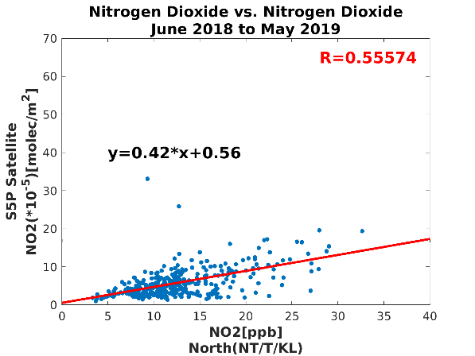
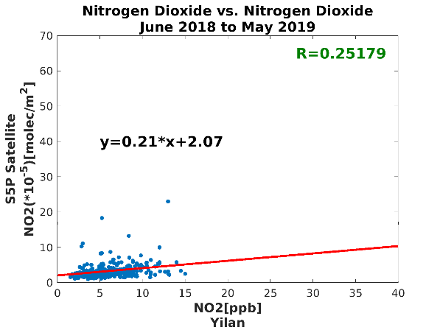
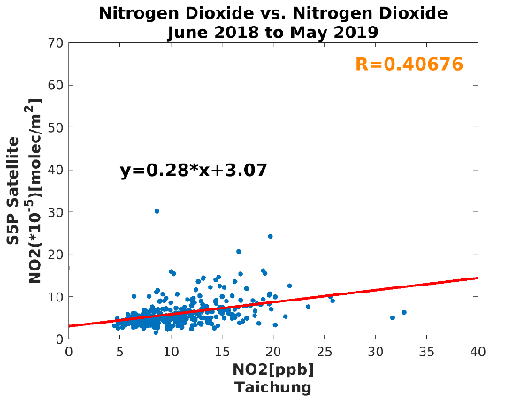
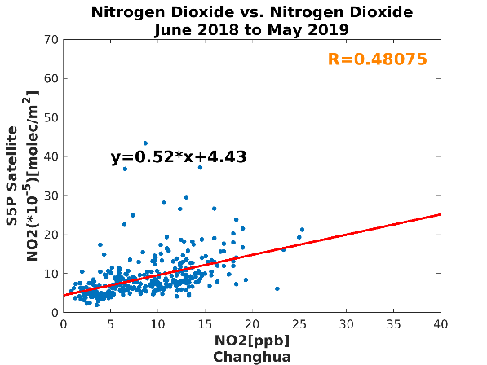
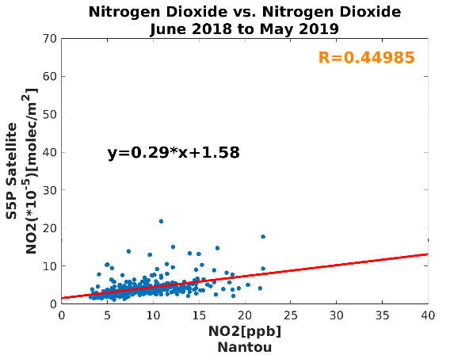
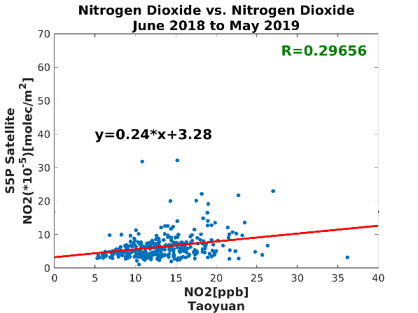
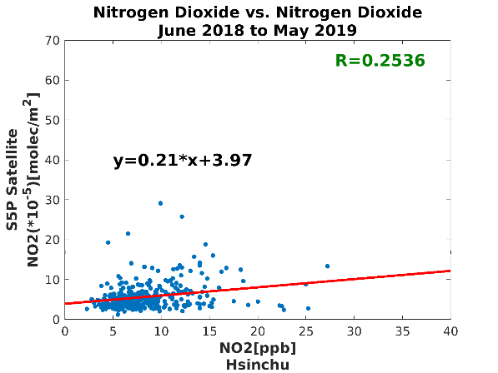
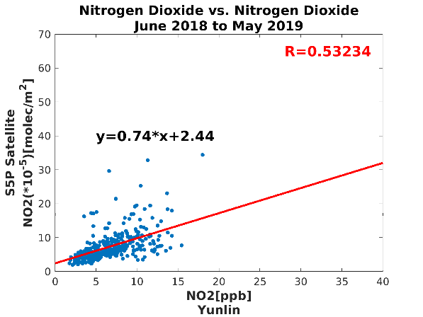
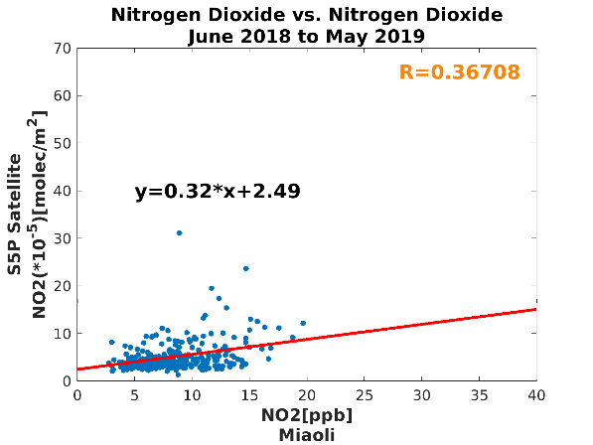
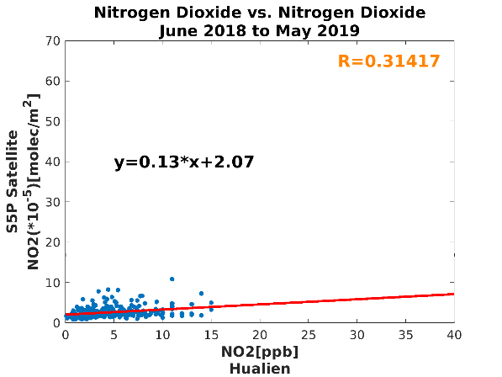
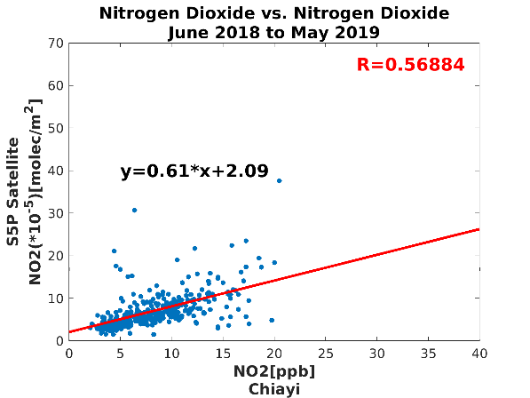
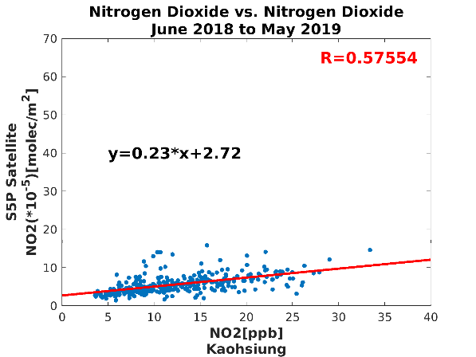
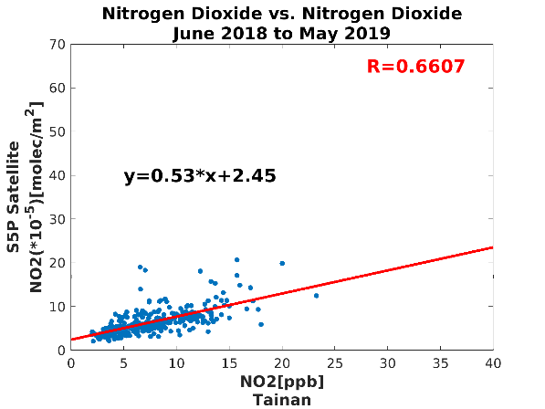
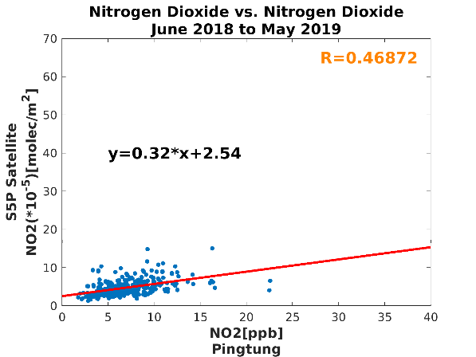
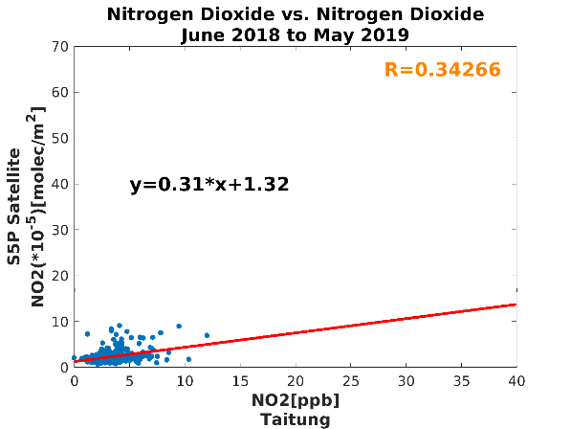
Correlation
NO2_ Daily Correlation
Modestly
Moderately
X- Surface / Y- Satellite
0.3
0.5
Highly
Northern
Pixel numbers>> Stations
Central
Eastern
Southern

Slide 4
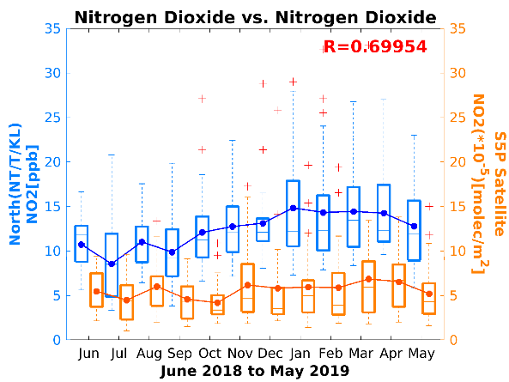
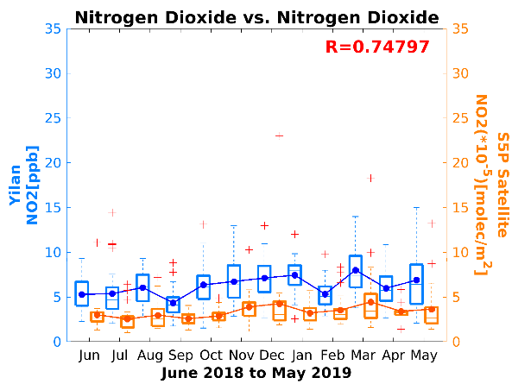
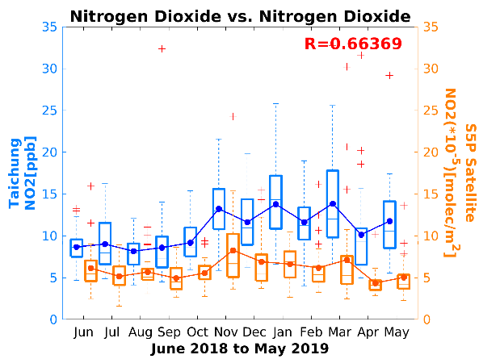
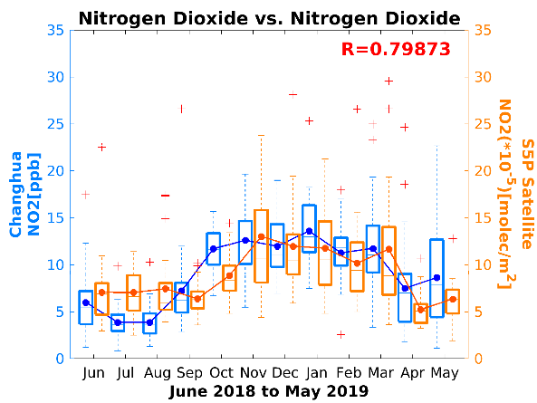
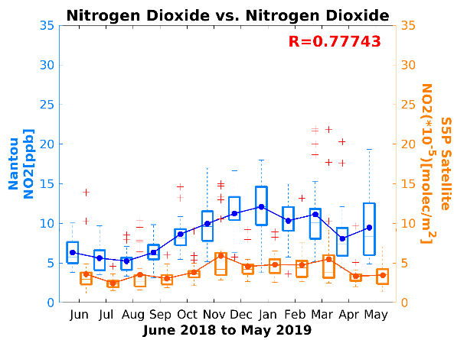
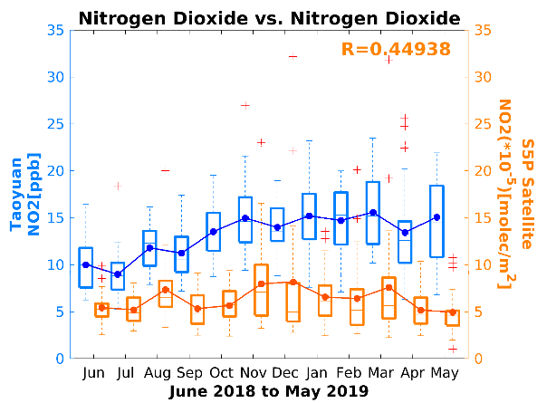
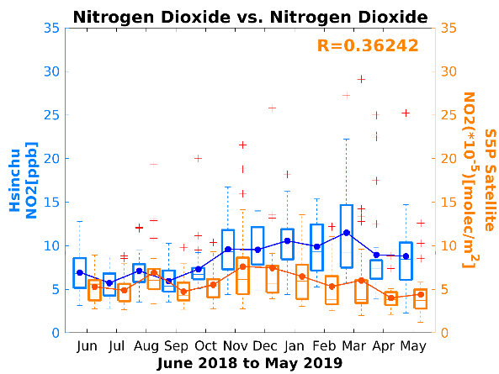
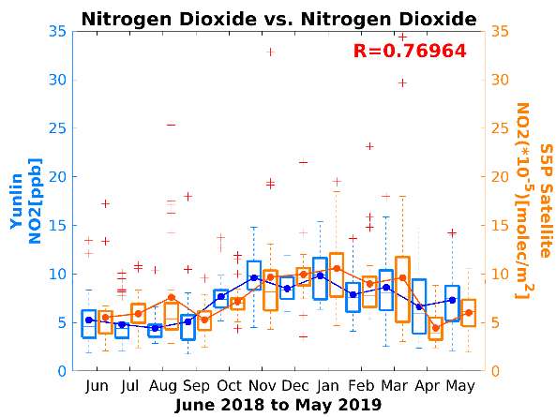
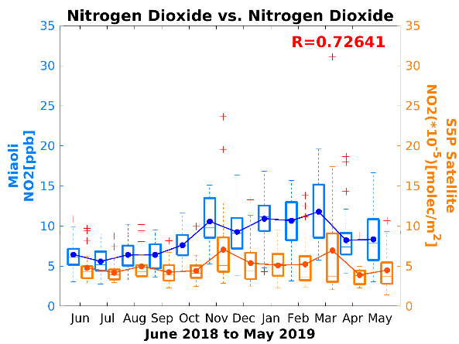
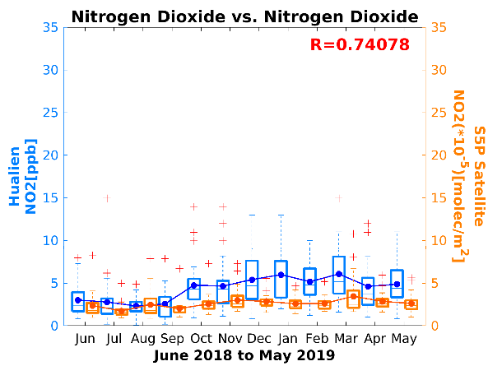
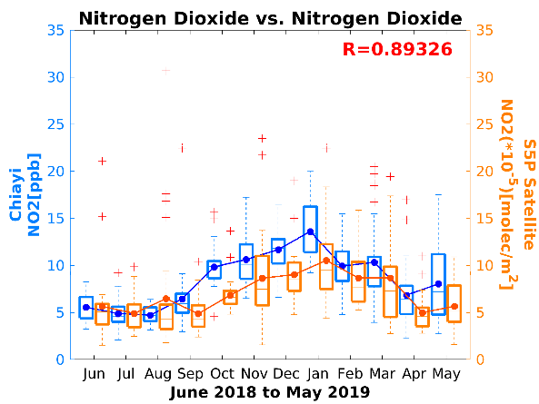
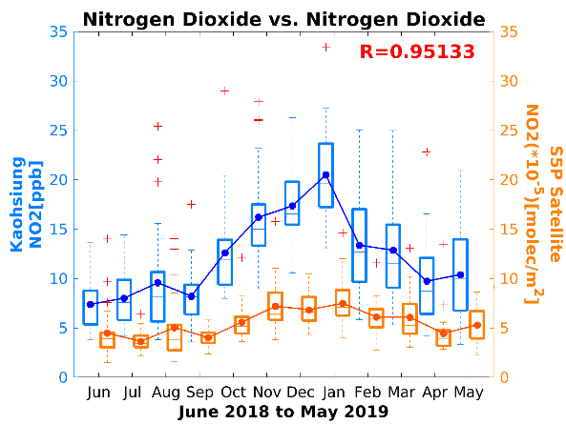
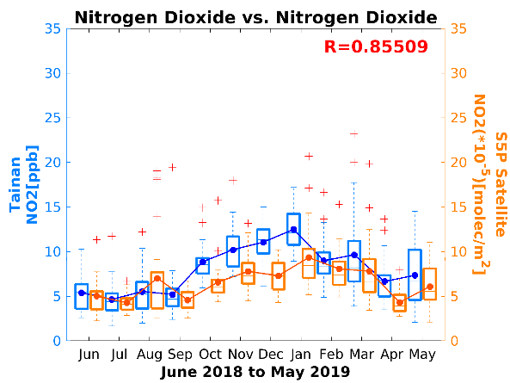
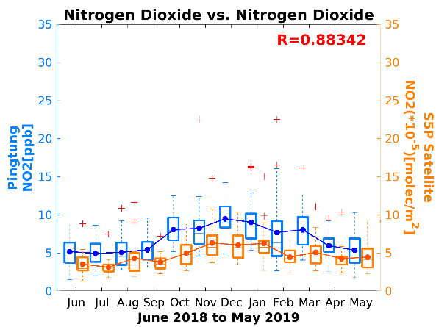
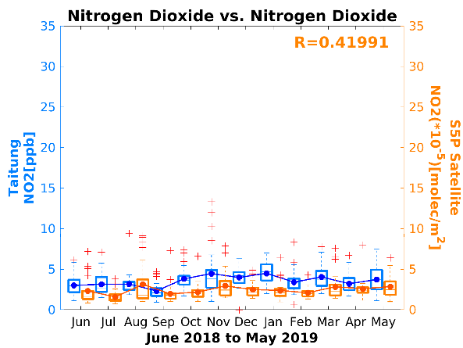
M-: Monthly Variability
S-: Seasonal Variability
NO2_ Monthly Correlation
Surface / Satellite
Northern
S-/M-: Spring/Winter>Fall> Summer
Central
Low concentration
Eastern
Low concentration
Southern
S-South>Central> North/East
S-/M-: Winter/Fall>Spring> Summer
Low concentration

Slide 5
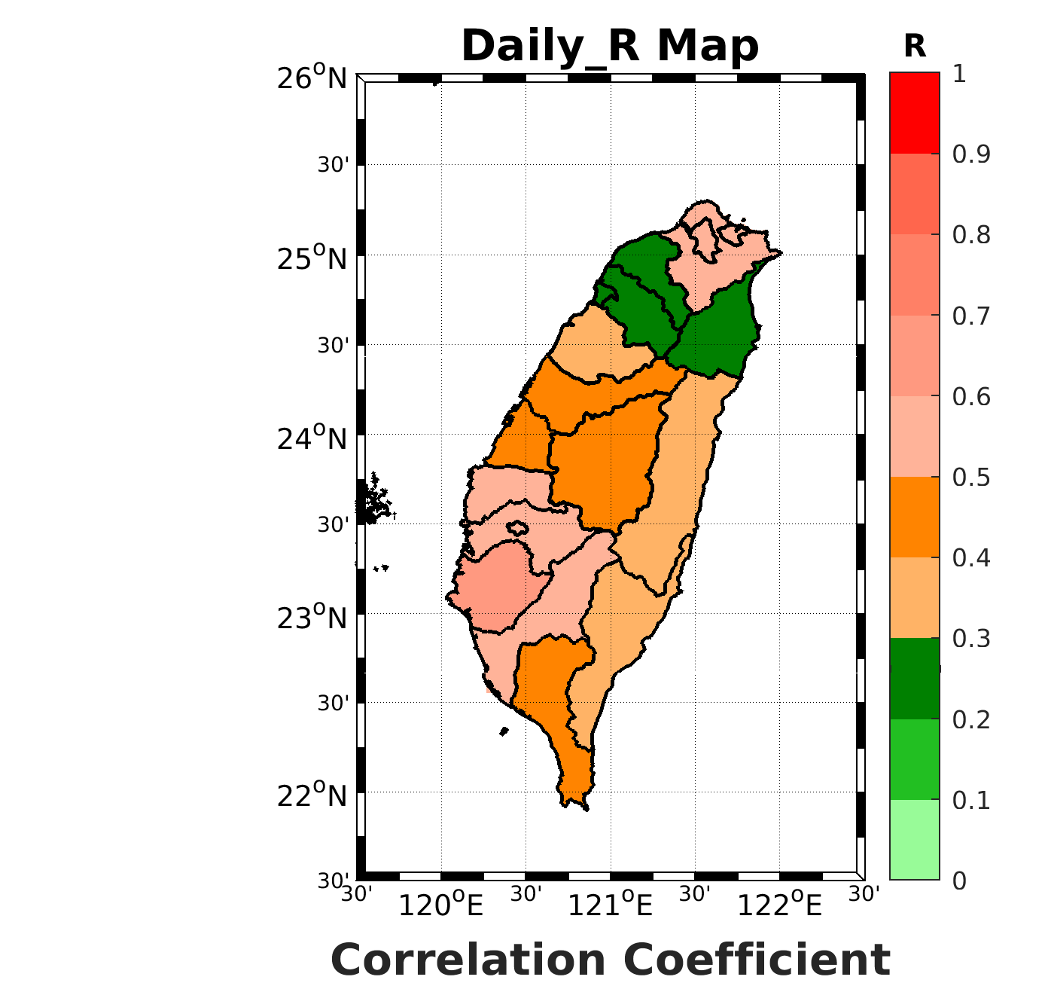
Northern
Central
North
S5P
Yunlin
S5P
Southern
Eastern
These county in monthly correlation are better than in daily correlation.
Spatial distribution of Pollutant
Surface Station
>
>
>
S5P
S5P
Height
Moderately
Modestly
Highly
Tainan
Hualien
Polluted concentrations are associated with wind direction in every regions.
>
$$≈$$
>
West
East

Slide 6
Summary
Most of these sub-regions in monthly correlation are better than in daily correlation.
The tendency of surface NO2 is similar to the tropospheric NO2 in most of counties in Taiwan.
There are lower NO2 concentration in Eastern Taiwan.
NO2 seasonal variation in Southern is larger than in northern Taiwan.
In Taiwan, there are lower NO2 concentration in summer and higher NO2 concentration in winter.
Both ground-base and satellite observations indicated the relationship between wind direction and pollution.
Spaceborne TROPOMI on S5P can be conducting related research in Taiwan.

