Slide 1

Improving air quality forecasting with the assimilation of GOCI AOD retrievals
Soyoung Ha and Zhiquan Liu
National Center for Atmospheric Research, Boulder, Colorado, USA
National Institute of
Environmental Research
Republic of Korea
EGU AS5.4/NH1.25 on May-5-2020

Slide 2
Aerosol data assimilation in WRF-Chem/GSI
KORUS-AQ (May 2016)
D1 – 27km
MET IC/LBCs
(UM forecasts)
Chem LBCs
(MOZART-4)
D2 -9km
Observations
(1-hrly Surface PM_{2.5}, 6-hrly MODIS & GOCI AOD)
First Guess
(WRF-Chem v3.9.1; MOZART-GOCART)
Data Assimilation
(GSI V3.5)
Background Error Covariance
(NMC)
Emission
(EDGAR-HTAP V2, MEGAN, FINN)
observation operator for MODIS and GOCI AOD: CRTM v2.2.3
48-24h forecast diffs for one month of May 2016
Superobing AOD at 27 km resolution before GSI
AOD error estimation based on Choi et al. (2018)

Slide 3
Impact of aerosol assimilation on surface PM_{2.5} forecast
GOCI assimilation:
Monthly mean Analysis increment (A-B)
PM_{2.5} forecast accuracy (%)
Assimilation of GOCI AOD increases PM_{2.5} over the entire atmosphere.
The benefit of the AOD assimilation mostly comes from monitoring the upstream area thru a wide horizontal coverage.
Aerosol assimilation is effectively improving the prediction of surface PM_{2.5} for 24 hrs.
ALL (red): Assimilation of (surface PM_{2.5} + MODIS AOD + GOCI AOD)
=> GOCI AOD retrievals help improving surface PM_{2.5} forecasts, when assimilated with ground PM_{2.5} observations.

Slide 4
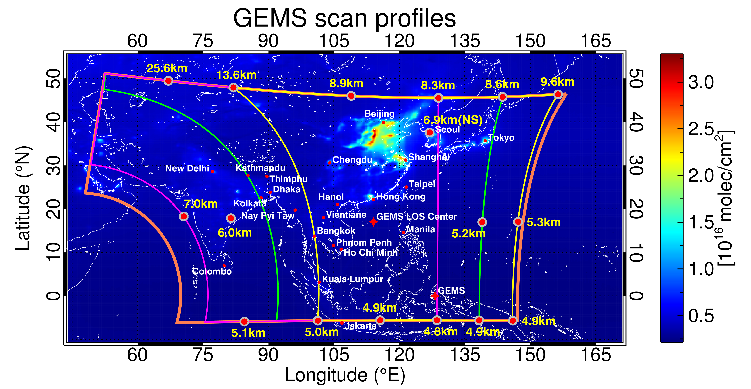
Future plan
WRFDA V4 is being expanded for chemical DA for surface PM, gas concentrations (such as O₃, SO₂, CO, NO₂) as well as AOD for chemistry options other than MOZCART.
Current GSI
WRFDA_2020
Toward the assimilation of AOD and gas profiles
Gas phase chemistry
MOZART
RACM
Regional Atmospheric Chemistry Mechanism
Aerosol chemistry
Bulk
GOCART
MADE
Modal Aerosol Dynamics Model for Europe
Gas phase/particle partitioning
No Secondary Organic Aerosol (SOA)
VBS
Volatility Basis Set
Kim et al. (BAMS2019)

