Slide 1



Specific features of the structure of oligotrophic peatlands in the Arctic ecoregion
N. Laverov Federal Center for Integrated Arctic Research of the Russian Academy of Sciences
Dr. Selyanina Svetlana
Ponomareva Tamara
Arkhangelsk, Russia

Slide 2
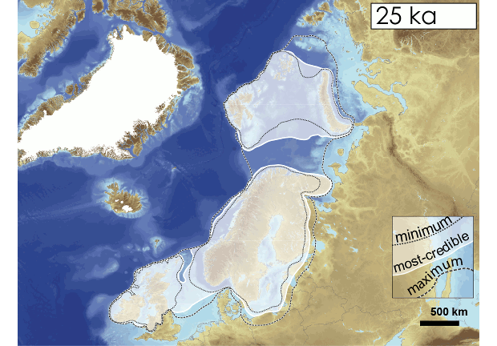
Formation of bogs in the Arctic ecoregion
Bogs in the Euro-Arctic region of the Russian Federation began to form at the end of the last glaciation (20-9 thousand years ago) [1];
The onset of the glacier was characterized by the closure of the throat of the White Sea and the springing of the rivers flowing into it. As a result, there was a backward movement of rivers, an invasion of the sea up to 300 km inland [2];
Deglaciation began about 13 thousand years ago, Arctic ecoregion completely cleared from ice approximately 9 thousand years ago [5];
The movement of the last glacier in Scandinavia and the north-west of Russia (25 000-9000 years ago)
Postglacial terrain features and formation of large number of lakes, when the remains of a glacier melt led to active swamping of vast territories. The cooling and increase in precipitation at the beginning of the Atlantic period (about 4.5 thousand years ago) contributed to the strengthening of these processes [5].
The mechanical texture of glacial and fluvioglacial sediments, as well as the formation of a sufficiently powerful layer that shields marine deposits, along with the terrain features, served as factors that caused the predominance of oligotrophic bogging processes;
The region combines the bogs of the two large bog provinces of Northern Europe - the South-pribelomorskaya and Pechora-Onega [1,3,4]. Bogs cover up to 30% of the territory in the Arctic ecoregion of the Russian Federation (more than 80% are oligotrophic peatlands) [6].

Slide 3
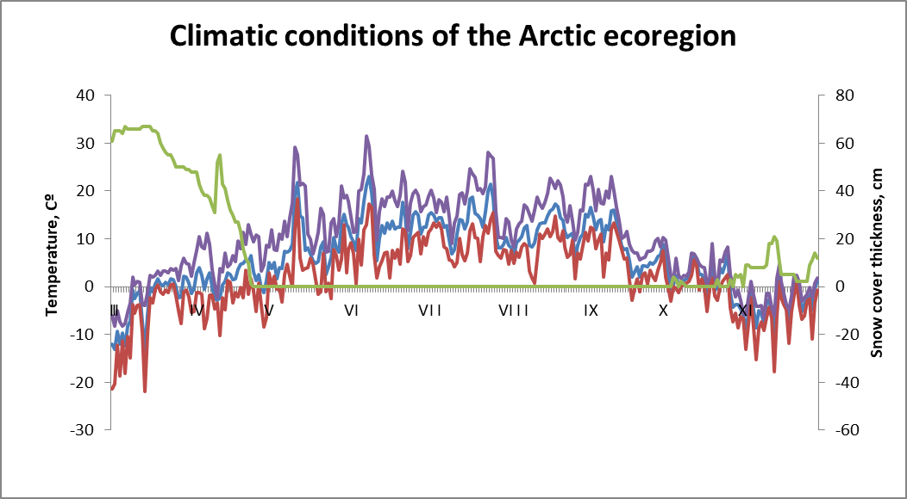
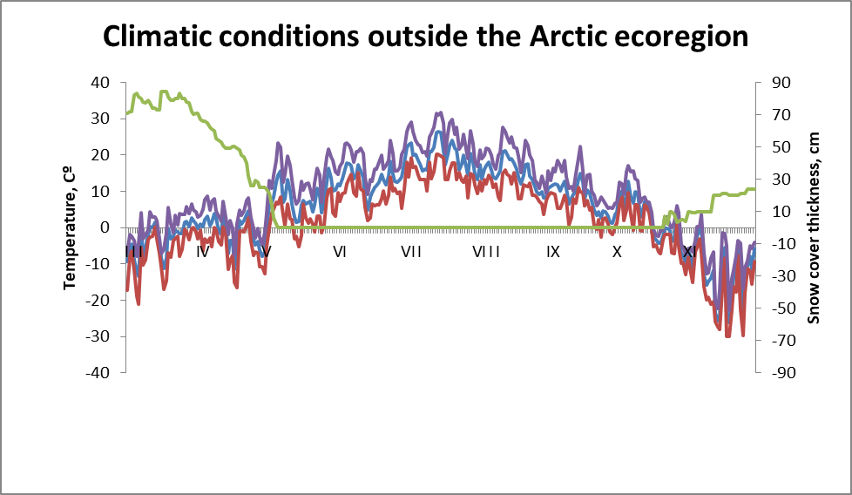
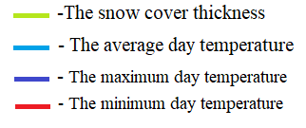
Climatic features of the formation of oligotrophic peat bogs
The process of peat formation at study sites in the Arctic ecoregion takes place in a moderately cold, weakly continental Atlantic-Arctic climate with the pronounced influence of the White and Barents Seas. The influence of air mass transfers from the Atlantic is also noted.
The process of peat formation on sites outside the Arctic ecoregion takes place in the continental climate zone. Here, the continental air of temperate latitudes dominates throughout the year. In summer, the meridional circulation intensifies, as a result of which both Arctic and tropical air enter the territory. The Atlantic air flows here, largely transformed, with western transport,.

Slide 4
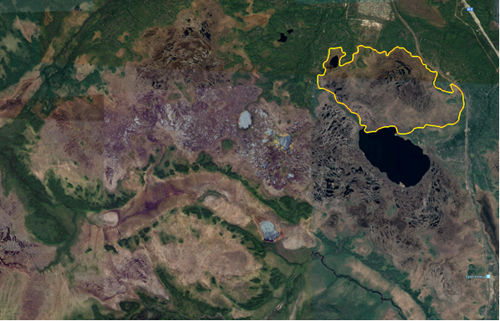
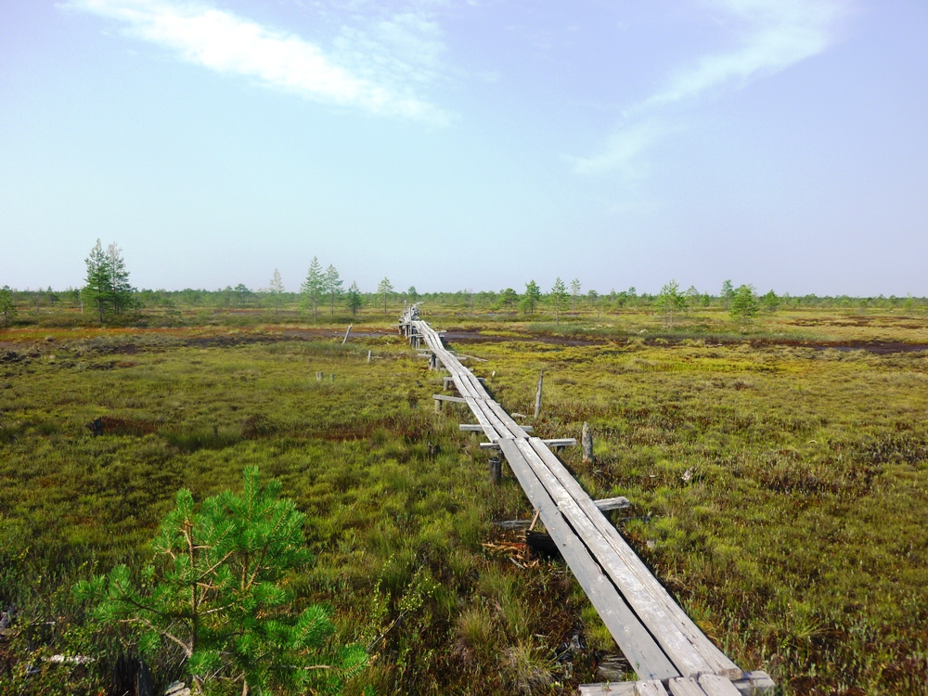
Study sites in the Arctic ecoregion
Oligotrophic bog of the North-west of the Russian plain
(Ilas bog massif, Arkhangelsk region)
Location: 64°19'43"N, 40°36'45"E;
The area of ​​the bog massif is 89 km²;
South-pribelomorskaya bog province;
Raised oligotrophic peat bog in the prevalence of sphagnum mosses, cotton grass and suppressed pine;
Natural humidity 92%;
The botanical composition of the deposit: very homogeneous with the participation of oligotrophic sphagnum mosses 95-100%;
The average degree of decomposition of 15-20%;
Peat accumulation rate: ≈ 0.17 cm/year;
The average depth of the deposit is
3.2-4.3 m. The maximum depth is up to 7 m.
The satellite image of the bog massif IBM-1
General view of the bog massif IBM-1

Slide 5
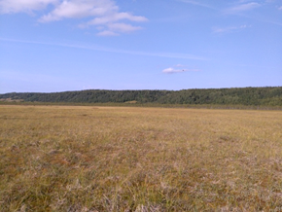
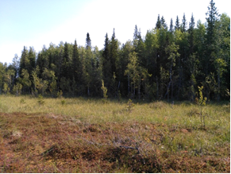
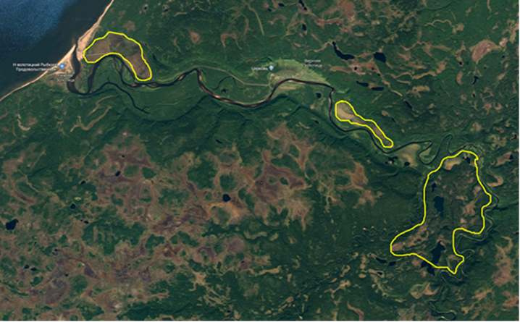
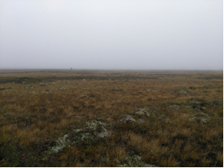
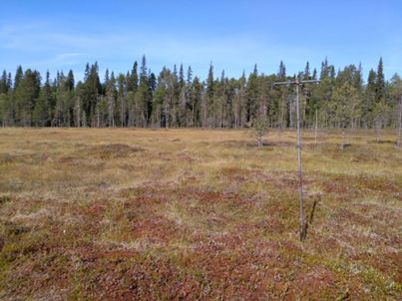
Study sites in the Arctic ecoregion
Oligotrophic bogs of the lower stream of the Zolotitsa River
Location: 65°38'N, 40°31'E;
Zol-9, Zol-8 - bogs of the South-pribelomoskaya bog province;
Zol-6, Zol-7 – bogs of the Pechora-Onega bog province;
Study sites are raised oligotrophic peat bogs with a predominance of sphagnum mosses;
Natural humidity 90-95%;
The botanical composition of the deposit: homogeneous with the participation of oligotrophic sphagnum mosses 90-95%;
The average degree of decomposition of 15-20 (30)%
Zol-8
Zol-6
Zol-9
Zol-7

Slide 6
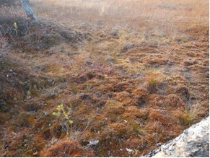
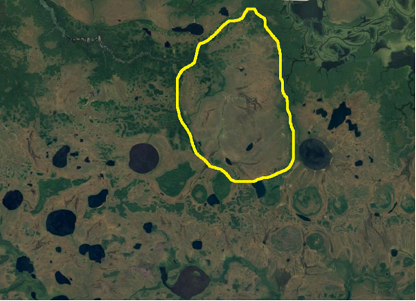
Study sites outside the Arctic ecoregion
Oligotrophic bog of the Western Siberia (Bog station Mukhrino, Yugra)
Location: 60°53'20"N, 68°42'09"E;
Raised oligotrophic peat bog in the prevalence of sphagnum mosses, cotton grass, without a tree layer;
Natural humidity 90-95%;
The peat deposit with a very high density;
The botanical composition of the deposit: very homogeneous with the participation of oligotrophic sphagnum mosses 95-100%;
The average degree of decomposition of 10-30%;
The average depth of the reservoir is 3.5-4.0 m.
The satellite image of the bog massif HM-3
General view of the bog massif HM-3

Slide 7
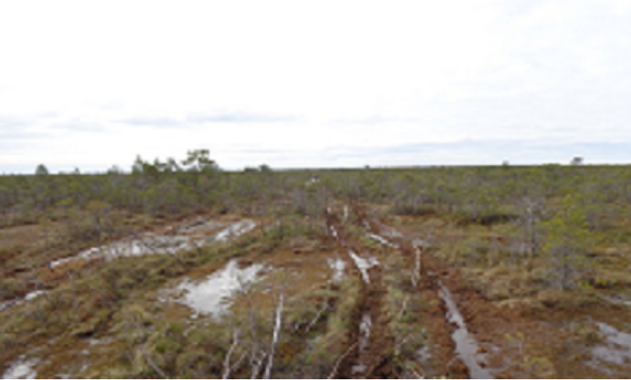
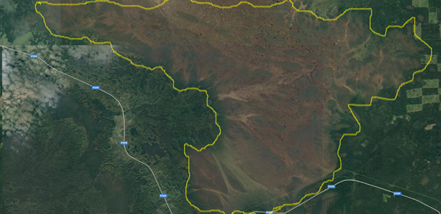
Test sites out of the Arctic ecoregion
Oligotrophic bog of the Western Siberia (Vasyuganskoe bog, Tomsk)
Location: 56°58'19 ''N, 82°36'22''E;
Raised oligotrophic peat bog in the prevalence of sphagnum mosses, cotton grass and shrubs, with a layer of suppressed pine;
Natural humidity 90-95%;
Botanical composition of the deposit: layers with cotton grass and sphagnum moss composition alternate. The participation of sphagnum mosses 80-90%;
The average degree of decomposition of 15-25%;
The average depth of the deposit is more than 1.0 m.
The satellite image of the bog massif NR-2
General view of the bog massif NR-2

Slide 8
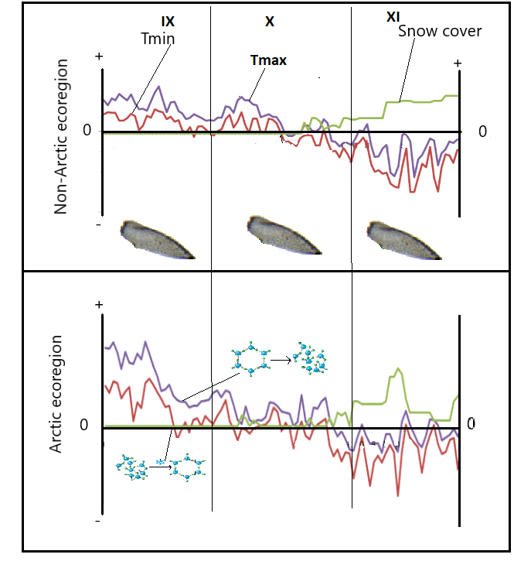
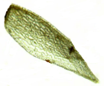
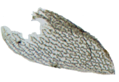


The impact of freeze-thaw cycles on peat macrostructure
Month

Slide 9
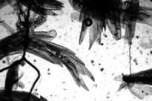
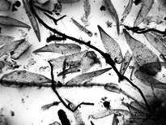
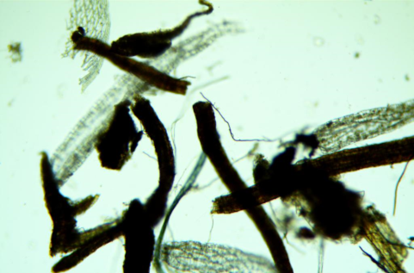
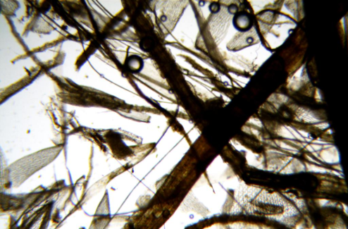
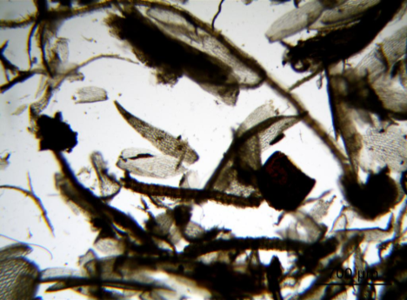
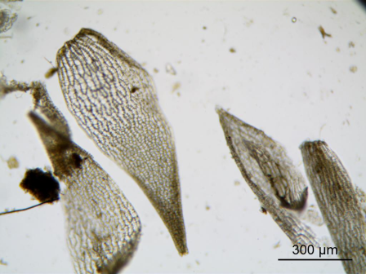
The peat structure on raised oligotrophic bogs outside the Arctic ecoregion
Climatic, physico-chemical, biological and geochemical features of the peat formation in raised oligotrophic bogs inhibit the processes of bio-transformation. Therefore, the peat is characterized by a low degree of decomposition and high preservation of macro- and microstructure in these types of bogs. This process is most clearly seen in the continental climate zone outside the Arctic ecoregion.
NR-2
HM-3

Slide 10
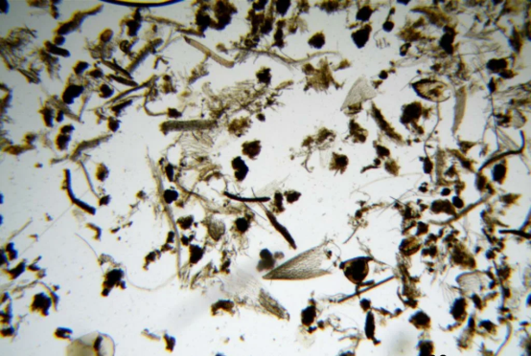
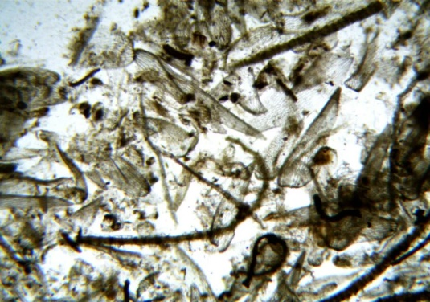
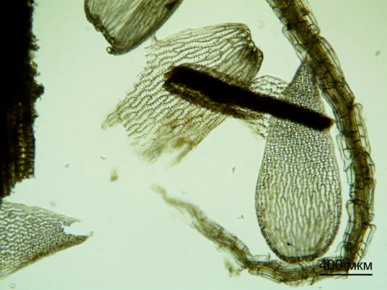
The peat structure on raised oligotrophic bogs in the Arctic ecoregion
Studies of raised oligotrophic bogs of the Arctic ecoregion revealed features of the peat formation process. The microscopic investigation showed that the structure of plant residues turned out to be disturbed, at very low rates of decomposition. Therefore, it is not connected with the processes of decomposition of organics.
Sphagnum moss leaves have a torn structure, while the outer cell layers retain the cellular structure.
It should also be noted that the stalks of sphagnum mosses are not subject to mechanical rupture of tissues - the hyaline cells on the stems are in an undisturbed state.
IBM-1

Slide 11
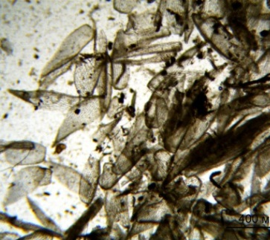
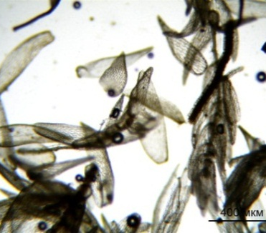

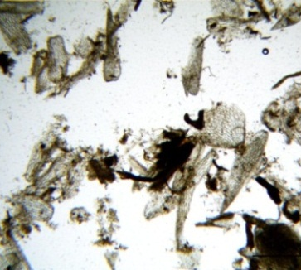
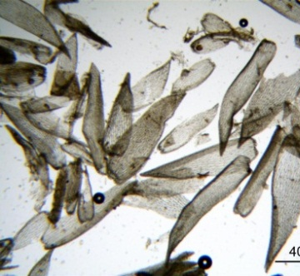
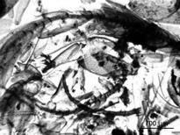
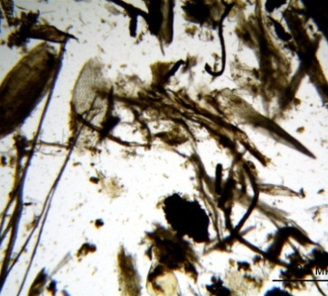
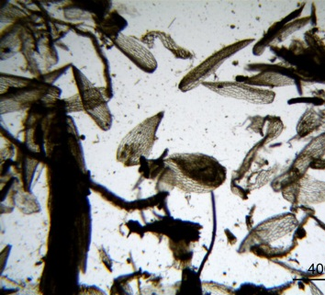
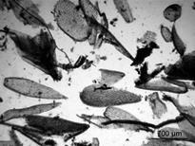
Peat structure at different depths
ST-1
HM-3
NR-2
20-40 cm
0-20 cm
120-140 cm
20-70 cm
320-340 cm
70-100 cm
Microphotographs of peat samples from various depths of the study sites ST-1, HM-3 and NR-2 (magnification 4X)

Slide 12
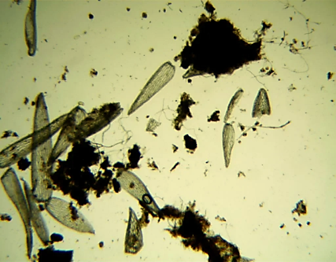
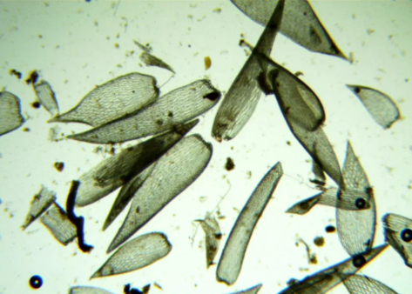
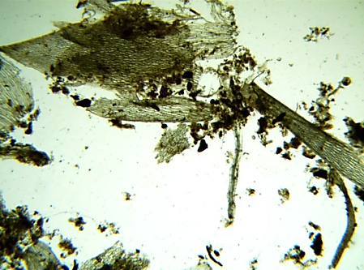
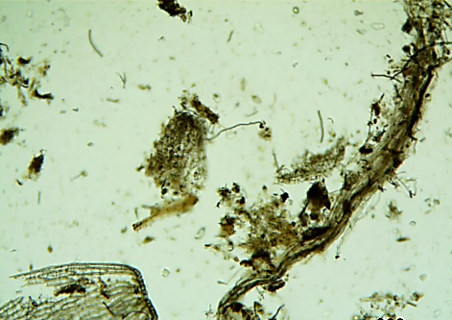
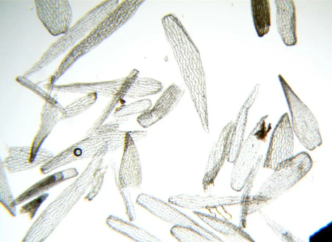
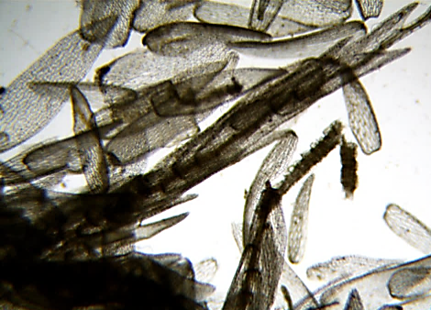
Specific features of the structure of oligotrophic peatlands in the Arctic ecoregion
Study sites in the Arctic ecoregion
Zol -9 (20-60 cm)
Zol-8 (20-60 cm)
Zol -6 (20-40 cm)
Zol 7 (20-60 cm)
Study sites outside the Arctic ecoregion
HM-3 (20-40 cm)
NR-2 (20-40 cm)

Slide 13
Conclusion
Plant residues in peat deposits of raised oligotrophic bog massifs are characterized by high preservation of cell structures.
There is no mechanical destruction of plant residues, characteristic of the bogs of the Arctic ecoregion, during the bog formation in the continental climate zone.
A significant difference in structure is probably due to freezing-thawing cycles during the formation of a stable snow cover in autumn.
The specific character of defragmentation of plant residues in the conditions of oligotrophic bog massifs of the Western segment of the Russian Arctic is revealed in comparison with similar peat deposits of Western Siberia.

Slide 14
Literature
Smagin V.A., Noskova M.G., Antipin V.K., Boychuk M.A. Diversity and phytocenotic role of mosses in the marshes of the south-west of the Arkhangelsk region and adjacent territories // Proceedings of the Karelian Research Center of Russian Academy of Science. 2017. No1.
Jensen M., Demidov I.N., Larsen E., Lysa A. Vistula glaciers, lakes and sea level in the Arkhangelsk region: correlation opportunities and problems. The problem of correlation of Pleistocene events in the Russian North. Abstracts of the international workshop. December 4-6, 2006 St. Petersburg, 2006. Р. 45.
Katz N. Ya. Swamps of the globe. M.: Nauka, 1971.
Yurkovskaya Т. Main latitudinal and longitudinal characters of Russian mire vegetation // Proc. IAVS Symposium. Opulus Press: Uppsala. 2000. P. 130-132.
Ashchepkova A.A., Semikolenny A.A. Deposits of swamps and caves of the Pinega karst massif (Arkhangelsk region) as an indicator of changes in the natural environment in the Pleistocene-Holocene // Speleology and spelestology: collection of materials of the V international scientific correspondence conference (on the occasion of the 100th anniversary of A.V. Ryumin) / Ed. V.S. Zhitenev. - NISPR, Naberezhnye Chelny, 2014. S. 92-98.
Diggelen R. (2018). Mires and Peatlands of Europe: Status, Distribution and Conservation. Restoration Ecology. DOI: 26. 10.1111/rec.12865.

Slide 15
Thank you for your attention!
See you at EGU 2021 (Vienna, Austria)!

