Slide 1
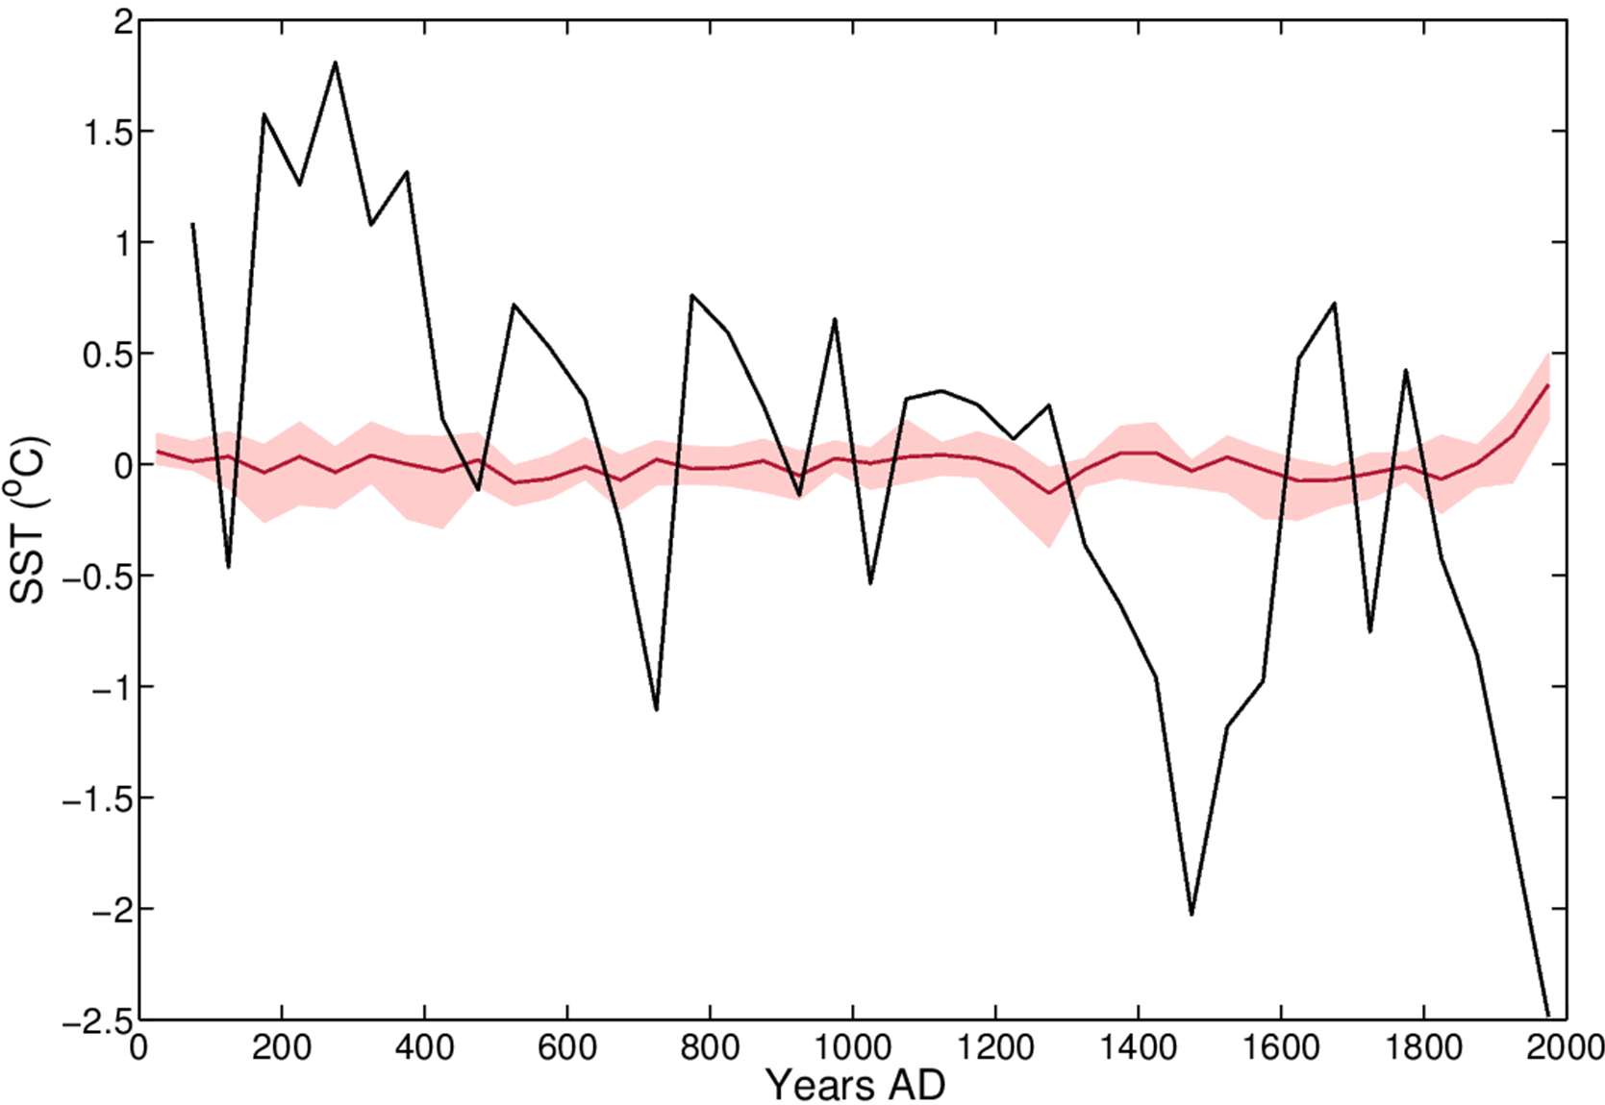
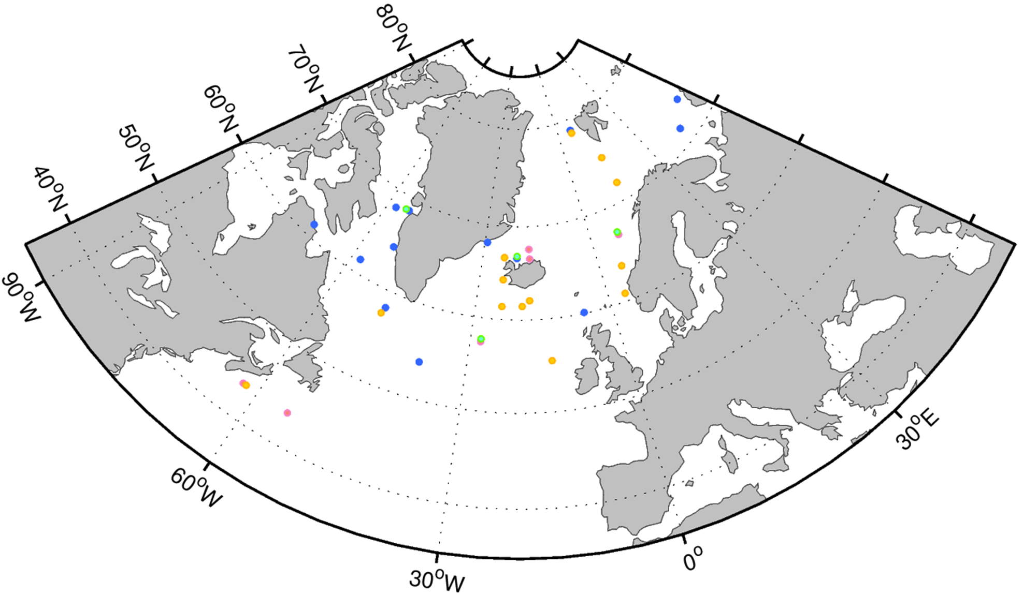
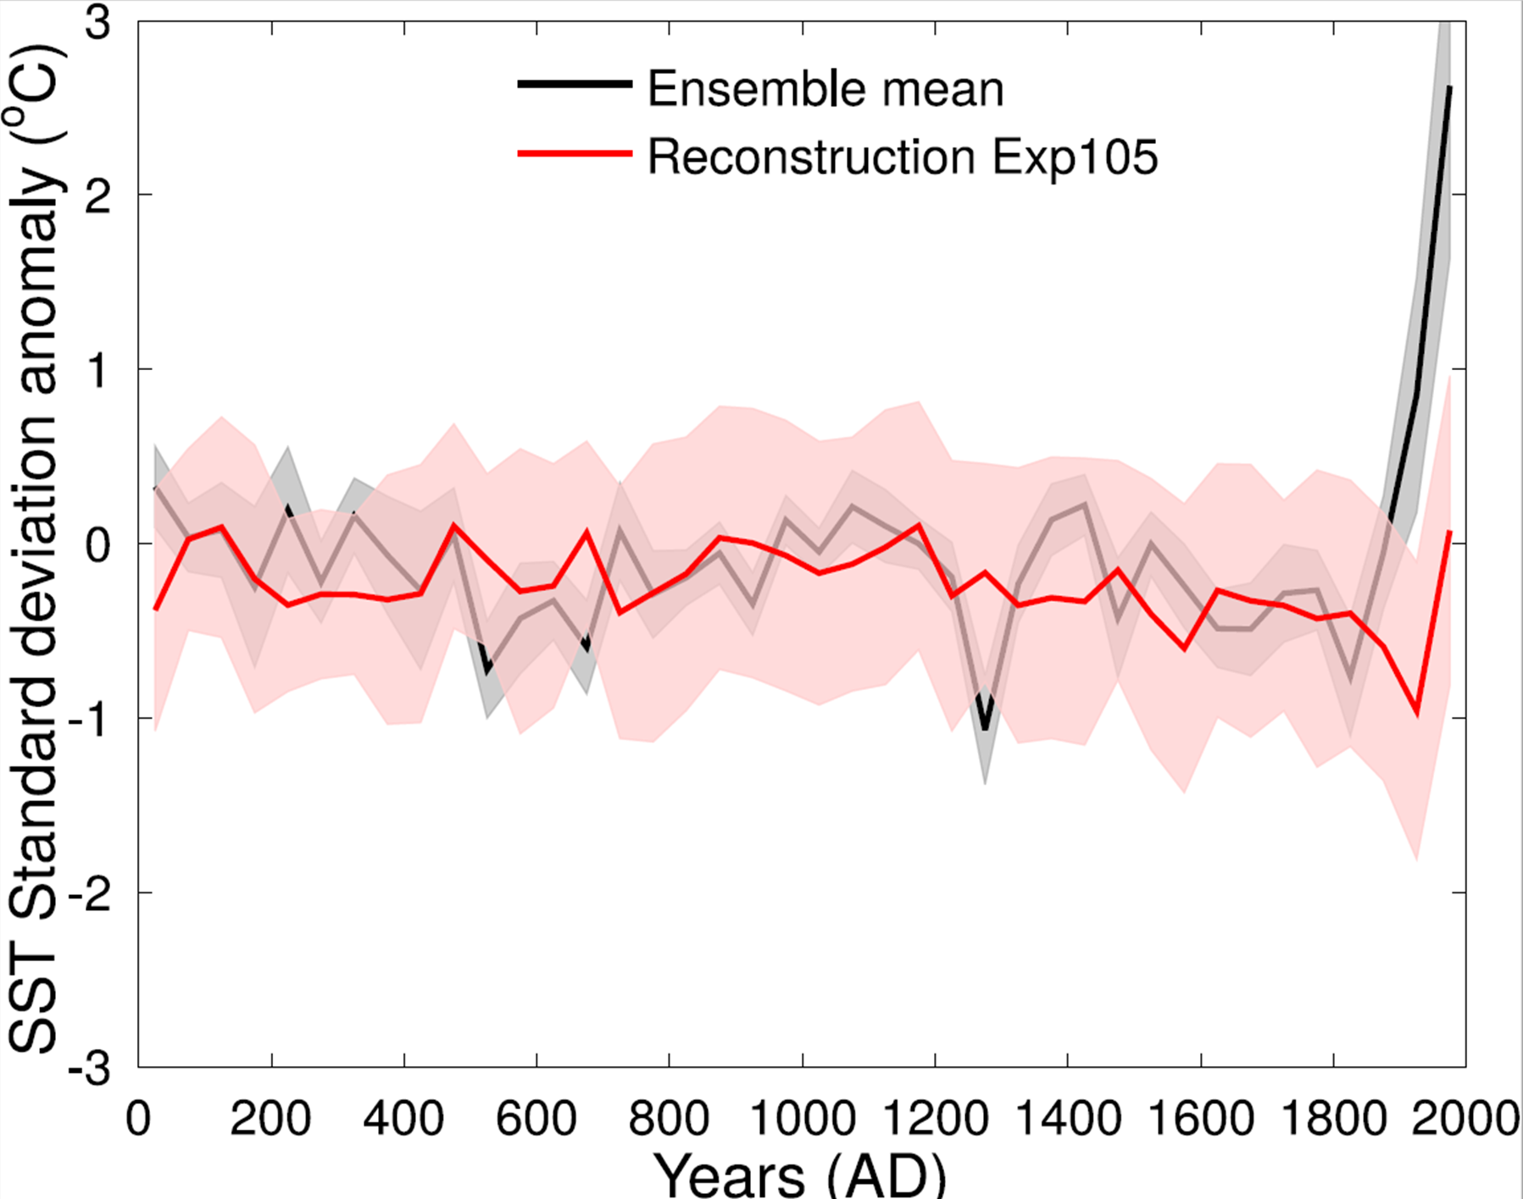
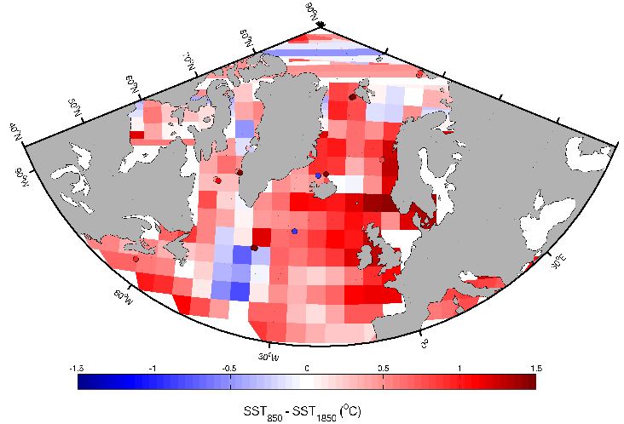
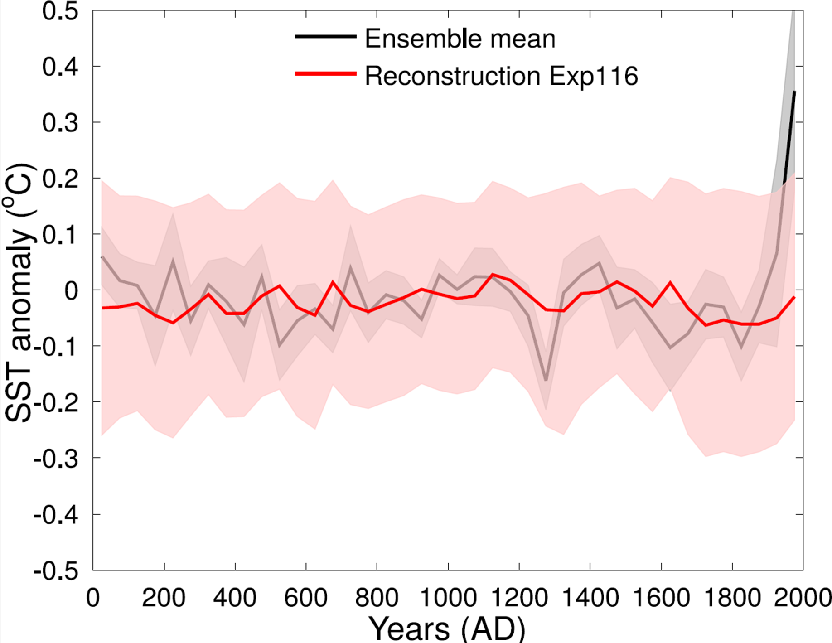
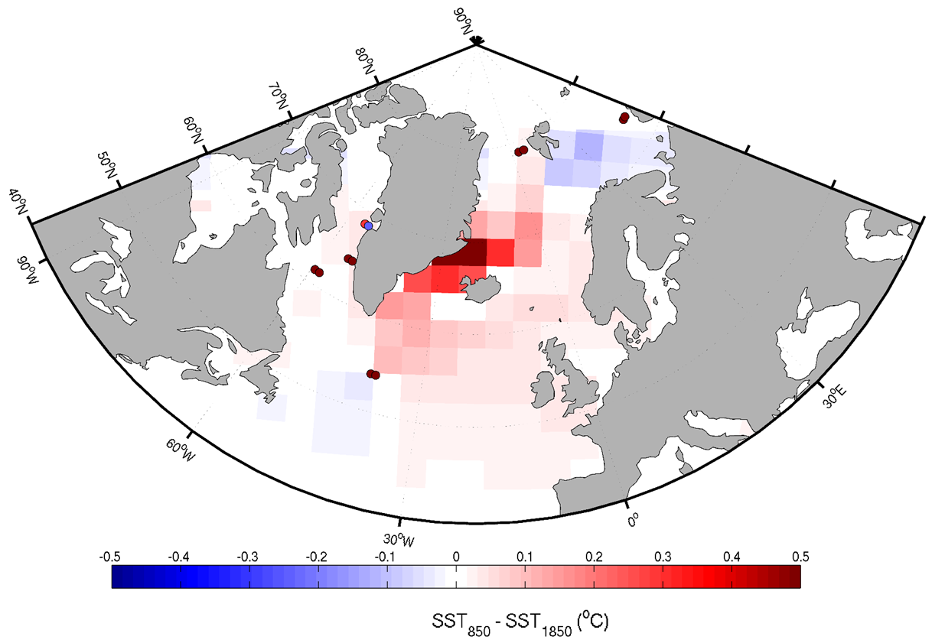
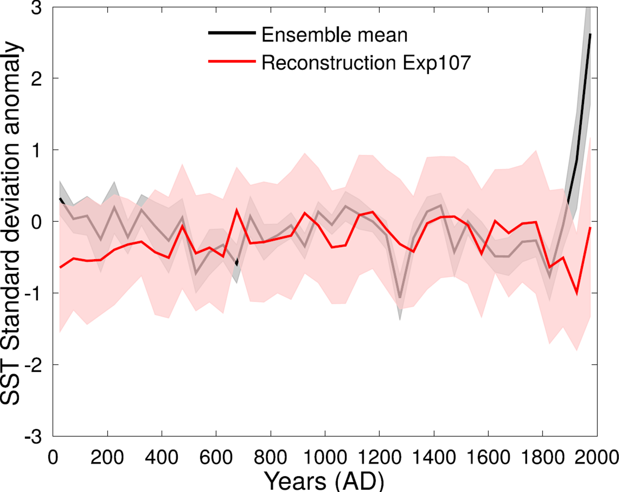
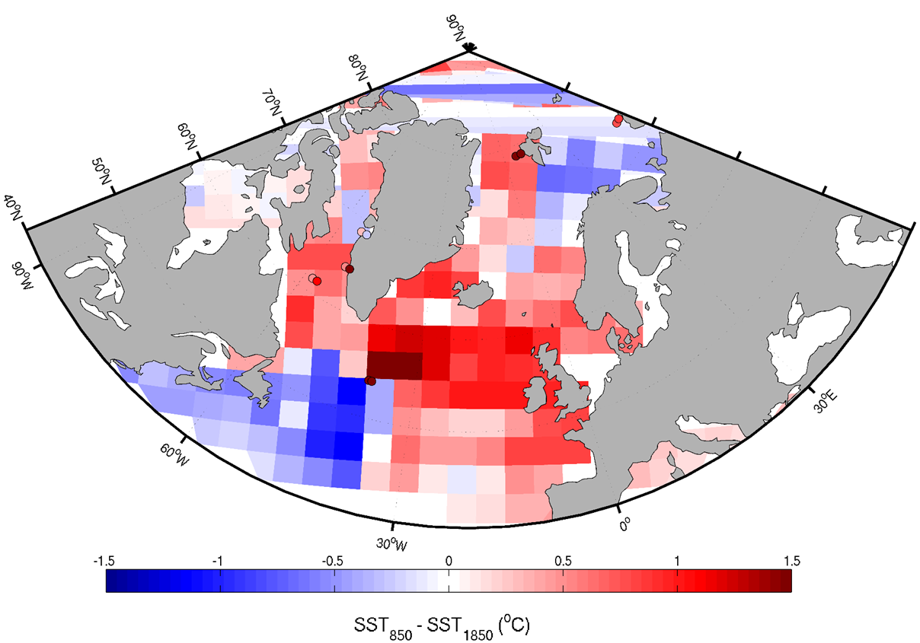
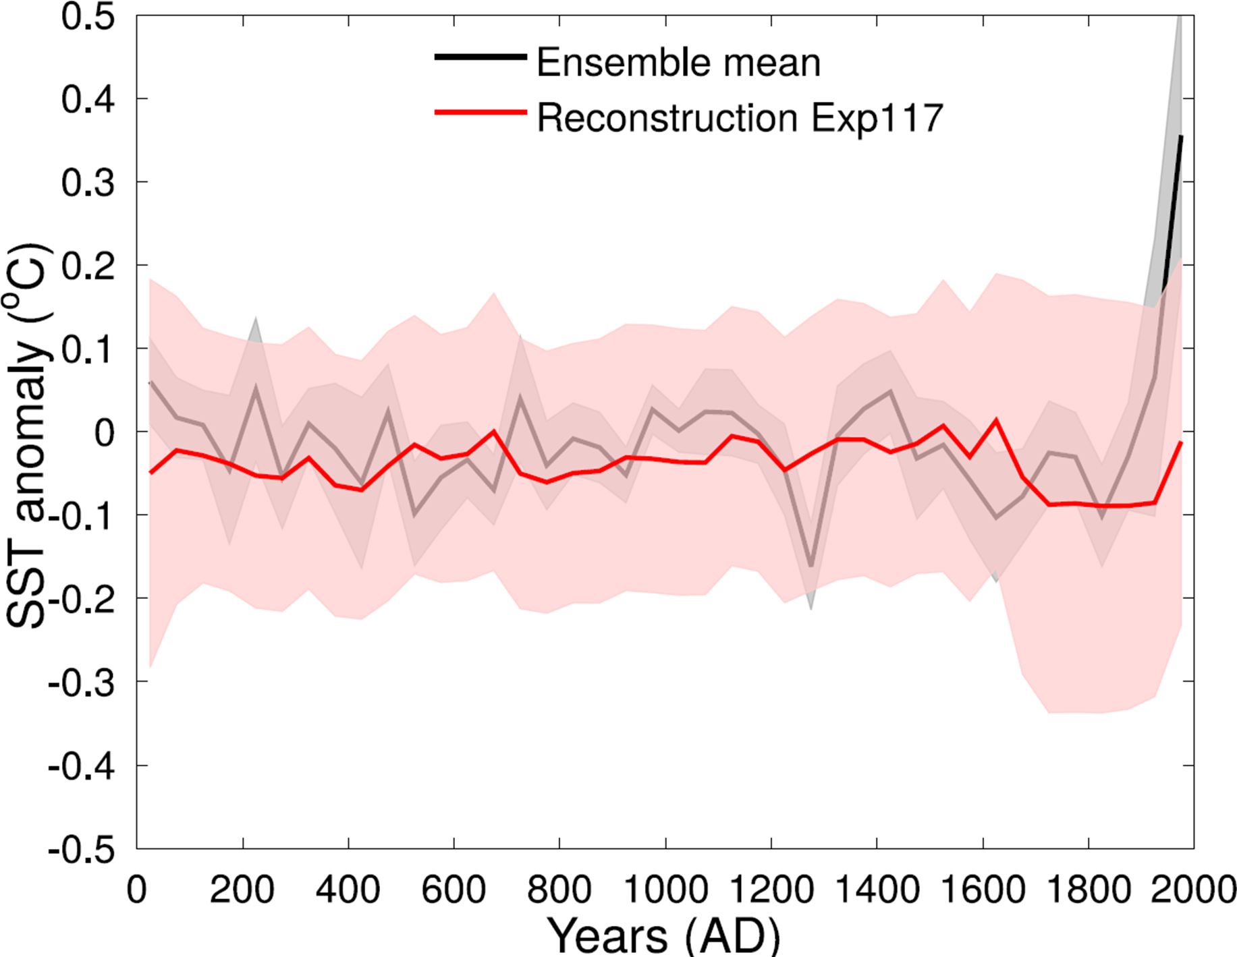
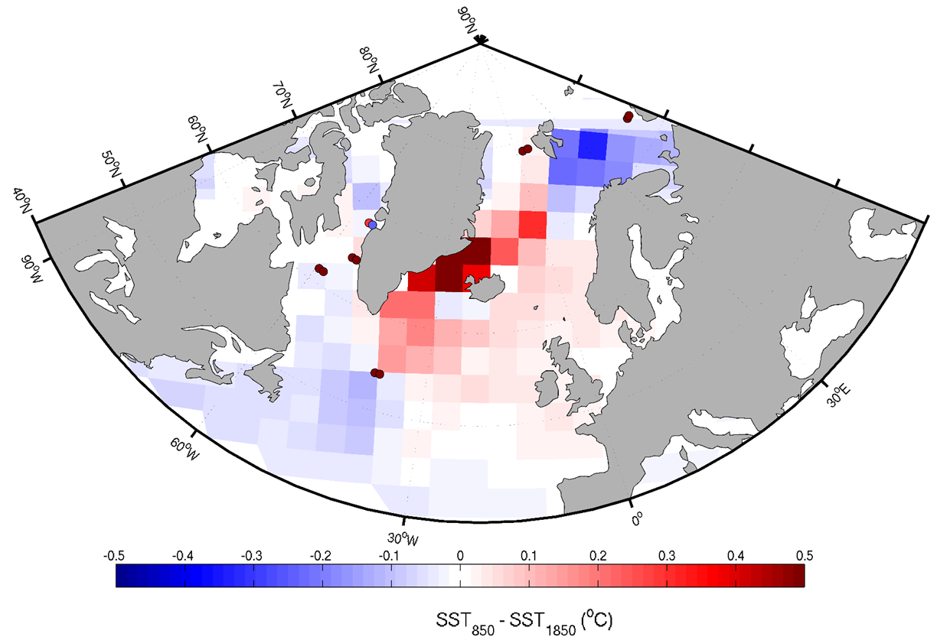
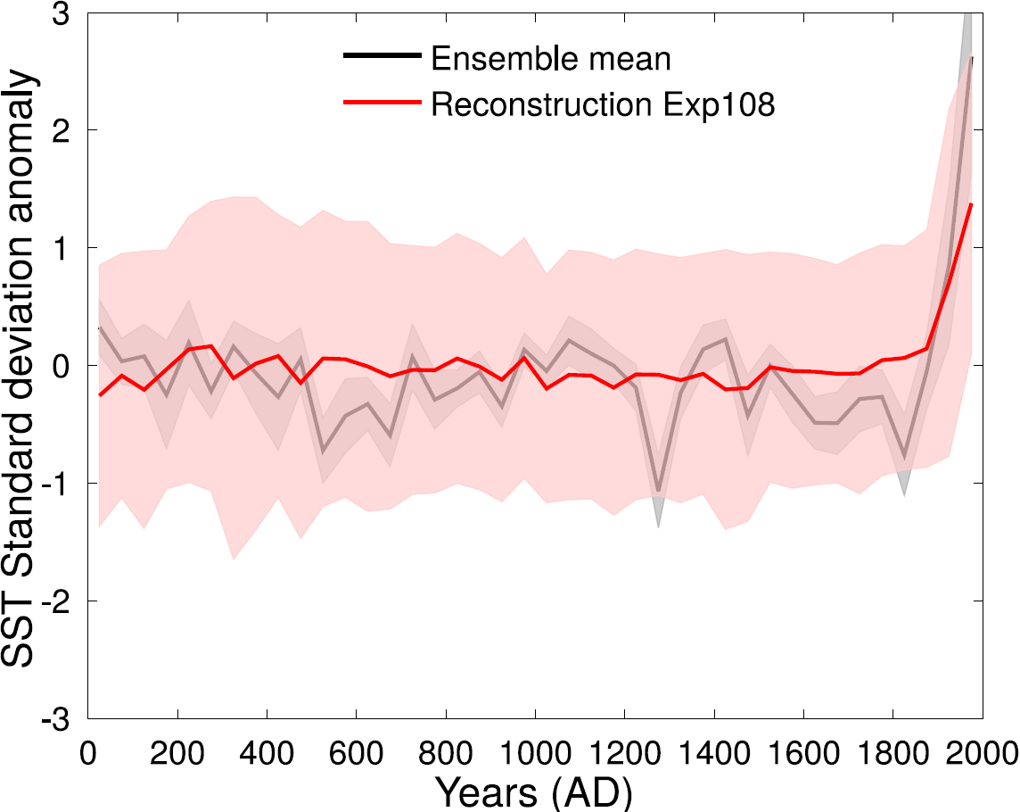
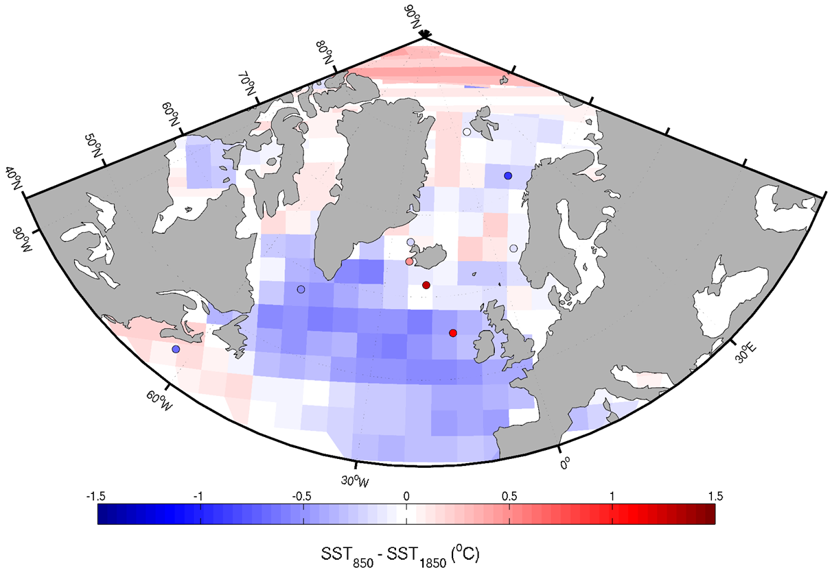
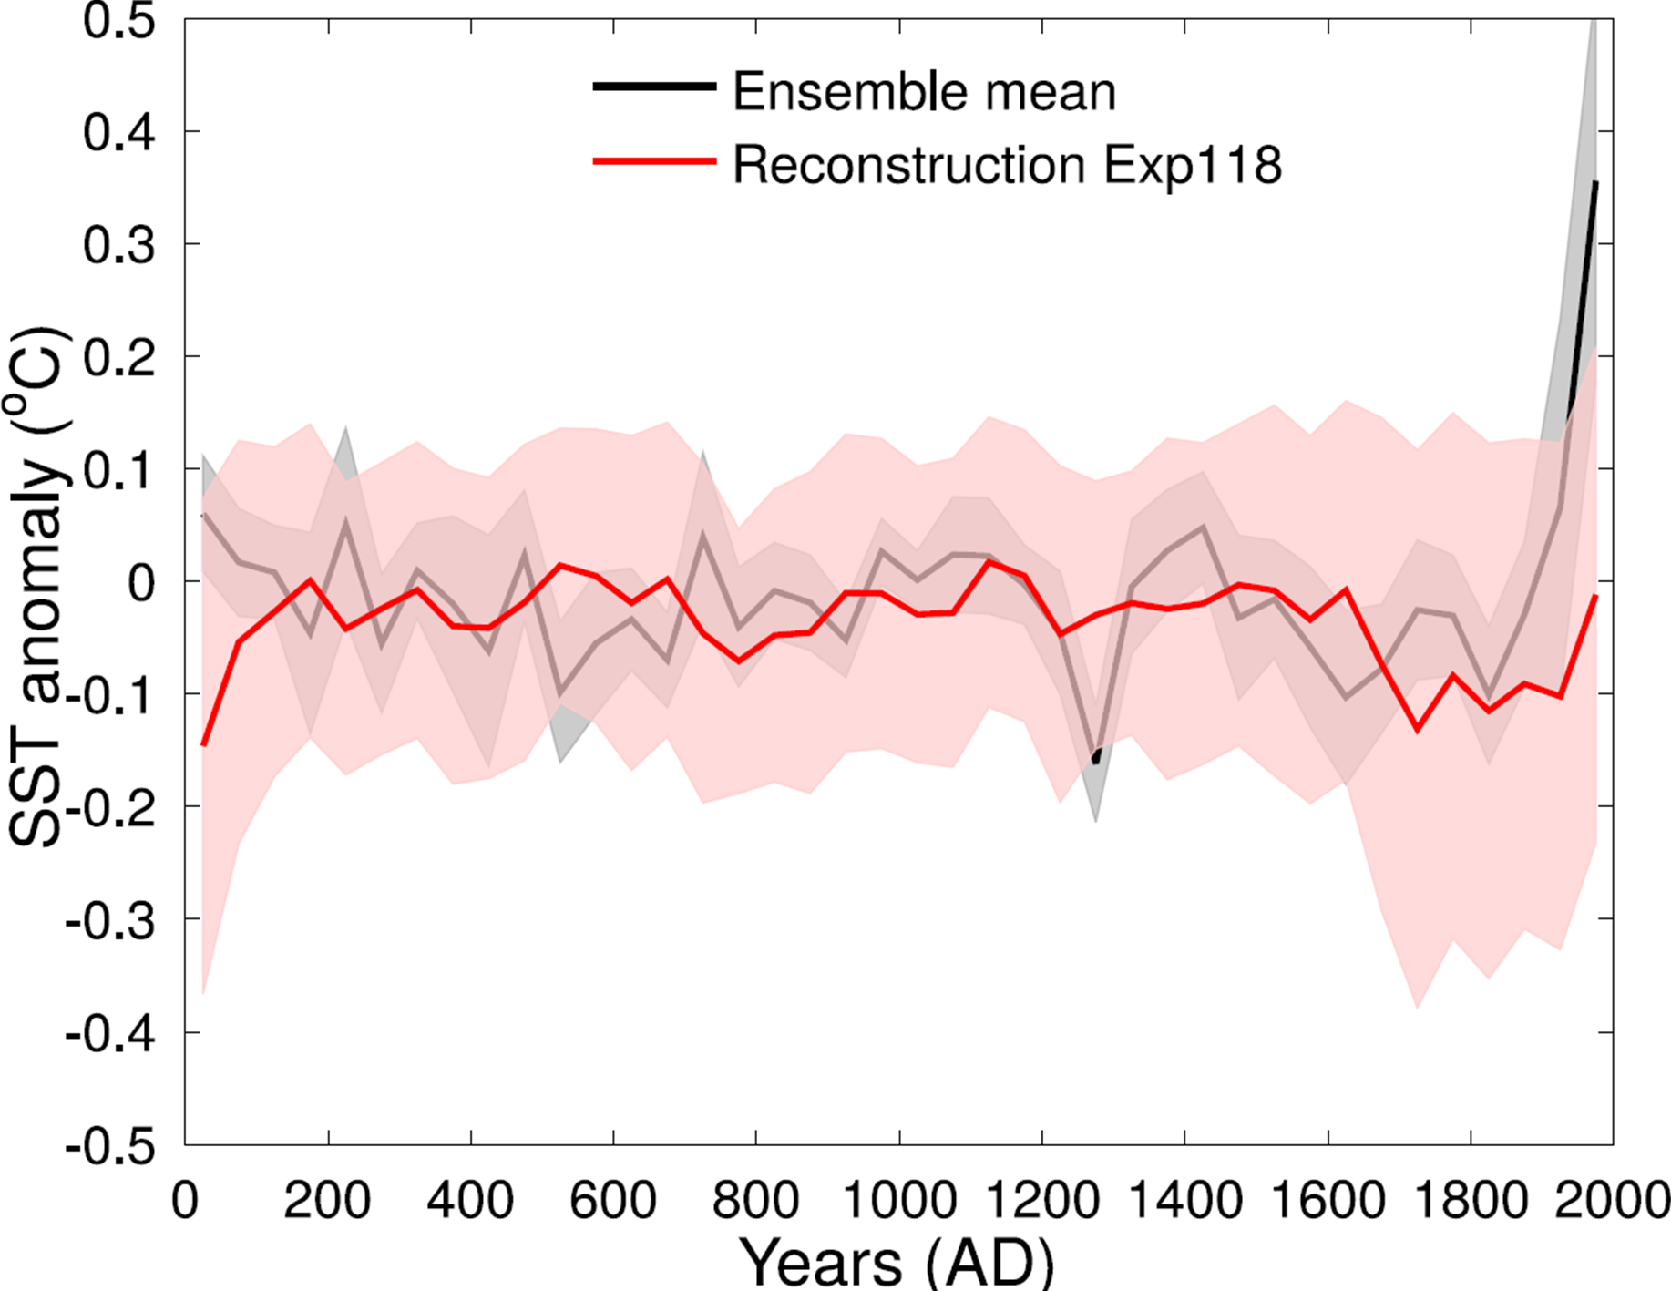
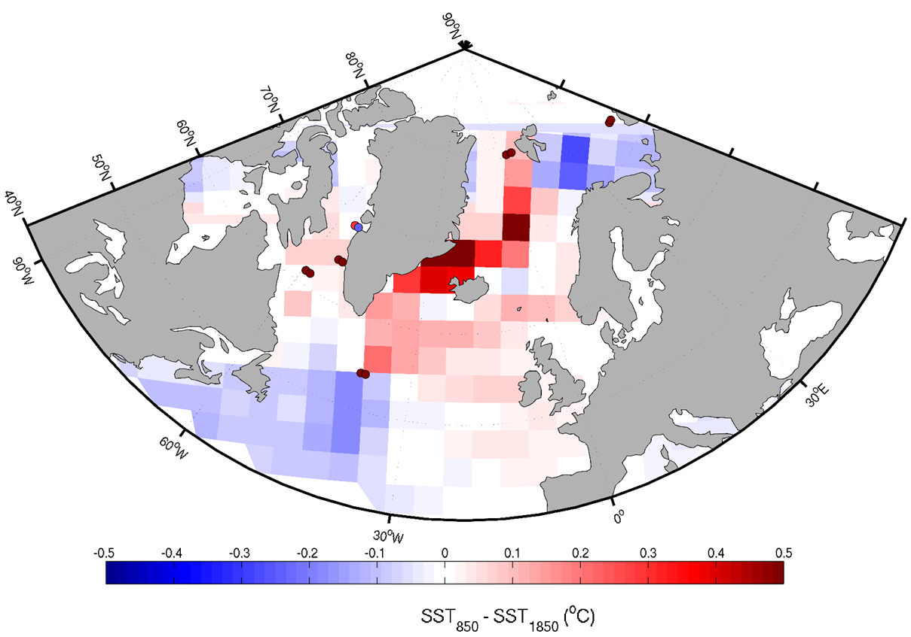
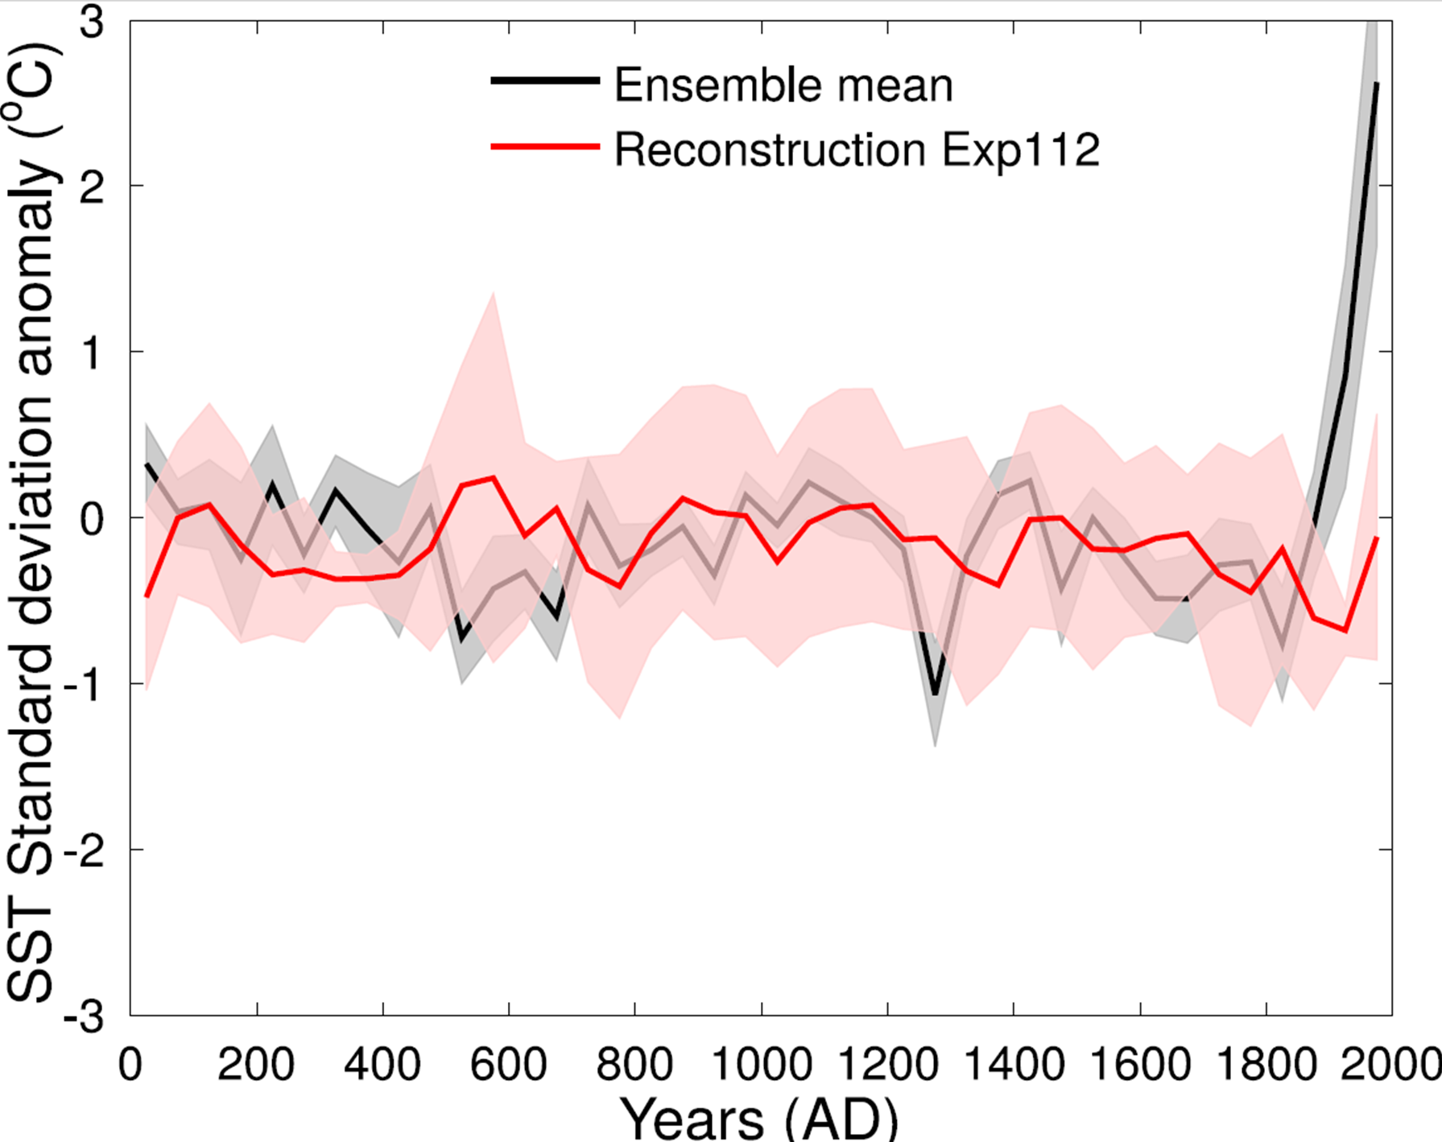
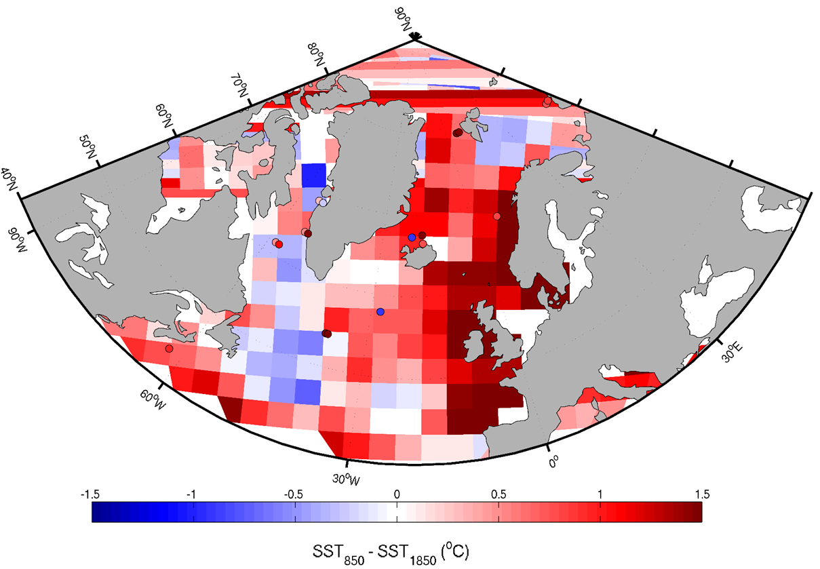
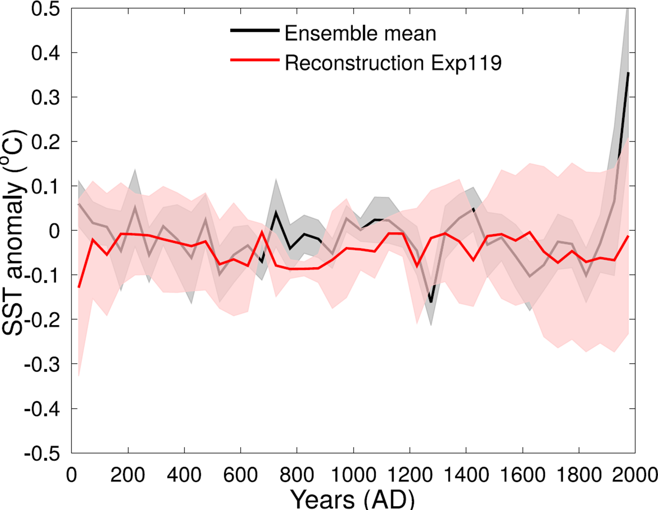
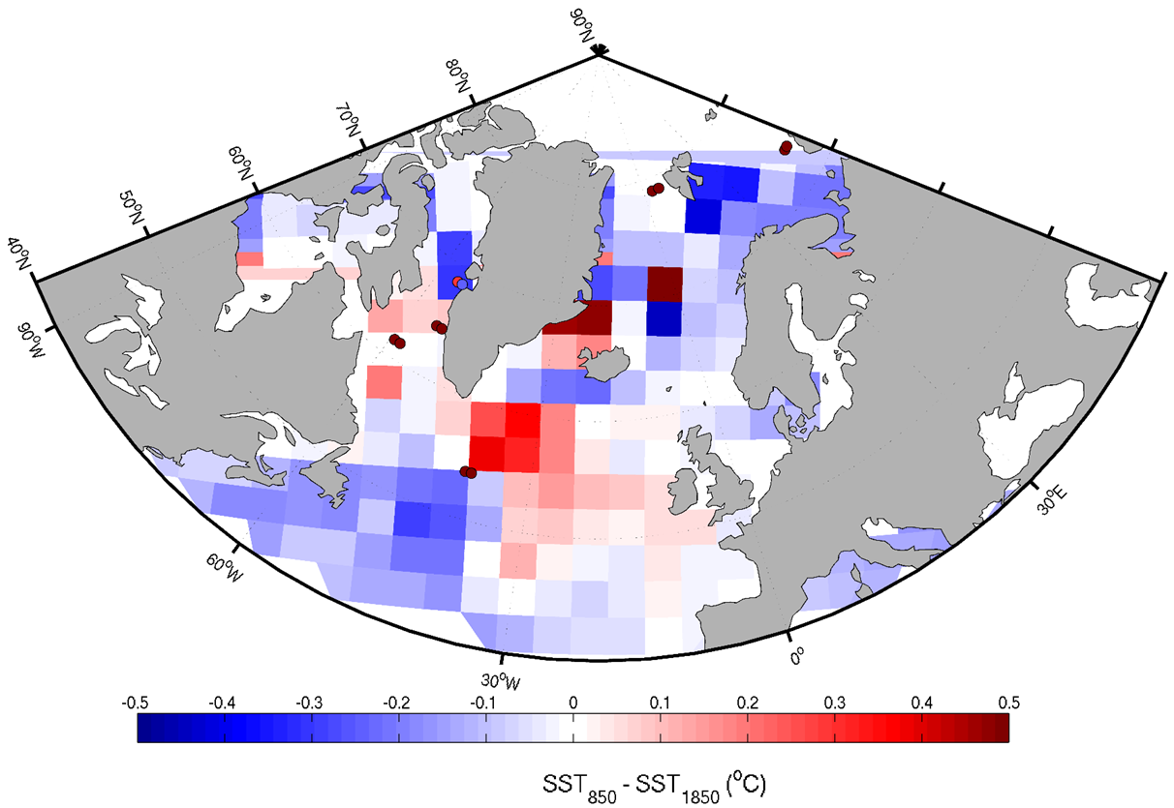
Data assimilation of oceanic proxies in the North Atlantic over the Common Era
H. Goosse¹, Gaëlle F. Gilson¹, F. Klein¹, G. Lenoir^{1,} A. de Vernal², M. N. Evans³, and C. Saenger⁴
EGU2020-2926
¹Université catholique de Louvain, Earth and Life Institute, Louvain-la-Neuve, Belgium
²Université du Québec à Montréal, Centre de recherche en géochimie et géodynamique (Geotop), Montréal, Canada
³Derpartment of Geology and Earth System Science Interdisciplinary Center, University of Maryland, College Park, Geology, College Park, MD
⁴University of Washington, Joint Institute for the Study of the Atmosphere and Ocean, Seattle
Contact: gaelle.gilson@uclouvain.be
1. Background
2. Oceanic Proxies
Models and proxies represent different quantities and are each affected by biases and uncertainties, resulting in different estimates of interannual variability (Fig. 1). Here, we test several model-data comparison experiments through offline data assimilation of SST reconstructions from marine proxies .
Forams (Mg/Ca, assemblages, δ¹⁸O)
Dinocysts Diatoms
Alkenones
SST anomaly (°C)
Fig 1. SST anomalies of the LOVECLIM ten member ensemble (red)
and core ENAM9606 (black) over the past 2000 years.
Years (AD)
Fig 2. Location of proxies by type.
3. Impact of Proxy Choice
4. Empirical Model-Data Scaling
Methods
Four proxy datasets (Fig. 2) were used to study the impact of proxy choice on local and regional reconstruction:
All proxies representing surface conditions: dinocysts, alkenones and diatom-based reconstructions (n=36)
Dinocysts only (n=26)
Foraminifera only (n=12), assimilated at 200-m depth;
All proxies (n = 49), with surface proxies assimilated at the surface and forams assimilated at 200-m depth.
Fifty-year interpolated proxies and fifty-year averaged model ensemble members time series were standardized in order to dismiss the mismatch in model-data variance. Data were assimilated into LOVECLIM v1.3 (Goosse et al., 2010) using an ensemble particle filter (Dubinkina et al., 2011).
The skill of the reconstruction is assessed locally through the Coefficient of Efficiency (CE):
Results
All proxy databases lead to skillful local reconstructions (CE > 0);
It is technically possible to combine surface and subsurface proxies, but the constraint is high;
The spatial structure of the regional reconstruction depends on the number and type(s) of proxies used;
Model-Data Scaling Experiments with Dinocyst Records
Exp. 1: No scaling: assimilation of unscaled dinocysts and model time series.
Exp. 2: Model scaling: model time series are scaled by the variance ratio between SST observations from HadISST (Rayner et al., 2003) and modeled SSTs:
Exp. 3: Proxy scaling: dinocysts time series are scaled by the variance ratio between observed and reconstructed SSTs. An additional weighting factor is introduced to account for the change in variance with timescale, with β = 0.37 (Huybers and Curry, 2006).
Exp. 4: Model and proxy scaling: both proxy and model scalings are applied
Results
Raw data assimilation without scaling of the proxies does not work (exp. 1);
Scaling proxies is necessary to have efficient local reconstructions (exp. 3);
The regional pattern of the reconstruction is stable, but the amplitude varies.
Mean temperature over the Atlantic
Temperature 850 minus 1850 AD
Mean temperature over the Atlantic
Temperature 850 minus 1850 AD
Surface proxies (n=36)
Experiment 1 No scaling
Mean CE for all sites = 0.40
SST₈₅₀-SST₁₈₅₀ (°C)
Mean CE for all sites = 0.20
SST₈₅₀-SST₁₈₅₀ (°C)
Dinocysts (n=26)
Experiment 2 Model scaling
Mean CE for all sites = 0.43
SST₈₅₀-SST₁₈₅₀ (°C)
Mean CE for all sites = 0.20
SST₈₅₀-SST₁₈₅₀ (°C)
Forams (n=12)
Experiment 3 Proxy scaling
Mean CE for all sites = 0.41
SST₈₅₀-SST₁₈₅₀ (°C)
Mean CE for all sites = 0.62
SST₈₅₀-SST₁₈₅₀ (°C)
All proxies (n=49)
Experiment 4 Model + proxy scaling
Mean CE for all sites = 0.34
SST₈₅₀-SST₁₈₅₀ (°C)
Mean CE for all sites = 0.59
SST₈₅₀-SST₁₈₅₀ (°C)
Fig 3. Left: mean ensemble reconstruction (red line) and its uncertainty (red shading) for each assimilation experiment (different proxy dataset) for the North Atlantic region. The black curve and grey shading are the ensemble mean and range of the model LOVECLIM before assimilation. Right: Reconstructed SST anomaly between 850 AD and 1850 AD corresponding to each experiment. Red (blue) indicates relatively warmer (colder) surface oceanic conditions in 850 AD (Warm Medieval Period).
Fig 4. Left: mean ensemble reconstruction (red line) and its uncertainty (red shading) for each assimilation experiment (different scaling applied) for the North Atlantic region. The black curve and grey shading are the ensemble mean and range of the model LOVECLIM before assimilation. Right: Reconstructed SST anomaly between 850 AD and 1850 AD corresponding to each scaling experiment. Red (blue) indicates relatively warmer (colder) surface oceanic conditions in 850 AD (Warm Medieval Period).
References
Dubinkina, S. et al. (2011). Testing a particle filter to reconstruct climate changes over the past centuries. Int J Bifurcat Chaos 21(12):3611-3618.
Goosse, H. et al. (2010). Description of the Earth system model of intermediate complexity LOVECLIM version 1.2. Geosci Model Dev 3:603-633.
Huybers, P., & Curry, W. (2006). Links between annual, Milankovitch and continuum temperature variability. Nat 441(7091):329.
Rayner, N. A. et al. (2003). Global analyses of sea surface temperature, sea ice, and night marine air temperature since the late nineteenth century. J Geophys Res Atmos 108(D14).

