Slide 1
Sensitivity to Tendency Perturbations of Tropical Cyclone Short-range
Intensity Forecasts Generated by WRF
Xiaohao QIN, Wansuo DUAN*, and Hui XU
LASG, Institute of Atmospheric Physics, Chinese Academy of Sciences, Beijing 100029, China
E-mail: duanws@lasg.iap.ac.cn
Presentation highlight
Model error is an important source of TC short-range intensity forecast error.
The errors associated with the potential temperature change in the inner core and middle layers of the atmosphere of TCs influence the TC intensity forecast uncertainty more probably.
The NFSV-tendency error tends to correct model and make a much accurate forecast of TC intensity.
The NFSV-tendency error sensitivity provides guidance to the implemental of the observatons asociated with TC intensity forecast.

Slide 2
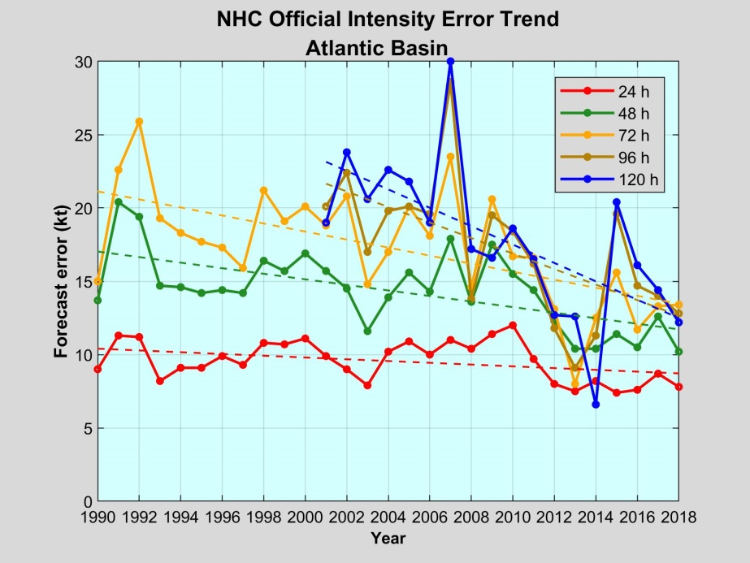
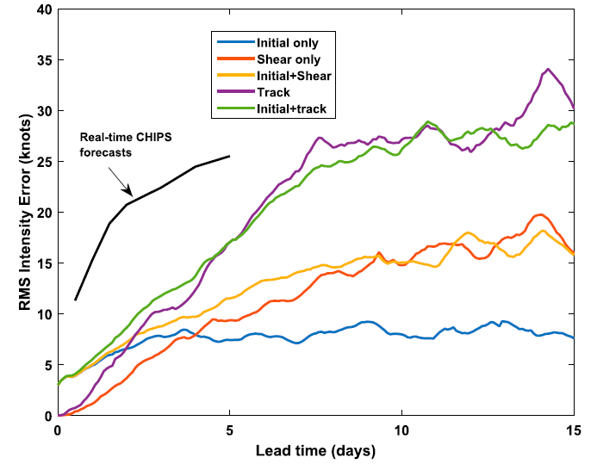
Motivation
（adopted from the 2019 annual report of NHC)
24 h error: 3-5 ms^{-1;} 48 h error: 6-7 ms⁻¹
(Adopted from Emanuel and Zhang, 2016)
Root-mean-square intensity differences between the control experiment and five perturbation experiments. For comparison, the black curve displays the CHIPS ensemble-mean real-time forecast errors.
* Large uncertainty exists in short-range TC intensity forecast, and MODEL ERROR is an important contributor.
What is the sensitivity of the TC intensity forecast errors to the model errors?

Slide 3
Method: Nonlinear Forcing Singular Vector
Tendency equation:
$$\frac{∂U}{∂t}=F\left(U\left(x;t\right)\right)+f$$
$$J(f)=\frac{1}{2}{\left[{MSLP}_{t=T}\left(x_{0},f\right)−{MSLP}_{t=T}\left(x_{0},0\right)\right]}^{2}$$
Constructing a cost function:
NFSV, $f^{∗}$): the tendency error leading to the largest MSLP deviation from the CTRL [${MSLP}_{t=T}\left(x_{0},0\right)$]
where MSLP represents “Mimimum Sea Level Pressure”
Model:
TC cases:
WRFV3.6 and its adjoint model
Intensifying | Decaying
Dujuan (201521) | Neoguril (201408)
Parma (200917) | Nanmadol (201111)
Merant (201614) | Jangmi (200815)
Maintaining
Fungwong (201416)
Megi (201013)
Tembin (201214)
Horizontal resolution: | 90 km
Vertical resolution: | 31 levels (top at 20 hPa)
Parameterization schemes: | Lscondscheme (microphysics)
 | Surfdragscheme (PBL)
 | Ducuscheme (cumulus)
Spinning-up period: | 12-hrs
Simulation period: | 24-hrs

Slide 4
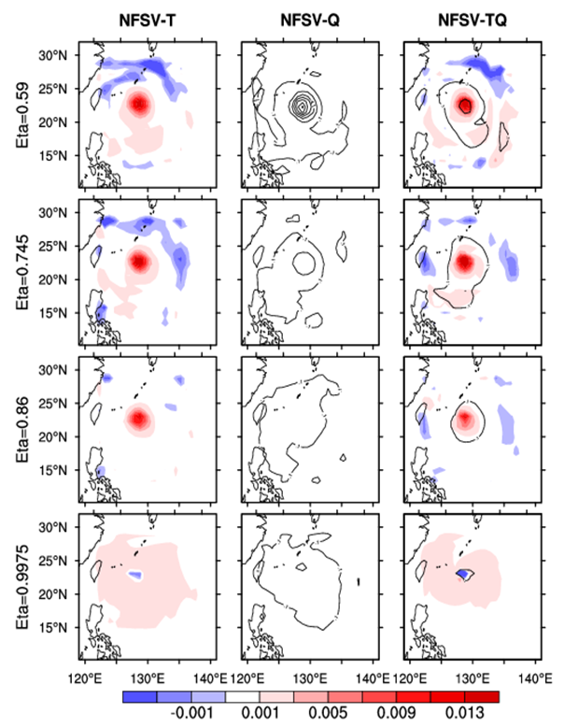
Results: Sensitive regions (model errors) identified by NFSV
The forecast uncertainty of TC intensity is more sensitive to:
The variation of Potential temperature, particularly
in the inner-core area of the TC
at the mid- and lower-levels (600 – 800 hPa)
The sensitivity here is CASE INDEPENDENT !
NFSV makes MSLP & Vmax deviating largely from the CTRL.
[TC case Dujuan (201521)]

Slide 5
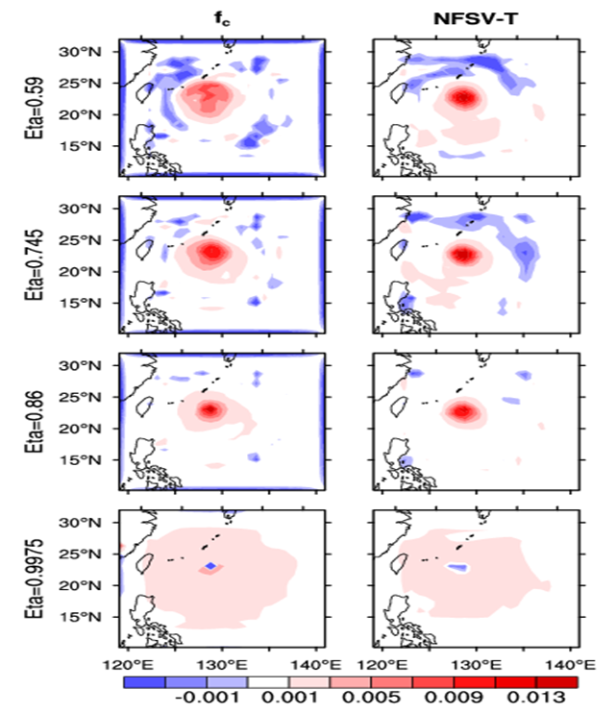
Implications
$$J(f_{c})=\frac{1}{2}{\left[{MSLP}_{t=T}\left(x_{0},f_{c}\right)−{MSLP}_{t=T}\left(x_{0},0\right)\right]}^{2}$$
Constructing a cost function:
${f_{c}^{}}^{∗}$：the correction item leading to the smallest MSLP deviation from the observation (${MSLP}_{t=T}\left(x_{0},0\right)$).
${f_{c}^{}}^{∗}$makes the MSLP approach to the observation obviously, with an averaged deviation of 4.5 hPa.
NFSV can be utilized to correct the WRF in adavnce and make the forecasted TC much close to the real TC.
Similar structure as NFSV!

Slide 6
Implications
Taking into account the characteristics of the FY-4 satellite, the results can guide the satellites to implement preferentially adaptive observations on some specific meteorological variable and specific area , so as to use these observations to effectively improve the model and then the short-term forecast of the tropical cyclone intensity.
Potential temperature
Moisture
Reference
1. Qin Xiaohao, Duan Wansuo, and Xu Hui, 2020.
Sensitivity on tendency perturbations of tropical cyclone
short-range intensity forecasts generated by WRF.
Advances in Atmospheric Sciences, 37, 291-306.
2. Duan W., F. Zhou. 2013. Nonlinear forcing singular vector of a two-dimensional quasi-geostrophic model. Tellus-A: 65, 18452, doi: http://dx.doi.org/10.3402/tellusa.v65i0.18452
INNER-CORE

