Slide 1




Deep convection in the Lofoten Basin: ARGO vs MITgcm
Aleksandr Fedorov^{1,2} and Tatyana Belonenko ¹
¹Saint Petersburg State University, Saint Petersburg, Russia
²Nansen International Environmental and Remote Sensing Centre, Saint Petersburg, Russia

Slide 2
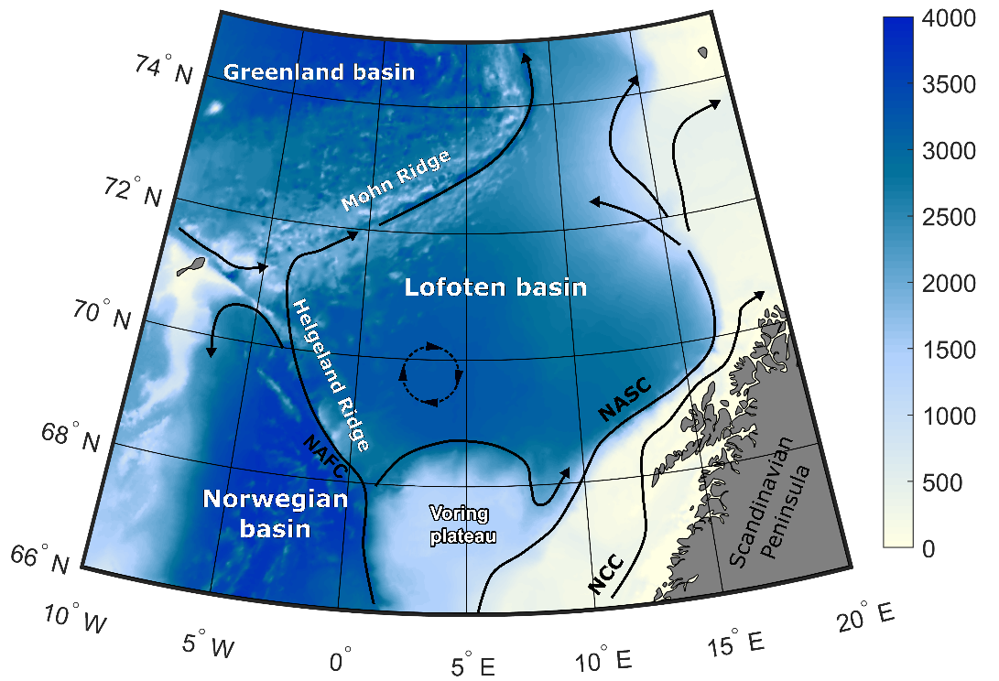
The Lofoten basin:
relatively warm and salty
mainly formed by Atlantic water
famous for the quasipermanent Lofoten vortex (the LV) (black circle on the figure)

Slide 3
The main goal of the research
This research has been supported by the Russian Science Foundation (RSF, grant no. 18-17-00027)
To describe the features of the winter moxing in the Lofoten basin

Slide 4
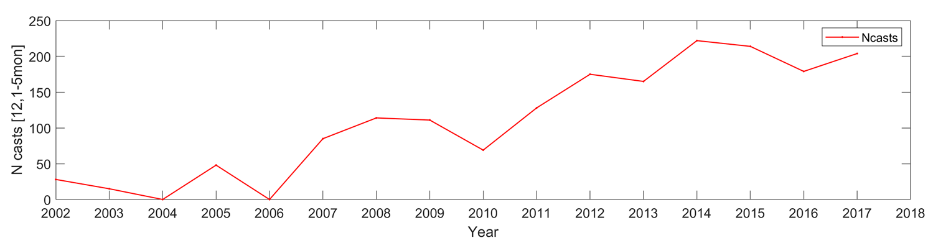
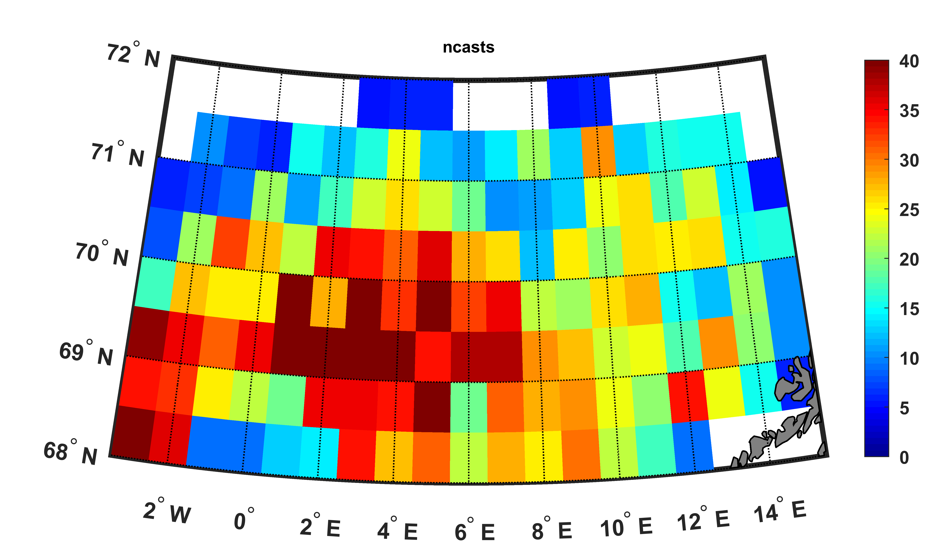
Data
Argo: over 5000 (1500 during December-Aril period) profiles for 2002-2017 from Global ARGO Data Repository
MITgcm: gridded 4x4 km on 50 layers for 1992-2012. The MITgcm simulation is provided by Denis Volkov
ERA-Interim: daily accumulated, 0.5x0.5°: net solar and thermal radiation; latent and sensible heat fluxes through the sea-surface; precipitation; evaporation.
Figure 1. Number of Argo casts for December-April yearly
Figure 2. Argo profiles density map
Notes:
The Argo profiles density map is demonstrated on the slide (fig.2). Dynamic effects leads to the concentration of the Argo floats in the central part of the basin.
Since 2007, there are no less 100 Argo profiles (fig.1) in the Lofoten basin almost each year.
The 2007-2017 period should be quite confident for the mixed layer depth estimation.

Slide 5
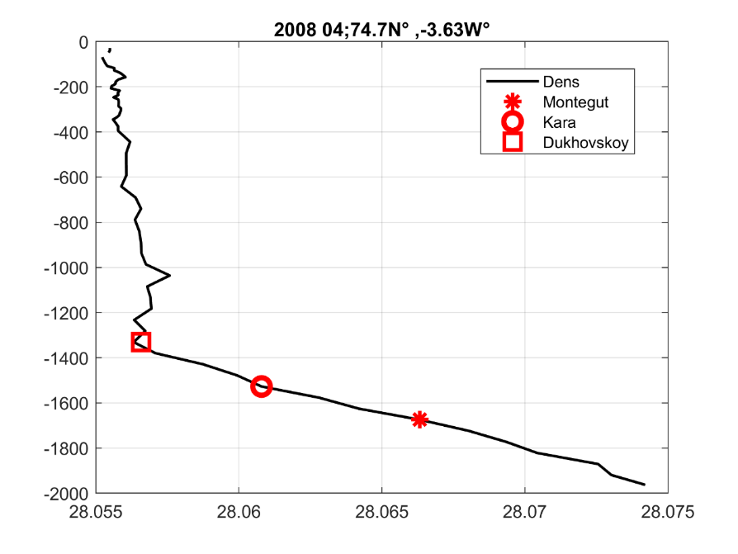
Methods
Montegut (2004) and Kara (2003) are based on predefined criterion of the difference in potential density between reference layer and layer bellow.
When the difference exceed predefined value the mixed layer depth (MLD) is fixed.
In case of Kara the criterion leads to the potential temperature deference.
Dukhovskoy method does not have a predefined criterion. The MLD is fixed on the layer h where the local potential density gradient |𝑑𝜎/𝑑𝑧| is higher than 3 STD’s in the layer ±100 m from h.
Figure 3. Potential density profile sampled
Notes:
The figure 3 examples the profile with wide MLD. All the methods are automatic.
The accuracy of the MLD assessments is visually controlled based on the random set of profiles with marked MLD (like on the figure).
The main method for the further analysis is Dukhovskoy method.
All the methods have already been used for the MLD evaluations in the Greenland Sea.
(see Fedorov A.M., Bashmachnikov I.L., Belonenko T.V. 2018. Localization of areas of deep convection in the Nordic seas, the Labrador Sea and the Irminger Sea. Vestnik of Saint Petersburg University. Earth Sciences. 63(3). 345–362 https://doi.org/10.21638/spbu07.2018.306. [In Russian] and
Bashmachnikov I.L.,Fedorov A.M., Vesman A.V., Belonenko T.V., Koldunov A.V., Dukhovskoy D.S. 2018. Thermohaline convection in the subpolar seas of the north Atlantic from satellite and in situ observations Part 1: Localization of the deep convection sites. Sovremennye Problemy Distantsionnogo Zondirovaniya Zemli iz Kosmosa. 15(7) 184–194. doi: 10.21046/2070-7401-2018-15-7-184-194. [In Russian] )

Slide 6
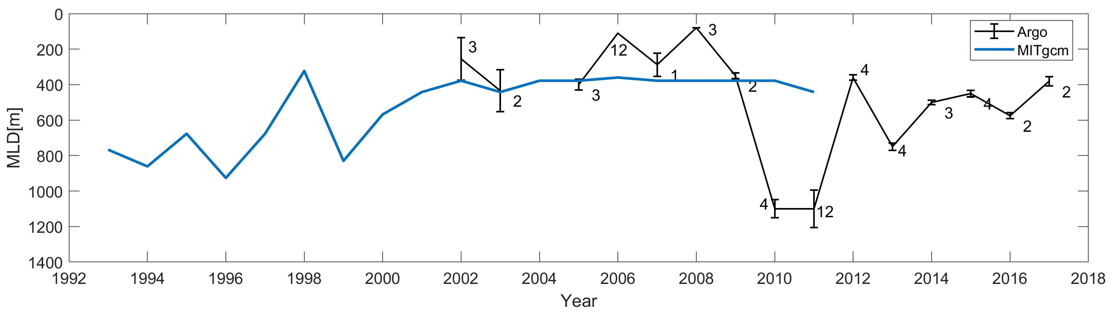
Maximum mixed layer depth as a measure of convection intensity
Figure 4. Maximum mixed layer depth (MMLD). Blue line is for MITgcm and the black one corresponds the value from Argo. Numbers mark the month when the MMLD was observed by Argo
Notes:
The use of MITgcm in the current study is to describe features of the MLD variability in the region.
Though we have to make sure that our MIT simulation reproduce well convective mixing in the Lofoten basin.
In-situ data have lots of limitations, that is why it is not able to be used for some kinds of analysis (spatial seasonal variability etc.)
The MITgcm demonstrates similar range of the MMLD variability (fig.4): 350-1000 meters as Argo.

Slide 7
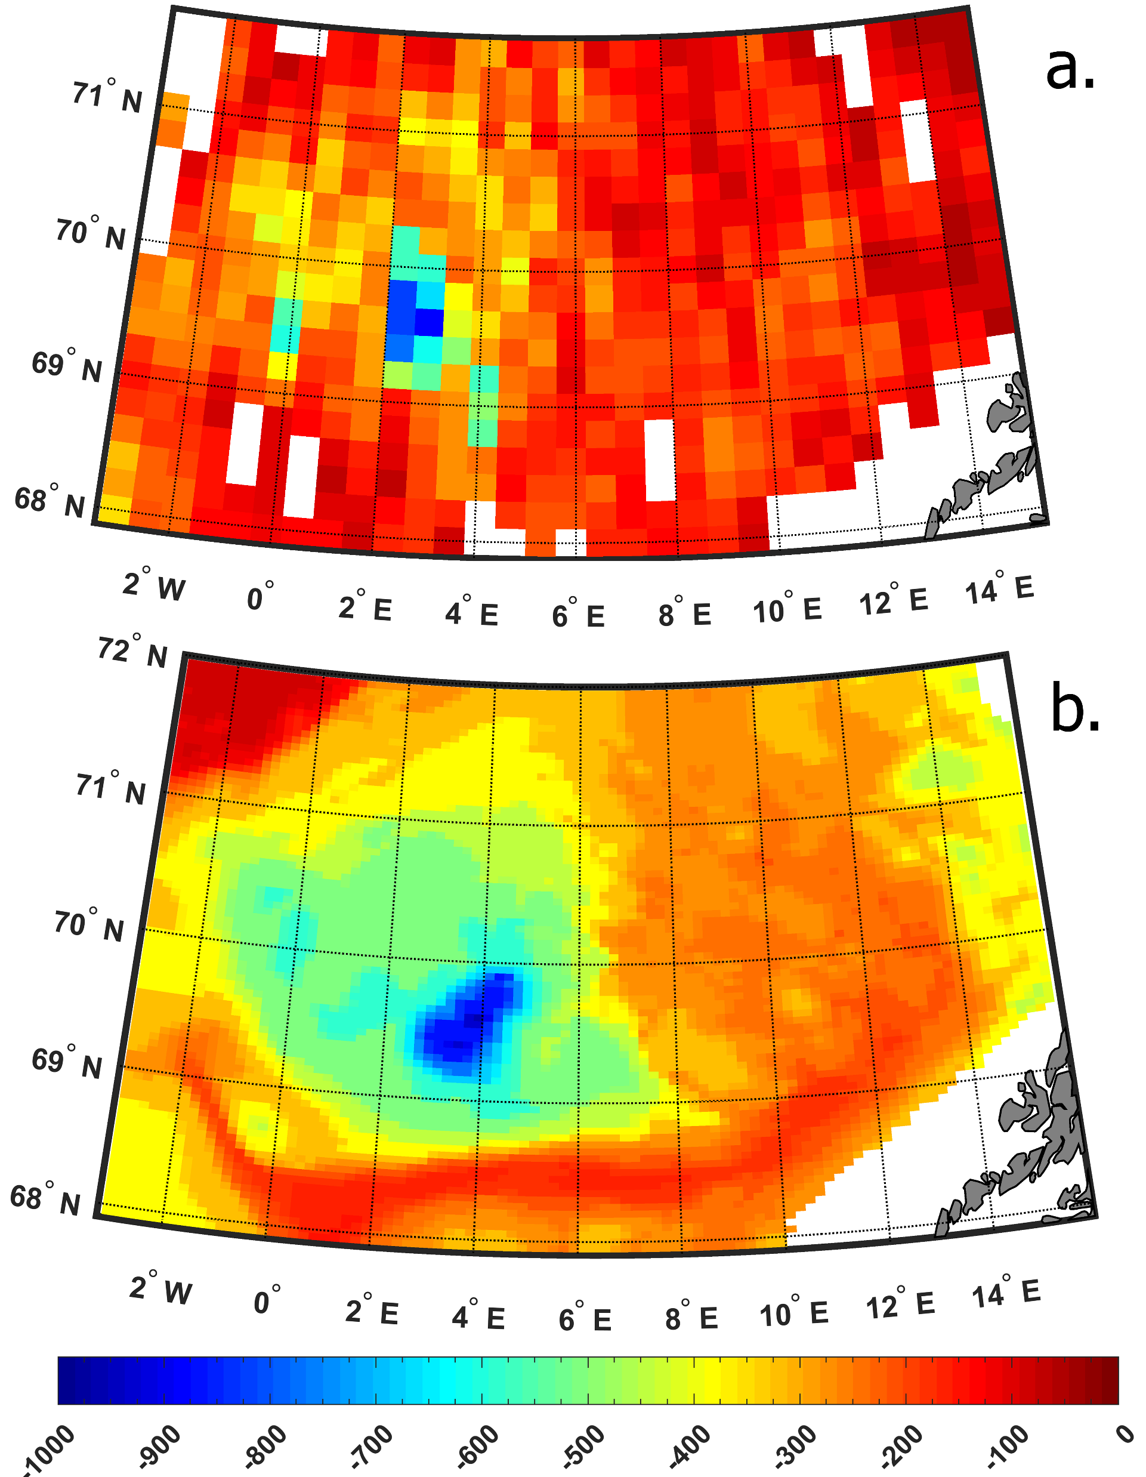
Localization of the MMLD
Figure 5. Localization of the MMLD – maximal value in each cell of the grid for the hole period: a. – Argo grid25x25km; b. - MITgcm
Notes:
In all cases both distributions reflect the same features of the MMLD location (fig.5).
The highest values are concentrated in the area where the Lofoten vortex (LV) observed most often.

Slide 8
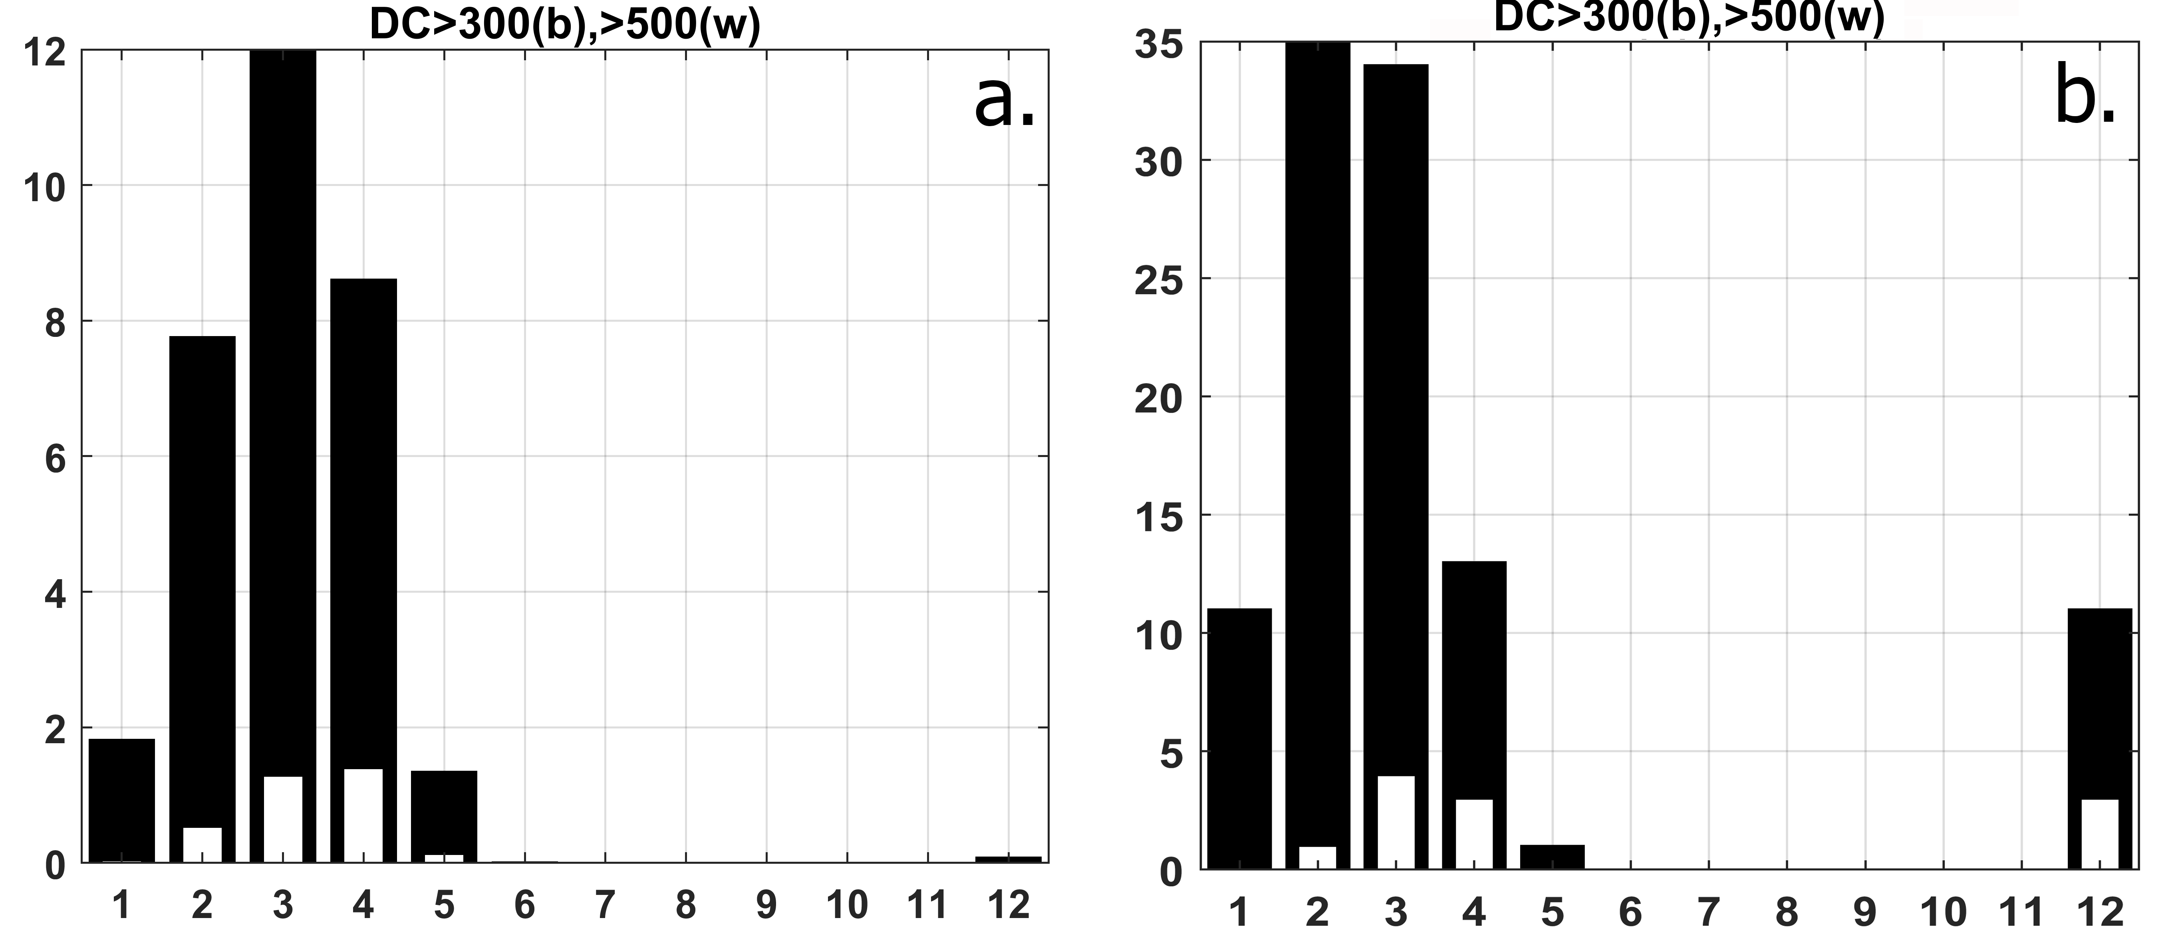
Seasonal variability
The highest values of the MLD are observed during February-April period of the year
Values higher than average can be observed since December till May
Figure 6. Amount of the profiles with the MLD higher than 300 meters by white bar and higher than 500 meters by black one. a. – MITgcm [%]; b. – Argo(pieces)

Slide 9
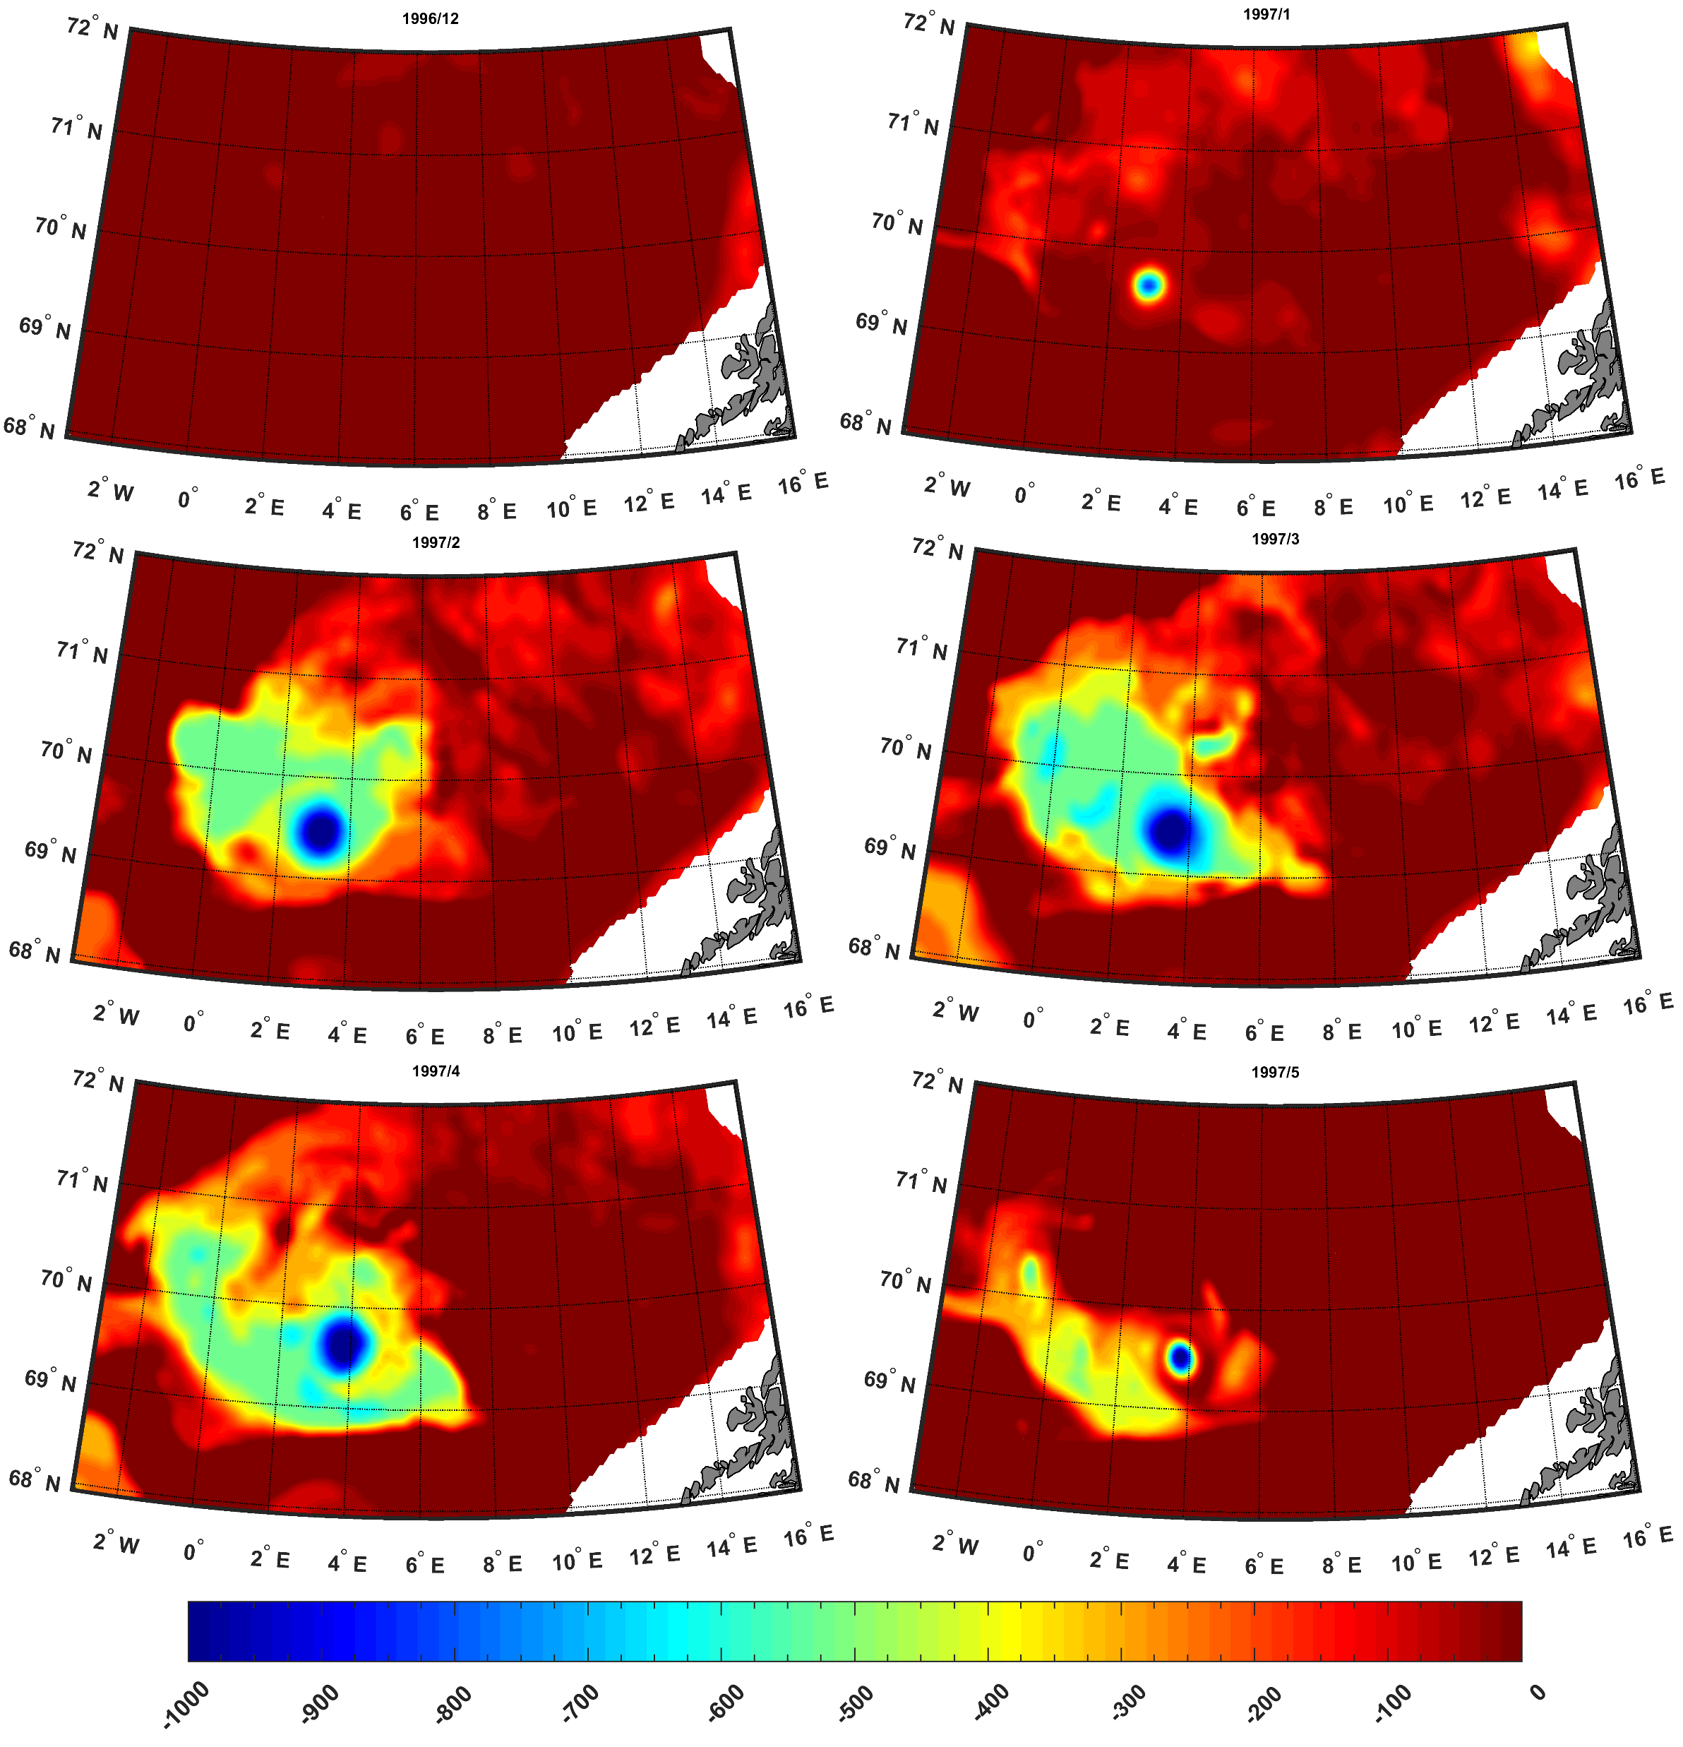
Spatial features by the MITgcm
The most developed convection occurs since February till April covering the wide area in the central part of the basin exceeding 500 meters depth
It starts to decay in May and fully disappear in June
Figure 7. MITgcm spatial distribution of the monthly MLD for 1996/1997 winter

Slide 10
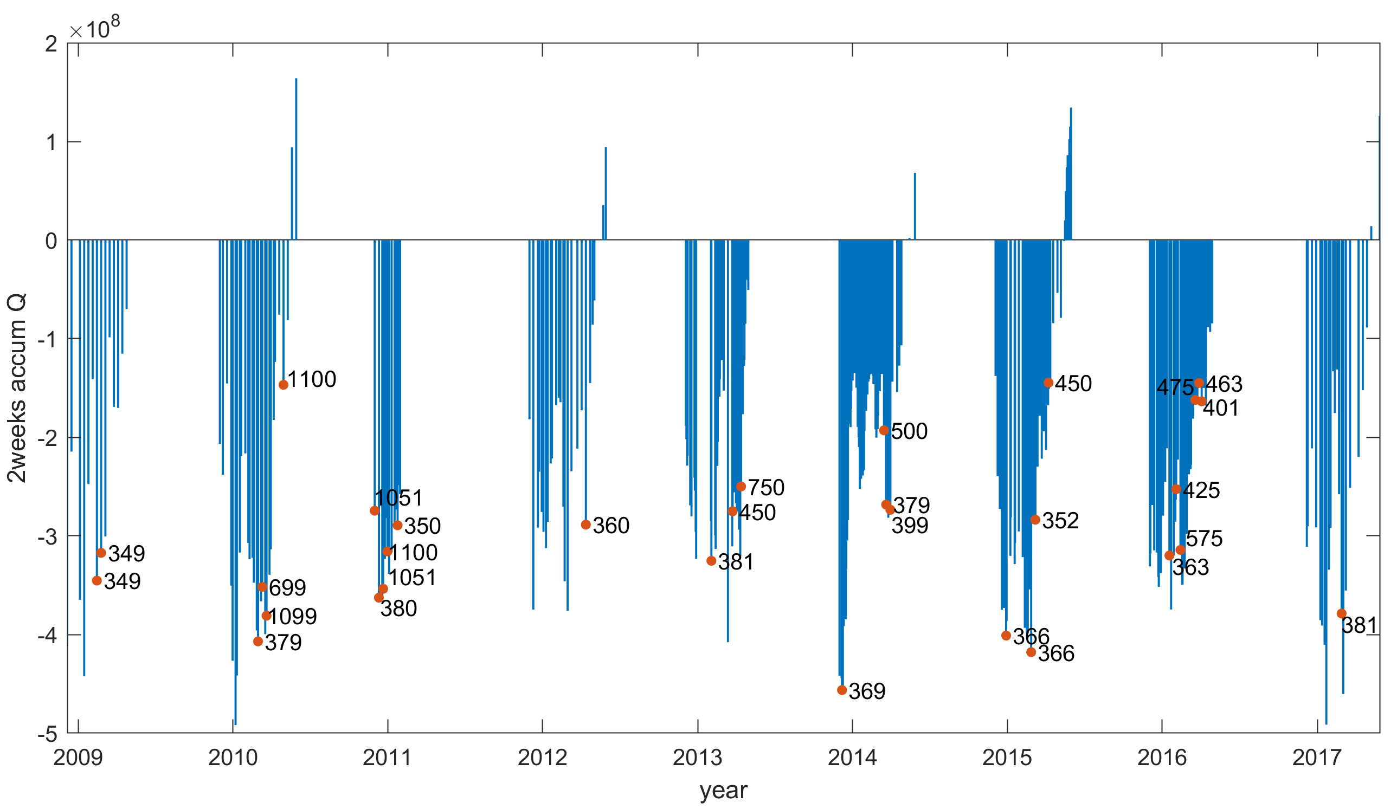
Anomalous convection in 2010
In December 2010, the MLD higher than 1000 were observed 3 times.
Previous winter in March and April 2010 it exceeded 1000 meters as well
Accumulated for two weeks heat fluxes demonstrates that intensive mixing (red dots) is preceded by strong cooling (heat loss).
Figure 8. ERA Interim ocean-atmosphere heat fluxes accumulated for two preceding weeks in the closest point to each Argo profile location: red dots mark the MLDs higher than mean MLD+STD (349m) and numbers – the MLD value.
Notes:
On the other hand, some profiles were preceded by strong cooling but there were no high MLDs.
Such conditions occur due to other processes such as vortex interactions, that are weakening the mixing.

Slide 11
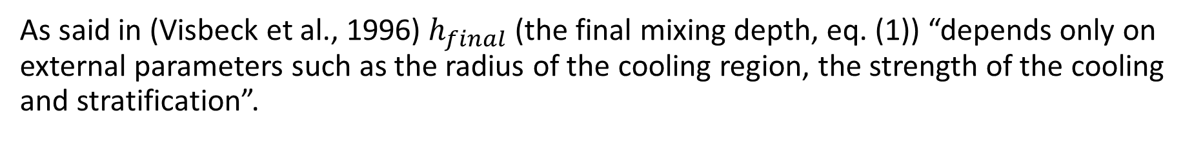
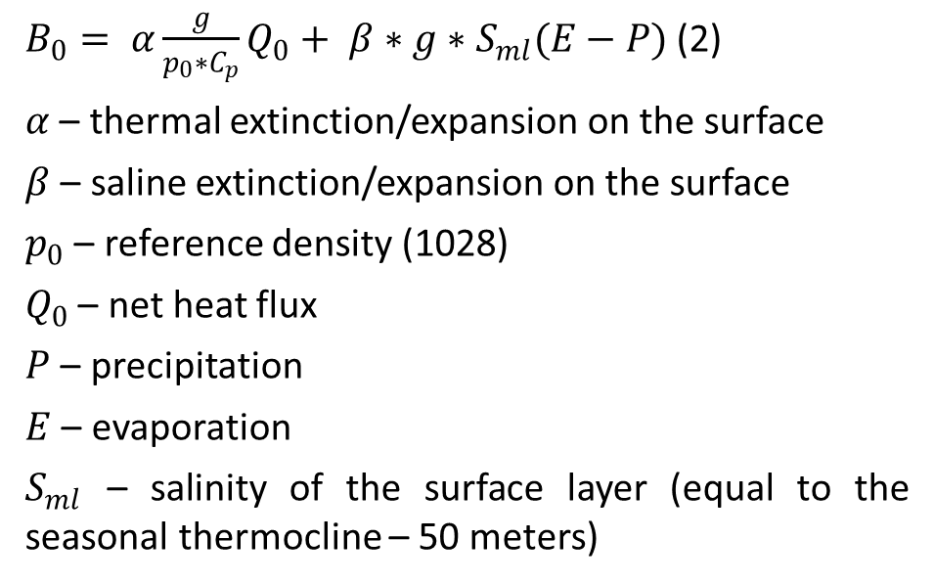
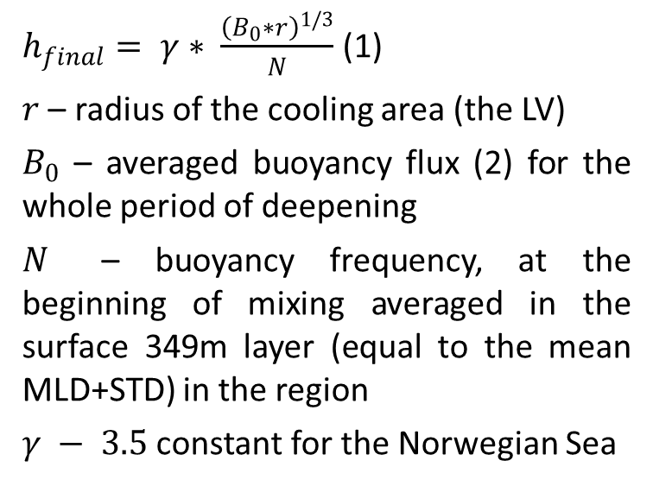
Analytic assessments of the MLD according to the buoyancy loss (Visbeck et al., 1996)
As said in (Visbeck et al., 1996) $h_{final}$ (the final mixing depth, eq. (1)) “depends only on external parameters such as the radius of the cooling region, the strength of the cooling and stratification”.
$B_{0}= α\frac{g}{p_{0}∗C_{p}}Q_{0}+ β∗g∗S_{ml}(E−P)$ (2)
$α$ – thermal extinction/expansion on the surface
$β$ – saline extinction/expansion on the surface
$p_{0}$ – reference density (1028)
$Q_{0}$ – net heat flux
$P$ – precipitation
$E$ – evaporation
$S_{ml}$ – salinity of the surface layer (equal to the seasonal thermocline – 50 meters)
$h_{final}= γ∗ \frac{{\left(B_{0}∗r\right)}^{1/3}}{N}$ (1)
$r$ – radius of the cooling area (the LV)
$B_{0}$ – averaged buoyancy flux (2) for the whole period of deepening
$N$ – buoyancy frequency, at the beginning of mixing averaged in the surface 349m layer (equal to the mean MLD+STD) in the region
$γ − 3.5$ constant for the Norwegian Sea
Notes:
Buoyancy flux depends on the Atmospheric conditions, that we take from ERA-Interim: net heat flux through
the surface (sum of net solar and thermal radiation; latent and sensible heat fluxes through the sea-surface) and
difference between evaporation and precipitation.
[Visbeck M., Marshall J., Jones H. 1996. Dynamics of isolated convective regions in the ocean. J. Phys. Oceanogr. 26. 1721-1734.]

Slide 12
Analytic MLDs
Two opposite situations are analyzed:
Strong convection during December 2010 (Argo profiles on December 1st 20th 30th of) the MLD varies from 380 to 1099 meters
Standard winter convection during February 2015 (Argo profiles on February 6th 11th 15th 21st 26th) the MLD varies from 150 to 366 meters
In both cases Argo profiles were close to the Lofoten vortex center
Table 1. Real MLD and analytic MLD: values of variables that were taken for analytic assessments
month-year | MLD [m] | h_{final} [m] | N₁ [c⁻¹] | B₀ [kg*m⁻³*c⁻¹] | R [m]
12-2010 | 1099 | 1090 | 4,37*10⁻⁴ | 7.25*10⁻⁸ | 35000
02-2015 | 366 | 365 | 9,91*10⁻⁴ | 4.13*10⁻⁸ | 27000
Notes:
Comparison of the parameters in the table can conclude that in case of these two situations final depth
of mixing actuallly depends on the radius of the cooling region, the strength of the cooling and stratification
as it was mentioned by (Visbeck et al., 1996).

Slide 13
Conclusions
Mixed layer depth assessments according to Argo profiles and MITgcm are compared: both datasets demonstrates equal range of MLD variability as spatial as temporal in the Lofoten basin.
Maximal MLD varies from 350 to 1100 meters in the basin, reaching maximal value during February-April period.
Maximal values are mostly located in the central part of the Lofoten basin and tends to be inside the Lofoten vortex.
Two opposite situations (in context of the winter mixing intensity) are analytically compared, the dependency of the final mixing depth from the radius of the cooling region, the strength of the cooling and stratification has been confirmed for the profiles located inside the LV

