Slide 1

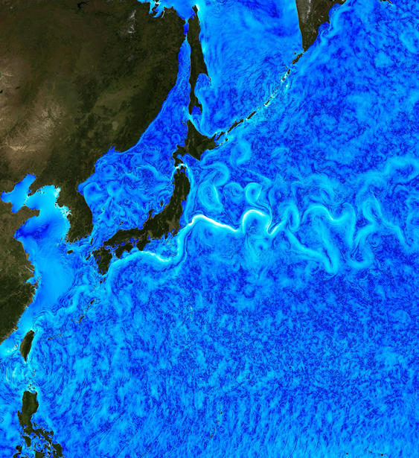




Interannual-to-decadal variability of the Kuroshio extension:
Analyzing an ensemble of global hindcasts from a Dynamical System viewpoint.
Giusy Fedele^{1,4} (giusy.fedele@unive.it),
Thierry Penduff², Stefano Pierini³, M. Carmen Alvarez-Castro^{4,5}, Alessio Bellucci⁴ and Simona Masina⁴
(1) Cà Foscari University of Venice, Italy, (2) Université Grenoble Alpes, CNRS, IRD, Grenoble INP, IGE, Grenoble, France, (3) Parthenope University, Naples, Italy, (4) Euro-Mediterranean Center on Climate Change, Bologna, Italy, (5) University Pablo de Olavide, Seville, Spain
Credit: C. Henze, NASA Advanced Supercomputing Division

Slide 2
ABSTRACT

Slide 3
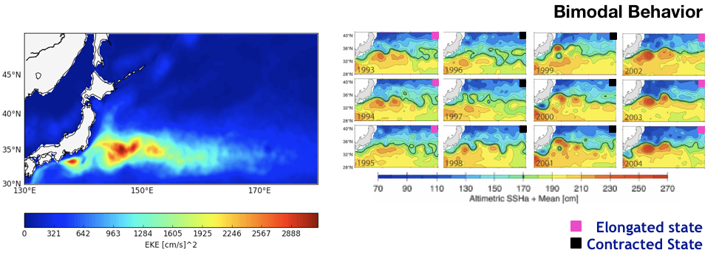
Why studying the Kuroshio Extension (KE) from a Climatic Point of View?
The KE is known to undergo relevant variations on the decadal time scale. The mechanisms that generate the mean structure of the KE and its low frequency variability (LFV) are still under debate.
The KE LFV strongly affects the mid-latitude coupled ocean-atmosphere system. Several studies show the importance to simulate mesoscale eddies in order to estimate well the impact on the atmosphere. What about the impact of the resolution of the atmospheric model on the KE?
Figures Adapted from Qiu and Chen, 2005 (right)

Slide 4
GOALS
To assess the role of the intrinsic variability and external forcing in driving the KE LFV
To assess the KE predictability in order to better understand the ocean-atmosphere interactions and the source of the associated predictability
METHOD
Explore a large ensemble of ocean/sea-ice eddy-permitting model simulations: OCCIPUT

Slide 5
OCCIPUT*
Simulation | EXTENT AND RESOLUTION | MEMBERS AND DURATION | Forcing | SIMULATED VARIABILITY | Time sampling
OCCITENS | Global 1/4° | 50-members ENSEMBLE 1980-2015 | Full variability (ERA-interim) | Forced and intrinsic variability | 5 days
OCCICLIM | Global 1/4° | 1 member 300 years | Climatological Seasonal Cycle | Pure intrinsic variability | 5 days
*Penduff et al. (2014) and Bessières et al. (2017)

Slide 6
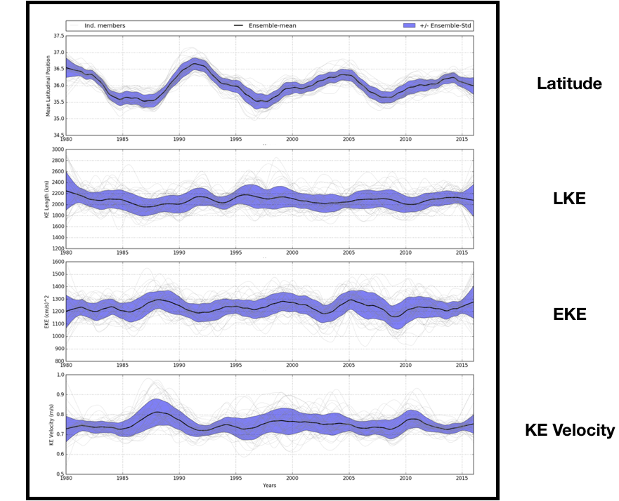
KE LFV Indices after post-processing (Nonlinear detrending filter and Lowess Low Pass Filter)
OCCITENS
Reference SSH isoline of the jet (0.7 m)
Average in the box (141-153°E, 32-38°N)
Max total geost. velocity in the box
(141-153°E,30-40°) integrated zonally
Time

Slide 7
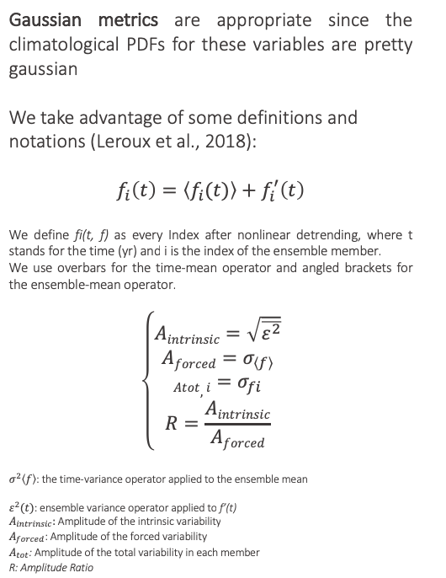
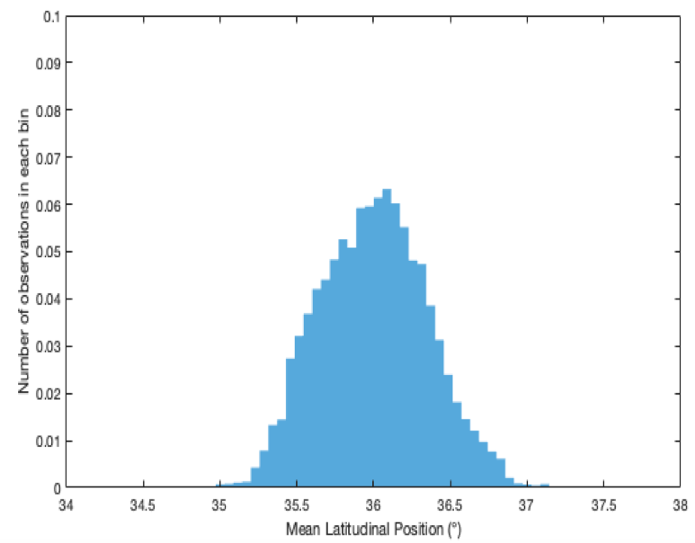
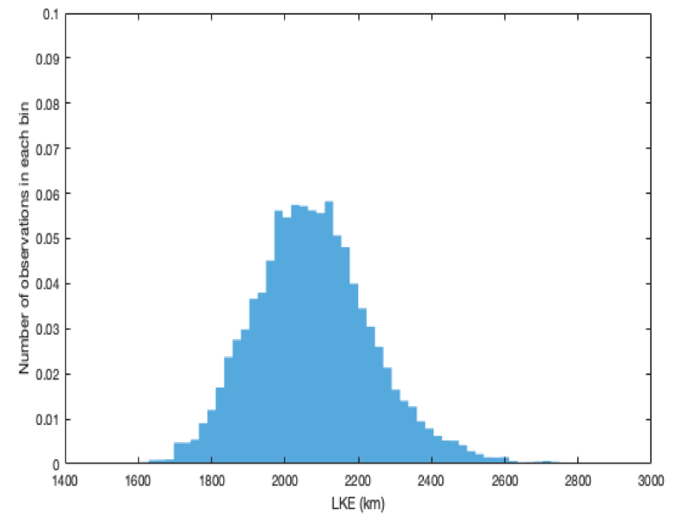
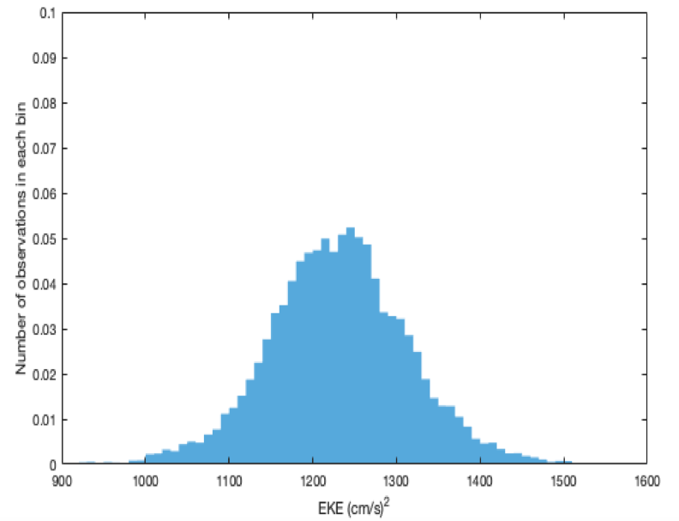
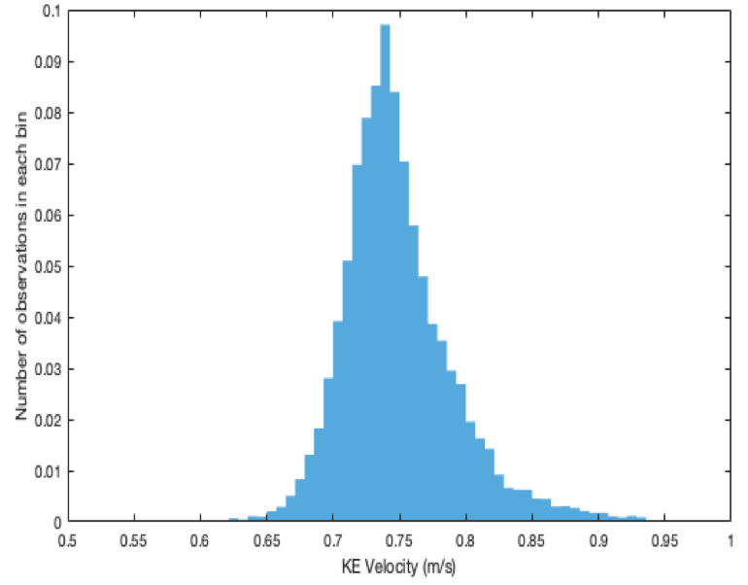
OCCITENS
Latitude
LKE
EKE
KE Velocity
Time

Slide 8
OCCITENS
A_{f} > A_{i}
A_{i} > A_{f}
Latitude
R=0.6
LKE
R=2.82
EKE
R=2.6
KE Velocity
R=2
Time

Slide 9
OCCICLIM
Pure intrinsic variability | EXTENT AND resolution | MEMBERS AND DURATION | Forcing | Time sampling
 | Global 1/4° | 1 member 300 yrs | Climatological Seasonal Cycle | 5 days
STRATEGY:
TO CREATE A PSEUDO-ENSEMBLE FROM OCCICLIM
50 members x 36 yrs have been built randomly from the indices already computed, in order to compare the pure intrinsic variability with the total one given by OCCITENS.

Slide 10
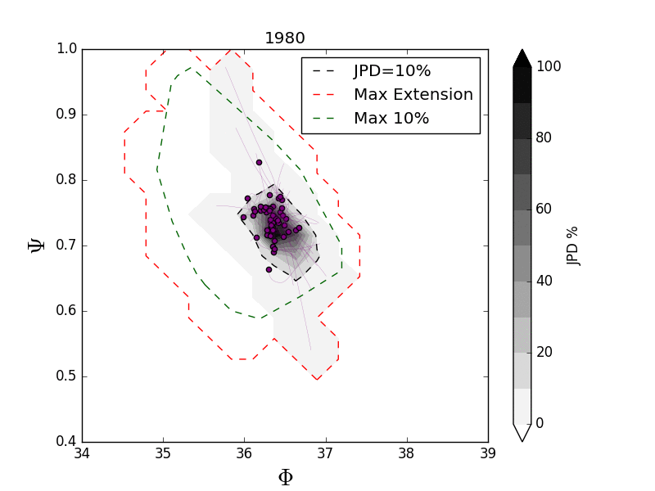
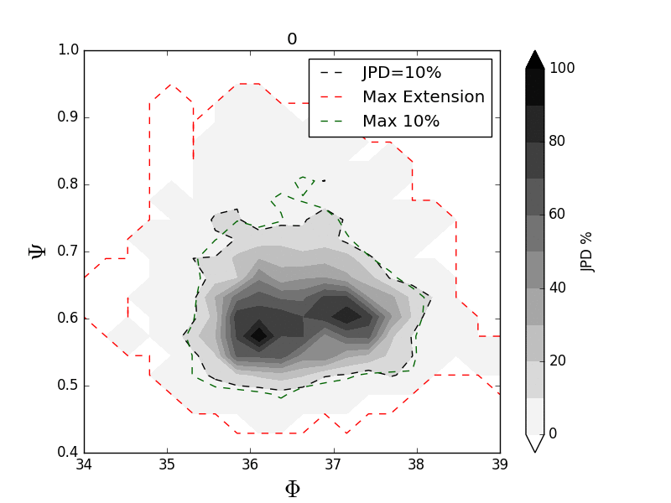
JOINT PROBABILITY DISTRIBUTION
OCCITENS
OCCICLIM
JPD (%)
JPD (%)
A case of intrinsic variability paced by an external forcing

Slide 11
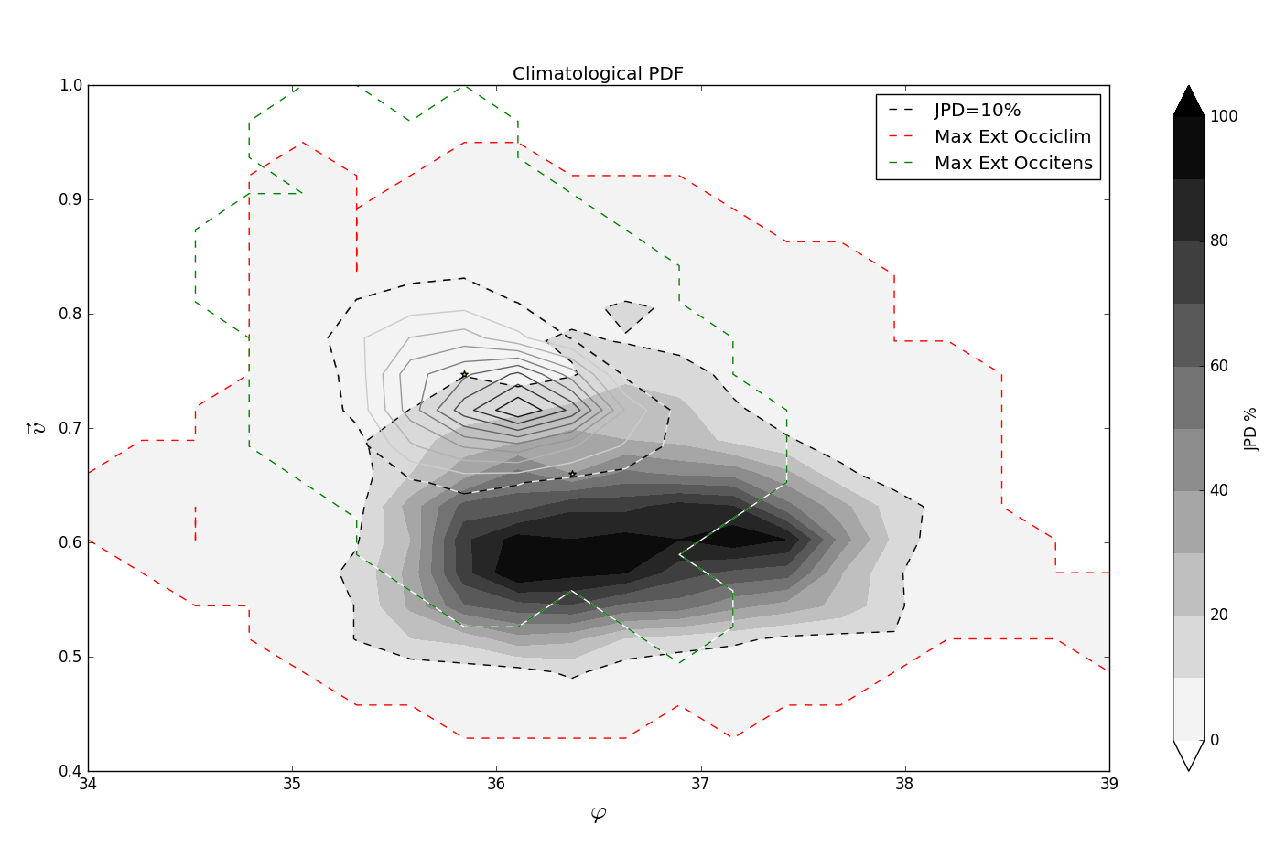


CLIMATOLOGICAL
JOINT PROBABILITY DISTRIBUTION
$$Ψ$$
JPD (%)
$$Φ$$
The external forcing reduces the attractor in the phase-space

Slide 12
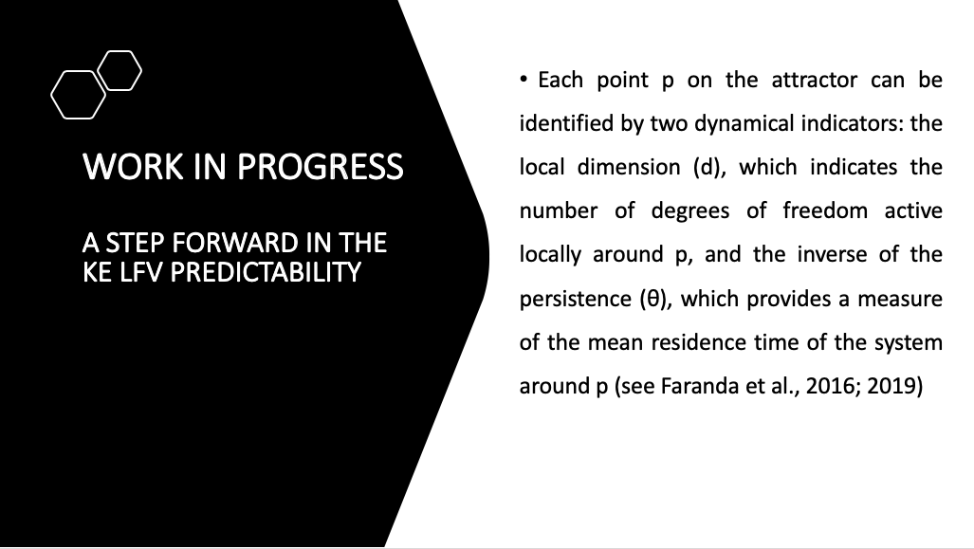

Slide 13
Predictability
Θ and d have been computed for a new index given by a linear combination of four indices:
LKE, EKE, VEL, LAT
Θ for each member is smaller in OCCITENS than in OCCICLIM, while d in the two datasets explore similar ranges.
The OCCITENS dataset is more predictable.

Slide 14
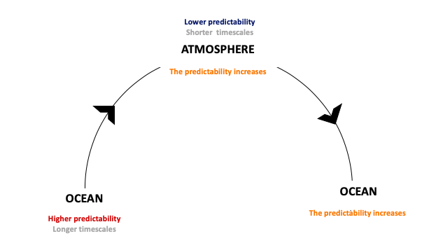
The ocean (more predictable) transfers a signal to the atmosphere (less predictable) through air-sea interactions; therefore, the atmosphere becomes more predictable when introducing the oceanic boundary conditions. Afterward, this signal is again transferred from the atmosphere to the ocean increasing its predictability (positive feedback).

Slide 15
CONCLUSIONS
The KE LFV can be interpreted as a case of intrinsic variability paced by an external forcing
The external forcing acts reducing the projection of the attractor in the phase-space.
The atmosphere increases the predictability of the KE LFV.
NEXT STEPS
To find the main features of the KE LFV associated with P05 and P95.
To better understand the ocean-atmosphere interactions and the source of the associated predictability.

Slide 16
References
Bessières, L. et al., 2017: Development of a probabilistic ocean modelling system based on NEMO 3.5: application at eddying resolution, Geosci. Model Dev., 10, 1091–1106.
Faranda, D. et al., 2016: Return times of hot and cold days via recurrences and extreme value theory. Climate dynamics, 47(12), 3803-3815.
Faranda, D. et al., 2019: The hammam effect or how a warm ocean enhances large scale atmospheric predictability. Nature communications, 10(1), 1316.
Fedele G. et al., 2019. Decadal variability of the Kuroshio Extension: The response of the jet to increased atmospheric resolution in a coupled ocean-atmosphere model (under review).
Fedele G. et al., 2020. Interannual-to-decadal variability of the Kuroshio Extension: Analyzing an ensemble of global hindcasts from a Dynamical System viewpoint (submitted).
Penduff T. et al., 2014: Ensembles of eddying ocean simulations for climate, CLIVAR Exchanges, Special Issue on High Resolution Ocean Climate Modelling, 19.
Pierini S., 2014: Kuroshio Extension Bimodality and the North Pacific Oscillation: A Case of Intrinsic Variability Paced by External Forcing. J. Climate, 27, 448–454.
Pierini, S., 2019: Statistical Significance of Small Ensembles of Simulations and Detection of the Internal Climate Variability: An Excitable Ocean System Case Study. J Stat Phys.
Qiu, B., and Chen, S., 2005: Variability of the Kuroshio Extension jet, recirculation gyre and mesoscale eddies on decadal timescales. Journal of Physical Oceanography 35, 2090–2103.

Slide 17
THANKS FOR YOUR ATTENTION
Fedele G. (giusy.fedele@unive.it)
Credit: C. Henze, NASA Advanced Supercomputing Division

Slide 18


Slide 19

Strong connection between the LFV variability of the KE velocity and latitude.
AVISO
ENSEMBLE MEAN
MEMBER #1
$$\sim 10 yrs$$
Geostrophic Surface Velocity (m/s)
OCCITENS

Slide 20
OCCICLIM
Top) The yearly JPD in the mean latitudinal position (Φ) - KE velocity (Ψ) domain for the years 0,7 and 35 in the OCCICLIM pseudo-ensemble. The shaded lines are the 10% instantaneous JPD (black), the maximum 10% JPD isoline extension along the 36-yrs time series (green) and the maximum extension of the 0% JPD isoline along the 36-yrs time series (red). Bottom) The center of gravity positions of the JPD for each year (yellow dot) and along the 36-yrs time series (black dots)
Three
Cg Mean
positions

Slide 21
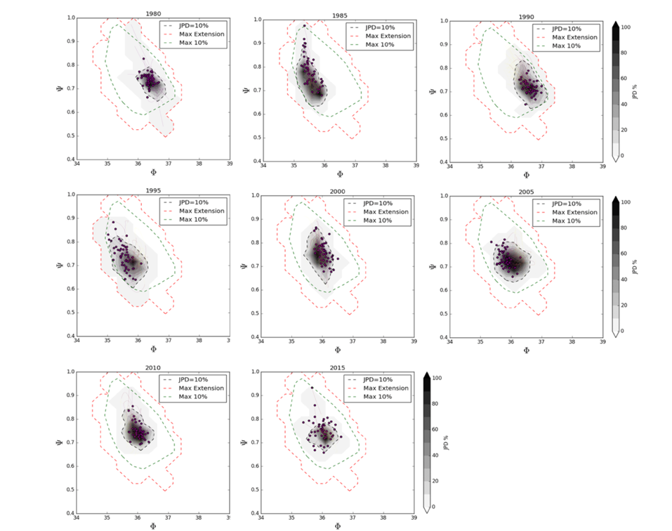
OCCITENS
Yearly JPDs in the mean latitudinal position (Φ) - KE velocity (Ψ) phase state every 5 years between 1980-2015 in the OCCITENS ensemble. The gray shading represents deciles of yearly JPDs with 10% isolines shown in dashed black; the red and green lines are the same in each plot and indicate the maximum extension throughout this 36-year period of the 0% and 10% deciles of the JPDs, respectively. The purple lines show for all members the trajectory of the KE in this phase space throughout the current year, and the last points are indicated by purple dot.

Slide 22
Clockwise loop
Anticlockwise loop
Center of gravity position
There is not a prior direction along the trajectories in the phase-space in agreement with the study by Gentile et al. in 2018.
OCCITENS

Slide 23
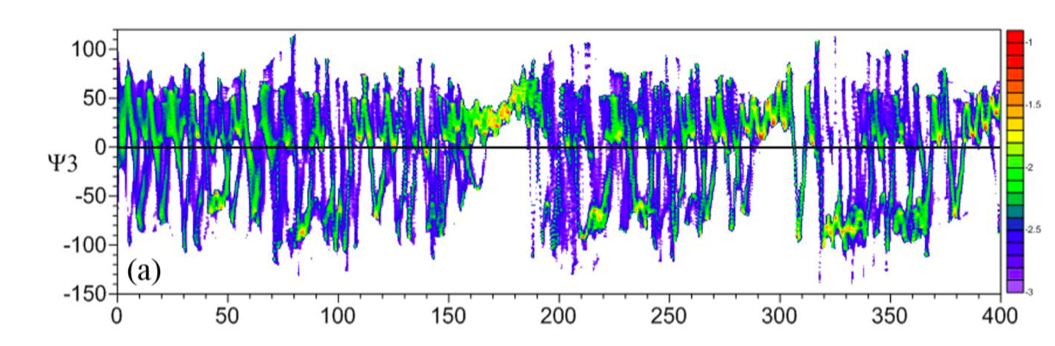
The trajectories converge in a restricted region
Adapted by Pierini, 2019

Slide 24
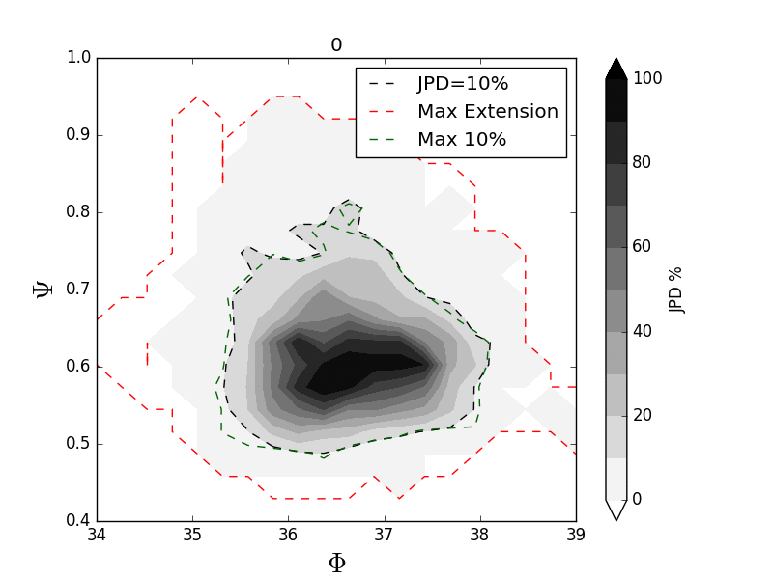
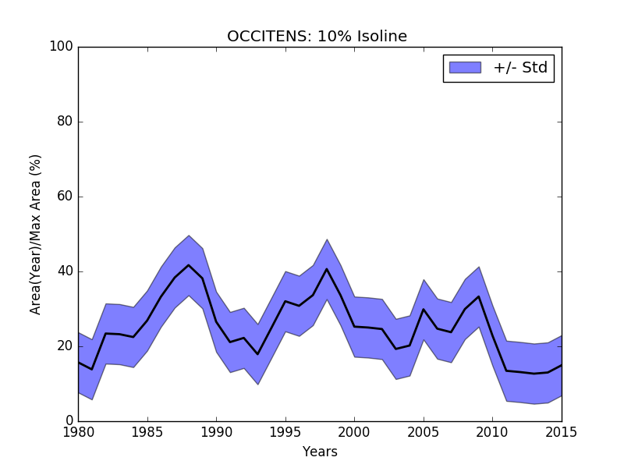
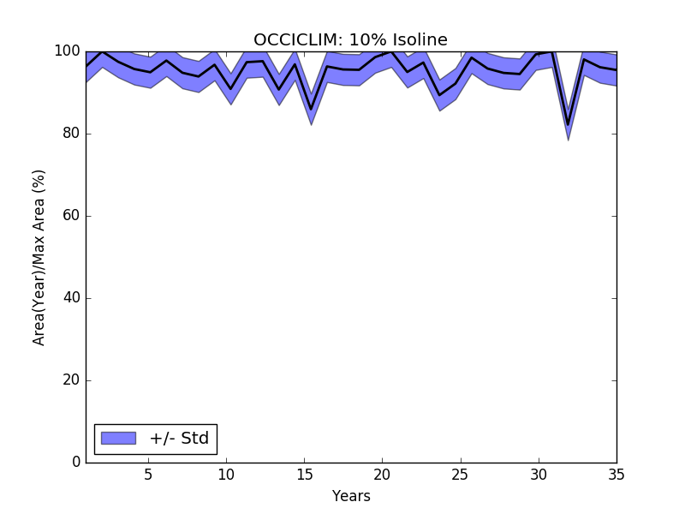
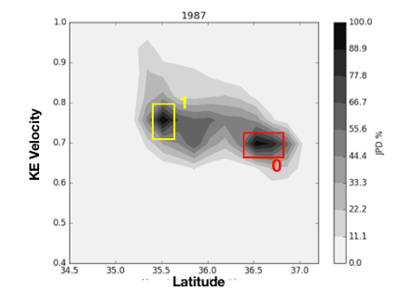
OCCITENS
OCCICLIM
X X
TWO
MODES
OCCITENS: 10% isoline
OCCICLIM: 10% isoline
Area(Year)/Max Area (%)
3yrs time window centered around 1987

Slide 25
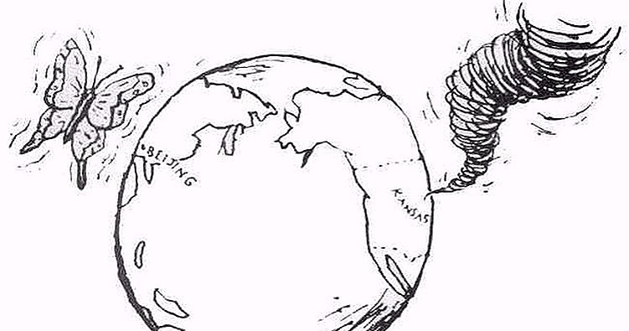
ONGOING WORK:
To investigate the more and the less predictable states in the KE LFV.

Slide 26
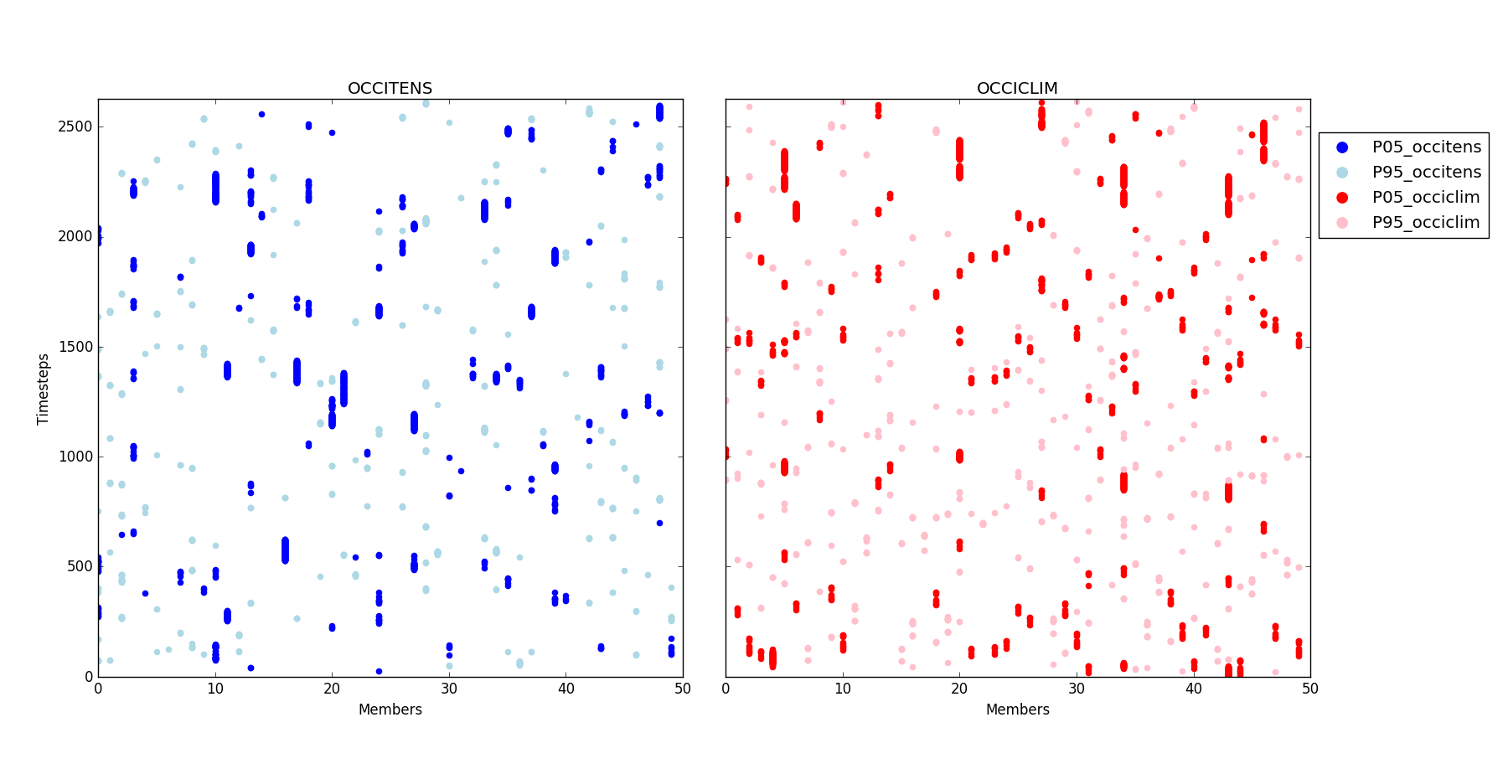
Timesteps associated with the P05 and P95 percentiles computed for each member
(both d and $Θ$are in P05/P95).

Slide 27
Timesteps associated with the P05 and P95 of the total ensemble.
OCCITENS
P05
P95
Time [years]
Members
OCCICLIM
P05
P95
Timesteps
Members

