Slide 1
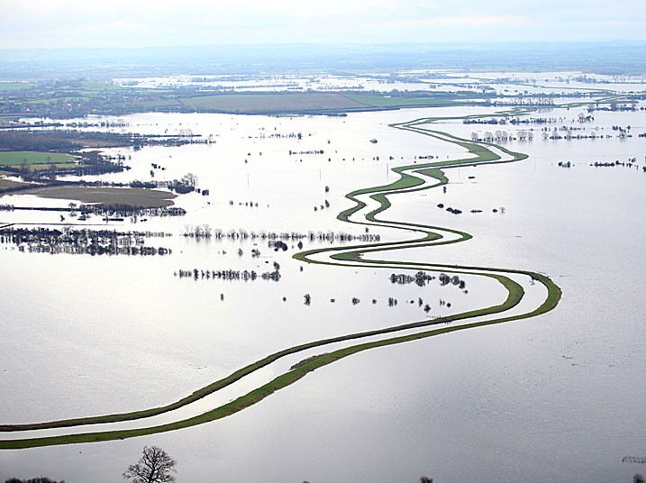
Estimating out-of-bank discharge uncertainties using a hydrodynamic model and nationally available datasets Rob Milsom, Gemma Coxon, Jeff Neal

Slide 2
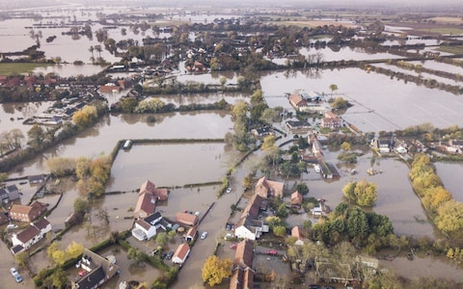
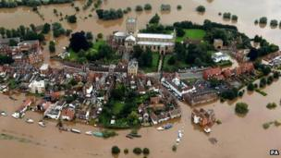
Important to have accurate estimates of stream flow data for predictions and forecasts of flood risks and hazards…
UK Flooding River Don 2019 (left)
River Severn 2007 (right)
Source: BBC
…but the stage-discharge relationship is subject to substantial uncertainties particularly at high flows
From Coxon et al (2015)

Slide 3
Hydraulic modelling can be used to produce more reliable stage-discharge relationships beyond the range of observed measurements BUT these methods are often data intensive restricting their use across large samples of gauges Key Aim: Estimate out-of-bank discharge uncertainties using a hydrodynamic model and nationally available datasets

Slide 4
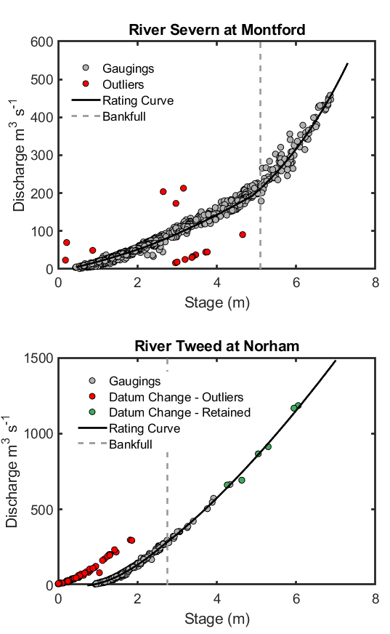
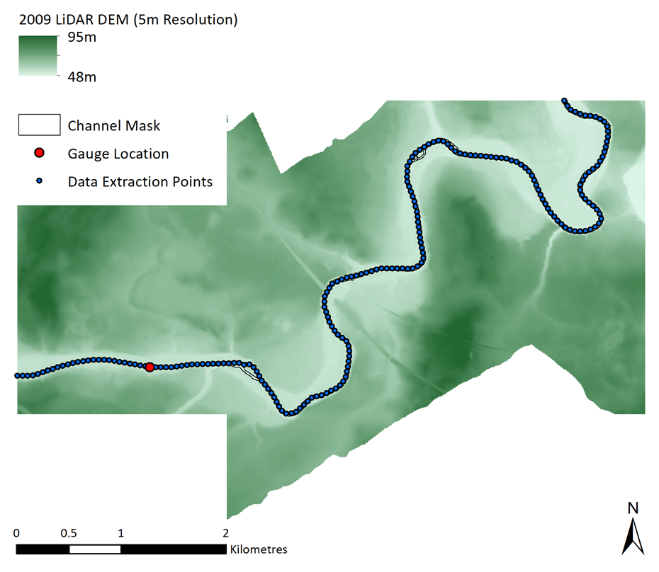
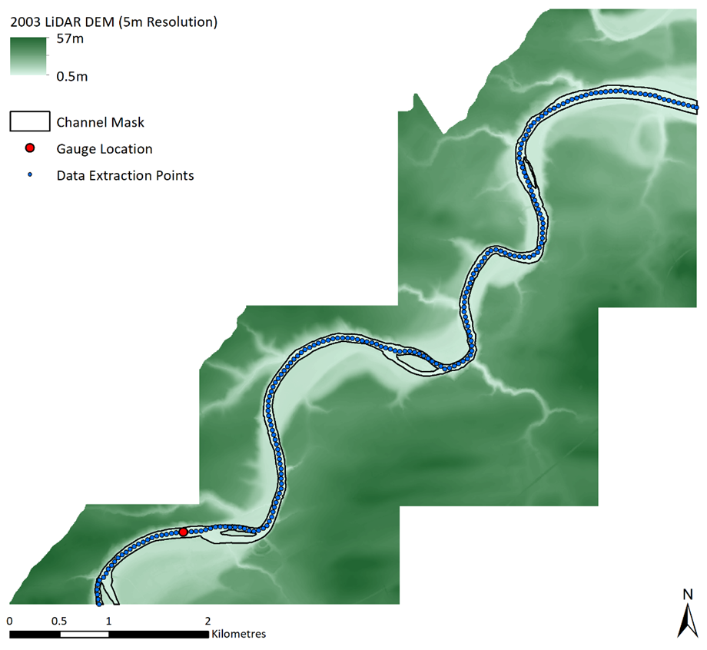
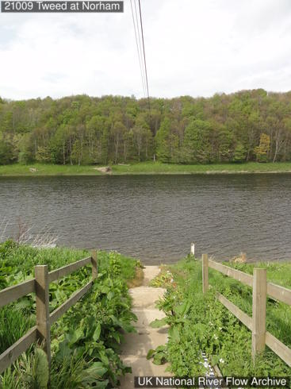
Two gauging stations in the UK selected as case studies

Slide 5
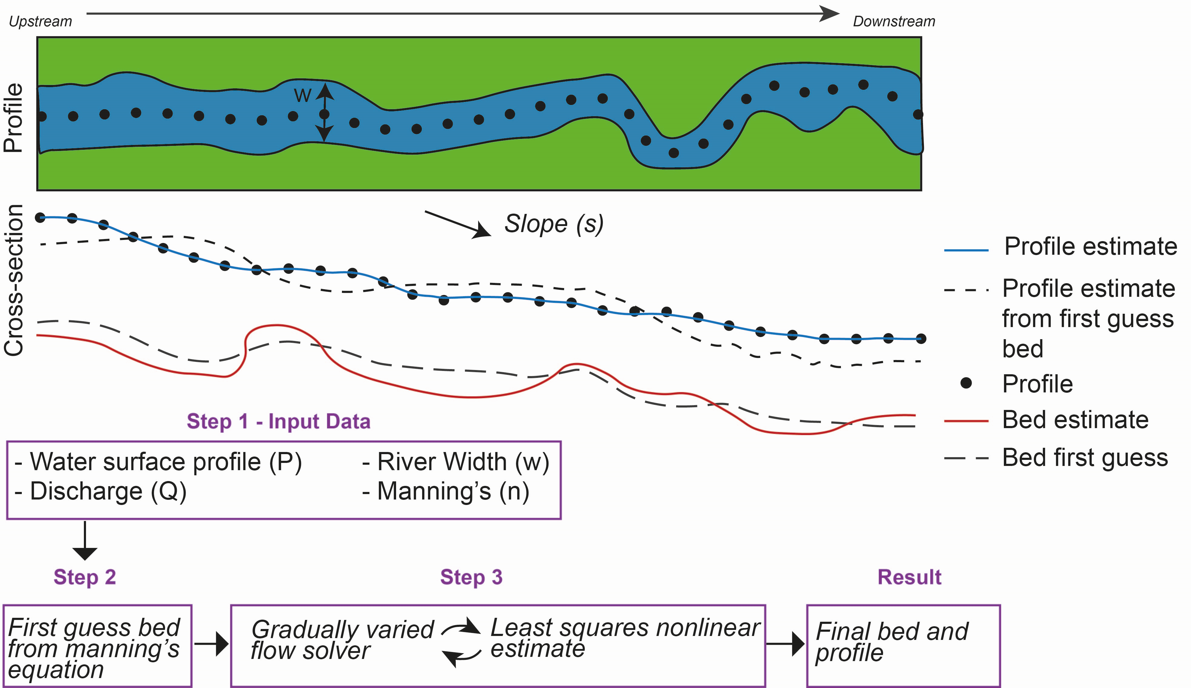
To build the hydraulic model, we need river bathymetry
Traditionally defined with cross-section or sonar data, but this can be difficult to source
Instead, estimate bathymetry from LiDAR water surface and gauge discharge

Slide 6
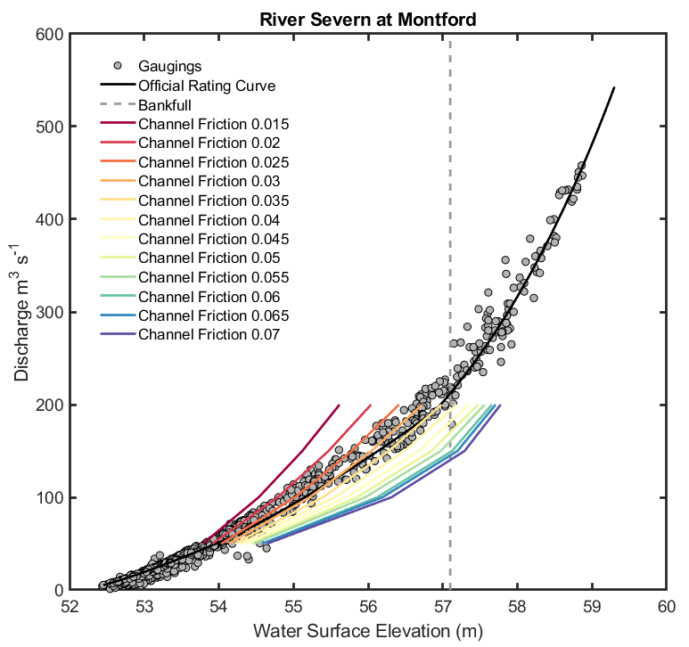
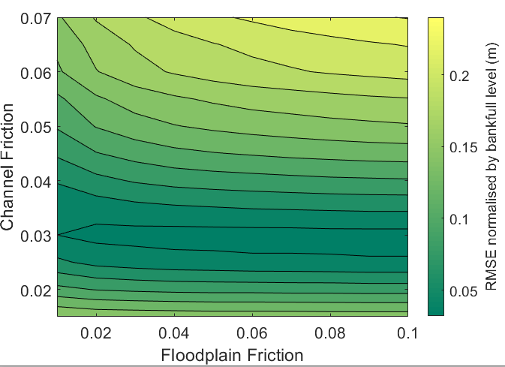
Calibrate friction using inbank stage discharge observations (Example shown for Montford)
Run hydraulic model to steady state for a number of discharges
Calculate RMSE (normalised by bankfull level) of observed water surface elevation (mean of stage-discharge measurements) against simulated water surface elevations
Best performing friction values used to simulate out of bank flows

Slide 7
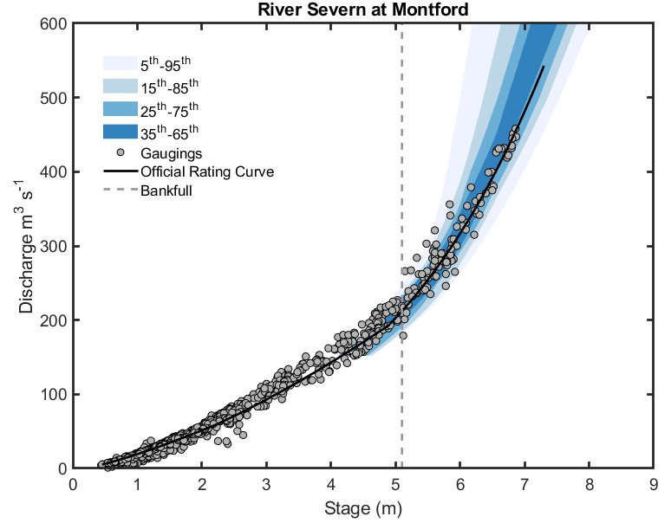
The model predictions showed a close fit to the official rating curve and out-of-bank stage-discharge measurements
Percentile Uncertainty Bounds
Uncertainty bounds reflect uncertainty in channel and floodplain friction

Slide 8
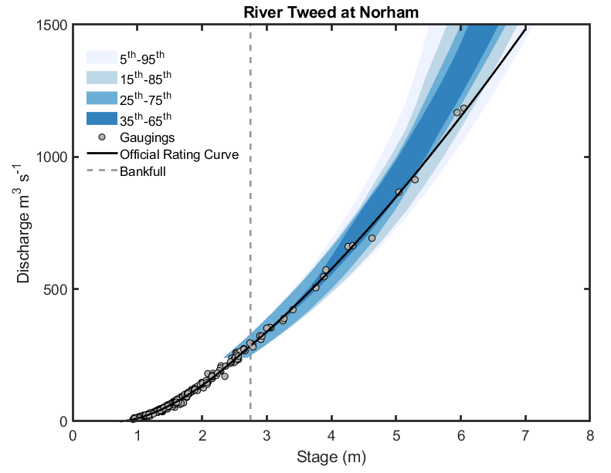
The model predictions showed a close fit to the official rating curve and out-of-bank stage-discharge measurements
Percentile Uncertainty Bounds
Uncertainty bounds reflect uncertainty in channel and floodplain friction

Slide 9
This holds promising results for quantifying out-of-bank discharge uncertainties across large samples of catchments to enable robust national flood risk assessment.
Next Steps
Apply the framework across more gauging stations – particularly those with more complex out-of-bank behaviour
Improvement in model calibration, weighting of friction parameters and derivation of final uncertainty bounds

