Slide 1
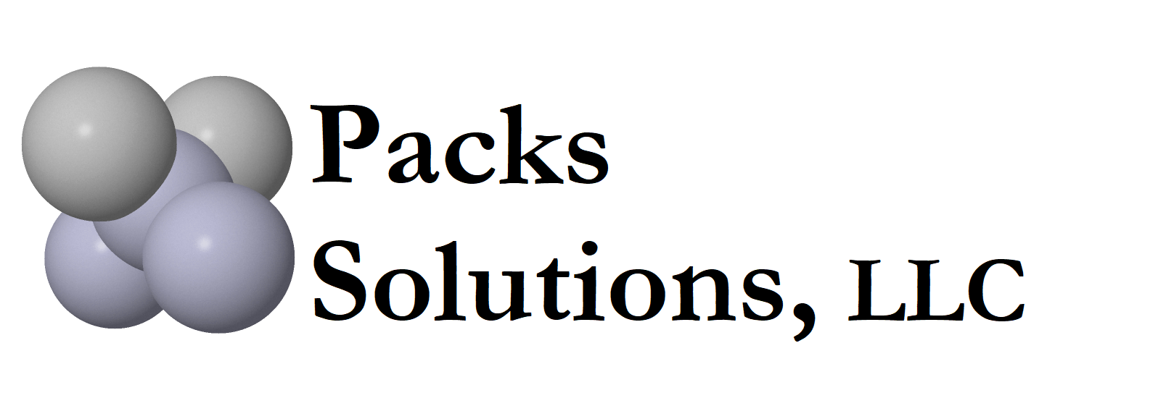
Dental Amalgam and Dissolved Mercury Reduction
A system, not just a separator.
A cost-effective solution

Slide 2
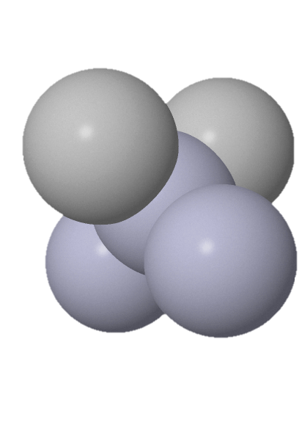
Packs Solutions, LLC
William Purves
President
- 20+ years in mercury abatement.
- Has been working in analytical research and laboratory analytical environment since 1972.
- Inducted into the International Activated Carbon Hall of Fame in 2018 for his work using activated to remove mercury from water
and air.

Slide 3
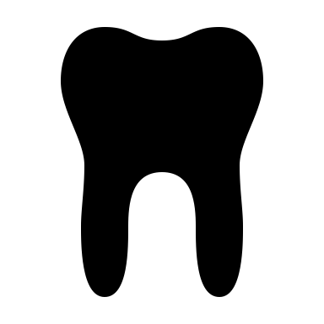
Amalgam
Dental amalgams contain approximately 50% elemental mercury by weight
A blend of mercury, silver, tin, zinc, copper, and other metals.

Slide 4

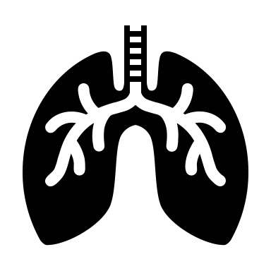
Humans and Mercury Vapor
Reaction will continue at an extremely low level
Swallow dissolved mercury in saliva
Respire vaporous mercury
Reaction generates dissolved mercury and vaporized mercury over a long period of time.
No chemical reaction goes to 100% completion.
Mercury Aspiration
No amalgams 0 ng/M³
1-2 amalgams 50-100 ng/M³
3+ amalgams 150-1,000 ng/M³
American Industrial Hygiene Association maximum daily exposure recommendation 25,000 ng/M³.
Notes:
Give story about breathing into mercury machine.

Slide 5
Mercury Usage
Total Mercury Used in
the United States*
Percentage of Mercury Entering Wastewater
Treatment Plants**
Based on studies in the United States of America.
Dental
Other
Dental
Other
* From IAOMT March 2020 newsletter.
** From ADA publication 2005.

Slide 6
US EPA Rule
40 CFR Part 441
What the rule does…
State and local government enforce the regulation.
Requires hazardous waste recycling.
Follows ISO Standard 11143:2008 for separators – requiring 95% separation rate.
What the rule does not do…
Does not set a mercury discharge limit for dental facilities.
Does not require the use of Best Available Technology (BAT).
Does not address dissolved mercury. Only concerned with solid amalgam/mercury.
Compliance required by 14 July 2020.
Reality: Many small and mid-sized wastewater treatment plants are unable to meet federal regulations with a 95% separation rate.
Notes:
The lack of a limit has created enforcement issues between dentist and treatment plant
The lack of BAT in the regulation does not further development of better separators.

Slide 7



ISO vs Environment
Based upon ISO 11143
95% of solids are captured.
10 grams used in test
500,000,000 ng escapes to the treatment plant
.5 grams passes through
ISO test does not remove enough amalgam and dissolved mercury to levels needed by wastewater treatment plants.
1,000,000 ng of amalgam can pollute 80,000 liters of water.
~265 bathtubs

Slide 8






Mercury and the Environment
Sludge
Landfill
Incineration
Fertilizer
How mercury enters the environment.
POTW
Water
Bodies of water
Notes:
Solids by settling and filtration
Dissolved by Chemical Binding and Flocculation
Solid particles down to 10 microns can be removed by settling and filtration if flow is below 100 ml/minute. Higher flow will allow larger particles to pass through.
Once removed, the amalgam waste becomes part of the POTW's sewage sludge, which is then disposed:
In landfills. If the amalgam waste is sent to a landfill, the mercury may be released into the ground water or air.
Through incineration. If the mercury is incinerated, mercury may be emitted to the air from the incinerator stacks.
By applying the sludge to agricultural land as fertilizer. if mercury-contaminated sludge is used as an agricultural fertilizer, some of the mercury used as fertilizer may also evaporate to the atmosphere.
Source: https://www.epa.gov/mercury/mercury-dental-amalgam

Slide 9





Mercury and the Environment
Elemental mercury
Bodies of water
Bacteria
Mercury impacts our food supply.
Methylmercury is a neurotoxin.
Converts to methylmercury
Bioaccumulation in fish
Fishing
Consumption

Slide 10
Preliminary Pandemic Study
Samples were taken from 10 wastewater treatment plants. Most dental offices reduced operations on March 15, 2020 and only performed emergency operations in April 2020.
The control treatment plant has no discharge from industry nor dental offices.
Impact of dental discharge on mercury discharged from 10 wastewater treatment plants.
* This is an on-going study. Details and updates to this study can be found at www.packssolutions.com.

Slide 11

Removing Amalgam is not just a separator.
It’s a system!
Packs Solutions
Best Management Practices

Slide 12
Line Cleaners
The first step to a cleaner system

Slide 13
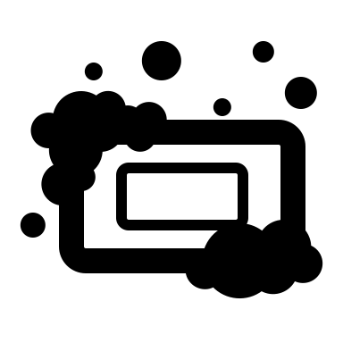
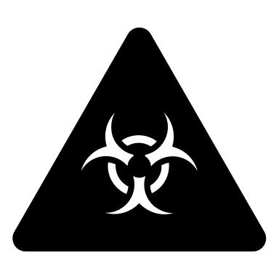
Line Cleaners
Neutral pH 6-8
US EPA requires a line cleaner with a neutral pH of 6 to 8.
Removes particulate and bio-film
Disinfects

Slide 14
Amalgam Dissolves in Water
pH levels impact dissolved mercury.

Slide 15
Packs Super Traps
Advanced filtration technology to reduce mercury buildup

Slide 16
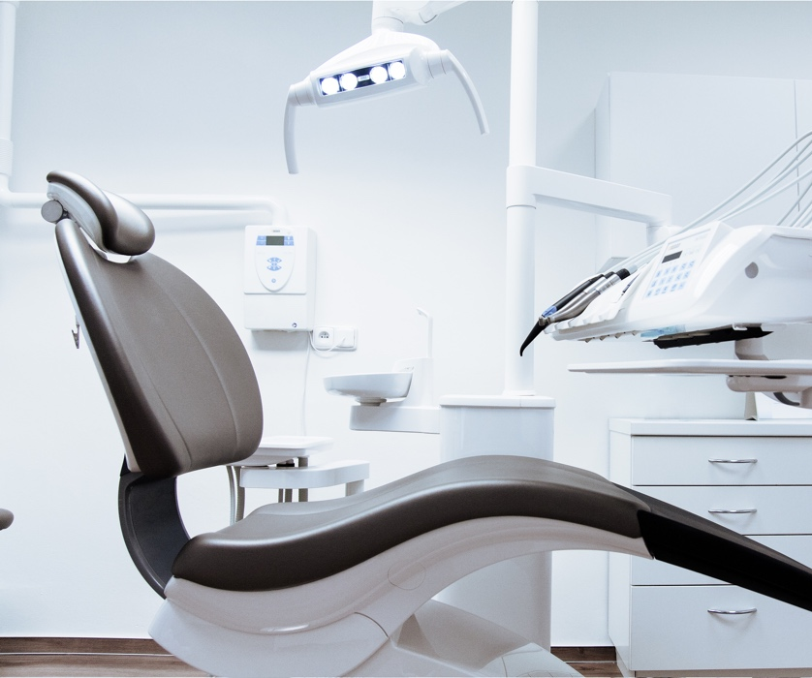
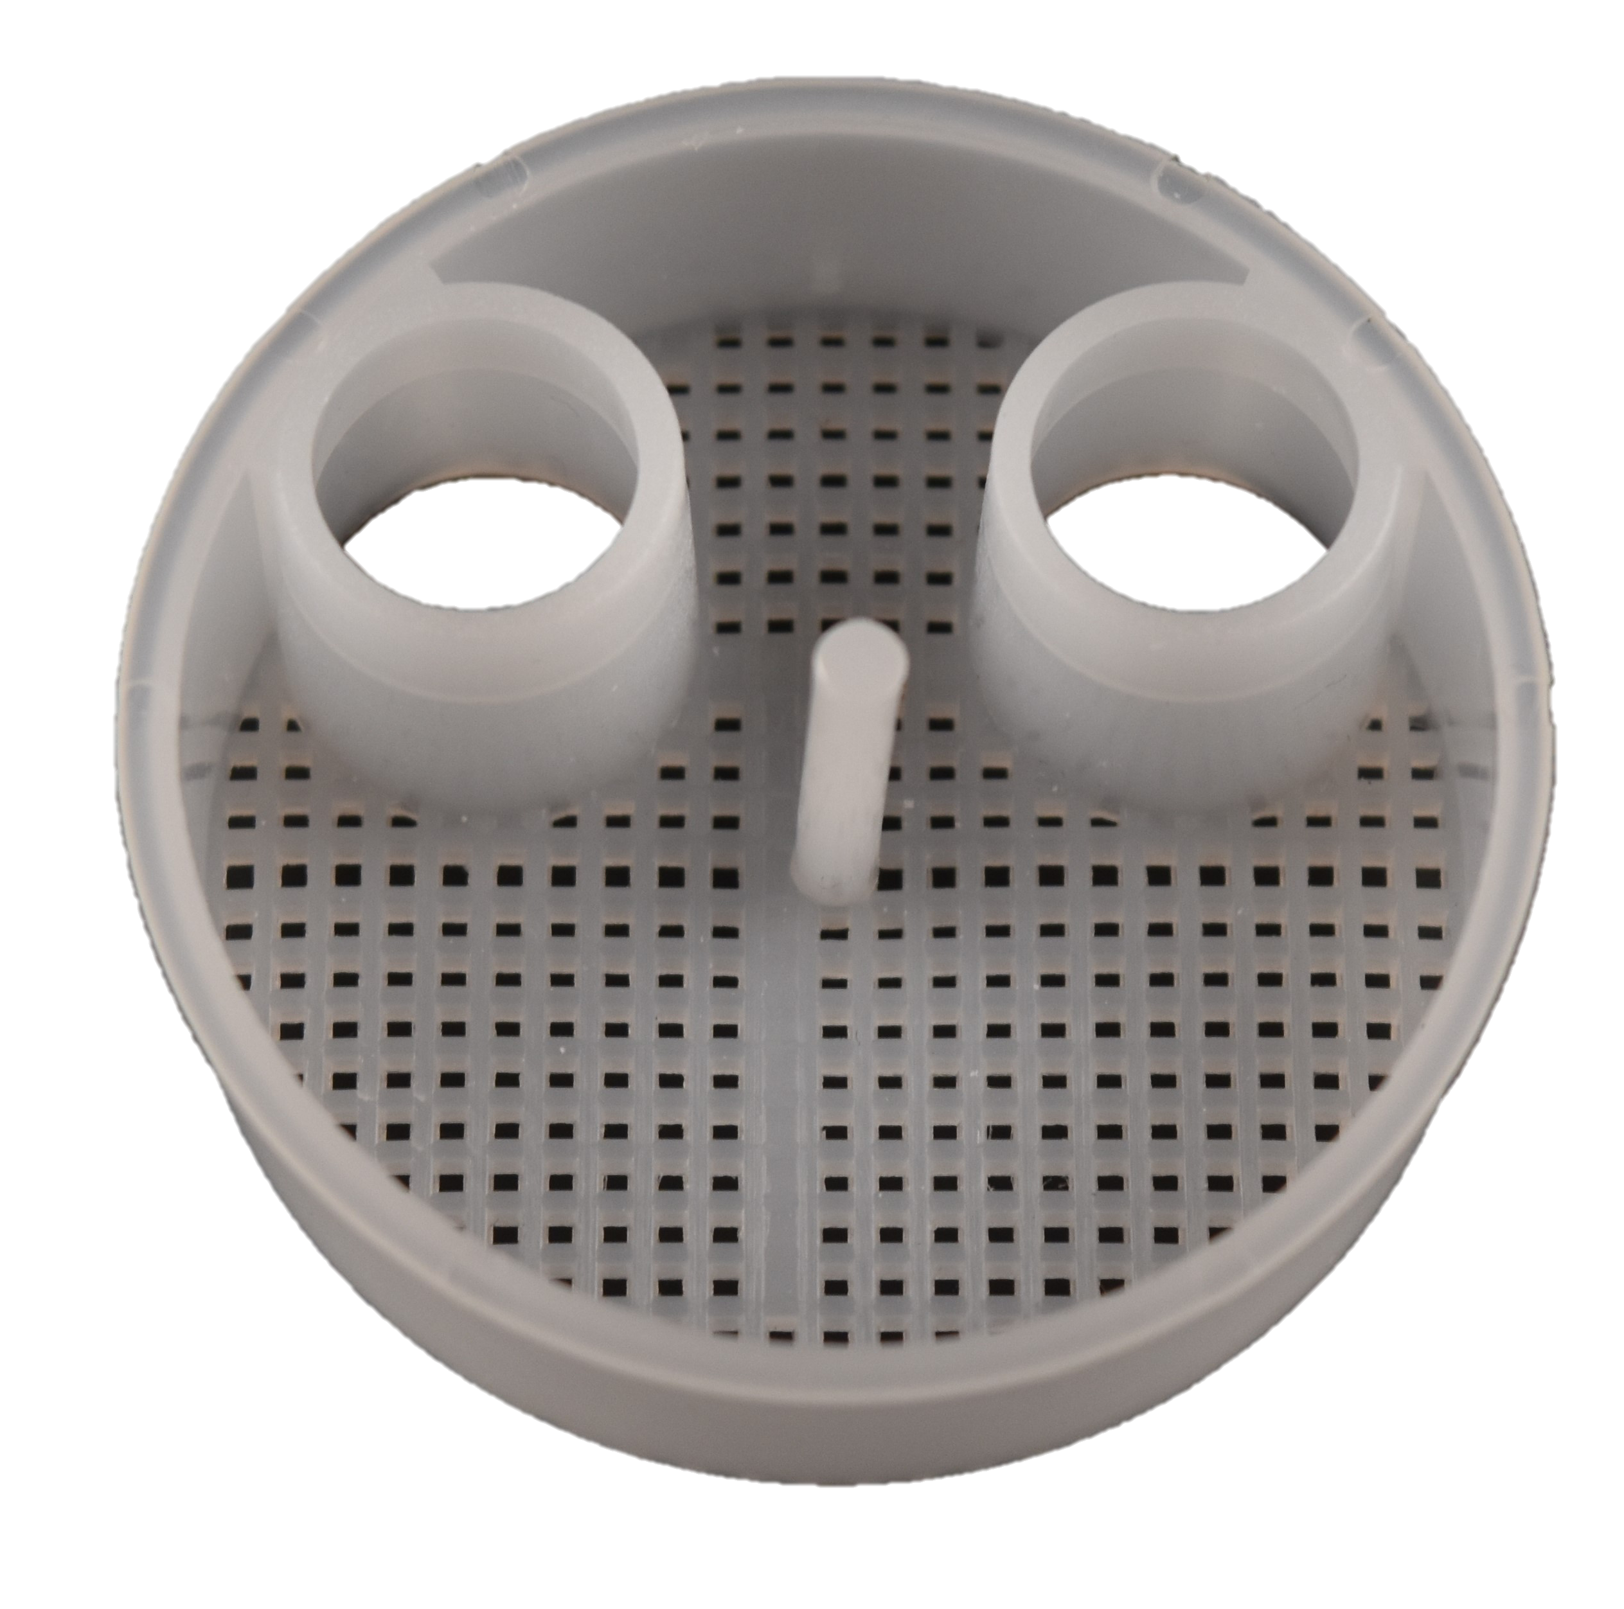
Traditional
Chairside Trap
Very porous: 99%+ amalgam passes through to the separator.

Slide 17
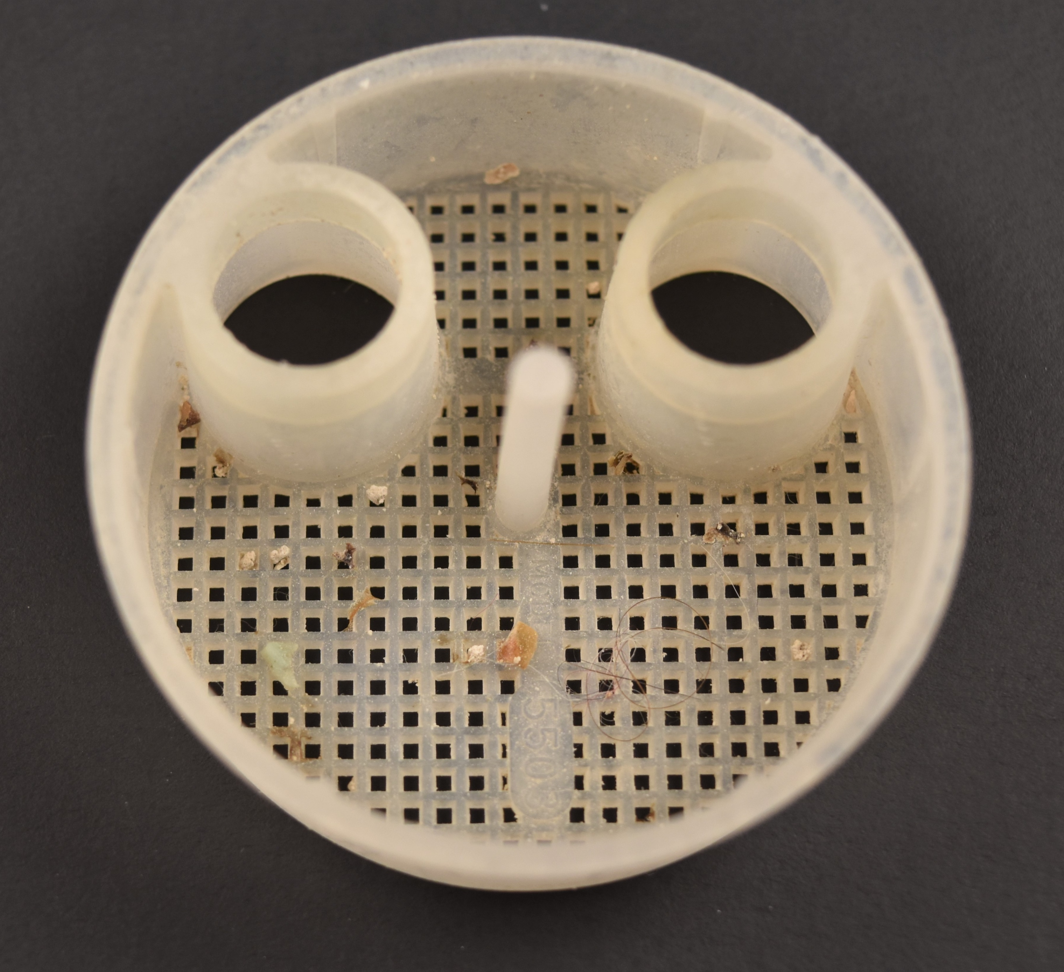
Traditional
Chairside Trap
Very porous: 99%+ amalgam passes through to the separator.

Slide 18
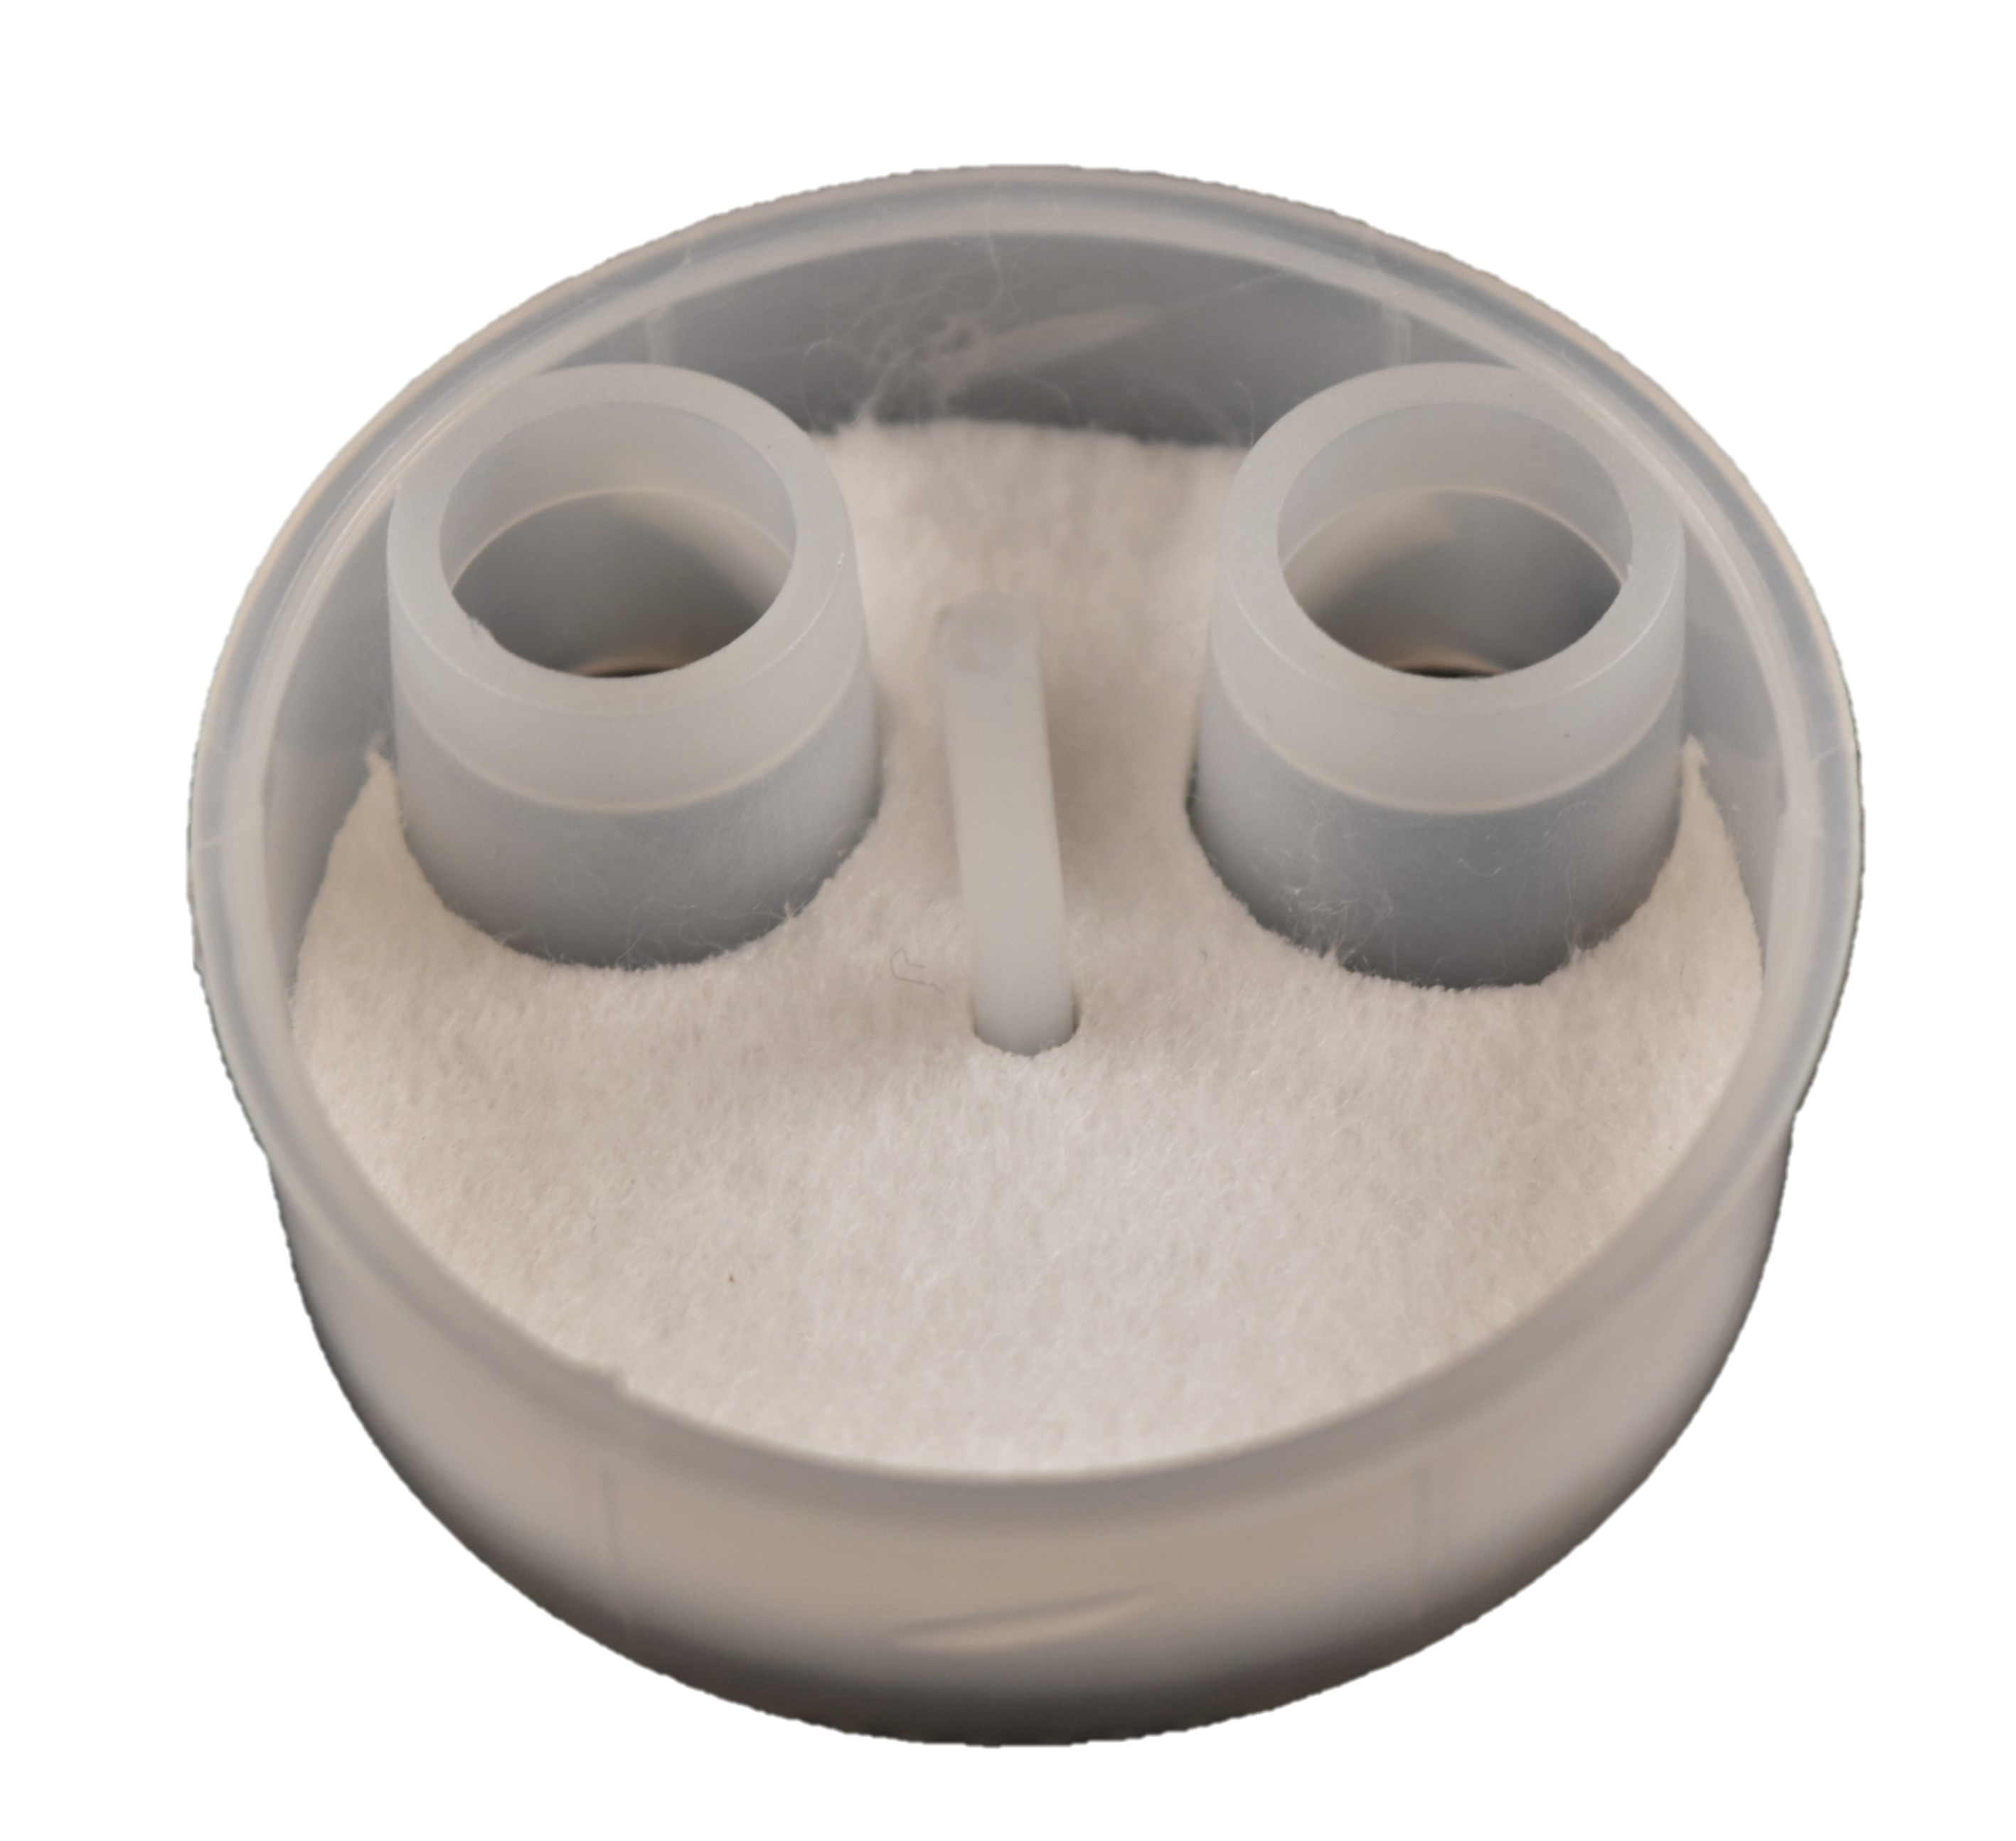
Packs Super Traps
Uses advanced filtration technology.
Reduces mercury buildup in vacuum lines.

Slide 19
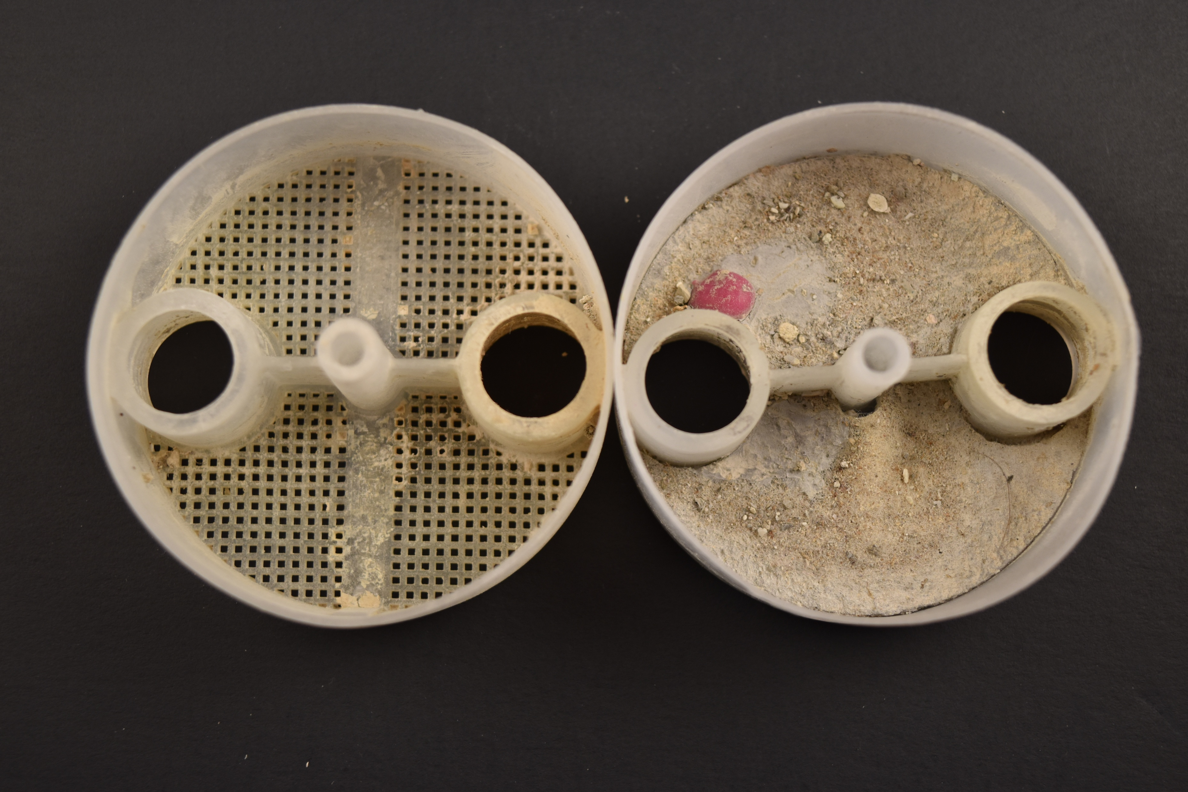
Packs Super Traps
Uses advanced filtration technology.
Reduces mercury buildup in vacuum lines.

Slide 20
Packs Super Traps
Added Packs Super Traps
Dental office only added Packs Super Traps, no other modifications.
Data based on an actual dental office in a city with a discharge limit of 10,000 ng/L.
99.05% reduction in mercury

Slide 21
Self-Contained Amalgam Separator
with Activated Carbon

Slide 22
Separators Based on Outdated Technology
Dental Office | Separator Type and Condition | Total Mercury (ng/L) | Dissolved Mercury (ng/L) | Sample Location
Dental Office A | Cartridge-Based Poor Condition | 17,500,000 ng/L | 7,500,000 ng/L | Discharge to Street
Dental Office B | Cartridge-Based Half Full | 7,290,000 ng/L | 2,530,000 ng/L | Discharge to Street
Dental Office C | Cartridge-Based New Cartridge | 660,000 ng/L | 452,000 ng/L | Lower Chamber Cartridge
Dental Office D | Cartridge-Based New Cartridge | 534,000 ng/L | 378,000 ng/L | Lower Chamber Cartridge
Dental Office E | Self-Contained | 6,510,000 ng/L | 3,660,000 ng/L | Discharge to Street
Dental Office F | Self-Contained | 10,500,000 ng/L | 5,210,000 ng/L | Discharge to Street
Data collected from dental offices in 2013 using outdated technology being used today.
Presented to US EPA on 10 November 2014 in a hearing regarding 40 CFR Part 441

Slide 23
Mercury
Discharge Study
Location | Separator Type | June 2019 Discharge Amount
Dental office 1 | No Separator | 11,500 ng/L
Dental office 2 | Cartridge-Based | 4,350 ng/L
Dental office 3 | Self-Contained | 16,500 ng/L
Dental office 4 | No Separator | 180,000 ng/L
Dental office 5 | Cartridge-Based | 49,600 ng/L
Dental office 6 | Cartridge-Based | 1,280,000 ng/L
Dental office 7 | Cartridge-Based | 1,050,000 ng/L
Dental office 8 | Cartridge-Based | 124,000 ng/L
Dental office 9 | Cartridge-Based | 15,400 ng/L
Dental office 10 | Cartridge-Based | 10,900 ng/L
Dental office 11 | Cartridge-Based | 204,000 ng/L
June 2019 – ongoing
The city had a discharge
limit of 10,000 ng/L.

Slide 24
Separator with Activated Carbon
Replaced Separator
Dental Office 10 replaced a cartridge- based amalgam separator with a self-contained amalgam separator using activated carbon.
Reduces dissolved mercury.
66.51% reduction in mercury

Slide 25
Separator with Activated Carbon & Packs Super Traps
Mercury Discharge (ng/L)
Dental Office 1 and Dental Office 5 replaced cartridge-based amalgam separators with a self-contained amalgam separator using activated carbon and added Packs Super Traps.
91.13% reduction
in mercury
99.20% reduction
in mercury

Slide 26
Proper Recycling of
Amalgam Waste
As mandated by US EPA rule 40 CFR Part 441

Slide 27


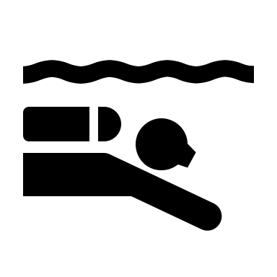
The following items must be recycled:
Recycling of Amalgam Waste
Scrap amalgam
Packs Super Traps or chair-side traps
Teeth containing amalgam
Vacuum Pump Filters and/or Lines
Spent Amalgam Capsules
Amalgam Sludge
Dental offices must recycle amalgam waste through approved methods.
Notes:
Office Vapor Levels
Amalgam that is left as waste in carpets, on instruments, in traps or not properly contained will continuously generate mercury vapor.
All general dental offices have mercury vapor present. The range of concentration depends upon management of amalgam waste.
Does not place amalgams
35 ng/M³
Have used or place amalgams
7,500 ng/M³
Amalgam is Non-Hazardous when placed in a human mouth.
Amalgam is Hazardous when removed from a human mouth
Any amalgam waste is Hazardous before being placed in a human mouth.

Slide 28

Packs Solutions Best Management Practices (BMPs)
Mercury Discharge (ng/L)
~ 6,000,000
Implemented Packs Solutions BMPs
October 2017 - Ongoing
This 3-chair dental office was violating local discharge limits. The dental office implemented Packs Solutions BMPs.
99.99% reduction in mercury
Total cost over 3 years: $1,520*
*Does not include cost of standard cleaning chemicals nor recycling.
Notes:
The 3 chair office has been using the super trap and maintenance free separator with adsorption media since October 2017.

Slide 29
Cost Effective
The total annualized cost of the system only includes the separator and Packs Super Traps. Cleaning chemicals are excluded as there is no change in their usage. Recycling costs are also not included.
Cost data from three dental offices utilizing Packs Solutions BMPs (provided by office managers).
Dental Office | Before System Change | Packs Super Traps & Separator
3-chair dental office | $1,200 | $880
4-chair dental office | $1,050 | $760
6-chair dental office | $1,400 | $1,120

Slide 30
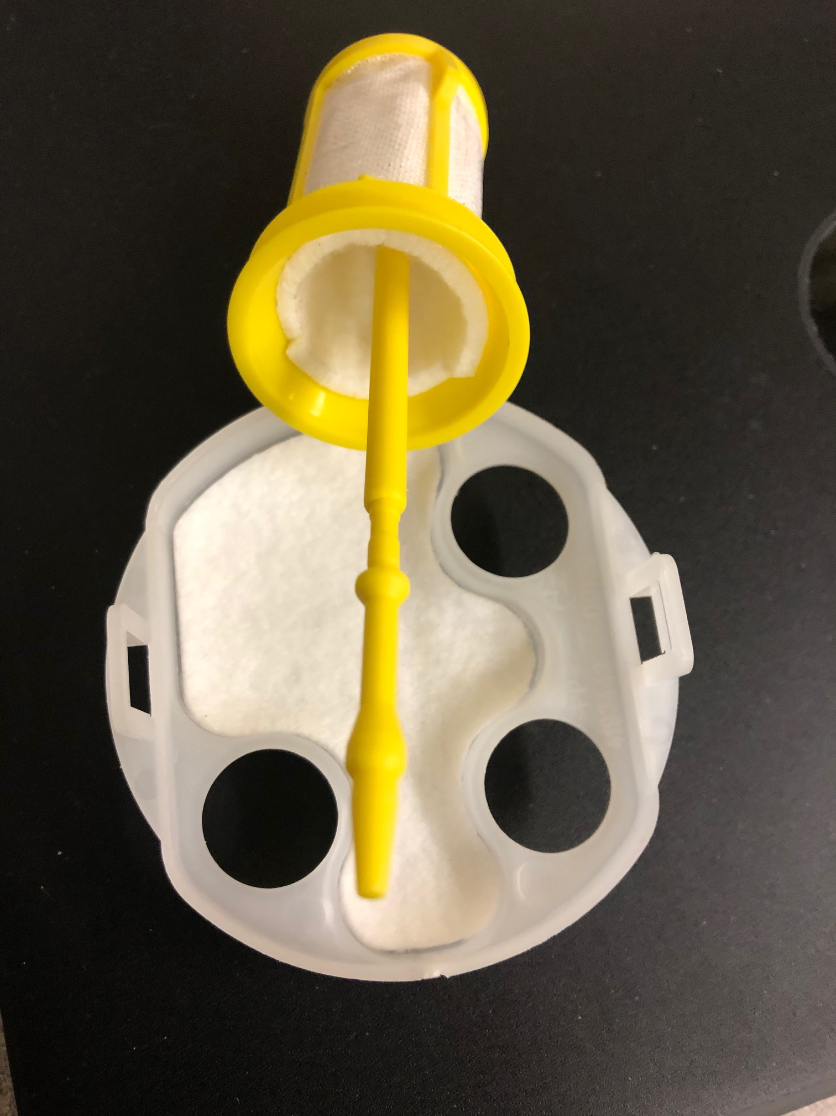
Can Be Done Worldwide
International version of other packs Super Traps
(provided by an Australian dental facility)

Slide 31

Consulting
Packs Super Traps
Recycling
William Purves
Bill@packssolutions.com
+1 (330) 687-3367
www.packssolutions.com
info@packssolutions.com
+1 (234) 201-0523
www.packssolutions.com

