Slide 1
Do chemical characteristics affect the potential of biochars to adsorb cations?
Jose Maria Garcia Castro de Barragan^{1.2}.
Elena Fernandez-Boy². Michael Knicker³. Regina León Ovelar^{1.2.4}. Heike Knicker^{1*}
¹ Instituto de Recursos Naturales e Agrobiologia de Sevilla (IRNAS-CSIC). Sevilla. Spain
² Departamento de Cristalografía. Mineralogía y Química Agrícola. Universidad de Sevilla. Sevilla. Spain
³ Consult Michael Knicker (CMK). München. Germany
⁴ Laboratorio de Química*. Facultad de Ingeniería. Universidad Nacional de Asunción. San Lorenzo. Paraguay
*knicker@irnase.csic.es

Slide 2
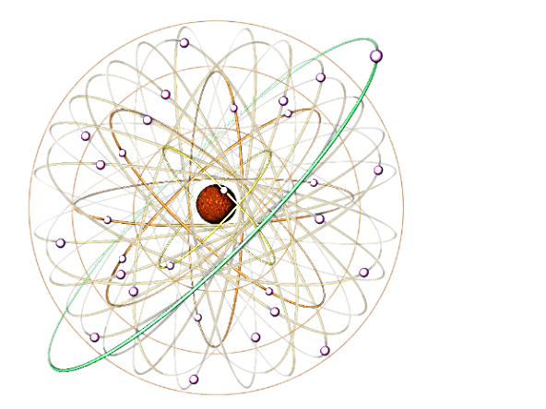
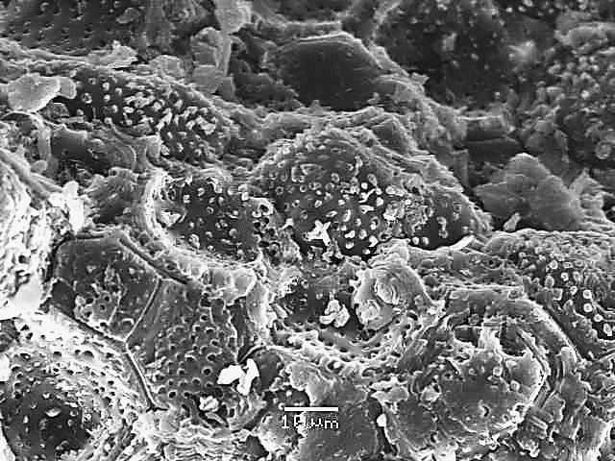
Summary: Reasoning
Biochar adsorbs cations:
use as filter for heavy metals
soil amendment with nutrients storage capacity
As a paramagnetic Ion, Cu²⁺ shortens the Spin-Lattice Relaxation time (T₁) of the ¹³C and its ¹H to which it is adsorbed.
Cu
NMR Relaxometry on Cu²⁺- doted pyrochars allows the determination of C-groups involved in the adsorption of cations
Revealing relationship between chemical composition and adsorption efficiency
Using pyrochars with different aromaticity and chemical composition may contribute to a better understanding of the adsorption mechanism

Slide 3
Summary: Results
The Adsorption to the three pyrochars used in this study was best fitted with the Freundlich model
The adsorption efficiency increased with aromaticity of the sample
We found indications that crystalline domains of weakly charred pyrochars from cellulosic feedstock did not allow Cu²⁺ to access all potential adsorption sites
Aside from charged functional groups, π-orbitals of aromatic rings contributed to Cu²⁺ adsorption
Cu
Porosity is not the main factor determining Cu²⁺ adsorption to pyrochar;
Accessibility of Cu²⁺ to pores and the availability of π-orbitals of aromatic rings seem also to play an important role.

Slide 4
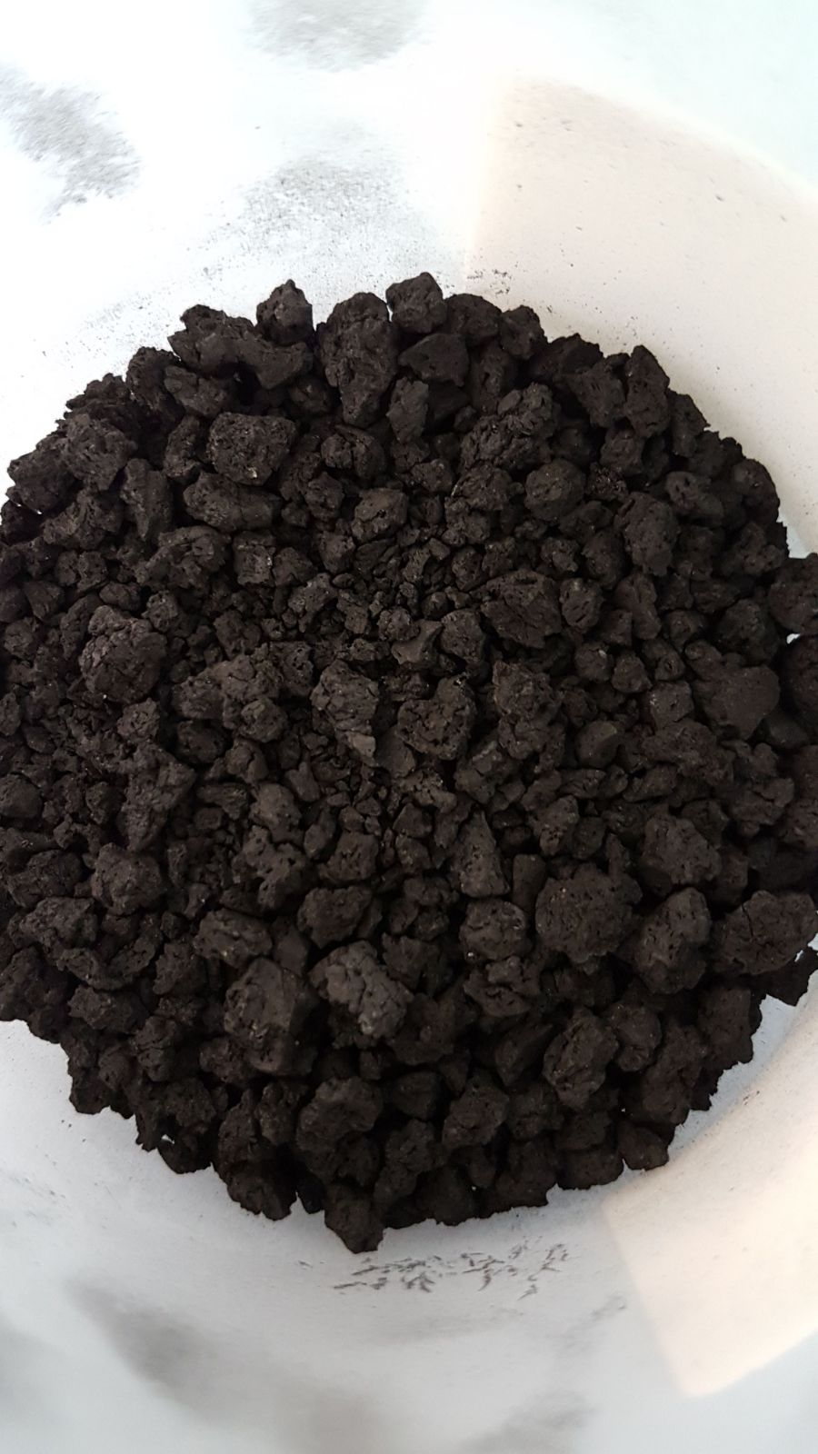
Introduction: Organic Waste - a Valuable Resource
Industry
ORGANIC
WASTE
Agriculture
Valorization:
Biochar
Pyrolysis (low oxygen)
Soil amendment
Slow-release fertilizer
Gardening soil
Water clean-up
Soil remediation
Filter (water clean-up)
etc.
Definition:
Ecologically sustainable organic feedstock
Heterogeneous substance
High aromaticity
High organic C content
EBC (2012)
Material with:
High porosity
High waterholding capacity
Cation adsorption

Slide 5
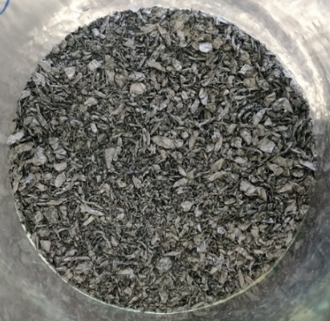
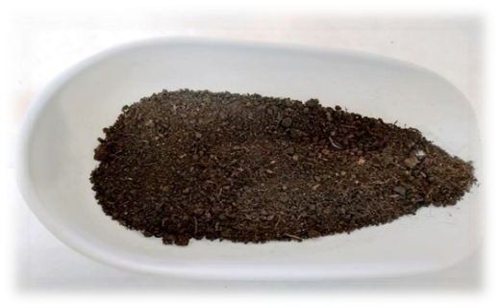
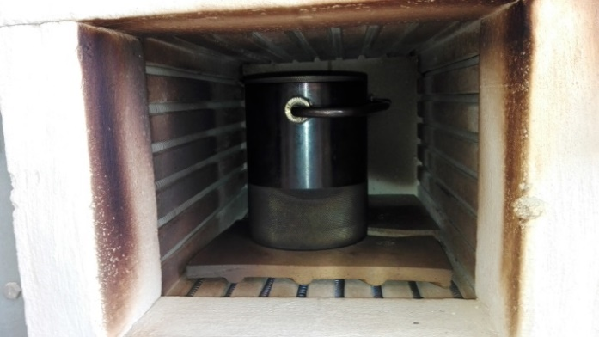
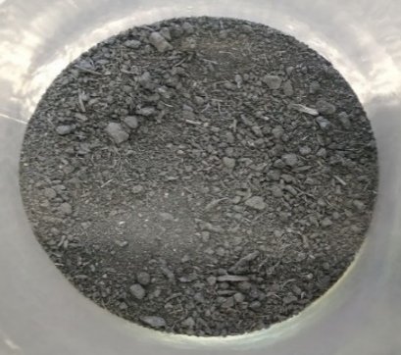
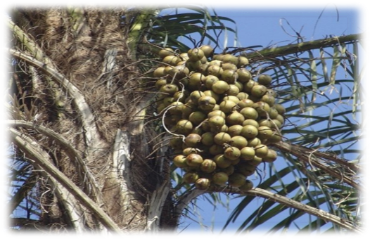
But: Biochar ≠ Biochar!
Biochar structure depends on:
Feedstock
Production conditions
Chitin(Ch0)
Chitin char (Ch400)
400ºC. 3h
500ºC. 3h
Peat (Pe0)
Peat char (Pe500)
Acrocomia endocarp
(Ac0)
Acrocomia endocarp char
(Ac450)
450ºC. 0.5h

Slide 6
Table 1: Elemental composition of chitin, peat and Acrocomia endocarp and their chars produced at 400°C, 500°C and 450°C, respectively. the pH (H₂O) and the BET surface area (SA) (CO₂) of the chars.
Material | C g kg⁻¹ |  | H g kg⁻¹ |  | N g kg⁻¹ |  | Ash g kg⁻¹ |  | O* g kg⁻¹ | H/C_{atm} | C/N (w/w) | O/C_{atm} | pH (H₂O) |  | S_{BET} m²g⁻¹
Ch0 | 437.7 | ± 2.0 | 64.4 | ± 0.7 | 63.8 | ± 0.4 |  |  |  | 1.8 | 6.9 |  | 6.9 | ± 0.0
Ch400 | 700.1 | ± 2.2 | 28.0 | ± 0.1 | 86.1 | ± 1.0 | 11.8 | ± 0.1 | 143.7 | 0.5 | 8.1 | 0.2 | 6.4 | ± 0.0 | 216
Pe0 | 429.0 | ± 8.8 | 49.5 | ± 2.0 | 8.7 | ± 0.3 |  |  |  | 1.4 | 49.2 |  | 6.2 | ± 0.1
Pe500 | 684.1 | ± 3.7 | 26.8 | ± 0.5 | 14.3 | ± 0.3 | 140.1 | ± 1.3 | 134.8 | 0.5 | 47.9 | 0.1 | 8.4 | ± 0.1 | 192
Ac0 | 487.4 | ± 1.7 | 55.8 | ± 0.4 | 1.8 | ± 0.0 |  |  |  | 1.4 | 264.4 |  | 5.9 | ± 1.2
Ac450 | 564.8 | ± 2.5 | 46.7 | ± 0.2 | 2.8 | ± 0.1 | 16.8 | ± 0.1 | 368.8 | 1.0 | 202.7 | 0.5 | 7.3 | ± 0.1 | 178
*Calculated by the sum of ash. C. H. and N contents subtracted from 1000 g of sample material.

Slide 7
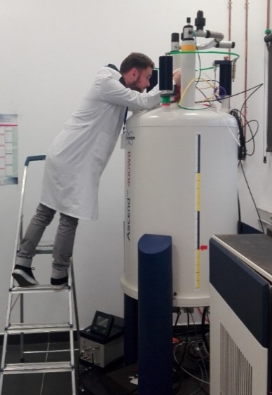
Chemical Composition Determined by Solid-state ¹³C NMR Spectroscopy
Aromatic
O/N-
Aromatic
O/N-
Carboxyl
Alkyl
Alkyl
Carboxyl
Alkyl
Alkyl
Bruker Avance III 400 MHz
73
23
75
60
127
83
Cross-polarization: 1 ms
Magic angle spinning: 14 kHz
103
55
172
20
158
72
32
Ch0
Ch400
127
73
33
Difference in aromaticity (160-90 ppm):
Pe500 > Ch400 > Ac450
Difference in polarity P:
I(225-140 ppm) + I(90 – 45 ppm)
P =
I(140-90 ppm) + I(45-0 ppm)
Ac450 > Ch400 > Pe500
116
129
105
62
155
155
39
Pe0
172
Pe500
169
72
18
72
72
104
104
64
116
64
116
154
131
56
157
132
56
33
20
Ac450
172
20
Ac0
172
300
200
100
0
-100 ppm
300
200
100
0
-100 ppm

Slide 8
Hypothesis:
Different chemical compostion, polarity, pH and BET surface (CO₂) may lead to:
Differences in the Cation Adsorption?
Differences in the Adsorption Mechanism?
Adsorption experiments with paramagnetic Cu²⁺
NMR-Relaxometry:
Relaxation time is affected by paramagnetic Cu²⁺
Determination of affected C group allows identification of binding site

Slide 9
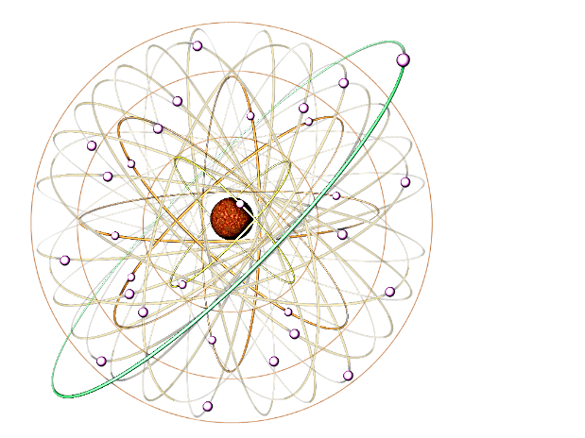
Adsorption of Cu²⁺ onto Biochar: Experimental Design
200 mg biochar + Cu(NO₃)₂ (0.9-17 mM)
Shaking for 24 h at 25ºC
Separation of solid and liquid phase
Determination of Cu²⁺ concentration in the solution (C_{e})
Calculation of Cu²⁺ concentration in solid (Q_{e})
Q_{max:} maximum adsorption capacity (mmol g⁻¹)
K: Langmuir constant (L mg⁻¹)
K_{d}: Freundlich distribution coefficient.
n: correction factor constant
Langmuir
Cu
$$\frac{C_{e}}{Q_{e}}= \frac{1}{K·Q_{max}}+\frac{C_{e}}{Q_{max}}$$
Freundlich
$$Q_{e}=K_{d} {C_{e}}^{1/n}$$
$$lnQ_{e}=\ln{K_{d}}+\frac{1}{n}lnC_{e}$$
copyright: freepng.es

Slide 10
Adsorption Isotherms of Cu²⁺ to Ch400

Slide 11
Adsorption Parameters of Cu²⁺ to Ch400, Pe500,
Ac450
 | Freundlich |  |  | Langmuir
 | R² | K_{d} | n | R² | Q_{max} (mg/g) | K (l/mg)
Ch400 | 0.8596 | 0.1122 | 2.7480 | 0.8392 | 19.63 | 2.142
Pe500 | 0.8854 | 0.1177 | 2.4624 | 0.848 | 25.73 | 1.973
Ac450 | 0.568 | 0.0144 | 1.0618 | 0.3426 | 12.84 | 1.227
Better R² with Freundlich: non-ideal adsorption on a heterogeneous surface
n > 1: higher Cu²⁺-concentration decreases relative adsorption
K_{d} (Adsorption affinity): Pe500> Ch400 > Ac450 (very low adsorption)

Slide 12
Relation between Adsorption of Cu²⁺ with Surface Area, pH and Aromaticity
Biochar | Single point surface area at P/Po (m²/g) | BET Surface Area (CO₂) | pH | Aromaticity | Polarity
Quitina (Ch) | 163.36 | 216.13 | 6.4 | 74 | 0.32
Turba (Pe) | 158.89 | 192.41 | 8.4 | 88 | 0.27
Acrocomia (Ac) | 140.02 | 177.62 | 7.3 | 26 | 1.18
No evident relationschip between K, K_{d} and surface area or pH
Adsorption efficiency increases with aromaticity and decreasing polarity
Adsorption to charged groups as main mechanism is unlikely!!!

Slide 13
NMR Relaxometry for the Identification of Cu²⁺ Adsorption Sites:
Theoretical Background
Magnetic field
Nuclear spins given into a static magnetic field will align themselves on two different energy levels according to the thermal equilibrium
A radio frequency-pulse (rf) moves spins from the lower to the higher energy level
Termination of the pulse allows the spins to return (relax) to their thermal equilibrium with the spin-lattice relaxation time rate, T₁.
Relaxation
Thermal Equilibrium (starting point!)

Slide 14
Theoretical Background: T₁ and Molecular Properties
T₁ depends on:
Short T₁
Long T₁
Molecular size / mobility:
Solid-state
small
large
Interaction with paramagnetics at a distance < 1 nm decreases efficiently T₁

Slide 15
Theoretical Background: T₁ and Domaine Size
Spin Diffusion: Spins in close neighborhood “communicate” their relaxation behavior among each other, which results in one common T₁:
The size of the „communication radius. L“
depends on T₁:
Kind and range of T₁s used in the present study:
Kind of T₁ | Time (ms) | L (nm)
T_{1roh-H} | 0.1 – 20 | 2 - 30
T_{1H} | 20-940 | 30 -160
T_{1C} | 2000 -34000 | Non*
Long T₁
Short T₁
Small
radius
Large radius
* The low natural abundance of ¹³C does not allow spin-diffusion

Slide 16
Information Obtainable from the Determination of T₁:
Identification of C groups which are affected by Cu²⁺ adsorption: T_{1C}
Changes in molecular mobility: T_{1H}, T_{1Hroh}
Minimal distance between domaines: T_{1H}, T_{1Hroh}
Chemical composition of fast and slowly relaxing pool
Selecting an adsorption mechanism according to the results

Slide 17
T_{1Hroh} versus Q_{e} (Cu²⁺) in Ch400
165
slow
COOH
111
107
4000
fast
3000
128
127
153
142
2000
141
O
Biphenyl
1000
127
Furan-type
0
125
4000
123
3000
127
2000
1000
153
OH
0
4000
3000
2000
1000
0
0
5
10
15
20
0
5
10
15
20

Slide 18
T_{1Hroh} versus Q_{e} (Cu²⁺) - conclusions
None or only weak but positive correlations between T_{1Hroh} and Q_{e}:
Decrease of domain mobility after Cu²⁺ Adsorption overcomes shortening due to paramagentic interaction?
Aromatic C and alkyl C show pools with fast and slow T_{1Hroh} (no spin diffusion among them, thus no interactions)
Domains with small and large molecules: Distance: > 7.5 nm
Carboxyl C and O-alkyl C is only present in the slow fraction with higher molecular weight
Located mostly in ether and ester bonds. This makes them unlikely to serve as cation-adsorption site
T_{1Hroh} is comparable for all peaks within one domain
Efficient spin ¹H spin diffusion does not allow the identification of a specific adsorption site
Comparable results for Pe500

Slide 19
T_{1Hroh} versus Q_{e} (Cu²⁺) – Ac450
T_{1Hroh} Ac450 >> T_{1Hroh} Ch400 = T_{1Hroh} Pe500:
Remaining crystalline cellulose-like units in Ac450
Carboxyl, O-alkyl and alkyl show two domains
Presence of amorphous units (short T_{1Hroh})
T_{1Hroh} short (carboxyl, alkyl) increases with Q_{e}
“Stabilization“ of amorphous domains?
T_{1Hroh} versus Q_{e} of aromatic C shows no correlation

Slide 20
T_{1H} versus Q_{e} (Cu²⁺) – Ch400, Pe500
For all C-groups the “one-pool”–fit works best
T_{1H} O/N-alkyl (ether, N-alkyl; 90 – 45 ppm) > T_{1H} aromatic C (160-100 ppm)
T_{1H} of all C-groups are affected by Cu²⁺
Minimum T_{1H}: aromatic C (20-30 ms) < O/N-alkyl C (50 – 60 ms)
→ aromatic C as the preferential adsorption site ?

Slide 21
T_{1H} versus Q_{e} (Cu²⁺) – Ac450
Without Cu²⁺, there is only one “pool”
Cu²⁺ (4 mg g⁻¹) → 2 pools (T_{1H} ≈ 50 ms → efficient spin diffusion < 35 nm)
T_{1H}-slow stays almost constant
T_{1H}-fast decreases with Q_{e}
Minimum T_{1H} for all C groups: 30 ms
Cu²⁺ adsorbs only on certain surfaces (pores are to small for entrance of Cu²⁺?)
¹H spin diffusion affects only C in a radius < 35 nm
Core C (T_{1H}-slow) with a distance > 35 nm
is not affected by Cu²⁺ adsorption

Slide 22
T_{1C} versus Q_{e} (Cu²⁺) – ChCu400
Without Cu²⁺, there is only one “pool”
Cu²⁺ (4.8 mg g⁻¹) → 2 pools
All aromatic C are affected by Cu²⁺
O-Alkyl C shows no evidence for adsorption
NO evidence for C with preferential sorption
Cation adsorption to π-orbitals of the aromatic rings?

Slide 23
T_{1C} versus Q_{e} (Cu²⁺) – AcCu450
O-substituted groups show adsorption
No evidence for adsorption on alkyl C
Aromatic C shows 2 pools after Cu²⁺ addition
Cu²⁺ adsorption is different for Ac450 and ChCu400

Slide 24
Conclusions
Cu²⁺ adsorption correlates best with aromaticity of the char, possibly because in the highly aromatic pyrochars, charged groups such as carboxyl or ether are involved in bridging the aromatic domains or within an crystalline domaine (Ac450) and thus not accessible for Cu²⁺.
Cu²⁺ did not or only slightly affect T_{1Hroh}:
Effect of decreasing mobility due to chelating is more pronounced than the paramagnetic effects?
Smaller domain size (indicated by smaller T_{1H}) of the highly aromatic chars offer more surface and thus more sites for adsorption than slightly charred material derived from woody residues (showing large T_{1H}).

Slide 25
Conclusions
In Ac450 containing both polar groups and aromatic structures, both groups are involved in the adsorption.
We have no evidence that alkyl C or methoxyl C were involved in the adsorption
Low Cu²⁺ adsorption in Ac450 may be best explained by crystalline structures, reducing the accessibility of Cu²⁺ to adsorption sites and the low content of aromatic C offering binding do their π-orbitals

Slide 26
Thanks
To the organizers that made this online conference possible
MINECO (Spain) and FEDER (CGL2012-37041/CGL2015-64811-P)

