Slide 1



A sub-regional approach for the analysis of atmospheric teleconnection influence on precipitation in Calabria (southern Italy)
Giulio Nils Caroletti¹, Roberto Coscarelli¹, and Tommaso Caloiero²
¹Research Institute for Geo-hydrological Protection, National Research Council of Italy, Rende (CS), Italy
²Institute for Agricultural and Forest Systems in the Mediterranean, National Research Council of Italy, Rende (CS), Italy
Corresponding author: giulio.nils.caroletti@irpi.cnr.it
Acknowledgments:
The Project INDECIS is part of ERA4CS, an ERA-NET initiated by JPI Climate, and funded by FORMAS (SE), DLR (DE), BMWFW (AT), IFD (DK), MINECO (ES), ANR (FR) with co-funding by the European Union (Grant 690462).

Slide 2
Motivation
Importance of precipitation as a climatic and meteorological variable
Need to detect the relationships between teleconnections and precipitation at different temporal and spatial scales

Slide 3
Theoretical framework
Large-scale systems
  Teleconnections
    at-distance interactions between widely separated Earth’s regions
    recurring patterns of the atmospheric circulation, or the coupled atmosphere-ocean system
    cause global climate variability from seasonal to interannual to interdecadal time scales
    follow a quasi-periodic fluctuation
  Atmospheric circulation anomalies
    related to teleconnections
    influence temperature and precipitation fields
Impact on precipitation
  influence precipitation directly
  establish a favourable environment to deep moist convection, and thus extreme precipitation
  help triggering dry conditions and drought.

Slide 4
Work hypothesis
Does correlation of a regional database with teleconnection indices provide more insight on teleconnection-precipitation relationships than correlating one station data to indices?
Is there a change in the correlation of teleconnection indices with precipitation over time?

Slide 5
Data and methodology
Pearson correlation precipitation vs teleconnection indices
Precipitation in Calabria (southern Italy):
  1951-2010 database of 79 rain gauge stations
  located at the center of a climate change hot spot (Mediterranean region)
  High-density, validated, homogenized, long-time network
Teleconnection indices:
  NAO, ONI, MOI, WeMOI, EA, EA/WR, SCAND

Slide 6
Regional databases/1 – rainfall zones
The five Rainfall Zones (RZs) of the study area
RZ mean monthly precipitation

Slide 7
Regional databases/2 - precipitation
Let be a time series of rainfall data, with time-steps
Let be a time series of teleconnection index values taken at the same time-steps.
Let M be the number of stations belonging to a RZ
Each j-th station will have N_{j} valid precipitation data

Slide 8
Regional databases/3 - precipitation
The new precipitation database, that considers each precipitation datum as an independent measure to be used in the relationship with the teleconnection index, becomes:
Q is the length of the whole new database and is equal to the sum of the number of valid time steps for all available stations

Slide 9
Regional databases/4 - teleconnections
Each individual precipitation measure has been compared with the corresponding time-step teleconnection index value.
Thus the new teleconnection database is:
Q is the length of the new database and is equal to the sum of the number of valid time steps for all available stations

Slide 10
Regional databases/5 - correlation
Pearson correlation coefficient (CC):
where μ and σ are the mean and standard deviations (of precipitation P and teleconnection index T)
significance level: 0.05
missing data:
  N_{j} will differ from station to station due to differences in missing data in the series
  Stations will have a different weight on correlation results

Slide 11
Results/1
Using individual stations, only a fraction of them will yield significant correlations
A regional database will use all the valid data available
Rainfall Zone | stations correlating significantly (1)
I1 | 54%
I2 | 31%
I3 | 37%
T1 | 50%
T2 | 44%
Calabria | 43%
(1) Averaged over all the correlations in the study

Slide 12
Seasonal teleconnection indices vs seasonal precipitation
Results/2

Slide 13
Seasonal teleconnection indices vs monthly precipitation
Results/3

Slide 14
Monthly teleconnection indices vs monthly precipitation
Results/4

Slide 15
Results/5
Most significant CCs are comprised between 0.2 and 0.4 (weak correlation)
Only a minimum part of CC > 0.4
Monthly teleconnections have a slightly higher chance of correlating significantly with monthly precipitation (16,3% of outcomes vs 15% for the seasonal correlations)
The study confirms that all the teleconnections chosen for the study correlate with precipitation in Calabria
MOI and WeMOI being the most relevant

Slide 16
Results/6
Changes in precipitation-teleconnection correlation between 1951-1980 and 1981-2010
  Increase in magnitude and quantity of significant MOI-precipitation CCs
  Decrease of quantity of significant ONI-precipitation CCs

Slide 17
Conclusions
Increase in magnitude and significance of results with regional database instead of station precipitation-to-teleconnection index correlation
Changes in correlation patterns over time
  Climate change? Natural variability?
This is a general method that, in principle, can be reproduced
  for any variable of a large-scale nature
  for any region
  for every teleconnection

Slide 18
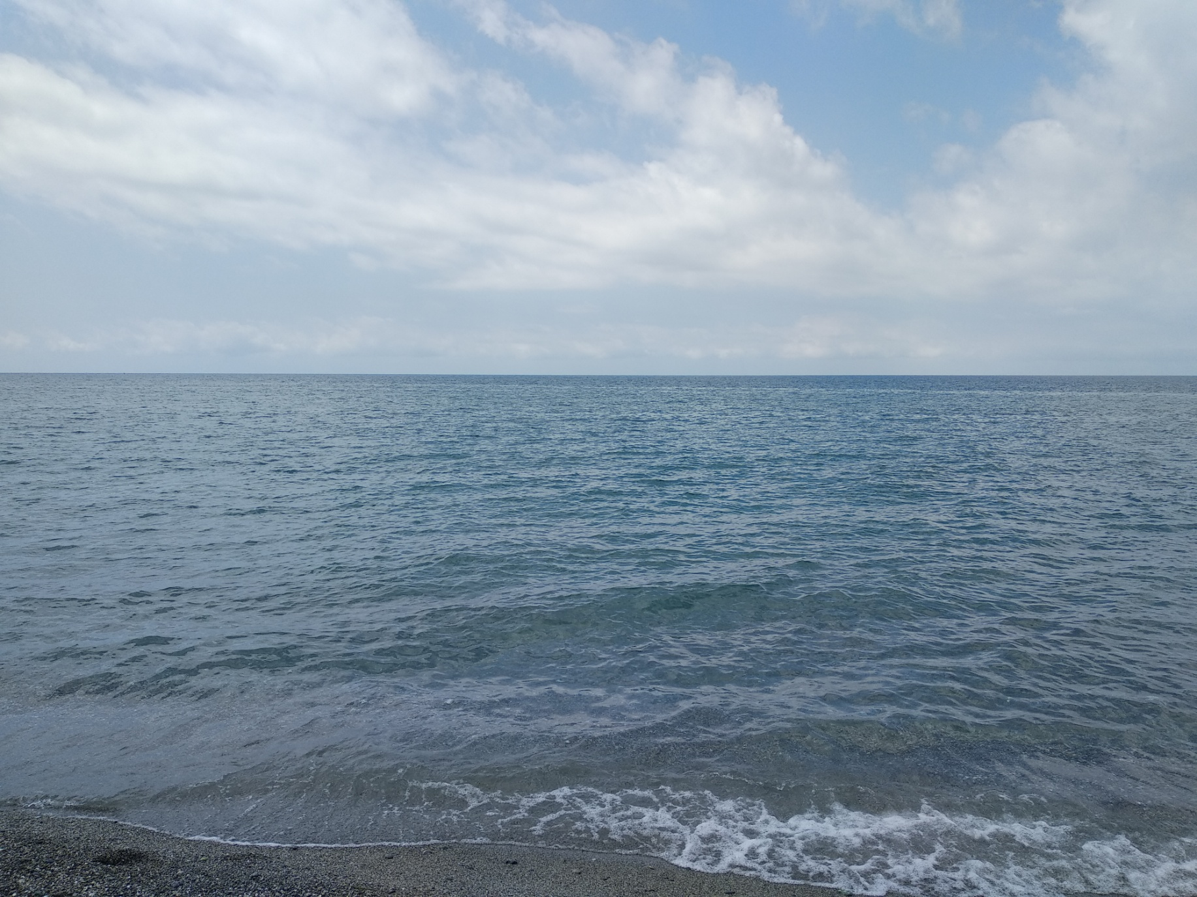
Thank you for your attention
Criticism and feedback welcome at: giulio.nils.caroletti@irpi.cnr.it
Tyrrhenian Sea, Province of Cosenza, Calabria. Original picture.

