Slide 1
Creating a global database with return periods of extreme sea levels caused by tropical and extratropical cyclones
Job Dullaart, Sanne Muis, Nadia Bloemendaal, Maria Chertova, Jeroen Aerts
EGU Online, 4-8 May 2020
Contact: job.dullaart@vu.nl

Slide 2
Outline
Creating a global database with return periods of extreme sea levels caused by tropical and extratropical cyclones
1. Why?
2. How?
3. Status?

Slide 3
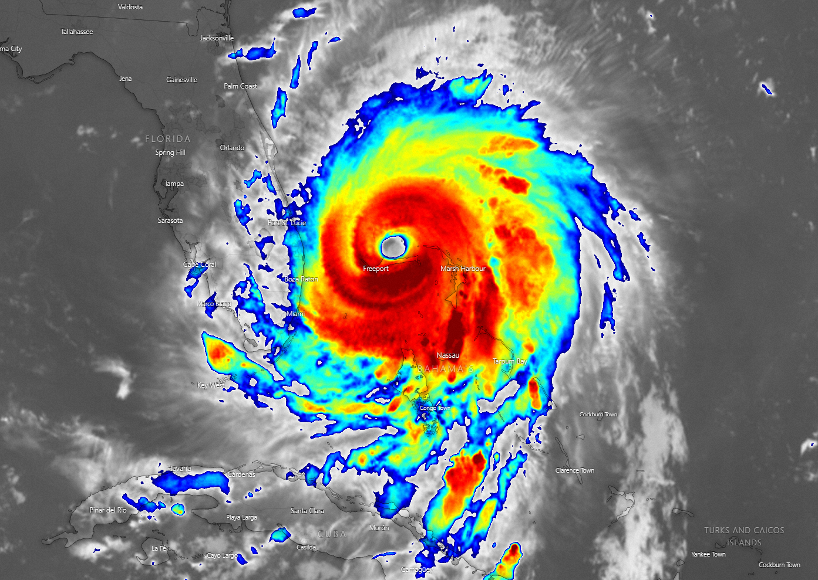
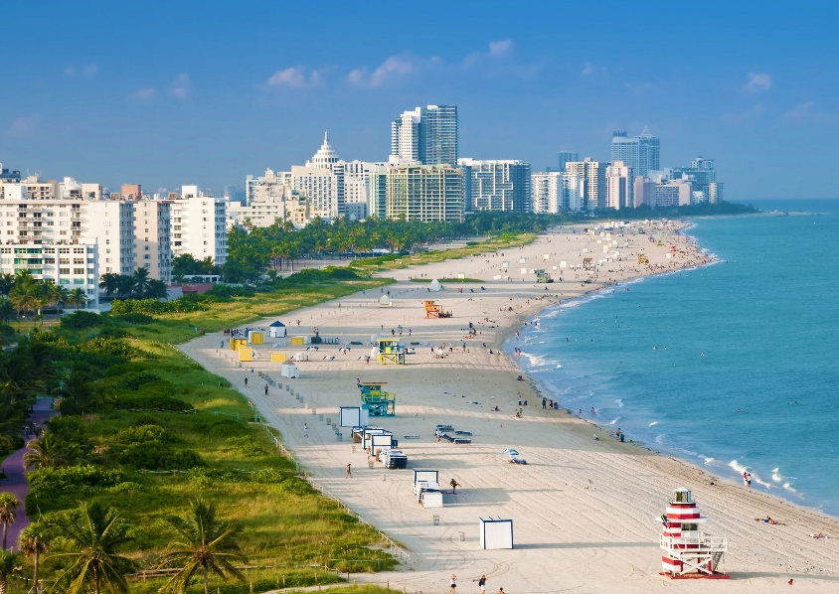
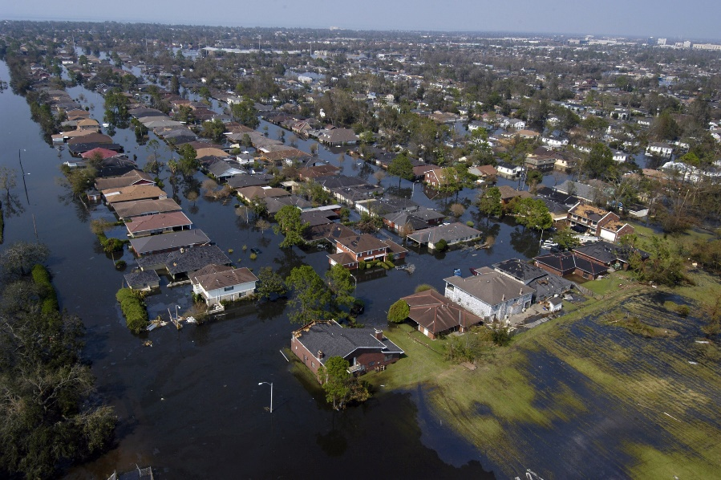
1. Why? Flood risk in coastal regions
Storm surges and tides can cause flooding
Many people live
near the coast
Each year several billion dollars of damages

Slide 4
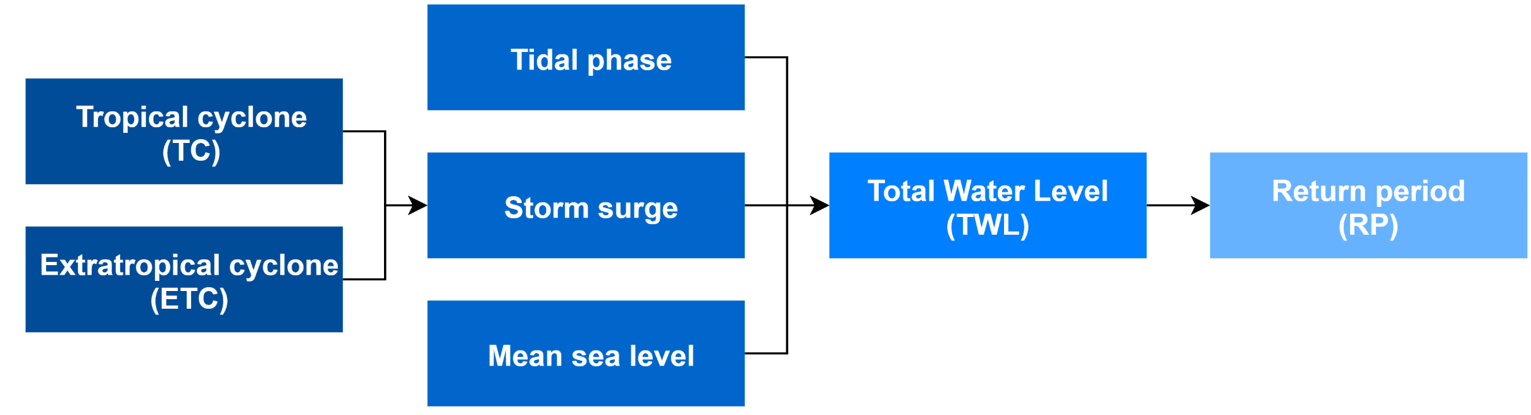
1. Why? Return periods have many applications
Extreme sea levels can be devastating
Assess flood hazard and flood risk
Evaluate the costs of not mitigating climate change
Prioritize adaptation efforts
Land use planning

Slide 5
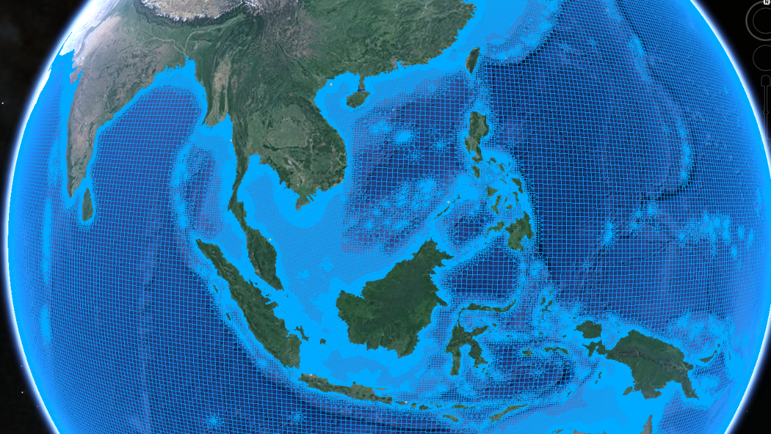
2. How? Tide gauges vs hydrodynamic models
Tide gauge stations Hydrodynamic models
GESLA-2 (Woodworth et al., 2017) GTSM (Verlaan et al., 2015)
Time series are too short for tropical cyclones (TCs):
Occur infrequently
Only a few make landfall
Affect a small coastal area
Result: Underestimation of RPs in TC prone areas

Slide 6
2. How? GTSM + STORM (tropical cyclones)
STORM
Generate synthetic TC tracks to extend the TC record
Applied to IBTrACS (Knapp et al., 2018)
Figure: IBTrACS extended to 1.000 years
(Bloemendaal et al., 2020)
EGU2020-2568

Slide 7
2. How? GTSM + STORM (tropical cyclones)
STORM
Generate synthetic TC tracks to extend the TC record
Applied to IBTrACS (Knapp et al., 2018)
Figure: IBTrACS extended to 1.000 years
(Bloemendaal et al., 2020)
EGU2020-2568

Slide 8
2. How? Spatio-temporal optimization (tropical cyclones)
Tropical cyclone ‘placing’
Forcing our hydrodynamic model (GTSM) with 10.000 years of tracks takes too long
Increase code efficiency: combine multiple TCs in one simulation
Figure: Visualization of TC placing in the North Atlantic basin
(Maria Chertova, EGU2020-21189)

Slide 9
2. How? GTSM + ERA5 (extratropical cyclones)
Extratropical cyclones
Force GTSM with ERA5 wind and pressure fields
Select all surge peaks at least 3 days apart to make sure we don’t look at the same event twice
Exclude all surge peaks that were caused by tropical cyclones
Figures: ERA5 wind field of ETC Ophelia (Copernicus Climate Change Service) & GTSM model grid

Slide 10
3. Status? Work in progress
Towards a global RPs database of extreme sea levels
Create probability density functions (PDFs) for:
Tropical cyclones (GTSM + STORM)
Extratropical cyclones (GTSM + ERA5)
Tides (GTSM)
Combine PDFs
Has been done on a regional scale before (Haigh et al. 2014)
Upscaling to global scale now possible with recently developed tools

Slide 11
Concluding remarks
Return periods of extreme sea levels provide useful information for flood risk adaptation and mitigation
More accurate climate forcing data (ERA5) and better hydrodynamic models (GTSM) have become available at the global scale
By generating synthetic TC tracks with STORM the data record can be extended
By incorporating return periods of ETCs and TCs separately we can create an accurate global database with return periods of extreme sea levels

Slide 12
Potential topics for discussion
Statistics: How to properly combine the probability density functions?
Tide-surge interaction: How does the omission of TSI affect our results?
Wind drag coefficient for TC surge modelling
Any other topic / question you have
Contact: job.dullaart@vu.nl

