Slide 1
The sensitivity of East Antarctic mass balance to air and ocean temperature
Jim Jordan¹, Hilmar Gudmundsson¹, Adrian Jenkins¹, Bertie Miles², Chris Stokes² and Stuart Jamieson²
Work funded by NERC grant :NE/R000719/1
^{Jim.Jordan@Northumbria.ac.uk}
1 – Geography and Environmental Sciences, Northumbria University
2 – Department of Geography, Durham University

Slide 2
The current state of the East Antarctic Ice Sheet (EAIS)
Largest single potential contributor to future sea-level rise, containing ~54 m of potential global mean sea level rise.
Despite this large potential, the EAIS is comparatively less studied than the faster changing WAIS.
Recent estimates show the EAIS to be losing mass (although at a slower rate than West Antarctica).
Whilst there is a large amount of variability in SMB, the overall mass trend is driven by ice dynamics.
When considering the dynamics effecting ice discharge, the ability of ice shelves to retard inland flow is of crucial importance.
The water mass currently driving the melting of East Antarctic ice shelves is relatively cool, Antarctic Bottom Water (ABW), although incursions of warmer Circumpolar Deep Water (CDW) have been observed in several locations.
SMB (blue), ice discharge (red) and total mass (red) of the EAIS since 1980 (Rignot et. al., 2019)

Slide 3
How the EAIS is likely to change over the next 100 years
Global temperatures are expected to rise, including for East Antarctica.
Oceanic temperatures are likewise expected to rise, leading to increased basal melting causing an increase in ice discharge due to a reduction in ice-shelf buttressing.
As well as general oceanic warming, there is the potential of a regime shift with warm CDW replacing cooler ABW in driving ice-shelf melting.
Warmer air temperatures are expected to lead to a rise in precipitation, leading to an increase in SMB.

Slide 4
How the EAIS is likely to change over the next 100 years (Ocean)
CDW | Observations | RCP 4.5 change | RCP 8.5 change
Temperature | 1.371 (°C) | +0.334 | +0.412
Salinity | 34.673 | -0.005 | -0.009
Table of predicted change in water mass properties from an ensemble of CMIP 5 simulations, adapted from Sallee et. al, 2015.

Slide 5
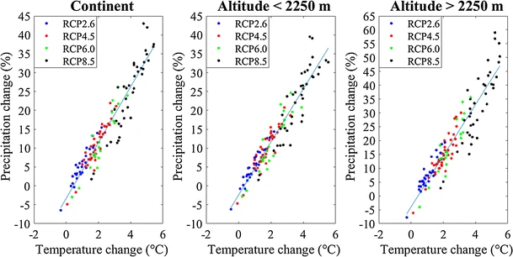
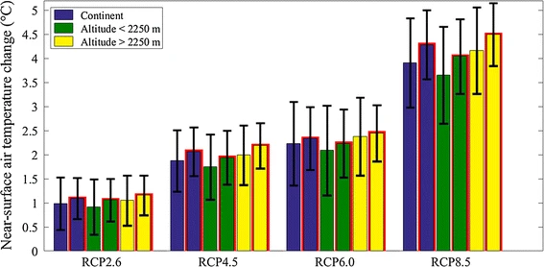
How the EAIS is likely to change over the next 100 years (Atmosphere)
Expected air temperature change and precipitation increase from CMIP5 model ensemble (Palerme et al, 2016)

Slide 6
Aims
Determine how the EAIS mass balance is likely to change over the next 100 years.
Assess the impact of different climate scenarios upon the EAIS mass balance.
Assess the potential change in EAIS mass balance arising from a regime shift from predominantly ABW driven melting to CDW driven melting.
Determine to what extent increased precipitation could counterbalance increased oceanic melting.

Slide 7
Methodology
Úa ice model, with precipitation given by RACMO (Van Wessem et al, 2014) and oceanic melting derived from the PICO box model (Reese et al, 2018).
RACMO field is uniformly increased by 7% per degree of warming, assuming RCP 4.5 leads to 2 degrees of warming and RCP 8.5 leads to 4 degrees.
PICO is calibrated to match current area averaged ice shelf melt-rates using current day observations of ocean temperature and salinity.
The temperature and salinity used by PICO are then increased by the expected change over 100 years for ABW (ABW forcing) or increased to the expected change over 100 years for CDW in addition to the average difference between ABW and CDW water masses (CDW forcing).
All temperature forcings are applied linearly over 100 years of model run time.
To account for model bias, all results are given in relation to a reference run with current day forcings applied for 100 years.

Slide 8
Methodology - Schematic
RACMO precipitation model
Air temperature change
Precipitation
Change in EAIS mass
Úa – Ice model
PICO box ocean model
Melting
Ocean properties change

Slide 9
Results - Disclaimer
Please bear in mind that results are very much work in progress, and should be considered as such.
Initial simulations have been performed, but investigations into model sensitivity to various parameters are still ongoing.
All results are shown in reference to a base simulation with present day forcing, therefore plots show this relative change in ice volume above flotation, ice volume or grounded ice area rather than absolute values.

Slide 10
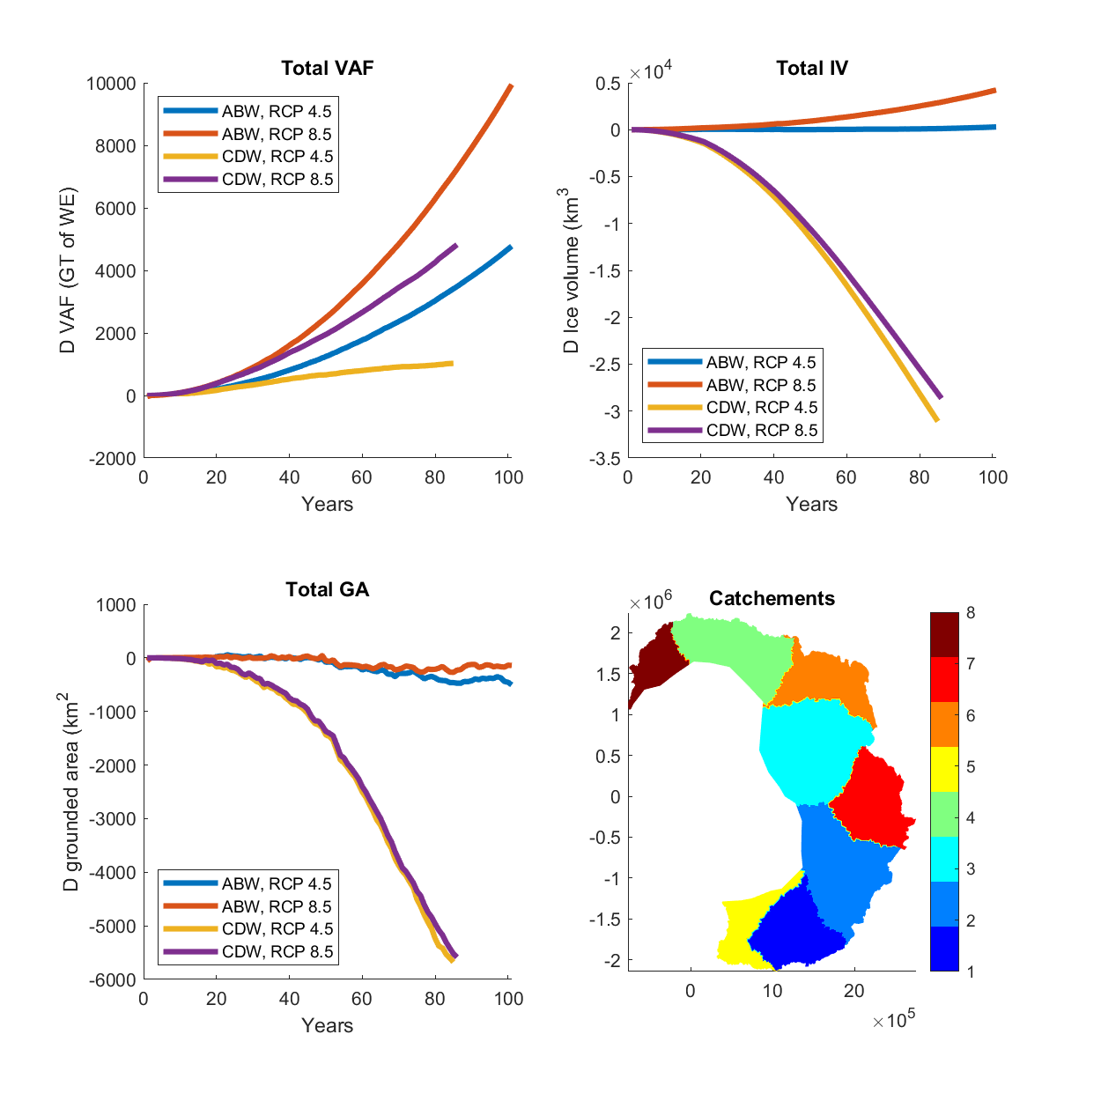
Domain-wide results

Slide 11
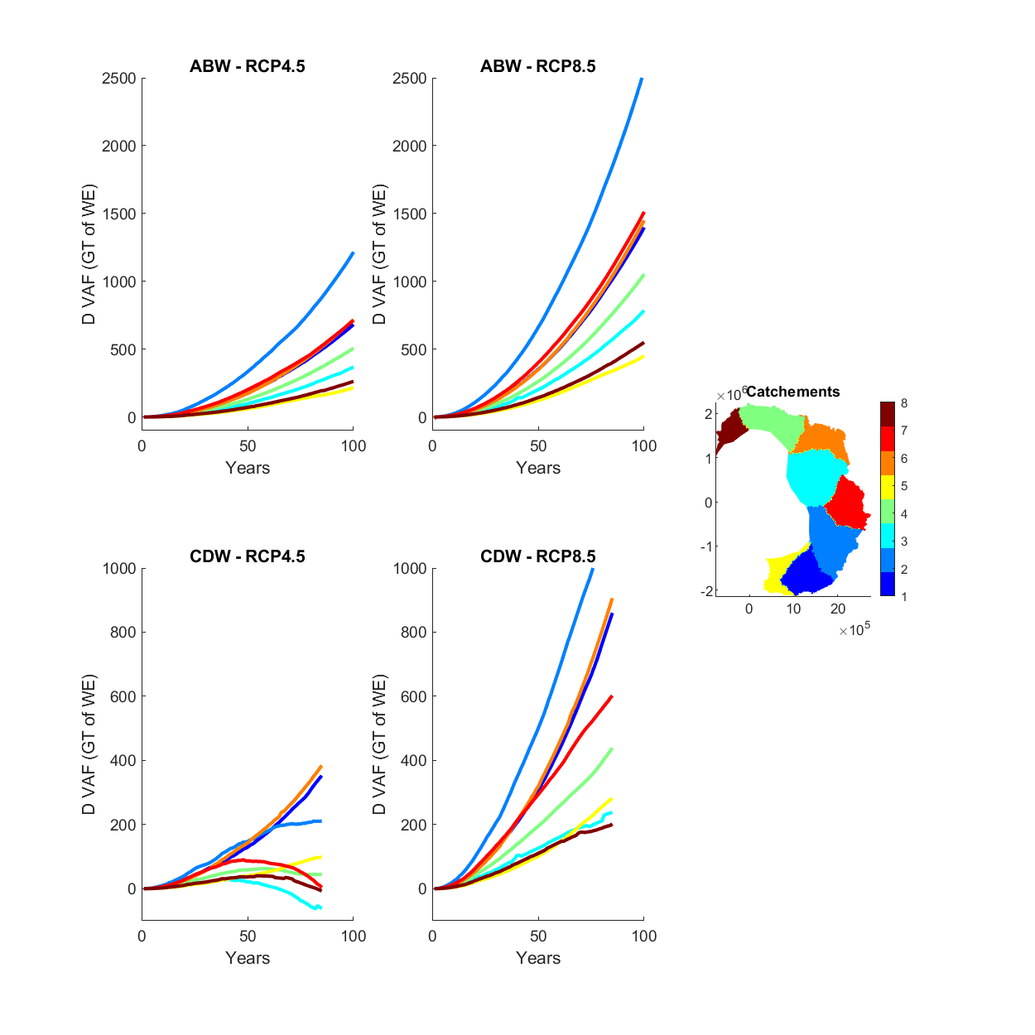
Melt forcing
Volume above floatation, broken down by region

Slide 12
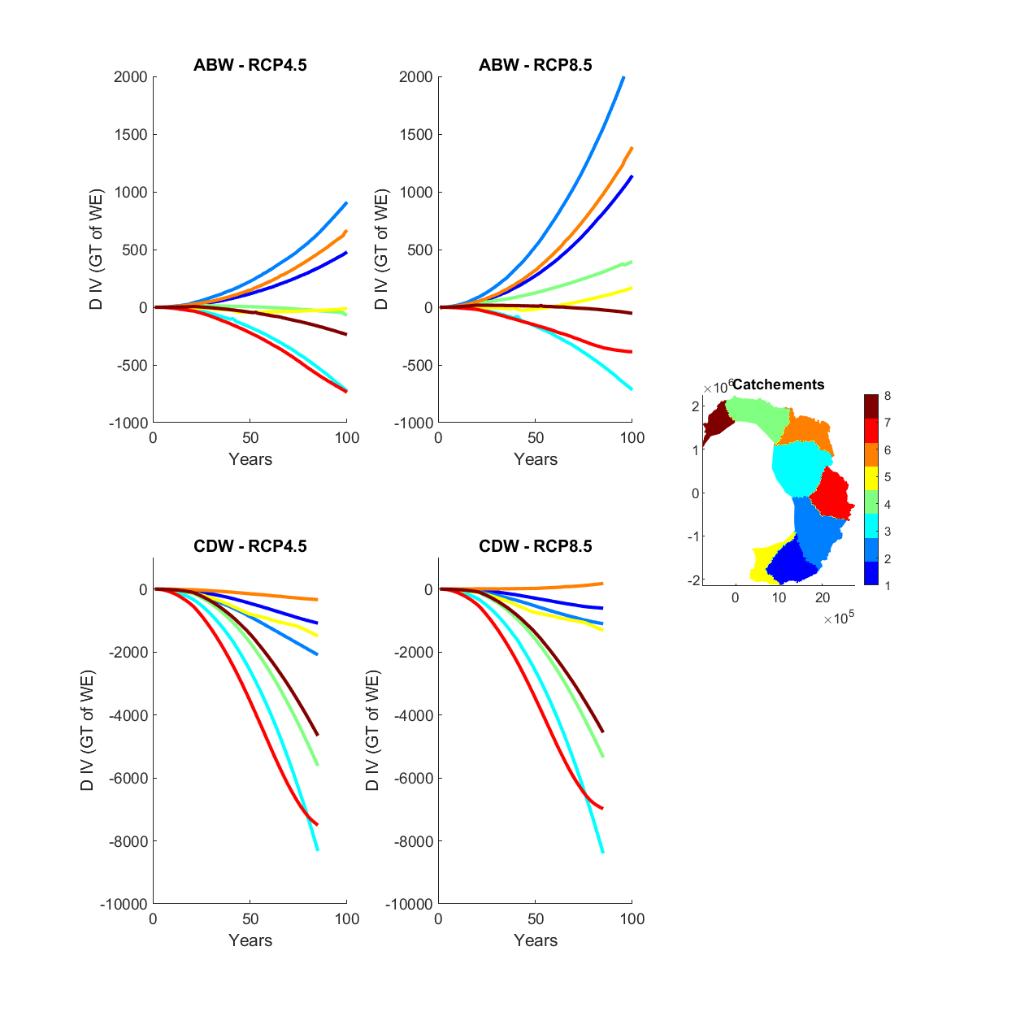
Ice volume, broken down by region

Slide 13
Grounded area, broken down by region

Slide 14
Discussion points – The whole of the EAIS
When considered as a whole, simulations show the EAIS gaining ice volume above floatation over the next 100 years, with inland snowfall more than counterbalancing increased ice discharge from ocean induced melt.
Going from RCP 4.5 to RCP 8.5 conditions has a relatively larger increase for air temperature (increased mass via precipitation) than ocean temperature (decreased mass via ocean melting) compared to going from present day conditions to RCP 4.5.
For cold ocean conditions, RCP 4.5 has little change in ice volume whilst there is a small increase in ice volume for RCP 8.5. For warm ocean conditions, total ice volume decreases in both RCP 4.5 and RPC 8.5 as increased ocean melting counters increased precipitation.
Volume above floatation still increases despite a decrease in total ice volume due to inland precipitation outweighing melting of floating ice.

Slide 15
Discussion points – Individual regions
Individual catchments do not behave identically to each other.
Rignot catchments K-A (Brunt Ice Shelf area), B-C (Amery Ice Shelf) and C-Cp (Shackleton-Denman Ice Shelf area) appear to have the least increase (or greatest decrease) in VAF.
Rignot catchments Ap-B (Shirase Ice shelf area), Cp-D (Totten Ice Shelf area), D-Dp (Cook Ice Shelf area) have the greatest increase in VAF.

Slide 16
Conclusion
Increased precipitation from a warming atmosphere has the potential to offset increased ice discharge from a warming ocean in regards to the mass balance of the EAIS over the next 100 years.
A reduction in grounded ice sheet area (and hence a reduction in volume above floatation) is more than compensated by inland precipitation.
Simulations show that if East Antarctic ice-shelf melt continues to be driven by Antarctic Bottom Water, then total ice volume is likely to be kept approximately constant, or actually slightly increase under the warmest air temperatures.
However, if ocean melting becomes predominantly driven by Circumpolar Deep Water then ice volume will decrease due to floating ice shelves melting, even if the volume of grounded ice above flotation increases.
In the case of the EAIS, the relative increase in VAF from precipitation and decrease in VAF from increased ice discharge are of roughly similar magnitudes. Small changes in the assumptions used here are likely to affect not just the magnitude of future mass balance change, but potentially also the sign.

