Slide 1
On the role of tropical waves triggering extreme rainfall and flood in Sulawesi, Indonesia: a multi-scale interaction perspective
Beata Latos¹, Thierry Lefort², Maria K. Flatau³, Donaldi Permana⁴, Piotr J. Flatau⁵, Dariusz Baranowski¹, Jaka Paski⁴, Erwin Makmur⁴, Eko Sulystyo⁴, Philippe Peyrillé² and Zhe Feng⁶
¹Institute of Geophysics, Polish Academy of Sciences, Warsaw, Poland (blatos@igf.edu.pl)
²Centre National de Recherches Meteorologiques, Meteo-France, Toulouse, France
³Naval Research Laboratory, Monterey, CA, USA
⁴Meteorological Climatological and Geophysical Agency, Jakarta, Indonesia
⁵Scripps Institution of Oceanography, San Diego, CA, USA
⁶Pacific Northwest National Laboratory, Richland, WA, USA

Slide 2
On January 22, 2019 heavy rainfall in the Southwest Sulawesi, Indonesia, triggered a major, deadly flood, the most devastating one ever reported. This happened during an interaction of a robust Convectively Coupled Kelvin Wave (CCKW) and Equatorial Rossby Wave (ER) with a great contribution of a big Mesoscale Convective System (MCS) which developed rapidly over the Java Sea. Potential causes of the flood, such as Madden Julian-Oscillation (MJO) activity, rainy season with monsoonal flow in the Karimata Strait and positive sea surface temperature anomalies supportive of convection are investigated.
Our analysis reveal that boundary layer moisture convergence into a low-pressure region forced convective organization on the mesoscale and ascend of moist air over orographic features of the Southwest Sulawesi. This chain of processes was a result of a propagation of a CCKW with contribution from an ER, embedded in larger-scale envelope of MJO. Further analysis of long-term flood and extreme rain data shows that 87% of DJF floods and 84% of extreme rain events between 1999-2019 were preceded by positive low-level westerly wind anomalies. We found that CCKW and ER activity over Sulawesi nearly double the chance of flood and extreme rain event development. Additionally, 23 days of an interaction of CCKW with ER over Sulawesi were identified, out of which 5 days (22%) were a flood and/or extreme rain days.
Our results suggest that tropical waves and their interactions can serve as one of extreme rain and flood precursors in the area of Southwest Sulawesi and probably beyond.

Slide 3
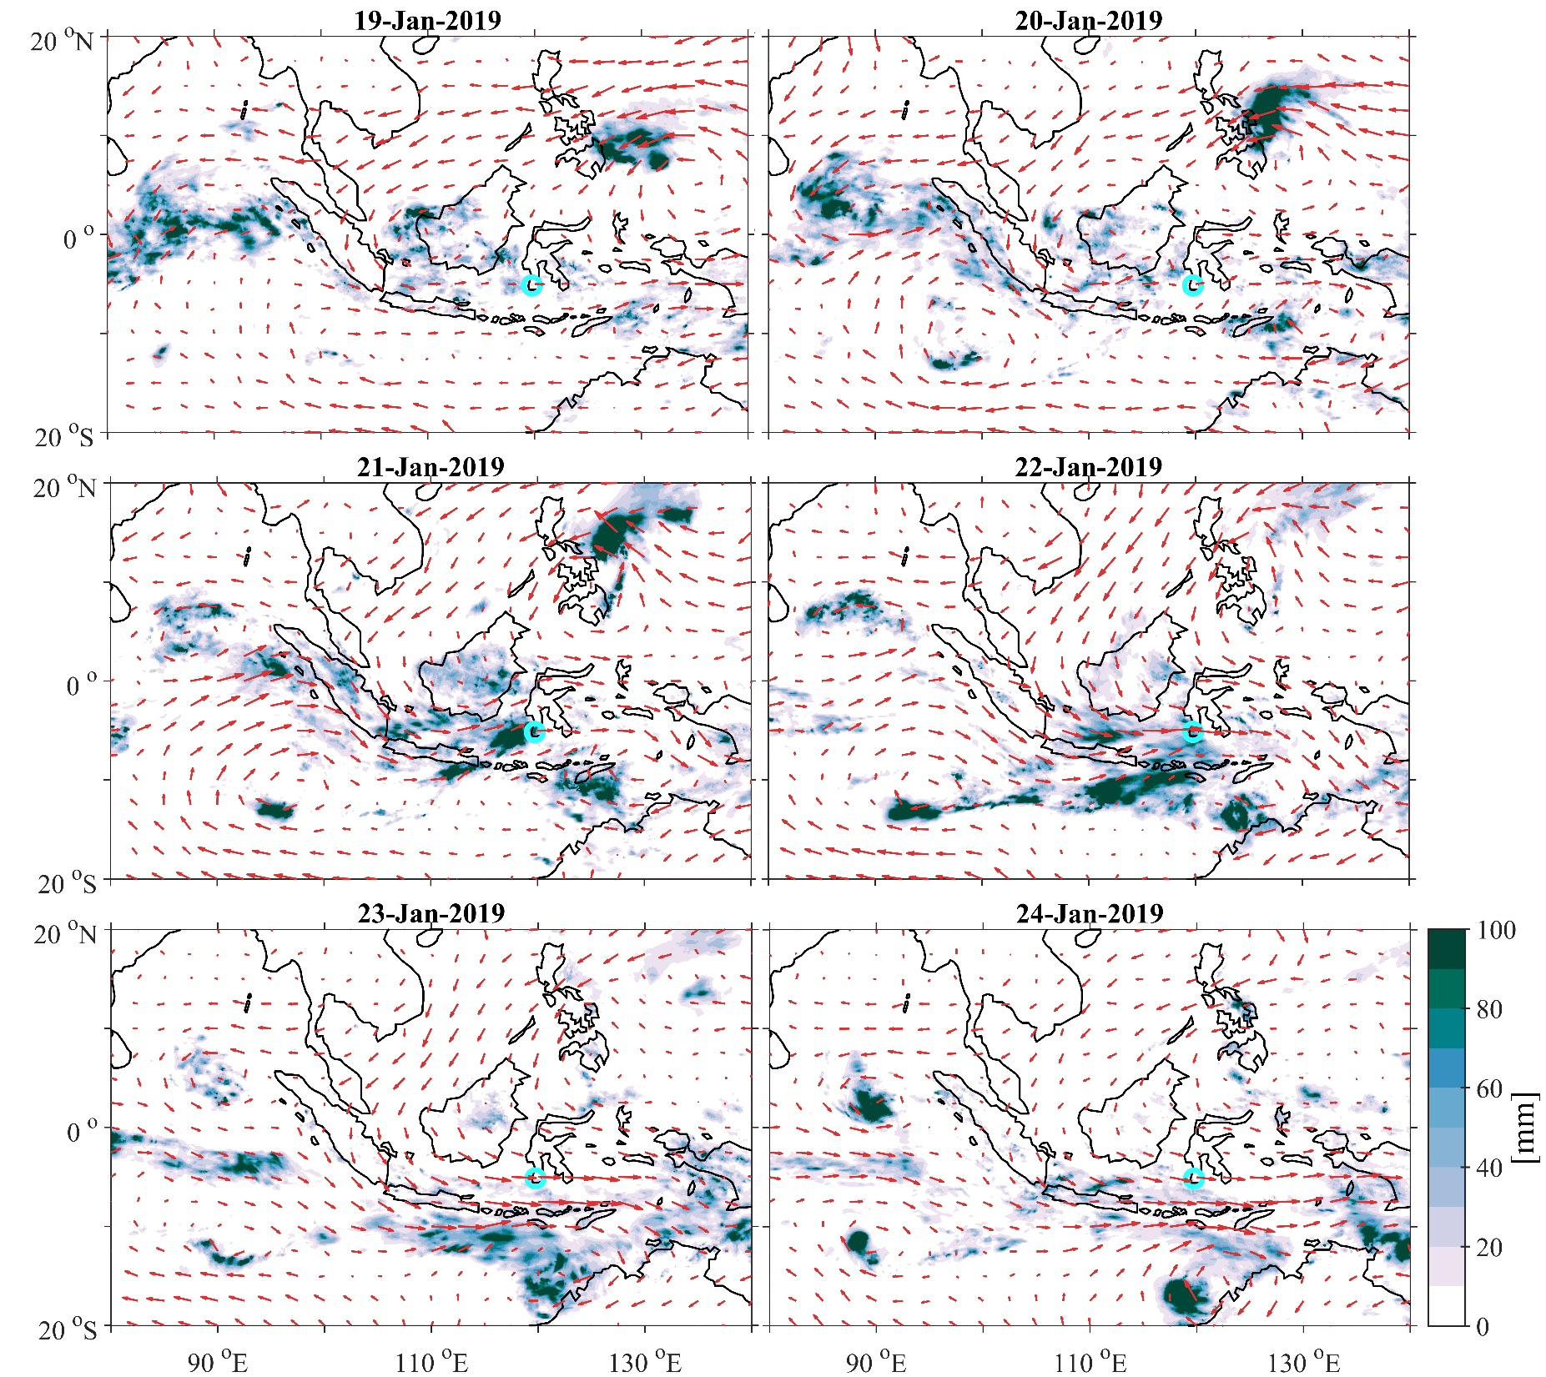
Daily mean 850-hPa winds (arrows, m s⁻¹) and daily accumulated precipitation (combined microwave-IR) estimate (shading, mm). The strongest winds across the set of panels are near 22 m s⁻¹. Flood zone is depicted by a circle. Time in UTC.

Slide 4
Composite of time evolution of total low-level (850mb) wind speed anomalies (A) in m s⁻¹, filtered for Convectively Coupled Kelvin Wave (B), Madden-Julian Oscillation (C) and Equatorial Rossby Wave (D) during January 2019 flood event. The arrows on the first row (A) show the direction and magnitude of wind speed anomaly, while shading represents the wind speed square anomaly, with an interval of 2 m s⁻¹. Positive wind speed square anomalies are colored greenish, negative are colored pinkish. To produce the wind anomaly vectors connected to each of the wave (B,C,D), filtering was performed separately on zonal and meridional daily wind anomalies. Vectors show the resultant direction and magnitude of wind speed anomaly. Resultant wind speed anomalies are also indicated by a shading with an interval of 1 m s⁻¹. Flood zone is depicted by a circle. UTC time.

Slide 5
Daily accumulated Integrated Water Vapor Transport (IVT) on January 21-22, 2019 (kg m⁻¹ s⁻¹). Flood zone is depicted by a circle. Time in UTC.

Slide 6
Long-term flood analysis was carried out based on data obtained from the Indonesian National Agency for Disaster Countermeasure (BNPB). The database consist of 39 days of DJF weather-driven floods between 1 January 1999 – 28 February 2019.
Extreme rainfall database was obtained based on data collected by Agency for Meteorology, Climatology and Geophysics of the Republic of Indonesia (BMKG) and consisted of 49 cases of daily rain accumulation exceeding 100 mm, with the same timespan as BNPB’s database.
Southwest Sulawesi is the spatial coverage of analyzed floods and extreme rain events.

Slide 7
Composite of time evolution of low-level (850mb) wind direction and wind speed anomalies distributed during floods (first row) and extreme rain events (second row) over the Southwest Sulawesi region (6–5°S; 119–120°E), plotted on wind roses. Each concentering circle represents a different frequency of time that the wind blow from the particular direction, emanating from zero at the center to 50% at the most outer circle. Wind speed anomalies are indicated by a color scale and contours, graduated at an interval of 2 m s⁻¹.

Slide 8
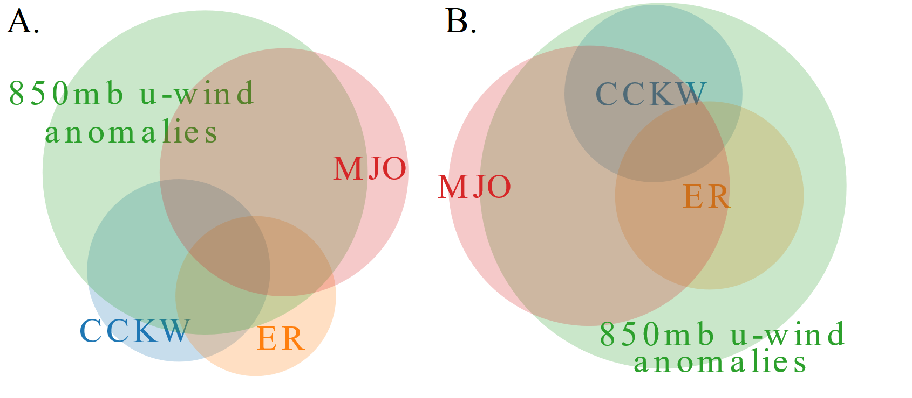
Factors that affected DJF extreme rainfall (A) and floods (B) between 1998/1999 – 2018/2019 in Southwestern Sulawesi, plotted on Venn diagrams. Abbreviations are: MJO – Madden Julian Oscillation, CCKW – Convectively Coupled Kelvin Wave, ER – Equatorial Rossby Wave. To determine the primary modes of tropical waves over Indonesia, empirical orthogonal function (EOF) analysis was applied to DJF 1998/1999 – 2018/2019 TRMM precipitation anomalies previously filtered for atmospheric equatorial Kelvin waves and ERA5 u-component of wind anomalies, previously filtered for Equatorial Rossby Waves. The resulting principal component (PC) time series in terms of time coefficients of the EOF were used as an index of tropical waves activity. Categories overlap when are not discrete, indicating that in particular rain/flood event more than one factor contributed.

Slide 9
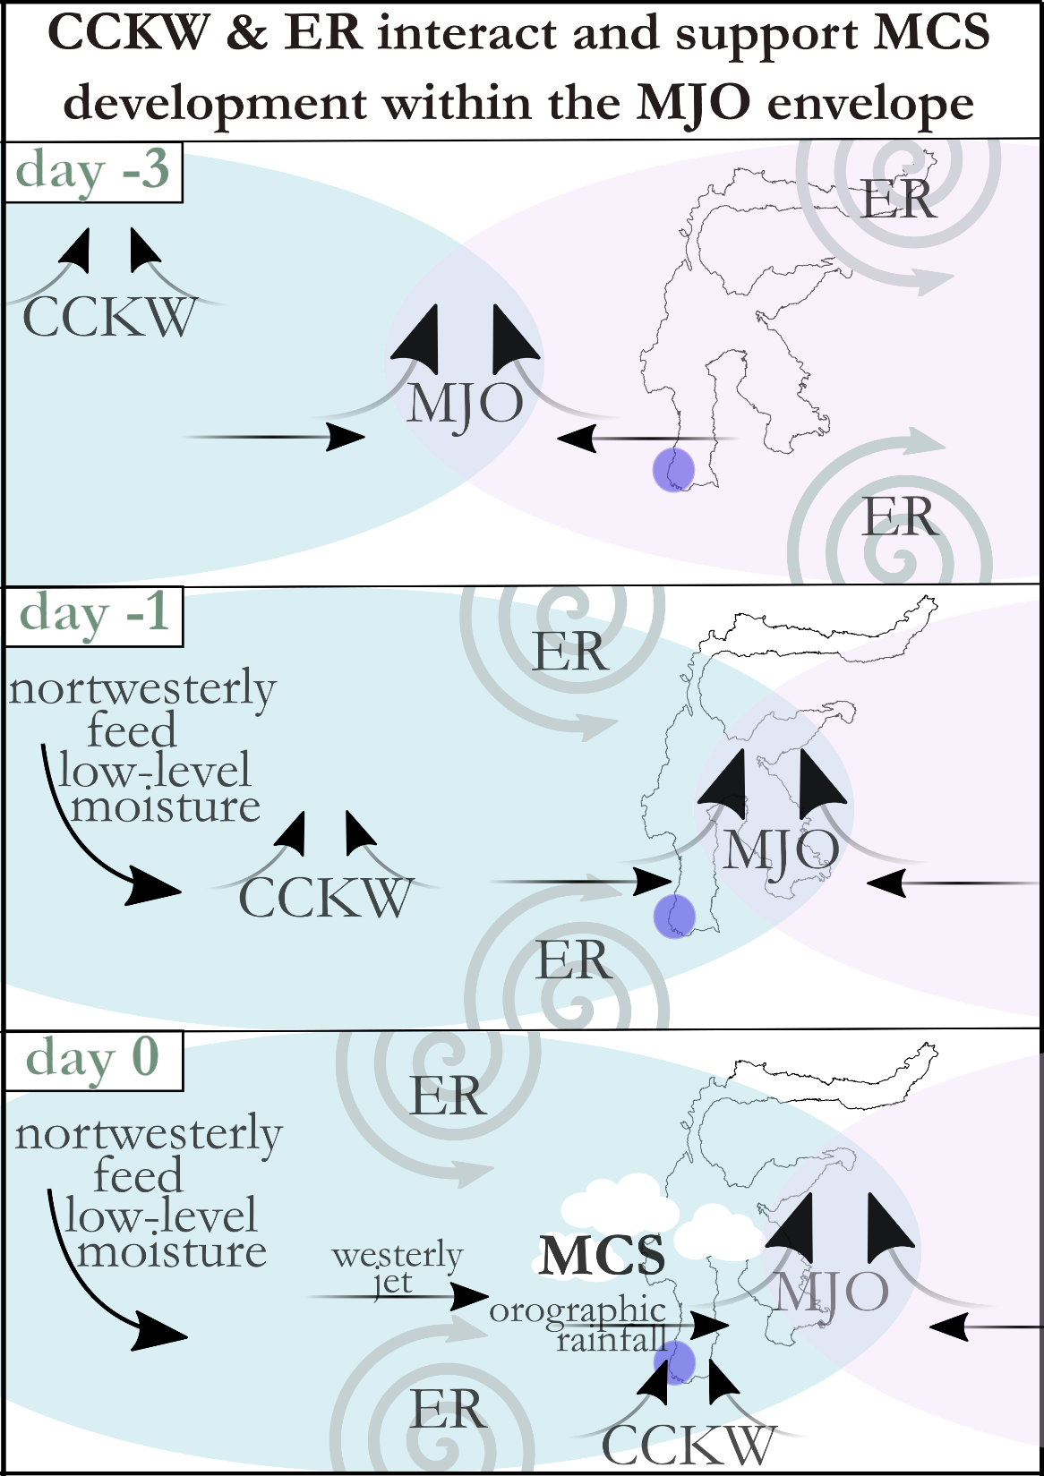
The simplified view of meteorological conditions supportive of extreme rain events and floods in Southwestern Sulawesi is provided by a conceptual diagram. The general idea is that CCKW and ER interact and support MCS development within MJO activity. MJO western phase provides an envelope of moist and prevailing westerlies in its western phase, which are preceded by large-scale convergence. CCKW provides local low-level convergence and westerly jet, while ER adds mid-level vorticity and northwesterly feed from South China Sea through Karimata Strait towards Java Sea (cold-surge-like flow). All those factors can contribute to MCS development and extreme rain or flood events, though not all them together are necessarily needed for such an event to occur.
Schematic depiction of the key processes responsible for extreme rainfall events and floods in Southwest Sulawesi.

Slide 10
feedback is welcome
This research has been supported in part by NSF grant 1724741 "Equatorial Line Observations (ELO) field campaign during the International Years of Maritime Continent (YMC)" program managed by Eric T. DeWeaver. Agency for Meteorology, Climatology and Geophysics of the Republic of Indonesia (BMKG) contribution supported the YMC ELO project. B.L. and D.B.B are grateful for support provided by the Foundation for Polish Science. The “Multi-scale interactions over the Maritime Continent and their role in weather extremes over Central and Eastern Europe” project is carried out within the Operational Programme Smart Growth 2014-2020, Measure 4.4: Increasing the human potential in R&D sector, HOMING programme of the Foundation for Polish Science co-financed by the European Union under the European Regional Development Fund.

