Slide 1
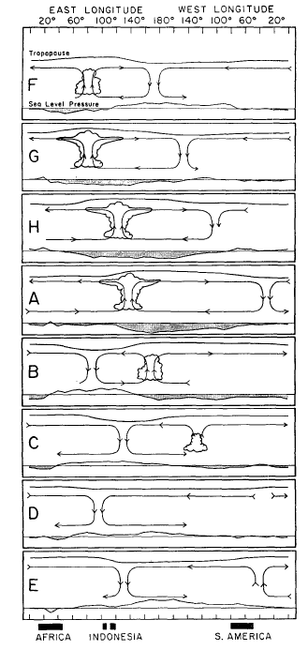
Dynamic Core of the MJO
Chidong Zhang¹ and Ji-Eun Kim²
1: NOAA Pacific Marine Environmental Laboratory; 2: Pusan National University
What Should an MJO Theory Explain?
Eastward propagation at the planetary spatial scale and intraseasonal (20 – 90 day) time scale
3-dimensional structure
Multi-scale structure
Seasonal cycle
Irregularity
Interaction with the extratropics
Interaction with the ocean
Interactions with other phenomena (ENSO, QBO, IOD, NAO, ….)
Initiation
Barrier effect of the Indo-Pacific Maritime Continent
Difficulty of simulations by global models
Behaviors in a warmer climate
……..
Madden and Julian 1972

Slide 2
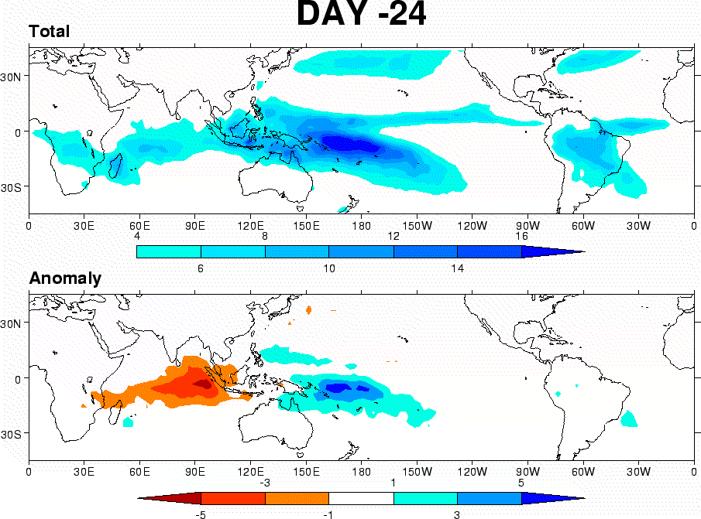
Fundamental Features of the MJO:
Eastward propagation at the planetary spatial scale and intraseasonal (20 – 90 day) time scale
Why does the MJO propagate eastward?
- Earth’s rotation!
What is the immediate consequence of the Earth’s rotation in the tropical atmospheric motions?
- The equatorial Kelvin wave and Rossby wave.
Can the MJO be a slowed-down Kelvin wave?
- Maybe (if there is a mechanism for selection of the spatial and temporal scales).
Courtesy of Adriane Matthews

Slide 3
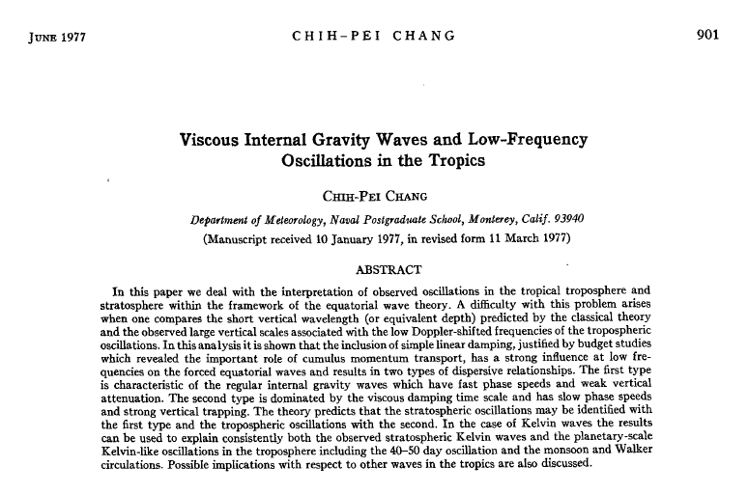
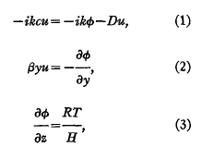
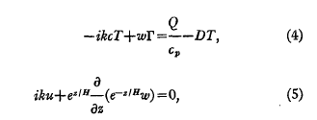
From the Kelvin wave to the MJO (then):

Slide 4

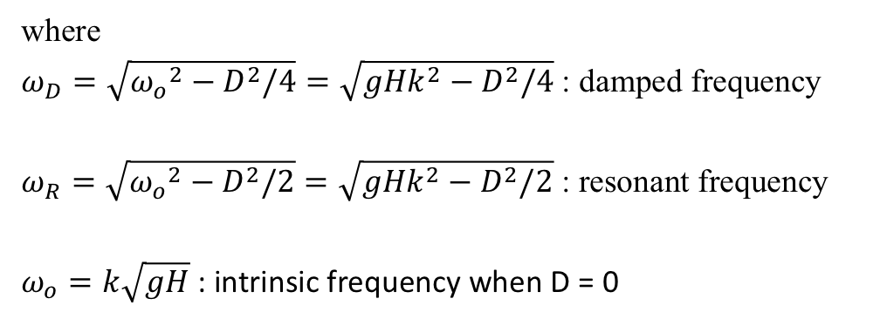

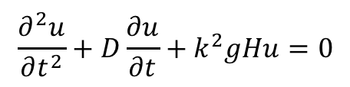

From the Kelvin wave to the MJO (now):
$\frac{∂u}{∂t}+\frac{∂φ}{∂x}=−Du$ (1)
$βyu+\frac{∂φ}{∂y}=0$ (2)
$\frac{∂φ}{∂t}+gH\left(\frac{∂u}{∂x}\right)=0$ (3)
+ (3) => $\frac{∂^{2}u}{∂t^{2}}+D\frac{∂u}{∂t}−gH\frac{∂^{2}u}{∂x^{2}}=0$
u = u(y,t)$e^{ikx} ⇒$
differential equation for a damped harmonic oscillator:
$$\frac{∂^{2}u}{∂t^{2}}+D\frac{∂u}{∂t}+k^{2}gHu=0$$
Transient (damped) solution: $u_{d}\left(x, y, t\right)={Y(y)e}^{− \frac{D}{2}t}e^{i(kx−ω_{D}t)}$
Steady-state (resonant) solution: $u_{r}\left(x, y,t\right)={Y(y)e}^{i(kx−ω_{R}t)}$
where
$ω_{D}=\sqrt{{ω_{o}}^{2}−D^{2}/4}=\sqrt{{gHk}^{2}−D^{2}/4}$: damped frequency
$ω_{R}=\sqrt{{ω_{o}}^{2}−D^{2}/2}=\sqrt{{gHk}^{2}−D^{2}/2}$ : resonant frequency
$ω_{o}=k\sqrt{gH}$ : intrinsic frequency when D = 0

Slide 5
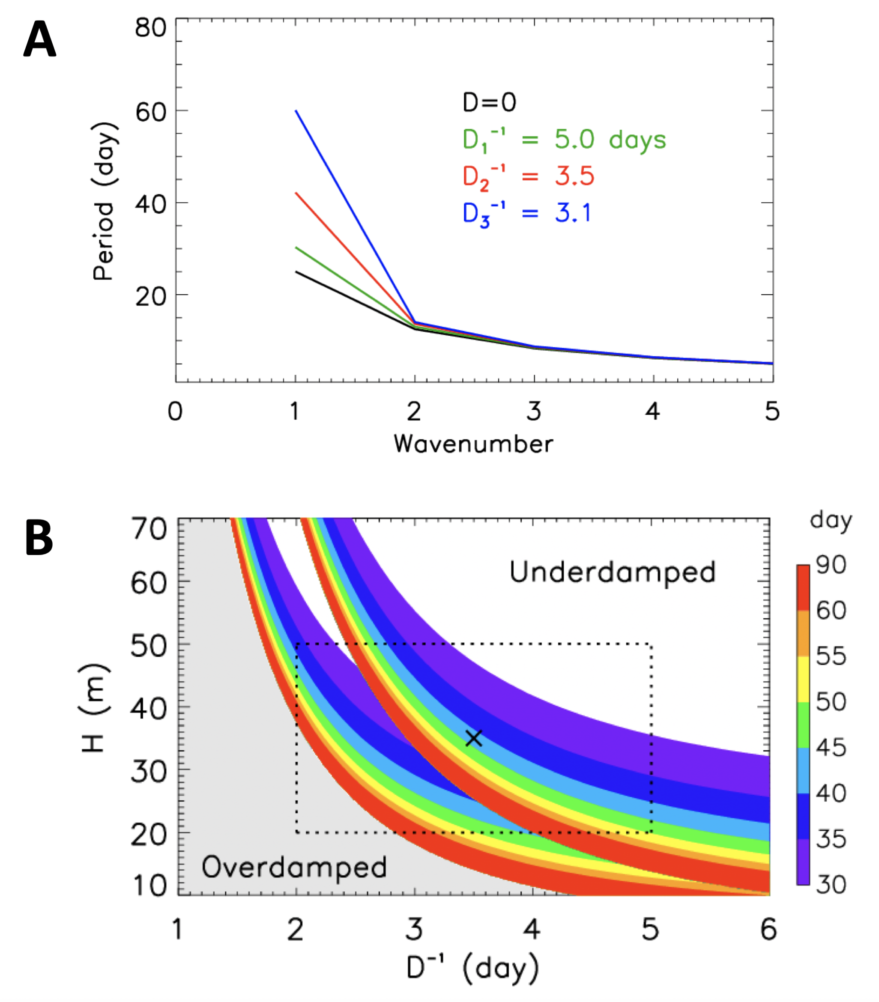
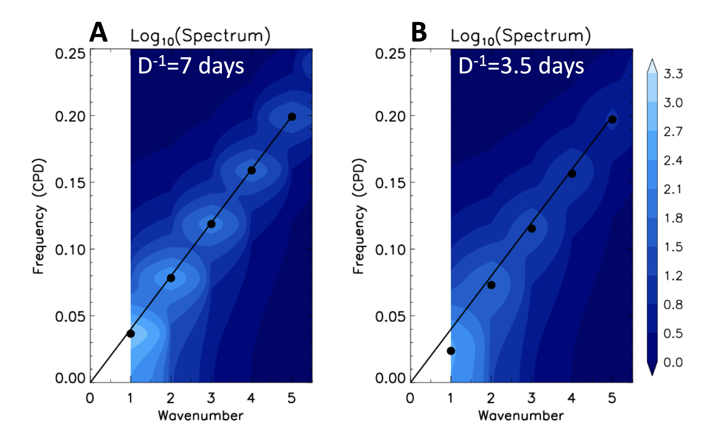
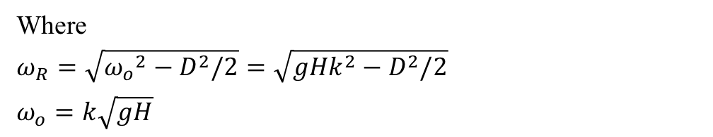



H = 35 m
Steady-state (resonant) solution: $u_{r}\left(x, y,t\right)={Y(y)e}^{i(kx−ω_{R}t)}$
Where
$ω_{R}=\sqrt{{ω_{o}}^{2}−D^{2}/2}=\sqrt{{gHk}^{2}−D^{2}/2}$
$ω_{o}=k\sqrt{gH}$
Theoretical power spectral response to Gaussian white noise forcing
$$ω_{D}$$
$$ω_{R}$$
k = 1
$D/{2ω}_{o}$>1

Slide 6
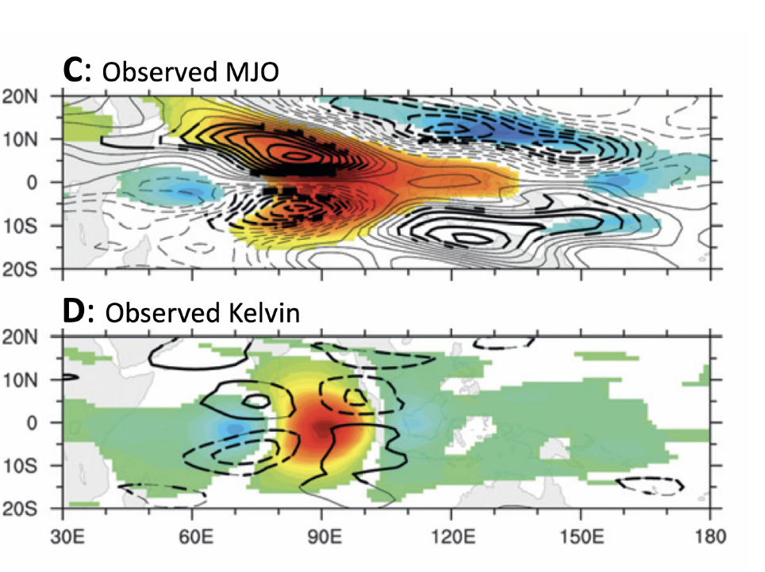
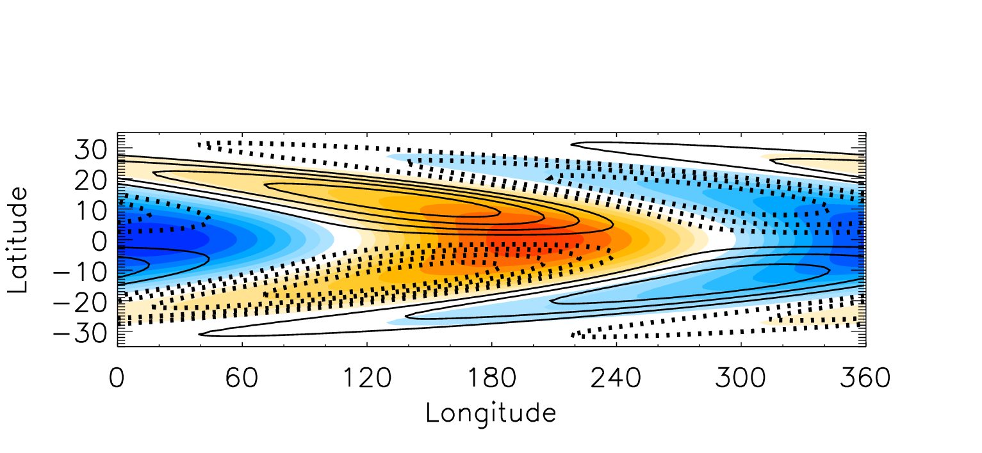
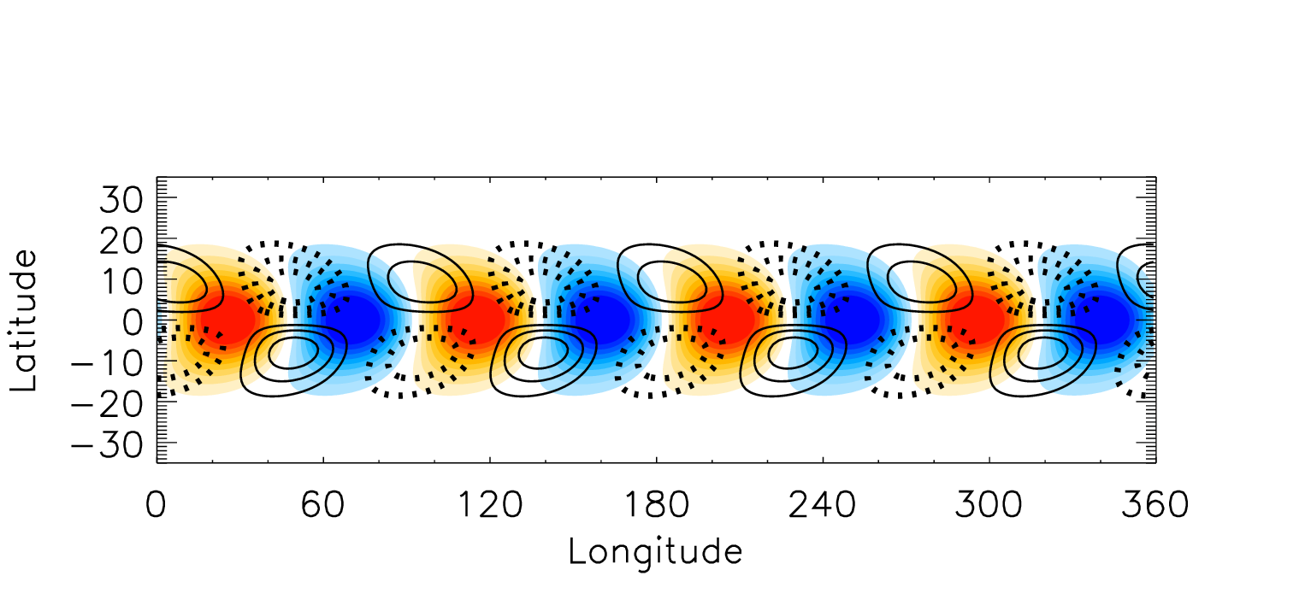
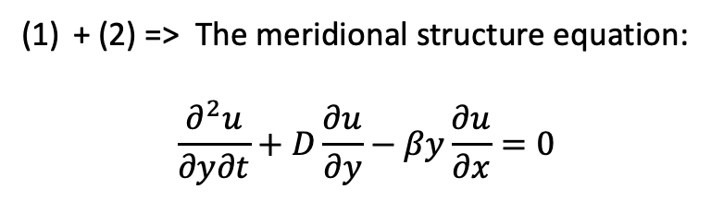
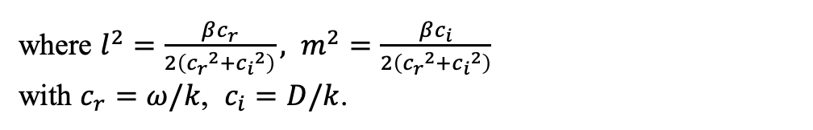

From the Kelvin wave to the MJO (now):
+ (2) => The meridional structure equation:
$$\frac{∂^{2}u}{∂y∂t}+D\frac{∂u}{∂y}−βy\frac{∂u}{∂x}=0$$
$\frac{∂u}{∂t}+\frac{∂φ}{∂x}=−Du$ (1)
$βyu+\frac{∂φ}{∂y}=0$ (2)
$\frac{∂φ}{∂t}+gH\left(\frac{∂u}{∂x}\right)=0$ (3)
The resonant solution =>
$$Y\left(y\right)=e^{−l^{2}y^{2}}e^{im^{2}y^{2}}$$
where $l^{2}=\frac{βc_{r}}{2\left({c_{r}}^{2}+{c_{i}}^{2}\right)},$ $m^{2}=\frac{βc_{i}}{2\left({c_{r}}^{2}+{c_{i}}^{2}\right)}$
with $c_{r}=ω/k$, $c_{i}=D/k$.
H = 35 m and D⁻¹ = 3.5 days
PV (contours), Rainfall (colors)
PV (contours), divergence(colors)
k = 1
k = 4

Slide 7
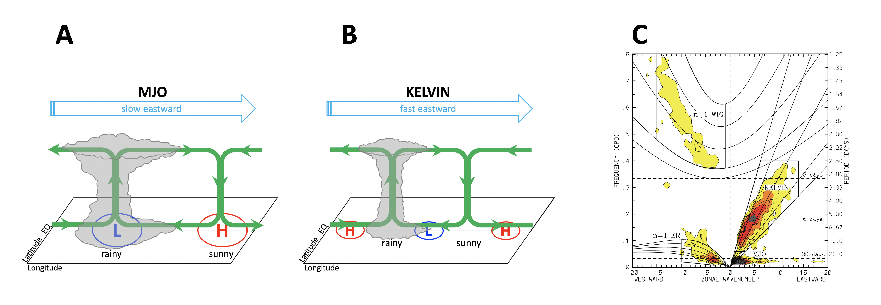
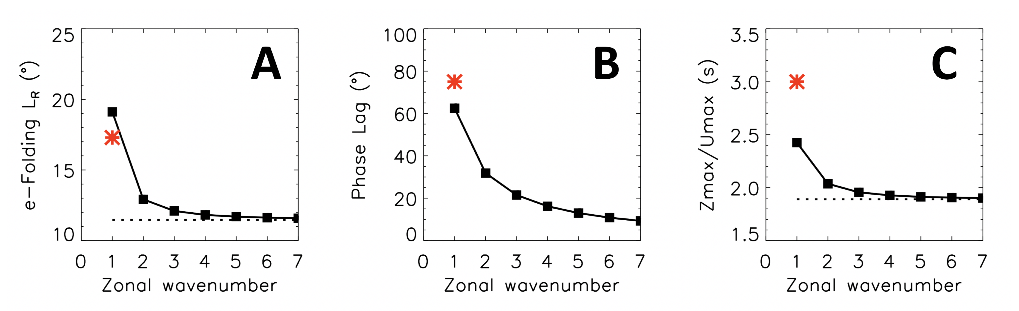
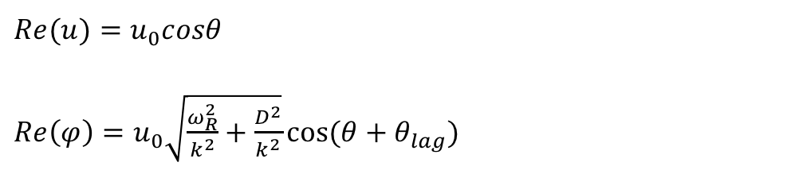

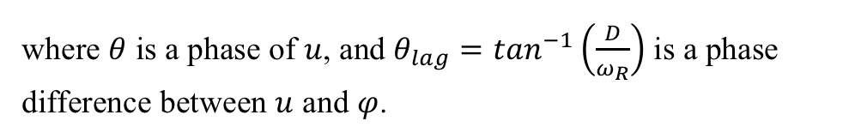
From the Kelvin wave to the MJO (now):
$\frac{∂u}{∂t}+\frac{∂φ}{∂x}=−Du$ (1)
$βyu+\frac{∂φ}{∂y}=0$ (2)
$\frac{∂φ}{∂t}+gH\left(\frac{∂u}{∂x}\right)=0$ (3)
The resonant solution into (1):
$Re(u)=u_{0}cosθ$
$Re\left(φ\right)=u_{0}\sqrt{\frac{ω_{R}^{2}}{k^{2}}+\frac{D^{2}}{k^{2}}}cos⁡(θ+θ_{lag})$
where $θ$ is a phase of $u$, and $θ_{lag}=\tan^{−1}\left(\frac{D}{ω_{R}}\right)$ is a phase difference between $u$ and $φ$.
H = 35 m and D⁻¹ = 3.5 days

Slide 8
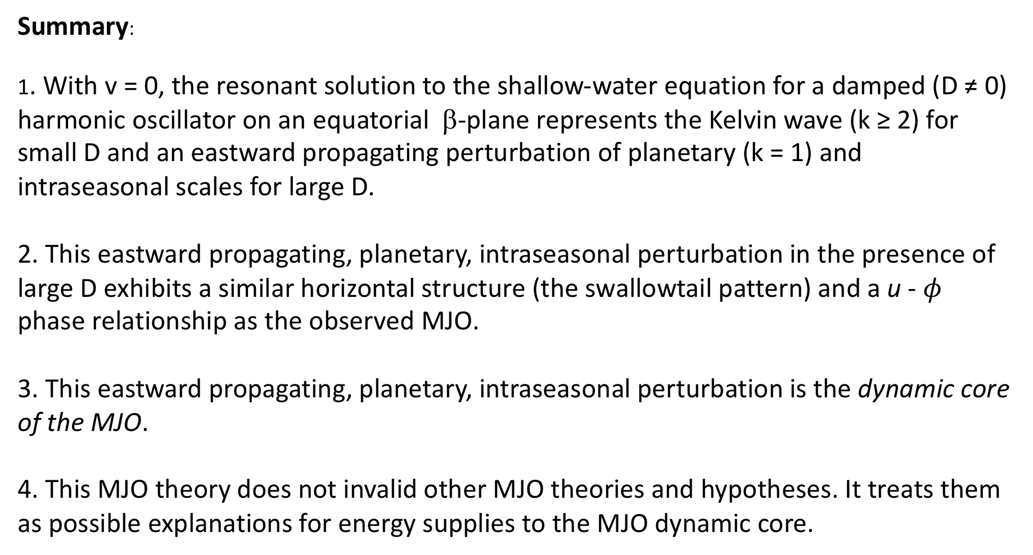
Summary:
1. With v = 0, the resonant solution to the shallow-water equation for a damped (D ≠ 0) harmonic oscillator on an equatorial β-plane represents the Kelvin wave (k ≥ 2) for small D and an eastward propagating perturbation of planetary (k = 1) and intraseasonal scales for large D.
2. This eastward propagating, planetary, intraseasonal perturbation in the presence of large D exhibits a similar horizontal structure (the swallowtail pattern) and a u - $φ$ phase relationship as the observed MJO.
3. This eastward propagating, planetary, intraseasonal perturbation is the dynamic core of the MJO.
4. This MJO theory does not invalid other MJO theories and hypotheses. It treats them as possible explanations for energy supplies to the MJO dynamic core.

Slide 9
Moisture Mode Thinking of MJO Dynamics
The Matsuno solutions to dry shallow-water equations on an equatorial β-plane does not include the MJO;
Other variables must be included to yield to an MJO solution;
Moisture is the needed ingredient for an MJO solution;
=> Moisture mode theory of the MJO

Slide 10
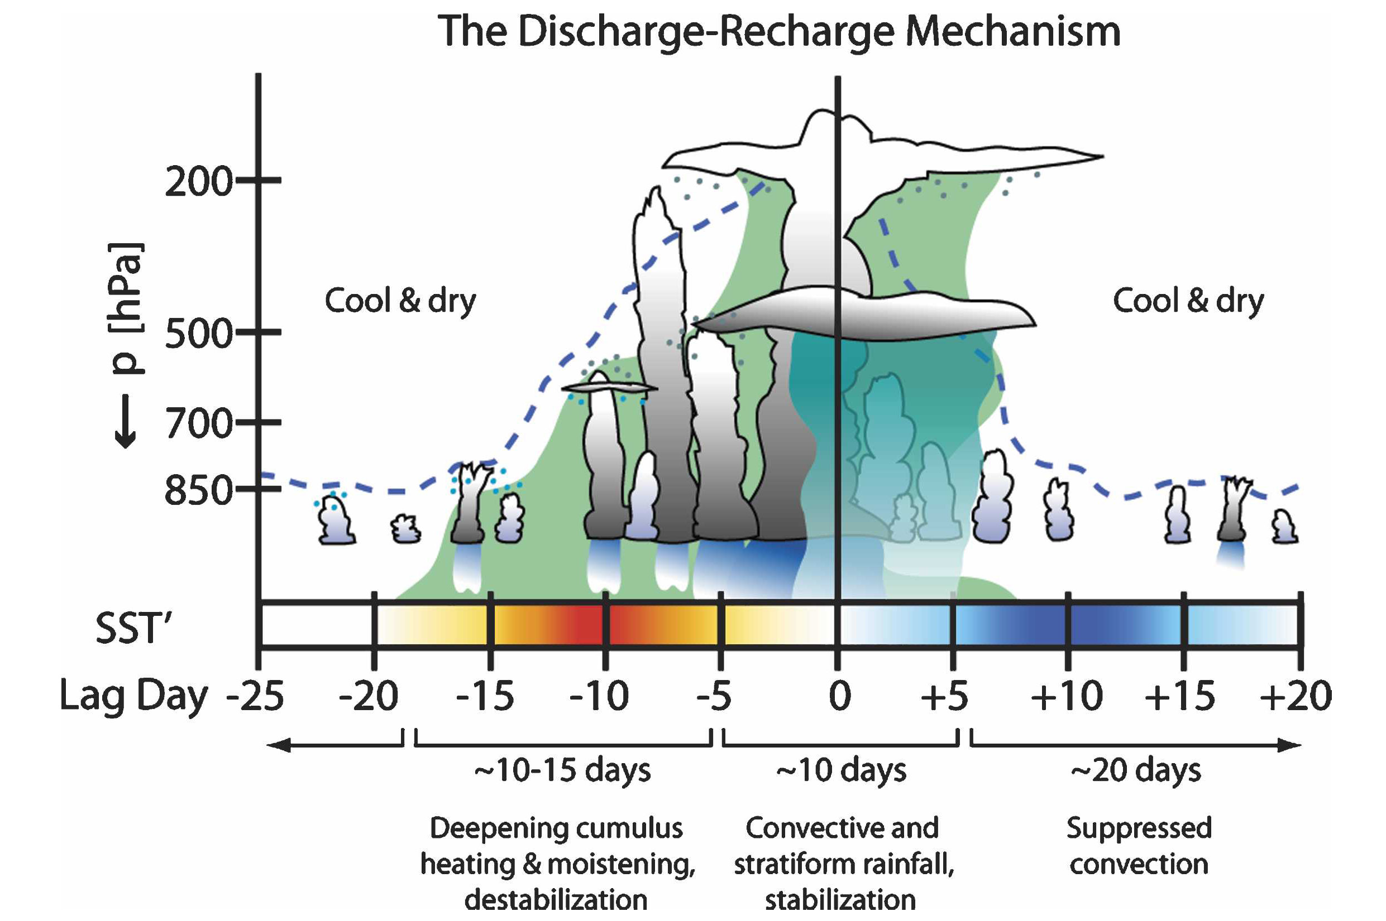
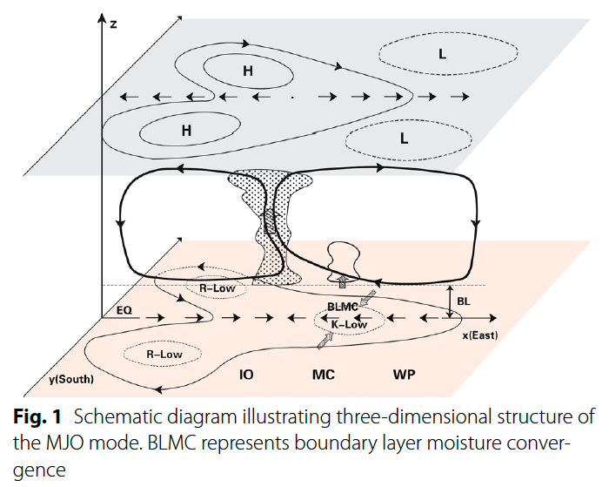
What causes the zonal asymmetry in moisture?
Boundary-layer frictional convergence (Wang 1988, etc.)
Dry-air advection by the Rossby wave (Biello and Majda 2005; Majda and Stachmann 2009; Wang et al. 2016; Adames and Kim 2016; etc.)
Longitude
After Benedict and Randall (2007)
Wang et al. (2016)

Slide 11
Papers | D⁻¹ (day) | Phenomena/Approaches
Matsuno (1966) | 1.8 | forced stationary motion/theory
Chang (1977) | 5 | MJO/theory
Gill (1980) | 2.5 | tropical circulation/ theory
Chang and Lim (1982) | ≥3 | Rossby waves/theory
Neelin et al. (1987) | 2-5 | MJO/theory
Seager (1991) | 1.25 | tropical mean circulation/ simulations
Yu and Neelin (1997) | 2 | convective adjustment/ theory
Raymond and Zeng (2000) | 0.5 | weak pressure gradient approximation/simulation
Wu et al. (2001) | 4-10 | tropical mean circulations/theory
Bretherton and Sobel (2003) | 2, 10 | Weak temperature gradient approximation/ theory
Biello and Majda (2005) | 5 | MJO/theory
Lin et al. (2005) | 3-5 | Linear damping of the MJO/diagnostics
Papers | D⁻¹ (day) | Phenomena/Approaches
Heartel et al. (2008) | 1 | MJO and 2-day waves/ theory
Kuang (2008) | 4, 10 | convectively coupled equatorial waves/theory
Lin et al. (2008) | 1-10 | Walker circulation/ diagnostics
Blossey et al. (2009) | 1 - 10 | subtropical clouds in CRM
Lee et al. (2009) | 10-20 | responses to heating/ simulation
Sugiyama (2009) | 5 | Moisture mode/theory
Kuang (2011) | 2.5 | moist static energy/ simulation
Romps (2012) | 1 | weak pressure gradient approximation/theory
Sobel and Maloney (2012) | 1 | MJO/theory
Romps (2014) | 1-10 | Rayleigh damping/ theory, simulation
Adames and Kim (2016) | 3 | MJO/theory
Stechmann and Hottovy (2017) | 16 | MJO and equatorial waves/theory
Issues:
1. Damping:
-Du
D⁻¹ = ∞

