Slide 1
Developing an Autonomous Hovercraft for Benthic Surveying in Very Shallow Waters
Meghan Troup, PhD Candidate
David Barclay, Matt Hatcher

Slide 2
Mapping in Shallow Waters (<5 meters)
Current Common Methods of Mapping
A Novel Alternative: Autonomous Hovercraft
Optical mapping methods (LiDAR, satellite imagery, aerial photography) are limited by cloud cover and turbidity and may lack detail in resolution
Boats, AUVs, and many ASVs have limited maneuverability in shallower waters
Manual in situ mapping or using underwater video can be inefficient and require spatial interpolation
Hovercrafts float on a cushion of air, allowing for near-frictionless movement over a surface
The propulsion mechanism of the vehicle is above water, limiting the amount of disturbance below
The sonar arm can be raised and lowered automatically once the hovercraft reaches a depth of at least 10 cm

Slide 3
Project Objectives:
Develop hovercraft vehicle capable of following a programmed path autonomously and survey in water shallower than 5 meters
Analyze sonar data to infer sediment type, presence and extent of eelgrass, and small-scale bathymetry
Create detailed map of survey sites using high resolution sonar mosaics

Slide 4
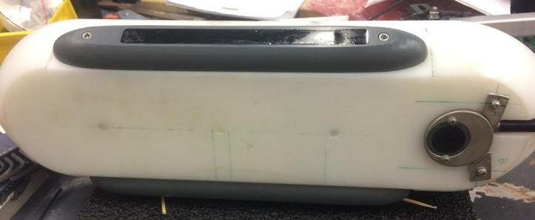
Hovercraft Development
Single engine and attached fan mounted at an angle creates both lift and thrust
Steering controlled by twin rudders in fan’s exhaust
Sonar data collection controlled by on-board computer
Navigation and IMU controlled by autopilot, connected to base computer via telemetry radio
GPS has Real Time Kinematic abilities and can reach centimeter accuracies.
Side-scan and single beam sonar combination provides depth and seafloor characteristics as well as imagery over a horizontal range
Side-scan Transducers
Single-beam Echo Sounder

Slide 5
Evaluation of Hovercraft Proficiency
Measuring Success of Autonomy:
Does the Hovercraft reach programmed waypoints?
Yes!
How far from ‘desired’ is the hovercraft’s path between waypoints?
Measured hovercraft headings are compared to ‘desired’ headings (i.e. straight line from hovercraft’s instantaneous position to next waypoint) and given a score from 0 (>90 degrees from desired) to 1 (within 5 degrees of desired).
Hovercraft track (blue line) during testing. Programmed way points are shown by red dots and labelled. Accuracy of corresponding tracks are shown in rose plots.

Slide 6
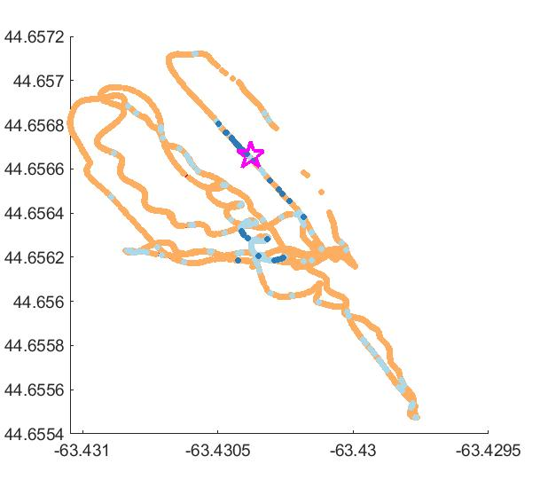
Hovercraft Applications
200
Eelgrass Marker
100
Mapping:
Bathymetry
Seafloor features (physical or geological)
Habitats
Environmental factors
Temperature
Salinity
Flow rate
Passive Acoustics
Bare Sand
Unknown
Eelgrass
100
Distance (m)
Distance (m)
50
0
0
85
170
Distance (m)
Results of a clustering classification algorithm on echo-sounder ping data. The beginning of a small eelgrass bed observed manually is marked with a star. Each color shown on the map has different backscatter features. Orange indicates bare sand, dark blue features indicate eelgrass, and the light blue feature is unknown.
0
55
110
Distance (m)

