Slide 1



PTDF NIGERIA
MODELLING FLUID MIGRATION AND SEISMICITY IN AN ACTIVE VOLCANO:
A CASE STUDY OF CAMPI FLEGREI CALDERA, SOUTHERN ITALY
Waheed Gbenga Akande^{1,2}, Gan Quan¹, David Cornwell¹ and Luca De Siena^{1,3}
¹School of Geoscience, University of Aberdeen, United Kingdom.
²Geology Department, Federal University of Technology, Minna, Nigeria.
³Institute of Geosciences, Johannes Gutenberg University, Mainz, Germany.
EGU MEETING MAY 2020
Notes:
References
AGIP (1987). Geologia e geofisica del sistema geotermico dei Campi Flegrei. Technical report, Settore Esplor e Ric Geoterm-Metodol per l’Esplor Geotermica. San Donato Milanese, Italy, p. 123.
Carlino , S., Troiano, A., Di Giuseppe, M. G., Tramelli, A., Troise, C., Som\ma, R., De Natale, G. (2016). Exploitation of geothermal energy in active volcanic areas: A numerical modelling applied to high temperature Mofete geothermal field, at Campi Flegrei caldera (Southern Italy). Renewable Energy 87 (2016) 54 – 66.
De Siena, L., Chiodini, G., Vilardo, G., Del Pezzo, E., Castellano, M., Colombelli, S., Tisato, N., and Ventura, G. (2017). Source and dynamics of a volcanic caldera unrest: Campi Flegrei, 1983–84. Scientific Report 7: 8099, 1 – 13.
Taron, J., D. Elsworth, and K.-B. Min (2009), Numerical simulation of thermal-hydrologic-mechanicalchemical processes in deformable, fractured porous media. International Journal of Rock Mechanics and Mining Sciences, 46, 842-854.

Slide 2
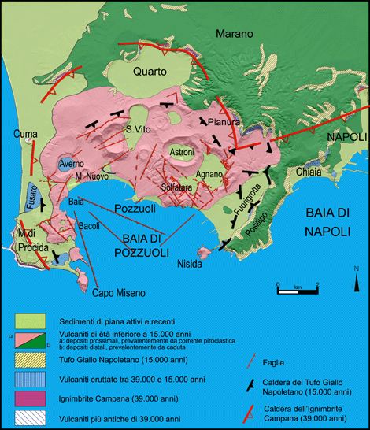
Modelling Fluid Migration and Seismicity in an Active Volcano:
A Case Study of Campi Flegrei Caldera, Southern Italy
Waheed Gbenga Akande^{1,2}; Gan Quan¹, David Cornwell¹ and Luca De Siena^{1,3}; ¹School of Geoscience, University of Aberdeen, UK.
²Geology Department, Federal University of Technology, Minna, Nigeria. ³Institute of Geosciences, Johannes Gutenberg University, Mainz, Germany.
PTDF NIGERIA
1. Introduction and Research Objectives
Campi Flegrei caldera (CFc, Fig.1) in the metropolitan area of Naples is notorious for its repeated volcanic unrests. Recent research suggests that these unrests feed local geothermal systems; CFc is thus a template for developing imaging techniques for geothermal energy resource.
This study aims to integrate geophysical observations (De Siena et al., 2017b; Calò and Tramelli, 2018; Akande et al., 2019) with rock physical and mechanical properties (e.g., Vanorio and Kanitpanyachaeron, 2015) to develop a caldera-wide fluid-flow modelling.
The motivation for this study is the consistent deduction of “caprock” from seismic imaging (e.g., Calò and Tramelli, 2018), and we pay particular attention to the roles of this blocking interface in the numerical simulation of fault slip and accompanied seismicity.
This work demonstrates the importance of multi-disciplinary approach in the study of an active volcano.
N
Fig. 1: Location of Campi Flegrei caldera (CFc),
Southern Italy.
http://www.archeoflegrei.it/i-campi-flegrei/
Notes:
References
AGIP (1987). Geologia e geofisica del sistema geotermico dei Campi Flegrei. Technical report, Settore Esplor e Ric Geoterm-Metodol per l’Esplor Geotermica. San Donato Milanese, Italy, p. 123.
Carlino , S., Troiano, A., Di Giuseppe, M. G., Tramelli, A., Troise, C., Som\ma, R., De Natale, G. (2016). Exploitation of geothermal energy in active volcanic areas: A numerical modelling applied to high temperature Mofete geothermal field, at Campi Flegrei caldera (Southern Italy). Renewable Energy 87 (2016) 54 – 66.
De Siena, L., Chiodini, G., Vilardo, G., Del Pezzo, E., Castellano, M., Colombelli, S., Tisato, N., and Ventura, G. (2017). Source and dynamics of a volcanic caldera unrest: Campi Flegrei, 1983–84. Scientific Report 7: 8099, 1 – 13.
Taron, J., D. Elsworth, and K.-B. Min (2009), Numerical simulation of thermal-hydrologic-mechanicalchemical processes in deformable, fractured porous media. International Journal of Rock Mechanics and Mining Sciences, 46, 842-854.

Slide 3
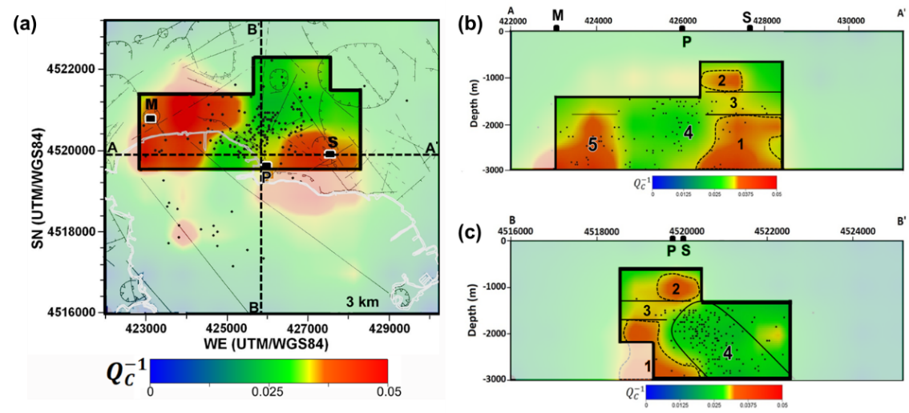
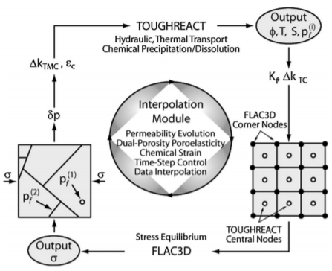
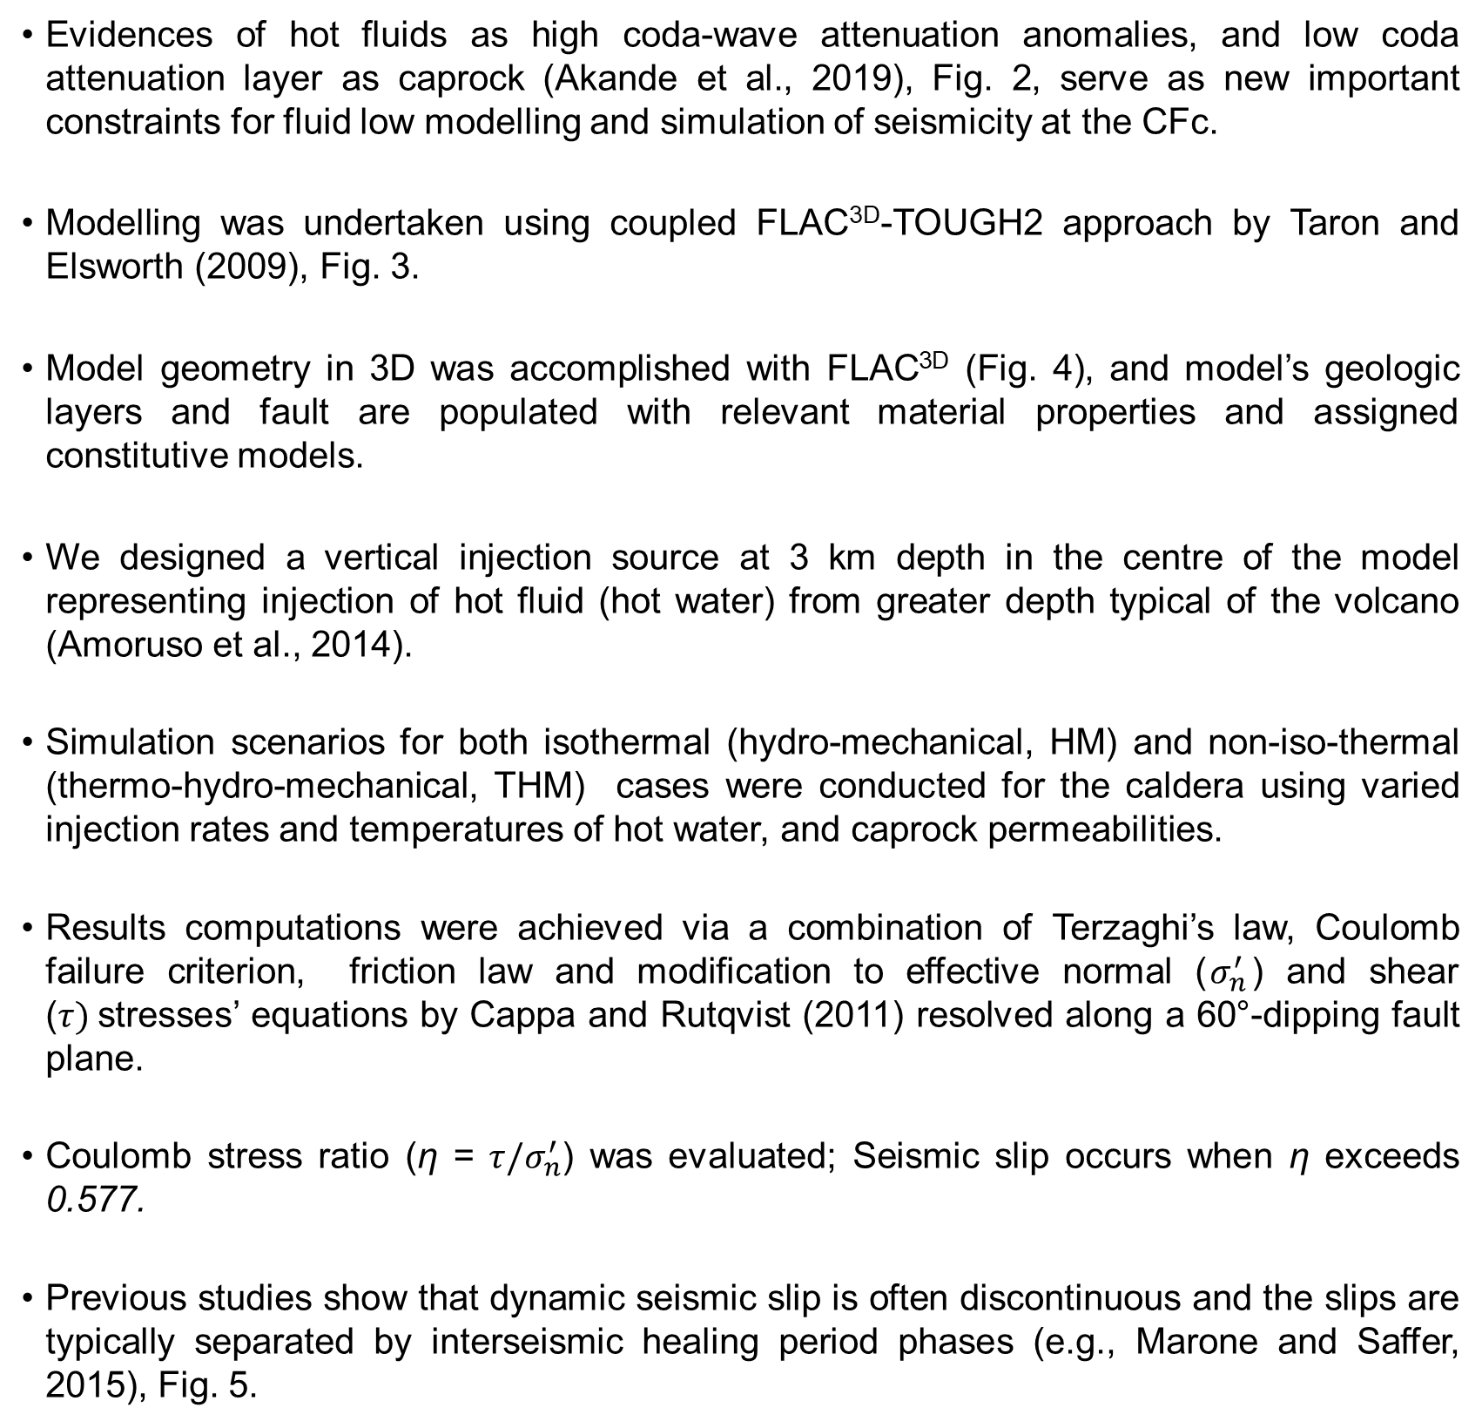
Modelling Fluid Migration and Seismicity in an Active Volcano:
A Case Study of Campi Flegrei Caldera, Southern Italy
Waheed Gbenga Akande^{1,2}; Gan Quan¹, David Cornwell¹ and Luca De Siena^{1,3}; ¹School of Geoscience, University of Aberdeen, UK.
²Geology Department, Federal University of Technology, Minna, Nigeria. ³Institute of Geosciences, Johannes Gutenberg University, Mainz, Germany.
PTDF NIGERIA
2. Methodology: Fluid Flow Modelling
Evidences of hot fluids as high coda-wave attenuation anomalies, and low coda attenuation layer as caprock (Akande et al., 2019), Fig. 2, serve as new important constraints for fluid low modelling and simulation of seismicity at the CFc.
Modelling was undertaken using coupled FLAC^{3D}-TOUGH2 approach by Taron and Elsworth (2009), Fig. 3.
Model geometry in 3D was accomplished with FLAC^{3D} (Fig. 4), and model’s geologic layers and fault are populated with relevant material properties and assigned constitutive models.
We designed a vertical injection source at 3 km depth in the centre of the model representing injection of hot fluid (hot water) from greater depth typical of the volcano (Amoruso et al., 2014).
Simulation scenarios for both isothermal (hydro-mechanical, HM) and non-iso-thermal (thermo-hydro-mechanical, THM) cases were conducted for the caldera using varied injection rates and temperatures of hot water, and caprock permeabilities.
Results computations were achieved via a combination of Terzaghi’s law, Coulomb failure criterion, friction law and modification to effective normal ($σ_{n}^{′}$) and shear ($τ)$stresses’ equations by Cappa and Rutqvist (2011) resolved along a 60°-dipping fault plane.
Coulomb stress ratio (η = $τ/σ_{n}^{′}$) was evaluated; Seismic slip occurs when η exceeds 0.577.
Previous studies show that dynamic seismic slip is often discontinuous and the slips are typically separated by interseismic healing period phases (e.g., Marone and Saffer, 2015), Fig. 5.
Figure 2: 3D coda attenuation maps generated for the 1983-1984 seismic unrests at Campi Flegrei caldera: (a) shows the resolved coda attenuation anomalies, (b) and (c) are the models shown for the dashed line A-A' and B-B' sections in Figure 1(a), respectively (Akande et al., 2019).
Figure 3: Coupling relationship between TOUGHREACT, FLAC^{3D}, and the Interpolation Module (Taron and Elsworth, 2009).
Figure 5: Friction coefficient versus plastic strain plot, whose friction table was used to model fault slip and seismicity. The figure is based on the knowledge of friction laws of natural earthquake (e.g., Dieterich, 1979; Ruina, 1980; Rice and Ruina, 1983).
Figure 4: Mesh Grid for Numerical Modelling of the CFc (K values show permeability of the modelled geologic layers).
Notes:
References
AGIP (1987). Geologia e geofisica del sistema geotermico dei Campi Flegrei. Technical report, Settore Esplor e Ric Geoterm-Metodol per l’Esplor Geotermica. San Donato Milanese, Italy, p. 123.
Carlino , S., Troiano, A., Di Giuseppe, M. G., Tramelli, A., Troise, C., Som\ma, R., De Natale, G. (2016). Exploitation of geothermal energy in active volcanic areas: A numerical modelling applied to high temperature Mofete geothermal field, at Campi Flegrei caldera (Southern Italy). Renewable Energy 87 (2016) 54 – 66.
De Siena, L., Chiodini, G., Vilardo, G., Del Pezzo, E., Castellano, M., Colombelli, S., Tisato, N., and Ventura, G. (2017). Source and dynamics of a volcanic caldera unrest: Campi Flegrei, 1983–84. Scientific Report 7: 8099, 1 – 13.
Taron, J., D. Elsworth, and K.-B. Min (2009), Numerical simulation of thermal-hydrologic-mechanicalchemical processes in deformable, fractured porous media. International Journal of Rock Mechanics and Mining Sciences, 46, 842-854.

Slide 4
Modelling Fluid Migration and Seismicity in an Active Volcano:
A Case Study of Campi Flegrei Caldera, Southern Italy
Waheed Gbenga Akande^{1,2}; Gan Quan¹, David Cornwell¹ and Luca De Siena^{1,3}; ¹School of Geoscience, University of Aberdeen, UK.
²Geology Department, Federal University of Technology, Minna, Nigeria. ³Institute of Geosciences, Johannes Gutenberg University, Mainz, Germany.
PTDF NIGERIA
3. Preliminary Results
Pore pressure took an order of day(s) time period to build up from the inception of hot water injection before the initiation of fault slips both in HM and THM cases, Figs. 6 - 8.
Seismic fault slips occur after ~7 days and ~6 days of hot water injection under isothermal (HM) and non-isothermal (THM) conditions, respectively, Figs. 6a,b and 7.
Thermal effects in THM case prompt seismic slip earlier, there is a time delay before seismic slips occur in the HM mode under similar simulation conditions, Figs. 7a-c.
Changes in the caprock permeability react differently to the rising and expanding pore fluid pressure front over time, and control the timing of fracturing and seismic slip, Fig. 8.
The modified ambient stress regime of the injection formation result in straining the caprock and this leads to the formation of microfractures that enhance its hydraulic properties, Fig. 8.
The breached caprock ultimately provides conductive migration pathways for hot fluids to pressurize the overlying fault at a shallower depth, Fig. 8.
Seismic fault slips occur earlier at higher injection temperatures, Fig. 9.
Figure 7: Comparison of results of HM and THM effects simulation results.
(c)
Figure 8: Pore pressure distributions at the end of the hot water injection simulations for corresponding indicated caprock permeabilities (K, m²). The left-hand side panel images (A-C) are for HM simulations, while the right side panel images (D-F) are for the THM simulations.
Figure 6: The evolution of: (a) fault Coulomb stress ratio and (b) permeability under the isothermal condition, (c) 60-degree-dip normal fault.
Notes:
References
AGIP (1987). Geologia e geofisica del sistema geotermico dei Campi Flegrei. Technical report, Settore Esplor e Ric Geoterm-Metodol per l’Esplor Geotermica. San Donato Milanese, Italy, p. 123.
Carlino , S., Troiano, A., Di Giuseppe, M. G., Tramelli, A., Troise, C., Som\ma, R., De Natale, G. (2016). Exploitation of geothermal energy in active volcanic areas: A numerical modelling applied to high temperature Mofete geothermal field, at Campi Flegrei caldera (Southern Italy). Renewable Energy 87 (2016) 54 – 66.
De Siena, L., Chiodini, G., Vilardo, G., Del Pezzo, E., Castellano, M., Colombelli, S., Tisato, N., and Ventura, G. (2017). Source and dynamics of a volcanic caldera unrest: Campi Flegrei, 1983–84. Scientific Report 7: 8099, 1 – 13.
Taron, J., D. Elsworth, and K.-B. Min (2009), Numerical simulation of thermal-hydrologic-mechanicalchemical processes in deformable, fractured porous media. International Journal of Rock Mechanics and Mining Sciences, 46, 842-854.

Slide 5


Modelling Fluid Migration and Seismicity in an Active Volcano:
A Case Study of Campi Flegrei Caldera, Southern Italy
Waheed Gbenga Akande^{1,2}; Gan Quan¹, David Cornwell¹ and Luca De Siena^{1,3}; ¹School of Geoscience, University of Aberdeen, UK.
²Geology Department, Federal University of Technology, Minna, Nigeria. ³Institute of Geosciences, Johannes Gutenberg University, Mainz, Germany.
PTDF NIGERIA
5. Further Work
We are finalizing the current study, and we aim to extend it to dynamic (seismicity) analysis to generate synthetic seismograms which are comparable to real seismograms recorded by seismic sensors at the caldera.
6. Key References
Akande, W. G., De Siena, L., Gan, Q., 2019. Three-dimensional kernel-based coda attenuation imaging of caldera structures controlling the 1982-84 Campi Flegrei unrest. Journal of Volcanology and Geothermal Research 381, 273-283.
Calò, M., Tramelli, A., 2018. Anatomy of the Campi Flegrei caldera using Enhanced Seismic Tomography Models. Scientific Reports 8 (16254), 1-12.
Cappa, F., Rutqvist, J., 2011. Modeling of coupled deformation and permeability evolution during fault reactivation induced by deep underground injection of CO2. International Journal of Greenhouse Gas Control 5, 336–346.
De Siena, L. Chiodini, G., Vilardo, G., Del Pezzo, E., Castellano, M., Colombelli, S., Tisato, N., Ventura, G., 2017b. Source and dynamics of a volcanic caldera unrest: Campi Flegrei, 1983-84. Scientific Reports 7 (8099), 1-13.
Taron, J., Elsworth, D., 2009. Thermal–hydrologic–mechanical–chemical processes in the evolution of engineered geothermal reservoirs. Int. J. Rock Mech. Min. Sci. 46, 855-864.
Vanorio, T., Kanitpanyacharoen, W., 2015. Rock physics of fibrous rocks akin to Roman concrete explains uplifts at Campi Flegrei Caldera. Science 349 (6248), 617-621.
Figure 9: (a) The evolution of fault Coulomb stress: Comparison of results of THM effect simulation results at various injection temperatures, and (b) large view of Fig. (a) showing the time window between 5 x 10⁵ and 1.0 x 10⁶ seconds, highlighting the timing of fault slip.
4. Conclusions
Seismic slips, and thus seismicity, at Campi Flegrei are a consequence of combined hydromechanical and thermal effects.
Caprock permeabilities have a first order control on the pore pressure accumulation, and on the timing of seismic slips.
The breached caprock provides conductive migration pathway for hot water to pressurize the overlying shallow fault to trigger seismicity.
Thermal effects and higher injection temperatures hasten the seismic slip processes.
Seismicities generated are in order of magnitude 3.0.
Acknowledgements
PTDF Nigeria
Host Institution
EGU Conveners
Notes:
References
AGIP (1987). Geologia e geofisica del sistema geotermico dei Campi Flegrei. Technical report, Settore Esplor e Ric Geoterm-Metodol per l’Esplor Geotermica. San Donato Milanese, Italy, p. 123.
Carlino , S., Troiano, A., Di Giuseppe, M. G., Tramelli, A., Troise, C., Som\ma, R., De Natale, G. (2016). Exploitation of geothermal energy in active volcanic areas: A numerical modelling applied to high temperature Mofete geothermal field, at Campi Flegrei caldera (Southern Italy). Renewable Energy 87 (2016) 54 – 66.
De Siena, L., Chiodini, G., Vilardo, G., Del Pezzo, E., Castellano, M., Colombelli, S., Tisato, N., and Ventura, G. (2017). Source and dynamics of a volcanic caldera unrest: Campi Flegrei, 1983–84. Scientific Report 7: 8099, 1 – 13.
Taron, J., D. Elsworth, and K.-B. Min (2009), Numerical simulation of thermal-hydrologic-mechanicalchemical processes in deformable, fractured porous media. International Journal of Rock Mechanics and Mining Sciences, 46, 842-854.

