Slide 1
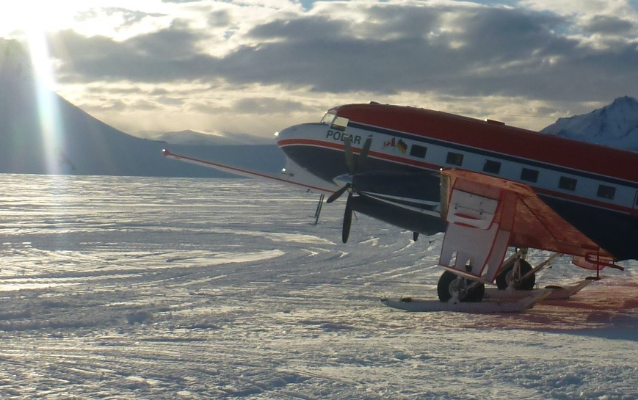
A look beneath the ice shelves of western Dronning Maud Land, East Antarctica:
Subglacial topography linked to ice shelf stability
Hannes Eisermannª, Graeme Eaglesª, Antonia Ruppel^{b}, Emma C. Smithª, Wilfried Jokat^{a,c}
ªAlfred Wegener Institute for Polar and Marine Research, Bremerhaven, Germany
^{b}Federal Institute for Geosciences and Natural Resources (BGR), Hannover, Germany
^{c}University of Bremen, Faculty of Geosciences, Bremen, Germany
Corresponding author: Hannes Eisermann, heiserma@awi.de
EGU 2020: Sharing Geoscience Online

Slide 2
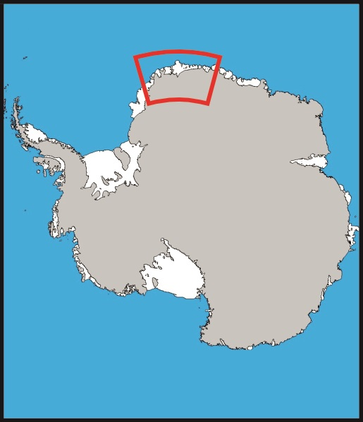
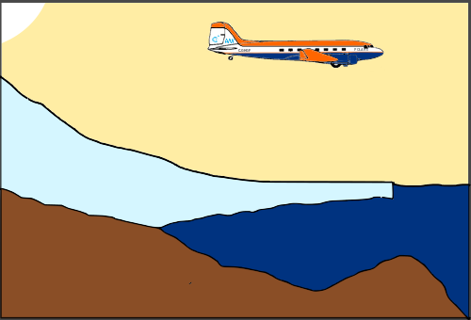
Introduction - Motivation
1
Ice shelves play a key role in stabilizing ice streams.
An increase in mass loss of an ice shelf is followed by increased drainage of its ice sheet¹.
Mass loss in western Dronning Maud Land (wDML) is dominated by basal melting and calving².
Accurate bathymetry beneath ice shelves is leading requirement for correctly estimating basal melt rates^{3,4}.
Subglacial topography beneath ice shelves of wDML is mainly unknown, besides sparse existing seismic data beneath Ekström and Fimbul^{5,6}.
Consistent and accurate bathymetric models therefore benefit estimations of ice shelf and ice sheet stability.
Ice shelves of wDML represent 10 % of East Antarctica’s total ice shelf by area². The ice shelves’ catchment area currently contains 341,000 Gt of ice above sea level, a sea level equivalent of about 0.95 meters.
Aim of the study is to model subglacial bathymetries beneath the ice shelves of wDML and draw conclusions on ice shelf stability.
A look beneath the ice shelves of western
Dronning Maud (wDML) Land, East Antarctica
?
?
?
EGU 2020: Sharing Geoscience Online

Slide 3
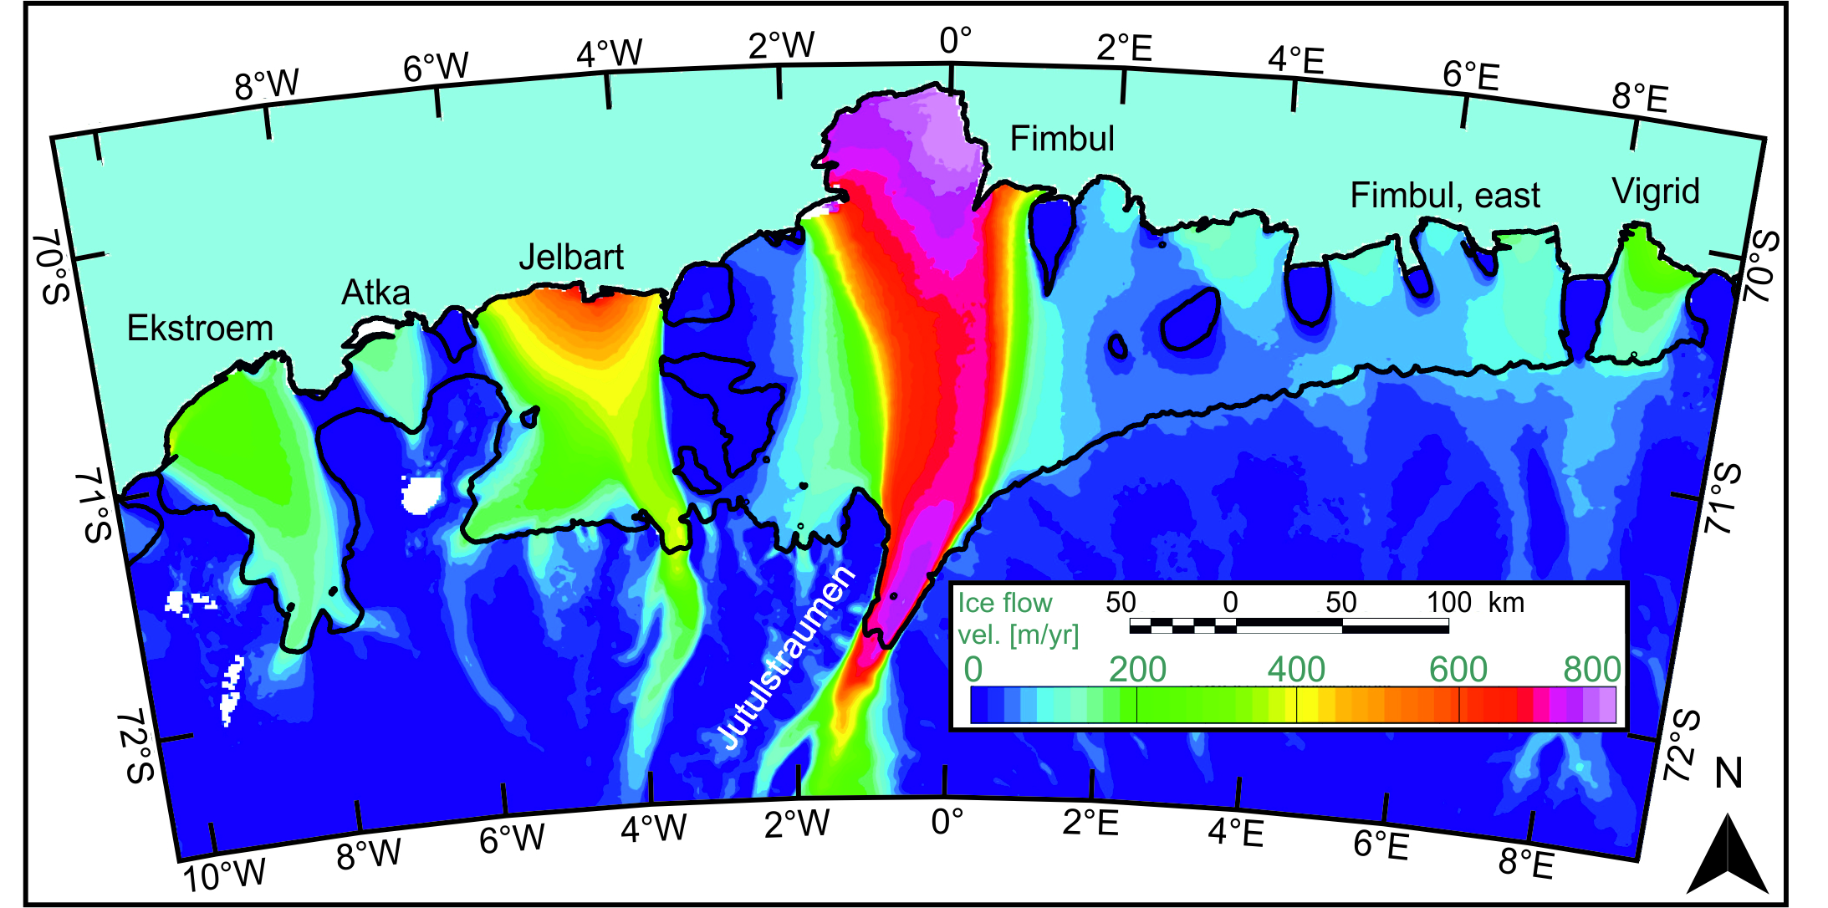
Introduction
2
The Weddel Gyre⁷ is traversing a narrow continental shelf in wDML from east to west. The narrow shelf permits a strong interaction between this coastal current and water cavities beneath ice shelves⁸.
The coastal current carries a mixture of water masses, including Warm Deep Water (WDW)^{)7.}
Basal melting beneath Fimbul⁹ is primarily caused by heated Antarctic Surface Water¹⁰.
Entry of WDW into cavities at Fimbul Ice Shelf is currently minimal and strongly dependent on bathymetric features^{11,12}.
We constructed bathymetric models beneath the Ekström, Atka, Jelbart, Fimbul and Vigrid ice shelves in wDML (Fig. 1) by inverting new and existing airborne gravity data, and incorporating seismic, multibeam and radar depth references (Fig. 2).
Geological variability is interpreted from magnetic anomalies. Well-founded magnetic interpretations can be employed to reduce uncertainty in final bathymetric models.
A look beneath the ice shelves of western
Dronning Maud (wDML) Land, East Antarctica
Figure 1: Overview of wDML showing ice flow velocities¹³ with main outlet glacier Jutulstraumen. Bathymetry models were generated for the named ice shelves.
EGU 2020: Sharing Geoscience Online

Slide 4
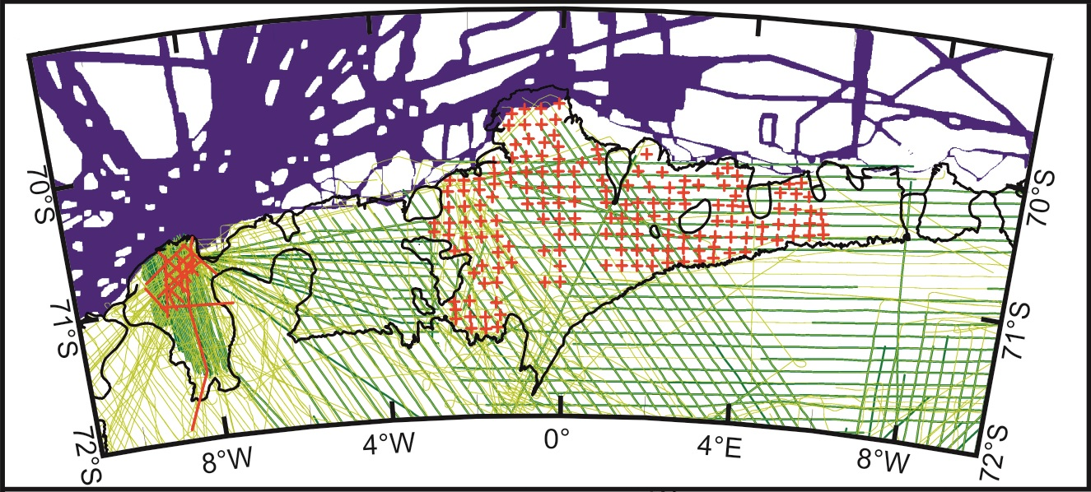
Introduction – Survey Area
3
Figure 2: Known topography and available gravity data in western Dronning Maud Land.
seismic data^{5,6}
swath bathymetry data ^{Appendix A}
gravity data^{14,15}
ice thickness radar data^{14,15}
, +
EGU 2020: Sharing Geoscience Online

Slide 5
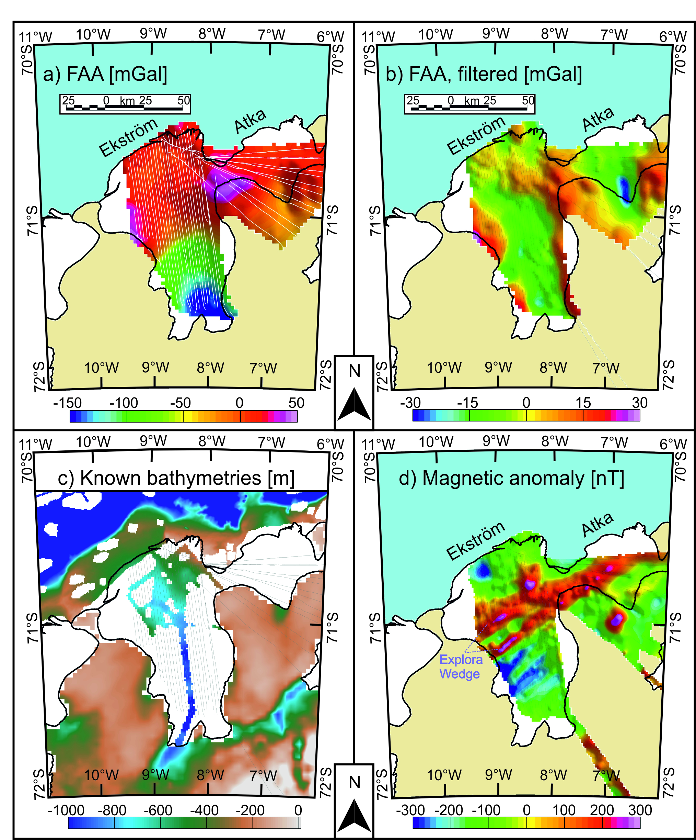
Materials and Methods - exemplified by Ekström Ice Shelf
4
Aerogeophysical data in Fig. 2 acquired during VISA campaigns in the early 2000s¹⁴ and part of a GEA campaign in 2016¹⁵.
Gravity data Acquisition:
ZLS Ultrasys Lacoste & Romberg Air/Sea gravimeter (used for Jelbart, Fimbul and Vigrid ice shelves).
GT-2A (used for Ekström, Atka and Jelbart ice shelves).
Magnetic Data Acquisition:
Scintrex Cs-3.
Gravity inversion using module GM-SYS 3D of Geosoft Oasis montaj.
Depth reference points from seismic data, swath bathymetry data and ice thickness radar data in grounded areas (see Fig. 3c).
Pre-Processing filters applied to the free air anomaly (FAA) enhance the resemblance between the FAA and known bathymetries.
FAA over the Ekström and Atka ice shelves are filtered using a 70 km high-pass filter, oriented at 45° to suppress features trending parallel to the main geological structures of the continental shelf (Fig. 3d).
These magnetic anomalies are interpreted as a succession of seaward dipping reflectors, namely the Explora Wedge^{16, 17, 18}.
Error estimations of bathymetry models in Appendix B.
Figure 3: Ekström & Atka ice shelves with grounded ice (beige), ice shelves (white) and ocean (blue).
EGU 2020: Sharing Geoscience Online

Slide 6
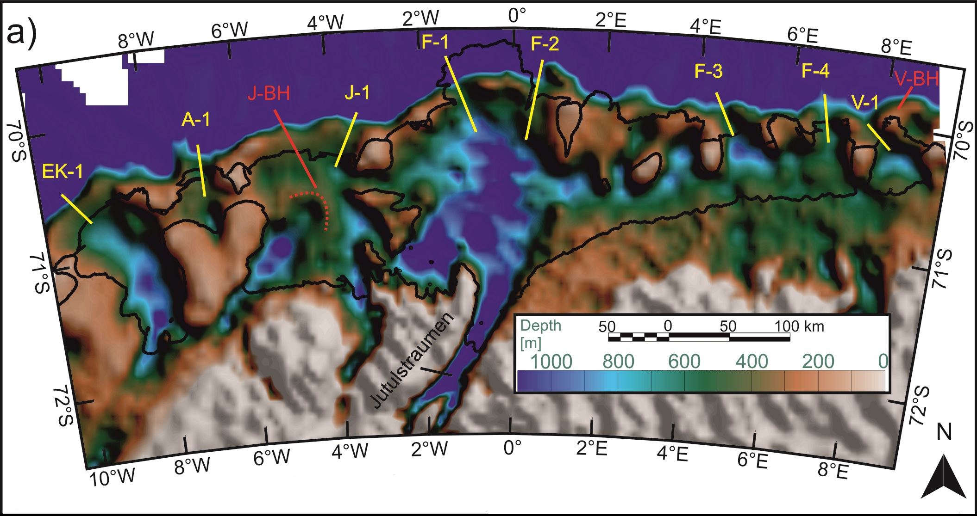
Results
5
Ice shelves overlie a seabed (mostly <1 km deep) that deepens between shallow sills close to the present-day calving fronts and the landward grounding line.
Bathymetric sills are interrupted by a series of distinct narrow gateways (e.g. ‘F-1’) between 390 and 600 m depth.
Troughs are resolved parallel to the directions of the main ice flow (Fig. 1) and are interbedded by small bathymetric highs (Fig. 4).
e.g. Fimbul Ice Shelf has depth maxima of 1300, 1250 and 1150 m, from south to north, set between 1000 m-deep bathymetric highs.
Jelbart Ice Shelf is underlain by two bathymetric troughs, separated by a broad rampart-like bathymetric high (‘J-BH’, Fig. 4).
Western trough terminates against this bathymetric high.
Eastern trough coincides with the present-day surface ice flow maximum (Fig. 1).
Figure 4: Bathymetry model for wDML based on gravity inversion and existing depth measurements. Gateways are marked in yellow as Ek-1 (deepest point at 390 m), A-1 (450 m), J-1 (430 m), F-1 (550 m), F-2 (450 m), F-3 (530 m), F-4 (600 m), V-1 (450 m). Distinct bathymetric highs are marked as J-BH and V-BH, over which the water column thickness is reduced to 50 and 40 m.
EGU 2020: Sharing Geoscience Online

Slide 7
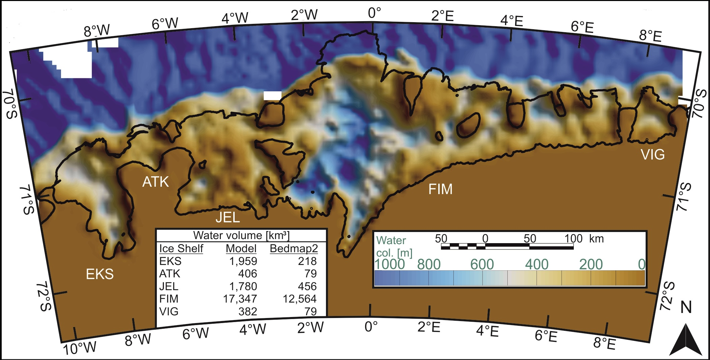
Results
6
Water column thickness in the center of Jelbart at ‘J-BH’ and in the north of Vigrid at ‘V-BH’ is reduced to just 50 and 40 m, respectively.
Modeled bathymetries show severe differences to previous bathymetry data compilations¹⁹, reaching up to several hundreds of meters for all wDML ice shelves.
Bedmap2 is currently the baseline data set for the majority of modeling studies in the area so far.
It underestimates the volume of water cavities by 63 % compared to our bathymetric model.
Excluding seismic measurements at the Fimbul Ice Shelf, which were incorporated in Bedmap2, cavity volume is underestimated by 444 % (Fig. 5).
Bedmap2 uses interpolation between known depth references and is therefore prone to fail in sparsely constrained regions.
Figure 5: Water column thickness beneath ice shelves of wDML based on bathymetry model and base ice positions inferred from ice thickness radar data.
Table shows differences of water volume compared to Bedmap2¹⁸ in km³.
EGU 2020: Sharing Geoscience Online

Slide 8
Discussion
7
The ice shelves of wDML are all underlain by seabed with:
Troughs traversed by small bathymetric highs, which suggest common origins and former glacier extents⁵.
Sills close to present-day calving fronts, implying their formation as end moraines by ice sheets that advanced to the continental shelf edges during the Last Glacial Maximum^{20,21}.
Shallow gateways in sills close to calving fronts (Fig. 4) limit the possible entry of WDW into the cavities.
Similar average thermocline depths of about 600 m in water depths of 1000 m¹².
Only small amounts of modified WDW creep into the Fimbul cavity^{11,12}.
Similar settings for neighboring ice shelves leads to assumption that present-day basal melting processes are mainly driven by solar-heated Antarctic Surface Water throughout wDML¹⁰.
Sills thus currently protect the ice shelf base from basal melting by considerable WDW ingress.
Figure 4: Bathymetry model for wDML based on gravity inversion and existing depth measurements. Gateways are marked in yellow as Ek-1 (deepest point at 390 m), A-1 (450 m), J-1 (430 m), F-1 (550 m), F-2 (450 m), F-3 (530 m), F-4 (600 m), V-1 (450 m). Distinct bathymetric highs are marked as J-BH and V-BH, over which the water column thickness is reduced to 50 and 40 m.
EGU 2020: Sharing Geoscience Online

Slide 9
Discussion
8
If ocean warming and/or a shallower thermocline in the future leads more warm water to breach the sills…
the deep troughs will permit fast access to the grounding line with little to stop basal melting from eroding wDML’s ice shelves.
Buttressing by grounding at pinning points plays an important role in stabilizing ice shelves by braking ice flow¹.
Broad bathymetric highs with minor water column beneath the Jelbart and Vigrid ice shelves might have acted as pinning points in the recent past.
Loss of buttressing might explain a high ice mass loss for the drainage area of the Jelbart Ice Shelf, compared to stable mass balances in neighboring drainage areas²².
The semi-circular bathymetric high beneath Jelbart suggests its formation as a moraine, caused by former glacial extents at the western trough and/or reduced erosion in the center of the ice shelf between its two marginal ice streams.
A depositional character might imply even shallower depths over ‚J-BH‘ than modeled, because of the relatively lower sediment density.
Figure 4: Bathymetry model for wDML based on gravity inversion and existing depth measurements. Gateways are marked in yellow as Ek-1 (deepest point at 390 m), A-1 (450 m), J-1 (430 m), F-1 (550 m), F-2 (450 m), F-3 (530 m), F-4 (600 m), V-1 (450 m). Distinct bathymetric highs are marked as J-BH and V-BH, over which the water column thickness is reduced to 50 and 40 m.
EGU 2020: Sharing Geoscience Online

Slide 10
Summary
9
Bathymetry models were constructed beneath Ekström, Atka, Jelbart, Fimbul and Vigrid ice shelves by gravity inversion.
Constrained by seismic, multibeam, and radar data, and geological variability interpreted from magnetic anomalies.
Models show that current topographic compilations used (e.g. Bedmap2)¹⁹ heavily underestimate the vulnerable ice shelf cavities of wDML by up to 798 % for the Ekström Ice Shelf and by 63 % in total.
The newly mapped seabed underlies 10 % of East Antarctica’s ice shelf inventory².
Bathymetry has a direct significance for the current and future stability of the wDML ice sheet. The catchment area contains water equivalent to about 0.95 meters of eustatic sea level rise.
Deep seawater cavities under all of the ice shelves.
Cavities partially secluded from open ocean by sills close to the continental shelf edge. These currently protect the ice shelves from basal melting by WDW ingress.
At present, the ice shelves probably experience basal melting mainly by warm surface waters. However, a shallowing thermocline depth with an increased entry of WDW into the cavities poses a significant risk to these ice shelves in the future.
Data Availability
Bathymetry model uploaded to ‚Pangaea‘ data repository, with depths relative to WGS84.
doi: 10.1594/PANGAEA.913742
Contact:
heiserma@awi.de
EGU 2020: Sharing Geoscience Online

Slide 11
References 1/2
1) Dupont, T., & Alley, R. B. (2005). Assessment of the importance of ice‐shelf buttressing to ice‐sheet flow. Geophysical Research Letters, 32(4). https://doi.org/10.1029/2004GL022024
2) Rignot, E., Jacobs, S., Mouginot, J., & Scheuchl, B. (2013). Ice-shelf melting around Antarctica. Science, 341(6143), 266-270. https://doi.org/10.1126/science.1235798
3) Goldberg, D., Gourmelen, N., Kimura, S., Millan, R., & Snow, K. (2019). How accurately should we model ice shelf melt rates? Geophysical Research Letters, 46(1), 189-199. https://doi.org/10.1029/2018GL080383
4) Tinto, K. J., Padman, L., Siddoway, C. S., Springer, S. R., Fricker, H. A., Das, I., et al. (2019). Ross Ice Shelf response to climate driven by the tectonic imprint on seafloor bathymetry. Nature Geoscience, 12(6), 441-+. https://doi.org/10.1038/s41561-019-0370-2
5) Smith, E. C., Hattermann, T., Kuhn, G., Gaedicke, C., Berger, S., Drews, R., et al. (2019). Detailed seismic bathymetry beneath Ekstroem Ice Shelf, Antarctica: Implications for glacial history and ice-ocean interaction. Geophysical Research Letters. https://doi.org/10.1002/essoar.10501125.1
6) Nøst, O. A. (2004). Measurements of ice thickness and seabed topography under the Fimbul Ice Shelf, Dronning Maud Land, Antarctica. Journal of Geophysical Research: Oceans, 109(C10). https://doi.org/10.1029/2004JC002277
7) Schröder, M., & Fahrbach, E. (1999). On the structure and the transport of the eastern Weddell Gyre. Deep Sea Research Part II: Topical Studies in Oceanography, 46(1-2), 501-527. https://doi.org/10.1016/S0967-0645(98)00112-X
8) Nicolaus, M., & Grosfeld, K. (2004). Ice-Ocean Interactions underneath the Antarctic Ice Shelf Ekströmisen. Polarforschung, 72(1), 17-29.
9) Langley, K., von Deschwanden, A., Kohler, J., Sinisalo, A., Matsuoka, K., Hattermann, T., et al. (2014b). Complex network of channels beneath an Antarctic ice shelf. Geophysical Research Letters, 41(4), 1209-1215. https://doi.org/10.1002/2013gl058947
10) Zhou, Q., Hattermann, T., Nøst, O., Biuw, M., Kovacs, K., & Lydersen, C. (2014). Wind‐driven spreading of fresh surface water beneath ice shelves in the Eastern Weddell Sea. Journal of Geophysical Research: Oceans, 119(6), 3818-3833. https://doi.org/10.1002/2013JC009556
11) Hattermann, T., Smedsrud, L. H., Nøst, O. A., Lilly, J. M., & Galton-Fenzi, B. K. (2014). Eddy-resolving simulations of the Fimbul Ice Shelf cavity circulation: Basal melting and exchange with open ocean. Ocean Modelling, 82, 28-44. https://doi.org/10.1016/j.ocemod.2014.07.004
12) Hattermann, T. (2018). Antarctic Thermocline Dynamics along a Narrow Shelf with Easterly Winds. Journal of Physical Oceanography, 48(10), 2419-2443. https://doi.org/10.1175/Jpo-D-18-0064.1
13) Mouginot, J., B. Scheuchl, and E. Rignot. (2017b). MEaSUREs Annual Antarctic Ice Velocity Maps 2005-2017, Version 1. [2016-2017]. Boulder, Colorado USA. NASA National Snow and Ice Data Center Distributed Active Archive Center. https://doi.org/10.5067/9T4EPQXTJYW9. [10/2019]
14) Riedel, S., Jokat, W., & Steinhage, D. (2012). Mapping tectonic provinces with airborne gravity and radar data in Dronning Maud Land, East Antarctica. Geophysical Journal International, 189(1), 414-427. https://doi.org/10.1111/j.1365-246X.2012.05363.x
15) Eisermann, H., Eagles, G., Ruppel, A., Smith, E. C., & Jokat, W. (in review). Bathymetry beneath ice shelves of western Dronning Maud Land, East Antarctica, and implications on ice shelf stability. Geophysical Research Letters.
16) Hinz, K., & Krause, W. (1982). The continental margin of Queen Maud Land, Antarctica: Seismic sequences, structural elements and geological development. Geol. Jahrbuch, E, 23, 17-41.
…
EGU 2020: Sharing Geoscience Online

Slide 12
References 2/2
…
17) Kristoffersen, Y., & Haugland, K. (1986). Geophysical Evidence for the East Antarctic Plate Boundary in the Weddell Sea. Nature, 322(6079), 538-541. https://doi.org/10.1038/322538a0
18) Jokat, W., Ritzmann, O., Reichert, C., & Hinz, K. (2004). Deep crustal structure of the continental margin off the Explora Escarpment and in the Lazarev Sea, East Antarctica. Marine Geophysical Researches, 25(3-4), 283-304. https://doi.org/10.1007/s11001-005-1337-9
19) Fretwell, P., Pritchard, H. D., Vaughan, D. G., Bamber, J. L., Barrand, N. E., Bell, R., et al. (2013). Bedmap2: improved ice bed, surface and thickness datasets for Antarctica. Cryosphere, 7(1), 375-393. https://doi.org/10.5194/tc-7-375-2013
20) Grobe, H., & Mackensen, A. (1992). Late Quaternary climatic cycles as recorded in sediments from the Antarctic continental margin. The Antarctic paleoenvironment: A perspective on Global Change; Antarctic Research Series, 56, 349-376.
21) Hillenbrand, C. D., Bentley, M. J., Stolldorf, T. D., Hein, A. S., Kuhn, G., Graham, A. G. C., et al. (2014). Reconstruction of changes in the Weddell Sea sector of the Antarctic Ice Sheet since the Last Glacial Maximum. Quaternary Science Reviews, 100, 111-136. https://doi.org/10.1016/j.quascirev.2013.07.020
22) Rignot, E., Mouginot, J., Scheuchl, B., van den Broeke, M., van Wessem, M. J., & Morlighem, M. (2019). Four decades of Antarctic Ice Sheet mass balance from 1979-2017. Proc Natl Acad Sci U S A, 116(4), 1095-1103. https://doi.org/10.1073/pnas.1812883116
EGU 2020: Sharing Geoscience Online

Slide 13
Appendix A - Data References for bathymetry model
A
Seismic data:
Smith, E. C., Hattermann, T., Kuhn, G., Gaedicke, C., Berger, S., Drews, R., et al. (2019). Detailed seismic bathymetry beneath Ekstroem Ice Shelf, Antarctica: Implications for glacial history and ice-ocean interaction, submitted to Geophysical Research Letters. https://doi.org/10.1002/essoar.10501125.1
Nøst, O. A. (2004). Measurements of ice thickness and seabed topography under the Fimbul Ice Shelf, Dronning Maud Land, Antarctica, Journal of Geophysical Research: Oceans, 109(C10). https://doi.org/10.1029/2004JC002277
Ice thickness radar data:
Riedel, S., Jokat, W., & Steinhage, D. (2012). Mapping tectonic provinces 484 with airborne gravity and radar data in Dronning Maud Land, East Antarctica, Geophysical Journal International, 189(1), 414-427. https://doi.org/10.1111/j.1365-246X.2012.05363.x
Grounding line estimates:
Mouginot, J., B. Scheuchl, and E. Rignot. (2017). MEaSUREs Antarctic Boundaries for IPY 2007-2009 from Satellite Radar, Version 2. Boulder, Colorado USA. NASA National Snow and Ice Data Center Distributed Active Archive Center. https://doi.org/10.5067/AXE4121732AD, [10/2019].
Swath bathymetry:
campaign data repository campaign data repsoitory
ant05_4 https://doi.pangaea.de/10.1594/PANGAEA.763938 ant15_4 https://doi.pangaea.de/10.1594/PANGAEA.724655
ant06_3 https://doi.pangaea.de/10.1594/PANGAEA.763882 ant16_2 https://doi.pangaea.de/10.1594/PANGAEA.724656
ant08_5 https://doi.pangaea.de/10.1594/PANGAEA.767654 ant16_3 https://doi.pangaea.de/10.1594/PANGAEA.724657
ant04_3 https://doi.pangaea.de/10.1594/PANGAEA.763923 ant17_2 https://doi.pangaea.de/10.1594/PANGAEA.763731
ant09_2 https://doi.pangaea.de/10.1594/PANGAEA.767553 ant17_3 https://doi.pangaea.de/10.1594/PANGAEA.763269
ant09_3 https://doi.pangaea.de/10.1594/PANGAEA.767555 ant19_2 https://doi.pangaea.de/10.1594/PANGAEA.701695
ant10_2 https://doi.pangaea.de/10.1594/PANGAEA.767517 ant20_2 https://doi.pangaea.de/10.1594/PANGAEA.733040
ant11_4 https://doi.pangaea.de/10.1594/PANGAEA.767549 ant22_3 https://doi.pangaea.de/10.1594/PANGAEA.724660
ant12_3 https://doi.pangaea.de/10.1594/PANGAEA.763235 ant23_8 https://doi.pangaea.de/10.1594/PANGAEA.668088
ant14_3 https://doi.pangaea.de/10.1594/PANGAEA.763232 ant23_9 https://doi.pangaea.de/10.1594/PANGAEA.668101
ant15_2 https://doi.pangaea.de/10.1594/PANGAEA.724653 ant27_3 https://doi.pangaea.de/10.1594/PANGAEA.766940
ant15_3 https://doi.pangaea.de/10.1594/PANGAEA.724654 PS101 https://doi.pangaea.de/10.1594/PANGAEA.894464
ant15_4 https://doi.pangaea.de/10.1594/PANGAEA.724655
EGU 2020: Sharing Geoscience Online

Slide 14
Appendix B - Error Estimation
B
Error envelope of bathymetry models arises from instrumental inaccuracies in data acquisition, limitations during data processing and uncertainties within the modeling process.
Different data qualities lead to contrasting error estimates for the Ekström and Atka ice shelves (GT-2A), the Jelbart Ice Shelf (compilation of GT-2A and ZLS data), and Fimbul and Vigrid ice shelves (ZLS Ultrasys system).
A Bouguer slab calculation using the density contrast of the water-seabed interface is performed after combining the following uncertainties:
Standard deviation of crossover errors in gravity data.
Geological variations:
density contrasts of +/- 100 kg/m³ in density models led to mean gravity residuals of 9 mGal.
Errors in ice thickness estimation of about ±10 m is added to the error.
Bathymetric models possess an error envelope of ±175 m beneath the Ekström and Atka ice shelves, ±225 m beneath the Jelbart Ice Shelf and ±210 m beneath the Fimbul and Vigrid ice shelves and are limited to a horizontal resolution of about 5 km.
EGU 2020: Sharing Geoscience Online

