Slide 1
Free
Soil Organic Carbon Accumulation under Different Forms of Organo-Mineral Fertilizers and Methods of Their Application on Ukrainian Black Soil
for beginners
Viktoriia Hetmanenko, Ievgen Skrylnyk, Anzhela Kutova
National Scientific Center “Institute for Soil Science and Agrochemistry Research named after O.N. Sokolovsky” Kharkiv, Ukraine

Slide 2
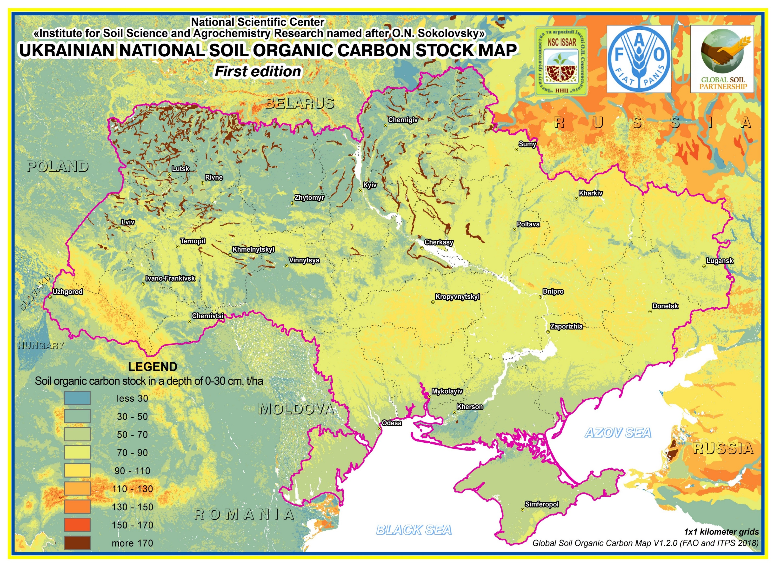
2010
TOC, %
TOC in soils of Ukraine
2015
Percentage of croplands area in Ukraine with different TOC content, % of total area of croplands
Notes:
For last decades SOC loss in soils has been surveyed in Ukraine. Areas of soils with high and very high humus content decreased from 30 percent in 1990 to 22 in 2010.

Slide 3
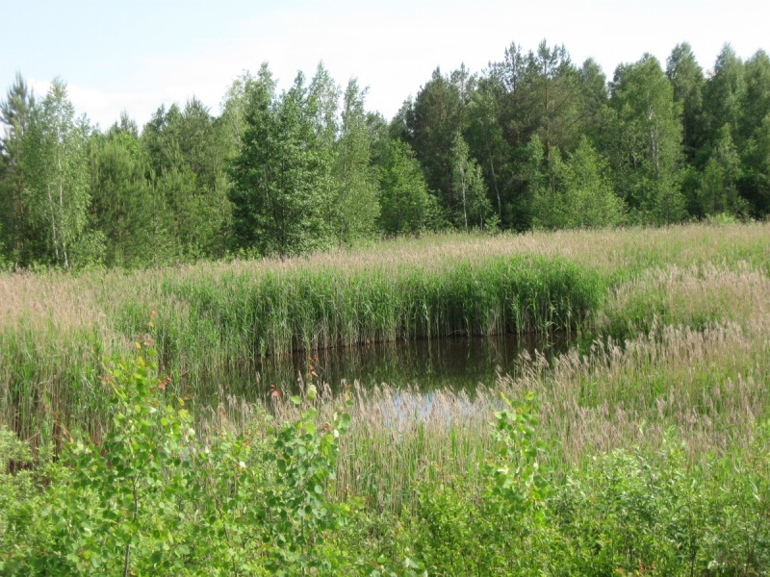
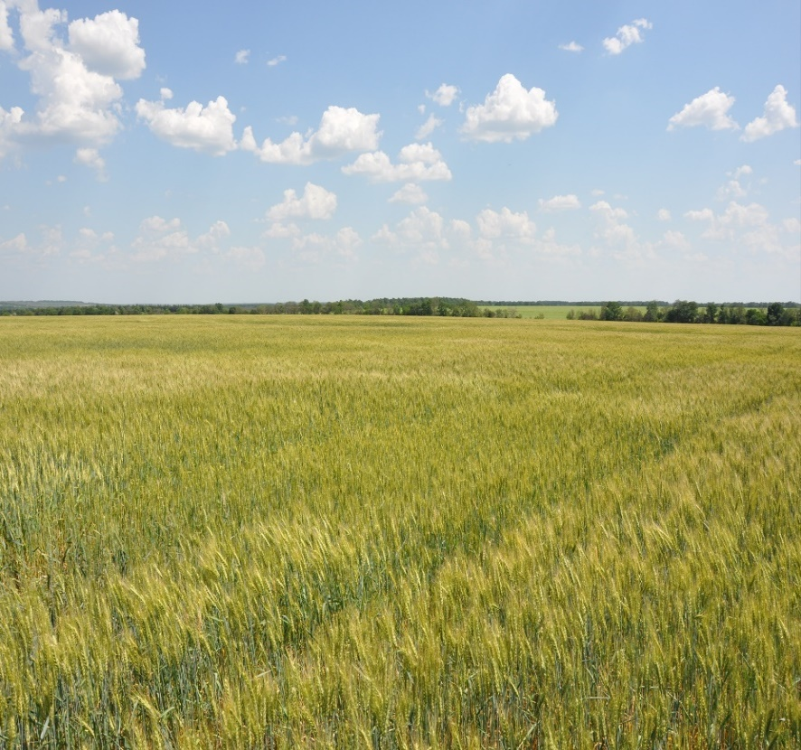
Average annual SOM loss in arable land in different zones of Ukraine
Forest-Steppe
Polissya
Steppe
0,18 t ha⁻¹
0,31 t ha⁻¹
0,37 t ha⁻¹
Polissya
Forest-Steppe
Steppe
Notes:
Meta-analyses showed significant decrease in SOC stocks after conversion of virgin lands into croplands in Ukraine. Since expedition of soil scientist Dokuchaev in 1882 organic carbon in soils of Ukraine has been decreased in 1.3 times. Statistical data indicates soil organic carbon loss in all natural zones of Ukraine. An average annual loss of total organic carbon from 1961 to 2010 was about 0.01% per year. The main reason of the mentioned process is enormous lack of organic fertilizers. Since 1985 there has been a decline of application of organic fertilizers in 16 times in Ukraine.

Slide 4
Rates of organic fertilizer application in Ukraine
Recommended
8–14 t ha⁻¹
Present
0,5 t ha⁻¹
Dynamics of organic fertilizers application in Ukraine
Years
Organic fertilizers applied, mln t | 1986-1990 | 1996-2000 | 2001-2005 | 2006- 2010 | 2011- 2014 | 2015-2019
 | 278 | 52 | 19 | 21 | 20 | 9
Notes:
To provide non deficit humus balance in soils of Ukraine it is recommended to apply 8 – 14 t of organic fertilizer per hectare. While the current rate is only half of ton, and in some areas even less. Only 1% of arable soils are treated with organic fertilizers.

Slide 5
Raw materials
for organo-mineral fertilizers production
Livestock and poultry waste
Organic materials of natural origin
Municipal waste
Crop residues
Manufacturing waste
waste of sugar factories
sewage sludge
bark, leaves, wood
peat, leonardite
sewage sludge
solid household waste
grist
cattle manure
chicken manure
lignin
waste of ethyl
production
sapropel,
biochar
pork manure
bark, leaves, wood
sawdust
mushroom substrate
Notes:
So, it is very important to provide enhancing of organic matter income into a soil. Due to decreasing of manure application the role of alternative fertilizers is constantly increasing. That is why an interest to organic fertilizer and soil amendments is very high as for traditional agriculture and for organic production even more

Slide 6
The composition of organic matter of local raw materials
Material | Сtot, % | Pyrophosphate extraction |  |  | Сha/Сfa | Humification degree | Ntot,%
 |  | Сtot | Сha | Сfa
Cattle manure | 30,1 | 6,9 | 4,2 | 2,7 | 1,6 | 14 | 2,4
Chicken manure | 30,2 | 5,1 | 1,1 | 4,0 | 0,3 | 4 | 4,9
Pork manure | 44,1 | 7,7 | 3,1 | 4,6 | 0,7 | 7 | 2,3
Sapropel | 34,8 | 4,7 | 2,1 | 2,6 | 0,8 | 8 | 3,9
Municipal sewage sludge | 22,4 | 2,9 | 0,9 | 2,0 | 0,4 | 4 | 2,3
Sewage sludge of leather industry | 26,0 | 7,0 | 2,1 | 5,0 | 0,4 | 8 | 3,7
Waste of gelatin production | 18,9 | 10,9 | 3,6 | 7,3 | 0,5 | 19 | 5,8
Notes:
To assess the role of organic inputs as a source of SOC, not only, the data about total content of carbon, but also its organic matter composition is necessary. Organic substances applied into a soil is an important factor of mineralization, synthesis and resynthesis of humic compounds. It is proved that a complex mixture of organic compounds with different degree of stability entered in a soil with organic inputs

Slide 7
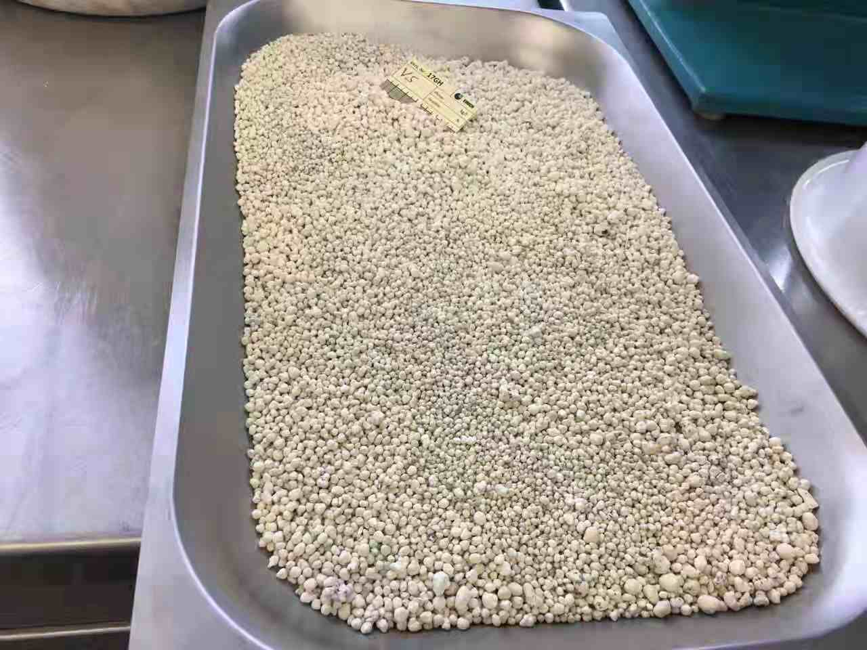
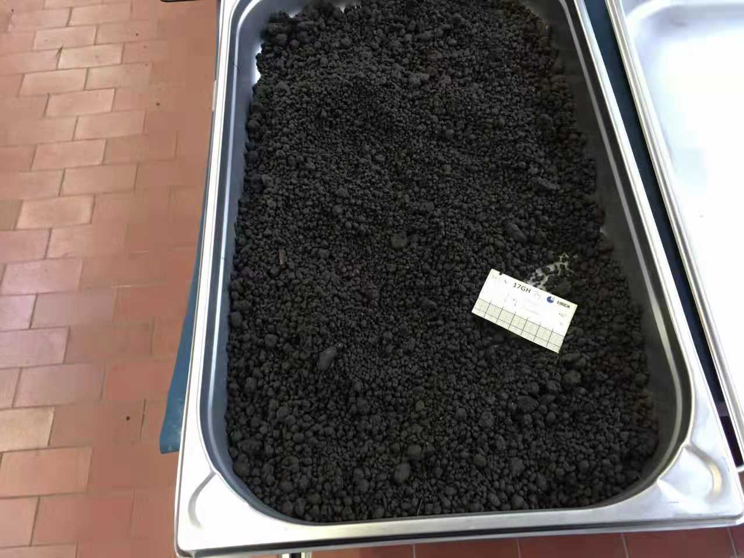
organo-mineral fertilizers (OMF) production
Quality control
Organic wastes
Shredding and conditioning
Calculations of components amount
Enrichment with nutrients
Organo-mineral pulp processing
Quality control
Solid OMF
Balanced composition for particular
crop and soil

Slide 8
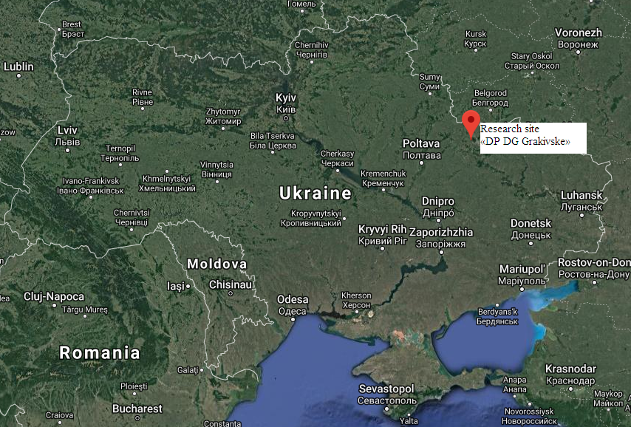
Experimental site
General trial data
Research was conducted on experimental field of the NSC ISSAR, Kharkivska oblast, v. Novy Korotich (Figure 1).
Natural-climatic zone – Forest-Steppe. The territory of experimental field is characterized by a temperate continental climate, sum of positive temperatures about 2400-2900 ○С. The average annual precipitation is 465-680 mm. Soil of the experimental field - chernozem typical. The three-replicate trials was set up according to the randomized complete-block design. The elementary plot size was 10 sq. m. Winter wheat was cultivated.
Location of the research site (Kharkivska oblast, v. Novy Korotich)

Slide 9
Total organic carbon content in topsoil (0-20 cm) was determined by Tyurin method based on dichromate oxidation.
Humic acids (Cha) and fulvic acids (Cfa) content were determined by Tyurin in modification of Kononova–Byelchykova. The extracted humic substances by NaOH were then separated into humic and fulvic acid fractions by acidifying the extract to pH 1.3–1.5 using 0.5 M H₂SO₄ at 68–70°C and humic acids were separated by filtering. Separated humic acids were re-dissolved in 0.1 M NaOH solution. Carbon content in the fractions of humic and a fulvic acid was determined by the dichromate oxidation procedure.
Field experiment scheme
Treatment | Total N fertilization (kg N ha⁻¹)
Manure: broadcasting or localized application | N₈₀
Organo-mineral fertilizer (amorphous or granulated form): broadcasting or localized application | N₈₀P₈₀K₈₀
NPK (chemical fertilizer): broadcasting or localized application | N₈₀P₈₀K₈₀

Slide 10
Treatment | Сorg, % | Сha | Сfa | Сhumin | Сha/Сfa
 |  | % tо Сorg
Without fertilizers (control) | 1.80 | 32.0 | 32.0 | 36.0 | 1.0
Manure | 1.84 2.22 | 38.0 38.5 | 31.5 30.4 | 30.5 31.1 | 1.2 1.3
Mineral fertilizer (NPK) | 1.87 1.62 | 33.5 18.4 | 40.4 31.6 | 25.6 50.0 | 0.8 0.6
Organo-mineral fertilizer (amorphous form) | 2.06 2.42 | 32.4 30.0 | 33.0 24.2 | 34.5 45.8 | 0.8 1.2
Organo-mineral fertilizer (granulated form) | 1.92 2.37 | 34.4 37.1 | 25.5 30.4 | 40.1 32.5 | 1.4 1.2
LSD_{0,05} | 0.09 0.19 |  |  |  | 0.2 0.2
Note. Above the line – data in case of broadcasting of fertilizers;
under the line – data in case of localized application of fertilizers.
Notes:
Higher efficiency of organo-mineral fertilizers was proven compared to manure and mineral fertilizers. Organic carbon content increased up to 33 % under the effect of organo-mineral fertilizers. An advantage of localized application of organo-mineral fertilizers over broadcasting was observed.

