Slide 1
Apatite Fission-track Dating from the Late Miocene Strata (Lilungshan Formation) in the Hengchun Peninsula, Southern Taiwan: Implications for Exhumation History 以晚中新世里龍山層磷灰石核飛跡定年探討台灣南部恆春半島剝蝕抬升歷史
Student: 杲紹伊 Shao-Yi Gao
Advisor: 陳文山 Wen-Shan Chen
Department of Geosciences, National Taiwan University

Slide 2
1. Introduction
2. Methodology
3. Result & Discussion
4. Conclusion
Motivative
This study aims to investigate the thermal history regarding the Lilungshan Formation in the Hengchun Peninsula with low-temperature thermalchronometry (AFT).
Whether the AFT ages in our research region have been post-depositional reset or not?
Post-depositional reset → Basin evolution and exhumation history.
Without post-depositional reset → Source provenance analysis and exhumation history of source area (Yuli belt).
Notes:
探討抬升
深埋厚度

Slide 3
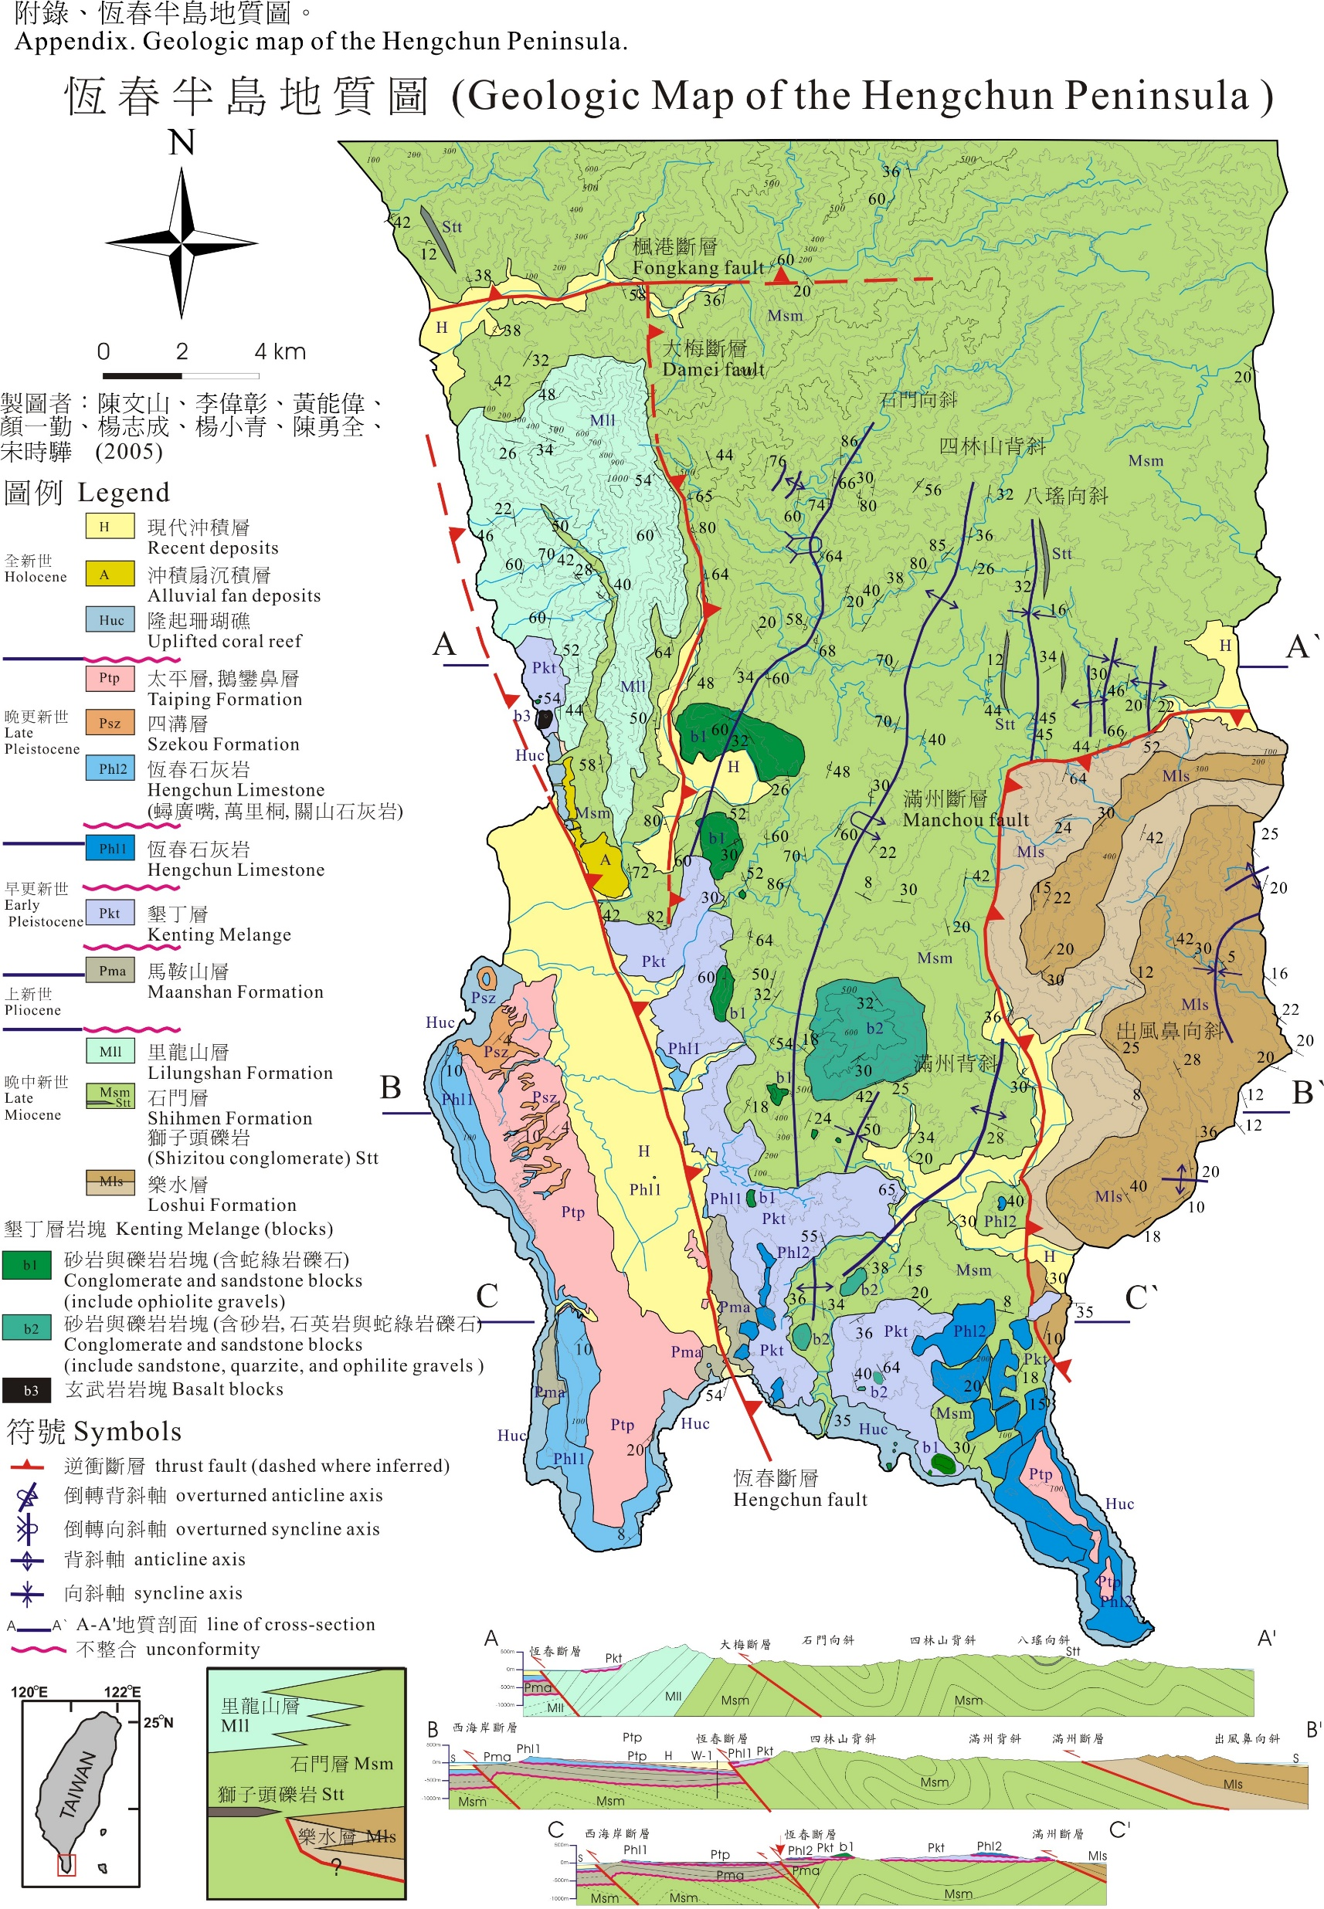
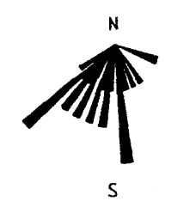
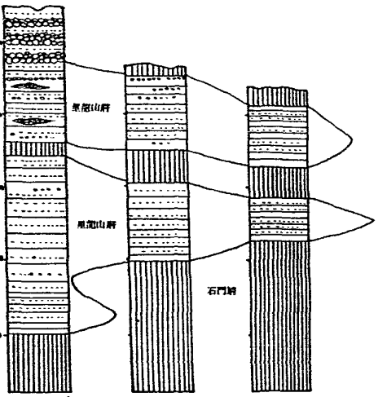
1. Introduction
2. Methodology
3. Result & Discussion
4. Conclusion
Geological background
In late Miocene, the Hengchun Peninsula was an accretionary prism.
Lilungshan Formation (1)NN11, 5.6~8.3Ma (Nannofossil) (2)Upper fan deposits in shelf environments (3)Paleocurrent: from the NW to the SE.
Outcrops of Yuli belt were low-grade metamorphic rocks in the late Miocene.
陳文山 (2005)
Notes:
地層柱 晚中新世時，恆春半島為增積岩體，處於後前陸盆地，此時脊梁山脈南部尚未造山。
里龍山層於超微化石年代NN11時沉積於淺海陸棚環境。
本研究區域位於里龍山層頂部的礫岩層，礫石為石英岩，基質為砂岩。
里龍山層的古水流方向由北向南， 其礫石(輕度變質岩)來自於北部造山帶 的玉里帶。

Slide 4
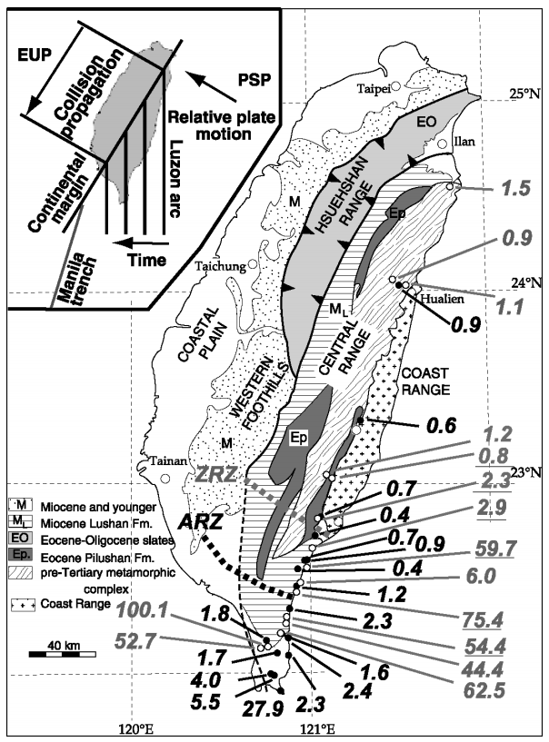
Literature review
1. Introduction
2. Methodology
3. Result & Discussion
4. Conclusion
The highlight samples are argillites from the Shihmen Formation.
AFT age has been totally reset at the metamorphic temperature of argillite.
Apatite FT closure temperature: 90-135°C Zircon FT closure temperature: 200-250°C Argillite metamorphic temperature: 200-250°C
Zircon FT ages from Liu et al. (2001): gray
Zircon FT ages from Willett et al. (2003): gray, underline
Apatite FT ages from Willett et al. (2003): black
Apatite ages are pooled ages (in Ma).
Notes:
樣本圖
砂岩: 來自整個集水區 B270 礫岩: 造山時同一區塊

Slide 5
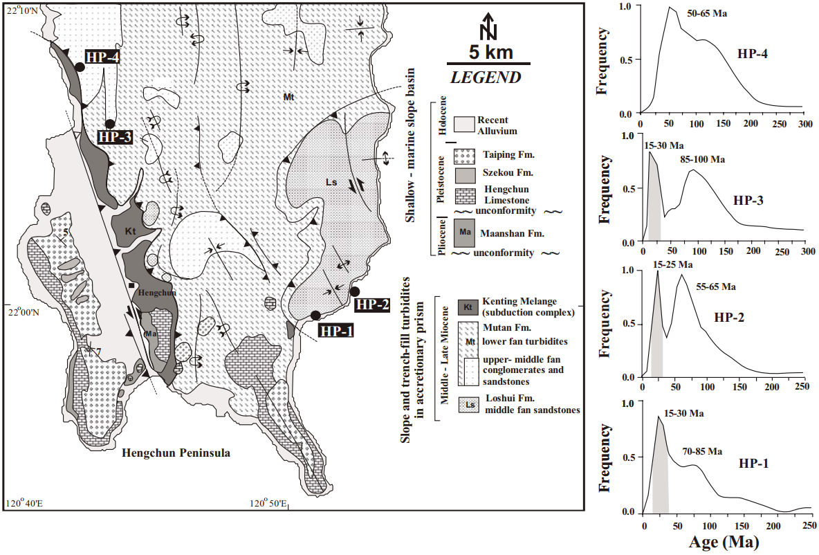
Literature review
1. Introduction
2. Methodology
3. Result & Discussion
4. Conclusion
The Lichi Mélange: A collision mélange formation along early arcward backthrusts during forearc basin closure, Taiwan arc-continent collision (Huang et al., 2008)
Deep-sea-fan sandstones.
The frequency of the Mesozoic peak is as high as the Neogene peak, similar to that found in the whitish sandstone blocks of the Lichi Mélange.
ZFT
Notes:
前人研究(青論合併進討論)
Fuller2006
Willett2003
Liu
#做成圖

Slide 6
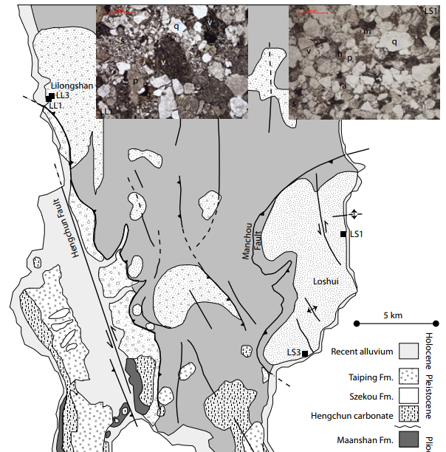
Literature review
1. Introduction
2. Methodology
3. Result & Discussion
4. Conclusion
Testing inferences from palaeocurrents: application of zircon double-dating to Miocene sediments from the Hengchun Peninsula, Taiwan (Kirstein et al., 2010)
The sandstones were medium to coarse grained with rounded to sub-angular mafic clasts.
ZFT
Notes:
前人研究(青論合併進討論)
Fuller2006
Willett2003
Liu
#做成圖

Slide 7
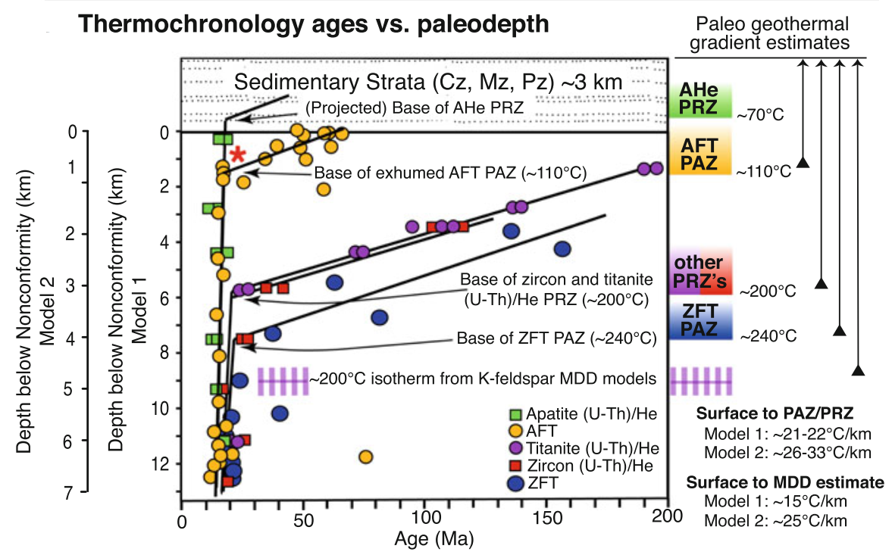
1. Introduction
2. Methodology
3. Result & Discussion
4. Conclusion
Thermochronometry
Closure Temperature
The accumulation of the radiogenic daughter product below a certain temperature range, but the radiogenic products are lost and the system is open above the temperature.
Cooling age
Bernet (2018)
Notes:
介紹封存溫度，FT長相，熱定年，在礦物地於封存溫度後開始計時 畫圖

Slide 8
1. Introduction
2. Methodology
3. Result & Discussion
4. Conclusion
Track-formation processes
Spontaneous fission is occurs with heavy nuclides of atomic number Z≧90 and atomic mass A≧230. Such as ²³⁸U (dominant), ²³⁵U, ²³²Th.
The three stages of track formation according to the “ion explosion spike” theory of Fleischer, Price, and Walker. (A) Ionization (B) Coulomb repulsion (C) Elastically straining. (After Fleischer et al., 1975)

Slide 9
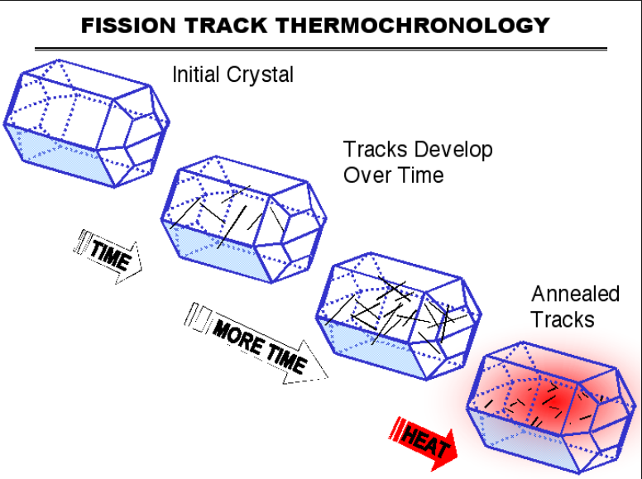
Fading of fission tracks
1. Introduction
2. Methodology
3. Result & Discussion
4. Conclusion
Anneal
Annealing means fission tracks fading due to the certain temperature higher than closure temperature.
Total reset → age record has been cleared
Notes:
樣本圖
砂岩: 來自整個集水區 B270 礫岩: 造山時同一區塊

Slide 10
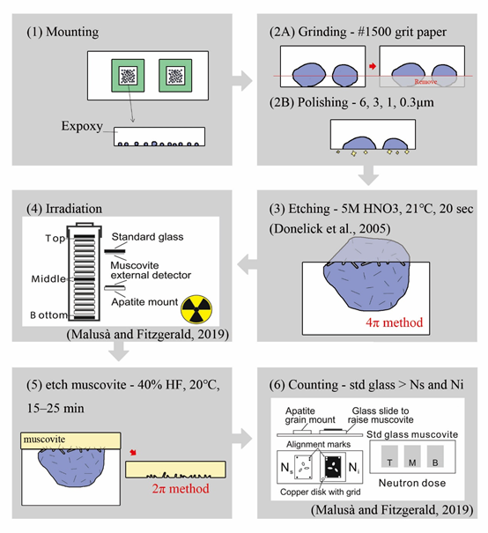
1. Introduction
2. Methodology
3. Result & Discussion
4. Conclusion
Preparation strategy
Mounting,
Polishing,
Etching,
Irradiate,
Counting.
*Using the External Detector Method (EDM)

Slide 11
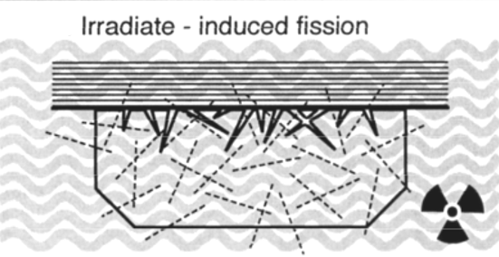
1. Introduction
2. Methodology
3. Result & Discussion
4. Conclusion
Fission-track age equation
is a first-order reaction just like decay equation. The decay equation is shown in the following:
ζ-calibration method
Hurford and Green (1982,1983)
ζ =$\frac{{(e}^{λdt})}{λd(ρs /ρi)sGρ_{d}}$
$(ρs /ρi)s$: Spontaneous and induced track ratio of standard sample
$$t=\frac{1}{λ_{d}}ln(λ_{d}\frac{ρ_{s}}{ρ_{i}}ρ_{d}\text{G}\text{ζ}+1)$$
$ρ_{s}$: Spontaneous track densities(N_{s}/cm²)
$ρ_{i}$: Induced track densities(N_{i}/cm²)
$λ_{d}$: Decay constant of ²³⁸U
$ρ_{d}$: Track density in a dosimeter
G: Geometry factor
$\text{ζ}$: Calibration factor

Slide 12
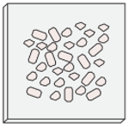
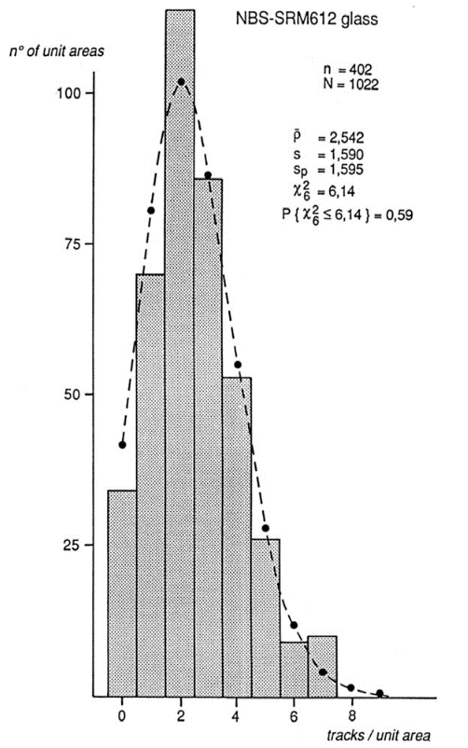
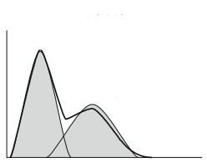
1. Introduction
2. Methodology
3. Result & Discussion
4. Conclusion
Age distribution → identify single- or multi-peak
*Standard error of passion distribution
ρ_{s1}
ρ_{s2}
ρ_{i2}
ρ_{i1}
t₁
ρ_{s1}/ρ_{i1}
ρ_{s2}/ρ_{i2}
t₂
Pooled age is used in low-uranium or young grains such as apatite.
ρ_{sn}/ρ_{in}
t_{n}
Ρ_{s(total)}
Ρ_{i(total)}
T
=ρ_{s1}+ρ_{s2}+…+ρ_{sn}
=ρ_{i1}+ρ_{i2}+…+ρ_{in}

Slide 13
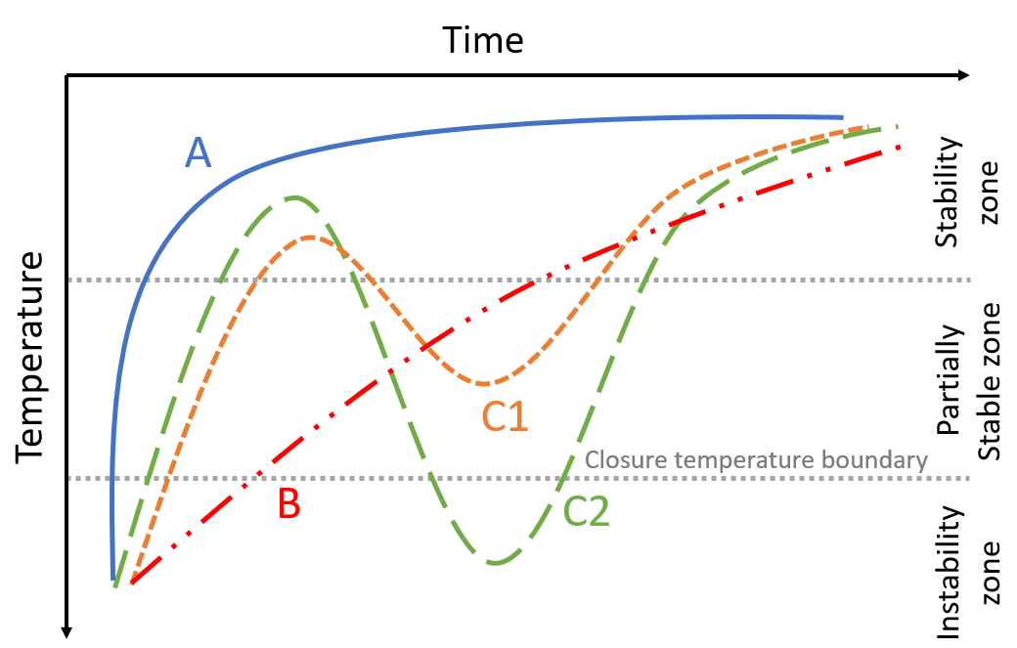
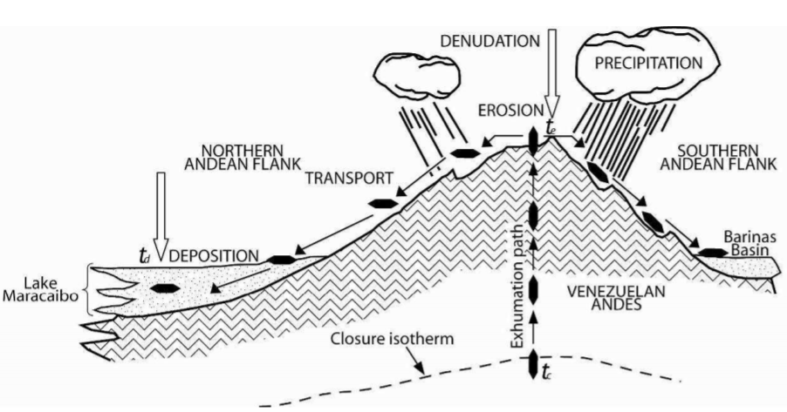
Geological interpretation of FT age
1. Introduction
2. Methodology
3. Result & Discussion
4. Conclusion
Deposition time
Beginning of uplift
After Wagner (1972)
curve A: fast cooling curve B: slow cooling curve C1: complex cooling with mix age curve C2: complex cooling with total reset age.
Cella, M. A. B. (2009) Modified from Crowley et al. 1989
Notes:
樣本圖
砂岩: 來自整個集水區 B270 礫岩: 造山時同一區塊

Slide 14
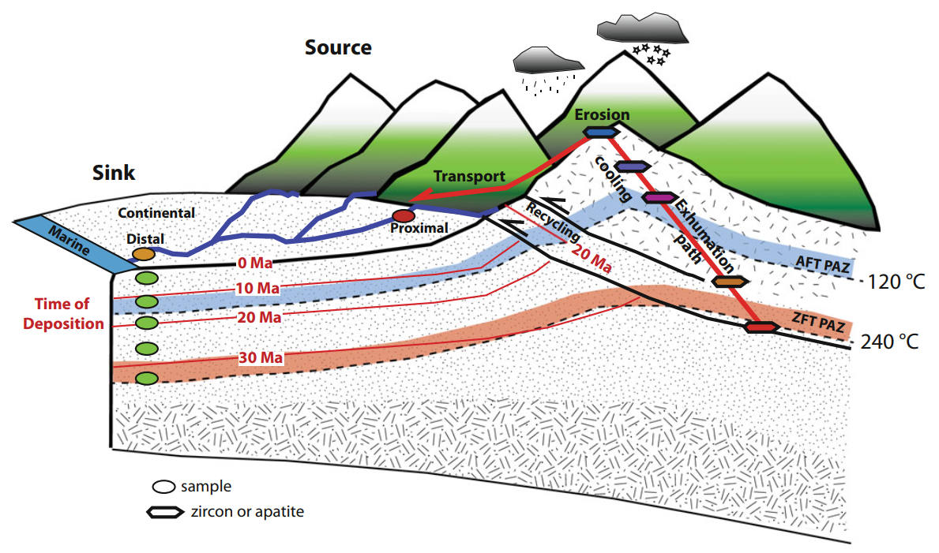
1. Introduction
2. Methodology
3. Result & Discussion
4. Conclusion
Detrital apatite fission-track(AFT) analysis on sandstones:
Exhumation signal
Source provenance analysis
Basin evolution
Bernet (2018)
Detrital AFT analysis on pebbles:
Cooling rate of source strata
Basin evolution
Lag time:
The difference between the apparent cooling age and the time of deposition.
Notes:
反剝蝕 圖重畫p210 p101

Slide 15
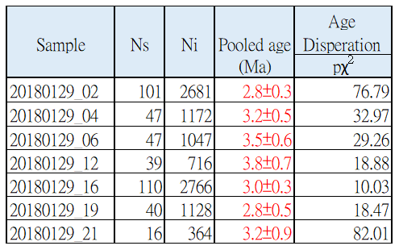
1. Introduction
2. Methodology
3. Result & Discussion
4. Conclusion
Conglomerate
When the pχ² >5, the FT age is more like single-peak.
Sandstone

Slide 16
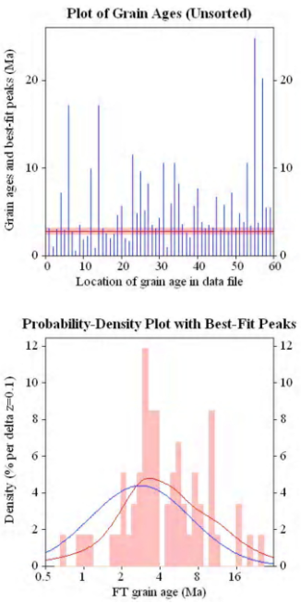
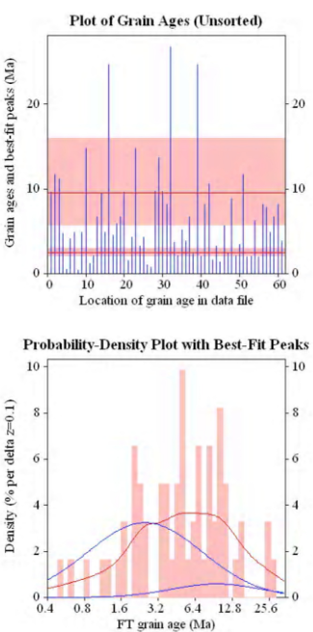
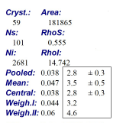
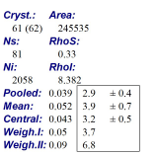
1. Introduction
2. Methodology
3. Result & Discussion
4. Conclusion
20180129_02 (Conglomerate)
20180129_23 (Sandstone)
Age components(Ma)
first peak | second peak
2.8 (100%) | -
Age components(Ma)
first peak | second peak
2.5 (87.4%) | 9.6 (12.6%)
Is the peak caused by chlorine-rich apatite in sandstone?
Can this be used to constraint the burial temperature?

Slide 17
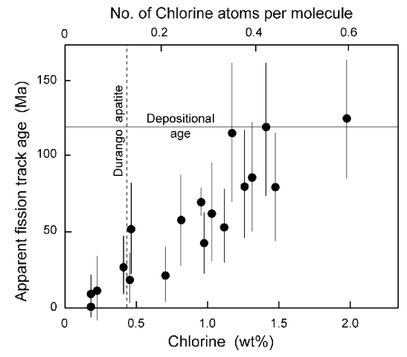
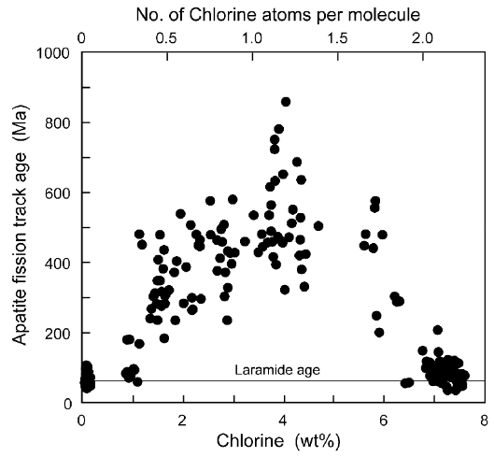
1. Introduction
2. Methodology
3. Result & Discussion
4. Conclusion
Compositional effects
Transition from hexagonal to monoclinic
symmetry in the most chlorine-rich apatite
High-chlorine grains resist annealing
and thus record an older age than
fluorine-rich grains.
Fluorine-rich apatites (such as Durango) typically show complete annealing of natural geological samples at temperatures of 90-100°C, chlorine-rich samples are characterized by an increase of the total annealing temperature to around 110-150°C
Gleadow (2002); Green et al. (1985)

Slide 18
1. Introduction
2. Methodology
3. Result & Discussion
4. Conclusion
Apparent cooling age: 3.2±0.2 Ma
*Time of deposition: 6~7Ma (NN11, 5.6~8.3 Ma)
Lag time between -4 to -2.6 Ma
Negative Lag Time
represents post-depositional annealing due to burial (Curve C2).
Deposition time
curve A: fast cooling curve B: slow cooling curve C1: complex cooling with mix age curve C2: complex cooling with total reset age.
Cooling time
After Wagner (1972)
Notes:
Lag time 圖表

Slide 19
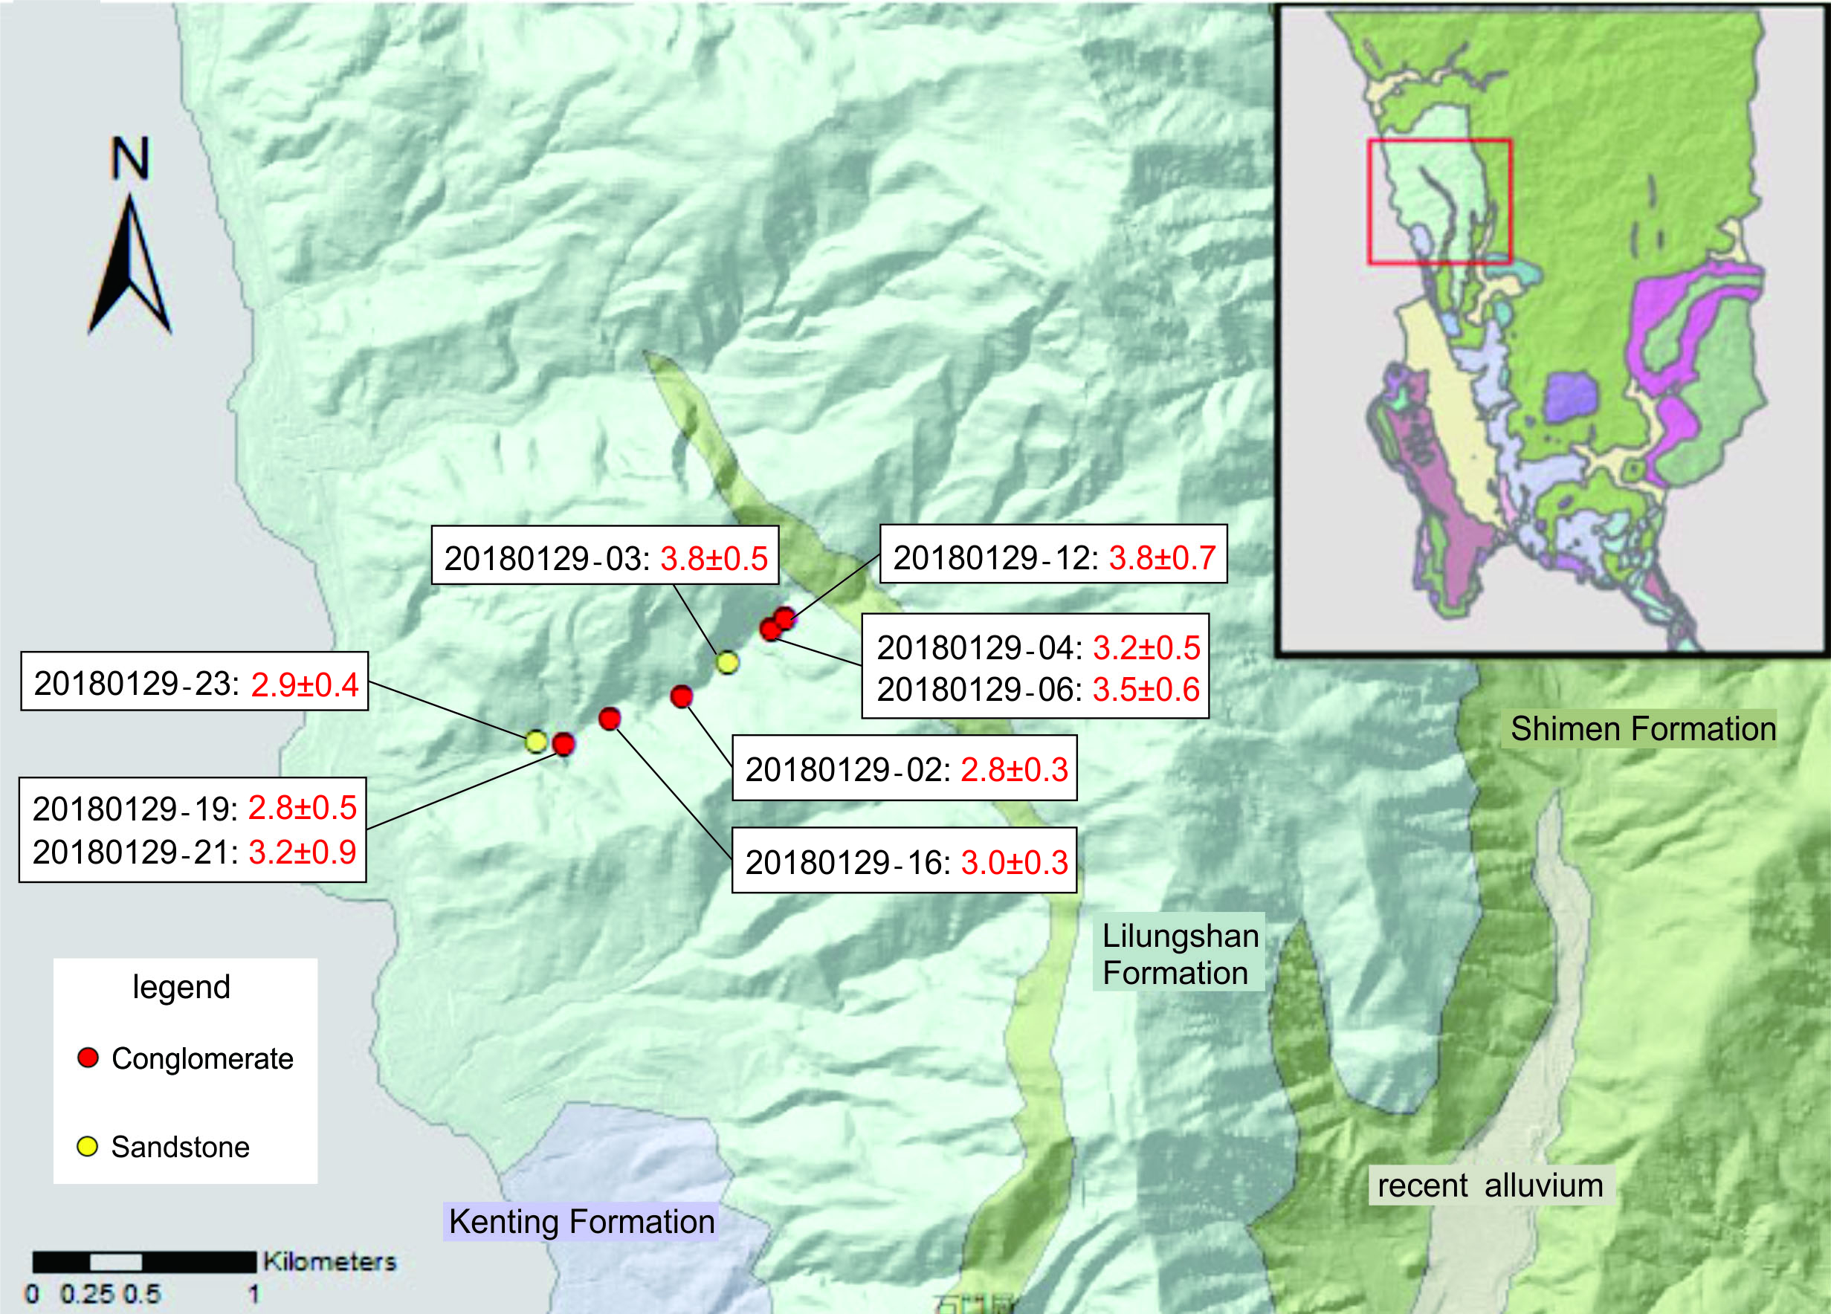
1. Introduction
2. Methodology
3. Result & Discussion
4. Conclusion
Discussion - Depth versus AFT age
Notes:
右側年代表格

Slide 20
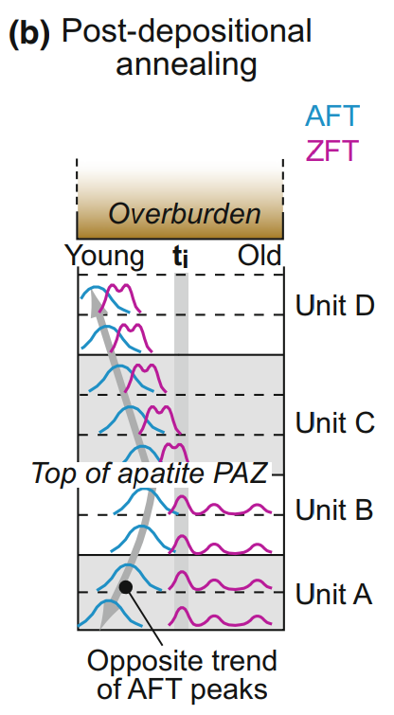
Discussion - Depth versus AFT age
1. Introduction
2. Methodology
3. Result & Discussion
4. Conclusion
Closure temperature
Fission-Track-Thermochronology-and-its-Application-to-Geology (Ch16)

Slide 21
Discussion - Depth versus AFT age
1. Introduction
2. Methodology
3. Result & Discussion
4. Conclusion
Thickness: 1077 m
Mean AFT age: 3.2 Ma
Exhumation rate of the basin: 1.2~1.3 km/m.y.
Time interval: 0.8 – 0.9 m.y. (theoretical value)
There was no correlation between depth and AFT age.
(1) The age distribution is within the error bar.
(2) Almost all the strata were above the depth of AFT closure temperature at the same time. → 3 million years ago, the Lilungshan Formation was an inclined stratum, which attitude was similar to today’s.

Slide 22
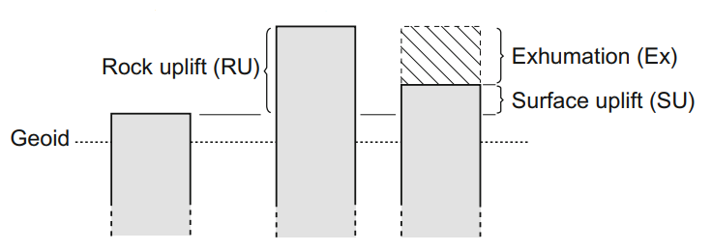
1. Introduction
2. Methodology
3. Result & Discussion
4. Conclusion
Paleo-burial depth
Exhumation rate
AFT age: 3.2±0.2 Ma
*Apatite closure temperature: 135 °C
*Geothermal gradient: 30°C/km
Surface temperature: 15°C
Paleo-burial depth = ($135−15)$/30 = 4km
Exhumation rate of the basin = Paleo-burial depth/ AFT age = 1.2~1.3 mm/yr.
Notes:
Lag time 圖表

Slide 23
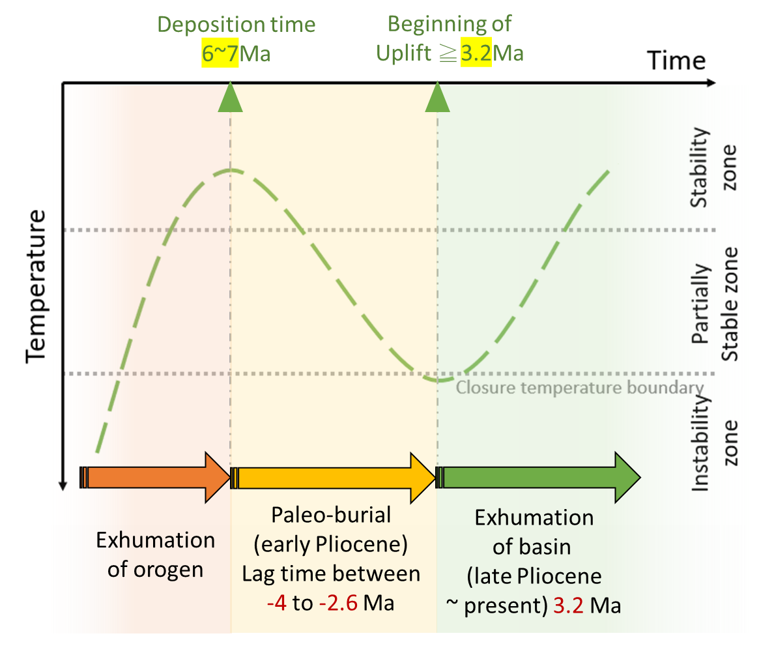
Exhumation history of the basin
1. Introduction
2. Methodology
3. Result & Discussion
4. Conclusion

Slide 24
1. Introduction
2. Methodology
3. Result & Discussion
4. Conclusion
AFT ages of the Lilungshan Formation have been totally reset due to paleo-burial.
Uplift of the Hengchun Peninsula was since 3.2±0.2 Ma.
Cooling rate of the basin: 35.3~40°C/Ma. (assumed geothermal gradient was 30°C/km)
The paleo-burial depth of the Lilungshan Formation is about 4~5 km.
Exhumation rate of the basin: 1.2~1.3 mm/yr.
Notes:
里龍山層之磷灰石核飛跡顆粒年代分布為單峰，應屬於完全癒合年代
里龍山層之冷卻速率為…
里龍山層之上覆岩層曾厚達…
恆春半島抬升的初始年代早於4Ma
in Late Miocene time the Hengchun Peninsula represented a half-graben basin on the Asian passive continental margin. The graben was filled with sediments derived from an uplifted low-grade metamorphosed terrane comprised of accretionary prism and forearc basin

