Slide 1
The analysis of heterogeneity and frequency of extreme storms under urban settings: A case study in Shanghai City
Zhengzheng Zhou, Qi Zhuang, Shuguang Liu
The department of Hydraulic Engineering,
Tongji University, Shanghai, China

Slide 2
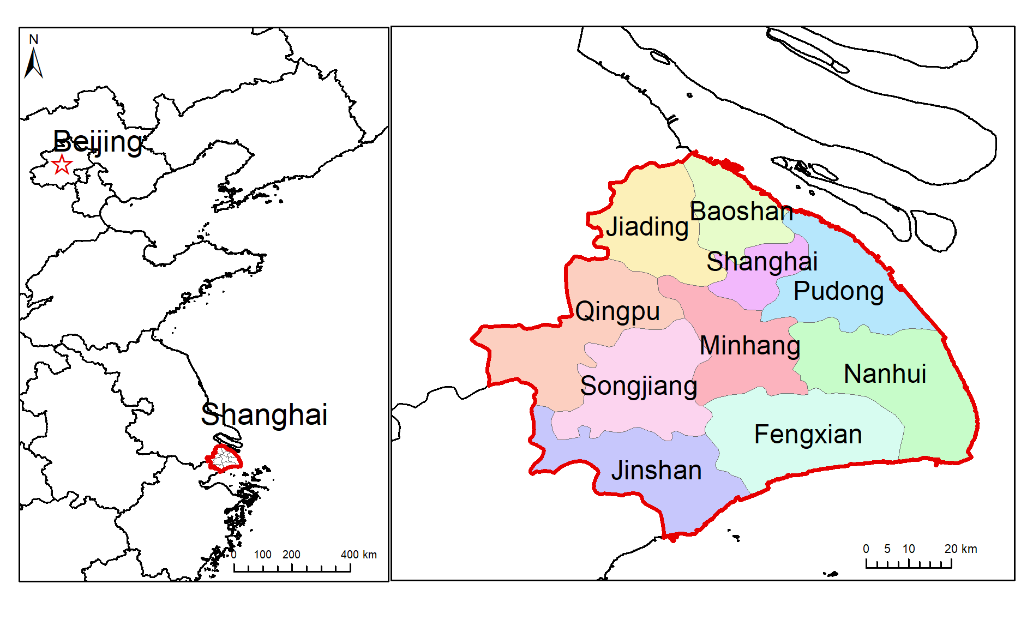
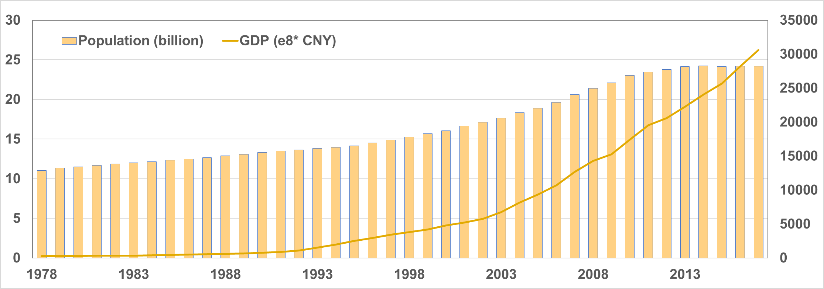
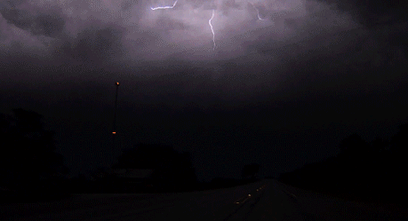
Introduction
Shanghai is one of the most important city in China.
The urban flooding is the major natural disaster in the city.
Extreme rainfall plays an important role in the flood.
The major objective of this study:
If there is a heterogeneity of extreme storms over the city?
How is the frequency of extreme storms?

Slide 3
Dataset and Study Area
Data source: The Integrated Multi-satellitE Retrievals for GPM (IMERG)
Data resolution: half-hourly 0.1°x0.1°, 2001-2018
https://disc.gsfc.nasa.gov/datasets/GPM_3IMERGHHE_06/summary
Study Area: Shanghai City (islands excluded)
Notes:
(roughly 10x10 km)

Slide 4
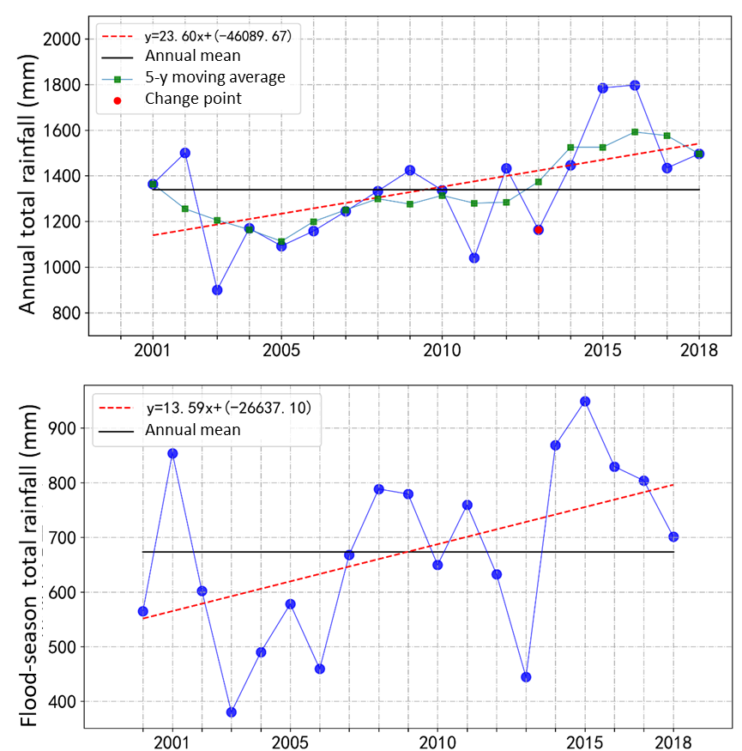
Rainfall Trend Analysis
Annual total rainfall:
Increasing trend
Change point: 2013

Slide 5
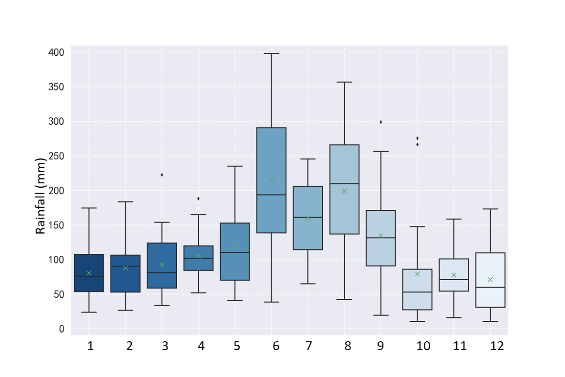
Intra-annual distribution
Maximum in June
Typhoon and convective storms
Flood-season (June-September)
Increasing trend
Large amount in 2014-2018
Rainy days: 40%
Total rainfall: 50.3%

Slide 6
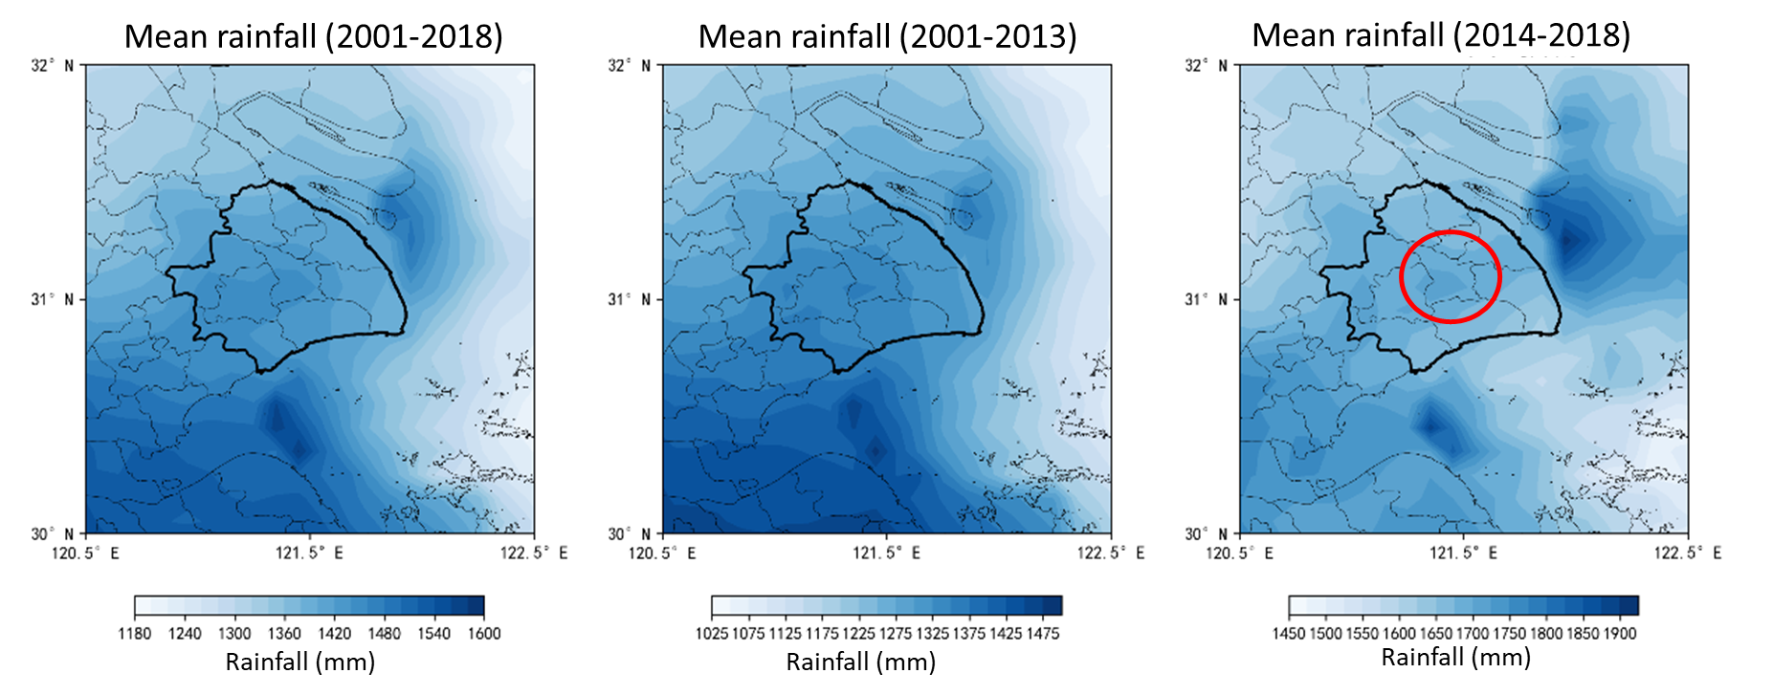
Spatial distribution of rainfall
The spatial distribution of rainfall varies during the 2000-2018 period
More rainfall is centered in the downtown area (2014-2018)

Slide 7
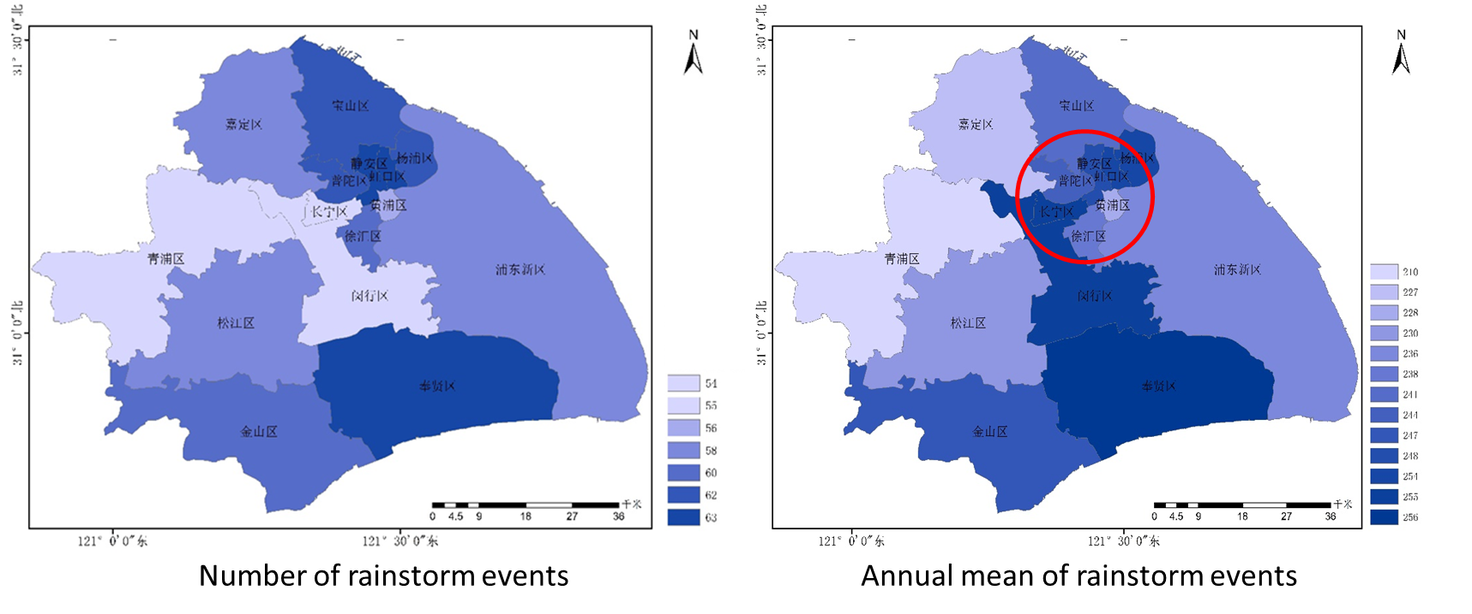
Spatial distribution of rainfall
Rainstorm: 1d total>100 mm
Centered in downtown and coastal area
Downtown area: caused by urban heat island
Coastal area in the south: caused by typhoon and coastal water vapor transport

Slide 8
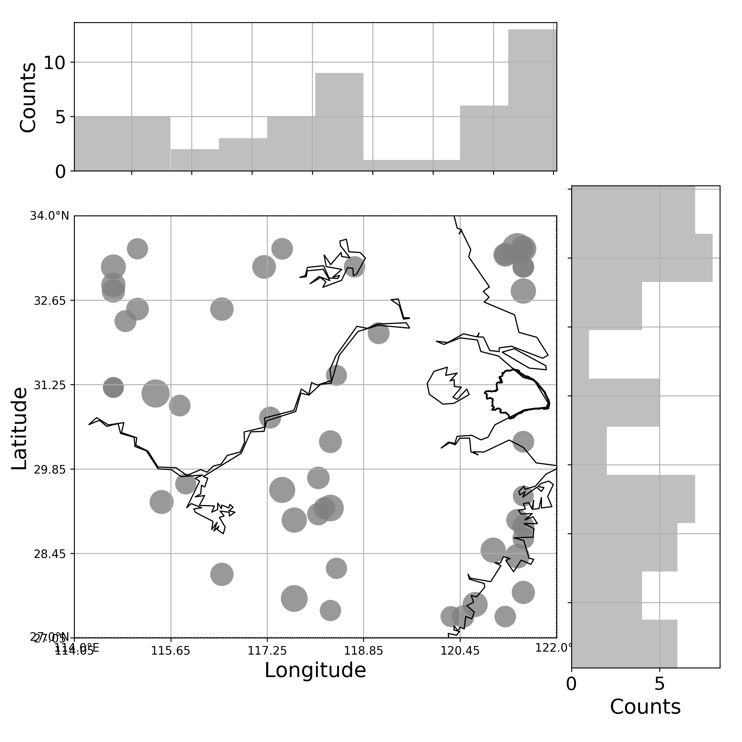
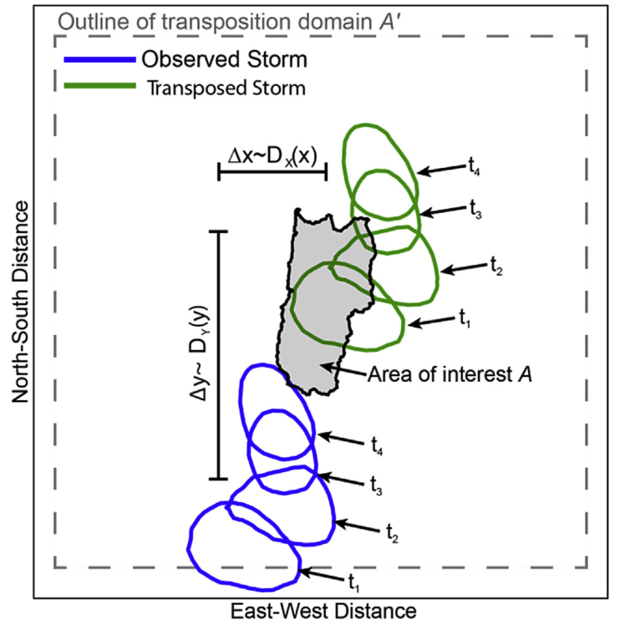
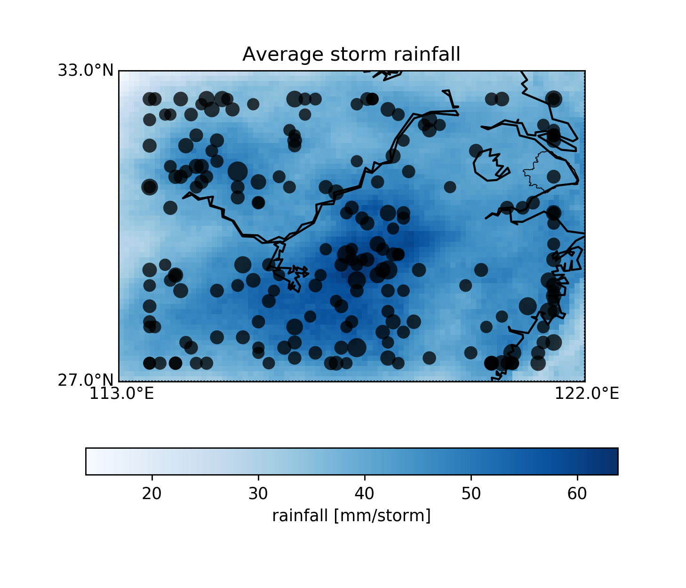
Design storm analysis
Stochastic storm transposition (SST)
Provide spatial-temporal distribution of design storm

Slide 9
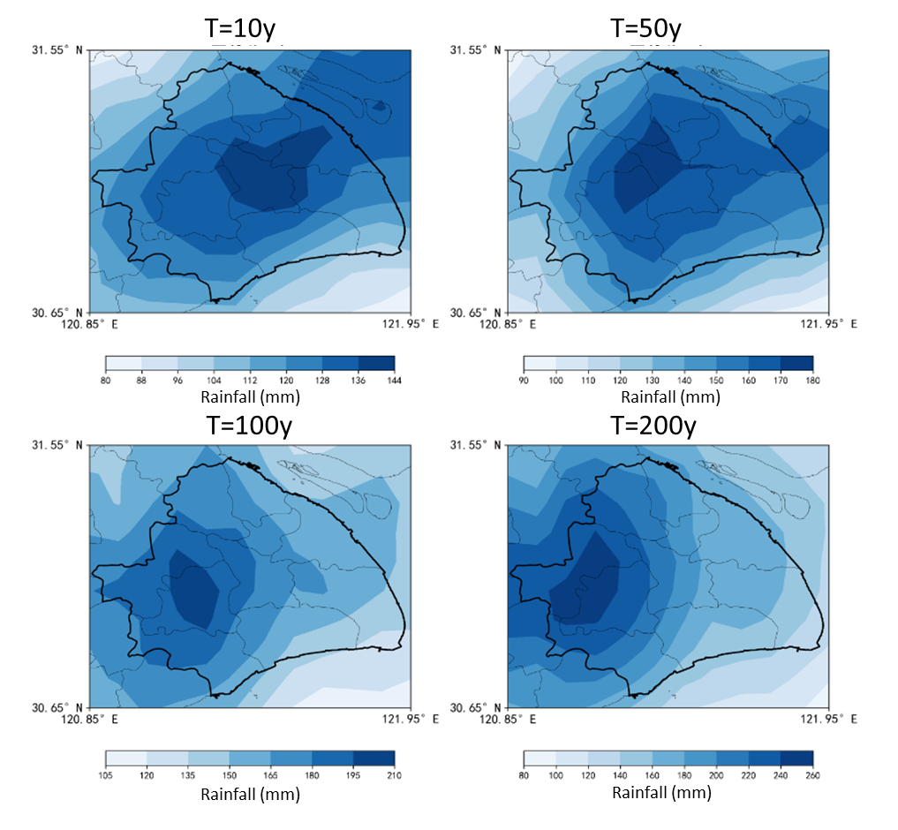
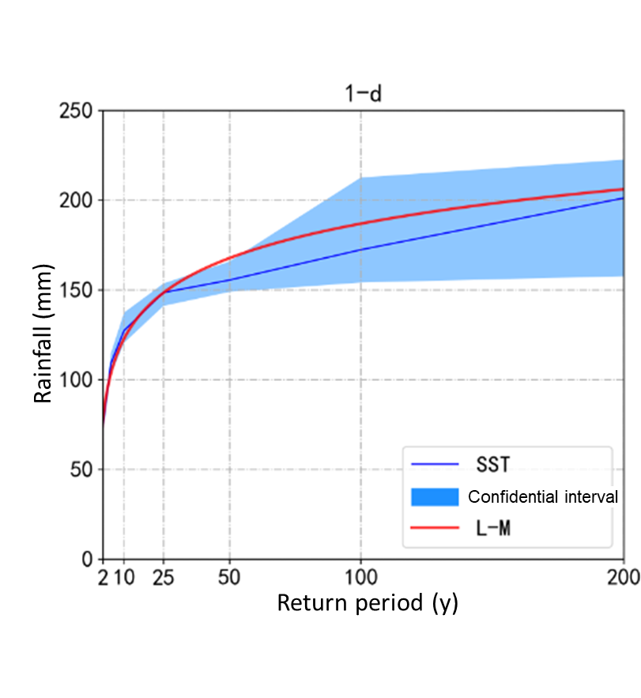
SST-based design storm
IDF results
Spatial-temporal distribution of design storm

Slide 10
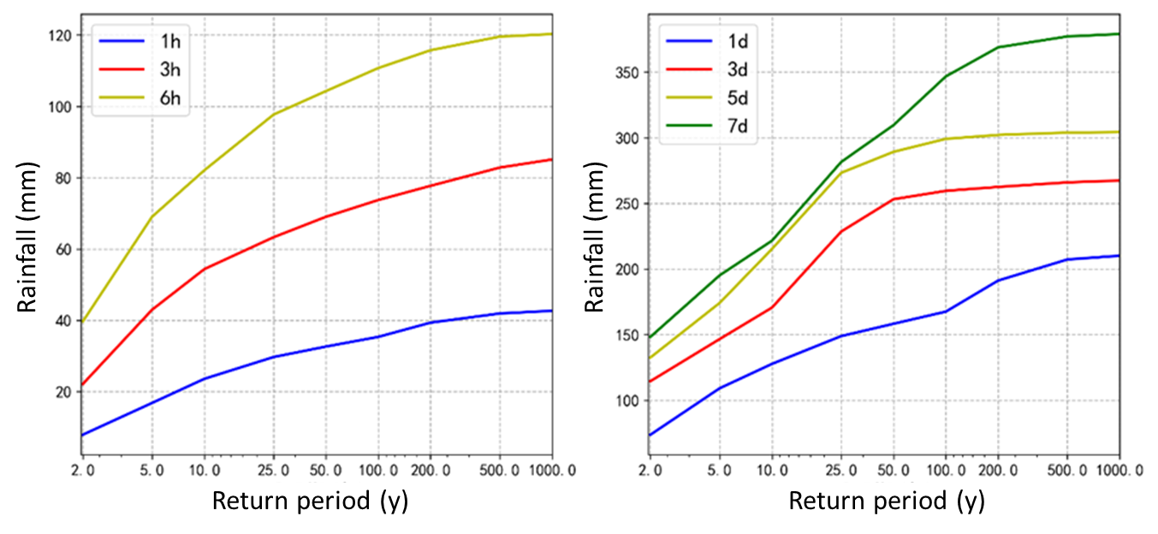
SST-based design storm

Slide 11
Conclusions
In the past 20 years, the annual total rainfall is increasing with a rate of 236 mm/10a.
The heavy rain and rainstorms contribute the major amount of rainfall in Shanghai. Most of them occur in flood season (June to September).
In recent years (2014-), the rainfall in downtown area is increasing, implying the impact of urban heat island.
The framework of SST provide an alternative approach for design storms with IDF curve and spatial-temporal rainfall structure, which is of much importance in urban hydrologic response.
Future works: Hydrological responses under heterogenous rainfall setting, and rainfall prediction under the influence of urban heat island using machine learning algorithm.

