Slide 1
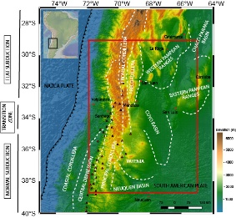
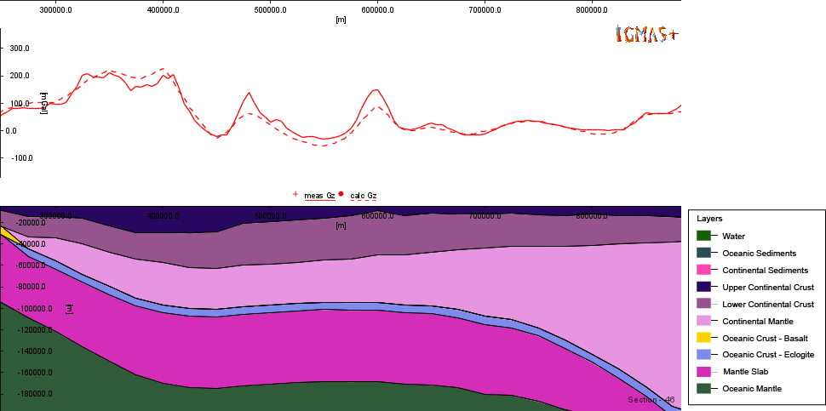
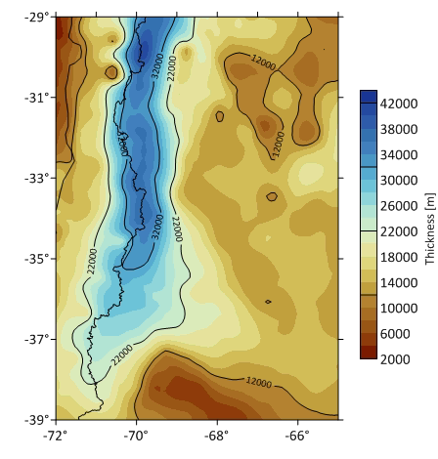
EGU 2020: Sharing geoscience online
@IRTG_StRATEGy
Lithospheric density structure of the southern Central Andes and their forelands constrained by 3D gravity modelling
Constanza Rodriguez Piceda ^{1,2}, Magdalena Scheck-Wenderoth ^{1,3}, Maria Laura Gómez Dacal ¹, Judith Bott ¹ , Claudia Prezzi⁴ & Manfred Strecker ¹
Geological setting
Method
Results
next
1: Helmholtz-Zentrum Potsdam GFZ - Deutsches GeoForschungsZentrum, Germany; 2: University of Potsdam, Institute for Geosciences, Germany; 3: RWTH Aachen, Germany; 4: CONICET, University of Buenos Aires, Argentina

Slide 2
Introduction
The southern Central Andes (27°-40°S) are part of the only present-day subduction orogeny, where the Nazca Plate subducts beneath the South-American plate (Fig. 1). They are characterized by some remarkable features, including:
N-S variation of the dip of the slab
N-S decrease of the amount of shortening, elevation, crustal thickening and orogenic width.
Accretion of terranes to the western margin during the Paleozoic
The shallow structures are relatively well documented, but the following unknowns remain regarding the deep lithospheric configuration:
What is the present-day structure of the southern Central Andes?
How does it reflect the tectonic history of the region?
How does it relate with surface deformation?
Is there any correlation with the subduction dynamics?
Fig. 1: southern central Andes overlain with morphotectonic units. The red rectangle shows the study area. The red triangles show the location of the active volcanic arc
back
next

Slide 3
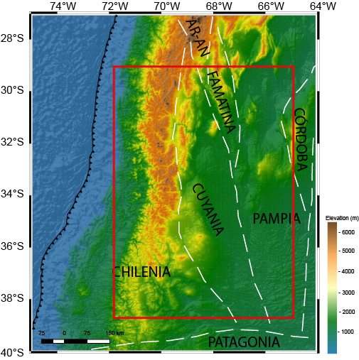
Introduction
Within the proposed paleogeographic models, the most widely accepted is the Chilenia-Cuyania-Pampia model (Fig. 2; e.g. Ramos et al. 1986, 2010; Astini et al. 1995; Rapalini 2005). Based on (near-) surface geological observations, these terranes would have different crustal compositions:
Chilenia: intermediate composition
Cuyania: mafic composition
Pampia: Felsic composition
Fig.2: Location of the terranes accreted during the Paleozoic proposed for the study area (Ramos et al. 2010)
back
next

Slide 4
Methodology
Generation of a 3D lithospheric-scale model by the integration of available geological and geophisical data
Integration of geo-scientific datasets
gravity modelling
3D model of the sediments, crystalline crust and lithospheric mantle
back
next

Slide 5
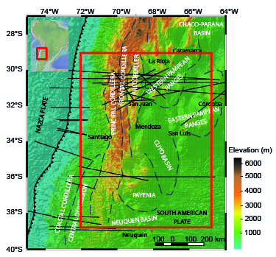
Data integration
Different data-sets were integrated to the model to constrain the lithospheric structure:
Digital elevation model:
ETOPO1 (Amante and Eakins 2009)
Vs tomography:
SL2013sv (Schaeffer and Lebedev 2013)
Seismic sections (Fig. 3):
Araneda et al. (2013)
Contreras-Reyes et al. (2008, 2014, 2015)
etc.
Seismically constrained 3D models:
Assumpção et al. (2013)
CRUST1 (Laske et al. 2013)
SLAB2 (Hayes et al. 2018)
Sediment thickness maps:
ICONS (Heine 2007)
Völker et al. (2013)
GlobSed (Straume et al. 2019)
Fig.3: Location of seismic sections used to constrained the 3D model
back
next

Slide 6
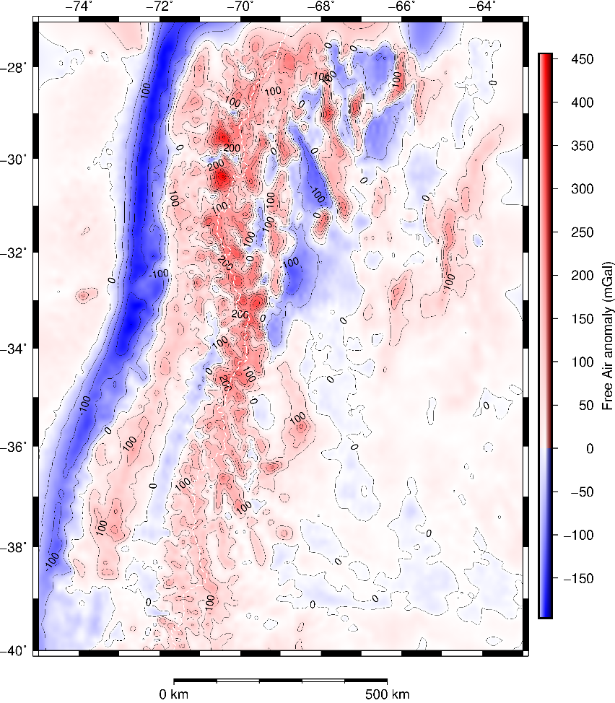
Gravity modelling
We further characterized the lithospheric structure testing the effect of the model with the gravity field. Using the defined configuration of the layers and assigning to them different densities, we compared the gravity field from the model against the measured gravity (Fig. 4). The gravity modelling part comprised two steps:
Forward modelling, using the interactive 3D gravity and magnetic application
Schmidt et al. (2010)
From this step, we computed a gravity residual (i.e. difference between the observed gravity and the gravity response from the model). The residual was used in the step 2
(2) Inverse modelling, using the python package
Uieda et al. (2013)
We inverted the gravity residual from step (1) to compute the thickness of the lower crust
Fig. 4: Gravity disturbances from EIGEN 6C4 (Förste et al. 2014, Ince et al. 2019)
back
next

Slide 7
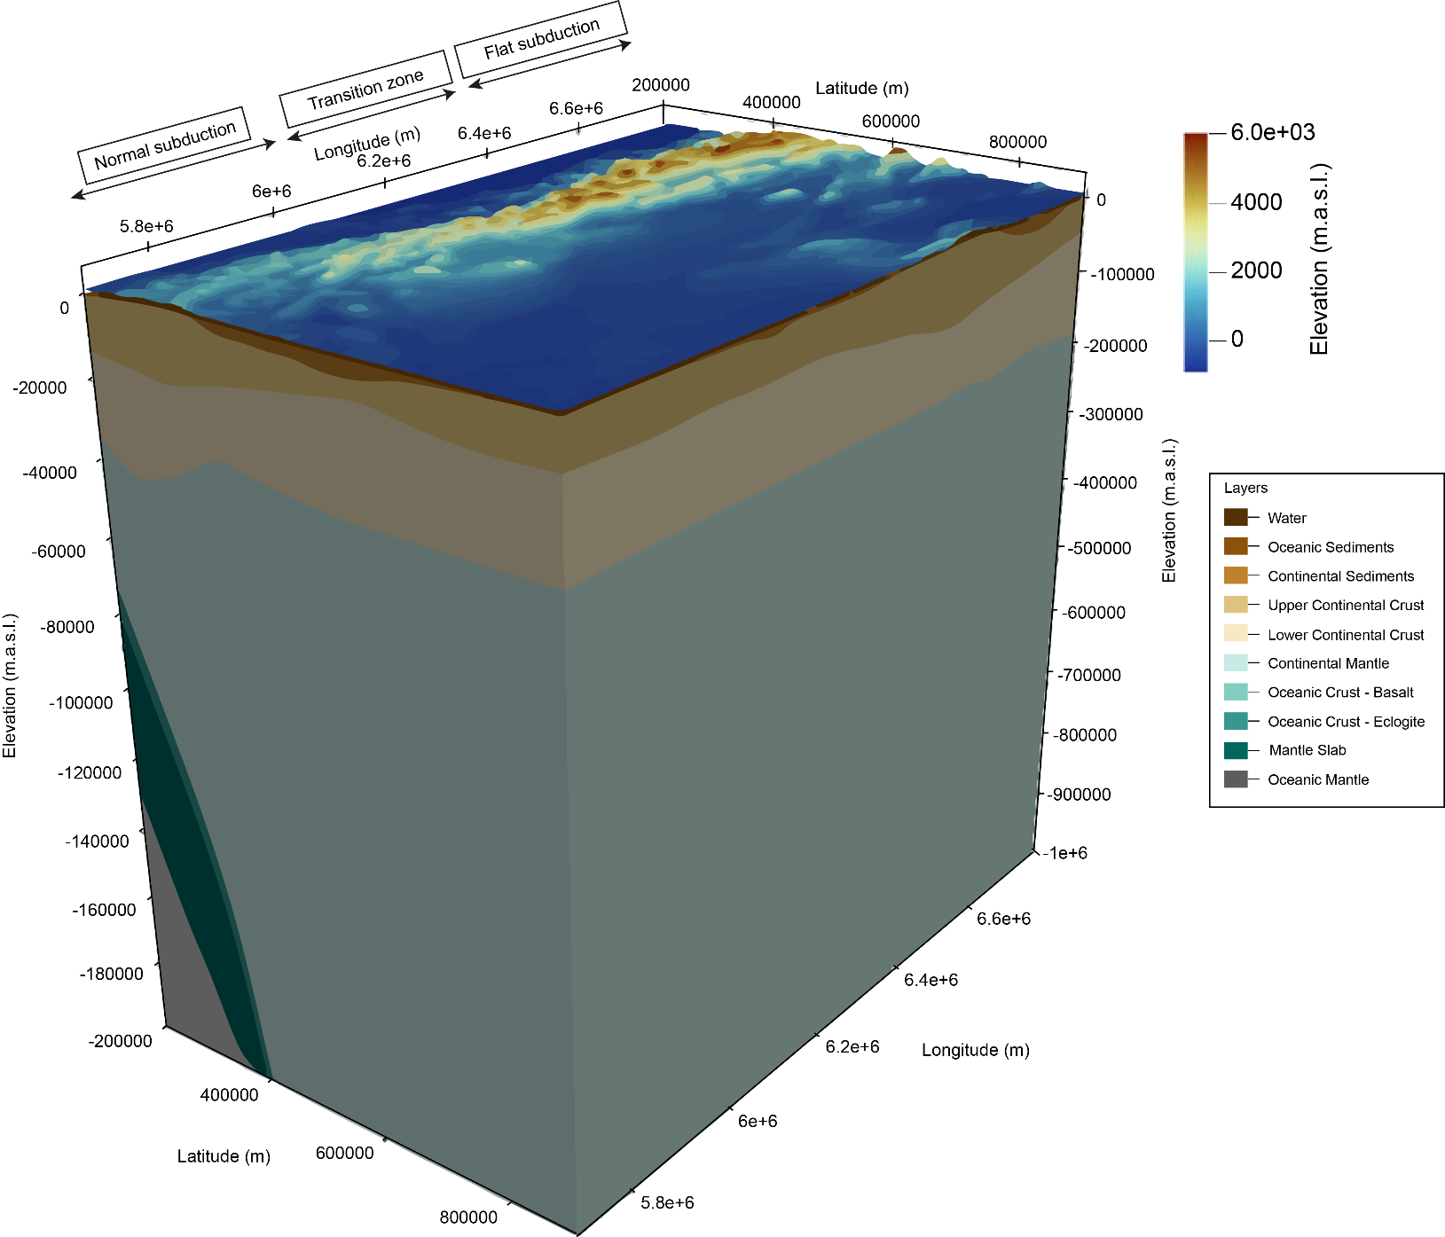
Results
We derived a 3D structural model of the southern Central Andes (Fig. 5) defining the first-order variations of thickness and density of the layers (e.g. Fig. 6)
Fig. 5: 3D model of the southern Central Andes
Fig. 6: Thickness of the upper crust
back
next

Slide 8
Results & outlook
Some of our main findings suggest:
Crystalline crust is thicker and lighter beneath the orogen compared to the forearc and foreland. These contrasts reflect different tectono-magmatic evolution of the segments
There´s no evident correlation between the boundaries proposed for the Pampia-Chilenia-Cuyania model and the deep lithospheric structure (thickness or density of the crystalline crust/lithospheric mantle)
The configuration of the northern segment (thick orogenic crust + thick and potentially strong foreland crust) might enhance the strong coupling between the plates . This might facilitate the flat subduction regime
Rodriguez Piceda et al. (under review)
Ongoing work:
Assess the thermal and rheological state of the lithosphere in the area
What is the influence of the upper plate structure on the type and extent of deformation?
back
next

Slide 9
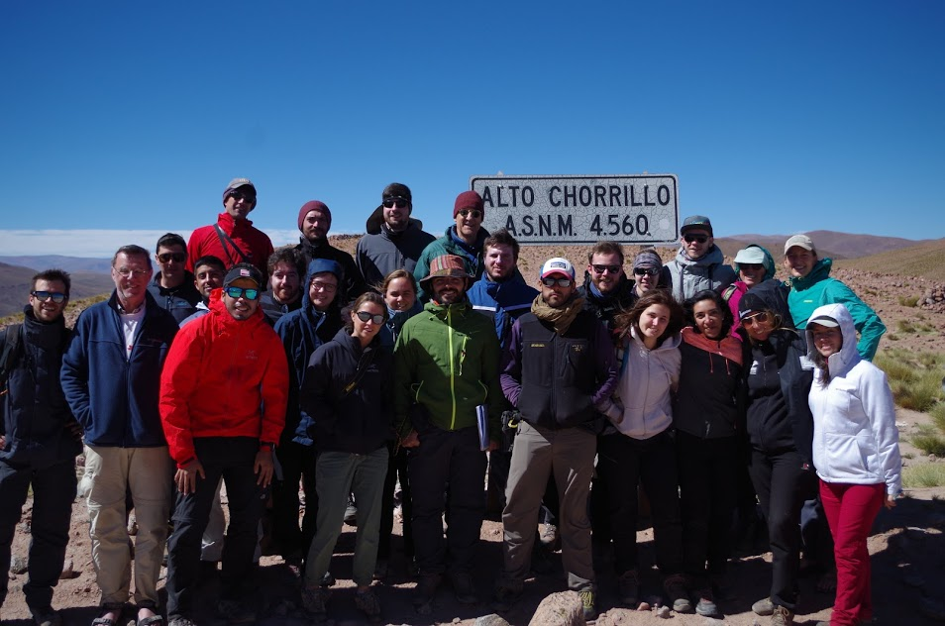
Thanks for reading. You can follow the updates of the project on the webpage http://www.irtg-strategy.de/en/ and on twitter (@IRTG_StRATEGy; @crpiceda)
Puna plateau, Strategy Field School 2019, Argentina
back
next
4

Slide 10
References
Amante, C. Eakins, B.W. (2009). ETOPO1 1 Arc-Minute Global Relief Model: Procedures, Data Sources and Analysis. NOAA Technical Memorandum NESDIS NGDC-24. National Geophysical Data Center, NOAA. https://doi.org/10.7289/V5C8276M
Assumpção M, Feng M, Tassara A, Julià J (2013) Models of crustal thickness for South America from seismic refraction, receiver functions and surface wave tomography. Tectonophysics 609:82–96
Astini R, Benedetto J, Vaccari N (1995) The early Paleozoic evolution of the Argentine Precordillera as a Laurentian rifted, drifted, and collided terrane: A geodynamic model. Geological Society of America Bulletin 107:253–273
Contreras-Reyes E, Grevemeyer I, Flueh ER, Reichert C (2008) Upper lithospheric structure of the subduction zone offshore of southern Arauco peninsula, Chile, at ∼38°S. J Geophys Res 113:B07303
Contreras-Reyes E, Becerra J, Kopp H, et al (2014) Seismic structure of the north-central Chilean convergent margin: Subduction erosion of a paleomagmatic arc. Geophys Res Lett 41:1523–1529
Contreras-Reyes E, Ruiz JA, Becerra J, et al (2015) Structure and tectonics of the central Chilean margin (31°–33°S): implications for subduction erosion and shallow crustal seismicity. Geophys J Int 203:776–791
Crameri F. (2018). Scientific colour-maps. Zenodo. http://doi.org/10.5281/zenodo.1243862
Hayes GP, Moore GL, Portner DE, et al (2018) Slab2, a comprehensive subduction zone geometry model. Science 362:58
Heine C (2007) Formation and Evolution of intracontinental basins. Dissertation. School of Geosciences. University of Sydney
Ince ES, Barthelmes F, Reißland S, et al (2019) ICGEM – 15 years of successful collection and distribution of global gravitational models, associated services, and future plans. Earth System Science Data 11:647–674
Laske G, Masters G, Ma Z, Pasyanos M (2013) Update on CRUST1.0 -A 1-degree Global Model of Earth’s Crust
Ramos V, Jordan T, Allmendinger RW, et al (1986) Paleozoic terranes of the central Argentine‐Chilean Andes. Tectonics 5:855–880.
Ramos VA, Vujovich G, Martino R, Otamendi J (2010) Pampia: A large cratonic block missing in the Rodinia supercontinent. Journal of Geodynamics 50:243–255.
Rapalini AE (2005) The accretionary history of southern South America from the latest Proterozoic to the Late Palaeozoic: some palaeomagnetic constraints. Geological Society, London, Special Publications 246:305–328
Schaeffer AJ and Lebedev S (2013) Global shear speed structure of the upper mantle and transition zone. Geophys J Int 194: 417-449
Schmidt S, Götze H-J, Fichler C, Alvers M (2010) IGMAS+–a new 3D gravity, FTG and magnetic modeling software. In: Zipf A, Behncke K, Hillen F, Scheffermeyer, J (eds) GEO-INFORMATIK Die Welt im Netz. Akademische Verlagsgesellschaft AKA GmbH, Heidelberg, pp 57–63
Straume E, Gaina C, Medvedev S, et al (2019) GlobSed: Updated total sediment thickness in the world’s oceans. Geochemistry, Geophysics, Geosystems 20:1756–1772
Uieda L, Oliveira Jr VC, Barbosa VC (2013) Modeling the earth with fatiando a terra. In: 12th Python in Science Conference
Völker D, Geersen J, Contreras-Reyes E, Reichert C (2013) Sedimentary fill of the Chile Trench (32–46°S): volumetric distribution and causal factors. Journal of the Geological Society 170:723–736.
back

