Slide 1
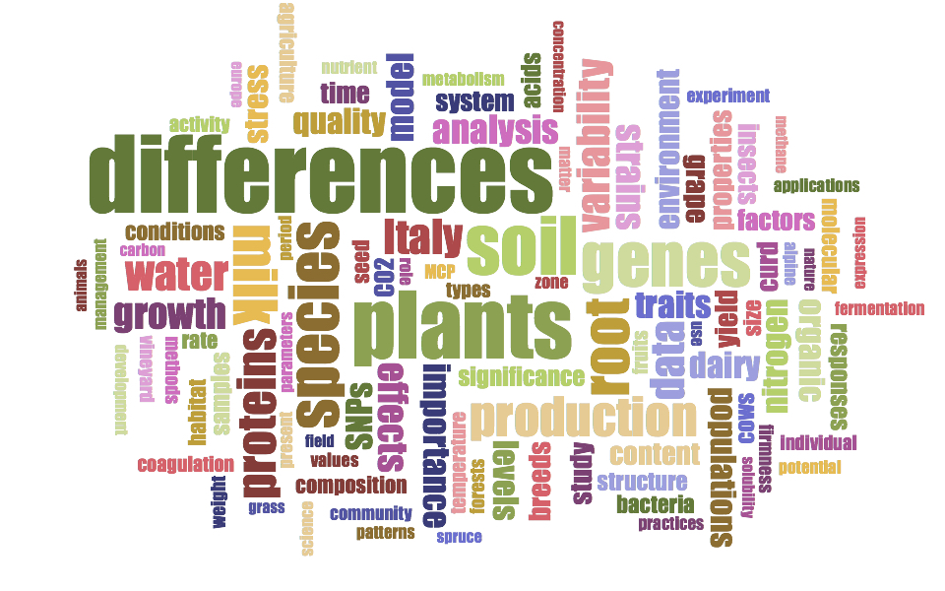

Glyphosate and AMPA dissipation at different depths in conventional and conservation agriculture
Laura Carretta, Alessandra Cardinali, Giuseppe Zanin, and Roberta Masin
EGU2020: Sharing Geoscience Online
Notes:
The aim of this study was to develop a method for glyphosate and AMPA analysis in soil with Ultra-High Performance Liquid Chromatography coupled with mass spectrometry using the AccQ Tag Ultra Derivatization Kit.
The method was applied to study the dissipation of glyphosate and the formation and dissipation of AMPA from a non-tilled field compared to a conventionally managed field.
This study was conducted at the Padova University Experimental Farm.
The year of the study was the 5th year of conservation tillage for the NT field.

Slide 2
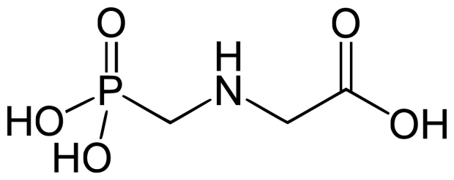
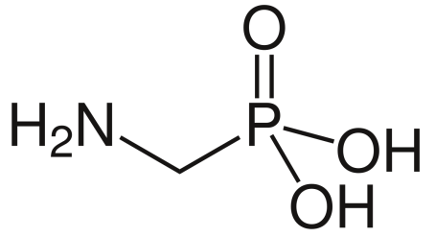
Introduction
Glyphosate (GLYP) is a non-selective, systemic, broad-spectrum, post-emergence herbicide, and it is the most used herbicide worldwide.
Aminomethylphosphonic acid (AMPA) is the main degradation product of glyphosate.
 | GLYP | AMPA
Molecular mass (g/mol) | 169.1 | 111.0
Water solubility at 20 °C (mg/L) | 10500 | 1466561
Dissociation constant (pKa) | 2.34ª | −
GUS leaching potential index | -0.29 | 0.04
DT50 (lab at 20°C) (days) | 15.0 | 121.4
DT50 (field) (days) | 23.8 | 419.0
K_{f} (mL/g) | 226.3 | 197.5
Mammals - Acute oral LD50 (mg/kg) | > 2000 | 8300
ª pKa(2) = 5.73.
Source: Pesticide Properties DataBase. https://sitem.herts.ac.uk/aeru/ppdb/
GLYP
AMPA
EGU2020: Sharing Geoscience Online
Notes:
The aim of this study was to develop a method for glyphosate and AMPA analysis in soil with Ultra-High Performance Liquid Chromatography coupled with mass spectrometry using the AccQ Tag Ultra Derivatization Kit.
The method was applied to study the dissipation of glyphosate and the formation and dissipation of AMPA from a non-tilled field compared to a conventionally managed field.
This study was conducted at the Padova University Experimental Farm.
The year of the study was the 5th year of conservation tillage for the NT field.

Slide 3

Introduction
GLYP is a very effective option for weed control in conservation agriculture.
Conservation agriculture is based on 3 principles:
Minimum mechanical soil disturbance
Crop rotation
Permanent soil organic cover
the reduction/elimination of tillage operations lead to a change in soil physical, chemical, and biological properties
the herbicide environmental fate may be potentially altered relatively to conventional tillage systems
EGU2020: Sharing Geoscience Online
3
Notes:
The aim of this study was to develop a method for glyphosate and AMPA analysis in soil with Ultra-High Performance Liquid Chromatography coupled with mass spectrometry using the AccQ Tag Ultra Derivatization Kit.
The method was applied to study the dissipation of glyphosate and the formation and dissipation of AMPA from a non-tilled field compared to a conventionally managed field.
This study was conducted at the Padova University Experimental Farm.
The year of the study was the 5th year of conservation tillage for the NT field.

Slide 4
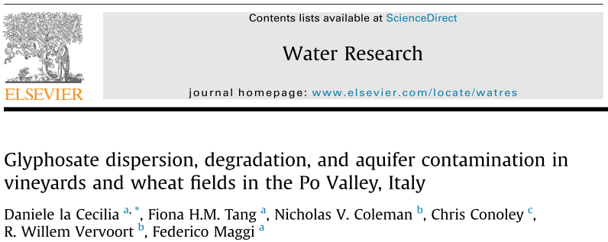
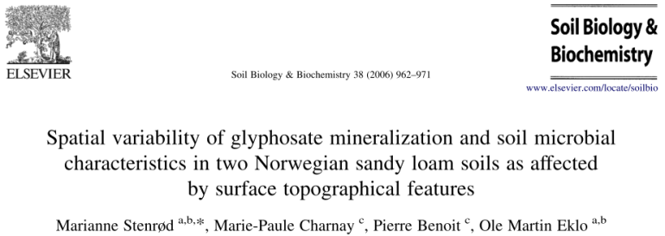
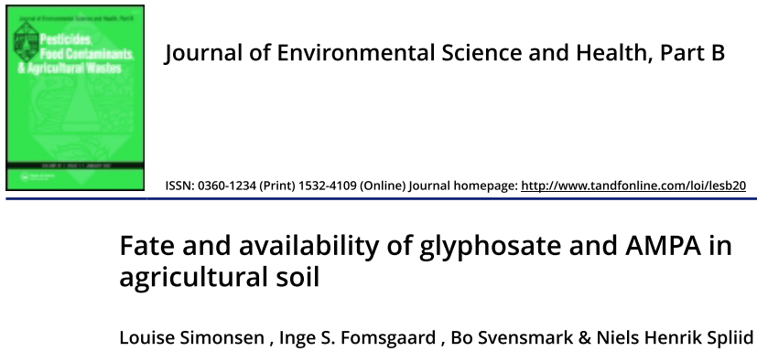
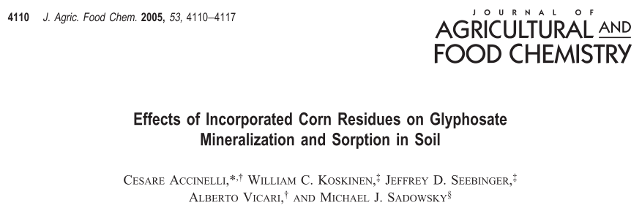
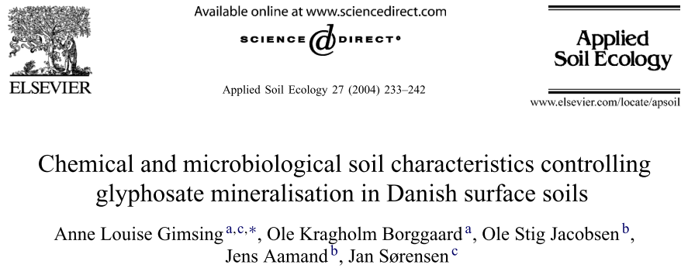
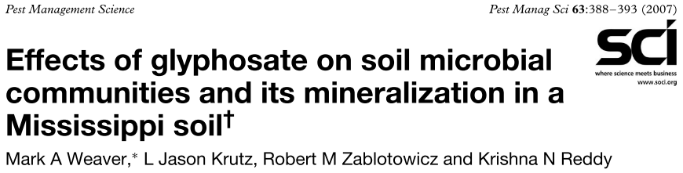
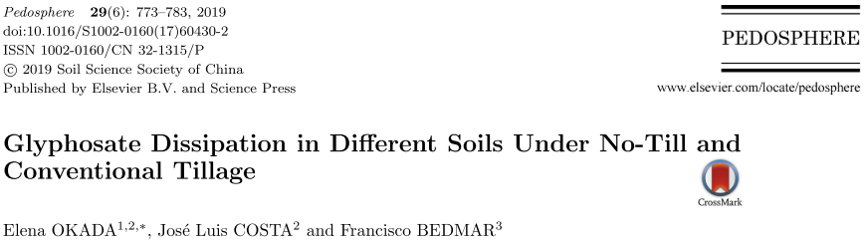
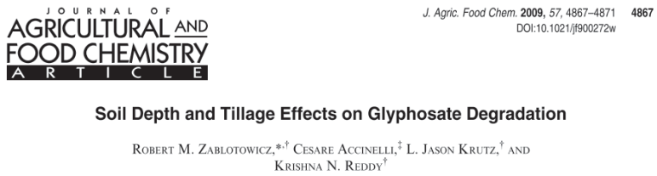
The scientific gap
Although GLYP and AMPA dissipation in agricultural soils has been extensively evaluated…
and
others…
…only few studies, none of them performed
under field conditions, have studied their
dissipation in conventional VS conservation agriculture.
EGU2020: Sharing Geoscience Online
Notes:
The aim of this study was to develop a method for glyphosate and AMPA analysis in soil with Ultra-High Performance Liquid Chromatography coupled with mass spectrometry using the AccQ Tag Ultra Derivatization Kit.
The method was applied to study the dissipation of glyphosate and the formation and dissipation of AMPA from a non-tilled field compared to a conventionally managed field.
This study was conducted at the Padova University Experimental Farm.
The year of the study was the 5th year of conservation tillage for the NT field.

Slide 5
Aim of the study
CT NT
The aim of this study was to investigate the effect of conservation agriculture
(no-tillage, NT) and conventional tillage (CT) on the adsorption of GLYP and on the dissipation of GLYP and AMPA at two depths:
0−5 cm
5−20 cm
crop residues
weeds
EGU2020: Sharing Geoscience Online
5
Notes:
The aim of this study was to develop a method for glyphosate and AMPA analysis in soil with Ultra-High Performance Liquid Chromatography coupled with mass spectrometry using the AccQ Tag Ultra Derivatization Kit.
The method was applied to study the dissipation of glyphosate and the formation and dissipation of AMPA from a non-tilled field compared to a conventionally managed field.
This study was conducted at the Padova University Experimental Farm.
The year of the study was the 5th year of conservation tillage for the NT field.

Slide 6
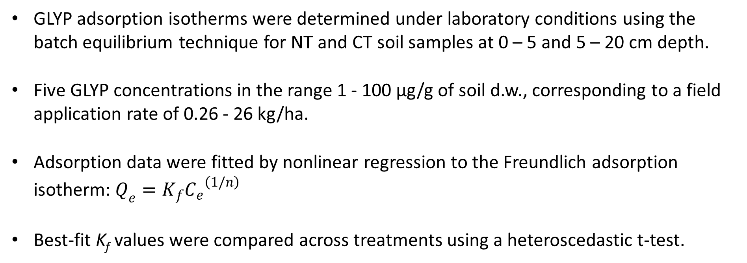
Materials and Methods: determination of soil adsorption of GLYP
GLYP adsorption isotherms were determined under laboratory conditions using the batch equilibrium technique for NT and CT soil samples at 0 – 5 and 5 – 20 cm depth.
Five GLYP concentrations in the range 1 - 100 µg/g of soil d.w., corresponding to a field application rate of 0.26 - 26 kg/ha.
Adsorption data were fitted by nonlinear regression to the Freundlich adsorption isotherm: $Q_{e}=K_{f}{C_{e}}^{\left(1/n\right)}$
Best-fit K_{f} values were compared across treatments using a heteroscedastic t-test.
EGU2020: Sharing Geoscience Online
6
Notes:
The aim of this study was to develop a method for glyphosate and AMPA analysis in soil with Ultra-High Performance Liquid Chromatography coupled with mass spectrometry using the AccQ Tag Ultra Derivatization Kit.
The method was applied to study the dissipation of glyphosate and the formation and dissipation of AMPA from a non-tilled field compared to a conventionally managed field.
This study was conducted at the Padova University Experimental Farm.
The year of the study was the 5th year of conservation tillage for the NT field.

Slide 7
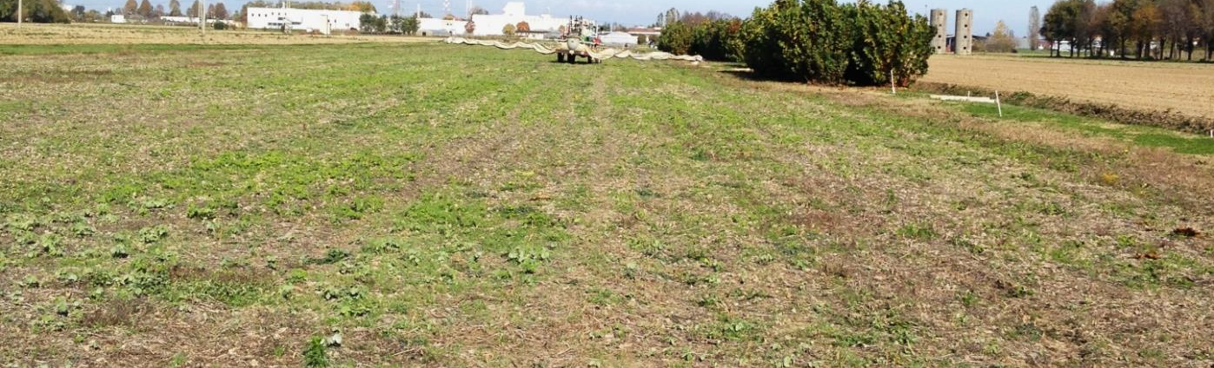

Materials and Methods: site description
The dissipation field trial was conducted from October 2018 to April 2019 at the Padua University Experimental Farm, North-East Italy.
On NT field, residues of the previous crop (maize) were left on the surface after harvesting. The mass of crop residues on the NT field was estimated by sampling and weighing the crop residues from three 2x5 m plots → 1485 kg/ha of dry matter.
NT
A visual survey on NT field revealed that the weeds covered 20-30% of the NT field area, with an estimated height of 5-10 cm.
EGU2020: Sharing Geoscience Online
7
Notes:
The aim of this study was to develop a method for glyphosate and AMPA analysis in soil with Ultra-High Performance Liquid Chromatography coupled with mass spectrometry using the AccQ Tag Ultra Derivatization Kit.
The method was applied to study the dissipation of glyphosate and the formation and dissipation of AMPA from a non-tilled field compared to a conventionally managed field.
This study was conducted at the Padova University Experimental Farm.
The year of the study was the 5th year of conservation tillage for the NT field.

Slide 8
Materials and Methods: dissipation study
On 18/10/2018, a pre-sowing treatment was applied on both NT and CT field with GLYP as a formulated product (Roundup Power 2.0) at a dose of 1.44 kg/ha of the active ingredient. On 26/10/2018, the fields were sown with wheat.
The dissipation of GLYP and the formation/dissipation of AMPA were followed for 182 days after their application → 2 sampling depths: 0-5 cm and 5-20 cm.
The concentrations of GLYP and AMPA in the soil were analysed by Ultra-High Performance Liquid Chromatography coupled with mass spectrometry.
* sampling
sowing
EGU2020: Sharing Geoscience Online
8
Notes:
The aim of this study was to develop a method for glyphosate and AMPA analysis in soil with Ultra-High Performance Liquid Chromatography coupled with mass spectrometry using the AccQ Tag Ultra Derivatization Kit.
The method was applied to study the dissipation of glyphosate and the formation and dissipation of AMPA from a non-tilled field compared to a conventionally managed field.
This study was conducted at the Padova University Experimental Farm.
The year of the study was the 5th year of conservation tillage for the NT field.

Slide 9
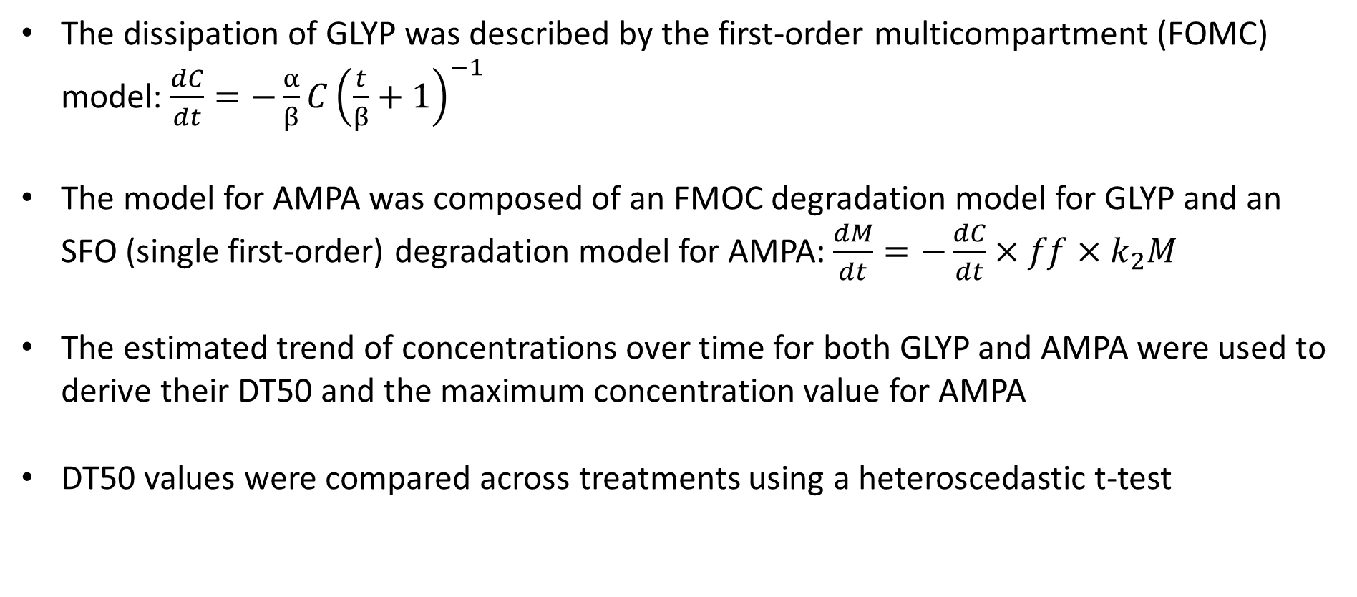
Materials and Methods: use of experimental data on a modelling approach
The dissipation of GLYP was described by the first-order multicompartment (FOMC) model: $\frac{dC}{dt}=−\frac{α}{β}C{\left(\frac{t}{β}+1\right)}^{−1}$
The model for AMPA was composed of an FMOC degradation model for GLYP and an SFO (single first-order) degradation model for AMPA: $\frac{dM}{dt}=−\frac{dC}{dt}×ff×k_{2}M$
The estimated trend of concentrations over time for both GLYP and AMPA were used to derive their DT50 and the maximum concentration value for AMPA
DT50 values were compared across treatments using a heteroscedastic t-test
EGU2020: Sharing Geoscience Online
9
Notes:
The aim of this study was to develop a method for glyphosate and AMPA analysis in soil with Ultra-High Performance Liquid Chromatography coupled with mass spectrometry using the AccQ Tag Ultra Derivatization Kit.
The method was applied to study the dissipation of glyphosate and the formation and dissipation of AMPA from a non-tilled field compared to a conventionally managed field.
This study was conducted at the Padova University Experimental Farm.
The year of the study was the 5th year of conservation tillage for the NT field.

Slide 10
Results: adsorption isotherms of GLYP
After five years of conservation agriculture, some chemical properties of the soil have been altered → GLYP adsorption was:
higher in NT soil than in CT soil, at both depths;
higher at 5 – 20 cm than 0 – 5 cm for both NT and CT soil
Soil | Depth | K_{f} (μg^{1−1/n} (ml)^{1/n} g⁻¹)
NT | 0 – 5 cm | 41.1
CT | 0 – 5 cm | 22.4
NT | 5 – 20 cm | 54.5
CT | 5 – 20 cm | 29.8
EGU2020: Sharing Geoscience Online
10
Notes:
The aim of this study was to develop a method for glyphosate and AMPA analysis in soil with Ultra-High Performance Liquid Chromatography coupled with mass spectrometry using the AccQ Tag Ultra Derivatization Kit.
The method was applied to study the dissipation of glyphosate and the formation and dissipation of AMPA from a non-tilled field compared to a conventionally managed field.
This study was conducted at the Padova University Experimental Farm.
The year of the study was the 5th year of conservation tillage for the NT field.

Slide 11
Results: GLYP dissipation and AMPA formation/dissipation
GLYP AMPA
GLYP initial dissipation was fast, followed by a slower decline.
At 0–5 cm no significant difference was observed in GLYP persistence between the two soil managements.
At 5–20 cm GLYP was more persistent in NT soil (DT50: 18 days) than in CT soil (DT50: 8 days).
EGU2020: Sharing Geoscience Online
11
Notes:
The aim of this study was to develop a method for glyphosate and AMPA analysis in soil with Ultra-High Performance Liquid Chromatography coupled with mass spectrometry using the AccQ Tag Ultra Derivatization Kit.
The method was applied to study the dissipation of glyphosate and the formation and dissipation of AMPA from a non-tilled field compared to a conventionally managed field.
This study was conducted at the Padova University Experimental Farm.
The year of the study was the 5th year of conservation tillage for the NT field.

Slide 12
Results: GLYP dissipation and AMPA formation/dissipation
GLYP AMPA
Crop residues and weeds on NT field reduced the amount of GLYP that reached the soil.
Weeds could also have influenced the dissipation by providing a delayed contribution of GLYP to the soil via root exudation.
This interference could explain the persistence and accumulation of glyphosate in NT soil profile.
EGU2020: Sharing Geoscience Online
12
Notes:
The aim of this study was to develop a method for glyphosate and AMPA analysis in soil with Ultra-High Performance Liquid Chromatography coupled with mass spectrometry using the AccQ Tag Ultra Derivatization Kit.
The method was applied to study the dissipation of glyphosate and the formation and dissipation of AMPA from a non-tilled field compared to a conventionally managed field.
This study was conducted at the Padova University Experimental Farm.
The year of the study was the 5th year of conservation tillage for the NT field.

Slide 13
Results: GLYP dissipation and AMPA formation/dissipation
GLYP AMPA
The fast initial dissipation of GLYP was reflected in an increase in the concentration of AMPA.
AMPA persisted longer than GLYP but, for this metabolite, no apparent effect was observed in response to the different soil management.
The observed differences could rather be attributed to the variability of experimental data, which in some cases complicated the curve fitting
EGU2020: Sharing Geoscience Online
13
Notes:
The aim of this study was to develop a method for glyphosate and AMPA analysis in soil with Ultra-High Performance Liquid Chromatography coupled with mass spectrometry using the AccQ Tag Ultra Derivatization Kit.
The method was applied to study the dissipation of glyphosate and the formation and dissipation of AMPA from a non-tilled field compared to a conventionally managed field.
This study was conducted at the Padova University Experimental Farm.
The year of the study was the 5th year of conservation tillage for the NT field.

Slide 14
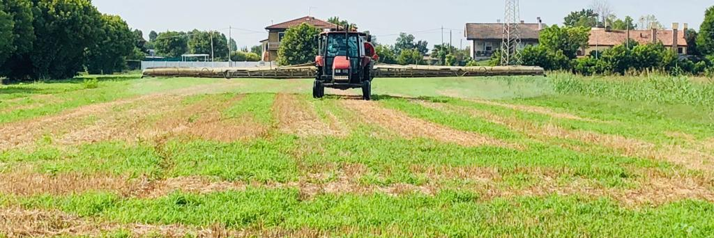
Conclusion
The higher persistence of GLYP observed under conservation tillage might increase the risk of soil pollution due to the accumulation of this chemical, especially in the case of repeated applications of glyphosate.
To get the maximum benefits from this soil management system and to limit the risk of glyphosate and AMPA pollution it is recommended to use this herbicide not more than one time per year and to calibrate the doses based on the actual infestation.
EGU2020: Sharing Geoscience Online
14
Notes:
The aim of this study was to develop a method for glyphosate and AMPA analysis in soil with Ultra-High Performance Liquid Chromatography coupled with mass spectrometry using the AccQ Tag Ultra Derivatization Kit.
The method was applied to study the dissipation of glyphosate and the formation and dissipation of AMPA from a non-tilled field compared to a conventionally managed field.
This study was conducted at the Padova University Experimental Farm.
The year of the study was the 5th year of conservation tillage for the NT field.

Slide 15
Thanks for your attention
laura.carretta.2@phd.unipd.it
EGU2020: Sharing Geoscience Online
15
Notes:
The aim of this study was to develop a method for glyphosate and AMPA analysis in soil with Ultra-High Performance Liquid Chromatography coupled with mass spectrometry using the AccQ Tag Ultra Derivatization Kit.
The method was applied to study the dissipation of glyphosate and the formation and dissipation of AMPA from a non-tilled field compared to a conventionally managed field.
This study was conducted at the Padova University Experimental Farm.
The year of the study was the 5th year of conservation tillage for the NT field.

