Slide 1
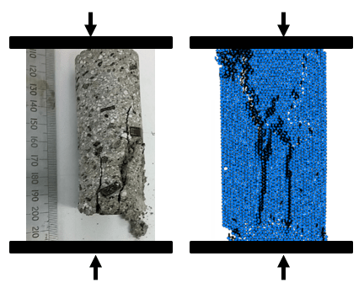
Upscaling of geomechanical properties in discrete element method (DEM) models of volcano-tectonics
START: Observe large scale
volcanic deformation
(i.e., dome collapse, caldera collapse)
Develop understanding
about volcanic process
Key question: how do we use mechanical properties of volcanic rock measured in the lab to inform us about volcanic processes at the field scale?
Establish mechanical
properties in the lab and calibrate within model
Infer upscaling of properties
required to produce
realistic model outcomes
Model geological process
using mechanical properties
Compare natural and
modelled observations

Slide 2
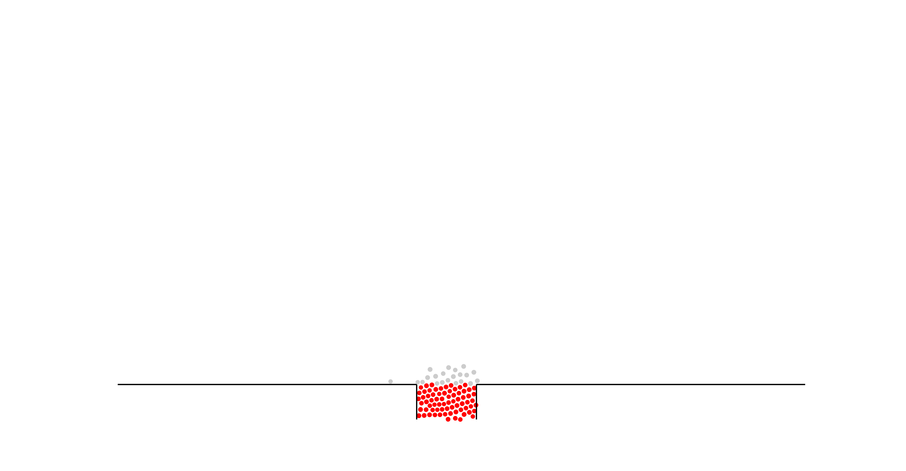
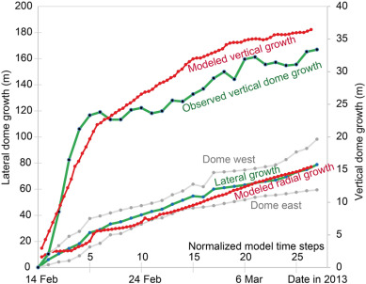
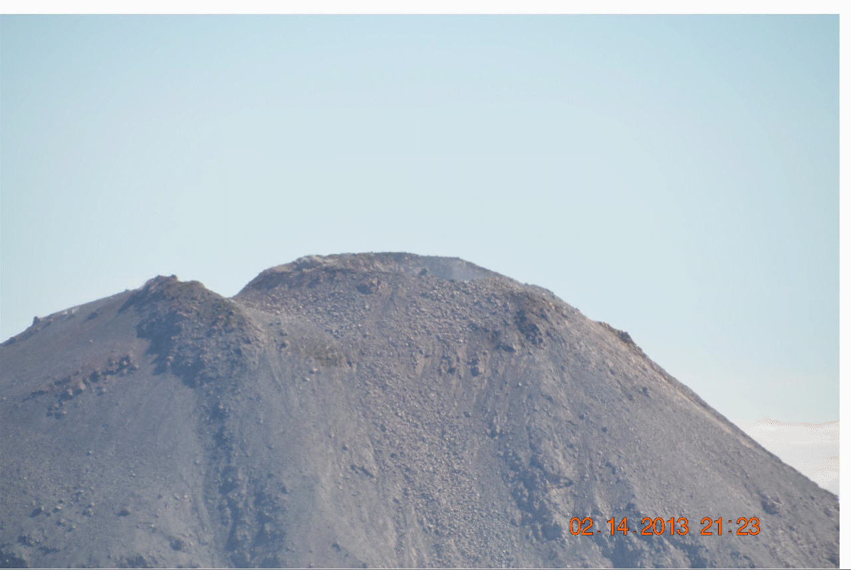
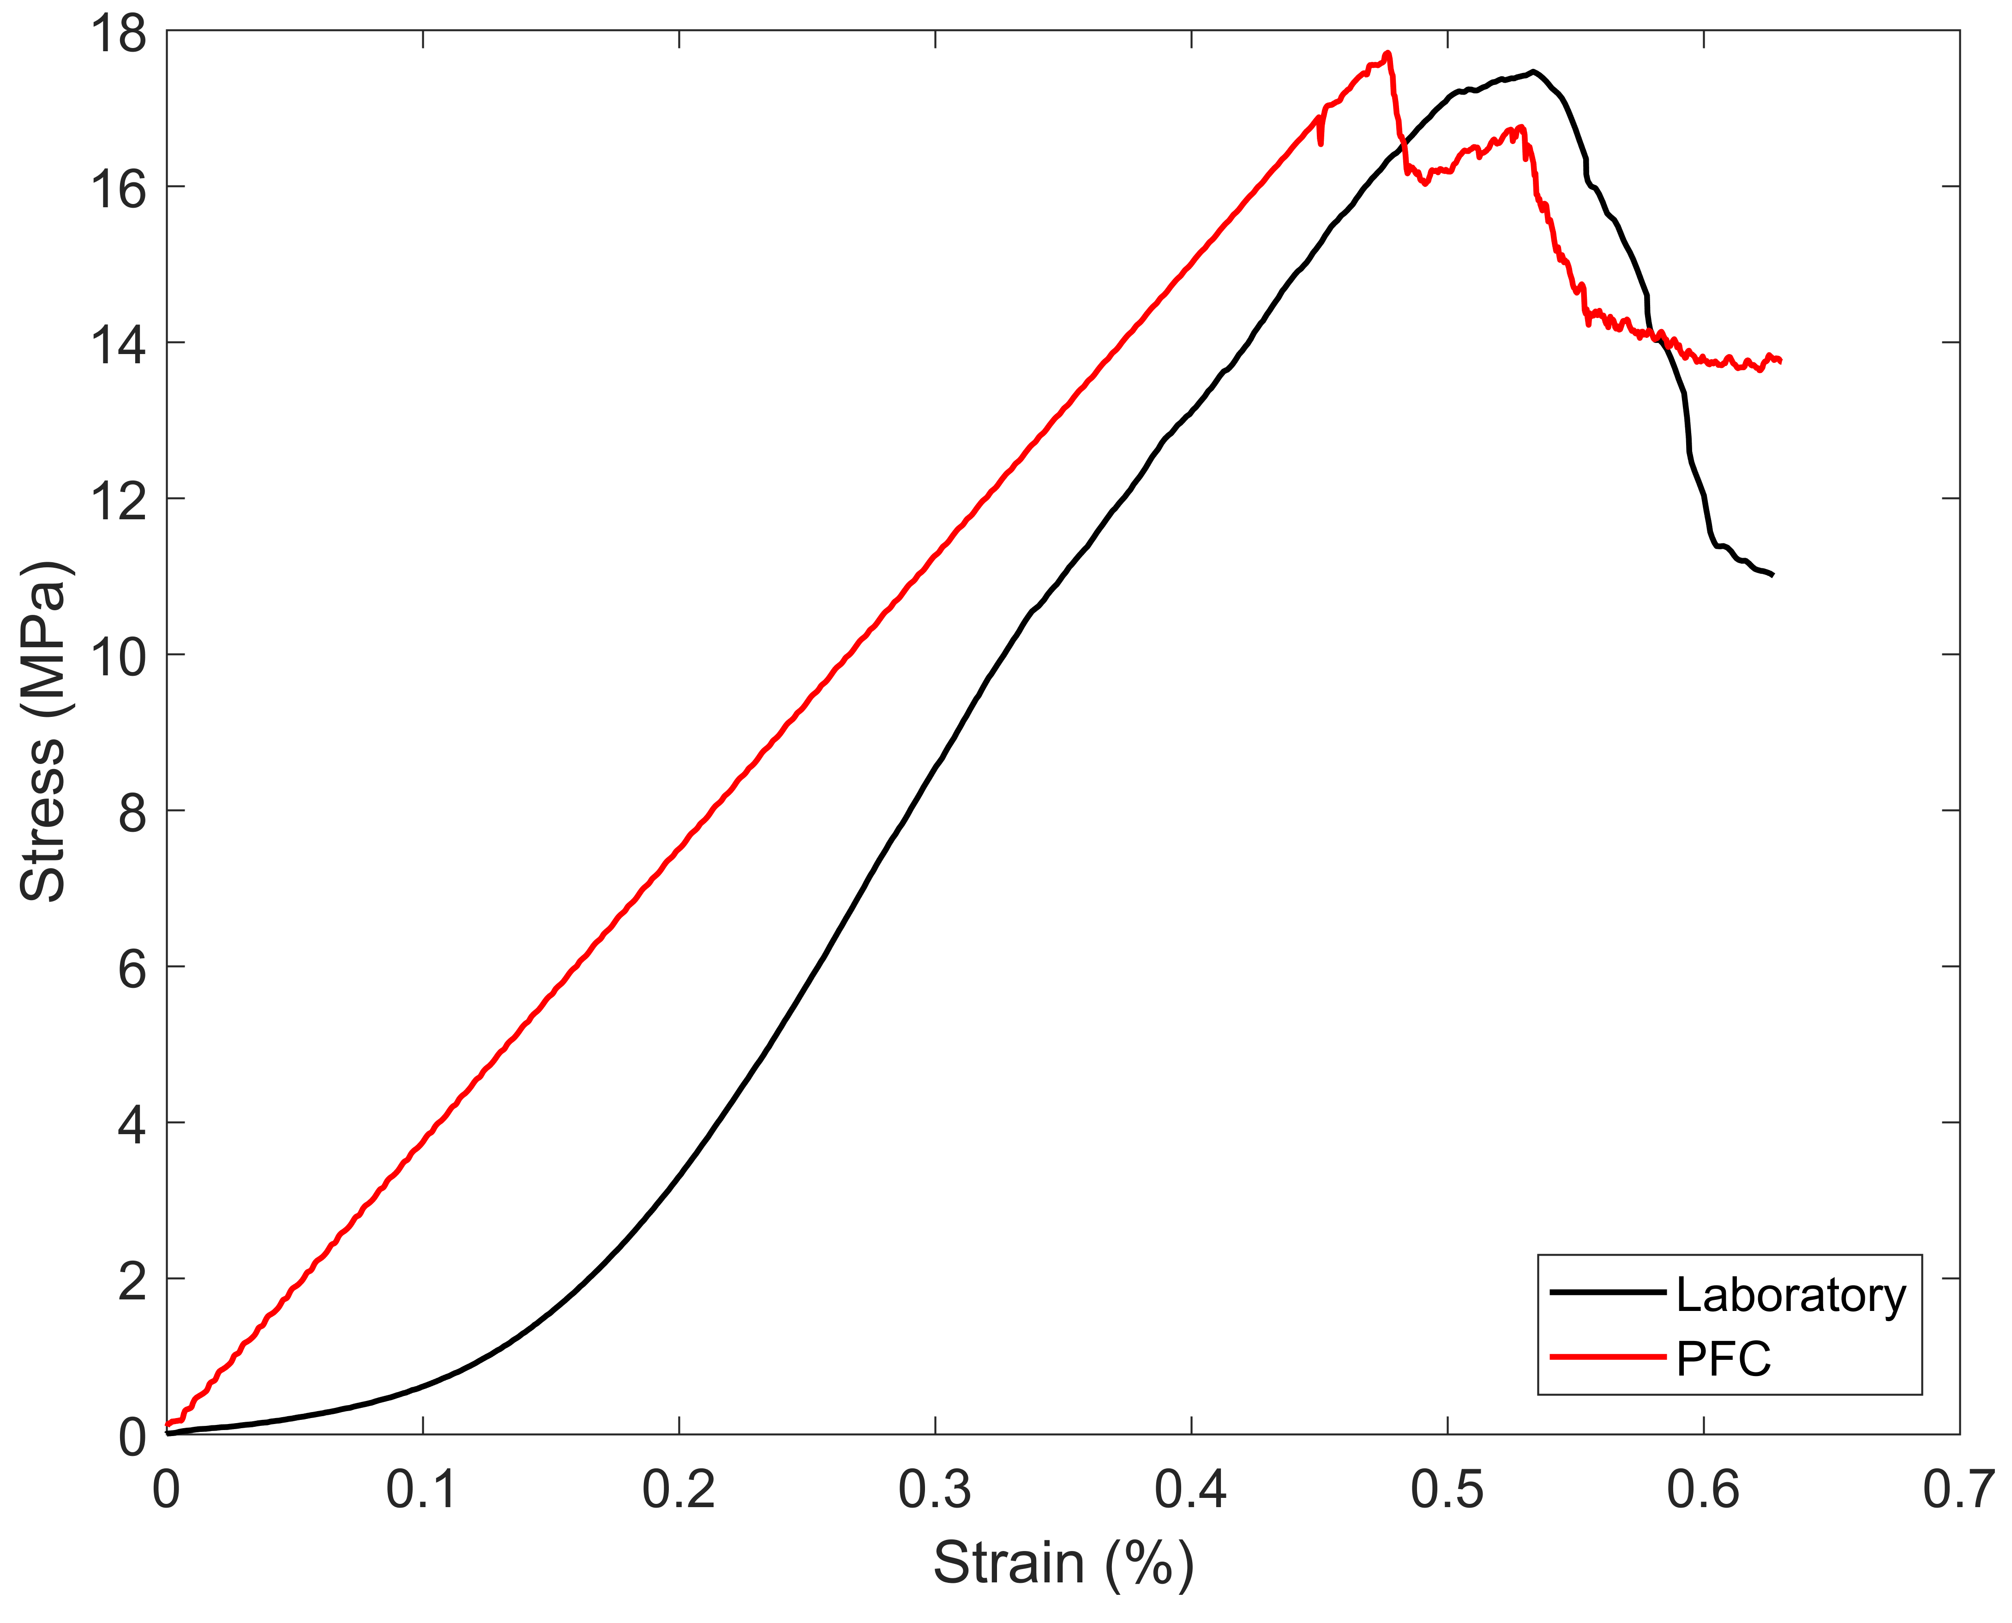
Determining geomechanical upscaling using observed and modelled lava dome growth
Observations
Geomechanical properties
DEM modelling
Walter et al., 2019, JVGR
The model is calibrated to the macro-scale behaviour of products from Colima (Heap et al., 2014).
We calibrate uniaxial compressive strength, uniaxial tensile strength, and Young’s modulus.
The fluid viscosity is also calibrated to expected viscosities at Colima.
Walter et al., 2019, JVGR
Typical DEM model of dome growth (red = fluid magma core, grey = solid talus)
Dome growth at Volcán de Colima in January- March 2013
Captured using time-lapse camera analysis
Dome builds to a critical height and then volume increase occurs through lateral growth
Comparing modelled and observed dome growth, we find very good agreement with both lateral and vertical growth
However, in order to obtain this agreement, we must apply an upscaling factor of 80% (i.e., using a UCS of 3.7 MPa instead of 17.5 MPa)
The model also shows that a stronger material is required to obtain the initial increase in height, e.g., through initial extrusion of denser conduit plug material

Slide 3
How can upscaling of geomechanical properties affect caldera failure mechanisms?
Strength = 10 MPa
Modulus = 1 GPa
Strength = 5 MPa
Modulus = 1 GPa
Strength = 1 MPa
Modulus = 1 GPa
An order of magnitude change in the UCS of the material significantly affects the failure style.
These models show the importance of understanding upscaling in developing accurate predictive models.
Realistic failure again requires an upscaling factor of ~50%.
blue shows areas of high strain accumulation (where particles move relative to their neighbours)
magma reservoir,
50% depleted
100 m
No obvious deformation of layers due to high strength
Blocky deformation, cracks at surface, piecemeal collapse
More continuous deformation of layers, fault generation
HIGH STRENGTH,
BRITTLE DEFORMATION
LOW STRENGTH,
DUCTILE DEFORMATION

