Slide 1





D227 Session HS6.3
A performance assessment method for SAR satellite-derived surface soil moisture data using a soil-water balance model, meteorological observations, and soil pedotransfer functions.
John Beale^{1,2}, Toby Waine¹, Ronald Corstanje¹, and Jonathan Evans²
1 – Cranfield University, Bedfordshire, UK
2 – UK Centre for Ecology and Hydrology, Wallingford, Oxon, UK

Slide 2
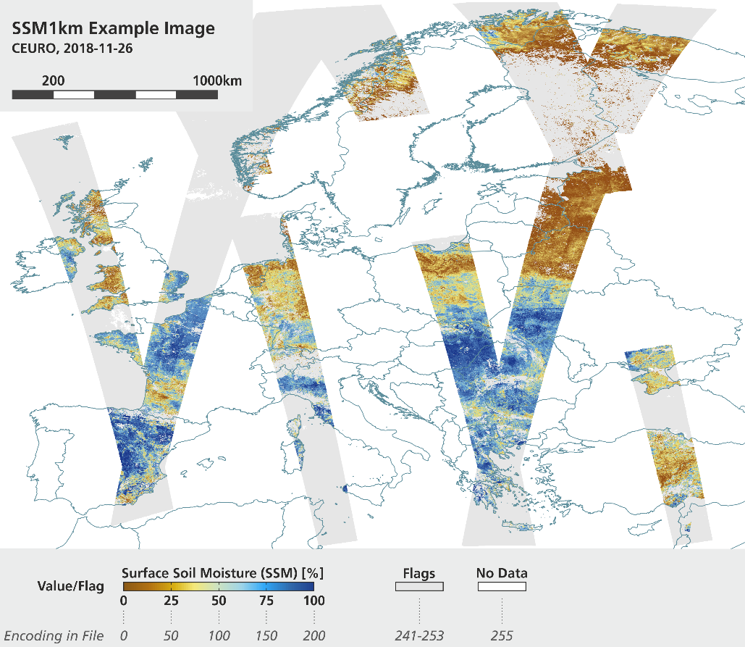
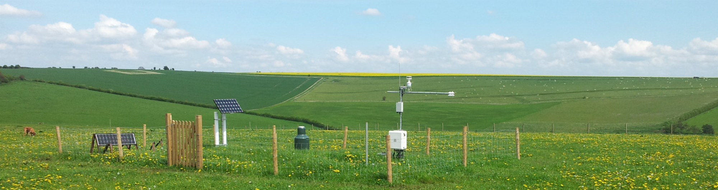
Introduction
Measurement of soil moisture (SM) is important for agriculture, meteorology and hydrology
Recently established SM monitoring networks (e.g. COSMOS–UK) provide quality data but sparse coverage
SAR, as a remote sensing technique, can provide complete coverage but performance influenced by many factors
Can the ground networks help assess the SAR performance and provide actionable data?

Slide 3
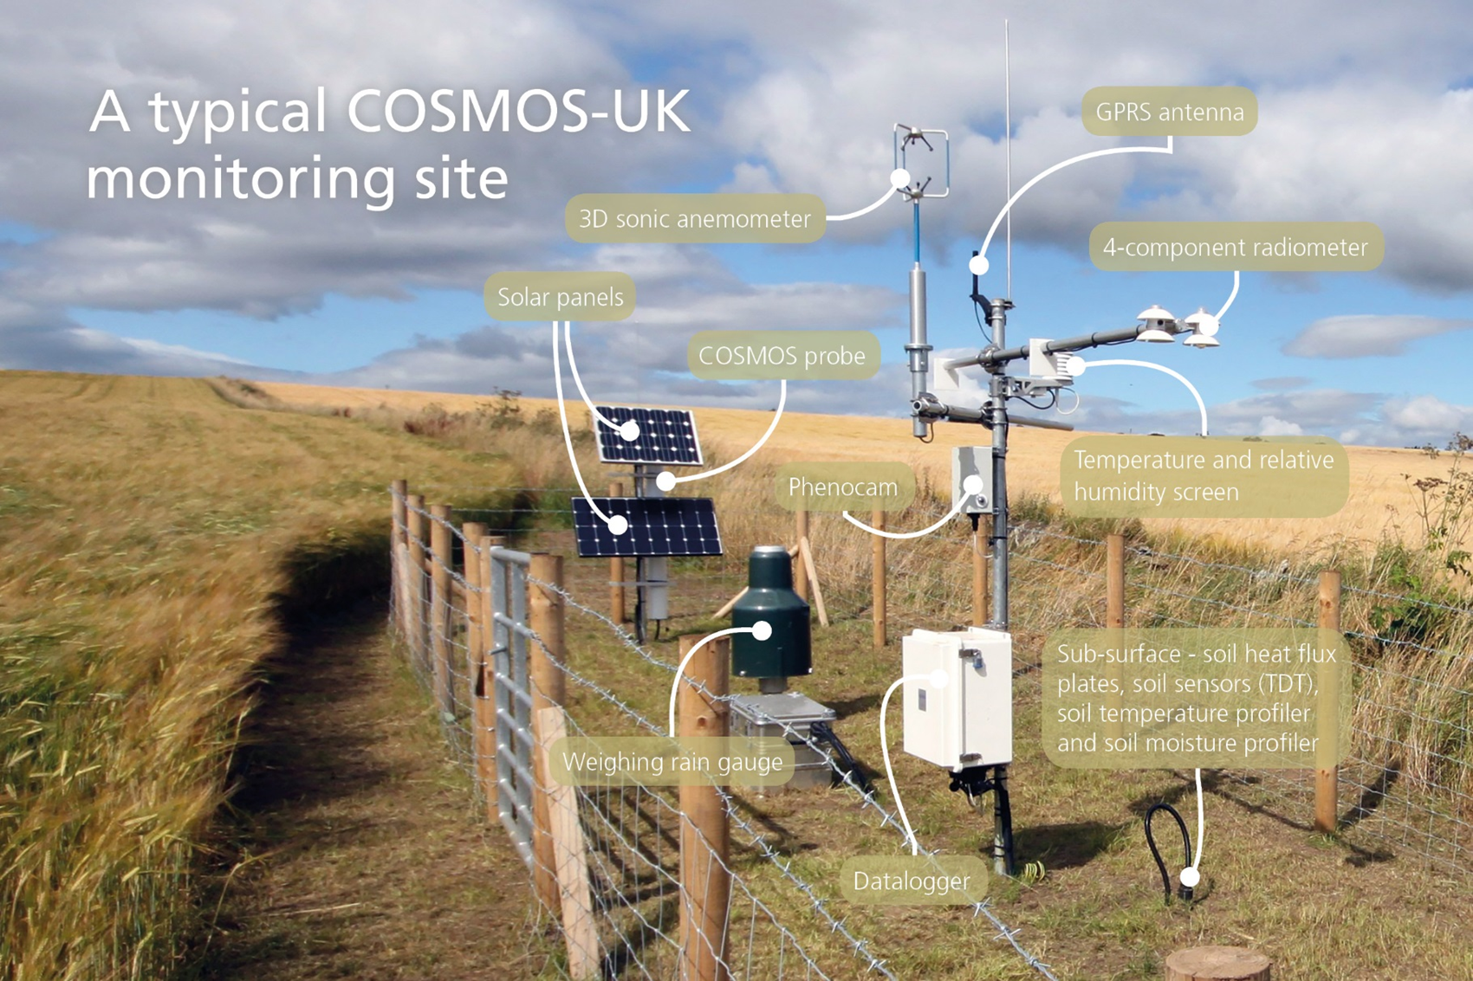
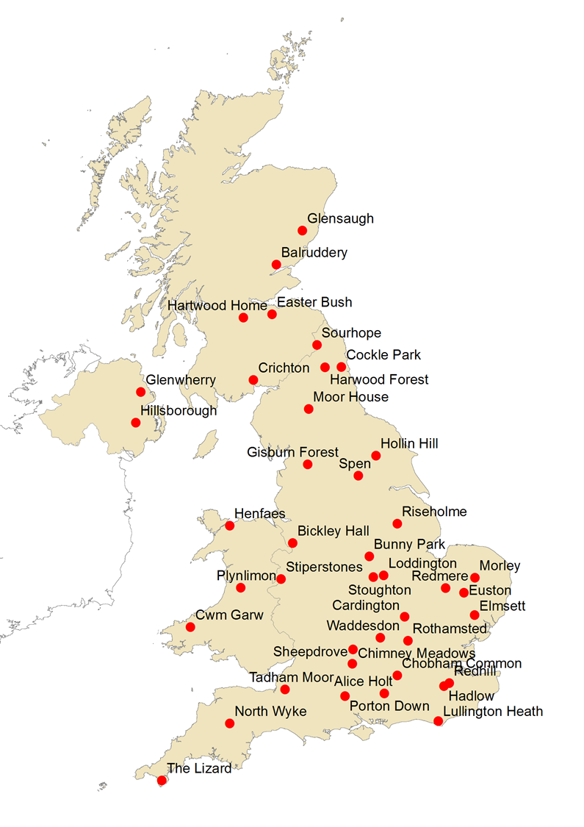

Slide 4
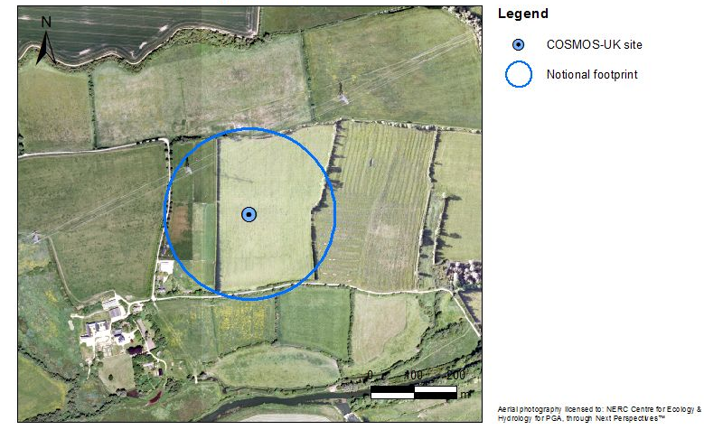
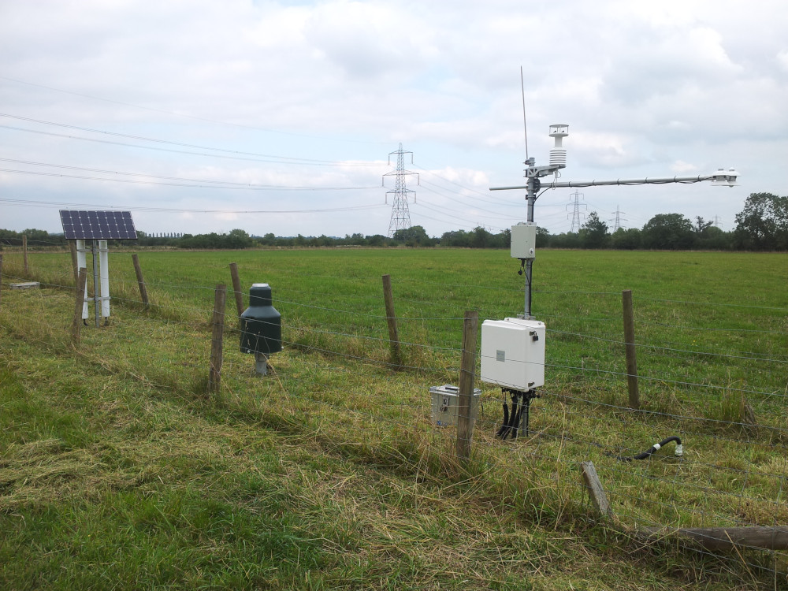
COSMOS-UK Chimney Meadows Site (CHIMN)
South of Witney, Oxon, by R. Thames
Improved Grassland
Sand To Sandy Loam

Slide 5
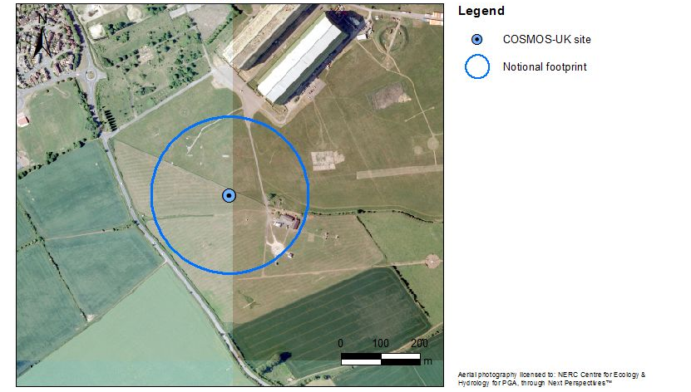
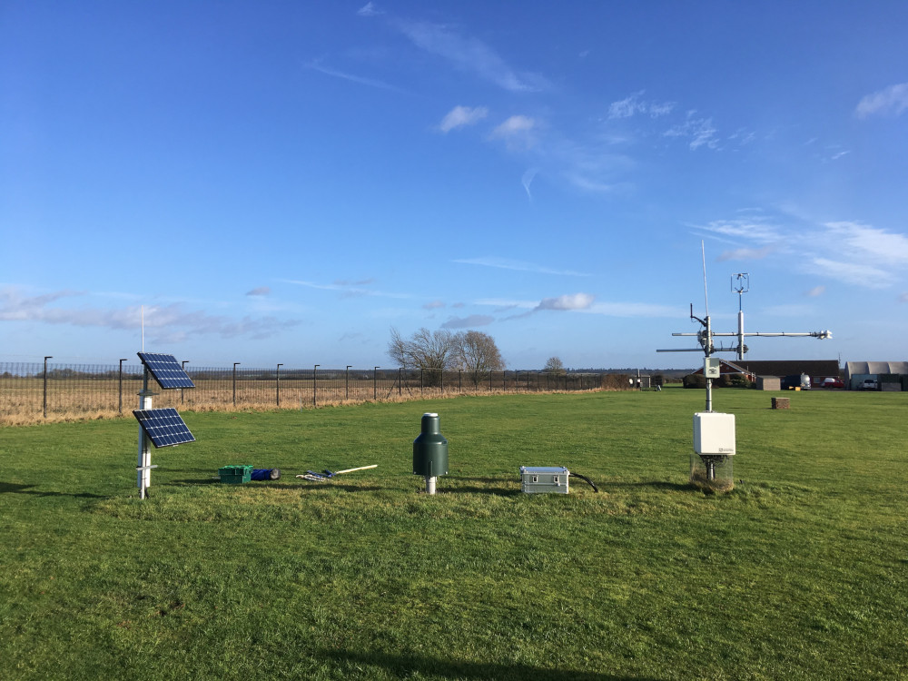
COSMOS-UK Cardington Site (CARDT)
South of Bedford, ex-airfield
Mown Grassland
Clayey Loam To Sandy Loam

Slide 6
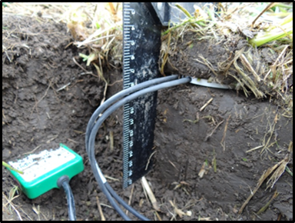
What are the issues?
Basis of comparison
  SAR SM data products may present as an index (SMI) relative to historically observed wet and dry conditions at each geospatial location, e.g. Copernicus SSM and SWI products, NASA-USDA SMAP Global Soil Moisture Data soil moisture profile
  SMIs may need to be converted to volumetric units to be useful, the errors introduced in this step may be significant.
Depth of Measurement
  SAR (e.g. C-band penetrates only a few centimetres into the soil)
  Ground sensors usually 5-10cm and more
  Surface SM is much more variable and not always highly correlated to deeper measurement – giving a pessimistic assessment of SAR performance

Slide 7
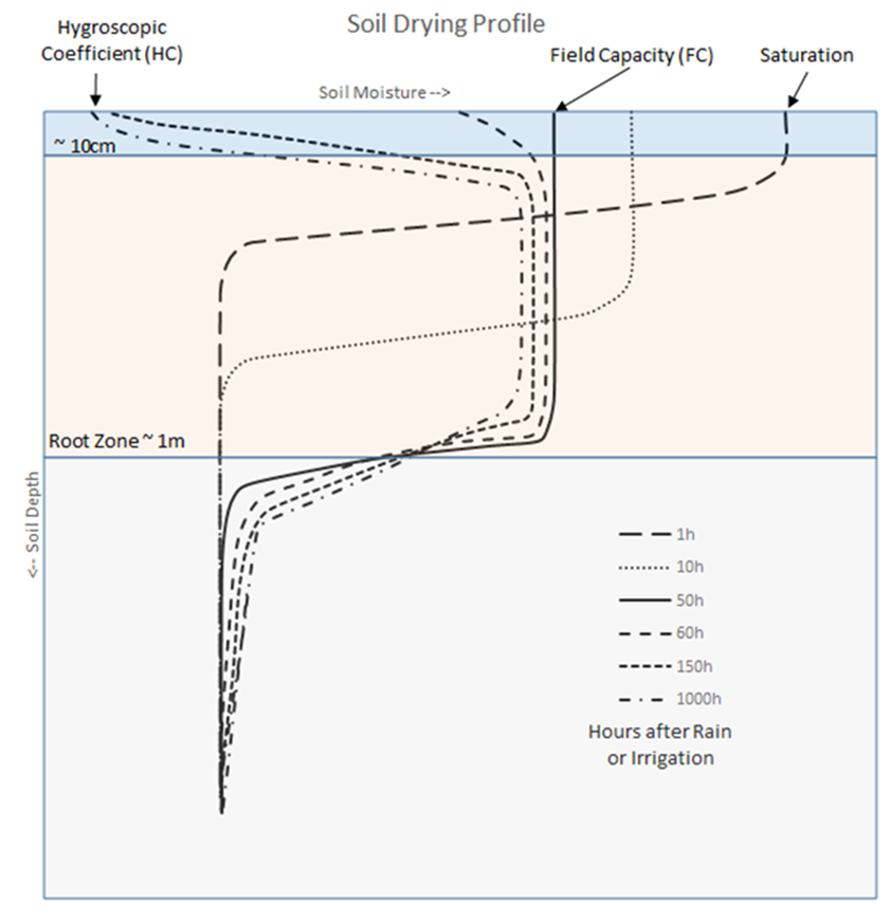
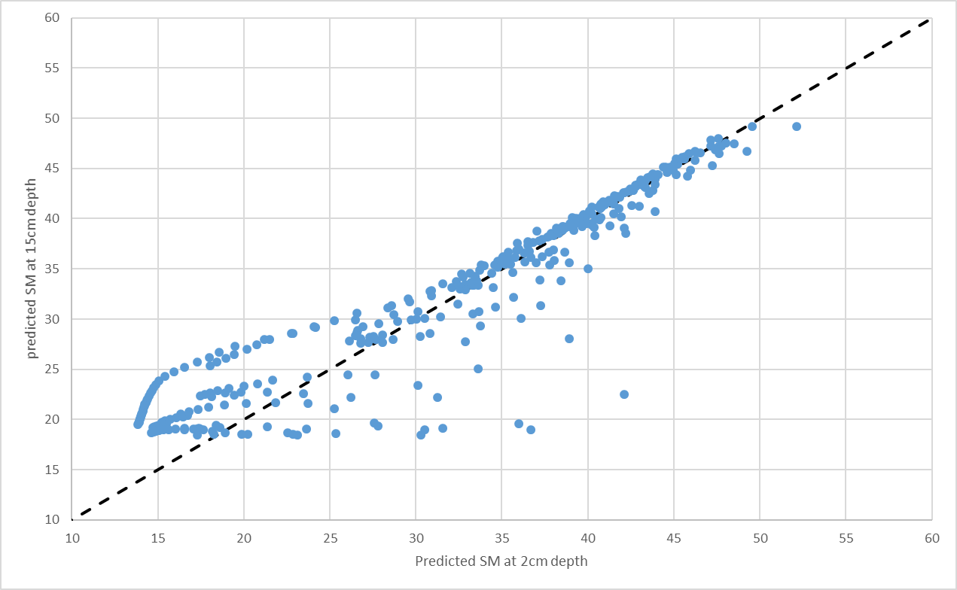
Soil moisture variability as function of depth
(Left) Soil water content depth profiles for different times, t, after irrigation or wetting at surface (t=50 is approx. end of the redistribution phase). Adapted from [5] p85-86
(Below) Scatter plot of predicted soil moisture at 2cm and 15cm for COSMOS-UK Chimney Meadows site in 2018 (HYDRUS 1D model)

Slide 8
Method
HYDRUS 1-D
Van-Genuchten model parameters from LANDIS HORIZON HYDRAULICS
LAI from MODIS MYD15A2H (500m grid)
Establish soil water balance Model at each site
Optimise performance to match SM measurements, update soil hydraulic parameters
Produce soil moisture profile at 2cm
Convert SAR SMI to VWC via updated local soil hydraulic parameters
Assess SAR product performance vs. ground measurement
Copernicus SSM product (1km grid)
COSMOS-UK sites with TDT measurements at 10cm (and more), rainfall, pET₀

Slide 9
Hydrus 1-D Optimisation Process
DATA
PREPARATION
ITERATION
OUTPUT
COSMOS-UK GEOMETRY 200m RADIUS
MODIS L4 LAI (MYD15A2H)
LAI TIMESERIES
HYDRUS 1D RUN
LANDIS NATMAP/
HORIZON
INITIAL SOIL HYDRAULIC PROPERTIES
2cm SM
ANALYSE SSM
COSMOS-UK METADATA
CROP ESTIMATE AND ROOTING DEPTH
ADJUST SOIL AND ROOTING
REVISED SOIL HYDRAULIC PARAMETERS
10cm SM
COSMOS-UK DAILY SUMMARY
POTENTIAL EVAPOTRANSPIRATION AND RAINFALL
COMPARE USING d_{r} & RMSE
BEST FIT?
GROUND MEASURMENT OF SM WITH TDT @ 10cm
Notes:
Single soil layer 25cm deep (CHIMN) or 15cm deep (CARDT)
Hydraulic parameters initially from HORIZON
LAI daily sequence interpolated from 8-day MODIS LAI Level 4 product (500m grid)
Potential Evapotranspiration (PET) from COSMOS-UK
Extinction Coefficient 0.463 (Typical value quoted many papers)
Rainfall from COSMOS (*1.05 for undercatch)
Grass roots: Surface(1) to 15cm (0)

Slide 10
HYDRUS 1-D Results of optimisation
CHIMN:
CARDT:
θ_{r} | θ_{s} | Alpha | n | K_{s} | I | d_{r} | RMSE | Source
0.1136 | 0.5456 | 0.054 | 1.2326 | 101.4 | 0.5 | 0.784688 | 4.311305 | Horizon
0.0844 | 0.5287 | 0.0123 | 1.4607 | 68.4 | 0.5 | 0.56055 | 8.957068 | Rosetta
0.042 | 0.616 | 0.012 | 1.32 | 52.5 | 0.5 | 0.837447 | 3.911477 | Optimised
θ_{r} | θ_{s} | Alpha | n | K_{s} | I | d_{r} | RMSE | Source
0.0959 | 0.4836 | 0.0492 | 1.2438 | 109.3 | 0.5 | 0.646815 | 8.786365 | Horizon
0.0705 | 0.4736 | 0.0062 | 1.6169 | 65.26 | 0.5 | 0.638548 | 9.866635 | Rosetta
0.005 | 0.62 | 0.0016 | 1.52 | 20 | 0.5 | 0.810798 | 5.281719 | Optimised

Slide 11
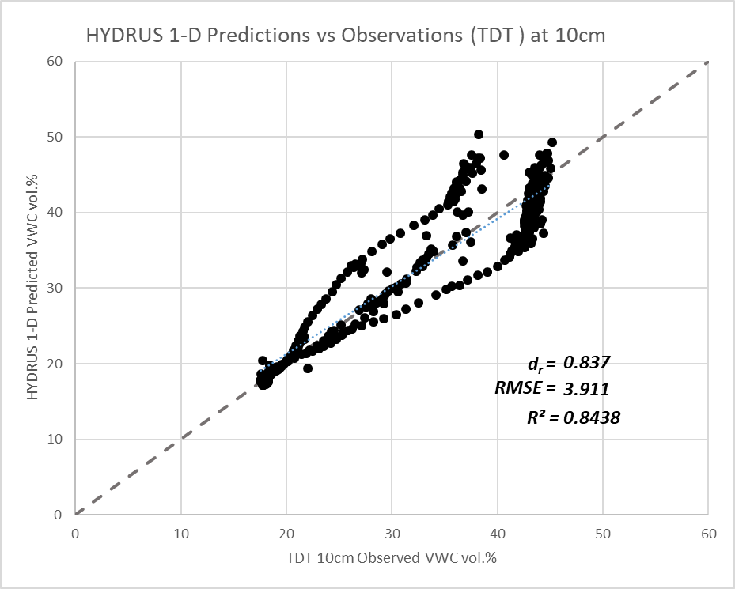
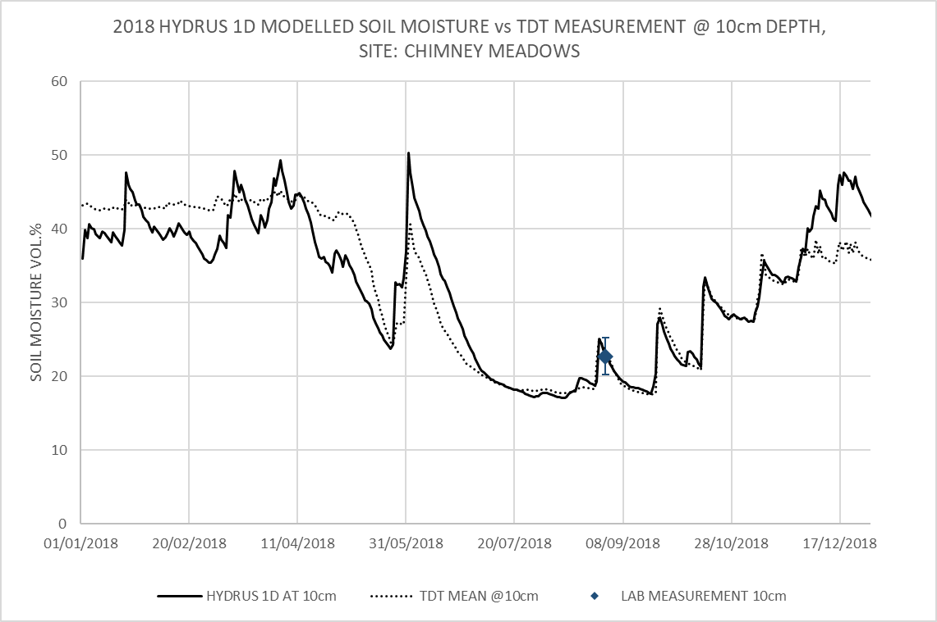
HYDRUS 1-D model fit at 10cm vs. TDT sensors - CHIMN

Slide 12
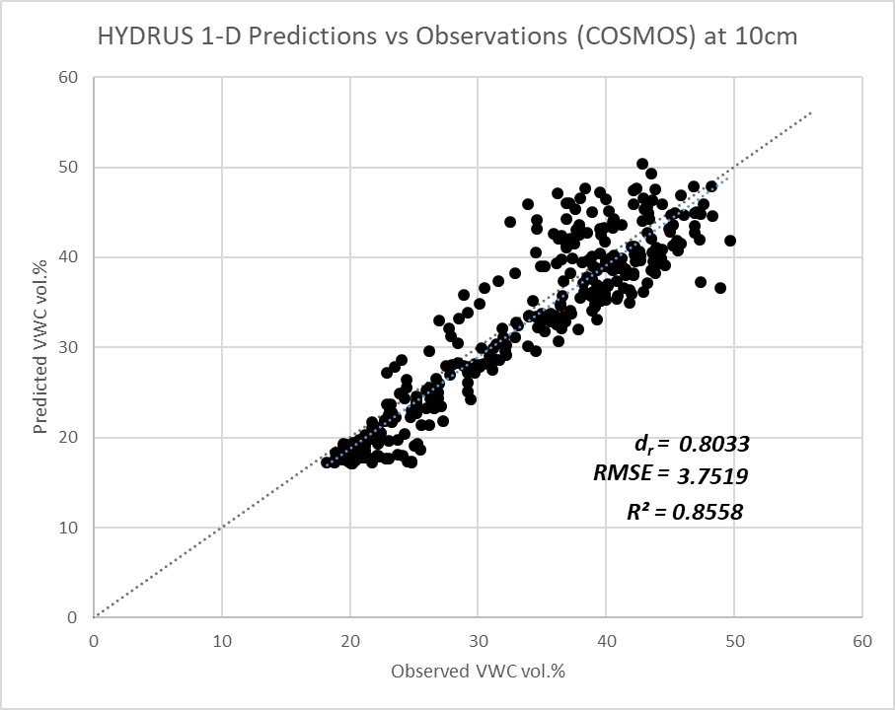
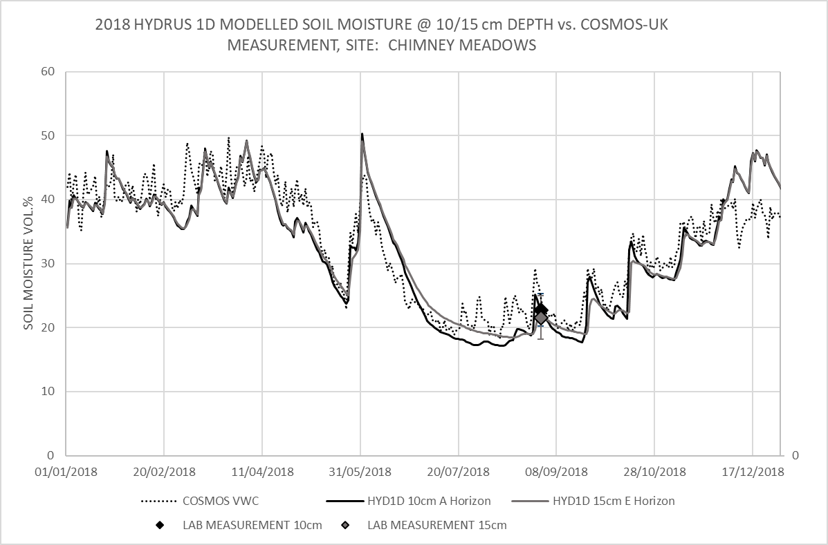
HYDRUS 1-D model fit at 10cm vs. Cosmic-Ray sensor - CHIMN

Slide 13
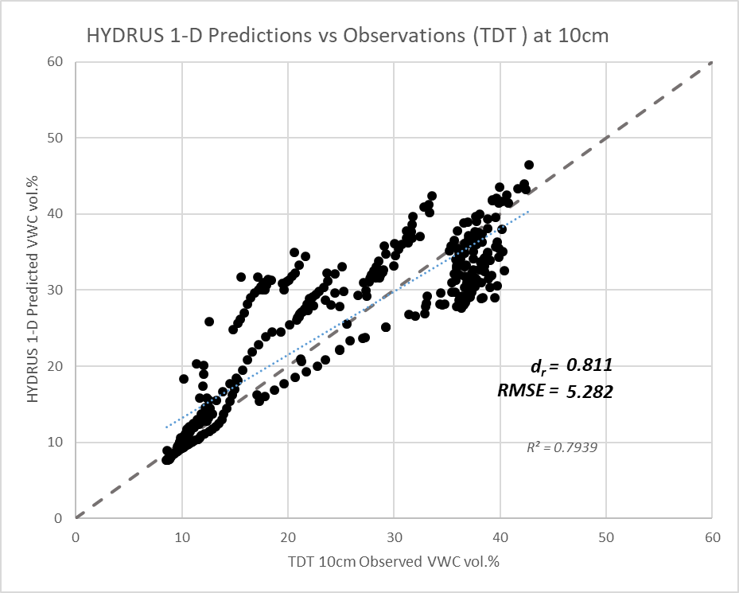
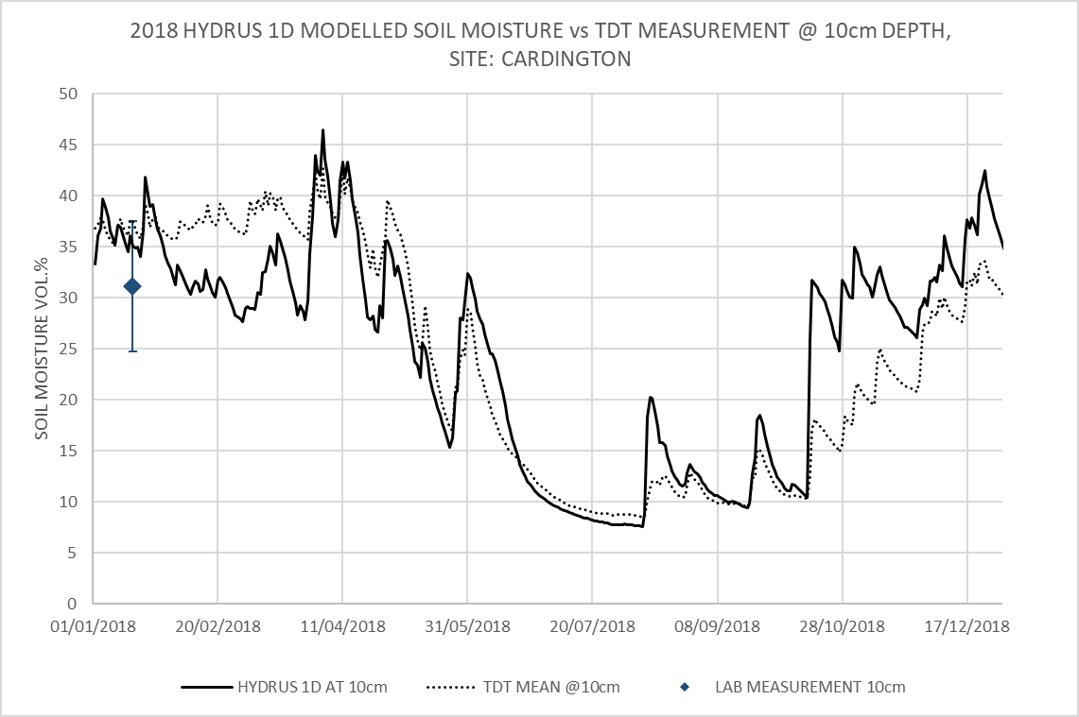
HYDRUS 1-D model fit at 10cm vs. TDT sensors - CARDT

Slide 14
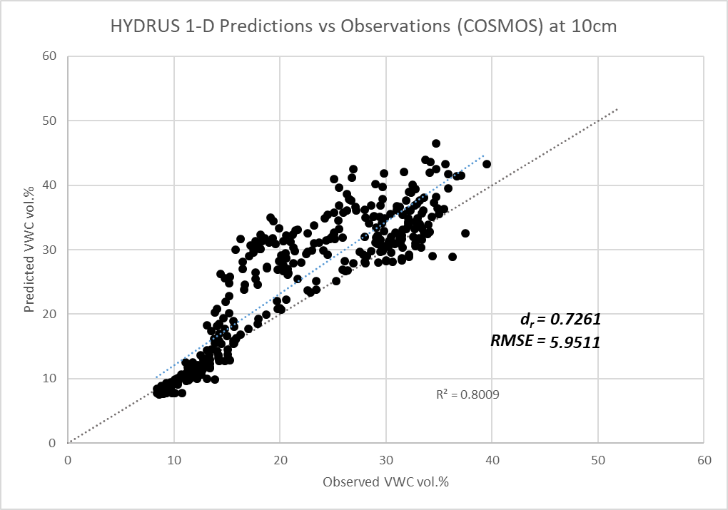
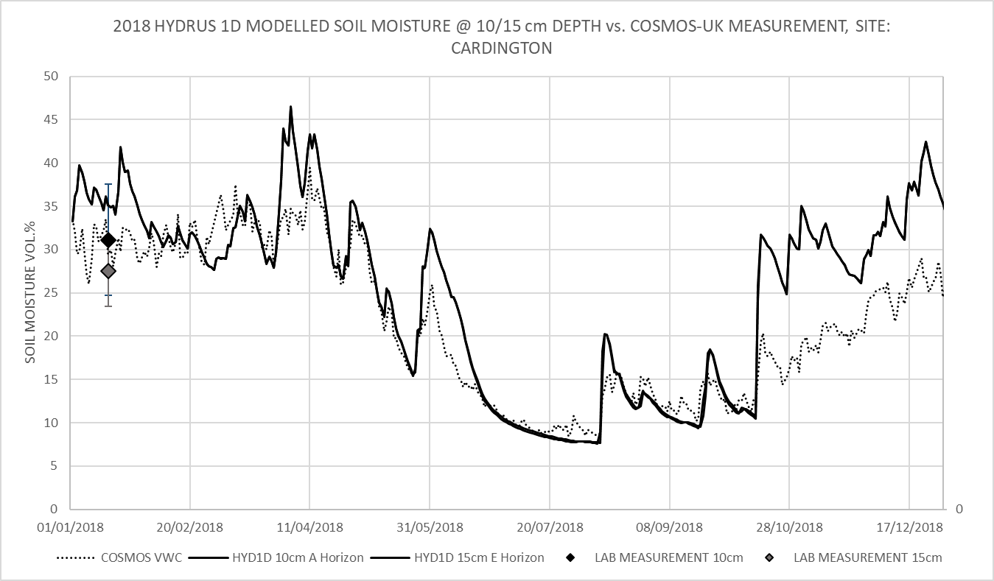
HYDRUS 1-D model fit at 10cm vs. Cosmic-Ray sensor - CARDT

Slide 15
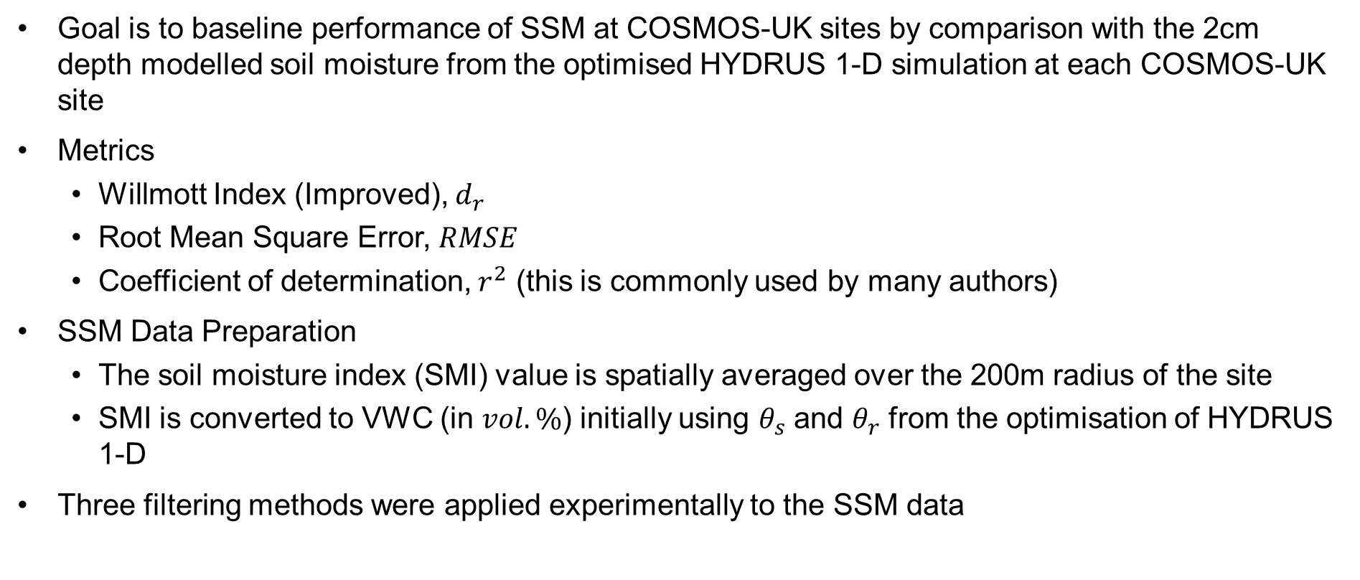
Initial Analysis of Copernicus SSM Data vs. 2cm model
Goal is to baseline performance of SSM at COSMOS-UK sites by comparison with the 2cm depth modelled soil moisture from the optimised HYDRUS 1-D simulation at each COSMOS-UK site
Metrics
  Willmott Index (Improved), $d_{r}$
  Root Mean Square Error, $RMSE$
  Coefficient of determination, $r^{2}$ (this is commonly used by many authors)
SSM Data Preparation
  The soil moisture index (SMI) value is spatially averaged over the 200m radius of the site
  SMI is converted to VWC (in $vol.\%$) initially using $θ_{s}$ and $θ_{r}$ from the optimisation of HYDRUS 1-D
Three filtering methods were applied experimentally to the SSM data

Slide 16
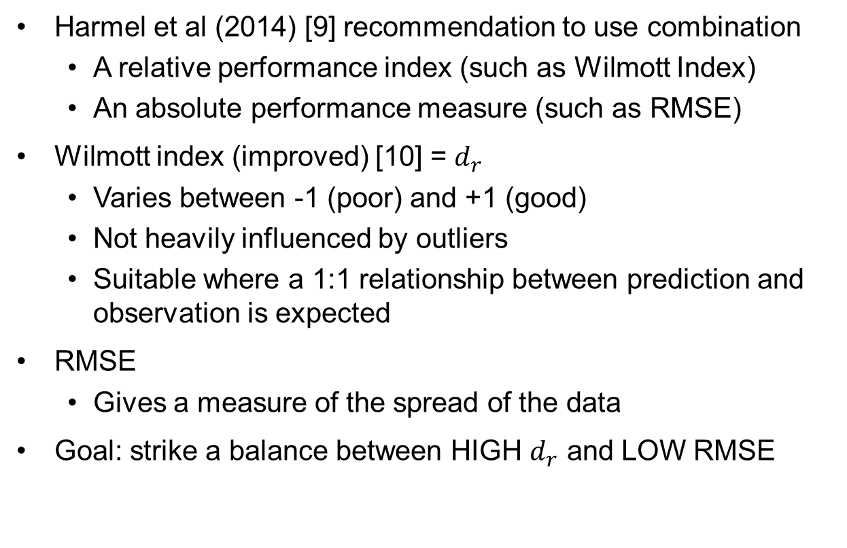
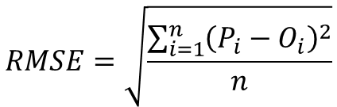

Metrics for Model Fit
Harmel et al (2014) [9] recommendation to use combination
  A relative performance index (such as Wilmott Index)
  An absolute performance measure (such as RMSE)
Wilmott index (improved) [10] = $d_{r}$
  Varies between -1 (poor) and +1 (good)
  Not heavily influenced by outliers
  Suitable where a 1:1 relationship between prediction and observation is expected
RMSE
  Gives a measure of the spread of the data
Goal: strike a balance between HIGH $d_{r}$ and LOW RMSE
$$c=2$$
$$RMSE=\sqrt{\frac{\sum_{i=1}^{n}{{\left(P_{i}−O_{i}\right)}^{2}}}{n}}$$

Slide 17
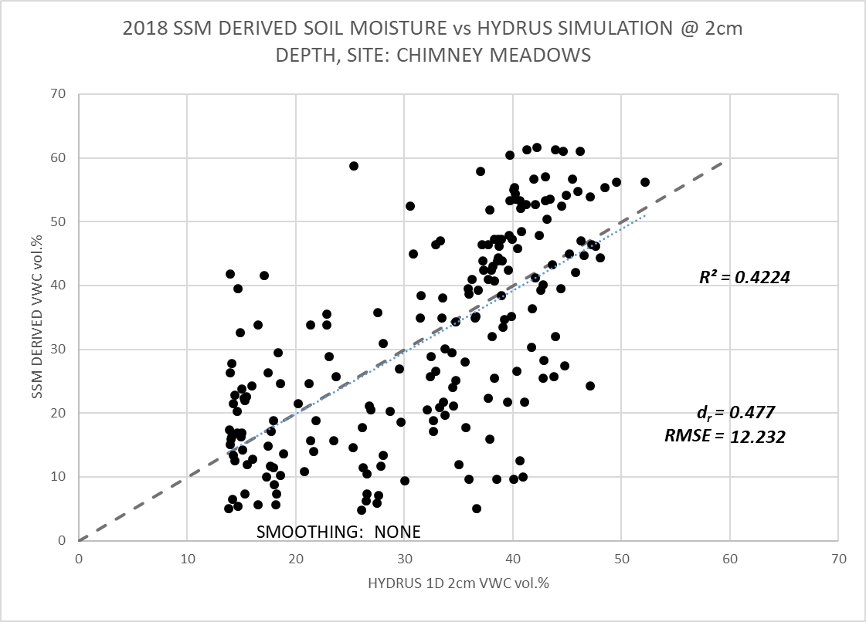
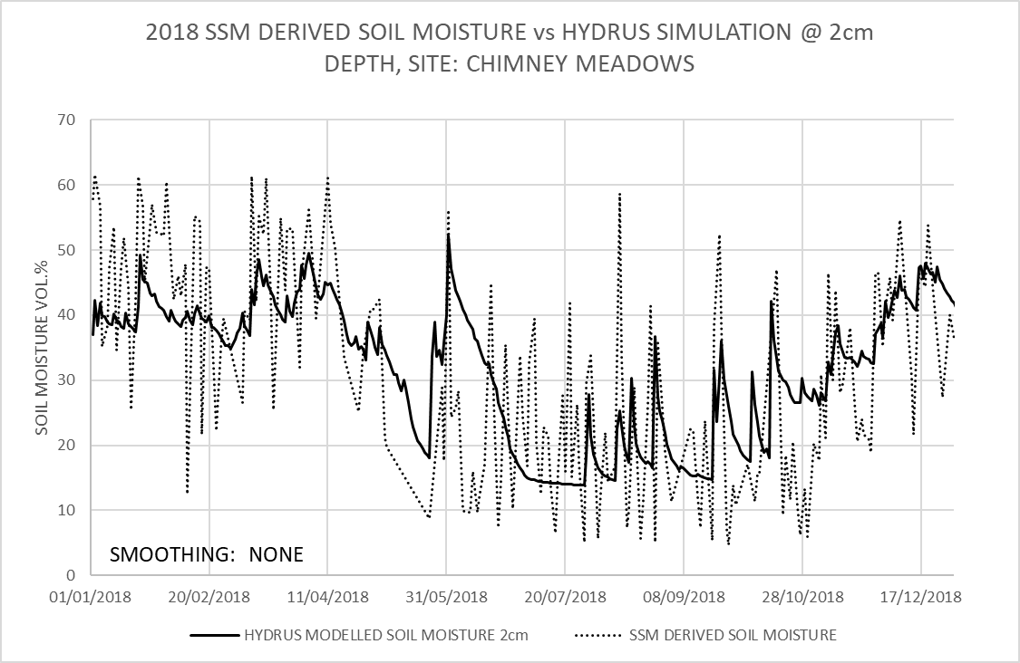
SSM versus 2cm depth HYDRUS-1D CHIMN

Slide 18
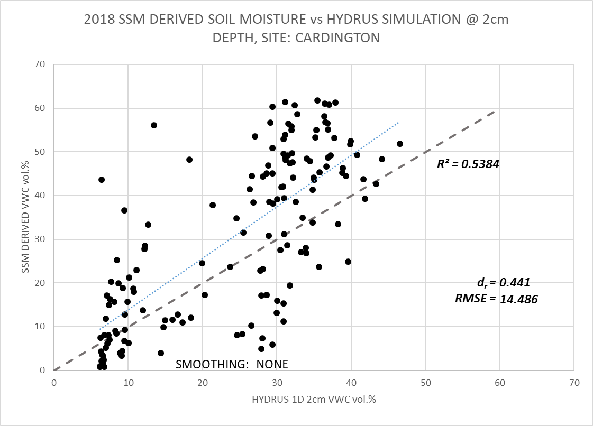
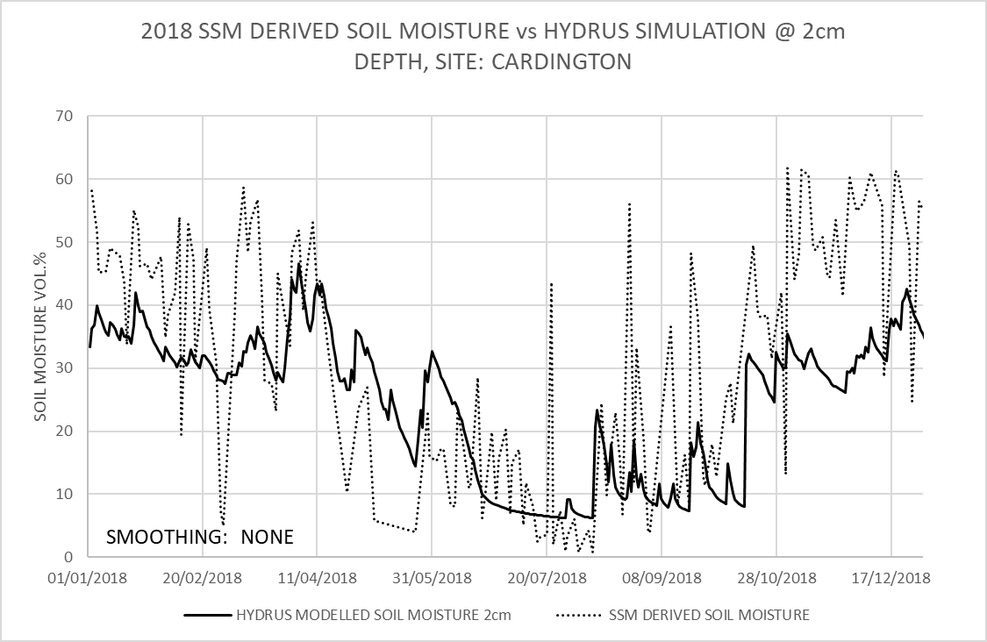
SSM versus 2cm depth HYDRUS-1D CARDT

Slide 19
Results – Benefit of using modelled 2cm Data
SITE | “Ground Truth” | Willmott Index d_{r} | RMSE | R² | Slope error (bias) | Offset (vol.%)
CHIMN | 2cm HYDRUS | 0.477 | 12.232 | 0.4224 | 3.3% | 0.5579
 | 10cm TDT | 0.453 | 12.227 | 0.4242 | -4.2% | -2.0962
 | COSMOS Sensor | 0.359 | 12.391 | 0.4357 | -19.7% | -8.5514
CARDT | 2cm HYDRUS | 0.441 | 14.486 | 0.5384 | -17.7% | 2.1452
 | 10cm TDT | 0.395 | 16.747 | 0.3496 | 5.2% | 8.2853
 | COSMOS Sensor | 0.146 | 14.474 | 0.4028 | -32.1% | 2.6868
The use of 2cm depth modelled data for SSM performance assessment results in a better overall fit (as described by the Willmott Index) and (generally) the lowest bias and offset.
This is based on two sites of similar type and needs further validation

Slide 20
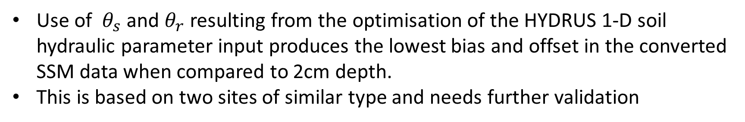
Best wet/dry references to concert SSM to VWC?
SITE | Reference set | Willmott Index d_{r} | RMSE | R² | Slope error (bias) | Offset (vol.%)
CHIMN | Optimised θ_{s}/θ_{r} | 0.477 | 12.232 | 0.4224 | 3.3% | 0.5579
 | HORIZON θ_{s}/θ_{r} | 0.57 | 10.14 | 0.4224 | 25.6% | 10.695
 | HORIZON FC/WP | 0.645 | 8.68 | 0.4224 | 60.3% | 21.903
CARDT | Optimised θ_{s}/θ_{r} | 0.441 | 14.486 | 0.5384 | -17.7% | 2.1452
 | HORIZON θ_{s}/θ_{r} | 0.536 | 11.625 | 0.5384 | 18.4% | 11.69
 | HORIZON FC/WP | 0.549 | 11.455 | 0.5384 | 55.8% | 21.718
Use of $θ_{s}$ and $θ_{r}$ resulting from the optimisation of the HYDRUS 1-D soil hydraulic parameter input produces the lowest bias and offset in the converted SSM data when compared to 2cm depth.
This is based on two sites of similar type and needs further validation

Slide 21
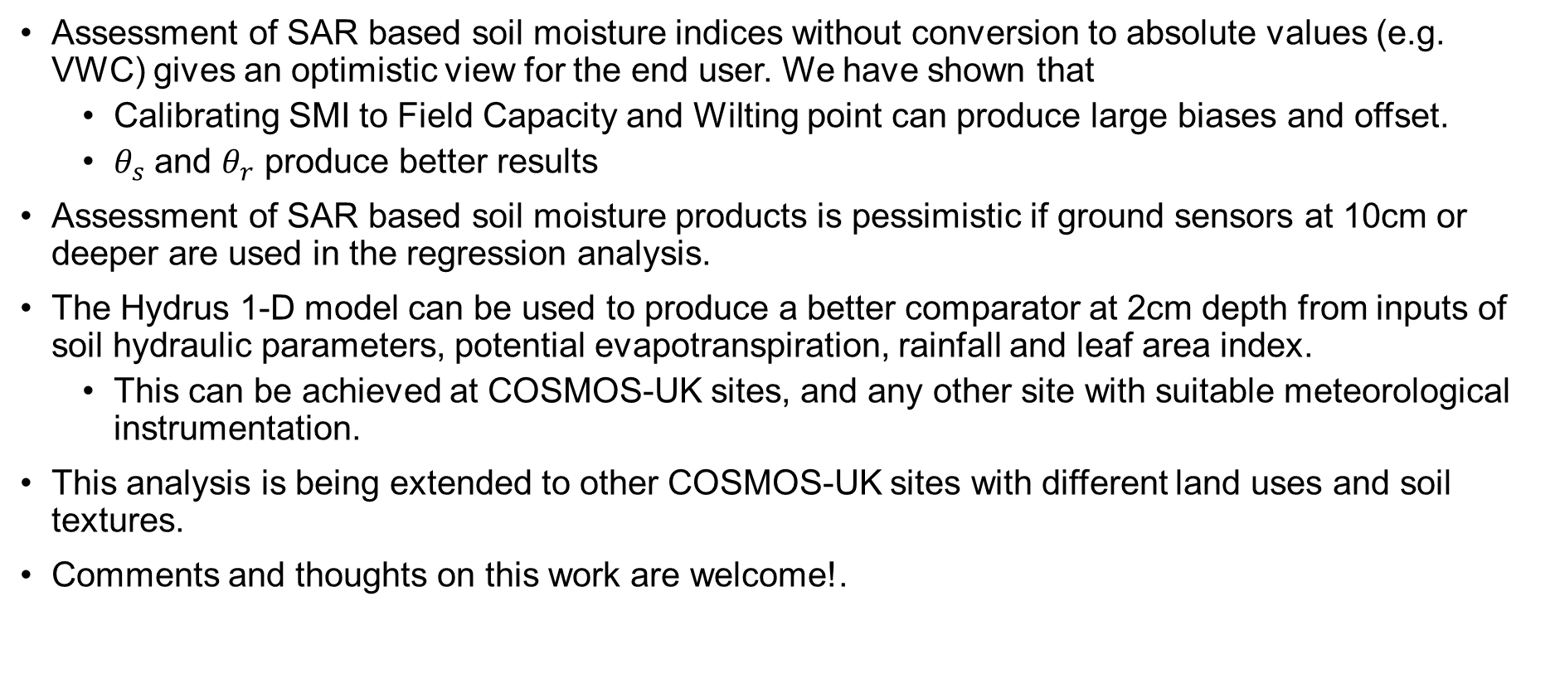
Initial Conclusions
Assessment of SAR based soil moisture indices without conversion to absolute values (e.g. VWC) gives an optimistic view for the end user. We have shown that
  Calibrating SMI to Field Capacity and Wilting point can produce large biases and offset.
  $θ_{s}$ and $θ_{r}$ produce better results
Assessment of SAR based soil moisture products is pessimistic if ground sensors at 10cm or deeper are used in the regression analysis.
The Hydrus 1-D model can be used to produce a better comparator at 2cm depth from inputs of soil hydraulic parameters, potential evapotranspiration, rainfall and leaf area index.
  This can be achieved at COSMOS-UK sites, and any other site with suitable meteorological instrumentation.
This analysis is being extended to other COSMOS-UK sites with different land uses and soil textures.
Comments and thoughts on this work are welcome!.
Notes:
References for this work:
Bauer-Marschallinger B. Copernicus Global Land Operations “Vegetation and Energy”. 2018; (1): 51.
Doubkova M., Wagner W., Naeimi V., Cao S., Bauer-Marschallinger B., Kidd R., et al. The Use of Sentinel-1 for Monitoring of Soil Moisture within the Copernicus Global Land Service. European Space Agency, (Special Publication) ESA SP. Prague: ESA; 2016. p. 105.
Hun E., Crow WT., Holmes T., Bolten J. Benchmarking a Soil Moisture Data Assimilation System for Agricultural Drought Monitoring. Journal of Hydrometeorology. 2014. pp. 1117–1134. Available at: https://ntrs.nasa.gov/search.jsp?R=20140016553
Nolan M., Fatland DR. Penetration depth as a DInSAR observable and proxy for soil moisture. IEEE Transactions on Geoscience and Remote Sensing. March 2003; 41(3): 532–537. Available at: DOI:10.1109/TGRS.2003.809931
Hanks RJ. Applied Soil Physics. New York, NY: Springer New York; 1992. Available at: DOI:10.1007/978-1-4612-2938-4
HYDRUS 1-D: Šimůnek, J., M. Šejna, H. Saito, M. Sakai, and M. Th. van Genuchten, The HYDRUS-1D Software Package for Simulating the Movement of Water, Heat, and Multiple Solutes in Variably Saturated Media, Version 4.17, HYDRUS Software Series 3, Department of Environmental Sciences, University of California Riverside, Riverside, California, USA, pp. 343, 2013.
Cranfield University. LandIS - Land Information System - Homepage Soil Portal. 2017. Available at: http://www.landis.org.uk/ (Accessed: 12 December 2017)
Hollis JM., Lilly A., Higgins A., Jones RJA., Keay CA., Bellamy P. Predicting the water retention characteristics of UK mineral soils. European Journal of Soil Science. 2015; 66(1): 239–252. Available at: DOI:10.1111/ejss.12186
A: Harmel, R.D., Smith, P.K., Migliaccio, K.W., Chaubey, I., Douglas-Mankin, K.R., Benham, B., Shukla, S., Muñoz-Carpena, R. and Robson, B.J. (2014) ‘Evaluating, interpreting, and communicating performance of hydrologic/water quality models considering intended use: A review and recommendations’, Environmental Modelling & Software, 57 Elsevier Ltd, pp. 40–51.
B: Willmott, C.J., Robeson, S.M. and Matsuura, K. (2012) ‘A refined index of model performance’, International Journal of Climatology, 32(13), pp. 2088–2094.

Slide 22
Acknowledgements
The authors thank David Boorman (UKCEH) and Tim Hess (Cranfield University) for detail discussions on soil moisture modelling.
The following data sources are acknowledged:
  COSMOS-UK data: UK Centre for Ecology and Hydrology (UKCEH)
  LANDIS Data: Cranfield Centre for Environmental & Agricultural Informatics, Cranfield University
  Copernicus SSM: The product was generated by the Global component of the Land Service of Copernicus, the Earth Observation programme of the European Commission. The research leading to the current version of the product has received funding from various European Commission Research and Technical Development programs. This product has been generated from Sentinel-1 data distributed by ESA.
  MODIS Leaf Area Index:Myneni, R., Knyazikhin, Y., Park, T. (2015). MYD15A2H MODIS/Aqua Leaf Area Index/FPAR 8-Day L4 Global 500m SIN Grid V006 [Data set]. NASA EOSDIS Land Processes DAAC. Accessed 2020-05-11 from https://doi.org/10.5067/MODIS/MYD15A2H.006
This work was supported by the Biotechnology and Biological Sciences Research Council and the Natural Environment Research Council [grant number NE-R010218-1], through the Soils Training and Research Studentships (STARS) Centre for Doctoral Training. STARS is a consortium consisting of Bangor University, British Geological Survey, Centre for Ecology and Hydrology, Cranfield University, James Hutton Institute, Lancaster University, Rothamsted Research and the University of Nottingham.

