Slide 1
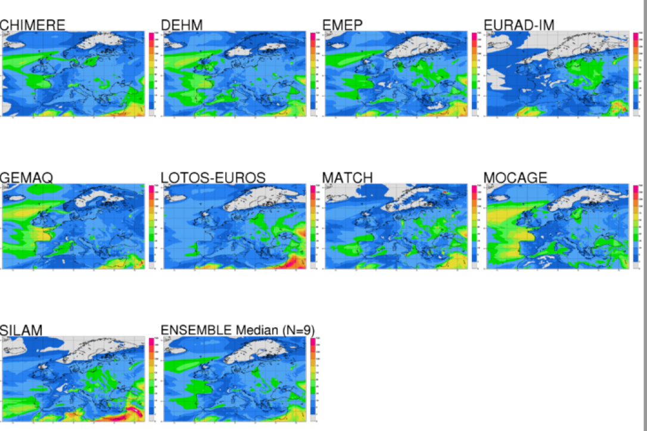



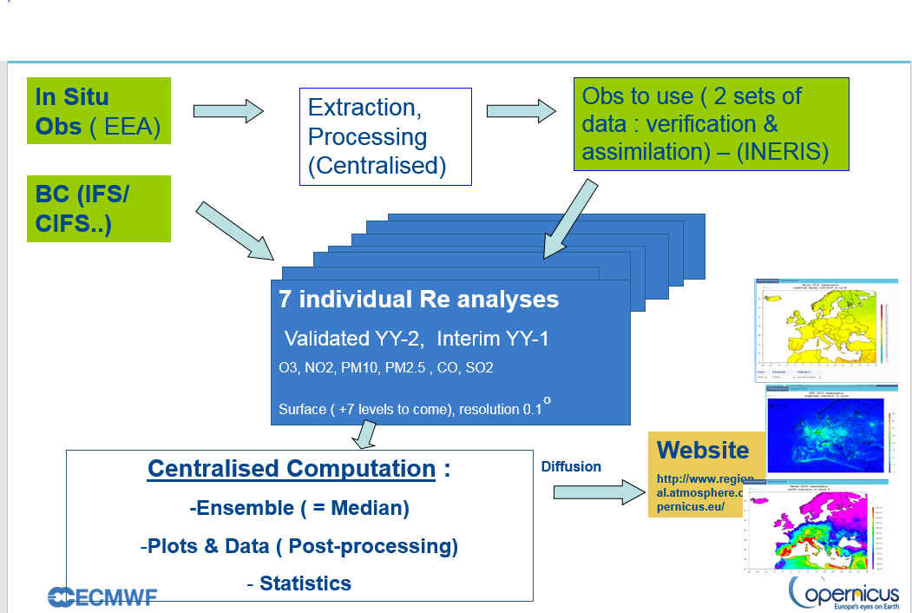
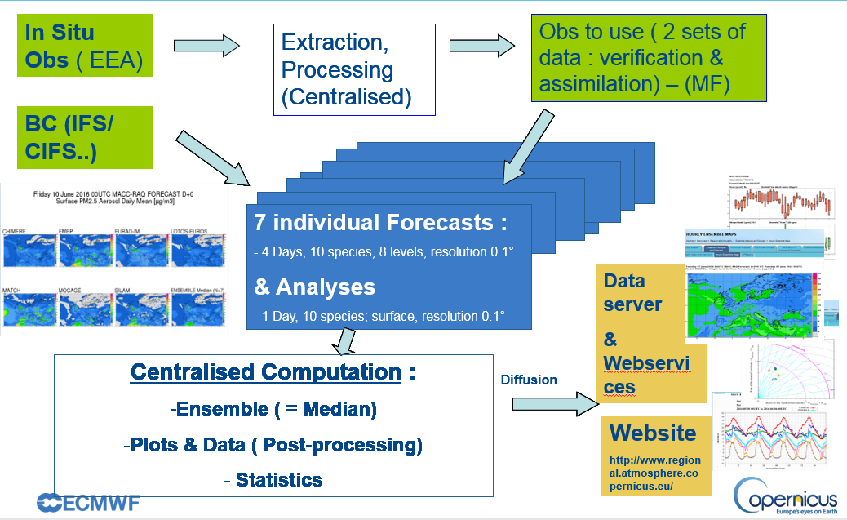
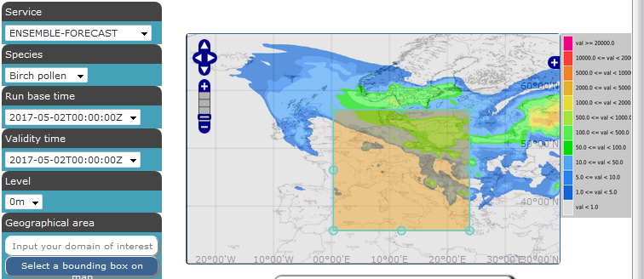
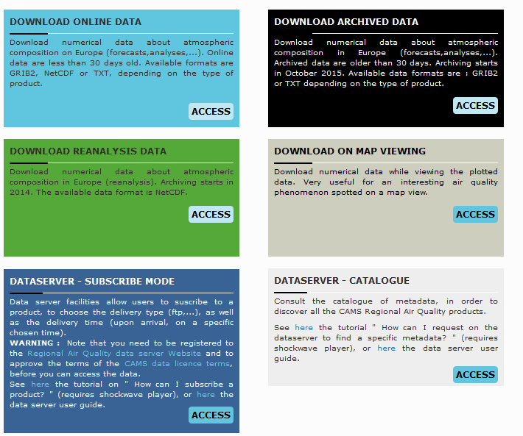
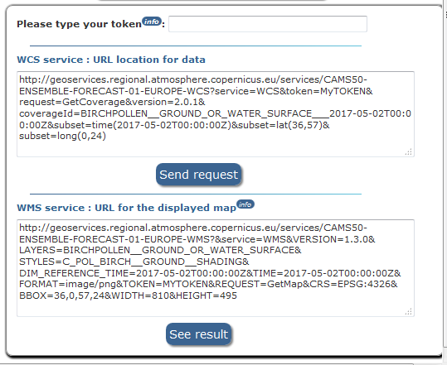

Copernicus Atmosphere Services
Regional Production
G. Collin¹, E. Blot¹, N.Assar¹, A. Colette², F.Meleux², L.Rouïl², J. Barré³
¹Météo-France,² INERIS, ³ ECMWF contact: gaelle.collin@meteo.fr
http://www.regional.atmosphere.copernicus.eu/
Operational Services
Available 24/7
With high service level
Main product is the ENSEMBLE: Median of the 9 individual models
Near Real time products (Forecasts & Analyses)
Reanalyses (Interim YY-1 and Validated for YY-2)
Download data services for: packages, archived data, WMS & WCS
Reanalyses: indicators on surface (seasonal and annual mean – surface concentration, etc.)
NRT products: static plots (jpg & pdf), numerical format and web services for all models, all levels, all species
Services Evolutions
Continuous development and evolutions of models, services and products
Validation of all models and of the Ensemble against in situ observation
Increase availability of output products for
  air quality management (diagnostics)
  forcing of national/local forecasts (boundary conditions)
9 Operational Models | 2 Candidate Models
CHIMERE (INERIS) DEHM (Aarhus Univ.) EMEP/MSC-W (Met Norway) EURAD-IM (RIUUK) GEM-AQ (WUT/IEP) Lotos-Euros (KNMI/TNO) MATCH (SMHI) MOCAGE (Météo-France) SILAM (FMI) | MINNI (ENEA) MONARCH (BSC)
Near Real Time Production Line
Reanalyses Production Line
9
9
Data distribution through web services based on standard / Web Map / Web Coverage Services to enable GIS implementation
Service access will evolve in 2020 with a distribution of CAMS regional data through the Copernicus Atmosphere Monitoring Service Atmosphere Data Store (ADS), developed and maintained at ECMWF

