Slide 1
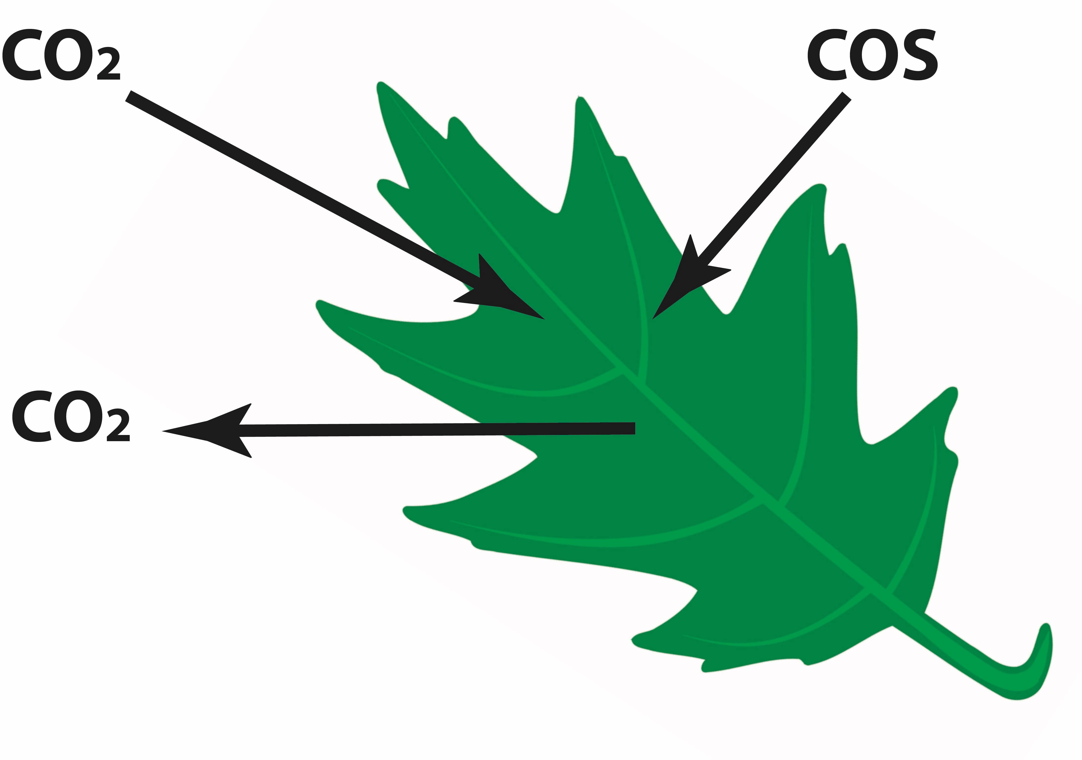
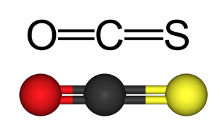
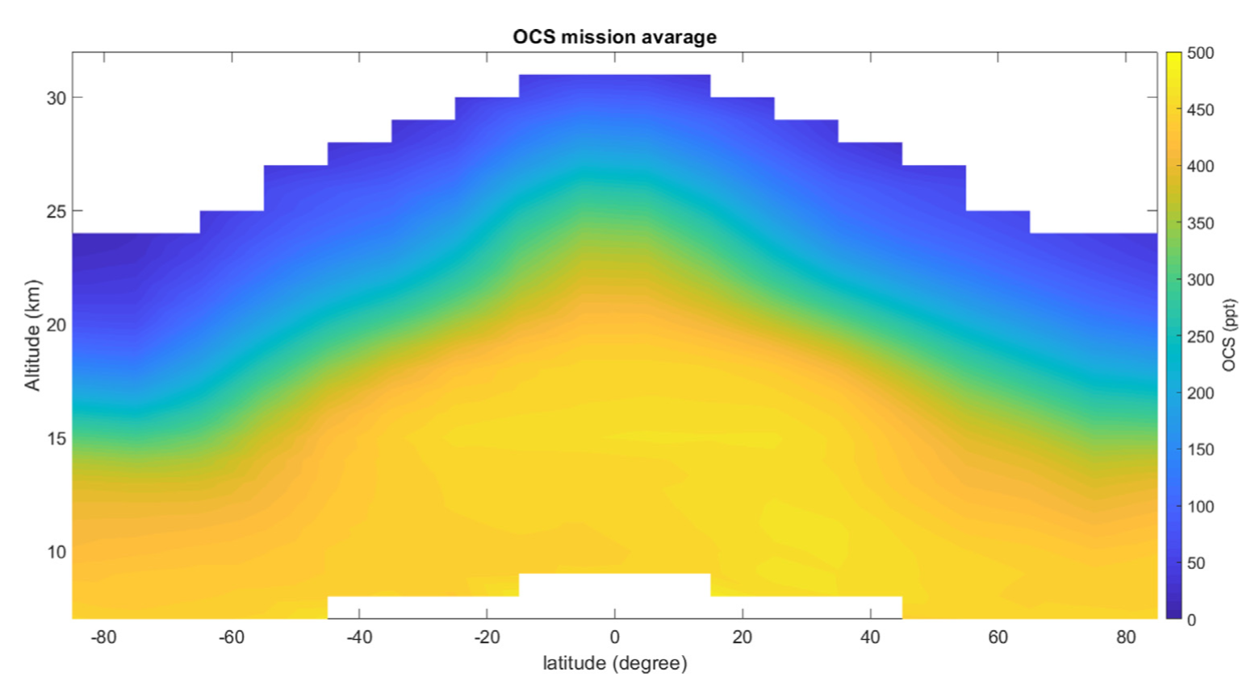
Isotopic Measurements
A New Tool for Studying Global Carbonyl Sulfide
Sophie Baartman¹, Elena Popa¹, Maarten Krol^{1,2}, Karina Adcock³, Johannes Laube⁴ & Thomas Röckmann¹
¹Utrecht University, Netherlands, ²Wageningen University, Netherlands, ³University of East Anglia, UK, ⁴Forzungszentrum Jülich, Germany

Slide 2
Content
Some slides contain additional notes with more information on the slide content. Find them in the note section underneath the slide
Introduction
What is carbonyl sulfide (COS) and what are its isotopologues
COS and the biosphere
COS and the stratosphere
Existing COS isotope measurements
Methods
Preliminary results
COS isotopes in firn air (EGRIP 2018)
COS isotopes from the stratosphere (StratoClim 2017)
Future plans
HEMERA 2021(?)
Summary

Slide 3
Introduction
Most abundant sulfur containing gas in atmosphere
Average tropospheric concentration: 500 ppt
Lifetime of about 2 years
Transported into stratosphere
Four stable sulfur isotopes
³²S | ³³S | ³⁴S | ³⁶S
95.02% | 0.75% | 4.21% | 0.02%
Notes:
The light isotope ³²S is the most abundant sulfur isotope, followed by ³⁴S and ³³S. ³⁶S is the least abundant isotope with only 0.02% occurrence. It is therefore not usually measured in atmospheric isotope studies. In the current study we will also only look at the three most abundant isotopes of sulfur in COS.

Slide 4
Notes:
The most important source of COS is the ocean, although actual quantity of the source is still under debate. Another source of COS into the atmosphere is industry, including fossil fuel burning and industries which use sulfur, such as rayon production. Biomass burning is also considered as a source of COS. However, it is not yet known how much this source contributes to the overall budget.
The largest sink of COS is the terrestrial biosphere. COS is also destroyed in the stratosphere by oxidation and photolysis reactions.

Slide 5
COS in biosphere
COS as a tracer for global primary production (GPP):
Uptake by plants follows same pathway as CO₂: COS is also destroyed by carbonic anhydrase (CA) and RuBisCo
COS uptake is essentially a one-way reaction
Majority of sources are separated from sinks
Problem: COS budget not closed, large missing sink → need for isotope measurements

Slide 6
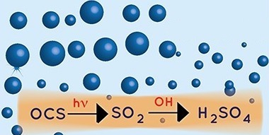
COS in stratosphere
COS broken down by oxidation and photolysis
Likely largest contributor to stratospheric sulfur aerosols
Photolysis likely to have strong isotopic fractionation effect
$CO^{32}S+hν\underset{→}{faster}CO+S$
$$CO^{34}S+hν\underset{→}{slower}CO+S$$
Photolysis and oxidation reactions to form SSA from COS (Kremser et al., 2016)

Slide 7
COS isotope measurements from ambient air so far:
Hattori et al. (2015) ambient air in Japan:
δ³³S: 1.6 +/- 0.5 ‰
δ³⁴S: 4.9 +/- 0.3 ‰
Δ³³S: -0.9 +/- 0.9‰
Kamezaki et al. (2019) ambient air in Japan:
δ³⁴S: 10.5 +/- 0.4 ‰
Angert et al. (2019) ambient air in Israel and Canary Islands:
Average δ³⁴S = 13.2 +/- 0.6 ‰ (no clear difference between locations)
Notes:
This is an overview of all the measurements of sulfur isotopes from COS in the ambient troposphere that have been conducted so far. Hattori et al. (2015) were the first ones to present S from COS isotope measurements from large samples (500 L) of Japanese ambient air. A later value study by the same group, published by Kamezaki et al. (2019) reports a different value of 10.5‰ for d34S, which they argue to be a better representation of the clean ambient atmosphere than their previous measurement. Angert et al. (2019) measured ambient air in both Israel and on the Canary Islands. They found an average value of 13.2‰ for d34S and they did not find a large difference in COS isotopic composition between both locations. They also argue that COS isotopic composition should be homogeneous globally in clean tropospheric air. Kamezaki et al. (2015) explain the difference between their results and that of Anger et al. (2019) by arguing that the air sampled in Japan was likely under the influence of pollution from China, which would make the sulfur lighter.

Slide 8
Methods
Measure S⁺ fragments with GC-IRMS
2 – 4 L samples
Current 3 L precision
³³S: 4.6‰
³⁴S: 2.1‰
System includes option to measure outside air at Utrecht semi-continuously

Slide 9
Pre-concentration system
See notes for more details
Sample or outside air pumped through a magnesium perchlorate dryer
COS is trapped in a collection tube with 200 mg of Tenax TA, cooled with dry ice - ethanol to -78 ∘C
Notes:
The pre-concentration system can either load a sample or it can pump in air from outside the lab in Utrecht. It then passes through a mass flow controller (MFC) and a magnesium perchlorate dryer, through a 6-way valve to the Tenax trap. The Tenax trap is cooled with a mixture of dry ice and ethanol to a temperature of -78 ∘C.

Slide 10
See notes for more details
COS is released from Tenax trap by heating it to 130 ∘C
COS is collected in focus trap, cooled by liquid nitrogen
Notes:
After the loading time is finished (about 30 – 60 minutes, depending on sample pressure) it is released from the Tenax by heating the trap to 130 ∘C. The gas then passes through a second 6-way valve to a focus trap that is cooled with liquid nitrogen to -196 ∘C.

Slide 11
See notes for more details
Focus trap is removed from liquid nitrogen and COS is released at room temperature
Gas passes through heated GC, to IRMS
Notes:
After another 30 minutes, the focus trap is taken out of the liquid nitrogen and the COS is released. The gas passes through a GC, which is heated to 120 ∘C and goes to the isotope-ratio mass spectrometer

Slide 12
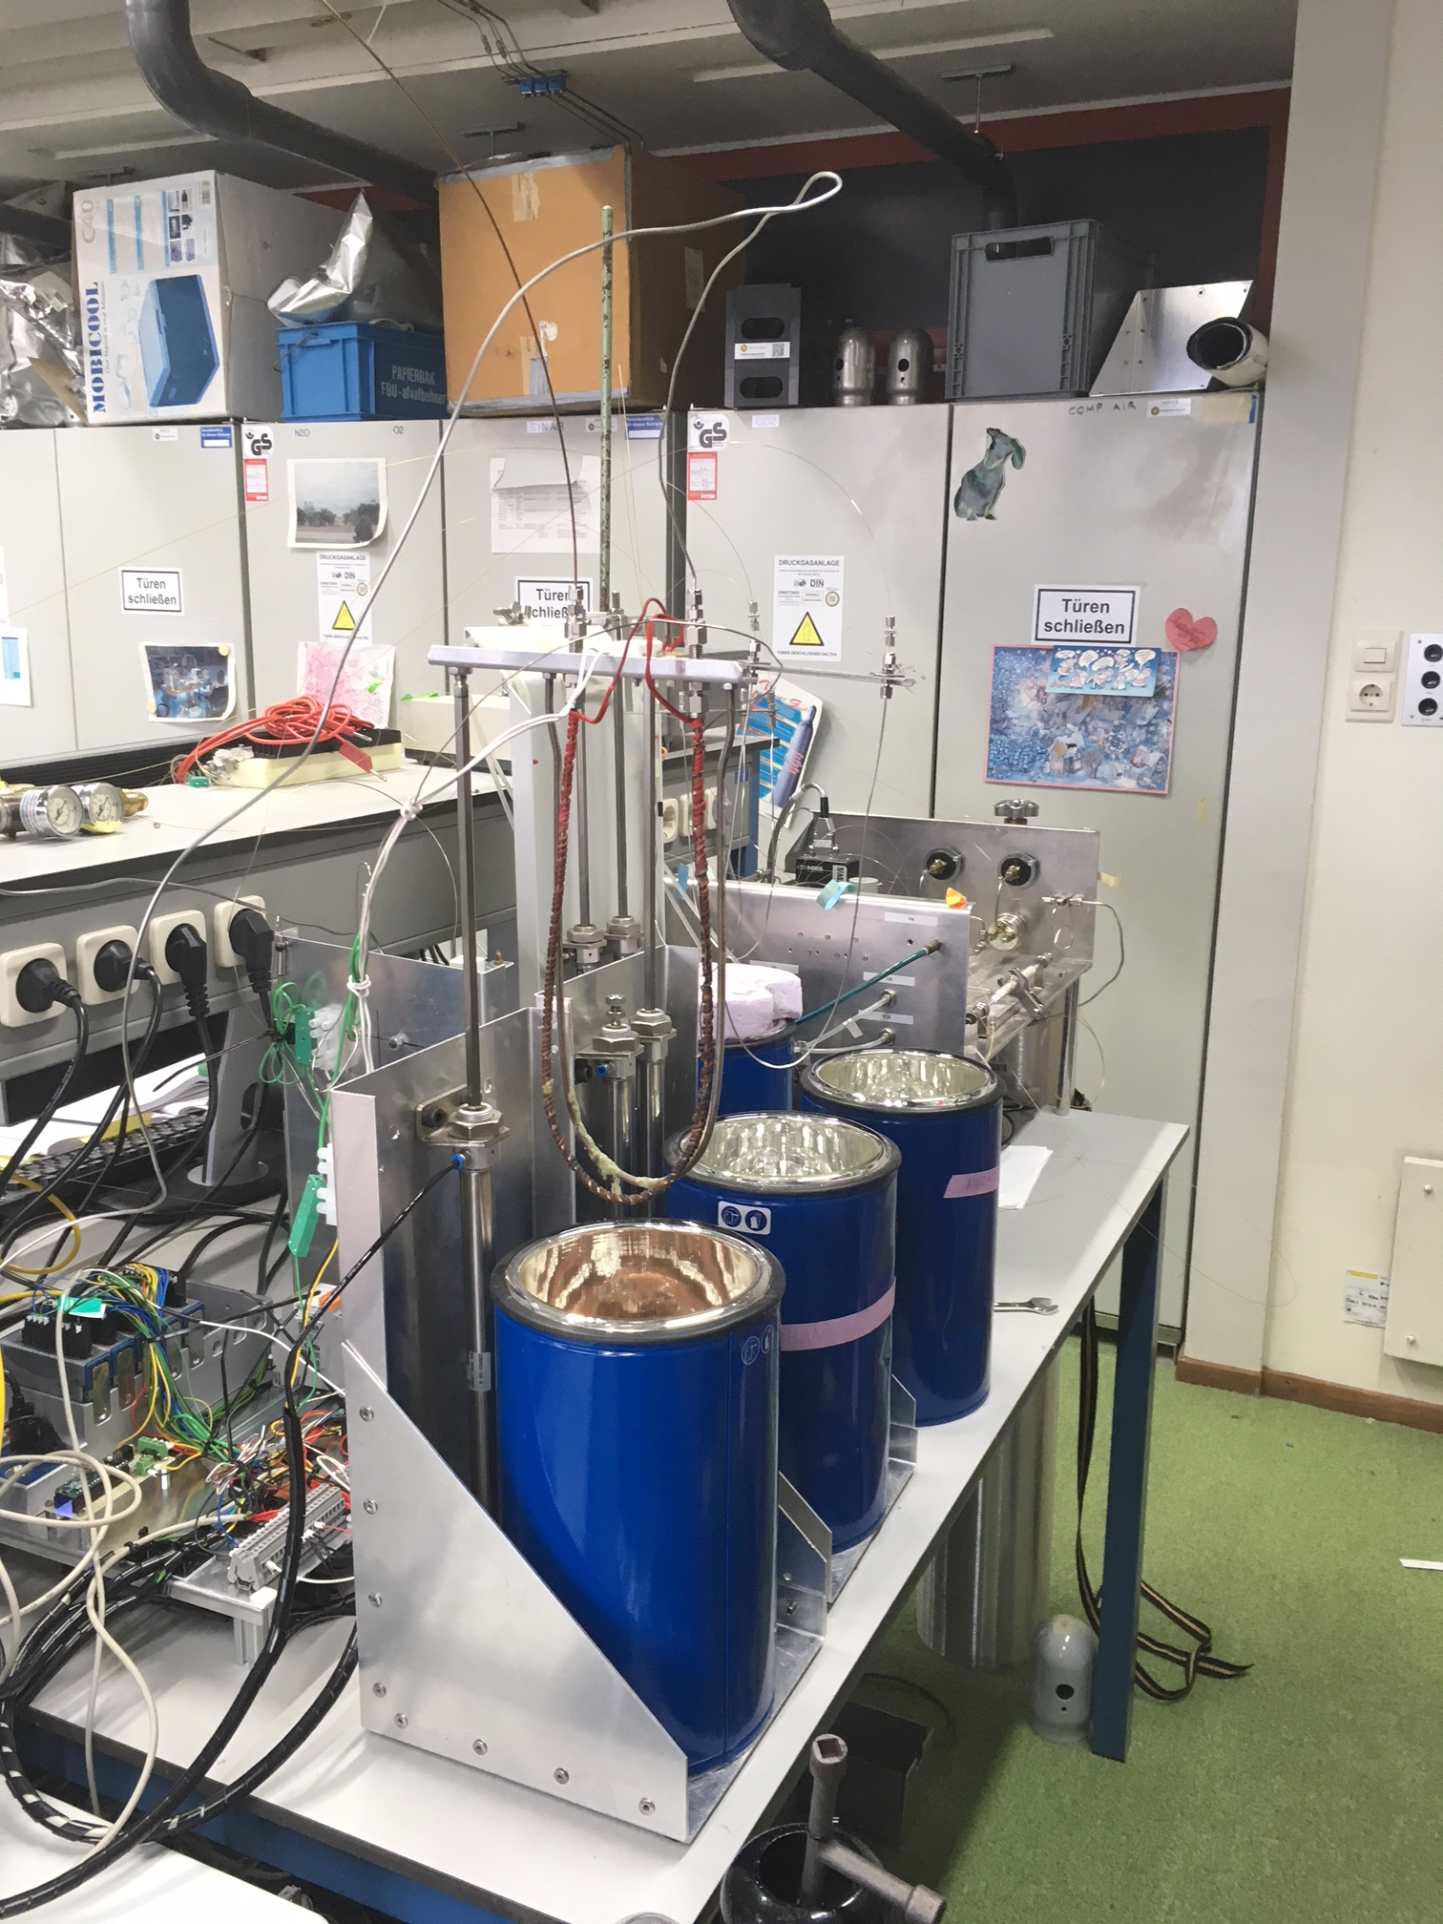
Pre-concentration system in real life

Slide 13
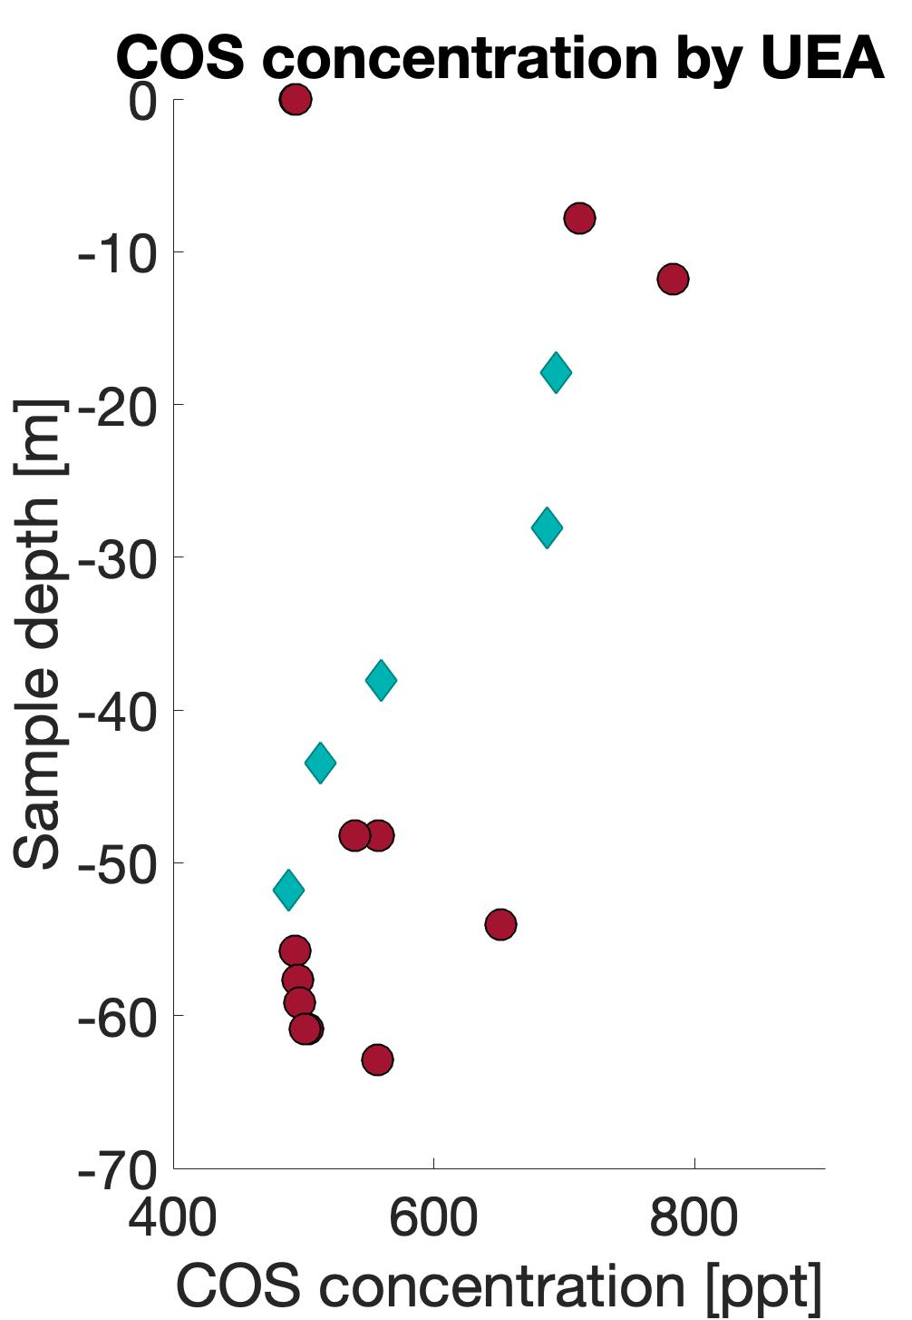
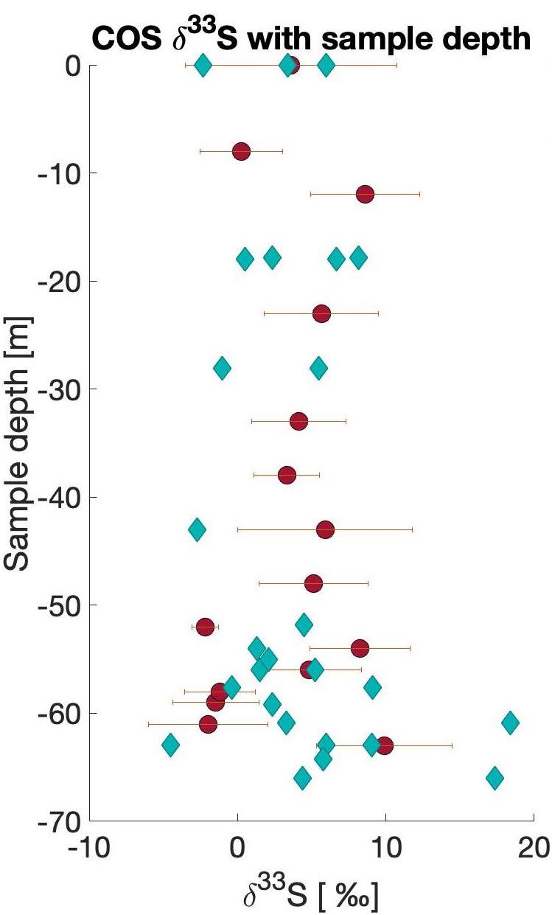
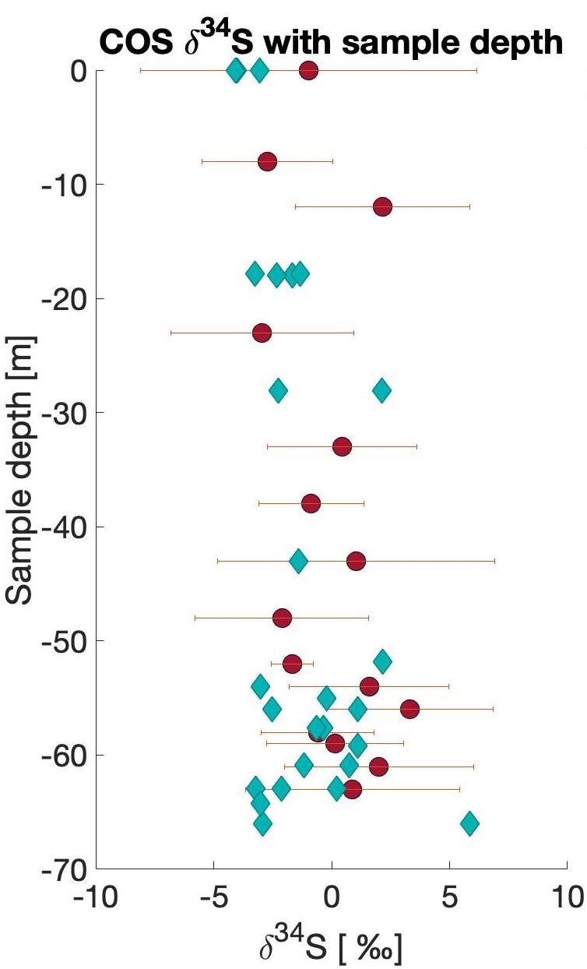
Preliminary results – EGRIP 2018 firn
Ice core drilling on Greenland. Picture taken by Thomas Röckmann during the EGRIP 2018 campaign
Note: uncalibrated isotope data! Only referenced to lab standard. Lab standard = EGRIP surface sample
Adcock, K., Laube, J. (unpublished data)
Notes:
East Greenland Ice coring Project (EGRIP) 2018 was a campaign that retrieved several ice and firn cores.
The COS concentration was measured by
We measured the firn air for COS isotopes. The approximate maximum age for this air was 30 years. Within that timeframe, COS sources and sinks have probably not changed a lot. A small decrease (10 - 16%) in COS mixing ratio has been reported between 1980 and 2000 (Montzka et al,, 2004), as well as a small increase (<10% per decade) since 2001 (Kremser et al., 2015). The distribution of anthropogenic sources shifted slightly to the southern hemisphere. We did not see significant changes in COS sulfur isotopic composition of firn air on Greenland. If there were any changes because of shifting of sources of COS, they were likely within our errorbars.
Note: uncoated cylinders were measured many times, the average was taken and a 1 sigma error bar is included on both sides, the coated canisters were only measured once or twice and their values are presented without errorbars

Slide 14
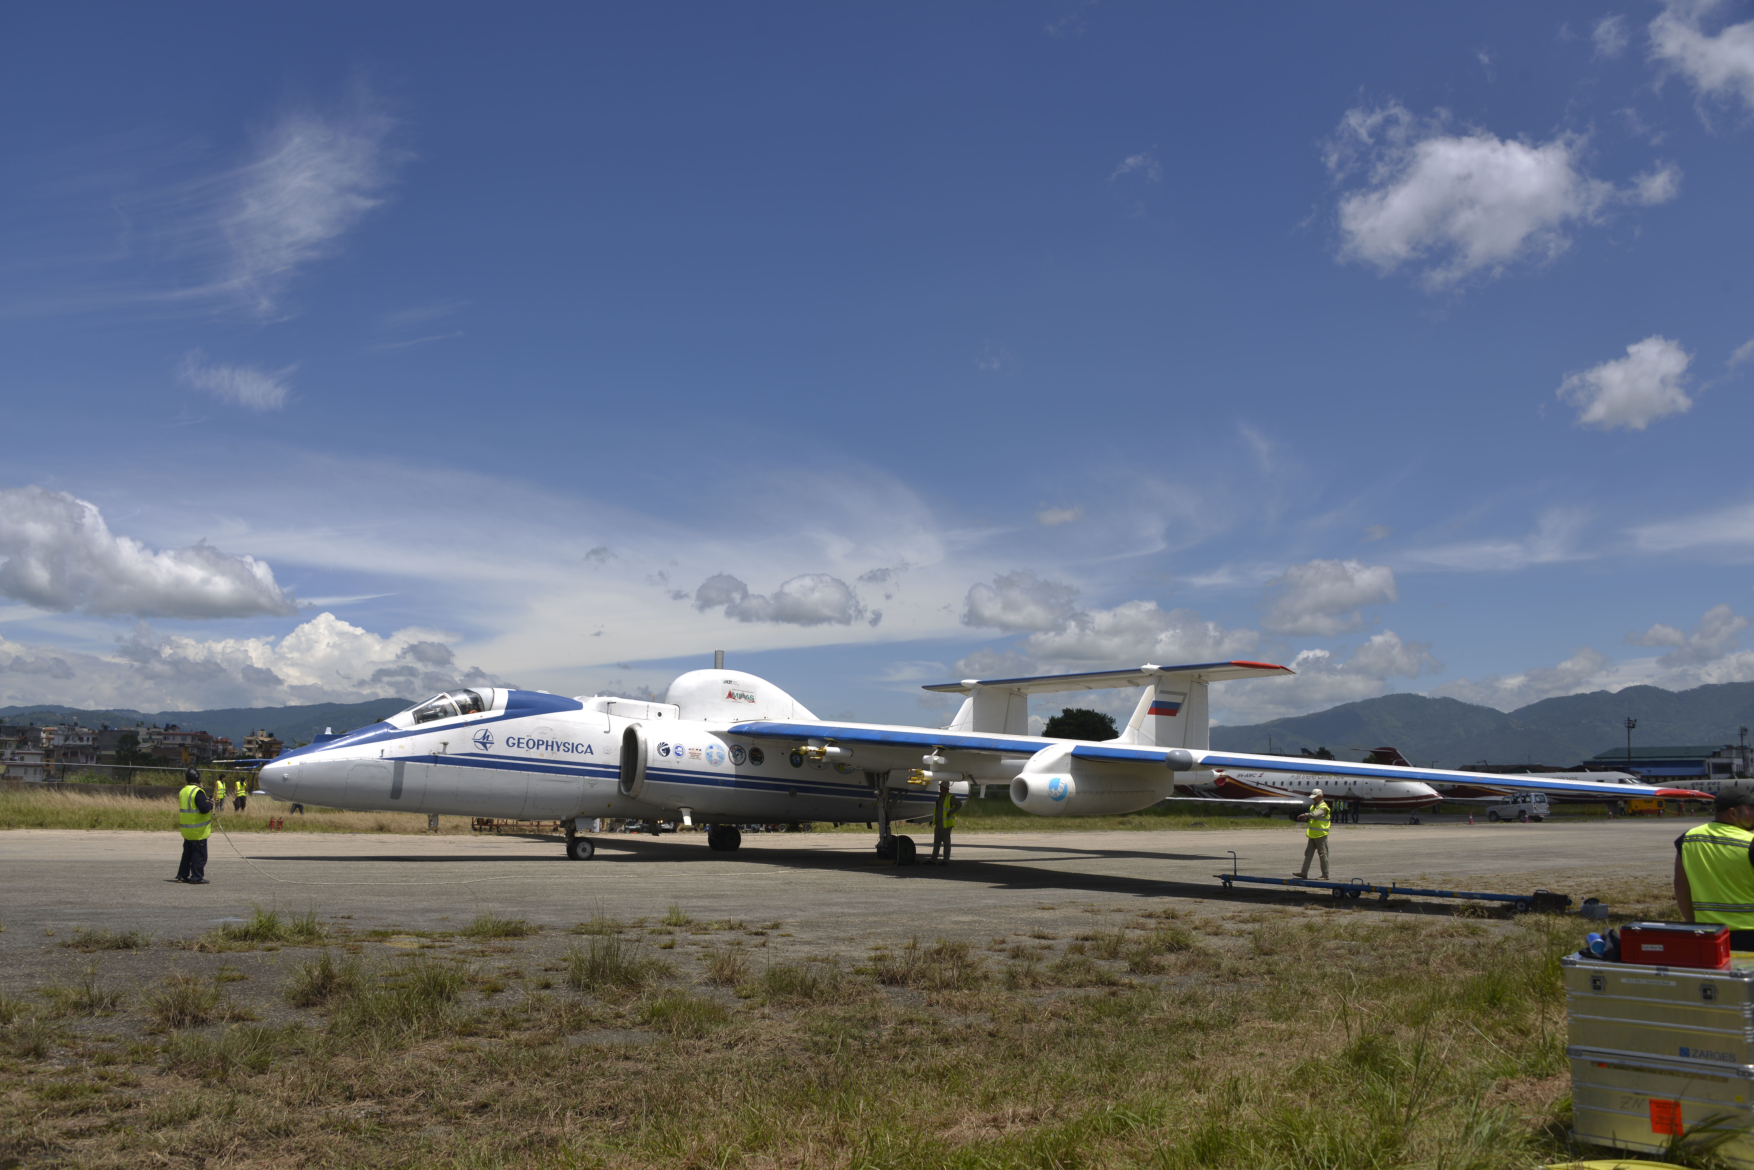
Preliminary results – StratoClim 2017, Kathmandu
Campaign with high altitude research aircraft Geophysica
From Kathmandu during the Asian Summer Monsoon Anticyclone
End of July, beginning of August
Samples between 10 and 20 km
COS isotopes in stratosphere never measured before
Geophysica aircraft in Kathmandu. Picture from StratoClim website: http://stratoclim.org/

Slide 15
COS concentration measurements of all samples from all flights that were measured for COS isotopes
Flights were conducted from July 29th to August 6th
COS concentration decreases with altitude
Rapid decrease above tropopause
Tropopause roughly around 18.5 km
Above tropopause, inmixing of older stratospheric air
Flight 6: varying concentrations because of pollution plumes
Adcock, K., Laube, J. (unpublished data)

Slide 16
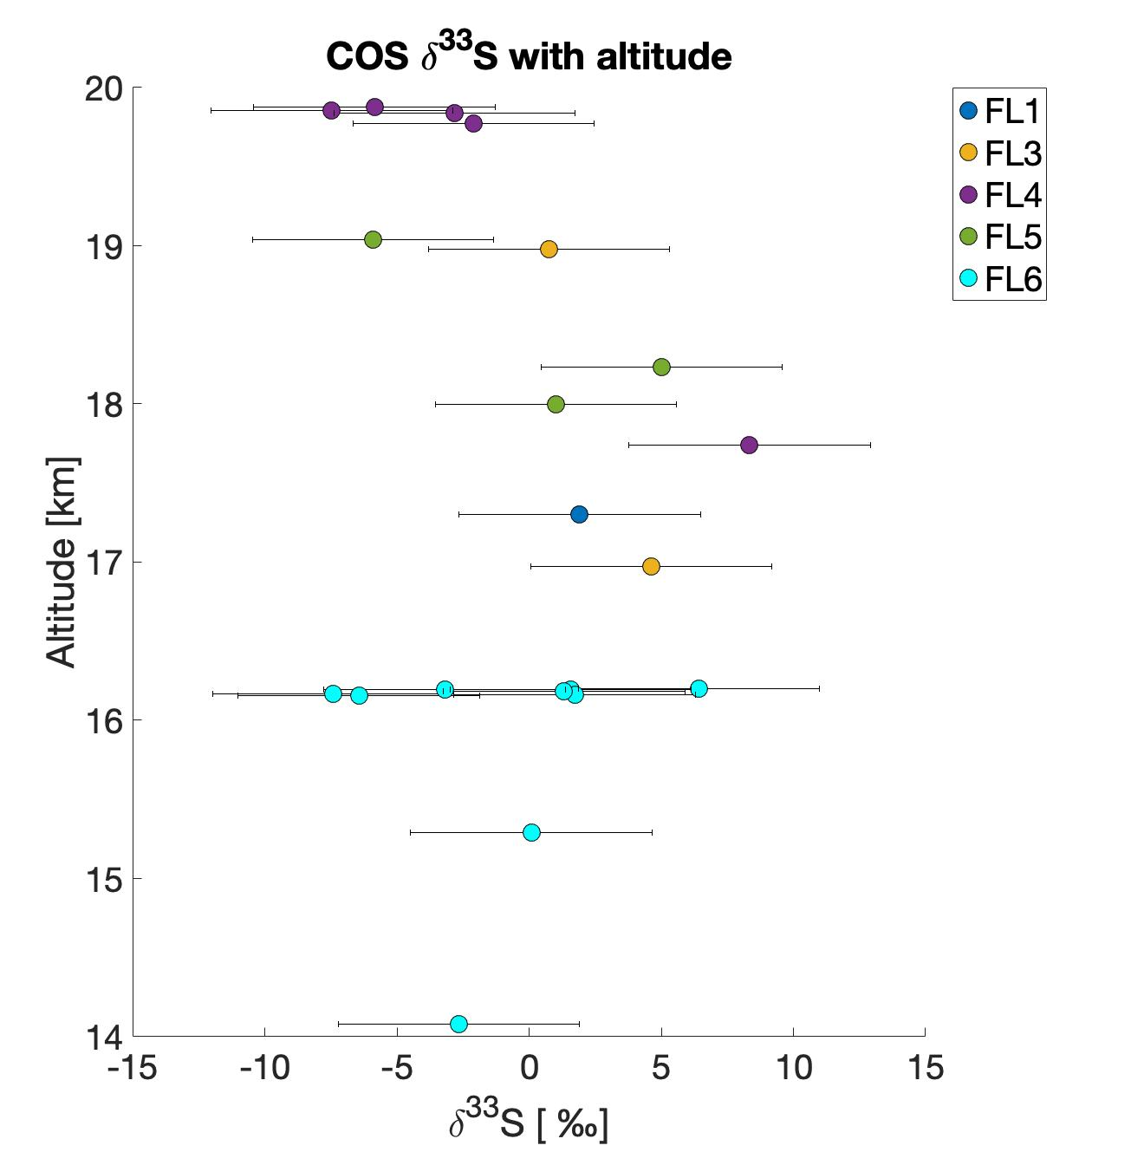
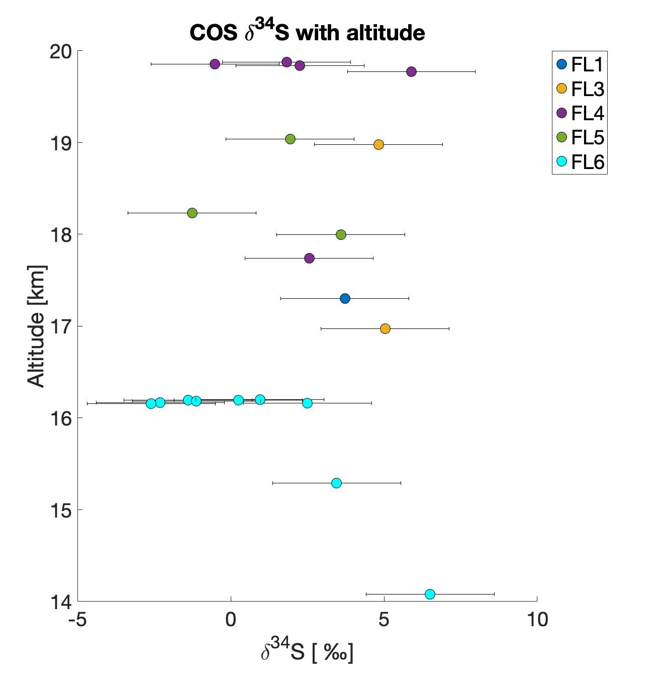
Note: uncalibrated isotope data! Only referenced to lab standard
Notes:
These are the isotope measurement results for all flights, plotted against altitude where the flask sample was taken. These values are not yet calibrated to the international sulfur standard, so one can now only look at the trends and the relative difference between values. From these figures, you can see that if you look at all flight combined, plotted against altitude, there is no distinct trend in d34S. There does seem to perhaps be a trend in the higher altitudes for d33S. However, it is difficult to interpret these data as flights were conducted on different days and different air masses were captured with varying mixing properties from several source areas in the SE Asian region. It is better to look at individual flights and see what is happening with the COS within these datasets

Slide 17
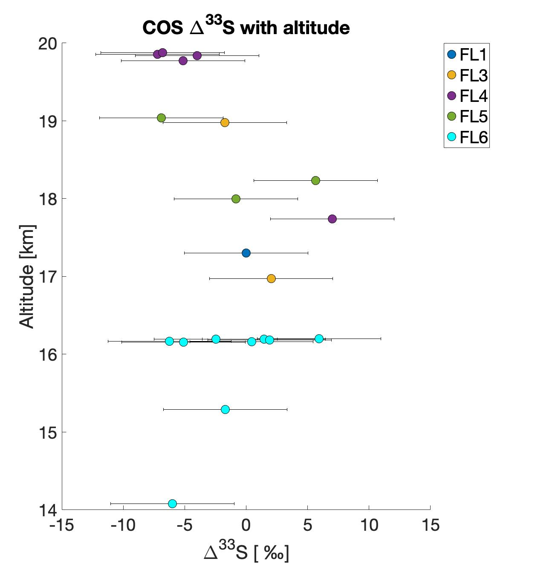
Mass independent fractionation
$$Δ^{SS}S=δ^{33}S−{[\left(δ^{34}S+1\right)}^{f}−1]$$
$$f=0.515$$
Not calibrated, so only trend can be assessed
Decreasing trend above the tropopause (18.5 km)
Air masses from different origins and ages, careful with conclusions

Slide 18
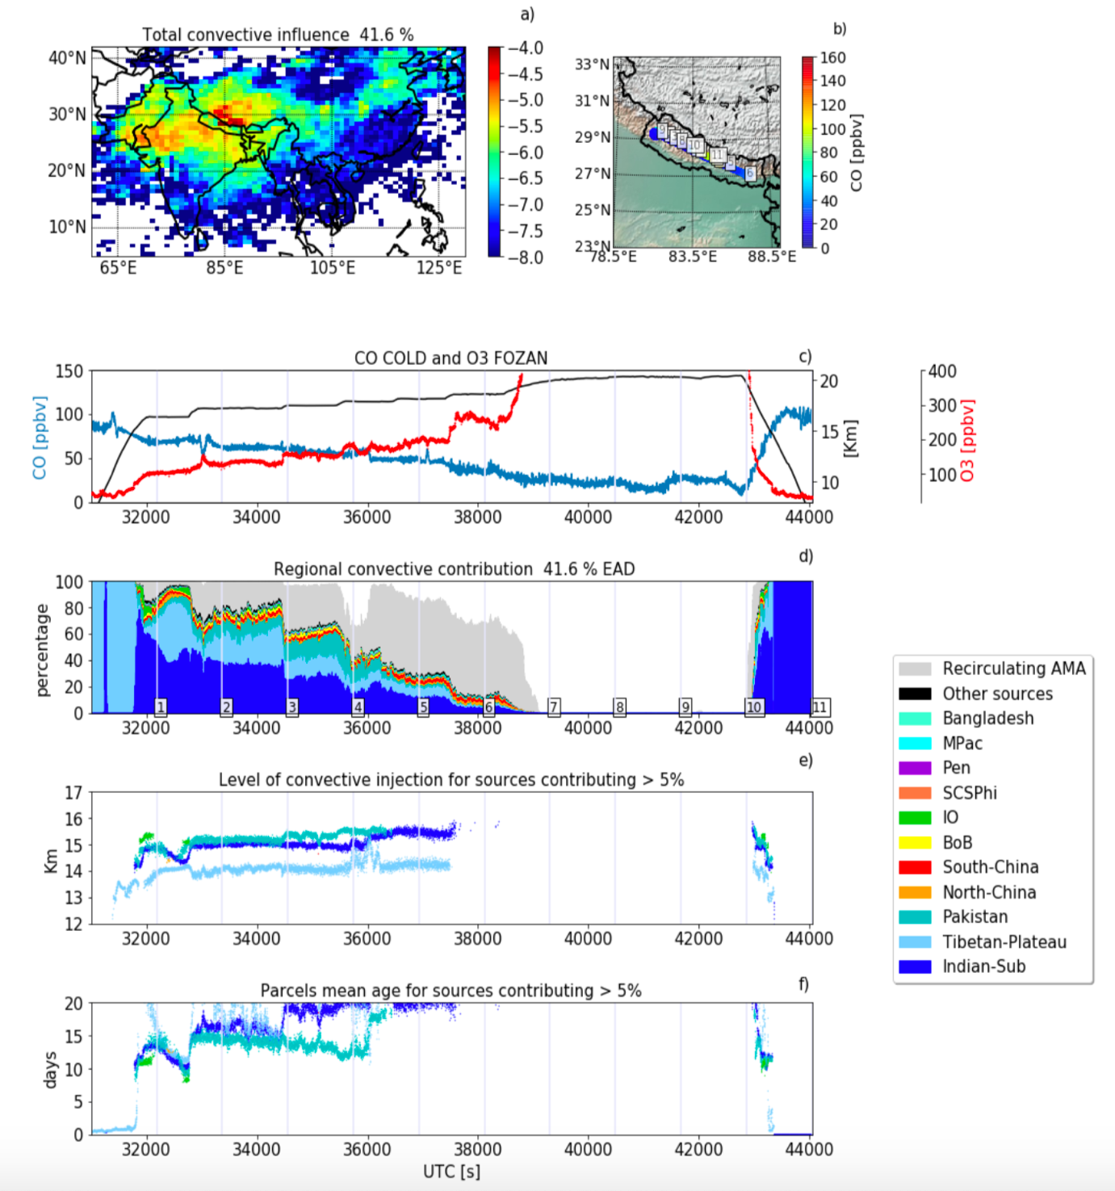
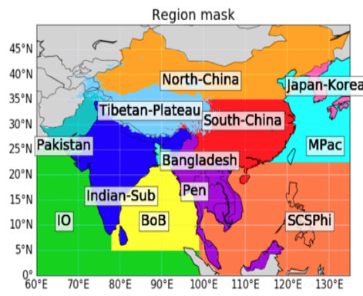
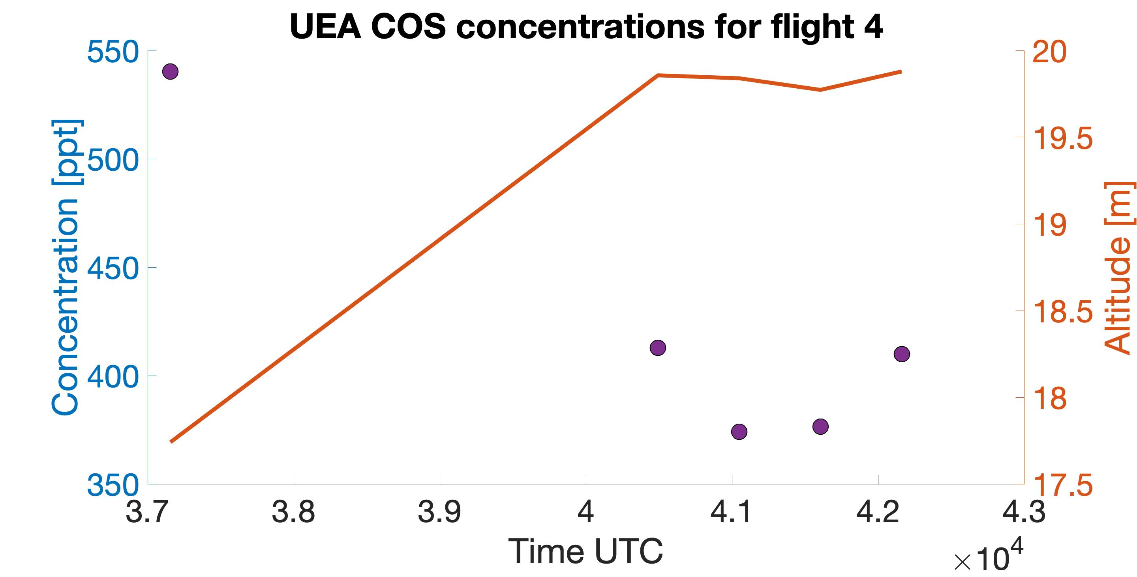
StratoClim flight 4
Flight 4 captured stratospheric air from around 39000 s
First flask sample = upper troposphere
Last four samples = lower stratosphere
Bucci et al. (in review)
Notes:
From the CO and ozone data from Bucci et al, we can see that flight 4 captured old stratospheric air from around 39000 seconds. We can see that this is also reflected in the COS concentrations as they decrease rapidly between the sample taken at 370000 and the other four samples taken after 40000 s. In the next slides I will show the isotope measurements and a comparison with methane concentrations to further investigate the influence of inmixing of stratospheric air on sulfur isotopes.

Slide 19
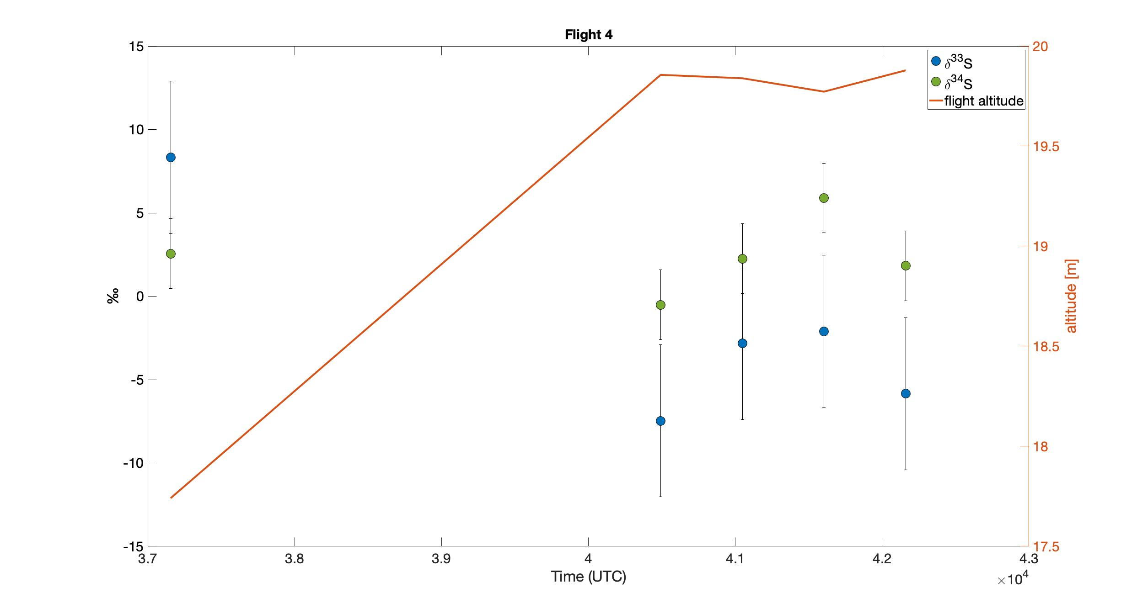
Comparison COS concentration and isotope values:
First sample, taken at lower altitude: about 150 ppt higher concentration than rest
The first sample has distinctively higher δ³³S than the rest of the samples
The other four samples, taken where there was mixing of stratospheric air, show interesting pattern
More enriched sulfur with lower COS concentration
See next slide for comparison with methane concentration data

Slide 20
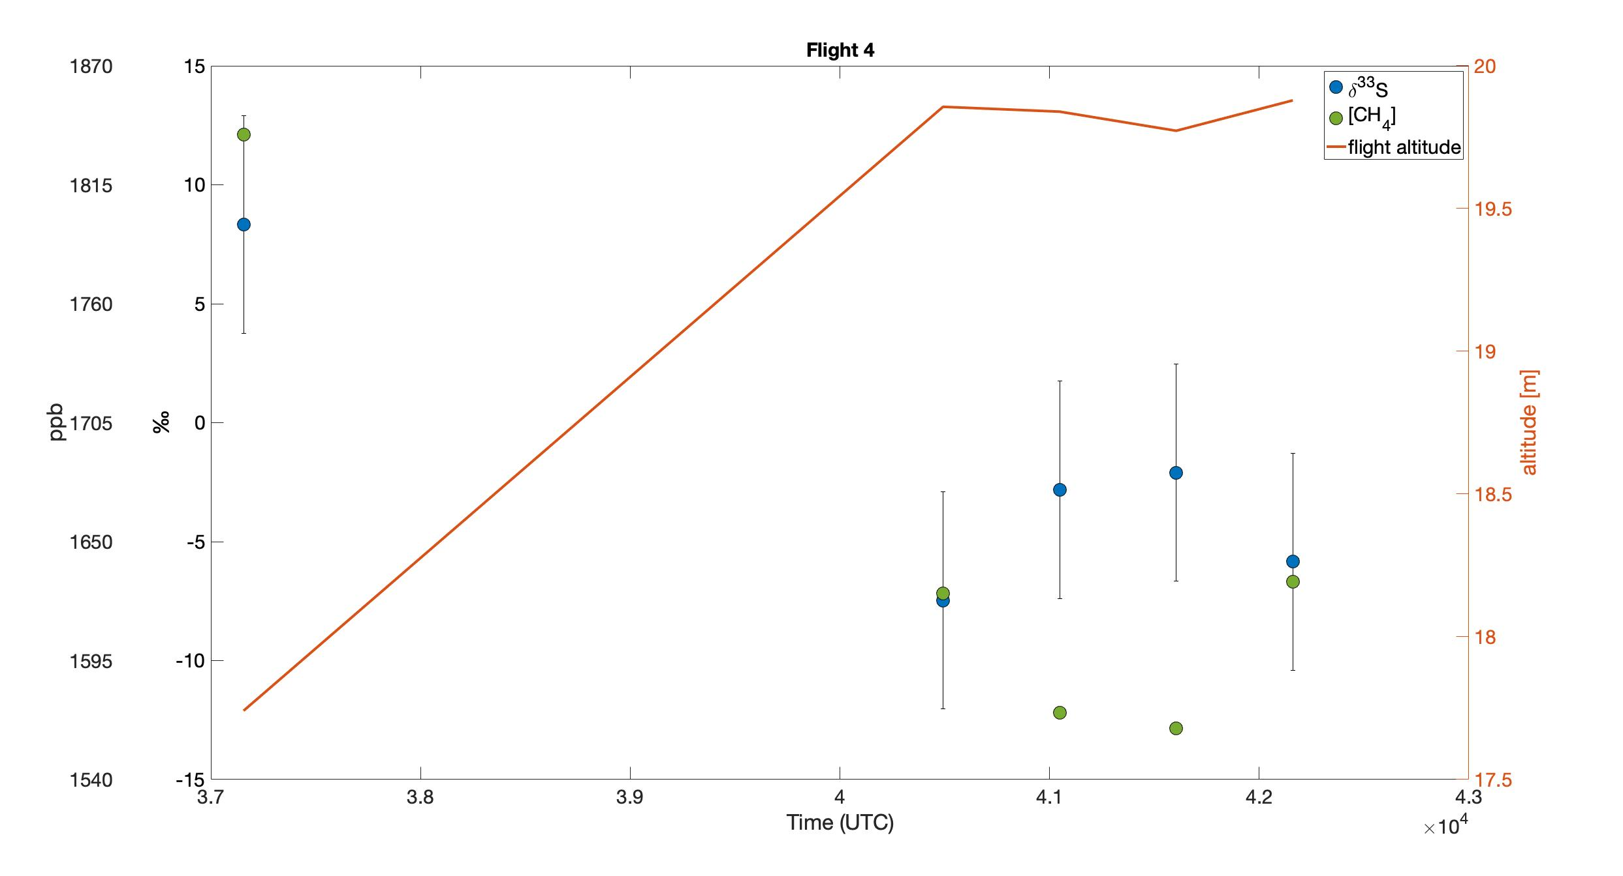
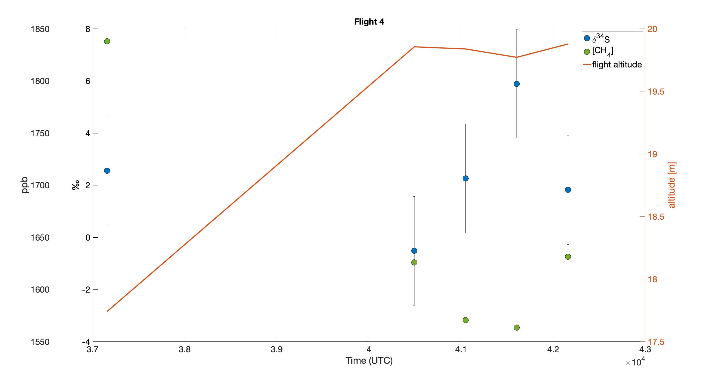
Comparison of COS isotope values with CH₄ concentrations:
First sample: high [CH₄]: tropospheric air
Higher δ³³S but δ³⁴S not significantly different
Last four samples: downward and upward trend in [CH₄]
Anticorrelation with both δ³³S and δ³⁴S
Could point to photolysis in stratosphere making S enriched in heavier isotopes

Slide 21
Future plans
Improve precision of measurement system
Calibration to international standard
Set up method for C isotopes from COS
Measure
Stratosphere: StratoClim, NASA ATom, HEMERA 2021 (?)
Diurnal and seasonal cycles: outside air from Utrecht semi-continuously
Volcano’s: Etna (and others)

Slide 22
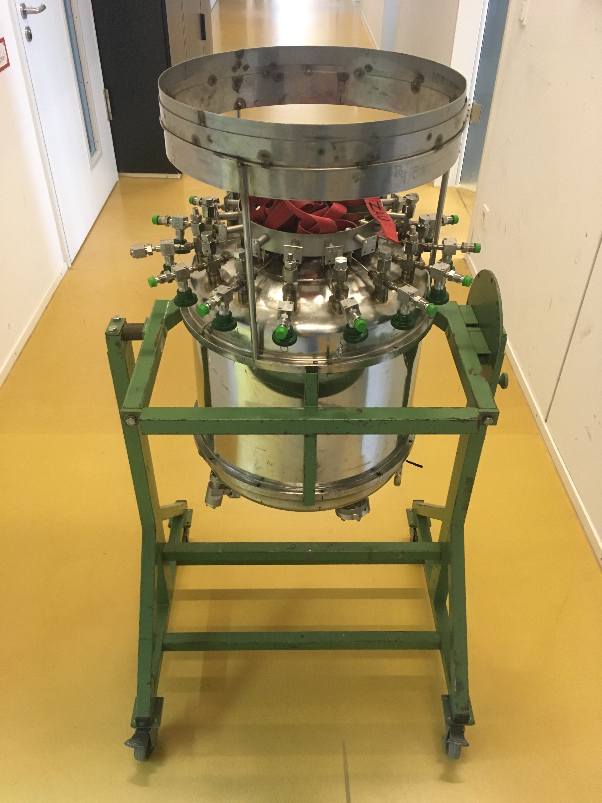
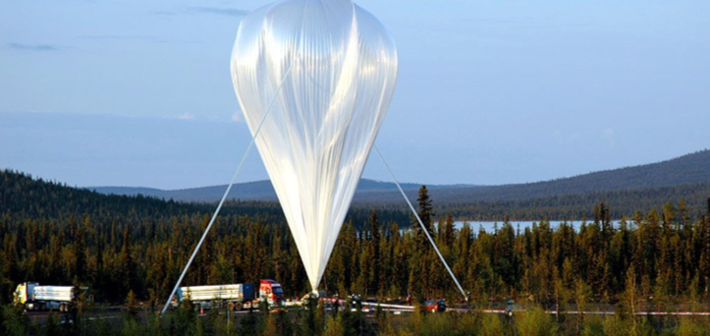
HEMERA 2021(?)
Balloon sampling in Kiruna, Sweden
August or September 2021 (hopefully)
Sampling up to 35 km
Strong signal from photolysis expected
Cyrosampler:
15 whole air samples
Selection flown with O₃ destructing catalyst
Measure
Age of air, chlorine and bromine budget (Andreas Engel)
LISA sampler, AirCore (Huilin Chen & Steven van Heuven)
CO₂, CH₄, H₂O (Mélanie Ghysel-Dubois)
Mega AirCore (Johannes Laube)
COS isotopologues (Sophie Baartman & Elena Popa)
Cryosampler in transport to Utrecht
Stratospheric balloon being launched from Kiruna. Picture from SSC website: https://www.sscspace.com/hemera/
Notes:
The HEMERA 2020 campaign was planned for this August/September. Unfortunately, due to the Corona crisis, this campaign has been postponed. We hope to still participate in the HEMERA 2021 campaign and gather interesting samples in the stratosphere to measure for COS isotopes.

Slide 23
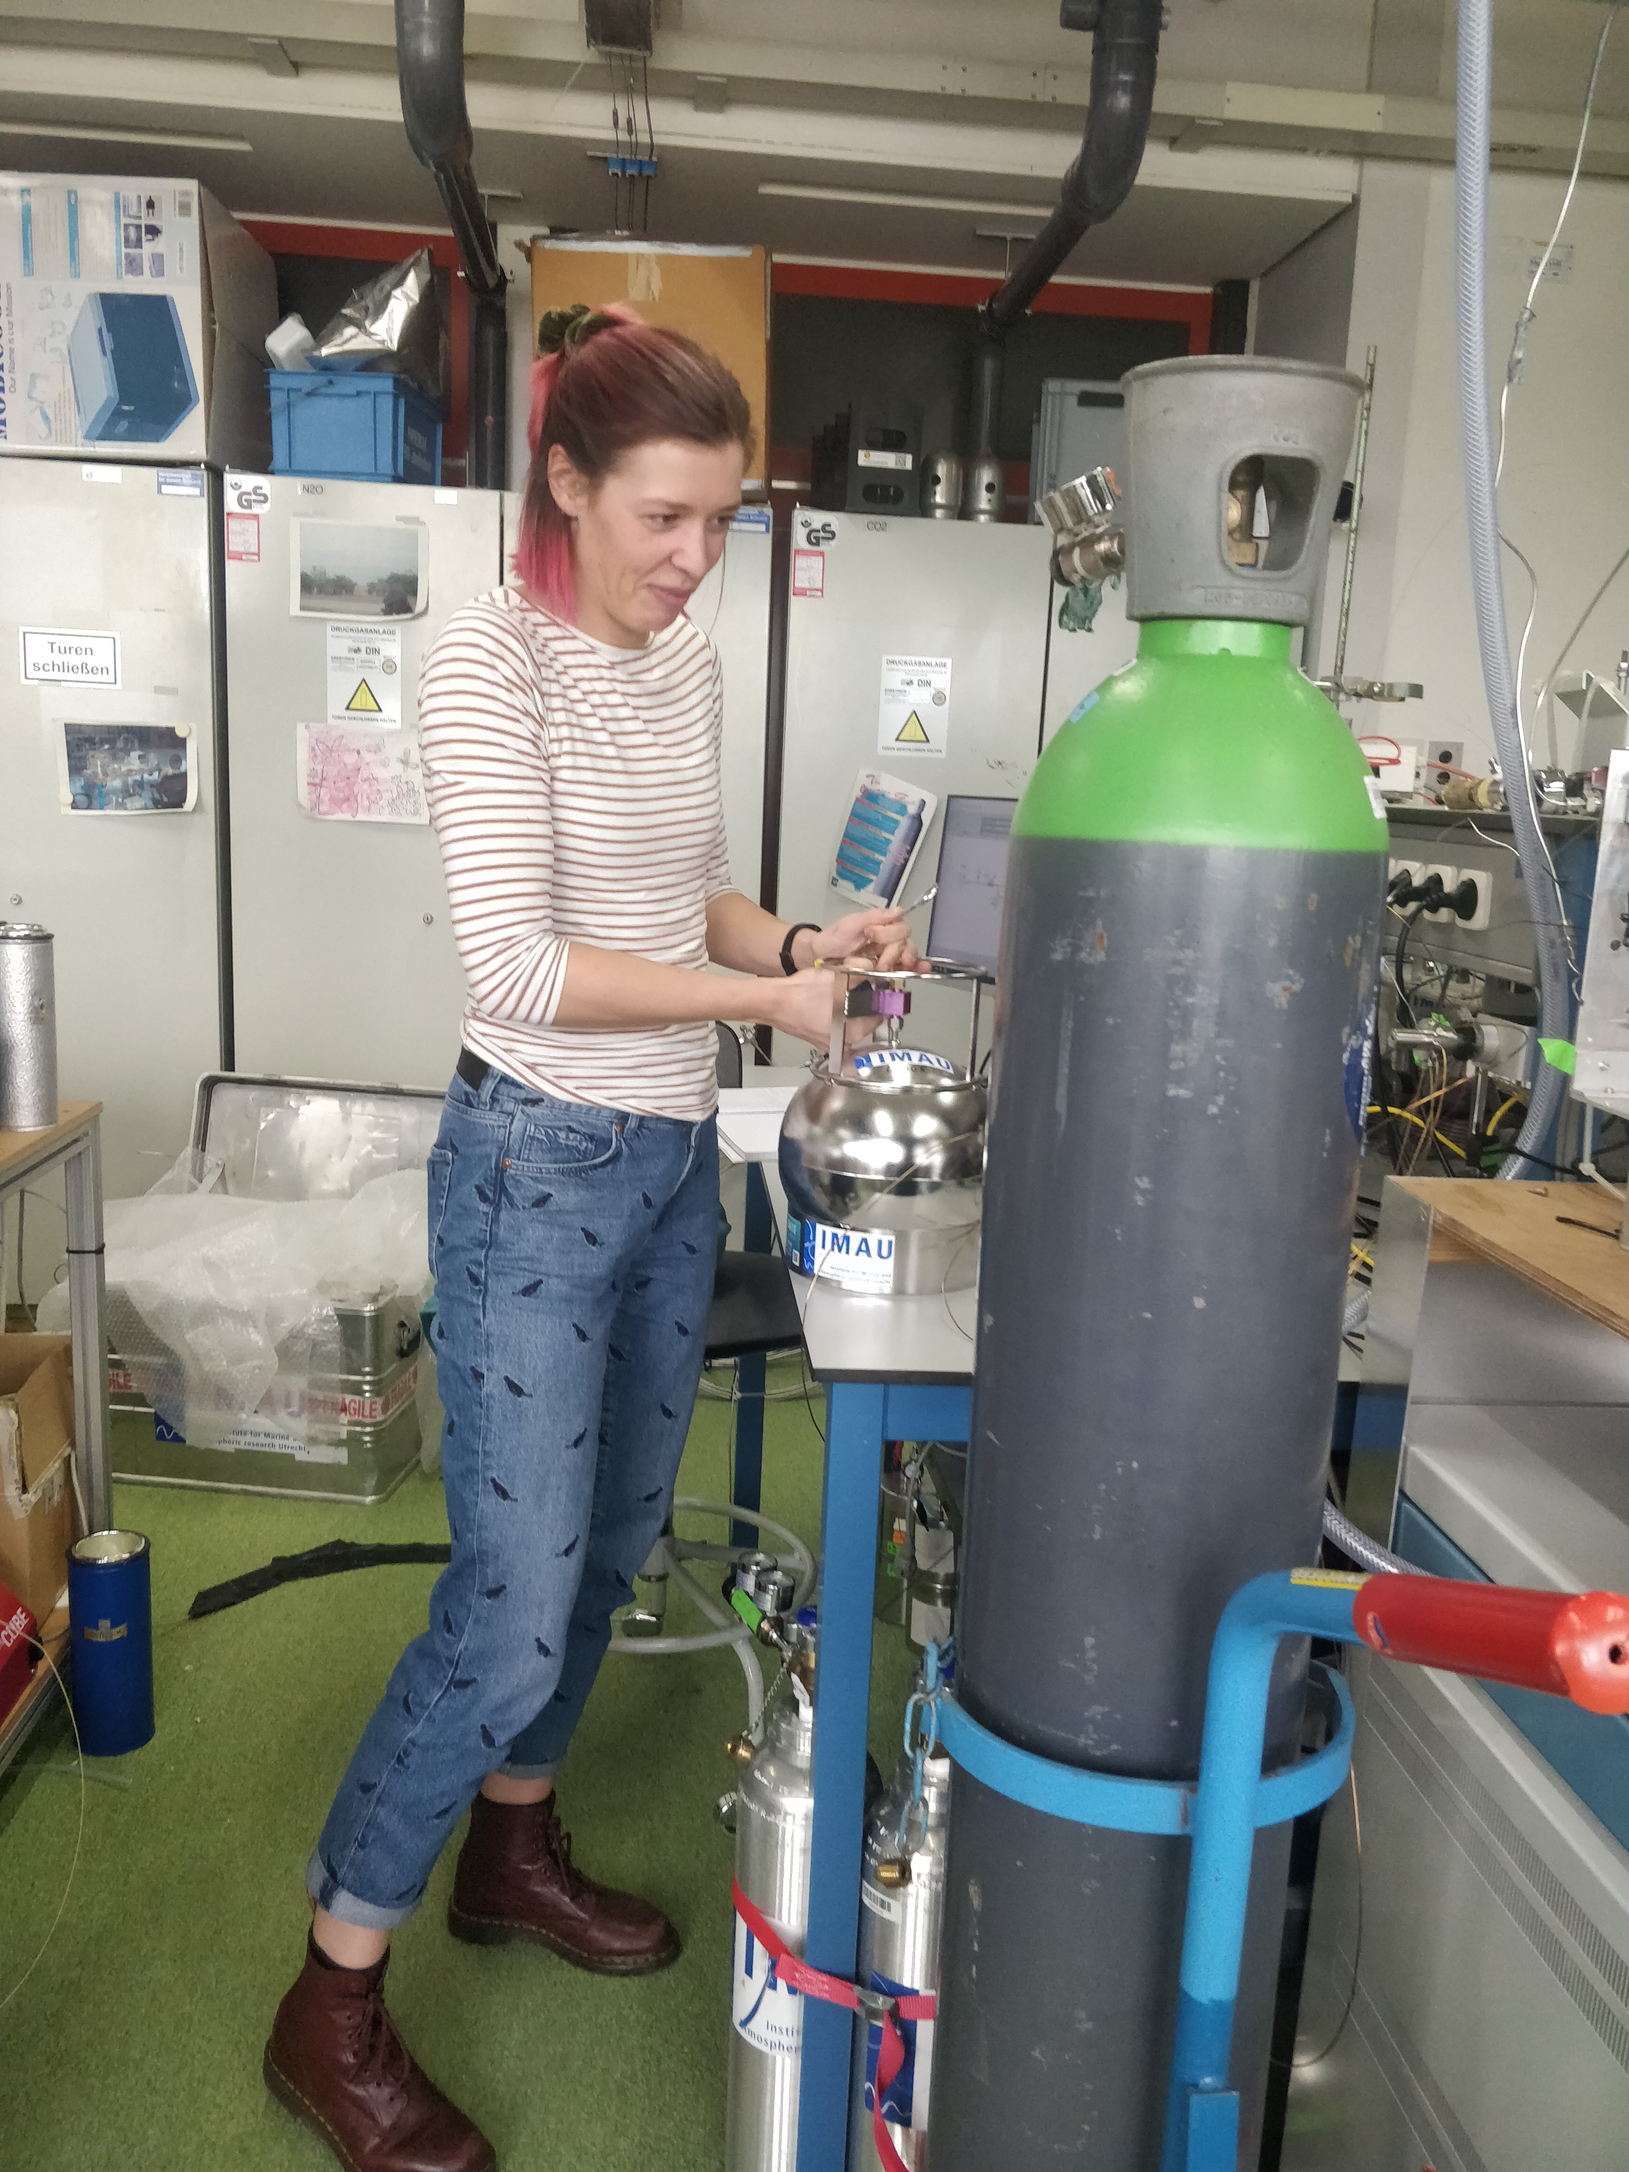
Summary
Developed a system for measuring S isotopes from COS
Small sample measurements possible: 2 – 4 L
EGRIP 2018 as test dataset: no strong signal detected
StratoClim 2017:
Anthropogenic signals flight 6
Possible photolysis signal flight 4
More measurements to be done
To do: precision improvement & calibration

Slide 24
Acknowledgements
Marc von Hobe, Chenxi Qiu, Jin Ma & Juhi Nagori for helping with interpretation of the data
EGRIP team
StratoClim team
IMAU technicians: Carina van Veen, Henk Snellen, Giorgio Cover & Marcel Portanger
This project has received funding from the European Research Council (ERC) under the European Union’s Horizon 2020 research and innovation program under grant agreement No 742798

Slide 25
Contact information
Sophie Baartman MSc.
Institute for Marine and Atmospheric research Utrecht (IMAU)
Utrecht University
s.l.baartman@uu.nl

