Slide 1
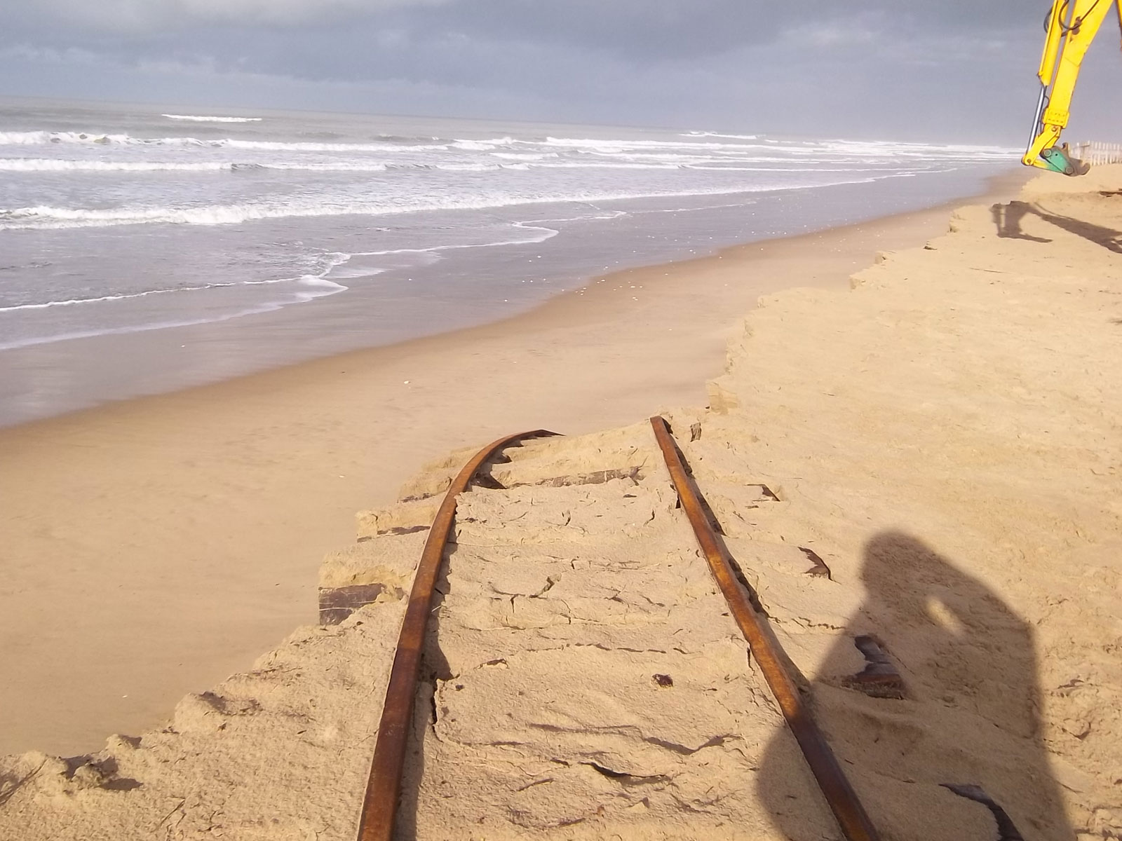
Likely and high-end impacts of regional sea-level rise on the erosion of European sandy coasts under high greenhouse gas emissions scenario
Rémi Thiéblemont¹, Gonéri Le Cozannet¹, Alex Toimil², Benoît Meyssignac³ & Iñigo Losada²
¹BRGM – French Geological Survey
²IH-Cantabria
³LEGOS - CNES/CNRS
http://www.le-ptit-train.com/environnement.htm#gallery-5
EGU VIRTUAL MEETING
MAY. 7th 2020

Slide 2
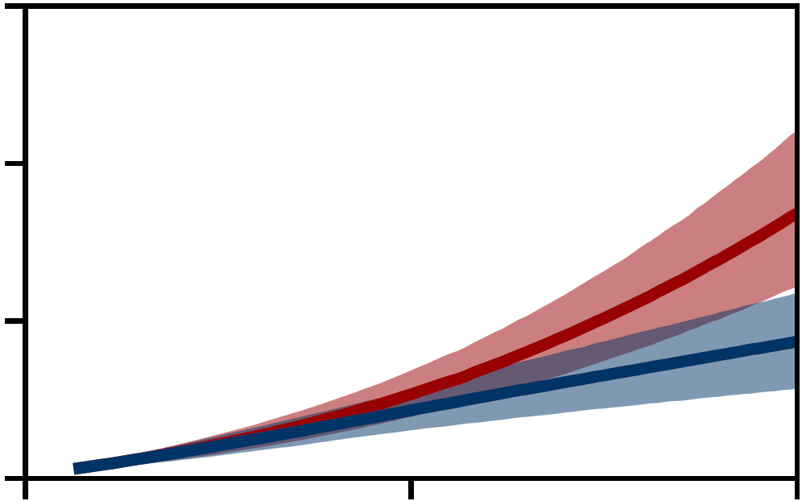
INTRODUCTION
Global sea-level projections
1.5
RCP8.5
RCP2.6
High-end scenarios
(e.g. Stammer et al., 2019)
1.1 m
1.0
Global Mean Sea-Level (m)
0.5
0.3 m
SROCC, 2019
0.0
2000
2050
2100
What is the impact of high-end sea-level projections on the retreat of European shoreline ?
2

Slide 3
WORKFLOW
Relative Sea-Level Change
EUROSION Coastal Geomorphology
$$ΔRSLC=ΔZ+ΔR_{barystatic−GRD}+ΔR_{GIA}+ΔR_{VM}$$
Identifying sandy coast segments (~25% of total length)
3 scenarios :
RCP8.5
High-End A (83rd of RCP8.5)
High-End B (worst model)
2 approaches:
1% constant slope
Deltares global slope dataset (Athanasiou et al., 2019)
SLR-induced Shoreline Retreat Model
Bruun Rule*
$$ΔS=ΔRSLC/tan⁡(β)$$
Sandy Shoreline Change Projections at European Scale
*controversial, but delivers larger erosion impacts than the alternative PCR model (Ranasinghe et al., 2011)
3
Notes:
Say orally how much of sandy coast segments

Slide 4
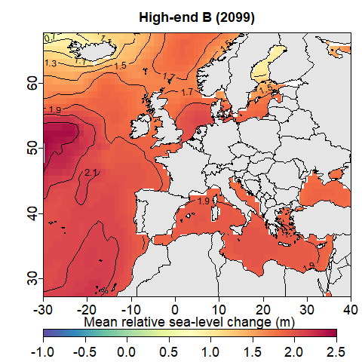
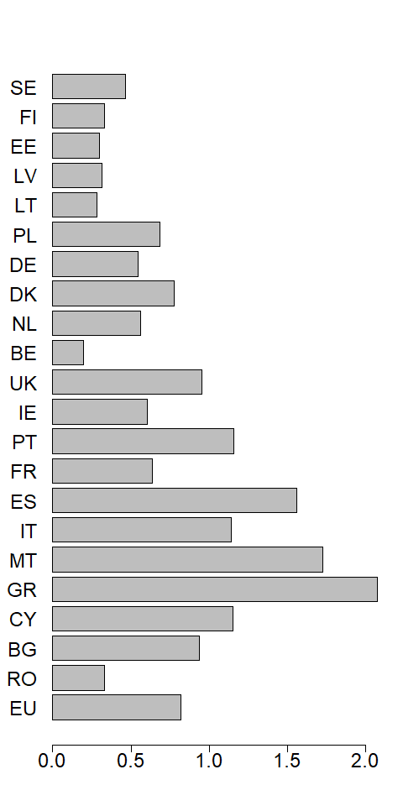
SEA-LEVEL PROJECTIONS & BEACH SLOPES
RSLR projections (2100 minus 1986-2005)
High-End B – Worst model case
Median Nearshore Slope/Country
Baltic
North Sea
Atlantic
Med. Sea
B. S
ΔRSLC_{RCP8.5-med} > 0.7 m
ΔRSLC_{High-end-B} > 1.7 m
Slope (%)
4

Slide 5
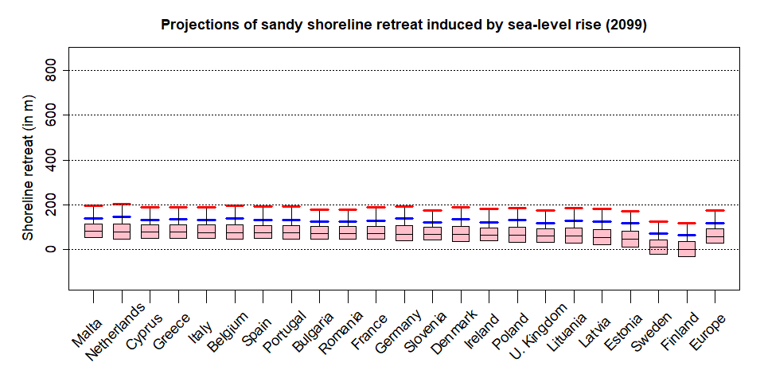
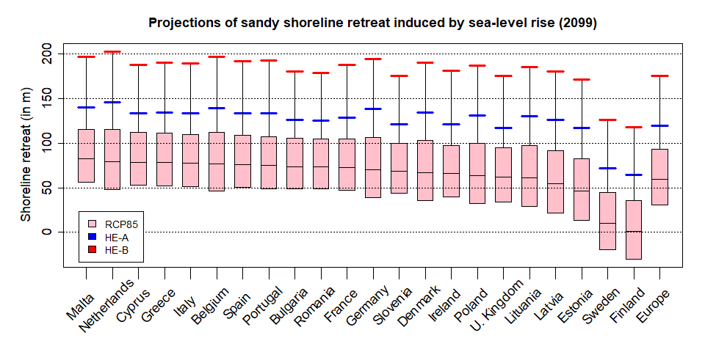
RESULTS
Shoreline changes per country in 2100 – 1% slope case
Baltic Countries overall less impacted due to the GIA influence
The relative contribution of the different components to regional SLR varies with scenarios => source of uncertainty in future projections.
5

Slide 6
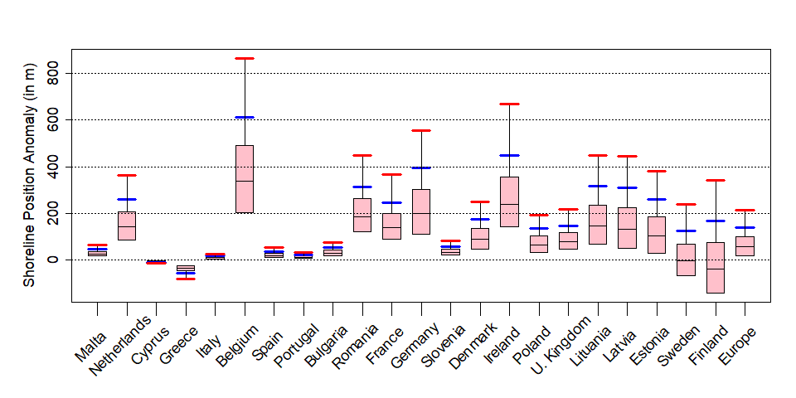
RESULTS
Shoreline changes per country in 2100 – (Deltares-1%) slope case
Larger shoreline retreats are projected for Europe when variations in nearshore slope are considered.
Accounting for nearshore slopes leads to large regional variability
Larger projected erosion in Northern Europe than Southern Europe, particularly under high-end scenarios,
6

