Slide 1

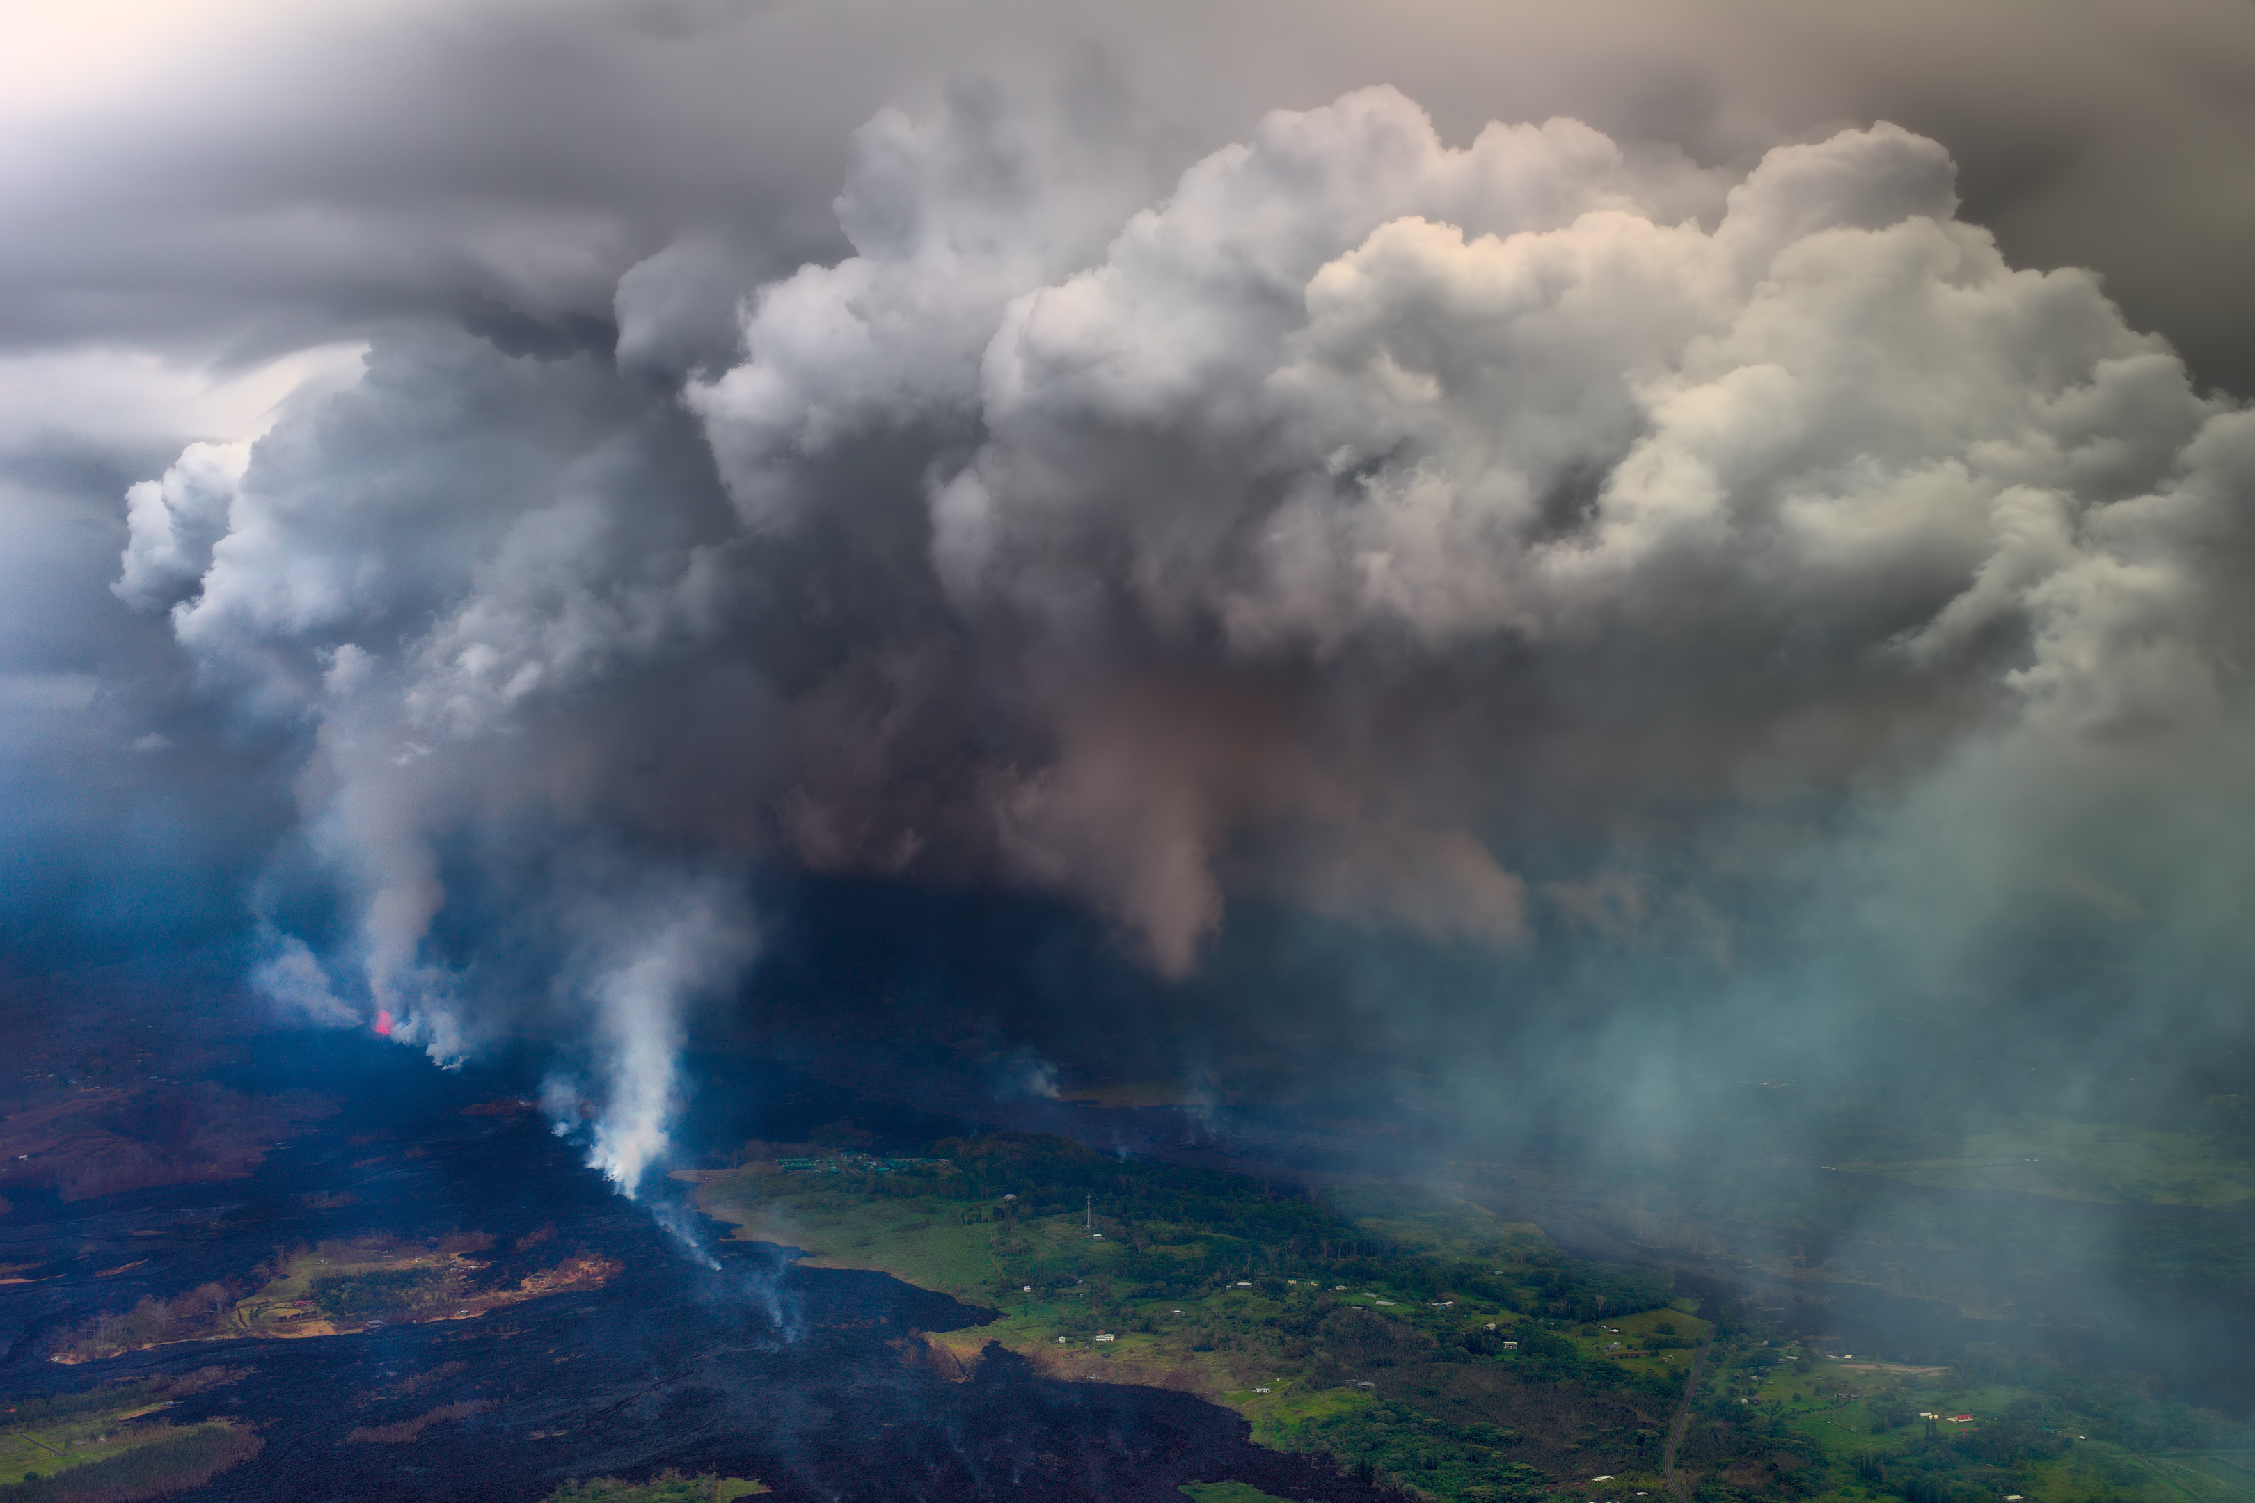
Tracking Sulfur and its Chalcophile Allies at Kīlauea Volcano, Hawai`i
Penny E. Wieser^{1*}, Frances E. Jenner², Marie Edmonds¹, John Maclennan¹, and Barbara Kunz²
¹University of Cambridge, UK ²Open University, UK
Motivation:
Understand the processes controlling the emission of S and other (often toxic) chalcophile elements at Kīlauea Volcano, Hawai’i.
Findings:
Sulfides saturate early at Kīlauea (~ 12 wt% MgO).
Element volatility, rather than sulfide resorption, predominantly controls the chemical composition of the volcanic plume.
For more info, flick through the slides, or read the paper (in press; GCA) https://eartharxiv.org/u6j79
Photo credit: Harry Durgin
Penny_Wieser

Slide 2
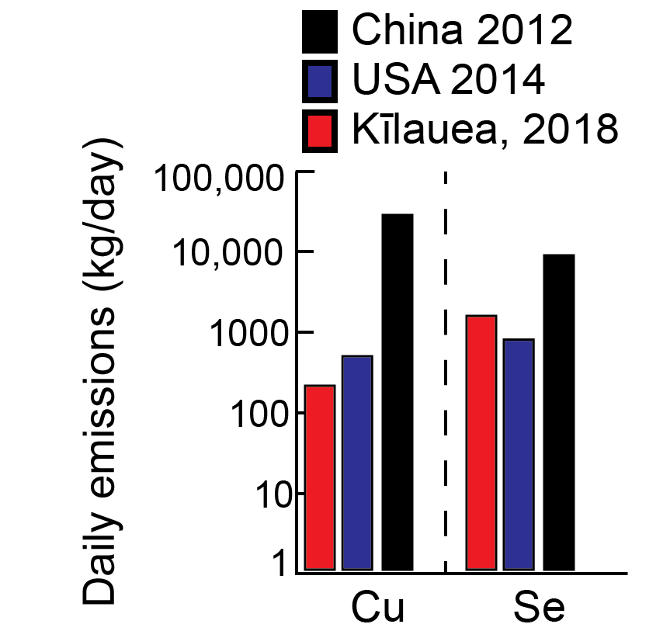
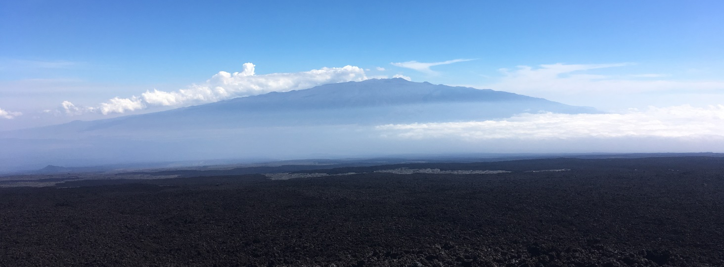
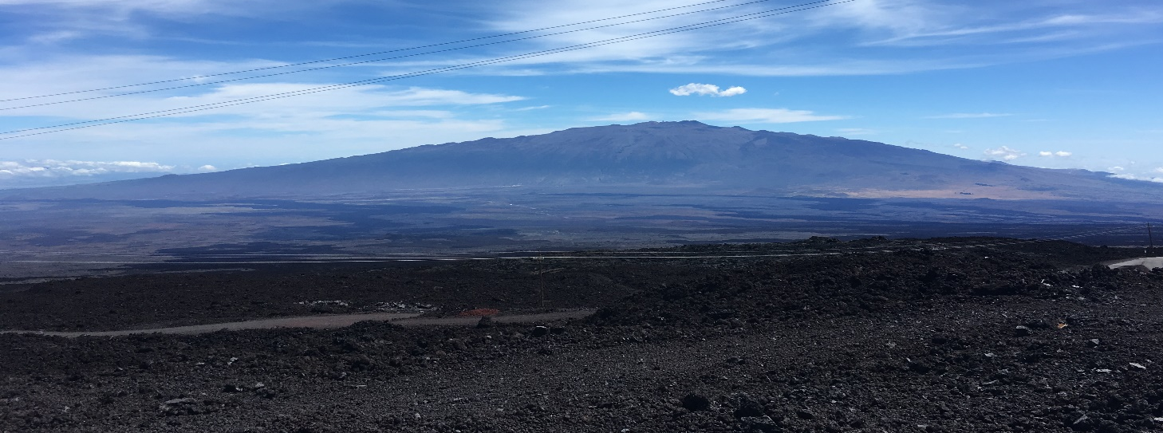
Motivation
c)
a) 2018 View of Mauna Kea obscured by “Vog”
Ilyinskaya et al., EGU2020-19656
Mason et al., EGU2020-162
Whitty et al., EGU2020-405
b) 2019 view, no eruptive activity at Kilauea – clear skies
Kīlauea Volcano emits globally-significant fluxes of S into the atmosphere, with implications for regional air quality (e.g., formation of volcanic smog – “Vog”).
Recent work has also demonstrated that the daily fluxes of chalcophile (S-loving elements) such as Cu and Se (c) rival the emissions of industrialized nations (Ilyinskaya et al.,EGU2020-19656)
However, the processes controlling S and chalcophile element behaviour are poorly constrained.

Slide 3
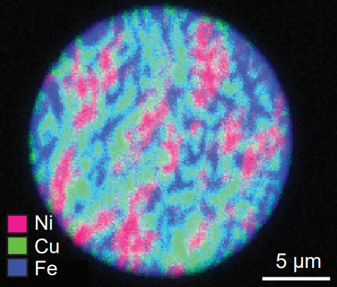
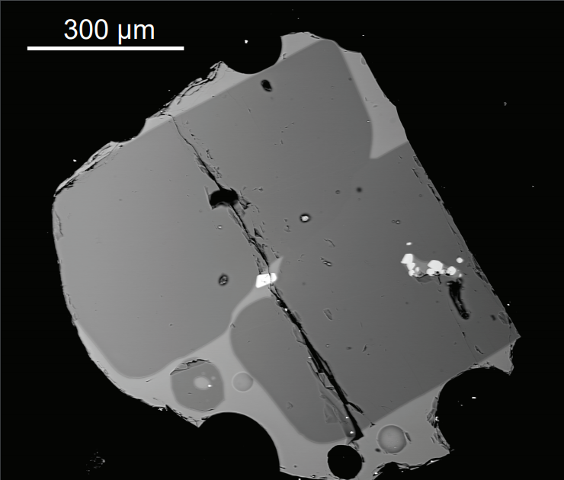
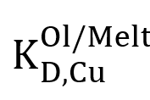
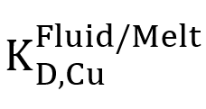
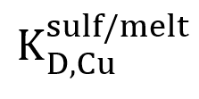
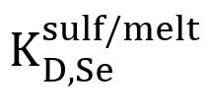
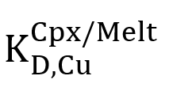
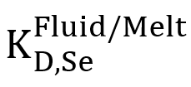
Chalcophile Element Partitioning
Se, Cu, As, Pb, Zn
Sulfide phase
Silicate phase
Degassing/resorption
~ 180-800
~0.1
~ 1-83
~ 380-1800
~0.21
= ???
Chalcophile element concentrations in magmatic systems are controlled by the 3-way partitioning between sulfide, silicate and fluid phases.
Sulfide-melt partitioning overwhelms the effects of silicate-melt partitioning, but the relative effect of fluid-melt partitioning is poorly constrained (and contradictory) -Submarine glasses retain high Se concentrations, yet aerosol studies show that volcanic plumes are Se-rich.

Slide 4
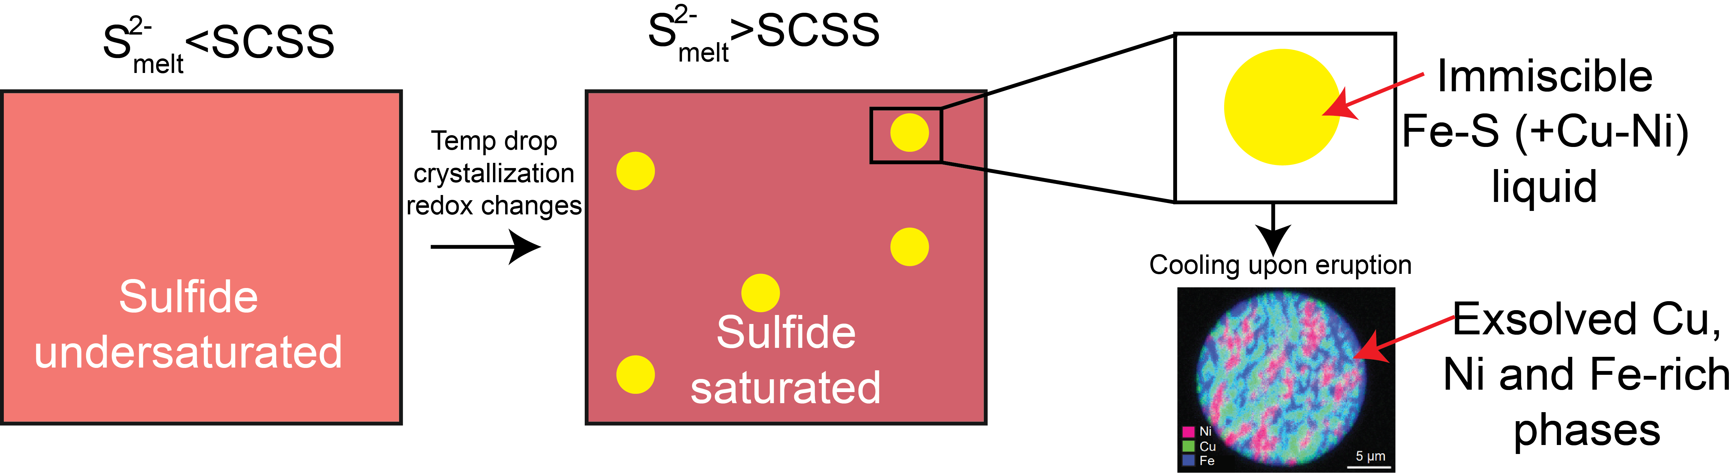
Introduction to Sulfide Saturation
2-
2-
Before the onset of low-pressure degassing (and the exsolution of a S-H2O-rich vapour), the presence/absence of sulfides controls the behaviour of S and other chalcophile elements.
Magmas become “sulfide saturated” when the concentration of S²⁻ in the melt exceeds the solubility of S²⁻.
This solubility limit is termed the “Sulfide concentration at Sulfide Saturation”, or the SCSS²⁻ .

Slide 5
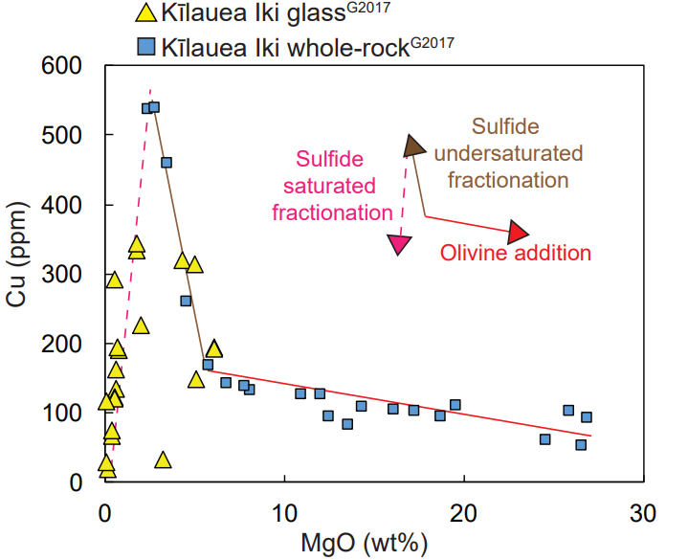
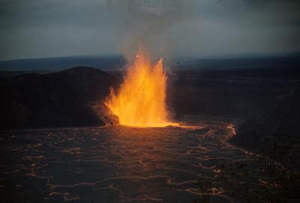
Previous work
Kīlauea Iki Eruption
Photo credit: USGS
b)
Fire fountain
a) Lava lake
Literature chalcophile element data for Kīlauean samples is restricted to glass analyses from melts fractionating within the Kīlauea Iki lava lake (a, Greaney et al., 2017).
This dataset shows that Cu behaves incompatibly until ~ 2 wt% MgO, suggesting that sulfides only saturate after extensive fractional crystallization (b).

Slide 6
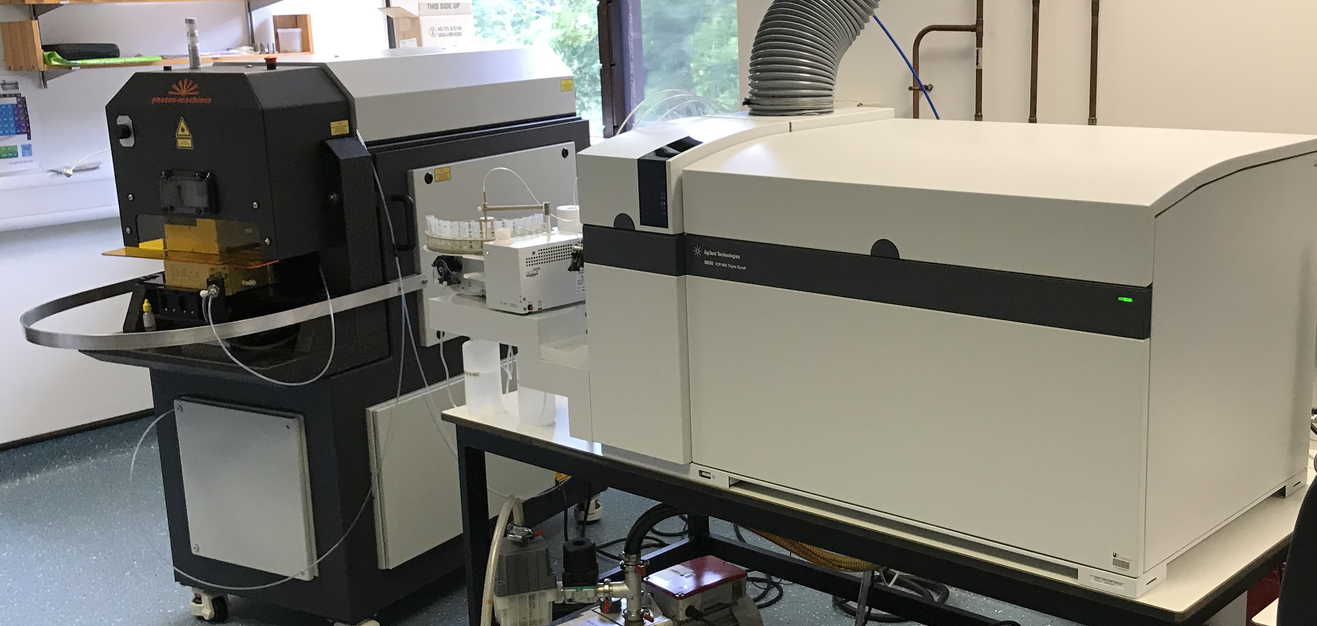
Our Approach
50 µm spot
(54 elements)
50 µm
Se – As line scan
100 µm
a)
b)
LA-ICP-MS set up at the Open University
Kīlauean melt inclusion
We perform LA-ICP-MS analyses of chalcophile elements (e.g., Cu, Se, As, Bi, Cd) on melt inclusions and matrix glasses from 4 Kīlauean eruptions using spots and line scans (a-b).
S, Cl and major elements were measured by EPMA.
New SEM-based mapping techniques were developed to rapidly hunt for sulfides, and quantify their bulk compositions.
Fractional crystallization models for S were compared to SCSS trajectories.

Slide 7
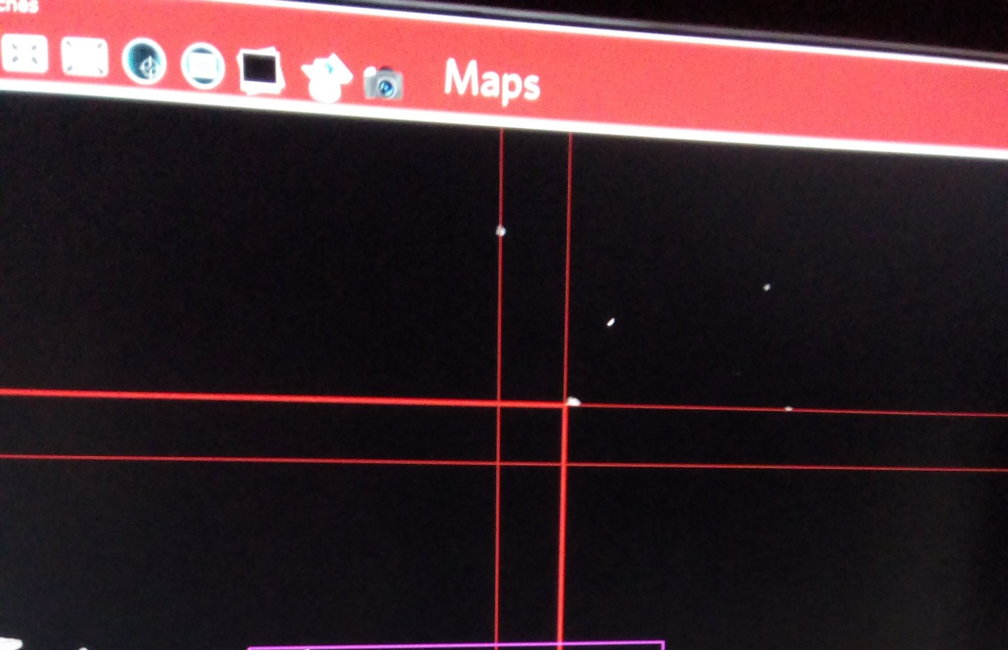
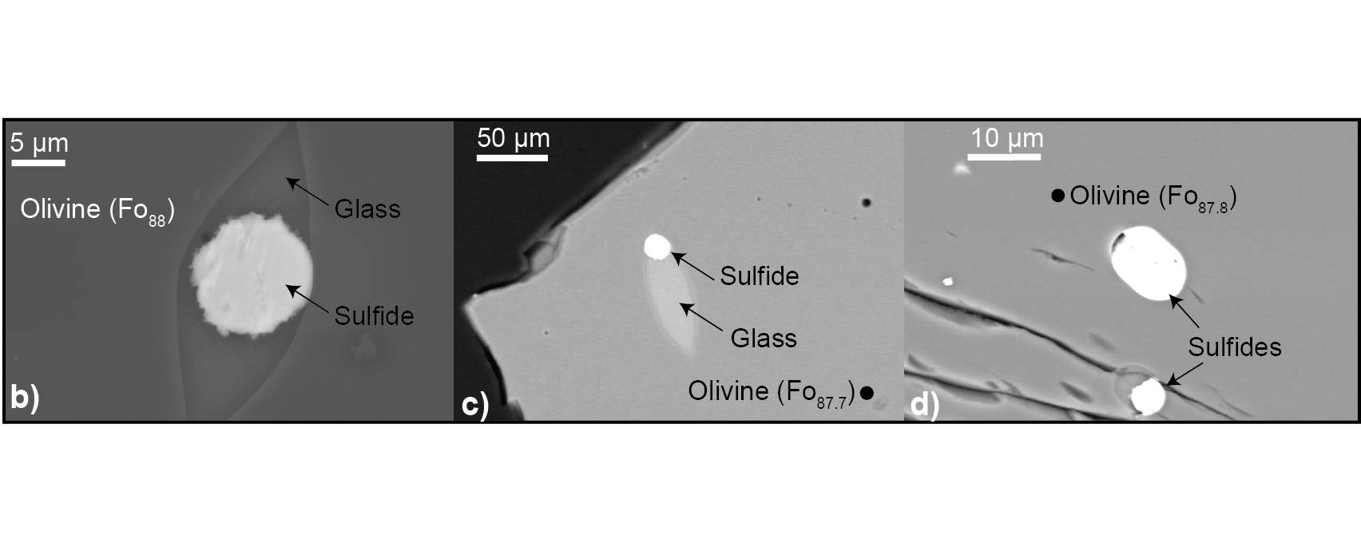
Sulfide Occurrence
BSE mapping was performed with the brightness and contrast adjusted so only sulfides were visible (white spots, a)
This method identifies sulfides down to 0.5 µm in short acquisition times (~30 mins per stub).
a)
We find sulfides within highly forsteritic olivine crystals (b-d), as well as within S-rich embayments with a range of MgO contents.
This suggests sulfides saturate at ~12 wt% MgO, significantly earlier than 2 wt% MgO.

Slide 8
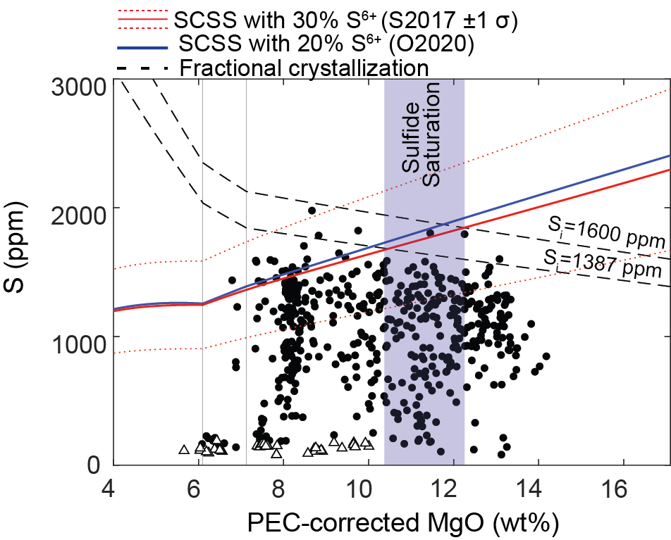

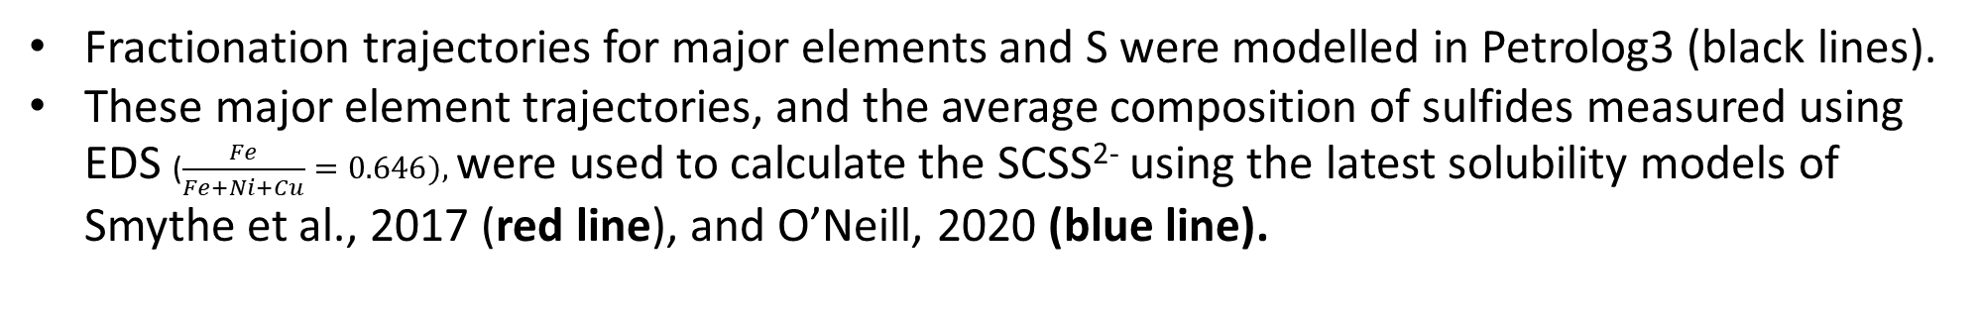
Modelling Sulfide Solubility
Fractionation trajectories for major elements and S were modelled in Petrolog3 (black lines).
These major element trajectories, and the average composition of sulfides measured using EDS ($\frac{Fe}{Fe+Ni+Cu}=0.646),$were used to calculate the SCSS²⁻ using the latest solubility models of Smythe et al., 2017 (red line), and O’Neill, 2020 (blue line).
As Kīlauean melts likely contain ~10-30% S^{6+,} we scale up the SCSS²⁻ by a constant:
These models predict that sulfides saturate at high MgO contents (~10-12 wt%). This supports our textural observations of sulfides hosted within highly Fo-rich olivines.

Slide 9
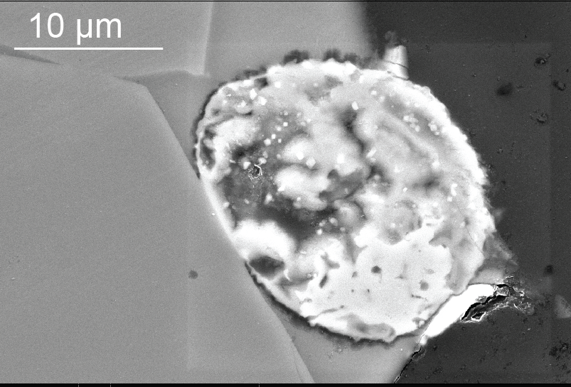
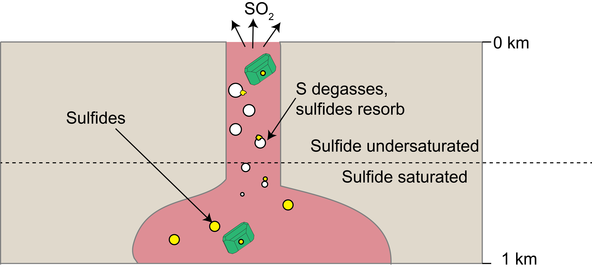
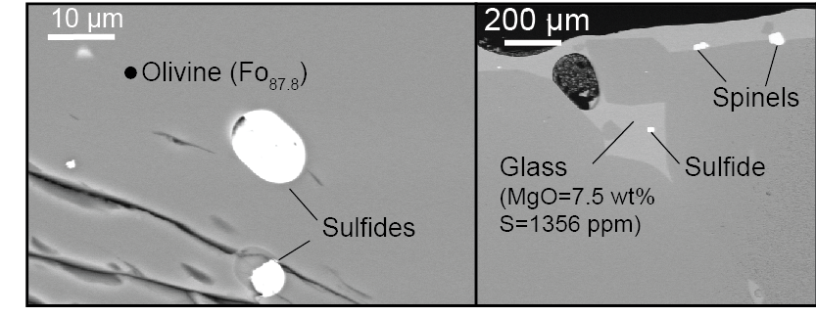
What Happens Upon Eruption? …
a)
d)
b)
c)
As melts ascend, S partitions from the melt into the vapour phase.
The S concentration of the melt drops below the SCSS, so the system becomes sulfide undersaturated once more. This drives the resorption of sulfides in contact with the melt.
Only sulfides isolated from the degassing melt survive (e.g., in embayments and olivines, b-c).
This accounts for the paucity of pristine sulfides in matrix glasses, and the presence of highly resorbed, Fe-S-O-rich features (d).

Slide 10
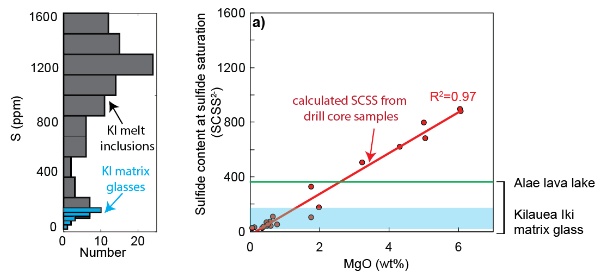
Reconciling Discrepancies with Lava-Lake Focused Studies
a)
b)
c)
Moore et al., 1980
Sides et al., 2014
The melt filling the Kīlauea Iki lava lake degassed its S upon eruption, so the S content (blue histogram and bar, b-c), was significantly lower than the SCSS (red line, c).
Significant amounts of fractionation were required to drive the SCSS below the S contents of the melts, even if S contents increased slightly during fractionation in the lake (green line).
Sulfide saturation in lava lakes occurs anomalously late due to S degassing, and is not representative of the fractionation path taken by undegassed melts at depth.

Slide 11
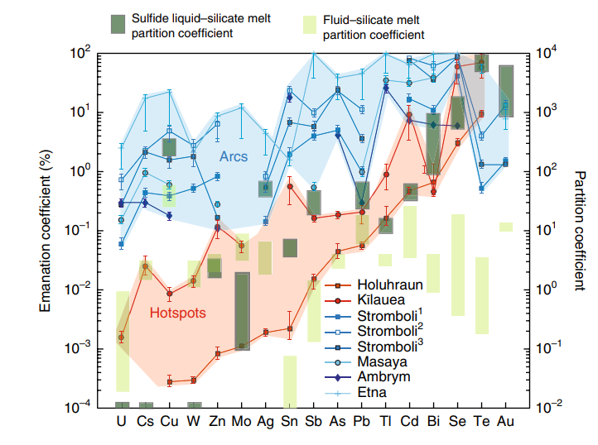
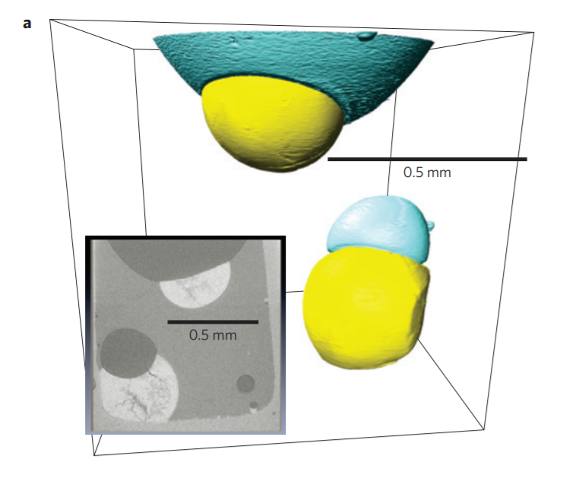
Degassing of Chalcophile Metals
a)
a)
Vapour bubble
b)
Sulfide
% degassed
Mungall, 2015
Edmonds et al., 2018
Based on observations of sulfides attached to bubbles (a), and the correlation between sulfide-melt partition coefficients and emanation coefficients (% of element degassed, b), It has been suggested that there may be an:
“Almost quantitative transfer of chalcophile elements from sulfide to bubble” – Mungall, 2015

Slide 12
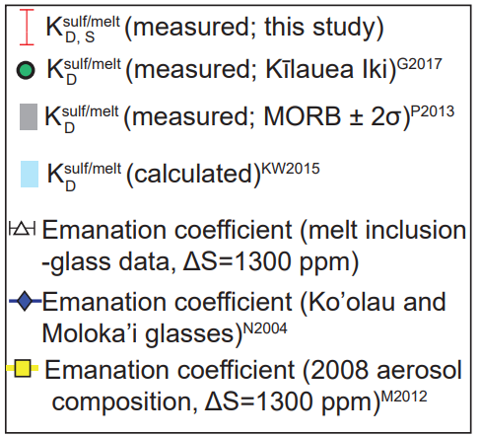
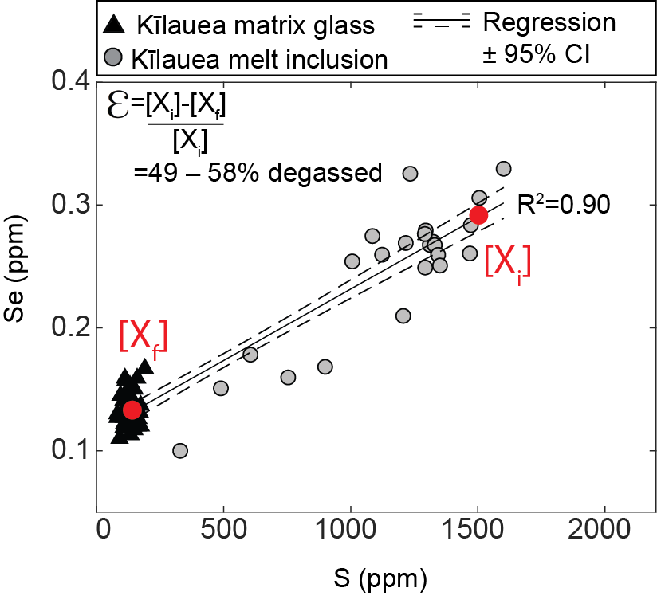
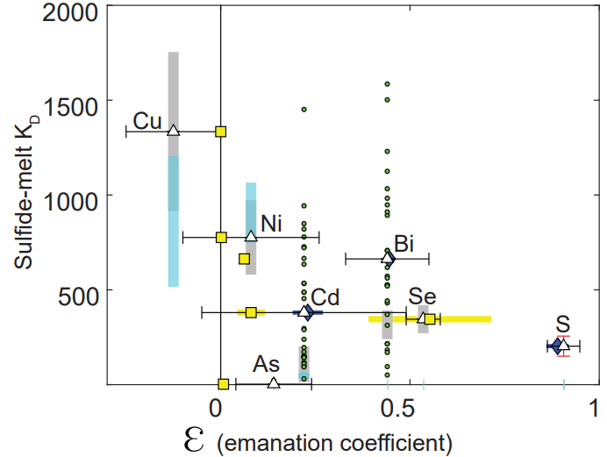
Degassing of Chalcophile Metals
a)
b)
We calculate emanation coefficients based on the gradient of a given element vs. S in a regression through variably degassed melt inclusions and matrix glasses (a).
There is no correlation between our emanation coefficient estimates and sulfide-melt KDs (or between literature estimates for emanation for Hawaiian volcanoes and KDs, b).

Slide 13
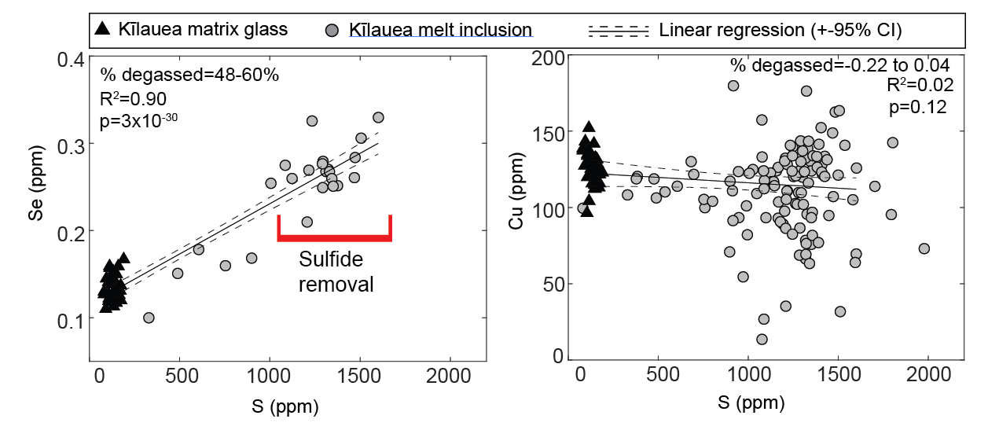
Degassing of Chalcophile Metals
The strongest evidence that sulfide-vapour partitioning doesn’t control the metal signature of the Kīlauean plume is the differential behaviour of Cu and Se.
The KD of Cu in MORB (~1334) is significantly higher than that of Se (~345; Patten et al. 2013)
The higher Se concentration of melt inclusions vs. glasses demonstrates that Se degasses.
Intriguingly, Cu concentrations are lower in melt inclusions than glasses (the opposite trajectory to that expected from degassing, or metal transfer from sulfide to vapour).

Slide 14
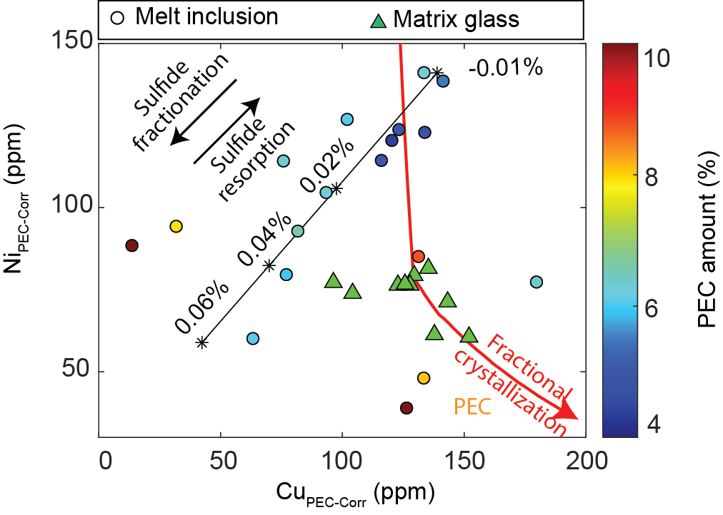
Release of Cu during sulfide-resorption
Melt inclusions follow a trajectory towards lower Ni and Cu indicative of sulfide fractionation (black lines).
Matrix glasses lie back on silicate-only fractionation trajectories (red lines).
No correlation with PEC amount, or visible sulfides, so isn’t secondary sulfide growth.
→Melt inclusions form as sulfides progressively deplete the melt.
→ Sulfide resorption upon eruption releases Ni and Cu back into melt, not the vapour.

Slide 15
Conclusions
1. Kilauean magmas saturate in sulfide in crustal storage reservoirs at high MgO (~12 wt %)
→ Previous studies focusing on lava lakes identified an additional phase of sulfide saturation that only occurs after extensive fractionation of degassed melts.
2. Extreme care is required to spot sulfide saturation in degassed subaerial lavas
→ Detailed SEM mapping of areas which have been isolated from the degassing melt is required to identify sulfides (e.g., within S-rich embayments, phenocrysts).
3. Ni and Cu released during sulfide resorption predominantly remain in the melt, rather than entering the volcanic plume
→ Matrix glasses follow silicate-only fractionation trajectories due to sulfide resorption, so do not preserve the chemical trajectories of sulfide fractionation at depth.
→ Only melt inclusions, which are isolated from this late-stage release of Cu and Ni, show evidence for sulfide fractionation in Ni vs. Cu space.
4. Se shows clear petrological evidence for degassing based on strong correlations with S.
→ Supports aerosol measurements indicating that Se is abundant in volcanic plumes.

Slide 16
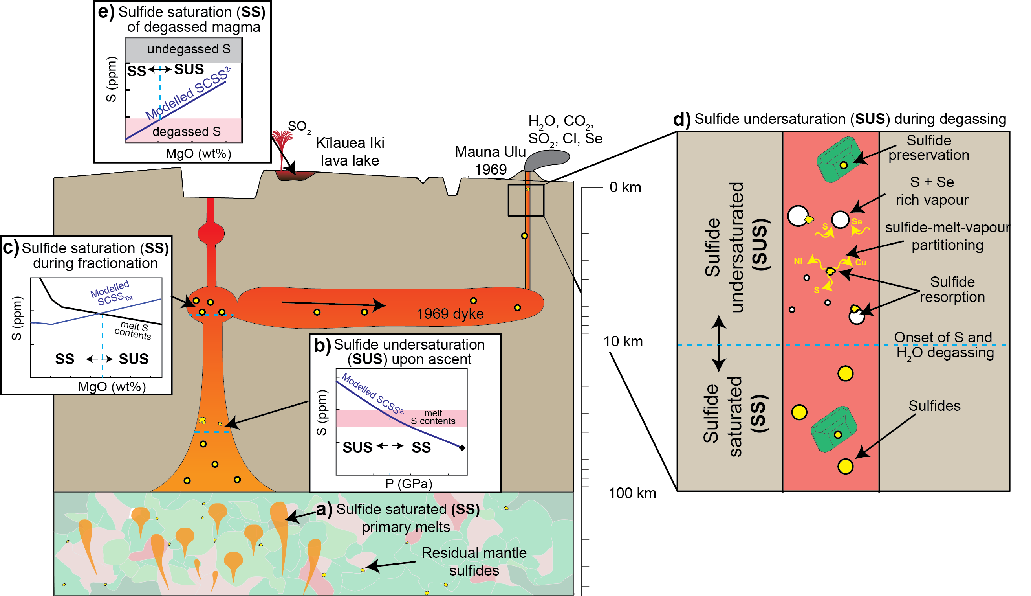

Further Details: Mantle to Plume
Our paper (GCA; In press) also demonstrates that residual sulfides are present in the mantle source throughout the melting interval.
Overall, Kīlauean melts experience 3 stages of sulfide saturation: In the mantle (a), crust (b), and within lava lakes (e), separated by episodes of sulfide resorption during ascent through the lithosphere (b), and degassing upon eruption (d).
https://eartharxiv.org/u6j79

Slide 17
References
Edmonds, M., Mather, T.A., Liu, E.J., 2018. A distinct metal fingerprint in arc volcanic emissions. Nature Geoscience 11, 790–794. https://doi.org/10.1038/s41561-018-0214-5
Greaney, A.T., Rudnick, R.L., Helz, R.T., Gaschnig, R.M., Piccoli, P.M., Ash, R.D., 2017. The behavior of chalcophile elements during magmatic differentiation as observed in Kīlauea Iki lava lake, Hawaii. Geochimica et Cosmochimica Acta 210, 71–96. https://doi.org/10.1016/j.gca.2017.04.033
Kiseeva, E.S., Wood, B.J., 2015. The effects of composition and temperature on chalcophile and lithophile element partitioning into magmatic sulphides. Earth and Planetary Science Letters 424, 280–294. https://doi.org/10.1016/j.epsl.2015.05.012
Norman, M.D., Garcia, M.O., Bennett, V.C., 2004. Rhenium and chalcophile elements in basaltic glasses from Ko’olau and Moloka’i volcanoes: Magmatic outgassing and composition of the Hawaiian plume. Geochimica et Cosmochimica Acta 68, 3761–3777. https://doi.org/10.1016/j.gca.2004.02.025
Mather, T.A., Witt, M.L.I., Pyle, D.M., Quayle, B.M., Aiuppa, A., Bagnato, E., Martin, R.S., Sims, K.W.W., Edmonds, M., Sutton, A.J., Ilyinskaya, E., 2012. Halogens and trace metal emissions from the ongoing 2008 summit eruption of Kīlauea volcano, Hawai`i. Geochimica et Cosmochimica Acta 83, 292–323. https://doi.org/10.1016/j.gca.2011.11.029
Moore, R.B., Helz, R.T., Dzurisin, D., Eaton, G.P., Koyanagi, R., Lipman, P.W., Lockwood, J.P., Puniwai, G.S., 1980. The 1977 eruption of kīlauea volcano, hawaii. Journal of Volcanology and Geothermal Research 7(3–4), 189–210.
O’Neill, 2020. The thermodynamic controls on sulfide saturation in silicate melts with application to Ocean Floor Basalts (in press, AGU books)
Patten, C., Barnes, S.-J., Mathez, E.A., Jenner, F.E., 2013. Partition coefficients of chalcophile elements between sulfide and silicate melts and the early crystallization history of sulfide liquid: LA-ICP-MS analysis of MORB sulfide droplets. Chemical Geology 358, 170–188. https://doi.org/10.1016/j.chemgeo.2013.08.040
Petrolog3 -https://agupubs.onlinelibrary.wiley.com/doi/10.1029/2011GC003516
Sides, I., Edmonds, M., Maclennan, J., Houghton, B.F., Swanson, D.A., Steele-MacInnis, M.J., 2014. Magma mixing and high fountaining during the 1959 Kīlauea Iki eruption, Hawai‘i. Earth and Planetary Science Letters 400, 102–112. https://doi.org/10.1016/j.epsl.2014.05.024
Smythe, D.J., Wood, B.J., Kiseeva, E.S., 2017. The S content of silicate melts at sulfide saturation: New experiments and a model incorporating the effects of sulfide composition. American Mineralogist 102, 795–803. https://doi.org/10.2138/am-2017-5800CCBY

