Slide 1
Total ozone loss during the 2019/20 Arctic winter and comparison to previous years
F. Goutail, A. Pazmiño, J. P. Pommereau, F. Lefèvre, C. Clerbaux, A. Boynard, J. Hadji-Lazaro LATMOS/IPSL/UVSQ - CNRS, France,
W. Feng, M. Chipperfield, U. Leeds, UK,
M. Van Roozendael, BIRA-IASB, Belgium ,
N. Jepsen, DMI, Denmark,
G. Hansen, NILU, Norway,
R. Kivi, FMI, Finland,
K. Bognar, K. Walker, K. Strong, U Toronto, Canada.
Contact: florence.goutail@latmos.ipsl.fr

Slide 2
Objectives and Method
Quantification of chemical ozone loss inside polar vortex by
comparison between modeled passive ozone and measurements
MEASUREMENTS
Total ozone => SAOZ/NDACC UV-Visible network
Twice daily at twilight
=> Satellites IASI and OMI-Doas
MODELS 3D CTM
REPROBUS and SLIMCAT
both model use ECMWF 1000 - 0.01 hPa (80 km)
2 runs: a) Passive ozone initialized on December 1, 2019
REPROBUS from ECMWF ozone operational analysis
SLIMCAT from the output of a long-term simulation
b) Full chemistry

Slide 3
UV-Visible SAOZ
Zenith sky UV-visible spectrometer
Differential Optical Absorption Spectroscopy
Ozone: Chappuis bands (450-550 nm)
Consistency between stations: 3% (NDACC Intercomparison)
PSC days removed using a color index or stratospheric temperature
SAOZ Arctic network
Zhigansk
(CNRS/CAO)
Eureka
(CNRS/UoT)
Salekhard
(CNRS/CAO)
Thule
(DMI)
NyAlesund
(NILU)
SondreStromfjord
(CNRS/DMI)
Sodankyla
(CNRS/FMI)
ScoresbySund
(CNRS/DMI)
Harestua
(BIRA)

Slide 4
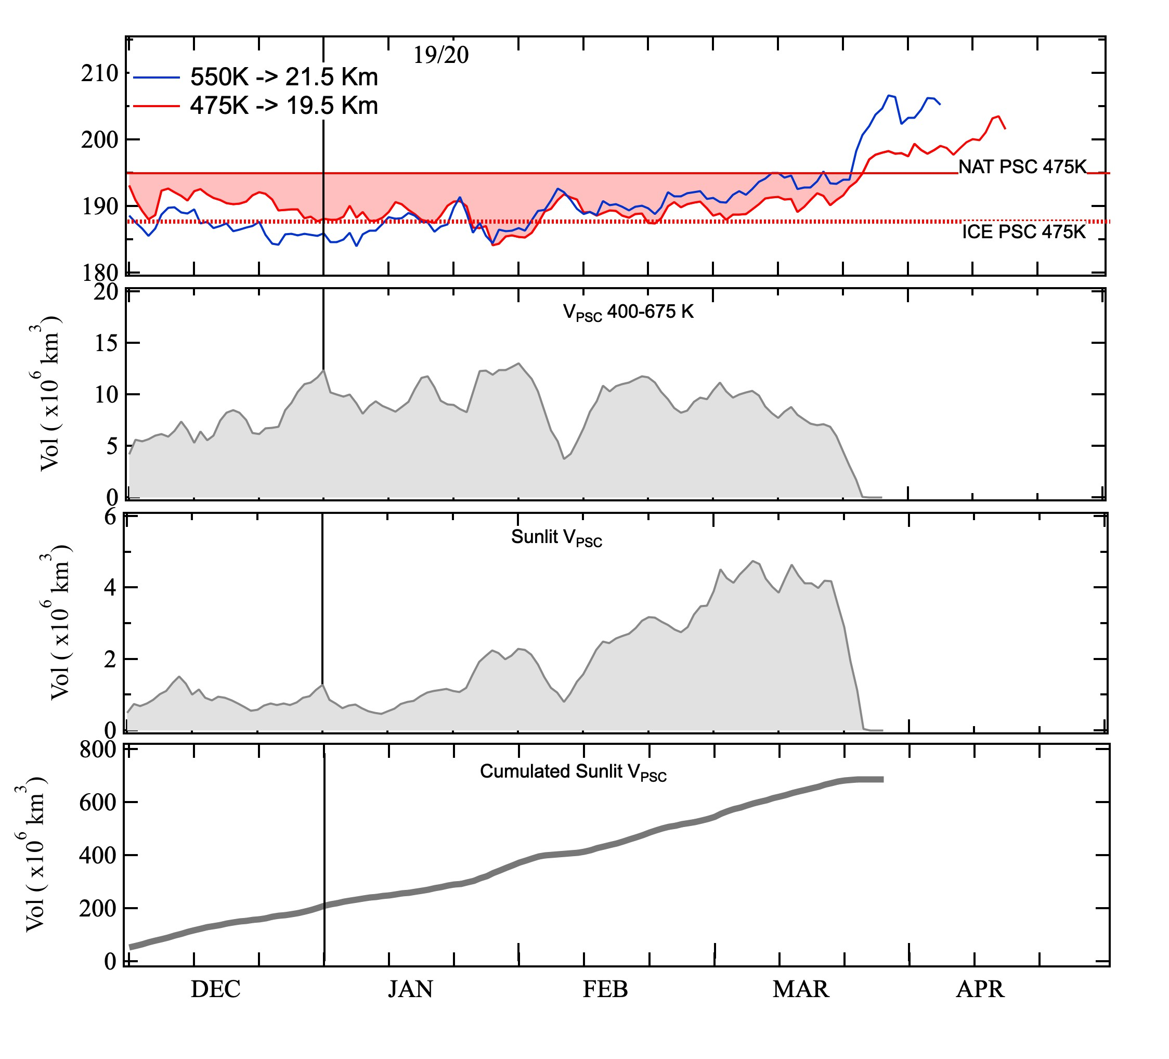
METEOROLOGY 2019/2020
T Min
T<Tnat from Dec 1 up to Mar 20 at 475K (red) and 550K (blue)
Large V_{PSC} from early Dec up to March 20.
Large sunlit V_{PSC} after Feb.10.
V_{psc}
Sunlit V_{psc}
Cumul. V_{psc}

Slide 5
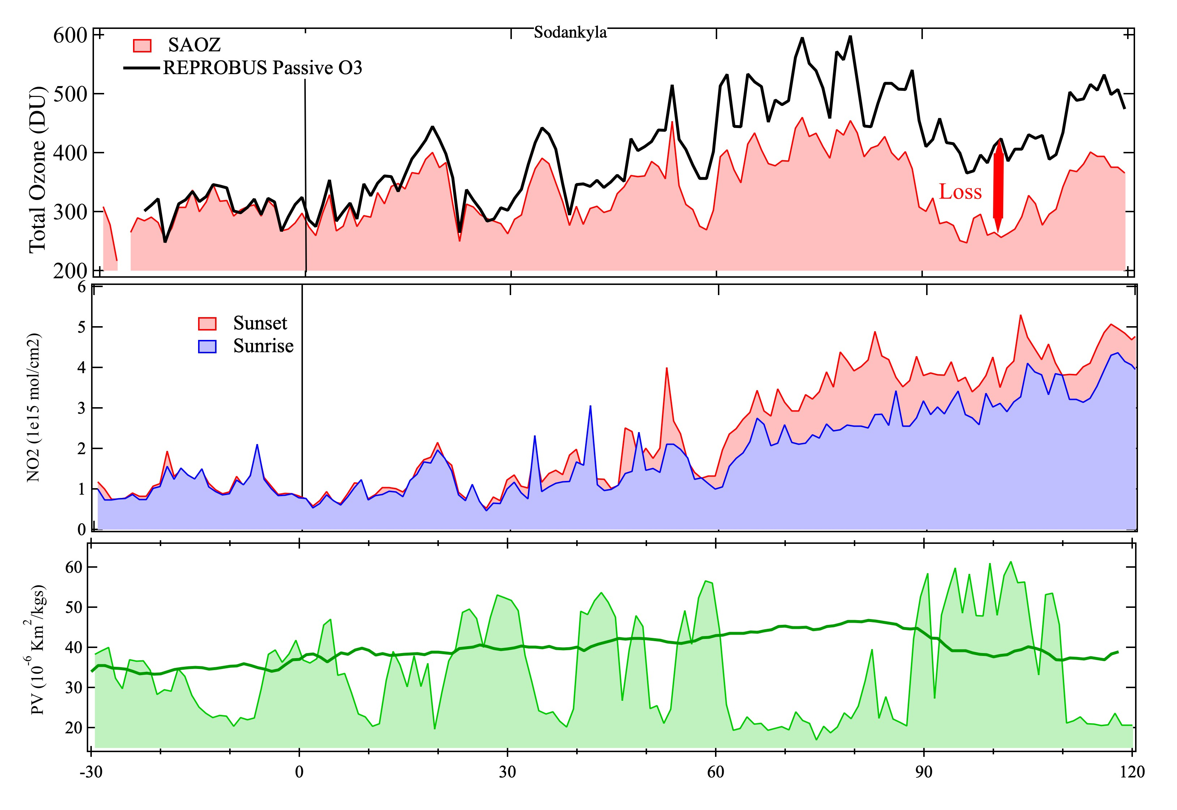
SAOZ Total Ozone and NO₂
Sodankyla (Finland)
Ozone
Black: Model passive O3
Pink: O₃ columns
NO₂
Blue: NO₂ sunrise
Pink: NO₂ sunset
PV 475K
PV Mimosa model
vortex edge (Nash criteria)
Dec Jan Feb Mar Apr
Sodankyla, one of the most representative station, in this winter

Slide 6
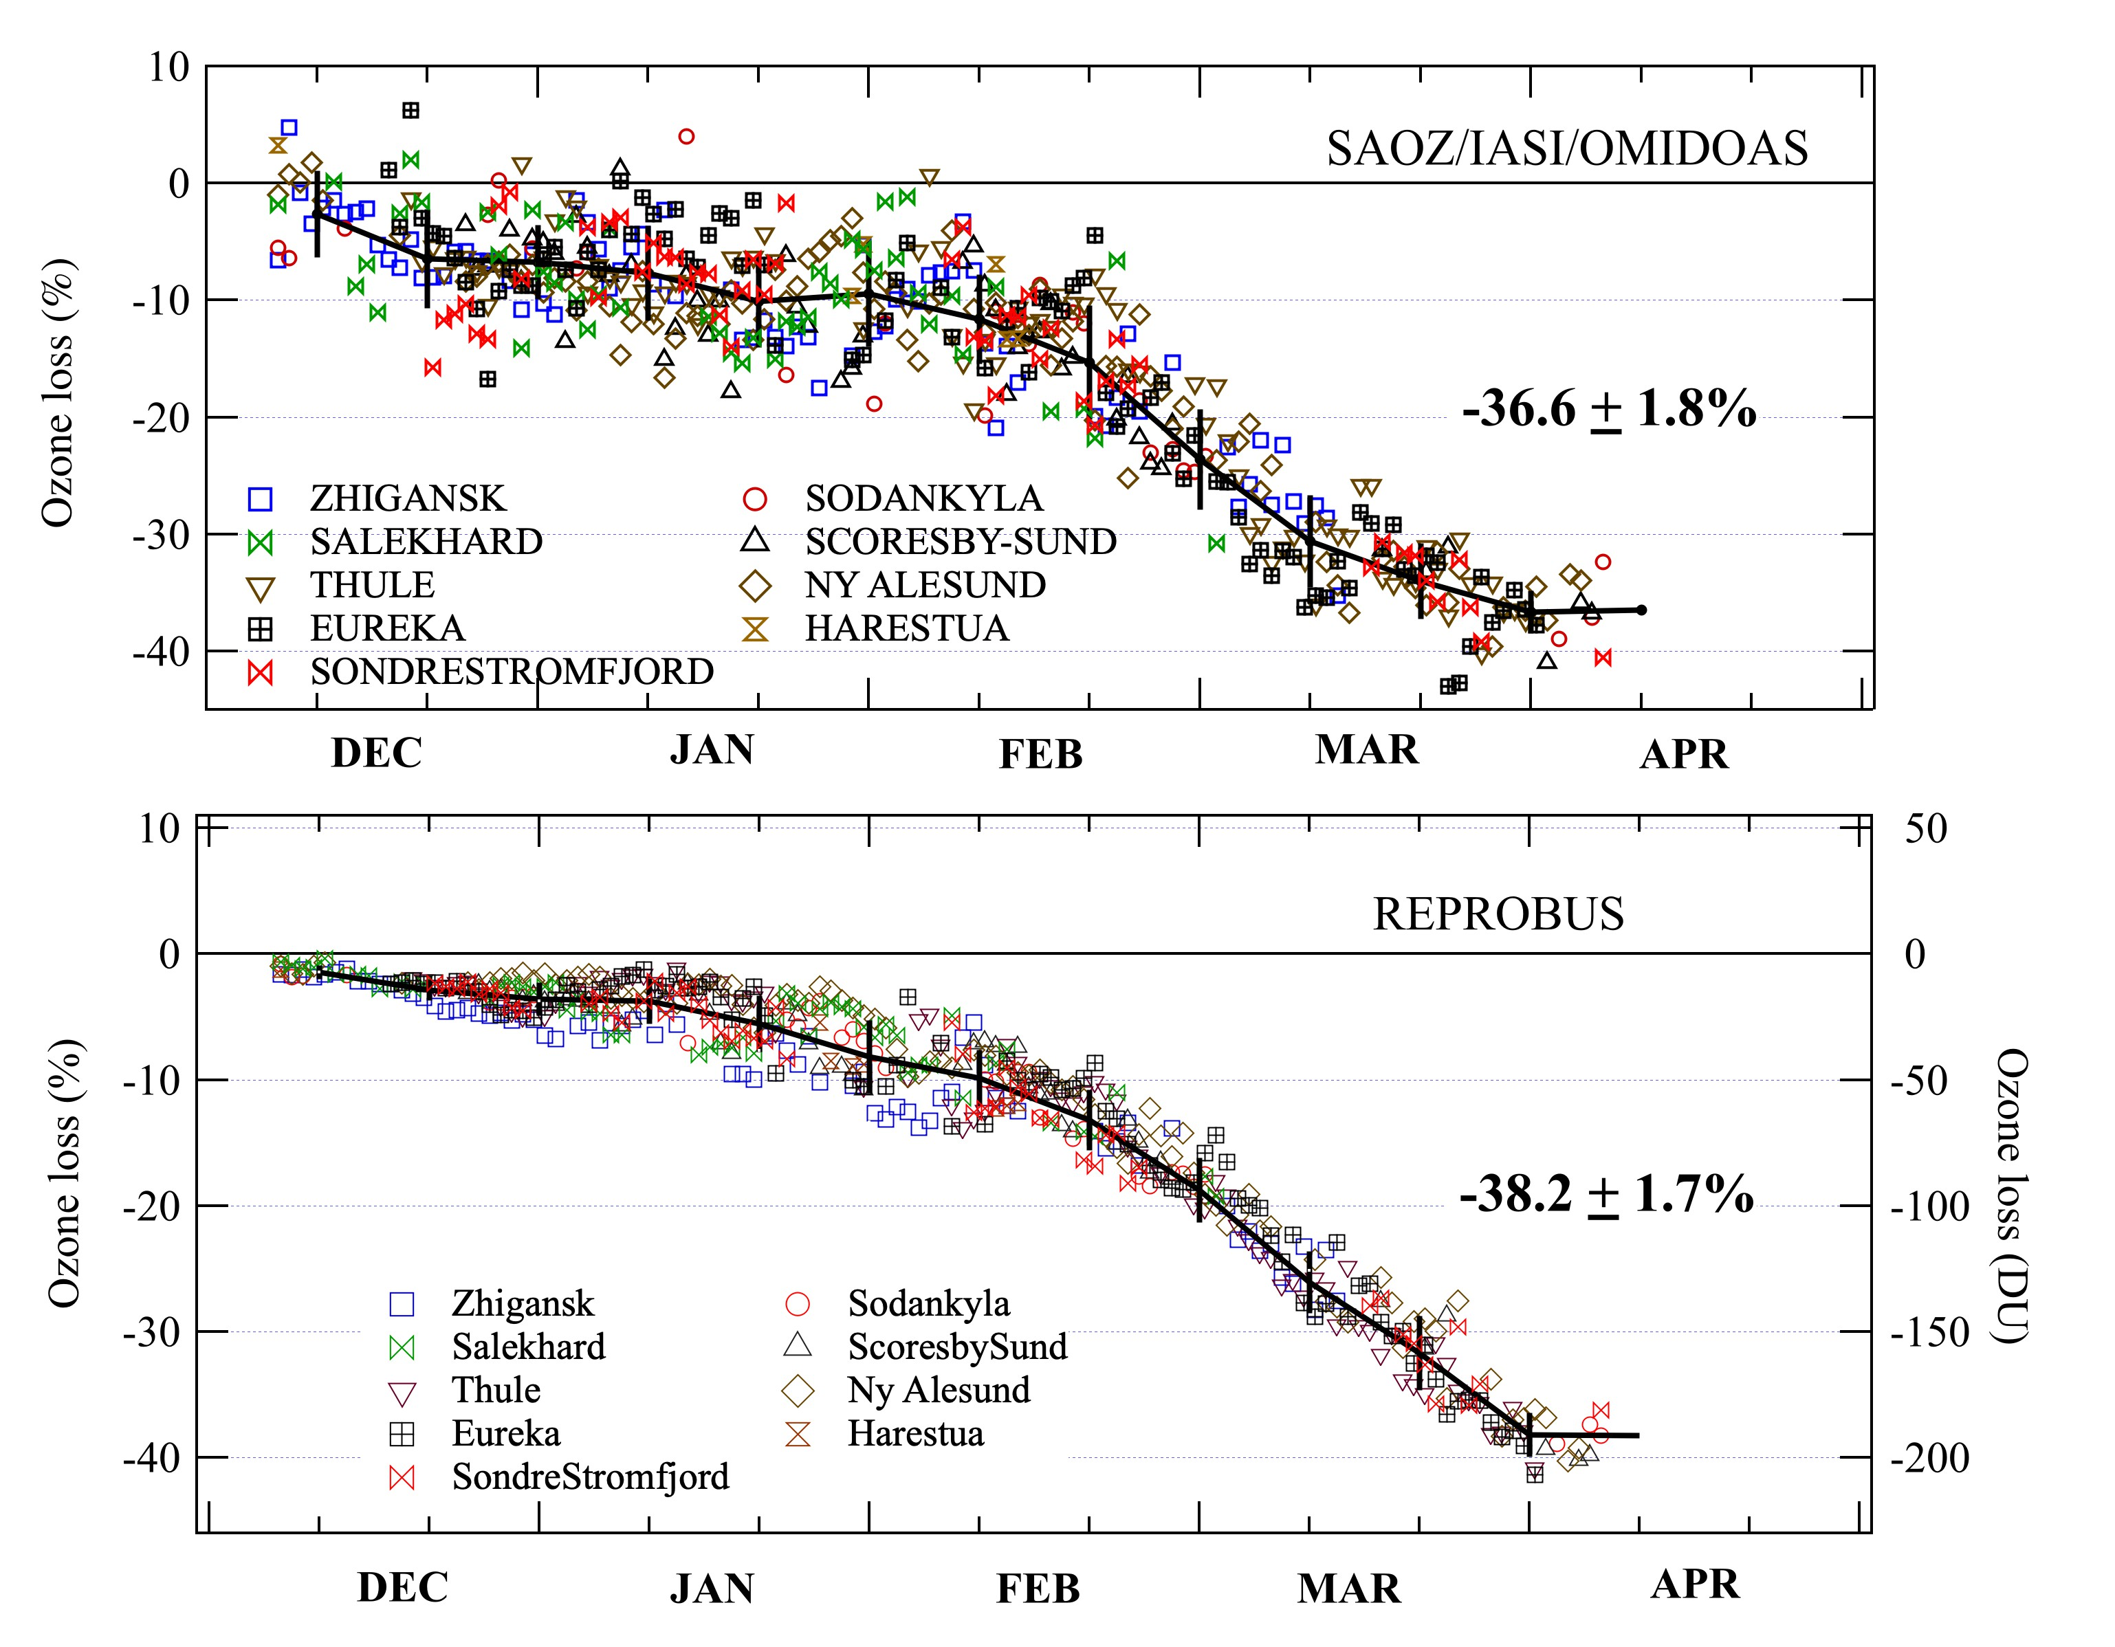
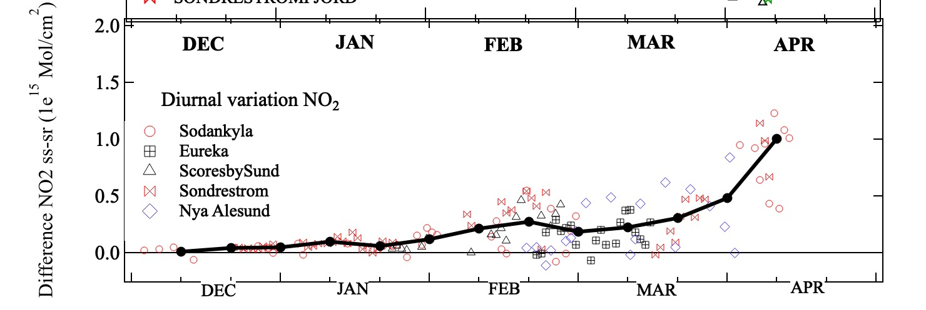
Ozone loss and denitrification
Ozone loss (Passive tracer method)
Total ozone loss above SAOZ stations inside vortex
NO₂ column difference between sunset and sunrise inside vortex
ΔNO₂ (difference sunset-sunrise)
Chlorine activation index
Top:
Early Dec - Jan 30 : Ozone depletion starts slowly
Feb 1- 20: Small decrease in low-sun chlorine-activated vortex - rate 0.25%/day
Feb 20-Mar 10: rapid decrease in sunlit vortex – rate 0.7%/day.
Mar 30 : No more depletion - Cumulated loss: 37 ± 2%
Bottom:
Dec-Jan : No diurnal variation - Absence of NOx in vortex- Chlorine activated
Feb 1- Mar 30: ΔNO₂ slow increase -> Partial chlorine de-activation high altitude
Mar 30: ΔNO₂ fast increase -> Chlorine fully deactivated

Slide 7
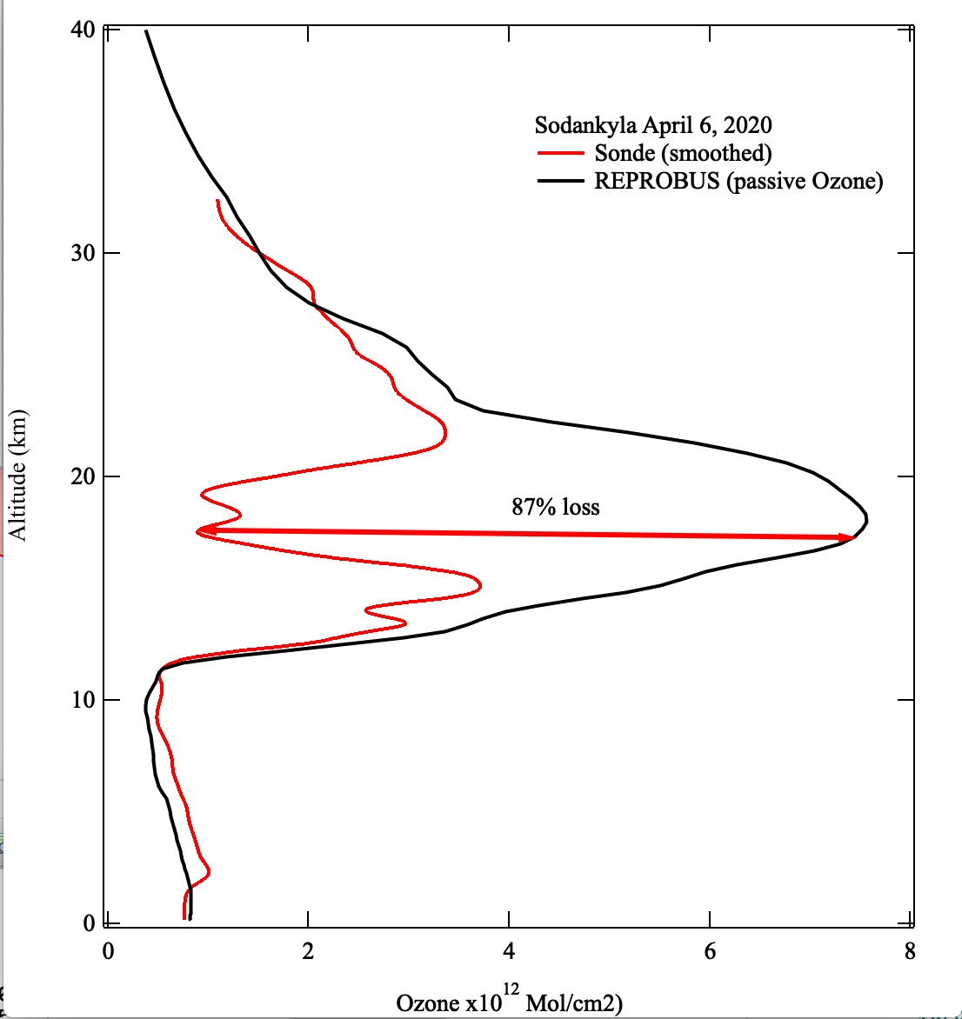
Ozone loss from ozonesonde at Sodankyla
SAOZ: 235 DU
On April 6, 2020
87% ozone loss between 18 and 20 km
More than 40% ozone loss between 16 and 21 km

Slide 8
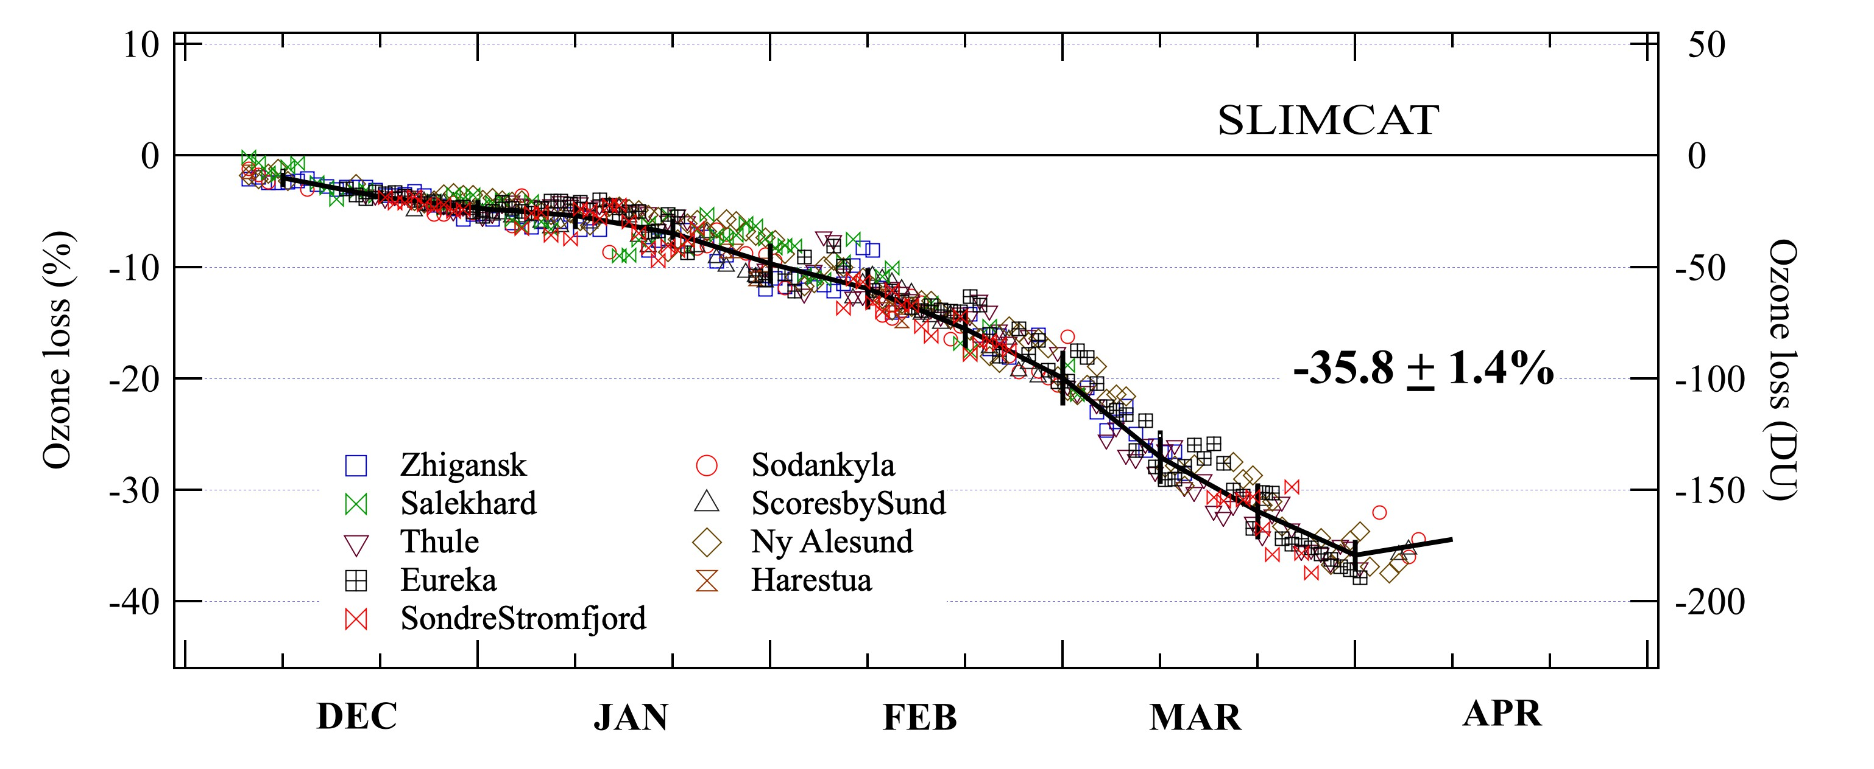
SAOZ loss and Models Simulations
SAOZ: 37%±2%
3D CTM Model :
Excellent agreement
Same timing as SAOZ
Similar amplitude
REPROBUS: 38 %±2%
SLIMCAT: 36 %±1%

Slide 9
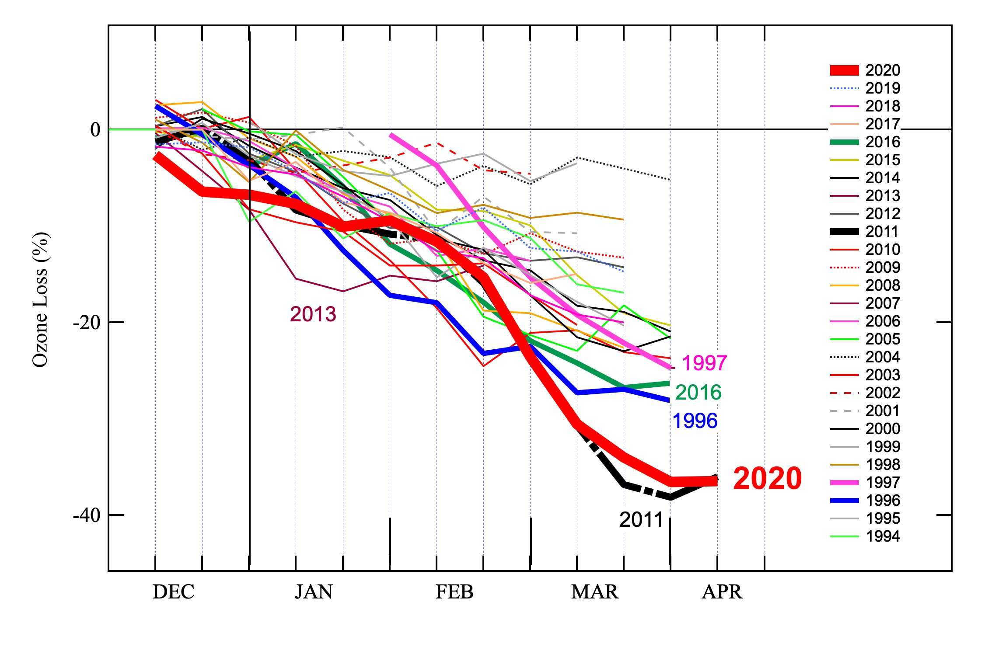
Ozone loss rate comparison to previous winters
All years: The O3 loss rate from 0.1% /day to 0.7% /day
2020: -> Loss starts already in December (similar to 2013)
-> Slow decrease Dec 20 - Jan 30 in dark vortex (similar to 2010)
-> 0.25%/day decrease Jan 30 - Feb 20 similar to 1996, 2010, 2011, 2016
-> 0.7%/day fast decrease Feb 20 –Mar 10 in sunlit vortex (similar to 2011)

Slide 10
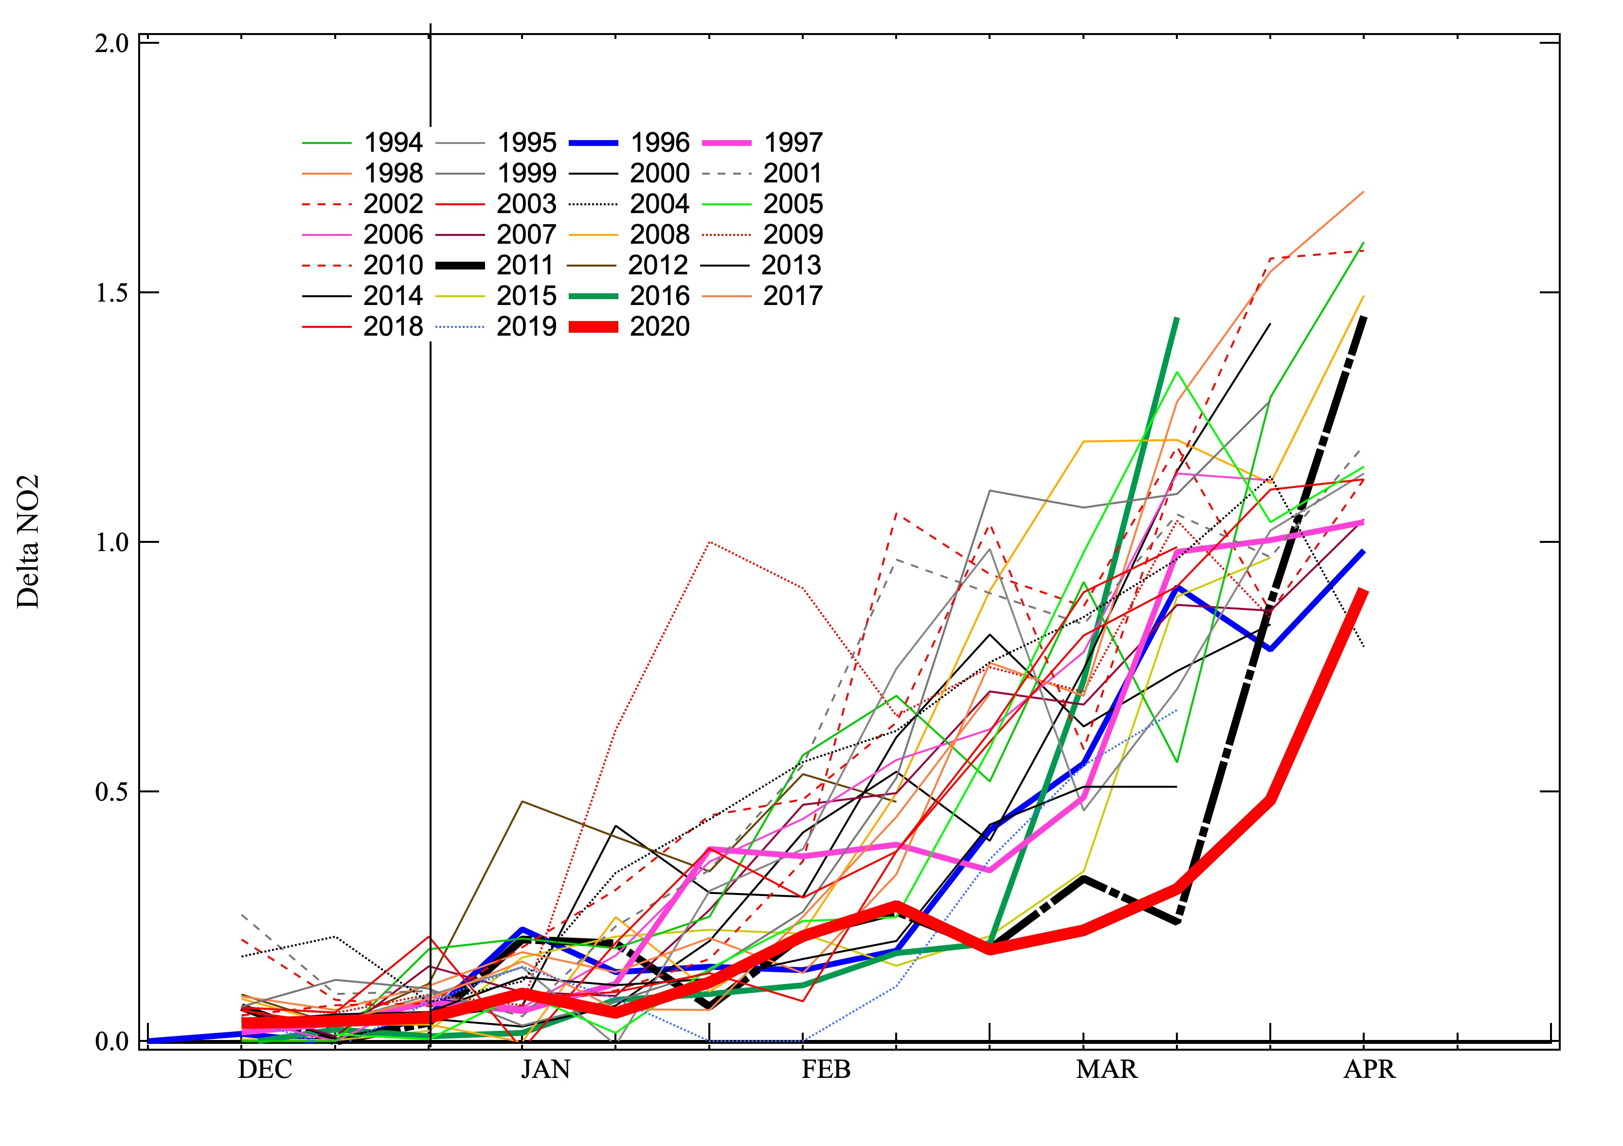
Δ NO₂ comparison to previous winters
All years: The Δ NO₂ fast increase date is from Jan 1 up to March 30
2020: -> Slow increase between Feb 1 - Mar 20 (similar to 1996, 2011, 2016)
-> Fast increase after March 30 : the longest period of de-noxification

Slide 11
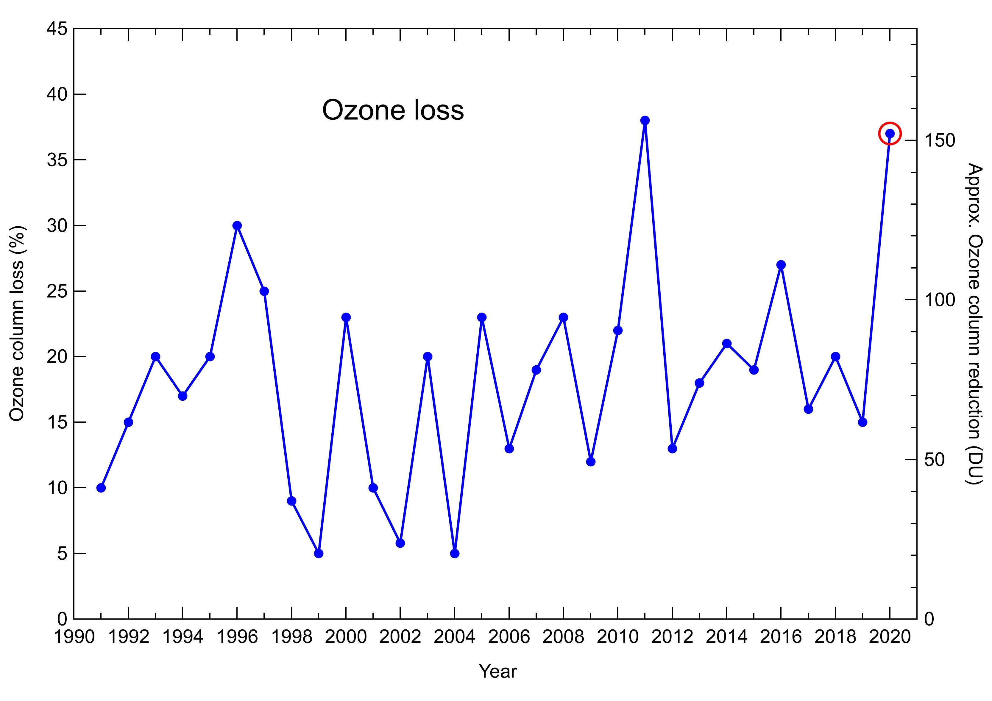
O3 loss comparison to previous winters
All years: O₃ loss from 5% up to 38% with an average of 20%
2020: Record loss 37-38% similar to 2011

Slide 12
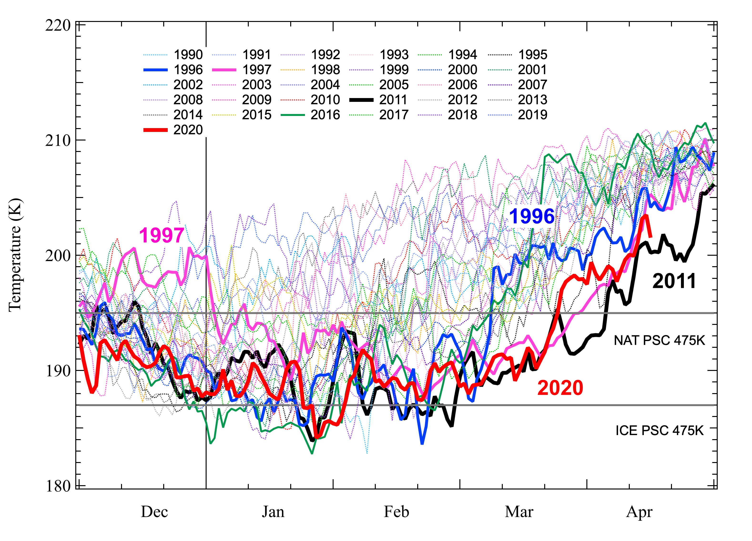
Temperature comparison to previous winters
T min 475K
All years: Temperature and SSW date highly variable
Number of days with T>Tnat from 18 days up to 125 days/winter
2020 -> Temperature below Tnat from early Dec until March 20 (120 days)

Slide 13
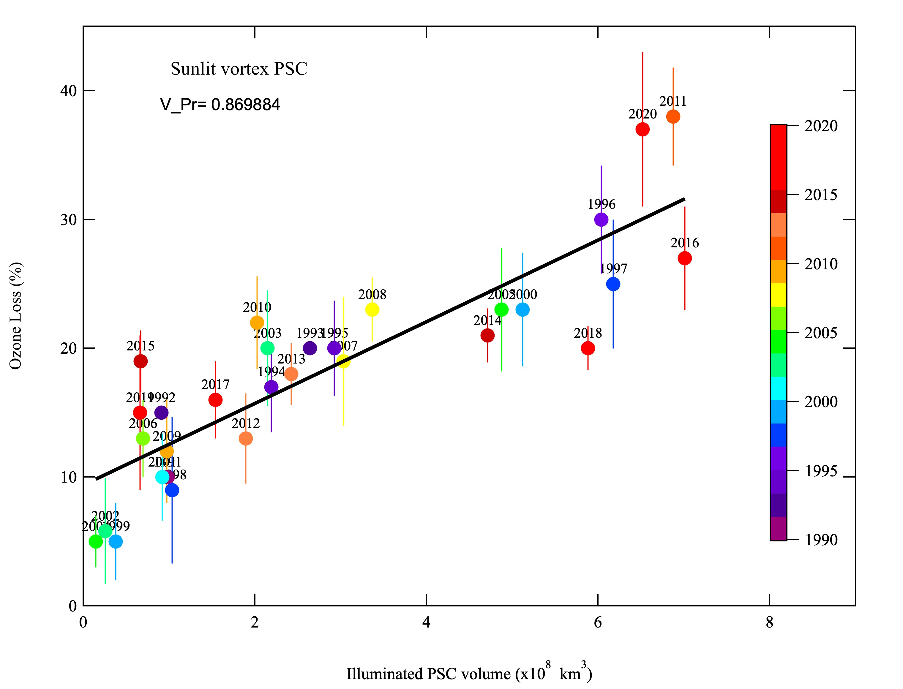
Correlation between O₃ loss and cumulated sunlit PSC
2020
All years: Nice linear relationship Vpr=0.87 on 1990-2020 period
2020 -> O₃ loss overestimated (like 2011 - long lasting vortex with high PSC)

Slide 14
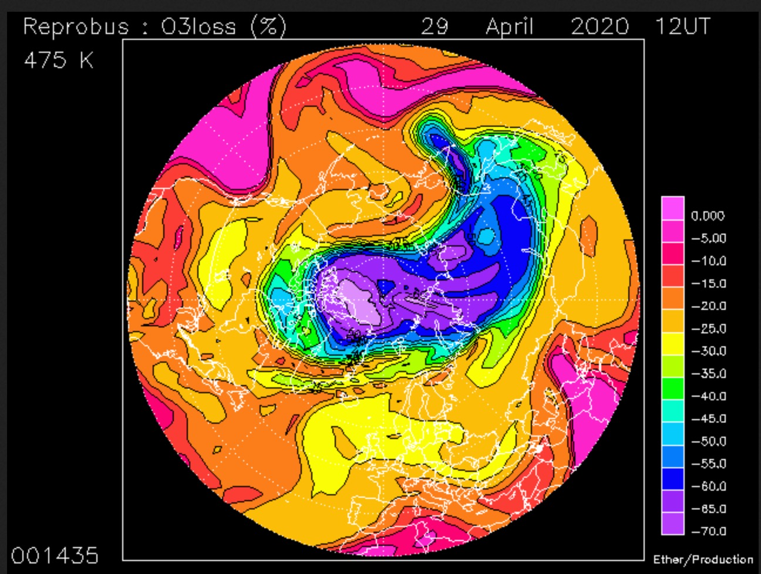
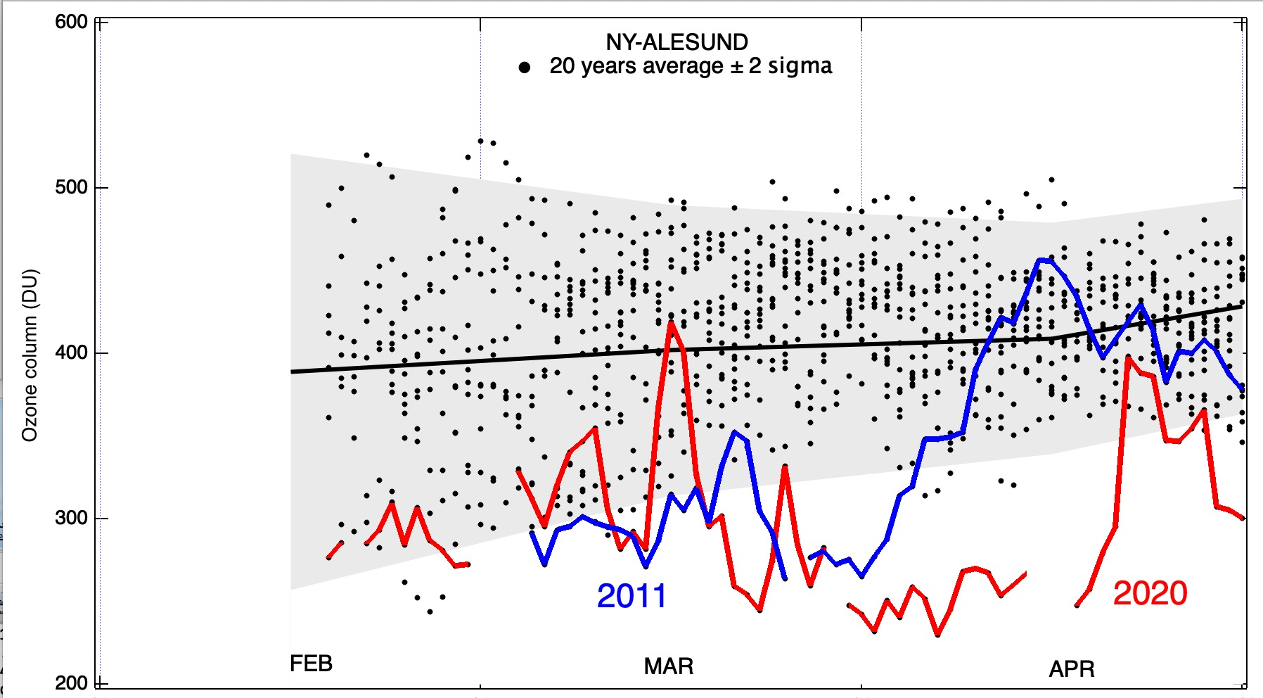
Ozone column inside vortex in March-April 2020
Ny-Alesund: Vortex still present on April 29 with >60% loss at 475K
Low O₃ column in March: 301 DU
(similar to 2011: 295 DU)
Record low column in April
All years: Ozone column average: March: 402 DU April: 409 DU
2020 -> April : 295 DU Record ozone deficit ~115 DU

Slide 15
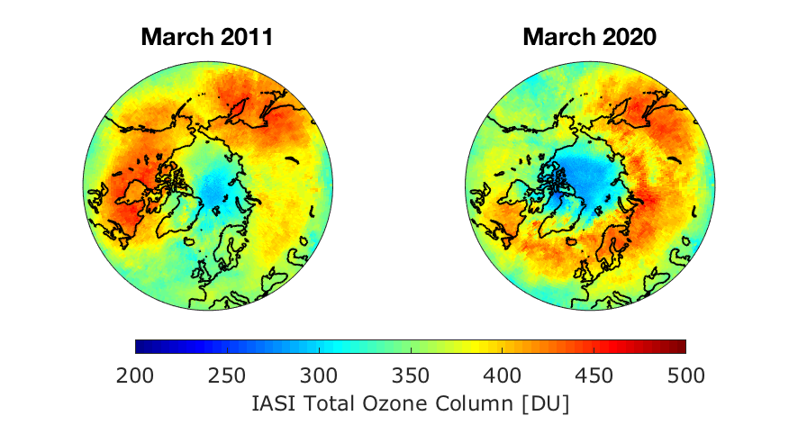
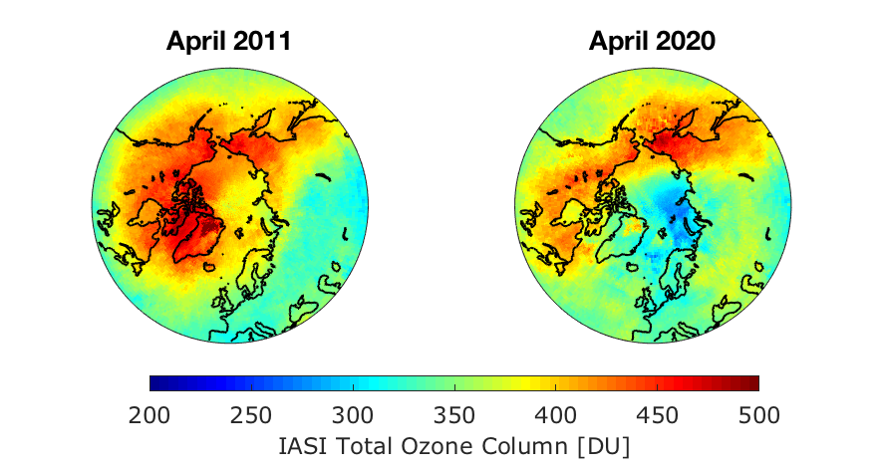
Total ozone column from IASI/Metop
March 2020:
Record low column
since 2007
Previous record:
March 2011
April 2020:
Record low column still persisting

Slide 16
CONCLUSION WINTER 2019/2020
Unprecedented long lasting strong vortex until end of April
NAT PSC : until March 20
Absence of NO_{x} = chlorine activation index until end of March
Ozone loss: 2 periods
  Slow ozone loss rate: 0.25%/day Feb 1 - Feb 20
  Fast ozone loss rate: 0.7%/day Feb 20- Mar 10
Large total ozone loss amplitude 37%, similar to 2011
Excellent agreement with 3D CTM models REPROBUS and SLIMCAT
Record low ozone column in March in the Arctic vortex
    and, for the first time, also observed in April.

Slide 17
Acknowledgements
The authors thank the SAOZ stations operators and ECMWF for the meteorological analysis.
This work was supported by the French CNES and CNRS/INSU within the NDACC/OVSQ program.
The SAOZ network is part of NDACC (Network for Detection of Atmospheric Composition Changes).
The authors thank gratefully C. Boone at ESPRI data center /AERIS for providing MIMOSA, REPROBUS maps and model data above the SAOZ stations.
MIMOSA: http://www.pole-ether.fr
REPROBUS: http://www.pole-ether.fr
SAOZ: http://saoz.obs.uvsq.fr/SAOZ-RT.html
IASI: processed by LATMOS IASI Team
OMI-DOAS: https://avdc.gsfc.nasa.gov/pub/data/satellite/Aura/OMI/V03/L2OVP/ OMDOAO3/

